Slide 1


Moderation Best Practices for Viva Engage
Building Trust & Participation Across Your Network

Slide 2

Introduction & Objectives
Effective moderation in Viva Engage is key to maintaining a safe and inclusive space. It guides conversations, highlights relevant content, reduces exposure to inappropriate posts, and helps build trust while supporting company values and goals.
Agenda
Introduction & Objectives
Setting Up Your Viva Engage Network
Moderation Tools & Roles
AI-Powered Moderation
Managing Content Visibility
User-Level Controls
Further Learning & Resources

Slide 3


Setting up for success

Slide 4
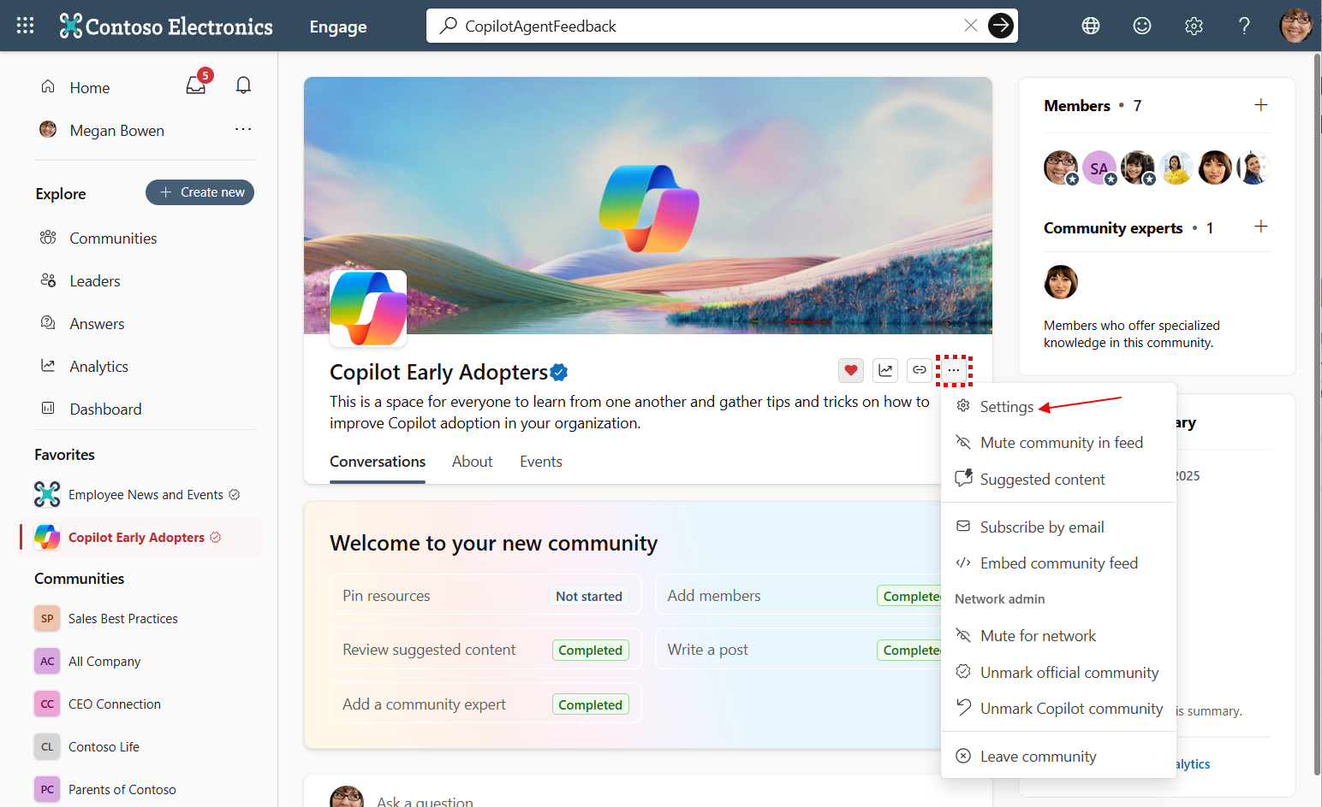
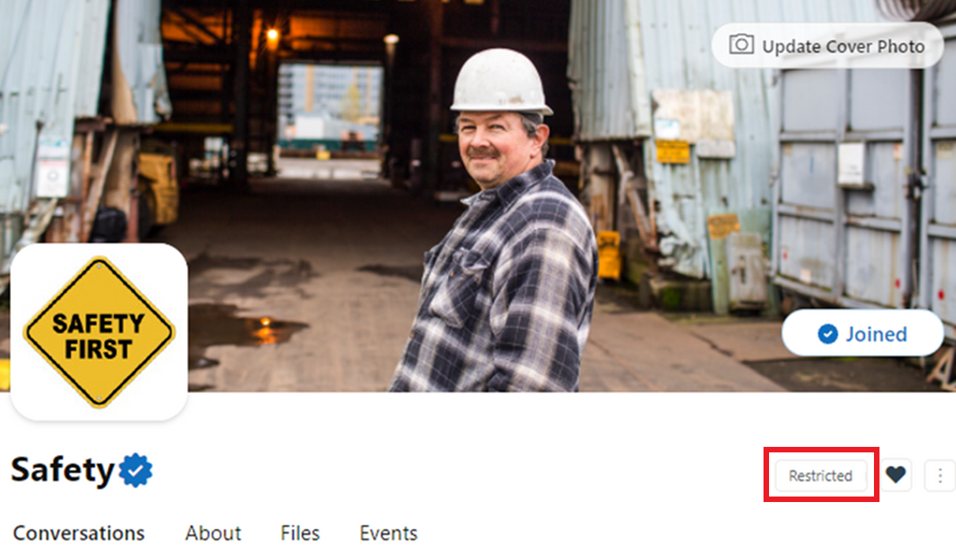
Community structure and purpose
Learn how to structure your Engage network and communities for clarity, relevance, and purposeful participation
01
Start with the ‘All Company’ community
Decide: Broadcast channel vs. peer-to-peer sharing
Rename “All Company” to reflect its role
See documentation: All Company community configuration
02
Establish Official Communities
Identify important business priorities: Leadership, business units, ERGs, geographies etc.
Use dynamic group membership for targeted inclusion
See documentation: Create a dynamic group
03
Restrict Communities to Reduce Noise
Restrict posting in large communities; allow employees to comment on existing posts
Use for high-traffic groups or sensitive topics
See documentation: Restrict posting

Slide 5
Post & Communicate Usage Policy
Create a usage policy that users are required to accept to help ensure conversations on Viva Engage are positive, constructive, and in line with your company policies and culture
Require users to accept usage policy before posting
See documentation: Usage Policy
Clearly state behavioral expectations and moderation approach
The usage policy should be positive and explanatory – not just a list of ‘don’ts’. Include links to reporting inappropriate content and to relevant company policies or training resources. Often organizations can repurpose a social media policy for Viva Engage
Open communication about moderation helps users feel comfortable posting content

Slide 6
Moderation tools & roles

Slide 7



Set up moderation roles
PERSONAS
Understanding the distinct roles in moderation helps ensure effective governance, clear communication, and a positive experience for all participants.
Network Admin
Corporate Communications
Employees
Configures and manages Viva Engage communities, policies, and permissions
Assigns roles and oversees compliance with company standards
Reviews flagged content, mutes users, and enforces moderation actions
Updates usage policies and communicates behavioral expectations
Broadcast official news and updates to targeted communities
Ensure messaging aligns with company values and compliance standards
Collaborate with admins to manage high-visibility channels
Participate in conversations, share ideas, and engage with content
Follow usage policies and behavioral expectations
Report inappropriate content and contribute to a positive culture

Slide 8

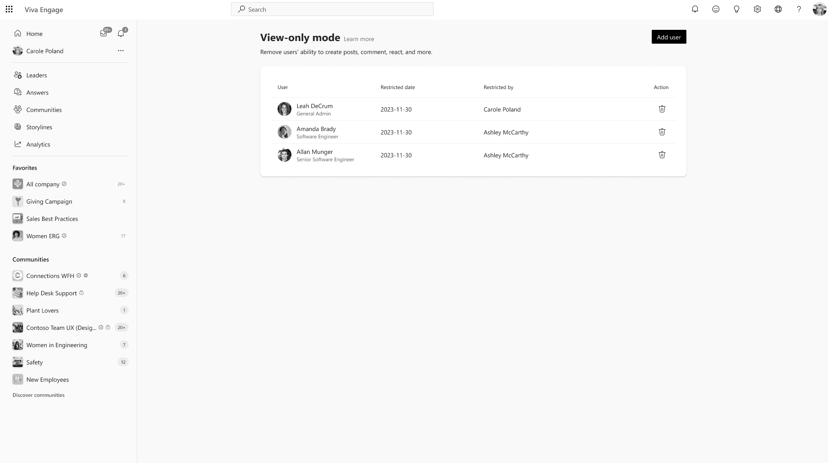
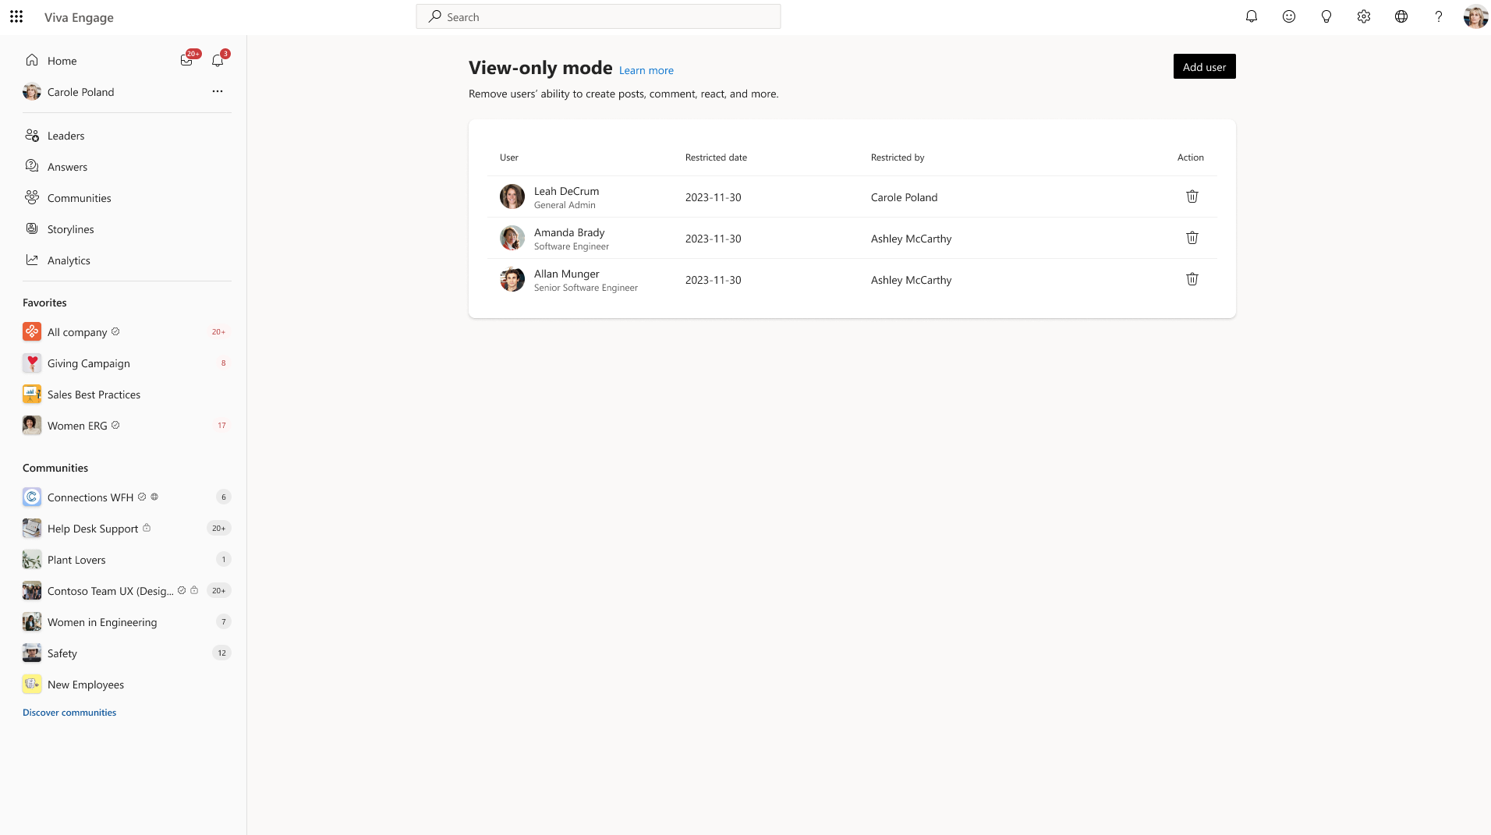

Essential Admin Moderation Features
Explore the key moderation tools and processes available to admins and communicators for managing conversations and content.
Move Conversation & Role Assignment
Govern “Move conversation” feature—decide who can move posts
See documentation: Configure Engage tenant
Assign roles: Network admins, corporate communicators, community admins
See documentation: Manage admin roles
Example: Only admins can move posts between communities
View-Only Mode
Restrict selected users to read-only access. Users are able to see the content but not contribute
Learn more: View-only mode
Example: Employees can read but not post until Q&A opens

Slide 9

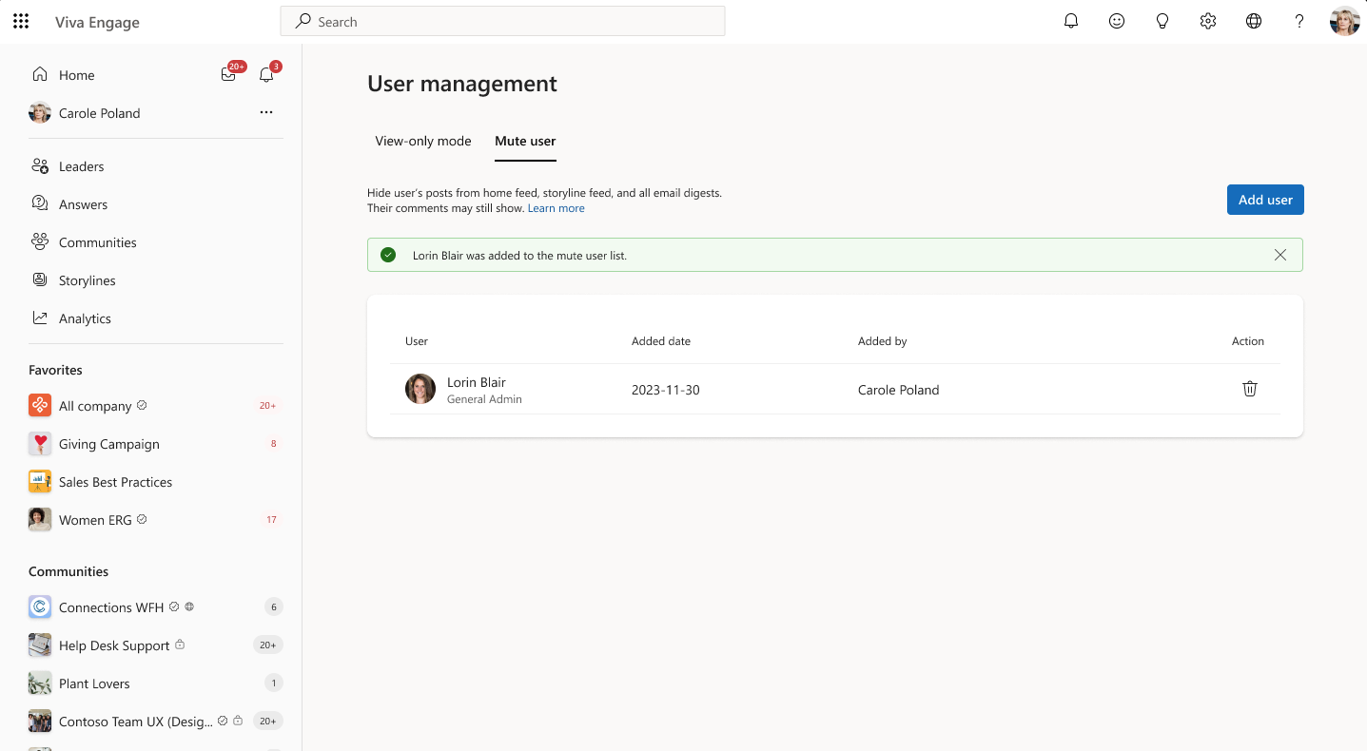
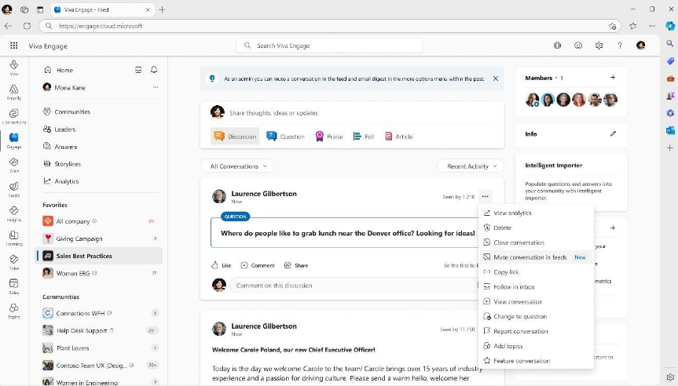

Muting Communities & Managing conversations
Admins and community managers can keep Viva Engage focused and positive by muting communities that aren’t broadly useful and managing conversations. These controls reduce noise and help everyone stay engaged with important updates.
Mute Communities & Conversations
Mute entire communities for network or individual users making busy conversations less noisy for everyone
Mute conversations to reduce visibility without deleting
See documentation: Configure Engage tenant
Example: Social interest group muted for non-members; lively thread muted from org-wide feed
Close, Move, or Delete Conversations
Close threads when answered to limit new comments
Move conversations to appropriate communities reducing confusion over which conversation where
See documentation: Move a thread
Delete content to prevent issues with inaccurate information, inflammatory or sensitive
Example: Off-topic post moved to “General Discussion”; inappropriate thread deleted

Slide 10
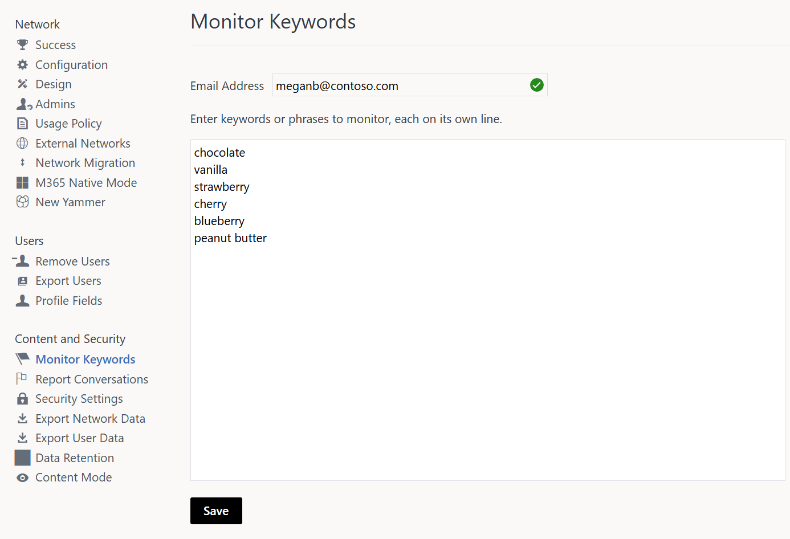

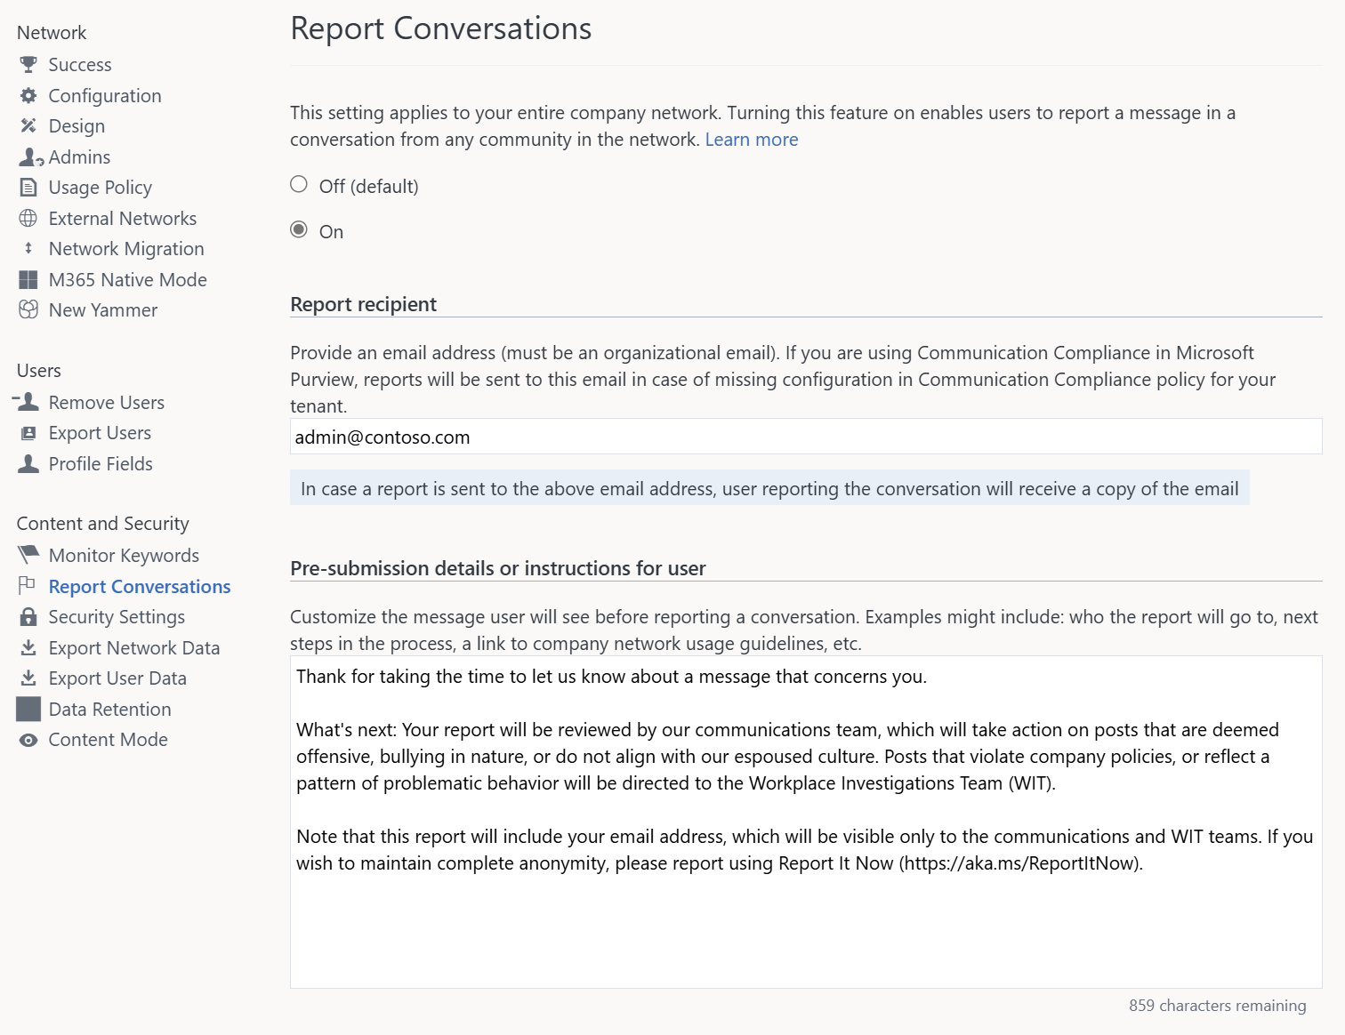

Admin Moderation Controls
These advanced moderation controls empower admins to proactively manage participation and content in Viva Engage, ensuring a safe, compliant, and focused environment for all users.
Keyword Monitoring
Create targeted keyword lists for compliance, crisis management, or sensitive themes
Automatically flag or block posts containing urgent, confidential, or restricted terms
See documentation: Keyword monitoring
Example: Moderators monitor for keywords like “urgent,” “confidential,” or “security incident” to intervene quickly
Report a conversation
Admins can set up ‘Report a Conversation’ to route to an email address or via Communication Compliance in Microsoft Purview
Determine a plan of action for review and closure
Learn more: Report a conversation

Slide 11
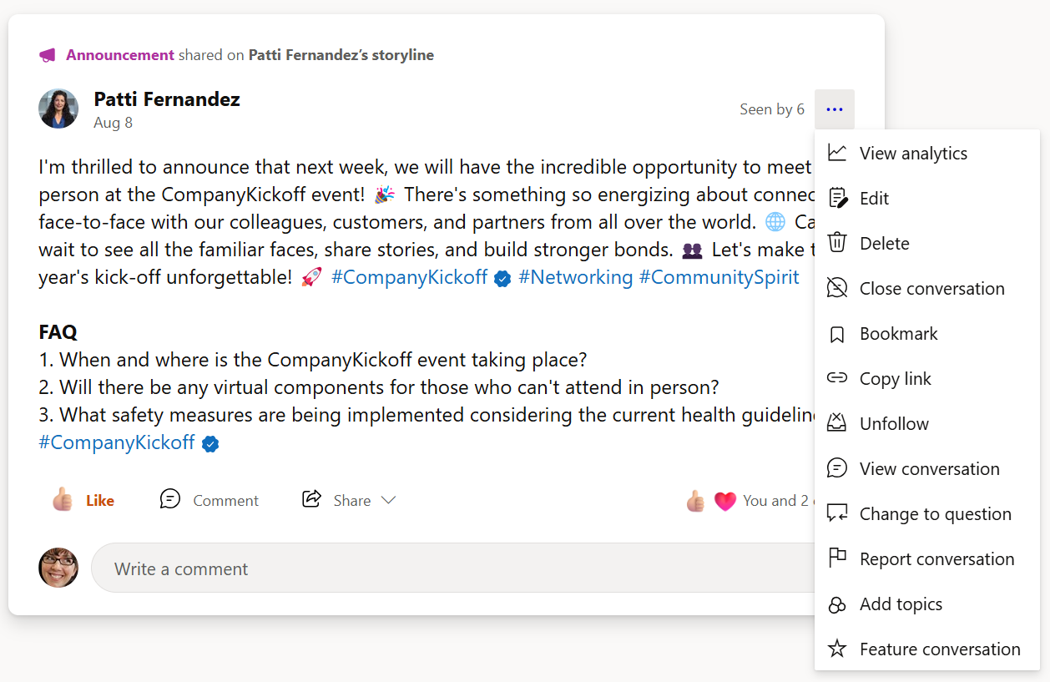
User Controls & Empowerment
SELF-MODERATION TOOLS
See how user-level controls and notification settings enable individuals to personalize their experience and manage their own content.
Users can close, move, or delete their own conversations. Coming soon, Q1 2026, hide user messages
Learn more: Move, share, mute conversations
Set custom notification settings: Unfollow, unsubscribe, manage digests
See documentation: Manage notifications
Mute communities from personal feed helping prioritize content important to them while blocking out noise
Learn more: Mute communities
Employees can also report conversations which are flagged for review by an Admin
See documentation: Report conversations

Slide 12
AI-powered moderation

Slide 13
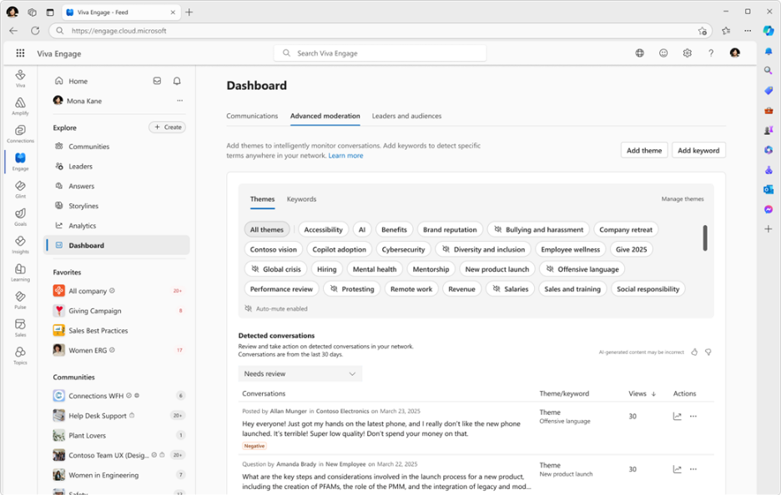
AI-Powered Theme Moderation*
AI-powered theme moderation in Viva Engage helps you understand messages better by looking at the context, not just matching keywords, so it can capture the full meaning of conversations.
Moderators can get notified when detections happen, see/triage in the dashboard, and know that there’s a baseline level of proactive action applied to specific conversation topics
Use Communications Dashboard to monitor and review themes
See more: Theme moderation
Automatically notify moderators, mute posts or conversations, and block posts coming Jan 2026
Example: Monitor offensive language, or important/sensitive themes
*AI-powered theme moderation is available with the Viva suite or Viva C&C license

Slide 14
Additional learning & resources

Slide 15
Determine moderation criteria and guidance
BEST PRACTICE
Create an action plan for moderation to kick in.
Sample
Criteria
Guidelines
Messaging
X amount of views
X amount of comments
X amount of employee complaints
If 1–2 of the criteria has been met…
Issue a warning and reminder of guidelines
If 3 items of criteria have been met…
Close thread to comment
If 3+ OR contains several comments in question
Delete full thread
As a reminder, please follow Zava Usage Guidelines when engaging in dialogue on Viva Engage. Dialogue that violates guidelines are subject to thread closure and further HR review

Slide 16

Keep learning with us
ON-DEMAND AND UPCOMING LEARNING
Access training, webinars, and documentation to deepen your understanding and support ongoing moderation excellence.
View the Engage Masterclass for in-depth walkthroughs and best practices.
Episode 1: Mastering admin and governance
Episode 4: Effective training and adoption strategies
Watch our moderation webinar, covering features and strategies for new and mature networks.
See how AI theme moderation and keyword monitoring work together for holistic, proactive coverage across a network.
Join our next Engage Masterclass series: aka.ms/VivaEngage/Masterclass

