Slide 1


Identity for the Firstline Workforce:
Empowering IT, managers, and Firstline Workers
Rachel Teller
Steve Ball

Slide 2
Objectives
Learn how identity empowers Firstline Workers productivity and controls
Demo how to manage Firstline Workers with Azure Active Directory
Notes:
Today, we'll talk about how the trends for customer and partner identity management are evolving as more relationships become digital. We’ll then look at how you can create customizable, flexible, and secure experiences for your users with Azure AD External Identities. We’ll wrap up with a few demos.
So let's get started!

Slide 3
Firstline Workers are found in all major industries
Particularly relevant in industries with distributed sites of employees and locations
Retail &
Consumer Goods
Manufacturing &
Resource
Travel &
Transportation*
Government
Health
Financial Services
Automotive
Agriculture
Media & Telco
Construction
Professional
Services
Non-Profit
*Include Airlines, Hospitality, etc.
Notes:
Firstly: Firstline.
“Who are we talking about? We hear the term “frontline” on the news everyday lately – but you might notice that at Microsoft, we often use a slightly different term: “Firstline” – it includes the ‘frontline’ nurses, soldiers, firefighters, police force who we respect as the heroes at the FRONT line of our current pandemic, our struggles, battles, and wars.
But our use of the word ‘Firstline’ also acknowledges something vital about the importance and value of this work force – and we wish to change how we think of the: we wish to (for a change) put their needs FIRST. Our “FIRST” line includes the less-visible and just-as-vital FIRSTLINE of workers who stock our shelves, drive our busses, clean the planes between flights, and harvest our food. These are the humble, often invisible people represent the FIRST LINE of our businesses, greeting customers at the front door, at the cash register, at the restaurant – they are FIRST to drive the BOTTOM LINE. They are first to arrive at work, they are first we call on to keep our (assembly) lines moving – They do the heavy lifting as we transform atoms into innovations (hold up phone as example) – and they represent the workforce most impacting the bottom line of our businesses, schools, governments, factories, fields and hospitals.
We use the word FIRST so that we remember to put them FIRST – not just pushing them out FRONT protecting us in a crisis. So, our investments here are designed to serve and celebrate these 2B workers whose vital work makes the world go round.
SB note, Q: is this too much? I can’t tell, may be too cheesy? Trying to find an authentic way to ground the use of our term “Firstline”

Slide 4





The Firstline Landscape
Roles vs. Goals: both are expanding + blurring
Firstline
Workers
Firstline Managers
IT
Executives
Customers
Focus
learning quickly, adding value immediately, ramping on tools & technologies, staying employed
Focus
stress,
task and people mgmt,
juggling people, processes, products
Focus
data management,
automation / scale
job security
Focus
Shadow IT, data security, efficiency,
the bottom line,
they require clarity + security
Focus
using your products and services w safety
and security
Notes:
The Firstline is also not just one place, it’s more of a spectrum. Today’s Firstline Worker may become next week’s Firstline Manager. In 2020, it’s also unclear who should help a new employee reset a password. Central IT? A call desk? Or maybe the manager who just hired you on the retail floor and helped you get productive in your first hour of work?
Traditional, last decade IT does not scale to serve the next 2B employees.
Each role also has vastly different expectations, needs and focus areas.
FLW: get and stay employed.
FLM: manage complexity, drive productivity
IT: security
Execs: growth, profitability
Customers: safety

Slide 5

The Firstline Landscape
Less than 25% of Firstline Workers indicate they have the right technology to do their job
Known Challenges
Firstline Workers
High stress, long hours, huge learning curve
No time for remembering UN/PW
Firstline Managers
Higher stress, longer hours, turnover
No IT training, limited tools,
no time
IT
High stress, security focus, centralized
Scale, onboarding latency, complexity
Today’s Firstline workplace is
Outdated & Fragmented & Complex
Notes:
Our Firstline Workers lead stressful lives, they often have multiple jobs with long hours. And we make this worse by offering them outdated practices and workplaces often filled with bulletin boards for scheduling, pagers for communications, multiple devices for factory or retail workflow, and complex, analog processes.
Firstline Managers often have it worse: they share the same tools and technologies as their staff, but they also have to find, hire, train and manage a dynamic – and often temporary workforce.
And IT, whose job is already very hard, also rarely has time or budget to focus on friction reduction – because they are often focused on security firedrills and budget compliance.

Slide 6
Demo – Onboard remotely and securely

Slide 7
Tenant Configuration
Connection to Azure AD with their HR System
  Workday OR
  SAP SuccessFactors
The following settings in the HR inbound provisioning app:
  Map users from different departments
  Map Azure AD “mobile” attribute to phone number set in HR
  Map Azure AD “department” attribute to the HR department
Set authentication policy
  Enables the “Retail users” group to perform “SMS Sign-in”
A Power Automate Script
  Queries Azure AD provisioning logs for new hires
  Takes mobile phone and registers it as an authentication method

Slide 8
Demo – Make remote management seamless

Slide 9
Tenant Configuration
Administrative Units for each location:
  Ex. Chicago, Seattle, New York, Houston, Atlanta
  All employees of that area in their respective Administrative Units
Privileged authentication administrator access for each “area owner”

Slide 10
Demo – Secure shared device scenarios

Slide 11
Tenant Configuration
MDM Managed devices connected to Azure Active Directory
App Configuration to push Microsoft Authenticator to shared devices.
Device policy to turn on Shared Device mode for the shared devices.
Applications that have been hardened to protect company data when used on shared devices.
Private Preview with Teams available now. Public Preview in Fall/Winter of 2020.

Slide 12
The way forward
1
2
3
4
Easier authentication – sufficiently simple, sufficiently secure
Easier device setup
and sharing –
remotely and at scale
Easier delegated management: onboarding
and de-provisioning – no more 5-day onboarding logistics
Enhanced communications, collaboration, connection –
intelligent devices that know context, intent, requirements

Slide 13
Get started today
Try out these features:
  SAP SuccessFactors to Azure AD user provisioning allows you to leverage SuccessFactors to provision your AAD accounts
  SMS sign-in enables Firstline Workers to sign into their Azure AD account with a one-time password (OTP) via text
  Delegated user management with My Staff empowers Firstline Managers to reset passwords and manage phone numbers for their employees
  Shared device sign-out for Android and iOS can be integrated into line-of-business apps using Microsoft authentication libraries
Learn more:
  Website: aka.ms/m365firstline
  Documentation:
    aka.ms/saptoazuread
    aka.ms/smssigninadmindocs
    aka.ms/mystaffdocs
    aka.ms/shareddevicedocs
@AzureAD
Notes:
We hope you get started testing these capabilities out. We’d love to hear from you on how these solve your needs, and how we can continue to improve. We’re looking forward to learning with you.

Slide 14
Watch related sessions:
aka.ms/DB152 - Digitally Transform an Essential Part of your Organization, the Firstline Workforce
aka.ms/OD258 - Enable Business Continuity for your Firstline Workforce with Microsoft Teams
aka.ms/PR114 - Deploy and Manage Teams Enabled Devices to Meet the Diverse Needs of Firstline Workforce
aka.ms/PR115 - Manage Distributed Firstline Workforces with Capabilities in the Microsoft 365 Admin Center
aka.ms/PR151 - Empowering your Diverse Firstline Workforce with Inclusive Technology
aka.ms/PR152 - Simplify your Firstline Work with Low-Code Solutions in Teams​
Additional Ignite Sessions
Check out all Microsoft Firstline Sessions
aka.ms/FirstlineSessions
Notes:
Check out all of our Firstline and Industry sessions to learn more!

Slide 15
Thank you!!!
Rachel Teller
Steve Ball

Slide 16
The Firstline Landscape
New Challenges:
COVID
Gig economy at scale
Remote work is the new norm
Was rapid growth, now stupid growth
Safety, new protocols
Decentralized identity, evolving standards
Personal devices, personal privacy vs. Contact Tracing
Notes:
Firstline work in 2020 has also moved to the Frontline with COVID, with Remote work as the new normal, video meetings and distributed collaboration is how it is and will be – not just for a few more weeks or months, but some believe – maybe forever?
Three other quick trends in new challenges worth noting:
The gig economy is real and growing
Decentralized Identity and contract tracing are front page news
Use of personal devices, in some places its growing, in others it is regulated, even forbidden.

Slide 17
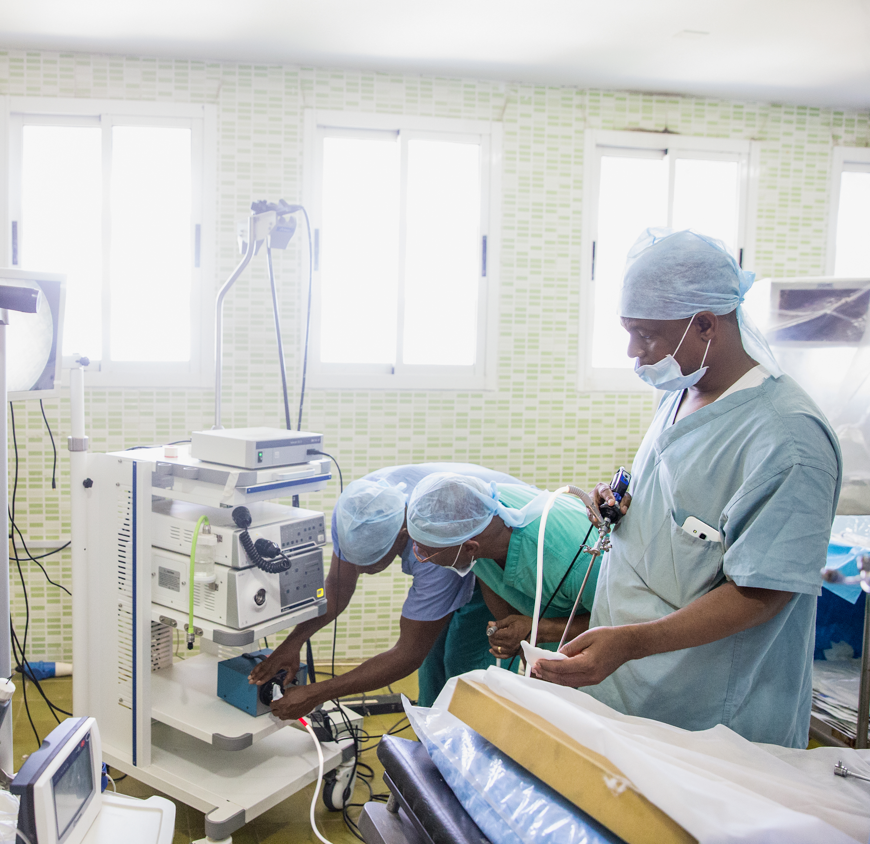


Firstline Workers are the backbone of your business
People
Product
Brand
Firstline Workers define
your customer experience
Firstline Workers are at the heart of your organization
Firstline Workers are the face
of your business
Notes:
These are the people who build our products, these people are the living representation of our brands, and their actions demonstrate our values.
They deserve our attention. And their work lives are HARD.

Slide 18
Opportunities
People
Processes
Empathy – getting to know today’s problems vs. applying last decade solutions
Digital Inclusion – give FLW and FLM modern communications and collaboration tools to drive efficiency
Motivation equation – what is the 'formula' to inspire a move away from Shadow IT?
Simplicity – KISSS OFF = Keep It Sufficiently Simple for the Security Officer From the Future
Security – is job one, unless it costs too much
Standards – yes, we have them.
Devices – sharing, managing, deploying at scale, personal vs work, MDM refusal, regulations
Notes:
So, let’s study some of the opportunities we have to adapt to the 2020 changing landscape… (review each of seven bullets)

Slide 19
Tension between security and simplicity
Moving the needle
72% of respondents agree that making sign-in seamless and secure for Firstline Workers will improve their productivity.
25% strongly agree that a simpler sign-in process would help move the needle.
72%
Agree
25%
Strongly agree
Source: Microsoft February 2020 research study with Pulse
Notes:
So, what makes the digital transformation of these ~2B humans so hard? #1 is the classic Identity paradox: tension between security and simplicity.
The usual / cliché response from both IT and software experience designers is this: choose one.
Clearly, our stressed-out Firstline Workforce does not need more complexity in their lives. But,… how much simplicity?

Slide 20


Tension Simple vs. Secure
Secure
critical / sensitive data
Let’s acknowledge this
tension by adopting two context-driven concepts:
SUFFICIENT SIMPLICITY
&
SUFFICIENT
SECURITY
SMS
JimBo@hotmail.com
+
LIVING
THE
DREAM
password1123
43561
Sign in
SMS
JimBo@hotmail.com
password1123
43561
Sign in
quick start: FLW first week
Simple
Notes:
The tension is real: but it is also context-driven. Example: why do we make our Firstline Workers create a new UN and PW in their first hour of work. It’s usually forgotten by the 2nd hour.
Proposal: the Firstline Worker’s authentication needs to be sufficiently simple and sufficiently secure to jumpstart their first week of work with minimal friction.
Ex. Perhaps their initial access is driven via SMS sign in on their personal device that gives them JUST ENOUGH ACCESS to start their job.
If our systems are smart, an FLW running an inventory tracking device should not require MFA on their first day of work.
For contrast, there are (of course) also roles and jobs where MFA is an hour one requirement. But there is no “one size fits all” authentication magic bullet.
What we require is a context-driven balance between SUFFICIENT SECURITY and SUFFICIENT SIMPLICITY – that depends on the access required and the responsibility of the role.

Slide 21
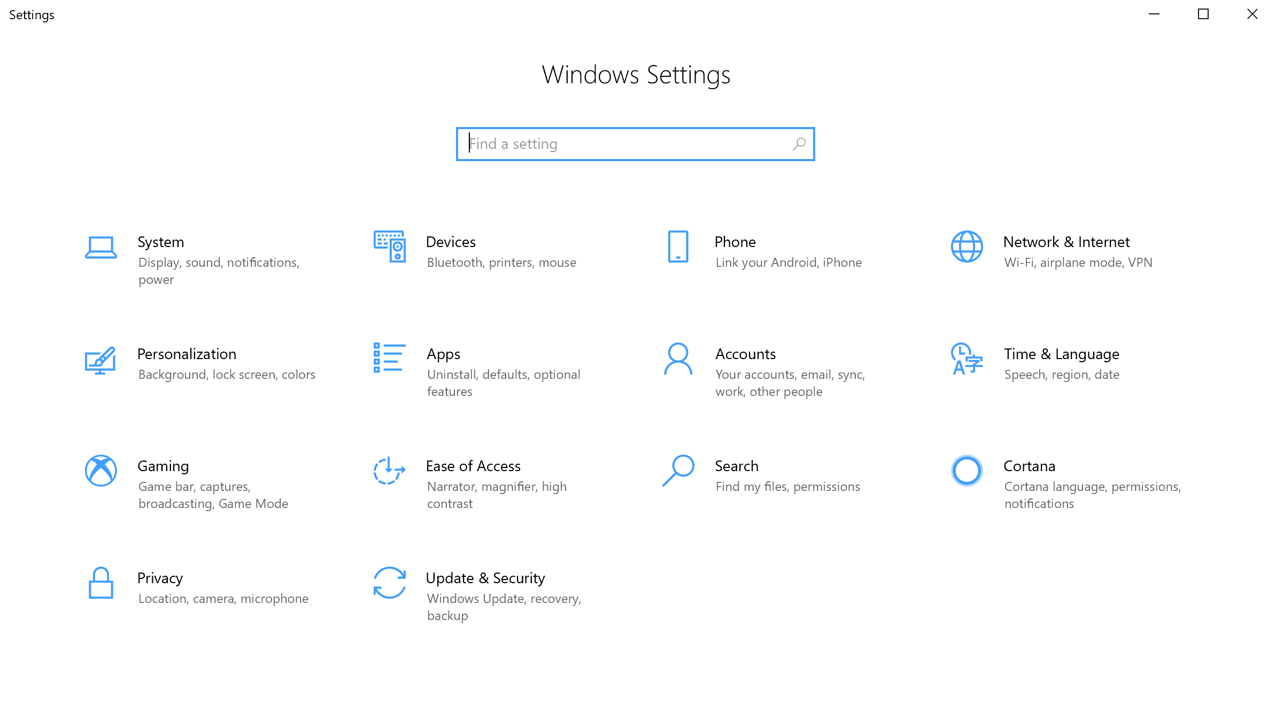
We say we want more security, but what does that mean for this role/user?
48%
Biggest concern for IT teams when introducing new tech to firstline workers.
17%
13%
13%
8%
1%
Security
Compliance
Cost
Scalability
Privacy
Other
Source: Microsoft February 2020 research study with Pulse
Notes:
One other well-known note about the difference between what we say and what we do: we say we want control, but we rarely visit control panels.
We say we want simple onboarding and processes for our dynamic workforce – but JOB ONE for IT is security and compliance.
This is a real source of tension – and turn over.

Slide 22



Shadow IT... the risk of making things too complex
54%
One of the reasons IT executives may be in support of a more seamless, secure sign-in experience is to proactively discourage Firstline Workers from unsanctioned technology or tools. 54% of IT executives suspected that Firstline Workers use a variety of unsanctioned “Shadow IT” including social messaging apps and document or file-sharing tools.
Source: Microsoft February 2020 research study with Pulse
Notes:
And we all may know this story: if our processes and MDM and security are TOO tight, what is the first thing that happens?
Shadow IT – I’ll show you my phone right how: WhatsApp, even for someone at Microsoft, is a dreaded backchannel used for quick work logistics communications – OR WORSE.

