Slide 1
SharePoint training for end users

Slide 2
Overview
1-hour, instructor-led training
What is happening when?
First day activities
How-to resources

Slide 3
What is happening when?

Slide 4

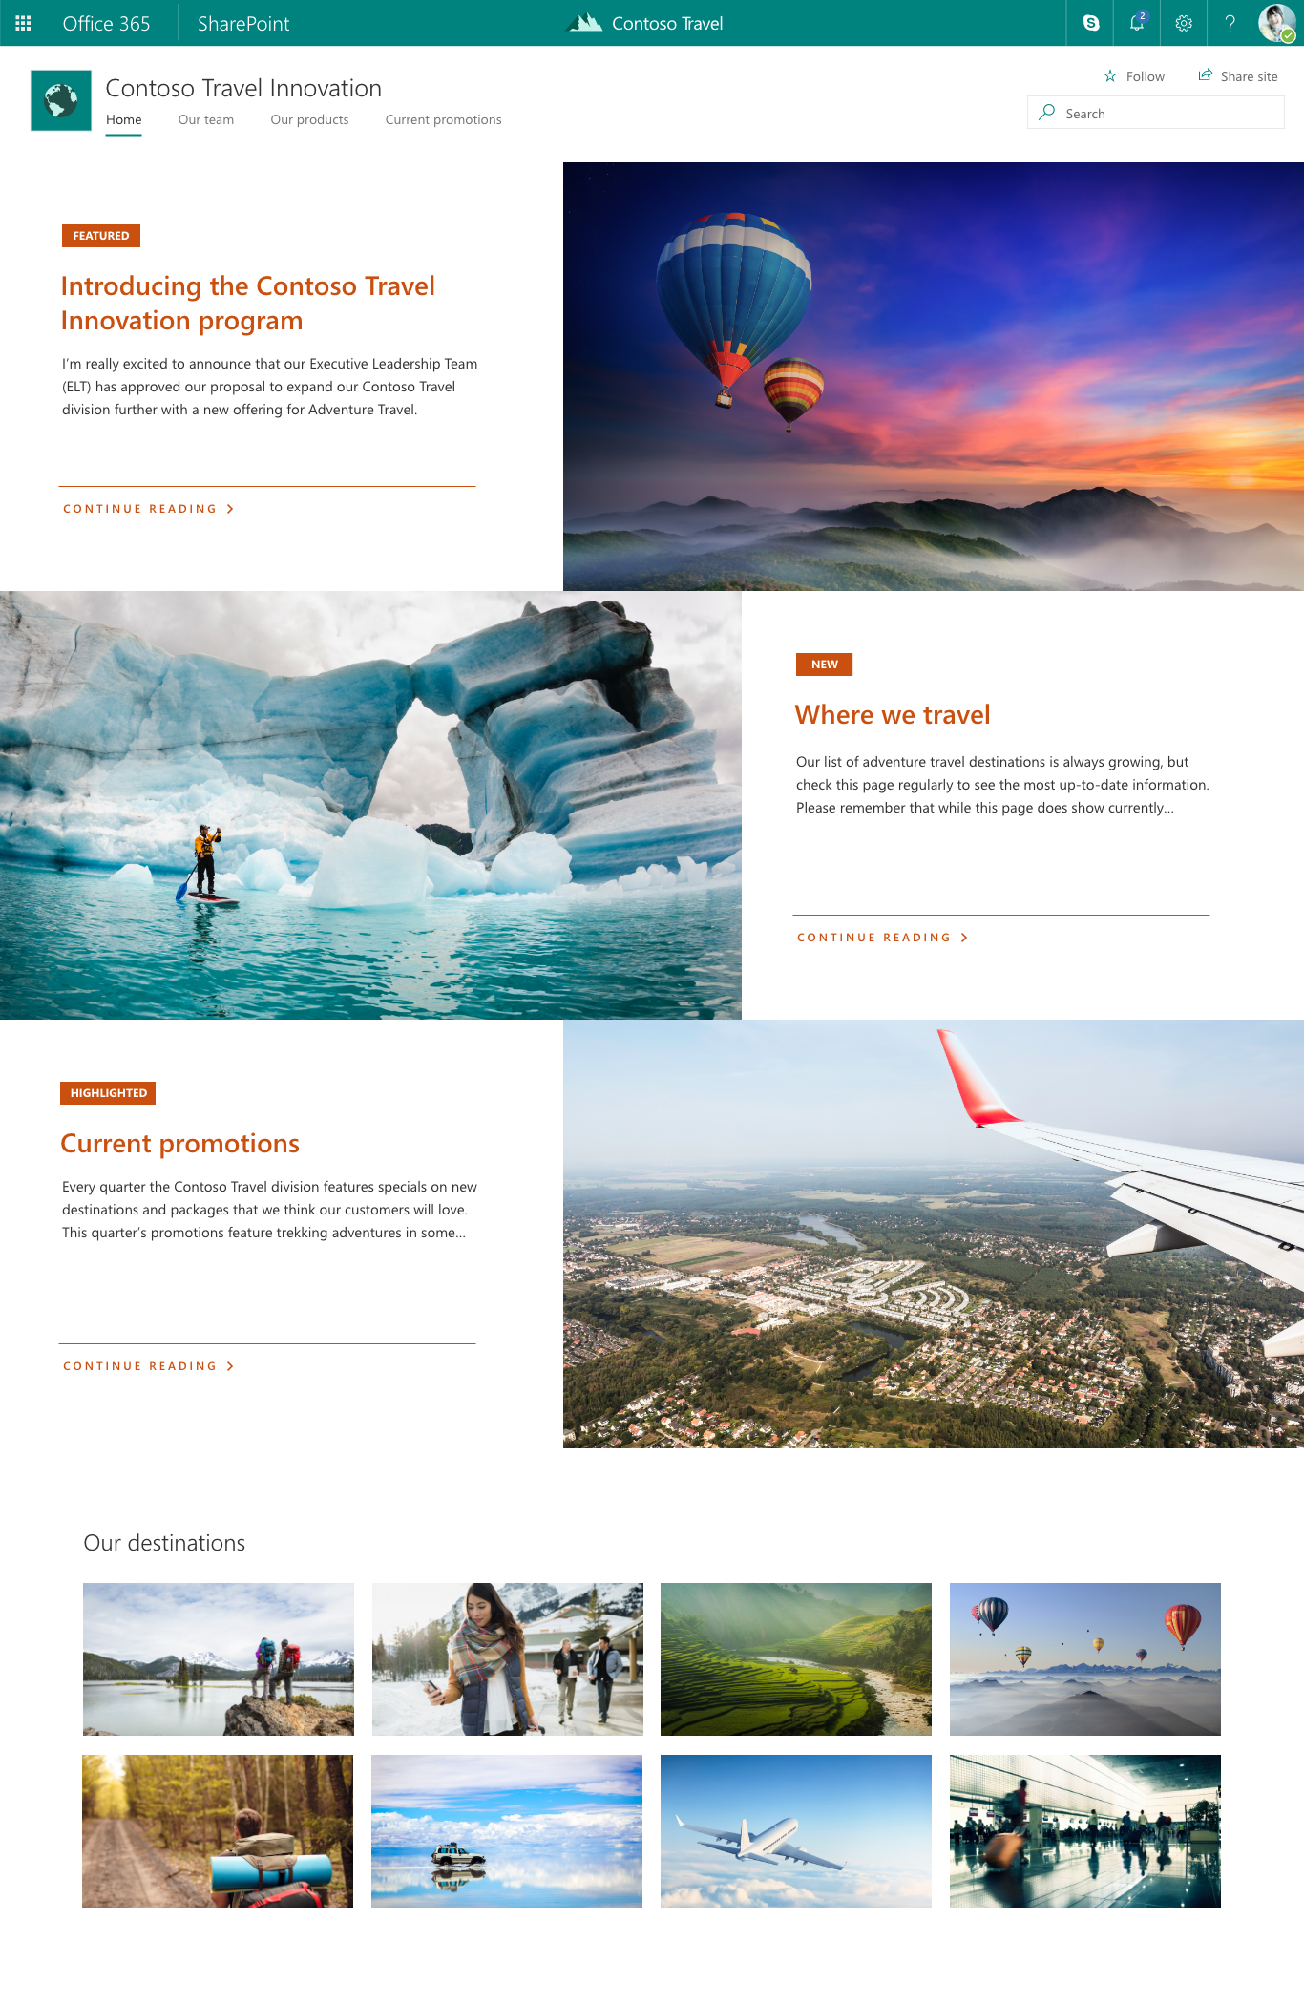
What is happening?
We are now using SharePoint, so you can inform and engage your peers from anywhere.
With SharePoint, you can:
Share content inside or outside your organization
Reach broad audiences with intranet sites
Share company news
Foster communities to share knowledge and best practices

Slide 5
When is it happening?
Go Live
 | Get ready |  | Get set |  | Go!
Communications & outreach | Early online announcements | Ongoing online announcements |  | Countdown messaging | Ongoing communication activities
Support |  |  | HelpDesk and Tech Lounges for early adopters |  | Ongoing Support HelpDesk and Tech Lounges for end users
Learning |  | Train the Trainer (Instructors, HelpDesk, Champions) |  | Training (online, self-paced, & instructor-led) | End user training (online, self-paced, & instructor-led) First-day launch materials available

Slide 6
First day activities

Slide 7
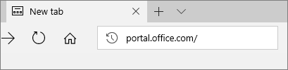
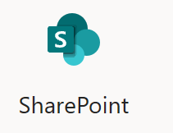
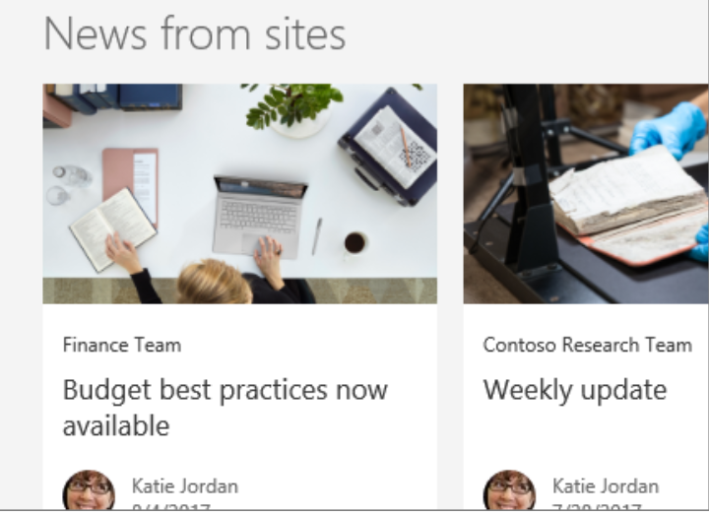
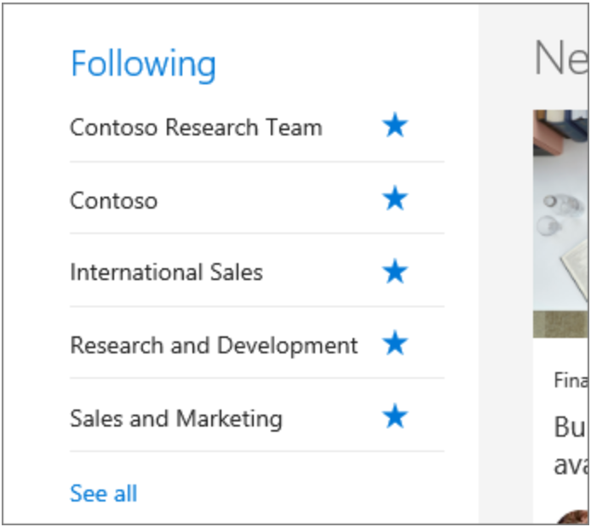
First day checklist
Sign in to SharePoint
  In a web browser, go to office.com
  Enter your email address:
  <name>@<organization url>.com
  Select the SharePoint tile on the on the Office 365 home page, or in the app launcher
Check out news
  The SharePoint homepage is your place to find sites, read news, or look up content. The right pane gives you easy access to relevant content.
Find your site
  The left navigation pane shows SharePoint sites you follow, those you've visited recently, and sites your company wants to spotlight.

Slide 8
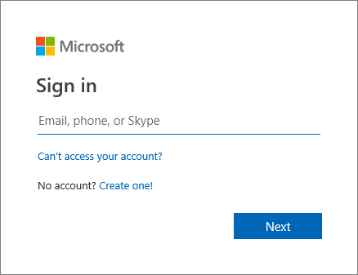
Sign in to SharePoint
In a web browser, go to office.com
1
2
Enter your email address:
<name>@<organization url>.com
<name>@ORG_ADDRESS

Slide 9
How-to resources

Slide 10

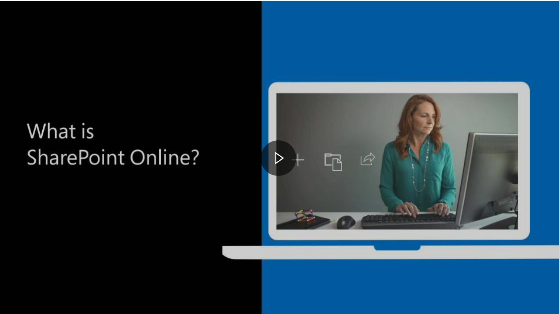
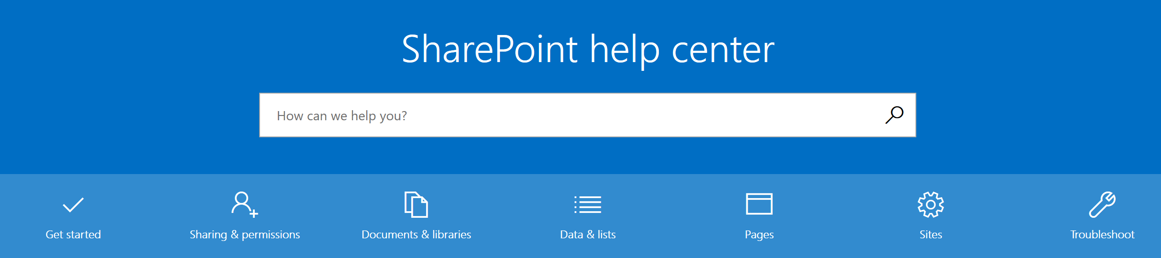
Recommended SharePoint learning path
QuickStart Guide |  | Video Training |  | Help Center
http://download.microsoft.com/download/C/3/4/C3468197-CE05-4738-A1D4-707B4738723A/SPO%20QS.pdf |  | https://support.office.com/article/sharepoint-online-video-training-cb8ef501-84db-4427-ac77-ec2009fb8e23 |  | https://support.office.com/sharepoint
>
>

Slide 11
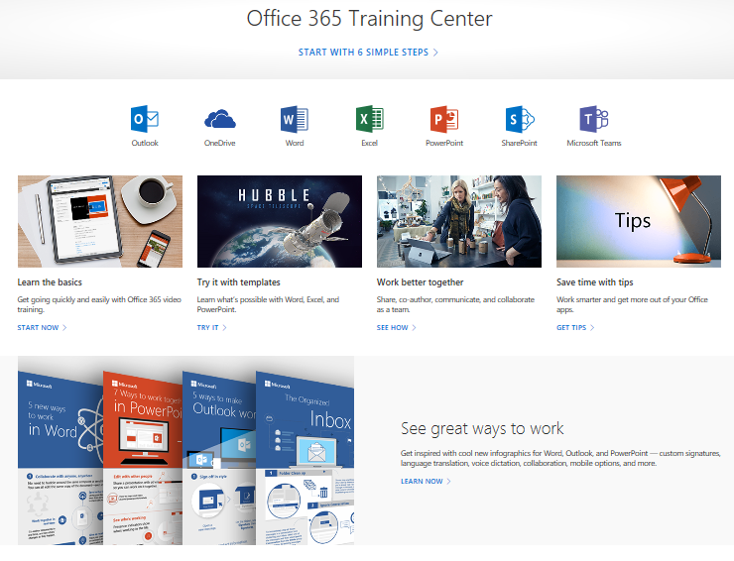
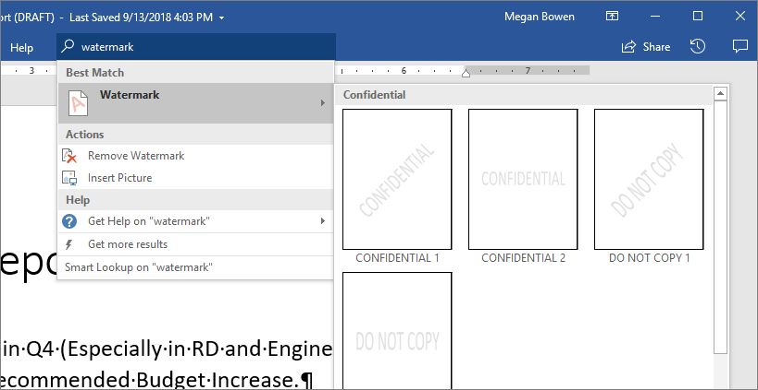
Additional training and help
Office 365 Training Center
https://support.office.com/en-us/office-training-center
  Get Templates, Tips, and a Collaboration Guide
  Discover new ways to work with infographics
1
Tell Me*
  Enter a Search term in the Tell me box to perform an action or get Help
*Available in Excel, Word, PowerPoint, Outlook

Slide 12
Q&A

