Slide 1

Guide to Cloud-native Endpoint Management
Guide to cloud-native endpoint management
Notes:
Before we begin, I want to recognize something important: for many organizations—especially those with long histories of endpoint management, diverse business units, and complex operational requirements—moving to cloud‑native endpoint management isn’t simple. It’s a significant shift that touches technology, process, people, and governance.
The goal of this deck is not to oversimplify that journey. Instead, it’s to give you a clear, structured, and actionable way to think about the transition. We built this content to help organizations like yours map out a thoughtful, realistic path—one that respects legacy environments while creating clarity on the future state.
As we walk through the slides, think of this as a blueprint you can use to design your own roadmap: how to sequence decisions, how to communicate with internal stakeholders, and how to bring alignment across IT, security, networking, procurement, and business units. Our aim is to help you build a plan that is achievable, grounded in best practices, and aligned to the outcomes you care about—security, efficiency, user experience, and operational resilience

Slide 2
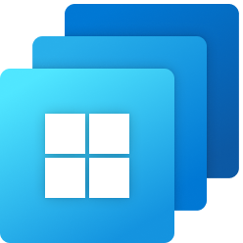

Agenda
What is Cloud-Native Endpoint Management and Why Now
Zero Trust explanation
Why Intune is instrumental in this journey
What does the journey look like
Steps in the journey
Notes:
Talk track (20–30s):
“Here’s our flow. First, we’ll define what cloud-native endpoint management is—and why the timing matters. Then we’ll ground it in Zero Trust. Next, we’ll show why Intune is foundational to executing that strategy, and we’ll walk through a practical journey: preparing, adopting, and operating fully cloud-native—with concrete steps and examples you can take back to your environment.”
Transition:
“Let’s level-set on what we mean by cloud-native endpoint management.

Slide 3



What is cloud-native endpoint management?
Microsoft Entra ID
Microsoft Intune
Notes:
Talk track (60s):
“When we say cloud-native endpoint management, we mean a holistic, cloud-first approach to protecting identities and devices—built for hybrid work. Microsoft Entra secures identity: strong authentication and conditional access so only the right people get access under the right conditions. Microsoft Intune extends that protection to devices across Windows, macOS, iOS, and Android—enforcing compliance, deploying apps, and enabling secure access from anywhere. Together, Entra and Intune create the backbone of a cloud-native strategy where security and productivity reinforce each other—not compete.”
Transition: “So why move now—what changes if you wait?

Slide 4
Why cloud native can’t wait
Improve security visibility, streamline operations
Simplify workflow and reduce response times to vulnerabilities
Future-ready flexibility and scalability
Notes:
Talk track (60–90s):
“Cloud-native isn’t just ‘modernization for modernization’s sake.’ The benefits compound quickly. You gain better security visibility and faster response because policy, compliance, and updates are managed centrally from the cloud. You simplify operations—fewer tools and fewer agents—so IT spends less time maintaining infrastructure and more time improving outcomes. And you become future-ready: scalable by design, adaptable to new threats, and ready for new capabilities like AI-assisted troubleshooting and analytics. Practically, it means fewer support tickets, better user experience, and stronger security controls aligned to Zero Trust.”
Transition: “That sets us up perfectly for Zero Trust—because cloud-native is how you operationalize it.”

Slide 5
Zero Trust + Cloud Native
Zero Trust
Cloud Native
Verify explicitly
Least privilege access
Assume breach
Notes:
Talk track (45–60s):
“Zero Trust is a strategy, but cloud-native is how you execute it at scale. The three principles map cleanly:
Verify explicitly with conditional access and strong identity signals.
Least privilege access by controlling elevation, apps, and configurations—without blocking productivity.
Assume breach by integrating device risk, threat signals, and automated remediation.
Cloud-native endpoint management makes those principles continuous and enforceable—not periodic and manual.”
Transition: “So if that’s the ‘why,’ Intune is the ‘how.’”

Slide 6
Microsoft Intune
Device management is foundational for Zero Trust
Simplified
Integrated
Secure
Cloud management thwarts risk, complexity and cost
Building trust
Efficient
Consolidated
Resiliency is built in the cloud
Unified
Notes:
Talk track (75–90s):
“Managing and securing the device ecosystem is foundational to Zero Trust—and that’s why Intune matters. The trends are undeniable: more endpoints, more platforms, and more threats increase complexity, risk, and cost. Intune addresses this by consolidating management and security workflows in the cloud. You see it in capabilities like: stronger device trust signals, zero-touch provisioning with Autopilot, integrated add-ons in Intune Suite that reduce tool sprawl, and unified cross-platform management—including Mac. And increasingly, AI assistance amplifies admin effectiveness—helping teams act faster with the right context. The core point: staying on legacy systems isn’t neutral—it weakens security, adds operational drag, and limits agility.”
Transition: “Now let’s look at the power of Intune in the broader Microsoft ecosystem.”

Slide 7









Intune Integrations
Combining Microsoft's best productivity tools with advanced security
Microsoft Solutions
seamless integration
Microsoft 365 Apps
baked experience
Microsoft 365
Multi-platform
Microsoft
Defender
Microsoft
Purview
Security
Compliance & Privacy
Identity & Management
Microsoft Teams
Outlook
Word
Excel
PowerPoint
Windows 11
Microsoft
Security
Microsoft
Sentinel
Microsoft
Priva
Productivity Suite
MAM-powered privacy and protection via Edge
Entra ID based remote assistance
Windows endpoint
security
Multicloud
Azure-hosted app content security
Custom Graph API app update distribution
Prioritized anomaly detection
Microsoft
Entra
Microsoft
Intune Suite
Windows 365
Cloud PC
Notes:
Talk track (45–60s):
“One of Intune’s biggest strengths is integrated value across Microsoft Security and Microsoft 365. When identity, endpoint management, endpoint protection, and compliance work together, you get a cohesive, user-centric model: fewer silos, less portal hopping, and more consistent policy enforcement. This helps organizations improve cybersecurity and compliance while simplifying IT operations and maintaining productivity—because security controls are built into the workflows users already rely on.”
Transition: “So how does a typical organization move from legacy to cloud-native?”

Slide 8
What does the transition look like?
On-prem Tech
Domain join
Domain Joined
Entra ID Joined
Cloud Tech
Entra ID join
Cloud Solution
On-prem Solution
Notes:
Talk track (45–60s):
“Most organizations are on a spectrum—from on-prem domain join and legacy tooling to cloud-first identity and management. The transition isn’t an overnight flip; it’s a managed shift where cloud adoption increases as on-prem dependency decreases. The goal is to steadily move device identity to Entra join and device management to Intune—so policies, apps, and security controls are delivered from the cloud and work consistently for a distributed workforce.”
Transition: “Let’s make that more concrete—especially for Windows.”

Slide 9

Cloud-native for Windows devices
Cloud-enable all workloads by moving them to Intune
Enroll existing devices into
co-management, Entra hybrid join
Provision
new cloud-native devices using Autopilot
Notes:
Talk track (30–45s):
“For Windows, the north star is straightforward: cloud-native new devices are Entra joined and managed by Intune—no hybrid join, no co-management required for those net-new endpoints. Along the way, you can enroll existing devices into a transitional state, but the cleanest long-term posture is Entra join + Intune management for modern, secure deployment and lifecycle operations.”
Transition: “Here’s a simple mapping of old world to new world.”

Slide 10

Legacy management
Cloud-native management
Configuration Manager |  | Microsoft Intune
Active Directory |  | Microsoft Entra ID
Group Policy |  | Setting Catalog
Local source/ distribution points |  | Delivery Optimization + Connected Cache
Task sequence |  | Windows Autopilot
Software Center |  | Company Portal
WSUS Server |  | Windows Autopatch
OS Image |  | Windows Autopilot
Print |  | Universal Print
3rd party UEM vendors |  | Microsoft Intune Suite
File Server |  | SharePoint and OneDrive
Notes:
Talk track (60s):
“This slide is a cheat sheet for modernization conversations. Legacy patterns—like domain-dependent identity, GPO, WSUS, task sequences, software center, and on-prem distribution points—map to cloud-native equivalents: Entra for identity, Settings Catalog for policy, Autopatch for updates, Autopilot for provisioning, Company Portal for app experience, Delivery Optimization/Connected Cache for content delivery, and Intune Suite to reduce third-party tool sprawl. The bigger takeaway: cloud-native isn’t missing capabilities—it replaces legacy components with cloud-first services that scale and simplify.”
Transition: “Now let’s walk the journey at a high level.”

Slide 11
Cloud-native journey
Start a POC to test and prepare Entra ID Join / Device Configuration
Deploy new devices with Autopilot /
Entra ID Join
Operate fully
Cloud-native
Notes:
Talk track (30–45s):
“Think of the journey in three phases. First, a proof of concept to validate Entra join and core device configuration. Next, you deploy new devices with Autopilot and Entra join to establish your ‘clean path’ forward. Finally, you operate fully cloud-native—where identity, policy, apps, updates, and security are delivered and managed consistently from the cloud.”
Transition: “Here’s what that looks like in a typical, practical path.”

Slide 12
Typical Path on Cloud-native Journey
Prepare
Adopt
Transition
Enroll existing devices
Configure Delivery Optimization
Configure Windows Hello for Business
Use Intune App Deployment
Manage updates
Deploy new devices with Autopilot /
Entra ID Join
Best practice: Start a POC to test and prepare Entra ID Join / Device Configuration
Notes:
alk track (60–90s + audience prompts):
“This is the practical order of operations we see work well. In Prepare, you enroll existing devices and start shifting core building blocks like content delivery and identity sign-in experience. In Adopt, you move apps and updates to cloud-first management—so you’re ready operationally. Then you Transition with Autopilot + Entra join for new devices—reducing dependency on imaging and on-prem processes.
(If interactive) I’ll ask a few quick questions as checkpoints: Who’s using ConfigMgr or WSUS for updates today? Any assumptions that Intune can’t deploy certain app types? And who believes Entra join blocks access to on-prem resources? We’ll address each directly as we go.”
Transition: “Let’s start with the first step: enrolling existing devices.”

Slide 13
Prepare – Enroll existing devices
Notes:
Talk track (15–20s):
“In the prepare phase, we begin by bringing existing devices under cloud management. This creates immediate value—visibility, compliance enforcement, and the ability to progressively move workloads without forcing a ‘big bang’ migration.”
Transition: “Here are the two main enrollment paths.”

Slide 14
Enroll existing devices in Intune
Prepare
Adopt
Transition
Enroll existing devices
Configure Delivery Optimization
Configure Windows Hello for Business
Use
Intune App Deployment
Manage updates
Deploy new devices with Autopilot /
Entra ID Join
Two paths
  With Microsoft Configuration Manager → Co-management
    Unattended automatic enrollment
    Enables controlled use of both Configuration Manager and Intune to manage devices
    Entra joined or Entra hybrid joined
  Without Microsoft Configuration Manager → Group Policy
    Enrollment initiated by licensed user login
    Entra hybrid joined only.
        *Check Microsoft Learn for how to Configure Microsoft Entra hybrid join - Microsoft Entra ID | Microsoft Learn
Notes:
Talk track (60s):
“There are two primary paths. If you have Configuration Manager, co-management is the most controlled way to transition—letting you use both tools while you move workloads over time, for Entra joined or hybrid joined devices. If you don’t have ConfigMgr, you can enroll using Group Policy—but that’s limited to Entra hybrid join and enrollment triggers when a licensed user signs in. The key message: co-management provides a structured glide path; pure cloud-native is the destination.”
Transition: “Let’s look at what it means to connect ConfigMgr to Intune.”

Slide 15
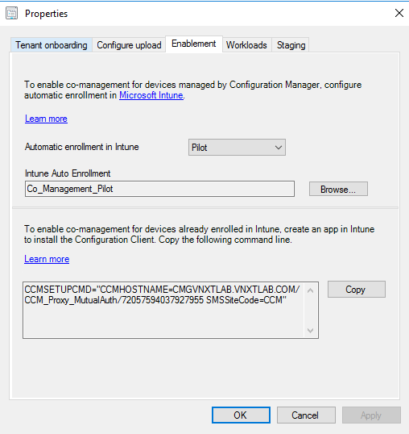
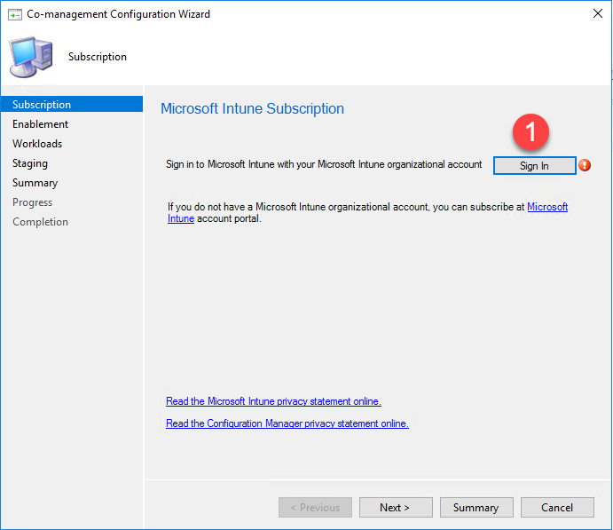
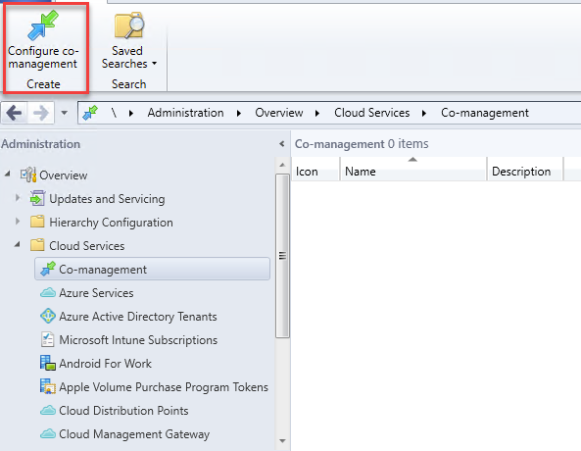
Connect Configuration Manager to Intune
Prepare
Adopt
Transition
Enroll existing devices
Configure Delivery Optimization
Configure Windows Hello for Business
Use
Intune App Deployment
Manage updates
Deploy new devices with Autopilot /
Entra ID Join
Notes:
Talk track (30–45s):
“This is the foundational setup for co-management. Once ConfigMgr is connected to Intune, you can pilot cloud-managed workloads safely while keeping continuity for operations. It’s the ‘bridge’ that allows you to validate policies, app deployment, and update management in Intune—without disrupting existing management until you’re ready.”
Transition: “Then we ‘swing’ workloads—starting small, proving success, and scaling.”

Slide 16
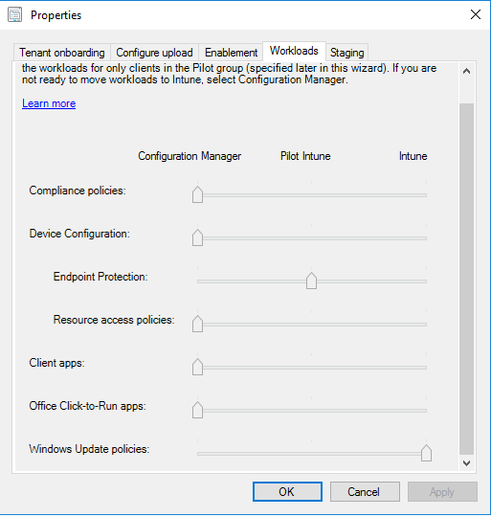
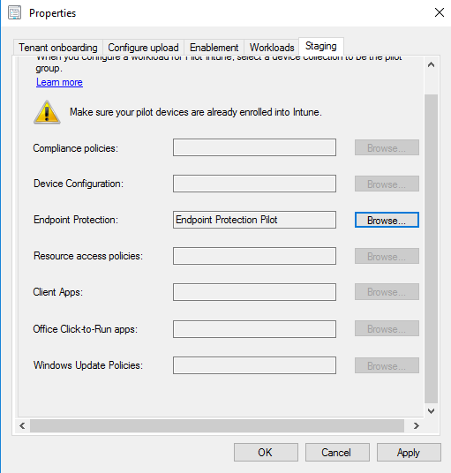
“Swing” Configuration Manager Client Workloads to Intune
Prepare
Adopt
Transition
Enroll existing devices
Configure Delivery Optimization
Configure Windows Hello for Business
Use
Intune App Deployment
Manage updates
Deploy new devices with Autopilot /
Entra ID Join
Use Pilot collection for test, then move all workloads to the cloud.
Notes:
Talk track (45–60s):
“This is the disciplined approach: use a pilot collection first, validate outcomes, then progressively move workloads to Intune. This reduces risk and builds confidence. The best practice is to treat each workload move as a measurable improvement—fewer touchpoints, faster remediation, and simpler policy control—before expanding to the broader fleet.”
Transition: “And if you don’t have ConfigMgr, here’s the alternative.”

Slide 17
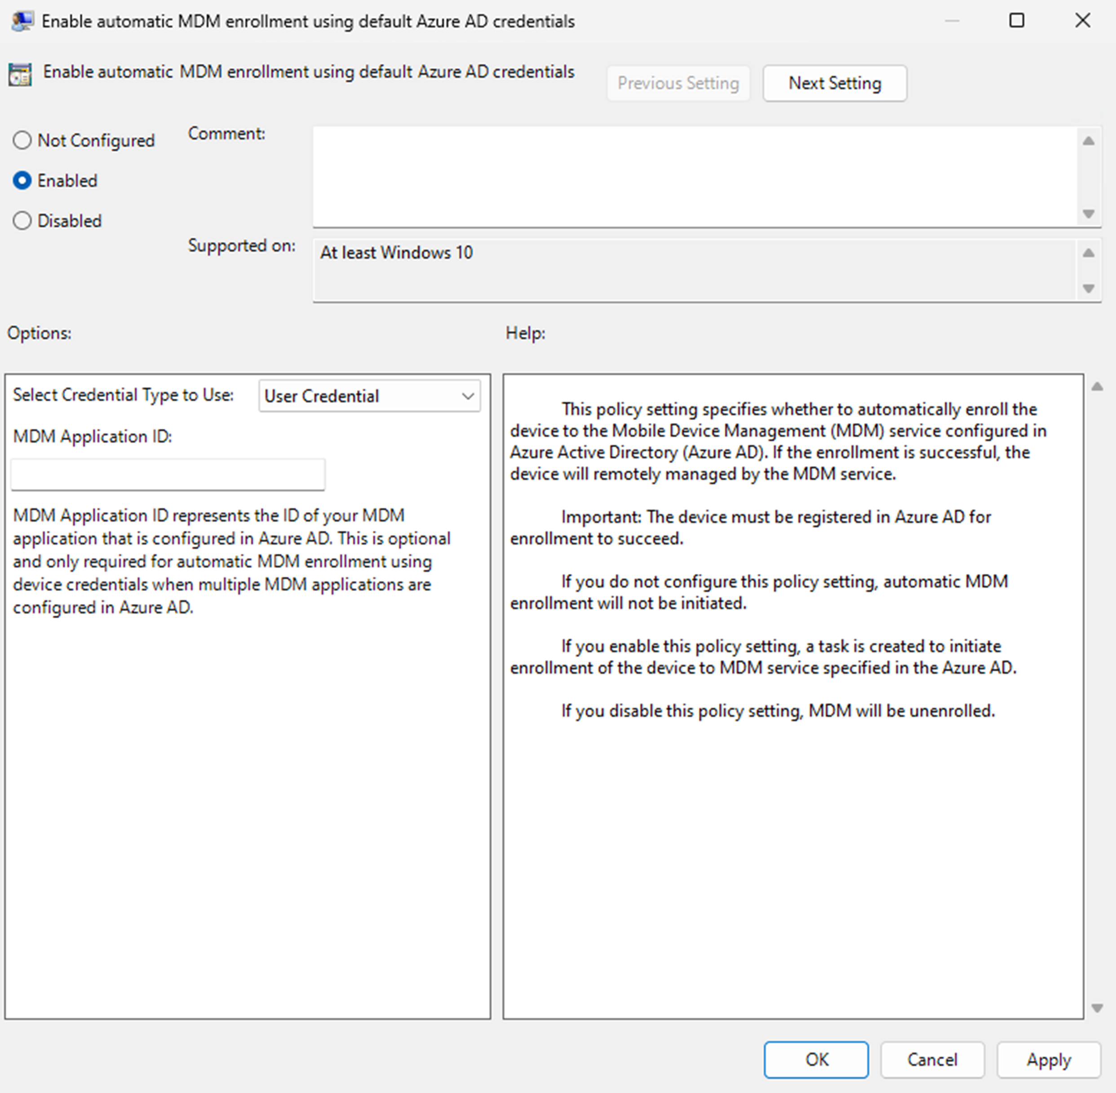
Enroll existing devices without
Configuration Manager
Prepare
Adopt
Transition
Enroll existing devices
Configure Delivery Optimization
Configure Windows Hello for Business
Use
Intune App Deployment
Manage updates
Deploy new devices with Autopilot /
Entra ID Join
Requirements
  Entra ID P1/P2 licensing
  On-premises Active Directory Integrated with Microsoft Entra ID
  Entra hybrid joined devices only
  Enrollment triggered by Group Policy
Caveats
  Triggered when a licensed Intune user logs into the device
    *Check Microsoft Learn for how to Enroll a Windows device automatically using Group Policy | Microsoft Learn
Notes:
Talk track (45–60s):
“For environments without ConfigMgr, automatic enrollment through Group Policy is an option—primarily for Entra hybrid joined devices. It requires Entra P1/P2 licensing and AD integrated with Entra. The caveat is important: enrollment is triggered by a licensed Intune user logging into the device. So it can be effective, but it’s not as flexible as co-management. Again—the message is: these are transition tools; cloud-native new devices are Entra joined and Intune managed.”
Transition: “Next, we optimize how content is delivered—because updates and apps are where cost and user experience show up fast.”

Slide 18
Prepare – Configure Delivery Optimization
Notes:
Talk track (15–20s):
“Once devices are enrolled, improving content delivery is one of the quickest wins. Delivery Optimization reduces bandwidth strain and speeds updates and app installs—especially important for distributed and remote environments.”
Transition: “Here’s what Delivery Optimization and Connected Cache do.”

Slide 19
Configure Delivery Optimization
Prepare
Adopt
Transition
Enroll existing devices
Configure Delivery Optimization
Configure Windows Hello for Business
Use
Intune App Deployment
Manage updates
Deploy new devices with Autopilot /
Entra ID Join
Delivery Optimization (First Choice)
Content Delivery
Network (CDN)
Management
Console
Your own devices contribute to reduce the overall Internet bandwidth
Download reliably from multiple http and peer sources in parallel
Cloud managed peer discovery to find the best local sources
Flexible download throttling controls
Distributed
Customer on-prem Server
Connected
Cache
Microsoft Connected Cache (when peer-to-peer configuration is not sufficient)
Distribution Point
OR
Server Container host
Delivery Optimization
Customer Local Network
Dedicated
Transparently and dynamically cache content Optimization, consumed by devices on your network​
Better bandwidth reductions in sites with limited access
Supporting networks where peer-to-peer cannot be used
Check Microsoft Learn for more about
What is Delivery Optimization? | Microsoft Learn
Microsoft Connected Cache overview | Microsoft Learn
Notes:
Talk track (60–75s):
“Delivery Optimization is cloud-managed peer-to-peer content distribution—devices help each other download content locally, reducing internet bandwidth and improving reliability by pulling from multiple sources in parallel. It also supports throttling and smart peer discovery to find the best local sources. If peer-to-peer isn’t sufficient—like constrained networks or specific site designs—Microsoft Connected Cache provides transparent caching for even better bandwidth reductions. Together, they modernize the old ‘distribution point’ concept for the cloud era.”
Transition: “And it’s not just Windows updates—here’s what it can accelerate.”

Slide 20
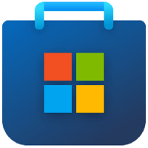




Delivery Optimization Supported Content
Prepare
Adopt
Transition
Enroll existing devices
Configure Delivery Optimization
Configure Windows Hello for Business
Use
Intune App Deployment
Manage updates
Deploy new devices with Autopilot /
Entra ID Join
Windows Updates
Microsoft Store apps
Defender definitions
Intune Win32 apps
Microsoft 365 apps
install and updates
Microsoft Edge updates
Full list at aka.ms/DeliveryOptimization
Notes:
Talk track (30–45s):
“Delivery Optimization helps across a broad set of content types: Windows updates, Microsoft Store apps, Defender definitions, Intune Win32 apps, Microsoft 365 Apps installs and updates, and Edge updates. This matters because it reduces time-to-update and user disruption across the entire endpoint lifecycle—not just patch Tuesday.”
Transition: “Now let’s talk configuration—how you turn it on in your environment.”

Slide 21
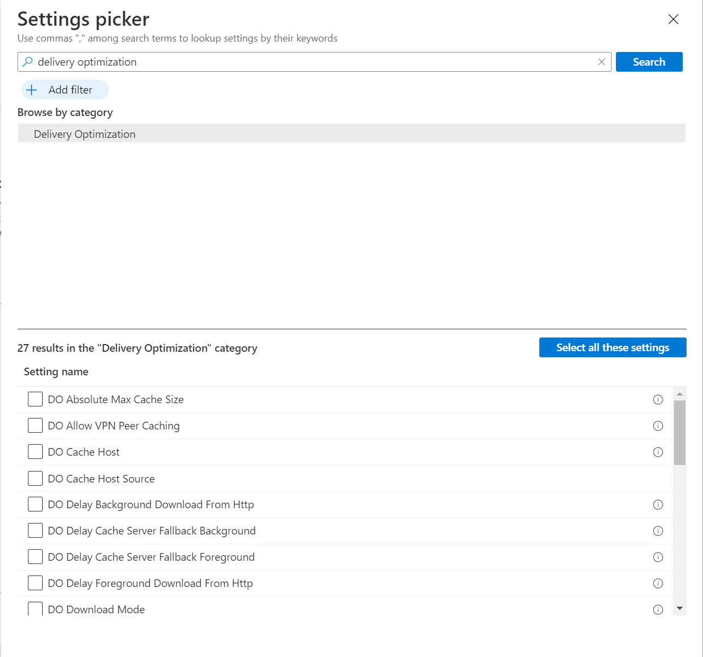
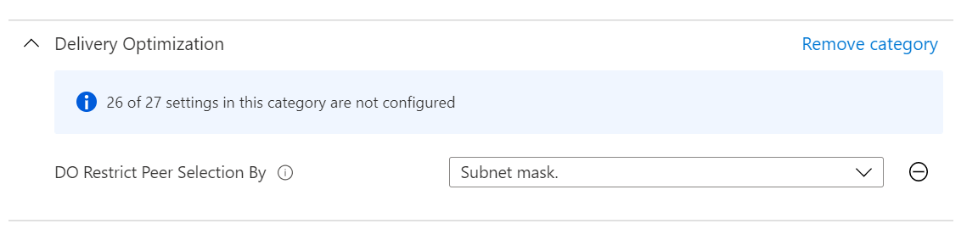
Configure Delivery Optimization
Prepare
Adopt
Transition
Enroll existing devices
Configure Delivery Optimization
Configure Windows Hello for Business
Use
Intune App Deployment
Manage updates
Deploy new devices with Autopilot /
Entra ID Join
Configure in Group Policy or Settings Catalog
Learn more >
Notes:
Talk track (30–45s):
“You can configure Delivery Optimization either through Group Policy or through Intune’s Settings Catalog. The main point is consistency: define the behavior once, target the right groups, and manage it centrally. This is a good example of how cloud-native management reduces ongoing operational overhead compared to maintaining on-prem distribution infrastructure.”
Transition: “Next up: sign-in experience and passwordless—Windows Hello for Business.”

Slide 22
Prepare – Configure Windows Hello for Business
Notes:
Talk track (15–20s):
“In the prepare phase, Windows Hello for Business is a high-impact step because it improves both security and end-user experience—enabling strong, phishing-resistant authentication in a way users actually like.”
Transition: “Let’s address a common misconception first: Entra join and on-prem access.”

Slide 23
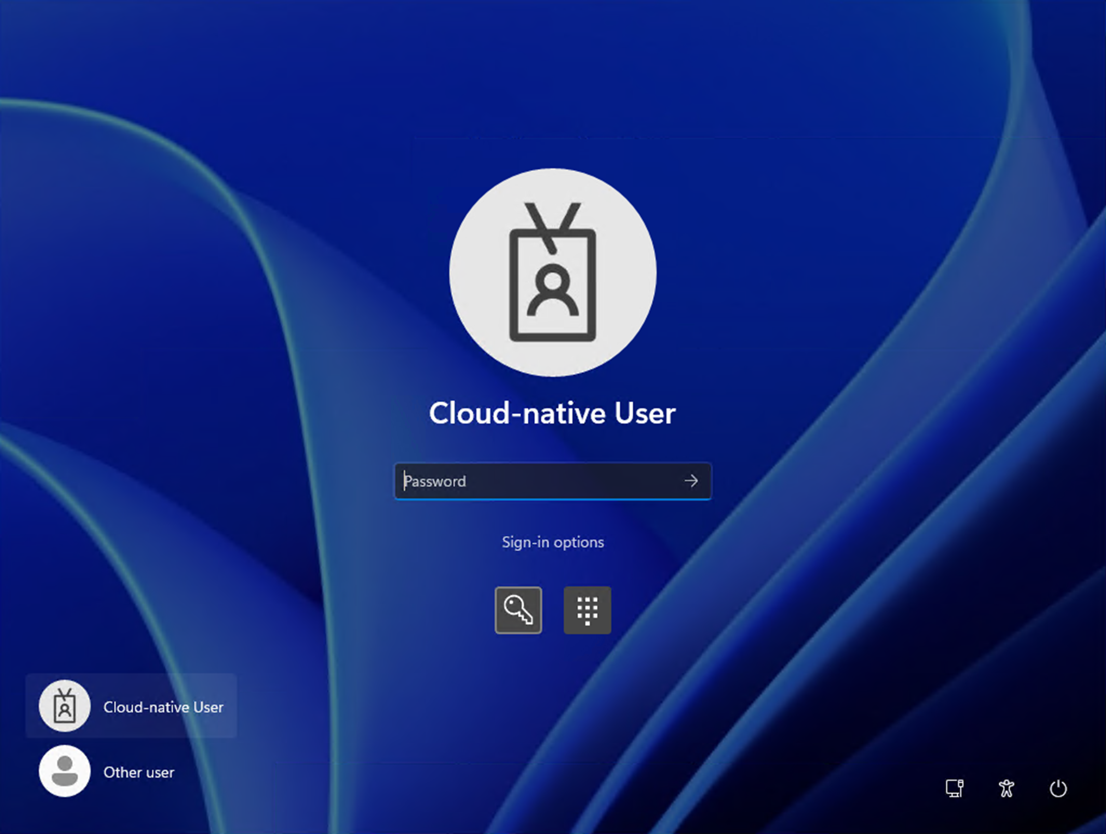
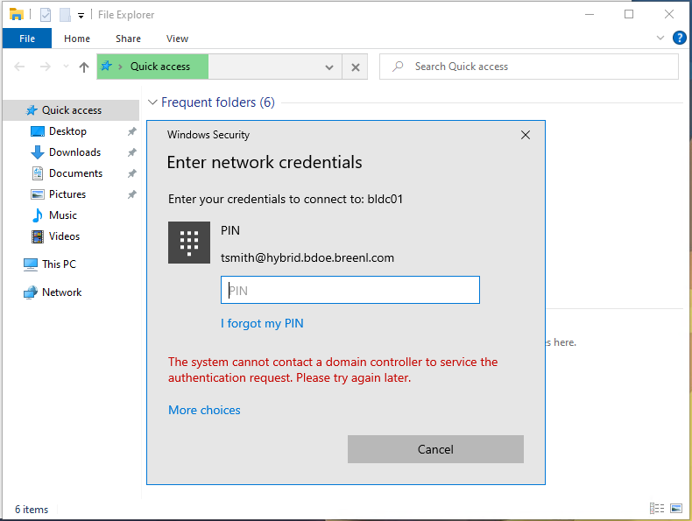
Configure Windows Hello for Business
Prepare
Adopt
Transition
Enroll existing devices
Configure Delivery Optimization
Configure Windows Hello for Business
Use
Intune App Deployment
Manage updates
Deploy new devices with Autopilot /
Entra ID Join
✅ Entra joined devices can SSO to on prem resources (file shares, printers, web apps).
Step 1: Test by logging on with password
If you are encountering issues like:
Step 2: Configure Windows Hello Trust
  *Check Microsoft Learn for Windows Hello for Business cloud Kerberos trust deployment guide
Notes:
Talk track (45–60s):
“Entra joined devices can single sign-on to on-prem resources like file shares, printers, and web apps—as long as there’s network connectivity and identities are synced appropriately. If you see issues, a simple test is logging in with a password to validate baseline access, then configure the recommended trust model for Windows Hello. The goal is seamless access with stronger authentication—without breaking legacy dependencies during transition.”
Transition: “Now let’s zoom out to why passwordless is a game-changer.”

Slide 24
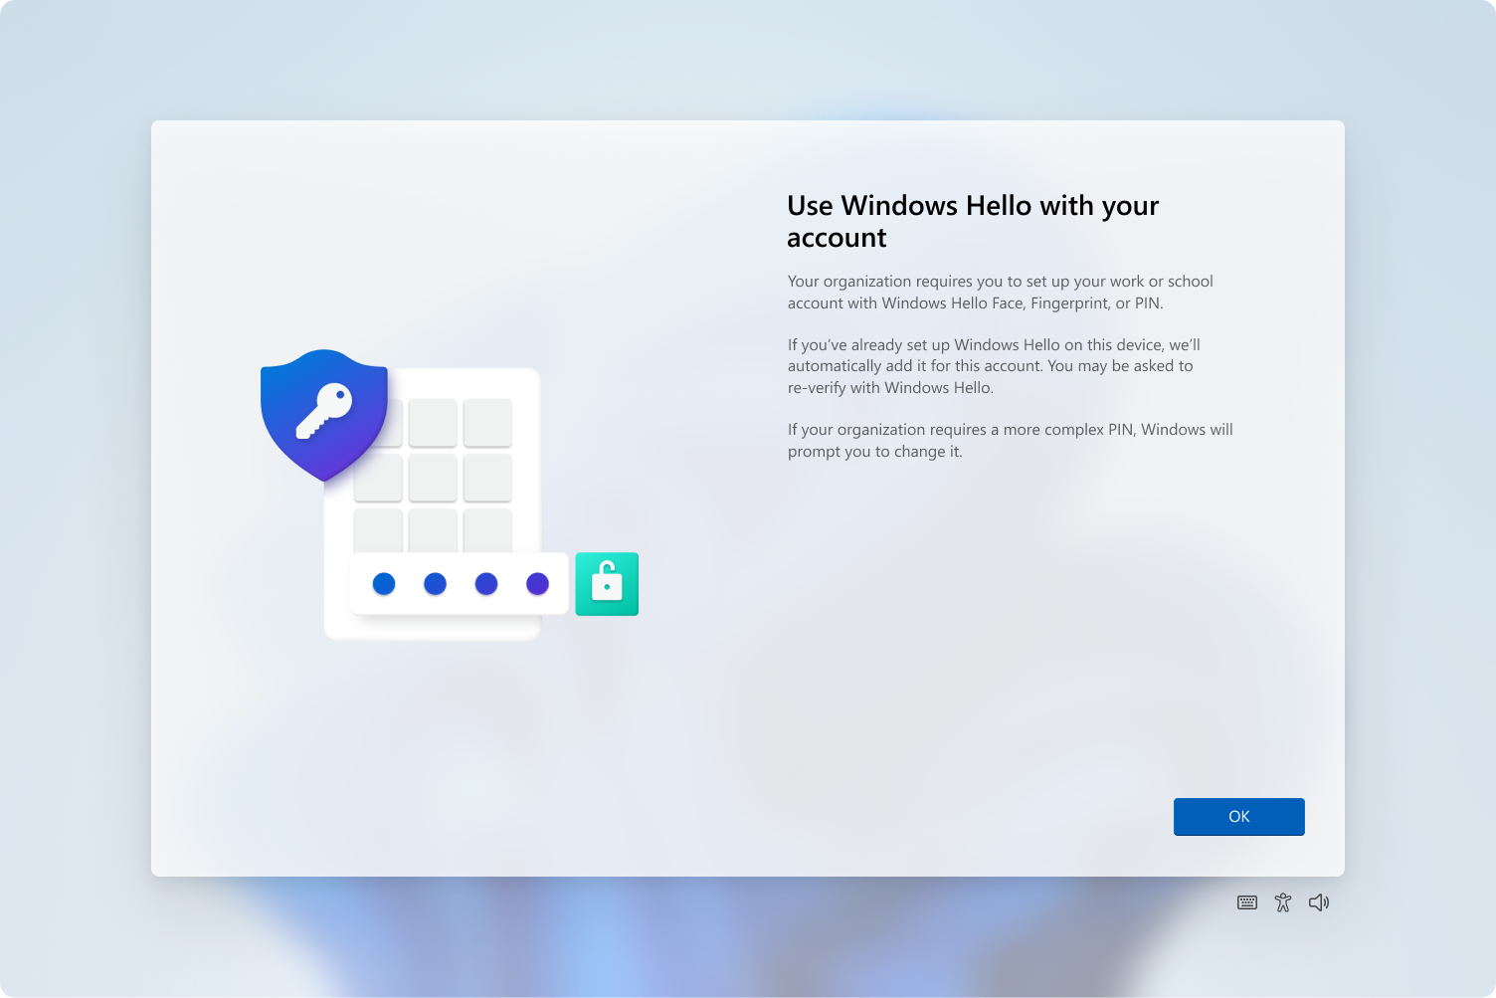
Windows Hello + Passwordless
Prepare
Adopt
Transition
Enroll existing devices
Configure Delivery Optimization
Configure Windows Hello for Business
Use
Intune App Deployment
Manage updates
Deploy new devices with Autopilot /
Entra ID Join
Use Windows Hello for Business
to provide phishing-resistant, multi factor authentication with a great user experience.
✅ Meets MFA requirements
✅ Meets phishing resistant requirements
✅ Great user experience with unlock using PIN or biometrics
✅ Seamless set up flow
Notes:
Talk track (45–60s):
“Windows Hello for Business delivers phishing-resistant MFA with great UX. It meets MFA requirements, supports phishing-resistant authentication expectations, and improves daily productivity: users unlock with PIN or biometrics and avoid password fatigue. The best part is the setup flow can be streamlined so adoption is smooth—turning security from a friction point into a usability upgrade.”
Transition: “Now that devices are enrolled and foundational services are in place, we move into adoption—starting with apps.”

Slide 25
Adopt – Use Intune App Deployment
Notes:
Talk track (15–20s): “Next is app deployment—because cloud-native endpoints are only successful if apps arrive reliably, update cleanly, and stay compliant without constant IT intervention.”
Transition: “Here’s the app toolkit Intune gives you.”

Slide 26
Use Intune App Deployment
Prepare
Adopt
Transition
Enroll existing devices
Configure Delivery Optimization
Configure Windows Hello for Business
Use
Intune App Deployment
Manage updates
Deploy new devices with Autopilot /
Entra ID Join
Microsoft Store apps
Enterprise App Management
Intune Win32 apps
Microsoft 365 apps
Choose and deploy apps from the Microsoft Store
Pre-packaged apps
Guided update
* Part of Intune Suite
MSI, EXE, script
Requirement rules
Detection rules
Dependencies
Available app auto update
Supersedence
Configure, deploy and manage Microsoft 365 apps
Notes:
Talk track (60–75s):
“Intune supports the full range of app needs: Microsoft Store apps, Win32 apps (MSI, EXE, scripts) with requirement and detection rules, dependencies, and supersedence for clean upgrades. It also supports Microsoft 365 Apps deployment and management. For organizations that want to simplify third-party app packaging and updates, Enterprise App Management provides pre-packaged apps with guided updates—reducing packaging burden and helping you keep apps current. The message: app deployment is not a blocker—Intune is designed to handle real enterprise complexity.”
Transition: “And if you’re coming from ConfigMgr, there’s a clean way to bridge the experience.”

Slide 27
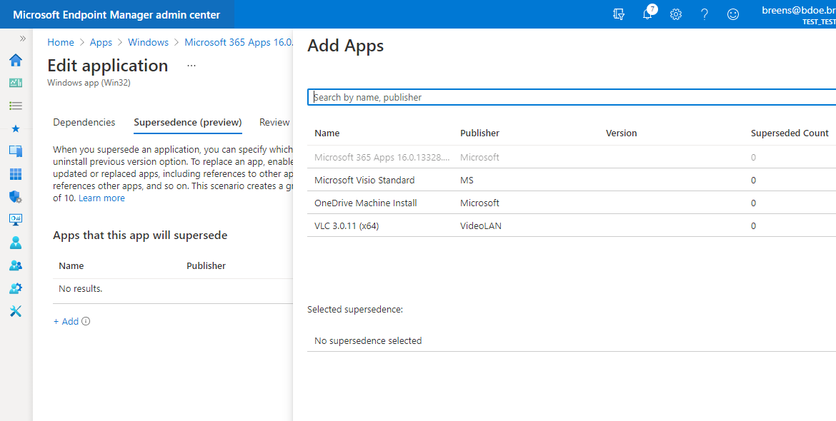

Use Intune App Deployment
Prepare
Adopt
Transition
Enroll existing devices
Configure Delivery Optimization
Configure Windows Hello for Business
Use
Intune App Deployment
Manage updates
Deploy new devices with Autopilot /
Entra ID Join
For Configuration Manager customers:
Switch co-management Client apps workload to Intune
Migrate apps from Configuration Manager to Intune
Deploy apps from Intune
Company Portal App
One-stop-shop to install apps from Configuration Manager and Intune
Notes:
Talk track (45–60s):
“For ConfigMgr customers, you can switch the co-management ‘client apps’ workload to Intune and migrate apps progressively. Users can still have a unified experience through Company Portal—so they have a single place to install apps whether the backend is Intune or ConfigMgr during transition. This reduces user confusion while IT modernizes the delivery model behind the scenes.”
Transition: “Next: updates—where automation and control both matter.”

Slide 28
Adopt – Manage updates
Notes:
Talk track (15–20s):
“Updates are one of the most visible operational burdens—and one of the biggest security levers. In cloud-native management, the goal is to automate the routine while keeping control over rings, pace, and business constraints.”
Transition: “That brings us to Windows Autopatch.”

Slide 29

Simplified endpoint management
Prepare
Adopt
Transition
Enroll existing devices
Configure Delivery Optimization
Configure Windows Hello for Business
Use
Intune App Deployment
Manage updates
Deploy new devices with Autopilot /
Entra ID Join
2
2
Windows Autopatch
Automate the process and maintain control
2
2
Windows Update policies
You do the work
and have control​
  Windows 10 Enterprise PC
  Windows 365 Enterprise Cloud PC
  Windows 11 Enterprise PC
  Azure Virtual Desktop
Notes:
Talk track (45–60s):
“Windows Autopatch is designed to automate updates while maintaining admin control. We brought Autopatch into the Intune console for a better end-to-end management experience, and there are APIs available if you manage updates through other tools. The key message is balance: Autopatch reduces manual work, helps keep devices current, and still allows you to define rollout structure and governance.”
Transition: “Let’s look at common quality update rollout scenarios.”

Slide 30
Quality Update Scenarios
Prepare
Adopt
Transition
Enroll existing devices
Configure Delivery Optimization
Configure Windows Hello for Business
Use
Intune App Deployment
Manage updates
Deploy new devices with Autopilot /
Entra ID Join
Single Update ring policy targeting Microsoft Entra groups
  Generally used when only testing quality update deployments in a few devices, example: IT department-only devices, Lab/dev devices.
  Also used when there’s no business requirements to mirror organizational structures for a gradual/phased rollout.
Multiple ring policies when creating/editing Autopatch groups
  Best when you need to mirror your organization structures, followed by a business requirement for a gradual/phased rollout, example: Departments like: Marketing, HR, etc. or Branch office locations such as: Chicago, New York, etc.
  Easier to manage different quality update deployment speed and cadences across departments and/or branch locations.
Deadline vs. Schedule-driven deployments (Autopatch groups-only)
  Deadline-driven
    It’s an end user-driven that allow end users to interact with the update deployment. End users might decelerate update in some cases.
  Schedule-driven
    Best used for devices that can only be restarted at specific days/times.
Notes:
Talk track (60–75s):
“For quality updates, there are a few common patterns. Some start with a single ring targeting Entra groups—great for small pilots or IT-only validation. Others use multiple rings for phased rollout aligned to departments or locations. Autopatch also supports deadline-driven versus schedule-driven deployments: deadline-driven gives end users some flexibility; schedule-driven is best for devices that must reboot at specific times. And for mature processes, Autopatch supports up to 15 rings—so you can match existing governance while gaining automation.”
Transition: “Feature updates follow similar principles, with some additional controls.”

Slide 31
Feature Update Scenarios
Prepare
Adopt
Transition
Enroll existing devices
Configure Delivery Optimization
Configure Windows Hello for Business
Use
Intune App Deployment
Manage updates
Deploy new devices with Autopilot /
Entra ID Join
Single policy targeting Microsoft Entra groups
  Generally used when only testing feature update deployments in a few devices, example: IT department-only devices, Lab/dev devices.
  Also used when there’s no business requirements to mirror organizational structures for a gradual/phased rollout.
Multi-phase release targeting Autopatch groups
  Best when you need to mirror your organization structures, followed by a business requirement for a gradual/phased rollout, example: Departments like: Marketing, HR, etc. or Branch office locations such as: Chicago, New York, etc.
  Easier to manage different feature update deployment speed and cadences across departments and/or branch locations.
  Additional deployment sequence/ordering controls for each phase of the deployment.
  It gives IT admins additional layer of gradual rollout controls on top of the gradual rollout capabilities that happen at the service level.
When a device isn’t eligible to run Windows 11, install the Windows 10 feature update
  Both scenarios above offer this setting so Autopatch can intelligently upgrade to the latest supported Windows OS version your device’s hardware support, without bringing additional IT admin overhead.
Notes:
Talk track (60–75s):
“For feature updates, you can use a single policy for limited testing, or a multi-phase release aligned to Autopatch groups when you need gradual rollout controls. The value here is layered control: you get phased deployment sequencing at the admin level, plus the service-level gradual rollout benefits. And Autopatch can intelligently handle cases where a device isn’t eligible for Windows 11—keeping it on the latest supported Windows 10 feature update without extra admin overhead.”
Transition: “Beyond OS updates, drivers and firmware are another big stability lever.”

Slide 32
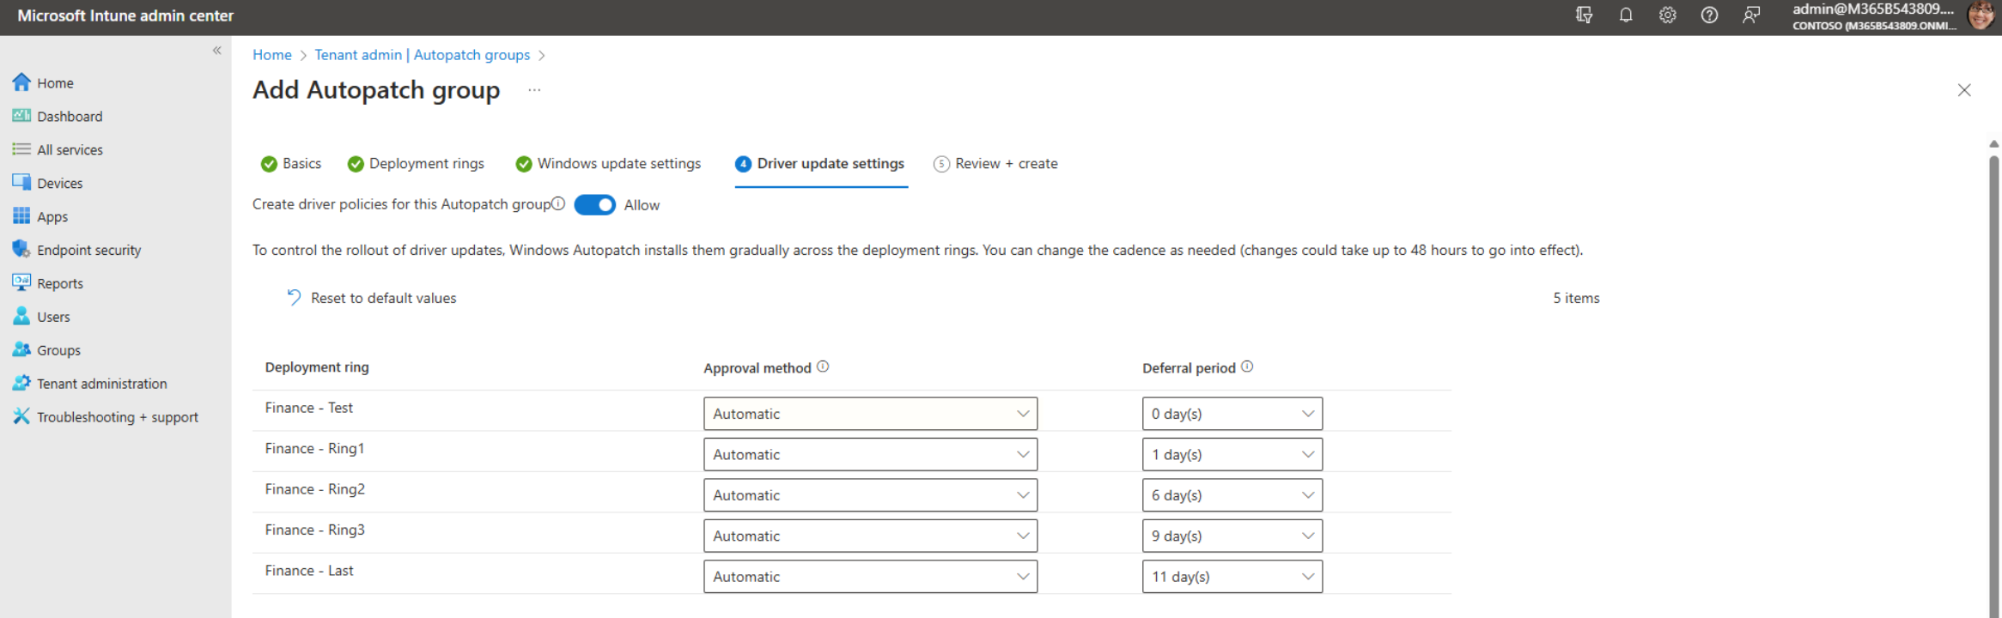
Customize Driver and Firmware Updates
Prepare
Adopt
Transition
Enroll existing devices
Configure Delivery Optimization
Configure Windows Hello for Business
Use
Intune App Deployment
Manage updates
Deploy new devices with Autopilot /
Entra ID Join
Automatic
Recommended drivers are automatically installed using Autopatch deployment ring rollout and Deferral period.
Manual
Drivers aren't installed in your environment without your explicit approval.
Demo
Notes:
Talk track (45–60s):
“This is where you balance automation and explicit control. In automatic mode, recommended drivers roll out using Autopatch rings and deferral settings. In manual mode, nothing installs without explicit approval—useful for sensitive environments. The broader idea is cadence customization: tune deadline, deferral, and grace periods for quality and feature updates, and use scheduled installs for devices that can only restart at specific windows.”
Transition: “If you want more detail, this next slide links to the announcement and deeper guidance.”

Slide 33

Driver and firmware updates
Manage Windows driver and firmware updates with Microsoft Intune | Microsoft Community Hub
Notes:
Talk track (15–20s):
“This is a helpful reference if you want the deeper background and rollout considerations for managing driver and firmware updates through Intune.”
Transition: “Now let’s talk about reducing disruption even further with Hotpatch.”

Slide 34
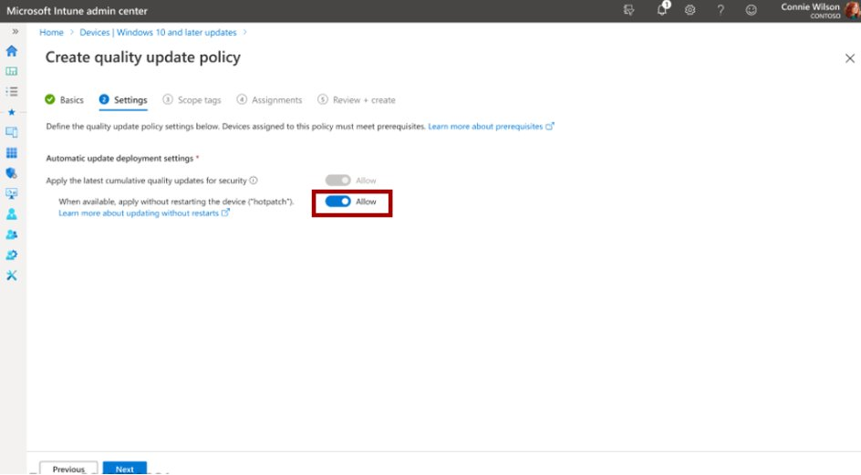
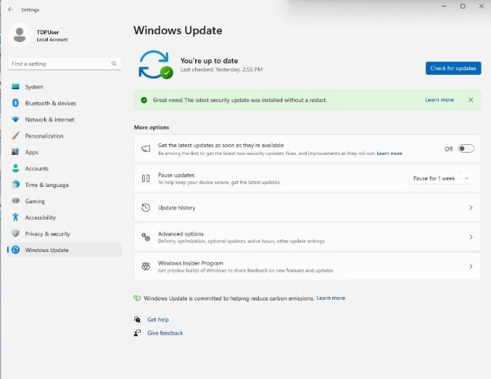
Hotpatch for Windows
Prepare
Adopt
Transition
Enroll existing devices
Configure Delivery Optimization
Configure Windows Hello for Business
Use
Intune App Deployment
Manage updates
Deploy new devices with Autopilot /
Entra ID Join
Keeping customers secure and productive without interruptions
Hotpatch for Windows are Patch Tuesday security updates that install
without requiring device restart.
Autopatch simplifies Hotpatch opt-in
OS security patches install without disruptions
Security updates immediately take effect upon installation — no restart required
Notes:
Talk track (45–60s):
“Hotpatch is about security without interruption. These are Patch Tuesday security updates that install without requiring a device restart—so users stay productive and security improves immediately. Autopatch simplifies the opt-in experience, and the headline is powerful: security updates take effect right away with fewer ‘restart now’ moments for end users.”
Transition: “Now that apps and updates are modernized, we move to net-new device deployment the cloud-native way.”

Slide 35
Adopt – Deploy new devices with Autopilot /
Entra Join
Notes:
Talk track (15–20s):
“This is the pivot point: once your services are ready, new device deployment becomes your fastest path to cloud-native at scale—using Autopilot with Entra join and Intune management.”
Transition: “Here are the practical steps to make that happen.”

Slide 36
Use Autopilot and Entra ID Join for new devices
Prepare
Adopt
Transition
Enroll existing devices
Configure Delivery Optimization
Configure Windows Hello for Business
Use
Intune App Deployment
Manage updates
Deploy new devices with Autopilot /
Entra ID Join
Specify your OS
(pro or higher), version and installed application requirements
Ask your OEM and Partner to start importing your devices
Set up Autopilot profiles
Notes:
Talk track (45–60s):
“The operational playbook is simple: work with your OEM/partner to import devices, define OS and application requirements, and set up Autopilot profiles. From there, provisioning becomes zero-touch: devices are Entra joined, automatically enrolled into Intune, and receive apps and policies from the cloud—reducing imaging complexity and getting users productive faster.”
Transition: “A common question at this point is: what about on-prem resources?”

Slide 37
Can I access on-prem resources from Entra joined devices (provided there is network connectivity)?
Prepare
Adopt
Transition
Enroll existing devices
Configure Delivery Optimization
Configure Windows Hello for Business
Use
Intune App Deployment
Manage updates
Deploy new devices with Autopilot /
Entra ID Join
YES - with Entra Connect synced identities.
Notes:
Talk track (30–45s):
“Yes—with Entra Connect synced identities and network connectivity, Entra joined devices can access on-prem resources. The practical message is that Entra join does not mean ‘no on-prem’—it means identity and management are cloud-first, while access to legacy resources continues during the transition.”
Transition: “Now let’s put it all together into a clear blueprint for creating cloud-native endpoints.”

Slide 38

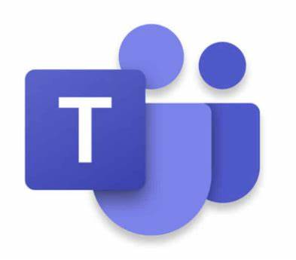


Create new Windows cloud-native endpoints
Prepare
Adopt
Transition
Enroll existing devices
Configure Delivery Optimization
Configure Windows Hello for Business
Use
Intune App Deployment
Manage updates
Deploy new devices with Autopilot /
Entra ID Join
aka.ms/gocloudnative
Phase 1 – Set up your environment
Phase 2 – Build your first cloud-native Windows endpoint
Phase 3 – Secure your cloud-native Windows endpoint
Phase 4 – Apply your custom settings and applications
Phase 5 – Deploy at scale with Windows Autopilot
Identity: Entra joined
Apps and settings: Microsoft Intune
Notes:
Talk track (60–75s):
“This slide is the blueprint. Cloud-native endpoints have two pillars: Identity is Entra joined, and Apps and settings are delivered by Intune. From there, the journey becomes repeatable: set up your environment, build your first endpoint, secure it, apply customizations, and then deploy at scale with Autopilot. The advantage is standardization—your organization gets a proven sequence that reduces trial-and-error and scales cleanly.”
Transition: “Finally, here are the best resources to continue learning or to share with customers.”

Slide 39
Cloud-native Resources
  What are cloud-native Windows endpoints - Microsoft Intune | Microsoft Learn
  Which option is right for your organization – Microsoft Intune | Microsoft Learn
  Tutorial-Get started with cloud-native Windows endpoints - Microsoft Intune | Microsoft Learn
  Cloud-native Windows endpoints: Begin by beginning | Microsoft Community Hub
  Zero Trust and Cloud-Native Windows - Microsoft Intune Blog
  How SSO to on-premises resources works on Microsoft Entra joined devices - Microsoft Entra ID | Microsoft Learn
Notes:
Talk track (20–30s):
“These resources help teams go deeper: cloud-native endpoint overviews, choosing the right join model, the step-by-step tutorial, and additional guidance on Zero Trust and SSO behavior for Entra joined devices. If you’re enabling a program, these links are great to include in follow-up notes so stakeholders can self-serve and move faster.”
Close (optional): “If you’d like, share your current state—ConfigMgr, WSUS, hybrid join—and we can map the fastest path to your first cloud-native pilot.”

