Slide 1
OneDrive Adoption Playbook
https://adoption.microsoft.com/onedrive/

Slide 2
The Success Factors outlined in this deck will help make sure you’re set up for a successful roll-out of OneDrive.
Throughout this deck, you will find templates to help you facilitate your organization’s OneDrive adoption campaign.
The Success Factors outlined in this deck will help make sure you’re set up for a successful roll-out, no matter what your business challenges.
Throughout this deck, you will find templates to fill in whic

Slide 3
Adoption Success Factors
LEARN AND REINFORCE
Stakeholders
Recruit executive sponsors
Empower OneDrive champions
Scenarios
Prioritize your One Drive scenarios
Measure success
Awareness
Implement OneDrive comms campaign
Execute OneDrive launch events
Training
Train end users
Ready help desk

Slide 4
Stakeholders

Slide 5
Stakeholders
Executive sponsors
Communications to all staff and supporting sponsors/leadership
Act as sponsor and face to the program
Use the technology to model how employees can use it
Success Owner
Ensure business goals set for OneDrive are realized
Drive end user adoption
Champions
Scale adoption efforts across the organization
Evangelize OneDrive and its value across teams
Welcome new users and answer questions
Mott MacDonald developed a network of technology champions by engaging the employees who are most interested and enthusiastic about the new capabilities. The company makes sure the champions are well-trained and sends them out into the business to coach and communicate with their colleagues.

Slide 6
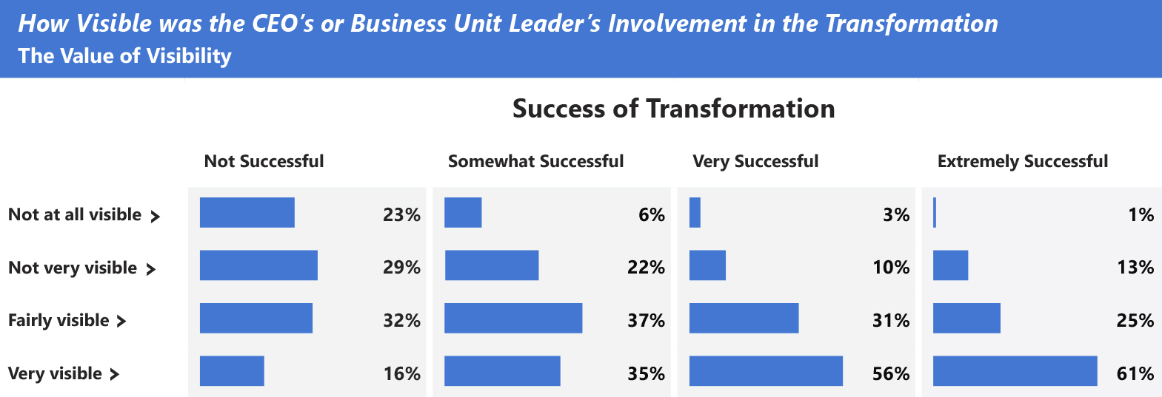
Why is the role of an Executive Sponsor crucial for project success?
An actively engaged executive sponsor is one of the top drivers of project success.
Adapted exhibit from “Creating organizational transformations”, July 2008, McKinsey Quarterly, www.mckinsey.com
Copyright© 2008 McKinsey & Company. All rights reserved. Reprinted by permission.

Slide 7
Executive Sponsor Communications
Executive Sponsor
Supporting Sponsors
Employees
Key messages
Outline the project’s 5 Ws (what, when, where, why’ and how)
How will benefit organization
Calls to action for supporting sponsors
Highlight resources to support transition
Key messages
Outline the project’s 5 Ws (what, when, where, why’ and how
How will benefit organization and end users
Calls to action for employees: start and stop behaviors
Highlight resources to support transition

Slide 8
How does a Champion help?
Info
Support
Enthusiasm
Answers
Keep your team up-to-date on what’s coming and when
Be on hand to answer questions and help get support involved when needed
Answer ad-hoc questions and demonstrate features
Help show your team the advantages of OneDrive

Slide 9
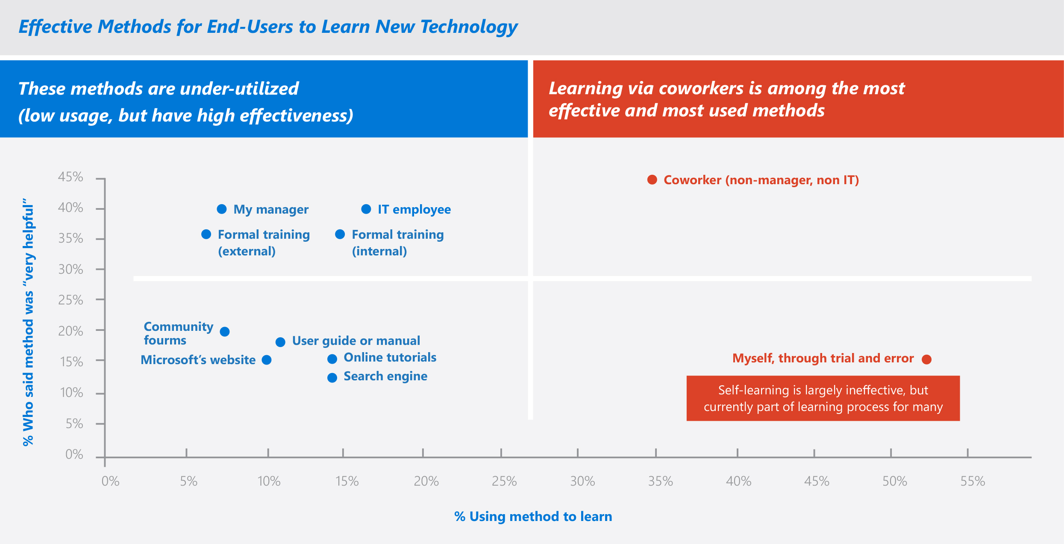
Why are Champions important?
Learning via coworkers is among the most effective and most used methods
In a Microsoft End-User study, research indicates learning from co-workers is among the most effective and used
methods in learning a new technology
SharePoint End-User Study, Apr 2013, Microsoft Corporation

Slide 10
Office 365 Champions Program
Stay Informed and Connected
Get your champions to sign up for this Microsoft led community, you’ll have access to following opportunities:
Regular email communications (community topics, latest news, tips and resources)
Regular champion-peer networking and sharing
Partnerships with Microsoft at premier events and meetups in your industry
Access to Microsoft subject matter experts and unique Office 365 training and content
https://aka.ms/O365Champions

Slide 11
Stakeholders
Stakeholder Group | Who
Executive Sponsor
Supporting Sponsor(s)
Success Owner
Champion(s)
Mott MacDonald developed a network of technology champions by engaging the employees who are most interested and enthusiastic about the new capabilities. The company makes sure the champions are well-trained and sends them out into the business to coach and communicate with their colleagues.

Slide 12
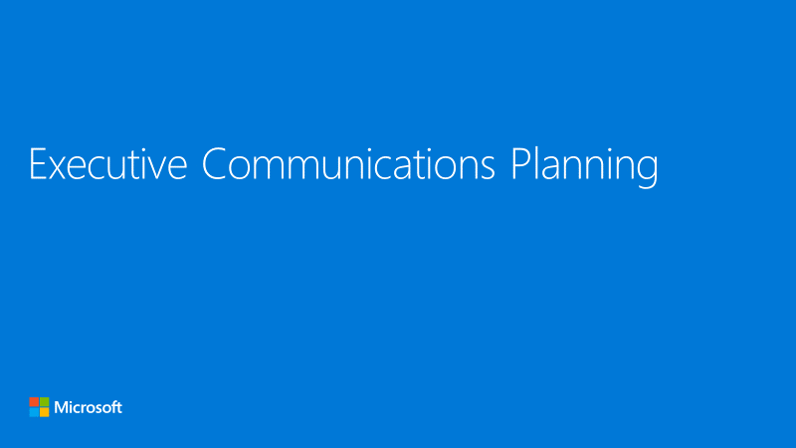
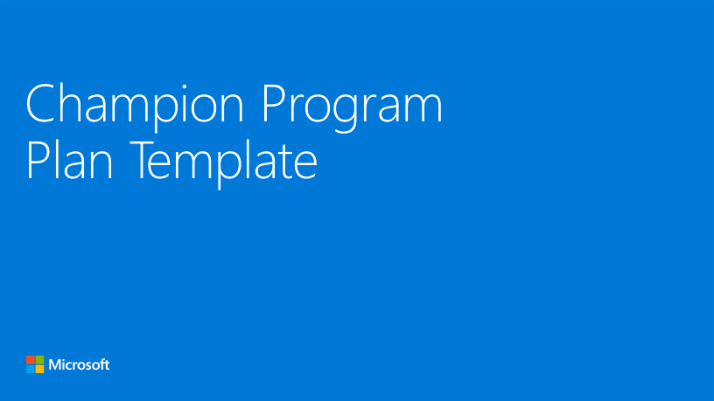
1
Plan executive sponsor communications
Use Executive Communications Planning deck
https://adoption.microsoft.com/files/onedrive/Executive-Communications-Planning.pptx
2
Build champions program
Create a plan using the Champion Program Plan
https://adoption.microsoft.com/files/Champion-Program-Plan-Template.pptx

Slide 13
Scenarios

Slide 14
Identify Scenarios
Why Scenarios are important:
What is a Scenario?
Scenarios cover the ways your people will use OneDrive to address business challenges or achieve defined goals.
Allow teams to understand how OneDrive can help them achieve more
Act as inputs and validation of OneDrive awareness messaging
Support awareness and readiness activities by putting products in context; people will know when and how to use them

Slide 15
OneDrive Scenarios
General
Finance
Human Resources
Marketing
Sales
Easily and securely store and access your files from all your devices.
From gathering data to conducting analysis and sharing insights, here are some of the key things OneDrive can help with:
From recruiting new talent to improving the way organizations develop and retain people, here are some of the key things OneDrive can help with:
From researching market trends to executing campaigns, here are some of the key things OneDrive can help with:
From developing new leads to closing deals, here are some of the key things OneDrive can help with:
Access files from all your devices
Work with anyone inside or outside your organization
Protect your work with enterprise grade security and compliance
Quickly find files that matter most
Simplify data gathering and spend less time on data validation
Secure your reports and update the way you distribute information
Access impactful analysis and provide actionable insights
Recruit new talent into your organization
Elevate employee onboarding and training
Develop people and retain top talent
Streamline personnel planning and reporting
Conduct and analyze research on competitors, products, and audiences to identify opportunities and define business goals
Strategize and develop business and marketing plans to achieve business goals
Create successful marketing projects, including campaigns, events, and more
Review campaign performance, sales data, and market results relative to goals
Improve the way you identify new customers and build their trust
Modernize selling products, goods, and services
Generate better solutions to customer problems, create a more personalized sales experience, and build stronger relationships
Analyze industry trends, business performance, and customer behavior to optimize sales performance

Slide 16
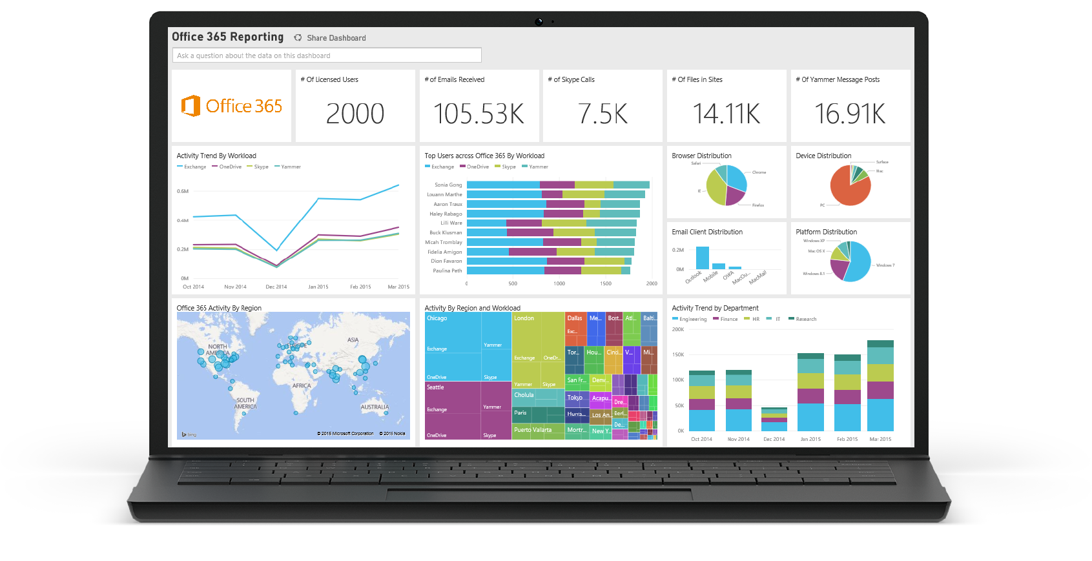
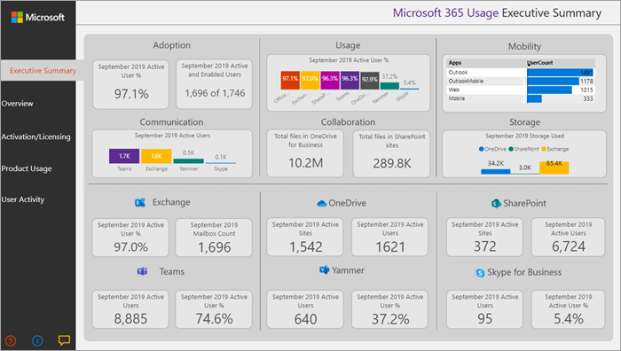
Measure with Microsoft 365 Usage Analytics
Microsoft 365 Usage Analytics
Basic OneDrive usage reports available in the admin center: Instructions on how to access and interpret the report are here

Slide 17
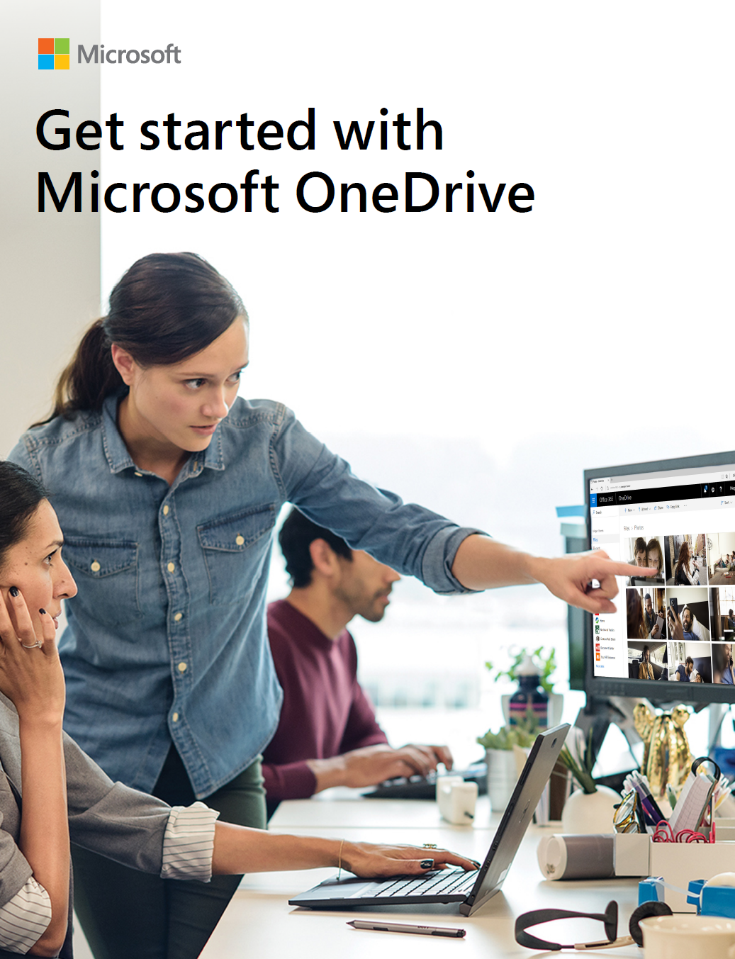
1
Identify and prioritize OneDrive scenarios
Use Usage Scenarios for OneDrive to identify scenarios
https://adoption.microsoft.com/files/onedrive/Usage-Scenarios-for-OneDrive.pdf

Slide 18
Awareness

Slide 19
Awareness
Teaser Campaign
First Day Set Up
Tips Campaign
Campaign to raise awareness regarding the value OneDrive will provide
Highlight scenarios of value that OneDrive will provide to organization and key roles
Generate excitement and awareness regarding the project
Gain staff buy-in for project by outlining ‘what’s in it for them’
Communication and guide(s) to help end users get set up quickly and easily
Campaign focused on key tips for OneDrive to help employees get the most value from working in new ways
Make it top of mind for staff regarding how to work in new ways with OneDrive
Reinforce new behaviors and resources to support – outline key stop, start, continue behaviors
Launch/Buzz Events
Events to kick-off OneDrive launch and support adoption post- launch
OneDrive scenario-focused events that showcase the user experience
PRE-LAUNCH
LAUNCH
POST-LAUNCH

Slide 20
Plan Communications
Define Objectives
Outline Audiences
Determine
Key Messages
Identify Senders
Outline Channels
Identify objectives for communication(s)
Define audiences for communications, including end user personas and project stakeholders (Sponsors, leadership, champions)
Answer the 5 Ws (who, what, when, where, why) and how
Outline the key project benefits for audiences
Identify senders that can influence key audiences identified
Outline how sponsor/success owner and champions can help amplify and scale key messages
Identify the channels that your key audiences engage with/on

Slide 21
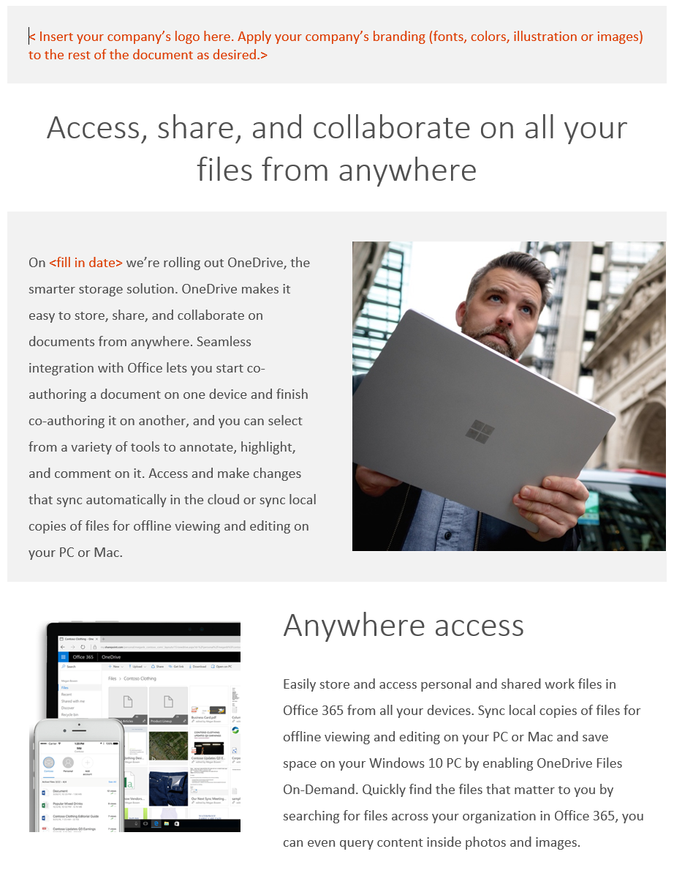
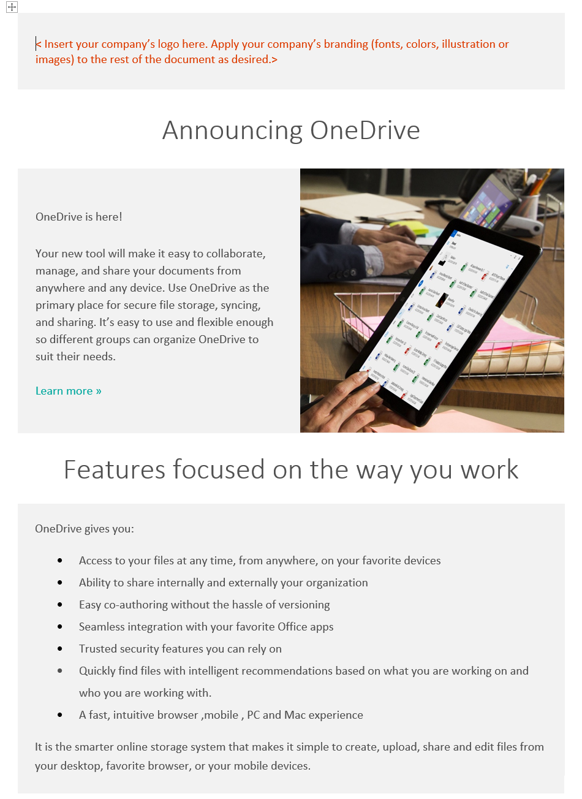
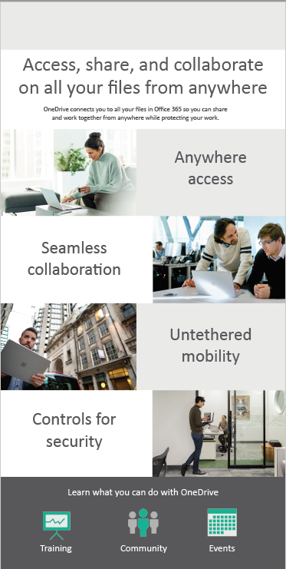
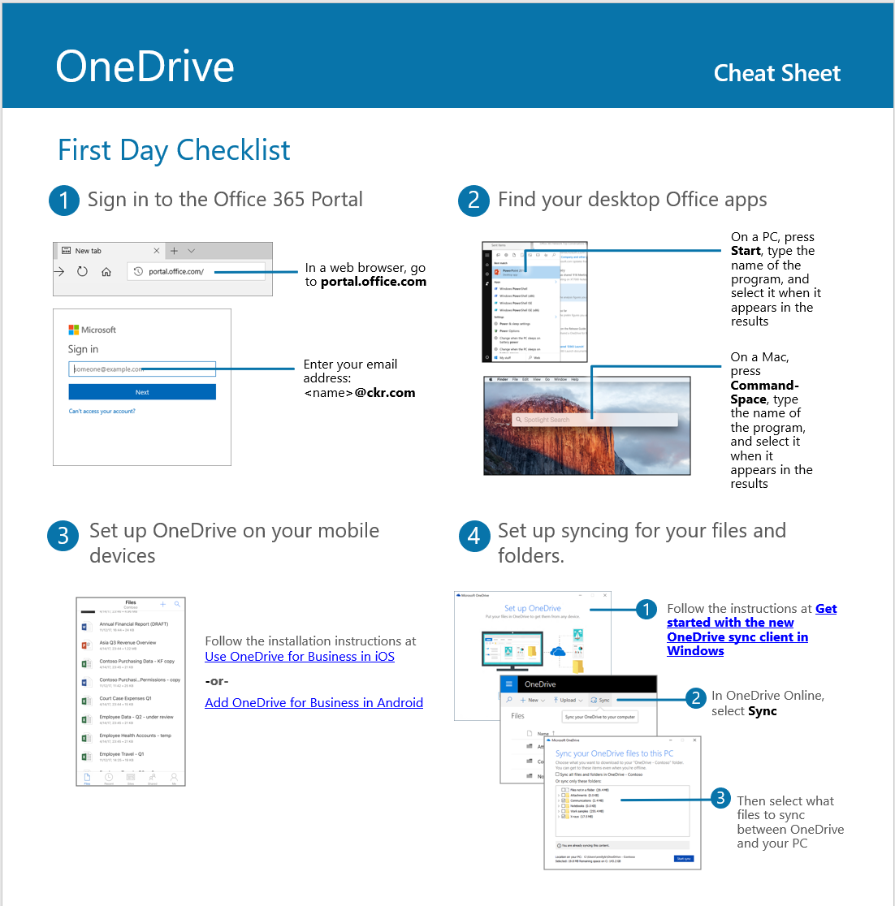
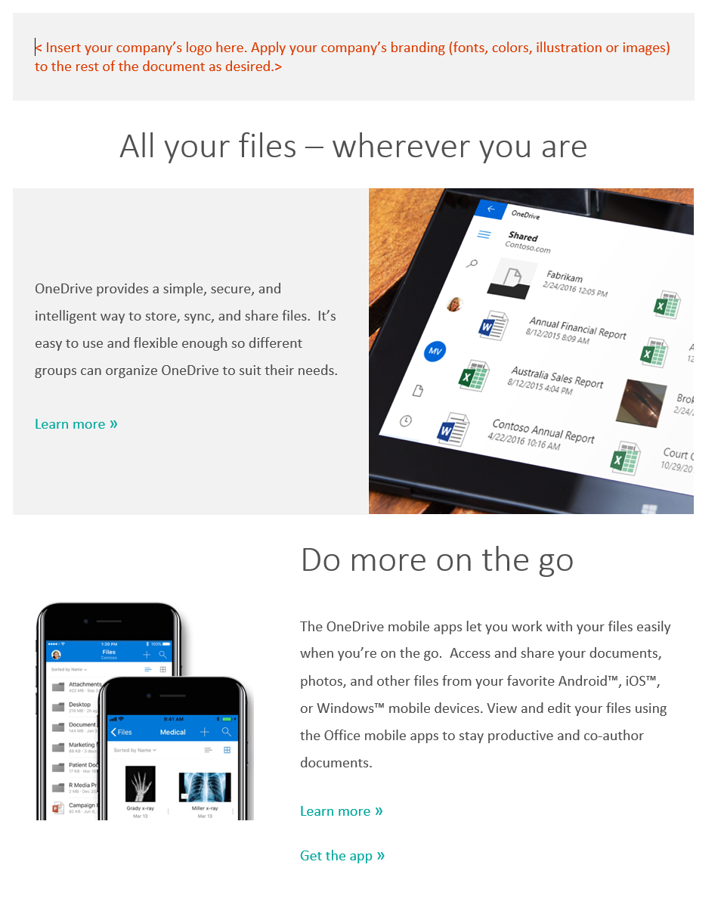
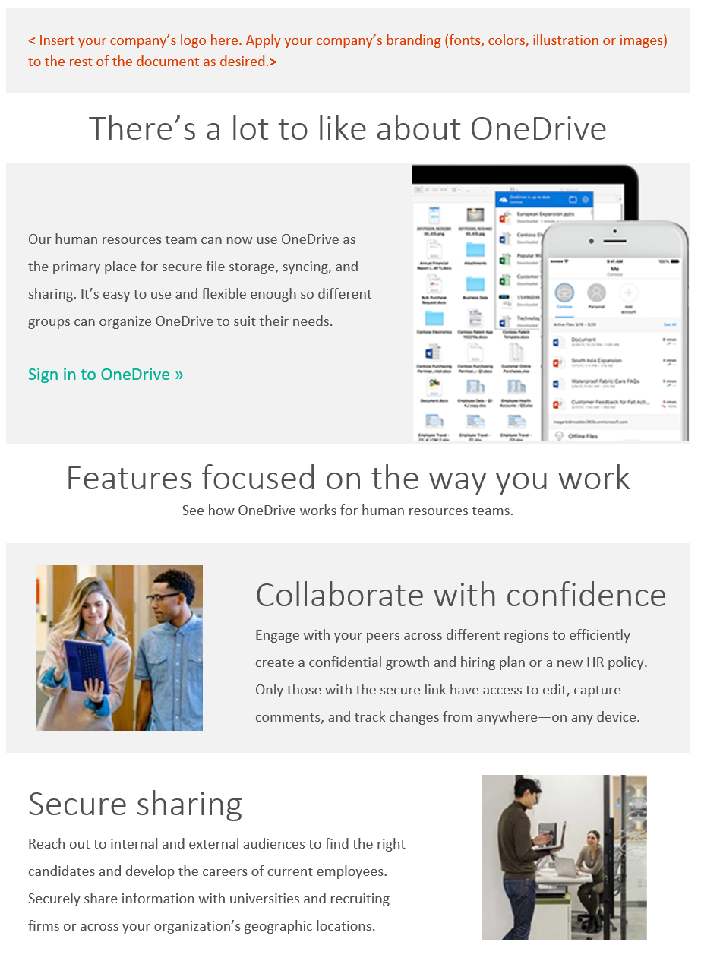
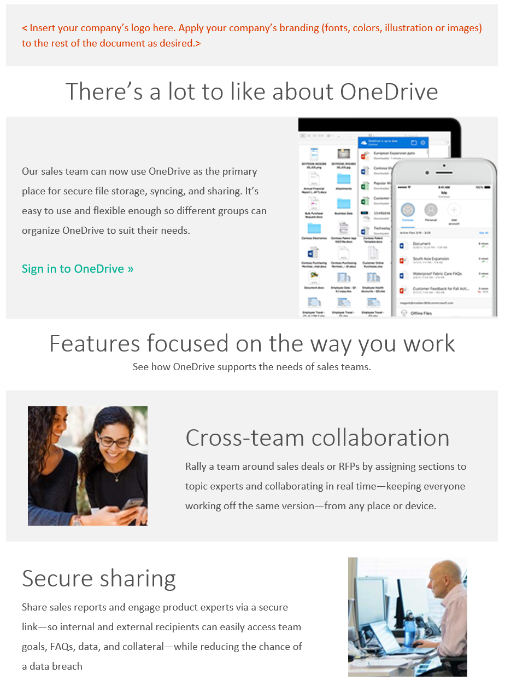
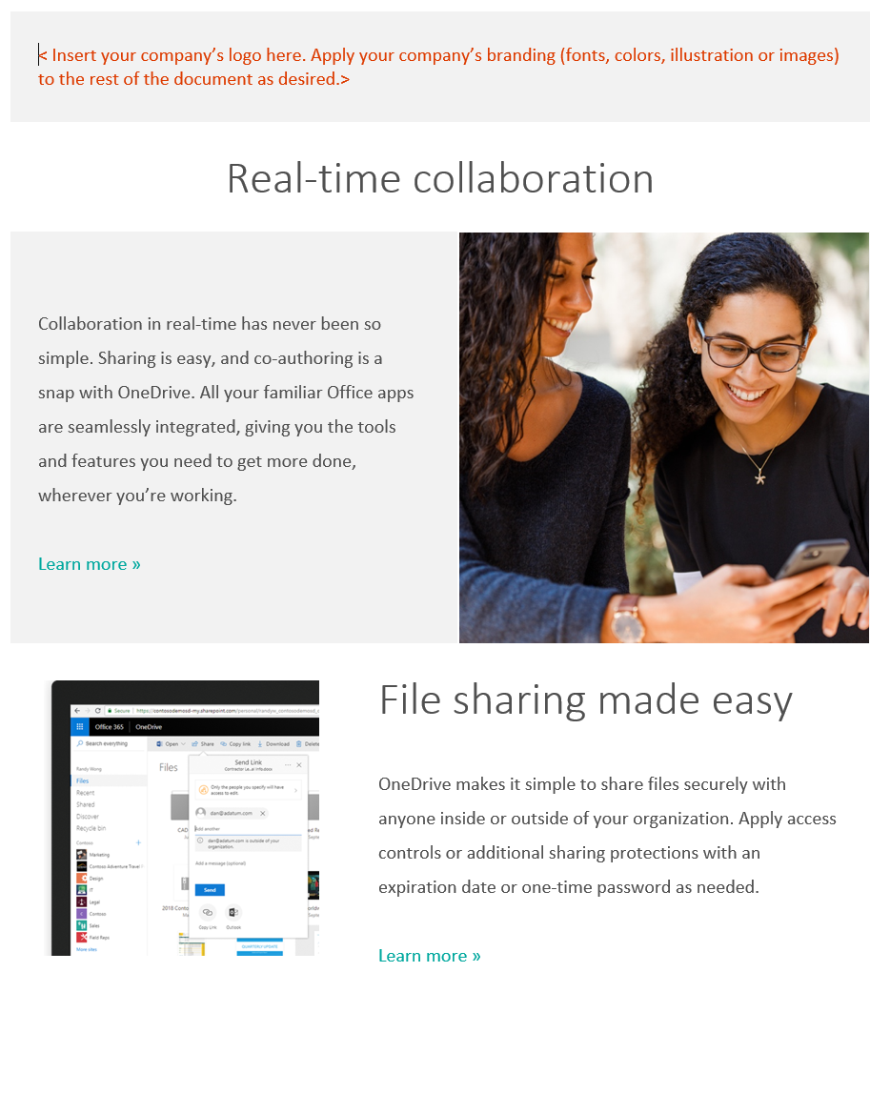
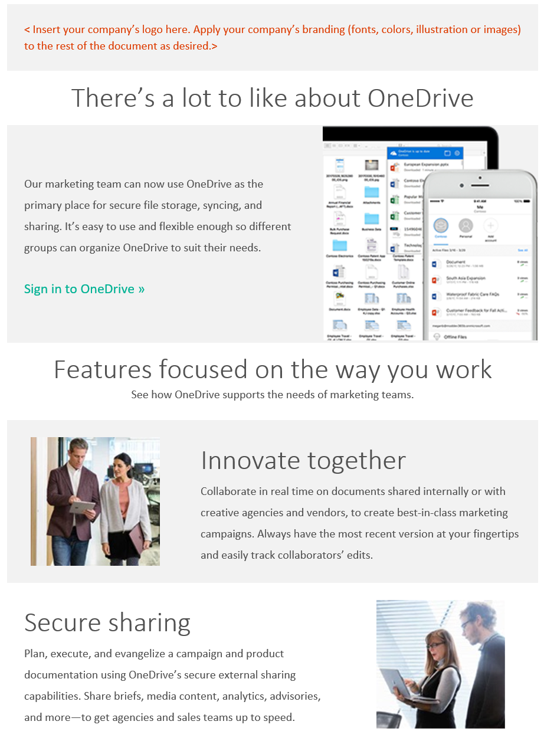
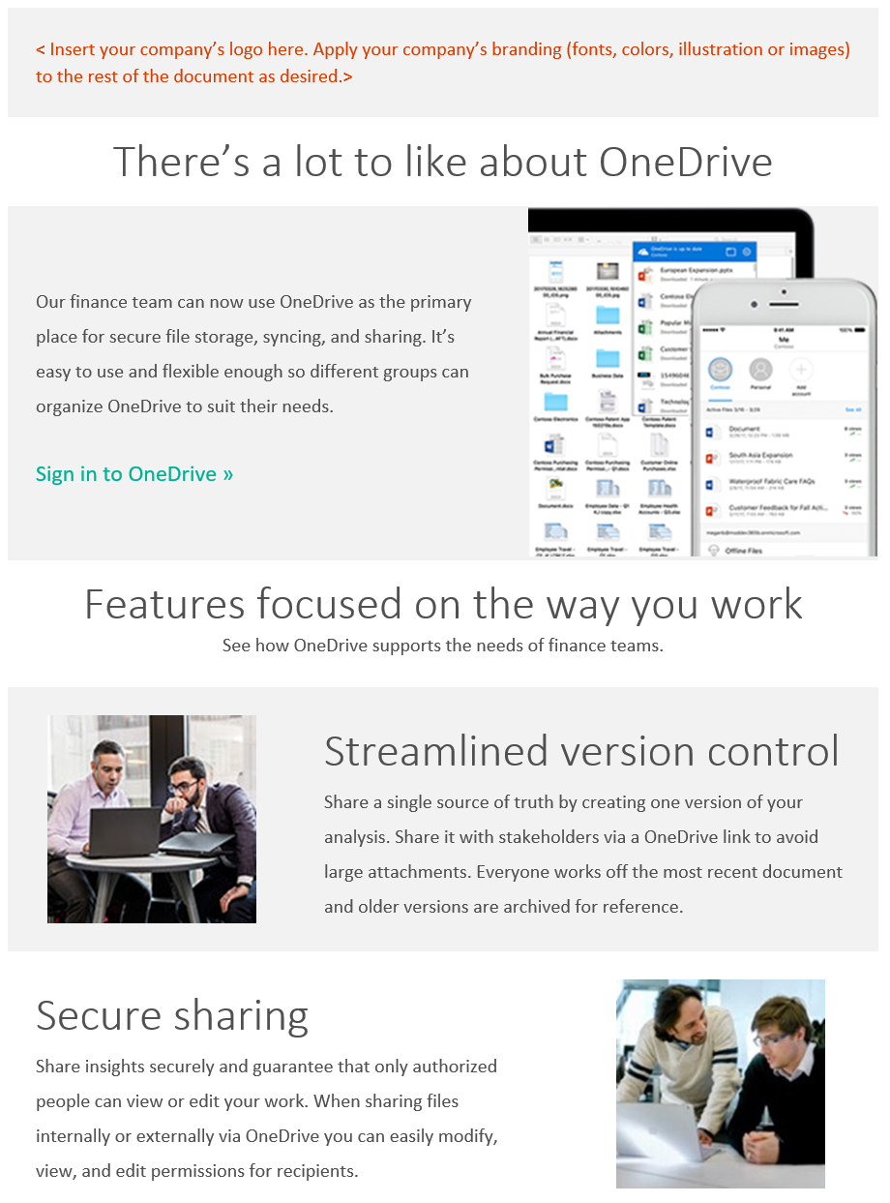
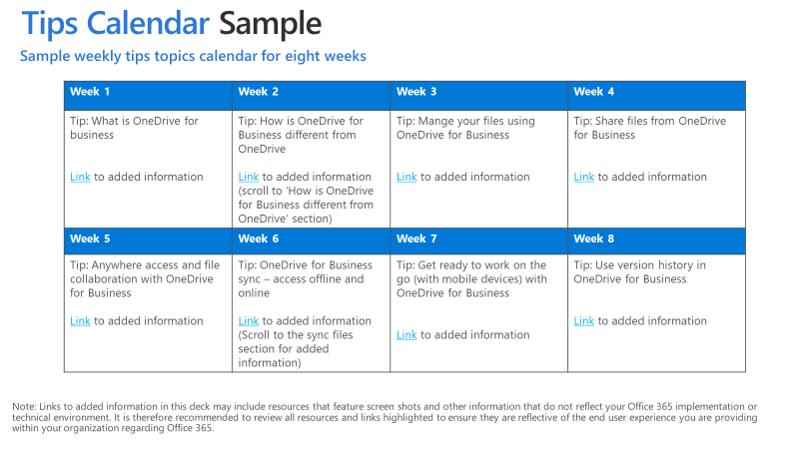
Use Available Templates
See Awareness at https://adoption.microsoft.com/en-us/onedrive/#awareness
Teaser Campaign
First Day Set Up
Email, flyer and poster templates
Launch email template and first day cheat sheet
Tips Campaign
Role Based Awareness
Tips email templates and calendar sample
HR, Sales, Marketing, Finance awareness email templates

Slide 22
Plan Launch/Buzz Events
How to choose your launch event:
Resources and tactics for an effective launch
Consider your goals for using OneDrive. How can your launch event support these objectives and these particular parts of the business?
Consider your company culture. What types of activities will resonate with your leadership and your employees?
Consider your time and resources. Can you mix and match different event activities to plan something that suits your needs and fits into your schedule?
Consider existing company events. Is there an upcoming company event near the roll-out of OneDrive that could incorporate your launch?
The following are some resources, ideas, and tactics to help create an effective OneDrive launch:
Keynote from executive sponsor to kick off event
Booths/stations at onsite event that showcase/demo high-value OneDrive scenarios – scripted
Run online engagement events using Skype Meeting Broadcast for team members in remote offices

Slide 23
Encouraging
Ongoing Engagement
Increase OneDrive adoption over time with ongoing awareness and training activity.
Create a Yammer group to continue conversation on best practices and new features
Share success stories as to how people are using OneDrive in innovative and impactful ways
Periodically host additional engagement events like town hall meetings or lunch & learns to drive end user engagement
Set challenges for people and run competitions to celebrate the best ways they’ve used OneDrive to do work differently

Slide 24
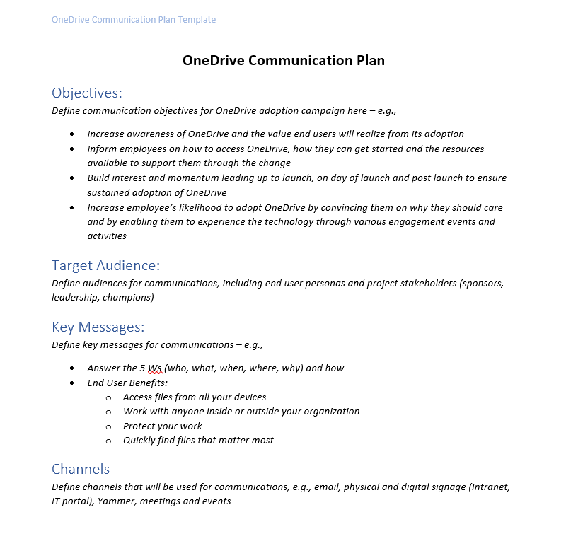
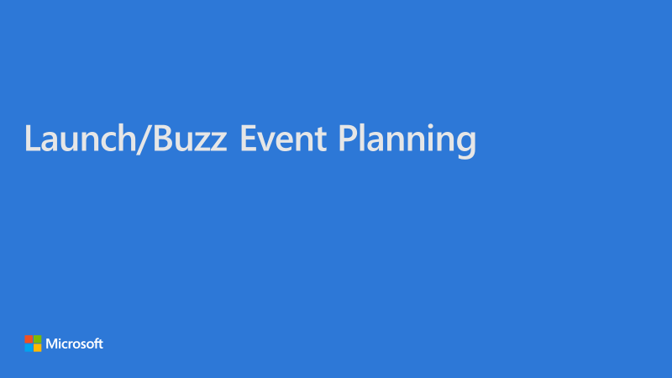
1
Plan awareness campaign with communication plan template
Use Communication Plan template to plan your OneDrive awareness campaign
https://adoption.microsoft.com/files/onedrive/OneDrive-Adoption-Campaign-Project-Plan-Template.pptx
2
Plan launch event
Use the Launch/Buzz Event deck to plan your launch event
https://adoption.microsoft.com/files/onedrive/Launch-and-buzz-event-planning.pptx

Slide 25
Training

Slide 26
Training
Plan
Deliver Training
Deliver Training
Goals, audience, scenarios & methods
Develop and update training materials
Online, self-paced & instructor led
Online, self-paced & instructor led
Train the Trainer
Train the instructors, helpdesk & champions
OneDrive Training Portal
Set up end user OneDrive training portal
Deliver Training
Online, self-paced & instructor led
PRE-LAUNCH
LAUNCH
POST-LAUNCH

Slide 27
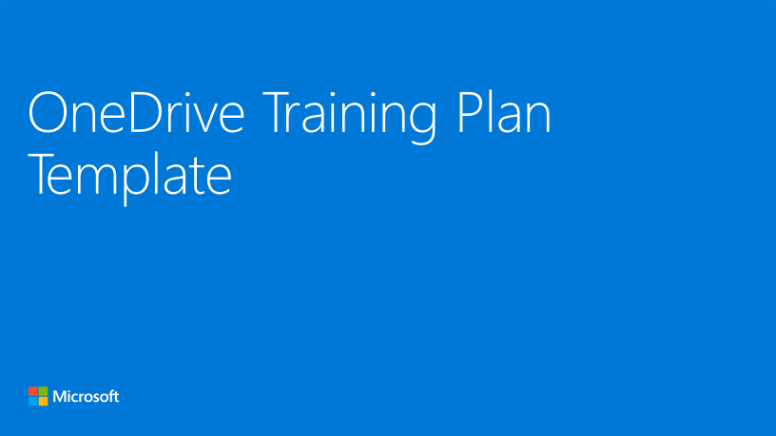
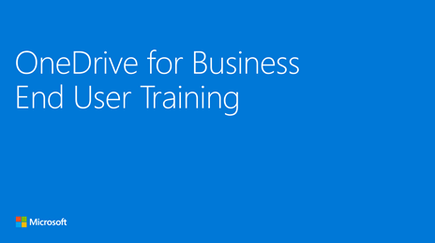
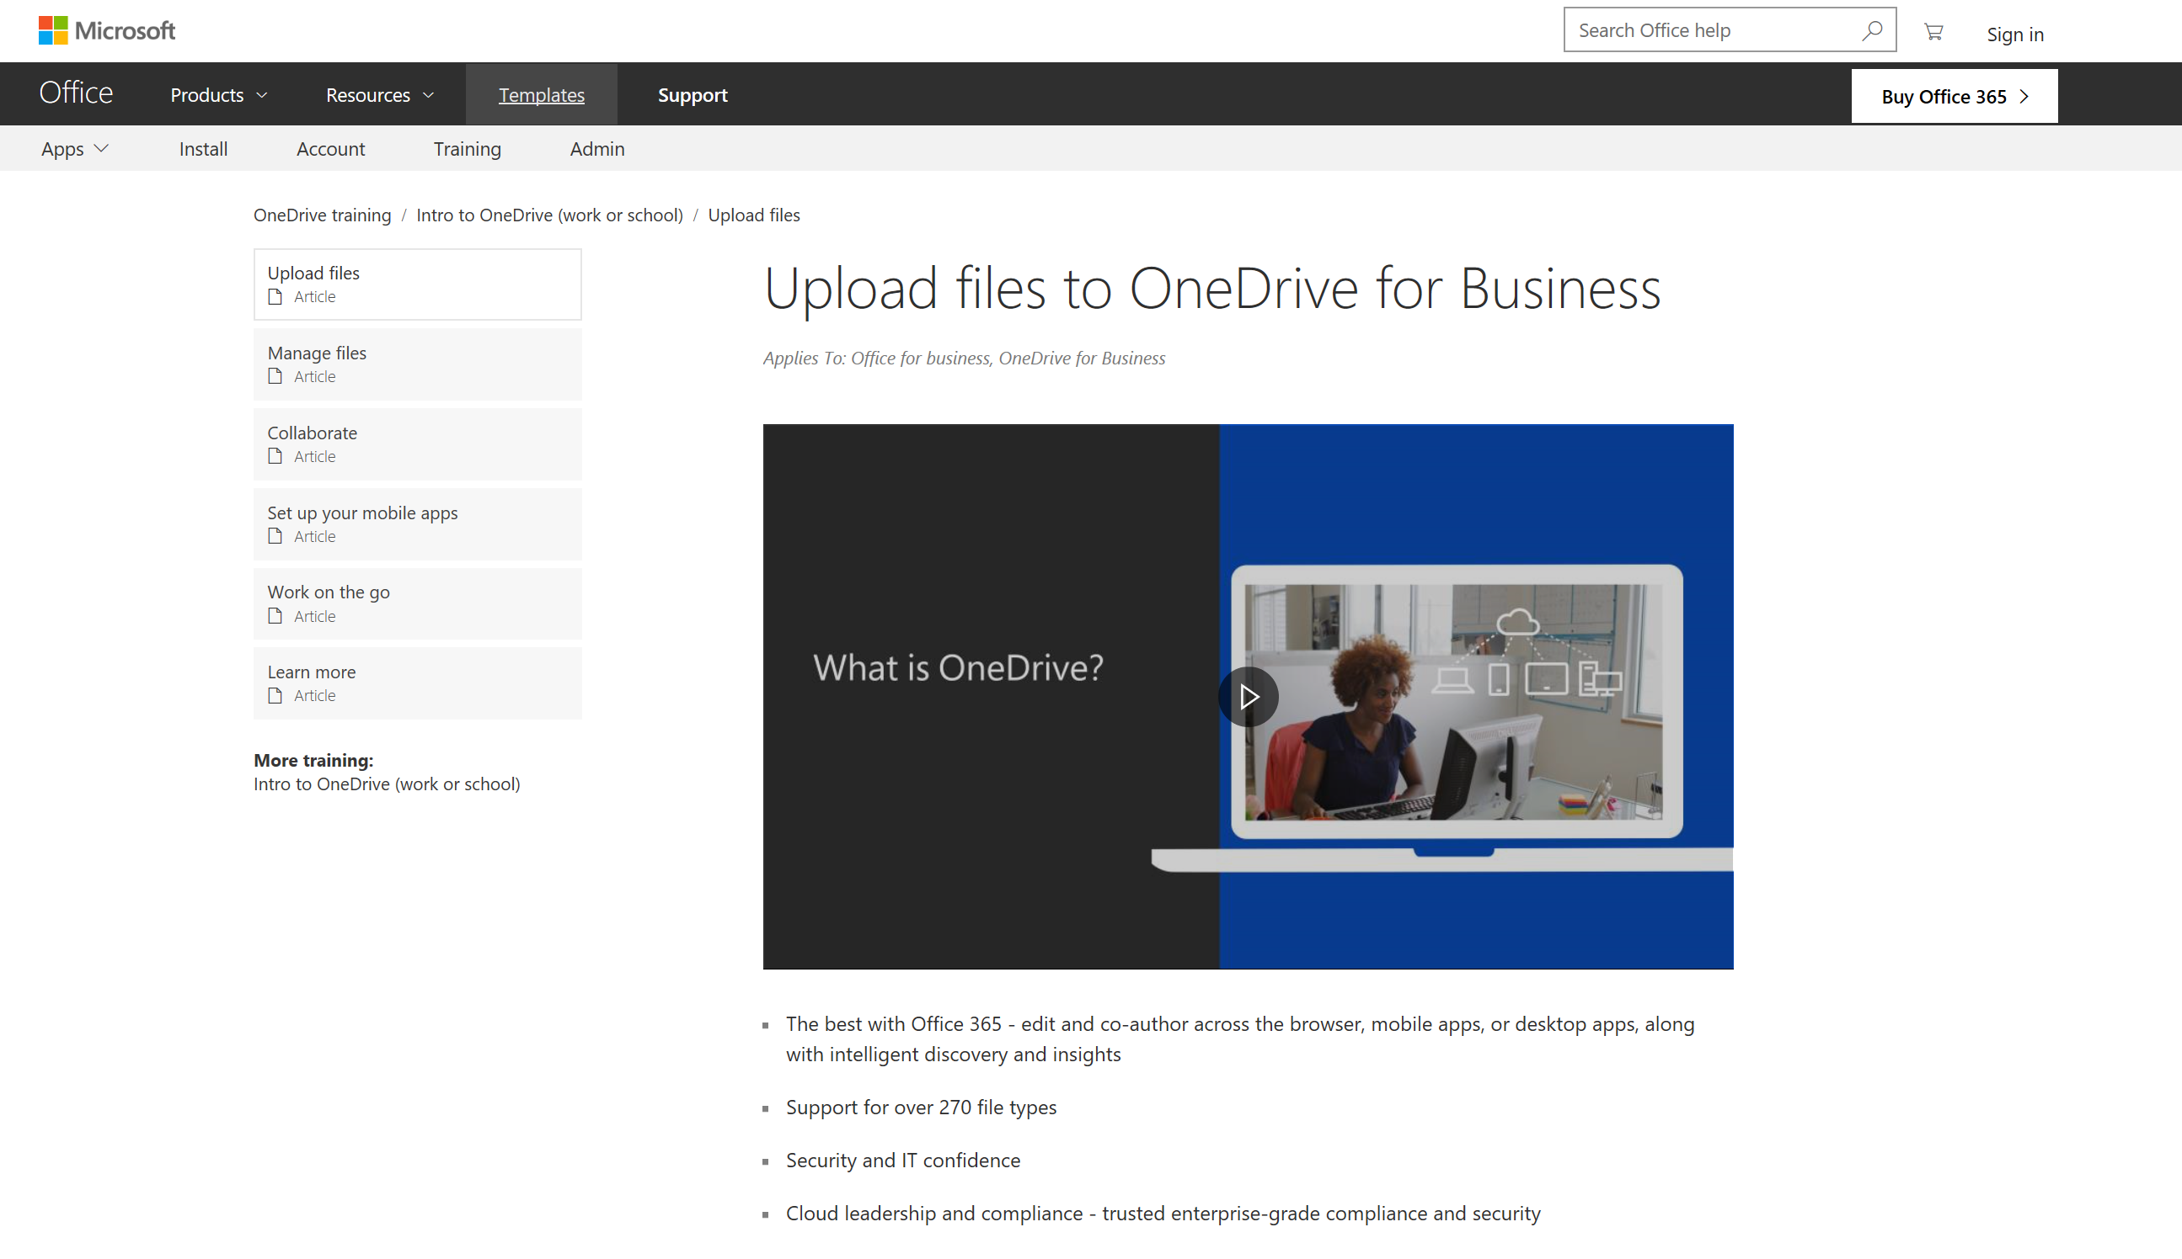
1
Develop training plan
Use the OneDrive Training Plan Template to build your training plan
https://adoption.microsoft.com/files/onedrive/Training-Plan-Template.pptx
2
Train help desk, champions, and training instructors
Use the End User Training deck to train the trainers
https://adoption.microsoft.com/files/onedrive/OneDrive%20instructor-led%20End%20User%20Training%20FINAL.pptx
3
Deliver training
Use the available online training materials to train end users
https://adoption.microsoft.com/en-us/onedrive/#end-user-product-training

Slide 28
Next Steps

Slide 29
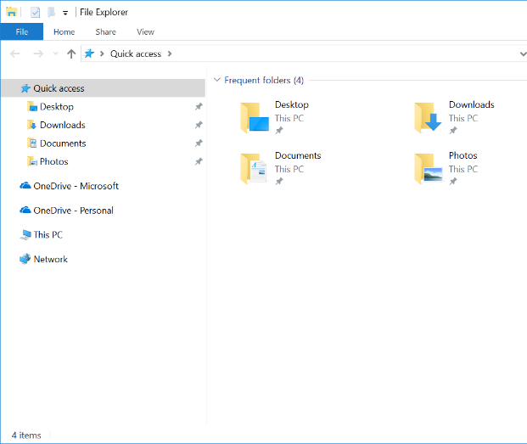
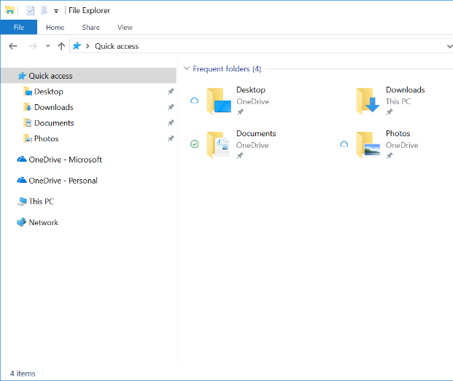
Known Folder Move (KFM)
As a next step consider implementing Known Folder Move (KFM). KFM makes it easier to move files in your users' Desktop, Documents, and Pictures folders to OneDrive. This lets users continue working in the folders they're familiar with and access their files from any device. It also helps you make sure your users' files are backed up in the cloud if anything happens to their device.
Users don’t have to change the way they work, and admins can protect and classify the content on the user’s PC that was previously local and therefore not visible to IT.
Learn more: https://learn.microsoft.com/en-us/sharepoint/redirect-known-folders
BEFORE
AFTER

Slide 30
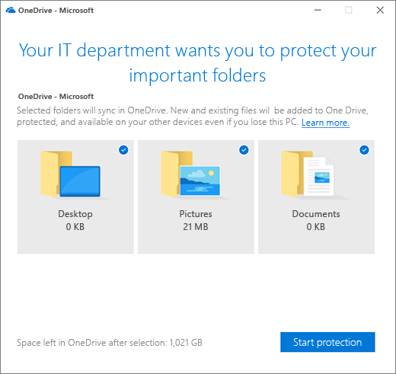
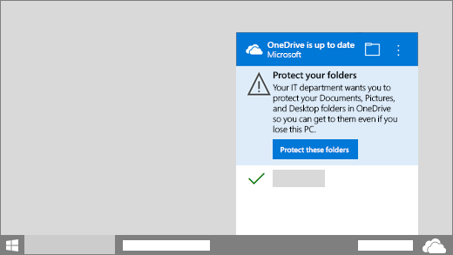
Implementing Known Folder Move (KFM) via Group Policy
USER INTERVENTION NOT REQUIRED
WITH USER INTERVENTION
*User notification is optional, set in Group Policy

Slide 31
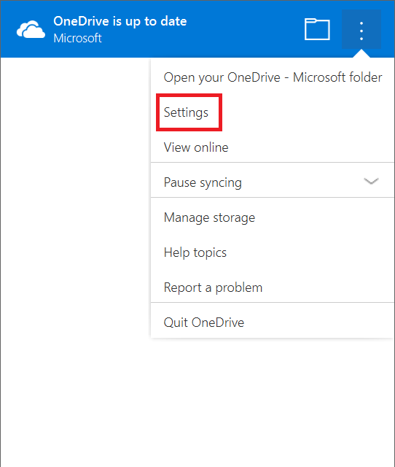
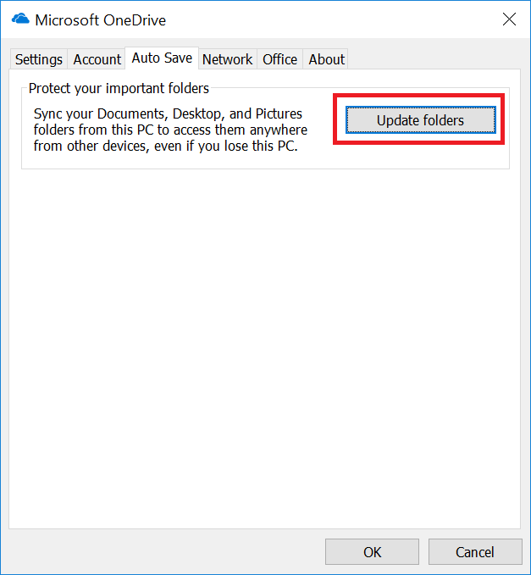
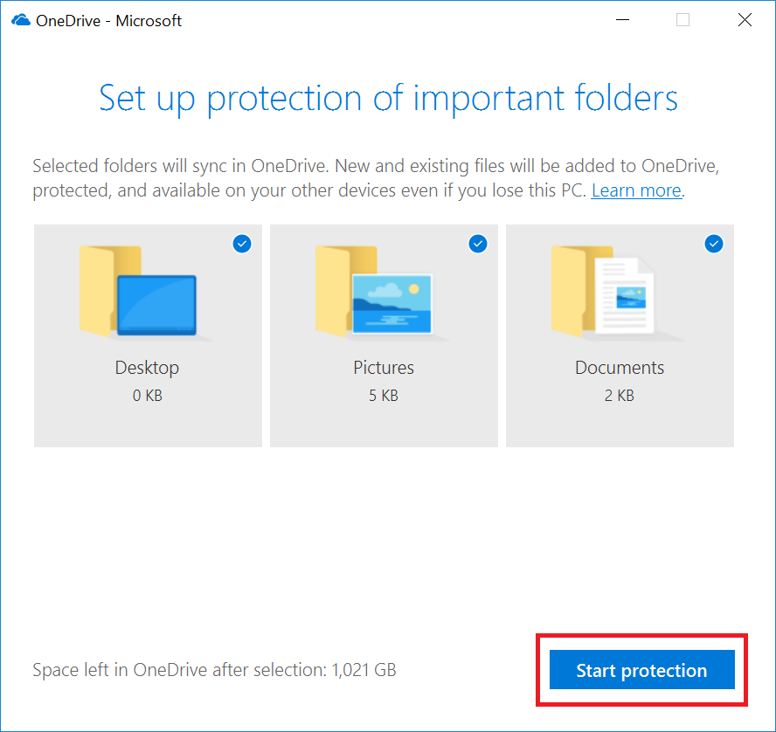
User Triggered Known Folder Move (KFM)

Slide 32
KFM FAQs
Can I automate this as an IT admin?
Yes. See information about group policies here.
Is there an Intune package I can use?
We are working to integrate the ADMX/ADML packages KFM with Windows Intune later this year.
Can I use this with Silent Account Configuration or other group policies?
Yes, you can use these group policies alongside any other group policies including Silent Account Configuration. Just make sure you don’t set policies that conflict with one another.
What operating systems does KFM work with?
Known Folder Move works with Windows 7, Windows 8/8.1 as well as Windows 10.
What is the difference between Folder Redirection and Folder Migration?
Folder Redirection redirects a local Windows folder to an equivalent folder in OneDrive but does not migrate any content from the local folder to OneDrive. That’s why folder redirection should only be used on brand new machines that don’t have existing content.
Folder Migration redirects a local Windows folder to an equivalent folder in OneDrive and does migrate the content from the local folder to an equivalent folder in OneDrive. Folder migration can be used on brand new or existing devices with or without content.
In general, we suggest you use folder migration over folder redirection whenever possible.
Are there any limitations on the files that can be moved to OneDrive as part of this process?
There are some limitations for supported files in the OneDrive sync client in general and those are listed here. In addition, there are some scenarios that KFM doesn’t support yet and will be documented in more detail in the future. One of those limitations is that locally created OneNote files can’t be moved to OneDrive through the KFM experience. If you have OneNote saved locally, please visit our support site on how to move it to OneDrive here.

