Slide 1
OneDrive for Business training for end users

Slide 2

Overview
1-hour, instructor-led training
What is happening when?
First day activities
OneDrive for Business how-to training
How-to resources

Slide 3
What is happening when?

Slide 4
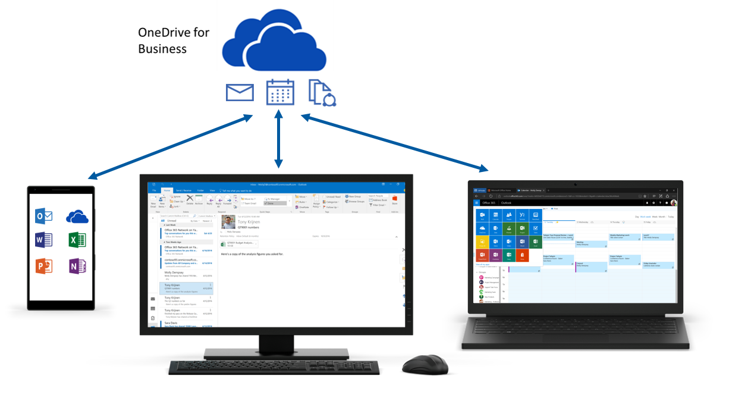
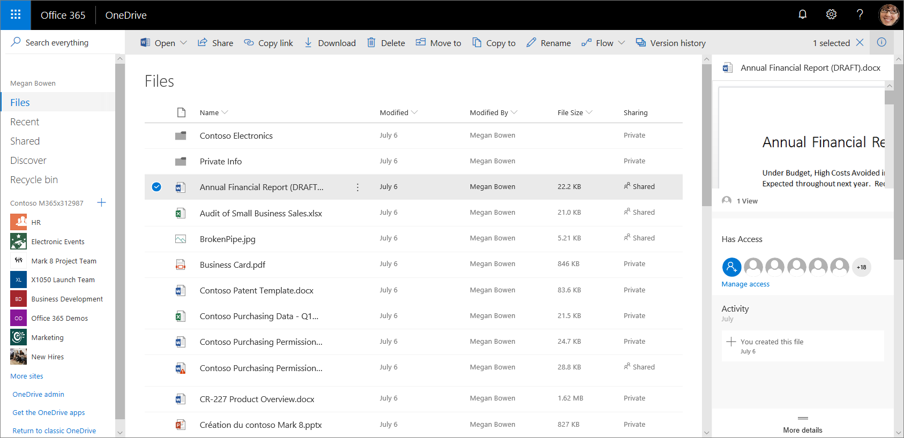
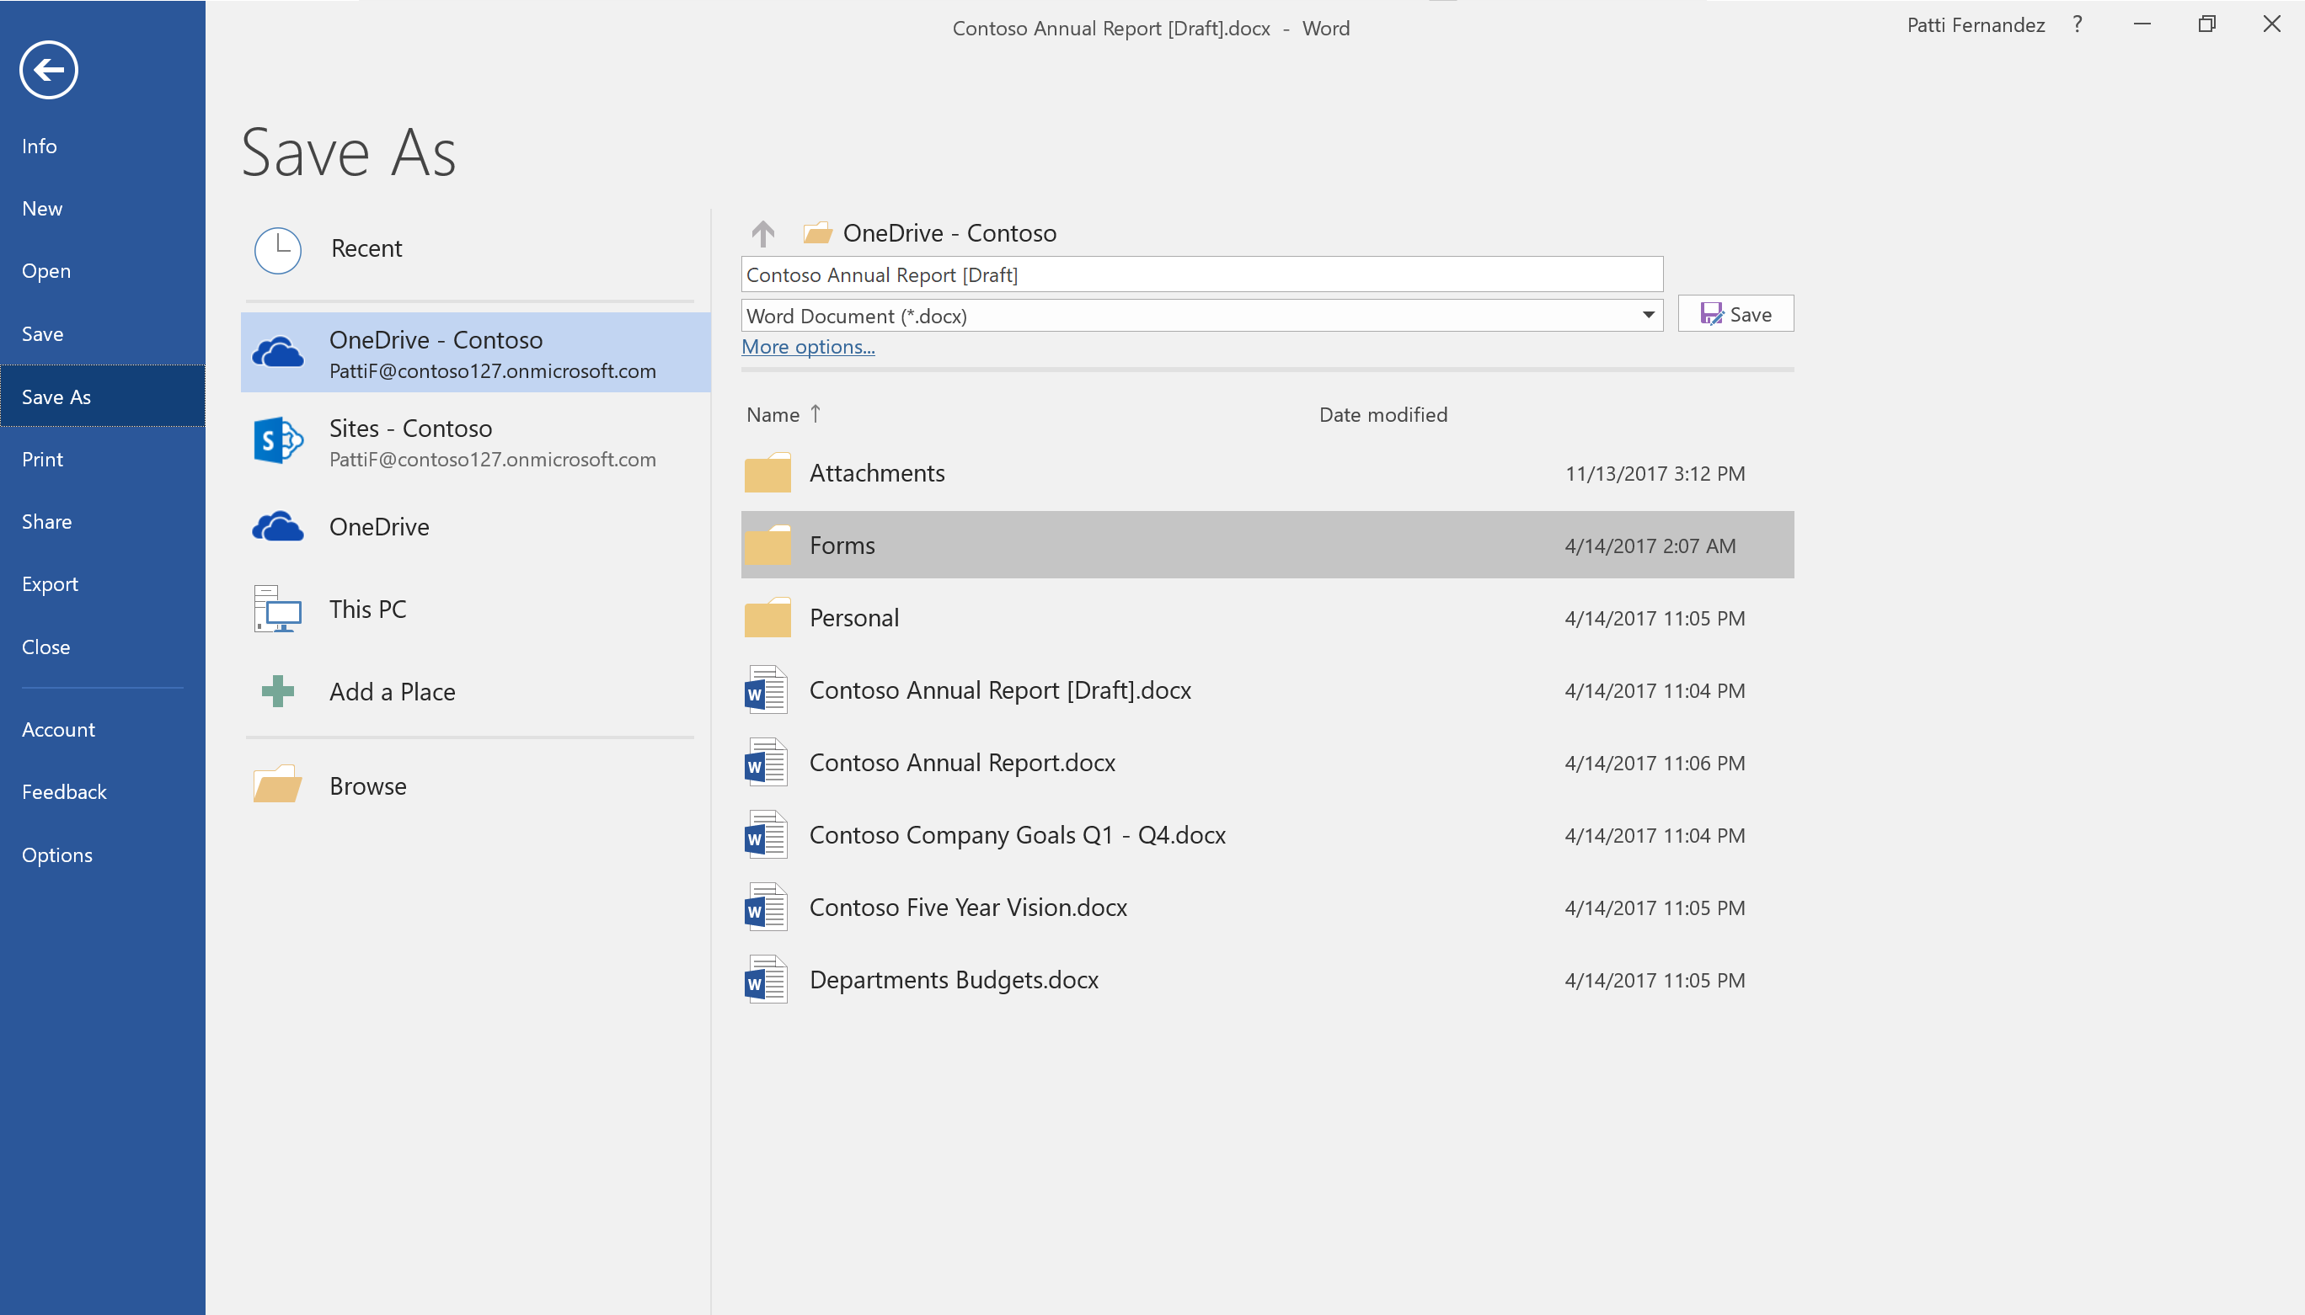
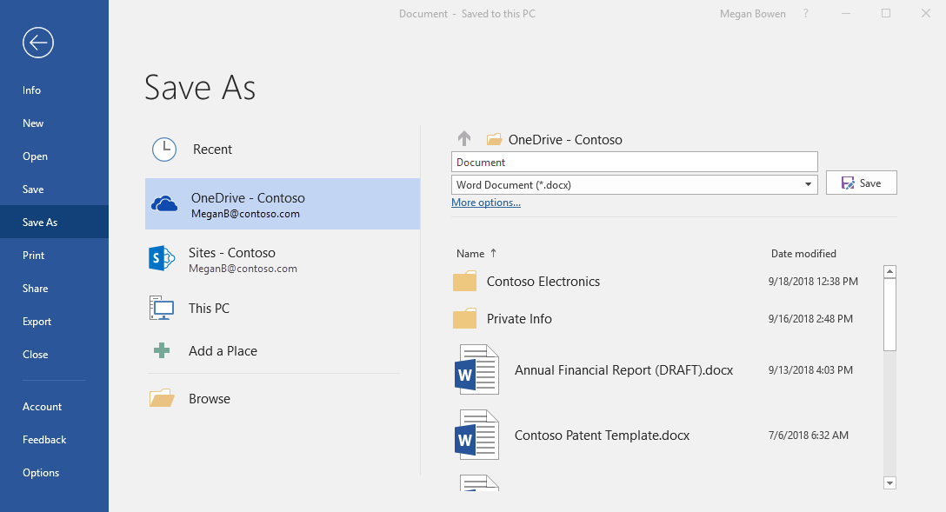
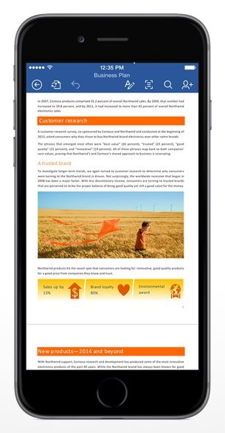
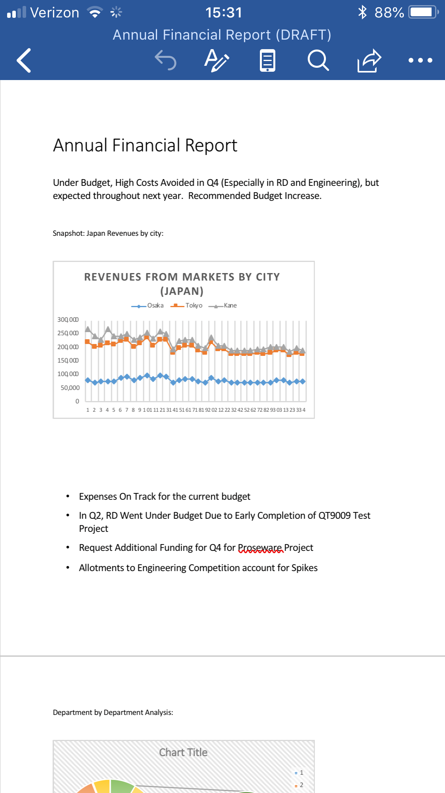
What is happening?
We are now using OneDrive for Business, so you can share and collaborate on all your files from anywhere.
With OneDrive, you can:
Access and edit your files from all your devices ​
Share inside or outside your organization​
Work together in real-time on Office documents¹​
Quickly find the files that matter to you​
Keep your files protected and backed up​
¹ Co-authors must be using Office 365, Office 2016, Office 2019, or the latest mobile apps

Slide 5
When is it happening?
Go Live
 | Get ready |  | Get set |  | Go!
Communications & outreach | Early online announcements | Ongoing online announcements |  | Countdown messaging | Ongoing communication activities
Support |  |  | HelpDesk and Tech Lounges for early adopters |  | Ongoing Support HelpDesk and Tech Lounges for end users
Learning |  | Train the Trainer (Instructors, HelpDesk, Champions) |  | Training (online, self-paced, & instructor-led) | End user training (online, self-paced, & instructor-led) First-day launch materials available

Slide 6
First day activities

Slide 7
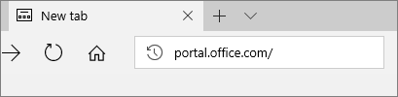
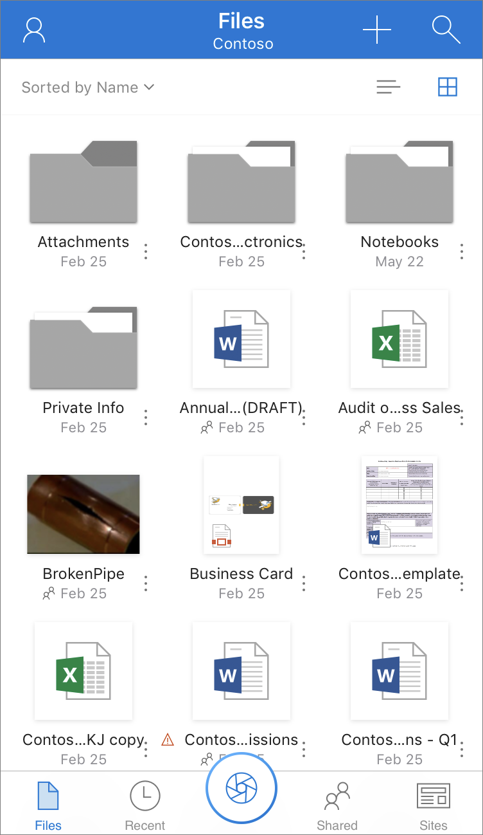
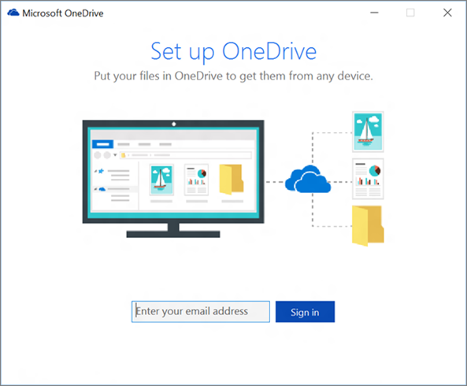
First day checklist
Sign in to Office 365
  In a web browser, go to office.com
  Enter your email address:
  <name>@<organization url>.com
Set up OneDrive on your mobile devices
  Follow your organization’s installation instructions, or see the installation instructions at:
  Use OneDrive for Business in iOS
  Add OneDrive for Business in Android
Set up syncing for your files and folders
  Follow your organization’s instructions, or see the installation instructions at:
  Sync files with the OneDrive sync client in Windows
  Sync files with the OneDrive sync client on Mac OS X

Slide 8
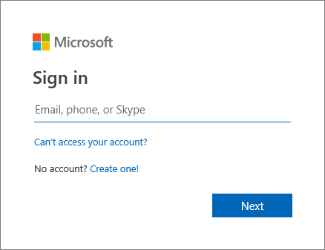
Sign in to Office 365
In a web browser, go to office.com
1
2
Enter your email address:
<name>@<organization url>.com
<name>@ORG_ADDRESS

Slide 9
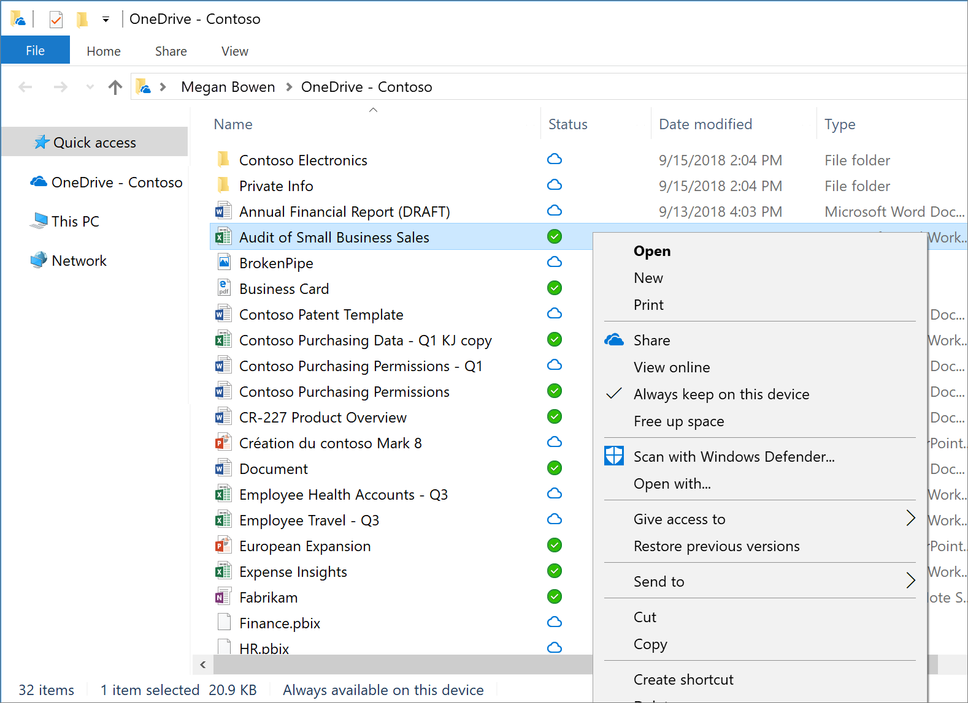
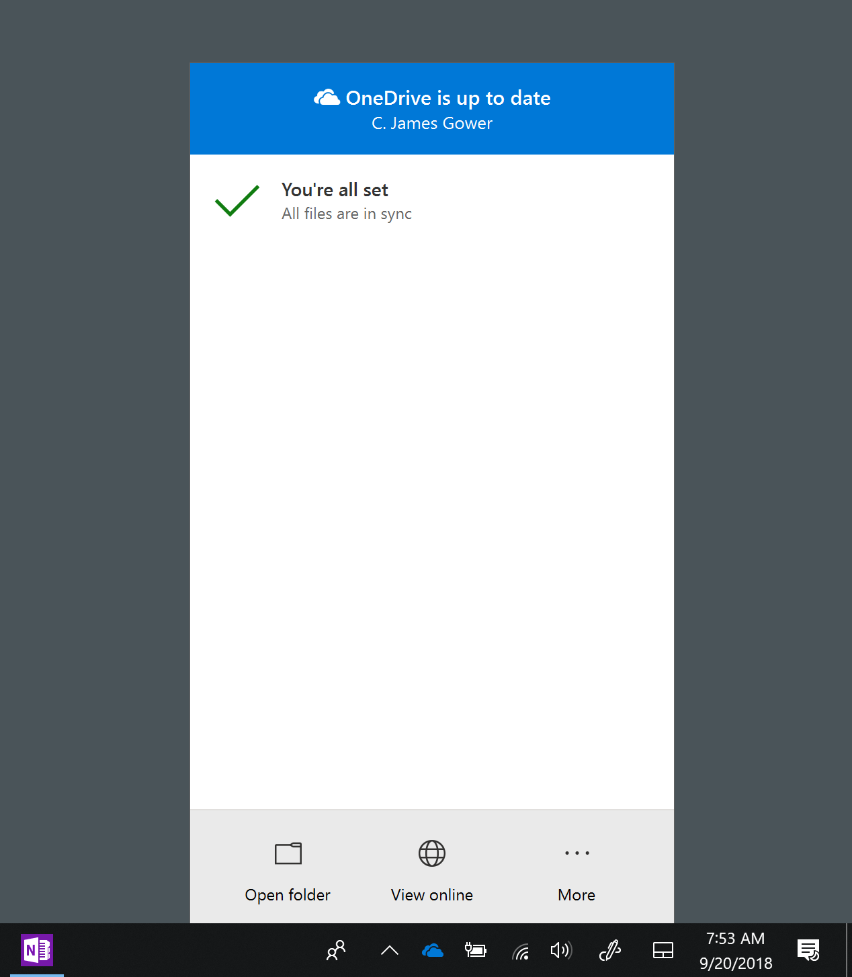
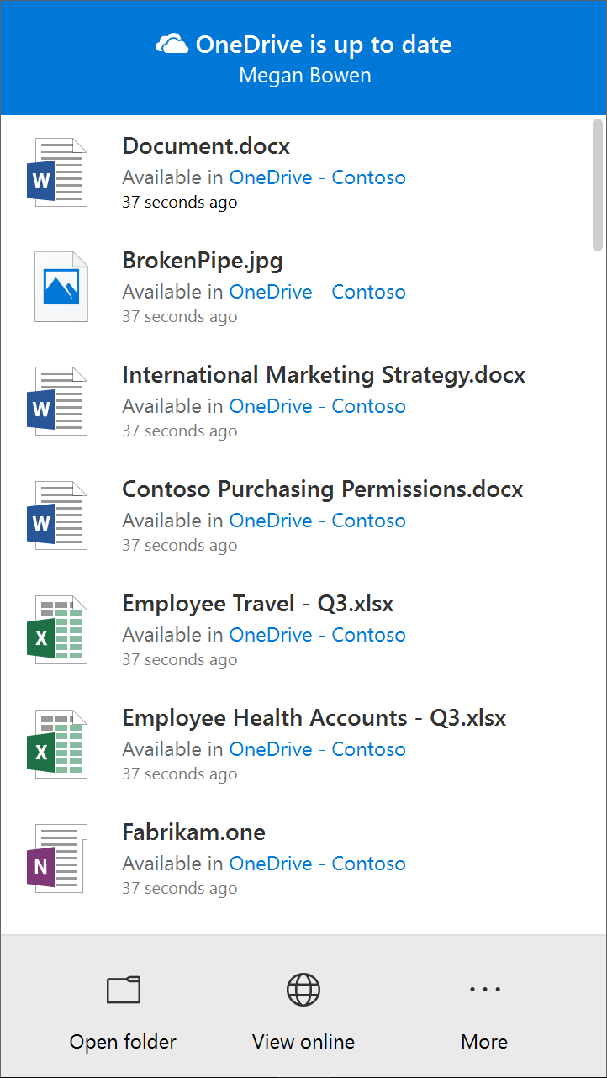
Set up syncing for your files and folders
Follow the instructions at Sync files with the OneDrive sync client in Windows
1
2
Select files you want always available
(see next slide).
3
In the Windows system tray, select the OneDrive icon to view the Activity center and see the sync activity and access options.
See Which version of OneDrive am I using? if you need to confirm which version of the Sync Client you have.

Slide 10
OneDrive Files On-Demand
With OneDrive Files On-Demand, you can set files and folders to always be available locally on your device or save space by making files online only.
In the taskbar, select the OneDrive icon, and select More > Settings. Then, on the Settings tab select Save space and download files as you use them.
Mark files/folders to be always available, even offline.<name>@ORG_ADDRESS
Change file/folders back to online only.
<name>@ORG_ADDRESS
Files you download to your device and available offline.
<name>@ORG_ADDRESS
Online only files/ folders do not use space on your device.
<name>@ORG_ADDRESS

Slide 11
OneDrive for Business how-to training
Notes:
Use the OneDrive for Business QuickStart guide (PDF) as a script outline to demo OneDrive.
https://download.microsoft.com/download/1/8/B/18B4B34F-13A5-4B65-A56B-CBE99DD4F63D/MS_Office_QuickstartOneDrive.pdf

Slide 12
Access: Access and edit your files from all your devices

Slide 13
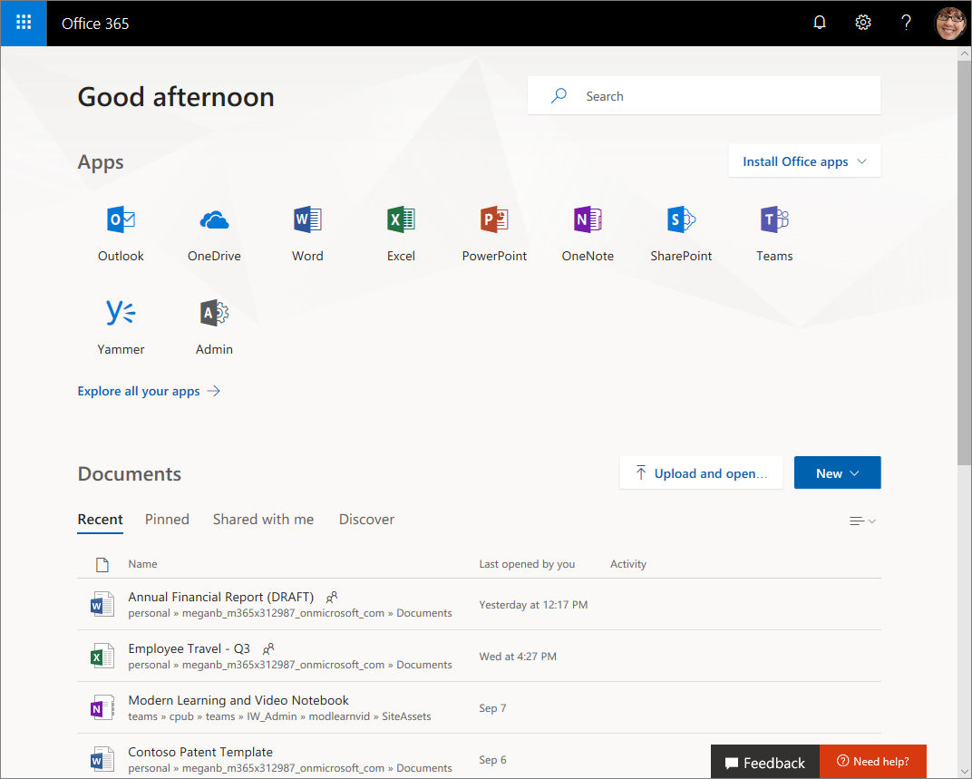
Open OneDrive
Sign in to office.com, then select OneDrive

Slide 14
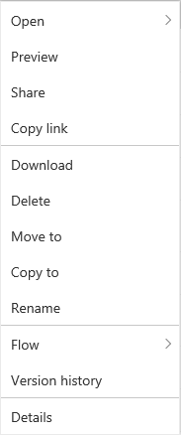



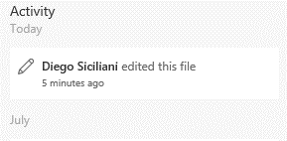
OneDrive tour
Select a command from menu bar,
or right-click a file in the list and select a command from menu
Select a file, then select to see the file’s info, preview, and recent activity, and to manage sharing rights
Find and restore earlier versions of your files
Find trending content, files shared with you, SharePoint sites you’re following, and more

Slide 15
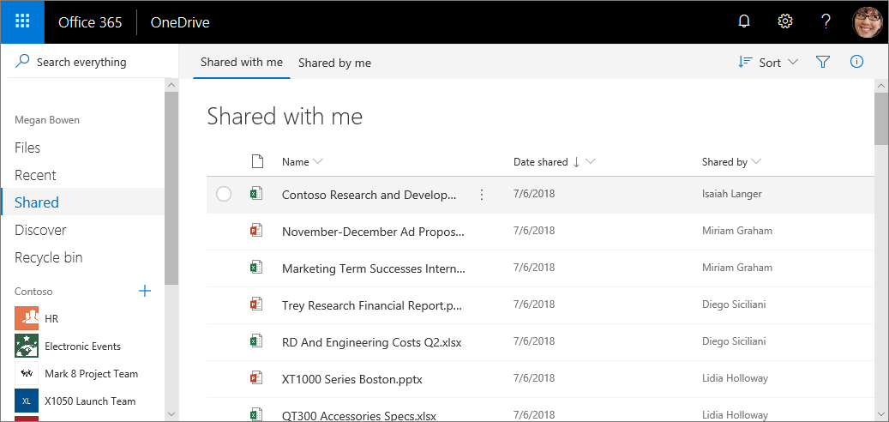

Access the file you want
Search for files across Office 365
See recently used files sorted by date
See files that have been shared with you or shared by you.
  Select to filter by when modified, file type, or who shared file
See files from SharePoint sites and Teams

Slide 16
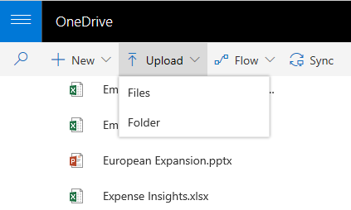
Upload a file
Select Upload > Files. Select the file or files to upload and then select Open. Or drag and drop from File Explorer.

Slide 17
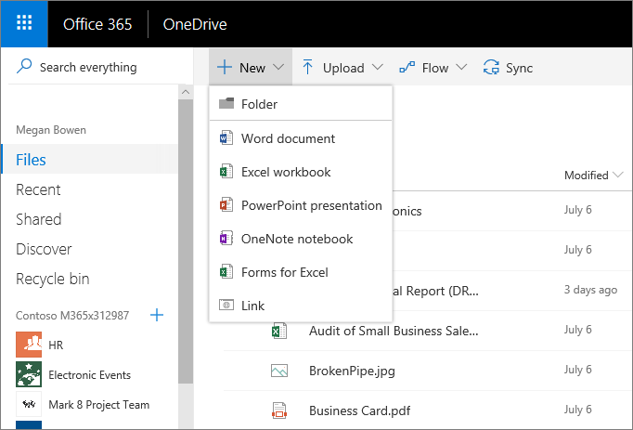
Create a file
To share a file from within Word, Excel, PowerPoint, or another Office app:
Select Share on the ribbon.
Or, select File > Share.
Note: If your file is not already saved to OneDrive, you'll be prompted to upload your file to OneDrive to share it.
Select who you want to share with from the drop-down, or enter a name or email address.
Add a message (optional) and select Send.
Select + New, and then select the type of file to create
    If you don’t see the New command, make sure to deselect any files in your list
Notes:
Do Create demo here.

Slide 18
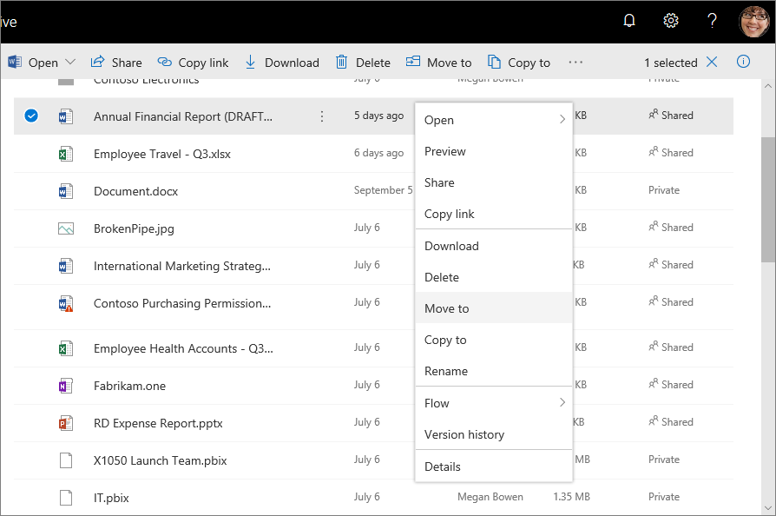
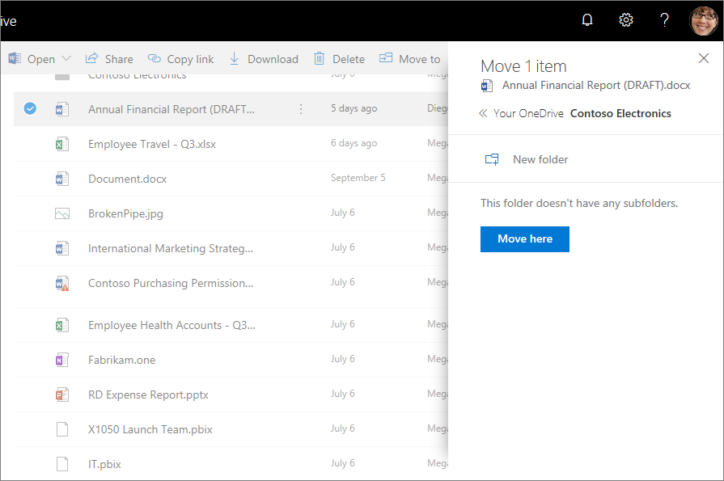
Move or copy a file
To share a file from within Word, Excel, PowerPoint, or another Office app:
Select Share on the ribbon.
Or, select File > Share.
Note: If your file is not already saved to OneDrive, you'll be prompted to upload your file to OneDrive to share it.
Select who you want to share with from the drop-down, or enter a name or email address.
Add a message (optional) and select Send.
To move or copy a file to a new location, select Move to or Copy to.
Then select where to move or copy the file, and select Move to or Copy to.

Slide 19
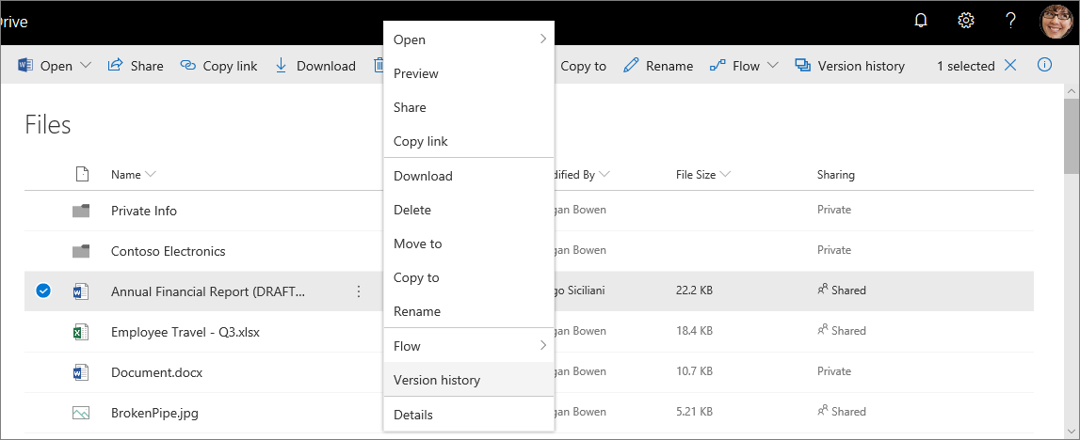
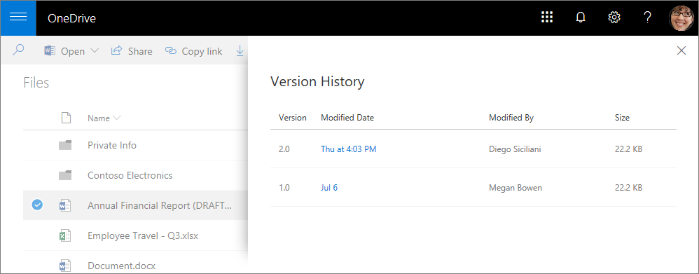
View file version history
Select a file and select Version history
1
Select a version of the file to open it. You can then save it as the current version, or save it under a new name.
2

Slide 20
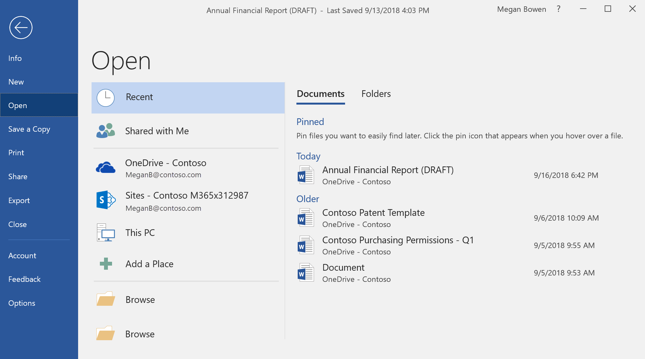
Open files in Office
Select File > Open
Open from the Recent list. Pin important files for easy access.
Open files from:
Files shared with you
Your organizational OneDrive
(OneDrive - <organization>)
SharePoint sites you’re subscribed to
Your personal OneDrive
Your PC

Slide 21
Save files to OneDrive
Select File > Save As
Save As to:
Files shared with you
Your organizational OneDrive
(OneDrive - <organization>)
SharePoint sites you’re subscribed to
Your personal OneDrive
Your PC

Slide 22
View your files from a mobile device
Tap Files to access your files and folders on OneDrive.
  Select next to a file to open the menu
…
Tap Recent to see your most recently active files.
Tap Scan to scan a document, whiteboard, or
business card.
Tap Shared to see files shared with you and discover content trending around you..
Tap Sites to access your SharePoint sites.

Slide 23
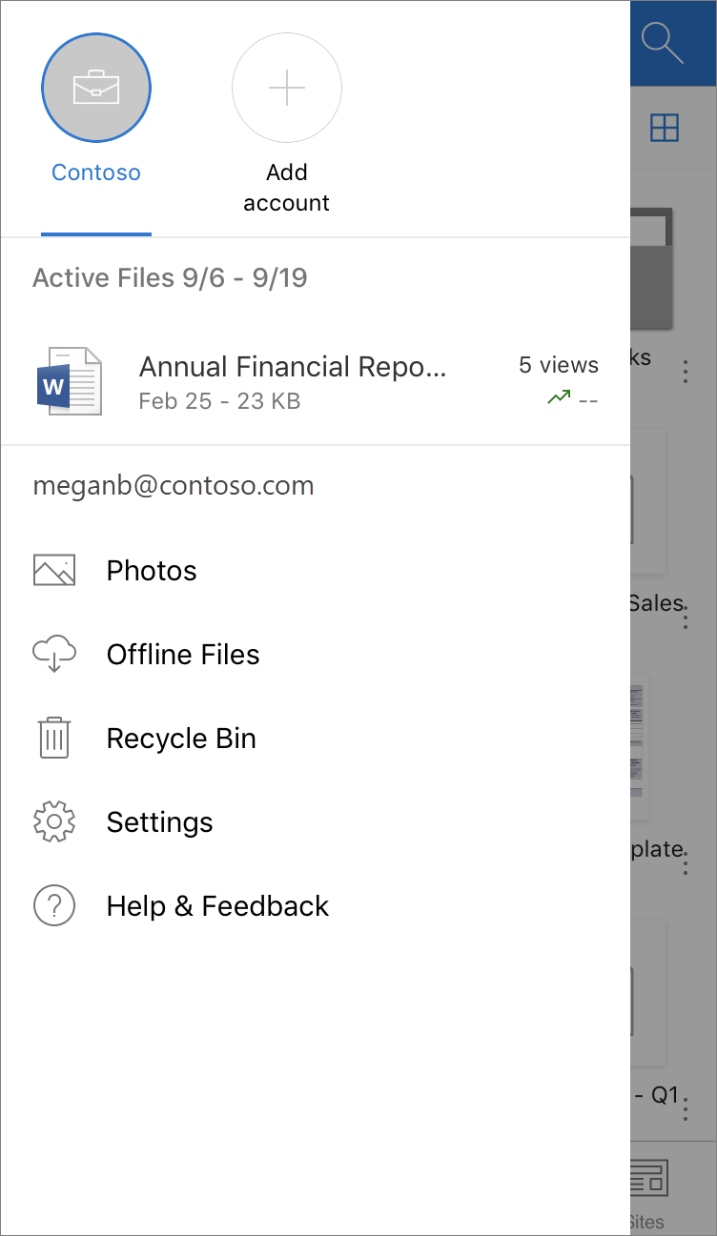
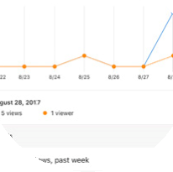
View and select your accounts
Open the OneDrive app and tap Me. Then tap the account at the top of the screen
Tap Add account to add an account. You can have multiple accounts, for instance, your work OneDrive and your personal OneDrive.
See trends views. Tap to see an activity chart.
Tap Offline Files to all the files you have taken offline.
Tap Recycle Bin to access and recover deleted files.

Slide 24
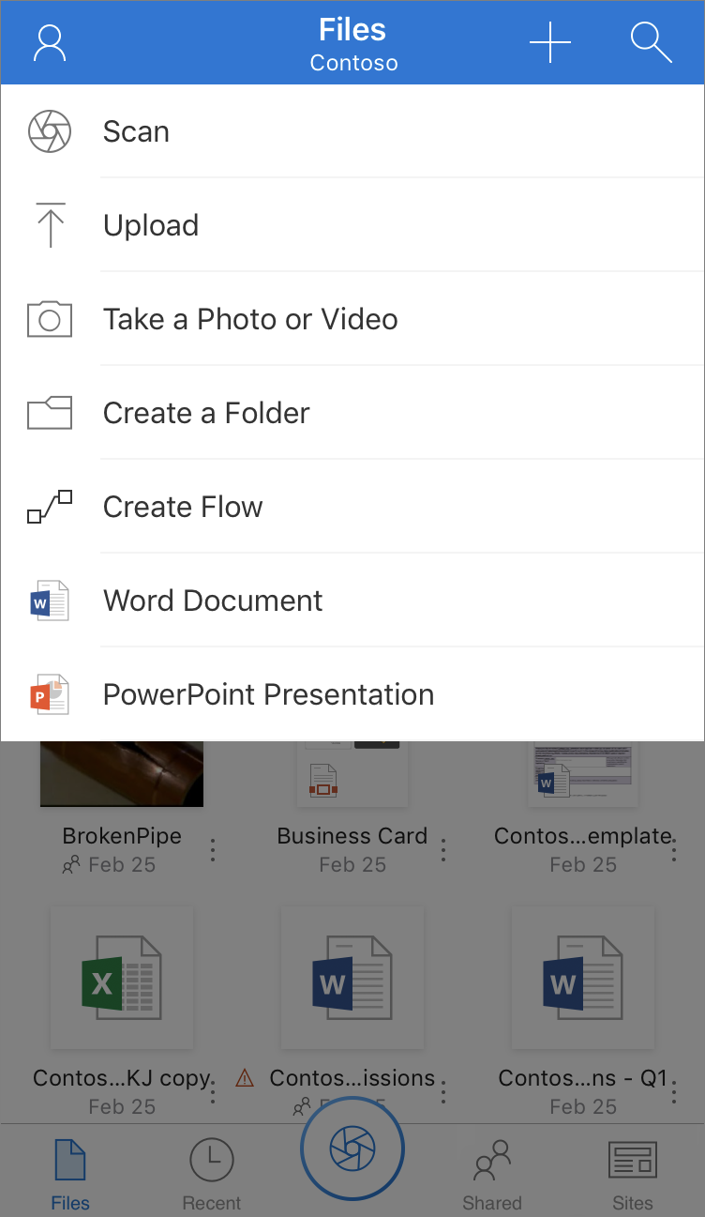
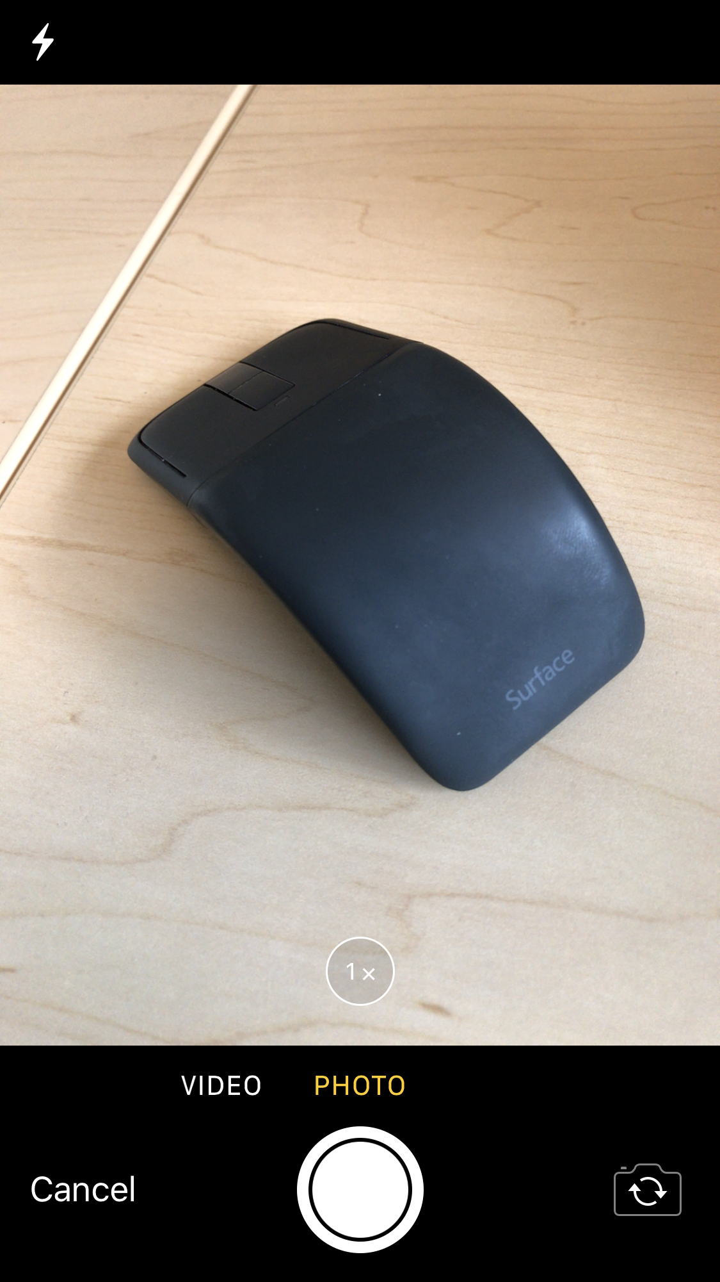
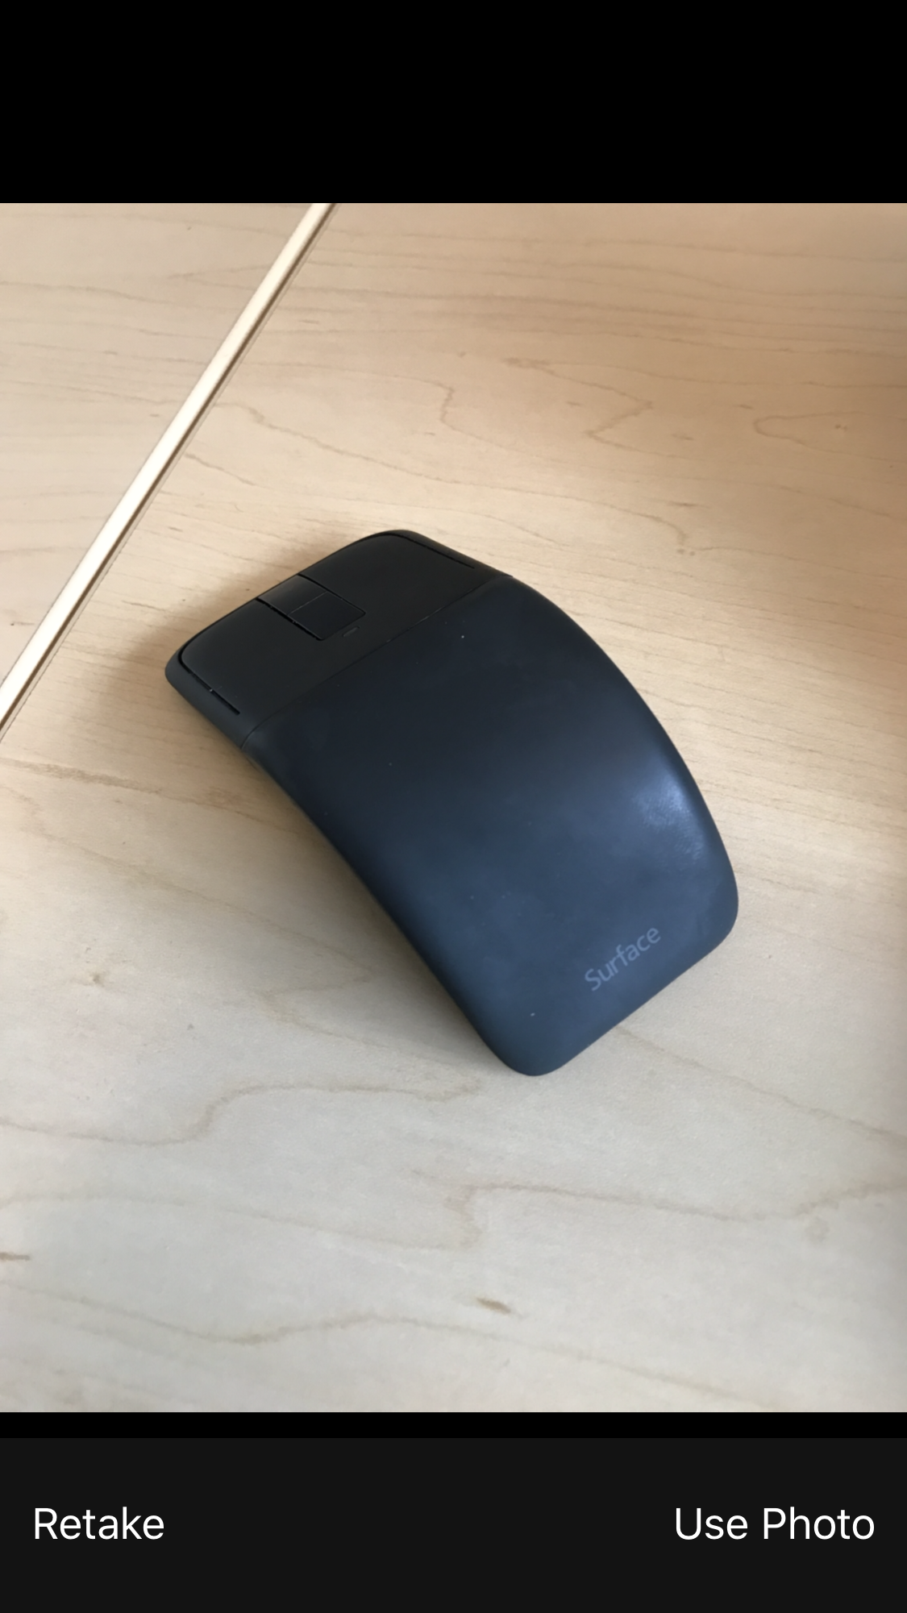
Take a picture from OneDrive
1
Tap Files > + >
Take a Photo or video
2
Tap to take photo
3
Tap Use Photo to save picture to OneDrive

Slide 25
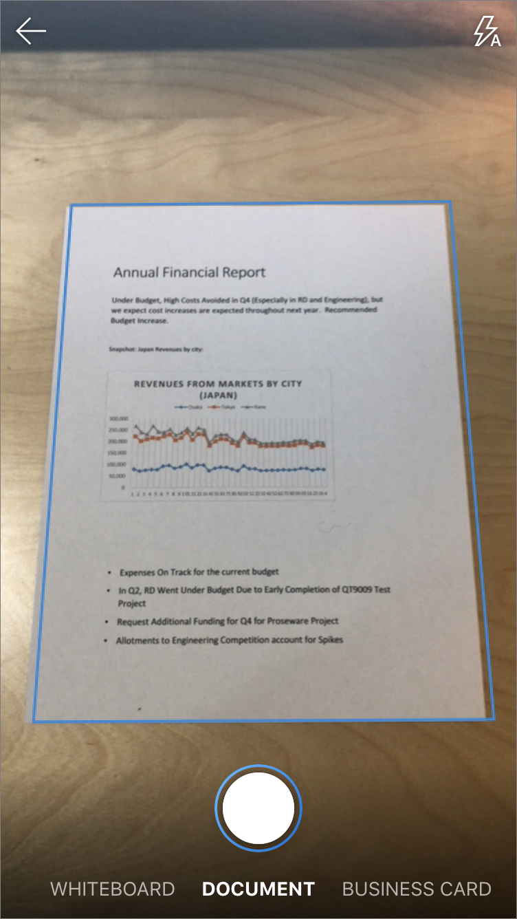
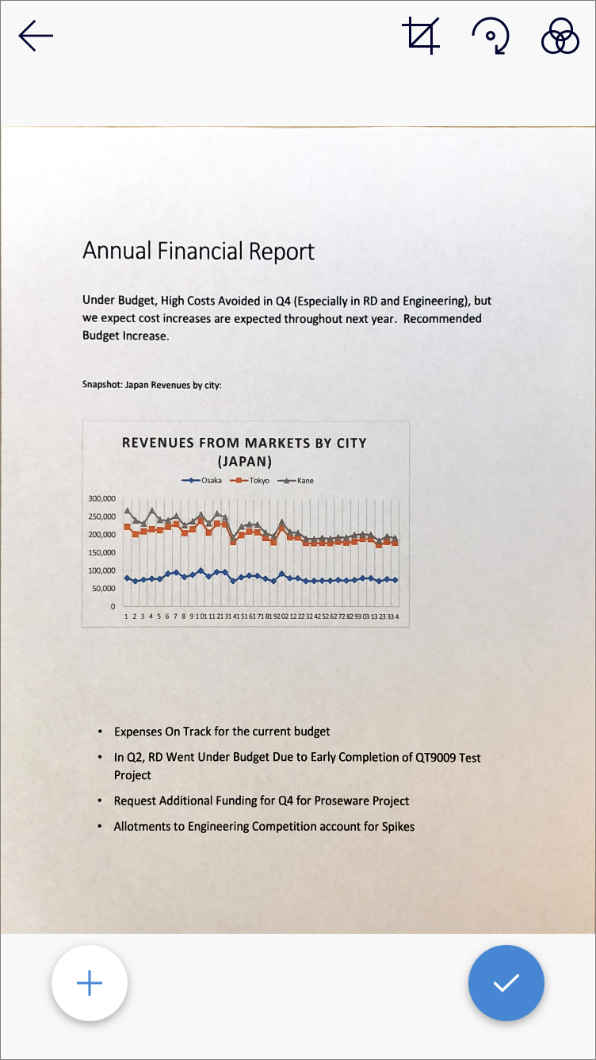
Scan a multipage document
1
Tap Scan
2
Tap Document
3
Tap + to take the picture of the next page
Notes:
Do photo demos here.

Slide 26
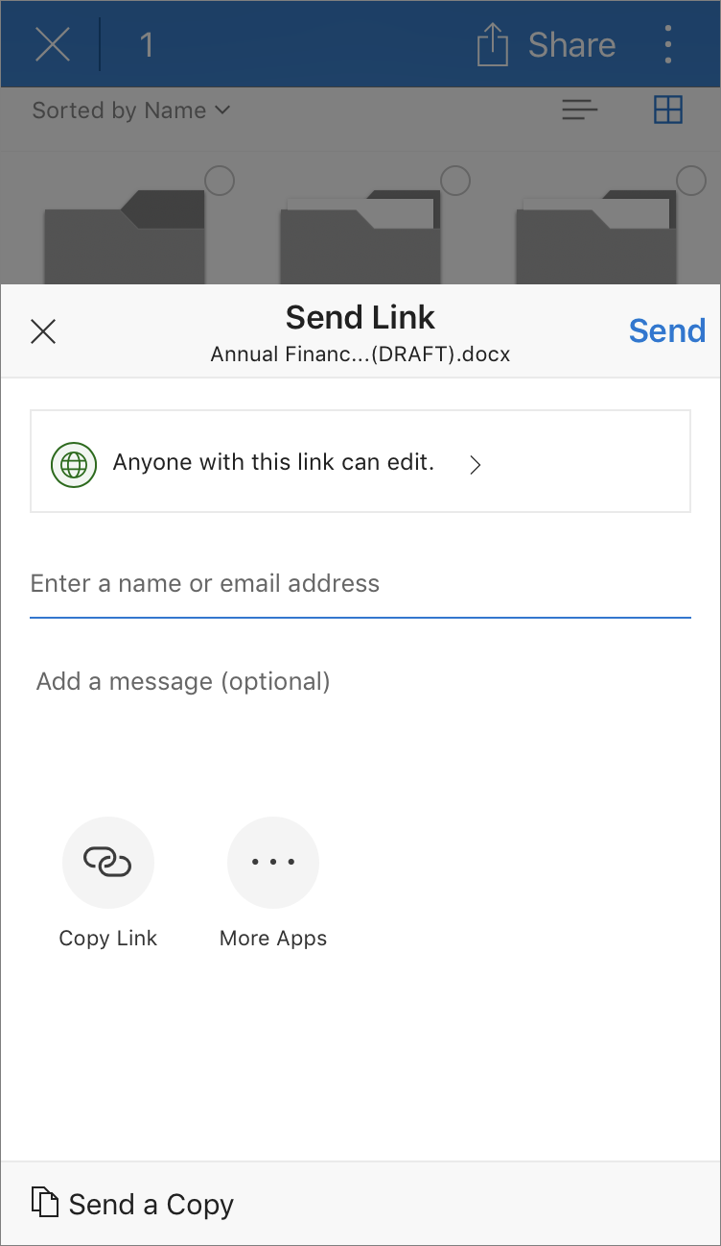
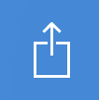
Share a file from a mobile device
Press and hold a file to select it, then tap Share.
Notes:
Demo sharing a link here.

Slide 27
Share: Share inside or outside your organization

Slide 28
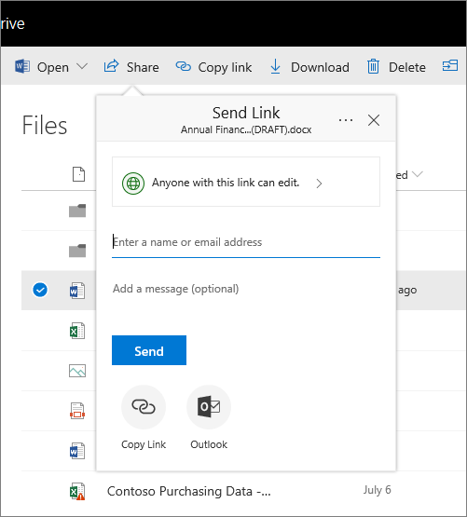
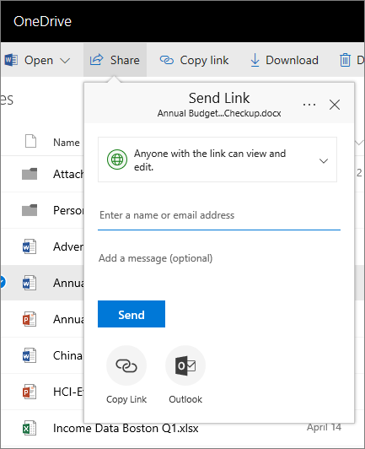
Share a file
Select Share
1
Select to choose share settings
  Note: See next slide for details
2
Enter who to share file with
3
  Select Send to send the sharing link directly to the recipients
Select Copy Link to get a link you can use in IMs, email, etc.
Select Outlook to open an email message window with the link already attached
4

Slide 29
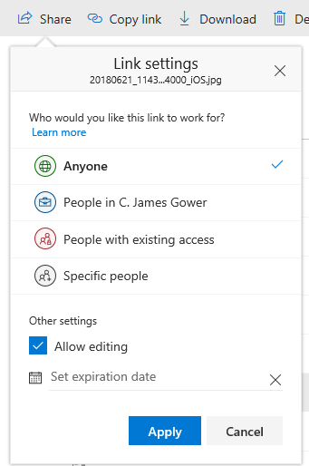
Choose your share settings
Annual Financ…(DRAFT).docx
Choose who can use the link:
Anyone – people inside and outside your org can access. Receive links directly or forwarded.
People in <organization> – everyone in your org can access.
People with existing access – create a link to be used by people who already have access.
Specific people – enter email addresses of the people you want to give access to.
Contoso
Allow link recipients to edit the file.
Leave blank to make link read-only.
  Set a date if you want the link to expire automatically

Slide 30
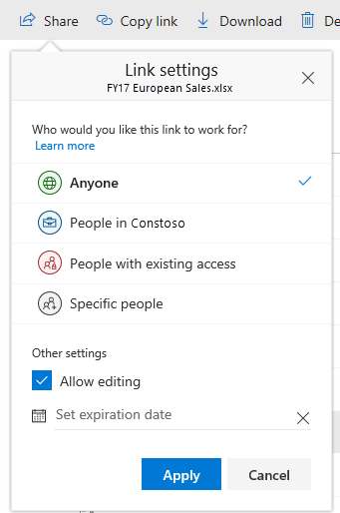
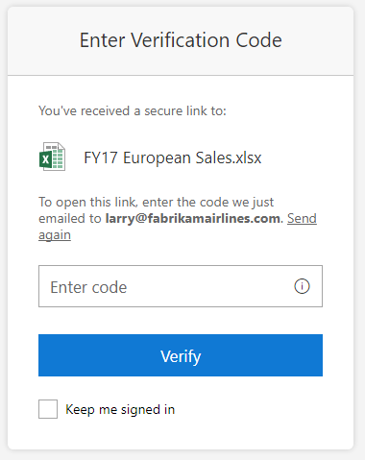
Share safely with people outside the company
Choose Specific people in Link Settings, and enter the email addresses of who you want to share the file with.
Annual Financ…(DRAFT).docx
They will be sent an email message with a time-limited, single-use verification code when they open the link. By entering the verification code, they prove ownership of the email account to which the secure link was sent.
Contoso

Slide 31
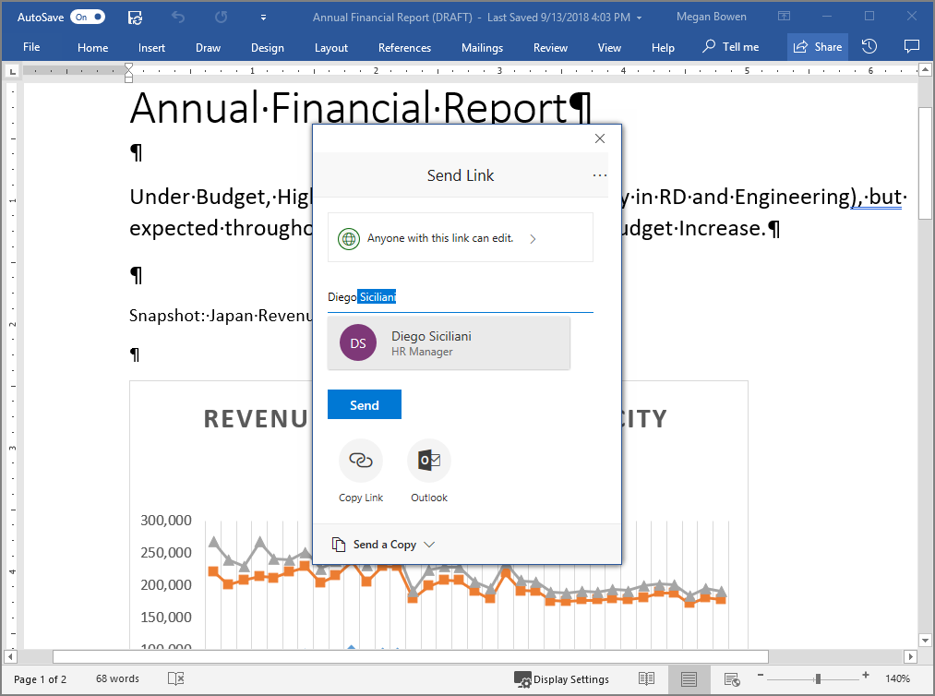

Share a file in Office on the desktop
Select Share on the ribbon, or select
File > Share
  If your file is not already saved to OneDrive, you'll be prompted to upload your file to OneDrive to share it.
Enter who to share the file with, select your share settings, and choose how to send the link.
1
2

Slide 32
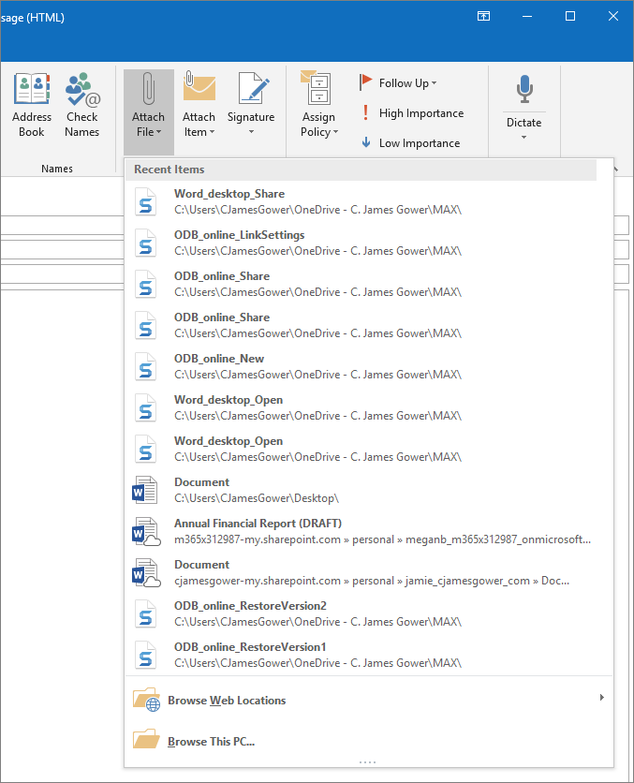
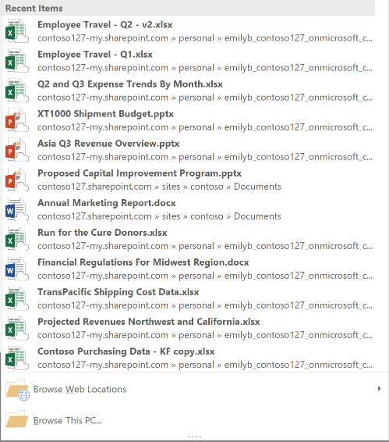
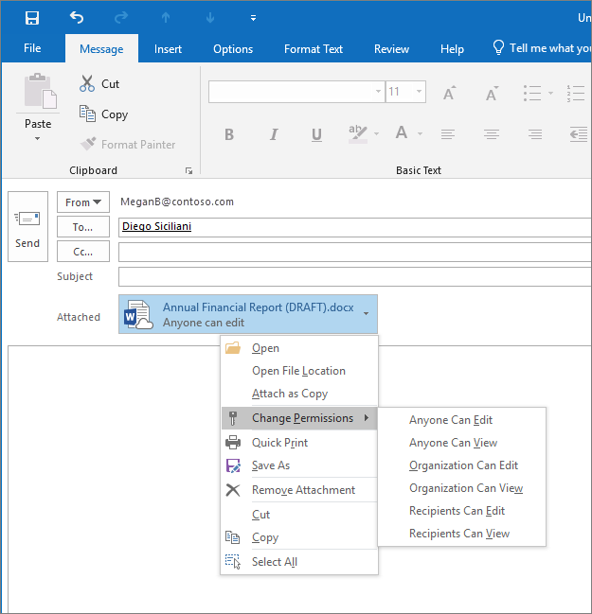
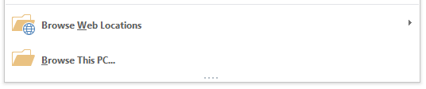
Share a link in Outlook
While composing an email, select
Message > Attach File
If the file you select is not already saved to OneDrive, you'll be prompted to upload your file to OneDrive to share
Select next to an attached file to change permissions and take other actions.

Slide 33
Collaborate: Work together in real-time on Office documents

Slide 34
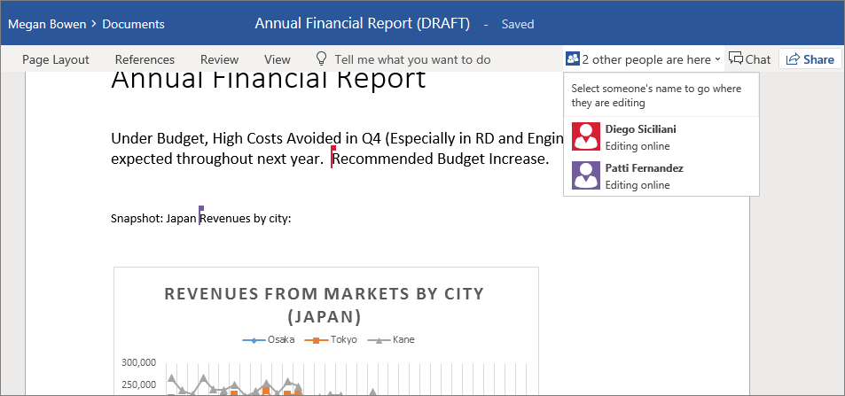
Coauthor a Word document
After you share a document, you can work on it at the same time with the people you shared it with.
Select the coauthoring notification to see names of the other people editing the document.
Select a coauthor to go to where they’re working in the document.
Notes:
Do coauthor demo here.

Slide 35
Discover: Quickly find the files that matter to you

Slide 36
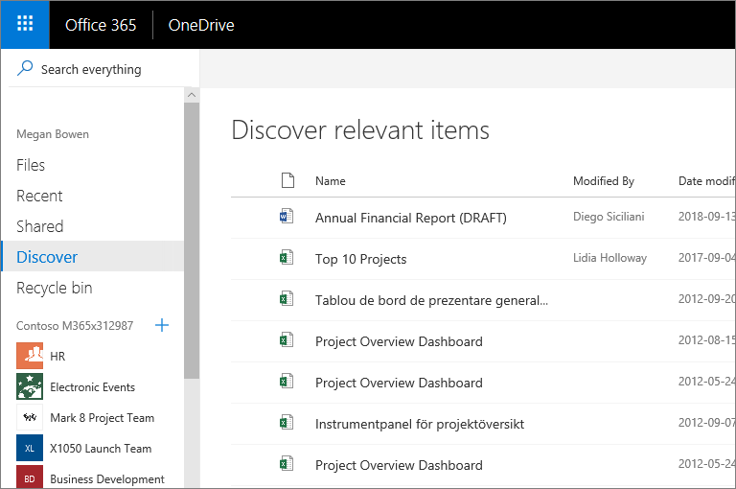
Find relevant content in Discover view
Select Discover in the navigation pane to view trending content in your organization and content relevant to your work.
Discover view is powered by Microsoft Graph. Discover view does not change any permissions. Your private documents are not visible to others and you can view only those documents that you have been given access to.

Slide 37
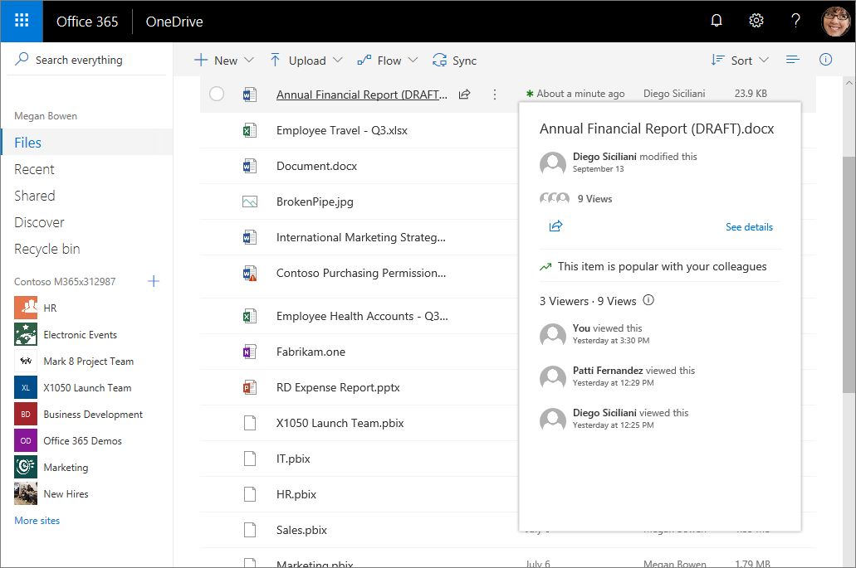

See file info in the Hover card
Hover over the name of a file to see a card with additional information on the file, like views and modifications.
Select See details on the card to open the information pane for the file.

Slide 38
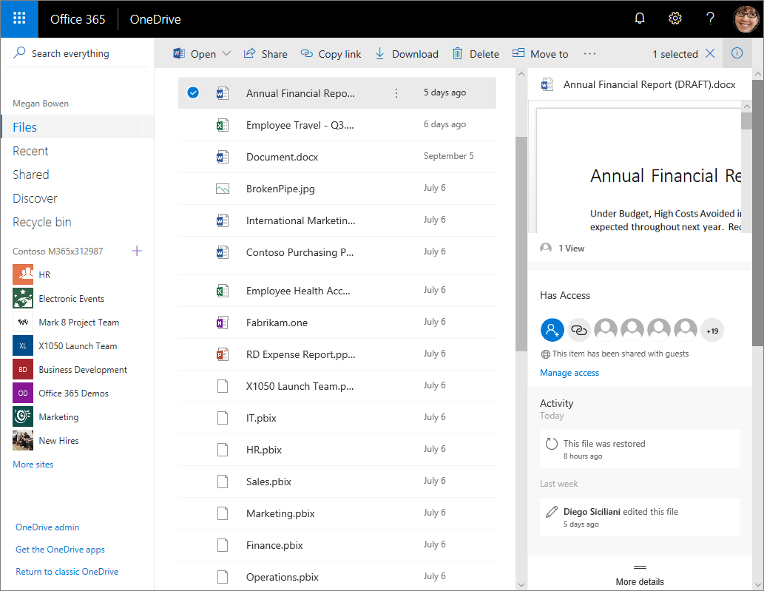
See file activity and other details on a file
Select See details on a file’s hover card, or select a file and then select to view details
See a preview of the file and the number of views
See who the file is shared with, and change or remove sharing settings
See any recent edits or other activity on the file
See other file information

Slide 39
Protect: Keep your files protected and backed up

Slide 40
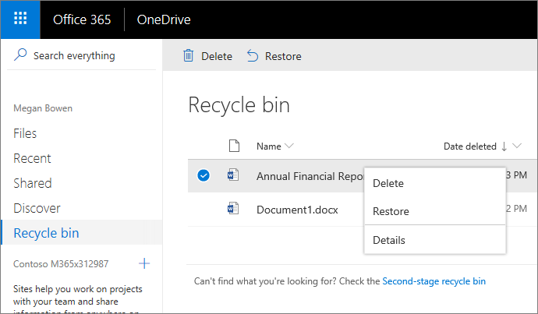
Restore a deleted file
You can restore items you delete, and items other people delete (as long as you have permission to edit the items) for up to 93 days.
Select Recycle bin
Right-click the file and select Restore.
1
2

Slide 41
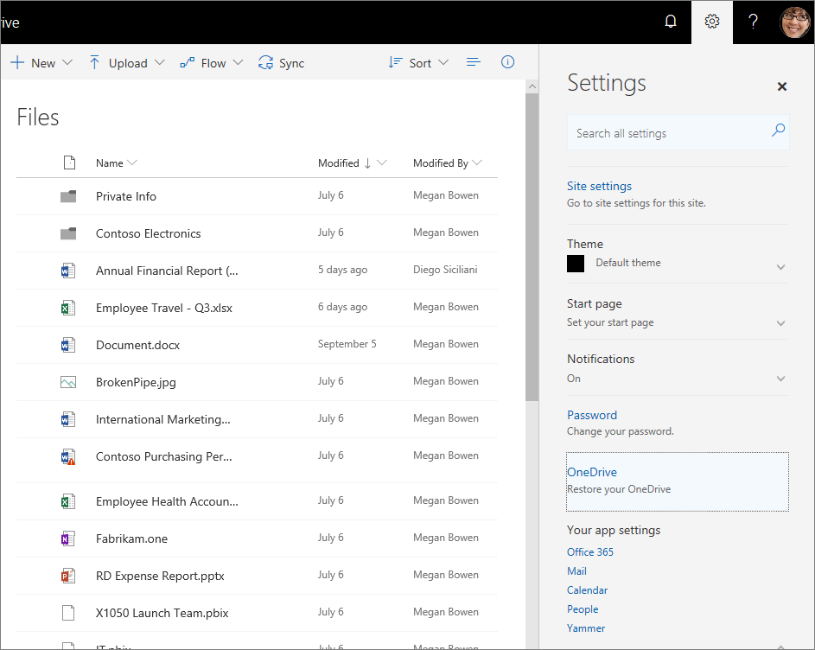
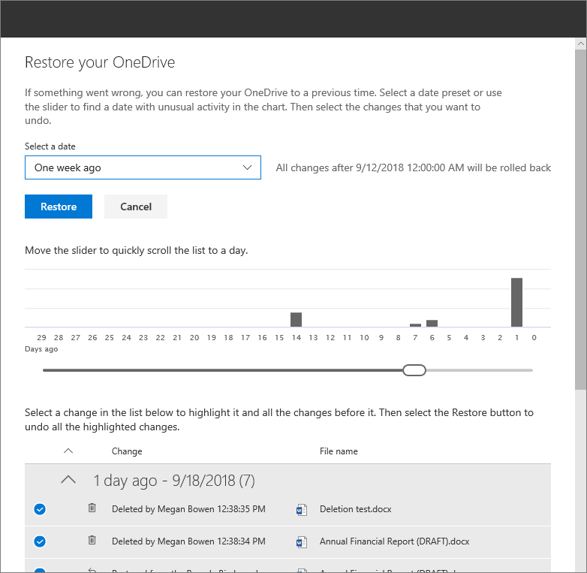
Restore your entire OneDrive
If your OneDrive files get deleted, overwritten, corrupted, or infected by malware, you can restore your entire OneDrive to a previous time.
Tap Settings > Restore your OneDrive.
1
Select a date and select the changes that you want to undo.
2

Slide 42
How-to resources

Slide 43



Recommended OneDrive learning path
QuickStart Guide |  | Video Training |  | Help Center
support.office.com/en-us/article/upload-files-and-folders-to-onedrive-a5710114-6aeb-4bf5-a336-dffa7cc0b77a |  | support.office.com/en-us/article/onedrive-video-training-1f608184-b7e6-43ca-8753-2ff679203132 |  | https://support.office.com/en-us/onedrive
>
>

Slide 44


Additional training and help
Office 365 Training Center
https://support.office.com/en-us/office-training-center
  Get Templates, Tips, and a Collaboration Guide
  Discover new ways to work with infographics
1
Tell Me*
  Enter a Search term in the Tell me box to perform an action or get Help
*Available in Excel, Word, PowerPoint, Outlook

Slide 45
Q&A

Slide 46
Thank you.

