Slide 1


Measure and share success guide
Office 365 Adoption

Slide 2
Where are you in the adoption process?
3
EXECUTE SUCCESS PLAN
2
PEOPLE ONBOADING
TECHNICAL ONBOARDING
CREATE
SUCCESS PLAN
IDENTIFY/PRIORITIZE
BUSINESS SCENARIOS
Identify key stakeholders
  Create a dynamic team of the right people to drive and effect change
  Identify & prioritize business scenarios
  Determine how your organization will use Office 365 to addresses your
  business goals and challenges
  Create success plan
  Create a plan for realizing your goals with Office 365
  Execute success plan
  Implement Office 365 in your organization
  Sustainment
  Drive ongoing adoption, manage change, measure and share success
IDENTIFY
KEY STAKEHOLDERS
      BOOST USER ENGAGEMENT AND DRIVE ADOPTION
    MANAGE AND PREPARE FOR CHANGE
    MEASURE, SHARE, SUCCESS, AND ITERATE
1
DRIVE VALUE
ONBOARD
ENVISION
4
2
1
FastTrack
3
4

Slide 3
Resources available
1
2
Identify key stakeholders
Identify & prioritize
business scenarios
Sustainment
Drive ongoing adoption, manage change, measure and share success
  Communication templates
  Training materials
  Office 356 Learning Center
  Measure and Share Success Guide
  Sample user satisfaction surveys
  Identify Key
  Stakeholders Template
  Identify and
  Prioritize Business Scenarios Template
3
4
Create a success plan
Execute success plan
  Create success plan at microsoft.fasttrack.com
  Champions Program Guide
microsoft.fasttrack.com 

Slide 4

What is this step all about?
  Next steps in the Office 365 rollout process
  You have been monitoring your team’s usage as well as collecting their feedback, ideas, and value wins. The next step in your adoption journey is to consolidate this feedback, assess your levels of success, and prepare to iterate on your approach by identifying new business scenarios, solutions, and audiences.
  Sharing relevant facts and figures
  Showing the positive changes brought about by rolling out Office 365 will encourage continued adoption and satisfy management and/or relevant business owners by showcasing the return on investment. As you go through this exercise, be sure to relate it back to the success criteria you established in the earlier adoption phases.

Slide 5
What do you need to showcase success?
  A mix of qualitative & quantitative results
Evaluate where you are before getting started.
Establish your benchmark and user surveys.
Identify business KPIs that
may improve based on desired outcomes (satisfaction, time to process an order, etc.).
Identify success stories and gather quotes using interviews, roundtables, Yammer Groups, etc.
Measure progress against your KPIs to complement the qualitative analysis with data.
Notes:
Your entire project team, including your project manager(s), executive sponsor(s), and champions should be involved in this step. As you go about measuring your success, your analysis should be one that is both quantitative and qualitative, and should tie back to the vision, business scenarios and solutions that you developed in the previous steps of the adoption journey.
Quantitative success measures can refer to usage statistics of the various Office 365 tools, whereas qualitative measures represent the success stories that illustrate the business value Office 365 has enabled your users to achieve.

Slide 6

Define your success criteria
  As you draft your success criteria,
  use the SMART mnemonic to guide you:
When you develop
  your ideal business scenarios and solutions,
  it’s critical to come up with a formal set of success criteria to measure the impact resulting from your Office 365 rollout. You’ll need to determine what should be measured, and how you will go about collecting both quantitative and qualitative data.
We recommend
  that you choose criteria that will help you showcase success to leadership, such as user satisfaction, employee engagement, adoption velocity, and figures related to your desired business scenarios.
S
  Specific:
  Clear and unambiguous; answers the questions, “What, why, who, where?”
M
  Measurable:
  Concrete; clearly demonstrates progress.
A
  Attainable:
  Realistic; not extreme.
R
  Relevant:
  Matters to stakeholders.
T
  Timely:
  Grounded to a specific target date; answers the question, “When?”
Notes:
Success criteria should be “SMART”.
As you draft your success criteria, use the SMART mnemonic to guide you:
S - Specific
Clear and unambiguous; answers the questions, “What, why, who, and where?”
M - Measurable
Concrete; clearly demonstrates progress.
A - Attainable
Realistic; not extreme.
R - Relevant
Matters to stakeholders.
T - Timely
Grounded to a specific target date; answers the question, “When?”

Slide 7
Success criteria examples
Success criteria | Method/source | Metrics | Example goal
Increased adoption Increased usage correlates to user adoption of the technology. | Quantitative Office 365 reports | Mailbox usage SharePoint usage Skype IMs and conferences Minutes of Skype audio used | Comparison of pre and post-rollout usage reports will show increasing adoption of 10% per month.
Training effectiveness Increased usage correlates to training effectiveness. | Quantitative Office 365 reports Qualitative End-user surveys Yammer groups and feedback | Mailbox usage SharePoint usage Skype IMs and conferences Minutes of Skype audio used Employee satisfaction | Comparison of pre and post-training usage reports will show increasing adoption per month. Employee net user satisfaction score is 130+ based on the final training survey.
Reduced operating costs Increased adoption correlates to reduced third-party conferencing usage, travel time, and resource allocation. | Quantitative Office 365 reporting Finance/accounting reports Help desk reports Travel and phone expense reports Output measures | Mailbox usage SharePoint usage Audio conferencing billing and usage Travel and phone expenses Help desk calls | Comparison of pre and post-Office 365 reports will \show cost savings. Post-rollout usage of third party phone conferencing should show decreasing usage of 10% per month.
Increased productivity Increased adoption correlates to faster communication and decision making, shorter time to complete tasks. | Qualitative End-user surveys Yammer groups and feedback | Time required to complete projects | Time to complete customer orders should drop by 15% within 6 months.
Improved collaboration Increased cross-team and cross-location communications. | Qualitative End-user surveys Yammer groups and feedback | Employee satisfaction Time saved | Teams that work from multiple locations will report improved feelings of connection with their teammates within 3 months of the Skype rollout.
Improved employee satisfaction Flexible working options improve employee satisfaction through increased engagement, reduced stress, improved work-life balance. | Qualitative End-user surveys Yammer groups and feedback | Employee satisfaction | Employee satisfaction improves by 15% within 6 months.
Notes:
Here are sample success criteria goals and metrics.

Slide 8
Measurements framework
  Scenarios
  Benefit areas
Based on the scenario, it is important to identify a baseline of usage of the scenario.
By identifying goals to drive adoption, you can identify goals to improve (Good, Better, Best)
and measure accordingly. As you move from Good to Better, new plans can be driven to
help drive adoption in that area and move
up in maturity.
The capability areas include technologies that are part of the scenario. Each scenario is comprised of multiple technologies when focusing on scenario-based activities, so identifying these can be critical in identifying which metrics to focus on.
Benefit areas are then quantified based
on the metrics or goals you have. These can
be equated to a specific benefit area and
measured over time to increase the value
to the organization.
  Agility
  Quality of service
  Financial
  GRC
  Capability areas
  Email (Exchange)
  Real-time communications (Skype)
  Collaboration (SharePoint)
  Enterprise social (Yammer)
  Measurement maturity
  Current methods
  Good
  Better
  Best

Slide 9
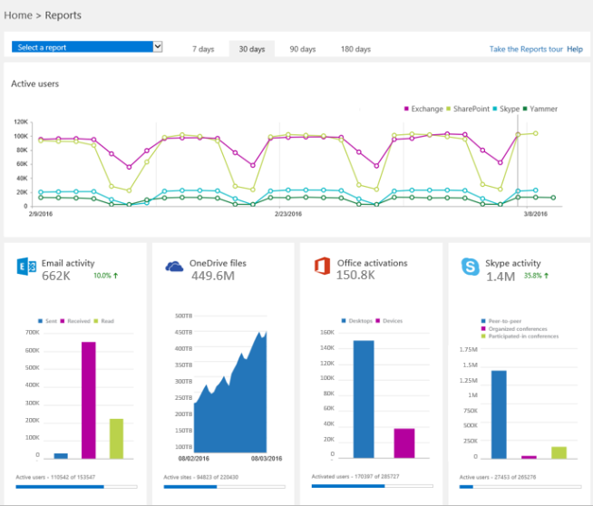
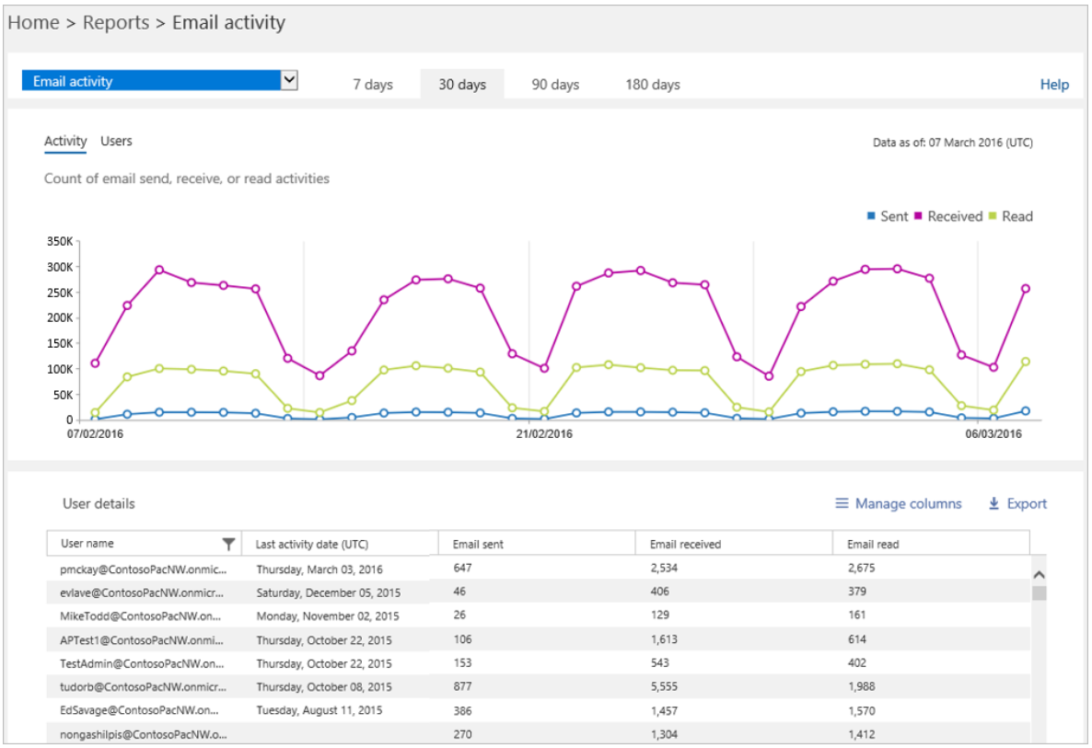
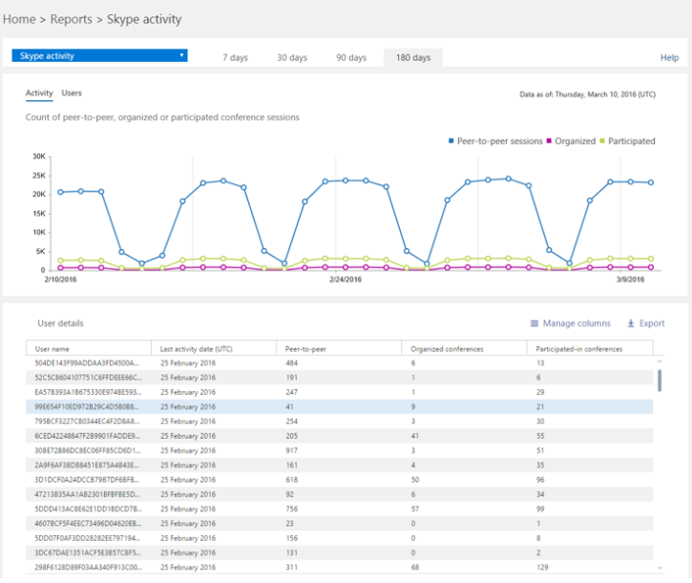
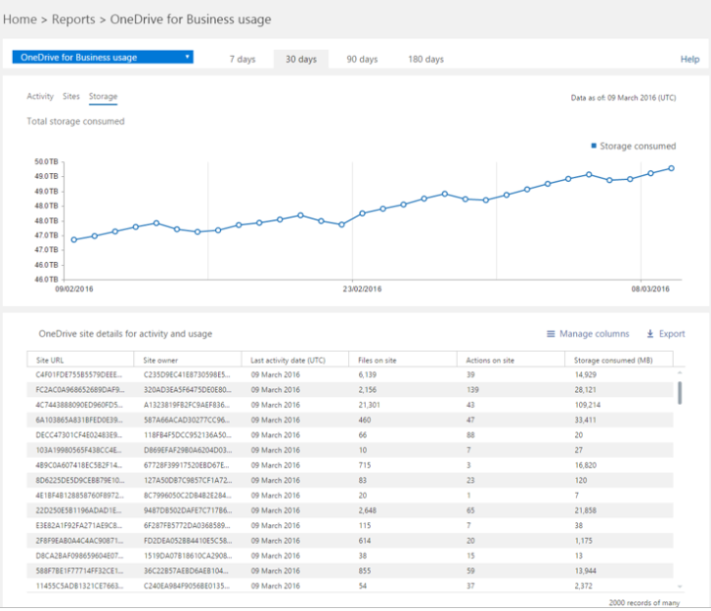
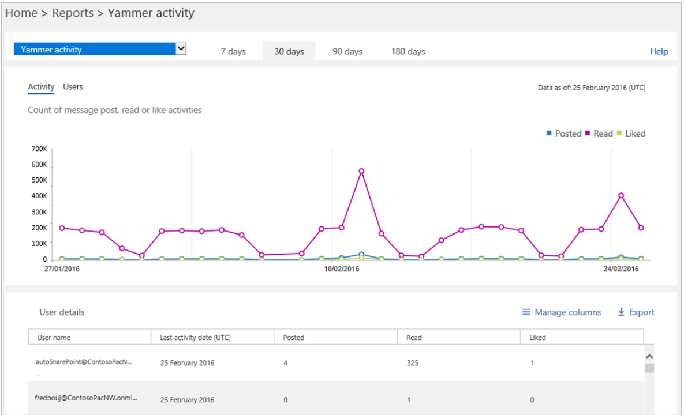
KPI dashboard sample to support capabilities
These graphs represent some of the reports available within the Office 365 Online Admin Portal that can tie to the metrics needed to represent consumption or adoption improvements.
  Activity Dashboard
  Exchange
  Skype
  SharePoint & OneDrive for Business
  Yammer
Notes:
- Slide 11: Matt - can you make sure this includes the latest screen shots for O365 reports - preferrably general and workload reports

Slide 10
Assess user satisfaction through surveys
At any point throughout your rollout, you’re encouraged to distribute satisfaction surveys to gather data about your users’ knowledge of and sentiment towards the new Office 365 workflows. The results will help you determine how successful the rollout has been and start thinking about how you can put this feedback into actionable next steps.
  Here are some suggestions for surveying end users during your launch:
Early adopters program
Full launch
  Circulate a baseline survey shortly before champions participating in
  your pilot receive activated accounts and devices, to gather data about their knowledge of Office 365.
  Release a survey halfway through your pilot to gather data about champions’ experiences with Office 365, and use the results to make
  any adjustments prior to a general rollout.
  Use a final survey immediately after the champions pilot period to determine whether you need to make further adjustments to your
  general training and awareness materials.
  Circulate a baseline survey shortly before users receive activated accounts and devices, to gather data about their knowledge of Office 365.
  Release a survey halfway through your launch to gather data about users’ experiences with Office 365 and use the results to make any necessary adjustments.
  After your organization-wide rollout, use a final survey to assess user satisfaction with the rollout process. You can release this survey 90 days after launch, and then in quarterly increments to help measure user adoption from a satisfaction and productivity standpoint.
Notes:
Use surveys to assess user satisfaction. Data drives decisions. You will be able to take feedback into the next steps for adoption.

Slide 11
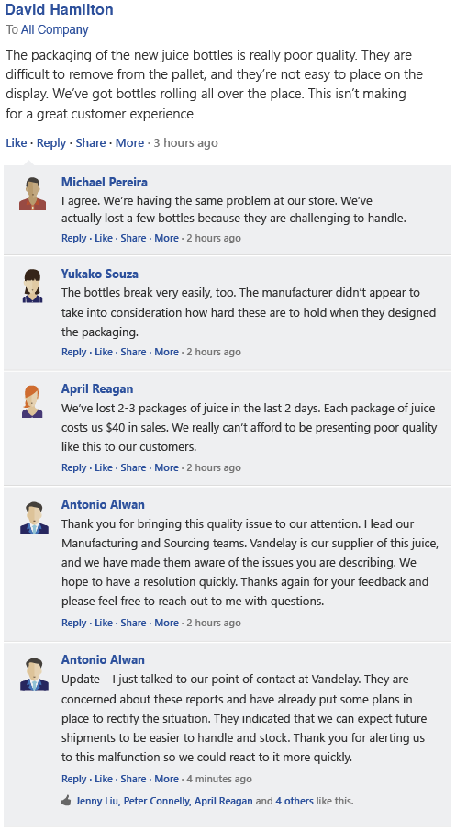
Capture qualitative
successes
An employee on the night crew flags a
non-routine problem
  Charleston
  Dallas
Other stores across the country confirm
the problem
  Salt Lake City
Success stories
  are oftentimes just as valuable as quantitative measures when demonstrating Office 365 success. Throughout
  your rollout, have your project team members and champions identify examples demonstrating cross-functional collaboration and teamwork. They can do
  this simply by surveying end-users about the personal value they have achieved and how Office 365 is helping them meet their goals.
Using Yammer
  you can easily tag conversations with a topic (such as #O365win) to follow their progression. When doing an analysis of the rollout, search for the topic to quickly surface the conversations demonstrating business value.
  Phoenix
An executive acknowledges
the issue
  Chicago
The problem
is resolved
Notes:
Success stories can be just as valuable as quantitative measures when demonstrating Office 365 success. Survey end users about the value they’ve achieved and how Office 365 is helping them meet their goals.

Slide 12
Share stories
  Capturing and sharing stories
  about your Office 365 successes is one of the best ways to demonstrate business value.
  When sharing a story about your experience with Office 365, be sure to include these details:
  Time. The story should begin with a time marker, so the audience knows when it happened.
  Characters. The story should feature names, so the audience knows who was involved.
  Events. The story should recount the events that took place.
  Visuals. The audience should be able to picture what has happened.
  Stories about business value can easily be shared
  internally through an Office 365 Success Stories group in your Yammer network. You can also share success stories externally with the wider Office 365 community via the Office 365 Network and use them to make feature-function training more relevant.
  Trainers should also use
  these success stories to make feature-function training sessions relevant to end-users.
Notes:
Make sure you capture and share success stories. Stories can be easily shared. They drive enthusiasm and help others see what’s possible.

Slide 13
Iterate
  Your adoption journey doesn’t end after launch day nor after measuring your launch impact. Driving adoption is a continuous cycle and you should constantly be looking for new ways that Office 365 can add business value to your organization to keep up with the evolving needs of your users.
Use the insights from your evaluation process to kick off additional trainings to educate users about best practices and high-impact Office 365 solutions.
Organize additional business scenario and solutions development sessions with more departments in your organization (refer to http://aka.ms/ProductivityLibrary for example scenarios). Afterwards, hold departmental trainings where you explain how Office 365 can drive success for each particular business line.
Periodically host additional engagement events, such as town hall style meetings or lunch and learns, to drive engagement in your network. Go back through Launch an Awareness Campaign to help you brainstorm event ideas.
Make sure to encourage your users and champions to develop ideas for how Office 365 can improve business practices and to share them with others via a Yammer group. Use these ideas to generate additional solutions and kick off additional trainings.
Notes:
Driving adoption is a continuous cycle. Look for new ways that Office 365 can add business value to your organization to keep up with the evolving needs of your organization and with the changing needs of your users.

Slide 14




Microsoft FastTrack
  Learn how to get the most out of Office 365, quickly get your team onboard,
  and drive adoption.
Scenarios
  Scenarios inspire people to work in new ways using Office 365, along with related communication kits to support adoption.
  Approach
  A three-step approach to drive adoption supported by downloadable templates and best practices.
  Resources
  Helpful resources to learn about other customer stories
  and special offers to make it easier to get started.
  Community
  Talk to thousands of other Microsoft customers as part of the
  driving adoption community at http://aka.ms/DriveAdoption.
  fasttrack.office.com 

