Slide 1
Executive Communications Planning

Slide 2
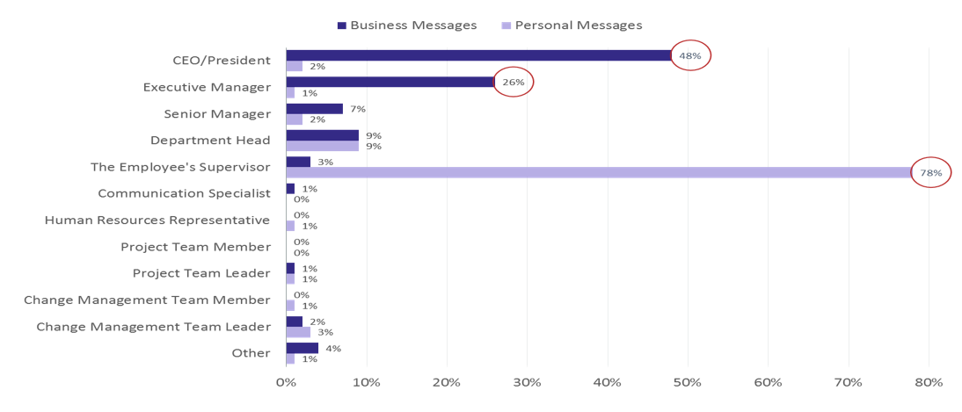
Influencers
Preferred senders of change messages

Slide 3
Executive sponsor communications
Executive Sponsor
CIO
Supporting Sponsors
Employees
Key messages
Outline the project’s 5 Ws (what, when, where, why’ and how
How will organization benefit
Calls to action for supporting sponsors
Highlight resources to support transition
Key messages
Outline the project’s 5 Ws (what, when, where, why’ and how
How will end users benefit
Calls to action for staff: start and stop behaviors
Highlight resources to support transition

Slide 4
Executive sponsor communications (to-supporting sponsors)
Executive Sponsor
Supporting Sponsors
Key messages
Outline the project’s 5 Ws (what, when, where, why’ and how
How will organization benefit
Calls to action for supporting sponsors
Highlight resources to support transition
Formats
Email
Leadership meetings – beyond IT
Newsletters – senior execs
Other channels – which resonate with staff

Slide 5
Communications - Executive Sponsor to supporting sponsors
Outline project 5 W’s (who, what, when, where, why) and How
Overview how organization will benefit
Calls to action for supporting sponsors:
  Communicate to end users about the change and new behaviors and that they support it
  Actively and visibly support new behaviors – such as store and share documents to OneDrive and encourage their teams to do the same
  Highlight resources to help their teams get ready
Timing – prior to Executive sponsor communications to all employees

Slide 6
Sample: A message from the CIO
Our OneDrive storage opportunities bring an incredible ability to store and share our data (where appropriate) in the cloud, where it is secured and backed up by Microsoft.
Every employee has at least a 1-5 Terabytes of storage. Trust your CIO, that’s a lot!
We also have incredible abilities to leverage these services for file sharing securely with One Drive.
<Insert name here>, CIO

Slide 7
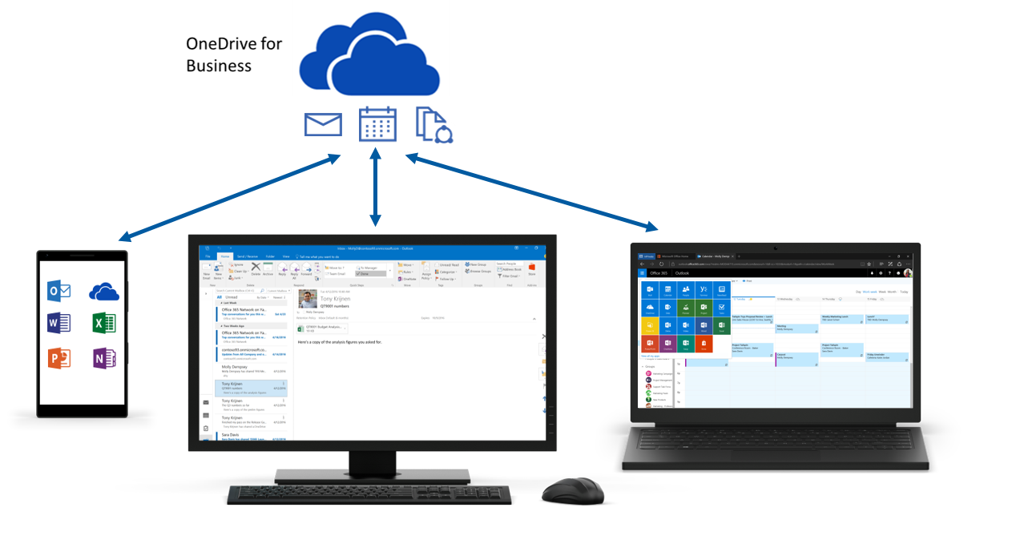
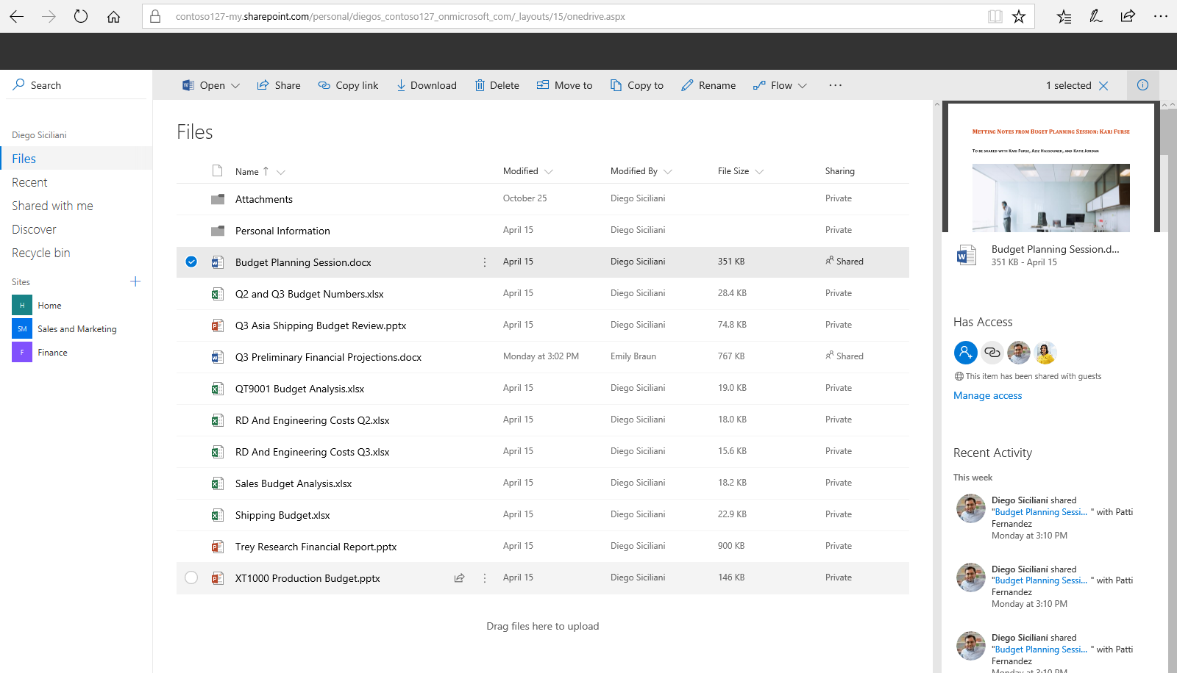
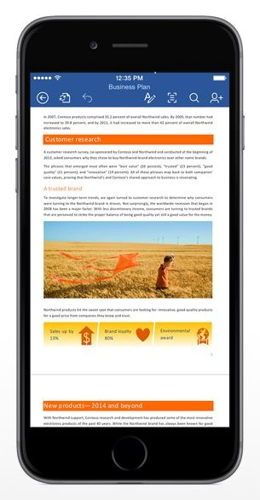
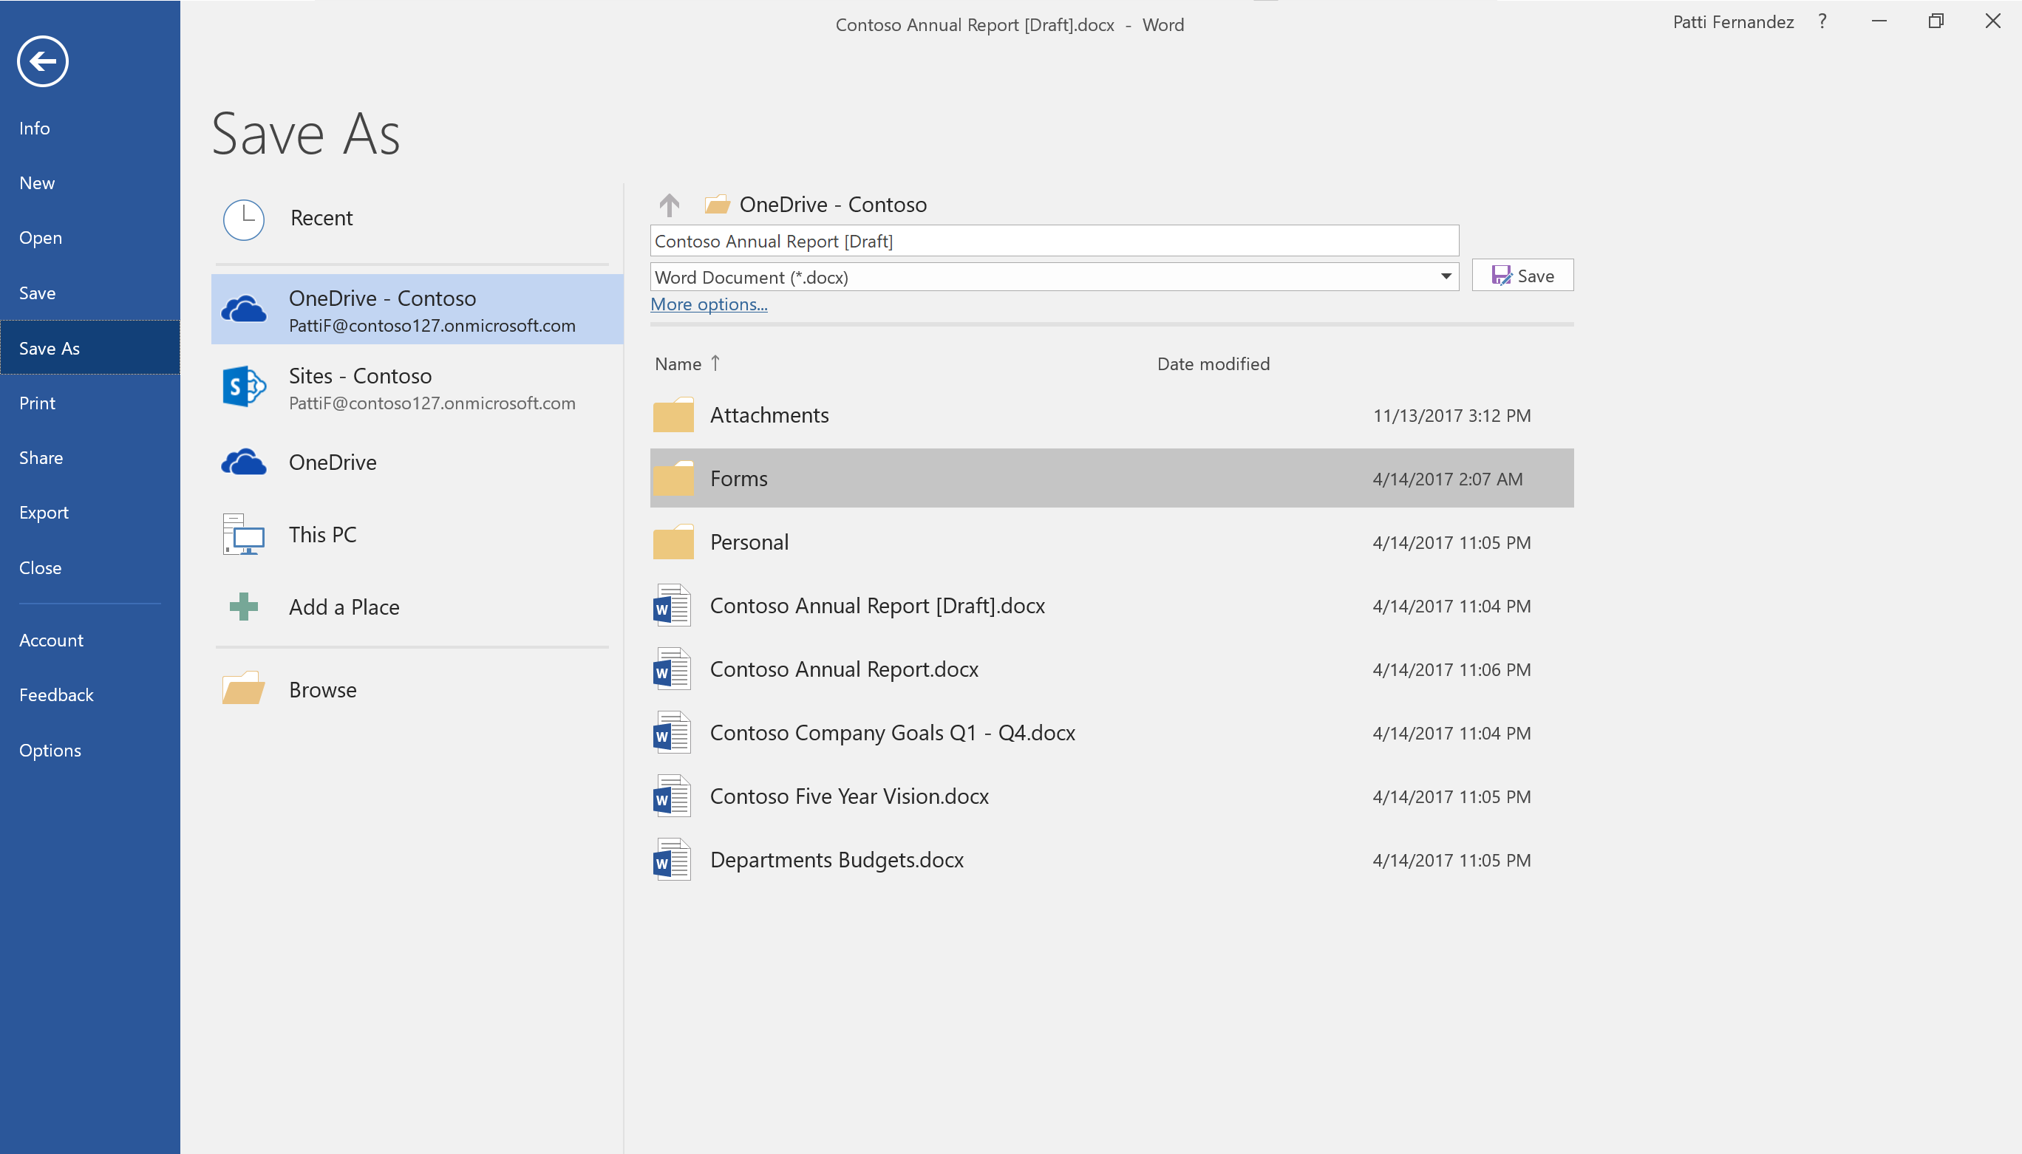
What is happening—and why?
Company is standardizing on OneDrive for Business for simplified cloud storage and sharing.
It’s already available to you now.
You have anywhere access to your files - get to your files on your desktop, from a browser, or on-the-go with mobile apps.
You can sync files to your desktop for access offline.
Open, save, and share Office documents to OneDrive without leaving the Office apps.
And coauthor documents in real time with coworkers.

Slide 8
Executive sponsor communications (to-employees)
Executive Sponsor
CIO
Prior to Launch
Employees
Key messages
Outline the project’s 5 Ws (what, when, where, why’ and how
How will end users benefit
Calls to action for staff: start and stop behaviors
Highlight resources to support transition
Formats
Video
Email
Other channels – which resonate with employees

Slide 9
Stop, Start, Continue Template
Outline new ways to work
Stop Start Continue
Reinforce new ways to work
Awareness campaigns
Sponsorship – leader of group/audience
Reinforcement focused on new ways to work and ‘start’ behaviors

Slide 10
Stop, Start, Continue Sample
Audiences
Admins | Leadership | Road Warriors | Knowledge Workers
Behavior change outline: Stop, start, continue
Stop Sharing documents and follow ups from meetings by email Using paper note books Start Sharing via OneDrive documents and meeting notes | Stop Using files share for documents Using paper note book Start Using OneNote to manage daily task list stored in OneDrive | Stop Sharing documents for input via email Downloading key docs to desktop for remote access Start Storing key documents in OneDrive for access anywhere | Stop Using files share for documents Using paper note book Start Using OneNote stored in OneDrive for key notes

Slide 11
OneDrive for Business - Scenarios - sample
Personas
Admins | Leadership | Road Warriors (Sales) | Security Sams | Storage Smiths
Scenarios – Personal productivity Anytime, anywhere access to documents One source of truth Easier colleague collaboration (asynchronous)
Manage to do and task lists (OneNote stored in OneDrive) Meeting agendas, notes, follow ups Resources and contacts – meetings/events | Draft of strategic, annual, quarterly plans Draft report performance reviews Manage daily to do and task lists | Access to documents anytime and anywhere Collaborating on documents with colleagues from the road Share and collaborate on files with vendors, partners agencies easily | Files stored in secure place File access to only those granted Collaborating with colleagues and vendors on secure documents | Sharing and collaborating on large files Large file storage – need space
Behavior change outline: Stop, start, continue
Stop Sharing documents and follow ups from meetings by email Using paper note books Start Sharing via OneDrive documents and meeting notes | Stop Using files share for documents Using paper note book Start Using OneNote to manage daily task list stored in OneDrive | Stop Sharing documents for input via email Downloading key docs to desktop for remote access Start Storing key documents in OneDrive for access anywhere | Stop Using files shares or unsecure platforms for document storage Start Using OneDrive for file storage – safe, secure | Stop Using USB keys or other storage devices Stop sharing files via USB keys Start Using OneDrive to store and share large files

