Slide 1
Microsoft 365 Modern Collaboration Architecture (MOCA) Extended version 1.2

Slide 2

Finding balance
Work devices
Personal devices
Devices
Family life
Satisfaction
Making a difference
Personal Identity
Professional Identity
Collaboration
Work-life balance
Expert
Technical Identity
Julie
Notes:
In today’s hybrid workplace, there are more demands on our attention and potential for distraction than ever. It’s become harder to harness our attention for longer periods as we bounce between our work and home life. Part of the challenge is the context switching between the different roles we have across our work and personal lives. We’re having to redirect our attention more often and the degree of distraction is larger as we switch across in and out of the different contexts.
In this addition of MOCA we’ve taken a look at the bigger picture and the different contexts we live and work in. Through the lens of human first, we take a look at these additional contexts with the goal of also understanding how, through more focused, strategic use of technology and adopting behaviours aligned to our organisational cultures, we can help individuals find balance. Let’s take a look at look at out first focus area – the individual.

Slide 3









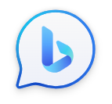




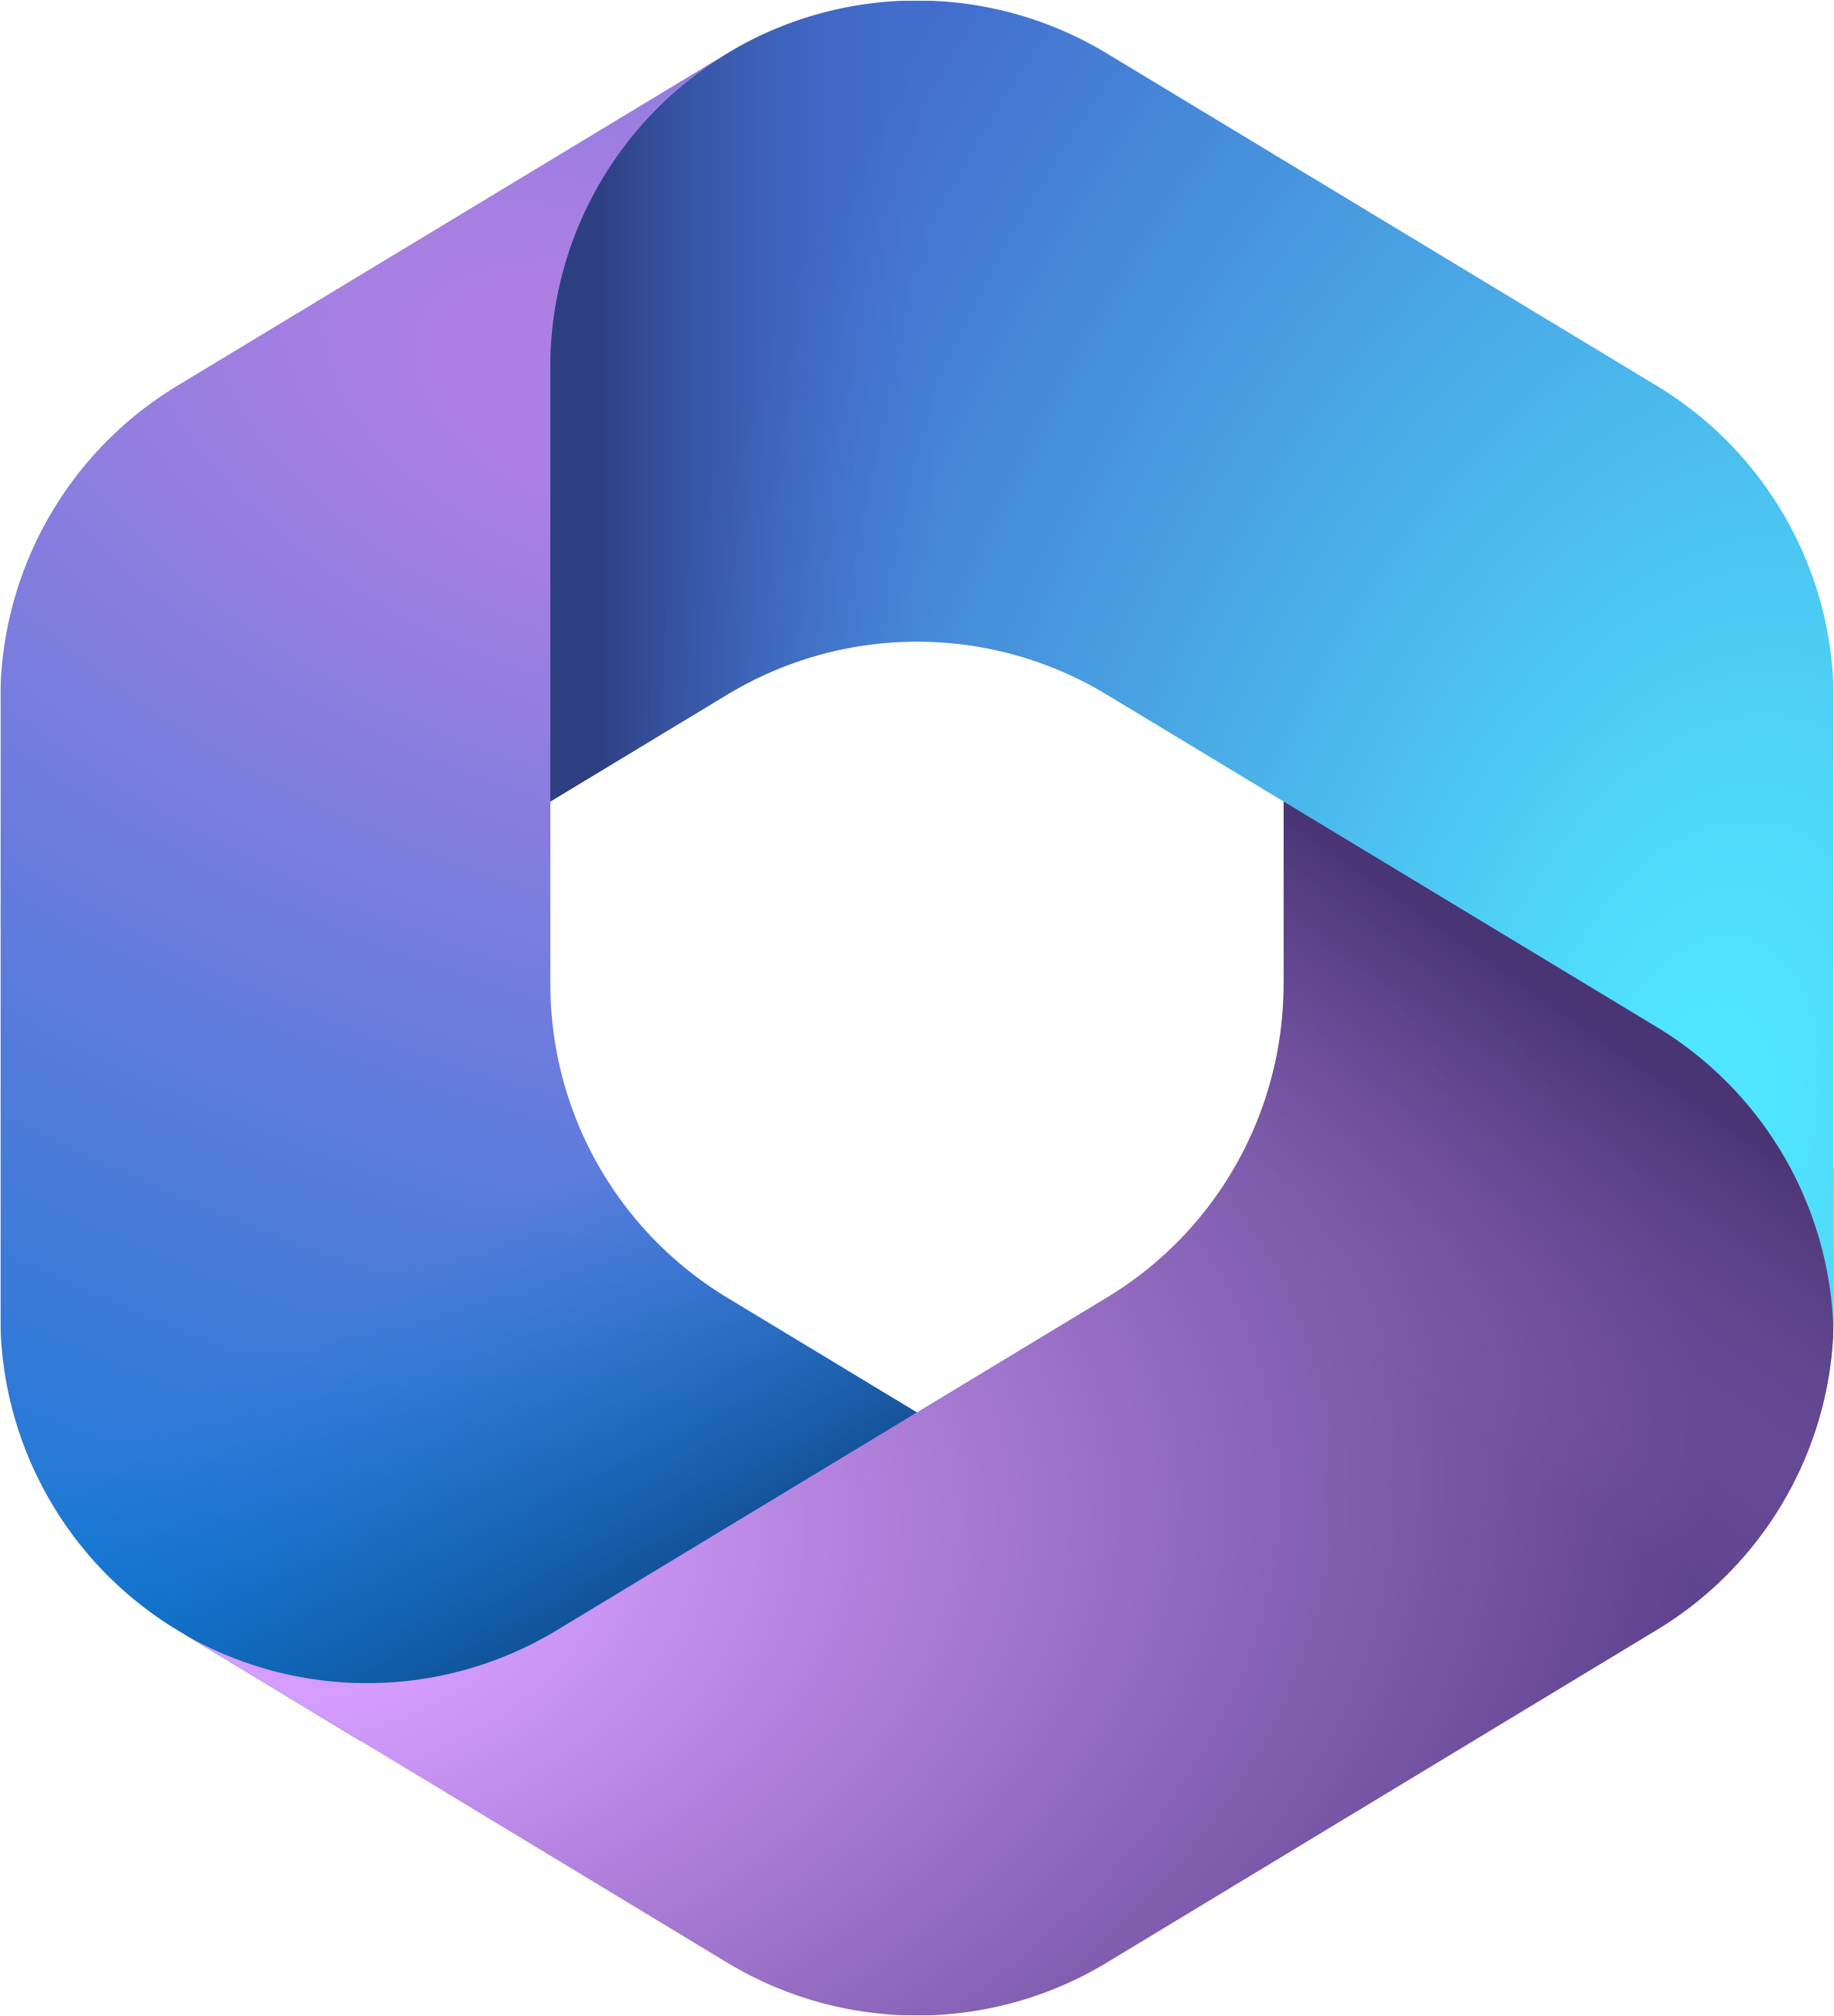
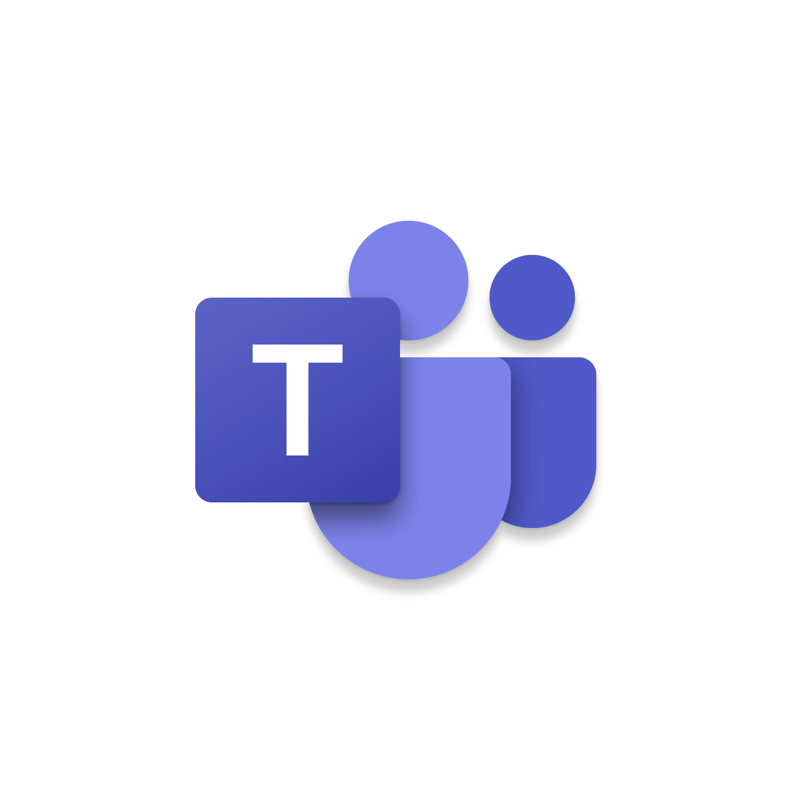









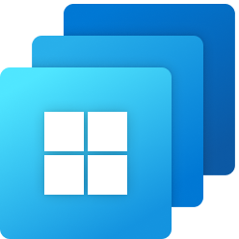
Individual focus
Individual Characteristics
Skills
Experiences
Mindset
Success definition
My Learning
Secure enterprise search
Develop content
Wellbeing & effectiveness
Chat (text, audio & video)
Automate routine tasks
Personal Assistant
Find documents & people
Portable Information Component
My files
Measure my impact
Accessible time
Track information & tasks
Send + receive instructions
Organize workspaces
Individual
Outlook
Individual: A single person, as distinguished from a group.
Notes:
All organisations hire individuals for their skills and experiences. In order to best utilise these skills and experiences, employees needs to be able to deliver against a number of different needs.
+
Microsoft 365 has a number of tools & applications that provide specialist capabilities to address these various needs of the individual. For example: email, which is best used for sending and receiving one-way instructional communication, Viva, which is a critical tool helping us reflect on how we spend our time and our attention as it related to our wellbeing and effectiveness, and OneDrive, which helps individuals store documents that they are accountable for, so they can be accessed anywhere, anytime and on any device securely.
+
In addition, people have to focus on their learning, powered by Viva Learning and LinkedIn Learning modules, that integrate directly into Microsoft Teams.
+
In addition, Outlook has a important role in helping employees organise their thoughts, their time and their tasks for the day to ensure that they get all their work done.

Slide 4

My Learning
Secure enterprise search
Develop content
Wellbeing & effectiveness
Chat (text, audio & video)
Performs
Automate routine tasks
Personal Assistant
Find documents & people
Portable Information Component
My files
Measure my impact
Accessible time
Track information & tasks
Send + receive instructions
Organize workspaces
Individual
Team
Team: A group of individuals, with interdependent activities, that work together towards a common goal.
Notes:
Though we all have autonomous parts to our role, an employee’s ability to have impact increases exponentially when they perform as a part of a team.
We define a team as “A group of individuals with interdependent activities, that work together towards a common goal”. Just because a group of people report up to the same manager, doesn’t make them a team by default, unless there is ‘interdependence in their work’, which creates the need for collaboration.

Slide 5






Team focus
Team Characteristics
Outcomes
Leader
Processes
Skills
Roles & responsibilities
Membership
Team wellbeing
Team meetings
Share screen/present
Capture notes
Our internal brand
Schedule work dependencies
Chat with team members
Store team files
Track information & work
Manage team tasks
Ideate
Manage team time
Manage shift-work
Team instructions
Performance insights
Team
Microsoft Teams
Team: A group of individuals with interdependent activities that work together towards a common outcome.
Notes:
A successful team needs a strong supportive framework comprising of
clearly defined outcome, the direction
Strong leadership accountable for the delivery of the outcome via a well thought-out, optimised and lean process; and
Access to the right skills, organised by defining the roles and responsibilities of the various team members.
+
To be an effective collaborator, employees need a variety of different capabilities, supported by Microsoft 365 tools and applications.
+
Just like Outlooks is where individuals go to organise themselves, Microsoft Teams is hub for teamwork, where we coordinate effort and demonstrate commitment to the team outcome.

Slide 6
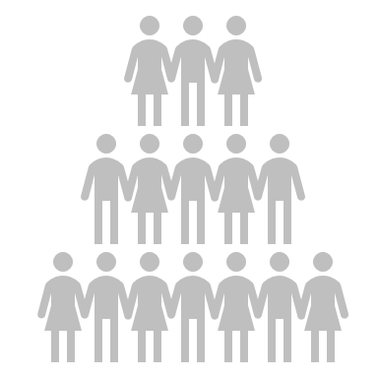
My Learning
Secure enterprise search
Develop content
Wellbeing & effectiveness
Chat (text, audio & video)
Performs
Automate routine tasks
Personal Assistant
Find documents & people
Portable Information Component
Grows
My files
Measure my impact
Accessible time
Track information & tasks
Team wellbeing
Send + receive instructions
Organize workspaces
Individual
Team meetings
Share screen/present
Capture notes
Our internal brand
70
:
20
:
10
Schedule work dependencies
Chat with team members
Store team files
Track information & work
Manage team tasks
Ideate
Manage team time
Manage shift-work
Team instructions
Performance insights
Community
Team
Community: A group of individuals with a common interest.
Notes:
Though we are often delivering for multiple initiatives at one time, we also need to continuously learn and grow as individuals.
Michael Lombardo and Robert Eichinger developed the 70:20:10 model, which suggests that 70% of all our learning comes from on-the-job experiences, 20% from feedback and developmental relationships, and 10% from formal training and courses. Typically, we working closely with around 8-16 people daily, which means that a significant portion of our learning comes from this close-knit group.
Wouldn’t it be great, if, in addition to this close-knit group, we could learn from people across the organisation, share experiences and develop new relationships?
+
Well, this is where the concept of “Communities” come in.
Communities are defined as a group of individuals with a common interest, or a common passion.

Slide 7
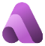


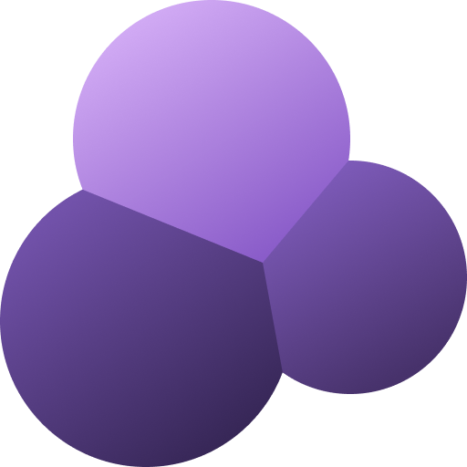



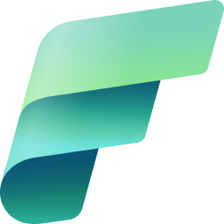


Community focus
Organizational focus
Corporate comms & news
Community Characteristics
Capture experience
Publish & broadcast video
Organizational Characteristics
Interest/passion
Leader
Innovation
Membership
Networking
Knowledge & updates
Active & Visible Sponsorship
Culture of enablement
Changing business processes
Balanced focus on employees, customers & shareholders
Storytelling
Culture of feedback
Share innovative ideas
Enterprise document store
Inner-source
Data intelligence
Community calls + events
Organizational behaviour
Community
$⊆$ Organization
Viva Engage
Community: A group of individuals with a common interest and a common passion.
Notes:
Communities are a great place to find and share information, innovate by building on ideas of others and learn by exchanging experiences and skills. This enables leaders across the organisation to keep employees engaged, promoting transparency, diversity and inclusion.
A community is typically coordinated by a community facilitator and offers a number of different ‘needs’ to its members.
+
Healthy communities drive knowledge creation, retention and application across the organisation. They keep the people tapped onto the heart-beat of the everyday and ensure that their wisdom and experience is retained for future generations of employees.
+
For an organisation to be “productive” and imbibe good behaviours, the leadership must develop the right enablement culture through new ways of collaborating, communicating and sharing information - that focuses on creating a learning mindset.
According to research done by Prosci, The #1 obstacle to success for a major change, is ineffective sponsorship.
+
An “Organization” is defined as - Social units (or human groupings) deliberately constructed and reconstructed to seek specific goals by coordinating the actions of their members.
The organisational perspective explore the generic capabilities that need to be established across the wider organisation, and include – the ability to assess organisational behaviour, live broadcasting, corporate communications & news, as well as the ability for people across the different business areas to create their own simple business solutions. Once again, the Microsoft 365 suite of technologies provide a holistic set of tools and applications that enable these core capabilities of every modern organisation.
+
Yammer is the Community Management Platform in Microsoft 365 and we see typically see News, Social and Center of Excellence as the most common type of communities.
----

Slide 8
Membership Characteristics
Membership Characteristics
Membership is mandatory based on skills required
Recommended team size is 5-12 individuals
Focus on outcome delivery aligned with strategic priority of the organization
Membership is optional based on interest or passion
The larger the community, the better
Focus on learning, innovating, capture organizational experience and employee engagement
Team wellbeing
Team meetings
Share screen/present
Corporate comms & news
Capture notes
Our internal brand
Capture experience
Publish & broadcast video
Schedule work dependencies
Chat with team members
Networking
Knowledge & updates
Store team files
Track information & work
Storytelling
Culture of feedback
Manage team tasks
Ideate
Share innovative ideas
Enterprise document store
Manage team time
Manage shift-work
Inner-source
Data intelligence
Team instructions
Performance insights
Community calls + events
Organizational behaviour
Team
Community + Organization
Notes:
Now, before we go forward, lets talk about some major differences between a team, and a community.
Let’s reflect on the definition of a team – a group of individuals, with interdependent activities that work together, towards a common goal.
So, the membership of each team member is mandatory, given that there is a dependency on their skills sets and their ability to complete their tasks.
Now think about this – each interdependency within the activity create additional risk towards achieving the outcome, and thus it is critical to manage the team size and the efficiency in team processes.
Research done by the Wharton University of Pennsylvania recommends that the ideal team size is between 5-12 members, which mitigates against the exponential increase in risk and focuses on getting work done.
With communities on the other hand, member is based on your interests. As employees need to tackle different challenges, they community membership also changes. The larger the community, the more perspectives members can benefit from. And where teams focus on outcome delivery, often aligned to the strategic priorities of the organisation, communities are there to ensure that employees are learning, growing, innovating and sharing the organisational experience.

Slide 9


My Learning
Secure enterprise search
Develop content
Wellbeing & effectiveness
Chat (text, audio & video)
Performs
Automate routine tasks
Personal Assistant
Find documents & people
Portable Information Component
Grows
My files
Measure my impact
Accessible time
Track information & tasks
Team wellbeing
Send + receive instructions
Organize workspaces
Individual
Corporate comms & news
Team meetings
Share screen/present
Publish & broadcast video
Capture notes
Our internal brand
Capture experience
Enables
Networking
Knowledge & updates
Schedule work dependencies
Chat with team members
Storytelling
Culture of feedback
Store team files
Track information & work
Share innovative ideas
Enterprise document store
Manage team tasks
Ideate
Inner-source
Data intelligence
Manage team time
Manage shift-work
Community calls + events
Organizational behaviour
Team instructions
Performance insights
Community + Organization
Team
Business Optimization
IT Operations
Notes:
The number of tools we use to complete business processes also direct how distracted our attention gets for a large number of people in organisations that work with repeatable and predictable processes. Optimizing these business processes by having a single tool support them ‘end-to-end’ can create focus in a centralised location.

Slide 10



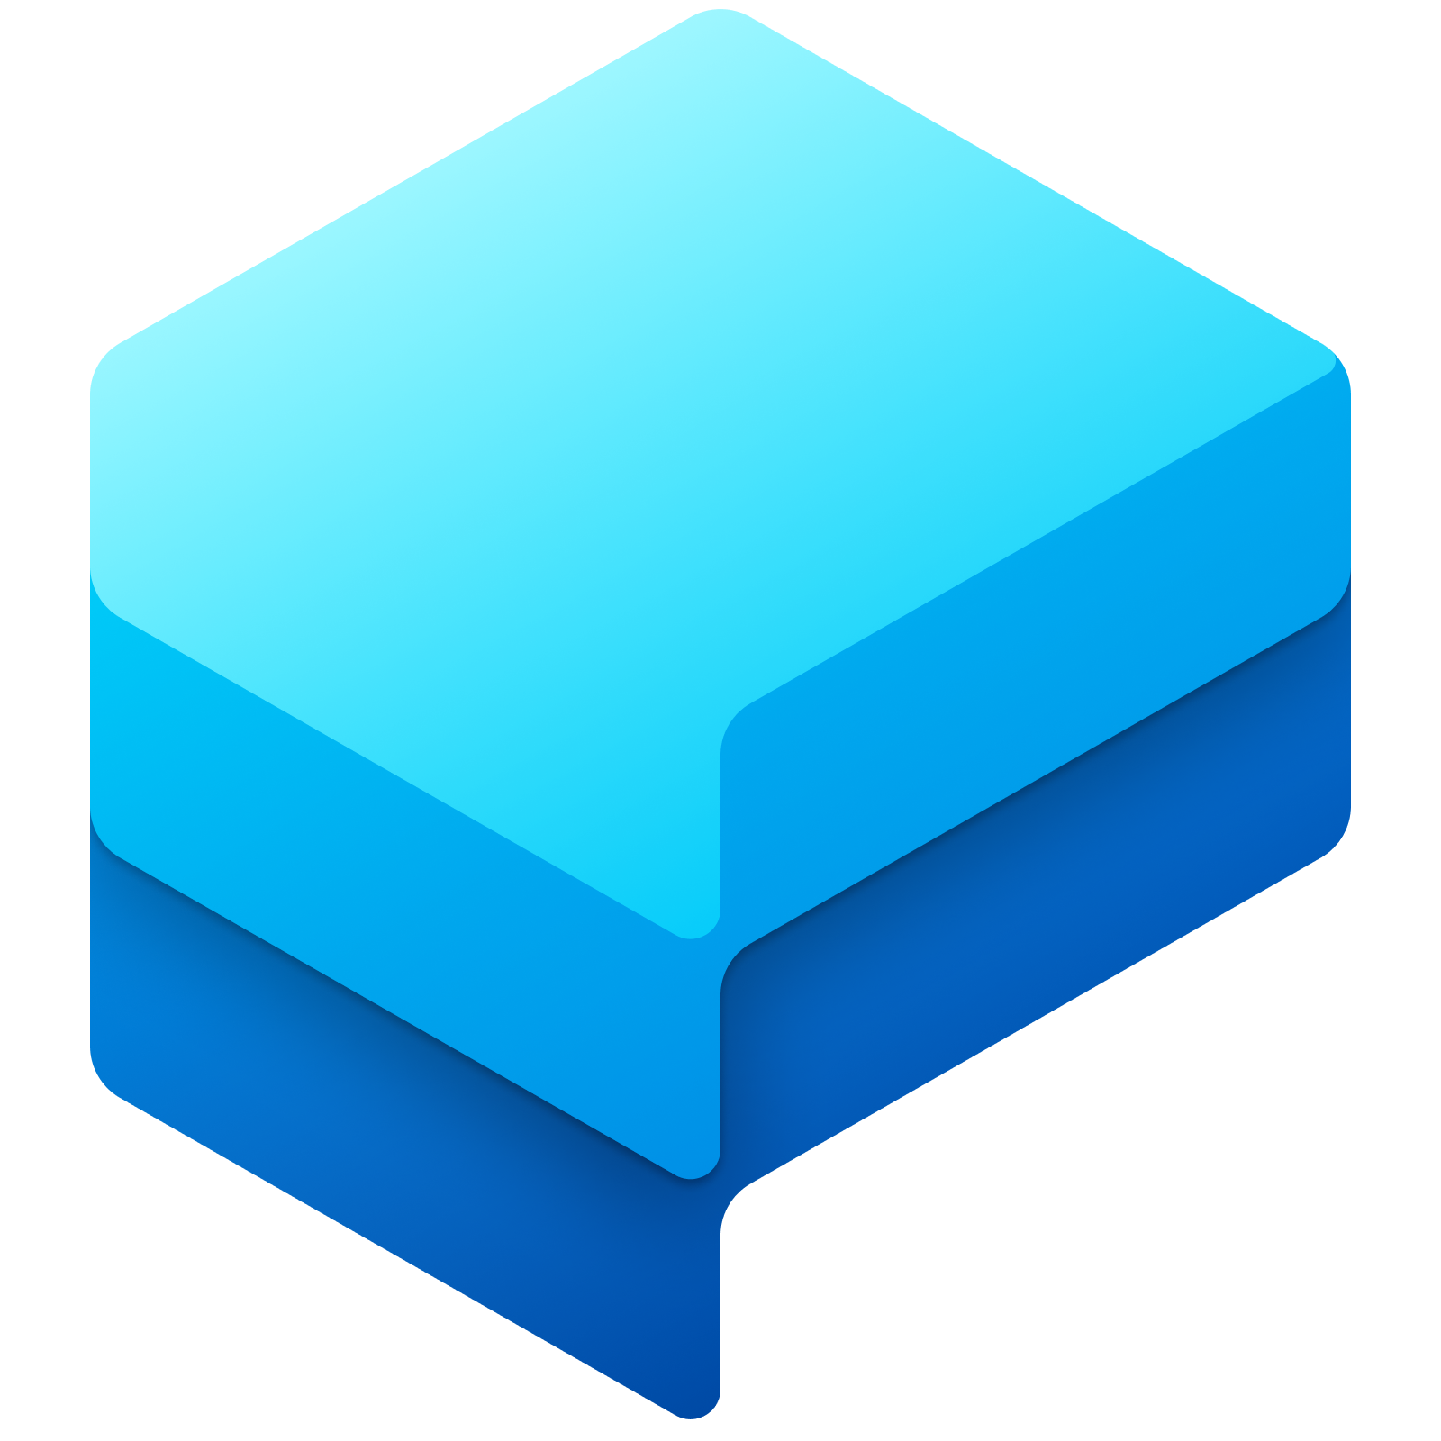
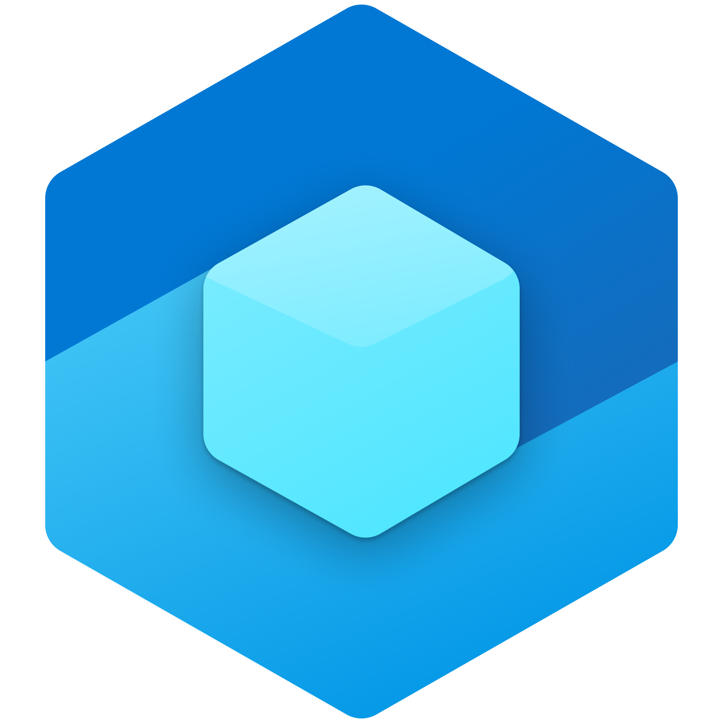

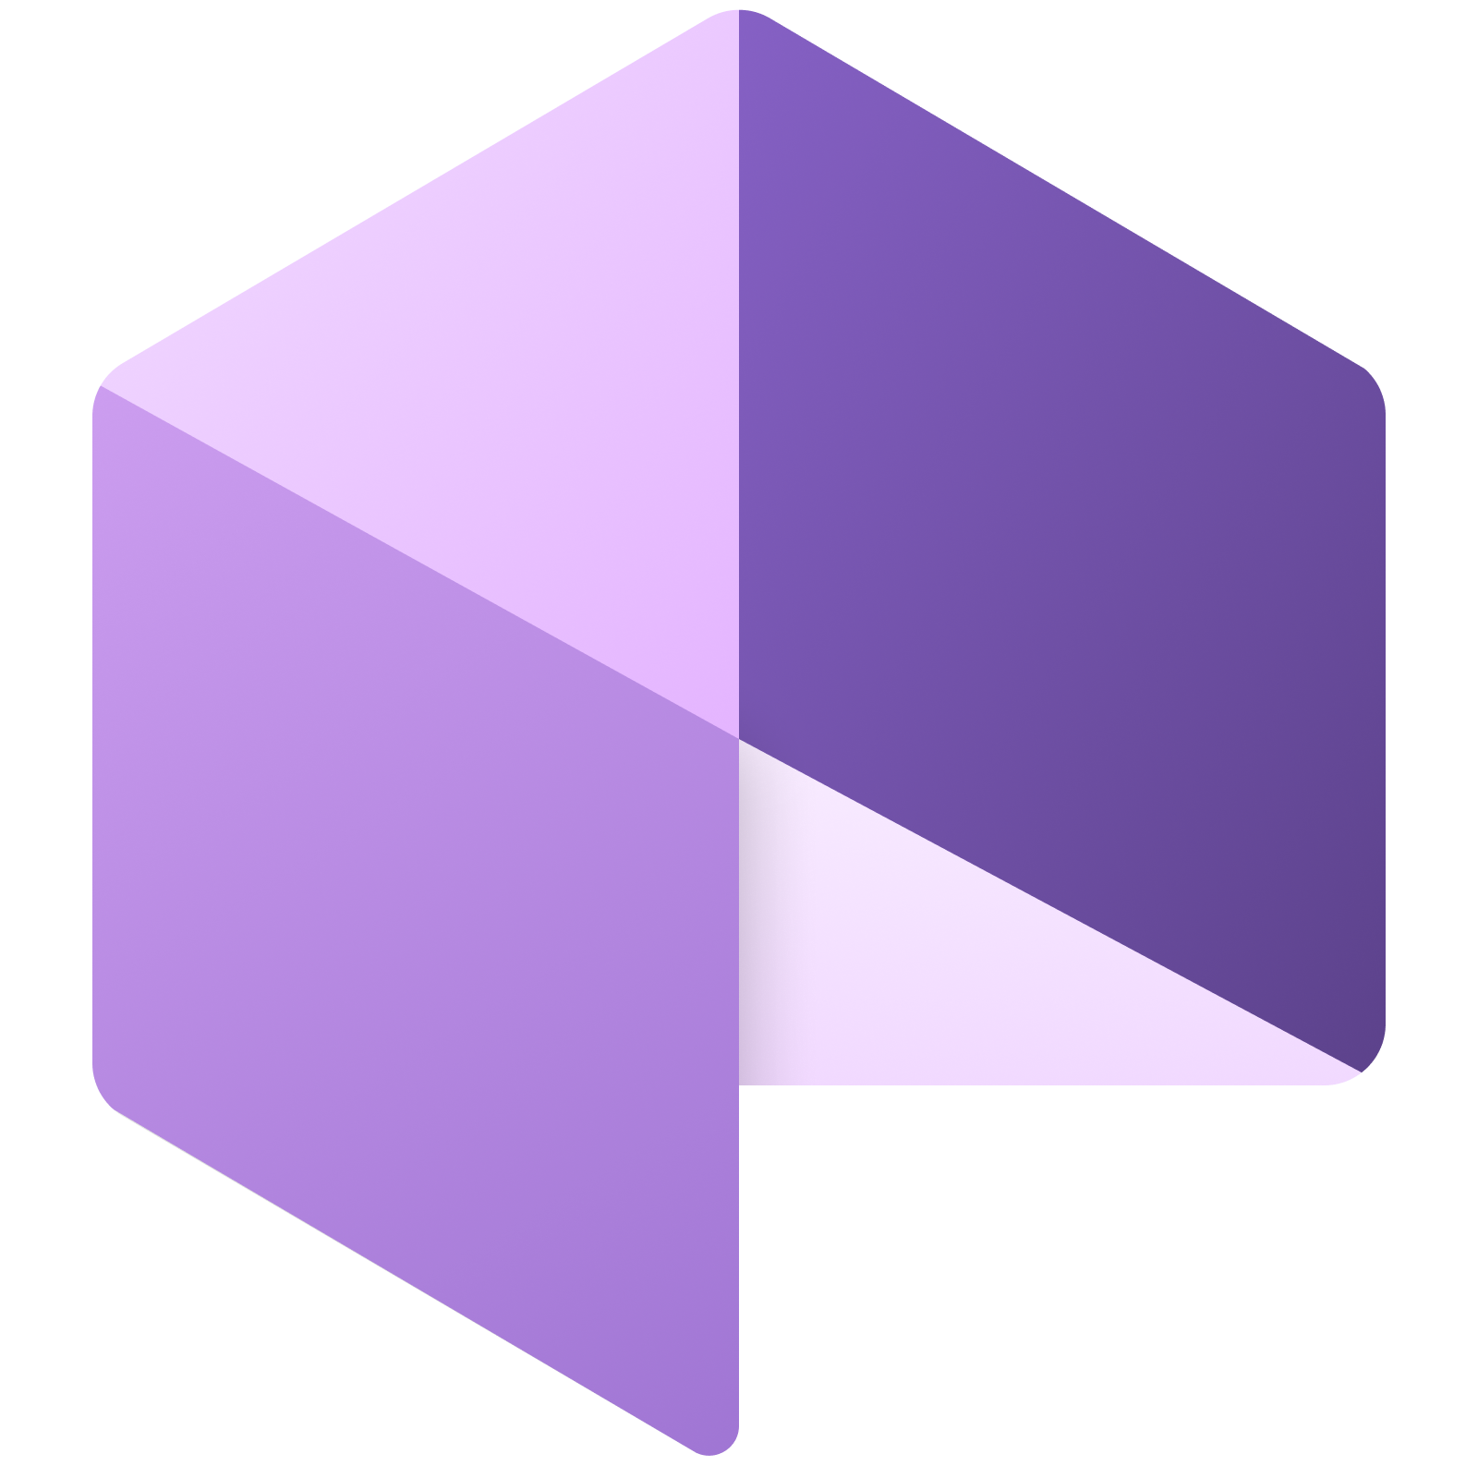
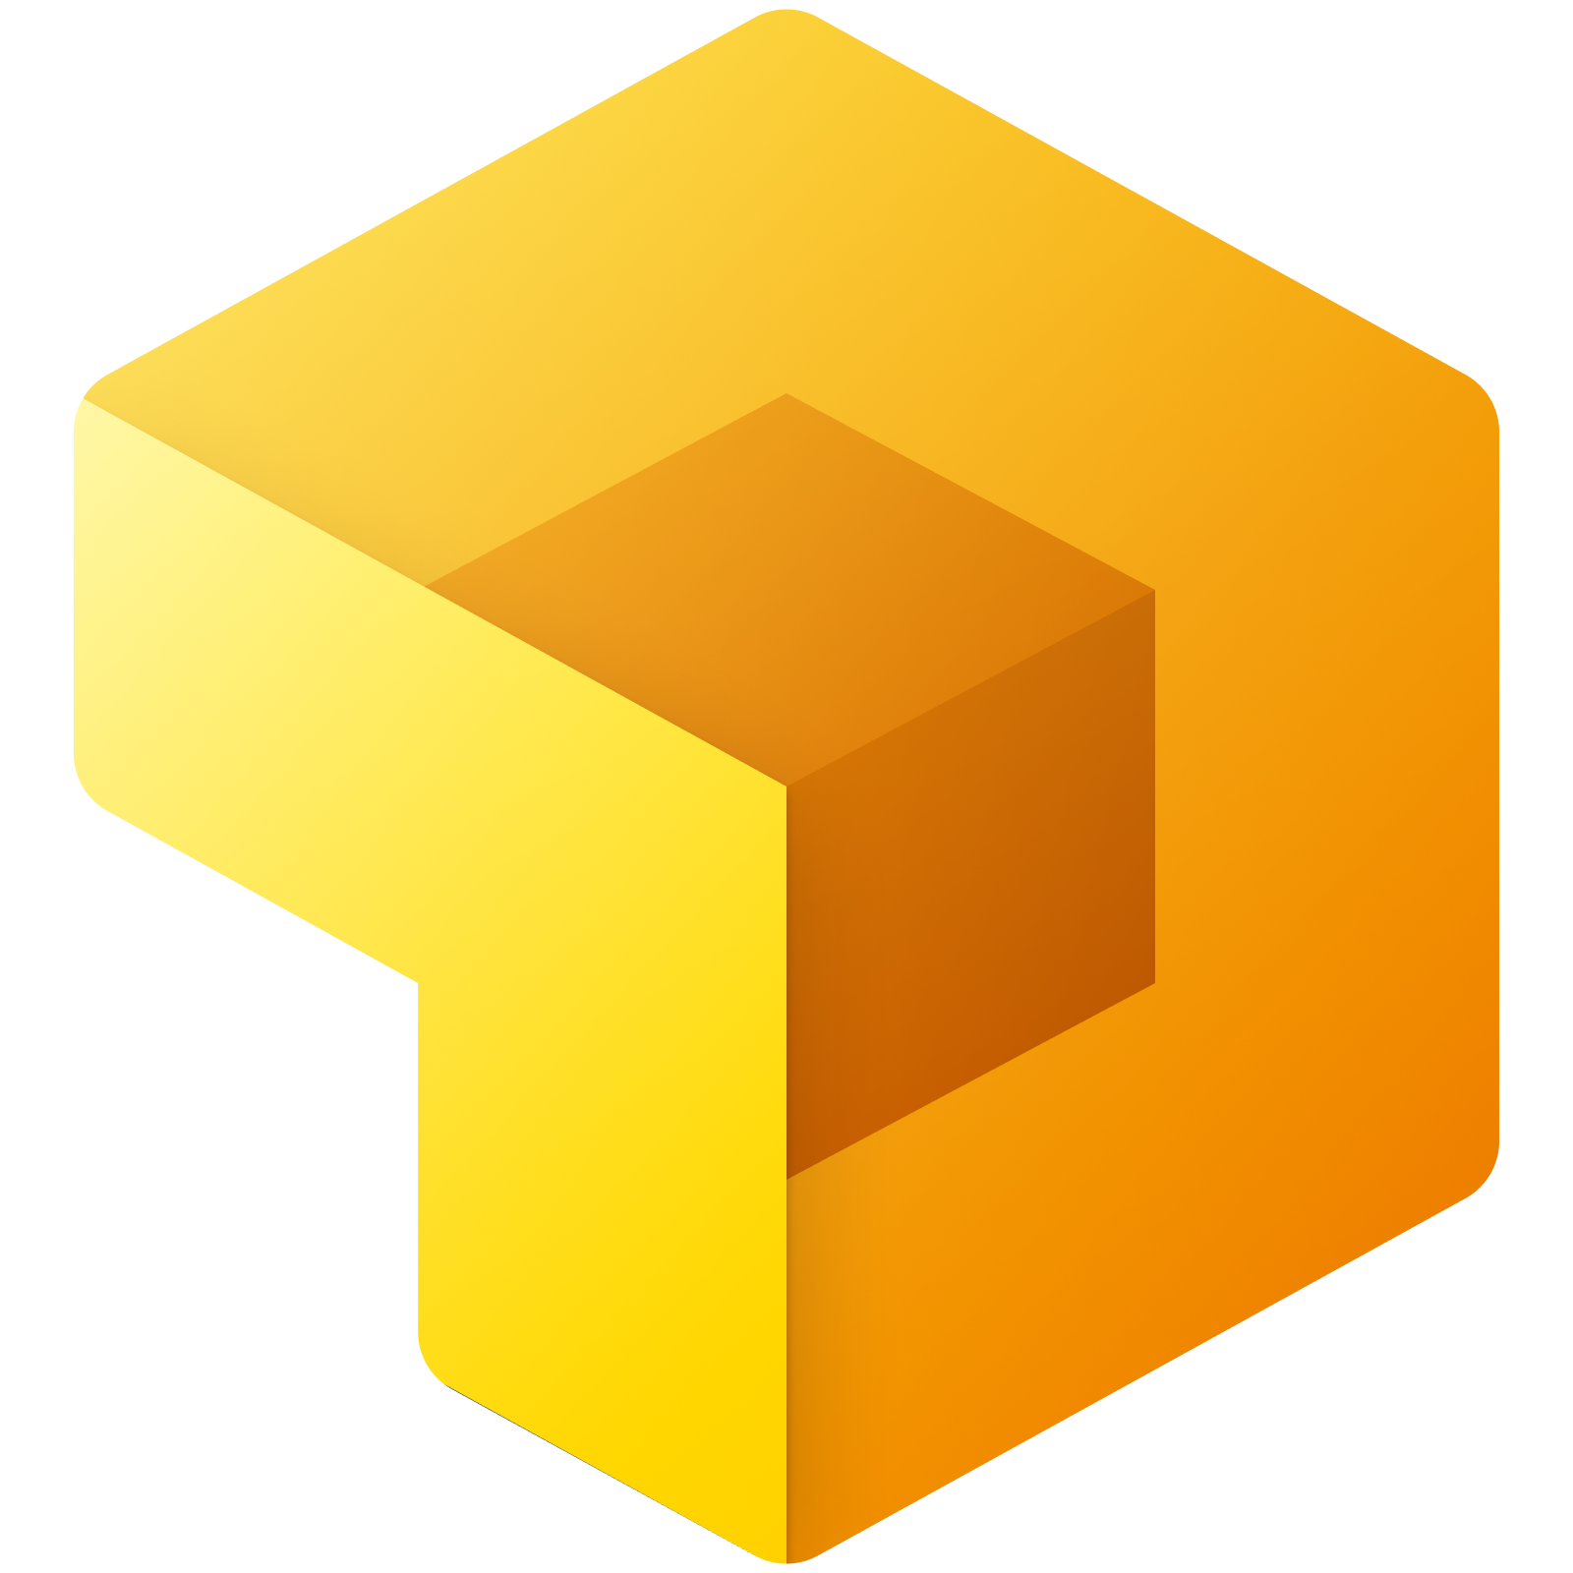













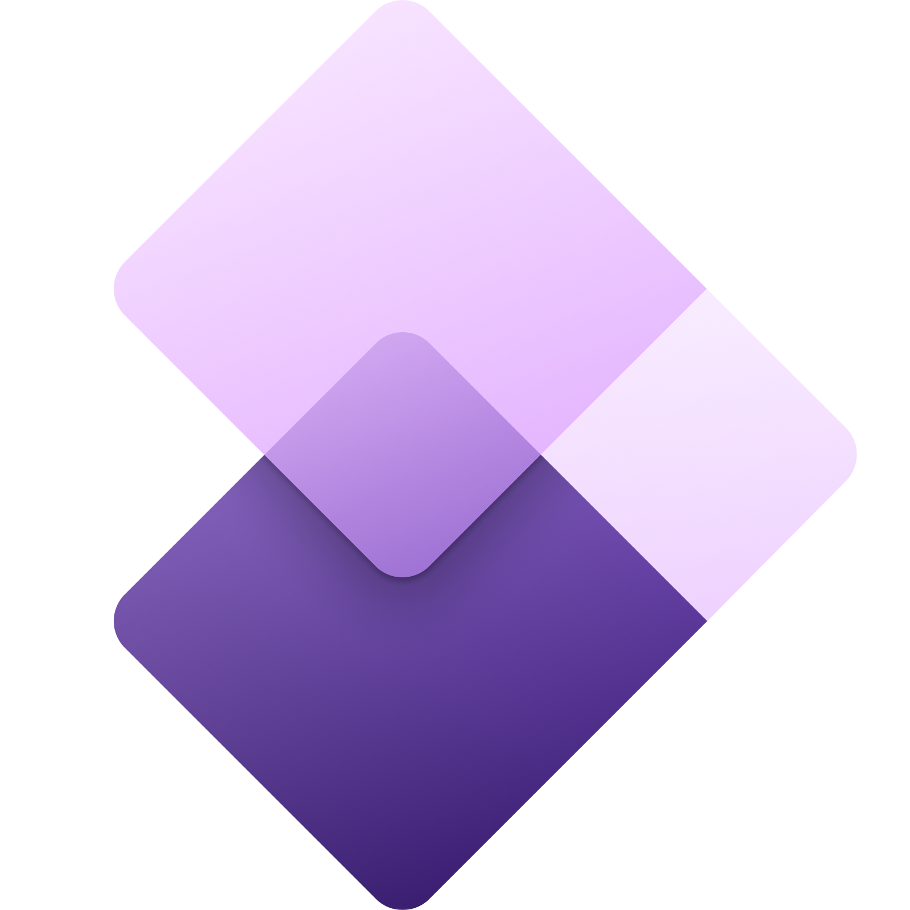



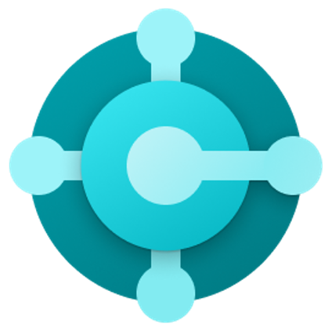






Business Optimization
Sales
Mixed Reality
Customer Service
Fraud Protection
Collecting Information
Product Insights
Customer Insights
Supply Chain Management
Retail
Field Services
Marketing
Market Insights
Finance
Project Services Automation
Business Central
Human Resources & Talent
Business Optimization
Dynamics 365 + Viva
Notes:
Generic capabilities like marketing, retail, sales and customer service business processes are all built on proven industry principles and thus it makes sense for organisation to invest in a single Business Applications platform where organisations can customize business processes to the exact needs of their organization.
+
Dynamics 365 provides organizations the perfect platform to be able to build and automate their business processes. Reducing the different applications that are used to complete a business outcome can significantly reduce potential distraction events, creating an environment with greater focus. For many organisations, a combination of spreadsheets, emails and phone calls can be simplified by a business processes and associated behaviours adopted by the business areas, enabled by the Dynamics 365 suite. This creates the ability for business to optimize their business processes, and how they spend their attention to achieve the desired business outcomes.

Slide 11
My Learning
Secure enterprise search
Develop content
Wellbeing & effectiveness
Chat (text, audio & video)
Performs
Automate routine tasks
Personal Assistant
Find documents & people
Portable Information Component
Grows
My files
Measure my impact
Accessible time
Track information & tasks
Team wellbeing
Send + receive instructions
Organize workspaces
Individual
Corporate comms & news
Team meetings
Share screen/present
Publish & broadcast video
Capture notes
Our internal brand
Capture experience
Enables
Networking
Knowledge & updates
Schedule work dependencies
Chat with team members
Storytelling
Culture of feedback
Store team files
Track information & work
Share innovative ideas
Enterprise document store
Manage team tasks
Ideate
Inner-source
Data intelligence
Manage team time
Manage shift-work
Community calls + events
Organizational behaviour
Team instructions
Performance insights
Community + Organization
Team
Sales
Mixed Reality
Customer Service
Fraud Protection
Agile Culture
Collecting Information
Product Insights
Customer Insights
Supply Chain Management
Retail
Field Services
Marketing
Market Insights
Finance
Project Services Automation
Business Central
Human Resources & Talent
Business Differentiation
Business Optimization
IT Operations
Notes:
In addition to the repeatable business processes, organisations need a competitive advantage, which creates the business differentiation, providing the organisational leadership to delivery their business strategy in their own unique way. Organizational leaders play a major role in driving an “Agile Culture”, where these specialised business processes can be automated.

Slide 12








Business Differentiation
Professional Developers
Citizen Developers
Plan
Virtual Agents
Code
Create own visualisation
Build
Agile Culture
Create own applications
Test
Create own automation
Release
Partner Solutions
Deploy
Managed services
Operate
Tailored applications
Monitor
Published applications
Business Differentiation
Developer Tools
Notes:
The ability to automate how people work though key business processes help organisations create their differentiation faster, giving them the ability to inch ever closer towards their business and strategic priorities. There are different scales for automation processes.
+
Professional developers help develop complex applications and provide a strategic advantage towards automation of key business activities. They go through Plan, Code, Build, Test, Release, Deploy, Operate and Monitor phases, the 8 steps of DevOps.
+
Here are the Microsoft Applications that help developers develop code faster and work with Operations teams to develop sustainable Line of Business applications.
+
The second scale focuses on democratising process automation. Instead of professional develops automating business processes, what if everyone in the organisation could automate small business processes, within the guard-rails provided by the IT security, governance and compliance teams? The ability to democratise automation gives every person within the organization to spot opportunities for improvement and using Virtual Agents, the ability to visualise data, automate information flows and create their own Line of Business applications, provide infinite opportunities to create ongoing business value. ‘Citizen development’ is revolutionizing value creation and is the next major technology leap, enabling creation of ‘low-code’ and ‘no-code solutions.’
+
Microsoft PowerPlatform provides the perfect platform for organizations to empower each person to identify and solve their business challenges, and challenges within their business area.
+
Lastly, Partner Solutions provide the opportunity for organisations to deploy specific Line of Business applications that Microsoft partners and software vendors have made available through the various Microsoft stores, including the Teams store.
Microsoft’s commitment to Developers is greater today that it has ever been previously. Similar to the business optimization focus area, developers help automate business processes, just these ones provide the business differentiation organisations need to compete in the marketplace.

Slide 13
My Learning
Secure enterprise search
Develop content
Wellbeing & effectiveness
Chat (text, audio & video)
Performs
Automate routine tasks
Personal Assistant
Find documents & people
Portable Information Component
Grows
My files
Measure my impact
Accessible time
Track information & tasks
Team wellbeing
Send + receive instructions
Organize workspaces
Individual
Corporate comms & news
Team meetings
Share screen/present
Publish & broadcast video
Capture notes
Our internal brand
Capture experience
Enables
Networking
Knowledge & updates
Schedule work dependencies
Chat with team members
Storytelling
Culture of feedback
Store team files
Track information & work
Share innovative ideas
Enterprise document store
Manage team tasks
Ideate
Inner-source
Data intelligence
Manage team time
Manage shift-work
Community calls + events
Organizational behaviour
Team instructions
Performance insights
Community + Organization
Team
Person
Operate as
Professional Developers
Plan
Citizen Developers
Sales
Mixed Reality
Code
Virtual Agents
Customer Service
Fraud Protection
Build
Create own visualisation
Collecting Information
Product Insights
Test
Agile Culture
Create own applications
Customer Insights
Supply Chain Management
Release
Create own automation
Retail
Field Services
Partner Solutions
Marketing
Market Insights
Deploy
Managed services
Project Services Automation
Operate
Tailored applications
Finance
Monitor
Published applications
Business Central
Human Resources & Talent
Business Differentiation
Extend
Business Optimization
IT Operations
Notes:
Business differentiation practices often extend the optimization processes, and thus are often designed as part of a cohesive business architecture strategy, and then continuously maintained as people show value through their ‘bottom-up’ innovation. These innovative projects are often delivered faster when people operate as a team – a group of individuals, with interdependent activities, that work together towards a common goal, or outcome.
+
Now that we have covered the 5 key focus areas of the extended MOCA model, let’s bring our focus to the most important component, the people within the organization, that work from the different perspectives of either an individual, a team member or a community member, delivering business optimization and differentiation to the organisation. People are really the superpower of every organization.

Slide 14



Person focus
Arts _
Cousin
Finance
Social worker
Marketing
Carer
Personal Identity
Retail
Community member
Purpose
Data Analytics
Friend
Growth
Manufacturing
Aunt/Uncle
Professional Identity
Adoption & Change Mgmt
Empowerment
Sibling
My Internal Brand
Sales
Parent
Wellbeing
Personal Role Identity
My Internal Profile
Security Professional
Connection
Business Role Identity
Sports person
Focus
IT Professional
Dancer
Public Brand
Customer Service
Singer
Technical Identity
Health
Artist/Musician
Safety & Security
My Enablement
Government
Gamer
Compliance
Person
Education
Cook
Governance
Field Services
Writer
Consulting
Technologist
Talent
Fraud Protection _
Notes:
With the human first approach, and the person at the centre of the MOCA model, we start to see the core needs in the individual context – their own identity that is universal across the other contexts they may work in. Although we are talking about identities here, this is used to categorise the different roles and respective needs a person might have in an organization.
Starting at the technical level, the person has to be able to login and access the tools they need to use to get their work done. Additionally, they need to feel that their organization protects them, their work and their devices from threats. This is where we see Azure AD playing a role and delivering a secure, compliant workplace.
Internally and externally, the person also has a need to manage their professional identity and their reputation. Internally, where people can shine through what they know and how the collaborate in a way that shares and builds on knowledge across the organizations. Here we see Yammer playing a role through participation in communities of practice and Delve when it comes to listing relevant skills and interests meaning colleagues can easily find the person. Externally, LinkedIn provides the platform through which the person can build and influence their external brand.
Then at the personal identity level, the needs of the person are focus on their sense of growth and what gives them purpose at work, the need to connect with others, and experience a feeling of empowerment because they have access to the knowledge, people and tools to do their job. Wellbeing is also a need here where more and more organizations are realizing the benefits to them and employees when they care for their employees in a holistic way. These factors can be cultivated by platforms like Viva.

Slide 15
Technical Identity
Personal Identity
Purpose
Growth
Professional Identity
Empowerment
My Internal Brand
Wellbeing
Connection
My Internal Profile
Focus
Technical Identity
Public Brand
My Enablement
Person
My Enablement
Collaboration Controls
Organizational Capability
Responsible use of IT
Enterprise Architecture
Lifecycle Management
Governance Design
Implements
Communications Flow
Regulations & Policies
Measures
Information Flow
Processes & Procedures
Records Management
Roles and Responsibilities
Role Based Access
Multi Factor Authentication
Governance
Data Retention
Sensitive Information Types
Secure Applications
Privileged Identity
Legal Hold & Case Mgmt
Information Protection
Secure Data & Information
Modern Management
Preventing Data Loss
Managing Privacy Risk
Secure Endpoints
Patch Management
Communications Compliance
Compliance Assessment
Secure Identity
Physical Access
Insider Risk Management
Audit
Safety & Security
Compliance

Slide 16
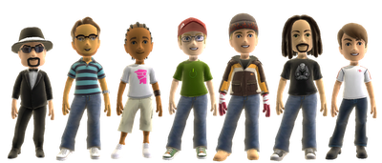


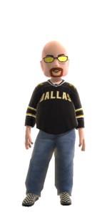


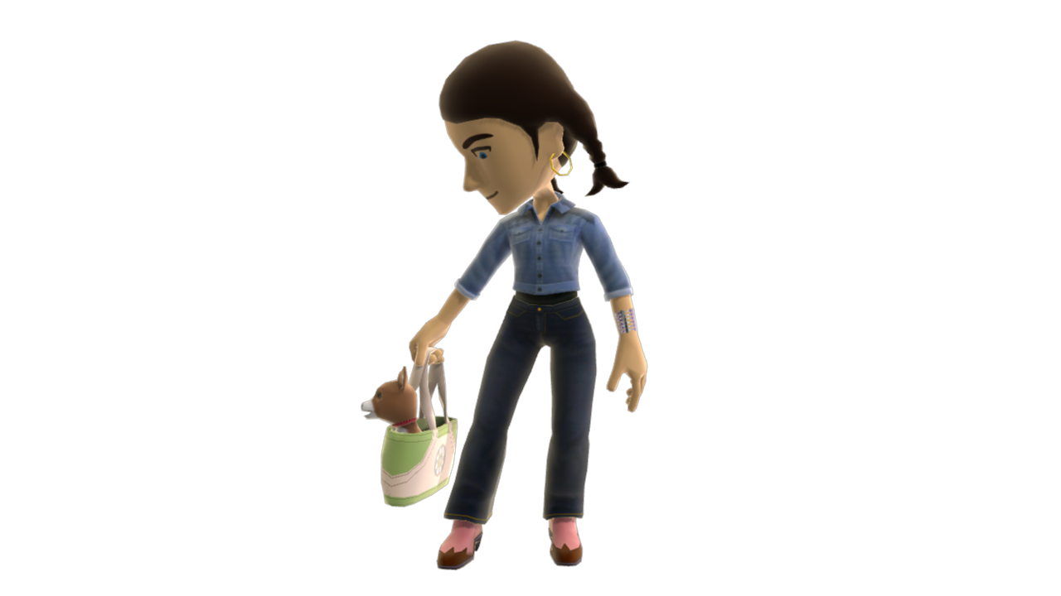


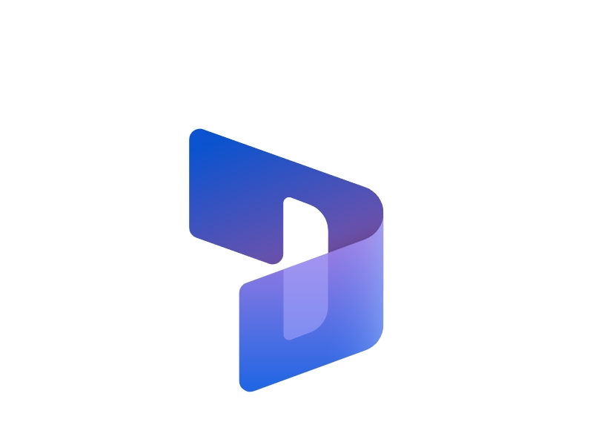
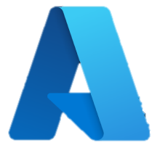




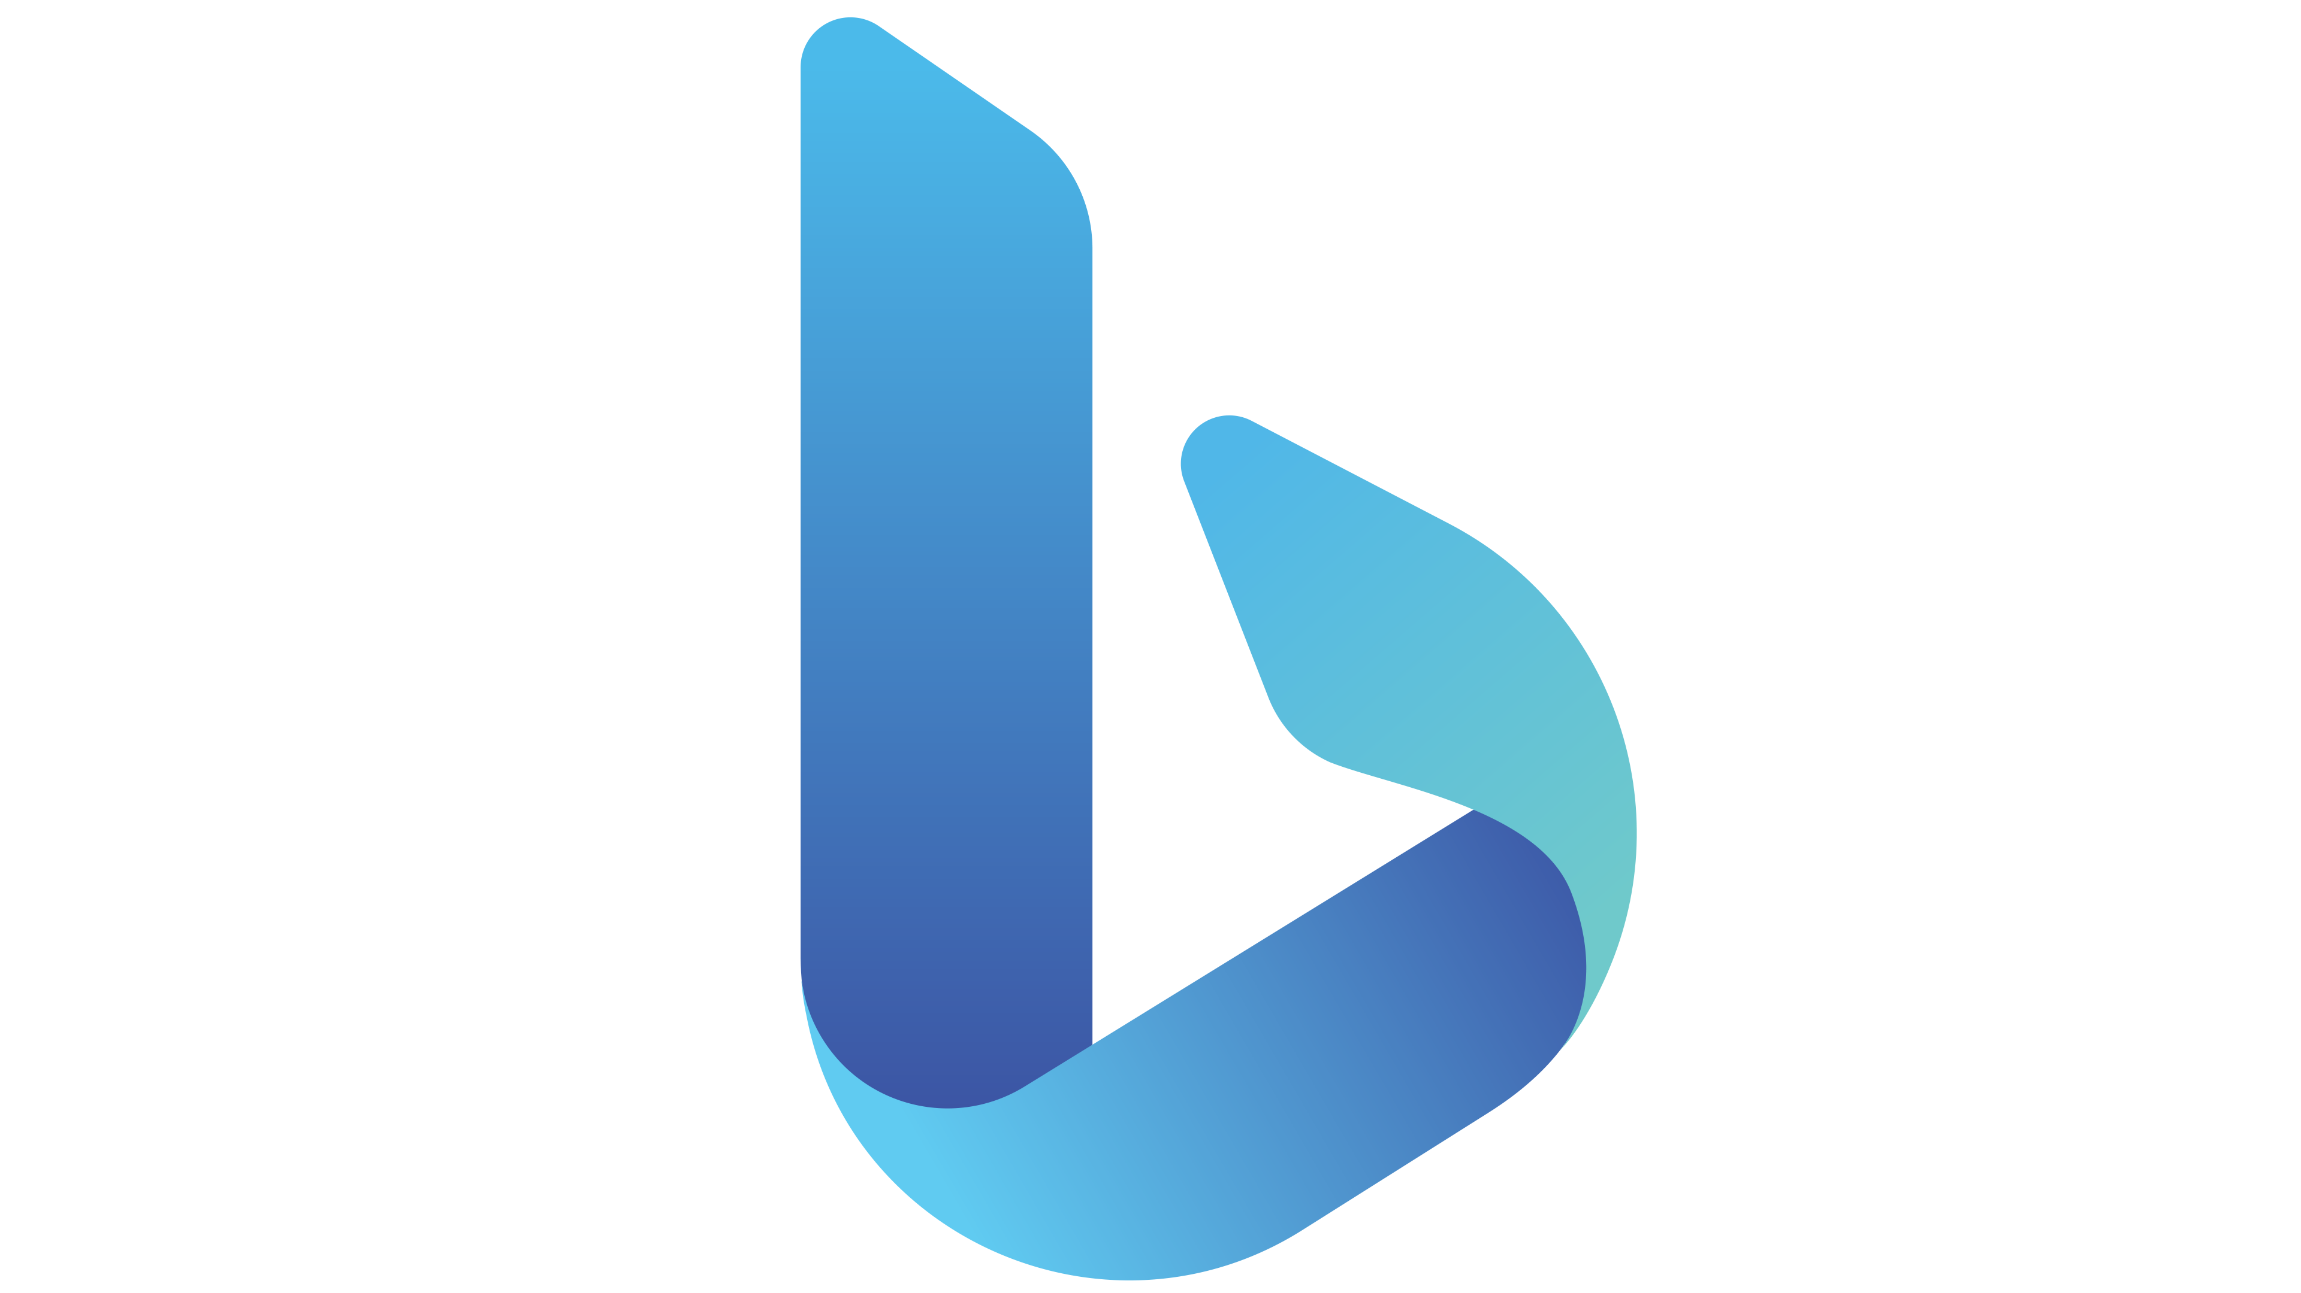




Person focus
Microsoft Metaverse
PowerPlatform
Digital Identity
My Avatar
My Items
My Places
Education
Business
Enterprise
Personal
Authentic Self
Work/Study
Life
Personal Identity
Purpose
Growth
Professional Identity
Empowerment
My Internal Brand
Wellbeing
Connection
My Internal Profile
Focus
Technical Identity
Public Brand
Safety & Security
My Enablement
Compliance
Person
Governance

Slide 17

Person focus
Microsoft Metaverse
PowerPlatform
Education
Business
Enterprise
Personal
Authentic Self
Work/Study
Life
Personal Identity
Purpose
Digital Identity
Growth
My Avatar
Empowerment
My Items
Wellbeing
My Places
Connection
Professional Identity
Focus
My Internal Brand
Technical Identity
My Internal Profile
Safety & Security
My Enablement
Public Brand
Compliance
Person
Governance

Slide 18
My Learning
Secure enterprise search
Develop content
Wellbeing & effectiveness
Chat (text, audio & video)
Performs
Automate routine tasks
Personal Assistant
Find documents & people
Portable Information Component
Grows
My files
Measure my impact
Accessible time
Track information & tasks
Team wellbeing
Send + receive instructions
Organize workspaces
Individual
Corporate comms & news
Team meetings
Share screen/present
Publish & broadcast video
Capture notes
Our internal brand
Capture experience
Enables
Networking
Knowledge & updates
Schedule work dependencies
Chat with team members
Storytelling
Culture of feedback
Store team files
Track information & work
Share innovative ideas
Enterprise document store
Manage team tasks
Ideate
Personal Identity
Inner-source
Data intelligence
Manage team time
Manage shift-work
Purpose
Digital Identity
Growth
My Avatar
Community calls + events
Organizational behaviour
Team instructions
Performance insights
Empowerment
My Items
Community + Organization
Team
Wellbeing
My Places
Connection
Professional Identity
Focus
My Internal Brand
Technical Identity
My Internal Profile
My Enablement
Public Brand
Operate as
Person
Professional Developers
Plan
Citizen Developers
Sales
Mixed Reality
Code
Virtual Agents
Customer Service
Fraud Protection
Build
Create own visualisation
Collecting Information
Product Insights
Test
Agile Culture
Create own applications
Customer Insights
Supply Chain Management
Release
Create own automation
Retail
Field Services
Partner Solutions
Marketing
Market Insights
Deploy
Managed services
Project Services Automation
Operate
Tailored applications
Finance
Monitor
Published applications
Business Central
Human Resources & Talent
Business Differentiation
Extend
Business Optimization
Notes:
And these organisational capabilities help to accentuate the effectiveness of communities, to keep people across the organisation continuously learning and growing, helping each individual become an even better version of themselves by applying their skills and experiences in a seamless way into their mundane, and to excel as a team player, so organisational outcomes can be delivered quicker, faster, cheaper and easier, aligned to the organisation’s strategic priorities.
This is Modern Collaboration Architecture, or MOCA, enabled by the Microsoft 365 suite of technologies.

Slide 19
Culture focus
Reciprocates
Builds
Commitment
Thought Leadership
Positive deviance
Positive resources such as hope and self-efficacy
Engagement
Individual
Builds
Builds
Psychological Safety
Sense of Achievement
Sense of belonging
Autonomy and trust
Performs
Grows
Meaning
Learning & mastery
Connection
Care & support
Enables
Team
Community + Organization
Reciprocates
Reciprocates
Creativity
Accountability
Energy
Performance
Attention
Time
Organisational citizenship behaviour
Person
#PeopleFirst
Notes:
When you put people at the centre, your modern workplace tools can become a change agent in your organisation. Especially in the hybrid world, being thoughtful about how we connect and collaborate is becoming key to getting work done and maintaining our balance. And yet research shows this training is still lacking in many organisations – how do we work in the hybrid world?
The opportunity is not just in the tools themselves, but on how we drive adoption of those tools. What are our digital cultural norms? How do we think about digital wellbeing? What training do our leaders and people need?
At the individual level, how is our digital workplace strategy encouraging people to take time for focus, to make progress on tasks? How are we encouraging employees to act on some of the work habits that may not be so positive for them?
At the team level, our collaboration processes should seek to build potency, optimism, learning, reflexivity, social connection, and trust, backed up by supportive leadership. How are we training our leaders to delegate whole tasks with complete information? How are we encouraging our teams to learn? How are we facilitating high quality connections? Because we all know the power of connection, right?
At the organisational level ultimately, it’s time to show we care. Employees who trust and feel supported by their organisations aren’t just happier, they have a higher self-esteem, are more likely to take risks of the good kind and have a better work-life balance. How can you leverage to the tools to show you care, to provide for learning and growth and reflect to employees a sense of how their work matters?
When we start to think this way, we can see how the way we collaborate and connect plays a role in building positive resources in our employees, teams and organisations. On the slide are just some of the many resources we can consider.
I recognise that this goes way beyond the tools, but when these bits and bytes are the foundation of how people connect and work gets done, they provide a great and often missed opportunity to examine how we work, drive change and reinforce organisational culture.
So what happens when we invest in our employees introducing the applications aligned to existing or new cultural frameworks we want to encourage?
Let’s start with the individual, when the organisation is meeting their needs in the way that work gets done – autonomy, mastery and purpose, high quality connections to colleagues, their interactions with their manager and more, we’re building up a resource call Psychological Capital made up of hope, self-efficacy, optimism and resilience. Think of this as a positive resource that fuels both performance and wellbeing. I caveat this with the fact that it is not endless and it’s important to be continuously renewing it. Employees will reciprocate the best of themselves – commitment, though leadership and positive deviance,
What happens when this individual is part of the team where processes and behaviours support psychological safety, allow the employee to make progress and feel that sense of achievement, build belonging (that thing that we all need to feel), and facilitate autonomy. We get creativity, accountability and ultimately energy.
In the organisational context, when organisations continuously re-iterate their meaning, give employees opportunities to learn, to connect to the broader mission and show that they care, you’ll get two of the most precious resources a person has - attention and time – put to great use for the organization and employees going above and beyond to do their best for the organisation and its customers.
Think about it, wouldn’t it be great if, when introducing new tools, you got culture ROI too? That’s where the big opportunity is in a world where our people differentiate us.
References:
Kurtessis, J. N., Eisenberger, R., Ford, M. T., Buffardi, L. C., Stewart, K. A., & Adis, C. S. (2017). Perceived Organizational Support: A Meta-Analytic Evaluation of Organizational Support Theory. Journal of Management, 43(6), 1854-1884. https://doi.org/10.1177/0149206315575554
Ipsen, C., van Veldhoven, M., Kirchner, K., & Hansen, J. P. (2021). Six Key Advantages and Disadvantages of Working from Home in Europe during COVID-19. International Journal of Environmental Research and Public Health, 18(4), 1826. https://www.mdpi.com/1660-4601/18/4/1826
Richardson & West, Dream Teams: A Positive Psychology of Team Working. Ch. 19 The Oxford Handbook of Positive Psychology and Work, Oxford University Press, 2013
Dutton, J. E., & Heaphy, E. (2003). The Power of High Quality Connections. In K. S. Cameron, J. E. Dutton, & R. E. Quinn (Eds.), Positive organizational scholarship : foundations of a new discipline (pp. 263-278). Berrett-Koehler.
Cameron, K. S., & Spreitzer, G. M. (2012). The Oxford handbook of positive organizational scholarship. Oxford University Press.

Slide 20
My Learning
Secure enterprise search
Develop content
Wellbeing & effectiveness
Chat (text, audio & video)
Performs
Automate routine tasks
Personal Assistant
Find documents & people
Portable Information Component
Grows
My files
Measure my impact
Accessible time
Track information & tasks
Team wellbeing
Send + receive instructions
Organize workspaces
Individual
Corporate comms & news
Team meetings
Share screen/present
Publish & broadcast video
Capture notes
Our internal brand
Capture experience
Enables
Networking
Knowledge & updates
Schedule work dependencies
Chat with team members
Psychological Capital
Storytelling
Culture of feedback
Store team files
Track information & work
Share innovative ideas
Enterprise document store
Manage team tasks
Ideate
Personal Identity
Inner-source
Data intelligence
Manage team time
Manage shift-work
Purpose
Digital Identity
Growth
My Avatar
Community calls + events
Organizational behaviour
Team instructions
Performance insights
Empowerment
My Items
Community + Organization
Team
Wellbeing
My Places
Connection
Professional Identity
Focus
My Internal Brand
Technical Identity
My Internal Profile
My Enablement
Public Brand
Operate as
Person
Streamlines
Professional Developers
Plan
Citizen Developers
Sales
Mixed Reality
Code
Virtual Agents
Customer Service
Fraud Protection
Build
Create own visualisation
Collecting Information
Product Insights
Test
Agile Culture
Create own applications
Customer Insights
Supply Chain Management
Release
Create own automation
Retail
Field Services
Partner Solutions
Marketing
Market Insights
Deploy
Managed services
Project Services Automation
Operate
Tailored applications
Finance
Monitor
Published applications
Business Central
Human Resources & Talent
Business Differentiation
Extend
Business Optimization
Notes:
Put together you see the final framework that takes a human first approach to collaboration.
So what is the Modern Collaboration Architecture, or MOCA?
Well, it is a human-first model that captures how individuals apply their skills and experience to their everyday job, so they can be effect team members, enabling the delivery of organisational outcomes faster, cheaper and easier; enabled by a community, that helps them continuously learn and grow; enabled by their leadership to not only optimize the way they work, but also to create innovate business differentiators, which will further enable the organisation to complete.
This is the power of the Microsoft Cloud, presented through the perspective of the Modern Collaboration Architecture.
Hopefully you have found this conversation helpful and this sets you up for your next steps to design the future of collaboration in your organisation.
Thank you.

Slide 21
Thank you. http://aka.ms/MOCA

