Slide 1
Configuring Windows Defender Application Control for New Teams
Deploying client firewall rules with WDAC

Slide 2
When to use this guidance
Where local merge is disabled
Security sensitive customers may choose to disable local merge of firewall rules to prevent Apps installing uncontrolled firewall exceptions. Ensure that all required system rules are built in your policy before disabling local merge. Note: this deck will showcase how to configure the Teams-specific rules; ensure that your environment has established all baseline/other required rules prior to adding the Teams rules.
Outbound connections are not allowed
Security sensitive customers may choose to disable local merge of firewall rules to prevent Apps installing uncontrolled firewall exceptions.

Slide 3
What you’ll need to configure
An App Tagging Policy in Windows Defender Application Control
Firewall rules that use the Windows Defender Application Control application tag to identify New Teams.
A deployment method in your environment

Slide 4
Generating an App Tagging Policy

Slide 5
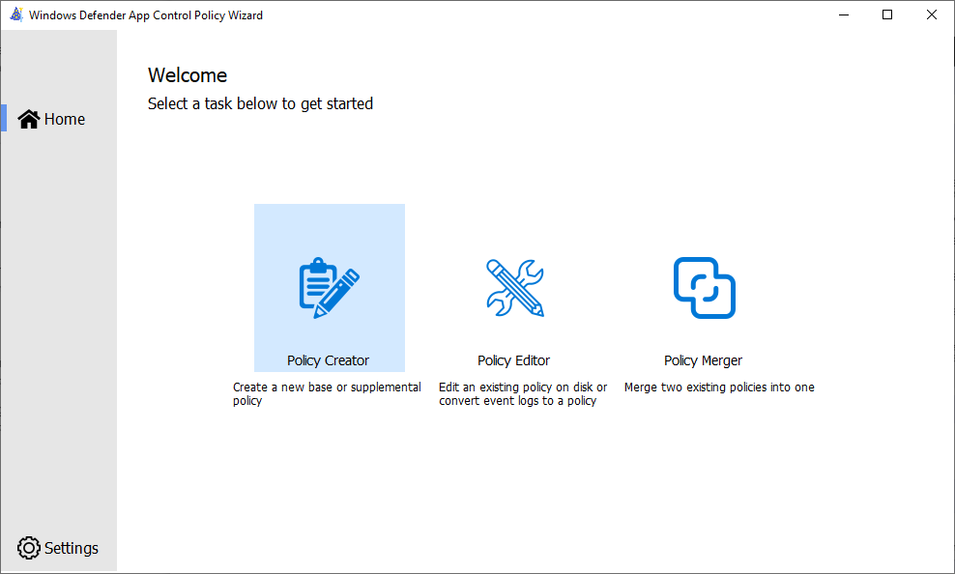
Creating a Policy with the WDAC Wizard - 1
Download the wizard from Microsoft WDAC Wizard (webapp-wdac-wizard.azurewebsites.net)
Install new teams from https://aka.ms/getteams on the reference system (where you will run the WDAC Wizard)
Launch the WDAC Wizard
On the Welcome screen, click on Policy Creator

Slide 6
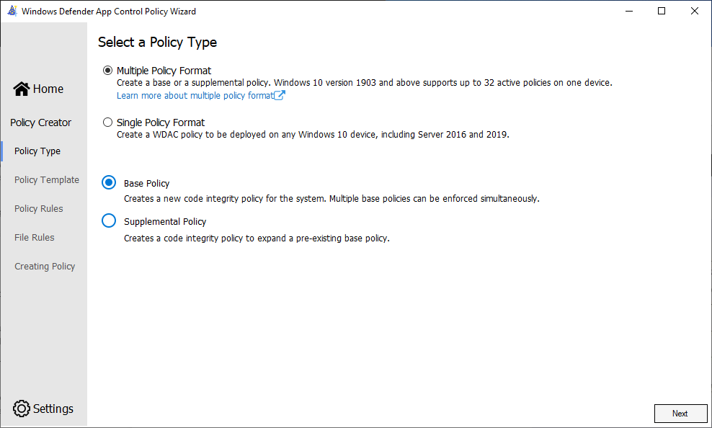
Creating a Policy with the WDAC Wizard - 2 Select a Policy Type
Select Multiple Policy Format
Select Base Policy
Click Next.

Slide 7
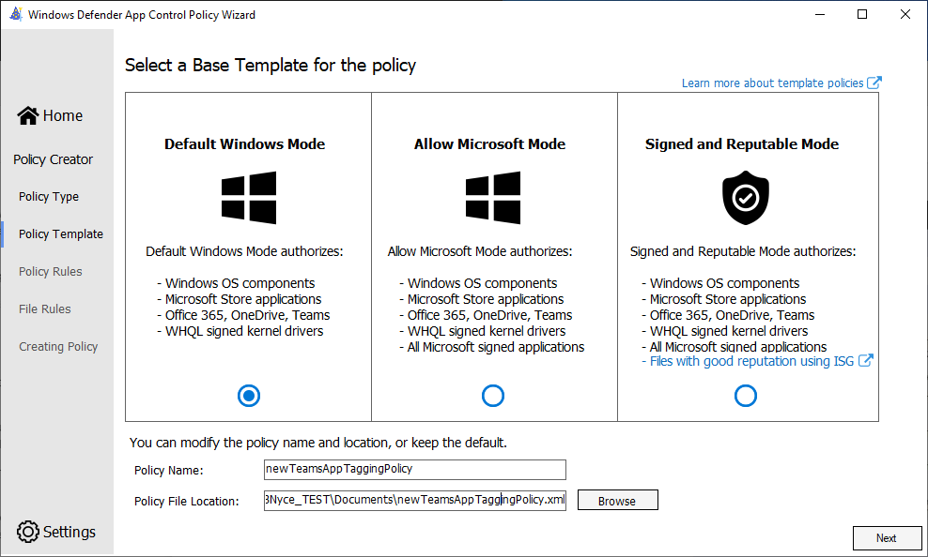
Creating a Policy with the WDAC Wizard - 3 Select a Base Template
Pick Default Windows Mode and provide a Policy Name.
Select a location to output the .xml file.
Click Next.

Slide 8
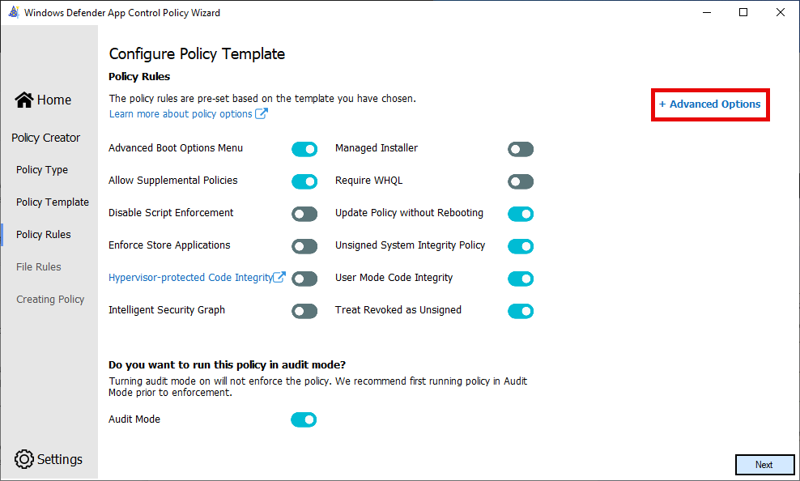
Creating a Policy with the WDAC Wizard - 4 Configure Policy Template
Click on + Advanced Options

Slide 9
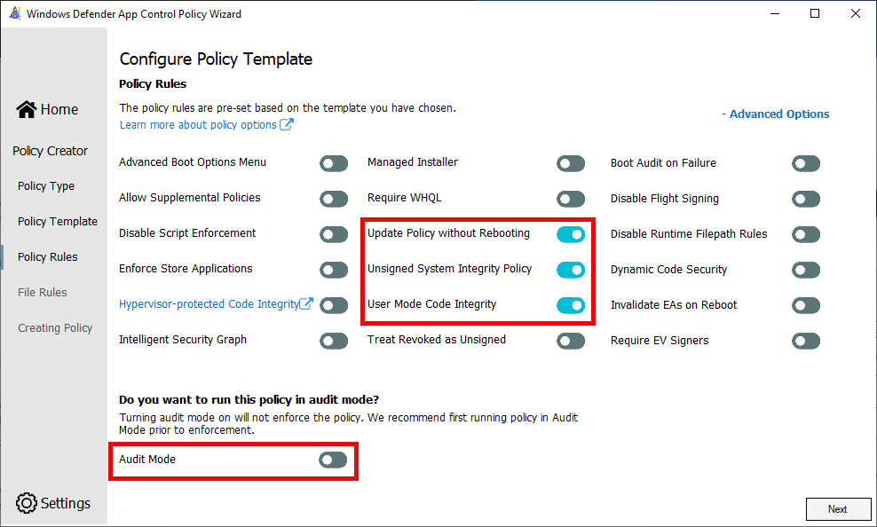
Creating a Policy with the WDAC Wizard - 5 Configure Policy Template
Under Policy Rules, ensure only the following are toggled on:
Update Policy without Rebooting
Unsigned System Integrity Policy
User Mode Code Integrity
Toggle off audit mode
Click Next

Slide 10
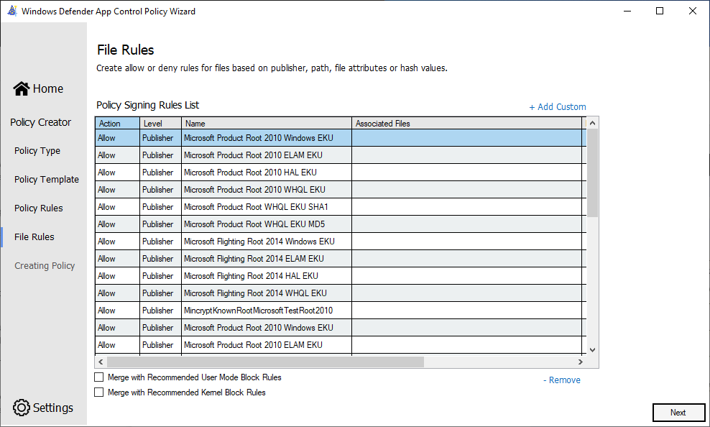
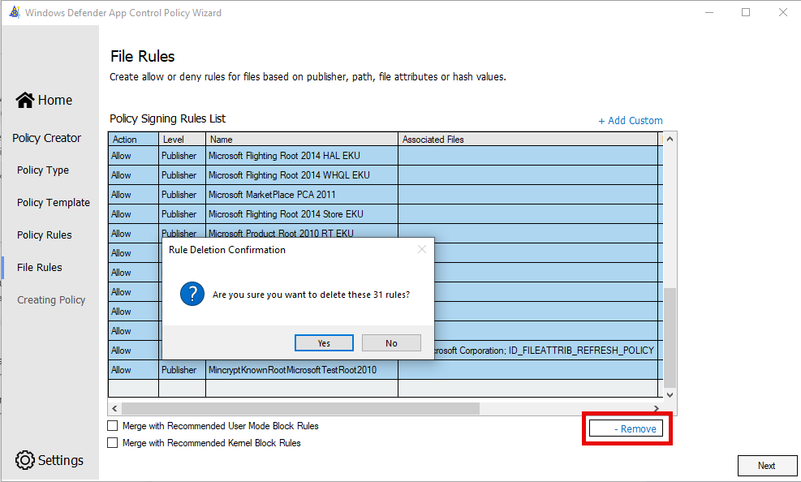
Creating a Policy with the WDAC Wizard - 6 Configure File Rules
In the Policy Signing Rules List table, click on the first row, hold down the SHIFT key, scroll to the bottom and click the last entry.
Click – Remove
In the Rule Deletion Confirmation dialog, click Yes

Slide 11
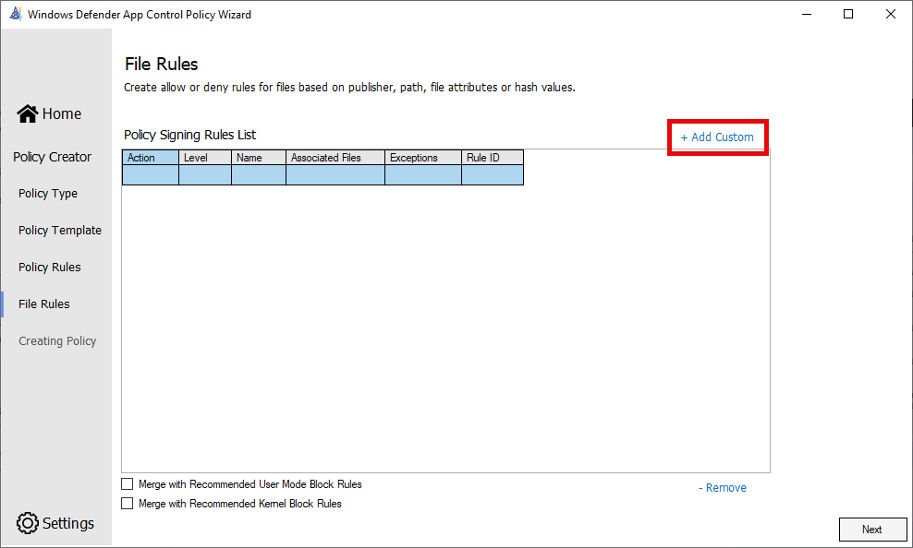
Creating a Policy with the WDAC Wizard - 7 Configure File Rules
You should now have an empty rules list.
You will create two rules.
Click on + Add Custom

Slide 12
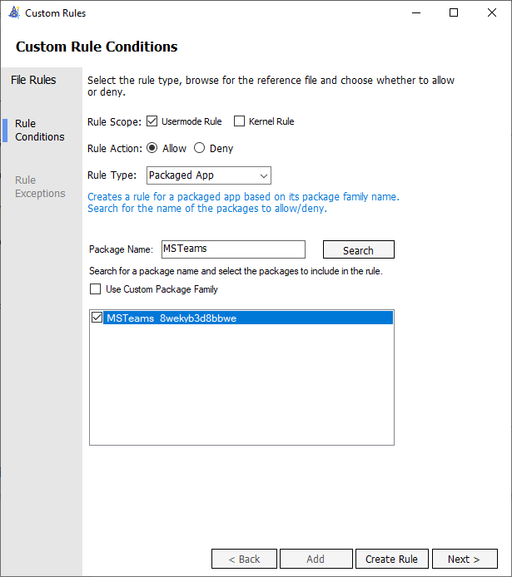
Creating a Policy with the WDAC Wizard - 8 Configure File Rules
Rule Conditions
Rule Scope: check Usermode Rule
Rule Action: Allow
Rule Type: Packaged App
Package Name: Search for MSTeams and check the box next to MSTeams_8wekyb3d8bbwe
Click Create Rule

Slide 13
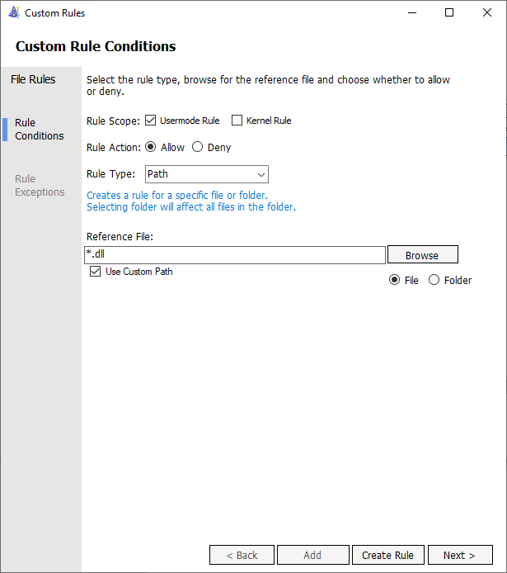
Creating a Policy with the WDAC Wizard - 9 Configure File Rules
Click on + Add Custom
Rule Conditions
Rule Scope: check Usermode Rule
Rule Action: Allow
Rule Type: Path
Reference File: check the box for Use Custom Path, and enter *.dll into the Reference File box.
Click Create Rule
WDAC Admin Tips & Known Issues - Windows Security | Microsoft Learn
Notes:
Because we are not building off the base policy, or allowlisting the Windows signers, we are adding this to improve perf. Since AppId Tagging policies evaluate but can't tag dll files, this rule will short circuit dll evaluation and improve evaluation performance.

Slide 14
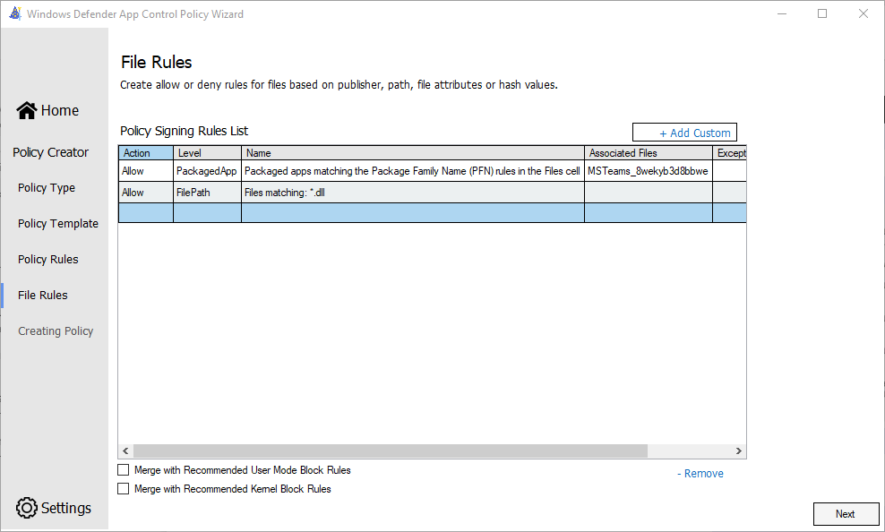
Creating a Policy with the WDAC Wizard - 10 Configure File Rules
Verify the only two rules listed are for the PackagedApp and FilePath.
Click Next

Slide 15
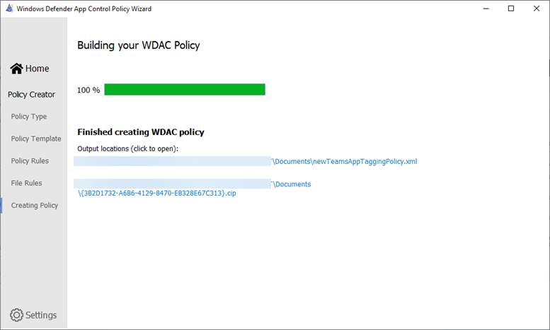
Creating a Policy with the WDAC Wizard - 11 Building your WDAC Policy
Note the output location for the XML file.
You will need this in the next step.

Slide 16
Creating a Policy with the WDAC Wizard - 12 Edit the XML file
Open the generated .xml file
Delete the highlighted block of text from the file which ends Value=“131” per screenshot
Save the file

Slide 17
Create an App Tagging Key PowerShell
Open an Admin PowerShell and run the following cmdlet:
Set-CIPolicyIdInfo -ResetPolicyID -FilePath .\newTeamsAppTaggingPolicy.xml -AppIdTaggingPolicy -AppIdTaggingKey "newTeamsKey" -AppIdTaggingValue "newTeamsValue”
Replace the FilePath with the XML location and newTeamsKey and newTeamsValue of your choice.

Slide 18
Deploying the App Tagging Policy via Intune

Slide 19
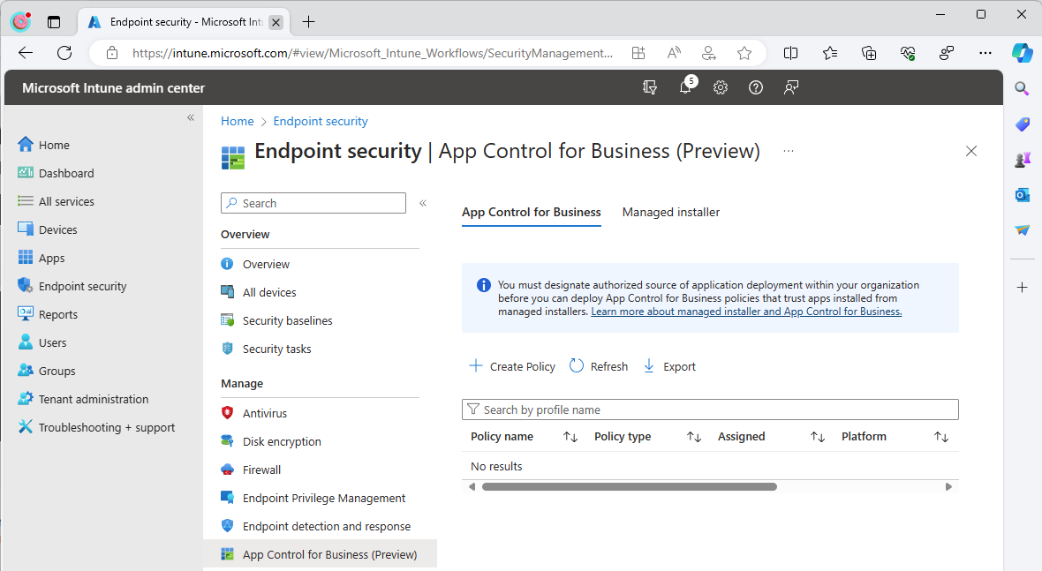
Configure Intune Create an App Control policy - 1
Under Endpoint security, click on the App Control for Business blade.
Click on + Create Policy

Slide 20
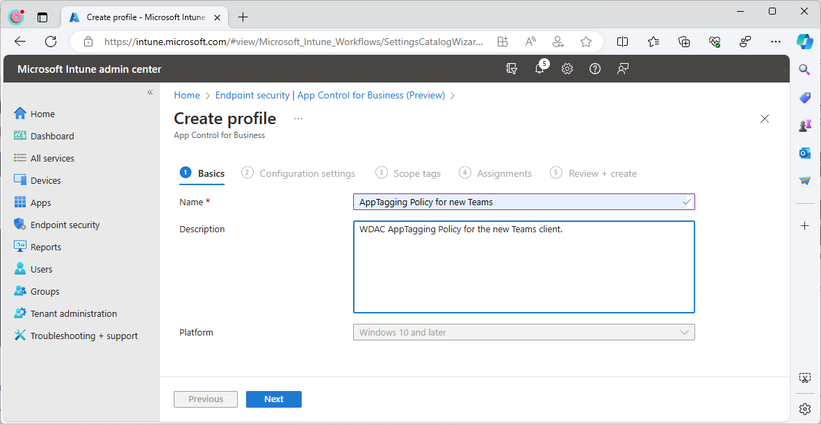
Configure Intune Create an App Control policy - 2
On the Basics tab, enter a Name and (optionally) a description.
Click Next

Slide 21
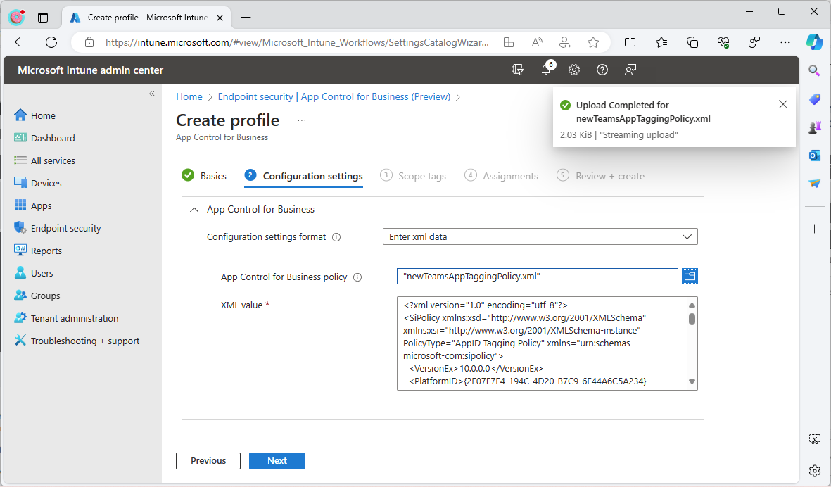
Configure Intune Create an App Control policy - 3
On the Configuration settings tab, pick “Enter xml data” in the dropdown next to Configuration settings format.
Click the folder icon to browse to your XML file (created in the previous section).
Click Next

Slide 22
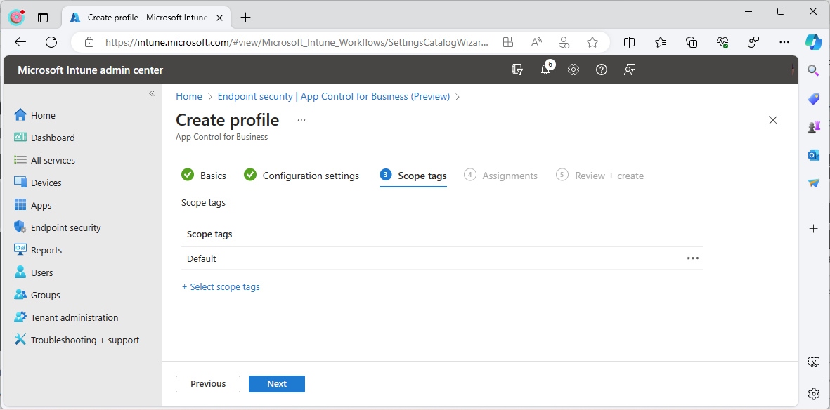
Configure Intune Create an App Control policy - 4
On the Scope tags tab click Next to accept the default scope.

Slide 23
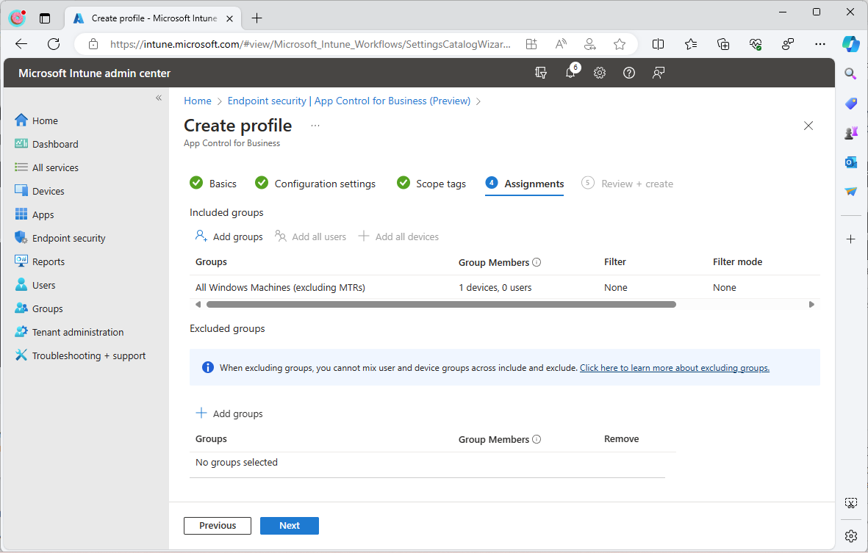
Configure Intune Create an App Control policy - 5
On the Assignments tab click Add groups and select your desired group of Windows machines to target.
Click Next

Slide 24
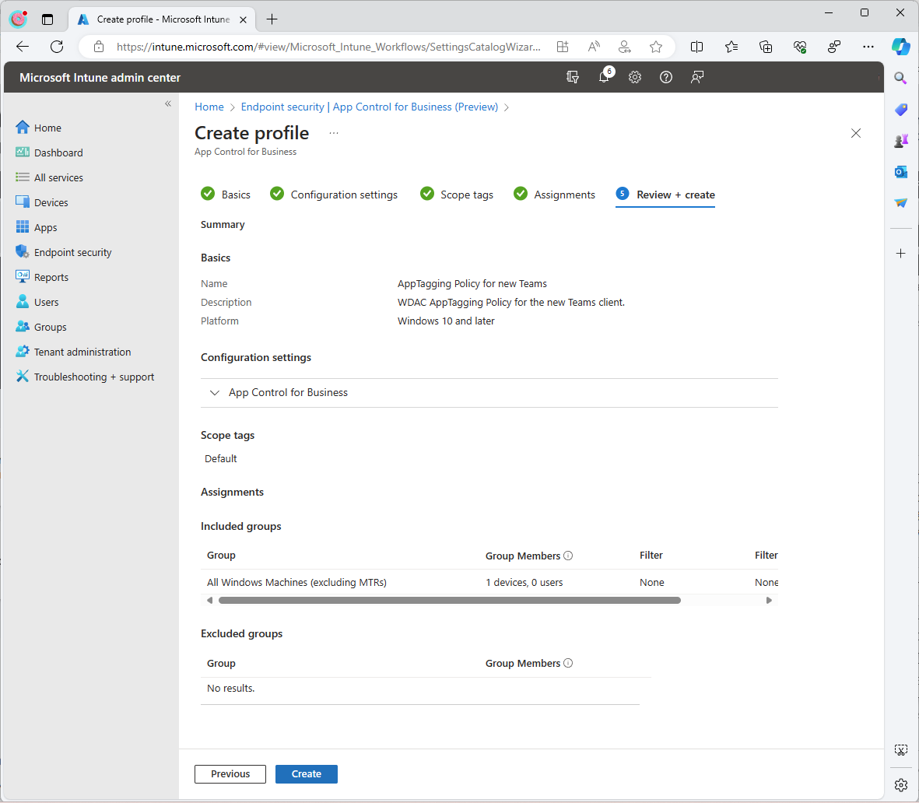
Configure Intune Create an App Control policy - 6
On the Review + create tab review the configuration for accuracy.
Click Create

Slide 25
Deploying your firewall rules with App Tagging

Slide 26
Configure Intune Planning your firewall rules
New Teams by default will create Windows Firewall rules on installation
Plan your required rules if you’re disabling Local Merge.
Ensure you consider both inbound and outbound TCP & UDP traffic flows per Microsoft guidance

Slide 27
Configure Intune Rule Examples
Setting | Outbound (All) | Inbound (UDP) | Inbound (TCP)
Enabled | Enabled | Enabled | Enabled
Name | IntuneAllowNewTeamsOutboundAll | IntuneAllowNewTeamsInboundUDP | IntuneAllowNewTeamsInboundTCP
Interface Types | Wireless, LAN | Wireless, LAN | Wireless, LAN
Network Types | FW_PROFILE_TYPE_DOMAIN FW_PROFILE_TYPE_PRIVATE FW_PROFILE_TYPE_PUBLIC | FW_PROFILE_TYPE_DOMAIN FW_PROFILE_TYPE_PRIVATE FW_PROFILE_TYPE_PUBLIC | FW_PROFILE_TYPE_DOMAIN FW_PROFILE_TYPE_PRIVATE FW_PROFILE_TYPE_PUBLIC
Direction | This rule applies to outbound traffic. | This rule applies to inbound traffic. | This rule applies to inbound traffic.
Action | Allow | Allow | Allow
Description | Outbound rule for new Teams to all destinations. | Inbound rule for new Teams for UDP traffic. | Inbound rule for new Teams for TCP traffic.
Protocol | N/A | 17 | 6
Policy App Id | newTeamsKey | newTeamsKey | newTeamsKey
The table shows examples rules for new Teams – this includes the outbound rule and two inbound rules (TCP/UDP).
You must replace the Policy App Id value with the value used in your deployment. In our earlier example, we used newTeamsKey.
You can adjust the Name, Interface Types, Network Types, and other items to suit your specific configuration - the table shows the minimum items that need to be configured.

Slide 28
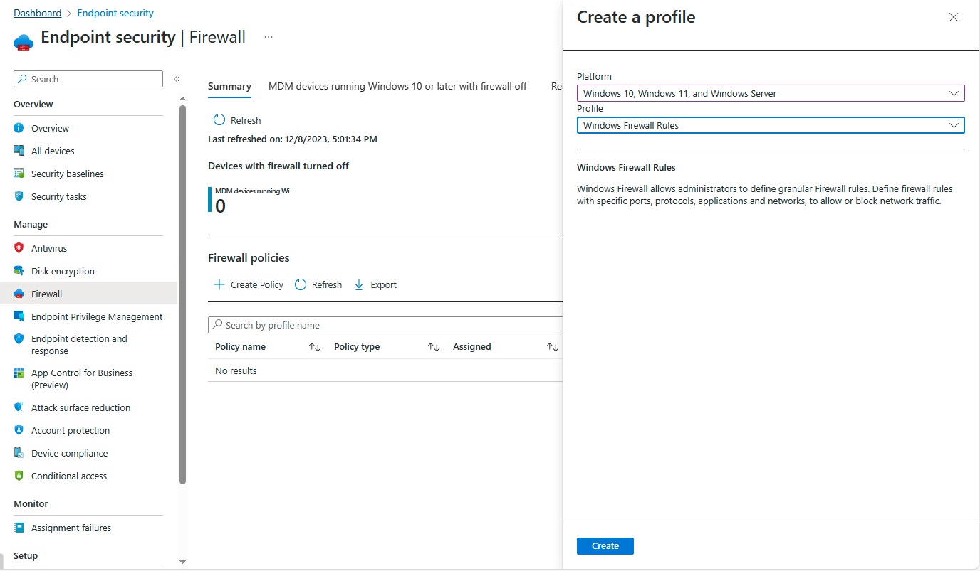
Configure Intune Create a Firewall Policy - 1
Select Endpoint Security on the left rail
Select Firewall under manage
Click Create Policy
Select Windows 10, 11, and Windows Server under Platform
Select Windows Firewall Rules under Profile
Click Create

Slide 29
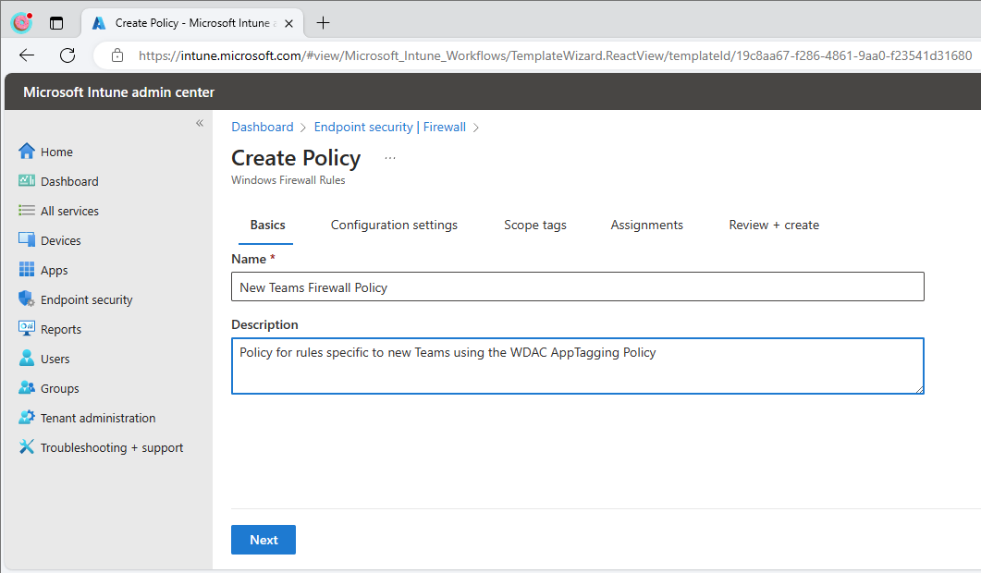
Configure Intune Create a Firewall Policy - 2
Enter a Name for your new Firewall Rules and Description
Click Next

Slide 30
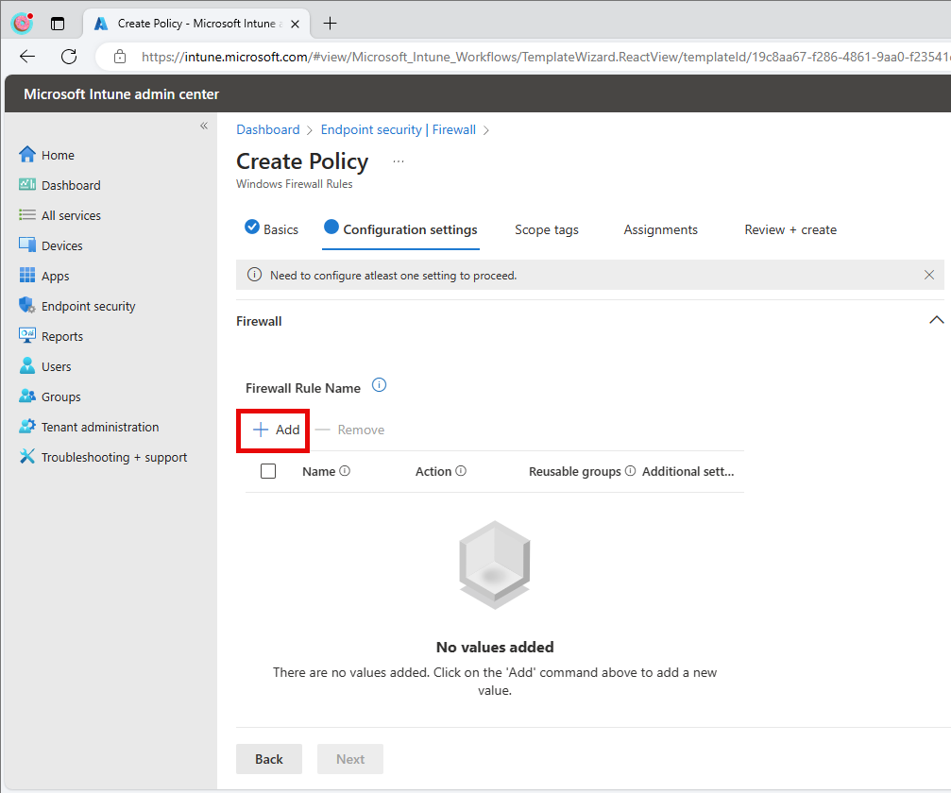
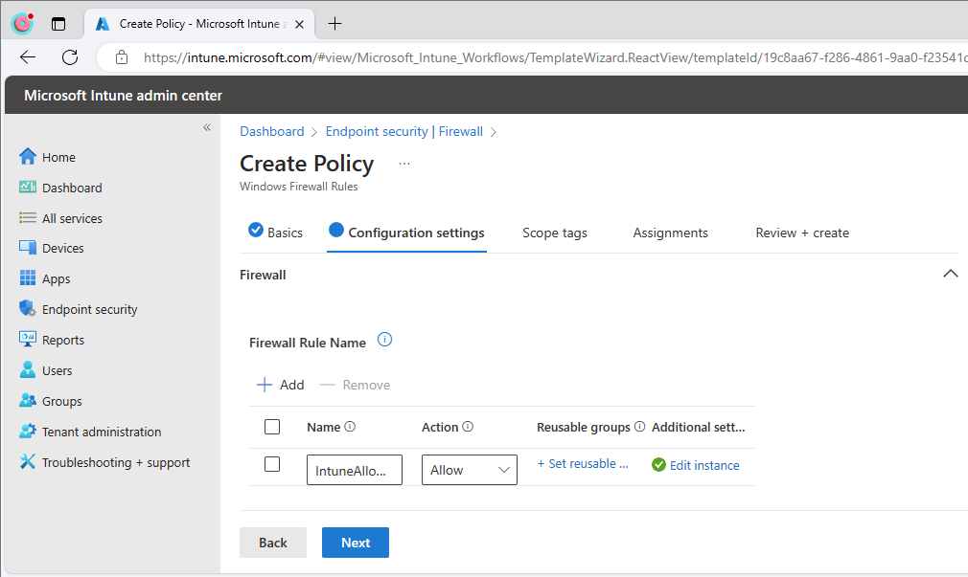
Configure Intune Create a Firewall Policy - 3
Under Firewall Rule Name, click + Add
Enter a name and set the action to Allow
Click on Edit instance

Slide 31
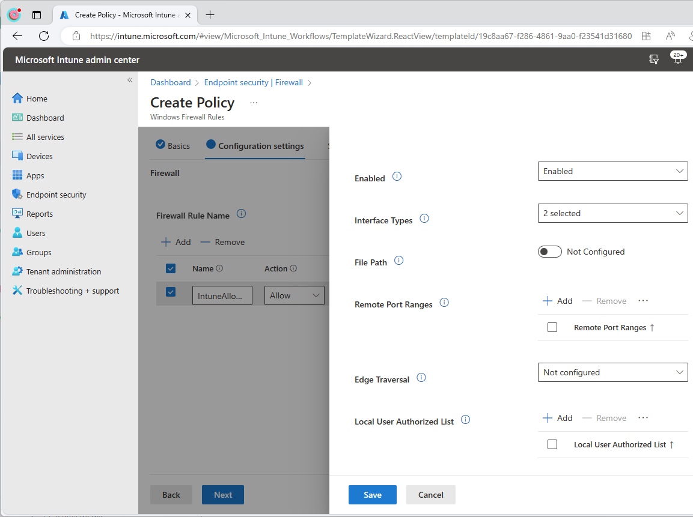
Configure Intune Configure the Rules - 1
Toggle “Enabled” to “Enabled”
Select your required interfaces for this rule
Select your required network types for this rule
Ensure the direction matches the traffic direction you want to apply this rule. Select outbound if you’re blocking all outbound traffic by default

Slide 32
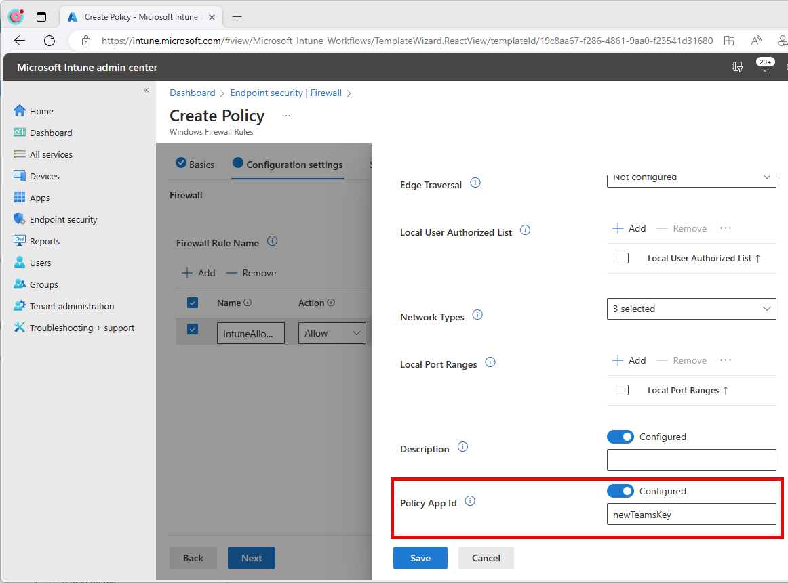
Configure Intune Configure the Rules - 2
Select “Policy App ID” to configured
Enter the name of the key you defined in the key/value pairing (which you created in the previous steps). [We previously used “newTeamsKey”]
Click Save.

Slide 33
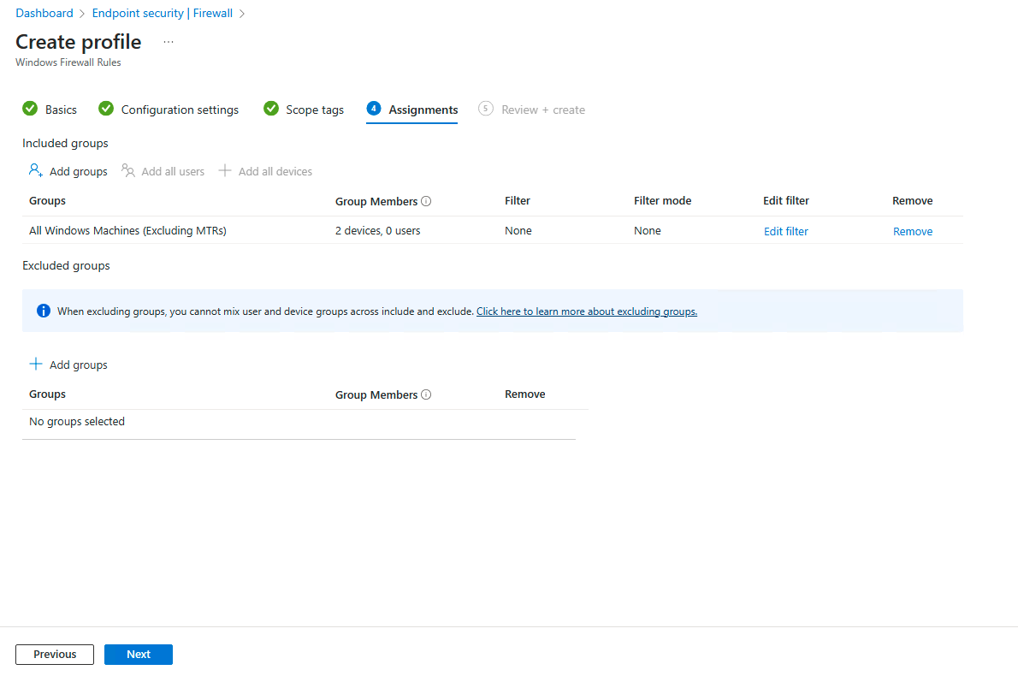
Configure Intune Configure the Rules - 3
Click Next twice (if you wish to skip Scope Tags)
Select your test group in Assignments by clicking “Add Groups”.
Click Next

Slide 34
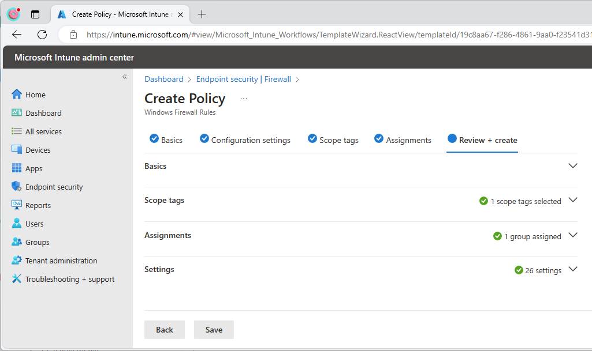
Configure Intune Validate the Profile
Validate the configuration you’ve created matches what you intended
Click Save to create the configuration on Intune and apply to the devices within your test group

Slide 35
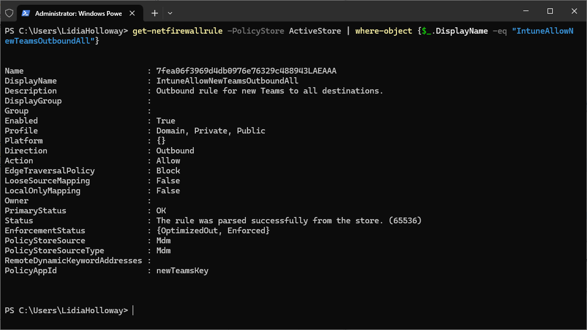
Configure Intune Validate on Windows
Testing and Debugging AppId Tagging Policies - Windows Security | Microsoft Learn – use this process to validate the new Teams application (Package Family) is tagged properly.
Use the following PowerShell to validate the firewall rules are received properly (replace bold with your rule name).
get-netfirewallrule -PolicyStore ActiveStore | where-object {$_.DisplayName -eq "IntuneAllowNewTeamsOutboundAll"}
Validate the configuration you’ve created matches what you intended on the Windows Workstation
Validate Teams functions as expected.
Use in a control group before large scale deployment.
Test

Slide 36
Deploying the App Tagging Policy via other methods

Slide 37
Other deployment methods:
Deploying Windows Defender Application Control (WDAC) policies - Windows Security | Microsoft Learn
MDM
Microsoft Configuration Manager
Script
Group Policy

Slide 38
Appendix

Slide 39
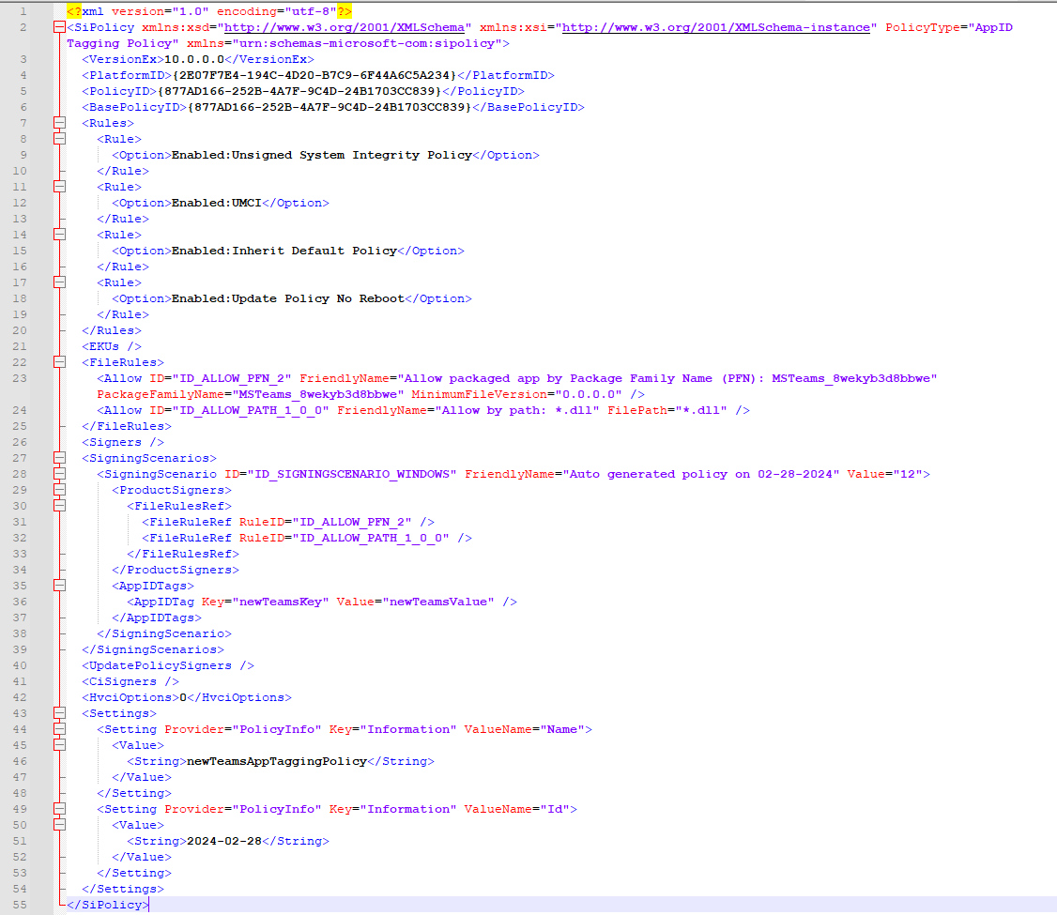
Example AppID Tagging Policy XML File

Slide 40
Deploying the App Tagging Policy via Intune - LEGACY
Legacy process (using device configurations and OMA-URI settings)

Slide 41
Converting your XML to a binary (CIP) File PowerShell
Run Convertfrom-CIPolicy .\newTeamsAppTaggingPolicy.xml ".\{PolicyIDGUID}.cip”
Replacing the FileName and {PolicyIDGUID} with your XML file name and the value you copied from the previous step.
A .cip file will be generated which is required for a later step.

Slide 42
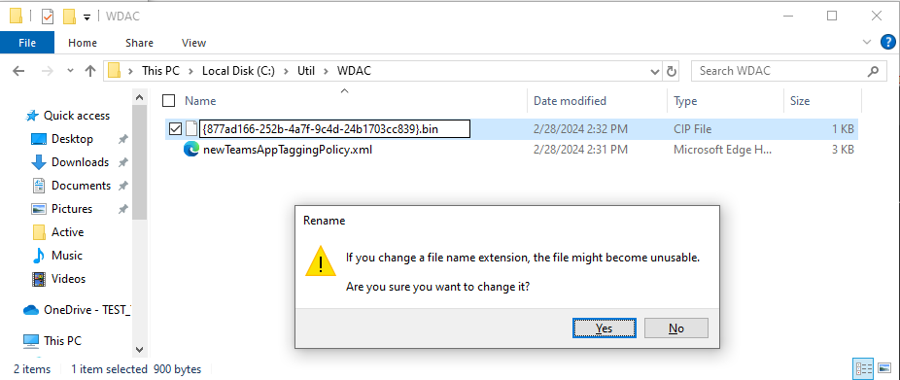
Preparing the CIP file for Intune Deployment
Navigate to the location of your xml and CIP files generated in the previous section.
Change the file extension of the .CIP file matching your policyID to be .BIN
In the Rename dialog, click Yes.

Slide 43
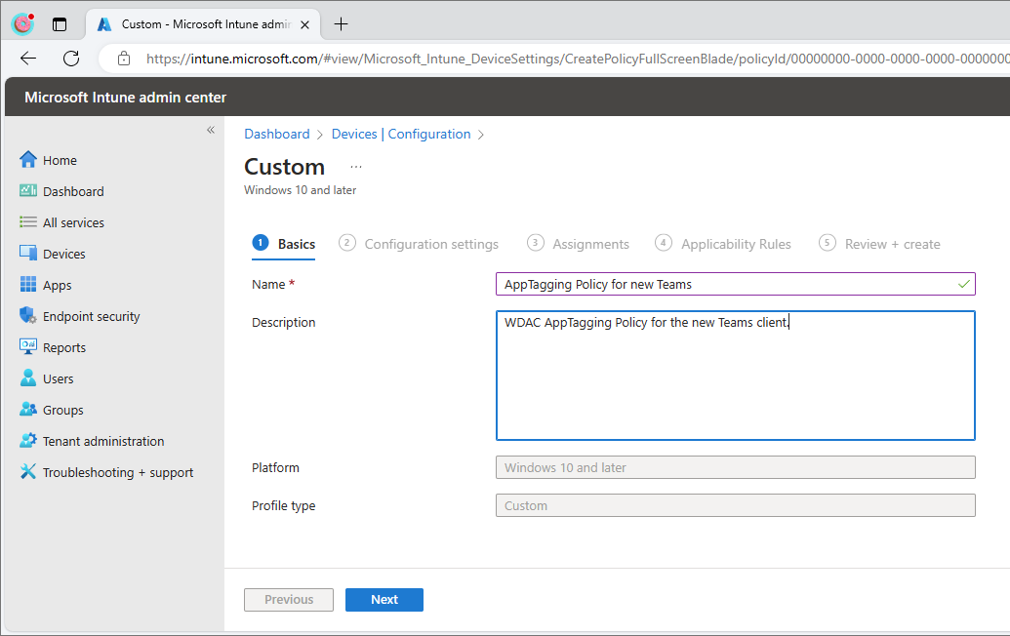
Configure Intune Create the configuration profile
Visit https://intune.microsoft.com using an account with the correct RBAC role
Click Devices and Configuration Profiles
Click Create and + New Policy
Select Windows 10 and later under platform
Select Templates under Profile type and click Custom
Click Create.
Enter a Name of your policy and a Description of your choice
Click Next

Slide 44
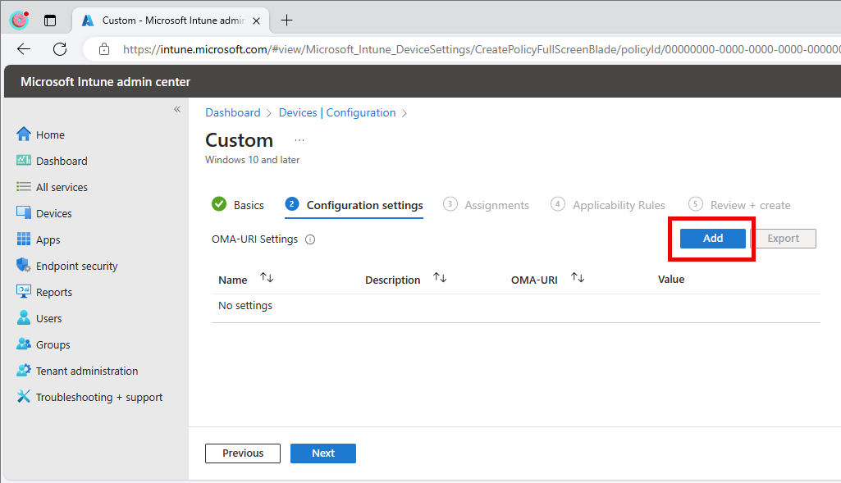
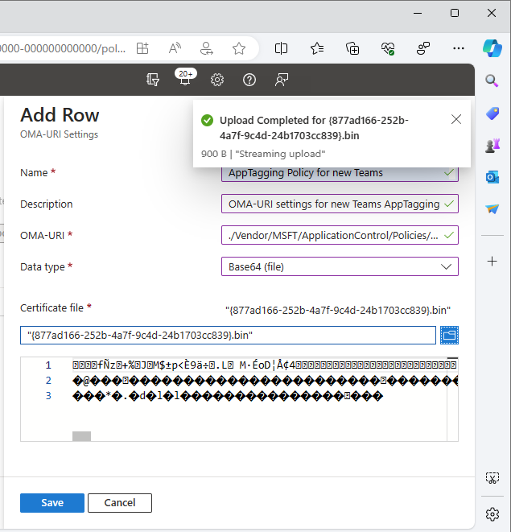
Configure Intune Configure the profile with required settings
Click Add
Enter a meaningful name and description for your OMA-URI setting
Enter the following OMA-URI setting in the following format:
./Vendor/MSFT/ApplicationControl/Policies/877ad166-252b-4a7f-9c4d-24b1703cc839/Policy
Replacing the text in bold with the policyGUID you generated when creating the CIP without the {}.
Select Base64 (file) for Data Type and find your .bin file you created in the previous step, and upload.
Click Save
Click Next

Slide 45
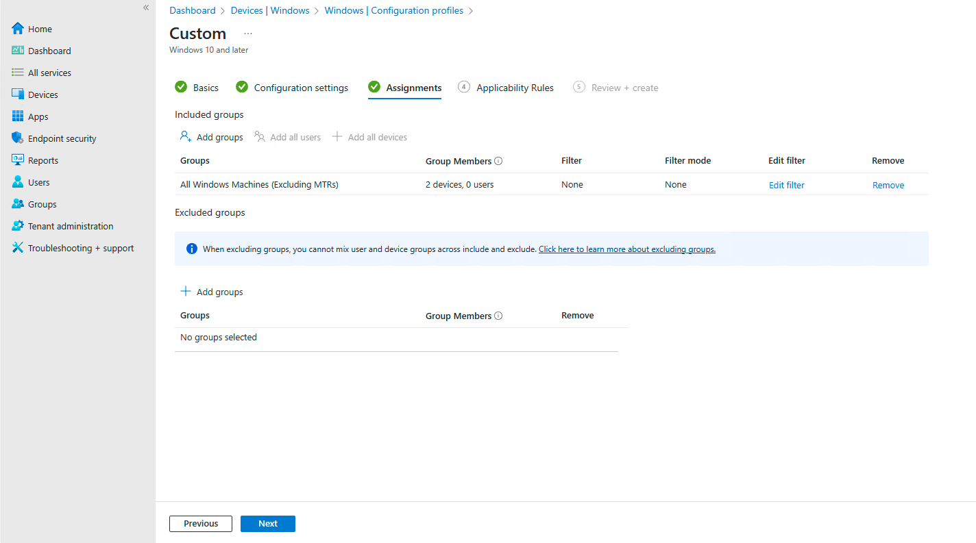
Configure Intune Assign your configuration to a test group
Under Included Groups
Select “Add Groups”
Find a test group that contains Windows machines to test the policy
Click “Next”

Slide 46
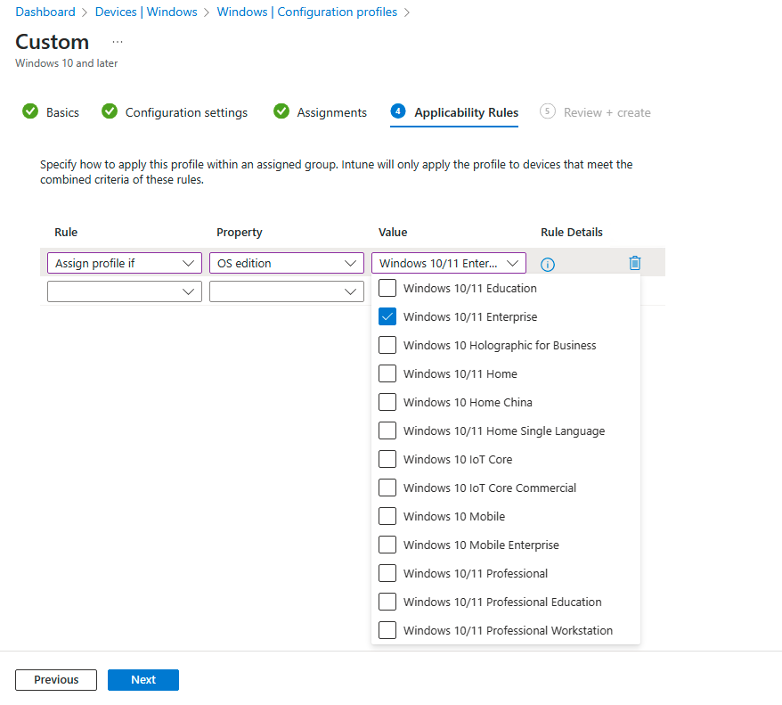
Configure Intune Applicability Rules (Optional)
Optionally create an applicability rule targeting Windows 10/11 Enterprise
Click Next

Slide 47
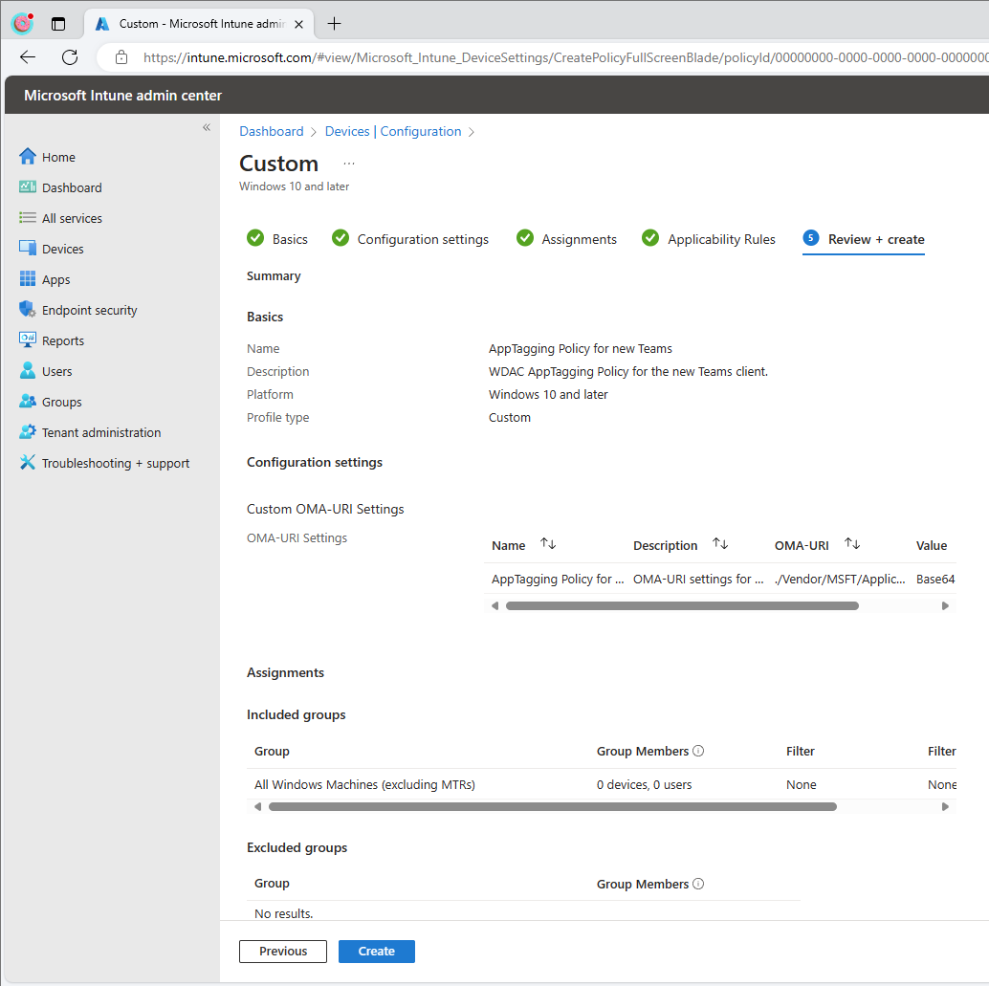
Configure Intune Review and Create
Validate configuration matches what you’re expecting from the previous steps
Click Create

