Slide 1
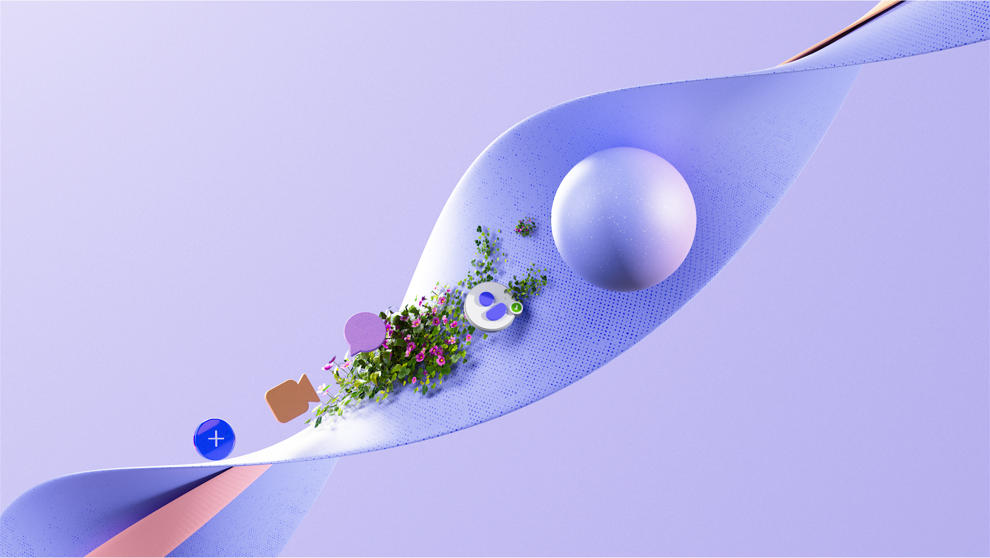
Redesigned meeting controls
Visual walkthrough guide

Slide 2

About the redesigned meeting controls
The redesigned Microsoft Teams meeting controls experience gives users a cleaner, more organized way to manage meetings. Core actions are easier to find, related tools are grouped in more predictable places, and users can personalize the controls they rely on most. The updated experience also helps reduce accidental clicks, keeps important meeting status information visible, and makes it easier to stay focused on the conversation while accessing the right tools when needed.

Slide 3
Redesigned Meeting Controls
Overview

Slide 4

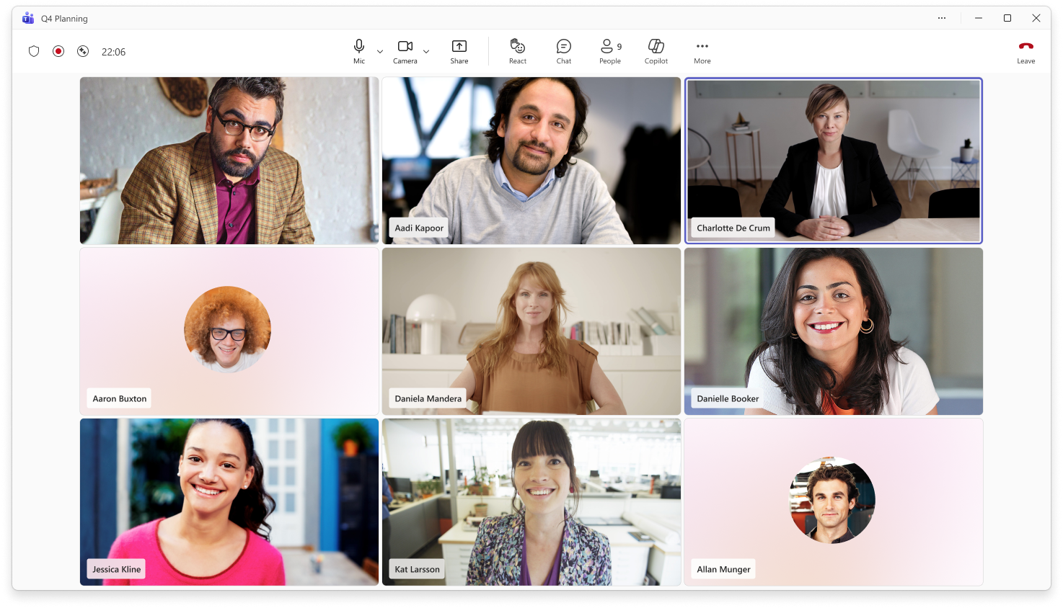
The redesigned meeting controls layout makes key actions easier to find and helps reduce accidental clicks.
1
2
Stay focused on the essentials
Mic, camera, and share are now centered, with mic placed before camera for a more predictable flow.
Find tools faster
Chat, reactions, apps, agents, and AI tools are grouped together for quick access during meetings.
1
2

Slide 5
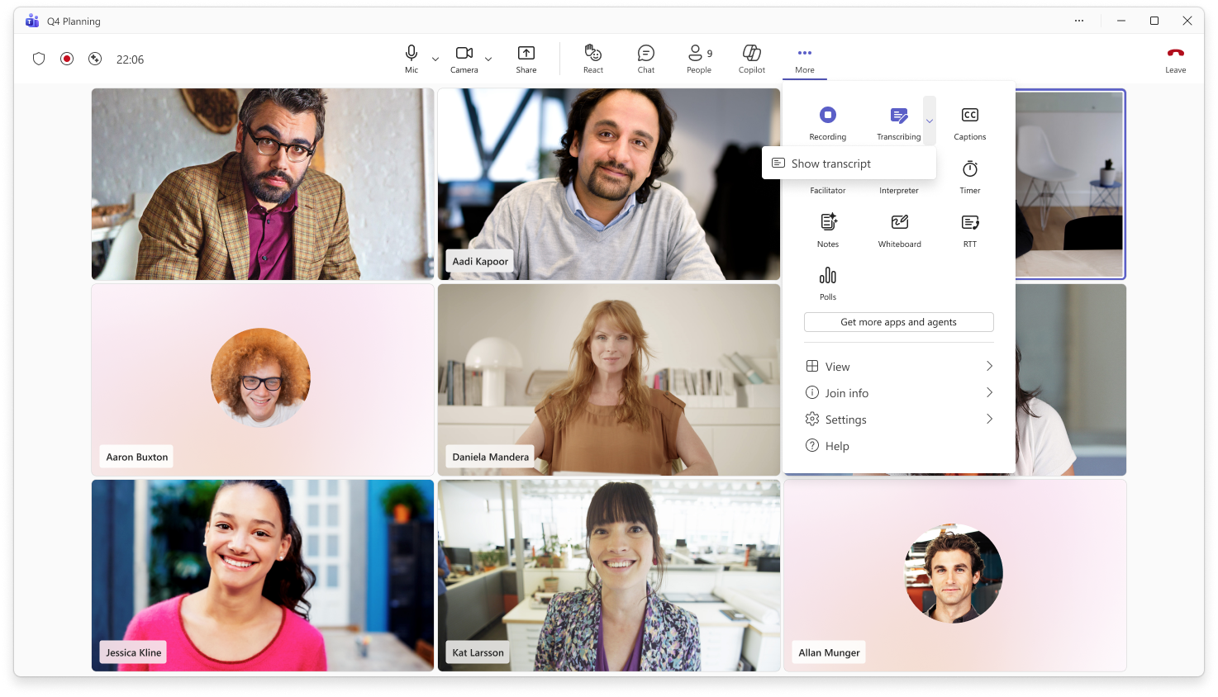
3
3
Find tools faster
The More actions menu is now easier to scan, with related actions grouped into clear sections. Buttons turn purple when active, giving users a clear visual cue that a setting or action is currently on.
Access settings in one place
View, join, settings, and help options are grouped together at the bottom of the menu.
4
4

Slide 6
6
5
5
Avoid accidental exits
The Leave meeting control is separated on the far right to reduce the risk of leaving or ending a meeting unintentionally.
Keep meeting status visible
Meeting status indicators remain unchanged, including encryption, recording, transcription, AI status, and meeting timer.
6

Slide 7
Value of redesigned meeting controls
Stay focus on the essentials
The redesigned meeting controls put the most common actions, like mic, camera, and share, in a clearer, more predictable layout. This helps people stay focused on the meeting instead of hunting for the controls they need.
Find tools faster
Related meeting tools are grouped together in More actions, making it easier to scan and find options like view, notes, rooms, apps, and AI tools. The cleaner organization helps users get to the right feature quickly without interrupting the flow of the meeting.
Make controls work your way
Users can drag frequently used tools into the main meeting controls area and arrange them in the order that works best for them. This makes important actions easier to reach while keeping the default layout simple for everyone.

Slide 8
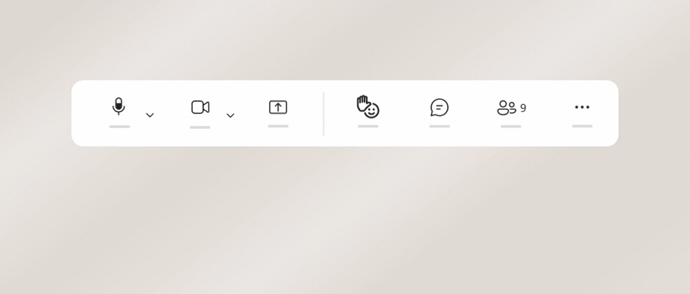
Raise hand is now in the React menu
Raise hand is now located in the React menu by default to help reduce accidental clicks.
Keep Raise hand within reach
If you use raise your hand often, drag it out of the React menu and pin it to the main meeting controls area.
Move it back anytime
To return Raise hand to the React menu, drag it back over More actions.

Slide 9
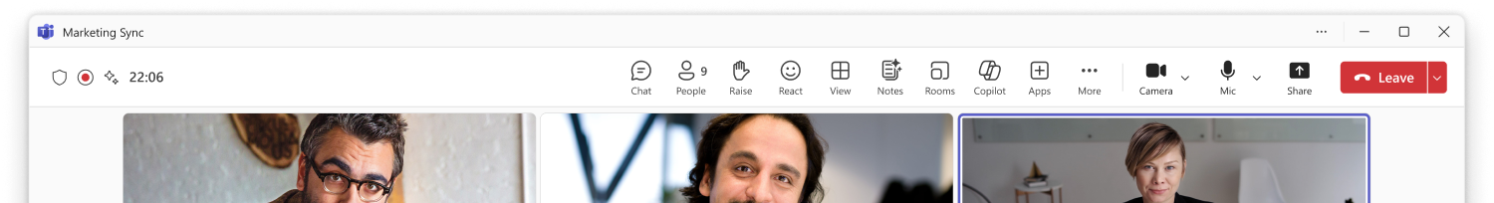
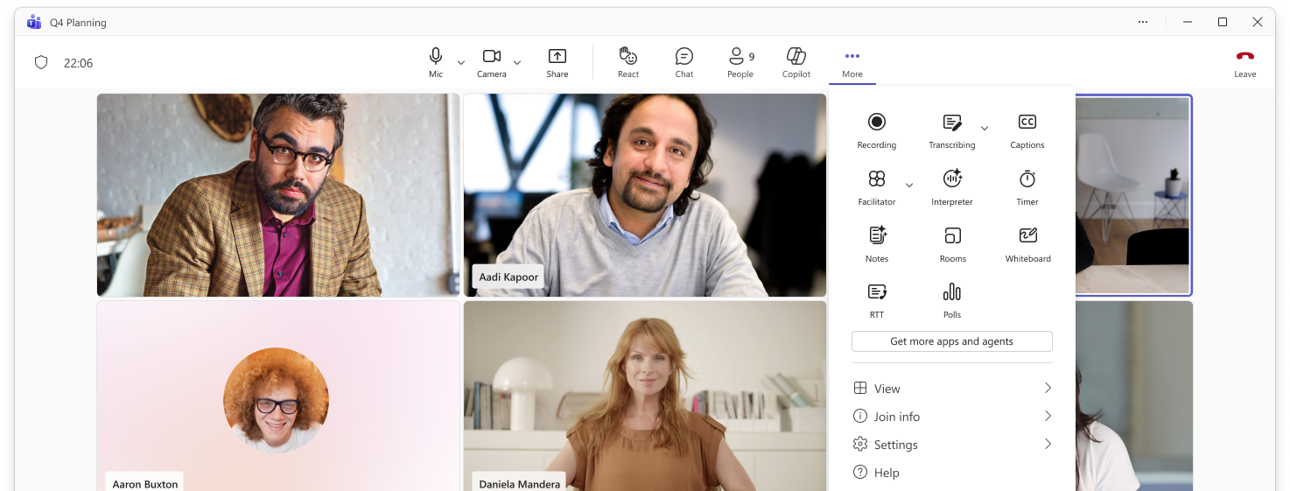
Meeting Tools are now in More actions
1
1
Some controls have moved
Meeting tools such as View, Notes, Rooms, and Apps have moved into the More actions menu to keep the main meeting controls area cleaner and easier to scan.
Find tools in one place
Open More actions to find these meeting tools alongside apps, agents, and other meeting capabilities.
2
2

Slide 10
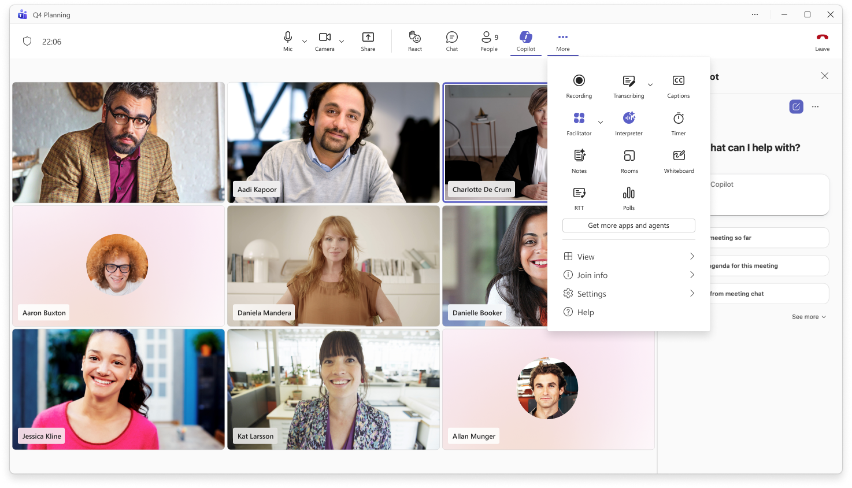
AI Tools are still easy to find
1
1
Access Copilot from the main controls
Copilot is available directly from the main meeting controls area.
Find more AI tools in More actions
Facilitator and Interpreter are available in the More actions menu alongside other meeting capabilities.
2
2

Slide 11
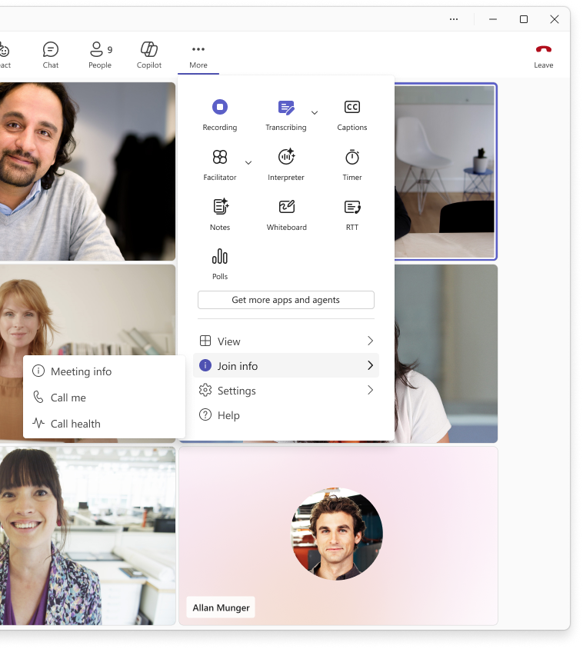
Meeting info is now in Join Info
1
Find join details in one place
Meeting info, Call me, and Call health are now grouped under Join info in the More actions menu.
1

Slide 12
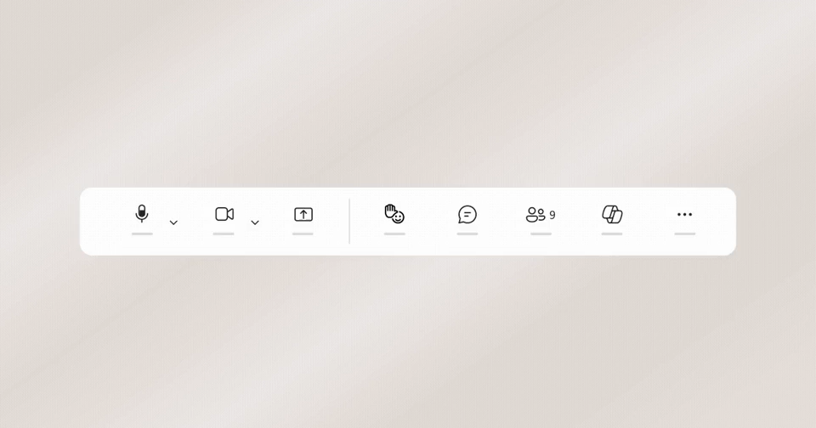
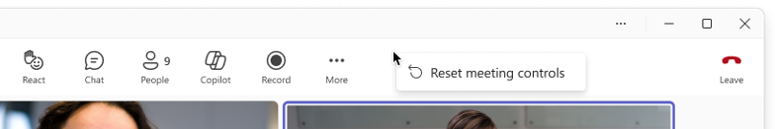
Customize your meeting controls with drag & drop
1
2
1
Pin tools for quick access
Drag controls from More actions to the main meeting controls area to access them quickly.
Rearrange your tools
Drag controls into the order that works best for you. Core meeting controls, like mic, camera, and share, stay fixed.
Reset anytime
To remove a pinned control, drag it back to More actions. You can also right-click to reset meeting controls to the default layout.
2
3
3

Slide 13
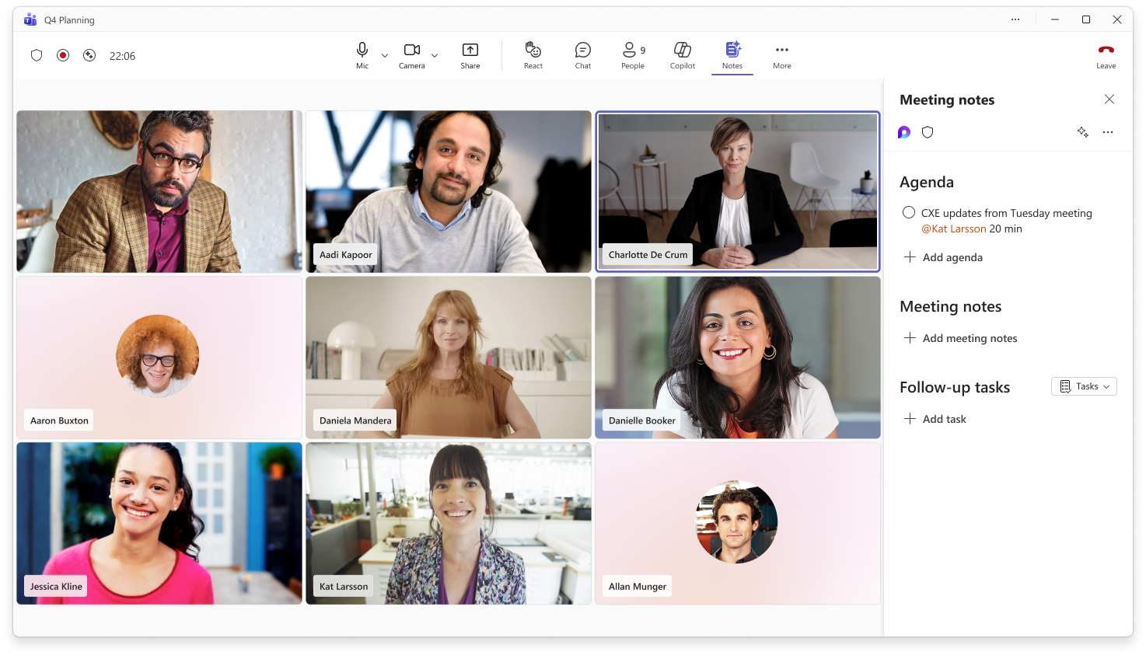
Get back to open panels faster
1
1
When you open certain meeting tools, like Notes, captions, timer, RTT, Whiteboard, or rooms, they appear in the main controls for that meeting so you can quickly return to their open panels without searching through More actions. They’re temporary and only show while open, keeping controls focused on what you’re using now.

Slide 14
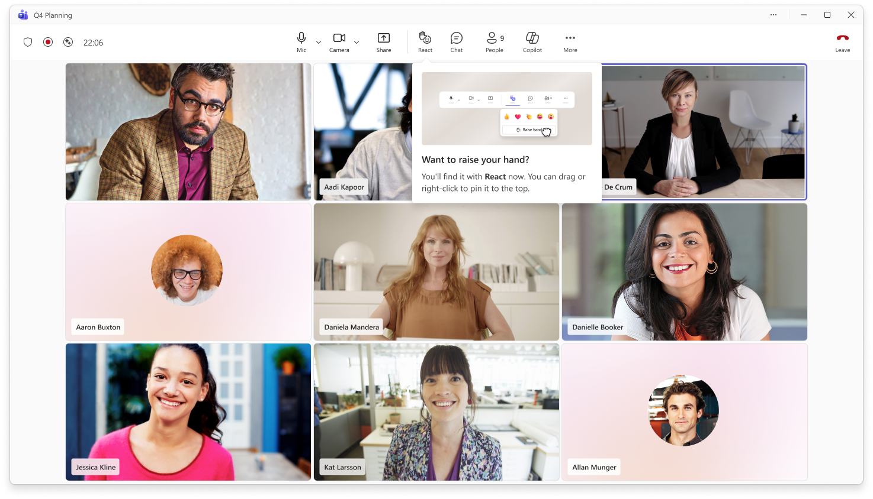
In-meeting Raise hand guidance
After users move to the new meeting controls, in-meeting guidance will help them find Raise hand in the React menu.
The guidance also shows users how to pin Raise hand to the main meeting controls area if they use it often.

Slide 15
FAQ
Q: Do configuration changes persist between meetings and across desktop and web?
Customizations you make to meeting controls, such as drag-and-drop changes or pinned controls, will persist between meetings. Meeting control changes made on desktop will also appear on web, and vice versa, when using the same device. These settings do not roam across devices, and the redesigned meeting controls are not supported on mobile.

