Slide 1
Microsoft Teams: The redesigned meeting controls experience
A guide for Champions, trainers, IT pros, and tenant admins

Slide 2
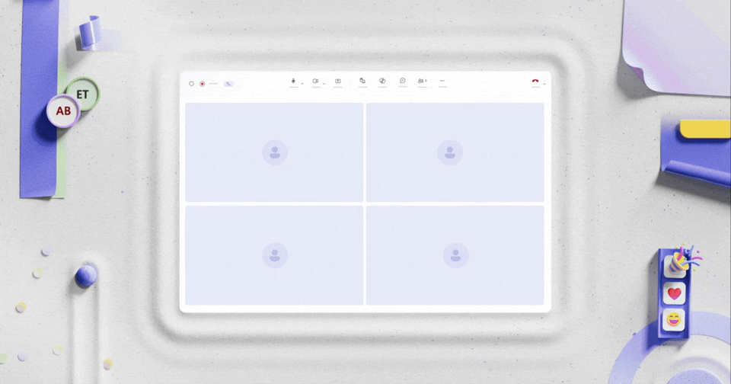
The redesigned meeting controls experience
The redesigned Microsoft Teams meeting controls create a cleaner, more organized meeting experience that helps users stay focused, reduce accidental actions, and quickly access the tools they need throughout the meeting.

Slide 3
Redesigned Meeting Controls
Overview

Slide 4
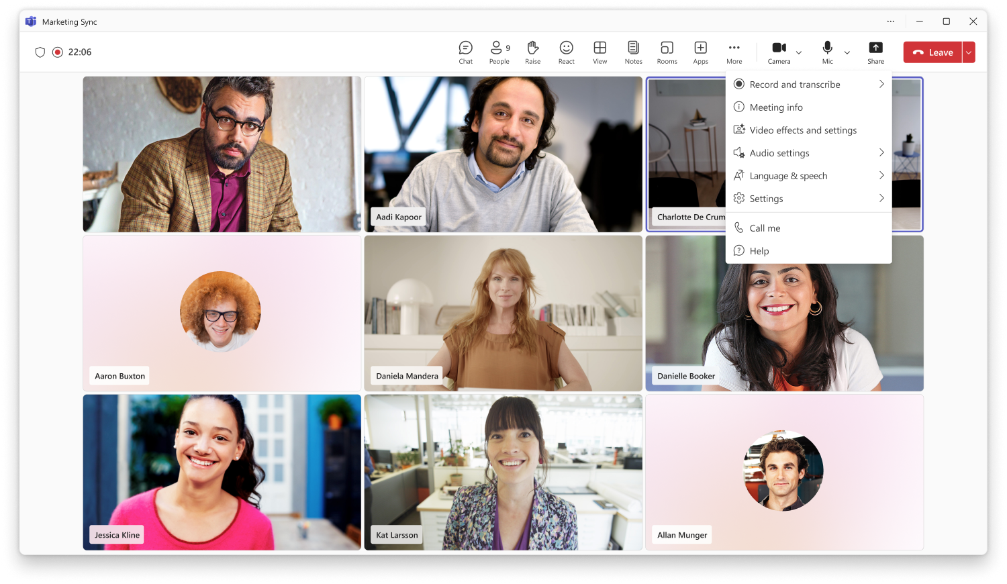
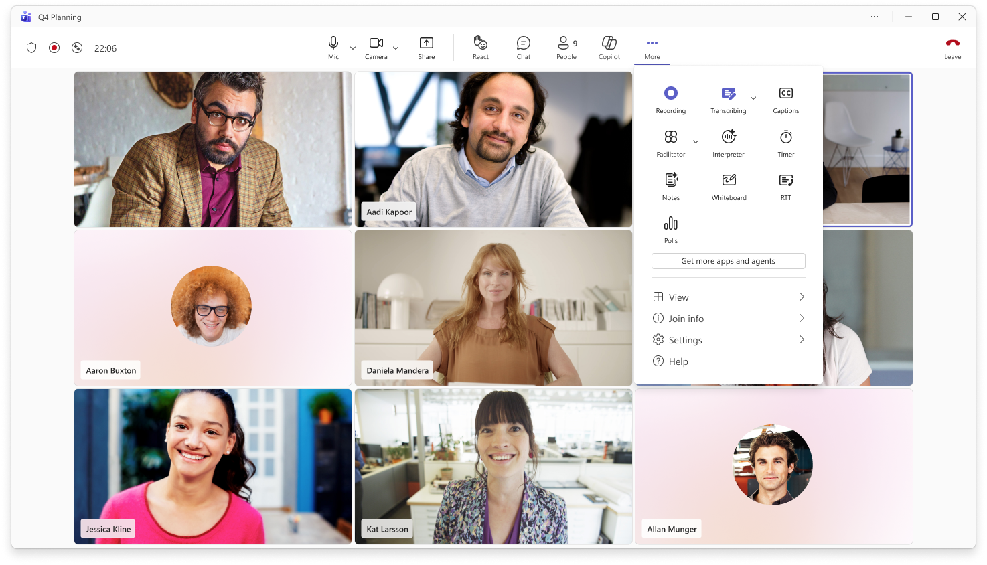
Overview: Cleaner layout for meeting controls
Current
Redesigned

Slide 5
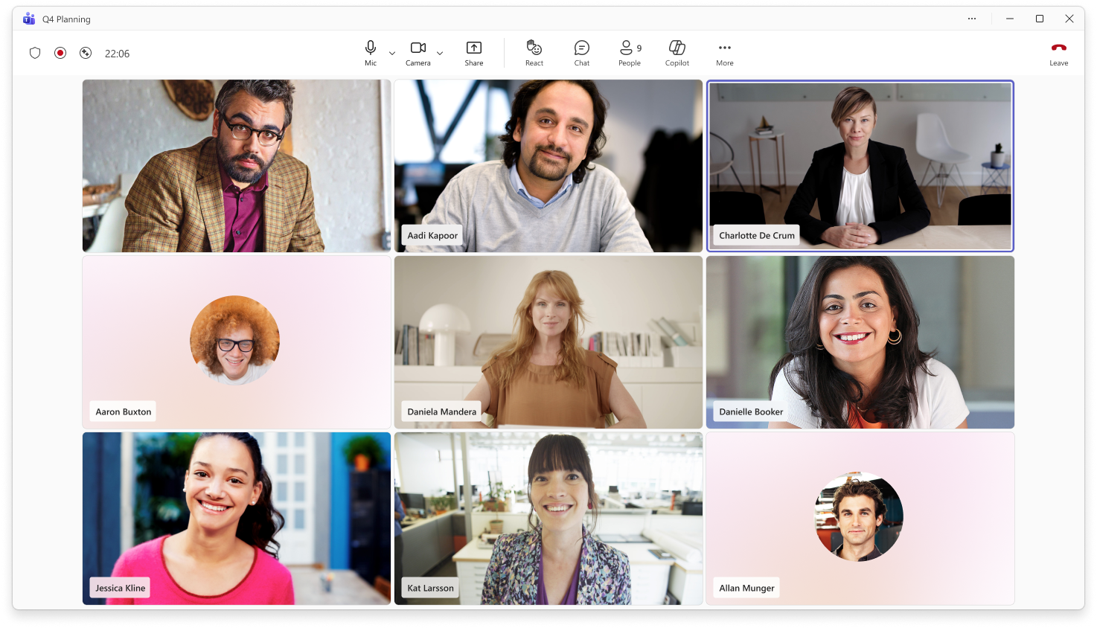
1
2
The redesigned meeting controls layout makes key actions easier to find and helps reduce accidental clicks.
Stay focused on the essentials
Mic, camera, and share are now centered, with mic placed before camera for a more predictable flow.
Find tools faster
Chat, reactions, apps, agents, and AI tools are grouped together for quick access during meetings.
1
2

Slide 6

3
3
Find tools faster
The More actions menu is now easier to scan, with related actions grouped into clear sections. Buttons turn purple when active, giving users a clear visual cue that a setting or action is currently on.
Access settings in one place
View, join, settings, and help options are grouped together at the bottom of the menu.
4
4

Slide 7
6
5
5
Avoid accidental exits
The Leave meeting control is separated on the far right to reduce the risk of leaving or ending a meeting unintentionally.
Keep meeting status visible
Meeting status indicators remain unchanged, including encryption, recording, transcription, AI status, and meeting timer.
6

Slide 8
What has moved?

Slide 9
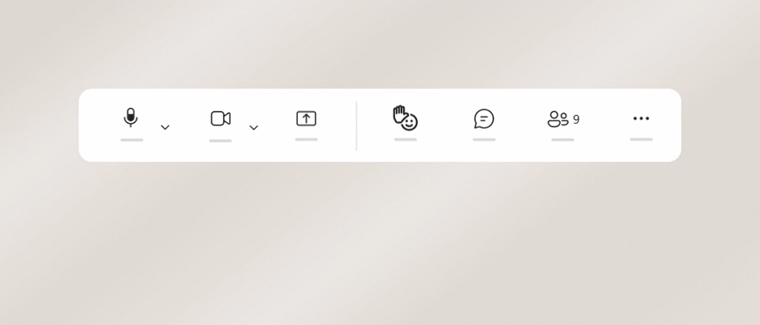
Raise hand is now in the React menu
Raise hand is now located in the React menu by default to help reduce accidental clicks.
Keep Raise hand within reach
If you use raise your hand often, drag it out of the React menu and pin it to the main meeting controls area.
Move it back anytime
To return Raise hand to the React menu, drag it back over More actions.

Slide 10
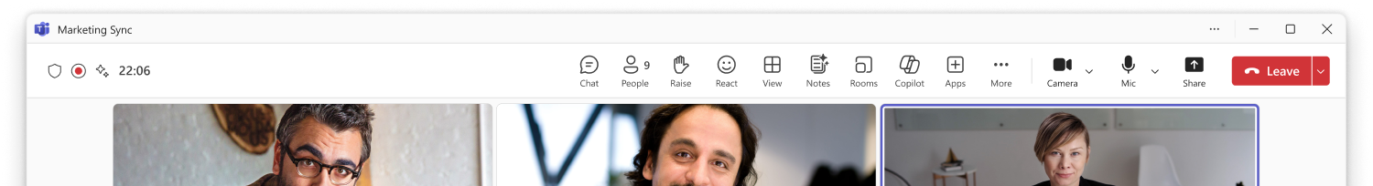
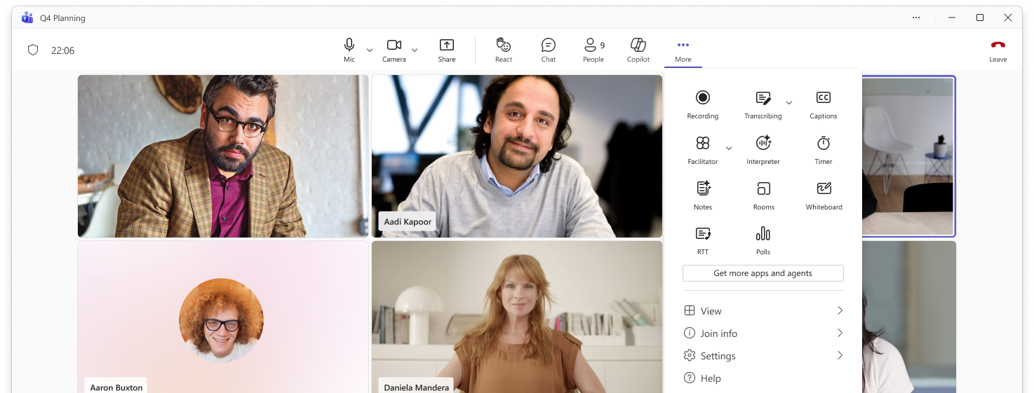
Meeting Tools are now in More actions
1
1
Some controls have moved
Meeting tools such as View, Notes, Rooms, and Apps have moved into the More actions menu to keep the main meeting controls area cleaner and easier to scan.
Find tools in one place
Open More actions to find these meeting tools alongside apps, agents, and other meeting capabilities.
2
2

Slide 11
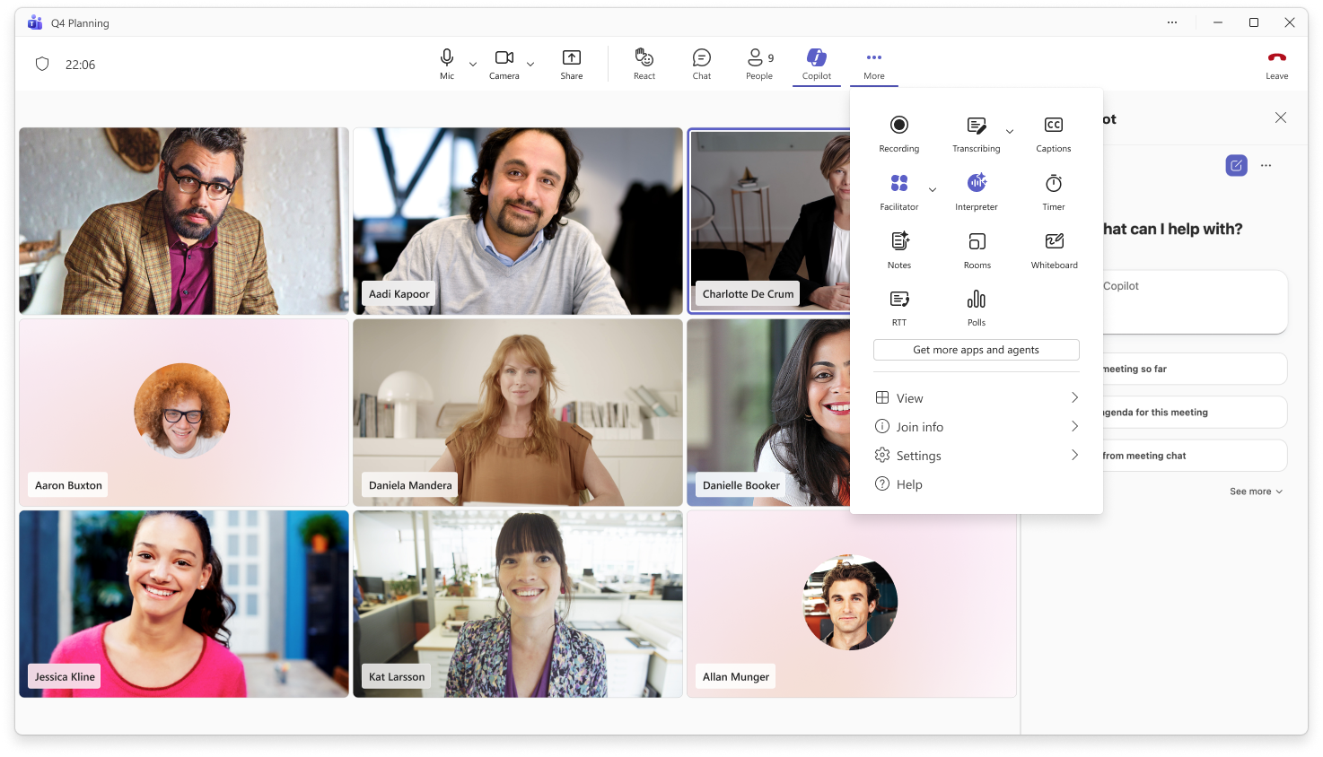
AI Tools are still easy to find
1
1
Access Copilot from the main controls
Copilot is available directly from the main meeting controls area.
Find more AI tools in More actions
Facilitator and Interpreter are available in the More actions menu alongside other meeting capabilities.
2
2

Slide 12
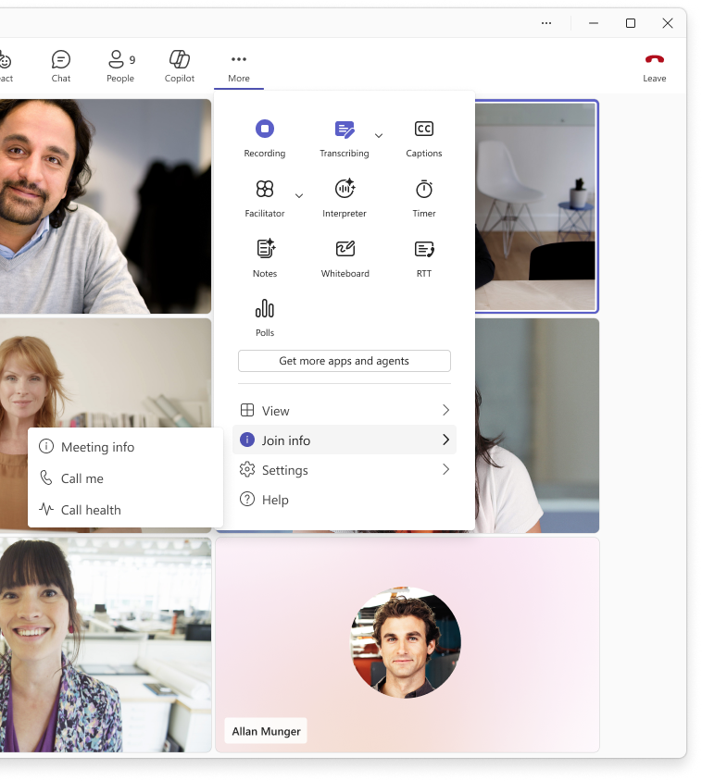
Meeting info is now in Join Info
1
Find join details in one place
Meeting info, Call me, and Call health are now grouped under Join info in the More actions menu.
1

Slide 13
What are the new features?

Slide 14
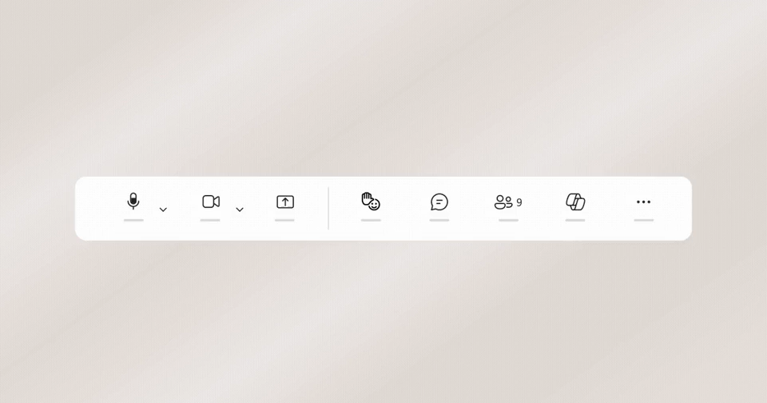
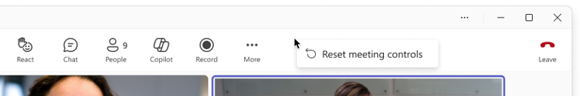
Customize your meeting controls with drag & drop
1
2
1
Pin tools for quick access
Drag controls from More actions to the main meeting controls area to access them quickly.
Rearrange your tools
Drag controls into the order that works best for you. Core meeting controls, like mic, camera, and share, stay fixed.
Reset anytime
To remove a pinned control, drag it back to More actions. You can also right-click to reset meeting controls to the default layout.
2
3
3

Slide 15
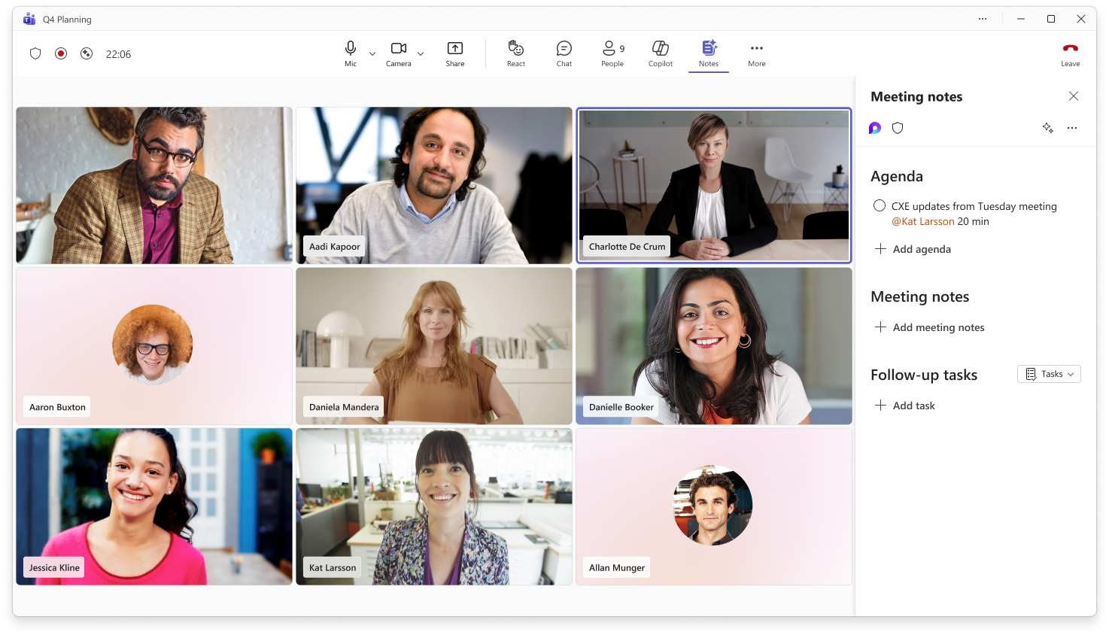
Get back to open panels faster
1
1
When you open certain meeting tools, like Notes, captions, timer, RTT, Whiteboard, or rooms, they appear in the main controls for that meeting so you can quickly return to their open panels without searching through More actions. They’re temporary and only show while open, keeping controls focused on what you’re using now.

Slide 16
Frequently asked questions: Meeting Controls
Is there an admin policy to enable or disable the redesigned meeting controls, or to set the default layout?
There are no new admin policies for the redesigned meeting and sharing experience. Each user can make choices to optimize for how they work best, guided by the in-product onboarding.
Is there an admin policy to pin highly used apps to the main meeting controls area?
You can manage apps setup policies in the Microsoft Teams admin center. Any existing policies you have in place will be honored. Apps pinned in a meeting show at the top of the meeting window. If there are more than two apps, the other apps display under the More option
Do configuration changes persist between meetings?
Any changes a user makes to their meeting controls through drag and drop or pinning will be persist between meetings. The configuration settings will not roam across devices.
Do configuration changes persist between desktop and web?
Any changes a user makes to their meeting controls through the desktop will appear on the web and visa versa on the same device. The redesigned meeting controls are not supported on Mobile at this time.
Is the new experience supported in government clouds?
The Message Center and Roadmap will have details on timing for government clouds GCC, GCC High, DoD.

Slide 17
End user onboarding & guidance

Slide 18
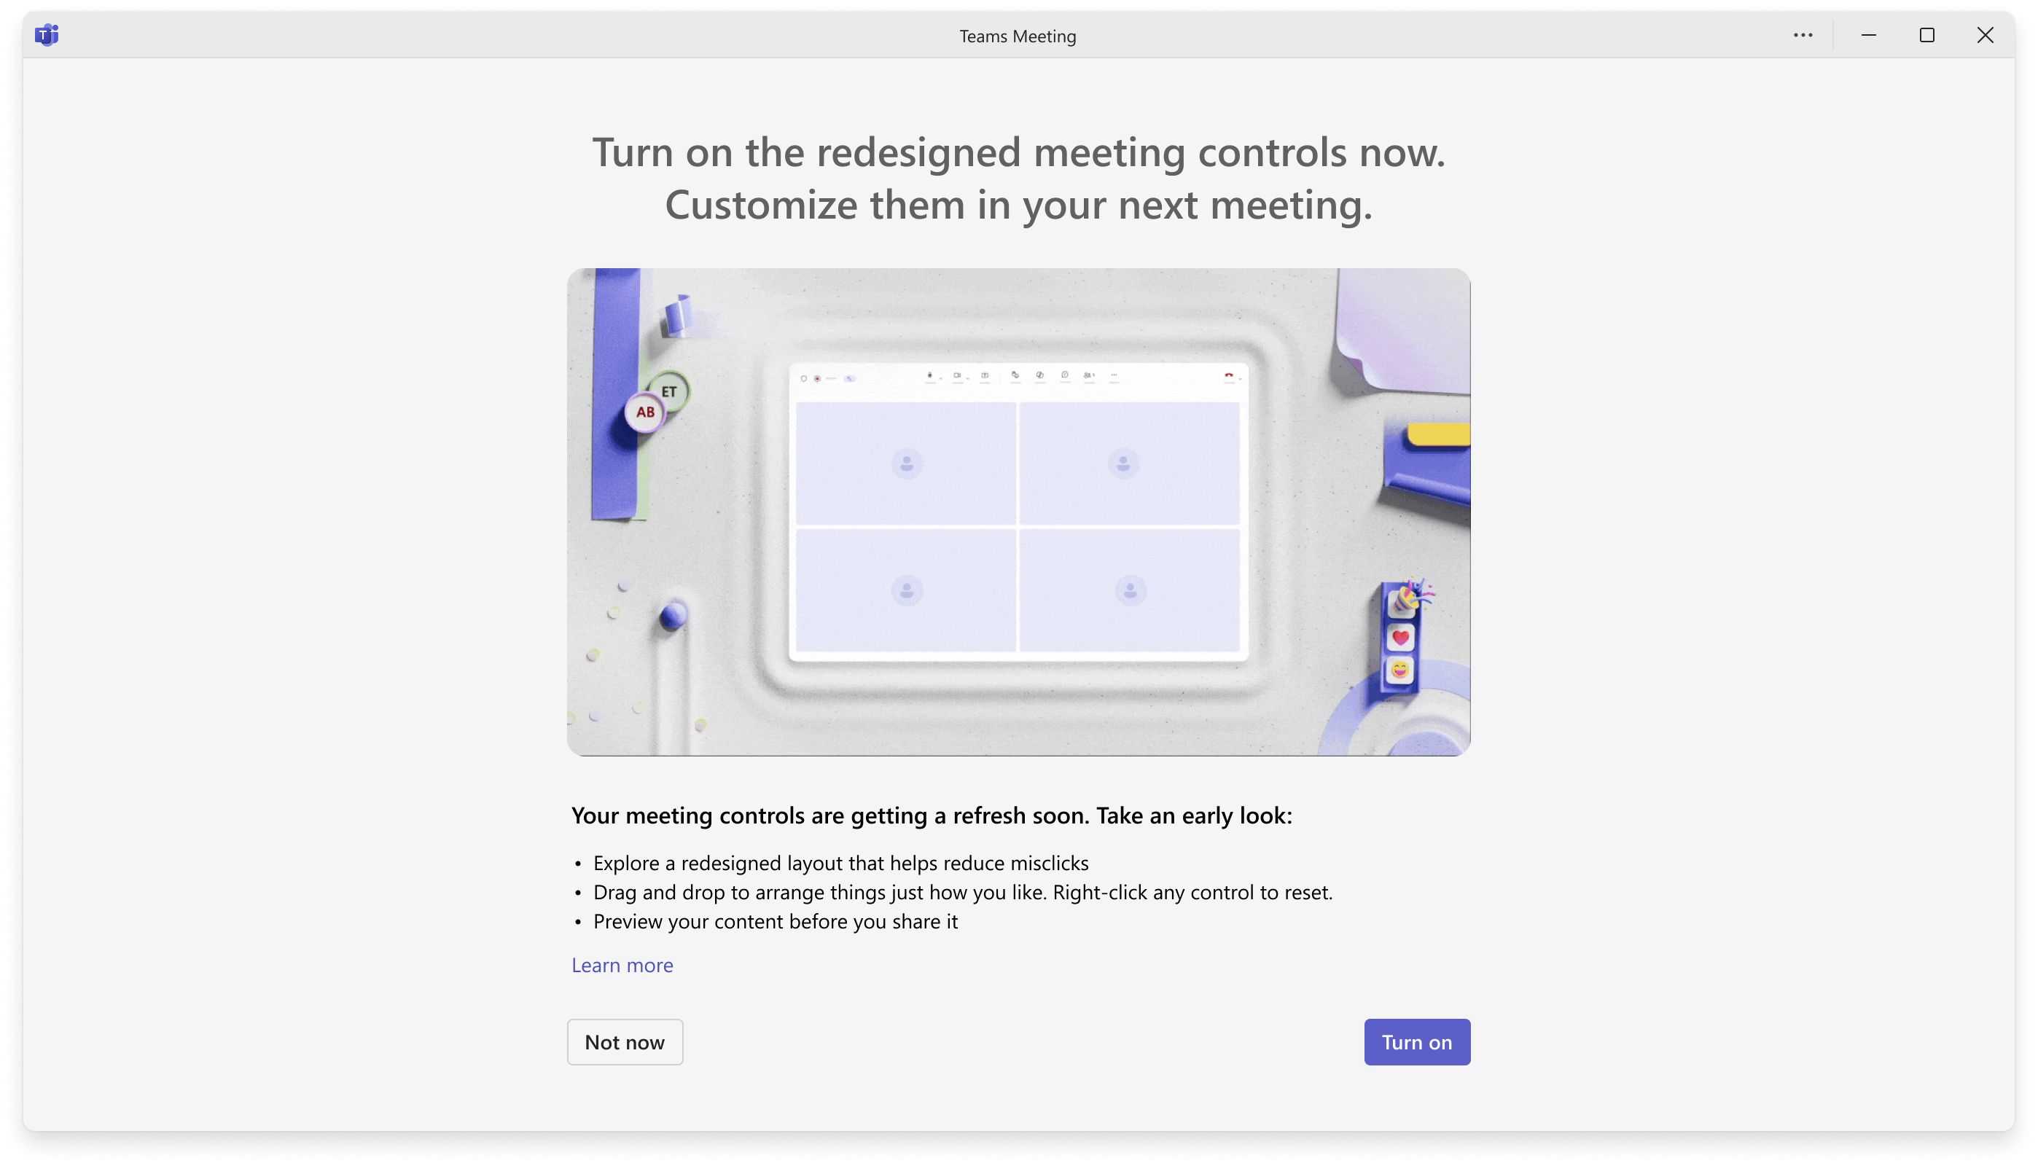
Opt into the redesigned meeting and sharing experience
Users may see an end-of-meeting prompt twice over a 10-day period, giving them the option to try the redesigned meeting controls.
If they choose Turn on, they’ll see the redesigned meeting controls the next time they join a meeting.
If they choose Not now, they’ll continue using the current meeting controls with no changes.

Slide 19
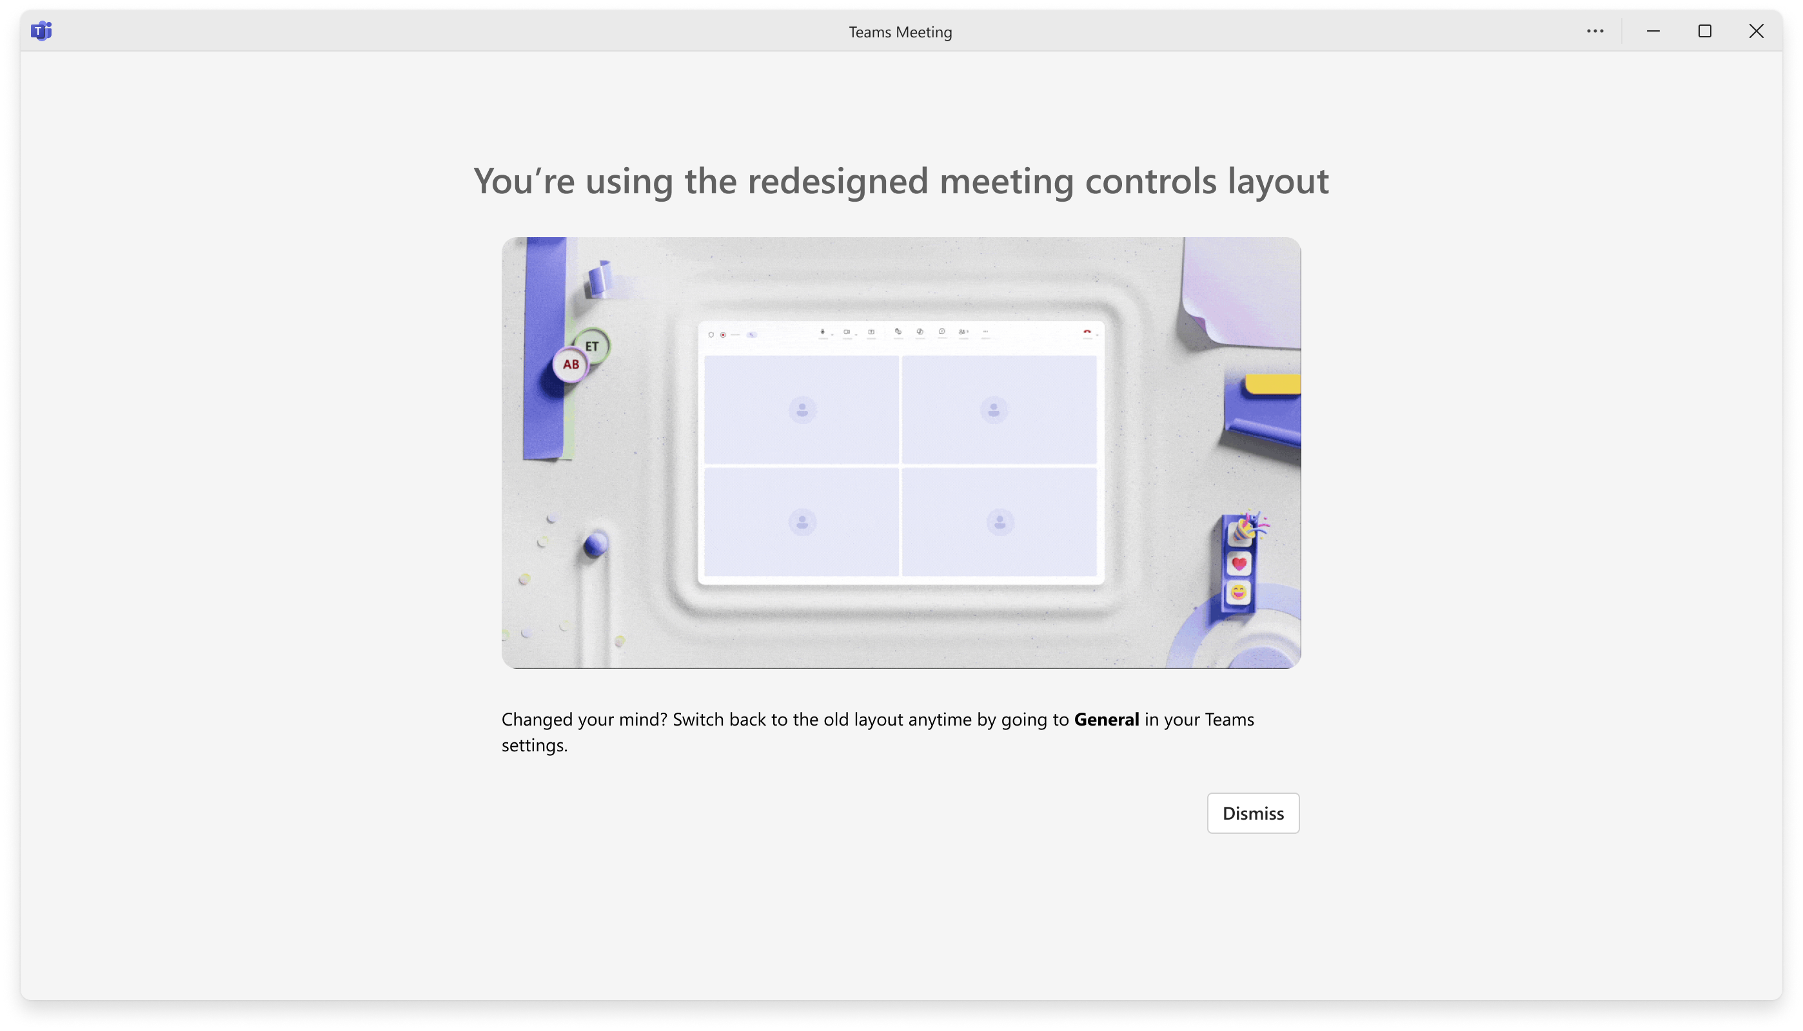
Automatic Migration after 20 days
On day 20, users who haven’t already turned on the redesigned meeting controls will be automatically moved to the new experience.

Slide 20
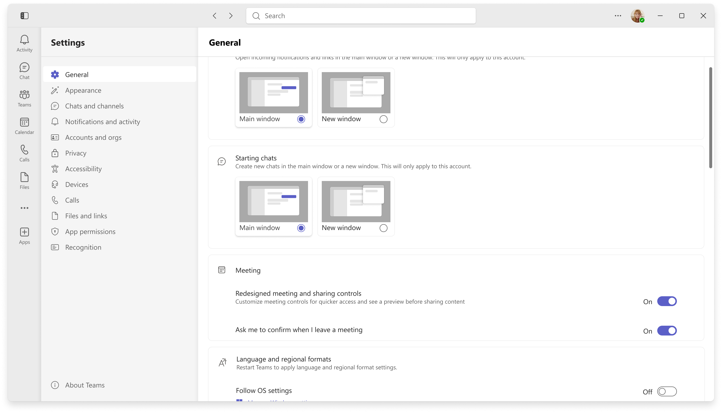
Users can temporarily switch back to the previous experience
After migration, users can temporarily switch back by going to Teams settings > General and turning off Redesigned meeting controls.
This option is available for a limited time. All users will eventually move to the new meeting controls experience.

Slide 21
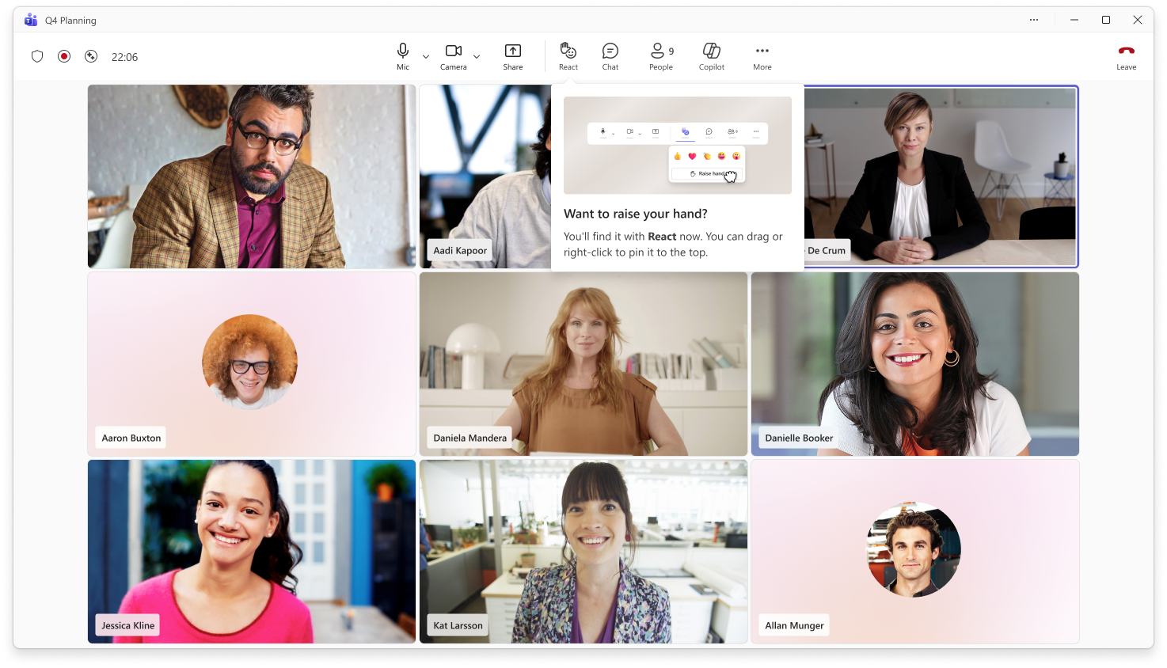
In-meeting Raise hand guidance
After users move to the new meeting controls, in-meeting guidance will help them find Raise hand in the React menu.
The guidance also shows users how to pin Raise hand to the main meeting controls area if they use it often.

