Slide 1
Teams Premium User Guide
Last updated: June 2023

Slide 2
OVERVIEW
As part of our continuous innovation, we have launched Microsoft Teams Premium. Built on the familiar, all-in-one collaborative experience of Microsoft Teams, Teams Premium makes meetings more intelligent, personalized, and protected—whether it’s one-on-one, large meetings, virtual appointments, or webinars.
Microsoft Teams Premium is generally available for our commercial customers, you can enjoy Teams Premium features with the following conditions:
Your Microsoft Teams Administrator, within your organization, has personally assigned you to have a Teams Premium license.
The Teams Premium feature you are looking to utilize was configured and enabled by your Microsoft Teams Administrator. (Excluding Intelligence features.)
To leverage the Intelligence Recap feature, the meeting should be recorded.
This guide will provide an overview of Microsoft Teams Premium features and their value. It will guide you step-by-step how to utilize each of the features. For each feature, it will explain:
Feature Introduction and user’s step by step guide
Overview and benefit of the feature
Feature visibility – who will see the feature within their Teams experience
Dependencies and limitations
aka.ms/SetUpTeamsPremium
Tell us how you are using Teams Premium! aka.ms/TeamsPremiumStory
Microsoft Teams Premium: Cut costs and add AI-powered productivity | Microsoft 365 Blog

Slide 3
Table of contents – Feature’s menu
Link to learn about the feature and walkthrough of how to utilize it in your meetings, (then press the link to go back here.
INTELLIGENT MEETINGS
Meeting recap features:
Auto-generated chapters
AI-generated notes and tasks
Personalized timeline markers
Speaker timeline markers
Live Translation
PERSONALIZED MEETINGS
Meeting templates
Branded meetings
Organizational-defined backgrounds
Together mode scenes
PROTECTED MEETINGS
Watermark
Sensitivity labels
Who can record
End-to-end encryption (E2EE)
ADVANCED Webinars
Advanced Virtual Appointments
How to get started - overview
Registration and reminders
Virtual Green Room
Manage what attendees see
RTMP-in
eCDN for Teams live Events
Overview: Getting started
Virtual Appointments app
Premium SMS Reminders
Virtual lobby with branding and logos
Org-level analytics in Teams Admin Center

Slide 4
Intelligent meetings

Slide 5
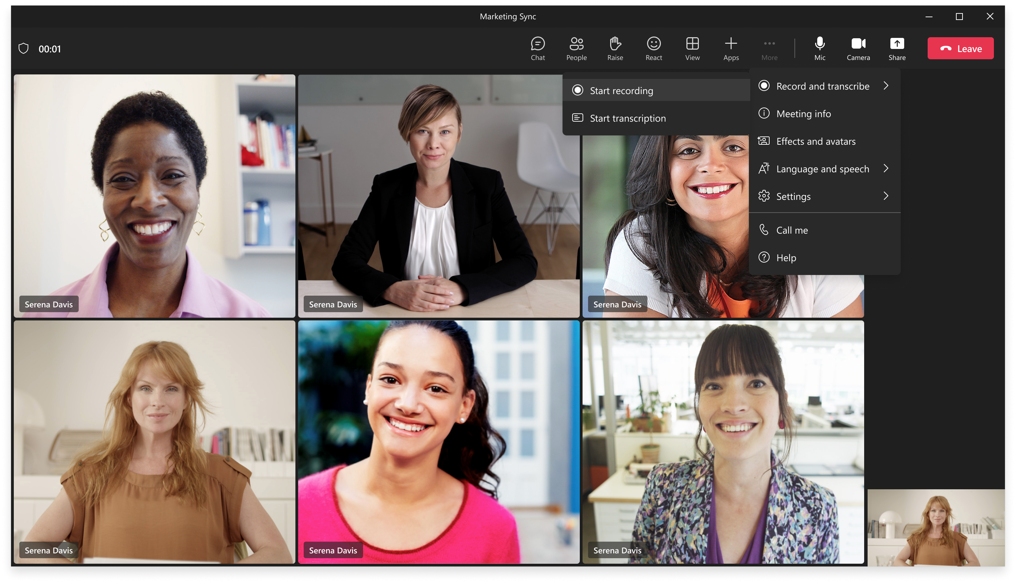
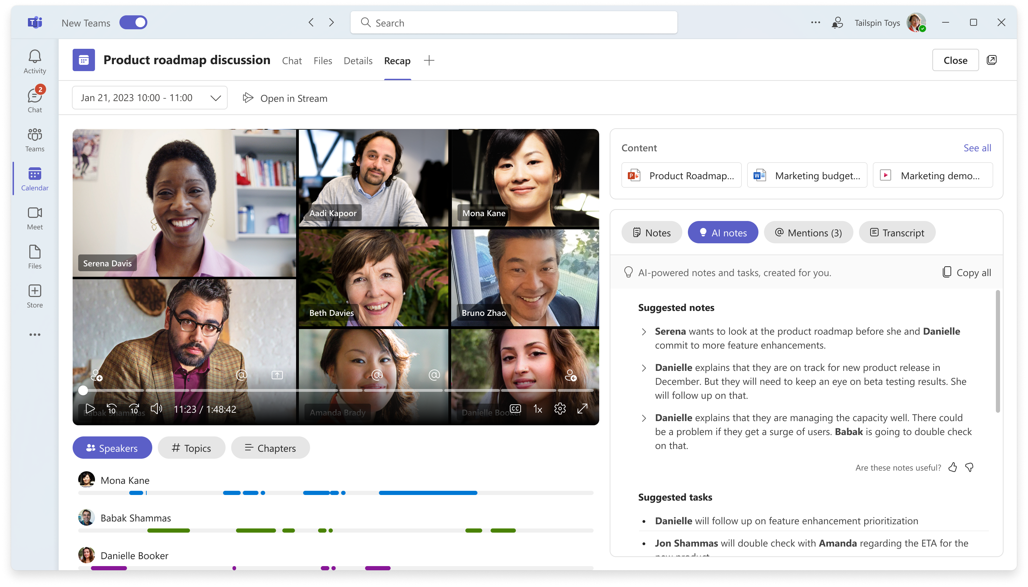
Organizer Guidance: Record the meeting
INTELLIGENT MEETINGS
Intelligent Meeting Recap
Introduction
Intelligent Meeting Recap uses AI to deliver a more personalized and intelligent overview of each meeting. It can help reduce the time you spend sifting through meeting transcripts and recordings, generate insights to help you discover the information that matters most to you, and make meeting follow up easier.
To record meeting, click Record and Transcribe and Start Recording.
User experience: Recap tab to find your intelligence
After the meeting ends, enter meeting’s Recap tab to recap and recall.

Slide 6
INTELLIGENT MEETINGS
Meeting Recap
Overview and Benefits
Smarter recordings and search will reduce meeting fatigue and help you stay in the know. Below is an overview of the Meeting Recap features and benefits:
 | Auto-generated chapters | AI-generated notes and tasks | Personalized timeline markers | Speaker timeline markers
Intro and Benefits | Automatically segments meeting recordings into chapters based on meeting transcript and PowerPoint Live that was shared.¹ Makes it easy for you to navigate recordings and understand the content of the meeting discussion. | Make the meetings you attend (or miss) more productive and impactful with AI-suggested notes and tasks so that conclusions and follow-ups are not missed. It helps users easily recall or recap past meetings. It’s like having your own virtual assistant at every meeting! | These markers will call out important moments in the meeting recordings, such as when your name was mentioned, when a screen was shared, and when you joined the meeting late or left early. | Speaker timeline markers appear below meeting recording. Organizes speakers in two ways: those you work closely with and most frequent speakers, allowing you to jump right to the moment when they spoke.
Feature Visibility | If a meeting organizer/recorder has a Teams Premium license, chapters will be generated and visible to all attendees (regardless of their Premium license status). | Users must have a Teams Premium license to get visibility to AI-generated notes and tasks. | Users must have a Teams Premium license to get visibility to personalized timeline markers. | Users must have a Teams Premium license to get visibility to speaker timeline markers.
¹ Also included in Stream recordings
Notes:
Coming soon
You can see when you joined or left a meeting in the meeting recording, so you can easily click and listen in where you left off.
Personalized timeline markers like when your name was mentioned, when a screen was shared, as well as speaker timeline markers for all speakers - organized by those you work most closely with.
Easily navigate Teams meeting recordings with automatically generated chapters to help you understand the content of a meeting discussion.

Slide 7
INTELLIGENT MEETINGS
Meeting Recap
Use Cases
Below are the primary use cases :
Industry | Use Cases
All | Invitee needs to recap a meeting they missed due to conflict or time zone difference. They click on the Recap tab to: Review all AI-generated notes and tasks Skip through chapters to find relevant topics Track when their name was mentioned, a screen was shared, and more by utilizing the personalized timeline markers
All | Invitee wishes to recall a meeting where they joined late, left early or were multitasking. They click on the Recap tab to: Review all AI-generated notes and tasks Click on the personalized timeline marker to catch up where they left off (before they joined or after they left) Jump right to the relevant chapter to catch up on a specific topic Track when their name was mentioned, a screen was shared, and more by utilizing the personalized timeline markers
Prerequisites
Intelligent Recap requires cloud recording to be enabled in standard meeting policies.
Users need a Teams Premium license and need to enable Transcriptions because the AI insights are generated from the transcript.
Recording a meeting is required.
For more information regarding responsible AI at Microsoft see Reflecting on our responsible AI program: Three critical elements for progress - Microsoft On the Issues

Slide 8
INTELLIGENT MEETINGS
Meeting Recap
Dependencies and Limitations
Intelligent Recap is available in following markets and cloud tenants:
 | Markets at GA | Cloud tenants at GA
Auto-generated chapters | Worldwide | Commercial, GCC
AI-generated notes | English only (US) | Commercial
AI-generated tasks | English only (US) | Commercial, GCC
Personalized timeline markers (leave/join, name mentions, screenshare) | Worldwide | Commercial, GCC
Speaker timeline markers | Worldwide | Commercial, GCC
Supported platforms:
Windows, Mac, Web
Unsupported platforms:
Mobile

Slide 9
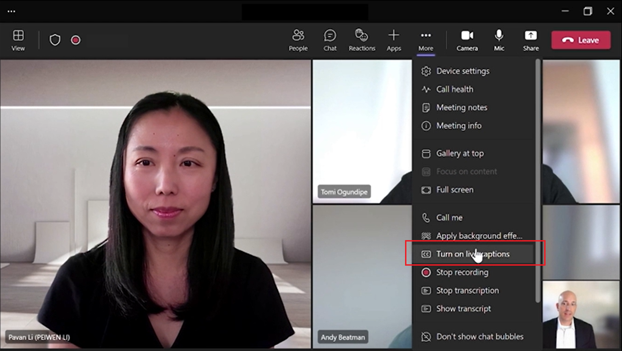
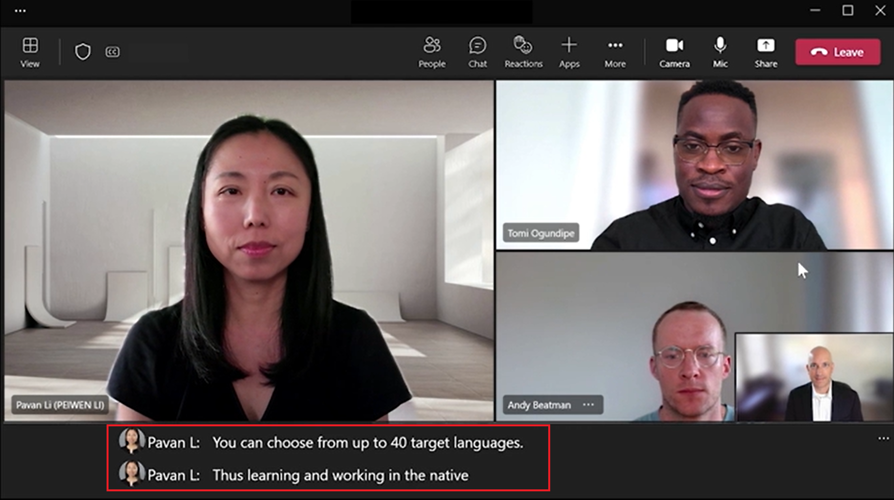
INTELLIGENT MEETINGS
Live Translation Captions
Introduction
Live Translation for Captions leverages Microsoft Speech Translation technology powered by Azure Cognitive Services to deliver AI-powered, real-time translations from 40 spoken languages.
User Guidance: Turn on Live Captions and select language (1 of 3)
Turn on Live captions:
Step 1: Hover over or click on More in the top navigation.
Step 2: Expand drop down and Turn on Live captions.

Slide 10
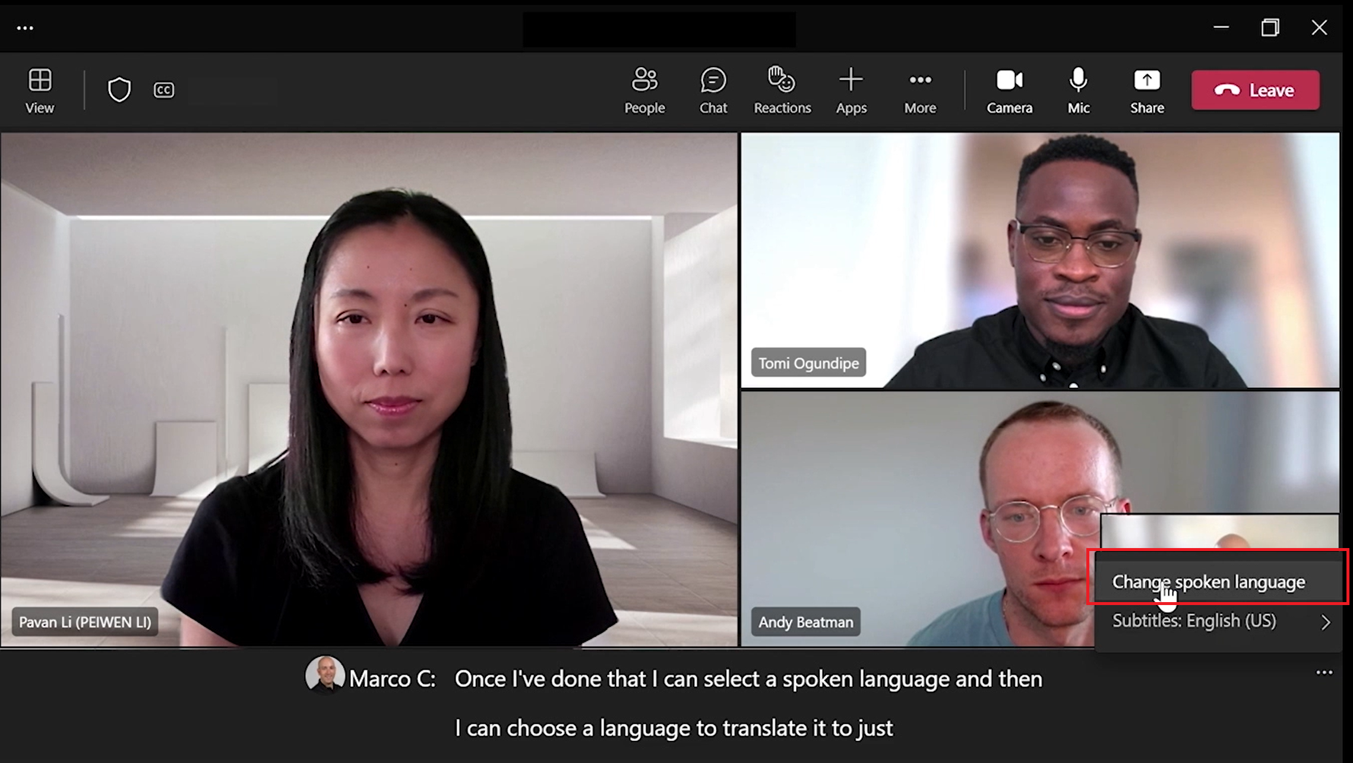
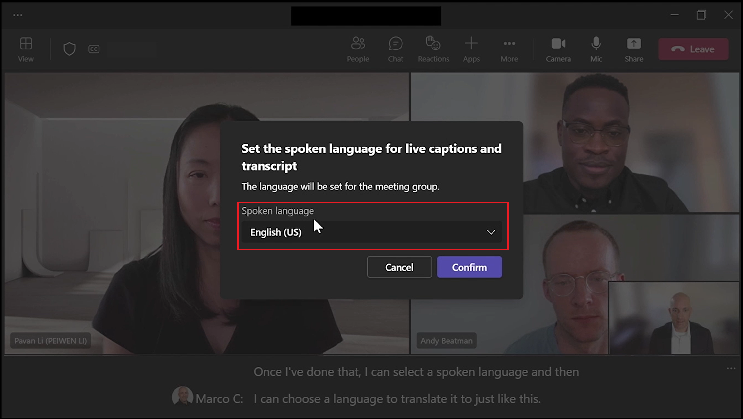
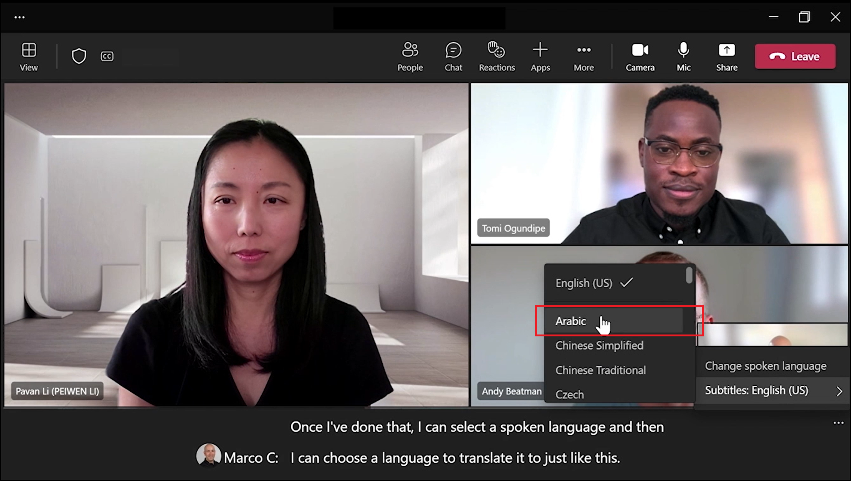
User Guidance: Turn on Live Captions and select language (3 of 3)
INTELLIGENT MEETINGS
Live Translation Captions
User Guidance: Turn on Live Captions and select language (2 of 3)
Change Spoken language
Step 1: Select Captions settings (to the right of the captions) and click on Change spoken language.
Step 2: Choose and set language (select from 40 languages!).
Step 3: Click Confirm/Update.
Change Translation language for captions
Step 1: Select Captions settings (to the right of the captions) and select ‘Subtitles’.
Step 2: Choose the language you want your captions translated to.

Slide 11
INTELLIGENT MEETINGS
Live Translation Captions
Overview and Benefits
Ideal for meetings with multi-lingual users and global audiences, Live Translation breaks down language barriers and allows users to fully participate in meetings by reading live captions translated in their native language or language of preference.
Live translation for captions will include speaker attribution as well—so you'll see not only what's being said, but who's saying it.
Feature Visibility
If the meeting organizer is licensed with Teams premium, Live translated captions will be available for all meeting participants.
Meeting organizer should be licensed with Teams premium license for participants to use this capability of feature.
Use Cases
Below are the primary use cases:
Industry | Use Cases
All | Global meetings where not all attendees first language is the same.
All | Clearly understand what is being said while taking notes during meetings when the spoken language isn’t your first language.
Education | Parent-Teacher meeting where the parent’s first language is different than the spoken language.
Notes:
@@B

Slide 12
INTELLIGENT MEETINGS
Live Translation Captions
Supported Spoken Languages
If you do not see a specific language below, click here to see if it’s been added recently.
English (US)
English (Canada)
English (India)
English (UK)
English (Australia)
English (New Zealand)
Arabic (Arab Emirates) (Preview)
Arabic (Saudi Arabia) (Preview)
Chinese (Simplified China)
Chinese (Traditional, Hong Kong SAR)
Chinese (Traditional, Taiwan) (Preview)
Czech (Czechia) (Preview)
Danish (Denmark)
Dutch (Belgium) (Preview)
Dutch (Netherlands)
French (Canada)
French (France)
Finnish (Finland) (Preview)
German (Germany)
Greek (Greece) (Preview)
Hebrew (Israel) (Preview)
Hindi (India)
Hungarian (Hungary) (Preview)
Italian (Italy)
Japanese (Japan)
Korean (Korea) (Preview)
Norwegian (Norway)
Polish (Poland) (Preview)
Portuguese (Brazil)
Portuguese (Portugal) (Preview)
Romanian (Romania) (Preview)
Russian (Russia) (Preview)
Slovak (Slovakia) (Preview)
Spanish (Mexico)
Spanish (Spain)
Swedish (Sweden)
Thai (Thailand) (Preview)
Turkish (Turkey) (Preview)
Ukrainian (Ukraine) (Preview)
Vietnamese (Vietnam) (Preview)
Notes:
Use live captions in a Teams meeting - Microsoft Support

Slide 13
INTELLIGENT MEETINGS
Live Translation Captions
Supported Translation Languages
If you do not see a specific language below, click here to see if it’s been added recently.
Arabic
Chinese Simplified
Chinese Traditional (Preview)
Czech
Danish
Dutch (Preview)
English
Finnish
French
French (Canada)
German
Greek
Hebrew
Hindi
Hungarian (Preview)
Italian
Japanese (Preview)
Korean (Preview)
Norwegian
Polish (Preview)
Portuguese (Brazil)
Portuguese (Portugal)
Romanian (Preview)
Russian (Preview)
Slovak (Preview)
Spanish
Swedish
Thai (Preview)
Turkish (Preview)
Ukrainian Vietnamese (Preview)
Dependencies and Limitations
There is no individual policy for translated captions; it is part of Live captions all-up.
Make sure the language you select is the language everyone is speaking in the meeting.
When you change the spoken language setting, it affects everyone. The captions and transcript language will change for all meeting participants.
Teams doesn't save captions.
Obscenities will be obscured by asterisks.
Teams may use a meeting's subject, invitation, participant names, and attachments to improve caption accuracy.
Supported platforms:
Desktop (Windows and Mac)
Mobile (iOS and Android)
Teams on Web (Edge and Chrome browsers)
Virtual Desktop
Unsupported platforms:
Microsoft Teams Rooms
Captions aren't yet available in government clouds on the Teams mobile app
Cloud Video Interop
Notes:
Use live captions in a Teams meeting - Microsoft Support

Slide 14
Personalized meetings

Slide 15
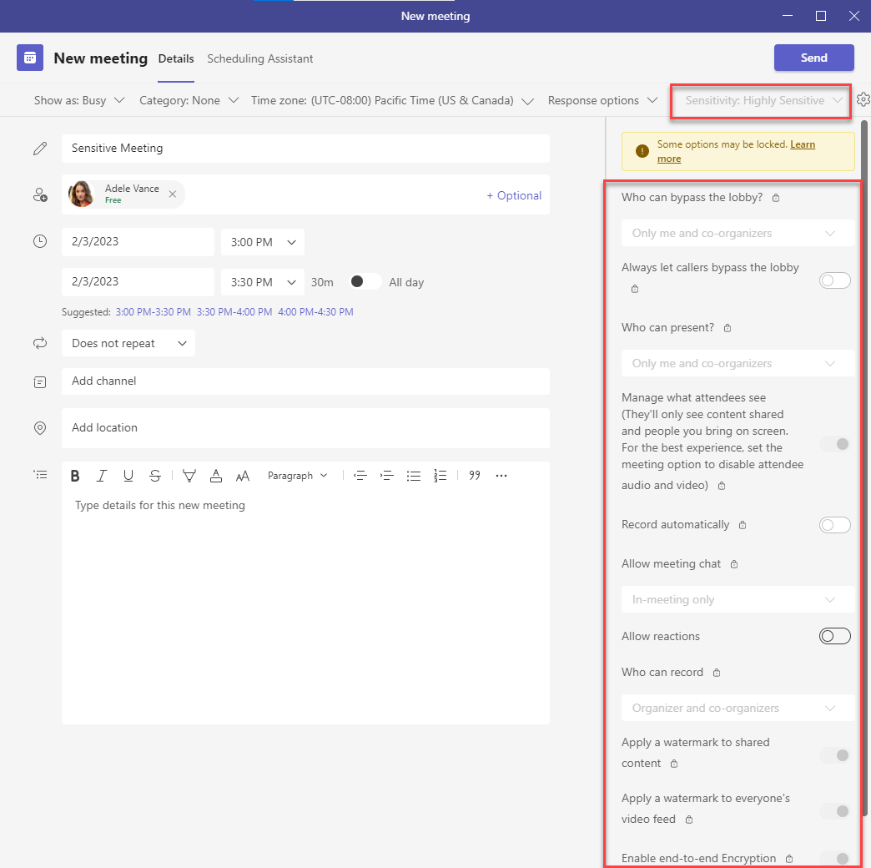
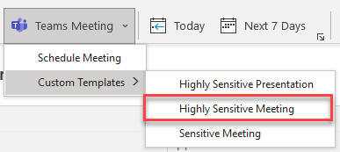
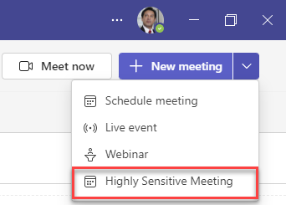
User Guidance
PERSONALIZED MEETINGS
Meeting Template
Introduction
Customized meeting templates are predefined for you , to automatically include the correct settings, reducing the time and thought process it takes to create and get the meeting right. With templates, leaders can ensure that their meetings adhere to company best practices and policies
Organizer Guidance
When a meeting template is made available to an organizer through a custom meeting template policy assignment, the template will be available in the Teams calendar and Outlook.
The settings are automatically applied based on the template (and in this case, sensitivity label).
Note: “Schedule meeting”, “Live event” and “Webinar” are built-in templates, controlled through other policies.
There is no user guidance, specifically. The Meeting Organizer is simply using the templates.

Slide 16
PERSONALIZED MEETINGS
Meeting Templates
Overview and Benefits
Meeting Templates allows IT Admins to customize and manage meeting settings, create standardized meeting templates, and make them available to meeting organizers when sending meeting invites.
Create a consistent meeting experiences for your organization.
Help ensure adherence to compliance requirements.
Allow organizers to select the right template for their meeting, reducing the time and thought process of getting the meeting right.
Meeting templates can be used to enforce settings or to set defaults. Each template setting can be locked so the meeting organizer can't change it, or can be left unlocked for the meeting organizer to change if needed
The following meeting settings can be controlled by using a meeting template:
Setting | Description
Chat | Specifies if the meeting chat is available. Can also be used to prevent chat before and after the meeting.
End-to-end encryption | Specifies if the meeting is encrypted.
Lobby | Specifies who can bypass the lobby and join the meeting directly.
Manage what attendees see | Specifies if meeting organizers can preview and approve content being shared on screen before other meeting participants can see it.
Mic and camera for attendees | Specifies if attendees can unmute and use their camera.
Notify when callers join and leave | Specifies if a sound plays when people calling in by phone join or leave the meeting.
Q&A | Specifies if attendees can use the Q&A feature to ask questions during the meeting.
Reactions | Specifies if attendees can use reactions or raise their hand in the meeting.
Recording | Specifies who can record and if the meeting is recorded automatically.
Sensitivity label | Specifies the sensitivity label to be used for the meeting.
Watermark | Specifies if watermarks are used for camera feeds and content that is shared on screen in the meeting.

Slide 17
PERSONALIZED MEETINGS
Meeting Templates
Feature Visibility
Meeting templates are assigned by policy by the IT Admin. By default, the Global policy allows users (licensed with Teams Premium) to see all available templates.
Use Cases
Below are the primary use cases:
Industry | Use Cases
Sales | Specialized Sales Templates for ensuring critical company information represented to close special deals are secure through Meetings that have Watermark and E2EE enabled by default
Education | Specialized Class and Lecture Templates to provide educators a hassle-free set-up experience
Recruiting | Specialized Recruiting Templates for interviews to ensure that meetings can’t be recorded, and chat can’t be copied

Slide 18
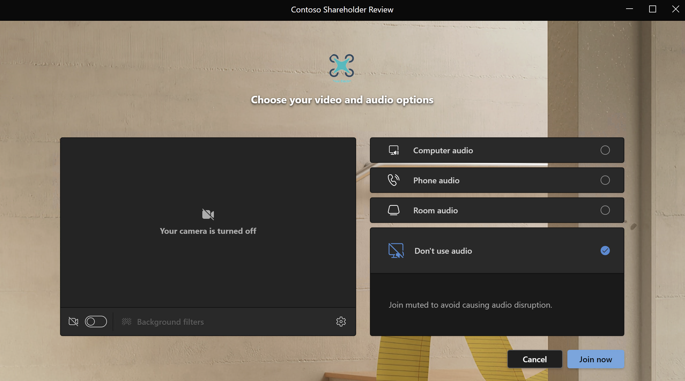
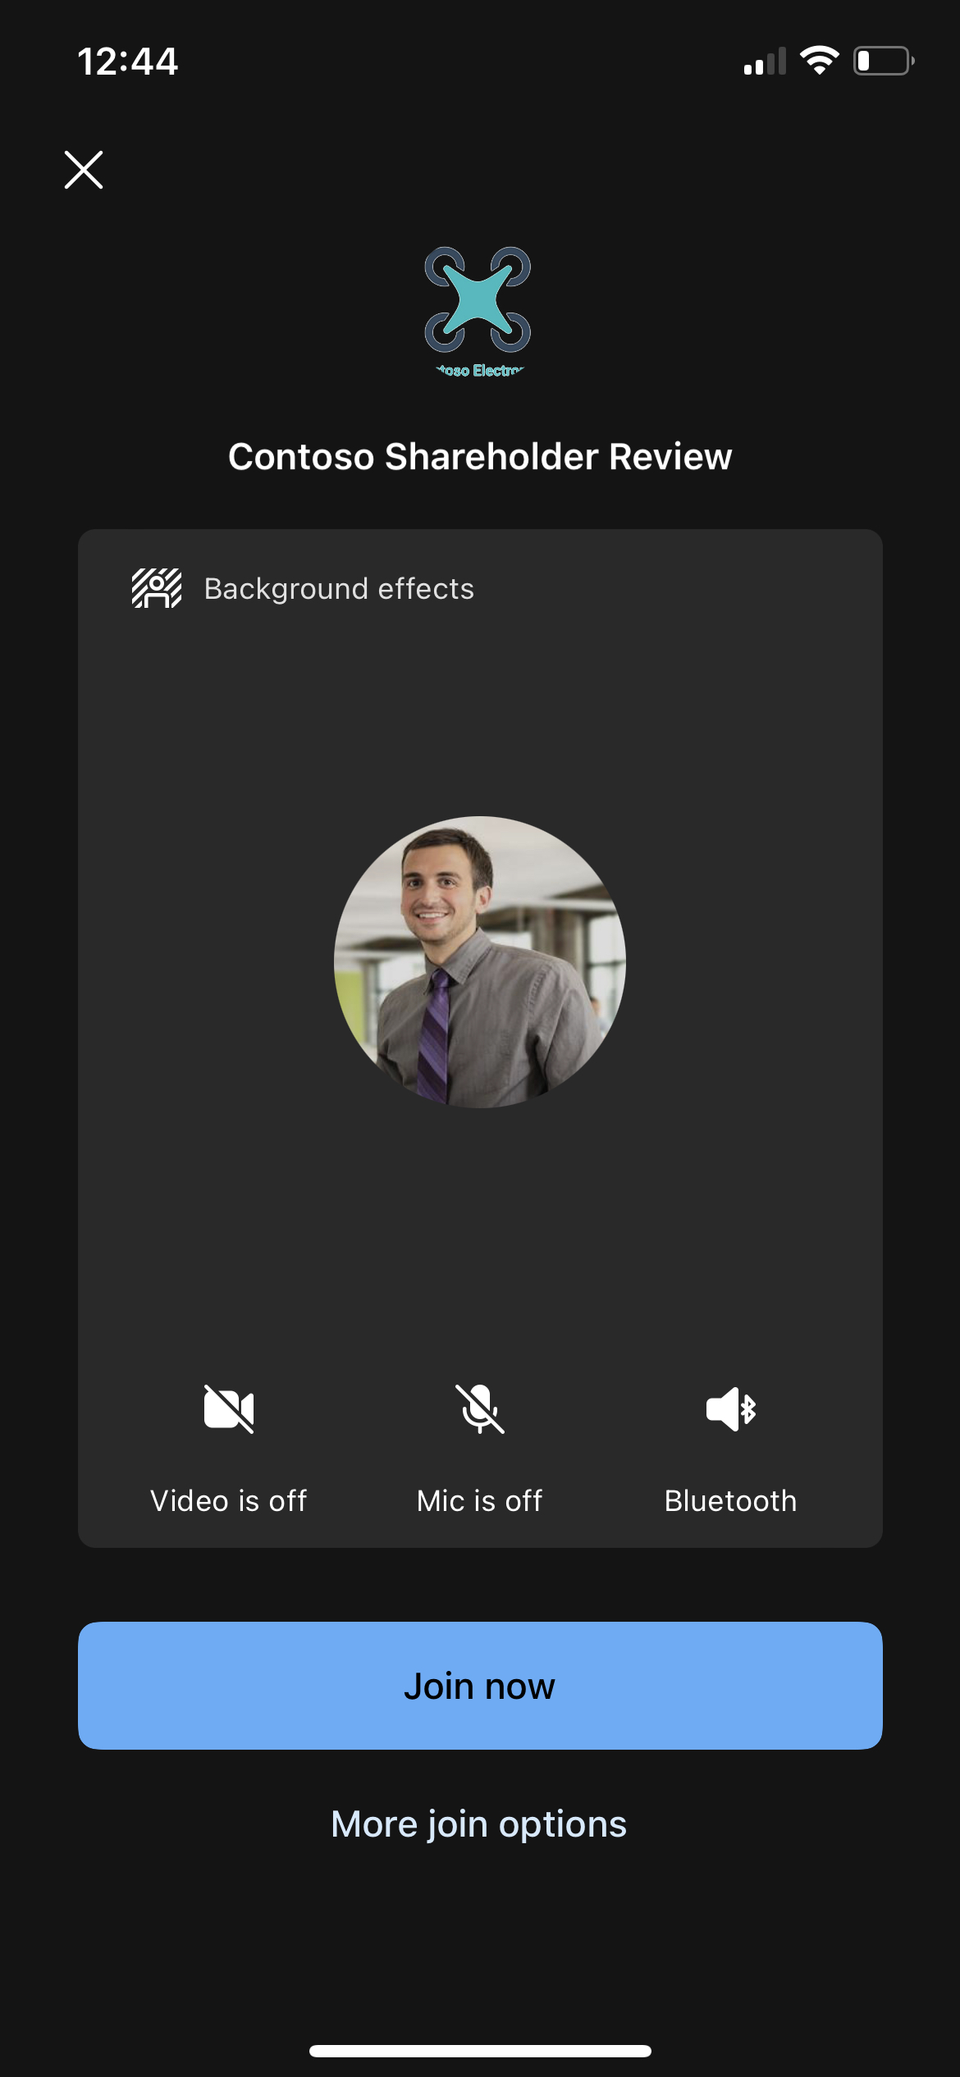
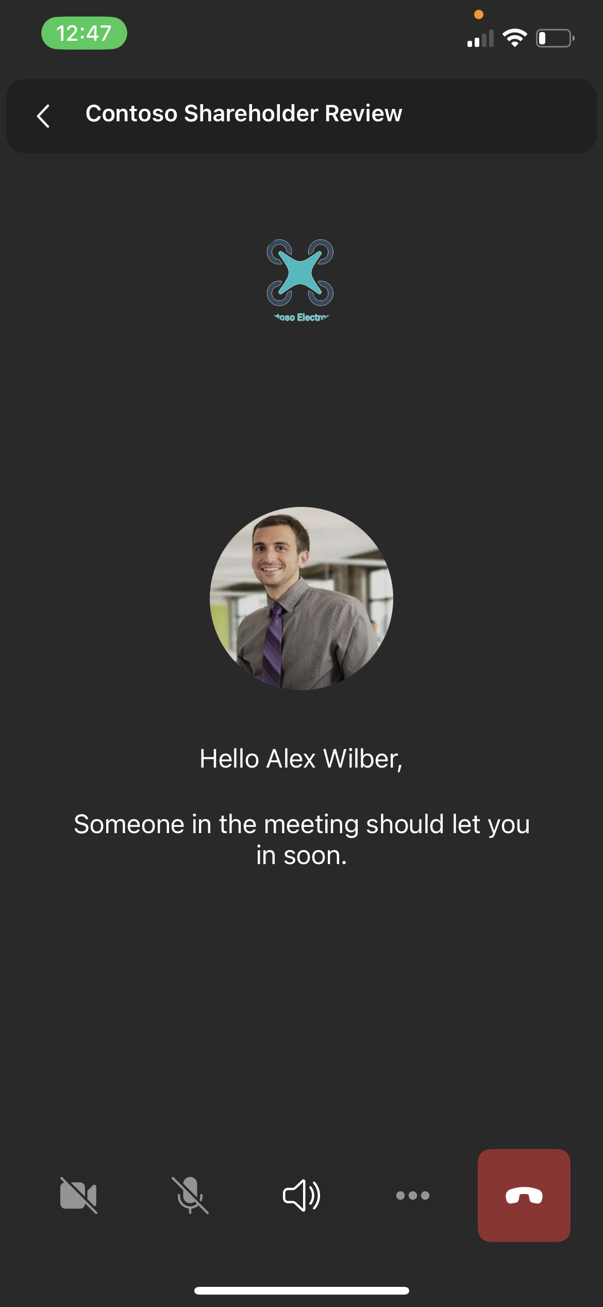
PERSONALIZED MEETINGS
Branded Meetings
Introduction
Branded Meetings let everyone see the logo and colors of your company when you join the meeting and allow your brand colors to be infused in the meeting itself.
Pre-Join Experience
Teams Desktop / Web Client
Teams Mobile Client
Meeting Lobby
Teams Desktop / Web Client
Teams Mobile Client

Slide 19
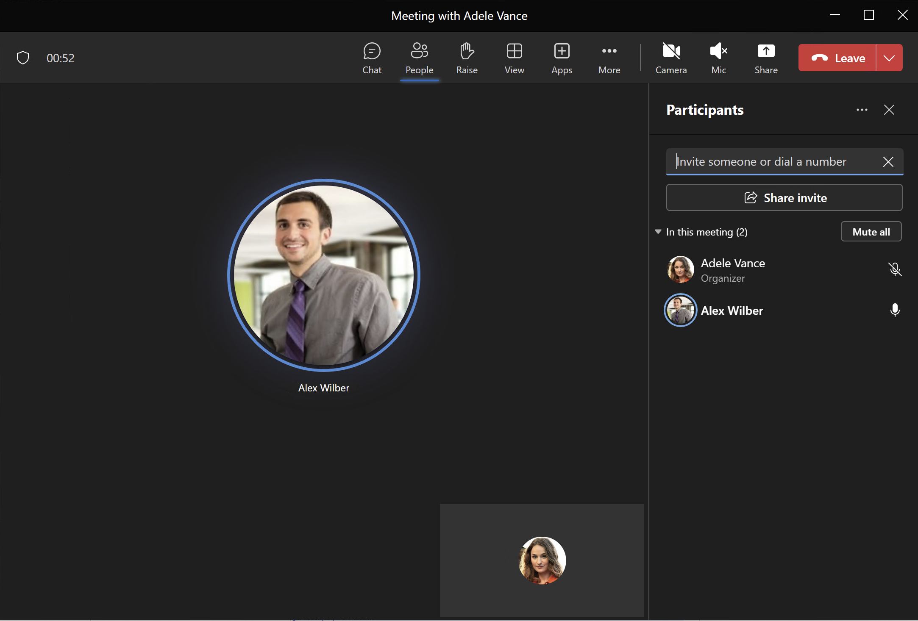
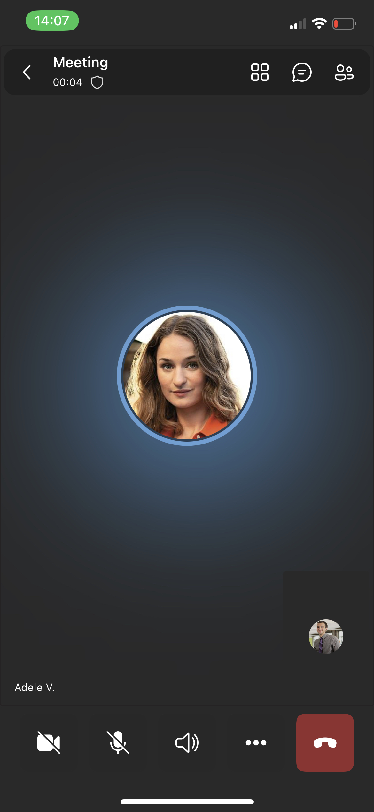
In Meeting Experience
PERSONALIZED MEETINGS
Branded Meetings
Teams Desktop / Web Client
Teams Mobile Client

Slide 20
PERSONALIZED MEETINGS
Branded Meetings
Overview and Benefits
Branded Meetings allows your organization to extend their branding to Teams meetings: personalize with your company's logo, brand imagery, and color palette, set branding organization wide, per group, or individually, and apply to pre-join, lobby and in-meeting experiences.
Foster internal corporate culture building and increase overall brand awareness with a consistent "look and feel“
Make a great first impression and provide a sense of professionalism and polish for all client and external meetings
Support marketing moments, product launches, company-events, culture, and holidays
Feature Visibility
Branded meetings are visible to all meeting attendees running supported Teams clients.
Use Cases
Below are the primary use cases:
Industry | Use Cases
Healthcare, Financial Services, Retail | Make a great first impression with your organization's branding prominently displayed in the meeting, providing a sense of professionalism for all client and external meetings.
Enterprise | Champion brand pride and foster corporate culture with a consistent "look and feel" for your internal and external meetings.
Banking | Create trust with external customers when discussing financial information by having your organization’s branding in the pre-join meeting lobby.

Slide 21
PERSONALIZED MEETINGS
Branded Meetings
Prerequisites
Meeting organizers applying branding within your organization must have a Teams Premium License.
Dependencies and Limitations
Settings available include:
Enforcing a theme, or enabling users to control whether a theme is applied through meeting options
Defining a theme containing visual components can include:
Organization logo
Organization image
Custom color
Supported platforms:
Desktop (Windows and Mac)
Mobile (Android 11+ and iOS only)
Teams Web Client
Unsupported platforms:
Teams Rooms
Branding will show during the following times:
 | Join Launcher | Meeting Pre-Join | Meeting Lobby
Logo | No | Yes | Yes
Image | No | Yes | Yes
Color | Yes | Yes | Yes

Slide 22
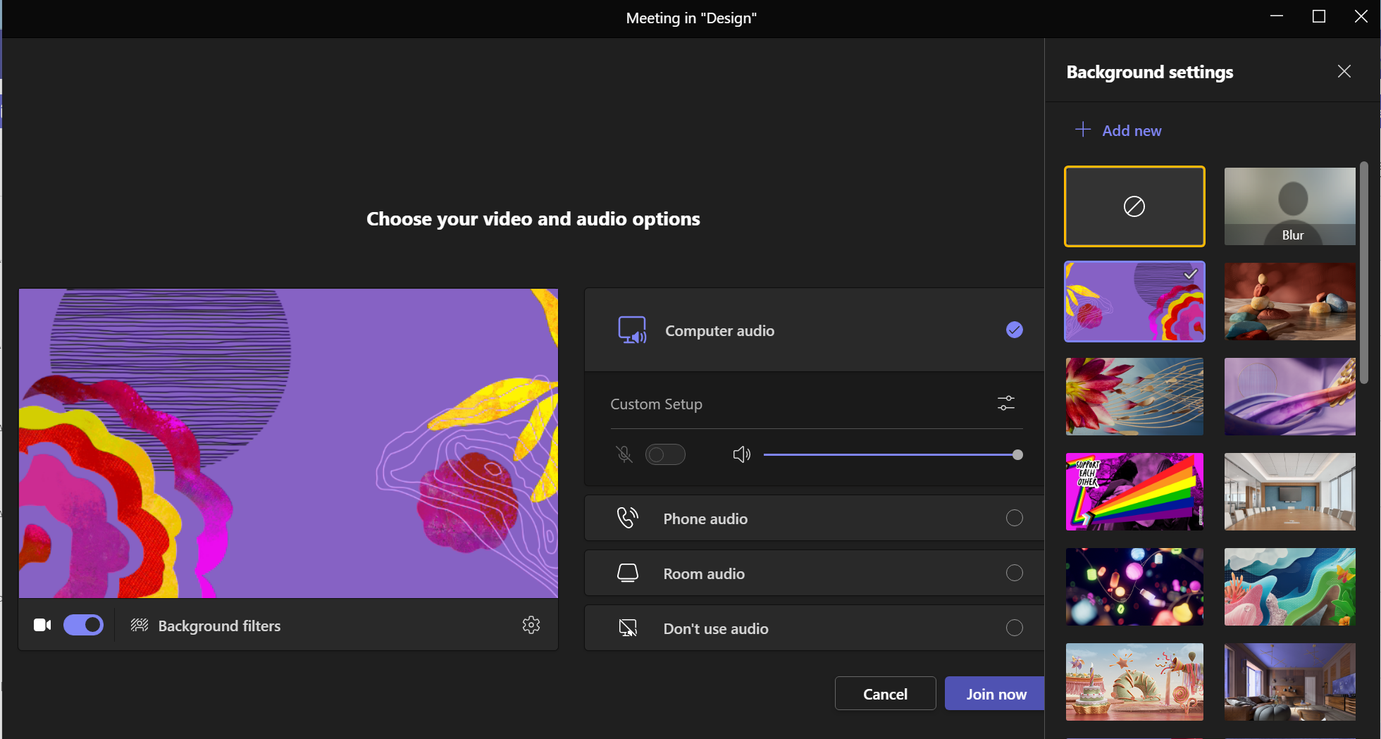
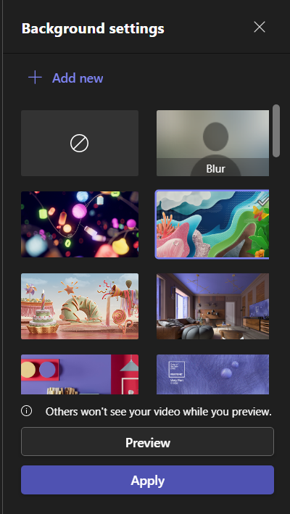
PERSONALIZED MEETINGS
Org-defined backgrounds
Introduction
You can now enable during the meeting a brand approved custom background images from a predefined organizational background your admin was place for you to choose from.
Using custom background in meetings for Desktop
Org-defined backgrounds will appear on licensed user’s interface, ordered by time of upload.
Desktop
Pre-join experience
Join a meeting in your calendar.
Enable camera.
Select Background filters.
Choose one of the org-defined backgrounds.
Close and click Join Now to enter the meeting.
In-Meeting Experience
Go to More on the top meeting toolbar.
Select Background effects.
Choose one of the org-defined backgrounds.
Hit Apply.

Slide 23
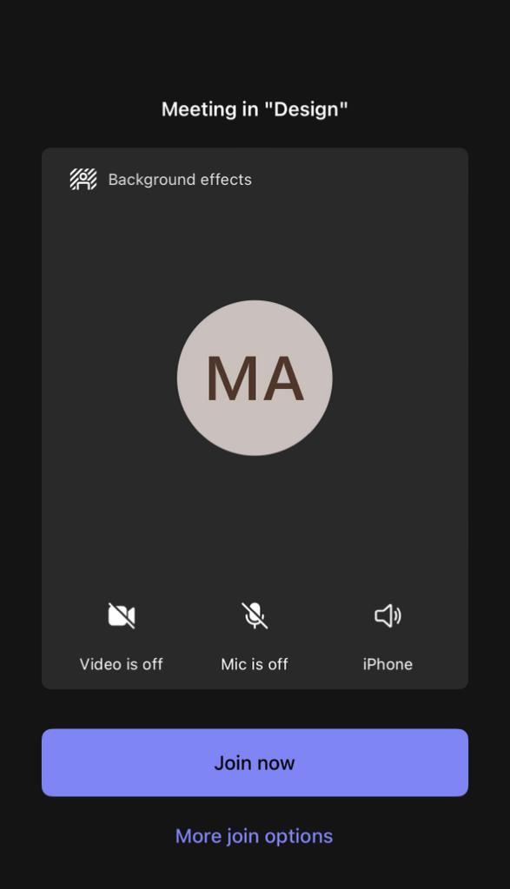
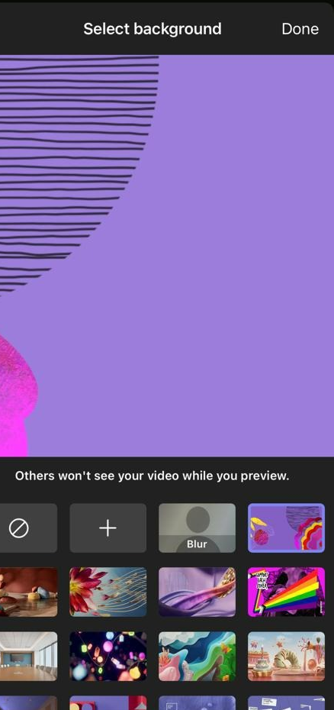
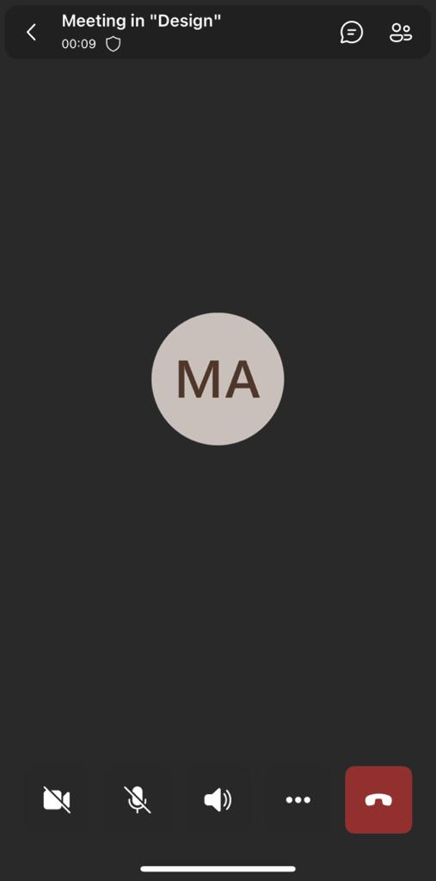
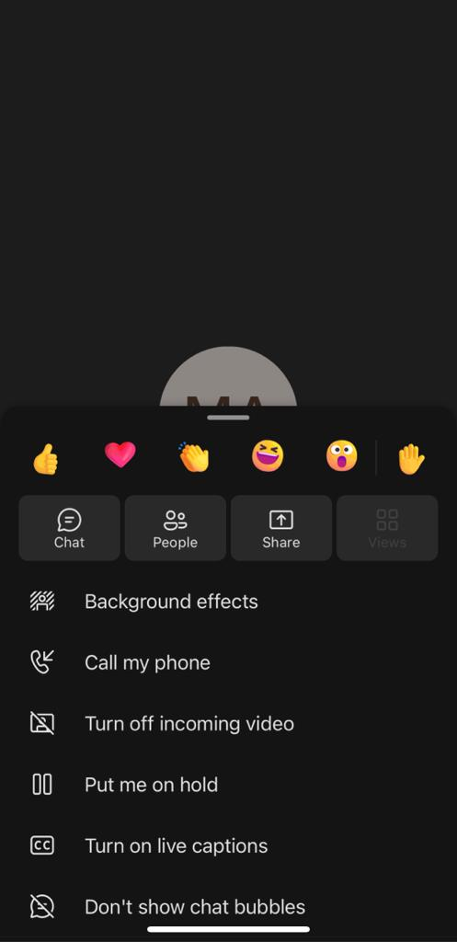
Using custom background in meetings for Mobile
PERSONALIZED MEETINGS
Org-defined backgrounds
Images will appear on licensed user’s interface, ordered by time of upload
Mobile
Pre-join experience
Join a meeting in your calendar.
Select Background effects.
Choose one of the org-defined backgrounds.
Click Done and hit Join Now to enter the meeting.
In-Meeting Experience
Click the three dots “…” on the bottom toolbar.
Select Background effects.
Choose one of the org-defined backgrounds.
Click Done

Slide 24
PERSONALIZED MEETINGS
Org-defined backgrounds
Overview and Benefits
Organizational backgrounds enable IT Admins to upload custom background images at a tenant level, making them visible to users in their org. Organizational backgrounds can support marketing moments, product launches, company-events, culture, and holidays.
Feature Visibility
Meeting participants must have a Team Premium license to have the ability to choose yuor own background from the provided organizational-defined backgrounds.
Use Cases
Below are the primary use cases:
Industry | Use Cases
All | Virtual Birthday Parties, Unique/iconic office spaces on your company’s campus, townhalls, All-hands in company auditoriums, Offsites in locations like the Grand Canyon
Government | Courtroom
Education | Classroom; University; branded certification or continuing education themes
Prerequisites
Each meeting attendee or user must have a Teams Premium license to benefit from the feature.
Dependencies and Limitations
Supported platforms:
Desktop (Windows and Mac)
Mobile (Android 11+ and iOS only)
Teams Web Client
Unsupported platforms:
Teams Rooms

Slide 25
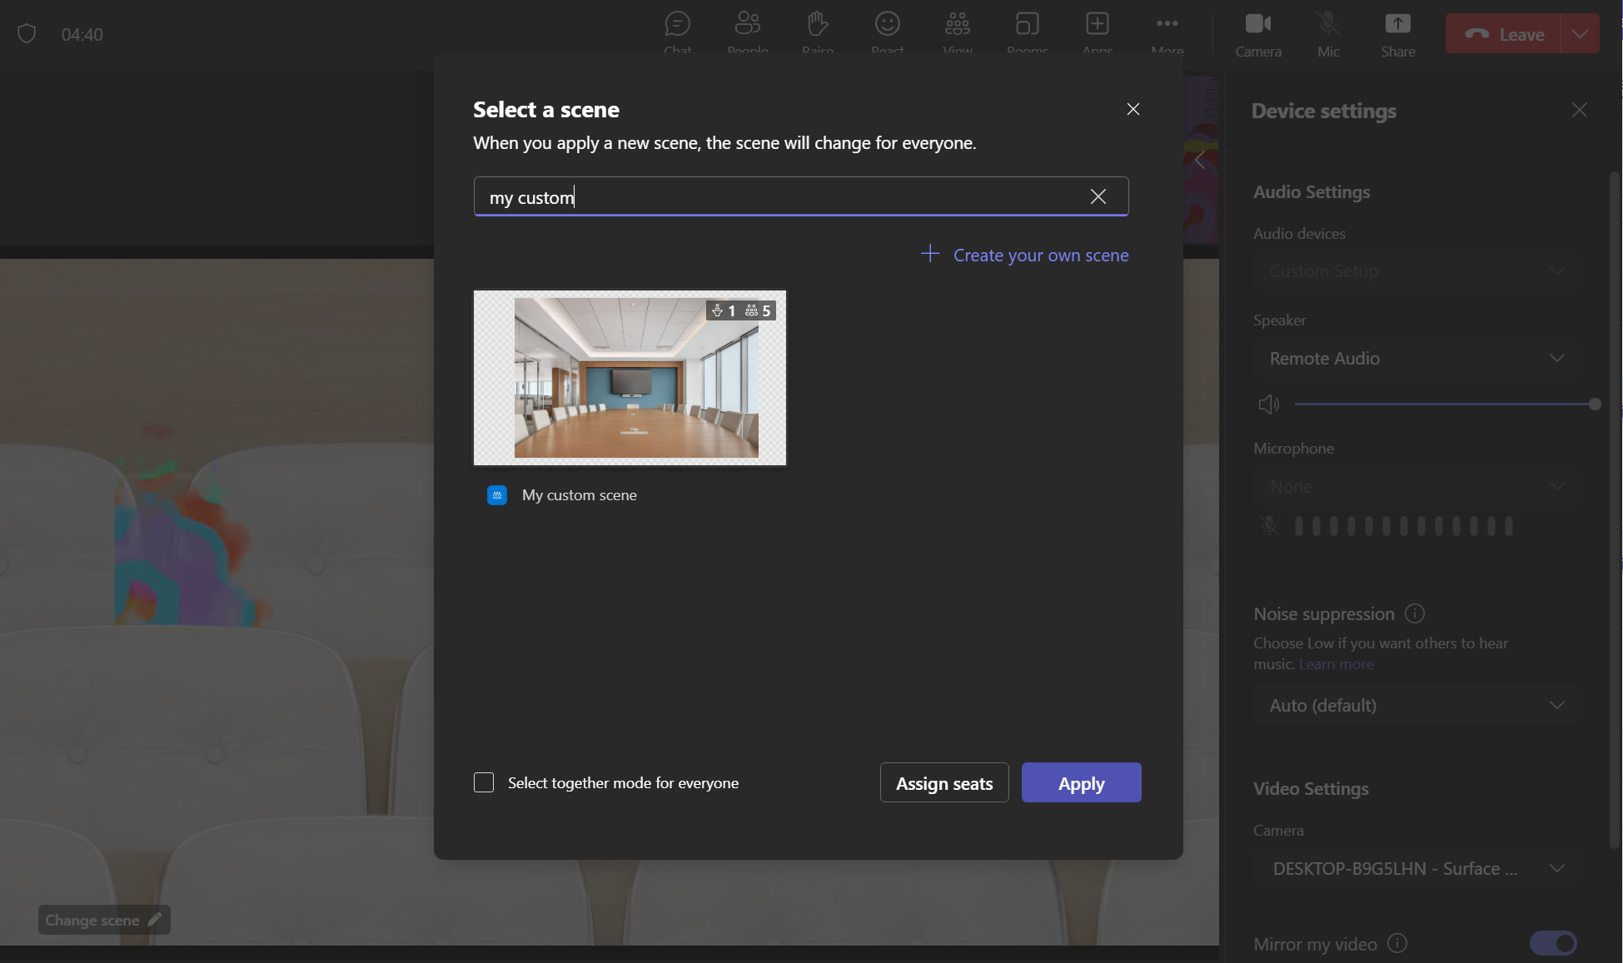
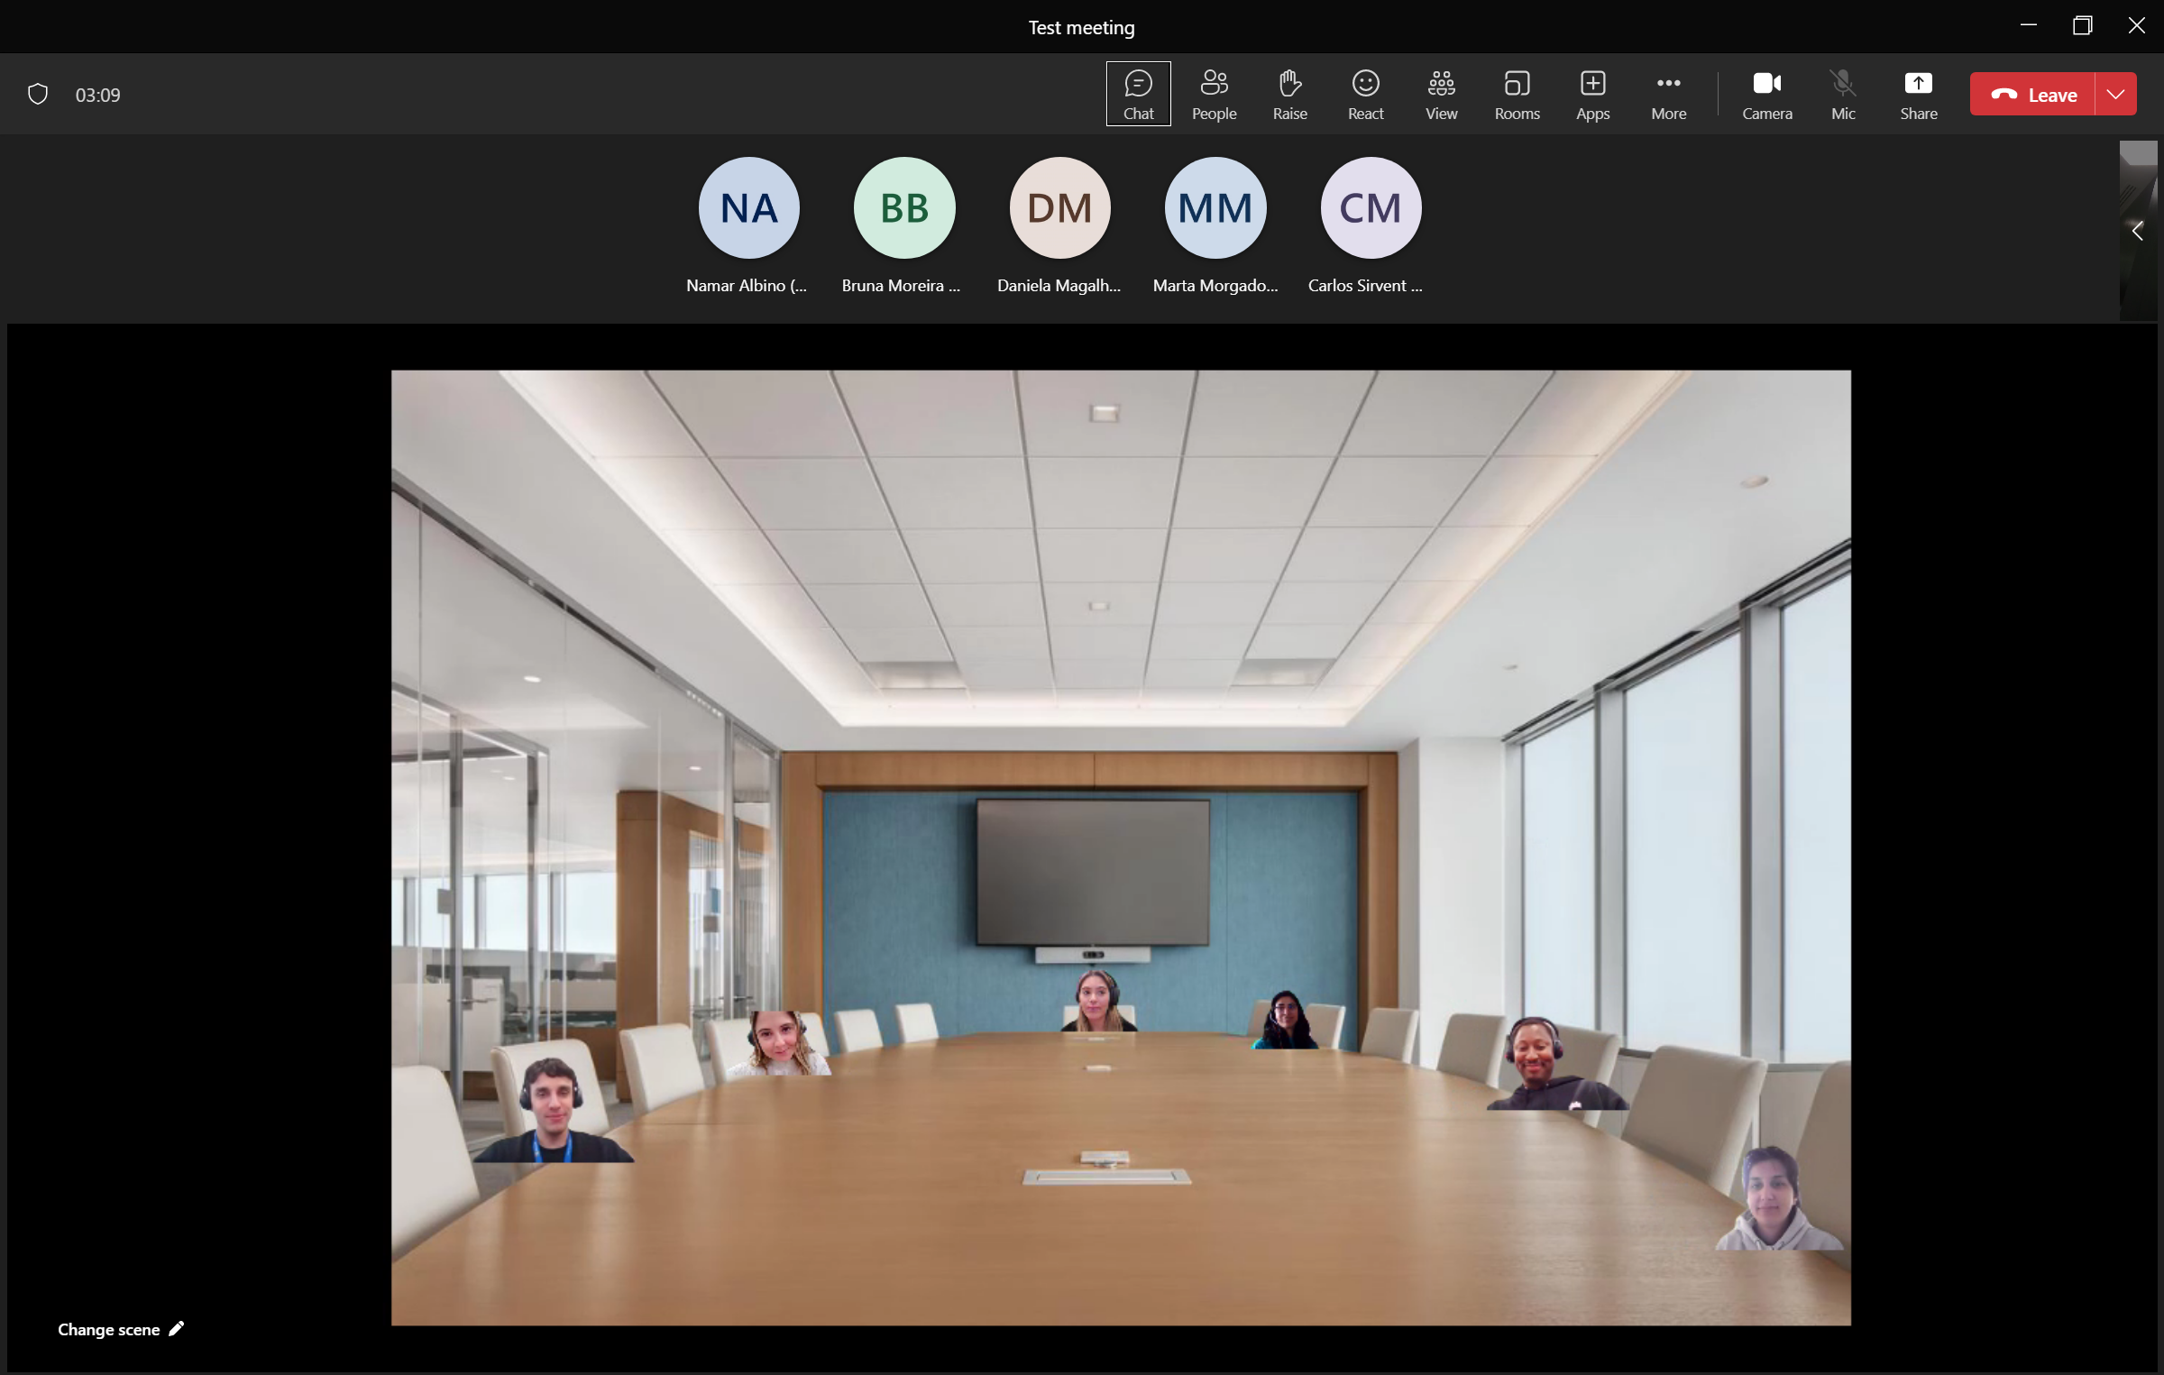
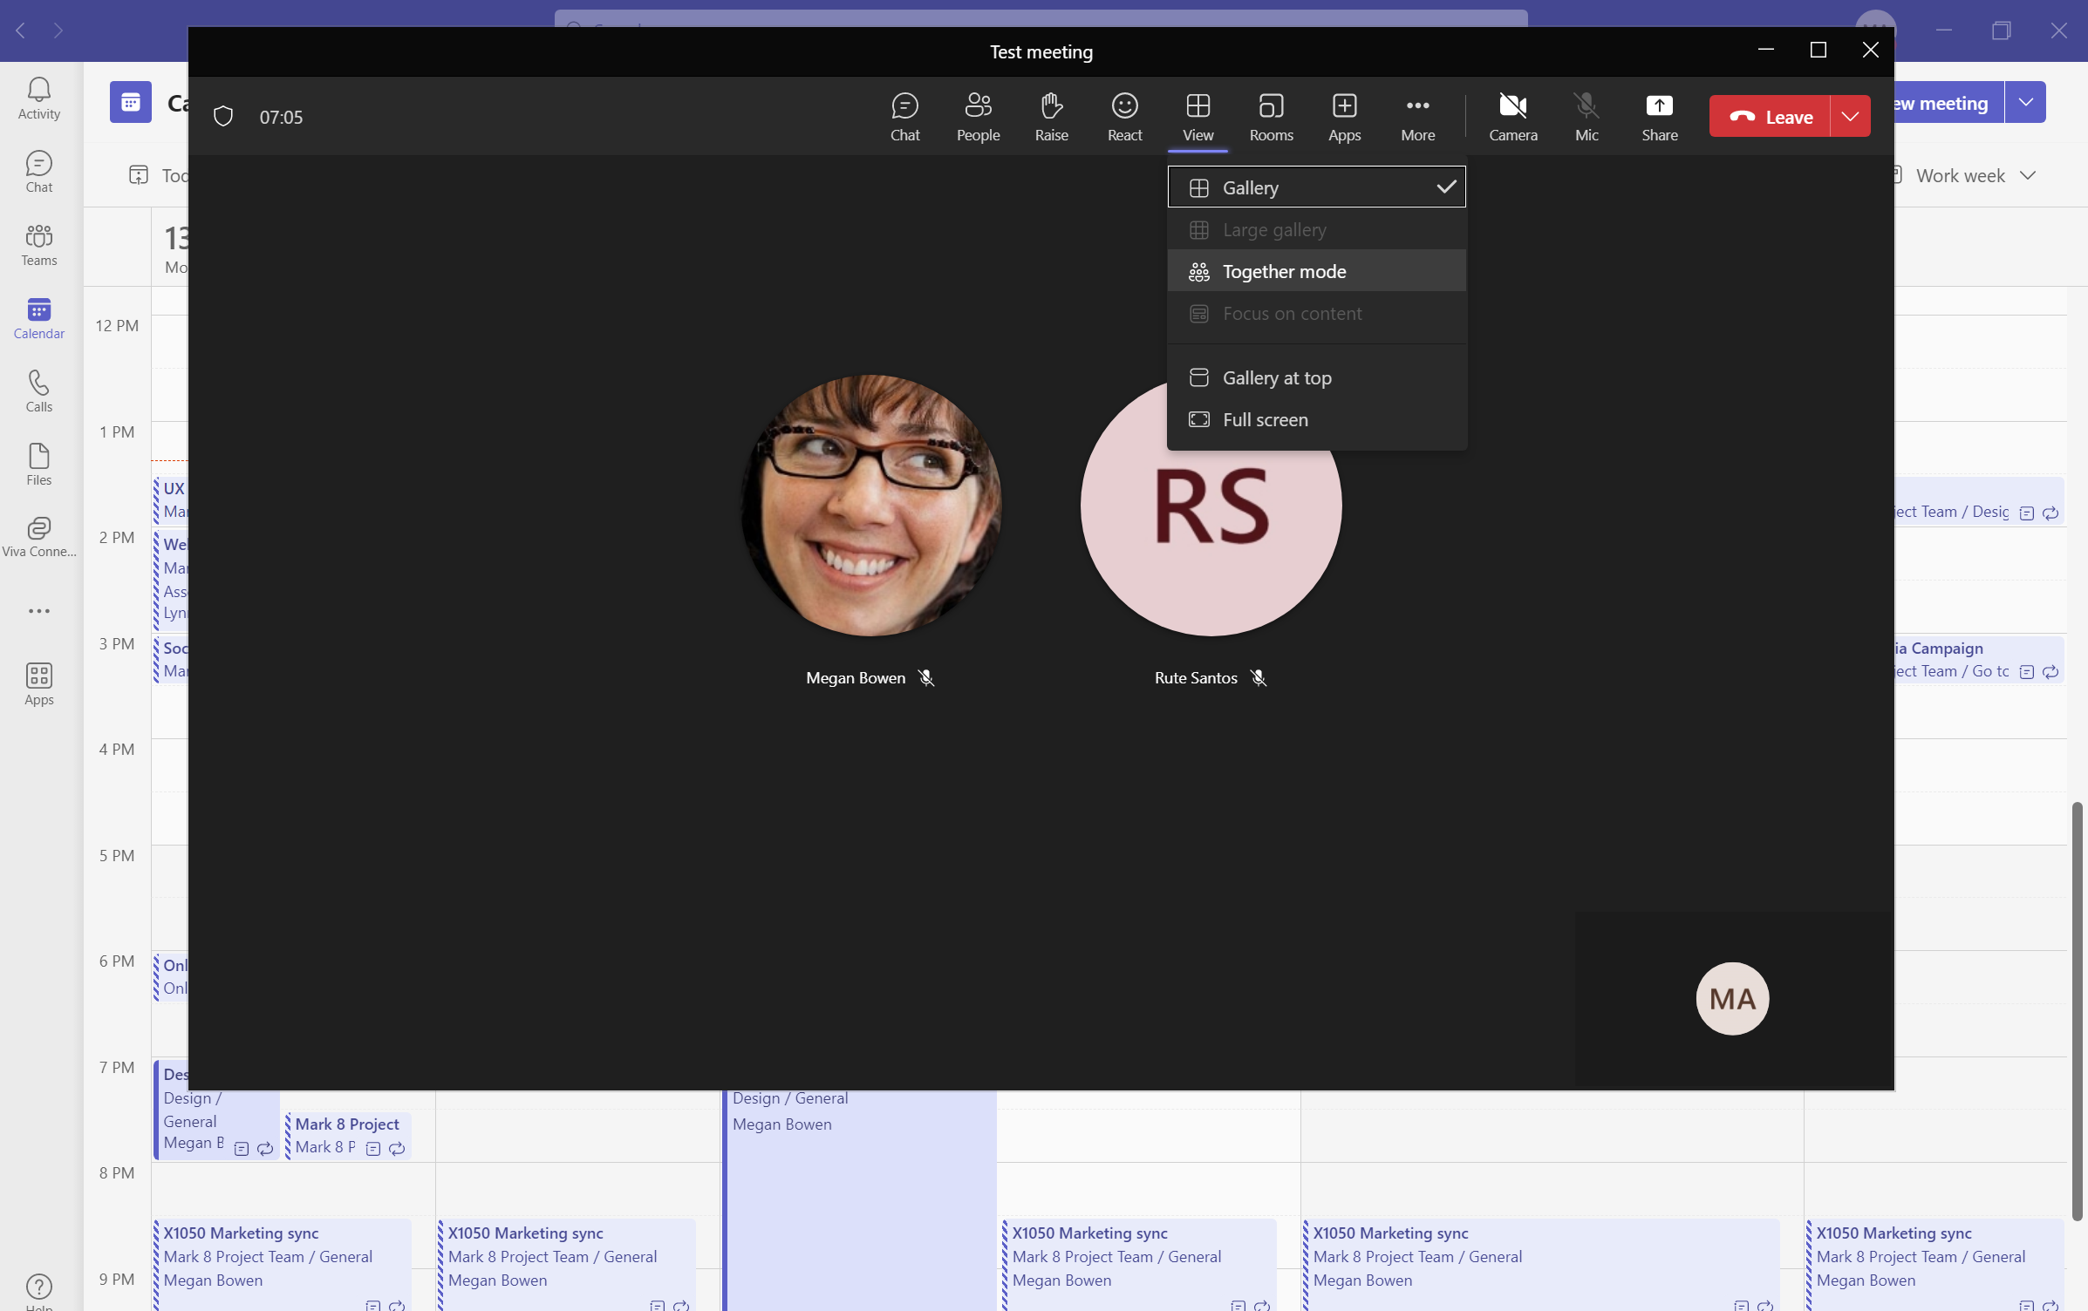
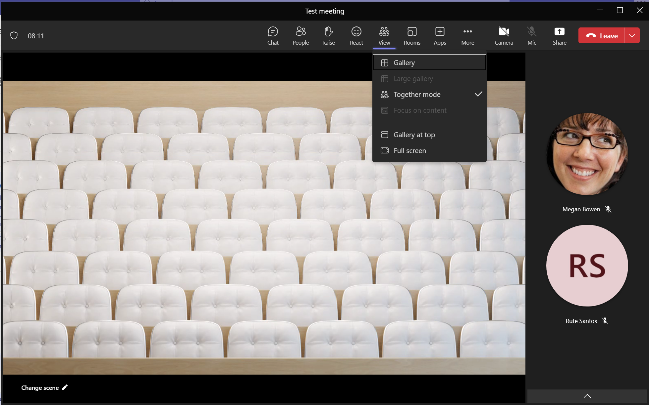
PERSONALIZED MEETINGS
Together Mode Scenes
Introduction
Provide you to choose a branded approved together mode scenes, as an immersive and engaging meeting environment in Teams Meetings.
Organizer Guidance: Changing together mode scenes
To change scenes for all participants in the meeting, organizers and presenters can check select together mode for everyone box and hit Apply.
User Guidance: Use together mode scenes
To use, select Together Mode in View. This will allow users to change the scene to the one created.

Slide 26
PERSONALIZED MEETINGS
Together Mode Scenes
Overview and Benefits
Custom Together Mode Scenes provide an immersive and engaging meeting environment in Teams Meetings.
Bring people together and encourage them to turn on their video.
Combine participants digitally into a single virtual scene.
Place the participants' video streams in pre-determined seats designed and fixed by the scene creator.
Feature Visibility
Meeting participants must have a Team Premium license to be able to select a custom Together Mode scene.
Use Cases
Below are the primary use cases:
Industry | Use Cases
All | Virtual Birthday Parties, Unique/iconic office spaces on your company’s campus, townhalls, All-hands in company auditoriums, Offsites in location like the Grand Canyon
Government | Courtroom
Education | Classroom; University; branded certification or continuing education themes

Slide 27
Protected meetings

Slide 28
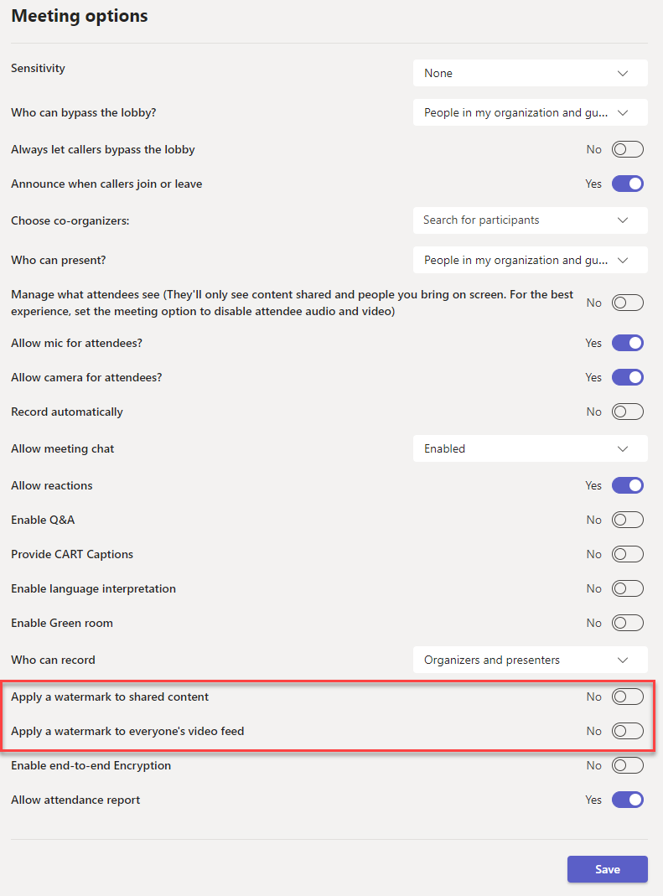
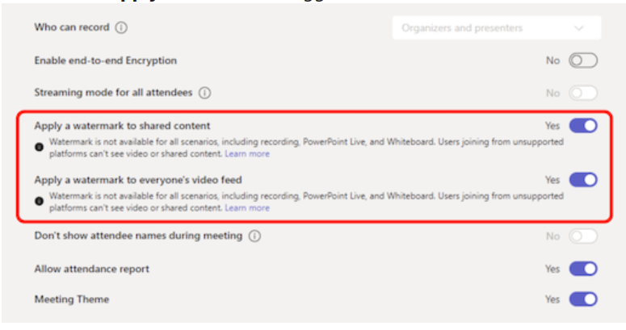
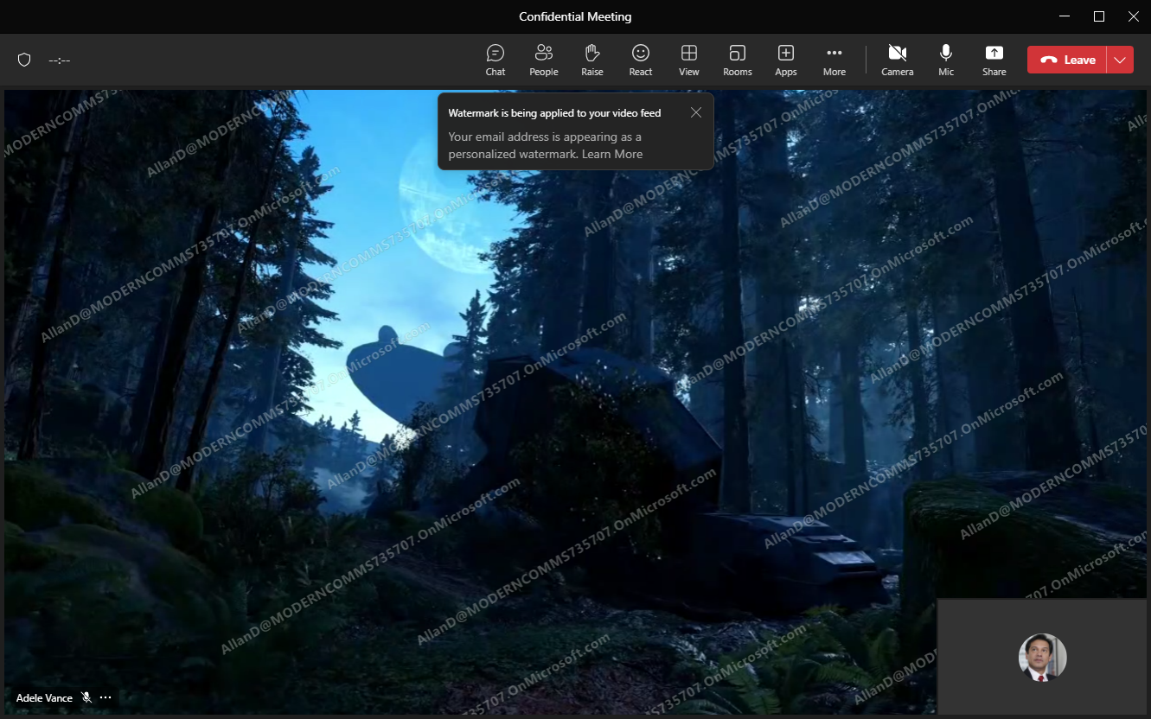
Organizer Guidance
PROTECTED MEETINGS
Watermark
Introduction
Meeting organizers can leverage a unique watermark over attendee screen shares and video feeds to confidently present and display sensitive information, aiming to deter of content leaks. This will help to protect shared content during meetings by generating an overlay (or watermark) with each individual participant’s email.
Watermark functionality is accessible to users with a Teams Premium license. When an organizer have Teams premium license, they can apply watermarks in their meetings by applying them to shared content or video feeds.
Create or open a meeting from your Outlook or Teams Calendar.
In Details, select Meeting Options.
Select Apply Watermark and turn on toggle(s) for shared content, video feed or both.
Select Save to apply the watermark to your meeting.
Attendee View: Watermark on video feed
When watermark is applied to everyone’s video feed (set to yes in Meeting Options), all incoming video feeds will have the viewer’s email address as the personalized watermark.

Slide 29
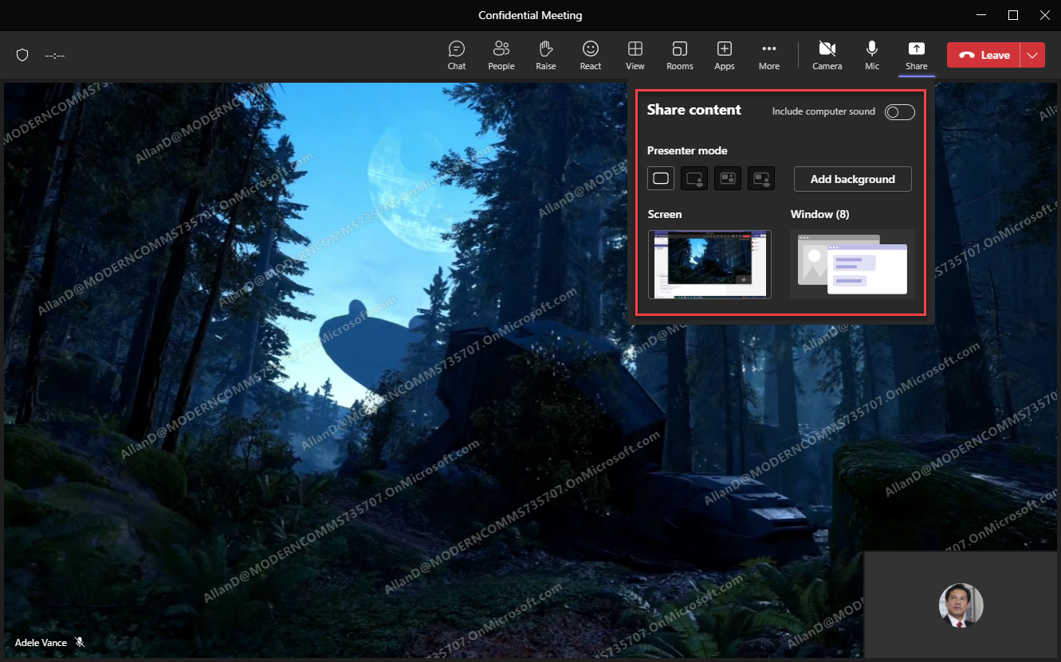
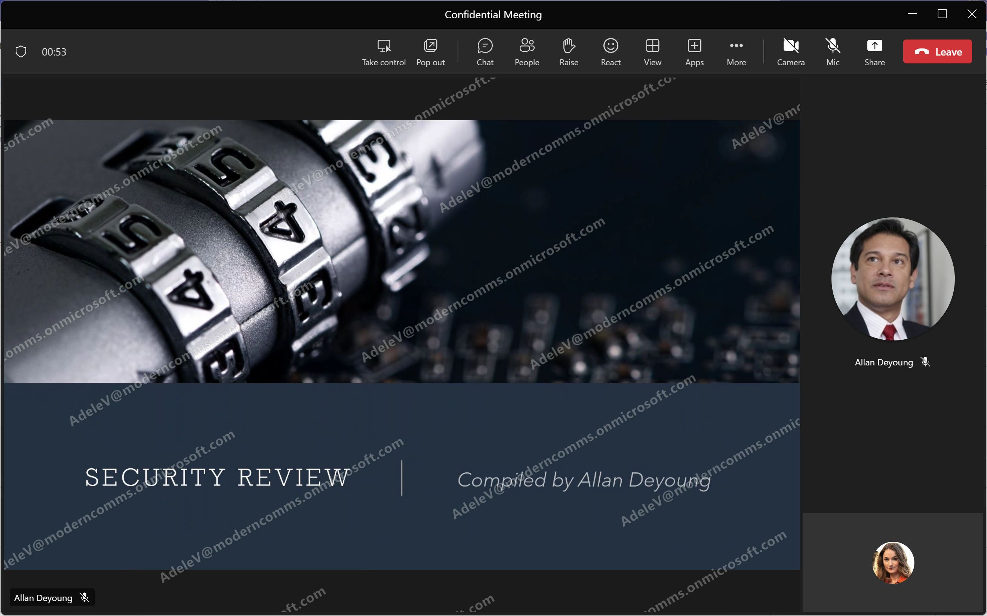
Applying watermark to shared content
PROTECTED MEETINGS
Watermark
The sharing tray will adjust to only show screen and window options when “apply watermark to shared content” is set to Yes. PowerPoint Live and Excel Live are not available.
Attendee View: Watermark on shared content
When watermark is applied to shared content (set to yes in Meeting Options), all incoming shared content feeds will have the viewer’s email address as the personalized watermark

Slide 30
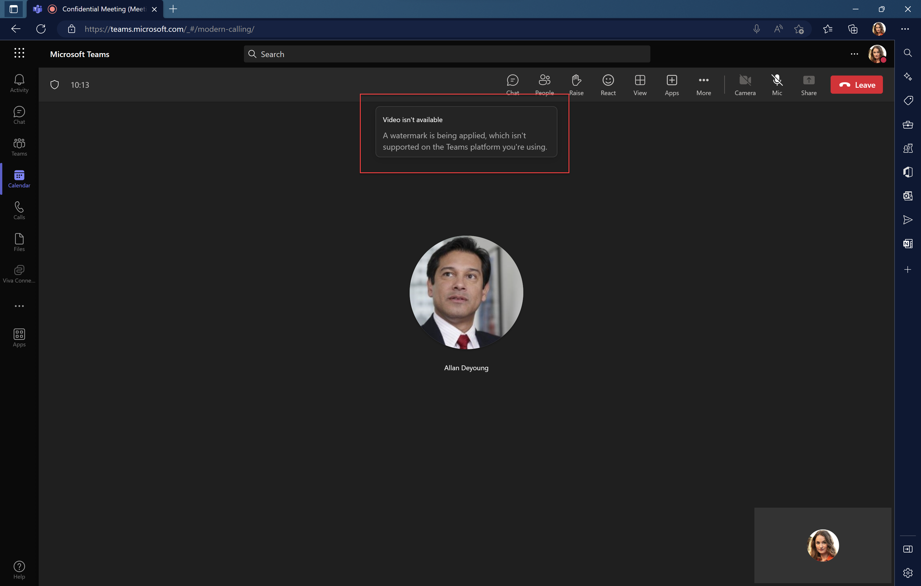
Attendee View: When attendee is using an unsupported meeting platform
PROTECTED MEETINGS
Watermark
When watermark option is turned on in Meeting Options, but attendee is using an unsupported meeting platform, the attendee will have an audio only experience.

Slide 31
PROTECTED MEETINGS
Watermark
Overview and Benefits
Watermark helps to protect shared content during meetings by generating an overlay (or watermark) with each individual participant’s email to safeguard confidential meetings. The watermark will be washed out and sit behind your text and pictures, so that it doesn't interfere with what's on the screen.
Deters participants from taking unauthorized screenshots and leaking sensitive or confidential content
Makes it easier to identify the source of leaked information
Feature Visibility
Watermarking is visible to all meeting participants if you are as the organizer has a Teams Premium license. Only organizer requires the premium license.
Dependencies and Limitations
The policy will be enabled by default for Teams Premium licensed users. IT admin will have the capability to disable the policy from the Teams Admin Center or Powershell.
Watermark can be turned on for:
Shared Content (desktop/window sharing only)
Video feeds
Supported platforms:
Desktop (Windows and Mac)
Mobile (iOS and Android)
Teams Room Systems (Windows and Android)

Slide 32
PROTECTED MEETINGS
Watermark
Watermark enabled? | Meeting limitations
For shared content... | Disabled features: Meeting recording Together mode Large gallery view PowerPoint Live Excel Live Whiteboard Shared content from cameras
For video feed... | Disabled features: Recording Together mode Large gallery view
Platforms that are not supported... | Audio only (no viewable shared content) for participants using: Teams for web client Virtual Desktop Infrastructure (VDI) Participants who are not signed in (anonymous participants) Direct Guest Join Meeting overflow (greater than 1,000 participants) Older Teams versions, Microsoft Teams (preview) Cloud Video Interop (CVI)²
² Check with your CVI partner for watermark support information.

Slide 33
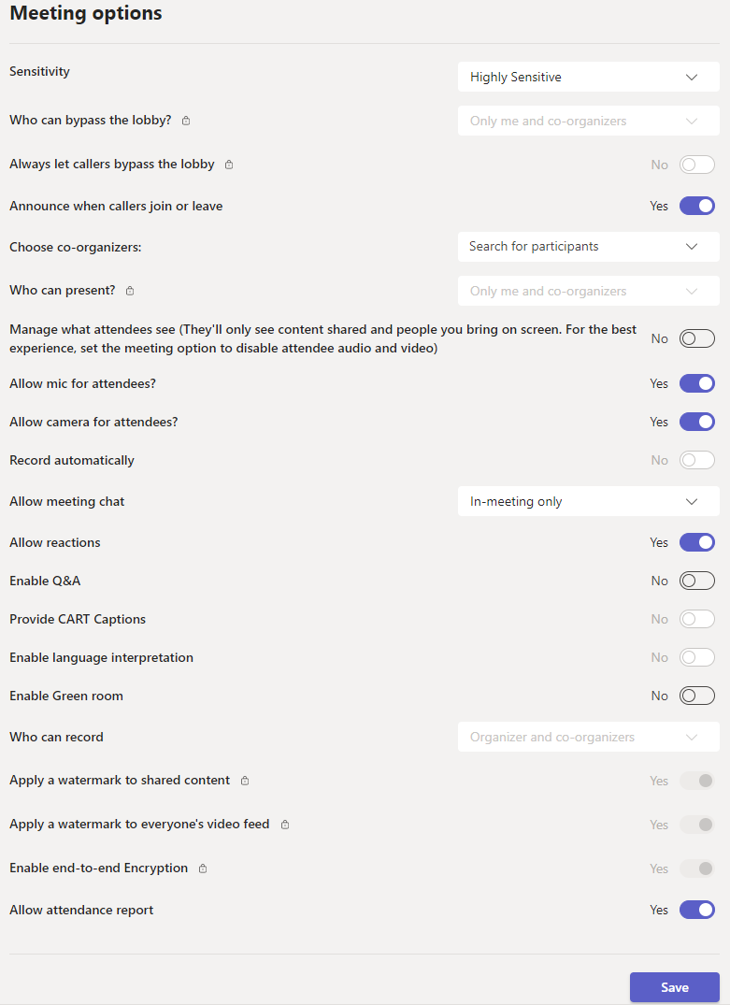
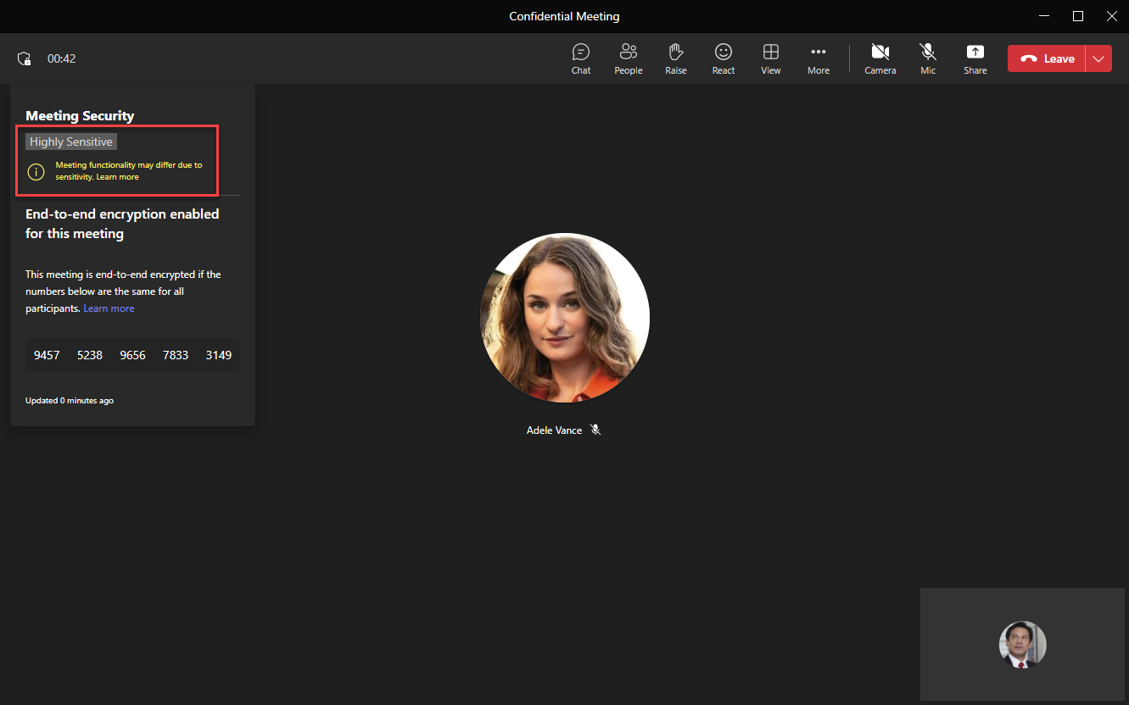
PROTECTED MEETINGS
Sensitivity labels
Introduction
For meetings that include discussing business-sensitive information that needs an extra layer of protection, meeting organizers can leverage sensitivity labels to automatically apply the most relevant and important meeting options based on the sensitivity of meeting content.
Organizer Guidance
Once published by IT Admin, the meeting organizer can choose the desired sensitivity label
Sensitivity labels can also be applied automatically:
As a default (configured in the published sensitivity label)
As part of a template
When there are overlapping settings between a template and sensitivity label, the sensitivity label configuration will override it.
Attendee: Meeting Experience
The security indicator in the upper left will show that a sensitivity label has been applied to the current meeting.

Slide 34
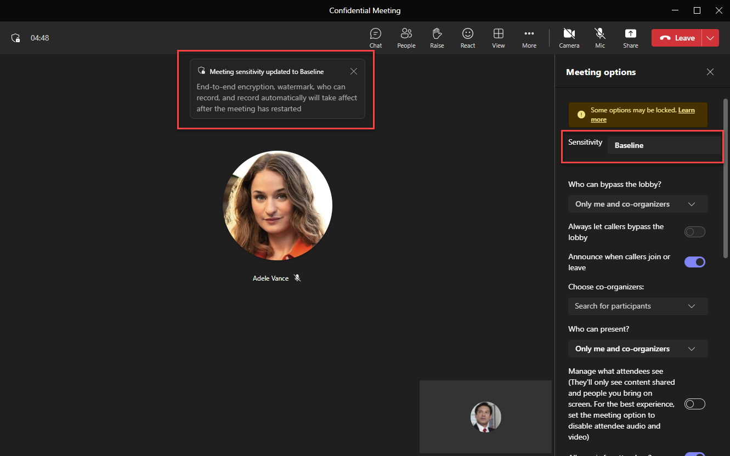
Attendee: In-Meeting Application
PROTECTED MEETINGS
Sensitivity labels
The meeting organizer can apply/change the sensitivity label during the meeting; however, some settings require the meeting to end and restart.

Slide 35
PROTECTED MEETINGS
Sensitivity Labels
Overview and Benefits
Sensitivity labels make it even easier to protect information and meeting invites from Outlook and/or Teams.
Prevent attendees from leaking sensitive or confidential information
Keep meeting subject, time, location and participants confidential
Prevent the meeting invite from being forwarded
Ensure settings are enforced when sensitivity labels are applied (labels are locked; cannot be changed)
When the meeting starts, any meeting options configured in the label are enforced. They include:
Who can bypass the lobby
Who can present
Who can record
End-to-end encryption for meetings
Automatically record
Watermark (video and screen sharing)
Prevent or allow chat
Prevent or allow copying chat contents to clipboard
Sensitivity labels configure and/or enforce meeting options when it's applied to the meeting. A user selects one of the company's existing sensitivity labels and applies it when setting up/editing the meeting. Compliance admins will need to enable their existing labels for Teams meetings in the Purview portal
Feature Visibility
Sensitivity labels are visible / applicable to all meeting participants once they are enabled/applied.
Note: Some of the meeting protection options will not change while the meeting is ongoing but will take effect for the next instance after everyone leaves and re-joins. Support for copy prevention for external meeting joiners, and for meeting chats on Safari, Firefox, and Mobile will come in a few months.

Slide 36
PROTECTED MEETINGS
Sensitivity Labels
Use Cases
Below are the primary use cases for Sensitivity labels for meetings:
Industry | Use Cases / Stories
Any Enterprise | Scheduling a private Executive Leadership meeting and want to ensure that highly sensitive information is not inadvertently shared. Labels can be used to restrict who can bypass the lobby, block copying from the meeting chat and enable end-to-end encryption.
Consumer Goods | Financial team working with investors
Human Resources | HR having an internal discussion or conducting an interview
Additional Roles Needed
Compliance Admin (configured through Purview Portal)
Prerequisites
Compliance Admin must have access to the Purview Portal (https://compliance.microsoft.com)
E3 + Microsoft 365 E5 Compliance OR E5 licensing
Teams Premium license
Labels can be applied to meeting invites in Teams or Outlook. Version support is noted here.

Slide 37
PROTECTED MEETINGS
Sensitivity Labels
Dependencies and Limitations
Before you use sensitivity labels for Teams, be aware of the following limitations:
Prevent copying chat limitations. The label setting to prevent copying chat to the clipboard is enforced for all channel chats, even outside channel meetings. For non-channel meetings, it's enforced only for meetings. This setting is currently unsupported for virtual desktop infrastructure (VDI). The methods supported to prevent copying chat: Select the text and then right-click > Copy or Ctrl+C. Copying using developer tools or third-party apps won't be prevented.
iOS and Android mobile devices don’t support labeling calendar items and Teams meetings.
Sensitivity labels are currently unsupported for customers using Teams Education SKUs. For more information, see Microsoft Teams service description.
Additional limitations, specifically related to Outlook and Teams, are documented at Use sensitivity labels to protect calendar items, Teams meetings, and chat - Microsoft Purview (compliance) | Microsoft Learn.
Platforms supported
Meeting Sensitivity Label | ‘Prevent copy/paste of meeting chat’
Desktop (Windows/Mac) Web (Edge/Chrome) Mobile (iOS, Android can only join labeled meeting but not schedule labeled meetings) Teams Room Systems (Windows and Android) | Desktop (Windows/Mac) Web (Edge/Chrome)
For information on the difference between sensitivity labels and Teams Classification, see Sensitivity labels for Microsoft Teams - Microsoft Teams | Microsoft Learn.
Note: It can take up to 3 days for SCC to allow management of Sensitivity labels for use with Teams meetings, once Teams Premium license has been procured.

Slide 38
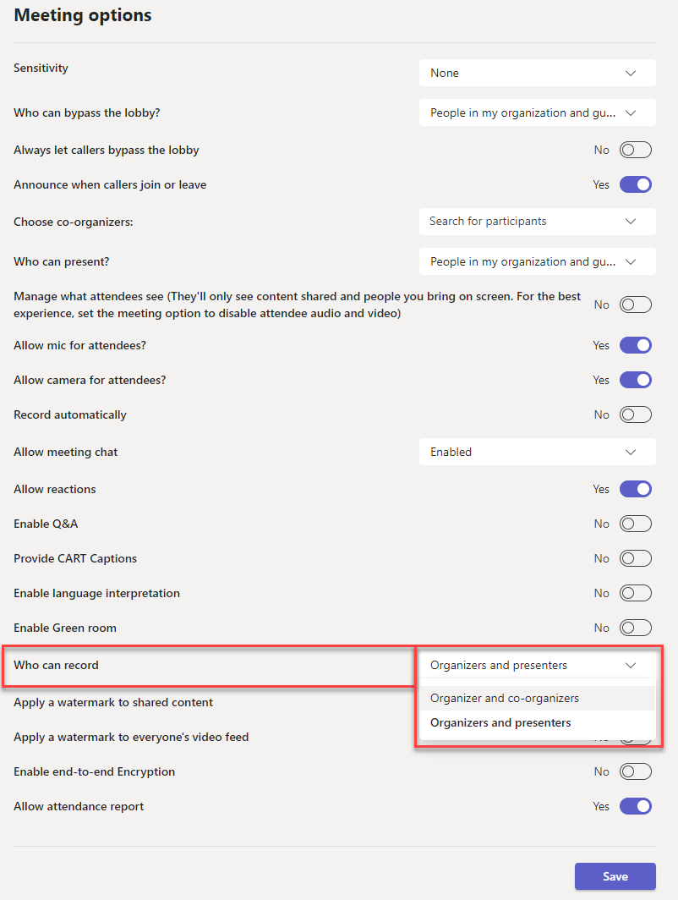
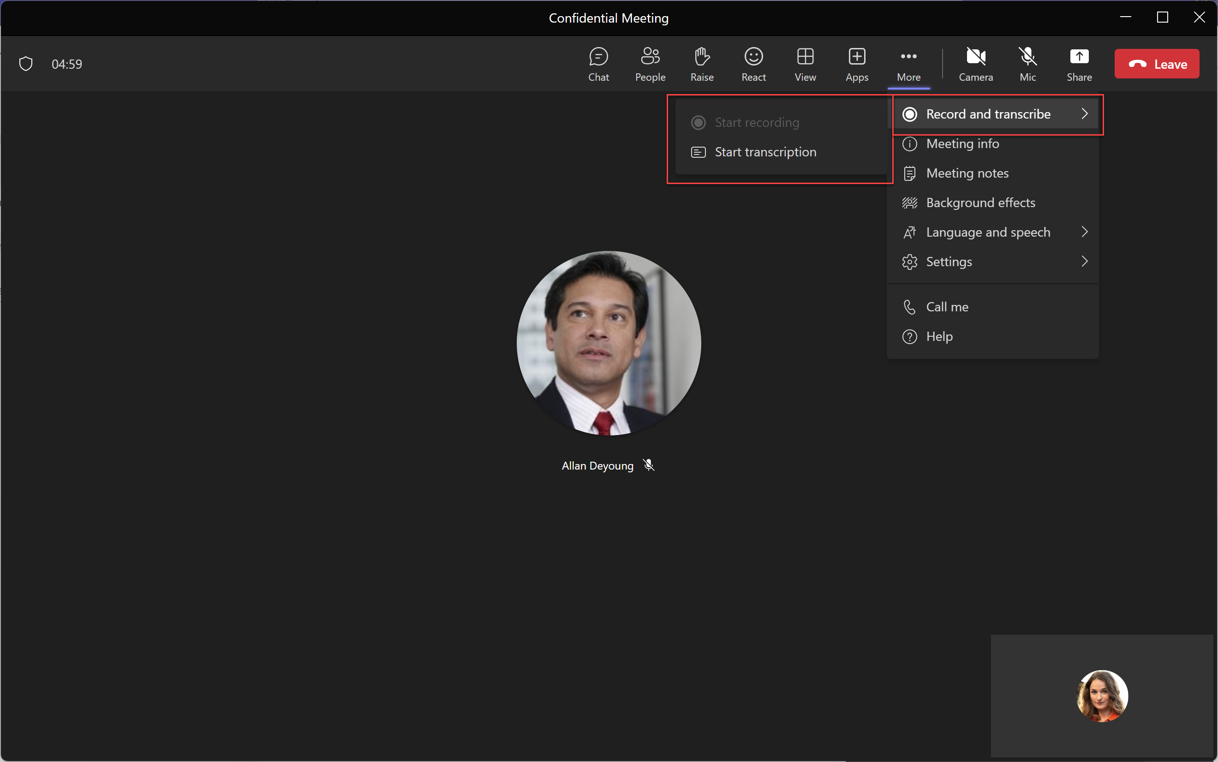
PROTECTED MEETINGS
Who can record
Introduction
Give you, as the organizer, additional protections to keep the discussion private, by easily manage who can record when scheduling Teams meetings.
Organizer Guidance
The meeting organizer can determine which roles have the ability to start and stop the recording on a per-meeting basis.
To apply, follow these steps.
Create or open a meeting from your Teams Calendar.
In Details, select Meeting options.
Go to Who can record and select from the drop down. You can choose from:
Organizers and presenters (default), or
Organizers and co-organizers
Select Save.
See Roles in a Teams meeting for details about selecting presenters and changing someone's role before and during a meeting.
Presenter view
When this option is set to Organizers and Co-organizers in Meeting Options, participants that are assigned the presenter role will not be able to start recording.

Slide 39
PROTECTED MEETINGS
Who can record
Overview and Benefits
With Teams Premium, meeting organizers can easily manage who can record when scheduling Teams meetings. This gives meeting organizers the ability to plan in advance for sensitive meetings and keep discussions private. There are two options for who can record a meeting:
Organizers and co-organizers, or
Organizers and presenters.
Feature Visibility
The ‘Who can record’ meeting option is visible to the meeting organizer. The ability to record will be available based on the option selected.
Use Cases
Below are the primary use cases:
Industry | Use Cases
Any Enterprise | In meetings with sensitive information being shared, limit the ability to record to the organizer or co-organizers only.
Education | Remote teacher preventing students from recording classroom lessons
Dependencies and Limitations
If any of the following meeting options are set to Yes, the who can record option will be unavailable (greyed out):
Record automatically
Apply a watermark to shared content
Apply a watermark to everyone’s video feed
Enable end-to-end encryption
It is recommended that organizations set security guidelines and instructions for usage of this feature.

Slide 40
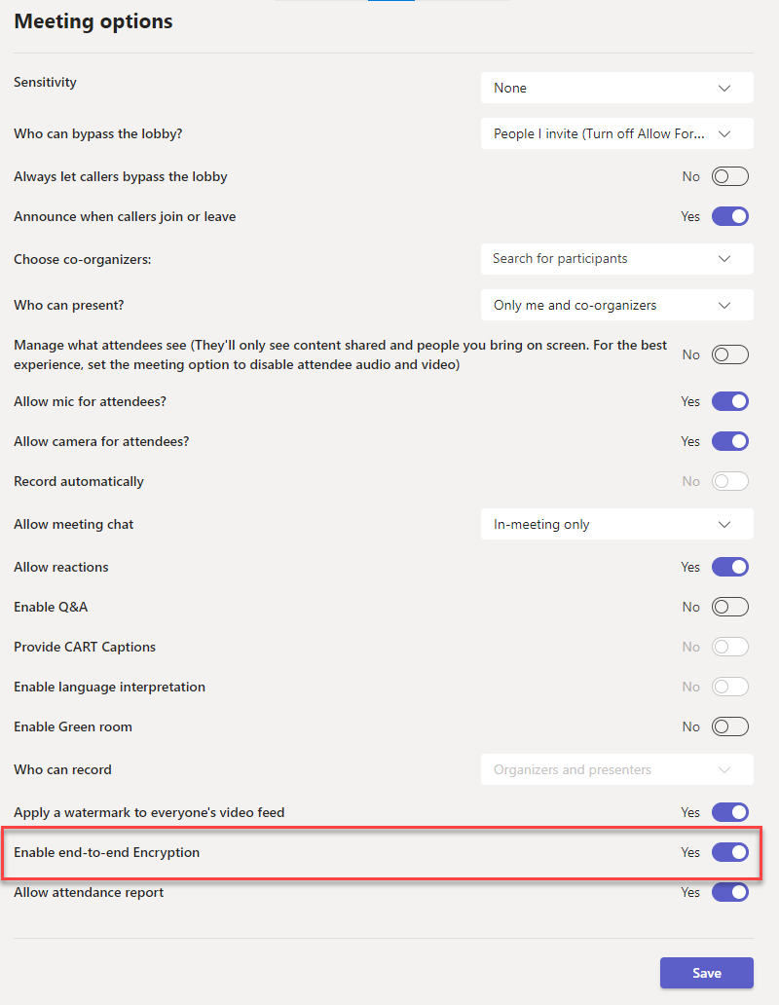
PROTECTED MEETINGS
End-to-end encryption (E2EE)
Introduction
For the extremely sensitive meetings that require disabling some of the core meeting features for an advanced encryption option, E2EE can be apply to a meeting,. The additional layer of encryption provides secure of the audio, video and screen sharing content in the meeting and ensures only participants in the meeting can hear or see the communication.
As a reminder, data exchanged during Teams calls or meetings is always secured using industry-standard encryption in transit and at rest.
Organizer Guidance
End-to-end encryption in a meeting can only be turned on or off before it starts.
Desktop
Go to your Outlook or Teams Calendar and select New meeting.
Go to Meeting options.
Turn on the Enable end-to-end Encryption toggle.
Select Save.
Enter the rest of your meeting details.
Select Save to schedule.
Mobile
Open your Teams mobile app.
Go to Details > Meeting options.
Enable end-to-end Encryption.
To verify end-to-end encryption is turned on for both parties, check whether your meeting is being encrypted successfully for both parties and look for the encryption indicator (a symbol of a shield and lock) on your meeting screen. Tap the indicator to see your meeting’s end-to-end encryption code and make sure the code is the same for both parties.

Slide 41
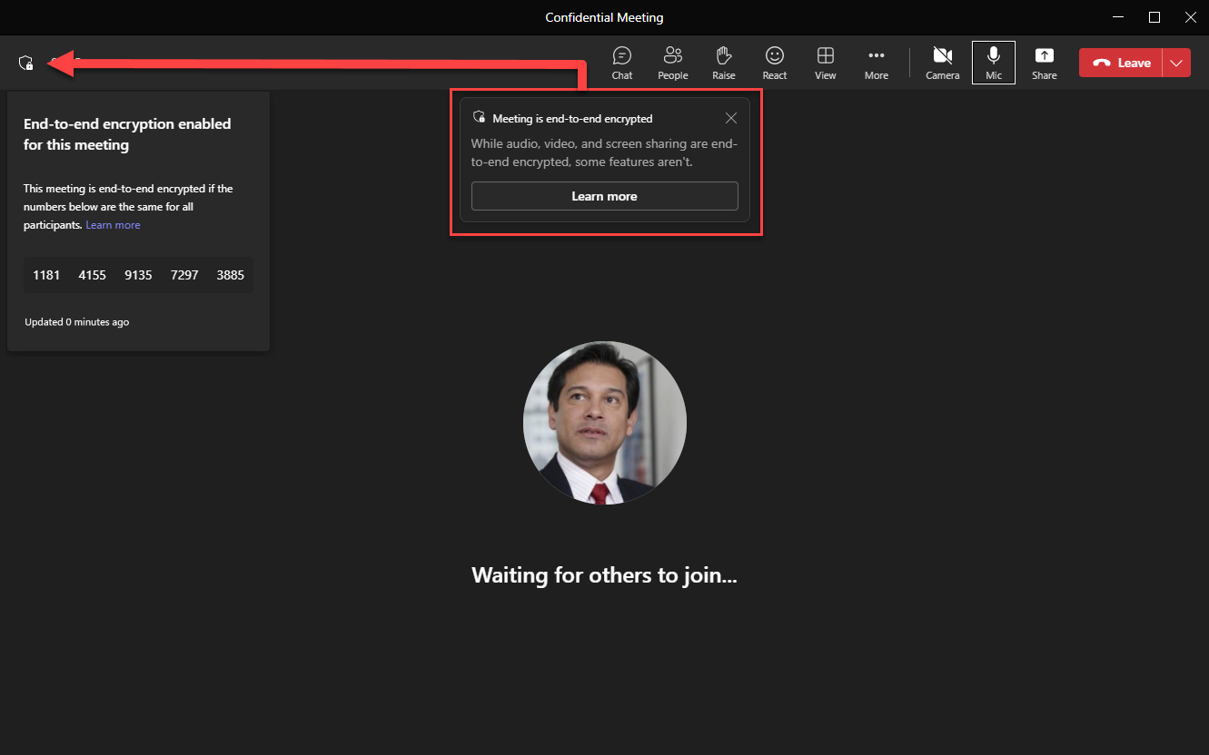
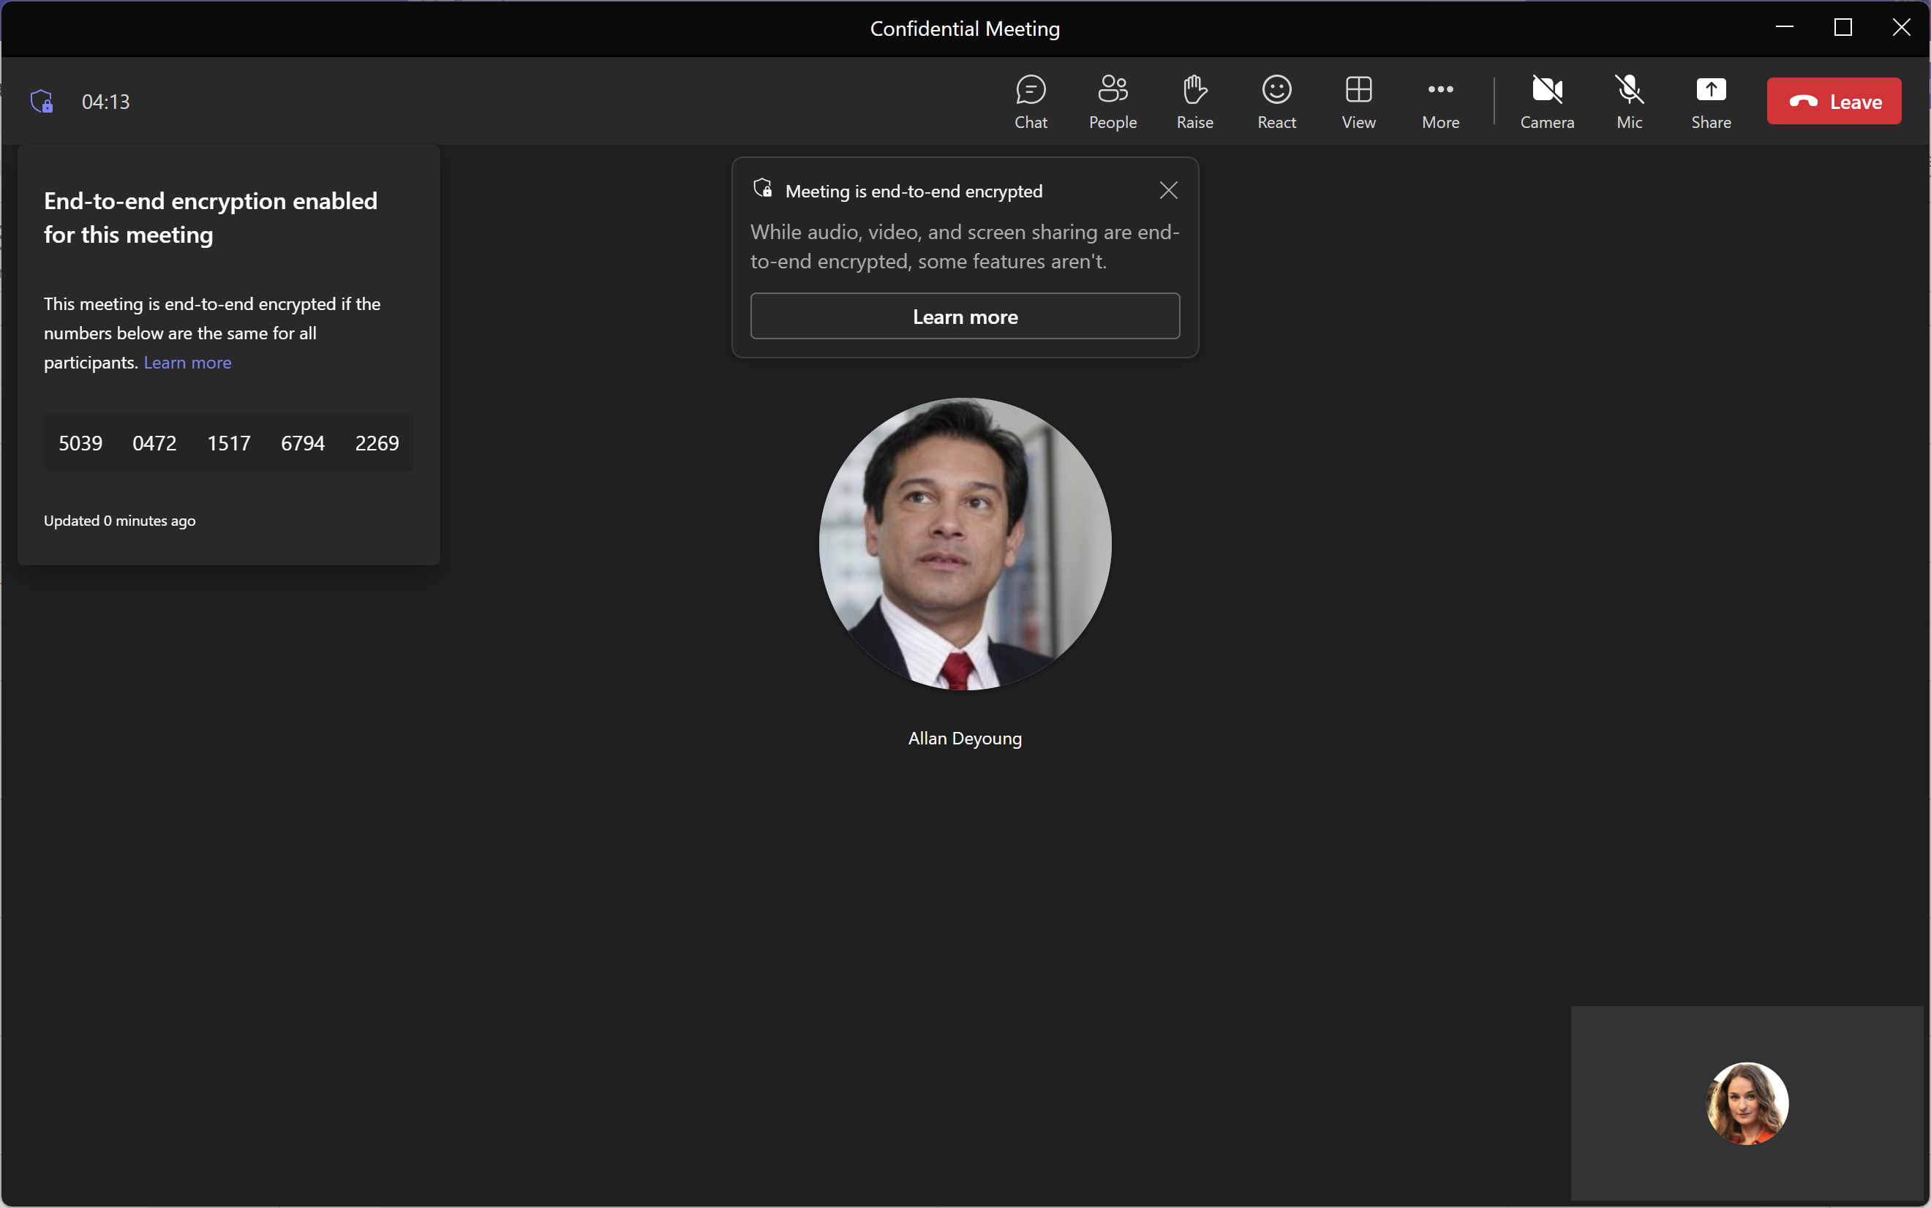
User Guidance: First Attendee Joins Meeting
PROTECTED MEETINGS
End-to-End Encryption
Example: Allan is the first attendee to join meeting
The encryption indicator in the upper left will show the current status
Click the indicator to reveal detailed status, including the code currently in use
The code will change when a new participant joins
The code will be the same for all participants
Desktop (Windows and Mac) and mobile (iOS and Android) only.
User Guidance: Second Attendee Joins Meeting
Example: Adele is the second attendee to join the meeting
When additional attendees join, the meeting code will change
Click on the indicator to view the new code.
Notes:
Learn more link -> https://go.microsoft.com/fwlink/?linkid=2210535

Slide 42
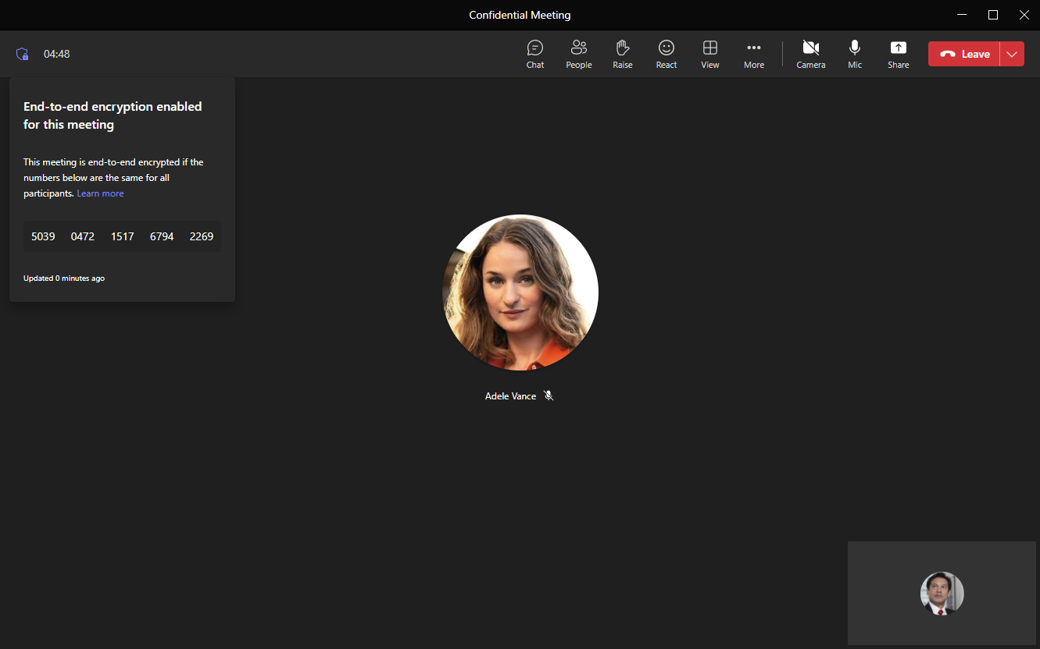
PROTECTED MEETINGS
End-to-End Encryption
User Guidance: Verification
When additional attendees join, the meeting code will change
Click on the indicator to view the new code
Notice this code (that Allan is viewing) is the same code that Adele saw when she joined (previous slide).
Notes:
https://go.microsoft.com/fwlink/?linkid=2210535

Slide 43
PROTECTED MEETINGS
End-to-end encryption (E2EE)
Overview and Benefits
For meetings that require heightened confidentiality, end-to-end encryption (E2EE) is an extra layer of security that:
Encrypts data at its origin and decrypts it at its destination.
Secures the audio, video and screen sharing content in the meeting.¹
Ensures only participants in the meeting can hear or see the communication.
Note: No other party, including Microsoft, has access to the decrypted conversations.
Feature Visibility
E2EE is visible to all meeting participants if you as the organizer has a Teams Premium license.
Dependencies and Limitations
When the E2EE option is enabled for meetings, it introduces feature and functionality tradeoffs. For this reason, the E2EE option should be used for very specific and targeted use cases defined by the customer's IT, Security and/or Compliance teams. E2EE can impact both the user experience and IT’s ability to govern the meeting.
Supports 50 participants maximum
E2EE communications become non-discoverable in compliance tooling. Participants that are configured with a compliance recording policy will be unable to join.²
An end-to-end encrypted meeting might take slightly longer to join.
The below features become unavailable in Teams meetings when E2EE is enabled:
Recording
Live captions, CART captions and transcription
Language interpretation
Companion mode
Together mode and Large Gallery views
PSTN Scenarios
Breakout rooms
PowerPoint Live
Excel Live
Note: When E2EE is not used, Teams data exchanged during calls or meeting is still protected with industry standard encryption in transit and at rest. Chat for end-to-end encrypted calls / meetings is protected with M365 encryption. For more information, see Media encryption for Teams.
¹ Apps, avatars, reactions, chat, and Q&A are not end-to-end encrypted, but are still secured with encryption.
Notes:
@@B

Slide 44
Advanced Webinars

Slide 45
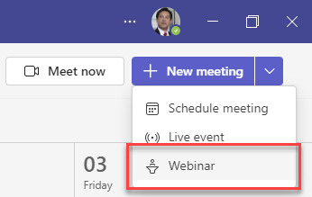
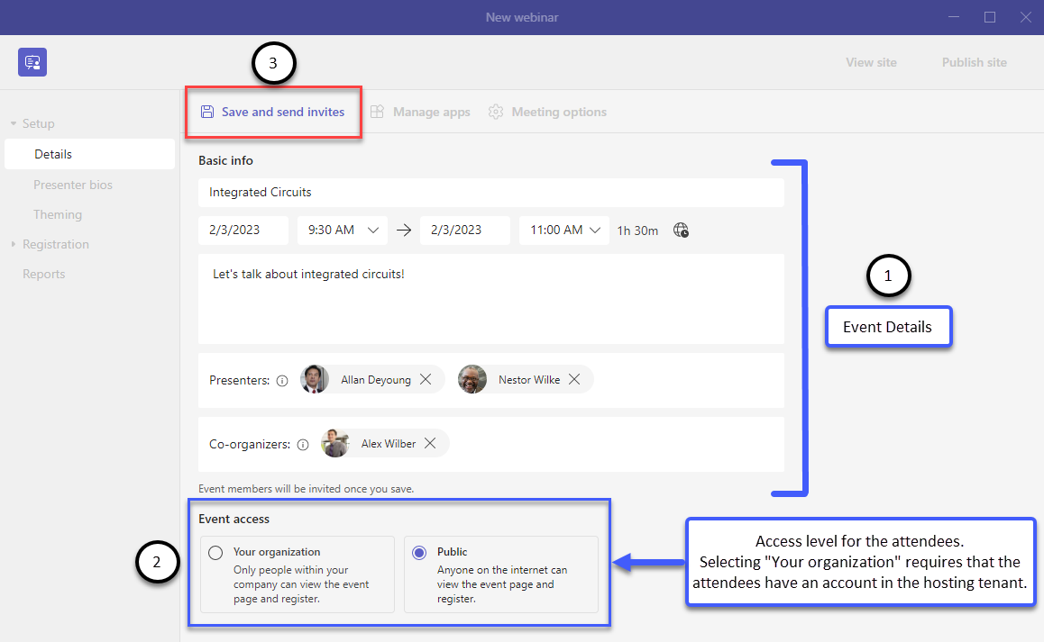
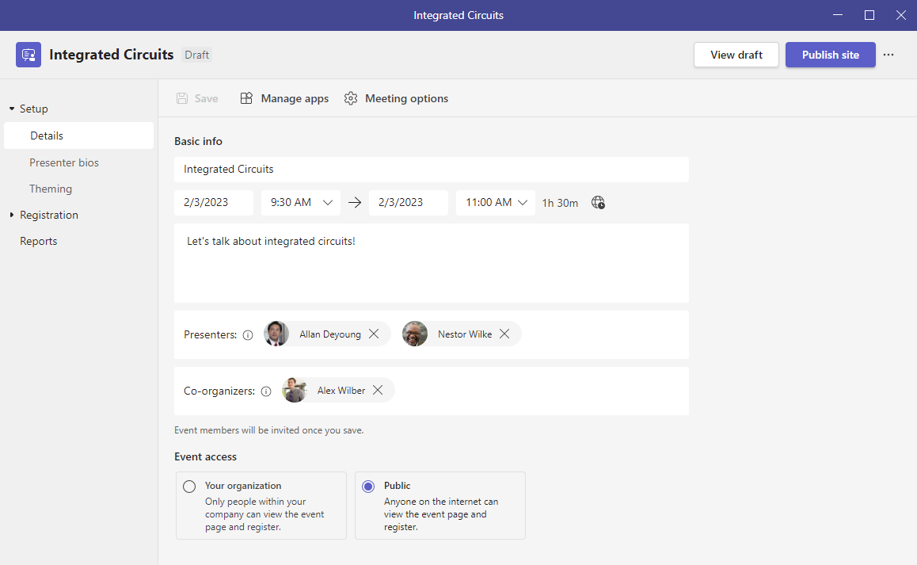
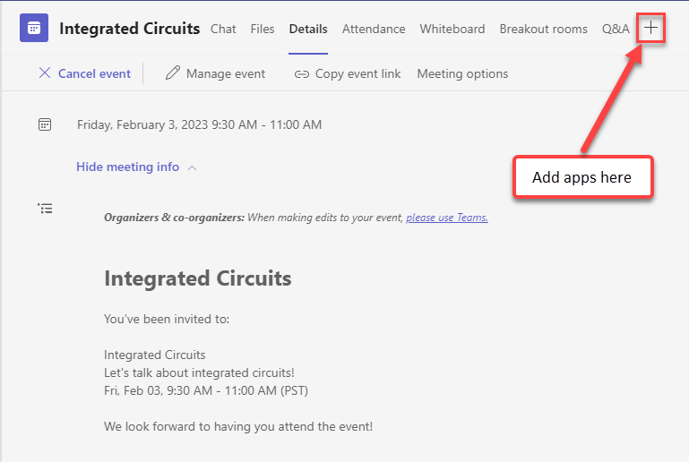
ADVANCED WEBINARS
Advanced Webinars: How to get started
Introduction
Host events with seamless registration and customized experiences getting the familiar and secure experience of Teams webinars combined with new host controls and event management controls that make it seamless to connect with any audience.
Organizer Guidance: Setting up new event (1 of 3)
Step 1: In Teams Calendar, click the down arrow next to New meeting and select Webinar.
Step 2: Fill in the event details.
Step 3: Select your level of access for attendees.
Step 4: Hit Save.
Notes
Hold to send invites until after you add additional presenters/ co-organizers).
Once published, the Event access type cannot be changed.
Organizer Guidance: Setting up new event (2 of 3)
Step 5: Click on Manage apps to bring up the webinar details.
Step 6: Click the + sign to add apps.

Slide 46
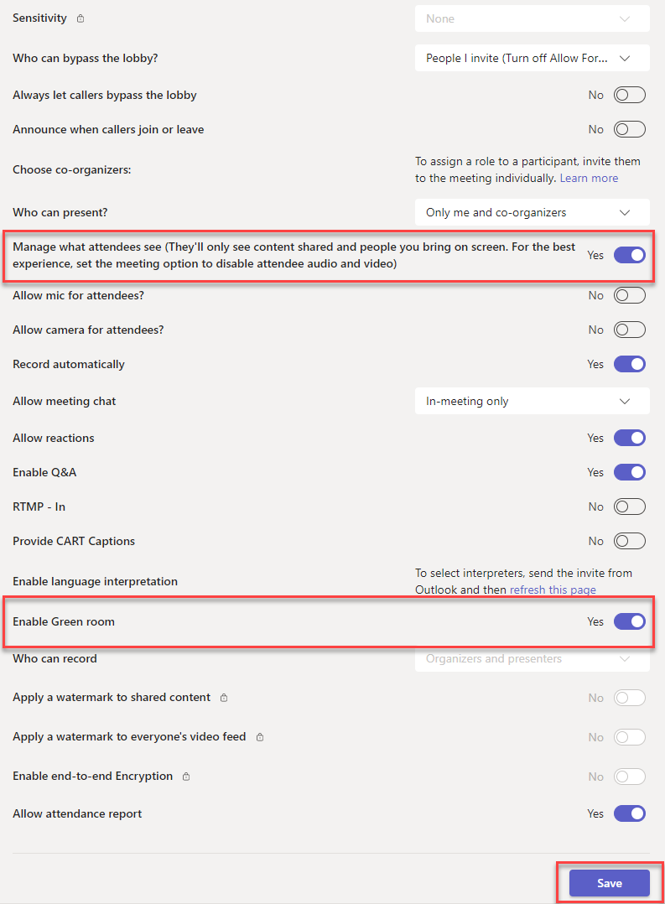
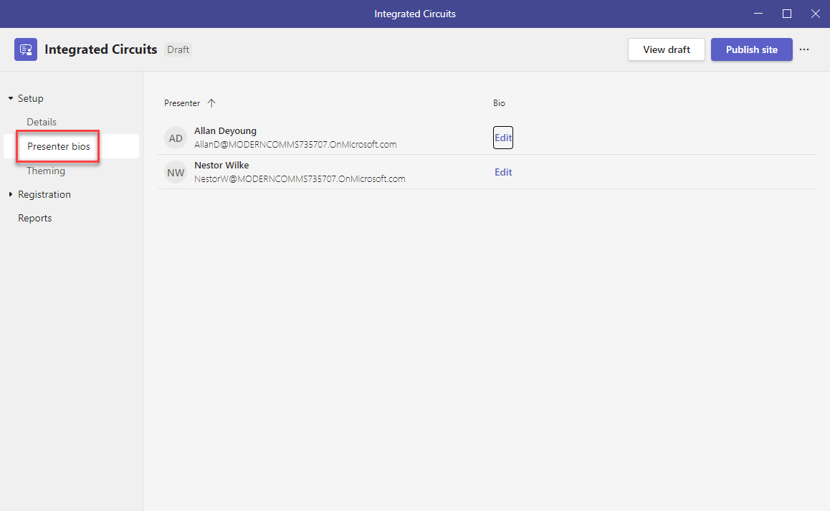
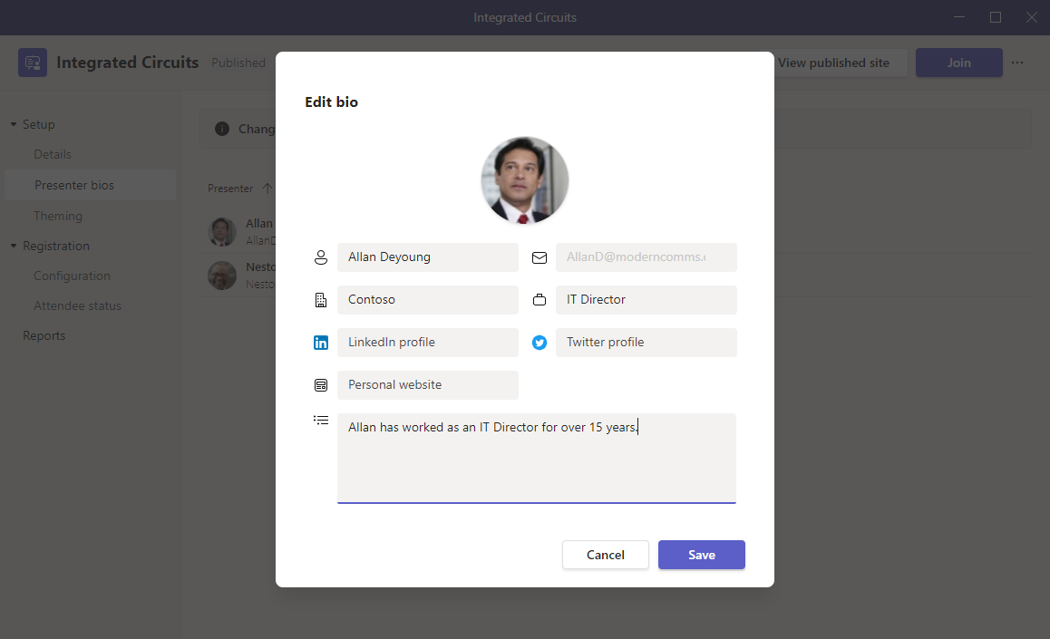
ADVANCED WEBINARS
Advanced Webinars: How to get started
Organizer Guidance: Setting up new event (3 of 3)
Step 7: Click Meeting options to bring up webinar meeting options.
Step 8: Toggle on Manage what attendees see and Enable Green Room (recommended).
Step 9: Click Save.
Organizer Guidance: Adding presenter bios
Step 1: Presenters that were added on the Details page will appear here. Click Edit to provide additional details. These details will appear on the event registration portal.
Step 2: Enter relevant information in the ‘Edit bio’ screen and click Save. Repeat as necessary for additional presenters.

Slide 47
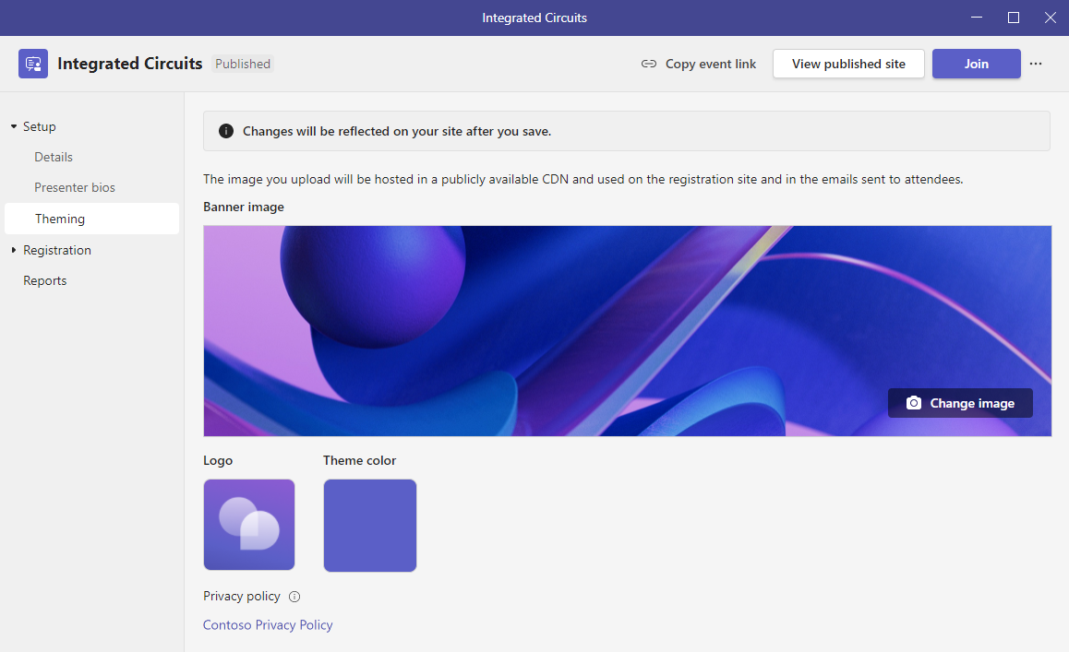
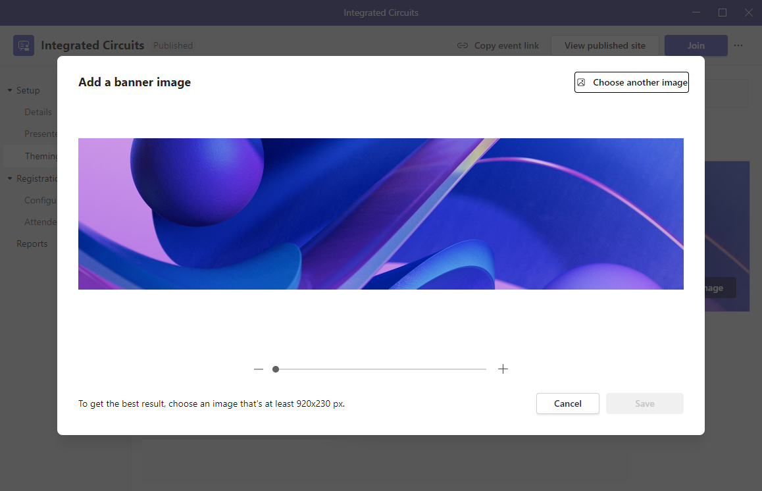
ADVANCED WEBINARS
Advanced Webinars: How to get started
Organizer Guidance: Adding event theming
The theming page allows meeting attendees to customize the background image on the registration page. It also allows you to upload a logo and theme color.
Step 1: Click on Change image to upload a new background image or Click on the Logo or Theme color to change.
Step 2: Preview, edit or resize image and click Save.

Slide 48
ADVANCED WEBINARS
Overview and Benefits
In today’s world, it’s hard to attract and engage attendees, whether it’s your own employees or potential customers.
Building upon the basic webinar functionality in Office 365 and Microsoft 365, Advanced Webinars give you new management controls that make it seamless to connect with your audience, whether internal or external.
By enabling, you get access to a simplified user experience, meeting registrations, a management recap, and many new feature and benefits including:
A registration page for your webinar
Ability to add co-organizers
A dedicated event page with branding and presenter bios
Advanced registration configurability, waitlist and manual approvals
Registration status overview
A virtual green room where presenters and meeting hosts can chat and stage content and a virtual waiting room where meeting attendees can engage while they wait for the event to start
Manage what your attendees can see or do during webinar
Support for RTMP-IN, to bring externally produced content into your webinar
Use Cases
Below are the primary use cases:
Industry | Use Cases
All - Enterprise, Education, Government, Retail, Healthcare, Financial Services | Online trainings where attendees can register and join a learning session Product demos and community webinars to connect with customers and do knowledge shares Marketing and sales events
Sales and Marketing | Connecting with potential leads to grow business
HR | Onboarding and training new team members
Notes:
@@B

Slide 49
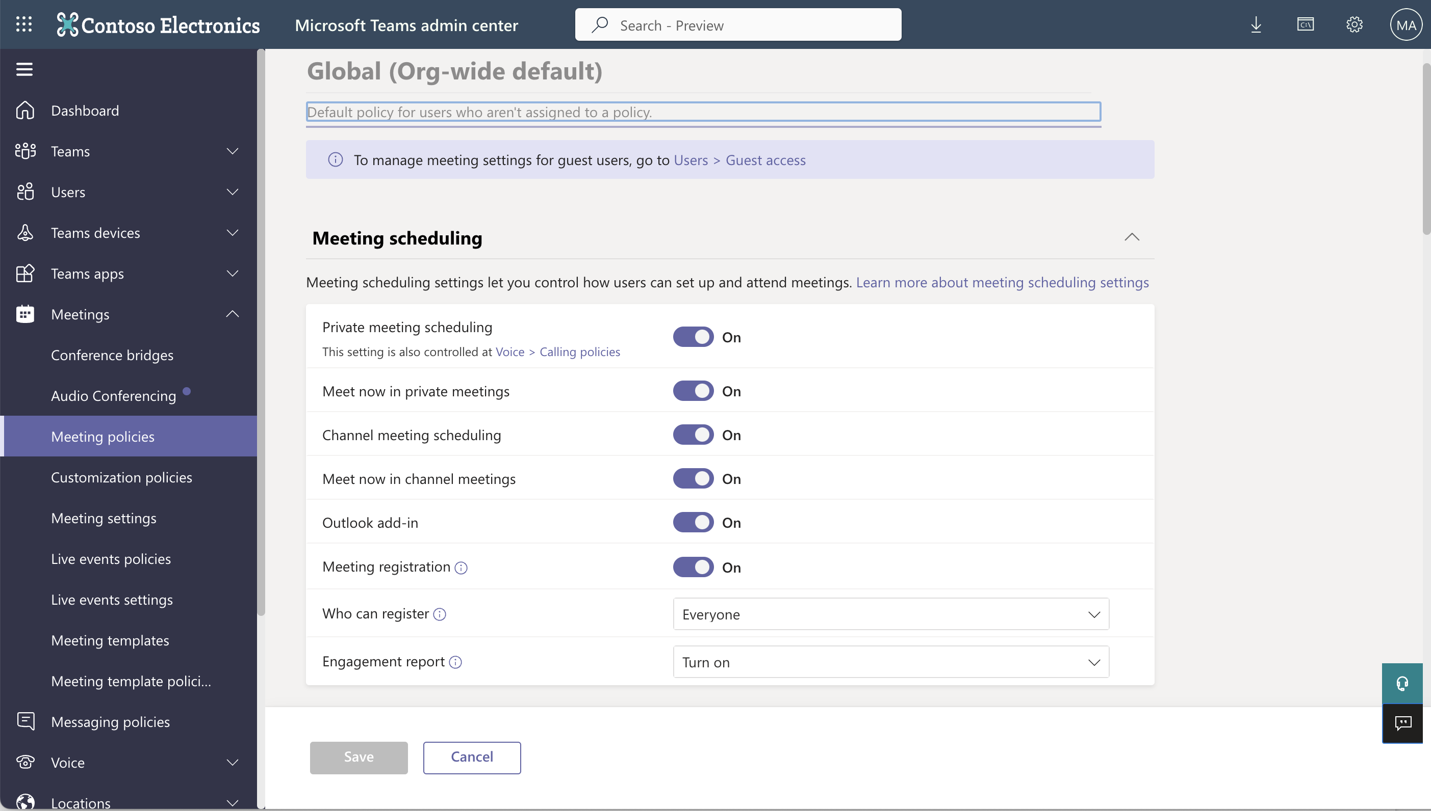
ADVANCED WEBINARS
Registration and Reminders
Introduction
Improving registration experience with registration waitlist and manual approval and the ability to customize the registration start and end times for better event management.
Organizer: Legacy Experience (v1)
Feature can be turned on in the Teams Admin Center (https://admin.teams.microsoft.com).
Step 1: Go to Meeting Policies.
Step 2: Click on Global (Org-wide default.)
Step 3: Go to Meeting scheduling.
Step 4: Toggle on OR off (to enable / disable meeting registration).
Step 5: Go to Who can register.
Step 6: Select everyone or everyone in the organization from the drop down.
Step 7: Click Save.
Legacy webinar (v1) experience

Slide 50
ADVANCED WEBINARS
Registration and Reminders
 | Registration waitlist & manual approvals | Automated reminder emails (COMING SOON)
Intro | Enable a waitlist for registered attendees to streamline capacity and manually approve registered attendees on the spot. | Ensure all registered attendees show up to your event by sending automated reminder emails.
Highlights | Require registrations and enables a waitlist after the event has reached capacity allowing additional people to register and be added as space becomes available Allow meeting organizers to review registration info and manually approve and reject registrants on a case-by-case basis Customize start and end times for registrations | Send emails ahead of the event Send emails to every confirmed registrant on the day of the event. Emails will include a custom-branded header, webinar details, and a link to join the event.
Benefits | Make it easier to manage registration ahead of webinar | Drive attendance Build excitement and attract attendees to your webinar
Visibility | Once registration is set and invites are sent to attendees, capabilities are visible to all the meeting attendees. | sent to attendees, capabilities are visible to all the meeting attendees.
Dependencies and Limitations
The new webinar experience is currently unavailable for on-premises users, Microsoft 365 GCC, Microsoft 365 GCC High, or Microsoft 365 DoD.
Supported platforms:
Scheduling a webinar is available on Teams desktop and web clients.
Joining a webinar is available on Teams desktop, web and mobile (iOS and Android) devices.
Unsupported platforms;
Cloud Video Interop (CVI) endpoints
Microsoft Teams Rooms (MTRs) as attendees
Notes:
@@B

Slide 51
Organizer view: Getting started
ADVANCED WEBINARS
Advanced Webinars: Virtual Green Room
Introduction
Webinars allow presenters to join the virtual green room so that preparation before the webinar is seamless. Presenters have the time and space to connect and do a quick briefing or test run without disturbing attendees. While attendees wait for the event to start, they can engage with the presenters and one another through chat and Q&A.
Once the meeting has started and presenters join, organizers and defined presenters will be entered into the Green Room. Attendees will not be admitted until the meeting is started.
Presenter view: Two presenters in Green Room
In this example, there are two presenters in the Green Room: Alan and Adele.
Alan and Adele can do A/V tech checks, etc. and prepare before going “live.”
Presenter 1: Alan is sharing via PowerPoint Live. This is his view of the Green Room.
Presenter 2: This is Adele’s view of the Green Room.

Slide 52
Organizer Guidance: How to start meeting
ADVANCED WEBINARS
Advanced Webinars: Virtual Green Room
Step 1: Click Start meeting (yellow button in upper right).
Step 2: Click start meeting in the pop-up box to confirm.
Organizer Guidance: Merging experiences
Meeting is starting….
Meeting start complete / Green Room closed
During this time, the presenters and organizers are moved out of the Green Room and into the same experience as the attendees.
After meeting is started, all participants (organizers, presenters, attendees) will have in the same experience.
Attendees can now see videos and content and hear audio from the presenters/organizers.

Slide 53
Attendee view
ADVANCED WEBINARS
Advanced Webinars: Virtual Green Room
Pre-event
Meeting starting

Slide 54
ADVANCED WEBINARS
Virtual Green Room
Overview and Benefits
On the day of the webinar, presenters and the meeting host are invited to join a virtual green room—a dedicated space separate from attendees—where they can talk in real-time, stage content, do a quick briefing, and a test run of the webinar.
Additionally, while attendees join and wait for the event to start, they’re greeted with a welcome screen to inform them the event will start shortly and can engage with the presenters and one another through chat and Q&A (if enabled).
Feature Visibility
The Green Room feature will only show up on the Meeting Options page if the organizer has a Teams Premium license. The Virtual Green Room is available for meeting organizers and co-organizers to configure. The organizer, any co-organizers and defined meeting presenters will have access to the Green Room before the event begins. Additionally, the welcome screen is visible to all attendees until the event formally begins.
Use Cases
Below are the primary use cases:
Industry | Use Cases
Marketing | Presenters huddle up to discuss and finalize agenda before the meeting officially starts
Education | Teachers (presenters) meet before a parent-teacher meeting / classroom session starts
All | A chance for presenters to test audio quality with headsets and test sharing content before going live with the audience
Notes:
@@B

Slide 55
ADVANCED WEBINARS
Virtual Green Room
Prerequisites
Meeting organizers must define separate presenter/attendee roles before they can enable the Green Room feature.
Dependencies and Limitations
Organizers can turn the Green Room on or off while a meeting/webinar is active, but the change will not be reflected unless they end and restart the meeting.
CVI presenters who join will wait with attendees for the meeting to start and cannot interact with users in the green room. In this state, any audio shared by the CVI presenter will be audible to other attendees.
If a user in the Green Room is made an attendee, they will be unable to speak or share their video.
If an attendee waiting for a meeting to start is made a presenter, then other attendees who are waiting for the meeting to start will be able to hear them. We recommend removing a user if you would like to promote or demote them. If the attendee that was promoted rejoins the meeting, they will enter the Green Room.
Compliance recording will not be available to those who join the Green Room or attendees who are waiting for the meeting to start; however, compliance recording will start for all specified participants once the meeting has also started.
Green Room capacity is limited to 100 presenters at a time.
Supported platforms:
Teams for desktop, web (Edge and Chrome browsers only) and mobile

Slide 56
ADVANCED WEBINARS
Manage what attendees see
Introduction
With the ability to manage what attendees see, you don’t have to worry about distractions in case someone’s video accidentally turns on or keeping focus while multiple profile photos of attendees show up on-screen. You can curate the attendee view, so attendees only see shared content and participants you bring on-screen.
Organizer Guidance: Getting started
This meeting option allows presenter(s) to control what attendee can see. If they enable (change to yes), attendees will only see content that is shared and people who are brought on screen.
Note: It requires defined presenter/attendee roles (everyone cannot be a presenter).
Step 1: In Teams, go to Calendar and select a meeting.
Step 2: Click on Meeting options.
Step 3: Go to Who can present, select Specific people, and add presenter name/alias.
Step 4: Toggle Yes on Manage what attendees see.
Step 5: For best experience, also make sure toggle is set to No on allow mic for attendees and allow camera for attendees.
Step 6: Hit Save.

Slide 57
Organizer Guidance: Presenter Layout
ADVANCED WEBINARS
Manage what attendees see
The “Off Screen” area is where the organizers/presenters will appear.
If organizer/presenter cameras are on, attendees will see video; if they are off, users will see an avatar and initials.
Anything inside the red border will be visible to attendees.
The first person to join will not see any people or content (since neither are shared by default).
Audio is always heard, regardless if the presenter is on screen or not.
This is the ”on screen” area visible to attendees.
When there is no content or people on screen, attendees will see a simple welcome message.
Organizer Guidance: How to bring presenter on screen
The “Off Screen” area is where the organizers/presenters will appear.
If organizer/presenter cameras are on, attendees will see video; if they are off, users will see an avatar and initials.
Anything inside the red border will be visible to attendees.
The first person to join will not see any people or content (since neither are shared by default).
Audio is always heard, regardless if the presenter is on screen or not.
Right click a person from in the ‘Off Screen’ area and select Bring on screen (to make them visible to attendees).
This screenshot shows when person is brought on screen

Slide 58
Organizer Guidance: How to take presenter off screen
ADVANCED WEBINARS
Manage what attendees see
Right click a person in the stage area (inside the red border) and select Take off screen.
The person will no longer be visible to the attendees and will return to the ‘Off Screen’ area on the left.
Screenshot to left shows when person is removed from screen
Organizer Guidance: How presenters can share content
Step 1: Click on the Share button.
Step 2: In the Share content tray, if you need to include audio with your sharing, toggle the Include computer sound option.
Step 3: In the Share content tray, select screen, window, PowerPoint Live, or Excel Live.
PowerPoint and Excel files are from the ‘Most Recently Used’ (MRU) list in OneDrive and SharePoint.
PowerPoint presentations will open in Presenter View by default (but you can change by toggling to No using the ellipsis (…) menu).
Step 4: The content and customizations selected will automatically be shared. (Content does not have to be brought on screen manually).

Slide 59
Organizer Guidance: Using Presenter Modes
ADVANCED WEBINARS
Manage what attendees see
When sharing content, presenters have the option of using three presenter modes:
They are accessible in the Share tray.
Step 1: Ensure your video camera is on.
Step 2: Click on the Share button.
Step 3: Click on presenter mode you want:
Standout
Side by side
Reporter
Step 4 (Optional): Click on Add background and select a predefined background image. Click the < to return to the share content window.
Step 5: Click on the content you want to share.
Note: When sharing using PowerPoint Live, the only Presenter Mode available is Standout.
Presenter Guidance: Managing Attendees
By default, attendees will not be visible in the off-screen area but occasionally presenters may want to bring individual attendees on screen.
When an attendee uses the Raise Hands feature, they will appear in the off-screen area.
The presenter can do the following by right clicking on the attendee’s photo in the off-camera area and selecting from the menu.
Mute participant
Allow/Disable Mic
Allow/Disable Camera
Lower Hand
Bring on screen
Select Bring on screen to make the attendee visible to the others.

Slide 60
ADVANCED WEBINARS
Manage what attendees see
Overview and Benefits
Minimize distractions and keep your audience focused and engaged by curating and managing what your attendees can see on screen, including shared content and presenter video. By doing so, you elevate and manage the production of your webinar to showcase a more dynamic presentation.
Conduct more professional and polished webinars
Determine who can present
Turn off or allow mic for attendees
Turn off or allow camera for attendees
Decide whose avatars or video feeds to spotlight during webinar
Feature Visibility
The meeting organizer requires a Teams Premium license to use this feature. Manage what attendees see is available for meeting organizers and co-organizers to configure. The organizer, any co-organizers and defined meeting presenters will have access to use this mode during the meeting.
Use Cases
Below are the primary use cases:
Industry | Use Cases
Marketing | A digital events specialist at a marketing agency, is hosting a webinar with her colleague to teach potential clients how to build a blog for their website. To make sure the webinar is highly engaging, she manages what the audiences sees by curating the attendee view to show the Presenter only. At the end, she allows attendees to raise their hand to ask questions live.
HR/Recruiting | Helps bring only the candidate on the stage and ensures that the interview panel is not visible to the candidate
Education | Teacher (acting as organizer) chooses a presenter and bring them on stage from a list of students
Notes:
@@B

Slide 61
ADVANCED WEBINARS
Manage what attendees see
Prerequisites
Meeting organizers must define separate presenter/attendee roles before they can enable the Manage what Attendees See feature.
Dependencies and Limitations
Presenters that are not “on screen” can still be heard in the meeting (if their microphone is active).
Supported platforms:
Presenter/organizer can use Teams desktop or web on Edge and Chrome

Slide 62
ADVANCED WEBINARS
RTMP-in
Introduction
RTMP-in provides the ability to bring external content into your event using a Real-Time Messaging Protocol (RTMP) stream (an ingest URL and key are provided).
Organizer Guidance: Getting started
RTMP-In can be enabled through the Meetings Options of the scheduled event.
Step 1: In Teams, go to Calendar and select a meeting.
Step 2: Click on Meeting options.
Step 3: Go to RTMP-In and turn toggle to Yes.
Step 4: Click Save.
RTMP-In is now enabled. You will see the Server ingest URL and Stream key listed.
Once enabled and configured, it appears as another video feed in the meeting (automatic fit-to-frame applied).

Slide 63
ADVANCED WEBINARS
Organizer Guidance: Presenter view
While you can use a number of different encoders, example screenshots below show OBS.
Once RTMP–In is enabled:
Step 1: Input the Server Ingest URL and Key into the encoder.
Step 2: In the encoder, click Start Streaming.
The feed will appear in the meeting as “Custom RTMP”.
Note: The screenshot to the right is using ‘Manage what attendees see.’ The Custom RTMP feed is in the Off Screen area.
Presenter and User: Content view
Custom RTMP feed after the presenter used Bring on Screen in the Manage what attendees see feature.

Slide 64
ADVANCED WEBINARS
RTMP-in
Overview and Benefits
You’ll be able to consume a stream from a custom RTMP source, whether it be a professionally produced event with more dynamic content like a video or high-quality screen sharing, to all attendees in the event, by leveraging an external encoder and enabling RTMP-in.
Feature Visibility
The meeting organizer configures this feature and is required to have a Teams Premium license. All meeting participants can consume the RTMP feed.
Use Cases
Below are the primary use cases:
Industry | Use Cases
Marketing | Helpful in streaming high quality recorded content during product launch events. E.g., product demo
Any Enterprise | Ideal for IT Admins to ingest external live or pre-recorded content into large meetings. E.g., CXO level townhalls
Dependencies and Limitations
There is a delay of about 2-3 seconds for the RTMP feed from the source to the destination.
Notes:
@@B

Slide 65
ADVANCED WEBINARS
Microsoft eCDN for Teams Live Events
Introduction
With Microsoft eCDN (Enterprise Content Delivery Network) organizations can seamlessly and securely live stream global meetings, all hands and townhalls, and distribute company-wide trainings using Teams Live Events.
User guide: No user guide is required.
Overview and Benefits
Microsoft Enterprise Content Delivery Network (eCDN) is a first-party offering that optimizes network performance for live video streaming and distribution within an enterprise.
Microsoft eCDN can help reduce the load on the corporate network, improve connectivity and video quality, and doesn’t require any additional installation on user endpoints and devices (is easy to install). It can also improve live event experiences in your organization.
Feature Visibility
Once enabled within the tenant, all internal attendees will be able to leverage the eCDN.
Use Cases
Industry | Use Cases
Any | Global meetings, all hands and townhalls, company-wide trainings, live streaming event
Prerequisites
Network Requirements:
https (443) to *.ecdn.microsoft.com (eCDN script download and WebSocket connection)
As of June 1st, 2023, we will be transitioning domains from *.ecdn.microsoft.com to *.ecdn.teams.microsoft.com. In preparation for the multi-week transition period, please add the new domain to any firewall, proxy, VPN or mDNS configurations you may have made. It's important to note that the transition will not be a clean cut-over, so both domains must be accounted for during the transition period
SCTP over DTLS over UDP for P2P connections (ports 1025-65535)
Notes:
@@B

Slide 66
ADVANCED WEBINARS
Microsoft eCDN for Teams Live Events
Dependencies and Limitations
Available in Premium as well as Standalone SKU
Integrated into first-party communication products (Teams, Yammer), but can also be used with third-party products
Organizations that have densely populated locations (for example, 5000 attendees in a central site) can use an eCDN to optimize the bandwidth by leveraging Peer-to-Peer (P2P) technology based on WebRTC
Without eCDN, 5000 attendees would pull in 5000 individual (unicast) stream – which could quickly saturate the ingress internet circuit
With eCDN, only a few streams would originate from the service, and other attendees would serve each other
Supported platforms:
Teams Live Event clients
Notes:
https://aka.ms/ecdn

Slide 67
Advanced Virtual Appointments

Slide 68
ADVANCED VIRTUAL APPOINTMENTS
Overview
Advanced Virtual Appointments build on the basic capabilities available in Microsoft Teams today and provides an end-to-end solution designed to help you drive better customer experiences and operational excellence for business-to-customer (B2C) engagements.
The Virtual Appointments app helps you streamline appointment management and allow administrators to set up and manage scheduled and on-demand virtual appointment in one location with advanced capabilities like appointment queuing.
SMS notifications – Deliver a frictionless customer experience that allows external attendees to receive text reminders of virtual appointments
Branded virtual lobby – Delight customer with a personalized and customer branded experience
Staff, department and organization-level analytics – Measure and view analytics to help measure the business value of your virtual appointments and reduce outcomes like customer no shows and wait times.
Benefits
Engage with customers in new ways to grow your business.
Build deeper relationships with customers and serve customers with increased efficiency and convenience.
Deliver frictionless, personalized and consistent customer experiences.
Integrate virtual appointments into your existing workflows with flexible scheduling and streamlined management.
Measure business outcome with rich analytics and reports.
Feature Visibility
Virtual Appointments are available to those that allow permission to use the virtual appointments app in Teams. The default is to allow for everyone.
Notes:
@@B

Slide 69
ADVANCED VIRTUAL APPOINTMENTS
Overview
Use Cases
Get an experience that's tailored to your industry. Here's a few examples of how you can use Advanced Virtual Appointments in your organization:
Industry | Use Cases
Financial services (Bankers, brokers, financial advisors, claims adjusters, notaries) | Facilitate safe, secure & compliant document management, share and discuss sensitive info: Financial consultations Fact-finding meetings Proposal presentations Brokering new deals Loan application, advisory and management Insurance policy and claim support Troubleshooting and issue resolution Transaction review Document notarization
Retail (sales associates, product experts, and design consultants) | Cultivate interactive engagements with customers: Sales presentations / presentation of customer orders in progress Technical and on-demand issue resolution Virtual fittings and consultations Virtual shopping experiences with customers Virtual showrooms tours / showcase sales items Focus groups
Healthcare | Patient care Medical services include diagnosis or post-op follow up Therapy sessions Updates and arrangements with family Consultations with clinicians and insurance providers Medical education and training Presentation of medical device
HR / Recruiting | Custom lobby rooms for job applicants Engaging with multiple interviewers at one time Post interview surveys
Notes:
@@B

Slide 70
ADVANCED VIRTUAL APPOINTMENTS
Overview
Prerequisites
A user must be allowed access to the virtual appointment app to set up the premium features.
The user must be licensed for Teams Premium.
Supported platforms:
Virtual Appointment app is available on Teams desktop and web clients.
Joining an appointment is available on Teams desktop, web and mobile (iOS and Android) devices.
End-to-end Virtual Appointments experience
*Coming soon
Value pillar | Capability or feature | Premium features | Features available in all paid Microsoft 365 licenses
 | Mobile browser join | ✓ | ✓
 | Lobby Waiting Room | ✓ | ✓
 | Forms integration | ✓ | ✓
Delight customers | SMS notifications | ✓
 | Custom waiting room, branding | ✓
 | 2-way lobby chat* | ✓
 | Post appointment follow-up* | ✓
 | Bookings: Scheduling and appointment management | ✓ | ✓
Streamline appointment management | Virtual Appointment meeting type in Teams* | ✓ | ✓
 | Virtual Appointment APIs | ✓ | ✓
 | On-demand queue | ✓
 | Scheduled queue | ✓
Measure rich analytics | Departmental Analytics | ✓
and reports | Organizational Analytics | ✓
With Microsoft 365, you can start using basic capabilities today that make it easy to join and schedule a business-to-customer meeting.
With Teams Premium, your organization gets advanced Virtual Appointment capabilities to drive operational excellence and personalize customer experiences.
Notes:
@@B

Slide 71
ADVANCED VIRTUAL APPOINTMENTS
Virtual Appointment App
Introduction
The Virtual Appointments app provides a dashboard for a quick view into schedules, queues, and analytics and tabs to deep dive into bookings schedule, queue view, analytics, and more. View and monitor all scheduled and on-demand virtual appointments in the Queue View. Schedulers can add a new booking, view relevant appointment details, and see appointment statuses throughout the day. They can also send email reminders to assigned staff and attendees and send SMS text notifications to attendees for scheduled appointments. Staff can even join appointments directly from the queue.
User experience: Home Page: Premium Features
Home Page has two new Premium tiles.
1
Queue: simplified queue view so meeting organizers can streamline appointment management to schedule, manage, and track insights for appointments.
1
2
Analytics: providing a snapshot of appointment analytics.
2

Slide 72
Virtual Appointment App
Advanced Meetings: Virtual Appointments
View and monitor all scheduled and on-demand virtual appointments in the Bookings calendar that you pinned, with updates in real time
Schedulers can add a new booking, view relevant appointment details, and see appointment statuses throughout the day.
Schedulers can also send email reminders to assigned staff and attendees and send SMS text notifications to attendees for scheduled app.
If a facilitator is running late, you can send messages to clients while they wait in the waiting room for their appointment to start.
Organizer Guidance: Booking steps
Step 1: In booking schedule click ‘New Booking’.
Step 2: Enter details.
Step 3: Click the check box if the patient consents to email and/or SMS communication.
Premium
Feature

Slide 73
ADVANCED VIRTUAL APPOINTMENTS
Virtual Appointment App
Overview and Benefits
The Virtual Appointments app provides a centralized hub or dashboard with schedules, queues, and analytics.
Better manage the end-to-end appointment experience in one location
View and monitor scheduled and on-demand appointments in real time
Join virtual appointments directly from the queue
Be notified when an attendee arrives and is in the ‘waiting room’
Get access to a virtual ‘walk-in’ queue
Track wait times, live status of a meeting, and more
Use Cases
Below are the primary use cases for the Virtual Appointment App:
Industry | Use Cases
All | IT Help Desk has a daily 2-hour block for virtual office hours where people could wait in walk-in queue.
Healthcare | Staff can monitor all scheduled and on-demand virtual appointments in real time. When a patient joins the waiting room, their status changes, and their wait time is displayed and tracked.
HR/Recruiting | Recruiters can schedule interviews, view relevant appointment details and see appointment status throughout the day. When it’s time for the interview, they can join the appointment directly from the queue.
Prerequisites
A user must be allowed access to the virtual appointment app to set up the premium features.
The user must be licensed for Teams Premium.
Dependencies and Limitations
None
Supported platforms:
Virtual Appointment app is available on Teams desktop and web clients.
Joining an appointment is available on Teams desktop, web and mobile (iOS and Android) devices.
Notes:
@@B

Slide 74
ADVANCED VIRTUAL APPOINTMENTS
SMS Reminders
Introduction
Attendees will receive a personalized confirmation and reminder text with details including the date and time of their appointment and a link to join.
User Guidance
Users will receive email or SMS invites and can join meeting via their desktop or mobile device.
From your email client. click Join your appointment.
From your mobile device click the provided link.
From a browser, browse to the dedicated booking page to schedule or join on-demand.
Overview and Benefits
IT Admins can set up SMS text reminders and enable by default, schedulers can adjust it on an as-needed basis.
SMS reminders reduce no-shows with appointment confirmation and reminder text messages.
Feature Visibility
Available to all attendees once the Organizer has Teams Premium license.
Use Cases
Industry | Use Cases
Healthcare | Patients receive an SMS message confirming their appointment and reminding them of their upcoming virtual appointment with their doctor.
Sales | A sales consultant is hosting a virtual appointment with a potential customer to showcase a new custom product because they live in different states. The day before the appointment the sales consultants sends a pre-appointment SMS reminder to make sure the customer attends.
Supported platforms:
Available on Teams desktop and web clients.
Notes:
@@B

Slide 75
ADVANCED VIRTUAL APPOINTMENTS
Virtual lobby with branding and logos
Introduction
Attendees joining appointments see your organizations logo.
Overview and Benefits
Create a custom waiting room lobby for your external attendees and give attendees a first-class experience with your organization's brand, including your logo, branding, and background images. Provides a more personal and professional experience aligning to your corporate brands.
Feature Visibility
Available by configuring meeting customization policies.
Use Cases
Below are the primary use cases:
Industry | Use Cases
Healthcare | Create a more personal and professional telehealth experience by customizing the lobby and pre-join experience with your organization's logos and colors.
Prerequisites
Meeting customization policy, with brand assets assign to the user.
Supported platforms:
Virtual Appointment app is available on Teams desktop and web clients.
Joining an appointment is available on Teams desktop, web and mobile (iOS and Android) devices.
Notes:
@@B

Slide 76
ADVANCED VIRTUAL APPOINTMENTS
Virtual Appointment Department-level Analytic
Introduction
Non-admins see a department-level report that provides data for the given department.
Departments can view usage trends to measure business value of virtual appointment and drive outcomes with no-shows and calendar-level analytics.
Overview and Benefits
With Virtual Appointment Analytics, individuals and departments can:
Track key metrics such as no-shows, wait times, and calendar-level analytics
View usage trends and historical experiences
Report on trends over time
Show organization-level analytics or drill down into individual appointment data
Gain insights to improve the customer experience and business outcomes.
Feature Visibility
Available to licensed users only.
Use Cases
Below are the primary use cases:
Industry | Use Cases
Sales | A sales consultant is hosting a virtual appointment with a potential customer to showcase a new custom product because they live in different states. After the appointment, the sales consultants checks the analytics for his week to find out how many no show there were and what the average wait time for a representative was.
Supported platforms:
Available on Teams desktop and web clients.
Notes:
@@B

Slide 77
Resources
Microsoft Teams Premium | Microsoft Teams
Introducing Microsoft Teams Premium, the better way to meet | Microsoft 365 Blog
Microsoft Teams Premium: Cut costs and add AI-powered productivity | Microsoft 365 Blog
Get Started with Microsoft Teams Premium - Microsoft Community Hub
Teams Premium Free Trial
aka.ms/SetUpTeamsPremium Tell us how you are using Teams Premium! aka.ms/TeamsPremiumStory
Questions on this document?
Email AskTeamsPremium
Do you have any feedback on this playbook? http://aka.ms/TeamsPlaybookFeedback

