Slide 1

Threads in Channels
Visual walkthrough guide

Slide 2

About threads
Organizations are looking to achieve more, and seamless collaboration moves work forward. Teams need to share knowledge, brainstorm ideas, and resolve challenges quickly.
Threads in channels help make collaboration more focused and efficient, encourage immediate back-and-forth communication, and maintain all the benefits of durable collaboration that channels offer.

Slide 3

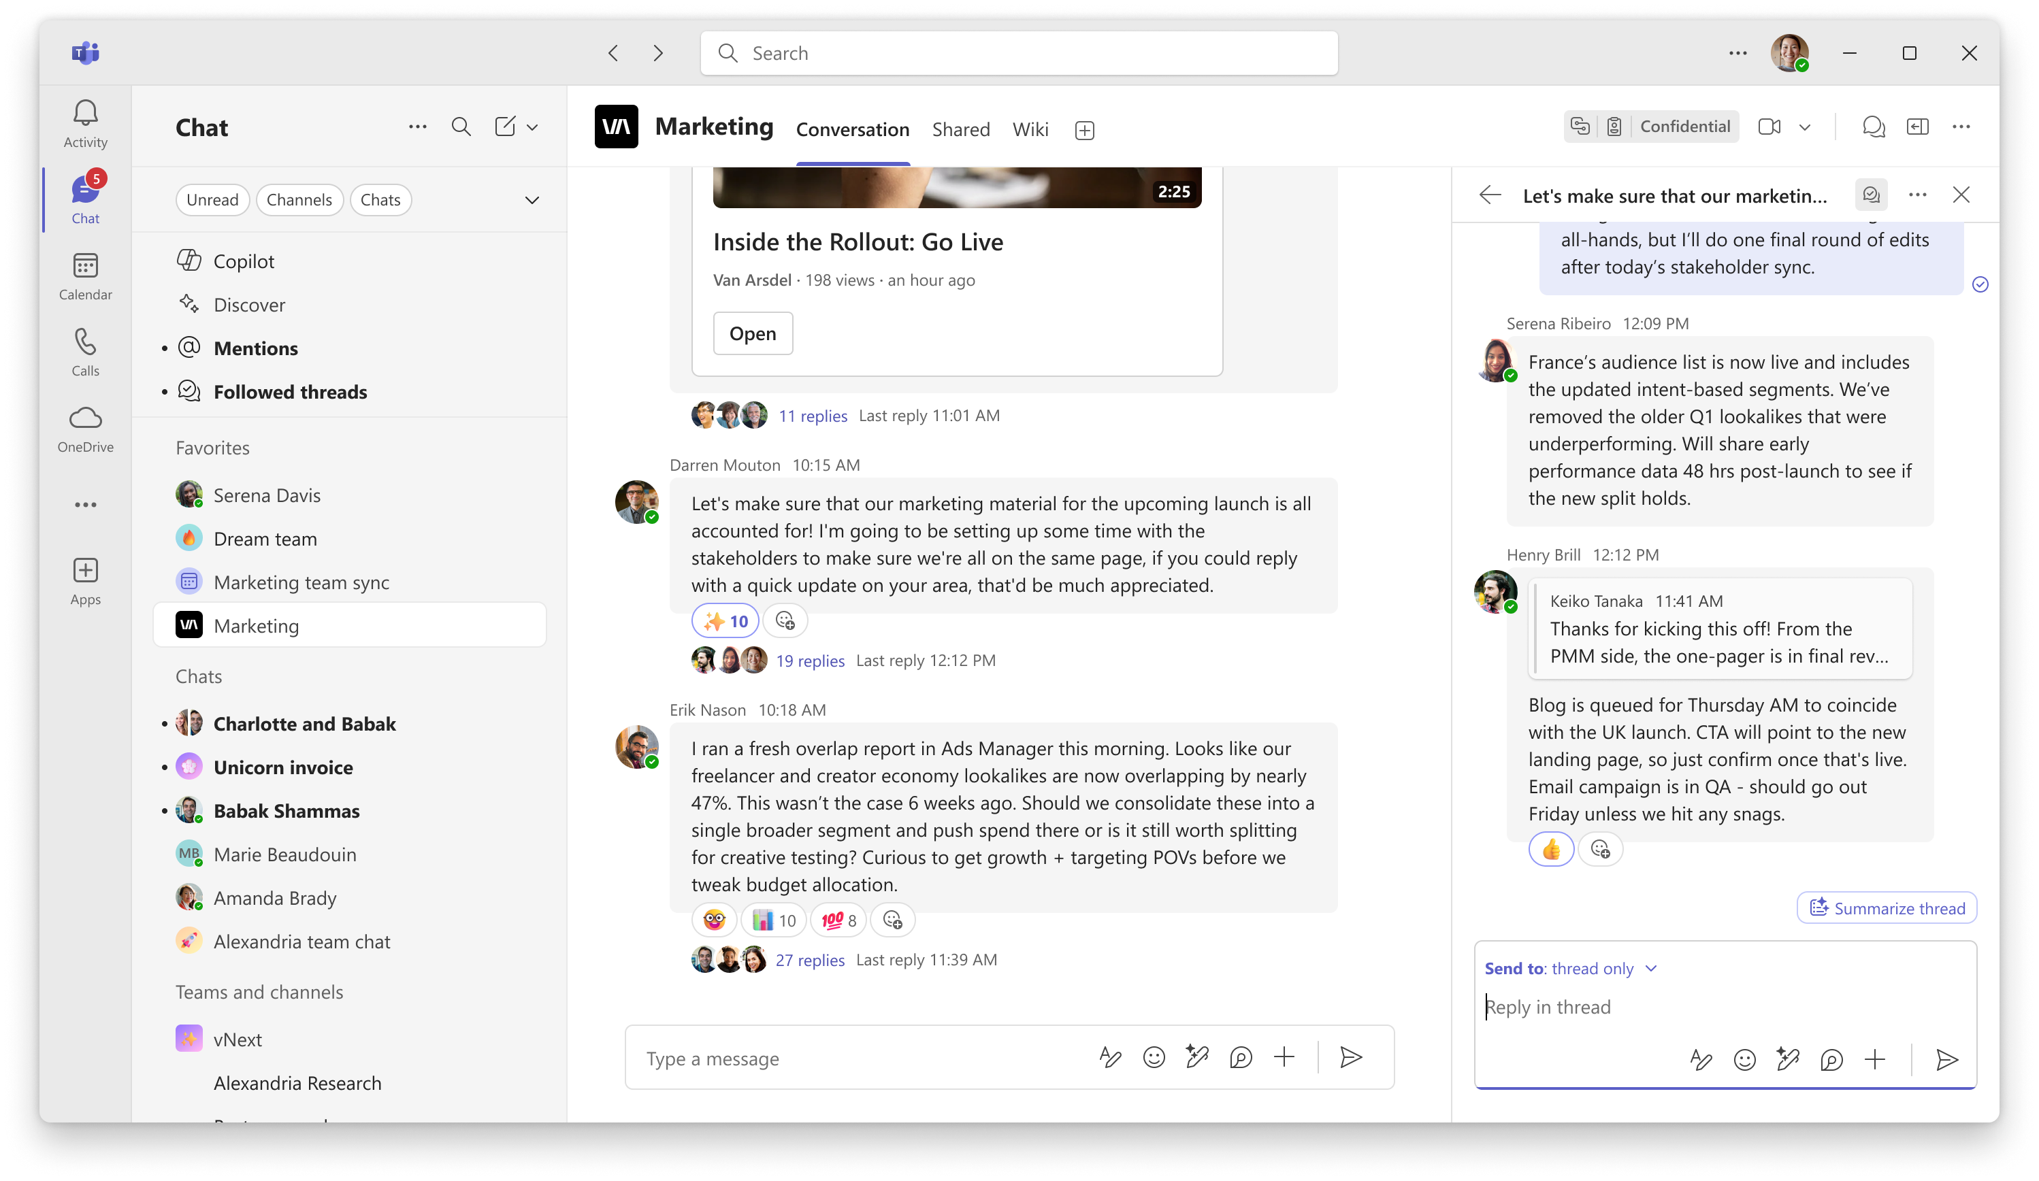
Threads in channels keep conversations focused and organized, so you can follow what matters without the noise

Slide 4
Value of channels
Work out in the open
All the conversations and meetings on a given project are available to everyone in the channel. There is only one place to check for updates, previous conversations are searchable, and there’s a central source of truth for a project.
Centralize storage
Channels are backed by a SharePoint site, so all files related to a project are centrally stored in one place and easy to find and access. If someone leaves the project, the content stays, preserving context for all others.
Opt in to notifications
Follow the threads you care about most so that you can focus on what matters, without being over-notified about less relevant conversations.

Slide 5
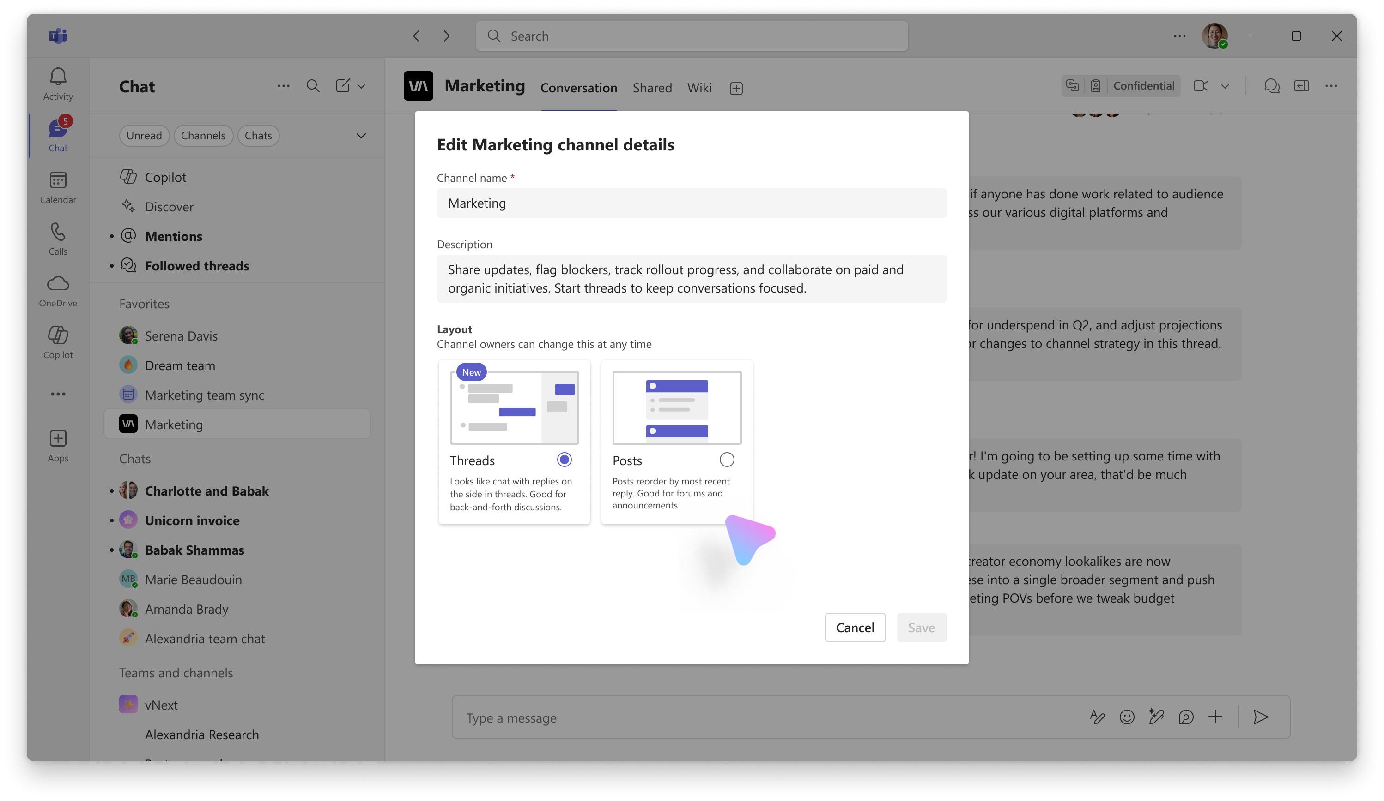
Create a threads channel
When you create a new channel, it will be a Threads channel by default.
Channel owners can switch between Threads and Post layout anytime.
Tip: choose a Shared channel type for more flexible membership.

Slide 6
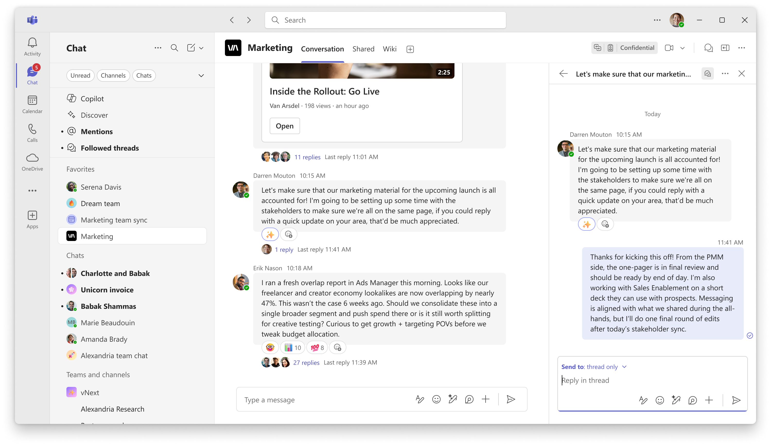
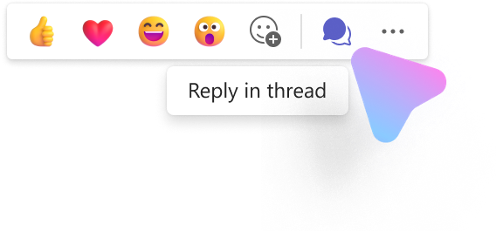
Reply in a thread
Hover over a message and select Reply in thread to start a new thread. This keeps all related messages on a given topic organized.
Tip: Use emojis on the headline message to indicate follow ups or actions taken.

Slide 7
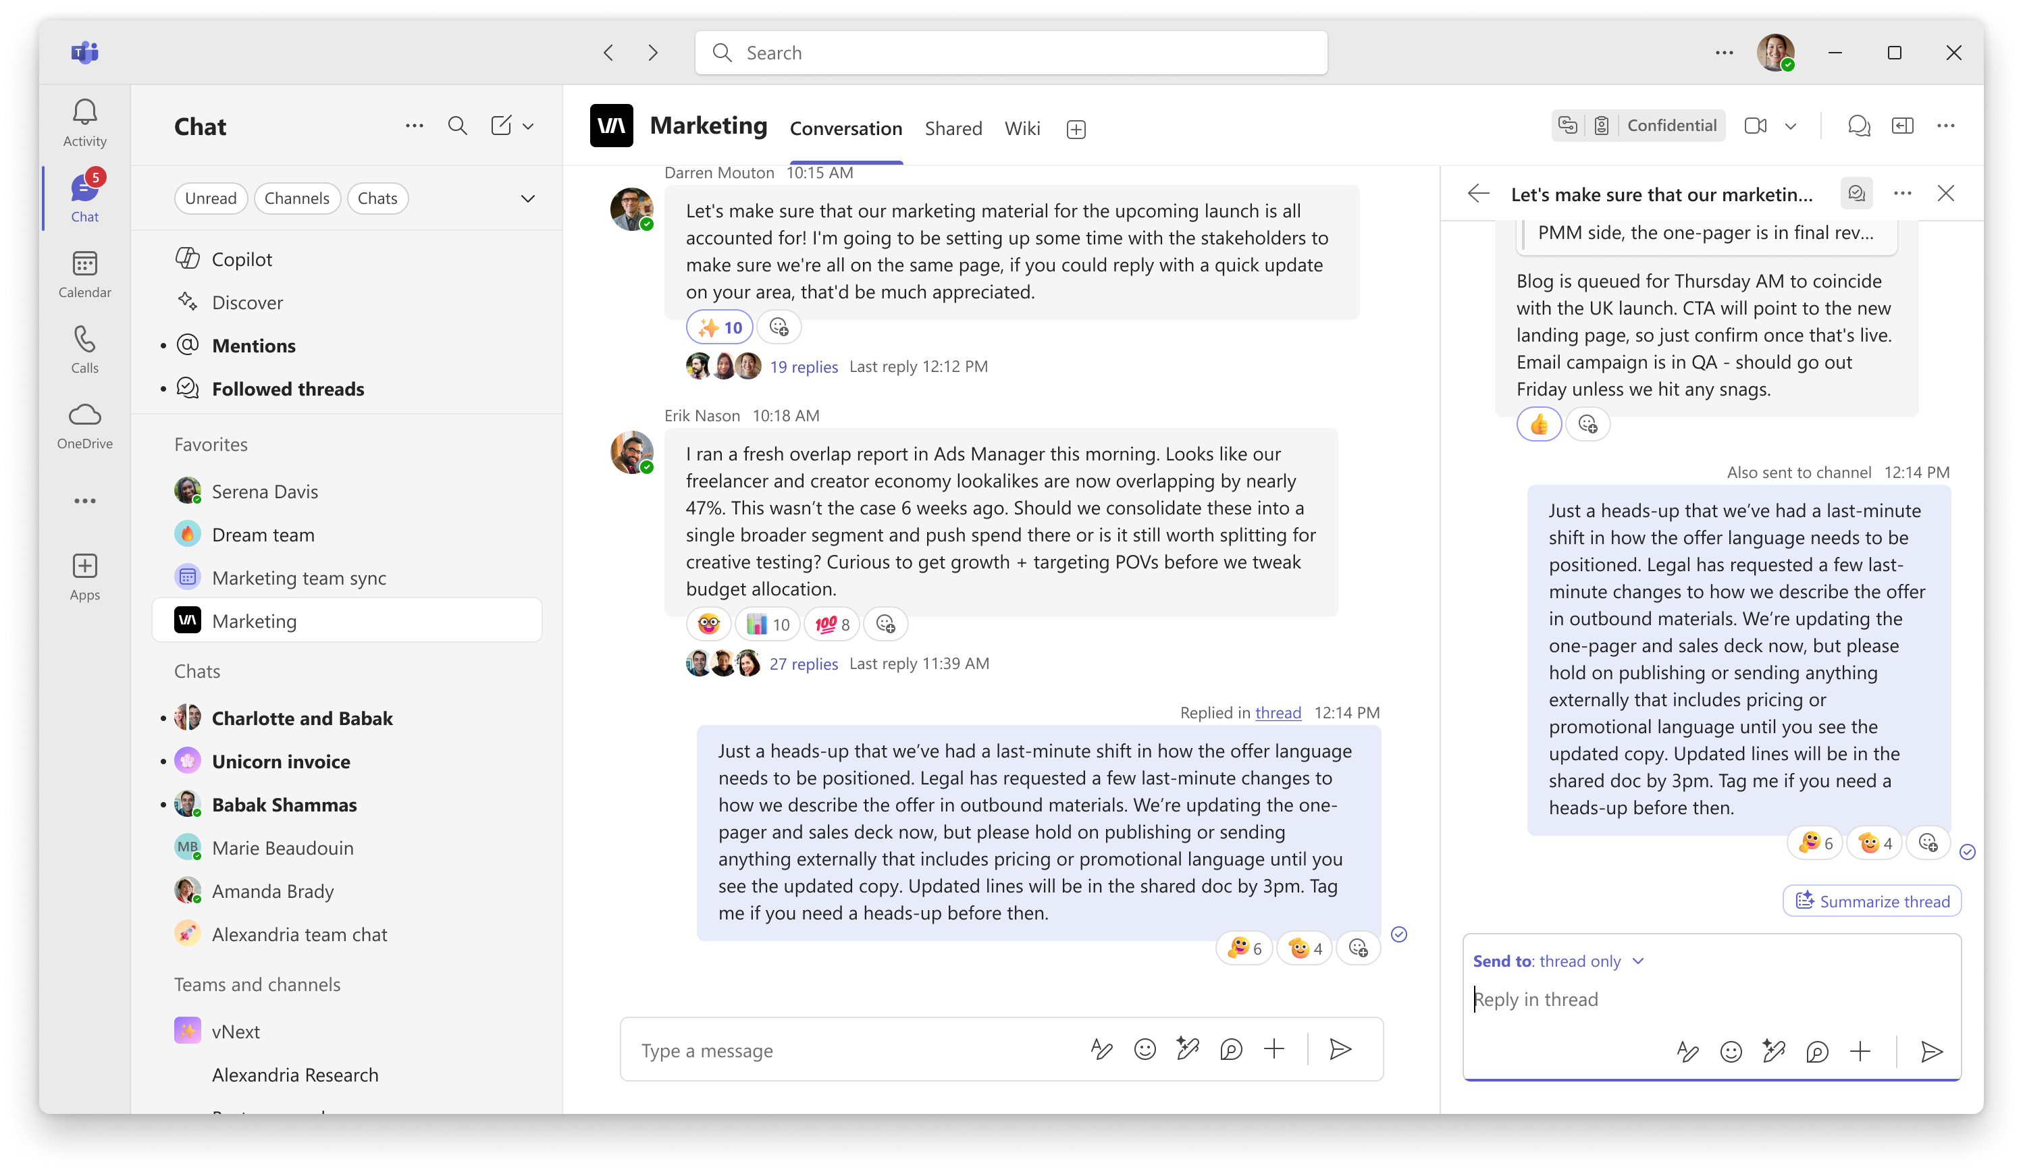
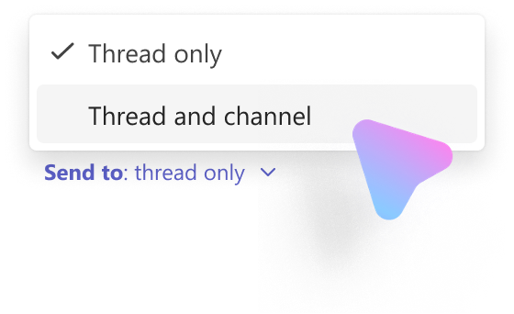
Send to thread and channel
Once you reach an outcome or decision, share back to the main conversation for visibility.
This reply will show up both in the thread and the main conversation, and future replies will stay organized in the thread.

Slide 8
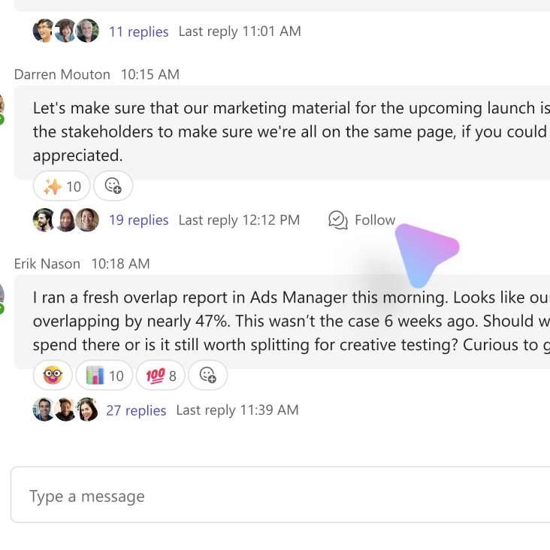
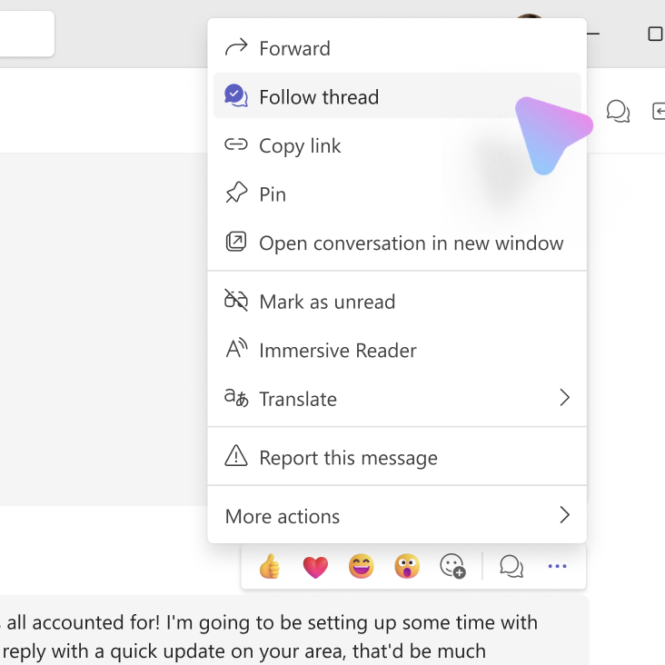
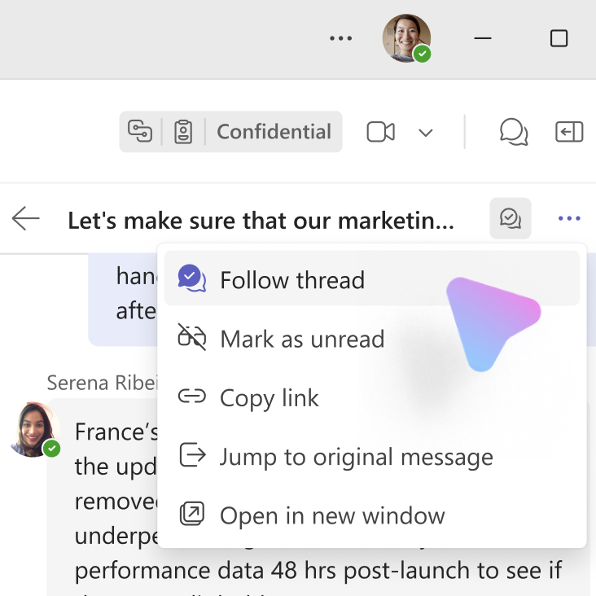
Follow a thread
Follow on hover
When there are already replies present, hover over the reply count and select Follow.
Follow in message actions
If you anticipate a particular message will generate an interesting discussion, hover over the message, go to Message Actions, and select Follow thread.
Follow in thread view
If you’re reading a thread and want to stay up to date on any future replies, you can also click the ... menu and select Follow thread.

Slide 9
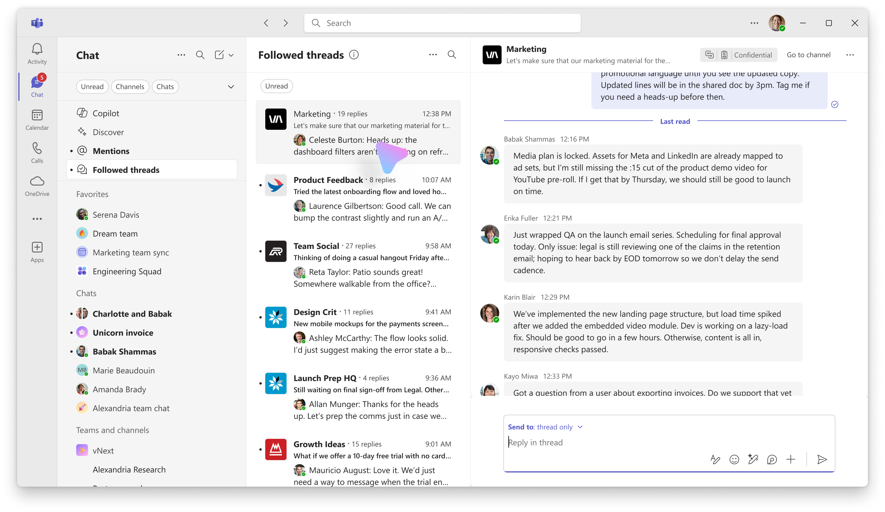
Followed threads view
Once a thread is followed, it will appear in your Followed threads quick view.
This view resembles an inbox, and you can quickly read and respond to all your threads without jumping between channels.

Slide 10
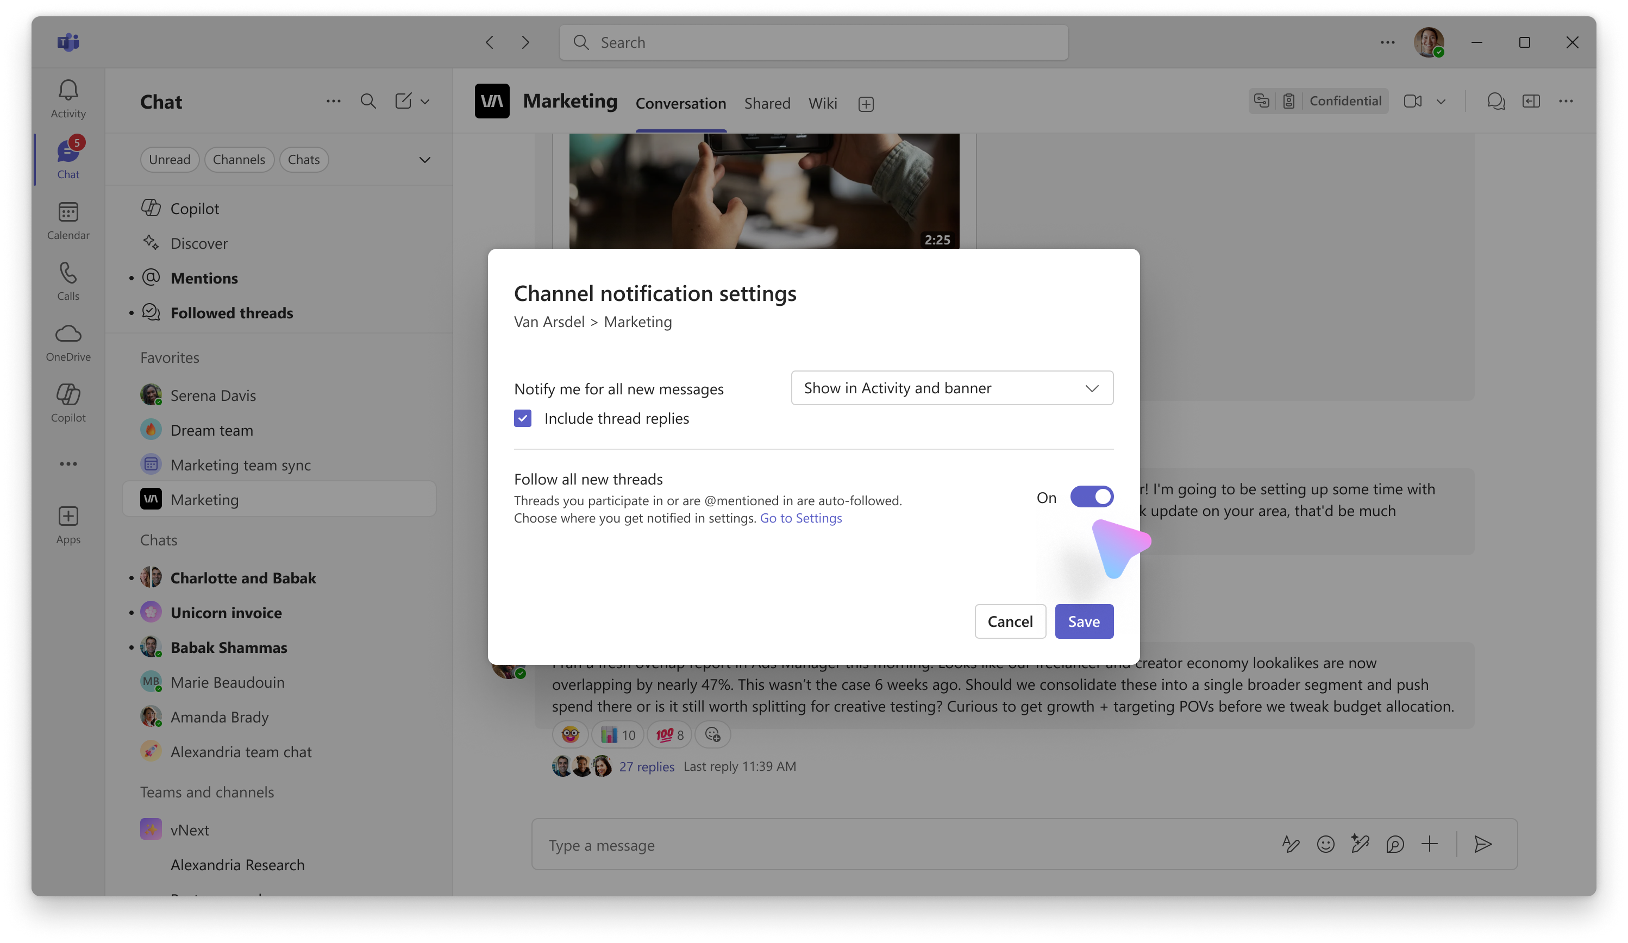
Channel settings
For a particularly important channel, you can configure the channel settings to automatically follow any new thread that gets created. These will show up in your Followed threads view.
You can also choose to be notified about any new message in Activity Feed, if you prefer to catch up through the Activity Feed.

Slide 11
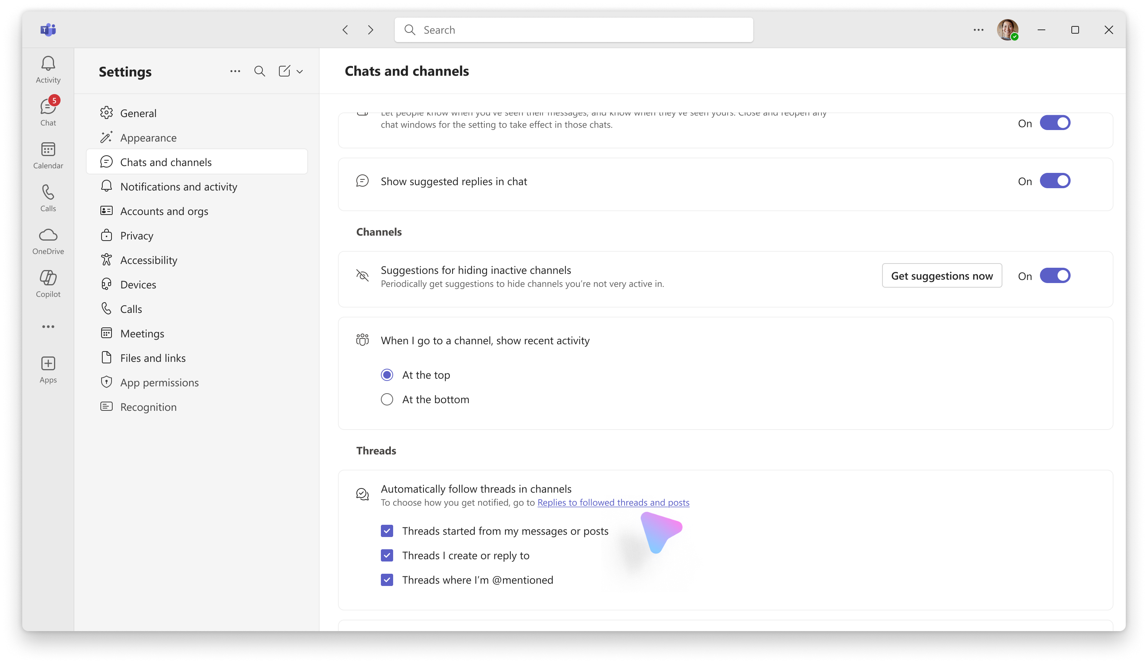
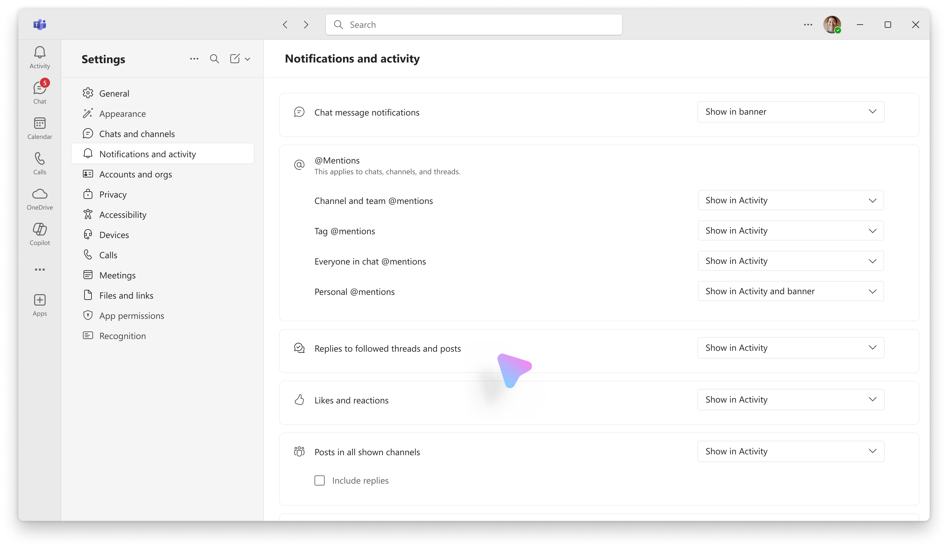
Settings for all your channels across Teams
Configure what is auto followed
Threads that are auto followed for you show up in your Followed threads quick view. This applies to your threads in Posts layout and Threads layout.
Configure how you get notified
Besides the Followed Threads quick view, you can also choose to get notified in the Activity Feed for replies to threads that you followed or auto followed.

Slide 12
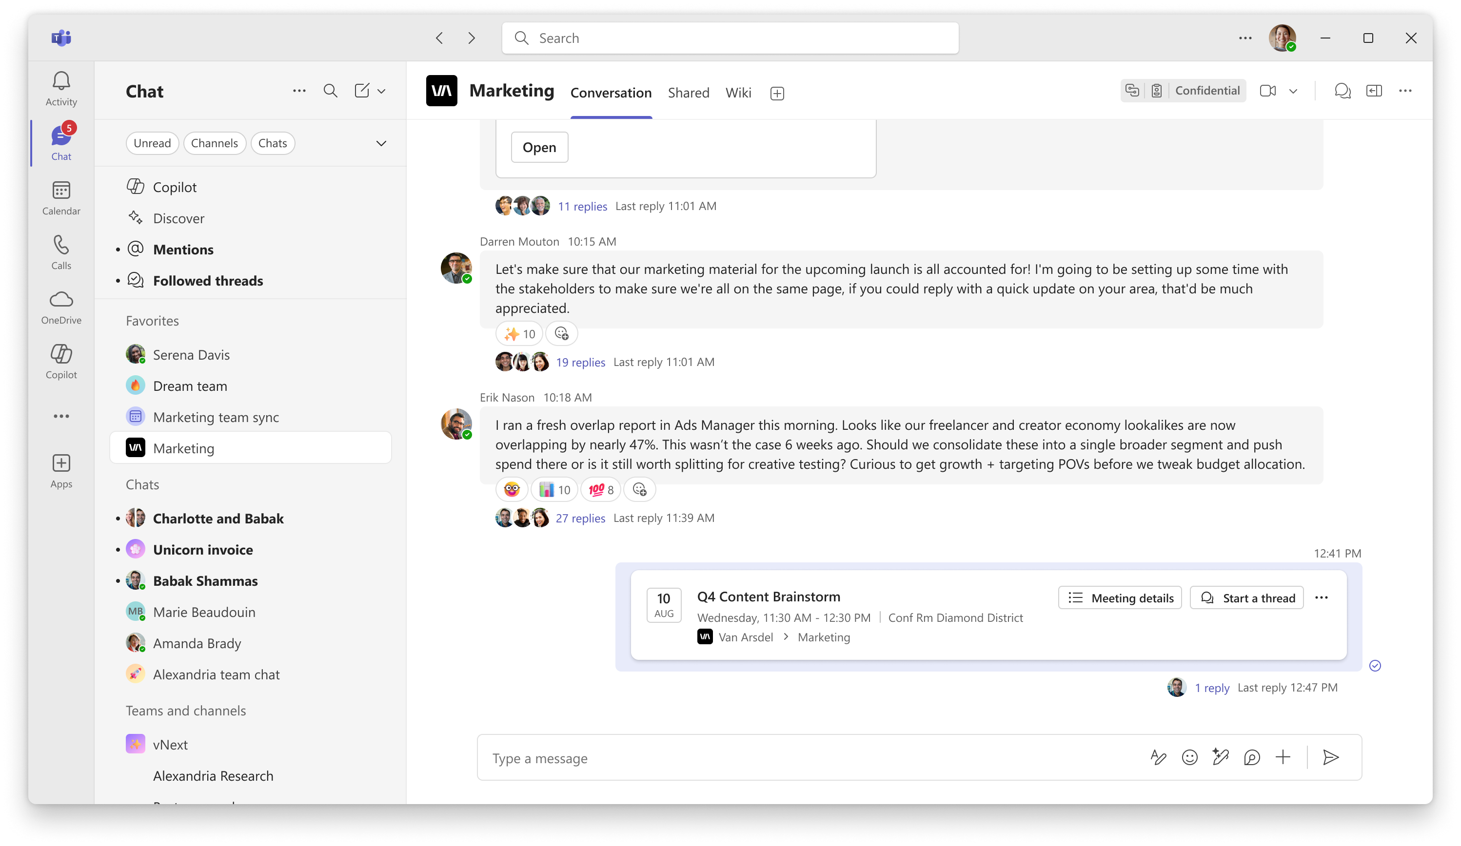
Channel meetings are threads
Keep all meeting chats centrally organized in one place with channel meeting threads.
A scheduled meeting or a Meet Now will have their own thread in the channel.
Tip: Add invitees directly so the meeting appears on their Outlook calendars.

Slide 13
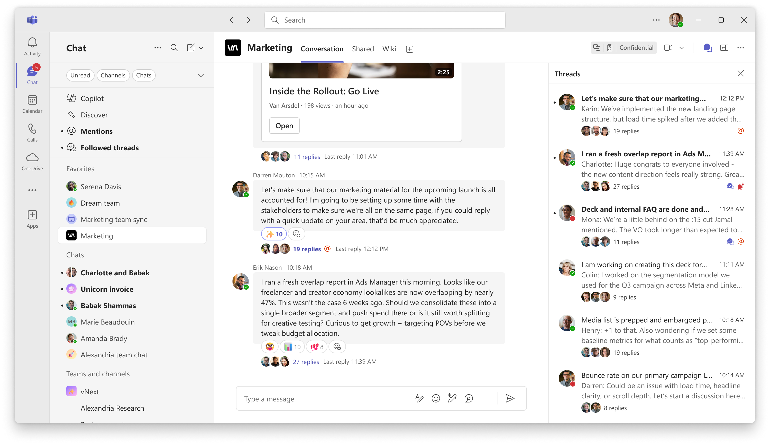

Catch up on all threads in a channel
The thread list has all the threads in a given channel.
Here, threads reorder by recency of replies, so you can catch up on most recent threads easily.

Slide 14
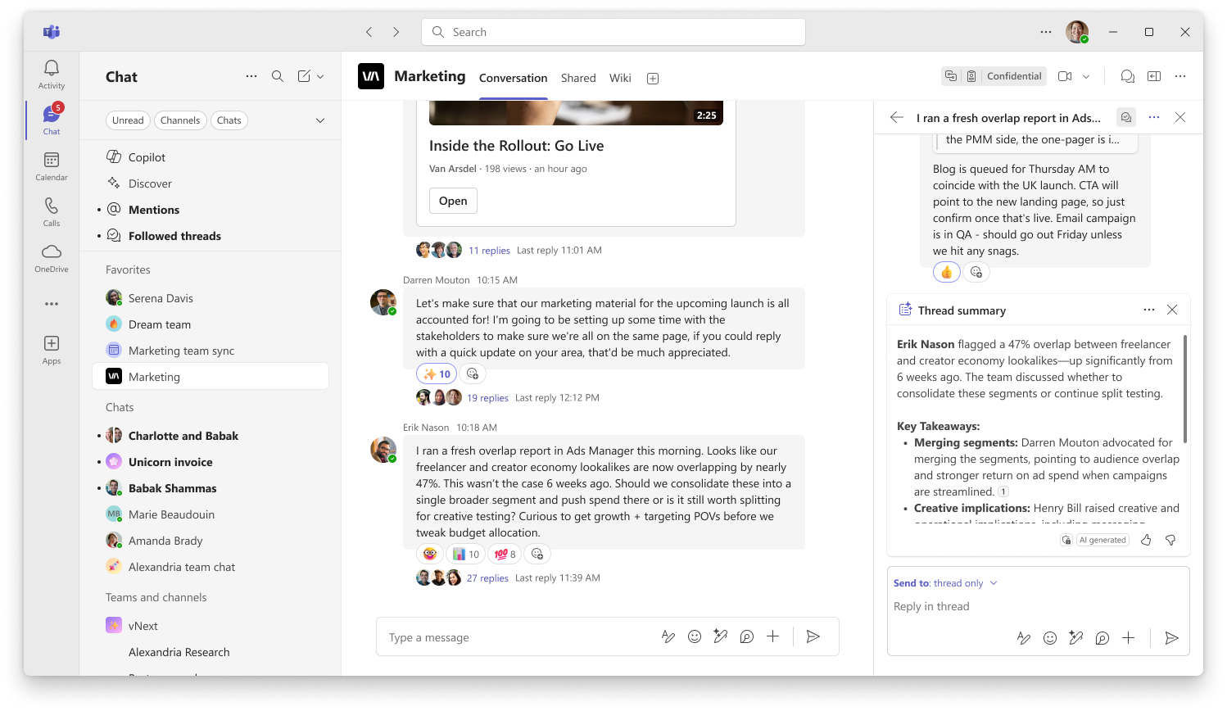
Catch up on a thread with AI
With a Copilot license, you can get an AI generated summary of a particular thread.
From the main conversation view, hover over a thread, select the ... menu for more options, and select Summarize thread.

Slide 15
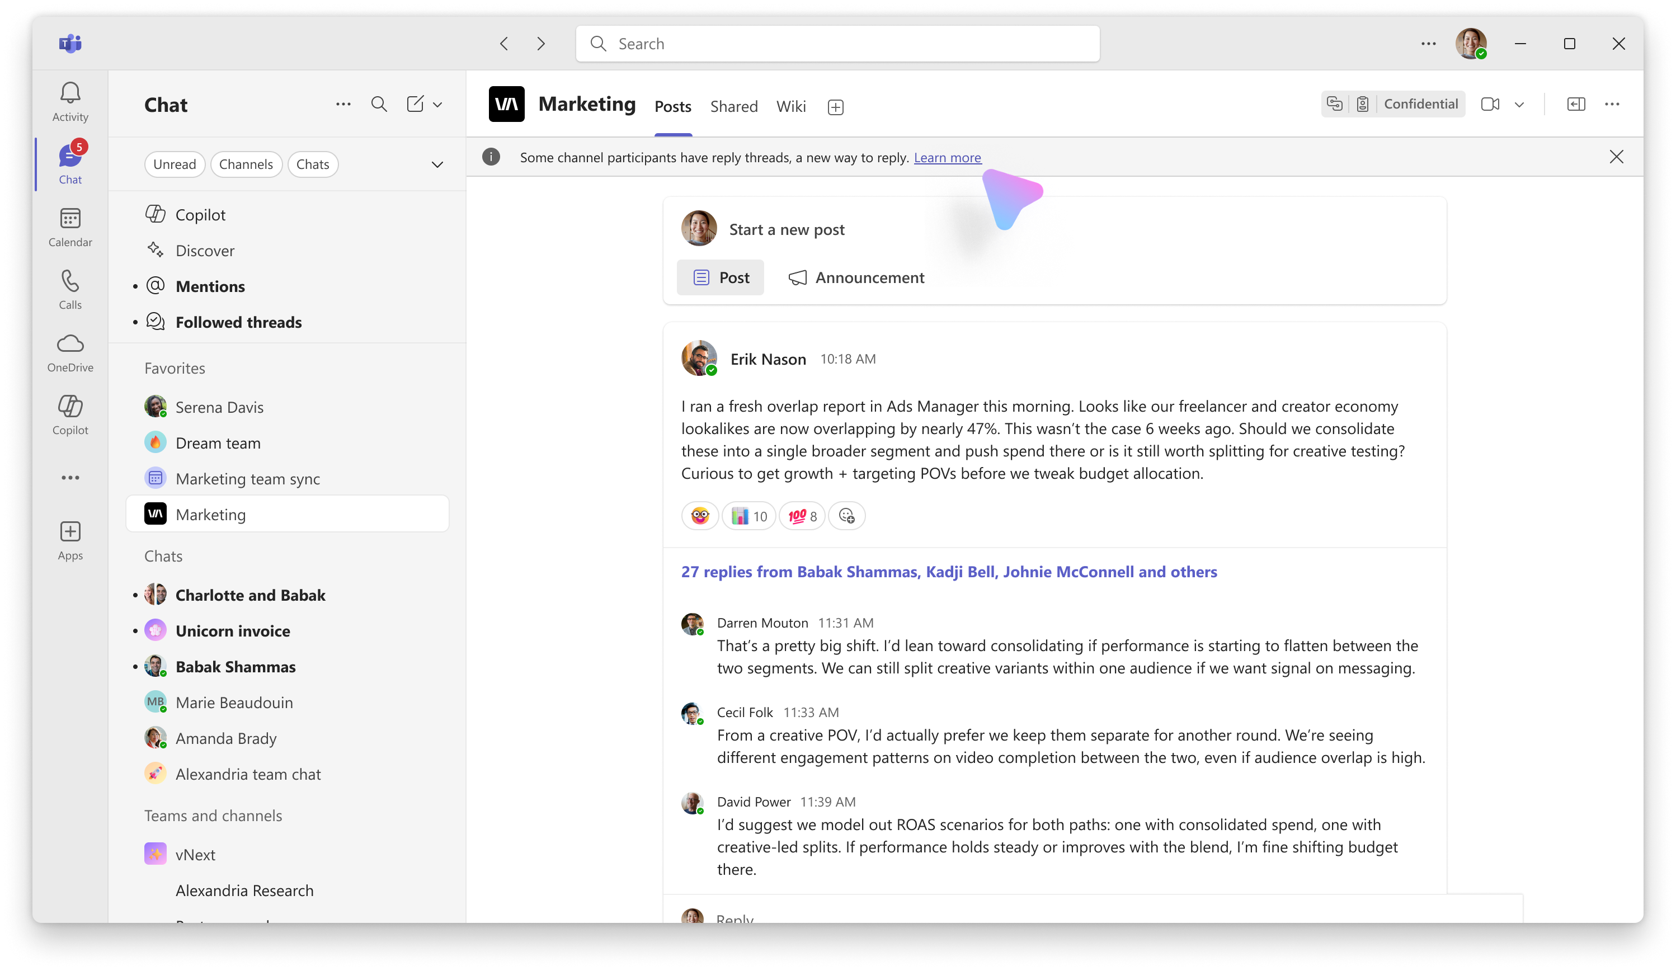
Backwards compatible
If you do not yet have threads available, you will see the channel in a Post layout view. A banner will let you know others see the channel in a Threads layout.
We suggest switching to Posts layout so everyone sees the same view and to avoid issues with bolding and notifications.

Slide 16
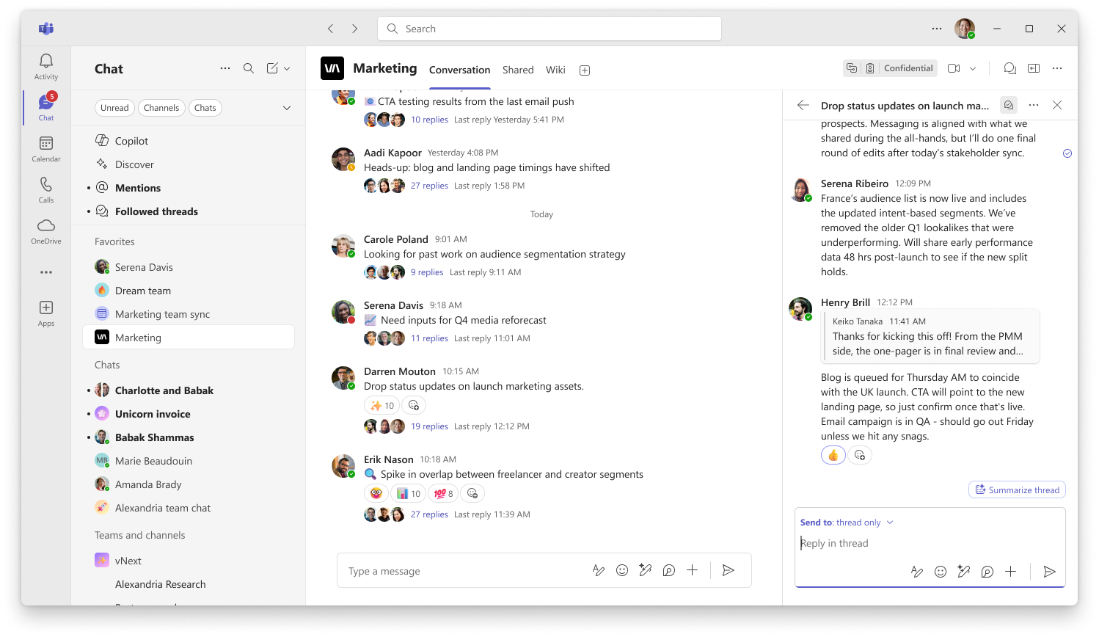
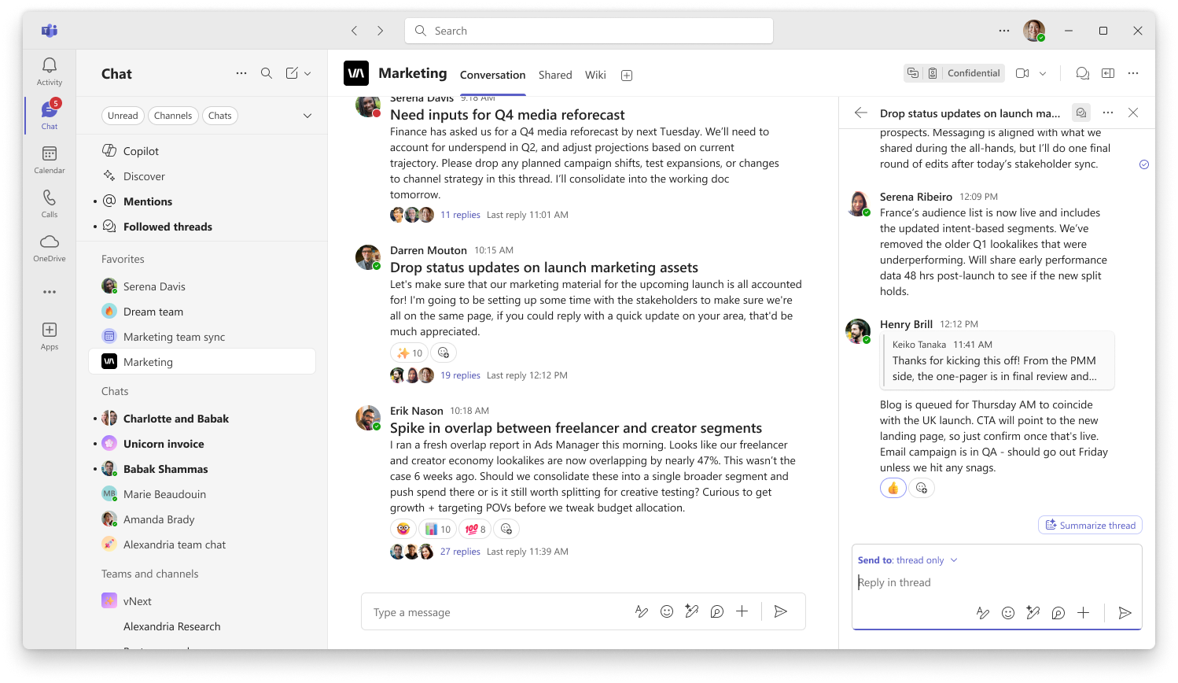
Two ways to use threading
Short headlines, details in the replies
You can use the main message as a title for the thread, and reply with more context. This way, the main channel view stays clear and scannable at a glance.
Titles with details in the main channel
You can also title your messages using the Format button in the compose box, and include the details as part of the message body. This allows you to stay aware of the details.

Slide 17
FAQ
Q: When should I use a threads vs a post layout channel?
Threads layout is a good choice when you want to keep the main conversation focused and only catch up on threads that are relevant to you. It’s ideal for collaborating with your working group.
Post layout is good for when you want to be caught up on every reply, since posts rearrange by reply recency and replies are shown in the main view. It’s also ideal for structured announcements.
Q: How is a threads channel different from a group chat?
Threads channels allow you to have deep dives in the thread without disturbing the main conversations. Channels also come with added benefits like centralized file storage, and everyone has the same level of access to all prior conversations.

