Slide 1






Microsoft Places
User and admin readiness guide

Slide 2

Microsoft Places Proof of Value
Plan
Enable
Grow
1
2
3
4
5
Reimagine flexible work with Microsoft Places
Discovery and pilot design
Deploy Microsoft Places
User readiness and adoption
Findings and next steps
You are here.

Slide 3
Objectives
This stage is to help you effectively engage users and drive adoption
1
Share the Microsoft Places Quick user guide, providing detailed instructions, in a step-by-step format, on how to utilize each Microsoft Places feature.
Leverage internal newsletters, social platforms, briefing videos and webinars, as well as teams and management meetings. Consider asking executive sponsor to promote the initiative through one or more of these channels.
Drive engagement by offering internal webinars, and ad-hoc training by your team on how to use the features.
We recommend you start your rollout with enhanced hero features. You can use the email template, which includes an embedded video, as a starting point.
Encourage discussion and candid feedback among participants.
A well-defined awareness strategy is key to successful adoption !
2
3

Slide 4
Microsoft Places
Guidance and tools to get you started

Slide 5
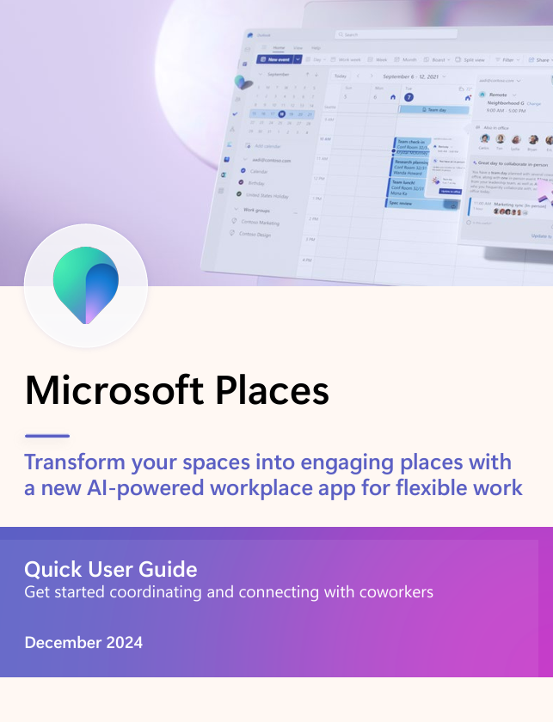
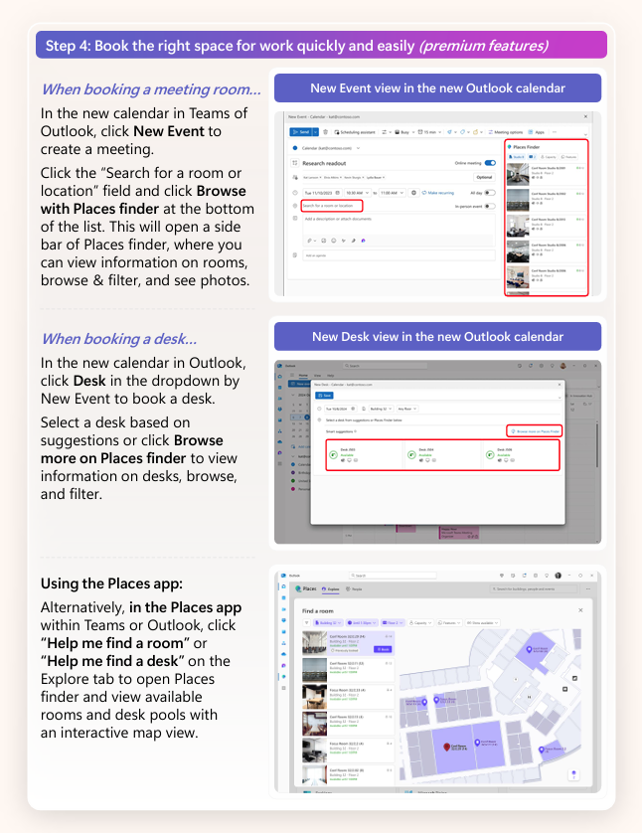
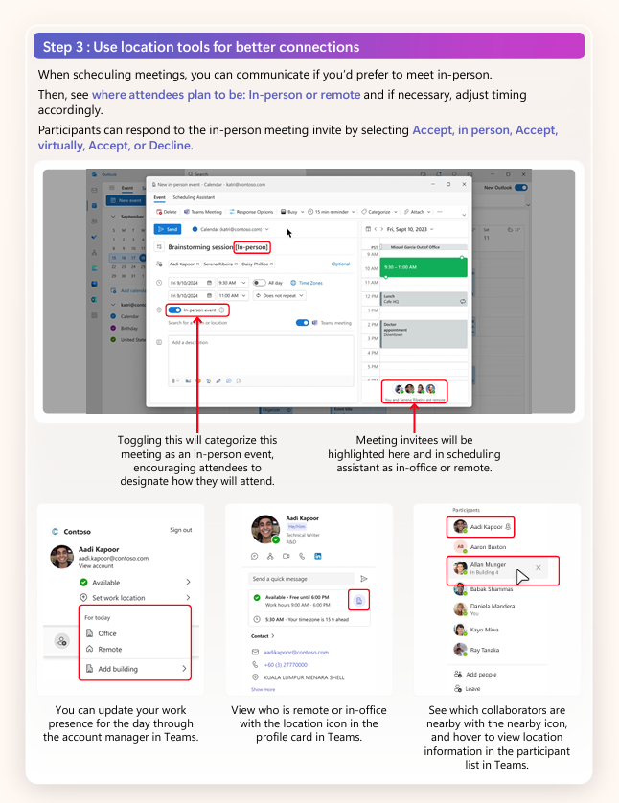
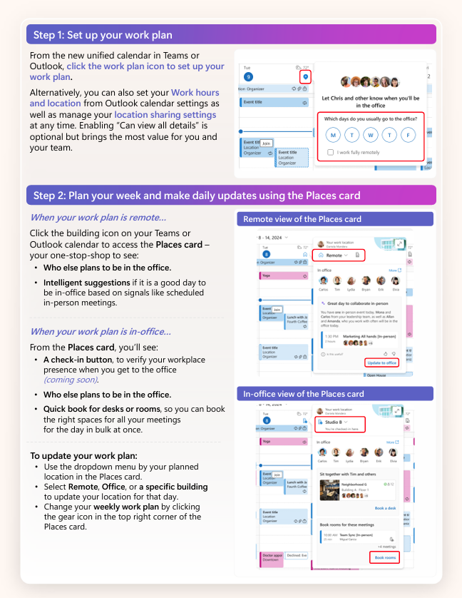
Microsoft Places - Quick User Guide
Share the Microsoft Places quick user guide, providing detailed instructions, in a step-by-step format, on how to utilize each Microsoft Places features.
It also offers additional insights and tips to help users maximize their experience with these features.
You can find the Quick User Guide here: Places Adoption

Slide 6
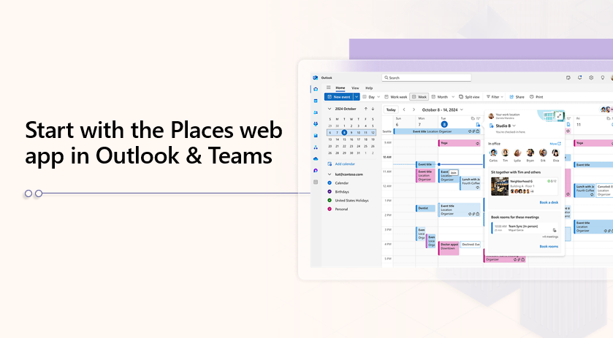
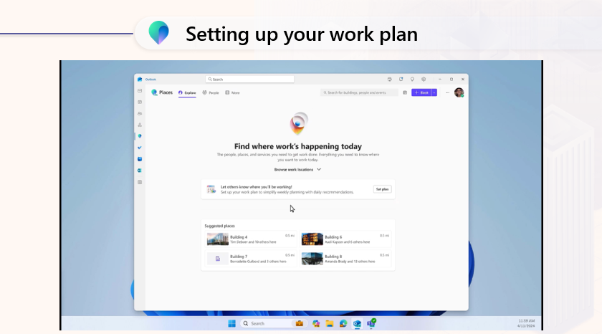
End User ‘Places’ demo videos (Presentation)
‘How to’ videos for the hero features
we recommend to start the engagement with:
  Microsoft Place demo presentation with videos
Gettings started with Places app
Create and manage your work plans
In-person events and Hybrid RSVP
Room and desk booking
Places Explorer
Workplace Presence
Copilot features
  Find videos in the readiness and adoption guide.
*Can be customized with the Organization’s contact and rollout information

Slide 7
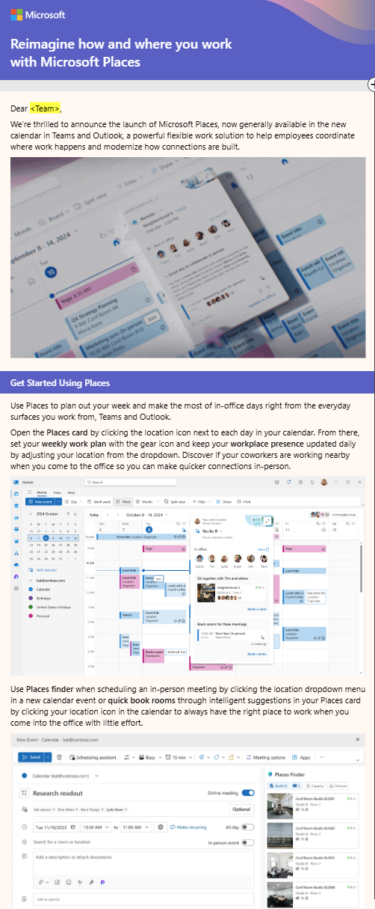
Example Email communications to end users
Communicate with end users through emails and posters, and implement gradual promotion plans
Emails .oft templates and communication suggestions templates (example)
Microsoft Places End User Adoption Email
Email OFT templates can be found in the user engagement content kit here: Places Adoption.
*Can be customized with the Organization’s contact and rollout information

Slide 8
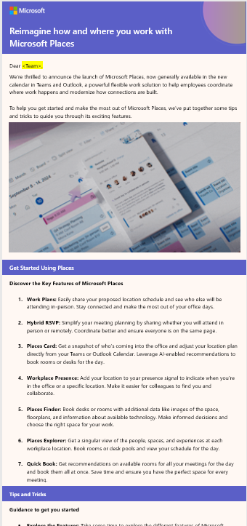
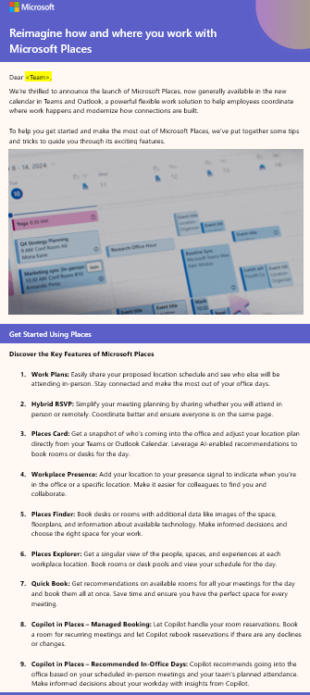
Example Email communications to end users – Tips and Tricks
Tips and tricks email template to help you get started
Tips and tricks emails .oft templates and communication suggestions templates
Enhance Your Workday with Microsoft Places Key Features and Tips – Core and Enhanced
Enhance Your Workday with Microsoft Places Key Features and Tips – Core, Enhanced and Copilot
Email OFT templates can be found in the user engagement content kit here: Places Adoption.
*Can be customized with the Organization’s contact and rollout information

Slide 9
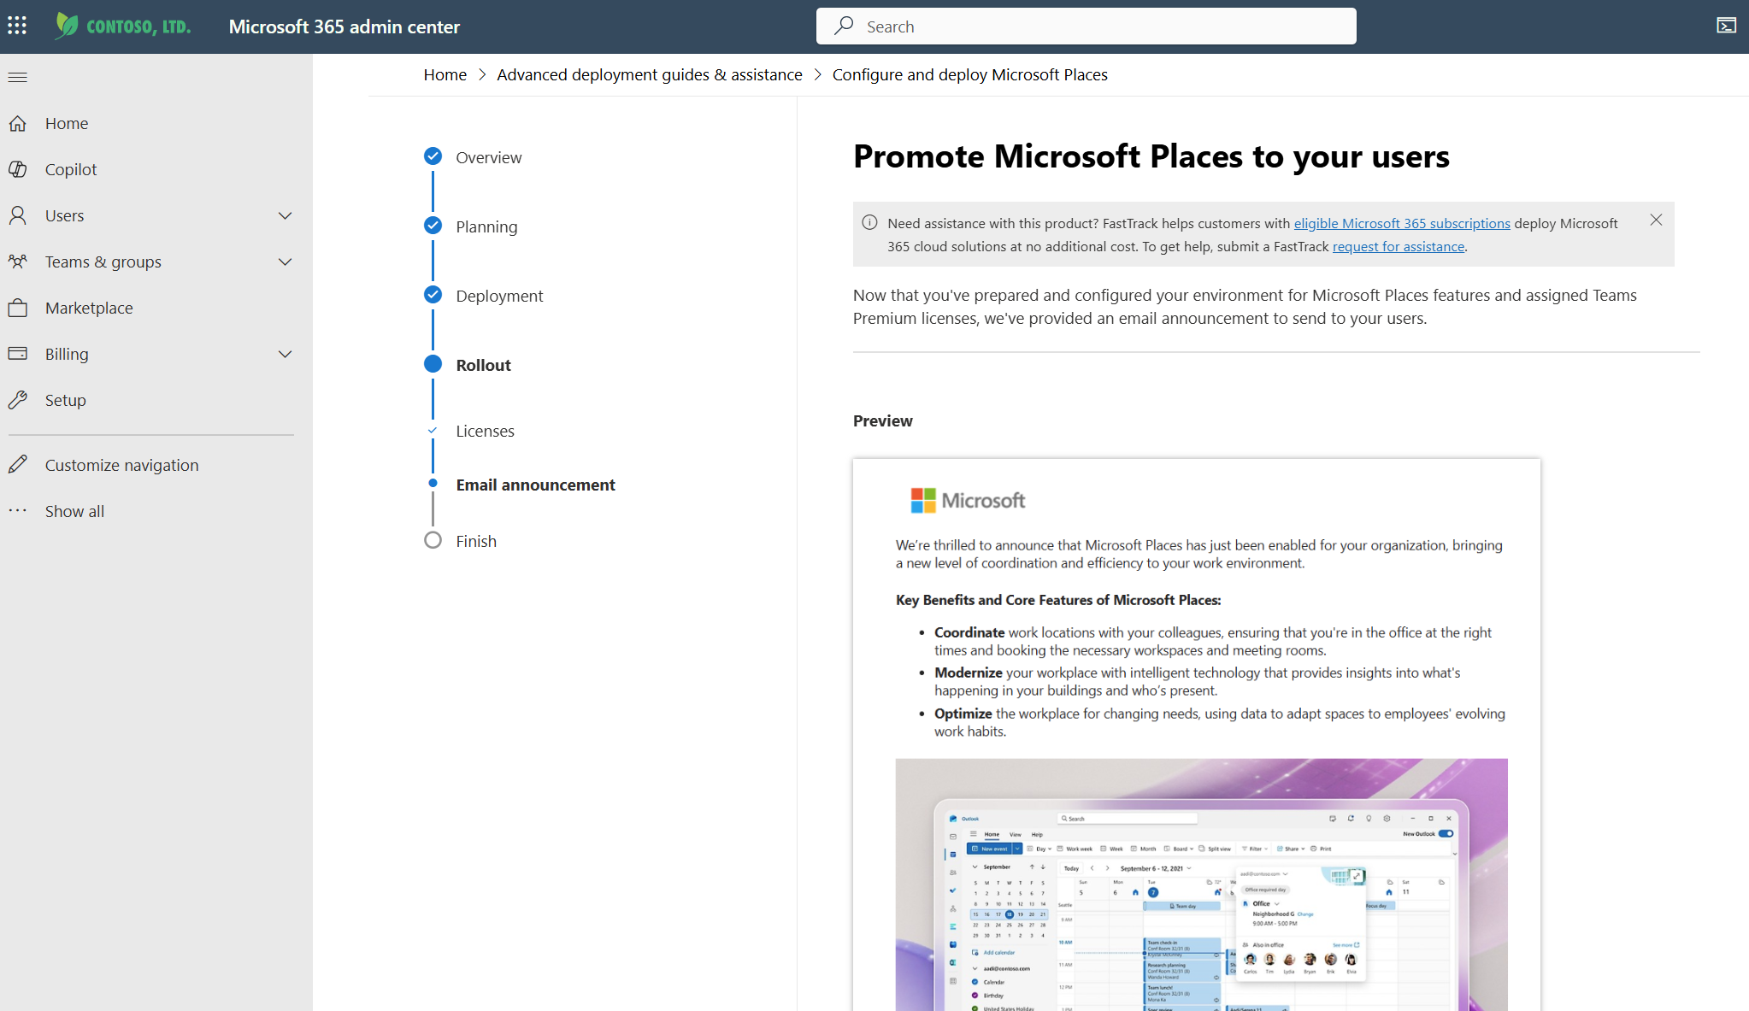
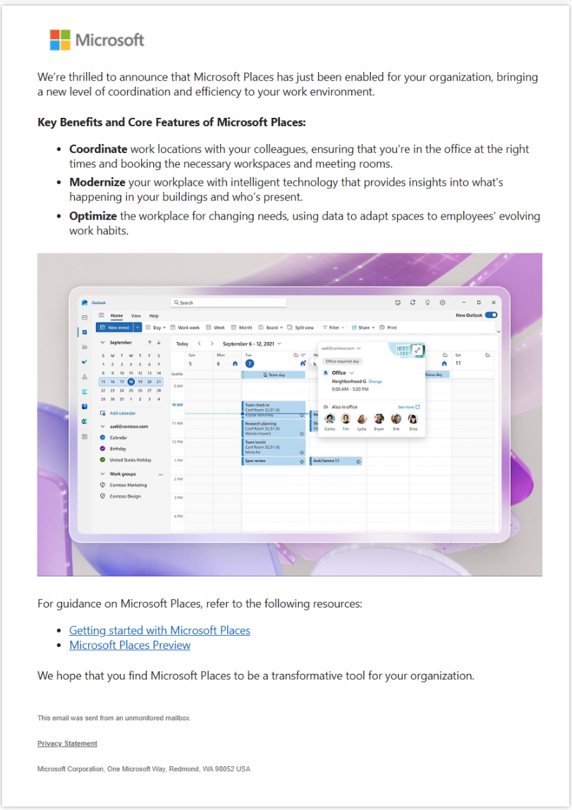
Promote ‎Microsoft Places‎ to your users – email announcement
Send email announcement from Microsoft 365 admin center using the Configure and deploy ‎Microsoft Places‎ advanced deployment guide
Once you've prepared and configured your environment for ‎Microsoft Places‎ features and assigned ‎Teams Premium‎ licenses, you can send an email announcement to send to your users from Microsoft 365 admin center.
Email OFT templates can be found in the user engagement content kit here: Places Adoption.
Microsoft Places advanced deployment guide

Slide 10
Core features - Suggested social platform communication to end users
Feature to promote among end users | Suggestion social posts for gradual feature exposure and promotion
Employee coordination & hybrid work planning in the natural flow of work. Work plans | Option 1: Enhance your in-person collaboration with Work Plans in Microsoft Places! Easily share your proposed location schedule and see who else will be attending in-person. Stay connected and make the most out of your office days. Discover more about Work Plans and how they can improve your work experience. Check out this video to learn more [link] Option 2: Maximize your in-person collaboration with Work Plans in Microsoft Places! Effortlessly share your location schedule and see who else will be in the office. Stay connected and make the most of your time at work. Learn more about how Work Plans can enhance your work experience. Check out this video to get started [link]
Creating in-person moments that matter In-person events Hybrid RSVP | Option 1: Simplify your meeting planning with Hybrid RSVP in Microsoft Places! Participants can easily share whether they will attend in person or remotely, making it easier to coordinate and prepare for hybrid meetings. Discover how Hybrid RSVP can enhance your meeting experience. Check out this video to learn more [link] Option 2: Make hybrid meetings a breeze with Hybrid RSVP in Microsoft Places! Effortlessly communicate your attendance preference—whether in person or remote—and see who else will be joining. Enhance your meeting coordination and ensure everyone is on the same page. Learn more about the benefits of Hybrid RSVP. Watch this video to get started [link]
Plan your workday Places Card Workplace presence | Option 1: Stay ahead of your workday with the Places Card in Microsoft Places! Easily see who’s coming into the office and adjust your location plan directly from your Teams or Outlook Calendar. Check out this video to learn more [link] Option 2: Optimize your office presence with the Places Card in Microsoft Places! Effortlessly see who’s in the office and adjust your plans directly from your Teams or Outlook Calendar. Learn more about the Places Card. Watch this video to get started [link]

Slide 11
Enhanced features - Suggested social platform communication to end users
Feature to promote among end users | Suggestion social posts for gradual feature exposure and promotion
Find the perfect workspace with Places Finder in Microsoft Places! Places finder | Option 1: Find the perfect workspace with Places Finder in Microsoft Places! Easily book desks or rooms with the help of additional data like images of the space, floorplans, and information about available technology. Make informed decisions and choose the right space for your work. Discover how Places Finder can enhance your booking experience. Check out this video to learn more [link] Option 2: Optimize your workspace booking with Places Finder in Microsoft Places! View detailed information on rooms, browse and filter options, and see photos to help you book the ideal space. Leverage additional data like images, floorplans, and technology details to make the best choice for your needs. Learn more about the benefits of Places Finder. Watch this video to get started [link]
Leverage AI-enabled recommendations to update your location to “Office,” book a room for a meeting, or a desk for the day Places Card Workplace presence Intelligent suggestions | Option 1: Stay ahead of your workday with the Places Card in Microsoft Places! Easily see who’s coming into the office and adjust your location plan directly from your Teams or Outlook Calendar. Leverage AI-enabled recommendations to update your location, book a meeting room, or reserve a desk for the day. Discover how the Places Card can streamline your workplace coordination. Check out this video to learn more [link] Option 2: Optimize your office presence with the Places Card in Microsoft Places! Effortlessly see who’s in the office and adjust your plans directly from your Teams or Outlook Calendar. Use intelligent suggestions to update your location to "Office," book a room, or reserve a desk. Make the most of your workday with seamless coordination. Learn more about the Places Card. Watch this video to get started [link] Option 3: Connect with your team and make the most of in-office days with Workplace Presence in Microsoft Places! Choose to share where you’re working for the day, making it easy for colleagues to collaborate with you. Learn more about Workplace Presence. Check out this video to get started [link]
Discover everything your workplace has to offer Places explorer | Option 1: Discover everything your workplace has to offer with Places Explorer in Microsoft Places! Get a singular view of the people, spaces, and experiences at each location. From booking a room or desk pool to viewing your schedule for the day, Places Explorer provides a comprehensive snapshot of your workplace. Learn more about how Places Explorer can enhance your work experience. Check out this video to get started [link] Option 2: Unlock the full potential of your workplace with Places Explorer in Microsoft Places! Easily get a snapshot of the people, spaces, and experiences at each building level. Book rooms or desk pools and stay on top of your schedule with ease. Discover how Places Explorer can streamline your workday.
Streamline your in-office meetings with Quick Book Quick Book | Option 1: Streamline your in-office meetings with Quick Book in Microsoft Places! Get recommendations on available rooms for all your meetings for the day and book them all at once in bulk. Save time and ensure you have the perfect space for every meeting. Learn more about how Quick Book can simplify your scheduling. Check out this video to get started [link] Option 2: Make your meeting planning effortless with Quick Book in Microsoft Places! Quickly get recommendations for available rooms for all your meetings and book them all at once. No more last-minute scrambles for space—Quick Book has you covered. Discover the convenience of Quick Book.

Slide 12
Copilot in Places features - Suggested social platform communication to end users
Feature to promote among end users | Suggestion social posts for gradual feature exposure and promotion
Say goodbye to scheduling headaches and let Copilot manage your room reservations seamlessly. Copilot in Places – Managed Booking | Option 1: Simplify your meeting planning with Copilot in Places! With Managed Booking, you can book a room for recurring meetings and let Copilot handle any room declines. Copilot will rebook single or recurring room reservations on your behalf based on availability. Say goodbye to scheduling headaches and let Copilot manage your room reservations seamlessly. Check out this video to learn more [link] Option 2: Take the hassle out of room bookings with Copilot in Places! Managed Booking allows you to book a room for recurring meetings and lets Copilot rebook reservations if there are any declines or changes. Enjoy a stress-free scheduling experience as Copilot finds the best available rooms for you. Discover how Managed Booking can streamline your meetings. Watch this video to get started [link]
Make the most of your in-office days with Copilot in Places! (Coming Soon) Copilot in Places – Recommended In-Office Days | Option 1: Make the most of your in-office days with Copilot in Places! Copilot recommends going into the office based on your scheduled in-person meetings and your team’s planned attendance. Understand if today is a good day to be in the office with insights from Copilot. Stay connected and make informed decisions about your workday. Learn more about Copilot’s recommendations. Check out this video to get started [link] Option 2: Optimize your office presence with Copilot in Places! Copilot provides recommendations on the best days to go into the office based on your meetings and team’s plans. Know if today is a good day to be in-person and get reasons why it’s beneficial. Enhance your work experience with Copilot’s insights. Discover more about Recommended In-Office Days. Watch this video to learn more [link]

Slide 13
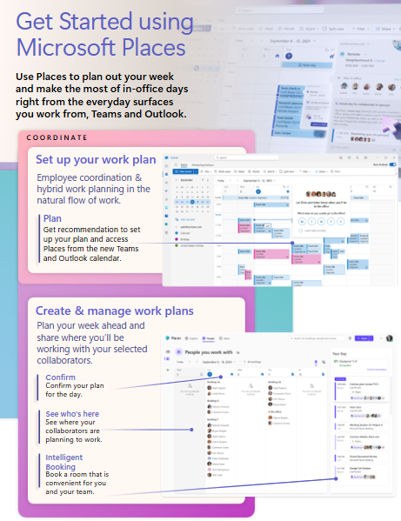
One pagers - Drive awareness and engagement
One pagers for getting started using Microsoft Places
(Can be edited for your organization’s needs)
Work Plans
Intelligent suggestions
Play your workday with Copilot
Room and desk booking
Intelligent booking
Copilot managed booking
Places explorer
Workplace presence
PowerPoint based flyer templates can be found in the engagement kit in the resources folder.

Slide 14
Getting started and example communication plan
Microsoft Places

Slide 15
Example Communication Plan
Start Now | Service available | T+3 days | T+7 days | T>7 days | Ongoing
Send Countdown: email to help users feel productive quickly with Microsoft Places Use the Microsoft Places posters and signage to raise awareness Promote features using the social post suggestions on company social communication platform | Use the Introduction to Microsoft Places to tell users that Microsoft Places is available for them. Send Microsoft Places quick start guide and how to videos | Send the Tips and Tricks email to help your users get the most out of Microsoft Places | Send the Tips and Tricks email to help your users get the most out of Microsoft Places. | Host a Webinar or Town Hall for questions and answers. Promote features using the post suggestions to your company communication platform for example Viva Engage to help your users get the most out of Microsoft Places. | Utilize one pagers and flyers to continue communicating with users to help them continue to feel productive.

Slide 16
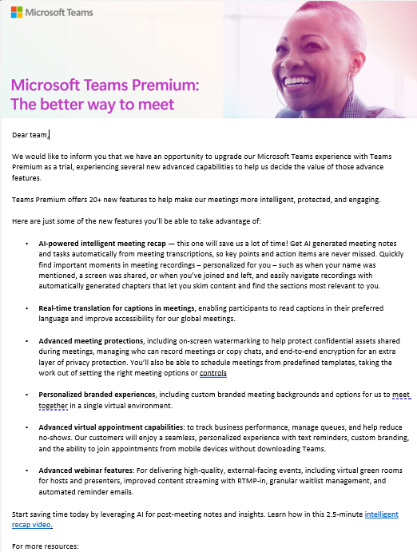
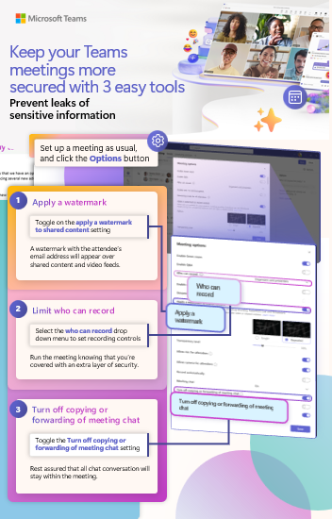
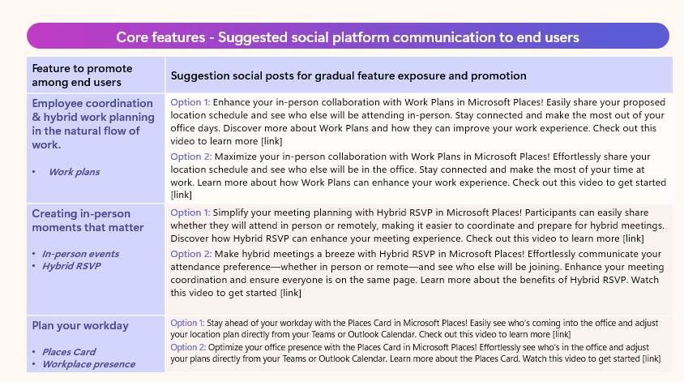
Start now
Send Introducing to Microsoft Places email
to help users feel productive quickly.
Use Microsoft Places posters and signage to raise awareness
Promote features using the post suggestions on company communication platform

Slide 17
Day of launch
Microsoft Places quick user guide to help users learn more about Microsoft Places features.
Share the How to videos so users can watch how to use Microsoft Places features in their own time.

Slide 18
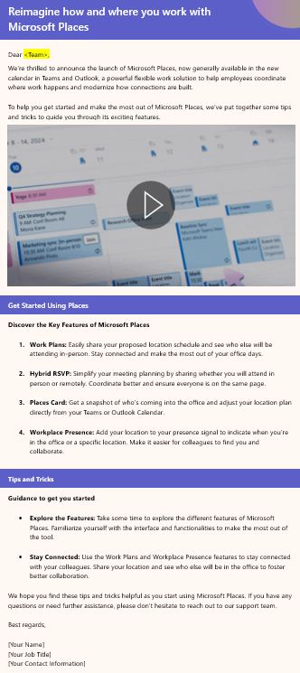
Three days post launch
Send the Tips and Tricks email to help your users get the most out of Microsoft Teams.

Slide 19
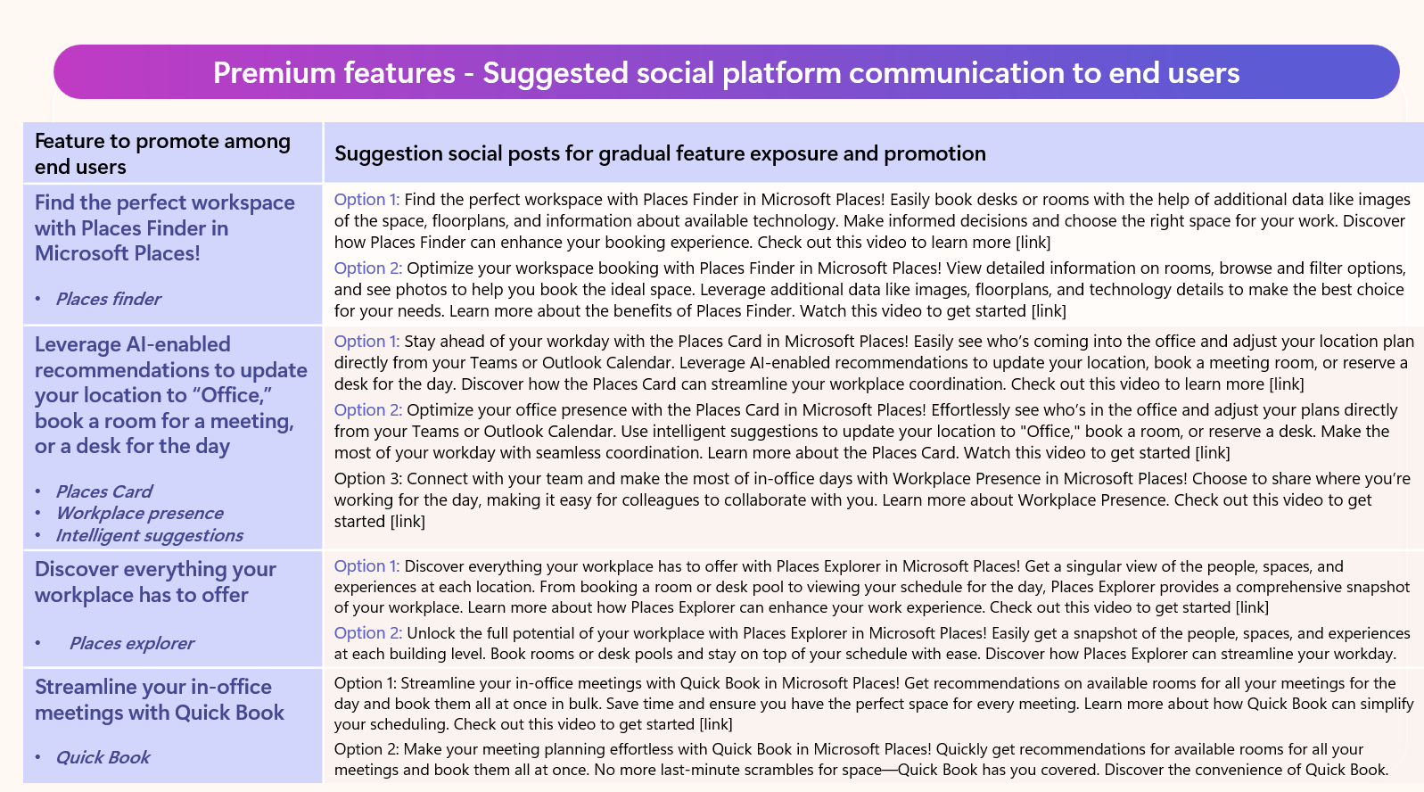
Seven days post launch
Host a Webinar or Town hall for questions and answers.
Promote features using the social post suggestions to your company social communication platform for example Viva Engage to help your users get the most out of Microsoft Places.

Slide 20
Ongoing Communication
Utilize one pagers and Persona brochures to communicate with users to help them to feel productive.

