Slide 1






Microsoft Places
Enablement Guide

Slide 2

Microsoft Places Proof of Value
Plan
Enable
Grow
1
2
3
4
5
Reimagine flexible work with Microsoft Places
Discovery and pilot design
Deploy Microsoft Places
User readiness and adoption
Findings and next steps
You are here.

Slide 3
Objectives
1
Verify pilot uses cases and features identified in the plan phase to enable.
Verify and assign licenses to pilot users. Reference: Microsoft Teams Premium licensing documentation.
Prepare your environment before pilot deployment and plan building setup
Enable Places core and enhanced features using this enablement guide or the Microsoft Places deployment guide.
2
3
4

Slide 4
Deploying Microsoft Places
01
02
03
04
05
06
Verify use cases and features
Prepare your environment
Configuring buildings and floors
Create and deploy floorplans (Optional)
Enable Places for End Users
Set up analytics

Slide 5
Verify pilot features
01

Slide 6
Microsoft Places pilot use cases
Verify
Choose one or more use case
Flexible work coordination
Find the best place to work
Understand space utilization
Outcome: Employees can confidently coordinate their in-office days by knowing who will be in the office, reducing the coordination tax, and feeling confident in their decision to work from the office.
Outcome: When opting to work from the office, employees can quickly locate and reserve available meeting rooms and collaboration spaces, ensuring they find the best space to work.
Outcome: An organization looking to understand its office space usage to gain insights and improve efficiency.

Slide 7
Flexible Work Coordination
Recommended features to pilot:
Use Case
  Work plans: Set and share work location schedules to
  coordinate in-office days with colleagues.
  Workplace presence: Add location to your presence signal to indicate when you’re in the office or a particular office.
  Hybrid RSVP: Allows employees to indicate if they will attend meetings in-person or virtually.
  In-person events: Easily communicate your intention to work together with an in-person meeting invite.
  Intelligent suggestions: Recommendations in Places card to update work location to ‘Office’, quick book suggested rooms, and other helpful hints.
  Places explorer: Get a singular view of the people, spaces, and experiences at each workplace location.
  Team guidance: Allows leaders and managers to define work patterns, set in-office expectations and adjust the rhythm to meet the needs of their teams.
Outcome:
Employees can confidently coordinate their in-office days by knowing who will be in the office, reducing the coordination tax, and feeling confident in their decision to work from the office.

Slide 8
Find the best place to work
Recommended features to pilot:
Use Case 2
  Places finder: Book desks pools or rooms with the value of additional data like images of the space, floorplans (optional), information about technology available.
  Quick book: For in-office meetings without a space booked, get recommendations for each meeting for the day and book at once in bulk.
  Intelligent suggestions: Recommendations in Places card to update work location to ‘Office’, quick book suggested rooms, and other helpful hints.
  Places explorer: Get a singular view of the people, spaces, and experiences at each workplace location.
  Copilot in Places: Managed booking: Copilot will recommend rooms based on various factors and will rebook rooms in case of update or conflict. (Optional - requires Copilot license)
Outcome:
When opting to work from the office, employees can quickly locate and reserve available meeting rooms and collaboration spaces, ensuring they find the best space to work.

Slide 9
Understand space utilization
Use Case
Recommended features to pilot:
  Space analytics based on intent usage: Provides insights into space utilization to optimize office layouts based on intent to come into the office, intent-based desk use and Room utilization based on intent to use
Optional
  Room check-in and auto-release: Allow reserved rooms to be automatically released if unoccupied. (Optional – recommended to have Microsoft Teams panels and/or Microsoft Teams Rooms for check in)
Outcome:
An organization looking to understand its office space usage to gain insights and improve efficiency.
  Please note - This use case depends on piloting the Flexible Work Coordination and/or Find the best place to work use cases to provide analytics.

Slide 10
Place core features
Verify
Feature | Description | Where | License | Deploy
Work plans | Set your work location schedule ahead of time, to let your coworkers know when you're planning to be in the office or remote. | Calendar in New Outlook¹; New calendar in Teams²; Microsoft Places app³ | Core | Yes/No
Workplace presence | Update your work location to let your coworkers know you’ve arrived in the office, and see who else is there that day. | Calendar in New Outlook; New calendar in Teams; Microsoft Places app | Core | Yes/No
In-person events | Request invitees to attend your meeting or event in person, and see each person's attendance mode along with their response in the event tracking pane. | Calendar in New Outlook; New calendar in Teams | Core | Yes/No
Hybrid RSVP | When an event is marked as in-person, participants can share whether they will attend in-person or virtually. | Calendar in New Outlook; New calendar in Teams | Core | Yes/No
Places card | Easily see who's coming into the office and quickly adjust your work plan from your calendar. | Calendar in New Outlook; New calendar in Teams; Microsoft Places app | Core | Yes/No
¹: New Outlook is currently available on Windows and on the web.
²: The new calendar experience in Teams is currently in preview, on Windows, MacOS and on the web.
³: The Microsoft Places app is available on the web and as a connected app inside Outlook, in Teams, and in the Microsoft 365 app (formerly Microsoft Office) - on desktop and mobile.
Notes:
¹: New Outlook is currently available on Windows and on the web.
²: The new calendar experience in Teams is currently in preview, on Windows, MacOS and on the web.
³: The Microsoft Places app is available on the web and as a connected app inside Outlook, in Teams, and in the Microsoft 365 app (formerly Microsoft Office) - on desktop and mobile.

Slide 11
Enhanced Places features
Verify
For ‎Microsoft Places‎ enhanced features, employees are required to have a ‎Teams Premium‎ license assigned.
Feature | Description | Where | License | Deploy
Places explorer | Get a singular view of the people, spaces, and experiences at each workplace location. | Microsoft Places app | Teams Premium | Yes/No
Places finder | New experience to book rooms and desks, with rich metadata including pictures, floorplans, A/V capabilities, accessibility, and more. | Calendar in New Outlook; New calendar in Teams | Teams Premium | Yes/No
Individual desk booking | Allow users to select and book individual desks for their day in the office. | Calendar in New Outlook; New calendar in Teams | Teams Premium | Yes/No
Room check-in and auto release | Allow users to check in to rooms, and for reserved rooms to be automatically released if unoccupied. | Teams chat, Teams panels, Microsoft Teams Rooms | Teams Premium | Yes/No
Quick book | When you're in the office and haven't booked rooms for your meetings, you can get recommendations and quickly add rooms for some or all of your meetings that day. | Calendar in New Outlook; New calendar in Teams; Microsoft Places app | Teams Premium | Yes/No
Team guidance | Allows leaders and managers to define work patterns, set in-office expectations and adjust the rhythm to meet the needs of their teams. | Microsoft Places app | Teams Premium | Yes/No
Intelligent suggestions | Tailored recommendations to organize your day, such as adding rooms for in-person meetings. | Calendar in New Outlook; New calendar in Teams; Microsoft Places app | Teams Premium | Yes/No
Space analytics | Visualize intended and actual occupancy data for your buildings, rooms and workspaces. | Microsoft Places app | Teams Premium | Yes/No
Notes:
¹: New Outlook is currently available on Windows and on the web.
²: The new calendar experience in Teams is currently in preview, on Windows, MacOS and on the web.
³: The Microsoft Places app is available on the web and as a connected app inside Outlook, in Teams, and in the Microsoft 365 app (formerly Microsoft Office) - on desktop and mobile.

Slide 12
Copilot enhanced Places features (Optional)
Verify
Verify that you have a Microsoft 365 Copilot license and have access to additional features such as managed booking.
Feature | Description | Where | License | Deploy
Managed room booking | Copilot will recommend rooms based on various factors, and will rebook rooms in case of update or conflict. | Calendar in New Outlook; new calendar in Teams | Copilot | Yes/No

Slide 13
Microsoft Places pilot features
Verify
Microsoft Places
Verify the features you would like to include in the pilot.
Coordinate productively
Modernize intelligently
Optimize effectively
Work plan
In-person events & hybrid RSVP
Places card, Places finder & Places explorer
Managed bookings with Copilot *
Desk booking
Room Booking
Quick book
Team guidance
Workplace presence
Floor plans (mapping) (Optional)
Places explorer
Service & amenities
Room check in with Teams Rooms & Devices**
Intent based Space analytics
Auto-release policies
Third party partner data integrations ** (Out of scope)
* A Microsoft 365 Copilot license is required to have access to the following additional Microsoft Places features. Microsoft 365 Copilot licenses are not part of this engagement and must be purchased separately.
** Not in scope as part of this engagement but can be reviewed separately.
Notes:
Agree on the scope of the pilot and what features will be enabled.

Slide 14
Prepare your environment
02
02a
02b
02c
Verify licensing
Verify management prerequisites
Overview of privacy controls

Slide 15


Verify licensing
Verify
02a

Slide 16
License Requirements
Qualifying Microsoft 365 subscription for Core features
Teams Premium license for Enhanced features
Microsoft 365 Copilot license for AI-driven features
Please refer to the following link for the latest information regarding licensing requirements and feature descriptions
Microsoft Places overview - Microsoft Places | Microsoft Learn
Notes:
Microsoft Places includes core, enhanced, and AI-driven features.
Customers with a qualifying Microsoft 365 subscription have access to core features, which include setting up and updating work plans, viewing collaborators’ work plans, accessing the Places card experiences in calendar, scheduling in-person meetings, managing hybrid RSVP, and workplace presence related capabilities.
Customers with a Teams Premium license have access to enhanced features such as Places finder, intelligent suggestions, Places explorer, team guidance, space analytics, and auto-release policies.
Customers with a Microsoft 365 Copilot license have access to additional features such as managed booking and recommended in-office days.

Slide 17
Verify licensing for core Places features
Verify
The following subscriptions provide access to core Places features:
Microsoft 365 Business Basic
Microsoft 365 Business Standard
Microsoft 365 Business Premium
Microsoft 365 or Office 365 (E1, E3, E5)
Microsoft 365 or Office 365 for Education (A1, A3, A5)
Microsoft 365 for frontline workers (F1, F3)
Additionally, these subscriptions provide access to core Places features in Teams:
Microsoft Teams Essentials
Microsoft Teams Enterprise
Microsoft Teams EEA

Slide 18
License availability
Verify
Verify if the required licensing is available
License | Required For | Quantity | Status
Verify licensing for core Places features | Verify licensing for core Places features | 1 License required per pilot user | Complete In-complete
Microsoft Teams Premium | For ‎Microsoft Places‎ enhanced features, employees are required to have a ‎Teams Premium‎ license assigned. Verify that you have a Microsoft Teams Premium license to enable enhanced Places features. | 1 License required per pilot user | Complete In-complete N/A
Microsoft 365 Copilot (Optional) | If pilot users want to pilot Copilot in Teams features a Microsoft 365 Copilot license is required for each pilot user. (Optional) | 1 License required per pilot user if Copilot features will be enabled in the pilot. | Complete In-complete N/A
1 required per user
Notes:
Partner Note: to acquire a trial license for the pilot, please use the process documented in the Delivery Guide or at https://aka.ms/PartnerLedCustomerTrials
Teams Phone licensing and trials
Microsoft Teams add-on licenses
https://docs.microsoft.com/en-us/MicrosoftTeams/teams-add-on-licensing/microsoft-teams-add-on-licensing
Set up Calling Plans – Find out if calling plans are available for your region
https://docs.microsoft.com/en-us/microsoftteams/set-up-calling-plans#step-1-find-out-if-calling-plans-are-available-in-your-countryregion
Operator Connect Operator Directory
https://cloudpartners.transform.microsoft.com/practices/microsoft-365-for-operators/directory

Slide 19
Assign licenses
Verify
Assign Teams Premium licenses to users
Action | Description | Status
Assign Licenses | Using the Microsoft 365 admin center Use the Microsoft 365 admin center to assign licenses to individual users or small sets of users at a time. You assign licenses on the Licenses page (for up to 20 users at a time) or the Active users page (for up to 40 users at a time). The method you choose depends on whether you want to manage product licenses for specific users or manage user licenses for specific products. For step-by-step instructions, see Assign licenses to users. If you need to assign licenses for a large number of users, such as hundreds or thousands of users, use PowerShell or group-based licensing in Microsoft Entra ID. Using PowerShell Use PowerShell to assign licenses to users in bulk. To learn more, see Assign licenses to user accounts with PowerShell. | Complete In-complete
Notes:
Assign Licenses
Assign licenses to users in the Microsoft 365 admin center
https://docs.microsoft.com/en-us/microsoft-365/admin/manage/assign-licenses-to-users?view=o365-worldwide
Microsoft Teams add-on licenses
https://docs.microsoft.com/en-us/MicrosoftTeams/teams-add-on-licensing/microsoft-teams-add-on-licensing

Slide 20
Verify management prerequisites
Verify
02b

Slide 21
Management prerequisites – Tools
Verify
To set up Places features within your tenant, you should make sure you follow these prerequisites for streamlining deployment:
Tools
Latest version of PowerShell 7
Exchange Online and Microsoft Places PowerShell modules
 | Description | Deployed
PowerShell 7 | Version 7.4.0 or above is required to configure and manage Microsoft Places. You can download the latest version here. | Yes/No
Exchange Online and Microsoft Places PowerShell modules. | If you haven't installed the Microsoft Places PowerShell module yet, run Install-Module -Name MicrosoftPlaces -Force. This is required on each computer used to manage Microsoft Places. You need an Exchange Online license to run the Microsoft Places PowerShell cmdlets. | Yes/No
Management prerequisites - Microsoft Places | Microsoft Learn

Slide 22
Management prerequisites – Permissions
Verify
You'll need two Exchange Online management roles: TenantPlacesManagement (to manage Places) and MailRecipient (to manage users and mailboxes). If you already have the Exchange Administrator role, you should be all set. Alternatively, you can create a new role group and grant the above two roles to it
Be assigned the TenantPlacesManagement role (to manage Places) and the MailRecipient role (to manage users/mailboxes) through a role group.
Alternatively create a new role group “Microsoft Places Management”
 | Description | Deployed
TenantPlacesManagement (to manage Places) MailRecipient (to manage users and mailboxes) | If you already have the Exchange Administrator role, you should be all set. This role has the necessary permissions to manage mail recipient objects, and administrators with the Exchange Admin role often have the TenantPlacesManagement role assigned to them as well. If that's not the case, use the following PowerShell cmdlet to assign this additional role to your account: | Yes/No
Create new role group | Alternatively, you can create a new role group called "Microsoft Places Management", grant the above two roles to it, and then assign users to that new role group. | Yes/No
Management prerequisites - Microsoft Places | Microsoft Learn
Notes:
You need an Exchange Online license to run the Microsoft Places PowerShell cmdlets.

Slide 23
Admin Guidance: Getting started
Enablement
Microsoft Places is configured through PowerShell.
Step 1: Install and use the latest PowerShell 7.
PowerShell
winget install --id Microsoft.PowerShell --source winget
Step 2: Ensure you have the required permissions to manage Places. You will require the TenantPlacesManagement (to manage Places) and the MailRecipient (to manage users and mailboxes) roles. If you are already assigned the Exchange Administrator Role, you are all set.
Step 3: Using the principle of least privileges, you can assign the TenantPlacesManagement and MailRecipient roles specifically. It’s recommended to assign these role to a group and then use role group membership to manage access. In the example below, we are using an Exchange Role Group called “Places Management” which needs to be already created.
PowerShell
Connect-ExchangeOnline
New-ManagementRoleAssignment –Role TenantPlacesManagement –SecurityGroup 'Places Management'
New-ManagementRoleAssignment –Role 'Mail Recipient Creation' –SecurityGroup 'Places Management'
New-ManagementRoleAssignment –Role 'Mail Recipients' –SecurityGroup 'Places Management'
Step 4: Installing and updating the Microsoft Places module uses the following commands.
PowerShell
Install-Module MicrosoftPlaces –Force
Update-Module MicrosoftPlaces -Force

Slide 24
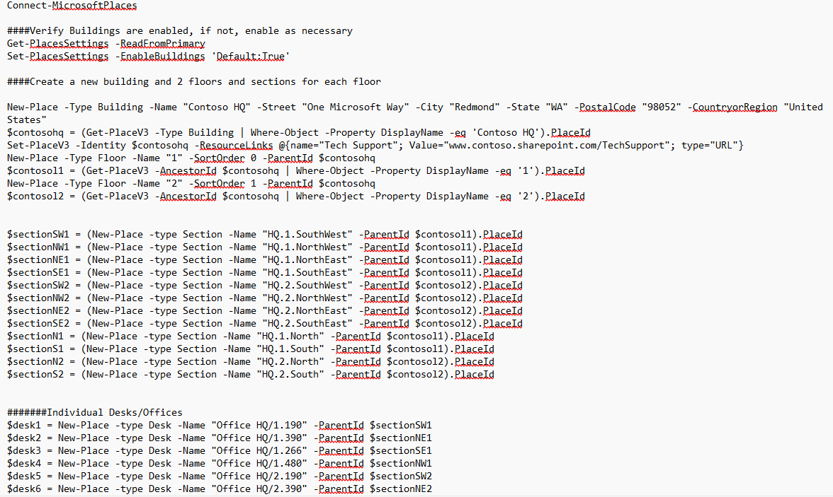
For an example Microsoft Places deployment PowerShell script please download the Microsoft Places deployment playbook
Please see the appendix for more details on the example deployment resources.

Slide 25
Overview of privacy controls
Verify
02c

Slide 26

How does Places protect my location data?
Users opt in to sharing location data
Places inherits your existing M365 security and compliance policies
Places does not track real-time location, nor does it provide additional location granularity outside of the office
There are user and admin controls in place to manage visibility of location data
Notes:
Copilot inherits your existing M365 security and compliance policies.
It can only access content if individuals have existing permissions.
And it does so under the conditions that you set, for example through conditional access.
Now the truth is, not every customer is completely confident that their permissions are set up appropriately.
The good news is, they already have the tools they need.
Teams, OneDrive, and SharePoint all have data access and retention controls that can be managed and enforced centrally.
And sensitivity labels – applied either manually or automatically – are respected and automatically applied by Copilot – giving you additional controls.

Slide 27
Overview of privacy controls
Verify
Microsoft is committed to providing you with the information and controls you need to make choices about how your data is collected and used when you're using Microsoft 365 Apps for enterprise.
Location data
Microsoft doesn't track or store any user's work location presence. Work location signals about in-office locations will be aggregated and anonymized in reports to determine office-occupation trends.
Overview of privacy controls for Microsoft 365 Apps for enterprise

Slide 28
Set up all buildings, floors, and sections (Required)
03
Approach #1:
OR
Approach #2:
Configuring buildings and floors with existing workspaces
Manually creating buildings and floors
Notes:
Microsoft Places depends on a fully established hierarchy of rooms/workspaces, sections, floors, and buildings.
The Initialize-Places cmdlet parses existing rooms, and workspaces in your organization, and generates the hierarchy on your behalf. Specifically, the cmdlet uses the RoomList information to infer the building and floor name of each room, or workspace. The cmdlet builds a hierarchy of places, allows you to review and revise the results, and upload the final file.
Alternatively, to manually configure all of your buildings, floors, sections, workspaces, and rooms, see the Manual setup section

Slide 29
Set up all buildings, floors, and sections
Microsoft Places depends on a fully set up hierarchy among your buildings, floors, sections, workspaces, and rooms. You'll start by creating buildings, floors, and sections. Then you will link them to rooms or workspaces using ParentId.
When buildings, floors, and sections are set up, you can use them:
When making work plans, which allows employees to share their proposed location schedule and see who else is attending in person.
When employees select their workplace presence by adding location to their presence signal to indicate when they're in the office, remote, or in another work location.
When employees check peek cards to see who's coming into the office and adjust their location plans directly from their Outlook calendar or receive notifications to book space on days in office.
A section is a grouping of spaces within a floor (for example, a neighborhood).
A desk is a new entity type in Places, which represents individual desks. These objects can be either bookable or non-bookable (default).

Slide 30

Understanding the Places Hierarchy
Building 1
Floor 1
Section 1
Floor 2
Section 1
Section 2
Conference Room
Floor 3
Section 1
Section 2
Desk
Desk Pool
Building 2
Desk
Desk Pool
Conference Room
Top level: Buildings
Floors:
Sections:
Bookable Resources
Creating a hierarchy of desks, rooms, sections, floors and buildings are critical for user experience with Places.

Slide 31
Admin Guidance: Configuring buildings and floors
Verify
Creating a hierarchy of desks, rooms, sections, floors and buildings are critical for user experience with Places.
We offer two approaches to create these in Places.
If your environment currently utilizes Room Lists to distinguish between buildings and floors, we recommend using Approach #1; if the Room Lists do not represent all your workplaces, we recommend Approach #2.
Approach #1:
Approach #2:
  Microsoft Places will generate the hierarchy on your behalf
  The Initialize-Places cmdlet is utilized to parse existing rooms and workspaces
  You will have the opportunity to verify and edit the generated hierarchy (also known as the Places Directory) in the ResourceAccountsMapped.csv file
  Only rooms and workspaces that are associated to a RoomList and not yet parented to a floor and building in the Places Directory will be included
  Manual configuration
  Planning and setup of all your buildings, floors, sections, rooms, and desk pools.
  For deploying core features across all locations, you must at a minimum create your buildings.
Select which approach to configure your buildings and floors

Slide 32
Approach 1:
Approach #1:
Configuring buildings and floors with existing workspaces
Configuring Buildings (and Floors) with existing workspaces

Slide 33
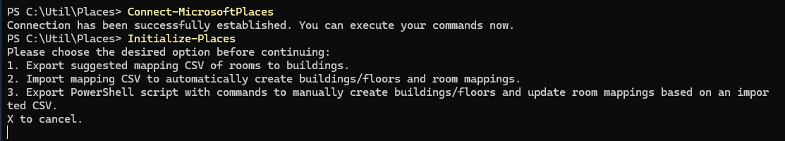
Admin Guidance: Configuring buildings and floors (existing rooms and workspaces)
Places: Approach #1
Enablement
If your tenant already has existing rooms and workspaces defined, you can use the Initialize-Places cmdlet to generate the required hierarchy on your behalf.
Step 1: Open PowerShell 7, and ensure you have the latest Places PowerShell version by running Update-Module.
Then, connect to Microsoft Places (Connect-MicrosoftPlaces).
After you have authenticated with an account that has proper management permissions, run the Initialize-Places cmdlet.
PowerShell
Update-Module MicrosoftPlaces -Force
Step 2: Use option 1 to export a CSV file containing existing rooms/workspaces.
Note: this will only show rooms and workspaces that are associated with an existing RoomList.

Slide 34
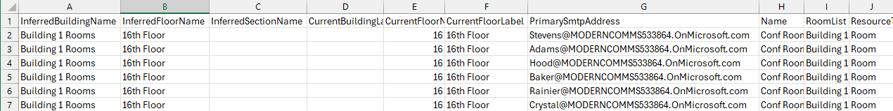
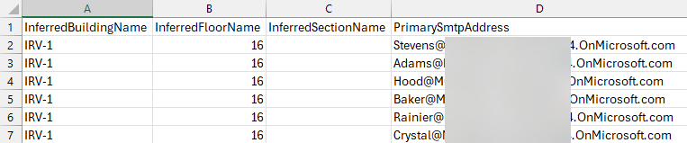
Admin Guidance: Configuring buildings and floors - existing rooms and workspaces (1/2)
Places: Approach #1
Enablement
Step 3: Review the content from the export. Add or correct the building and floor names in the InferredBuildingName and InferredFloorName columns. For any workspaces, you must add or correct the name in the InferredSectionName column to represent the desired zone or neighborhood on the floor (this is optional for rooms).
Step 4: Remove all columns except for InferredBuildingName, InferredFloorName, InferredSectionName and PrimarySmtpAddress. Save and close this file.

Slide 35
Admin Guidance: Configuring buildings and floors - existing rooms and workspaces (2/2)
Places: Approach #1
Enablement
Step 5: Open PowerShell 7 and connect to Microsoft Places (Connect-MicrosoftPlaces).
After you have authenticated with an account that has proper management permissions, run the Initialize-Places cmdlet.
Step 6: Use option 2 to import your updated CSV file. When completed, the script will generate a file summarizing the results and export it into the same folder as the file you imported.
Step 7: You can also use option 3 to preview the commands that will be executed. You will need to provide the same updated CSV file from Step 4 – this is needed to generate the PowerShell script (nothing is imported with this option).
Note: new buildings, floors and sections should be visible in Microsoft Places right away.

Slide 36
Approach 2: Part 1
Approach #2:
Manually creating buildings and floors
Manually creating buildings and floors

Slide 37
Admin Guidance: Configuring buildings and floors (manually)
Places: Approach #2
Before starting the manual creation of buildings, ensure that you gather details about your offices to create them inside of Places:
  Addresses
  Floor Counts
  Sections (Zones/Neighborhoods)
  Available Services
  Bookable resources for example
    Meeting / Conference Rooms
    Desks and desk pools
    Please make sure you understand and have all the information about the customer to build the Places hierarchy before enablement. You can use the diagram on the next slide to design the Place pilot hierarchy if required.

Slide 38
Places pilot hierarchy
Verify
Building 1
Floor 1
Section 1
Floor 2
Section 1
Section 2
Conference Room
Floor 3
Section 1
Section 2
Desk
Desk Pool
Building 2
Desk
Desk Pool
Conference Room
Top level: Buildings
Floors:
Sections:
Bookable Resources
Edit this slide to design your customer Places pilot Hierarchy before enablement.
Notes:
Edit this slide to design your customer Places pilot Hierarchy before enablement.

Slide 39
Manually creating buildings and floors steps
To set up places manually, you need to run individual PowerShell cmdlets to create each building and floor:
01
02
03
04
05
Create the building
Create the floors with ParentId set to a building.
Create sections on all such floors. ParentId of sections should be set to a floor.
Set the room's ParentId to the floor (or section, if desired). Workspace's ParentId must be set to a section.
Finally, use Set-PlaceV3 to add any extra metadata on buildings, floors, or rooms/workspaces.
Notes:
Configure buildings and floors - Microsoft Places | Microsoft Learn
https://learn.microsoft.com/en-us/microsoft-365/places/get-started/quick-setup-buildings-floors

Slide 40
Create Buildings & Floors
Places: Approach #2
You will need to complete these steps for each building & floor within your organization within the Places PowerShell module
Step 1: Create the building & define metadata. Save the PlaceId generated as it’s needed in step 2 (and later) to upload floor plans.
PowerShell
New-Place -Type Building -Name "Contoso HQ" -Street "One Microsoft Way" -City "Redmond" -State "WA" -PostalCode "98052" -CountryorRegion "United States" -IsWheelChairAccessible $true
Step 2: Create the floors tied back to the ParentId for the building they are in (note: ensure you only use the numerical value for the floor as the name, Places will automatically prepend “Floor” as the label in the user tools). Save the PlaceId generated for each floor, it’s needed in later steps (optional).
PowerShell
New-Place -Type Floor -Name “2" -ParentId <PlaceId of Contoso HQ>
Step 3: Add services to your building (optional)
PowerShell
Set-PlaceV3 -Identity <PlaceId of Contoso HQ> -ResourceLinks @{name="Tech Support"; Value="www.contoso.sharepoint.com/TechSupport"; type="URL"}

Slide 41
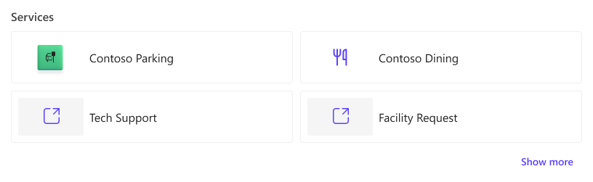
Add services to buildings
You can customize the Explore tab of the Microsoft Places app to help end-users discover services and amenities available in different buildings.
You can include web links and apps. For example, if a building has a cafeteria which offers online ordering, you can list the cafeteria and include a link to its website, or a link to a food ordering app.
Here's how services (both links and apps) appear on the Places app:
Adding services to buildings (optional)

Slide 42
Enable building info and nearby communication
Go beyond "Remote" and "In the office" signals and let employees share what building they plan to work from when they are in office and allow them to communicate with others in their building more easily.
We recommend that you add additional metadata on buildings, floors, rooms, and workspaces, such as capacity, A/V equipment, and room pictures.
Note: You can also choose to do this later.
Learn more
Add metadata
Work location settings

Slide 43
Approach 2: Part 2
Approach #2:
Configuring bookable resources
Conference Rooms
Desks
Configuring bookable resources

Slide 44
Admin Guidance: Configuring bookable resources
Verify
Recall in section 3 building set up section, we discussed the two approaches for configuring the hierarchy within Places. We also discussed configuring the buildings and floors in the building setup section.
Approach #1:
Approach #2:
  Microsoft Places will generate the hierarchy on your behalf
  The Initialize-Places cmdlet is utilized to parse existing rooms and workspaces
  You will have the opportunity to verify and edit the generated hierarchy (also known as the Places Directory) in the ResourceAccountsMapped.csv file
  Only rooms and workspaces that are associated to a RoomList and not yet parented to a floor and building in the Places Directory will be included
  Manual configuration
  Planning, and setup of all your buildings, floors, sections, rooms, and desk pools.
The following slides cover Approach #2 for configuring bookable resources.
In approach 1 you will have exported existing rooms and workspaces associated to room lists so creating new room and resource accounts with mailboxes may not be required. Please verify before configuring any new accounts and mailboxes.

Slide 45
Create Conference Rooms
Places: Approach #2
You will need to complete these steps for each conference room within your organization using the Exchange Online and Places PowerShell modules. We recommend you connect to both within one PowerShell 7 instance
Step 1: Create the conference room
PowerShell
New-Mailbox –Room -Alias "ConfRm-HQ-2.238" -Name "ConfRm HQ/2.238"
Step 2: Set the calendar configuration on each conference room. This example sets up the recommended configuration when adding a Teams Room to this space.
PowerShell
Set-CalendarProcessing –Identity "ConfRm-HQ-2.238" -AutomateProcessing AutoAccept -AddOrganizerToSubject $false -AllowRecurringMeetings $true -DeleteAttachments $true -DeleteComments $false -DeleteSubject $false -ProcessExternalMeetingMessages $true -RemovePrivateProperty $false
Step 3: Link your new workspace to the floor in your building and define metadata
PowerShell
Set-PlaceV3 –Identity "ConfRm-HQ-2.238" -Capacity 4 -Label "ConfRm HQ/2.238" -FloorLabel "2" -IsWheelChairAccessible $true -Tags "IntelliFrame Camera" -MTREnabled $true -ParentId <PlaceId of Contoso HQ Floor 2>
Note: new rooms (as well as changes to existing rooms) may take up to 24 hours to update.

Slide 46
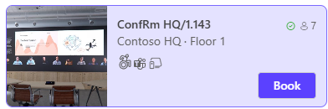
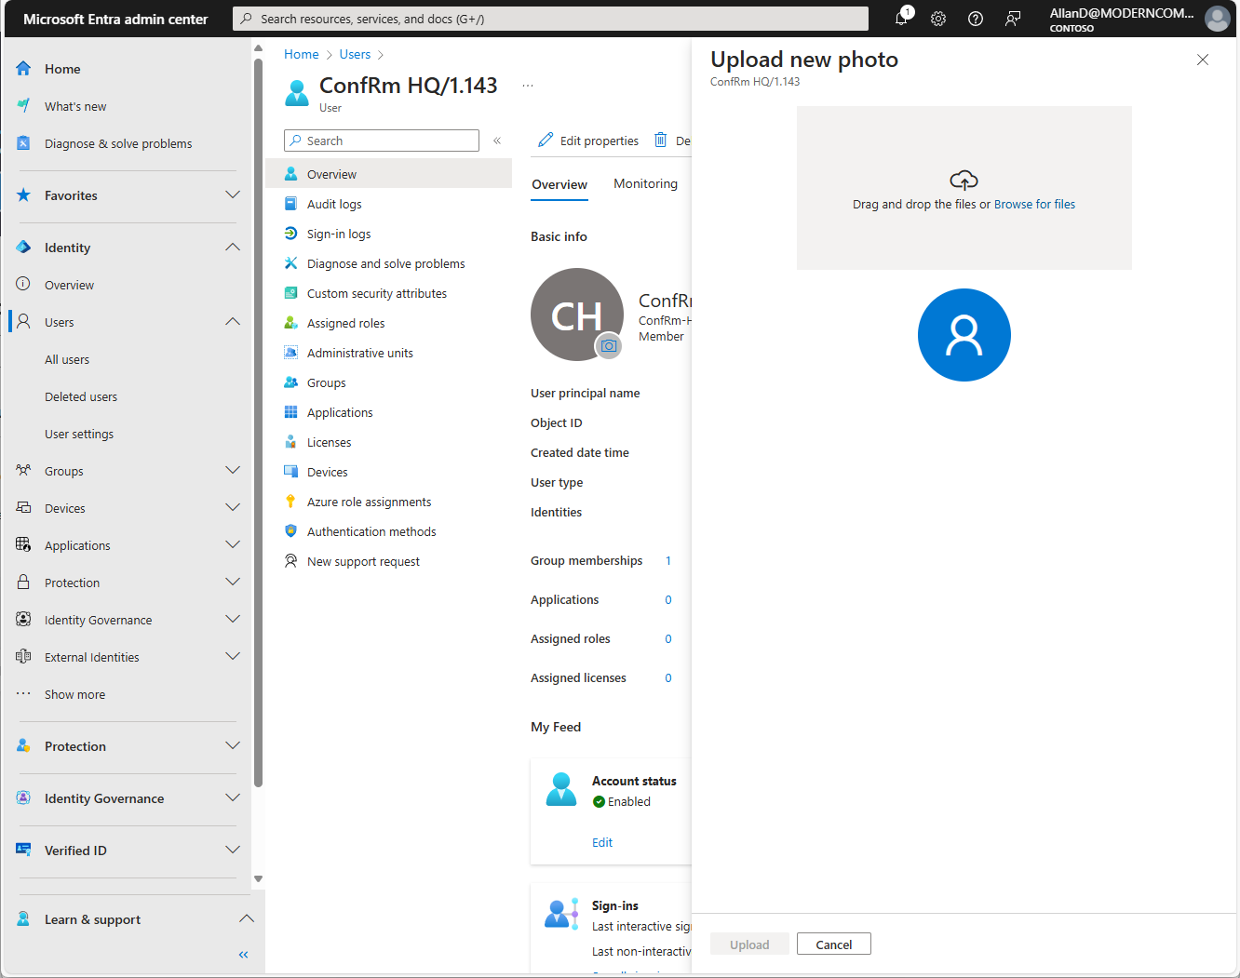
Admin Guidance: Updating the picture
Teams: Places app
To update the picture displayed with the bookable resource:
Step 1: Go to the Entra Admin Center (https://entra.microsoft.com).
Step 2: Under Users, click on All users.
Step 3: Search for the account associated to the resource. Click on this account to bring up the Overview screen. In this example, we have selected the ConfRm HQ/1.143 account.
Step 4: On the Overview screen, click on the camera icon next to the account name.
Step 5: In the Upload new photo dialog, drag & drop (or browse) for the desired picture file. Note: file cannot exceed 4MB in size. Click Upload.

Slide 47
Create Desk Pools (1/2)
Places: Approach #2
You will need to complete these steps for each desk pool within your organization using the Exchange Online and Places PowerShell modules. We recommend you connect to both within one PowerShell 7 instance
Step 1: Create the desk pool in Exchange Online
PowerShell
Connect-ExchangeOnline
New-Mailbox –Room -Alias "wksp-hq-2.160" -Name "Workspace HQ/2.160" | New-Mailbox –Room Workspace
Step 2: Set the calendar configuration on each desk/desk pool to align time zone and working hours as desired for that office as well as enforce the capacity of the desk
PowerShell
Set-MailboxCalendarConfiguration –Identity "wksp-hq-2.160" -WorkingHoursTimeZone "Pacific Standard Time" -WorkingHoursStartTime 09:00:00
Set-CalendarProcessing –Identity "wksp-hq-2.160" -EnforceCapacity $true
Step 3: Create a new section (also called a zone or neighborhood) associated to the desired floor in your building. In this example, we have created a section called “HQ.1.SouthWest” on the first floor of the Contoso HQ building.
PowerShell
Connect-MicrosoftPlaces
$building = Get-PlaceV3 -Type Building | Where-Object -Property DisplayName -eq 'Contoso HQ'
$floor1 = Get-PlaceV3 -AncestorId $building.PlaceId | Where-Object -Property DisplayName -eq '1'
$sectionSW1 = New-Place -type Section -Name "HQ.1.SouthWest" -ParentId $floor1.PlaceId

Slide 48
Create Desk Pools (2/2)
Places: Approach #2
You will need to complete these steps for each desk pool within your organization using the Exchange Online and Places PowerShell modules. We recommend you connect to both within one PowerShell 7 instance
Step 4: Make the desk pool available in the new desk booking experience. In this example, we’re associating this desk pool with an existing section that was created in Step 3, using the $sectionSW1 variable, and this pool has a maximum of 10 desks available.
PowerShell
Connect-MicrosoftPlaces
Set-PlaceV3 –Identity "wksp-hq-2.160" -Capacity 10 -Label "Workspace HQ/2.160" –FloorLabel “2" –IsWheelChairAccessible $true –Tags "Office", "Monitor", "Docking Station" –ParentId $sectionSW1.PlaceId
Step 5: Optionally, you can also configure and apply booking policies to the desk pool. Booking policies would allow you to control who is allowed to book desks within this desk pool (for example, you could ensure only engineering people can book desks from a desk pool in the engineering area).
PowerShell
Connect-ExchangeOnline
Set-CalendarProcessing –Identity "wksp-hq-2.160" –BookInPolicy "<users, groups>" –AllBookInPolicy $false
Note: new desk pools (as well as changes to existing desk pools) may take up to 24 hours to update.

Slide 49
Create Individual Desks for booking (1/2)
Places: Approach #2
You will need to complete these steps for each individual desk you want to configure within your organization using the Exchange Online and Places PowerShell modules. We recommend you connect to both within one PowerShell 7 instance.
Step 1: Create the desk and a new section (also known as a zone or neighborhood) associated to the desired floor in your building using the following commands. This example creates a new desk and associates it to a section named “HQ.1.SouthWest” on the first floor of the Contoso HQ Building.
PowerShell
Connect-MicrosoftPlaces
$building = Get-PlaceV3 -Type Building | Where-Object -Property DisplayName -eq 'Contoso HQ'
$floor1 = Get-PlaceV3 -AncestorId $building.PlaceId | Where-Object -Property DisplayName -eq '1'
$sectionSW1 = New-Place -Type Section -Name "HQ.1.SouthWest" -ParentId $floor1.PlaceId
$desk1 = New-Place -Type Desk -Name "Office HQ/1.190" -ParentId $sectionSW1.PlaceId
Step 2: Make the desk bookable by creating and associating a mailbox with the newly created desk object.
PowerShell
Connect-ExchangeOnline
$mbx1 = New-Mailbox -Room -Alias "office-hq-1.190" -Name "Office HQ/1.190"
Set-Mailbox $mbx1.Identity -Type Desk -HiddenFromAddressListsEnabled $true
Set-PlaceV3 $desk1.PlaceId -Mailbox $mbx1.Identity

Slide 50
Create Individual Desks for booking (2/2)
Places: Approach #2
You will need to complete these steps for each individual desk you want to configure within your organization using the Exchange Online and Places PowerShell modules. We recommend you connect to both within one PowerShell 7 instance.
Step 4: Add additional capabilities (metadata) to the desk object to allow users to choose a desk based on their needs and preferences. In this example, we will configure the desk as wheelchair accessible, with custom tags indicating this desk is in an office, with a monitor, docking station and a height adjustable desk. We’re using the desk that was created in Step 3, using the $desk1 variable.
PowerShell
Connect-ExchangeOnline
Set-Placev3 $desk1.PlaceId -IsWheelChairAccessible $true -Tags "Office", "Monitor", "Docking Station", "Height Adjustable Desk"
Step 5: Optionally, you can also configure and apply booking policies to the individual desk. Booking policies would allow you to control who is allowed to book this specific desk (for example, you could ensure only engineering people can book a desk in the engineering area).
PowerShell
Connect-ExchangeOnline
Set-CalendarProcessing –Identity $mbx1.Identity –BookInPolicy "<users, groups>" –AllBookInPolicy $false
Note: new desks (as well as changes to existing desks) may take up to 24 hours to update.

Slide 51
Create and deploy floorplans (Optional)
04
04a
04b
04c
04d
Source existing floorplans for conversation
(if available)
Manually create Places IMDF or work with a mapping partner
Correlate your Places objects with the elements in your IMDF
Upload your IMDF file into Places

Slide 52
Admin Guidance: Configuring floor plans (maps)
Places: Floor Plans
04a
While not strictly required, setting up floorplans makes the Microsoft Places experience better for end-users. It allows users to see building floor layouts, find points of interest, and helps them find nearby rooms and desks.
Before beginning, you should:
  Locate floor plans for your office building
  Determine the file format for your current floor plans (they likely require conversion)
  Determine if you would like to convert yourself or contract with a partner who specializes in creating and correlating IMDF files for Microsoft Places
It's advisable to consult corporate real estate or facilities team, as they may have existing floor plans that can be converted to IMDF or may be collaborating with an architect for the necessary files.

Slide 53
Set up floor plans (maps)
04a
To add your floor plans to Microsoft Places, you will need files in the IMDF format, with spatial information appropriately correlated to your building data and geo-referenced.
You can create and correlate your floor plans, associated neighborhoods, and rooms in the IMDF files yourself, work with existing real estate and facility management partners, or hire a specialized company to assist with this process.
Examples of potential partners who might assist with this effort are listed in the following article.
Configure floor plans (maps)

Slide 54
Floor Plan Creation Options
04b
Option 1: Partner engagement (recommended)
Specialized partners can help convert an existing floorplan into the proper format for use with Microsoft Places
Option 2: Manually create your floor plan
Manual floor plan creation involves crafting IMDF files in a specific format for Microsoft Places
The creation and correlation of IMDF files is very time-intensive with a steep learning curve
The IMDF files must also have all the bookable resources configured properly so they can be correlated to the objects that are created with Exchange and Places.

Slide 55
What are IMDF Files? (Floor Plans)
Places: Floor Plans
04b
Microsoft Places uses the IMDF (indoor mapping data format), an open mapping standard that builds on GeoJSON, to support interactive maps. Each IMDF file must include details for the entire building, including all floors. For specific IMDF requirements, refer to the guidelines here.
It's advisable to consult your corporate real estate or facilities team, as they may have existing floor plans that can be converted to IMDF or may be collaborating with an architect for the necessary files.
If your floor plans are in formats like PNG, PDF, or DWG, several partners can assist in converting them to IMDF (or full spatial data correlation services) for use with Places:
Archilogic - https://www.archilogic.com/imdf-conversion-service
Pointr - https://converter.pointr.cloud
Mappedin - https://www.mappedin.com/
Note: Microsoft does not specifically endorse the partners listed above, nor is this an exhaustive list.

Slide 56
IMDF Creation Tips
Places: Floor Plans
04b
The IMDF file should only contain elements for one building.
Ensure the map is geofenced.
The floor ordinal value in the IMDF must align with the SortOrder value of the floor in Places.
When creating the IMDF, assign unique names to each feature (workspace, desk pool, conference room) that correspond with the objects in Places for easier correlation.
For desk pools, create them as "rooms" within the IMDF, including a door, to ensure they are displayed in Places.
Include essential building elements like stairs and elevators as fully enclosed "rooms" marked with "Elevator" or "Stairway" to indicate their operational floors.

Slide 57
Correlating your Places objects with the elements in your IMDF (1/3)
Places: Floor Plans
04c
A correlated IMDF file contains the Places elements from your Microsoft Places environment, such as room names and PlaceIds, enabling integration with IMDF file elements.
If you’re working with a specialised partner, they will create the correlated IMDF file for you ready to upload to Places. You may need to provide them with an export of the spatial information from your Places environment, ensuring that object names match those on the floor plans.
Step 1: Export the spatial information for your building and objects that correspond to your IMDF file.
PowerShell
Get-PlaceV3 –AncestorId <PlaceId of Contoso HQ> | Export-csv "[path\to\ContosoHQExport.csv]"
Step 2: Use the Places PowerShell to export a mapfeatures.csv file containing all the elements in your IMDF. The MapFilePath parameter must point to an existing IMDF file.
PowerShell
Import-MapCorrelations -MapFilePath "[path\to\imdffile.zip]"

Slide 58
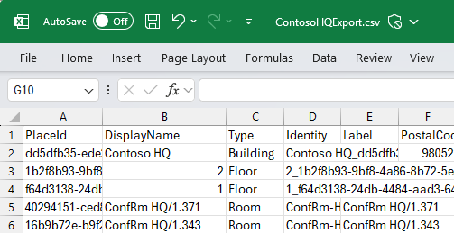
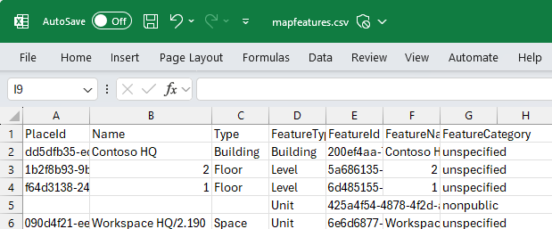
Correlating your Places objects with the elements in your IMDF (2/3)
Places: Floor Plans
04c
Step 3: Open both CSV files from Steps 1 and 2 side by side using a CSV editing tool like Microsoft Excel and perform the following:
Copy the PlaceId, Name, and Type elements from the Step 1 file into the Step 2 file (mapfeatures.csv), ensuring alignment with the corresponding building, floor, and unit elements. Each feature in the IMDF should have a unique name as reflected in the export.
Accuracy in this step is crucial for success. If you have matched display names in Places to the IMDF, consider using VLOOKUP in Excel to streamline the matching.
It's acceptable for some Identity, Name, and Type rows to be blank if there are no corresponding elements in Places; for example, stairways, elevators, and restrooms are classified as “stairs”, “elevator”, or “restroom” in the “FeatureCategory” section.
After matching, save your updated file as “mapfeatures.csv.”
Copy

Slide 59
Correlating your Places objects with the elements in your IMDF (3/3)
Places: Floor Plans
04c
Step 4: Generate a new correlated IMDF with your new “mapfeatures.csv” file
PowerShell
Import-MapCorrelations -MapFilePath "[path\to\imdffile.zip]" –CorrelationsFilePath "[path\to\mapfeatures.csv]"

Slide 60
Uploading your IMDF file into Places
Places: Floor Plans
04d
Caution: Prior to uploading a floor plan to Microsoft Places, ensure you have waited at least 24 hours after creating your buildings, floors, workspaces, & conference rooms.
If you’ve made any changes to them, you will need to wait 24 hours prior to uploading your floor plans. If you don’t wait, you may see elements not import correctly.
To upload a new floor plan into Microsoft Places, run the following:
PowerShell
New-Map –BuildingId <PlaceId of Contoso HQ> -FilePath "[path\to\imdf_correlated.zip]"
If you need to replace an existing floor plan, you’ll need to remove any existing plan using the syntax below. You’ll then need to run the command above to reimport.
PowerShell
Remove-Map –BuildingId <PlaceId of Contoso HQ>

Slide 61
Enable Places for end users
05
05a
05b
Add the Places app
Enable Places finder

Slide 62
Add the Places app
05a

Slide 63
Add the Places app
The Microsoft Places app is accessible on the web at https://aka.ms/places and as an app inside Microsoft Teams, Outlook, and the Microsoft 365 app (previously known as Microsoft Office).
The following guides can help you deploy and pin the Places app in Teams, Outlook, and Microsoft 365:
Preinstall and pin the Places app in Teams
Deploy the Places app in Outlook and the Microsoft 365 app

Slide 64
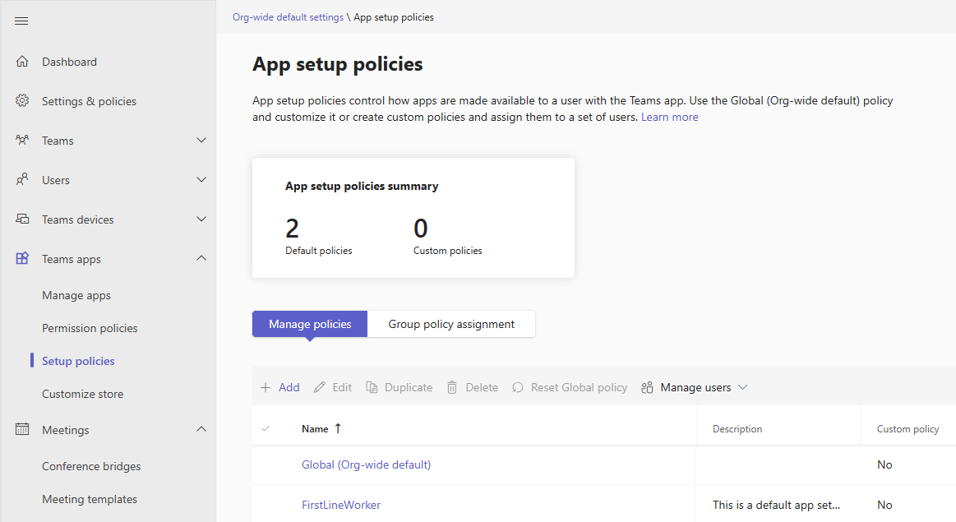
Admin Guidance: Pin the Teams app for specific users (1/4)
Teams: Places app
To create a custom policy to pin the Places app to the left rail:
Step 1: Go to your organization’s Teams Admin Center (https://admin.teams.microsoft.com).
Step 2: Under Teams apps, click on Setup Policies.
Step 3: Under Manage policies, click Add to create a new policy.

Slide 65
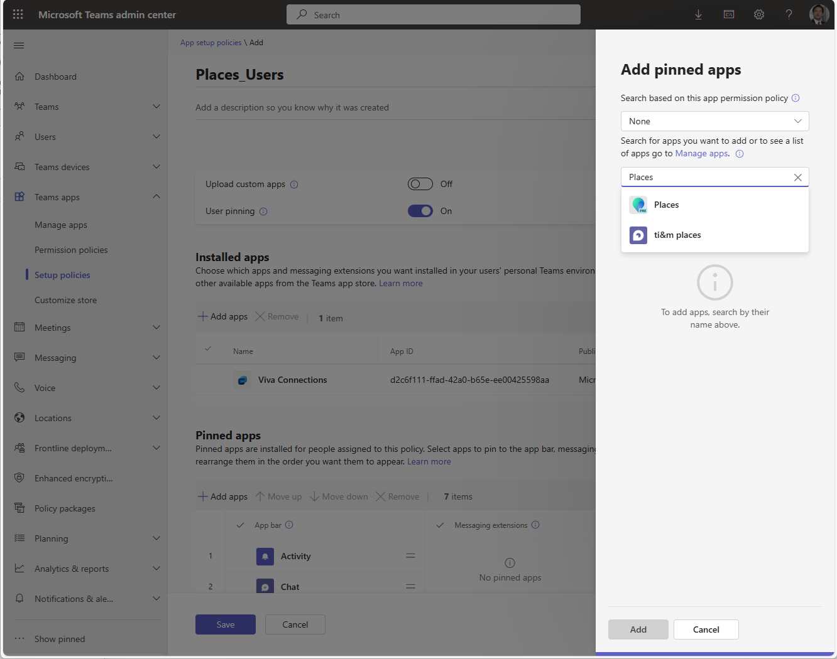
Admin Guidance: Pin the Teams app for specific users (2/4)
Teams: Places app
To create a custom policy to pin the Places app to the left rail:
Step 4: Enter a name for the policy: in this example, we used Places_Users.
Step 5: Under Pinned apps, click the Add apps button, and search for and select the Places app on the right.
Step 6: Click Add.

Slide 66
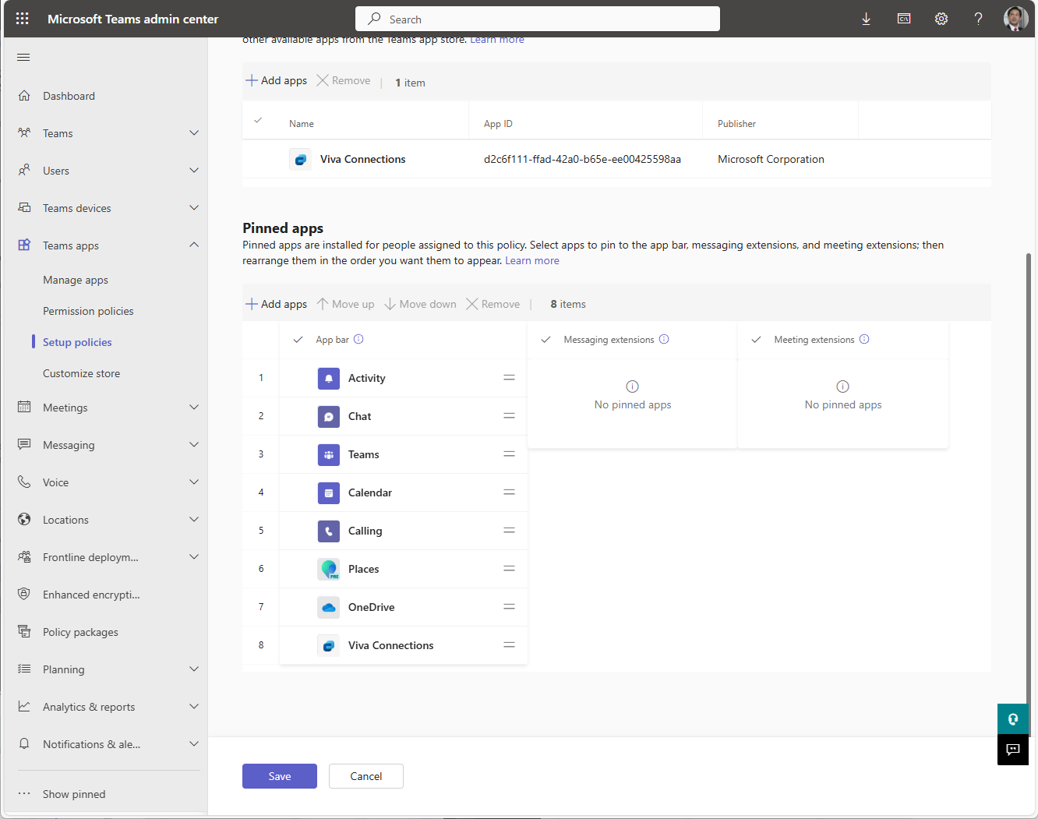
Admin Guidance: Pin the Teams app for specific users (3/4)
Teams: Places app
To create a custom policy to pin the Places app to the left rail:
Step 7: Use the handles on the right to drag and drop the apps into their desired position on the left rail.
Step 8: Optionally, click to the left of the app name to select (a check mark will appear) and use the Move up, Move down, or Remove options.
Step 9: Click Save.

Slide 67
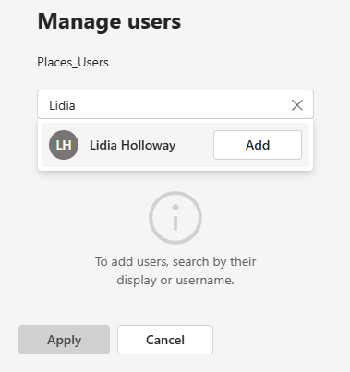
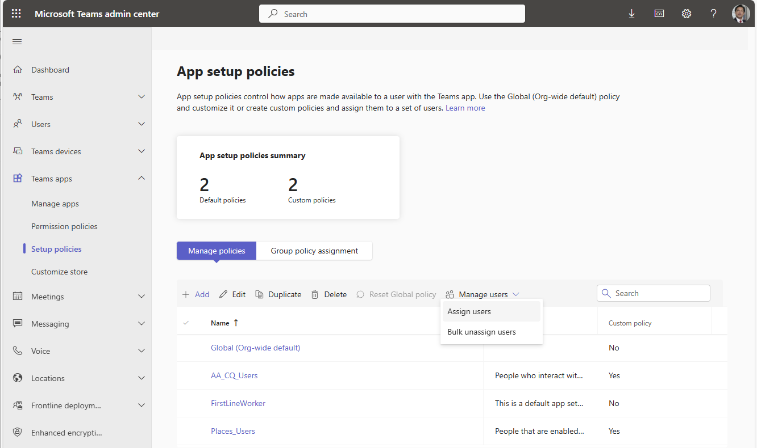
Admin Guidance: Pin the Teams app for specific users (4/4)
Teams: Places app
To create a custom policy to pin the Places app to the left rail:
Step 10: Back in the list of App setup policies, click to select the new policy (Places_Users), then click Manage users -> Assign users.
Step 11: In the Manage users window, search for and Add the desired user(s) to which this policy applies. In this example we have selected Lidia Holloway.
Step 12: Click Apply. Click Confirm, acknowledging the dialog that the assignment will take time to take effect.

Slide 68
Enable Places finder
05b

Slide 69
Places finder
Places finder is an advanced web-based feature within Microsoft Places that assists employees in locating available conference rooms and workspaces. This tool offers enhanced functionality compared to the existing Room Finder, empowering employees to select suitable meeting and working environments with confidence and efficiency.
Before you enable Places finder, you must do the following:
Create your building entities, sections, floors, and desks and associate them with existing or new rooms and workspaces accounts. For guidance on setting up buildings and floors in Exchange, see Configure buildings and floors.
Ensure that each resource account (room or workspace mailbox) has the necessary fields updated with accurate room and workspace data. Importing photos for each resource is recommended; otherwise, a stock photo will be used for each room. For instructions on adding metadata for rooms, see the Set-Place cmdlet. Examples of attributes that would be leveraged by Places finder can be found in Overview of Places finder.
Turn on Places finder for your users

Slide 70
Admin Guidance: Enable Places Finder
Teams: Places app
Places Finder replaces the Room finder experience in Outlook calendar, and in the new calendar in Microsoft Teams. Places Finder will show a much richer experience for conference rooms and workplaces once you've added metadata.
Note: in addition to having Places Finder enabled, users must also have the required licenses.
To enable Places Finder for everyone in your tenant, use the following PowerShell commands:
PowerShell
Connect-MicrosoftPlaces
Set-PlacesSettings –PlacesFinderEnabled 'Default:true'

Slide 71
Set up analytics
06
Enable analytics

Slide 72
Admin Guidance: Enable analytics
Teams: Analytics
Microsoft Places analytics provide a comprehensive view of planned vs. actual occupancy for buildings, rooms, and desk pools. These insights help real estate and facilities (RE&F) managers and admins optimize space management and enhance employee experience.
Step 1: Create a new security group to use for granting access to Places analytics. (Note: if you were part of the Preview for Microsoft Places, a group named Places Analytics Users was already created for this purpose – you can use this and skip to Step 3). Note: security group membership changes can take up to 24 hours to propagate.
Step 2: Assign the new security group using the Set-PlacesSettings command. The format for the OID is OID:<objectID>@<tenantID>
PowerShell
Set-PlacesSettings -SpaceAnalyticsEnabled 'Default:false,OID:f43fed93-bb47-4745-807d-d8f17b3e0888@5f713548-c9cc-46a5-9678-25dc6f1ebc23:true'
Step 3: Enabling buildings for analytics using the Set-PlacesSettings command in PowerShell.
#For All Buildings#
PowerShell
Set-PlacesSettings –Collection Places –SpaceAnalyticsBuildingsList ‘Default:All’
#For Two Buildings Only#
PowerShell
Set-PlacesSettings –Collection Places –SpaceAnalyticsBuildingsList ‘Default:<PlaceId1>,<PlaceId2>’
Note: It can take up to 12 hours for Places settings to propagate. For best performance, we recommend limiting analytics to 200 buildings.

Slide 73
Move to
User readiness and adoption
User readiness and adoption

Slide 74
Thank you !

Slide 75
Close

Slide 76

Appendix:
Microsoft Places deployment Playbook example
Example Building & Floor Plan
Download - https://aka.ms/PlacesDeployment

Slide 77
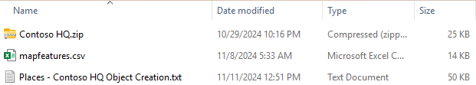
Example Floor Plan Creation & IMDF
The Microsoft Places deployment playbook has developed a sample IMDF file for your reference, which can be downloaded alongside PowerShell commands to set up corresponding objects in a fictional "Contoso HQ" within your lab.
The IMDF file contains pre-configured features and elements that align with the object names to be created in Exchange.
To import this map and its contents into your lab, follow these steps:
Step 1: Download the ZIP file and extract to a folder
Contoso HQ.zip -> Preconfigured IMDF file
mapfeatures.csv -> CSV of the elements from the IMDF file
Places – Contoso HQ Object Creation.txt -> PowerShell commands
Step 2: From PowerShell 7, connect to Exchange and Places PowerShell – authenticate with an account that has adequate permissions (either TenantPlacesManagement and MailRecipient, or the Exchange Administrator Role)
PowerShell
Connect-ExchangeOnline
Connect-MicrosoftPlaces
Download playbook - https://aka.ms/PlacesDeployment

Slide 78
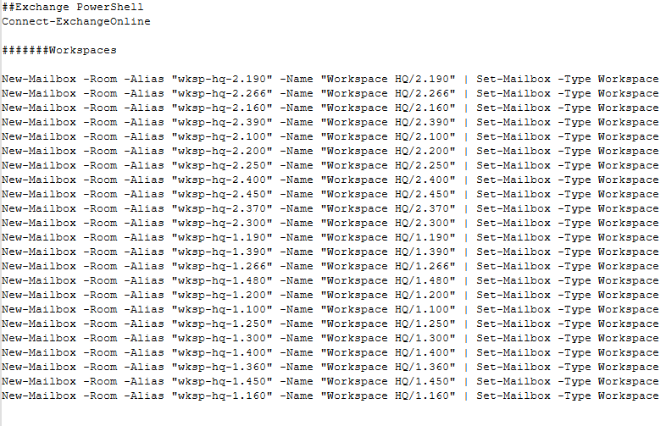
Correlating your Places objects with the elements in your IMDF (2)
Step 3: Run the commands in Places- Contoso HQ Object Creation.txt which will create the desks, desk pools, conference rooms, building and floors. You can copy/paste each block into the PowerShell 7 window, connected to Microsoft Places and Exchange Online. There are parameters in use for some of the commands – be sure to verify they have been properly initialized.
Step 4: Export the spatial information for your building (which contains unique GUIDs for your newly created items)
PowerShell
$contosohq = (Get-PlaceV3 -Type Building | Where-Object -Property DisplayName -eq 'Contoso HQ').PlaceId
Get-PlaceV3 –AncestorId $contosohq | Export-csv "[path\to\ContosoHQExport.csv]"
Download playbook - https://aka.ms/PlacesDeployment

Slide 79
Correlating your Places objects with the elements in your IMDF (3)
Step 5: Open ContosoHQExport.csv (used in step 4) and the provided mapfeatures.csv file (from the ZIP file) in Excel and:
Copy the PlaceId, Name, and Type elements from the Step 4 file (ContosoHQExport.csv) into the file provided in the ZIP (mapfeatures.csv), ensuring alignment with the corresponding building, floor, and unit elements. Each feature in the IMDF should have a unique name as reflected in the export.
Accuracy in this step is crucial for success. Since we have matched display names in Places to the IMDF, consider using VLOOKUP in Excel to streamline the matching.
It's acceptable for some Identity, Name, and Type rows to be blank if there are no corresponding elements in Places; for example, stairways, elevators, and restrooms are classified as “stairs”, “elevator”, or “restroom” in the “FeatureCategory” section.
After matching, save your updated file as “mapfeatures.csv.”
Copy
Download playbook - https://aka.ms/PlacesDeployment

Slide 80
Correlating your Places objects with the elements in your IMDF (4)
Step 6: Generate a new correlated IMDF using the updated mapfeatures.csv file from Step 5.
PowerShell
Import-MapCorrelations -MapFilePath "[path\to\imdf_correlated.zip]" –CorrelationsFilePath "[path\to\mapfeatures.csv]"
Step 7: Wait for 24 hours.
Step 8: Upload the correlated IMDF file into places and within a few minutes, you should see your floor plan inside of Microsoft Places.
PowerShell
New-Map –BuildingId ((Get-PlaceV3 -Identity "Contoso HQ").PlaceId) -FilePath "[path\to\imdf_correlated.zip]"
Download playbook - https://aka.ms/PlacesDeployment

Slide 81
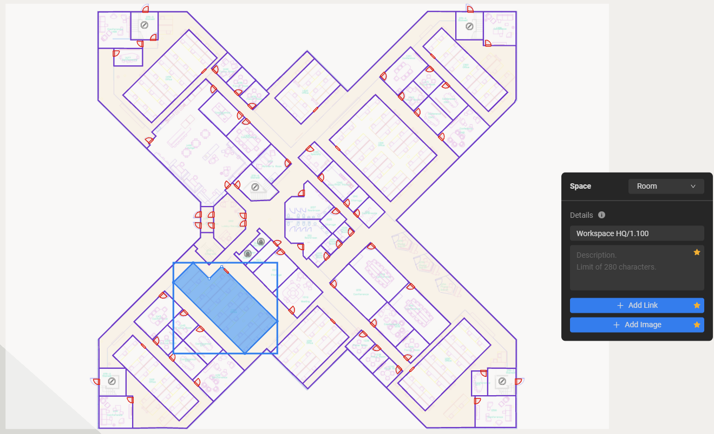
Example IMDF Using Mappedin
2
1
Desk Pool
Individual Desk
Conference Room
Elevator
Stairs
Hallway
6
2
3
4
4
5
1
3
6
5
The IMDF file includes designated areas such as conference rooms and desk pools, marked in purple, while red lines indicate required doorways. The shaded section represents a desk pool, classified as a Room in MappedIn, and the name used here corresponds precisely with the Display Name in Exchange.
Download playbook - https://aka.ms/PlacesDeployment

Slide 82
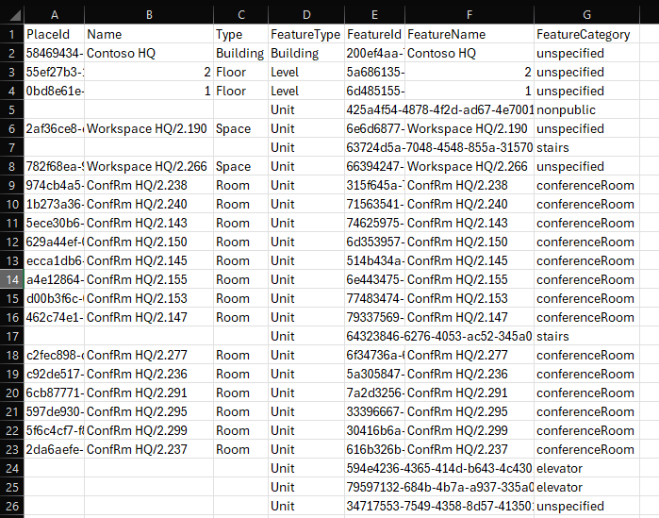
Example IMDF correlation file
Download playbook - https://aka.ms/PlacesDeployment

