Slide 1

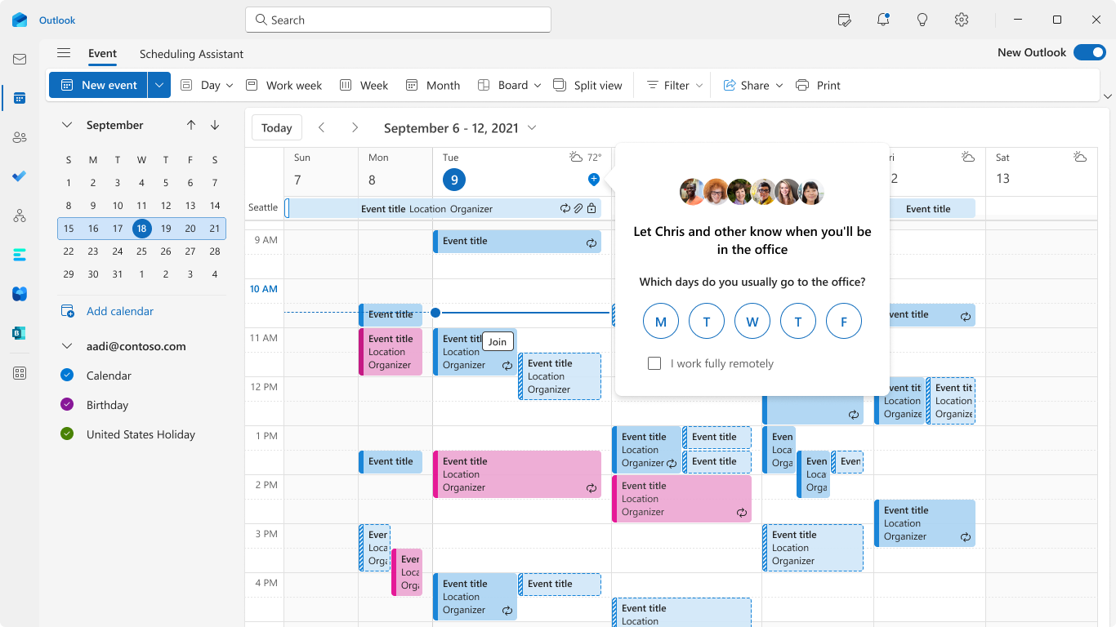
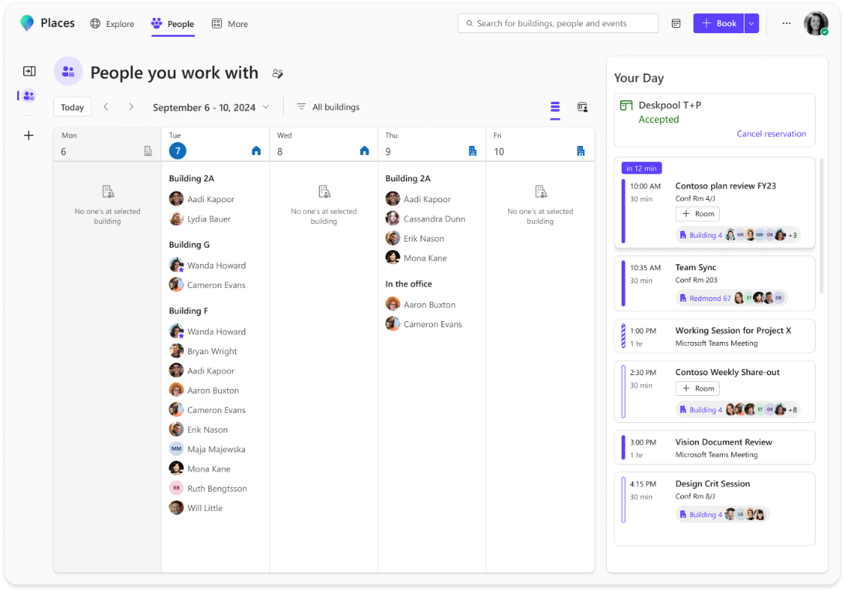
Make the most of in-office days
Use Places to plan out your week and make the most of in-office days right from the everyday surfaces you work from, Teams and Outlook.
COORDINATE
Set up your work plan
Employee coordination & hybrid work planning in the natural flow of work.
Plan
Get recommendation to set up your plan and access Places from the new Teams and Outlook calendar.
Create & manage work plans
Plan your week ahead and share where you’ll be working with your selected collaborators.
Confirm
Confirm your plan for the day.
See who’s here
See where your collaborators are planning to work.
Intelligent Booking
Book a room that is convenient for you and your team.

Slide 2
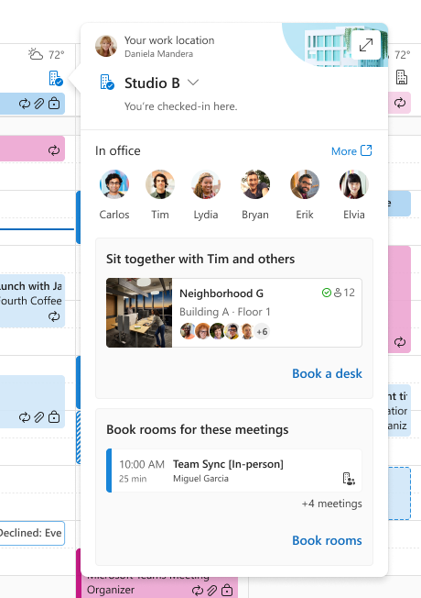
Plan your work day
Use Places to plan out your week and make the most of in-office days right from the everyday surfaces you work from, Teams and Outlook.
COORDINATE
Plan your workday
Enable ongoing coordination & workplace choice in the natural flow of work in the Places card.
Intelligent Suggestions
Leverage AI-enabled recommendations to update your location to “Office,” book a room for a meeting, or a desk for the day

Slide 3
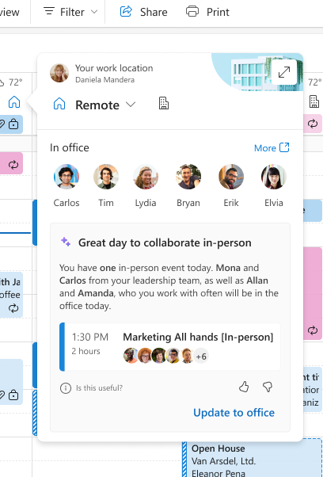
Plan your workday with Copilot
Use Places and Copilot to plan out your week and make the most of in-office days right from the everyday surfaces you work from, Teams and Outlook.
COORDINATE
Plan your workday
Enable ongoing coordination & workplace choice in the natural flow of work in the Places card.
Intelligent Suggestions
Leverage AI-enabled recommendations to update your location to “Office,” book a room for a meeting, or a desk for the day
Copilot recommended
in-office day
Copilot lets you know if today is a good day to go in office and provides reasons why it’s a good day to be in-person.

Slide 4
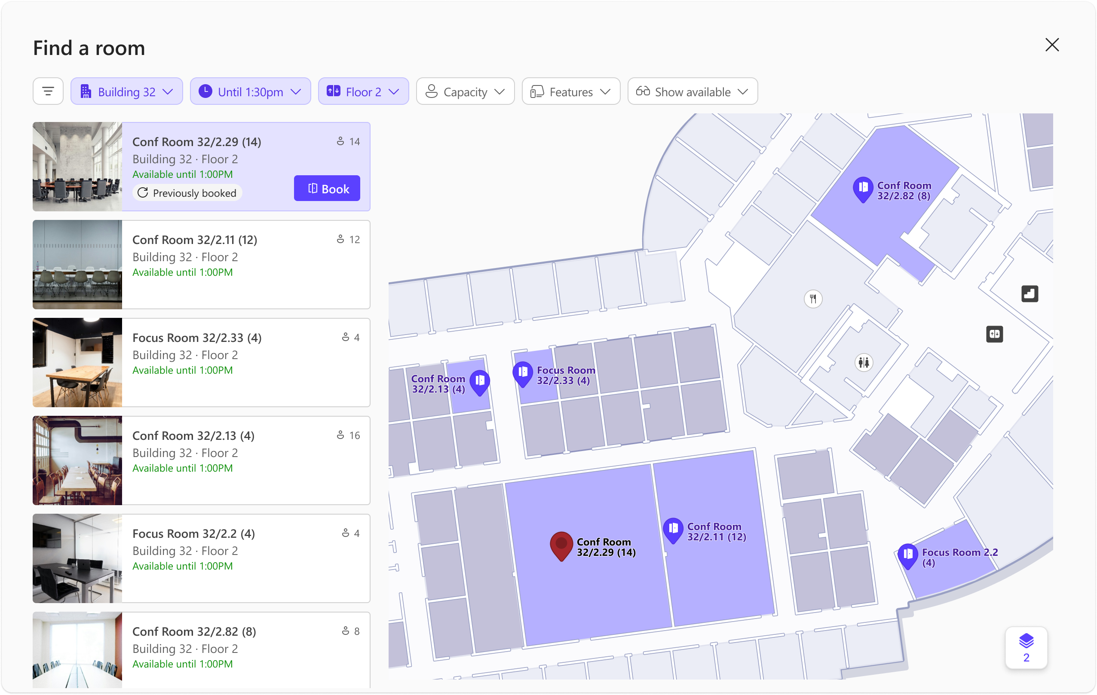
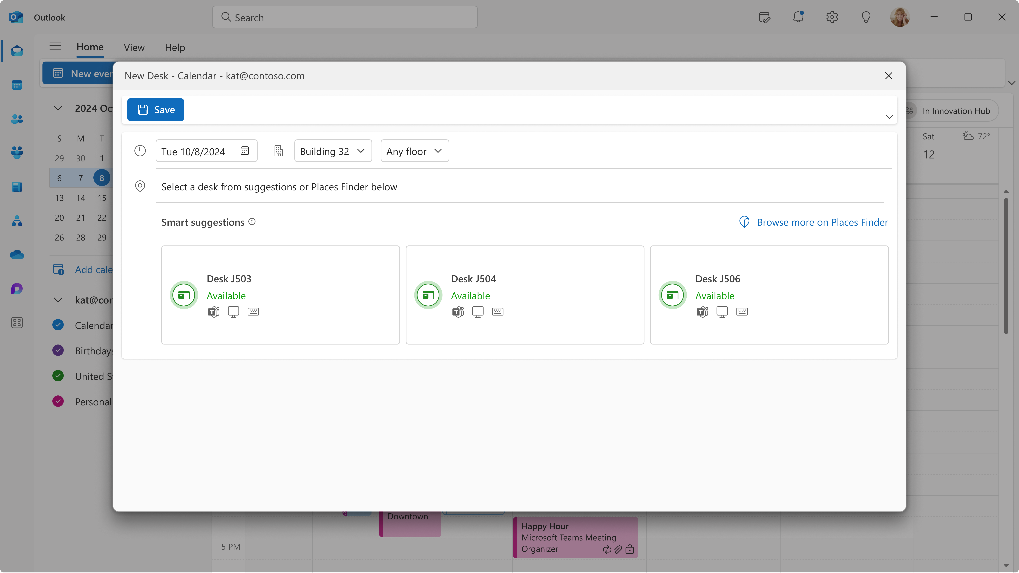
Help book the right space for your work
Using Places Finder, make room booking decisions with additional data: Images of the space, floorplans, information about technology available.
COORDINATE
Room Booking
Use Places finder to view information on rooms, browse & filter, and view photos to help book the right space for your work
Desk Booking
Book a desk to work from for the day with additional data: Images of the desk, floorplans, information about technology available.

Slide 5
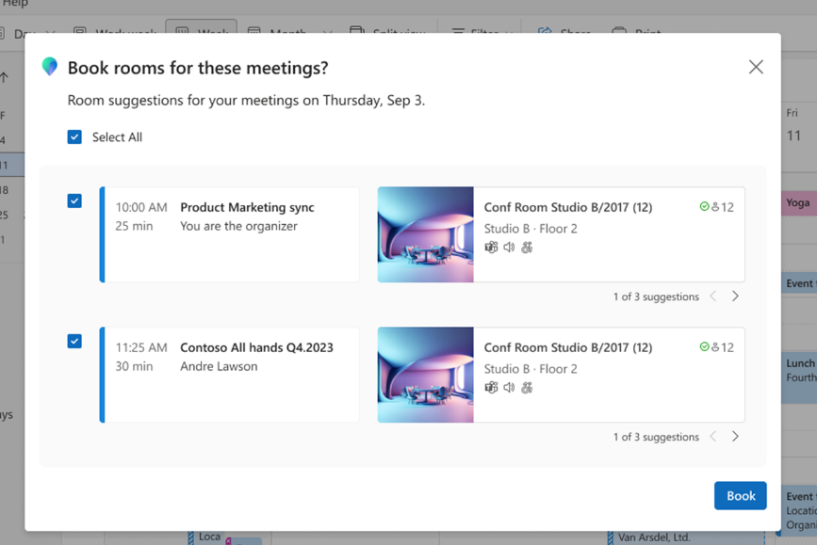
Intelligent
Booking
Get recommendations on available rooms for all your meetings for the day– and quickly book them all at once
COORDINATE
Room Booking
Use Places finder to view information on rooms, browse & filter, and view photos to help book the right space for your work
Desk Booking
Book a desk to work from for the day with additional data: Images of the desk, floorplans, information about technology available.
Intelligent Booking
Get recommendations on available rooms for all your meetings for the day– and quickly book them all at once

Slide 6
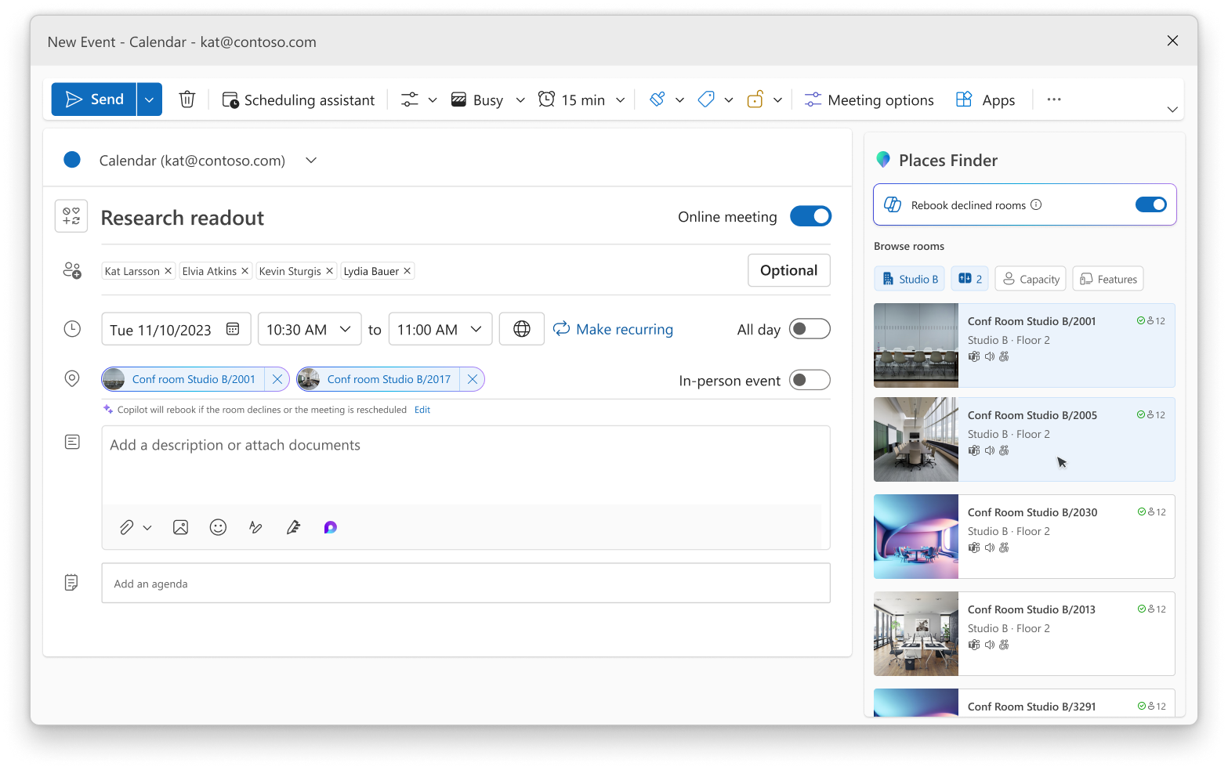
Copilot managed booking
Copilot can manage your room reservations through room declines or meeting changes by rebooking a new room on your behalf.
COORDINATE
Plan your workday with Copilot
With managed booking, let Copilot rebook single or recurring room reservations on your behalf based on room availability

Slide 7
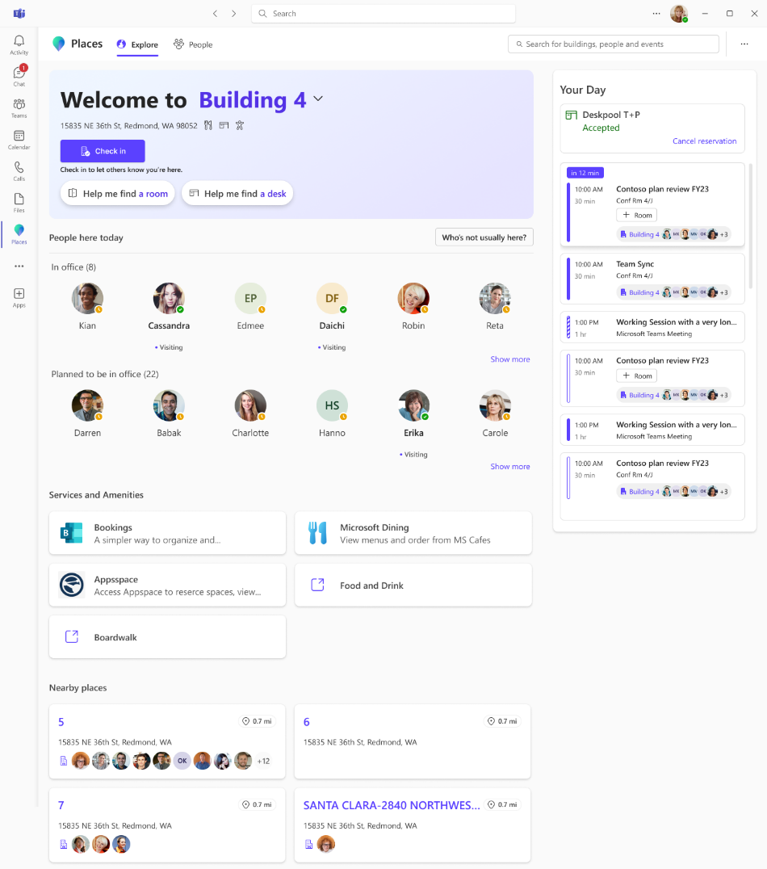
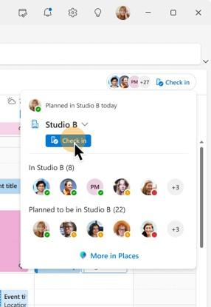
Understand your workplace
Rebuild connections and improve workplace experience
Modernize
Places Explorer
With Places explorer, get a singular view of the people, spaces and experiences at each workplace location.
Connect with your team
Build connections by understanding who’s around. Spur quick connections on the fly to make the most of in-office days.
Workplace Presence
See where people are located in Teams people card.
Add location to your workplace presence to share where you’re working for the day and make it easy for colleagues to collaborate with you in-office.

