Slide 1
Office 365 Engineering Direct (OED) CAB Session​​
Shelby Davis, Brian Pilato, Mikel Jackson
May 6, 2025

Slide 2

Microsoft 365 Community Conference

Slide 3


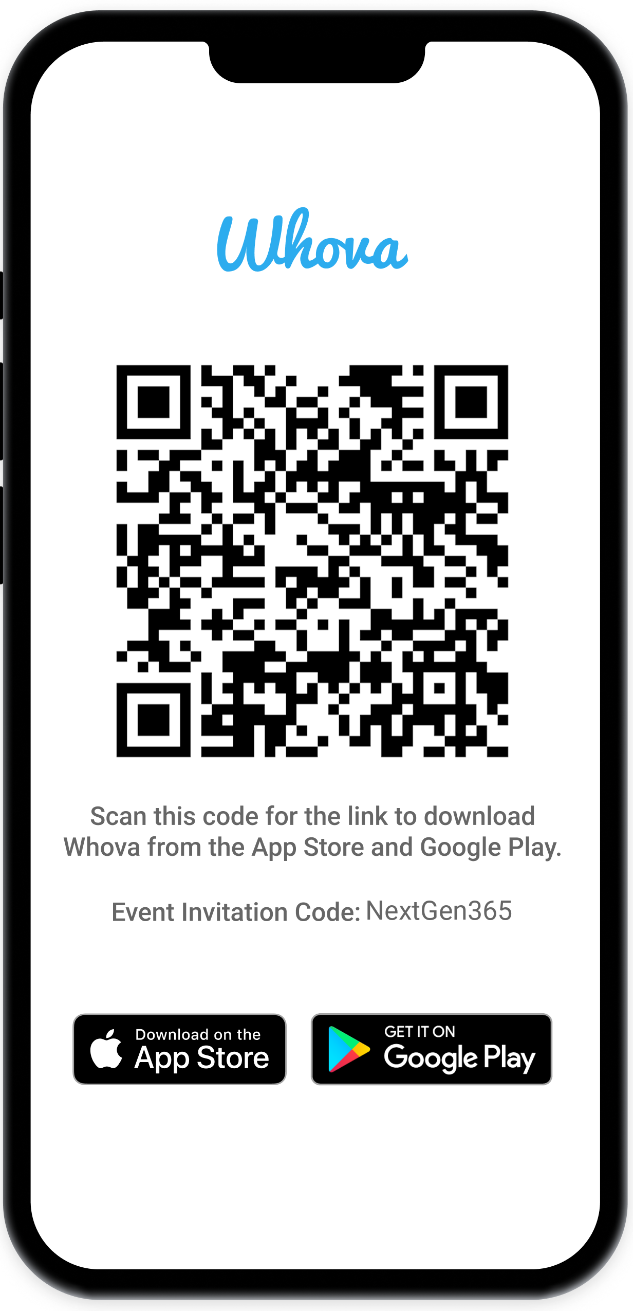
Join the event app to access:
The official event app for the
Microsoft 365 Community Conference
Event invitation code: NextGen2025
Event announcements
Personalized agenda, session details
Speaker & attendee profiles
Networking, meet-ups, messages
Event documents

Slide 4



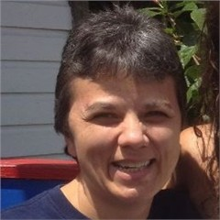

Shelby Davis
Principal Customer Experience PM Manager
Brian Pilato
Principal Customer Experience Program Manager
Mikel Jackson
Senior Customer Experience Program Manager
Becky Handy
Principal Service Engineering Manager
Kellie Erickson
Senior Service Engineering Manager

Slide 5
M365 OED and Executive Copilot and AI CAB Program events – July-Dec 2025
JULY 2025
M | T | W | T | F
 | 1 | 2 | 3 | 4
7 | 8 | 9 | 10 | 11
14 | 15 | 16 | 17 | 18
21 | 22 | 23 | 24 | 25
28 | 29 | 30 | 31
AUGUST 2025
M | T | W | T | F
 |  |  |  | 1
4 | 5 | 6 | 7 | 8
11 | 12 | 13 | 14 | 15
18 | 19 | 20 | 21 | 22
25 | 26 | 27 | 28 | 29
SEPTEMBER 2025
M | T | W | T | F
1 | 2 | 3 | 4 | 5
8 | 9 | 10 | 11 | 12
15 | 16 | 17 | 18 | 19
22 | 23 | 24 | 25 | 26
29 | 30
 | M365 OED CAB – In-Person (Redmond)
 | Quarterly M365 Copilot Adoption Call
 | M365 OED CAB Community Call
 | M365 Copilot Change Update
 | Copilot & AI Executive Community Call
 | International Customer Hubs (Locations TBD)
 | Executive Summit (Manufacturing)
OCTOBER 2025
M | T | W | T | F
 |  | 1 | 2 | 3
6 | 7 | 8 | 9 | 10
13 | 14 | 15 | 16 | 17
20 | 21 | 22 | 23 | 24
27 | 28 | 29 | 30 | 31
NOVEMBER 2025
M | T | W | T | F
 | 3 | 4 | 5 | 6
10 | 11 | 12 | 13 | 14
17 | 18 | 19 | 20 | 21
24 | 25 | 26 | 27 | 28
DECEMBER 2025
M | T | W | T | F
1 | 2 | 3 | 4 | 5
8 | 9 | 10 | 11 | 12
15 | 16 | 17 | 18 | 19
22 | 23 | 24 | 25 | 26
29 | 30 | 31

Slide 6
Office 365 Engineering Direct
Delivery Overview
Notes:
Welcome everyone to our session on Office 365 Engineering Direct. Today, we'll be providing an overview of the OED service and how it can benefit your organization. Let's dive in!

Slide 7
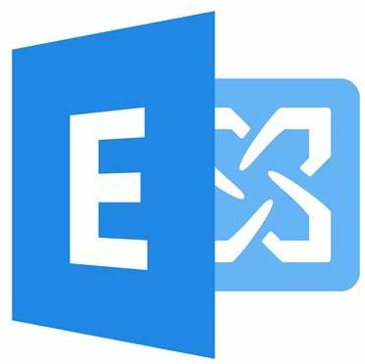

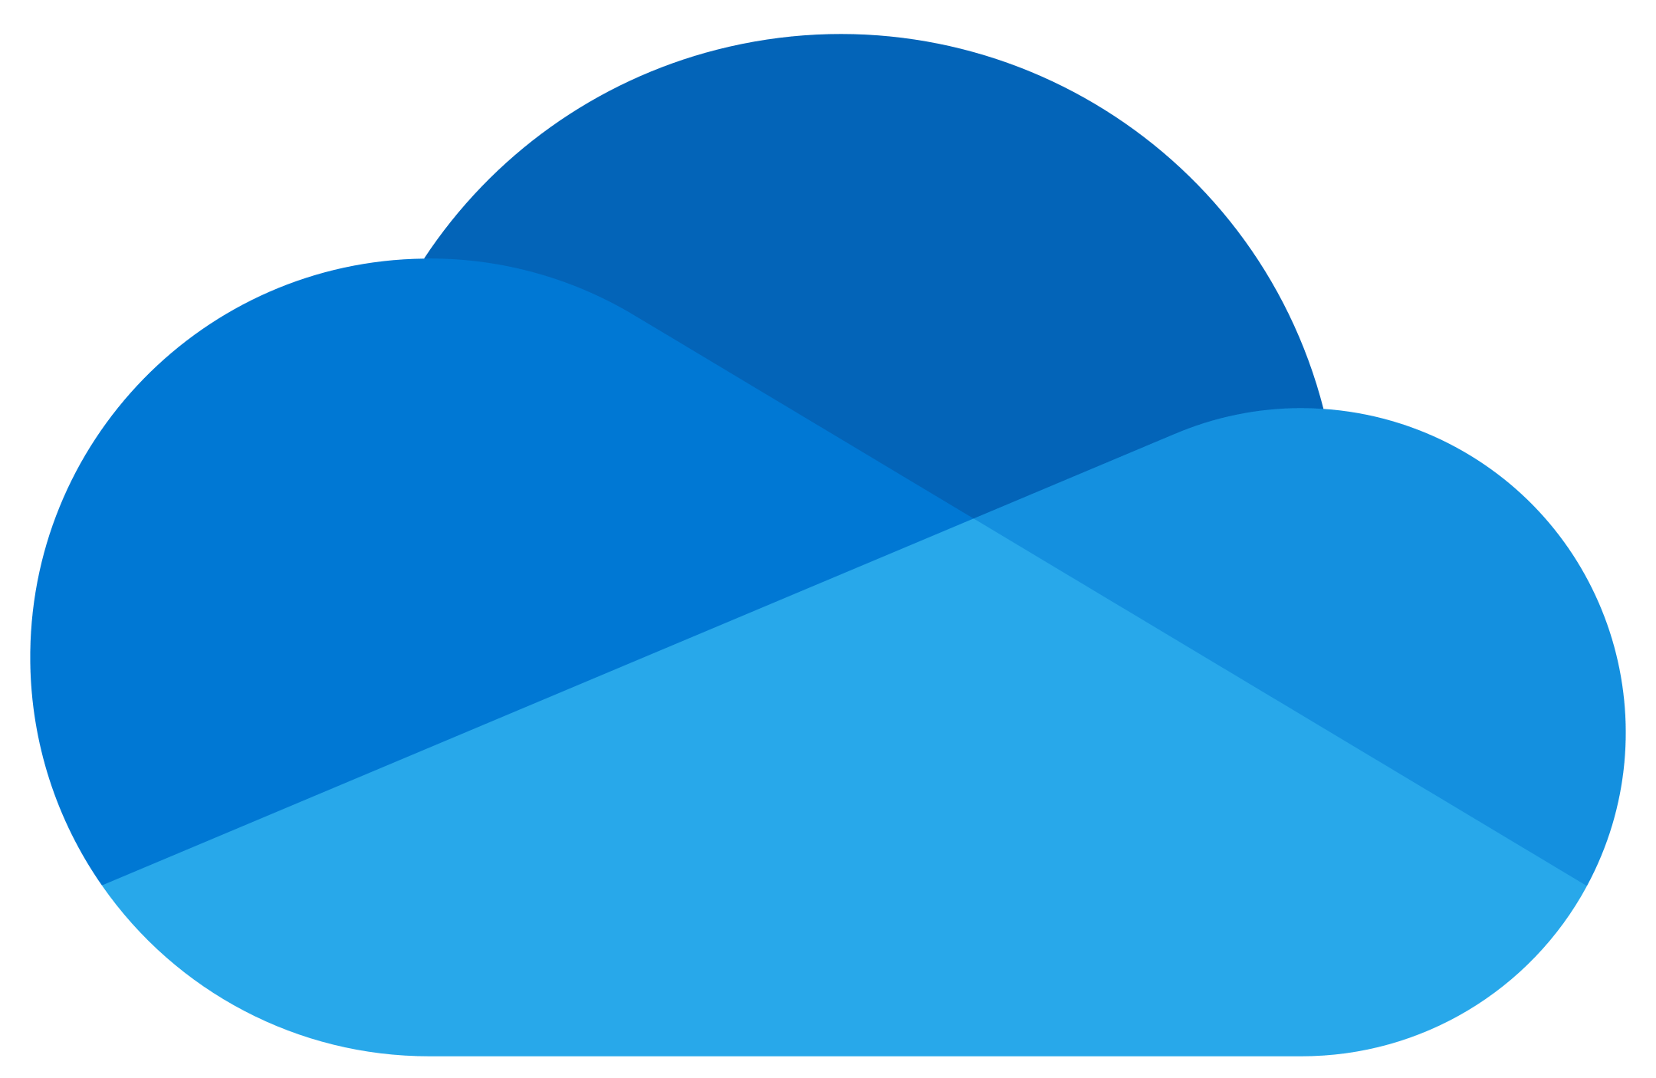

Office 365 Engineering Direct gives you an exclusive line to product group engineering teams to help manage your cloud productivity solutions effectively.
Office 365 Engineering Direct
Exchange Online
SharePoint Online
OneDrive for Business
Microsoft Teams
Notes:
What is Office 365 Engineering Direct?
Office 365 Engineering Direct gives you an exclusive line to product group engineering teams to help manage your cloud productivity solutions effectively. This service covers four key Office 365 applications: Exchange Online, SharePoint Online, OneDrive for Business, and Microsoft Teams.

Slide 8
What you get with Engineering Direct
Enhanced relationships with product groups, deeper access for support scenarios, and prioritized care
Critical issue prioritization | Advanced monitoring notification | Incident analysis | Business project awareness | Customer advisory input
Notes:
Benefits of Office 365 Engineering Direct
With Office 365 Engineering Direct, you get enhanced relationships with product groups, deeper access for support scenarios, and prioritized care. This includes critical issue prioritization, advanced monitoring notifications, incident analysis, business project awareness, and customer advisory input.

Slide 9
What you get with Engineering Direct
Enhanced relationships with product groups, deeper access for support scenarios, and prioritized care
Critical issue prioritization | Advanced monitoring notification | Incident analysis | Business project awareness | Customer advisory input
Prioritized escalation paired with a familiar support experience Escalate to Engineering functionality for high priority escalations Access to engineering teams for your critical issue escalations | Micro-level focus on the health of your tenant Notifications in Microsoft 365 Admin Center Enhanced proactive monitoring at a tenant level focused on key scenarios | Follow-up on service issues with a focus on critical escalations Customized review of the impact on your specific tenant | Collaboration during planned infrastructural changes Enhanced partnership and support for major business activities | Invitations to the Customer Advisory Board (CAB) twice a year and monthly community calls Targeted conversations with engineering leads on specific needs Broader relationships with industry professionals and other OED members
Notes:
What You Get with Engineering Direct
Let's break down what you get with Engineering Direct:
Critical issue prioritization: Prioritized escalation paired with a familiar support experience in the Microsoft Admin Center.
Advanced monitoring notification: Enhanced proactive monitoring at a tenant level focused on key scenarios. You’ll continue to use the Service Health Dashboard and Message Center in the M365 Admin Center, and you’ll also receive targeted posts based on your tenant’s telemetry
Incident analysis: Follow-up on service issues with a focus on critical escalations.
Business project awareness: Collaboration during planned infrastructural changes.
Customer advisory input: Invitations to the Customer Advisory Board, targeted conversations with Engineering leads, and monthly community calls.

Slide 10
What it means for you
Enhanced relationships with product groups, deeper access for support scenarios, and prioritized care
Critical issue prioritization | Advanced monitoring notification | Incident analysis | Business project awareness | Customer advisory input
Continue to open cases through the Microsoft 365 Admin Center with backend prioritization Leverage the Escalate to Engineering functionality as needed | Continue using the Service Health Dashboard and Message Center in the Microsoft 365 Admin Center Additional targeted posts based on your tenant’s telemetry | Request through your account team or case owner within 30 days of mitigation Results provided within 10 business days Note: On roadmap for Engineering Direct in the Microsoft 365 Admin Center experience | Work with your account team to share key projects at least 10 days before the start Engineering may follow up as needed Note: On roadmap for Engineering Direct in the Microsoft 365 Admin Center experience | Look for invitations from your account team Review information on upcoming events in the Engineering Direct in the Microsoft 365 Admin Center experience Let your account team know if you need additional contacts for your projects.
Notes:
What It Means for You
Here's what these features mean for you:
Continue to open cases through the Microsoft 365 Admin Center with backend prioritization leveraging the Escalate to Engineering functionality as needed.
Continue using the Service Health Dashboard and Message Center in the Microsoft 365 Admin Center.
Request incident analysis through your account team or case owner within 30 days of mitigation.
Work with your account team to share key projects at least 10 days before the start.
Look for invitations from your account team for upcoming events.

Slide 11
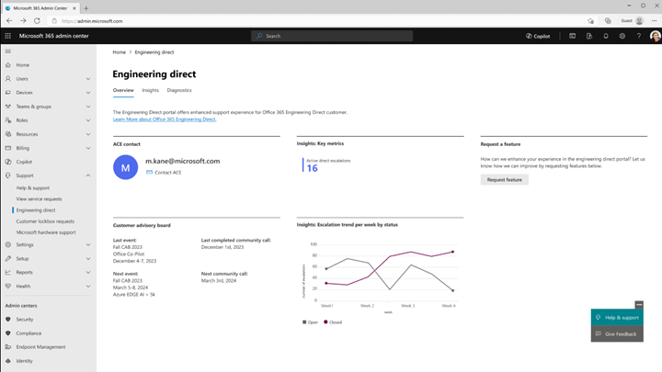
Office 365 Engineering Direct in the Microsoft 365 Admin Center:
Designed to support you every step of the way
Guidelines:
Find it under Support in the Microsoft 365 admin center.
Available to anyone in your tenant with an RBAC (role-based access control) support role.
Features:
Delivery metrics: See what OED offers and how you’re using the service.
Support insights: Track your support tickets with our engineering team.
Self-Service diagnostics: Get immediate insights and solutions for quick resolutions.
See full documentation at:
Engineering Direct Portal in the Microsoft 365 Admin Center - Microsoft 365 Enterprise | Microsoft Learn

Slide 12
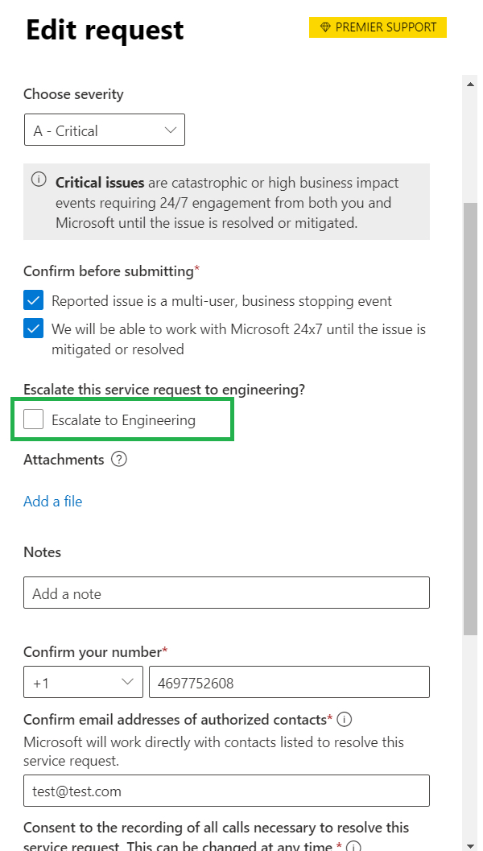
Office 365 Engineering Direct in the Microsoft 365 Admin Center:
Using the Escalate to Engineering feature
Guidelines:
This functionality is available for issues related to Exchange Online, Teams Online, SharePoint Online, and OneDrive for Business.
Service Request must be active and critical (Severity A).
Escalate catastrophic or high-impact issues that need immediate attention from our Engineering teams. We’ll work with you 24/7 until the issue is resolved or mitigated.
The user in the Microsoft 365 Admin Center must have a “Service Support Admin” role or higher-level permissions.
The issue must be raised through the M365 Admin Center (cases originating from Azure or other entry points cannot leverage this functionality)

Slide 13
We have an exciting future ahead.
Notes:
Thank you.
<Speaker Guidance: Spend the last few minutes discussing or answering any questions they may have. If they have additional topics on their EBC agenda, make sure you connect with their account team to inform them which AI priorities and business outcomes resonated the most during this session. If you are in a 1:1 direct customer engagement, make sure you note what their priorities and questions were and work with the broader account teams and units to facilitate the proper hand-offs or next steps (i.e. get them into a session at the Innovation Hub/MTCs).>

Slide 14
Expertise and tools for your journey
Technical expertise via our FastTrack partners
Tools, resources & training on our Adoption Hub
Events and real-world knowledge in our community
aka.ms/Microsoft/FastTrack
adoption.microsoft.com
aka.ms/TechCommunity
Notes:
Please leave this slide in for conference attendees.

Slide 15
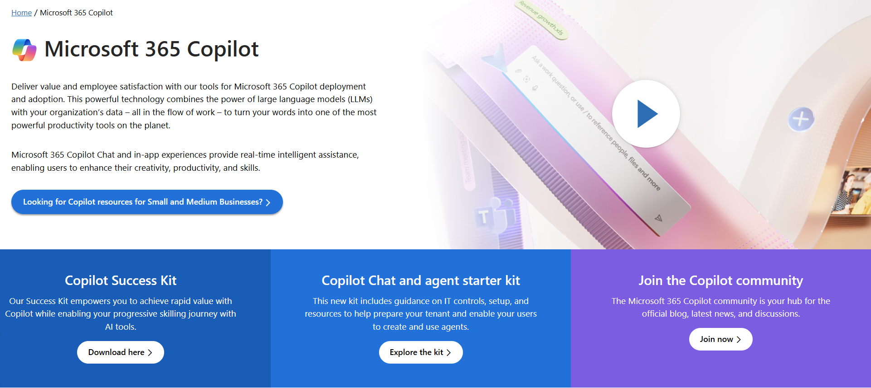
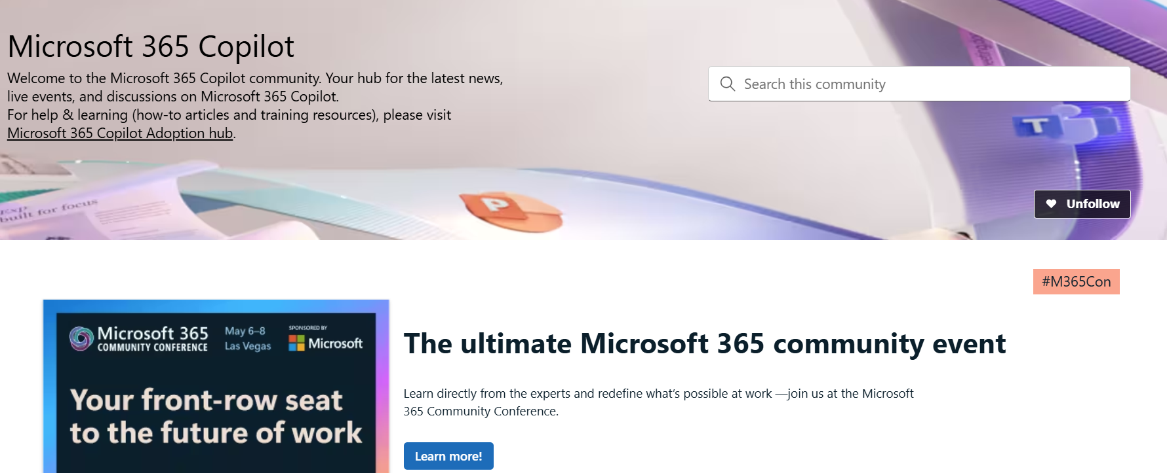
News & community content
Microsoft Community Learning aka.ms/Community/LearningChannel
Community led expert content on all your favorite Microsoft services.
Start your week with live news and event updates aka.ms/MondaysatMicrosoft
Watch live or on-demand & share our blog.
Notes:
To help you with adoption, the Copilot Readiness Hub is an open one stop shop for content, organized by role for your Copilot for Microsoft 365 journey.
You can use its recommendations to prepare and plan for your deployment, create a user experience strategy as I’ve presented today, and an adoption plan.
And as Copilot continues to evolve, keep coming back for new content that is published regularly.
You can also join the Copilot for Microsoft 365 community to get your questions answered and meet others who are leveraging Copilot for Microsoft 365 right now.

Slide 16
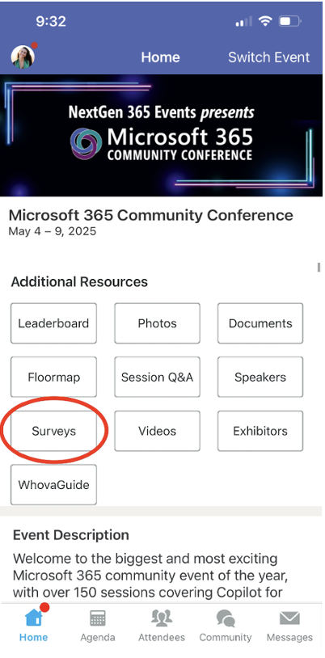
Session feedback surveys
We want to hear from YOU!
Share your feedback to make next years conference even better!
Here’s how –
Simply go to the Whova App on your smartphone.
Scroll down on the M365 Community Conference Homepage to ‘Additional Resources’ to click “Surveys’.
Click Session Feedback.
Scroll down to find this session title.
Complete the session feedback survey.
Finally, click ‘Submit’.
It’s just that easy!

Slide 17
