Slide 1
Unlock the Power of Copilot in Teams Meetings
Zaid Haque, Vincent Chan

Slide 2

Microsoft 365 Community Conference

Slide 3


Slide 4


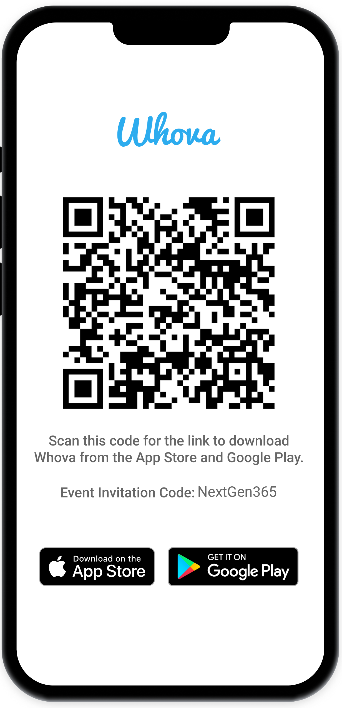
Join the event app to access:
The official event app for the
Microsoft 365 Community Conference
Event invitation code: NextGen2025
Event announcements
Personalized agenda, session details
Speaker & attendee profiles
Networking, meet-ups, messages
Event documents

Slide 5
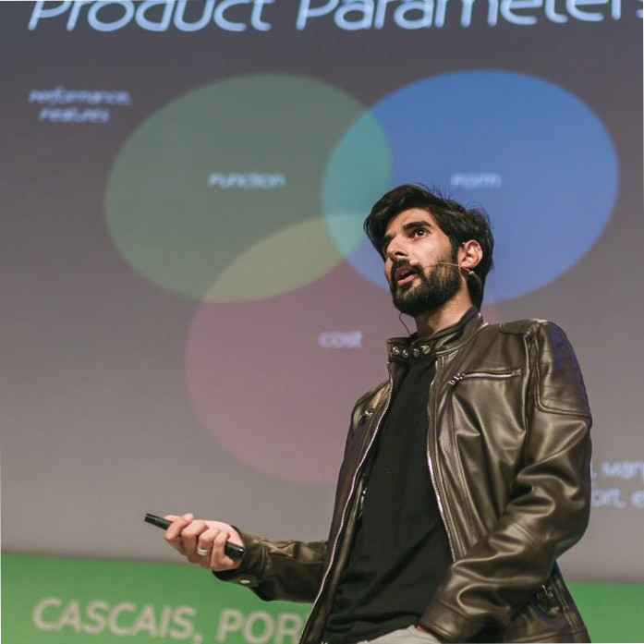


Zaid Haque
Product Manager
/in/zaidhaque/
Vincent Chan
Product Manager
/in/vincent-chan-30063526/

Slide 6
Our Vision
Copilot Users are informed, present and effective in meetings they attend as well as meetings they don’t.
Copilot is your trusted partner helping you in every meeting.
Notes:
COPILOT IN MEETINGS

Slide 7
Are you a power user of Copilot?
How do you use Copilot in Meetings?

Slide 8
Grounding data progression in Copilot
Transcript
Chat
Screenshare
General Availability
Fall 2023.
Copilot has access to what people said, but not tone, pitch, or any other audio information. It only knew about the people who talked.
General Availability Summer 2024.
Allows user to see the interaction between people talking in real time and people chatting about the conversation.
Public Preview started Spring 2025
Copilot can now understand what’s being shared on screen

Slide 9
Spectrum of Scenarios with Visual data
Level 1 Retrieve Screens | Level 2 Recap Screen content | Level 3 Recap across Transcript, Chat, Screens | Level 4 Adjust original screen content to make new content | Level 5 Adjusting original screen content based on Transcript/chat input
“Show me the screens that were shared so far” "Please display the charts that were shared in the quarterly review." Can you retrieve the screenshots from the product demo?" | “Which sales teams have exceeded their quota?” "What were the main takeaways from the customer feedback slides?" "Which products had the highest sales according to the presentation?" | “What were all the questions on the Monthly Roadmap slides?” "What were the main concerns raised in the meeting about the project timeline?" "What were the main action items from the discussion on the budget allocation slides?" | "Rewrite the chart with only the data from Q2." "Generate a new graph with the data from the last three months." “What was total operating expenses in 2023?” | "Rewrite the summary slide by including the feedback from the chat." "Adjust the budget allocation slide based on the suggestions from the meeting."

Slide 10
Screenshare Understanding
Demo
Notes:
Demo 1: Excel Spreadsheet
Demo 2: Cover letter

Slide 11

Microsoft Confidential

Slide 12
Spectrum – charted out
Amount of
Grounding Data
“Show me the slides along
with feedback on each”
“Prioritize items on the mind map
based on the conversation”
Magical
“Rewrite the slide/paragraph
based on the conversation”
Standout
What’s assigned to me?
“Filter the table with
items assigned to me”
Expected
“Show me the screens
shared so far”
“Translate the content
on screen”
“What was the MAU from
last month”
Prompt complexity

Slide 13
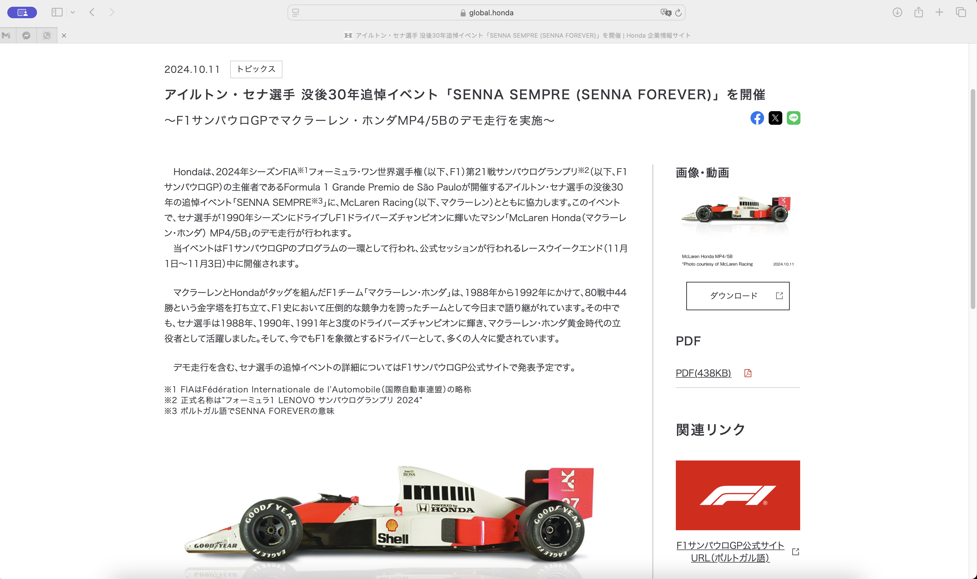
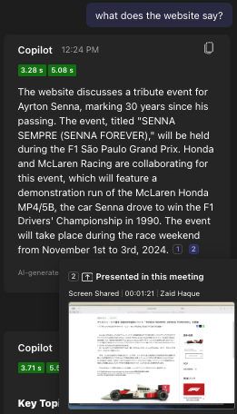
Live Translation and Summarization

Slide 14
FAQs for Screenshare Understanding
Where does it work?
Screenshare understanding works on Screenshares, Window Shares, and Camera Content shares (i.e. whiteboard). It does not yet support PPT Live or the Whiteboard App.
How do I start it?
Requires the meeting to be recorded (by anyone), with at least one Copilot licensed user invited to the meeting. The meeting also needs Screenshare.
For Public Preview, user who records, and user with Copilot both need to be in the Public Preview ring or below.
Where does it save the content?
Screenshare data is shared in the same place as the Recording. Only ‘unique key frames’ rather than every screen.
What about Accidental Sharing?
When a screen changes, Copilot will wait 10 seconds before taking a screenshot, giving people ample time in case they accidentally share something. Keep in mind, these frames will remain in the recording.
Does it support Sensitivity Labels?
Copilot will respect the sensitivity label of the Meeting. If a user shares a file in the meeting through chat/upload, the Meeting Sensitivity Label is inherited. If just a screenshare, ‘Highly Confidential’ files are not allowed to be screenshared.
Notes:
How does it work
Where does it save the content
What are the restrictions, how do you record
Accidental shares
Sensitivity labels

Slide 15
Coming Soon
Export to Word/Excel
Stop Generating
Suggested Prompts
Copilot responses can be easily exported to new Word/Excel files. (more apps to come in the future)
Ability to stop Copilot’s generation of content
Copilot will suggest follow-up prompts to keep the conversation going
…keep up to date on M365 Roadmap!

Slide 16
Our Vision
Copilot Users are informed, present and effective in meetings they attend as well as meetings they don’t.
Copilot is your trusted partner helping you in every meeting.
Notes:
COPILOT IN MEETINGS

Slide 17
Our Vision
Mobile Users are informed and actively contributing from anywhere at anytime with confidence.
Notes:
Let's start with our vision for mobile.
We want people to feel informed, empowered and able to jump in and contribute, wherever they are and whenever they need to. Work isn't tied to a desk anymore. It happens in the car, in line for coffee, or between meetings. Our goal is to make sure that being away from your desk doesn't mean you're out of the loop or unable to make an impact.
Teams Mobile is a powerful but very compact toolbox – a lot of very powerful and versatile capabilities are tucked away, due to form factor. Whova app poll: Do you currently use Copilot for Teams Meeting on Mobile (to catch up, generate meeting recap and action items etc) – 7/16 respondents says no. Good outcome today would be to drive awareness on how Mobile can help you and your team during the day

Slide 18




Top Tasks on Mobile
Catch Up
Communicate
Locate & Share
Plan & Prepare
Notes:
So, what are people actually doing on mobile?
If we look at the data, it's clear that most mobile activity is about quick triage and communication. Around 85% of the time, people are catching up—checking what's urgent, staying updated on progress, or flagging things to handle later. It's about making sure nothing slips through the cracks, even on a busy day. This is the reality for most of us: our days are full of interruptions and shifting priorities, and mobile is the tool we reach for to stay on top of things.
The next big piece is communication. About 70% of users are using mobile to chat, join quick meetings, or let others know when they're available. It's all about staying connected and making sure the team keeps moving, even if everyone's in different places. There's a real need for tools that make it easy to reach out, respond, and coordinate on the fly.
Of course, there are also moments when people need to find or share a document, or quickly check a resource. And sometimes, it's about managing your schedule or prepping for a meeting. These make up a smaller share of tasks done on a mobile, but they're still important for keeping things on track.

Slide 19
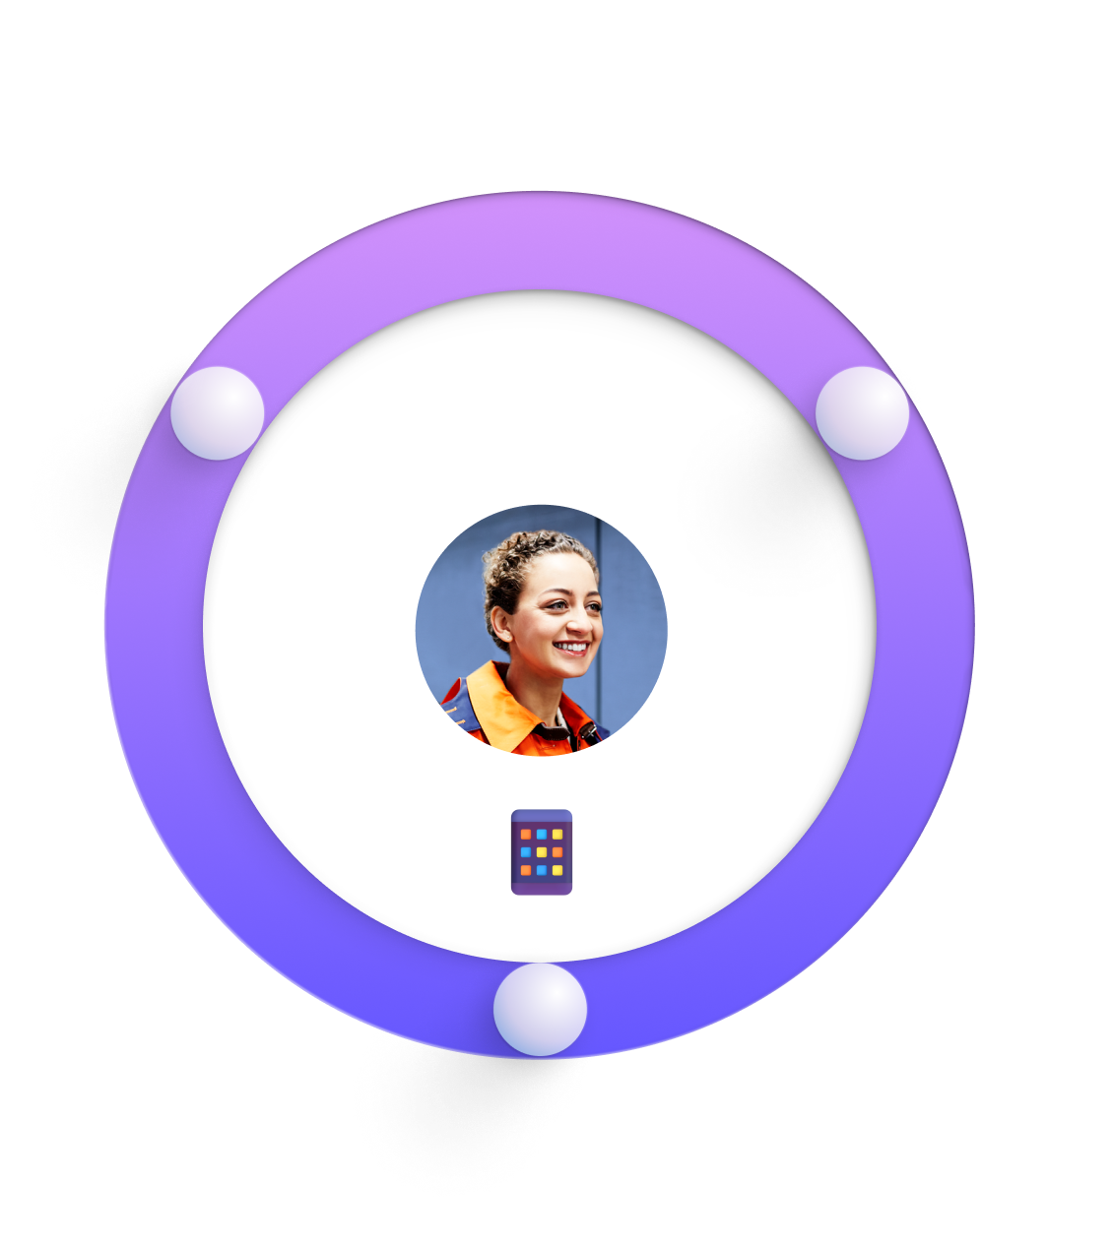



Key user jobs on mobile to save time & effort
Consume faster
Create better
Collaborate better
Notes:
Let's zoom out and look at the bigger picture.
When you break it down, there are three main things people need to do on mobile:
First, get information fast—whether that's catching up on messages or reviewing meeting notes. Second, create and share—maybe jotting down an idea, replying to a chat, or sharing a file. And third, keep collaborating—making decisions together and making sure nothing falls through the cracks.
But here's the thing: on mobile, these jobs usually happen in short bursts—during a commute, between appointments, or whenever you have a few spare minutes. That's where AI can really help. Instead of digging through meeting notes or chat or trying to remember what's important, AI can highlight what matters, summarize conversations, and handle some of the routine stuff for you. It's about making the most of those little windows of time, so you can keep things moving without feeling overwhelmed.
With AI assisting you, you don't have to worry about missing something important or losing track of where you left off. It's there to help you stay organized, respond quickly, and keep up with your team, especially on your most unpredictable days.

Slide 20

Sarah’s Day with AI in Teams Mobile
Meet Sarah: Modern Information Worker
Hybrid worker, often on the move
Needs to stay caught up on meetings & chats
Relies on Teams Mobile and Copilot for productivity
Notes:
Let's bring this to life with a small story.
I want to share with you a day in life of Sarah.
Sarah is a modern information worker. She's often on the move, working in different places throughout the day. Like many of us, she needs to keep up with meetings and chats, even when she's not at her desk. She uses Teams Mobile and Copilot to help her stay productive, wherever she happens to be.
Let's walk through a typical day for Sarah.

Slide 21
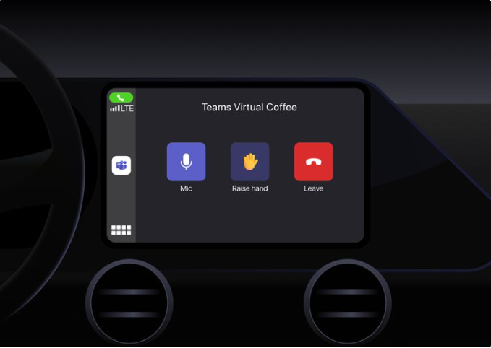
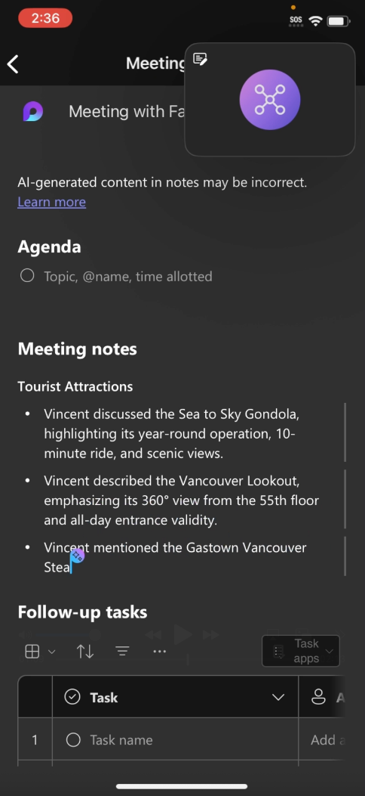

8:00AM - Morning Commute: Hands-Free Meetings
CarPlay + AI on Teams = Safe, Productive Start
Sarah connects her phone to her car and joins 8 AM Meeting with a few quick taps.
Meeting notes & action items captured automatically by Facilitator.
Notes:
Morning Commute
Sarah starts her day in the car. She connects her phone to her car's system, and with just a couple of taps, she's in her morning meeting—hands-free. She can listen in, contribute when needed, and doesn't have to worry about missing key points because the Facilitator in Teams Meeting is automatically capturing notes and action items for her. This means she can focus on driving safely, but still be present and engaged with her team.
What's great here is that Sarah doesn't have to choose between being productive and being safe. She can do both, and she knows that when she arrives at the office, she won't have to scramble to catch up or remember what was discussed.

Slide 22

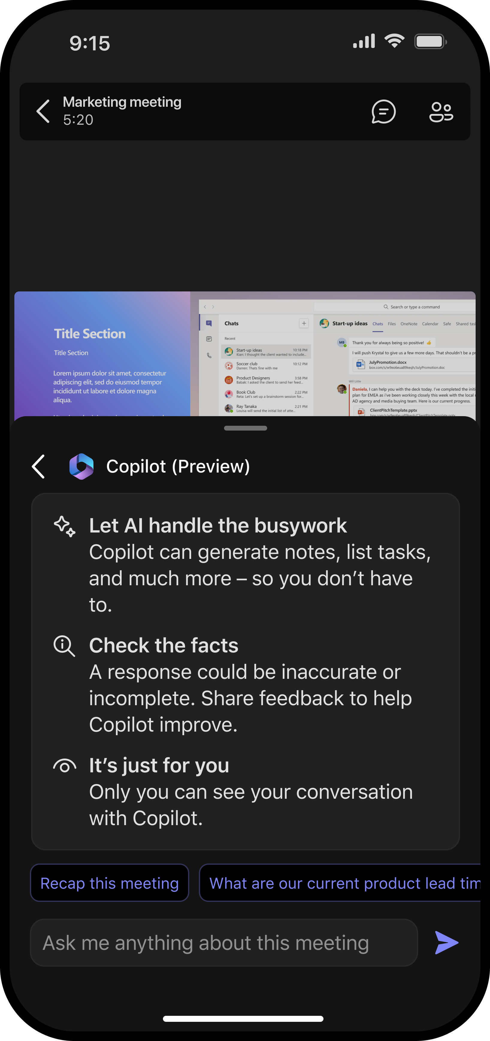



8:45am - Arriving at the Office: The Meeting Moves with You
From Drive to Desk, Productivity Never Stops
Sarah parks and unplugs her phone from CarPlay. The meeting continues seamlessly on mobile
She uses Copilot in Meeting to ask:
“What were the key risks discussed so far?”
Copilot instantly summarizes points from earlier in the meeting, keeping Sarah fully in the loop as she walks into the office
Meeting insights at the fingertips - easily access in-meeting and get more out of your conversations.
Notes:
Arriving at the Office
When Sarah gets to the office, the meeting continues seamlessly on her phone. There's no awkward transition, no need to reconnect or ask someone to repeat what she missed. If she wants to get up to speed on something that happened earlier, she can just ask Copilot for a quick summary. What is great here is Meetings on Team Mobile also has full support of Screen Intelligence - Copilot picks up what's being screenshared in the meeting and uses that to provide a richer, more informative response to Sarah. So she's always ready to jump in, and she doesn't feel like she's playing catch-up.

Slide 23

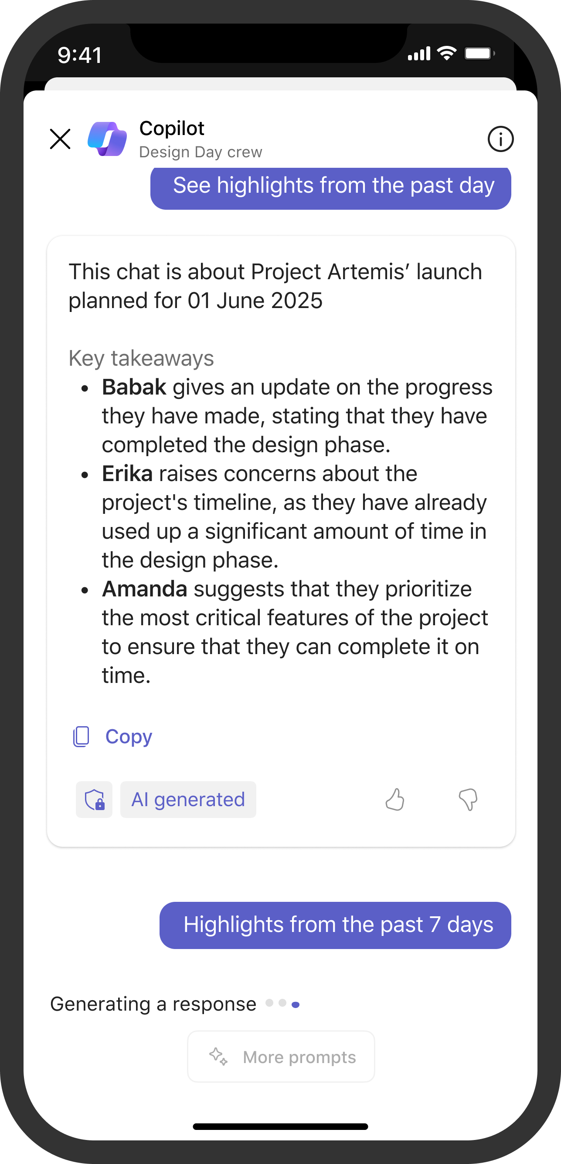
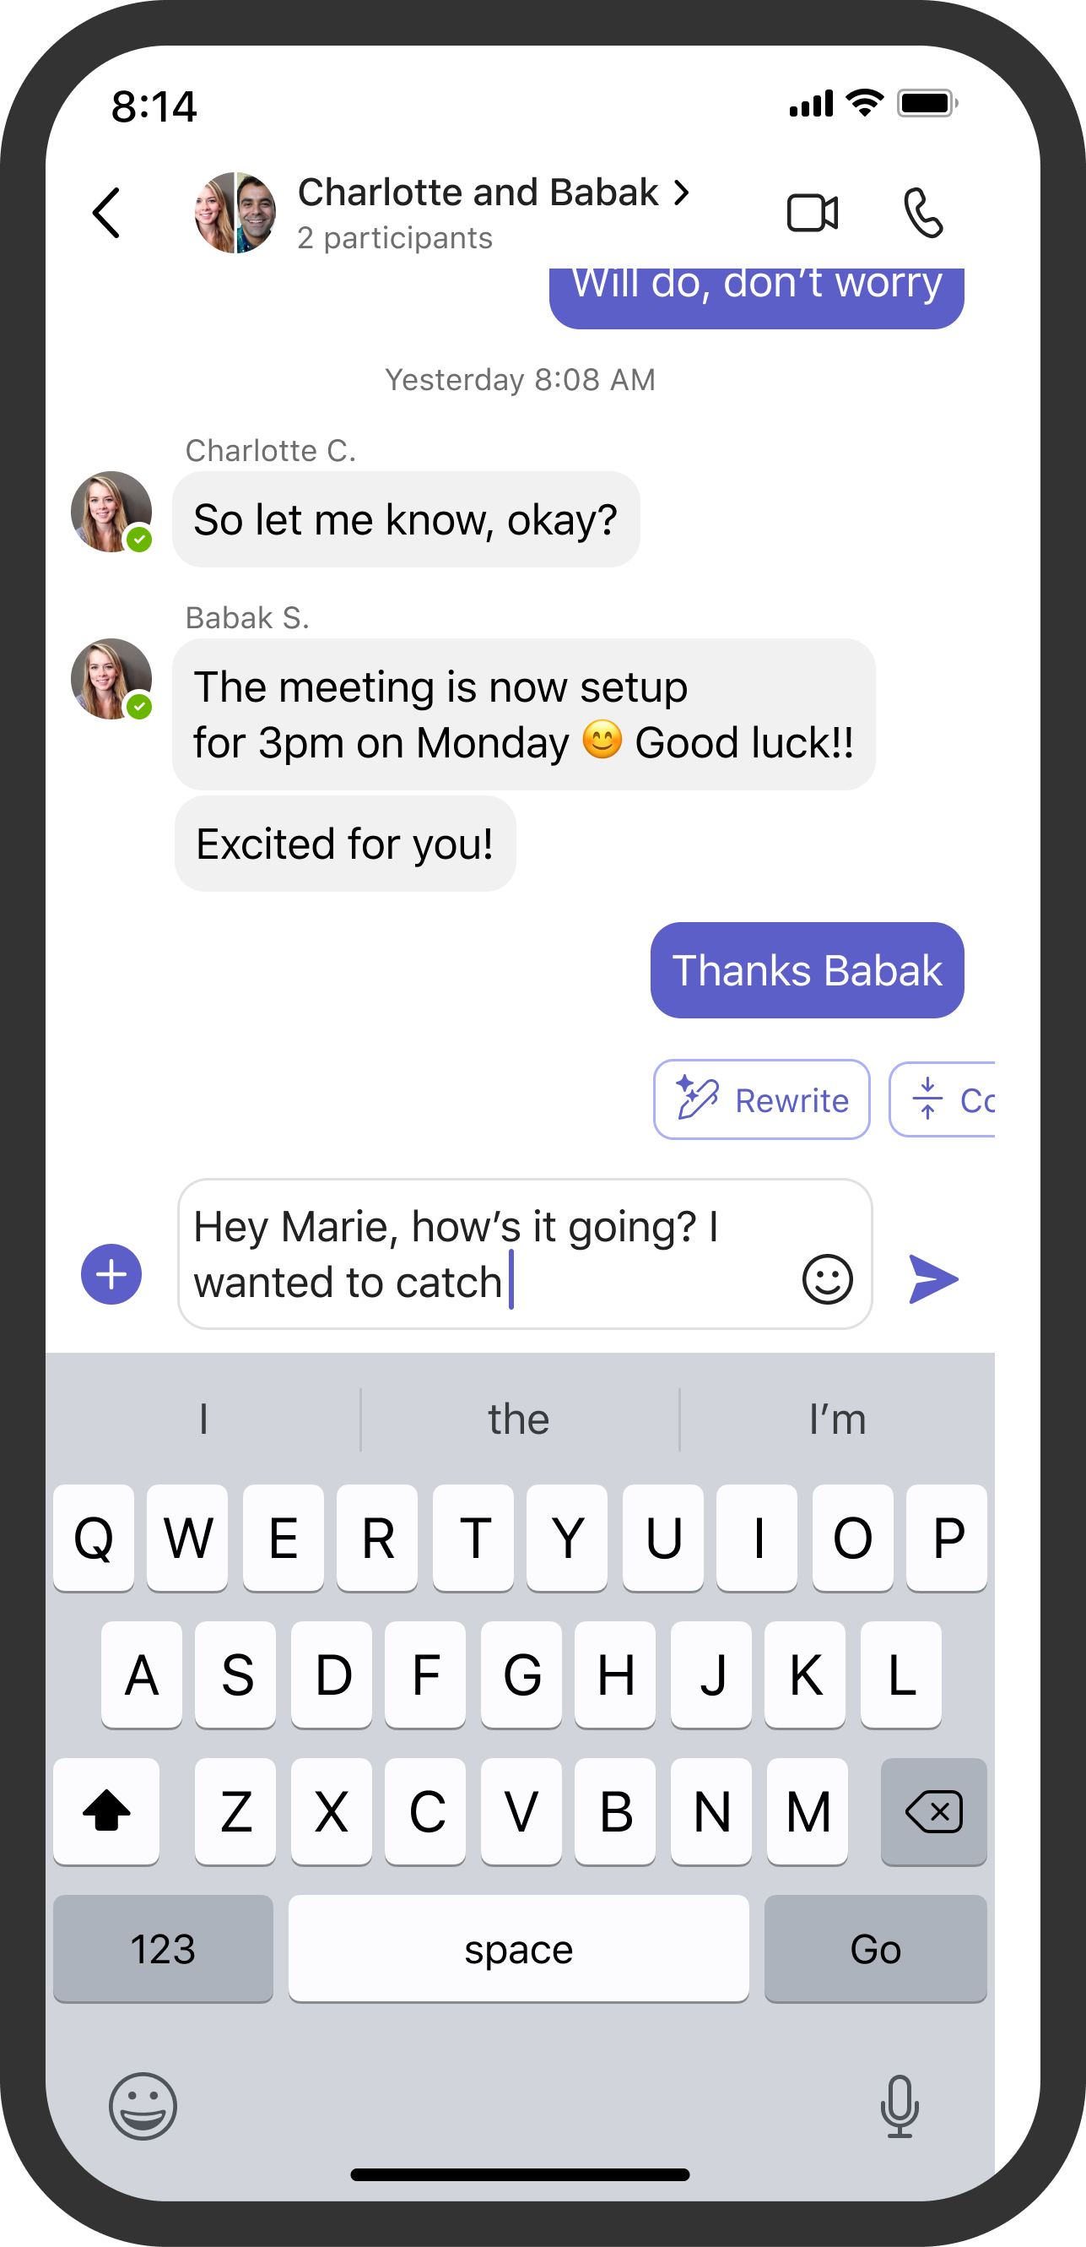
10:30am - Quick Catch-up: Stay Ahead in Every Break
Micro-Moments, Major Catch-up
With a few minutes between calls, Sarah checks Teams Mobile
Copilot summarizes chats and provides the highlights.
With help of Copilot, she composes replies directly from chat, staying on top of conversations.
Notes:
Between Meetings: Micro-Moments
Later that morning, Sarah has a few minutes between calls. Instead of letting those minutes slip by, she opens Teams Mobile. Copilot gives her a quick rundown of her chats, highlighting what's most relevant. With the help of Copilot, she can quickly compose a reply. This is a small thing, but it adds up—those little moments throughout the day become opportunities to move things forward, rather than just dead time.
It's also about reducing that feeling of being overwhelmed. Instead of facing a wall of text, Sarah gets a clear, prioritized view of what needs her attention. She can make decisions quickly, respond to what's urgent, and defer the rest for later.

Slide 24
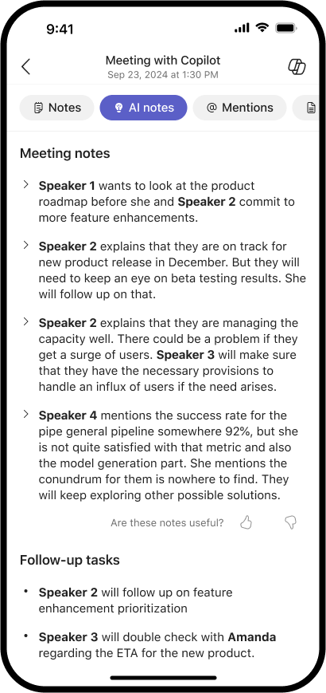

2:45pm - AI-Powered Recap: Instant Insights from Meetings
Double-booked in the afternoon, Sarah misses a meeting.
Later, she opens Meeting Recap:
Views the AI Summary and Recording to catch up and deep-dive.
Asks Copilot,
  “What decisions were made on the project timeline?”
  “Were there any action items assigned to me?”
Starts drafting an email update right in Meeting Copilot.
Notes:
Afternoon: Missed Meetings and Catching Up
In the afternoon, Sarah runs into a common challenge—she's double-booked and misses a meeting. In the past, this might have meant a scramble to get notes from a colleague or digging through a long transcript. Now, she just opens the Meeting Recap on her phone. She can see a summary, listen to the recording, or ask Copilot for the key decisions and action items. This means she can catch up quickly and move on, without feeling like she's falling behind or missing context.

Slide 25

4:00pm - Pocket to Desk: Seamless Continuity
At home, Sarah opens Teams on her laptop
All Teams Copilot recaps, action items, and chat summaries are synced.
She picks up her work right where she left off, with full context and continuity.
Notes:
Switching Devices: Continuity
As the day winds down, Sarah heads home and opens Teams on her laptop. Everything she did on mobile—notes, action items, chat summaries—is right there, ready for her to pick up where she left off. There's no need to hunt for information or redo work. It's a smooth handoff between devices, which makes her day feel a lot less scattered.

Slide 26

Sarah’s Day-in-Review
Hands-free meetings and notetaking for on-the-go productivity.
Meeting Recaps & Copilot Deep-Dives for instant clarity.
Copilot in Chat & Compose for efficient catch-up.
Cross-Device Continuity for seamless transitions.
No missed context, no wasted time.
Productivity in every moment, anywhere you choose.
Notes:
Reflecting on the Day
Looking back, Sarah's day shows how Teams Mobile and AI can support the way we actually work now. Hands-free meetings make her commute productive. Recaps and summaries help her stay on track, even when her schedule changes. Quick catch-ups in chat mean she doesn't get buried in messages. And switching between devices is seamless, so she doesn't lose momentum.
What really matters is that Sarah feels supported, not stressed. She's able to keep up, contribute, and stay connected, even when her day is unpredictable. She doesn't have to worry about missing out or losing track—her tools help her stay organized and responsive, without adding extra pressure.

Slide 27
…and we’re just scratching the surface…
Catch Up
Communicate
Locate & Share
Plan & Prepare
We’d love to hear from you!
Notes:
Looking Ahead
And honestly, we're just getting started. Catching up, communicating, sharing, and planning—these are just the basics. There's a lot more we can do, and your feedback is what will help us shape what comes next.
I'd love to hear from you—what challenges do you face when working on mobile? Are there moments in your day where you wish your tools could do more, or where you feel like something's missing? Your insights are incredibly valuable as we continue to improve and build features that really make a difference.
So, thank you for listening and for sharing your experiences. Together, we can make mobile work better for everyone.

Slide 28
We have an exciting future ahead.
Notes:
Thank you.
<Speaker Guidance: Spend the last few minutes discussing or answering any questions they may have. If they have additional topics on their EBC agenda, make sure you connect with their account team to inform them which AI priorities and business outcomes resonated the most during this session. If you are in a 1:1 direct customer engagement, make sure you note what their priorities and questions were and work with the broader account teams and units to facilitate the proper hand-offs or next steps (i.e. get them into a session at the Innovation Hub/MTCs).>

Slide 29
Q&A
Zaid Haque, Vincent Chan
May 8th. 2025

Slide 30
Expertise and tools for your journey
Technical expertise via our FastTrack partners
Tools, resources & training on our Adoption Hub
Events and real-world knowledge in our community
aka.ms/Microsoft/FastTrack
adoption.microsoft.com
aka.ms/TechCommunity
Notes:
Please leave this slide in for conference attendees.

Slide 31
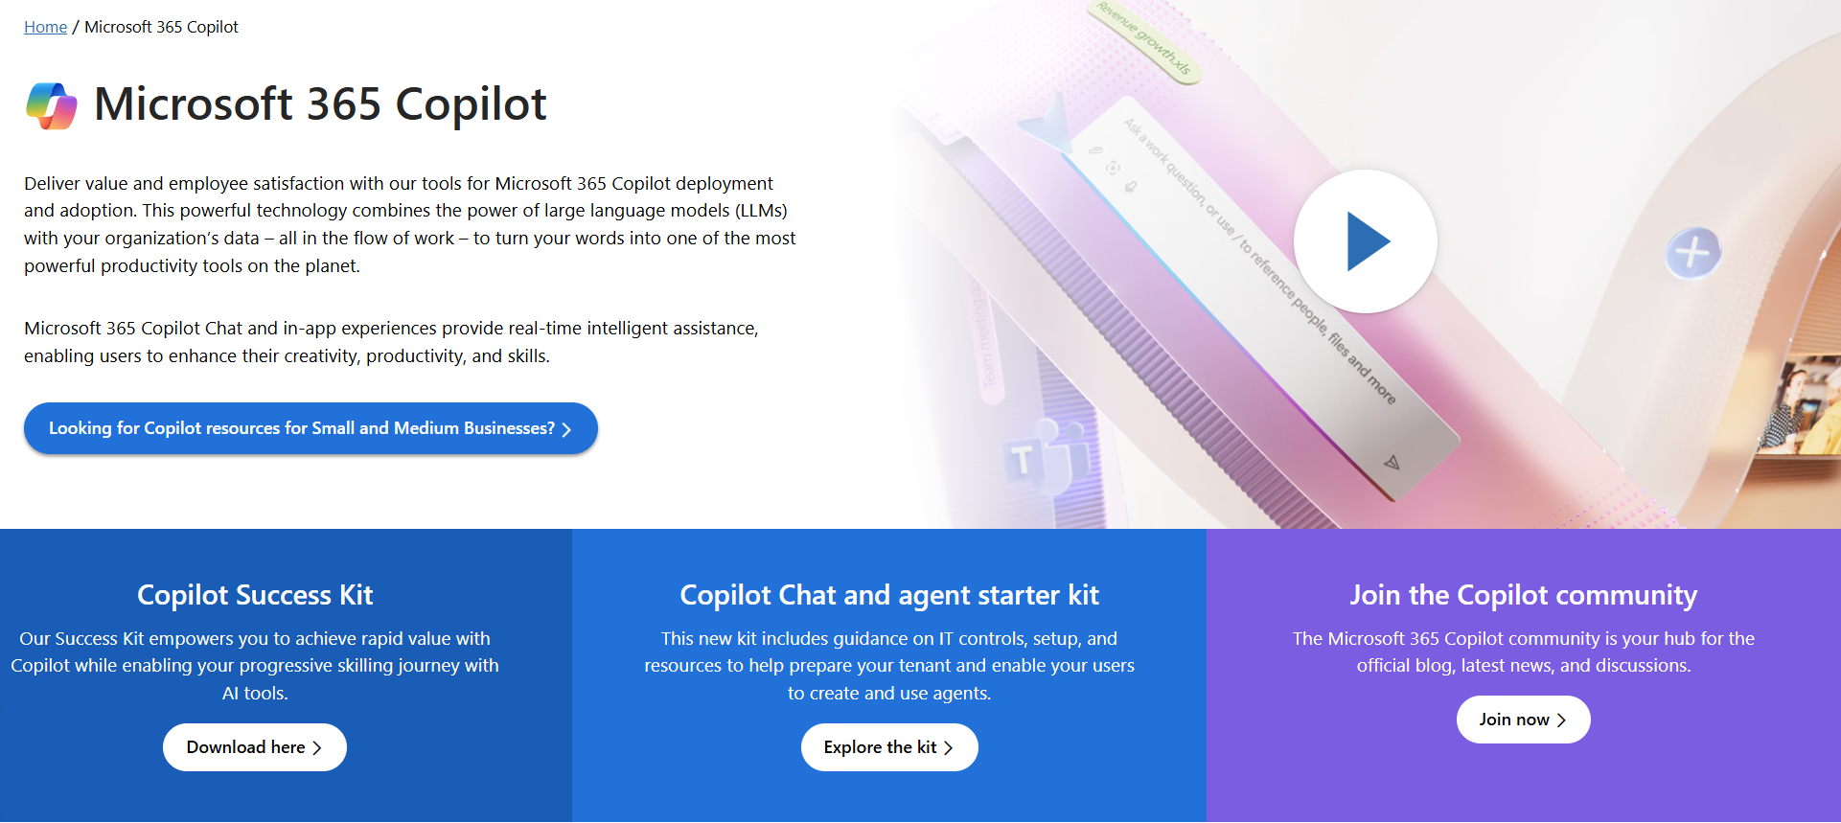
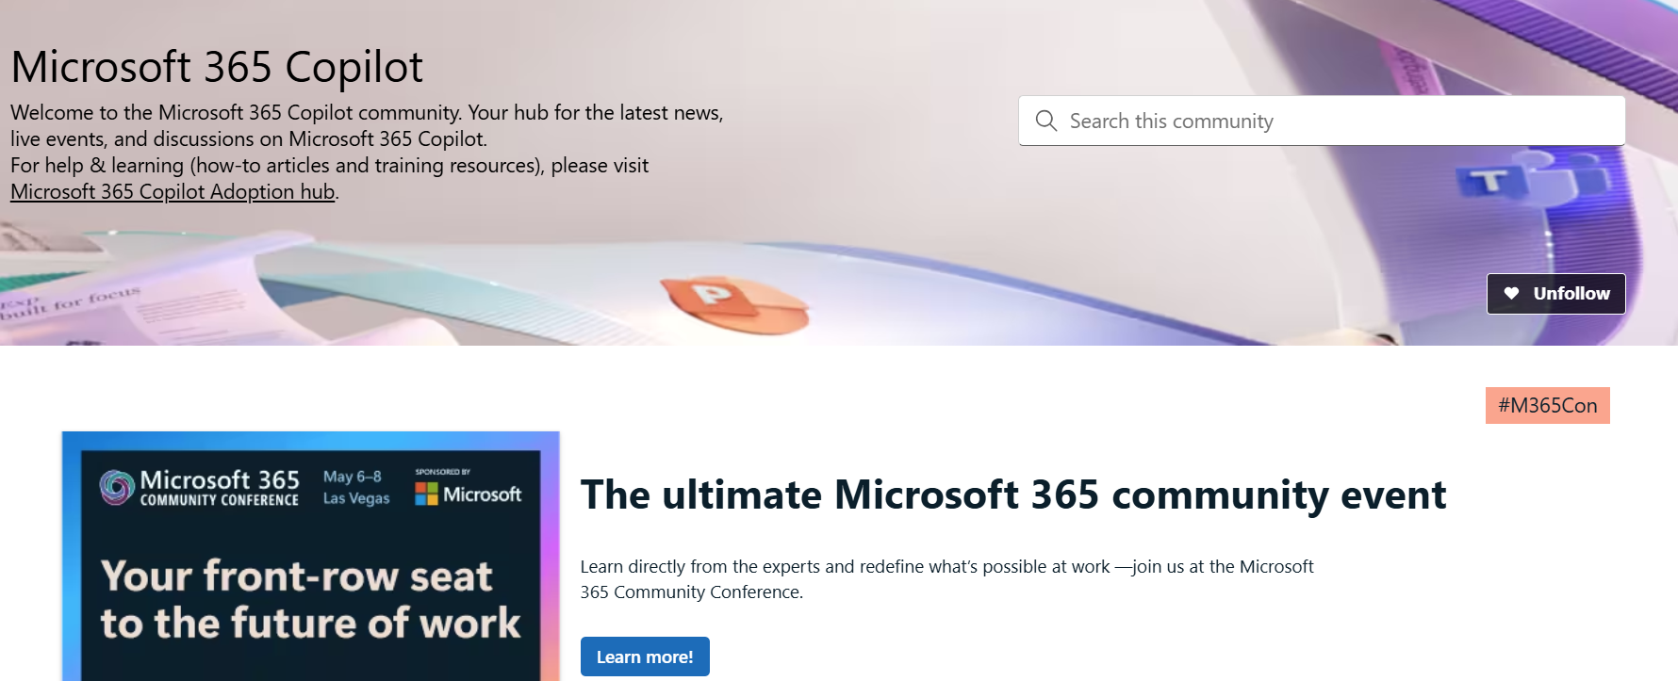
News & community content
Microsoft Community Learning aka.ms/Community/LearningChannel
Community led expert content on all your favorite Microsoft services.
Start your week with live news and event updates aka.ms/MondaysatMicrosoft
Watch live or on-demand & share our blog.
Notes:
To help you with adoption, the Copilot Readiness Hub is an open one stop shop for content, organized by role for your Copilot for Microsoft 365 journey.
You can use its recommendations to prepare and plan for your deployment, create a user experience strategy as I’ve presented today, and an adoption plan.
And as Copilot continues to evolve, keep coming back for new content that is published regularly.
You can also join the Copilot for Microsoft 365 community to get your questions answered and meet others who are leveraging Copilot for Microsoft 365 right now.

Slide 32
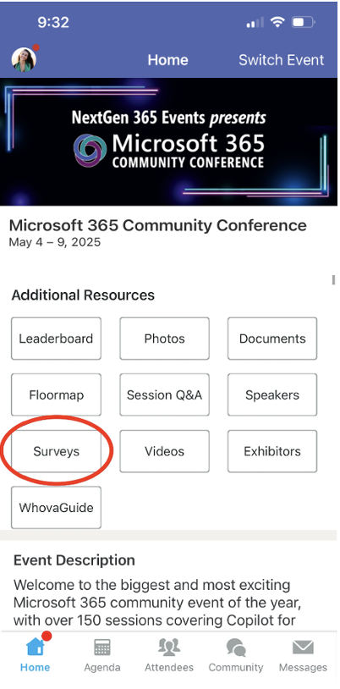
Session feedback surveys
We want to hear from YOU!
Share your feedback to make next years conference even better!
Here’s how –
Simply go to the Whova App on your smartphone.
Scroll down on the M365 Community Conference Homepage to ‘Additional Resources’ to click “Surveys’.
Click Session Feedback.
Scroll down to find this session title.
Complete the session feedback survey.
Finally, click ‘Submit’.
It’s just that easy!

Slide 33


