Slide 1

Microsoft 365 Community Conference
Notes:
``

Slide 2
Build agents within your applications with SharePoint Embedded
Marc Windle and Yogesh Ratnaparkhi
Notes:
[Marc]
Intros
Let’s do a show of hands – build AI app? Built SPE apps?

Slide 3


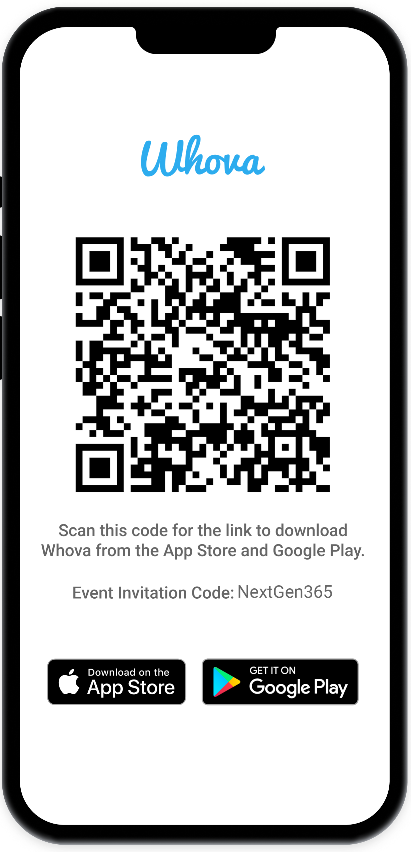
Join the event app to access:
The official event app for the
Microsoft 365 Community Conference
Event invitation code: NextGen2025
Event announcements
Personalized agenda, session details
Speaker & attendee profiles
Networking, meet-ups, messages
Event documents
Notes:
[Marc

Slide 4


Marc Windle
Principal Product Manager
Yogesh Ratnaparkhi
Principal PM Architect
Notes:
Marc to intro first. Yogesh intro next.
Intro – my story, started with Visual studio, then WXP, and how, it’s some type of an ai chat like Copilot and ChatGPT. How many of you build applications that deal with files and documents?
How many of you have built applications that use AI?
How many have built an application with SPE?

Slide 5
Here’s what we will discuss today
Build agents:
Agent in your app
Agent in Teams and Copilot
What it takes to build AI applications
Manage your application from the admin center
Overview
Admin
Demo
Notes:
You are in the right session. Because we are going to show you how to build AI application using SharePoint Embedded.
3-part session:
First, I will set the context around what’s an AI native application and what does it take to build a successful application
2nd, Marc will bring this notion to life by showing to amazing demos. First we will show you how to build an Agent in your application. And then, how you can publish an agent to Teams and Copilot. 3rd, I will walk through how to manage and govern your application from the admin centers including billing.

Slide 6

Every business application will be an AI app
Notes:
Reality - AI becoming the new runtime of business applications
Opportunity - Massive opportunity to empower users and customers do more.
Urgency – existential priority
But building a truly useful one, — that respects your data boundaries, understands your documents, collaborates like a teammate, and earns IT’s trust — is still painfully hard.

Slide 7



What is an AI-centric business application?
Conversational
Agentic
Contextual
Notes:
3 key characteristics of a true AI centric application
1. primarily conversational. Gone are the days of rigid structures of form and folders. Users will interact with your application using natural language to search the relevant information, build and edit a contract, organize their information.
2. business logic will be driven by agentic workflows. Triggering invoices, requesting approvals, processing applications. All will be driven by one or more agents. 3., most crucially – the AI interaction will be grounded in the application knowledge and user context. This is the single most aspect that will determine the success of the application.

Slide 8
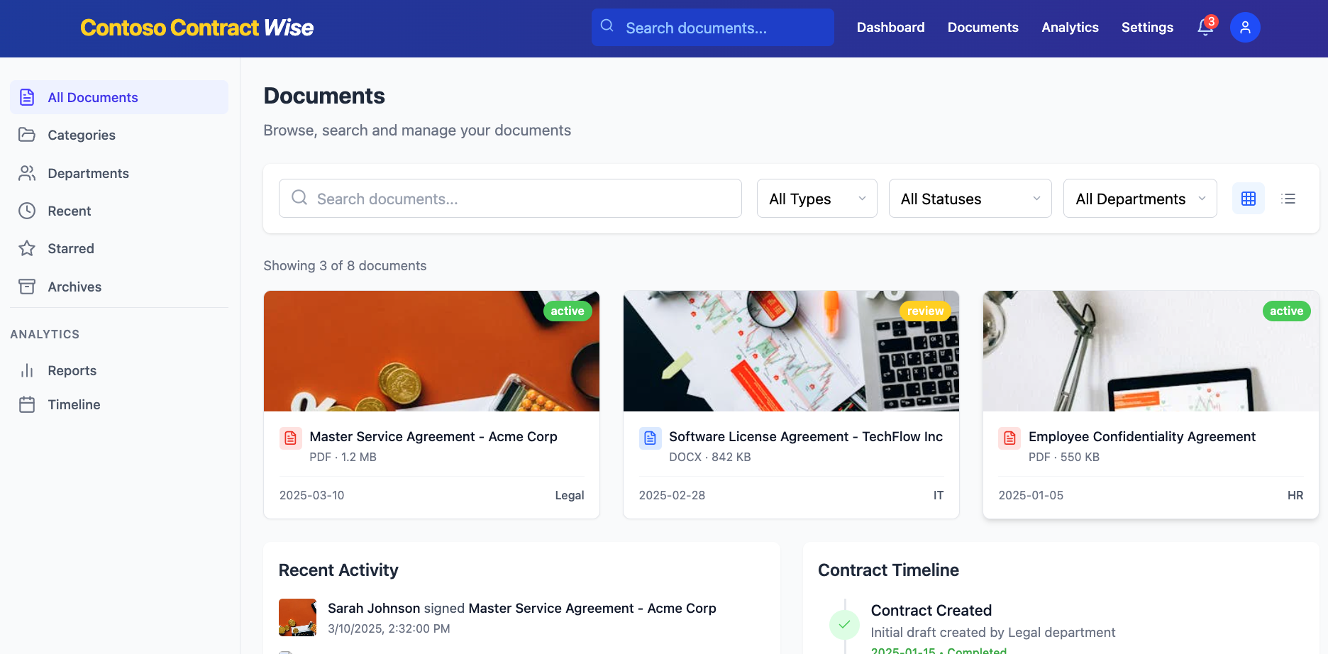
AI context lives in documents
AI needs to natively reason over domain knowledge in real time.
Notes:
Application context resides in unstructured files and documents – clinical notes, legal matters, financial statements, tax reports, audit logs.
Documents are the DNA of your business. AI needs to incarnate that DNA. Domain knowledge lets AI act —auto-journal entries, draft clauses, flag audit gaps.
Success lies in harnessing this knowledge through AI effectively

Slide 9
Why is building enterprise AI applications hard?
Notes:
But building such a system is incredibly hard.
I speak with customers every week, and the challenges they face are real.

Slide 10
Developer considerations
DMS
Document indexing
Retrieval and grounding
Orchestration
Notes:
Typically, a developer need build 2 systems – DMS and an AI stack to RAG over this content. DMS – store files securely, build read, write access, Office and sharing features.
AI stack – choose model, extract the content out of the DMS, vectorizing it, store in vector DB, building a RAG pipeline, and orchestrating the model responses within your application canvas.
In that process, a developer needs to re-create a subset of the DMS features, like access control, co-authorizing within the AI infrastructure.

Slide 11
IT considerations
DMS
Document indexing
Retrieval and grounding
Orchestration
Index freshness
Access control
Data protection policies
Data residency requirements
COGs management
Notes:
IT needs to govern additional surfaces.

Slide 12

Time to market is critical
A compliant DMS+AI integration takes months to build
You lose valuable time and resources when you could be delivering value sooner
Notes:
The time and resources spent on building a new Document Management System (DMS) and an AI stack could have been used to deliver immediate value to your end users. Faster delivery not only meets customer needs promptly but also accelerates feedback loops, allowing for continuous improvement and innovation.

Slide 13

AI apps deserve an AI-ready system
AI
DMS
Your application
IT
Notes:
What if you application got an out of box AI, collaboration storage and IT ready platform?

Slide 14

Full AI stack for enterprise apps and agents
Copilot
Collaboration
SharePoint Embedded
M365 commitments
M365 capabilities
Compliance
Notes:
That’s where SPE comes in. Brings 3 Cs necessary for AI solutions. It’s like giving your app a private Microsoft 365 brain — memory, intelligence, and trust included.

Slide 15
Full AI stack for enterprise apps and agents
AI
Collaboration
SharePoint Embedded
Commitments
Capabilities
Compliance
Notes:
That’s where SPE comes in. Brings 3 Cs necessary for AI solutions. It’s like giving your app a private Microsoft 365 brain — memory, intelligence, and trust included.

Slide 16
What is SharePoint Embedded
Notes:
So that’s the promise.
But what exactly is SharePoint Embedded? Let’s zoom in and look at how it works under the hood — and how it fits naturally into your app architecture.

Slide 17



A new way to build AI-native apps
line of business
ISV
HR app
Marketing app
Manufacturing app
SharePoint Embedded
APIs
Notes:
At the core, a place to store files and documents.
For your Lob apps or ISV scenarios
Accessible via APIs The basic building block = high value container
- offers copilot, collaboration and compliance to your documents.
Each container – own permission model - your application can organize its information architecture around these containers.
Depending on your application, you can have one, 100 or millions of containers. SPE is a headless SharePoint which means there’s no UX. Your application needs to expose UI to manage this the content through Graph APIs.

Slide 18


SPE is native to Microsoft tenant
HR app (LoB)
Audit app (ISV)
Fabrikam M365 tenant boundary
Graph APIs
SharePoint Embedded
HR app containers
Audit app containers
Notes:
Example - build an HR app for your internal employees. 1. create an Entra application, let’s call it Contoso HR, within your tenant.
2. create a container type and register with the HR app. Apps signature that gets stamped on all the containers
And then, you will provision containers to host the documents for the app.
Designate a container for each job requisition, with folders for each applicant storing the resume, cover letters, employment history etc. Only the hiring committee will have access to this container. Manager will have another container with job offers etc.
You are the provider and the consumer for this application. Let’s take another example where that’s not the case. You are an ISV called Contoso Audit.
Create an Entra app with your ISV tenant. Once you ready to deploy, your consuming tenants will need to register this application with their tenant. You define the application but the content stays within your customer, say Fabrikam’s tenant boundary.

Slide 19

SPE is native to M365 Copilot
Copilot Platform
SPE APIs
Microsoft Graph
Your application
SPE
SPO
OD
M365 storage partitions
Copilot Control System
Notes:
The best part is these containers reside with your Microsoft tenant and 100% native to the Copilot system.
Under the hood: the intelligence of Copilot meets the structure of SharePoint — tuned for your app.

Slide 20




Extend Copilot in your app
Automatic Vectorization, chunking and semantic indexing
Copilot
Collaboration
SharePoint Embedded
Rich document intelligence and understanding
Compliance
High quality grounding data
Copilot Platform and orchestration
Notes:
You get the full Copilot stack in your app.

Slide 21
Built-in collaboration and Office
Full Office Application Support
Copilot
Collaboration
SharePoint Embedded
Real-time co-authoring
Compliance
Secure file sharing
@mention and comments
Notes:
SPE is a headless SP. And I mean it. With SPE, you application get a built-in Office support for the documents so your users can start collaborating with their team like they would on OneDrive and sharepoint. You also get the the sharing, versioning and many other collaboration features you would expect in SharePoint.

Slide 22

Secured and compliant by default
Integrated with Entra ID
Copilot
Collaboration
Audit, eDiscovery, DLP
SharePoint Embedded
Sensitivity Labelling
Compliance
Multi-geo support
Notes:
And finally, as part of the Microsoft 365 tenancy, you get the enterprise features like Entra-enabled auth,
Purview capabilities like Auditing, eDiscovery, information protection with sensitivity labels and DLP policies. You also get the full business continuity promise and the scale with features like multi-geo.

Slide 23
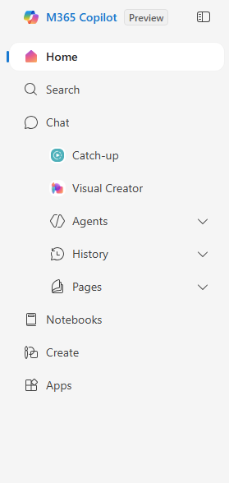
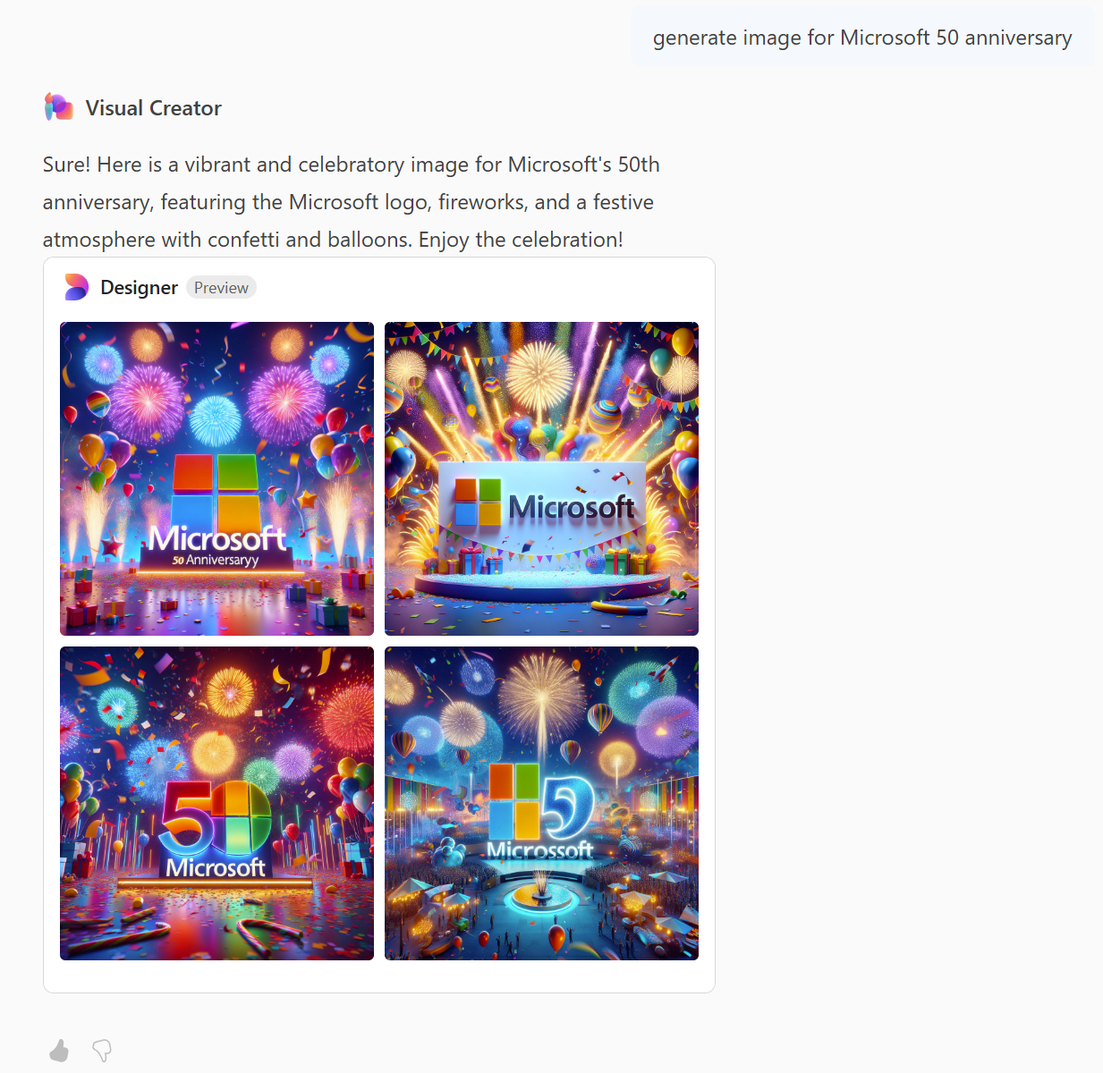
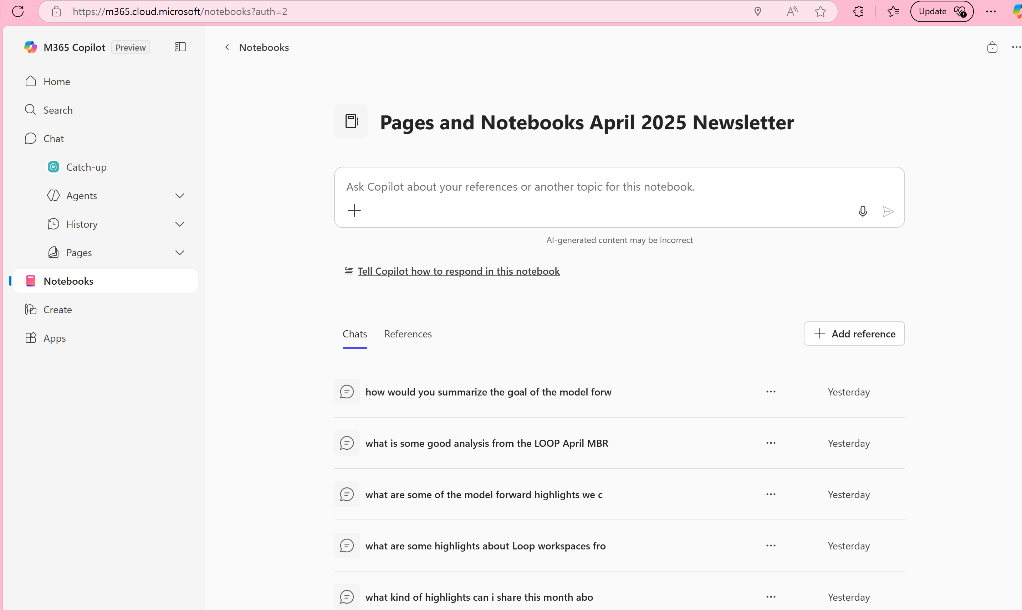
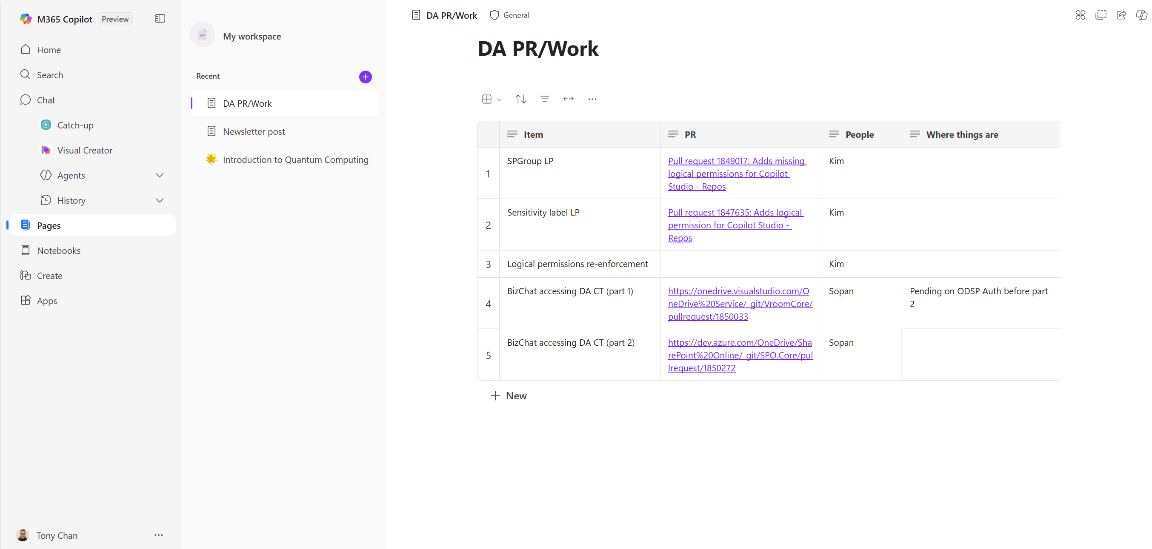
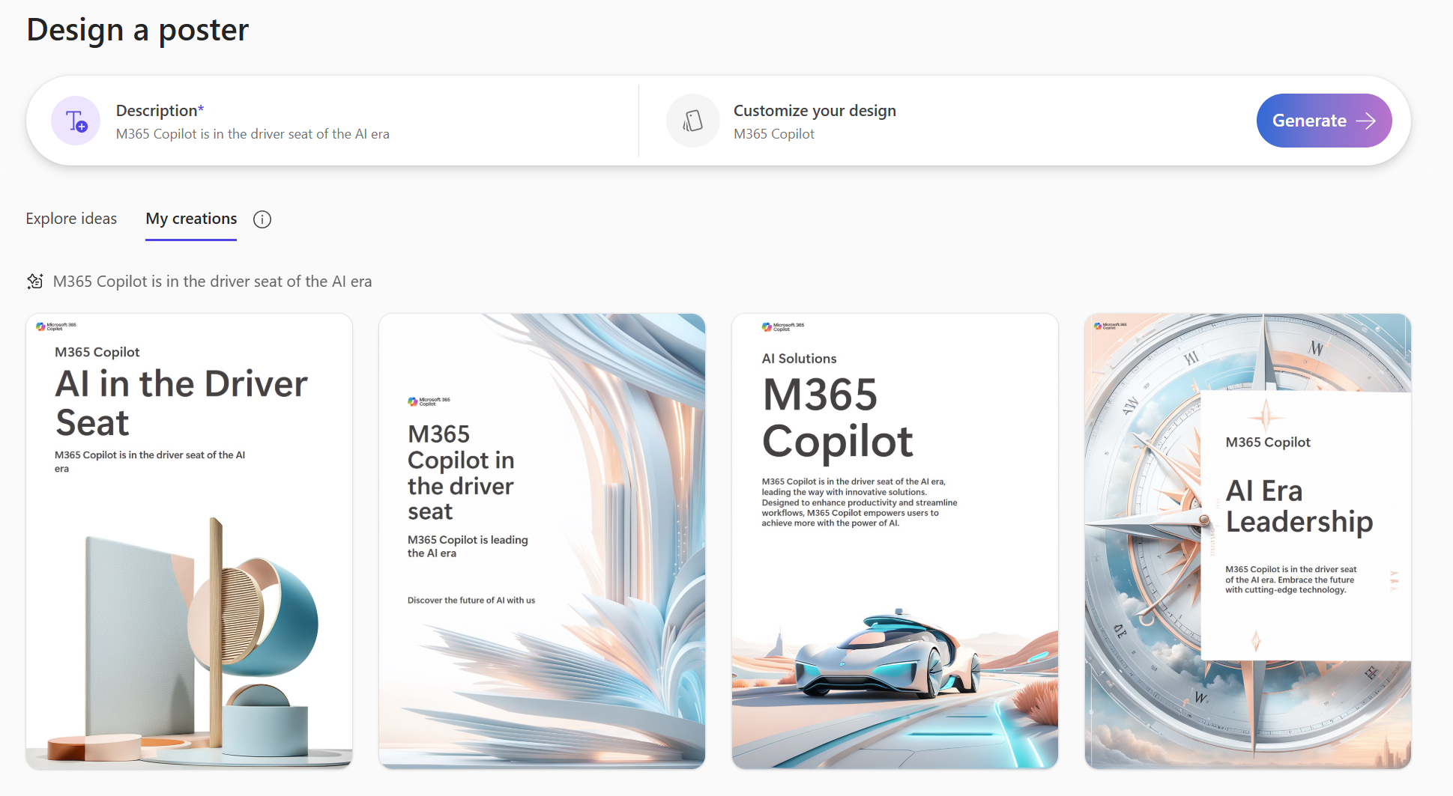
SPE is at the heart of M365 Copilot app
Visual Creator
1
Copilot Notebooks
3
Copilot Pages
2
1
2
3
4
Create (Designer)
4
Notes:
Reason why SPE is the default AI platform for Microsoft apps. Jeff showed this new home page during the keynote. Copilot centric. Excellent examples of AI native applications – Copilot pages, Copilot Notebook, designer…All built on SPE.
SPE, they get to focus on the experience, instead of building an AI stack and a DMS.
There are several other apps that are getting b

Slide 24
SPE supports diverse use cases
Insurance
Healthcare
Finance
Manufacturing
Professional Services
Government
Notes:
Since GA, we have numerous customers and ISVs building on SPE. The use cases include tax, legal, audit and other professional services. We have customers in finance, insurance, healthcare and most other sectors building AI forward applications

Slide 25




SPE supports 2 types of agents today
Visual Studio
GitHub
Type
SharePoint Embedded agents
M365 agents
Hosting
UX
Grounded on SharePoint Embedded documents
Notes:
To enable AI from the get-go, we offer 2 types of agents.

Slide 26
Building Agents with SharePoint Embedded
Build agents:
Agent in your app
Agent in Teams and Copilot
What does it take to build AI applications
Manage your application from the admin center
Overview
Admin
Demo
Notes:
Alright, let’s get into the details of what these two agents can do and how you can build them.

Slide 27
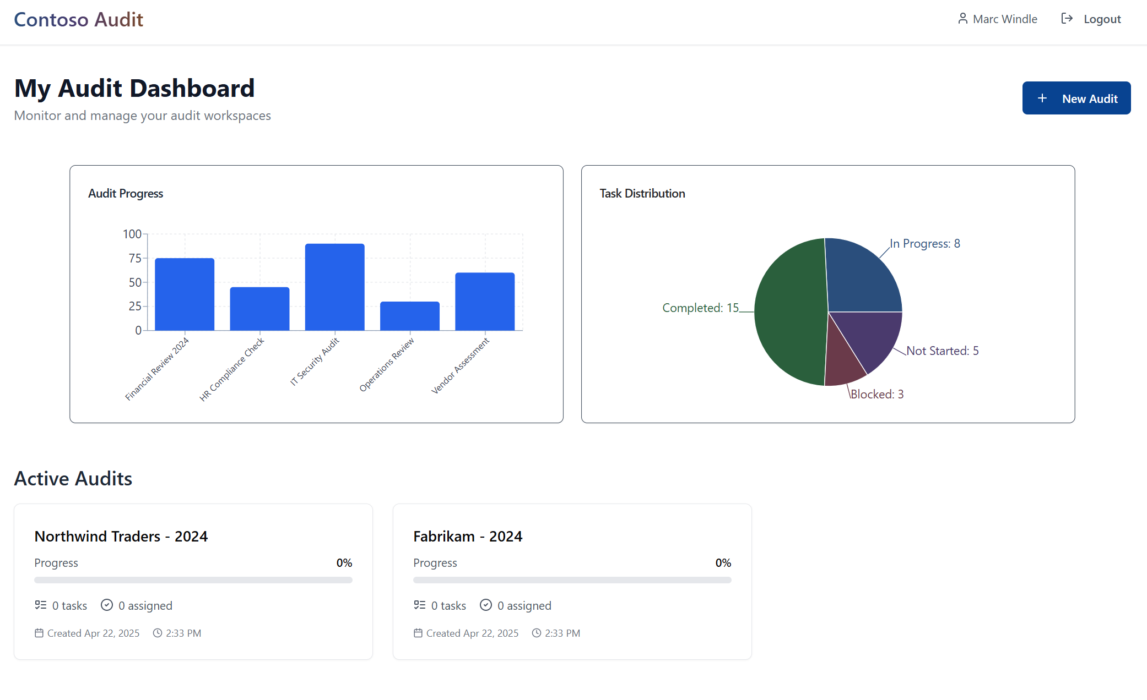
Use Case: Contoso Audit
Users collaborate within audit cases
Each case is a storage container
Internal and external collaborators
Financial and tax documents
Customer’s compliance policies honored
Data residency
Sensitivity labels + policies
eDiscovery
Audit
… and more
Notes:
Yogesh gave you a great overview of SharePoint Embedded, how it’s built for AI, and some of the use cases we’ve seen working with customers over the past couple of years.
I want to take one of those – the corporate Audit use case, and do a deeper dive into how you can leverage SharePoint Embedded and agents within it.
Imagine we’re building an app called Contoso Audit that enables auditors to work with external organizations to complete audit activities. We need a secure and compliant place where we can collaborate on documents that honors the policies of the host organization. Policies like data residency, sensitivity labels, eDiscoverability, auditability and more.
SharePoint Embedded is a great choice for this use case. Each Audit is a file storage container that resides within the host organization’s tenant, ensuring their compliance obligations are met. And, the SharePoint Embedded platform comes with collaboration built-in, something our auditors will need as they collaborate on documents across organizations.
But it’s not just about those collaboration and compliance fundamentals – in the age of AI, we need a way to unlock the knowledge in those documents and empower our auditors with modern AI capabilities so they can get their work done faster.

Slide 28
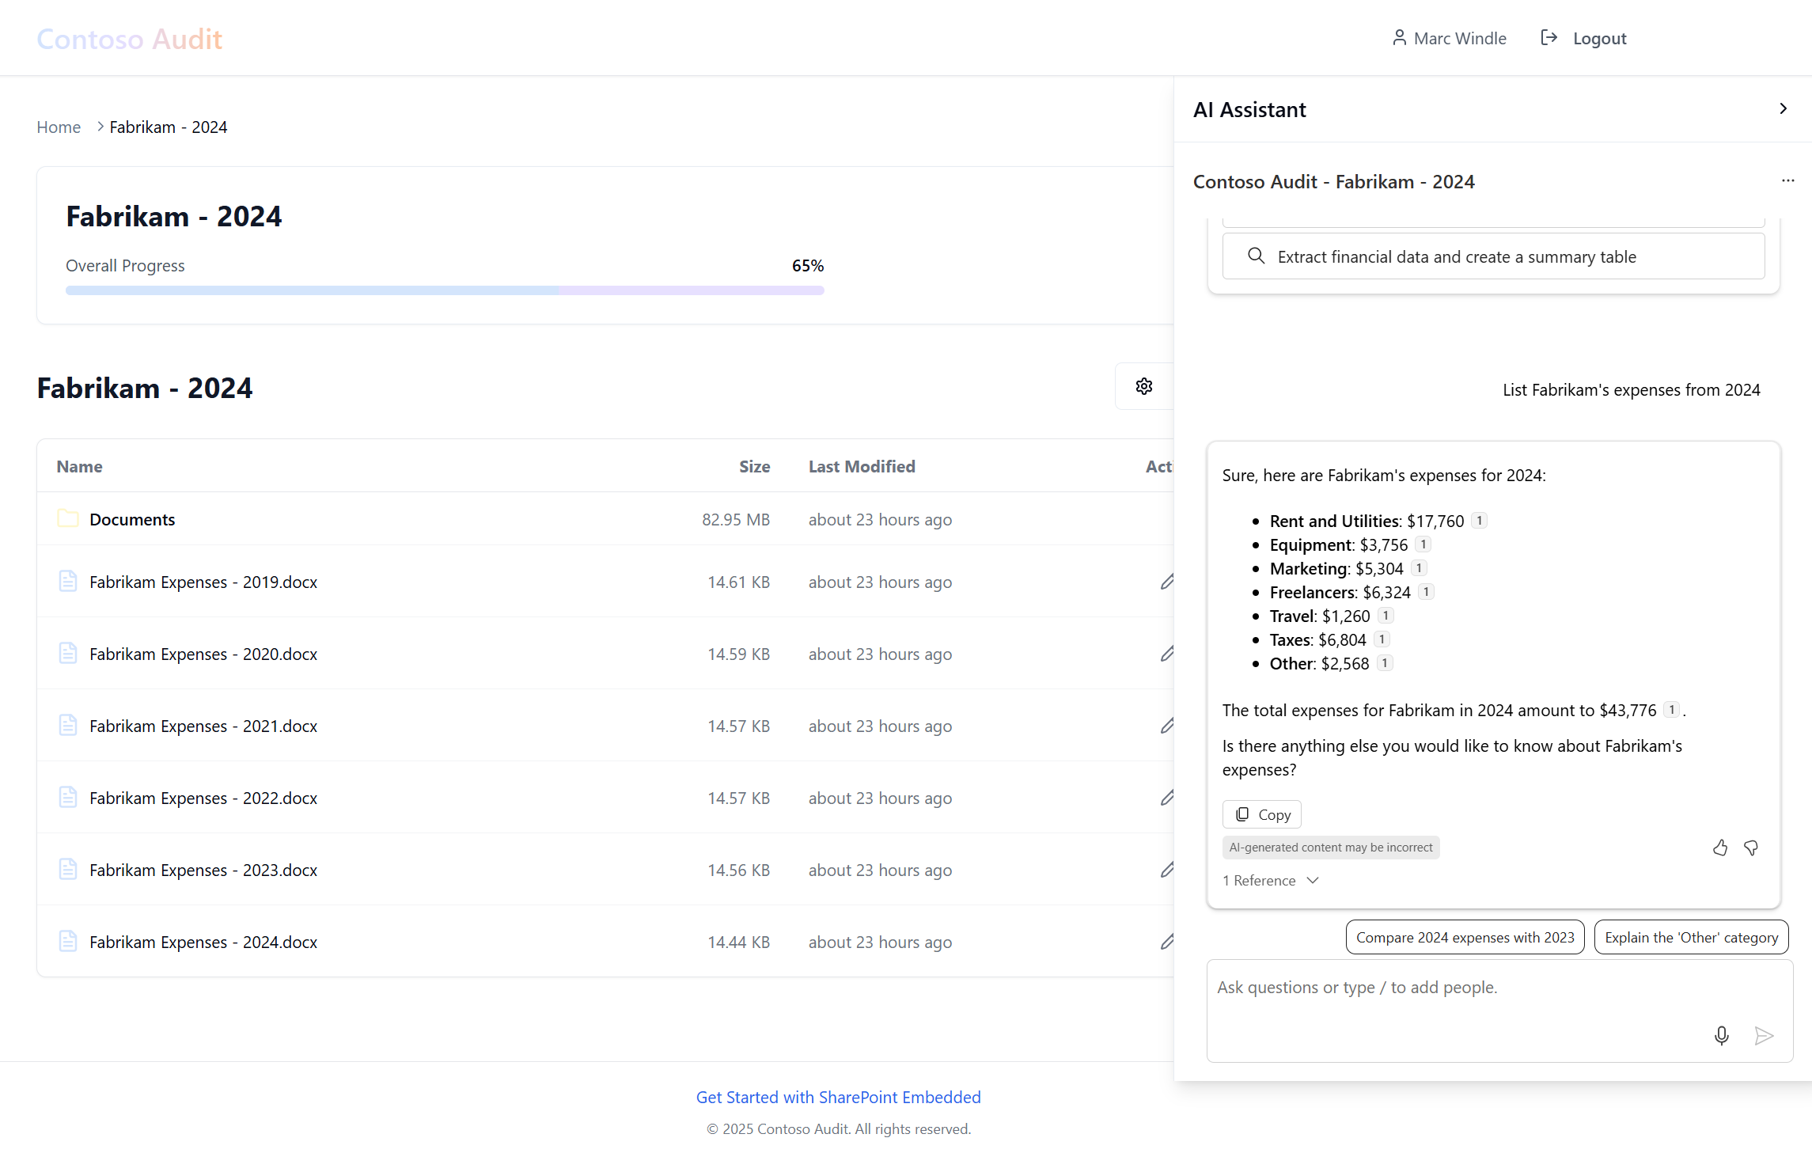
SharePoint Embedded Agent
Ready-made UI control you add to your web app
Microsoft 365 Copilot platform
Rich document understanding
Copilot orchestrated
Integrated security and compliance
Grounded on your app’s documents
Customize data sources, prompts, and UI
Consumption billed
Notes:
The SharePoint Embedded Agent is a drop-in, customizable UI control that can bring modern agent capabilities into the Contoso Audit web application. Auditors can use the agent within the app experience, leveraging the power of Copilot, with contextual grounding on the specific data relevant to an audit case in a secure and compliant way.
From the perspective of a developer – delivering this experience is easy. Add the ready-made SharePoint Embedded Agent UI control to your page, and you’re done. Not only is the user experience done for you, but the backend orchestration is automatically provided by the Copilot platform.
The SharePoint Embedded agent can be customized in a few ways:
Theme that controls it’s look and feel
Instruction that determines the agent’s personality, how it behaves, and the things it can do
Data sources that determine what knowledge it has access to
You can have as many of these agents as you want in your app experience – you can have a different agent experience for different users or pages.

Slide 29
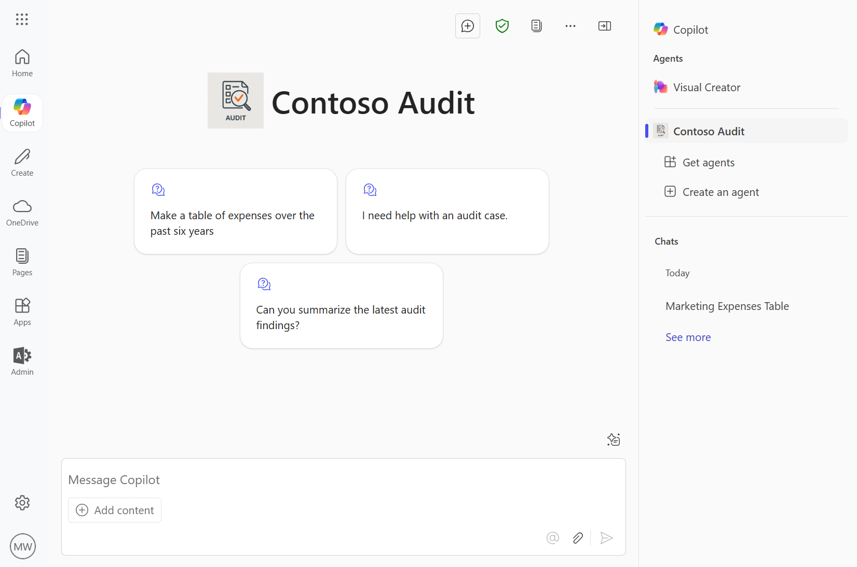
Agents in M365 Copilot and Teams
Reference your app’s knowledge in M365 agents
Customize prompts, data sources, and branding
Connect with your APIs to take actions in your app
Easily created with Teams Toolkit or Microsoft Copilot Studio
Notes:
Now, you might also want to be able to deliver an Agent experience for your app into Microsoft Teams and Copilot experiences. This brings us to the second type of agent, M365 agents.
Again, you can build M365 agents that reference your app’s SharePoint Embedded knowledge. For the Contoso Audit use case, we want to provide an agent experience that let’s auditors and other users chat with the data in their active audits to help simplify and speed up their tasks – and we want them to be able to do that where they are already working, in Microsoft Teams.

Slide 30
<Demos />
Building agents with SharePoint Embedded knowledge
Automatic Vectorization, chunking and semantic indexing
Rich document intelligence and understanding
High quality grounding data
Copilot Platform and orchestration
Notes:
Script
Show both apps working. Show collab
Show them how I made these (share how to do it), kick a new one off, show that for 30s then leave

Slide 31
<Demos />
Secure and Compliant Collaboration
Full Office Application Support
Real-time co-authoring
Secure file sharing
@mention and comments
Notes:
Script
Show login screen of Audit App and login
Open the AI assistant and discuss
Before we start using it, I want to show you just how easy it is to add the SharePoint Embedded Agent to your page:
Open VSCode and show the code that adds it
Show the code that customizes it:
Theme, title, etc
Instruction or ‘system prompt’
Conversatsion starters
Data sources --
Hit the “List and summarize recent documents” prompt and run it.
Hit the “Make a table of marketing…” prompt and run it.
Show inline citations
Show references
This content is automatically parsed, chunked, vectorized, and added to a security-trimmed semantic index. This control allows you to leverage Copilot orchestration for secure, responsible AI in your custom app.
Open the citation for the 2024 year – Copilot was able to extract the information from multiple documents to make the table I asked for.
I also want to point out that we are looking at this Office document with the collaboration experience that’s built into the SharePoint Embedded platform. Let’s look at collaboration in more detail:
Go back to web app, close the AI Assistant, and open the Documents folder.
“In here, we have some Office documents, a PDF, and a video”
The built-in preview client supports hundreds of file types. I can open a full-fidelity viewing experience of the PDF, and I can stream video”
Shift+click PowerPoint doc – show full fidelity web experience, show “Editing” vs readonly and Desktop. Show Share and manage access.
Shift+click Excel doc – again, we support Excel
Shift+click Word doc.
Show Copilot and say if your app users are licensed for Copilot, they automatically have their experience enhanced with Copilot capabilities in the Office clients.
Show how Yogesh is in there and we are co-authoring on the file together
Select some text, add a comment and at-mention Shyam. Do the share and notify
Before I show you the second type of agent you can build with SharePoint Embedded, I want to share how we built this Contoso Audit app and agent you’ve been looking at – we actually vibe-coded it.
If you haven’t been introduced to vibe-coding yet, it’s an AI system that lets you build working apps with words. There are a number of vibe coding apps out in the market today, GitHub Copilot, Vercel, Bolt, Loveable, and more. I’ve used Lovable to make the Contoso Audit app, but you can use whatever you like.
Go to prompt library – we have published some prompts used to build the Contoso Audit app, go ahead and remix them and try them out to build your own apps! These are available at aka.ms/spe-prompts
Let’s switch gears a bit and take a look at the second type of agent you can build on SharePoint Embedded – Declarative Agents that show up in Microsoft Teams and Copilot
Show Teams in Browser with the Contoso Audit agent up
Run the “Create a table of marketing …” prompt and discuss it’s results. The key thing here is that you can build the same agent behavior that grounds on your custom app’s data, and deliver that experience to your users in Copilot and right here in Teams. And with actions, you can actually extend your app’s functionality into Teams, providing users the ability to manage and take action on audit cases right from your agent.
These agents are very easy to build in Microsoft Copilot Studio or Teams Toolkit. Lets take a look under the hood at the definition of this agent.
Show Agent in vscode and discuss how it’s made and how it can reference SPE data

Slide 32
In the age of AI, every app should be intelligent
Apps
Data
GenAI models

Slide 34
Demo plans
Use Lovable to vibe-code a “Contoso Audit” web app that’s built on SharePoint Embedded
Add in the SharePoint Embedded Agent to enable intelligent chat to our Contoso Audit web app
Use Teams Toolkit to create a “Contoso Audit Agent” that can reason over audit cases in SharePoint Embedded from Microsoft Copilot and Teams.
Notes:
Script
Read this slide
Open Lovable and paste our starting prompt
Show what’s happening, show code being generated
Go to aka.ms/spe-vibe-code and show the prompts we are using
Go back to the slides and talk about the App we are making and the chat control
Go back to the demo (hopefully done!) and show the app working
Paste the spe-agent prompt and let it cook
Open VSCode Teams Toolkit and create a Declarative Agent
Add a section to reference a specific container
Provision the agent and visit M365 Copilot – play with it in there
Show the running web app and play with the new agent

Slide 35
Managing your application
Build agents:
Agent in your app
Agent in Teams and Copilot
What does it take to build AI applications
Manage your application from the admin center
Overview
Admin
Demo
Notes:
Microsoft 365 security & compliance policies automatically apply to SharePoint Embedded content
Let’s container contains document for a litigation.
Custodian will put a litigation hold on a container. Once it’s on you can create a review set, and export the relevant documents to support the case.

Slide 36
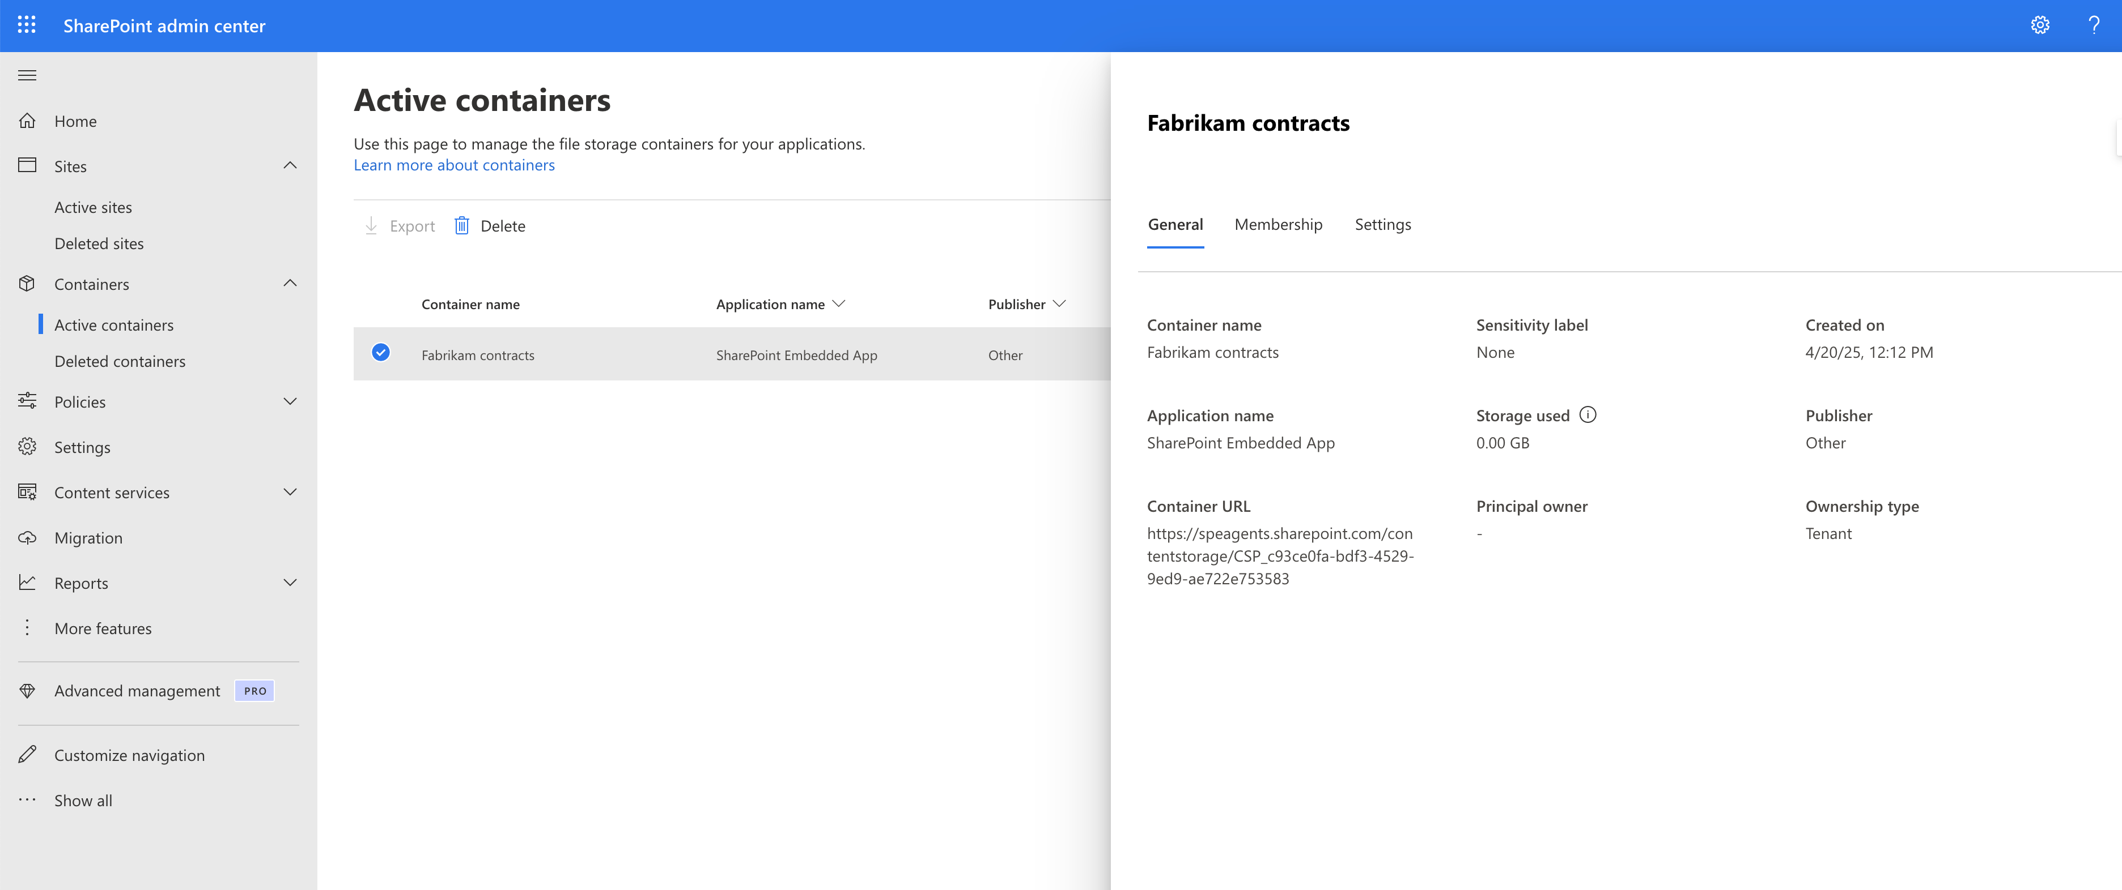
Manage containers from the admin center
Notes:
Set up the scenario for the admin of Contoso admin

Slide 37
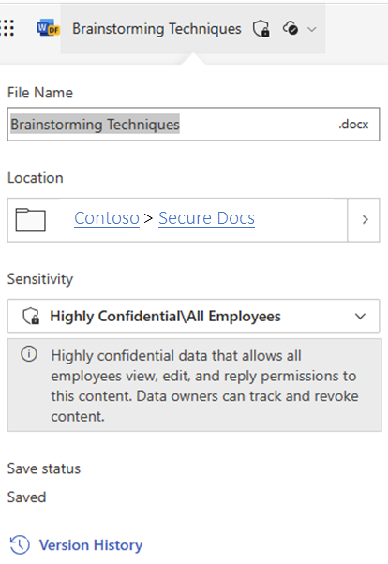
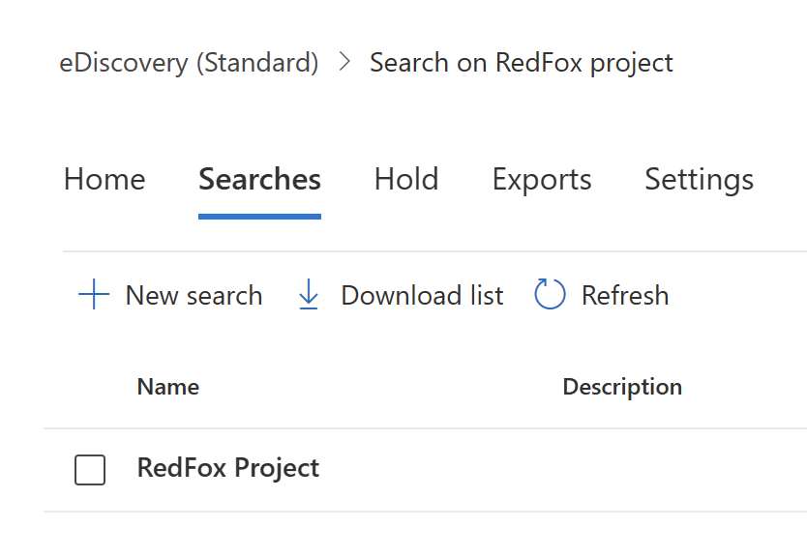
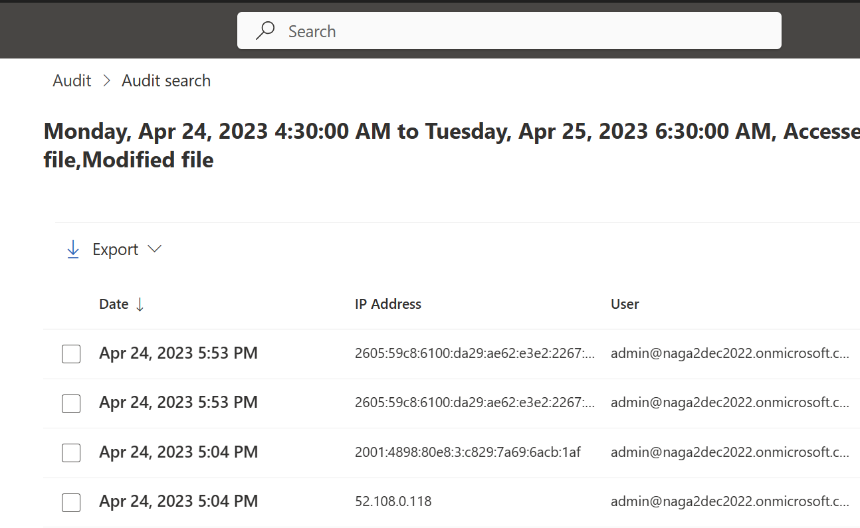
Microsoft Purview Integration
eDiscovery
Audit
Sensitivity Labels
Also supports DLP, BYOK, retention policy, multi-geo, conditional access and more.
Notes:
Microsoft 365 security & compliance policies automatically apply to SharePoint Embedded content
Let’s container contains document for a litigation.
Custodian will put a litigation hold on a container. Once it’s on you can create a review set, and export the relevant documents to support the case.

Slide 38
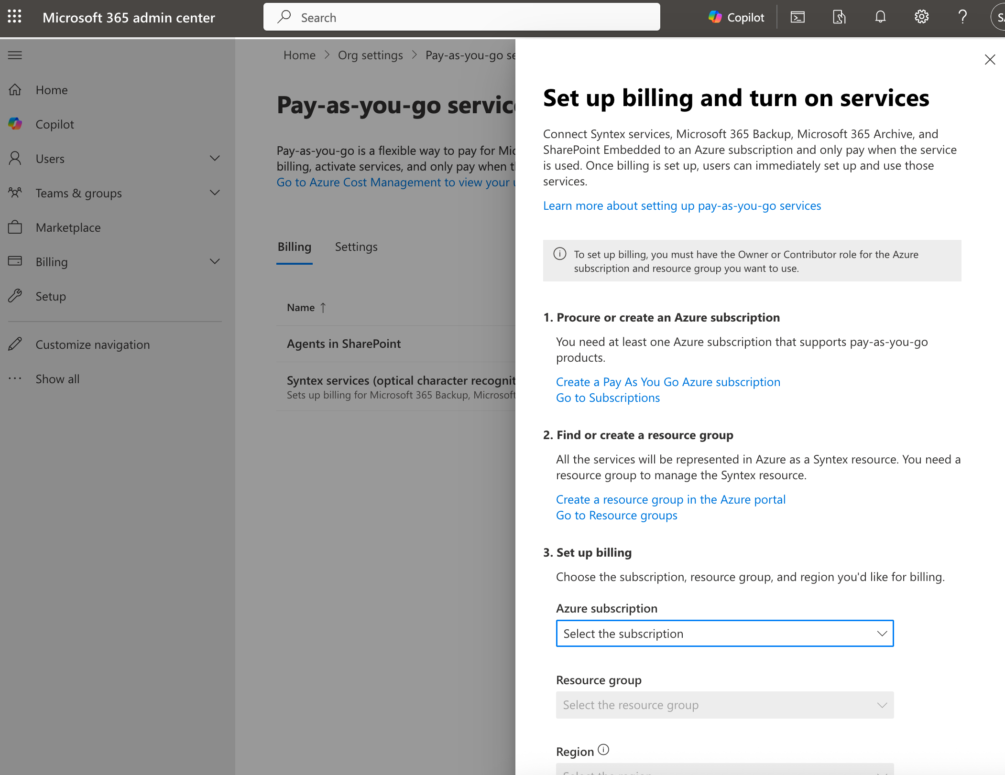
Enable billing from the Microsoft admin center
Pay based on your application’s consumption:
Storage
Graph API transactions
Express egress
Copilot interactions (coming soon)
Notes:
Remind it’s consumptive. Show the meters LoB and ISV
Standard (dev pays) or Passthru (customer pays)
Next slides x2 – Show them how to setup and manage for each
PowerShell and Azure Portal
MAC + Azure Portal

Slide 39
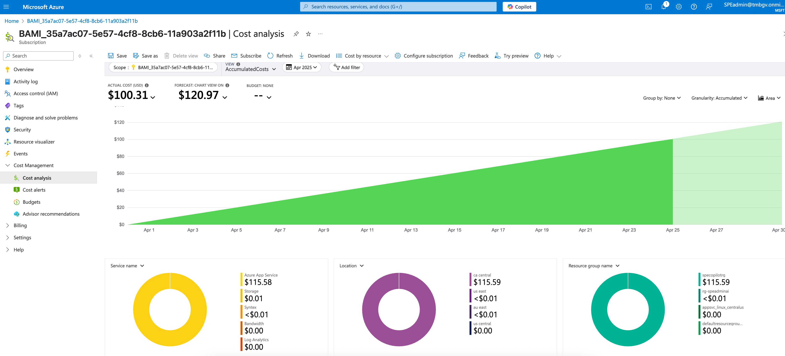
Manage billing
Notes:
Remind it’s consumptive. Show the meters LoB and ISV
Standard (dev pays) or Passthru (customer pays)
Next slides x2 – Show them how to setup and manage for each
PowerShell and Azure Portal
MAC + Azure Portal

Slide 40
Here’s what we covered today
What does it take to build AI applications
Build agents:
Agent in your app
Your Agent in Teams and Copilot
Manage your application from the admin center
Overview
Demo
Admin
Notes:
We covered a lot of ground so far. We build a case for document-centric AI applications and how SharePoint Embedded simplifies it. We saw you easy it is to ground Copilot within your application knowledge and user experience. And finally we reviewed the governance capabilities.

Slide 41
SPE is the fastest way to build AI apps
Copilot
Collaboration
SharePoint Embedded
M365 commitments
M365 capabilities
Compliance
Notes:
SPE enables an end to end AI solution for your custom applications along with office and collaboration features on top of a security and fundamentals of Microsoft 365 platform. I will say, It’s not a replace for your current technology. For you structured data, Azure SQL or Dataverse are the right choices. If you are storing large volumes of unstructured cold storage, blob is the right solution for you. But we recognized that the collaborative, unstructured content is underserved in the age of AI. And SPE closes that gap. We also recognize that many times, extending SharePoint will address most of your needs. But when you have a customer user experience, and you need a containerized document storage that only your application can manage, then SPE is a perfect match. And we are just getting started. We have an ambitious roadmap where we can enable more powerful agentic AI solutions, flexibility to extend knowledge beyond SharePoint Embedded and integrate natively within the Copilot Studio and Azure Studio. Stay tuned for these and many other features in the coming months.

Slide 42
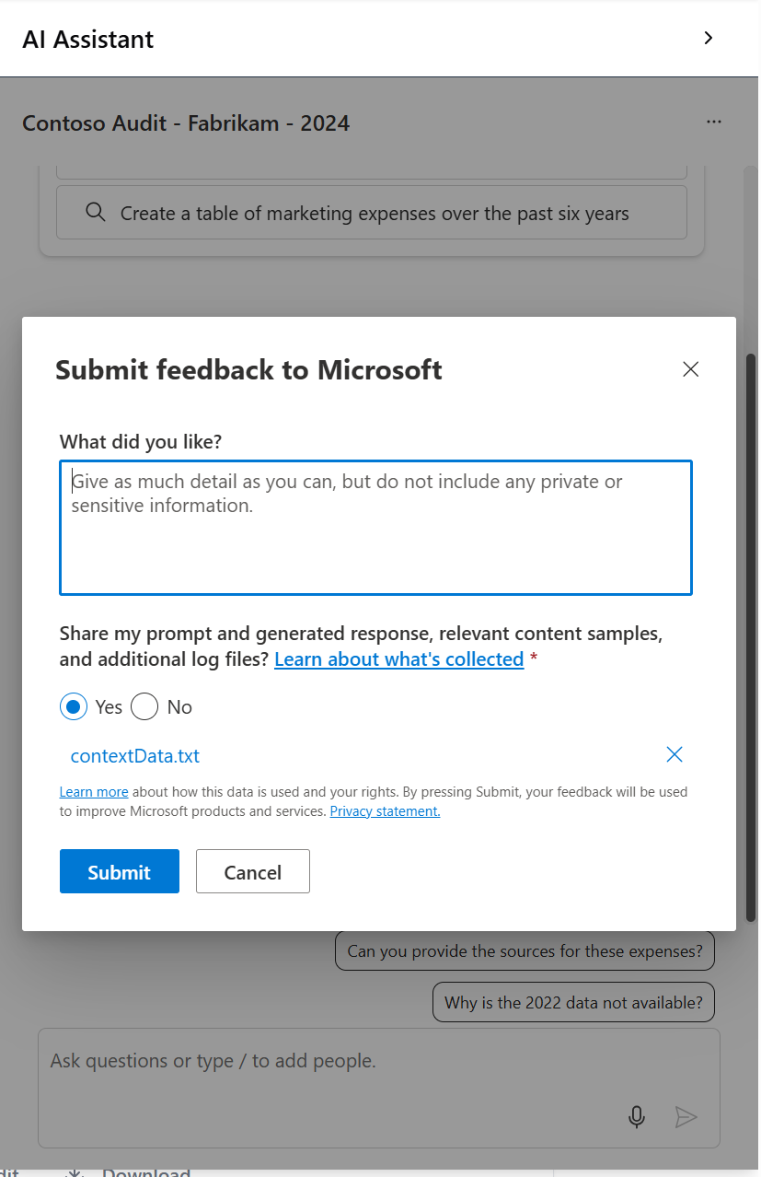
Build your apps & agents with SPE today
Get started at aka.ms/SPEagent
Build an agent in your SPE application
Vibe code with SharePoint Embedded: aka.ms/spe-prompts
Stay tuned at aka.ms/start-spe
Notes:
And we are just getting started. We have an ambitious roadmap where we can enable more powerful agentic AI solutions, flexibility to extend knowledge beyond SharePoint Embedded and integrate natively within the Copilot Studio and Azure Studio. Stay tuned for these and many other features in the coming months.

Slide 43
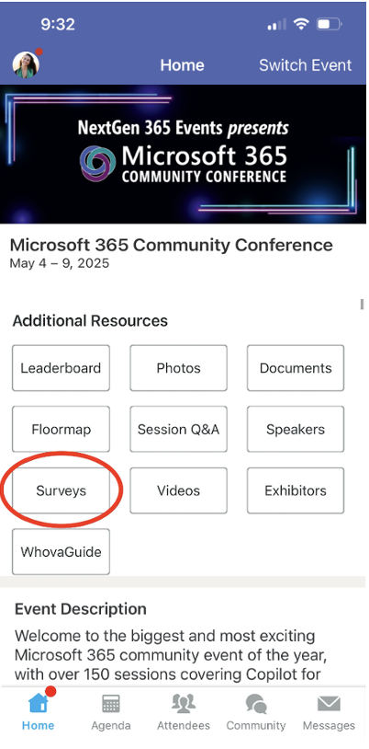
Session feedback surveys
We want to hear from YOU!
Share your feedback to make next years conference even better!
Here’s how –
Simply go to the Whova App on your smartphone.
Scroll down on the M365 Community Conference Homepage to ‘Additional Resources’ to click “Surveys’.
Click Session Feedback.
Scroll down to find this session title.
Complete the session feedback survey.
Finally, click ‘Submit’.
It’s just that easy!

Slide 44
When to use SPE
Collab + Compliance
Use SPE
Custom UX
Unstructured
Yes
Yes
Yes
SPE is a great fit when:
App-only access
Guess users
SaaS/ISV model
No
No
No
SPO
SQL, Dataverse
Blob
Notes:
I will say, It’s not a replace for your current technology. For you structured data, Azure SQL or Dataverse are the right choices. If you are storing large volumes of unstructured cold storage, blob is the right solution for you. But we recognized that the collaborative, unstructured content is highly underserved in the age of AI. And SPE closes that gap. We also recognize that many times, extending SharePoint will address most of your needs. But when you have a customer user experience, and you need a containerized document storage that only your application can manage, then SPE is a perfect match.

Slide 45
Pricing and Licensing
SharePoint Embedded uses pay-as-you-go (PAYG) billing through an Azure subscription. Billing is determined by how much data in GB you store in SharePoint Embedded, transactions used to modify and data that is egressed while using application built on SharePoint Embedded.
SharePoint Embedded pricing is as follows:
Service Meters | Meter Unit | Price
Storage | $/GB/Day | $0.00667
Graph API Transactions | $/1 API call | $0.00050
Express Egress | $/GB | $0.05
Copilot Studio meters | $/Copilot interaction | $0.12

