Slide 1
Enhance Your Virtual Desktop Infrastructure (VDI) User's Experience with New Optimization for Microsoft Teams
Fernando Klurfan, Principal Product Manager
James Parkes, Senior Product Manager
4/18

Slide 2


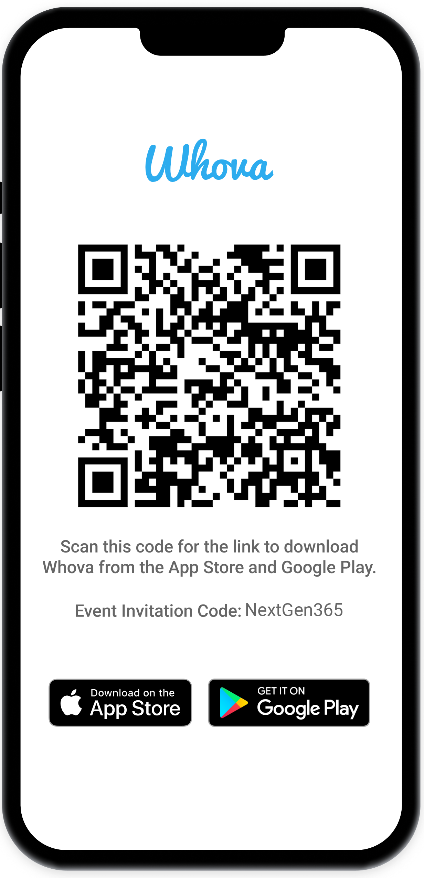
Join the event app to access:
The official event app for the
Microsoft 365 Community Conference
Event invitation code: NextGen2025
Event announcements
Personalized agenda, session details
Speaker & attendee profiles
Networking, meet-ups, messages
Event documents

Slide 3


Fernando Klurfan
Principal Product Manager VDI, Microsoft Teams
/@MsftFerK
James Parkes
Senior Product Manager Call Quality Management, Supportability, Microsoft Teams

Slide 4

What is the New Optimization for Teams (VDI 2.0)?
Definitions
A new media offloading architecture, based on the same media engine used in native Teams
(The media engine is called SlimCore)
It is the successor of the “VDI 1.0” architecture, that uses a WebRTC media engine bundled with VDI Clients (Citrix Workspace app, Omnissa Horizon Client, or AVD/W365 Remote Desktop Client)

Slide 5
What New Optimization of Teams (VDI 2.0) on virtual desktops brings to you
Improved audio and video quality
Direct support
Enhanced feature set
Streamlined updates
Empower users to work the way they want with familiar features from the Windows desktop app
Deliver a more satisfying user experience with faster improved calls and app reliability
Keep users up-to-date without impacting productivity through automated processes
Get support directly from Microsoft without needing to contact your VDI vendor
Notes:
Slide title: Support remote collaboration with an optimized Teams experience on virtual desktops
Our new Teams optimizations support remote collaboration by dramatically improving the virtual desktop user experience. These improvements come in four main areas:
Enhanced feature set: we’ve revamped the feature set for VDI users to provide you with familiar features from the desktop app in the VDI version of Teams.
Improved audio and video quality: we’ve also dramatically improved app quality and reliability to help you get the most from the app on VDI.
Streamlined updates: previously, updating Teams on VDI required starting by updating your VDI stack. We’ve dramatically simplified the process to make it easier than ever to stay up-to-date.
Direct support: we make it easy to troubleshoot Teams problems—you can come directly to us without having to engage your VDI vendor.
Now, let’s take a closer look at what these enhancements mean for you and your users.

Slide 6

Adoption

Slide 7
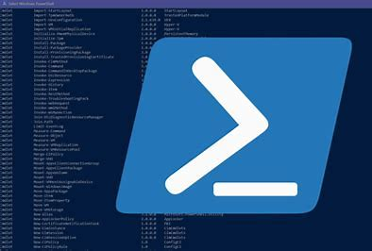

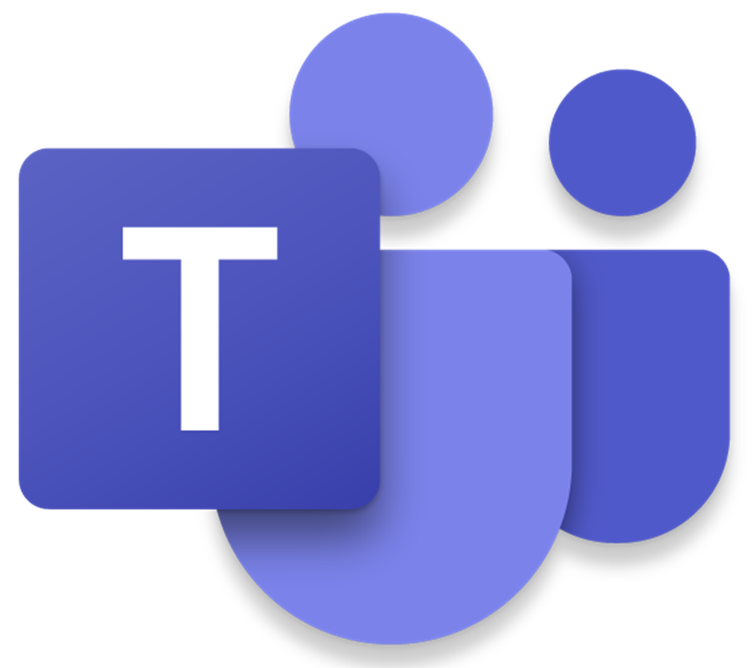



Reminder – new SlimCore Optimization architecture
VDI endpoint (fat/thin client)
VDI Server
MSIX C:\Program Files\WindowsApps
1
Teams App version X.Y.Z
VDI Client
4
X.Y.Z
Custom Virtual Channel
2
(HDX/RDP)
vdiBridge
MsTeamsplugin.dll
Exact version match between SlimCore on endpoint and Teams on VM is required to guarantee optimal performance and quality.
3
MsTeamsplugin.dll initiates the SlimCore MSIX download from CDN [https://res.cdn.office.net/*]
1
On New Teams launch in the VM, OR session reconnection with Teams already running, VdiBridge is activated
CDN
Slimcore (s)
2
MsTeamsPlugin is notified of the specific required SlimCore version
Slimcore (s)
SlimCore (s) MSIX X.Y.Z
3
and
4
If SlimCore already deployed, it is loaded immediately. If not, automatically downloaded and deployed from CDN
Notes:
ACRONYMS ========
PDS : Package delivery service. Web service used to distribute builds of Microsoft Teams to users.
MSIX : MSI extended. Application packaging format for Windows.
T1 : Teams 1.0 – Electron-based Teams desktop client.
T2.1 : Next generation Microsoft Teams desktop client, based on Webview2.
HKEY_CURRENT_USER\SOFTWARE\Microsoft\Teams\VDIOptimizationMode to 2 (REG_DWORD)
Registry Key : HKLM\SOFTWARE\Microsoft\Teams
Name : disableAutoUpdate
Type: DWORD
Value: 1

Slide 8

MSIX Tips for the Admin
Learn as much as you can about MSIX. What we knew as “installation” of MSI-based Win32 apps does not apply.
Staging (“unzipping the package C:\Program Files\WindowsApps”)
is the act of storing a copy of the packaged app to the local file system (Create pkgdir, extract content to pkgdir, create metadata dirs, apply ACLs). A packaged app must only be staged once, and can be performed without any user accounts existing on the device.
The staging of a packaged app can be performed on an offline image (.wim, .vhd, or .vhdx) or an online active OS.
> Get-AppxProvisionedPackage -online | where {$_.DisplayName -like '*Teams*’} (from an elevated PowerShell command)
Registration (“Wire up package for the user's profile”)
Registration occurs on a per-user basis and begins when a user logs on. The OS will then load the preinstalled packaged app package creating user specific app data, create FTAs, and app tiles in the start menu. This accomplished by the AppReadiness Service which is aware of all pre-installed apps and requests the Appx Deployment Service (AppxSvc) to deploy those packages.
> Get-AppxPackage -name MsTeams (from a PowerShell command under the user’s context, not as Admin. If output empty=Problem)
> Get-AppxPackage -name MsTeams –allusers (from an elevated PowerShell command, and compare with the previous command)
App packages and deployment (Windows Runtime apps) - Windows app development | Microsoft Learn
Preinstalling packaged apps - MSIX | Microsoft Learn
Notes:
Get-AppxProvisionedPackage Gets information about app packages (.appx) in an image that will be installed for each new user.
Get-AppxPackage Gets a list of the app packages that are installed in a user profile.
ProvisioningThe process of installing and registering packages (including files and registry keys) system-wide to eliminate the need for repeated installation by the other users. It can be done either as part of the OS or done during installation of an app.

Slide 9
UX

Slide 10
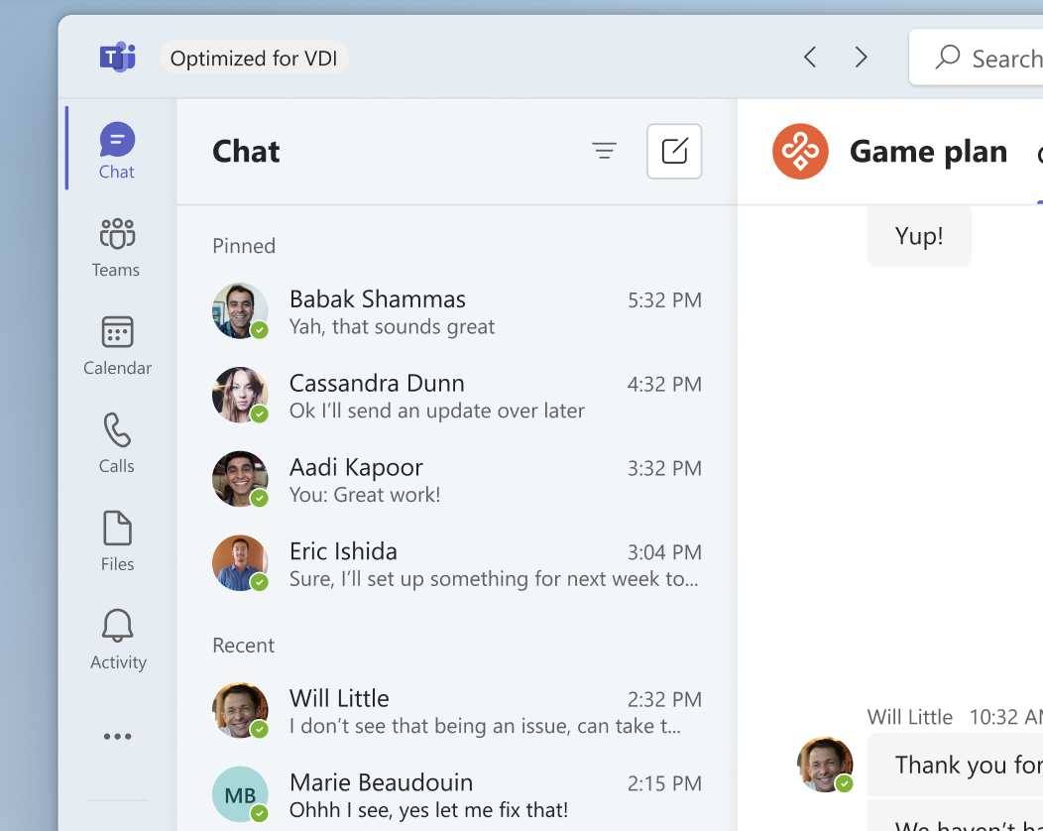
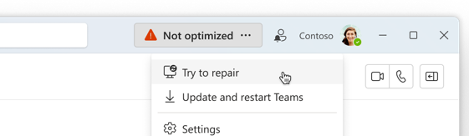
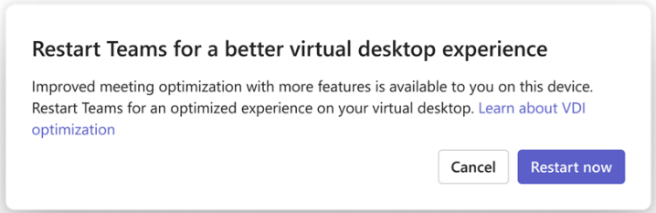
VDI Status Indicator

Slide 11
Supportability
Using Call Quality Dashboard, Teams Admin Center and other tools

Slide 12
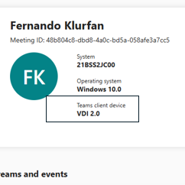
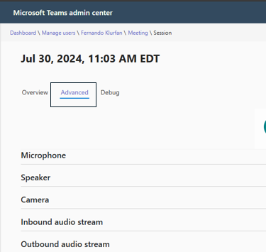
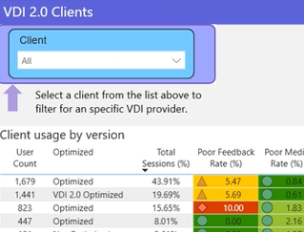
Microsoft Teams’ robust set of out-of-the-box tools makes it easy to support your VDI deployments
Real-time Analytics
Monitor your in-progress meetings
Call Analytics
Single User / Meeting troubleshooting
Call Quality Dashboard
Monitor and analyze across your tenant

Slide 13
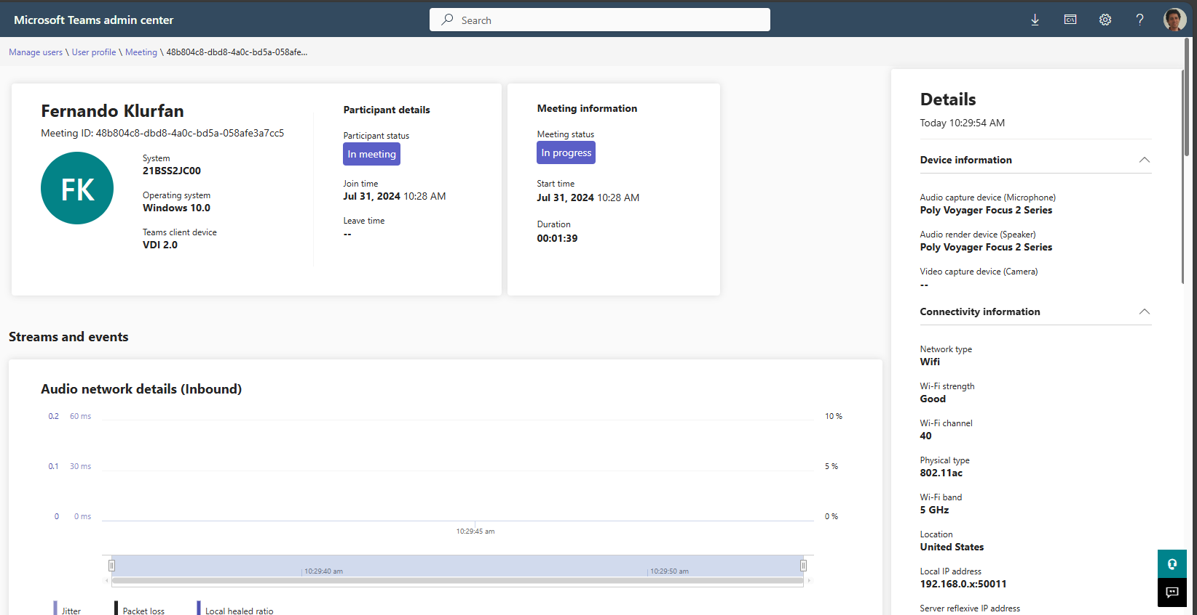
Teams Admin Center – Real Time Analytics
View quality for VDI clients in real-time:
Identify whether a device is using legacy or new VDI optimization
Capture and Render devices such as mics and headsets are properly identified in the new VDI optimization mode
Identify details about the VDI guest such as connection quality that were previously unavailable in Teams VDI

Slide 14
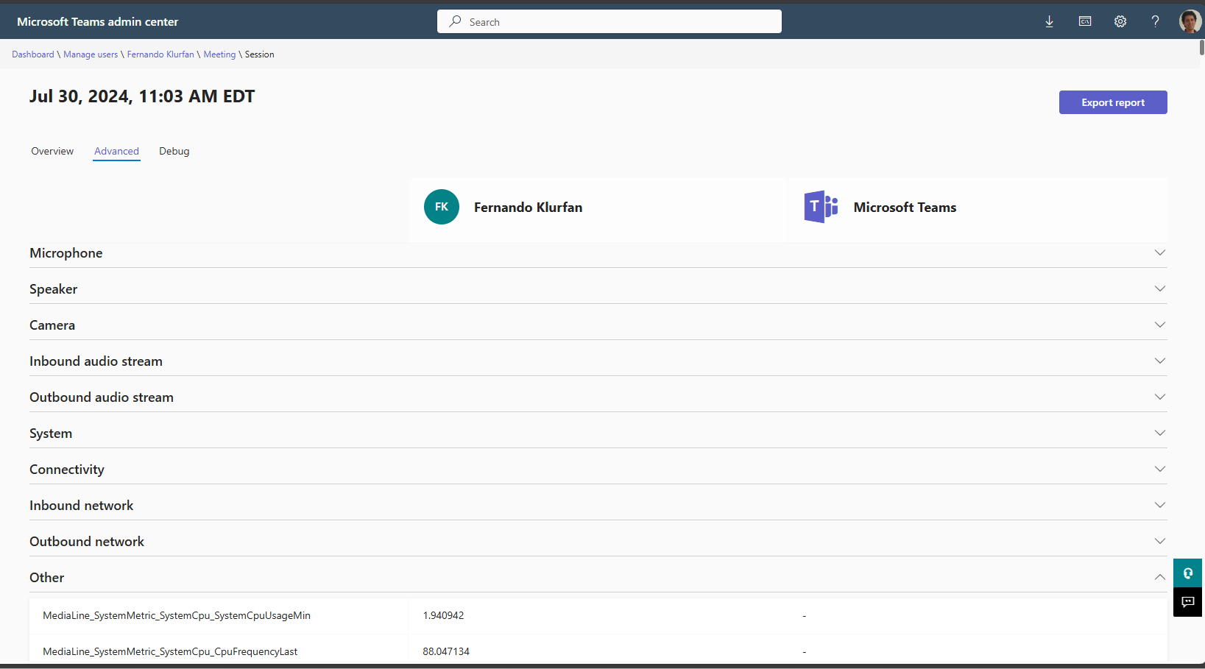
Teams Admin Center – Call Analytics (one user/meeting)
VDI diagnostic code is viewable in Call Analytics:
Four-digit VDImode value provides details into VDI type
First digit
1 or 2 = Citrix
3 = VMware
5 = Microsoft AVD/W365
Second digit
0 = Unoptimized
1 = Optimization possible with WebRTC
2 = Optimization possible with native stack
Note: The second digit does not specify if the optimized connected state is true, only if the capability was detected.

Slide 15
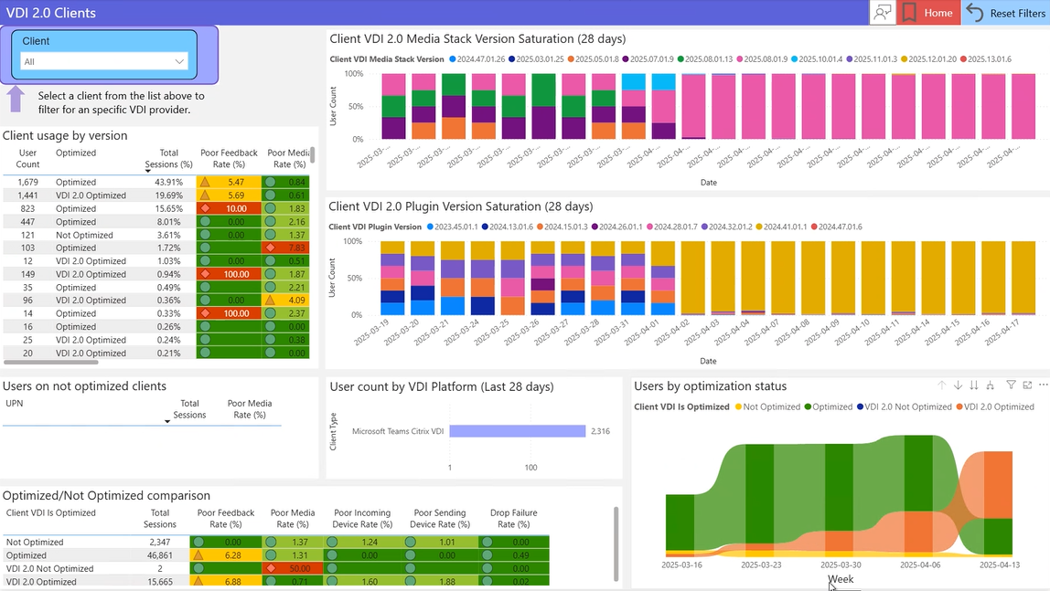
Call Quality Dashboard and QER Reports
CQD Reports built with Power BI for the new VDI media optimization in Teams
Track VDI adoption including:
Tracking version saturation for media stack and plugin
Population on using optimization at a glance
Quality and Optimization tracking
New optimization provides better support for new CQD intelligent media classifiers
VDI Is Optimized specifies if VDI optimization is possible but not occurring (Not Optimized), or possible and established (‘Optimized’)

Slide 16
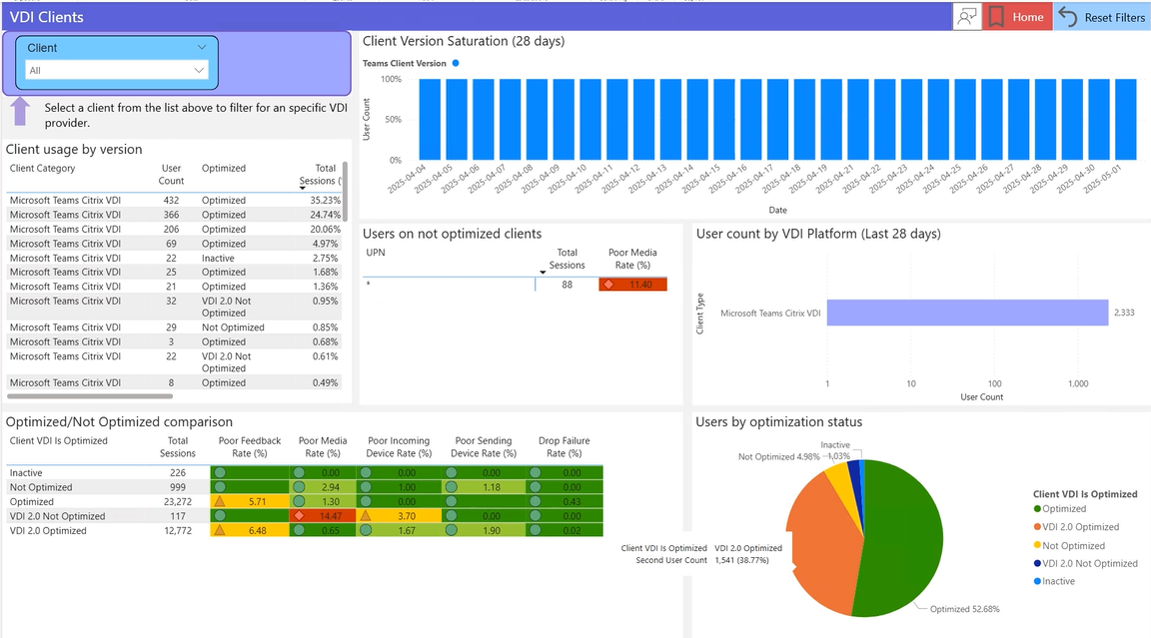
Call Quality Dashboard and QER Reports
CQD Reports built with Power BI for legacy VDI
Track VDI adoption including:
Tracking client version saturation
Population on not optimized at a glance
Quality and Optimization tracking

Slide 17
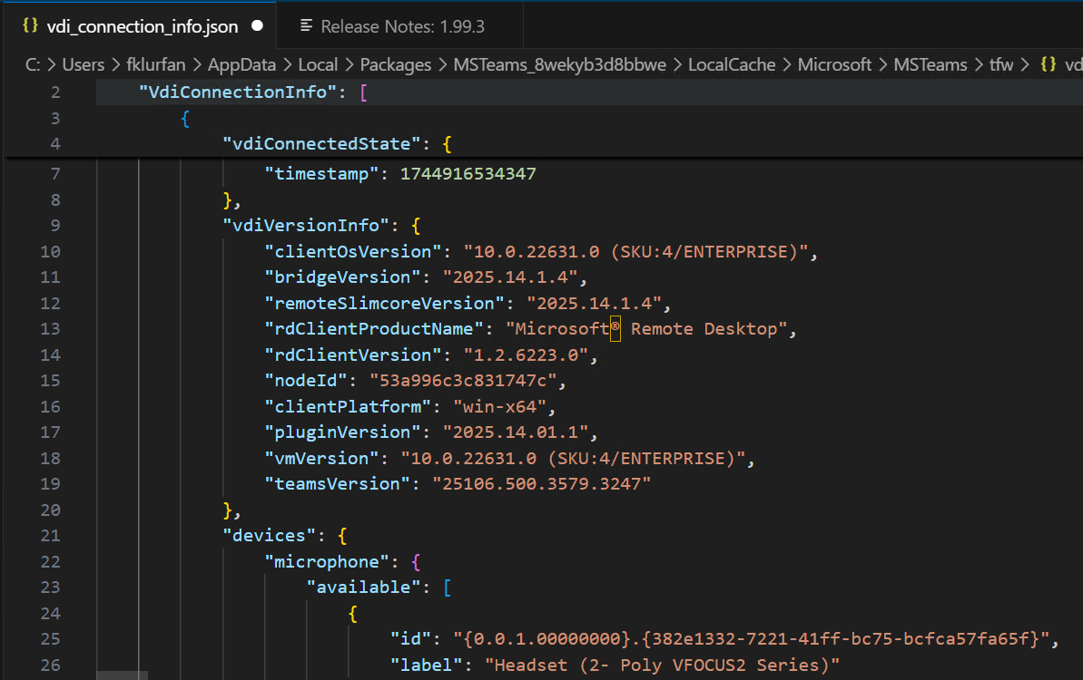
Monitoring API
Administrators can create custom scripts to query vdi_connection_info.json - this file in the virtual machine contains information about the current and last session, for example optimization status, peripherals and software versions of the different components. Location (in the VDA / RD Host): C:\Users<username>\AppData\Local\Packages\MSTeams_8wekyb3d8bbwe\LocalCache\Microsoft\MSTeams\tfw
Typical use cases for the monitoring API are:
Administrators deploying an automation script in VDA/RD Host to detect whether the client endpoint operating system has changed since the last connection, consuming the contents of the JSON file to compare the last two sessions' values, and issue their own alerts/pop-up messages.
Developers creating Third party apps that report the current state of the VDI optimization connection, consuming the contents of the JSON file to retrieve all available connection, optimization, and device information of the current Teams session.

Slide 18
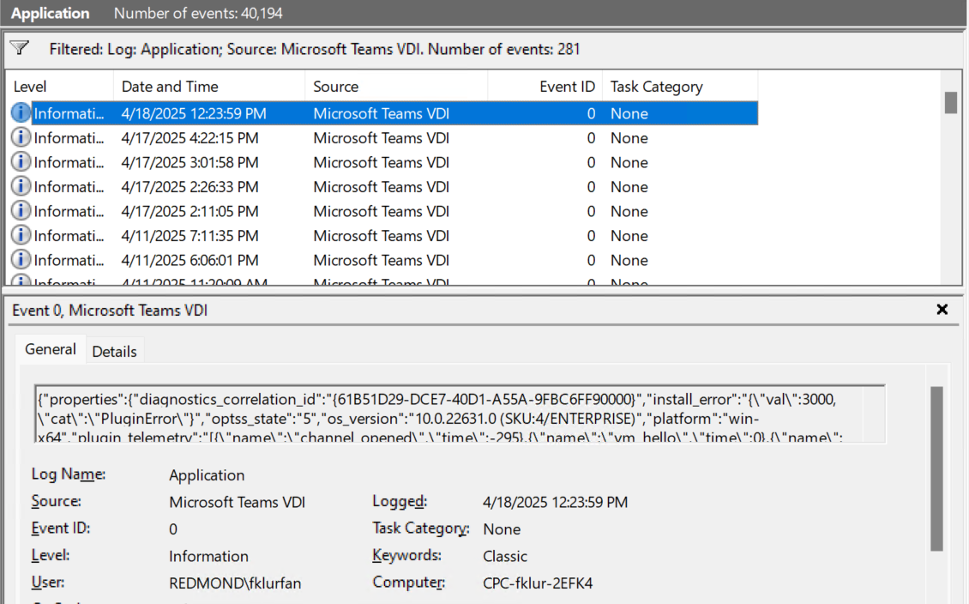
Event Viewer
Every connect/disconnect event gets logged in the Event Viewer running on the Virtual Machine. The Event Viewer can also display client-side related errors. Filter by Source (Microsoft Teams VDI) and Event ID (0). Error codes can be found in the New Teams logs for VDI section.

Slide 19
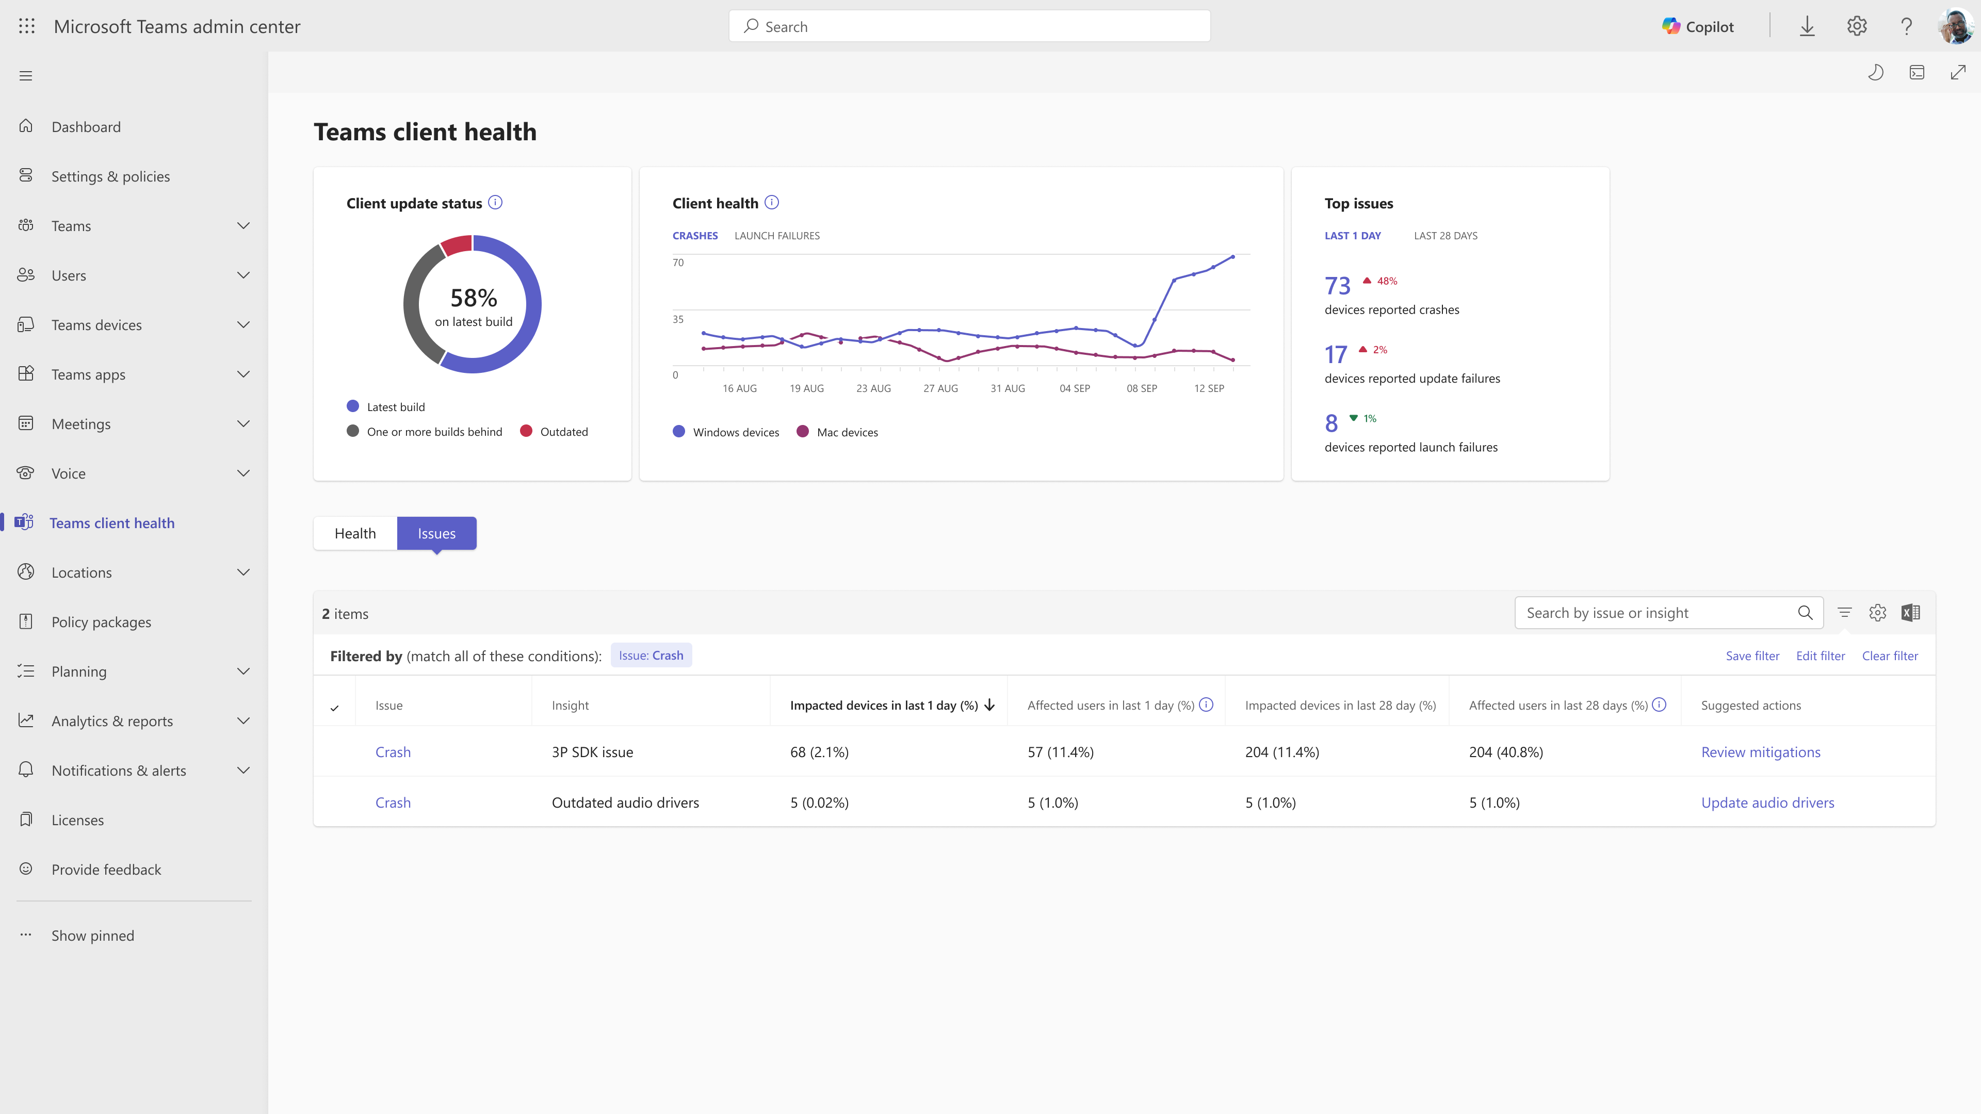

Teams client health in Teams admin center
Generally available Q2 CY25
Proactive monitoring of Teams client health (Client crashes , launch failures) across windows & Mac
Access to top Issues, actionable insights and mitigation for faster troubleshooting
Client update monitoring and granular version to proactively identify and avoid update issues

Slide 20
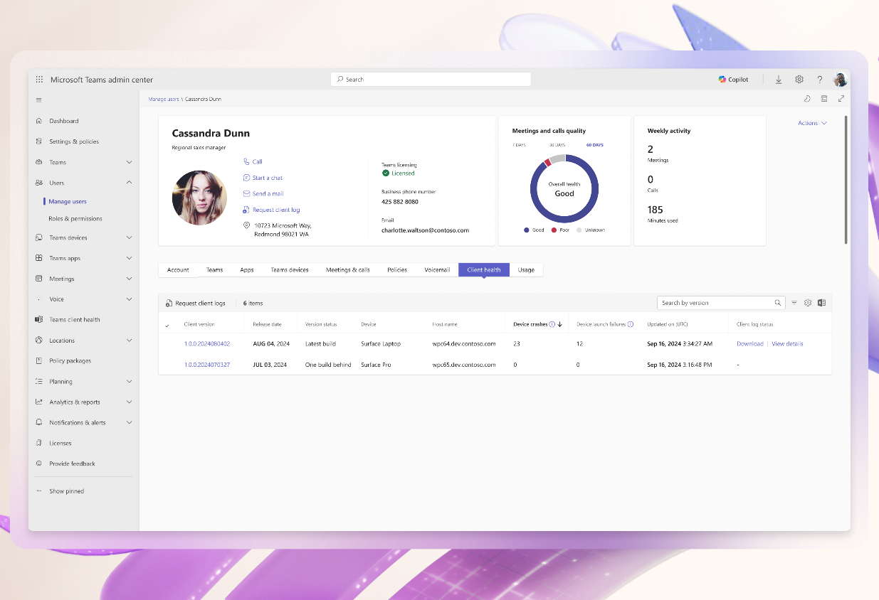
Remote log collection in Teams admin center​
Generally available Q2 CY25
Streamlining tedious workflow of log collection by enabling Admin triggered remote log collection
No end user interruption required
Admins can download, view and manage log files

Slide 21
Migration to new VDI optimization
Suggested Journey

Slide 22
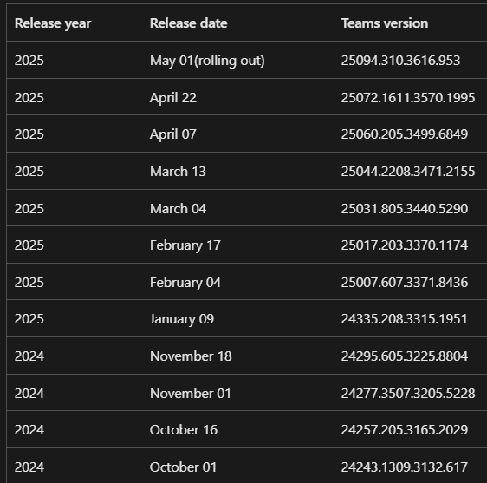
Keeping new Teams up to date
As announced in Message Center post 931401, Teams will follow a 90-day support cycle
Build | GA | 60d Warning | 90d EOS | Life
24231 | Sep-19 | Dec-1 | Jan-1 | 102d
24243 | Oct-1 | Dec-16 | Jan-16 | 105d
24257 | Oct-16 | Jan-1 | Feb-1 | 105d
24277 | Nov-1 | Jan-18 | Feb-18 | 107d
24295 | Nov-18 | Mar-9 | Apr-9 | 222d
24335 | Jan-9 | Apr-4 | May-4 | 114d
25007 | Feb-4 | Apr-17 | May-17 | 101d
25017 | Feb-17 | May-4 | Jun-4 | 111d
25031 | Mar-4 | May-17 | Jun-17 | 103d
25044 | Mar-13 | Jun-7 | Jul-7 | 116d
25060 | Apr-7 | Jun-22 | Jul-22 | 106d
25072 | Apr-23
Version update history for Teams app deployments - Office release notes | Microsoft Learn

Slide 23
Start the migration to the new optimization
Gain agility with new Teams deployment cadence. This keeps SlimCore up to date as well
Talk to your endpoint management team about Plugin deployments. SCCM/Intune/BYOD
Start ring rollouts (IT, Friends&Family, BU, etc). Either control via Teams Admin Center policy, or via plugin deployment

Slide 24
Additional Features with the new optimization
Team Premium
Protected Meetings
E2EE
Sensitivity Labels
Who can record
Personalized meetings
Meeting Templates
Branded meetings
Org Defined backgrounds
Custom Together mode scenes
Custom user policy packages
Intelligent meetings
Live translation
Meeting Recap
7x7 and 3x3 Gallery View
Zoom in / Zoom out
1080p video
HW Acceleration
Camera and light adjustment
Shared System Audio
Noise Suppression
Screen Capture Protection / App Protection
QoS support
Media Bypass/Location Based Routing
Simplified media engine updates
HID
Custom Backgrounds
Cross Cloud, Multi-tenant & Multi Account
New features come on day 1 with Teams on Windows desktop
*Few new features that require specific VDI work or are demanding on VDI compute (Video Avatars) might not make day 1.

Slide 25
Roadmap
AVD/W365 with Windows endpoints GA in Sept 2024
Citrix with Windows endpoints GA in Dec 2024
Mac AVD/W365 and Citrix will start private preview in May

Slide 26
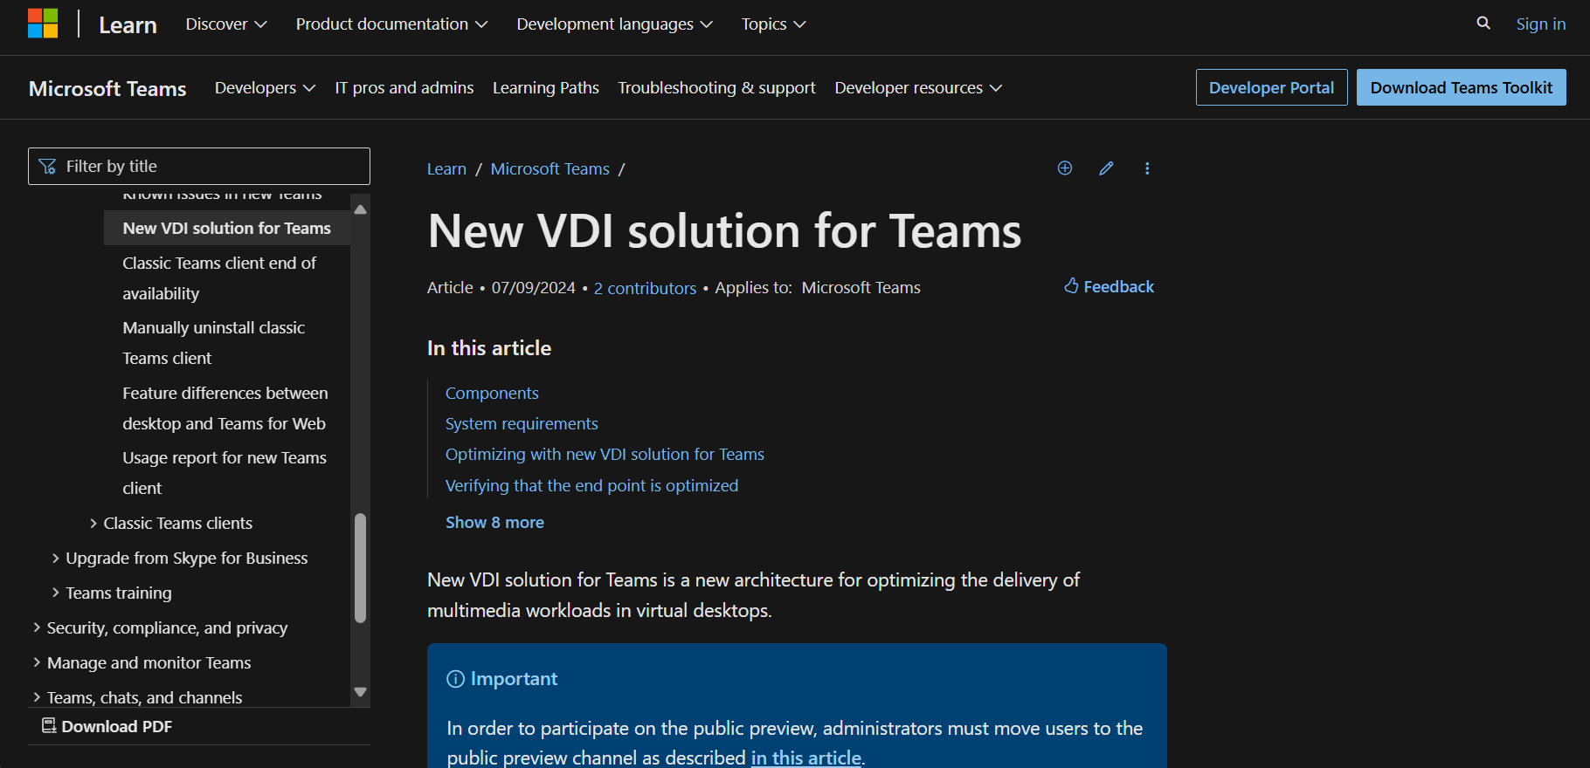
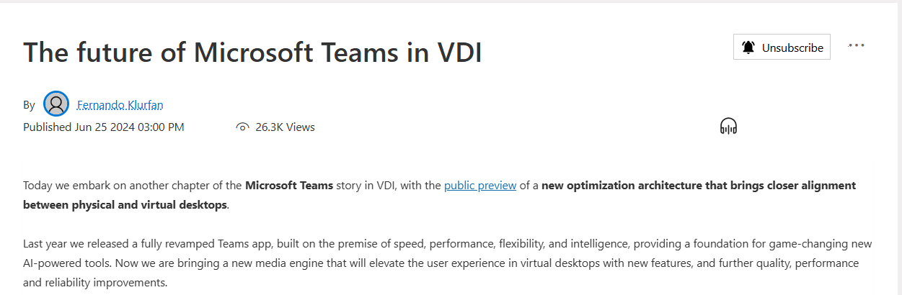
Resources:
New VDI solution for Teams - Microsoft Teams | Microsoft Learn
Blog (microsoft.com)

Slide 27
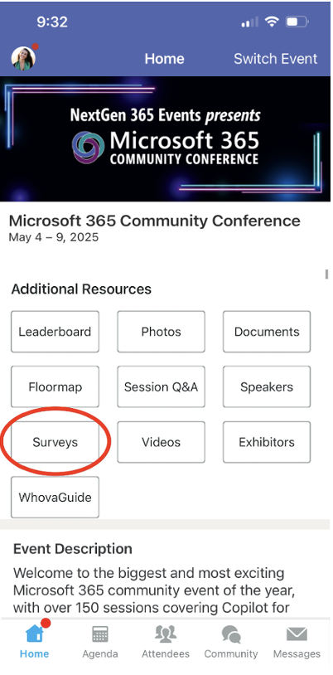
Session feedback surveys
We want to hear from YOU!
Share your feedback to make next years conference even better!
Here’s how –
Simply go to the Whova App on your smartphone.
Scroll down on the M365 Community Conference Homepage to ‘Additional Resources’ to click “Surveys’.
Click Session Feedback.
Scroll down to find this session title.
Complete the session feedback survey.
Finally, click ‘Submit’.
It’s just that easy!

Slide 28
Expertise and tools for your journey
Technical expertise via our FastTrack partners
Tools, resources & training on our Adoption Hub
Events and real-world knowledge in our community
aka.ms/Microsoft/FastTrack
adoption.microsoft.com
aka.ms/TechCommunity
Notes:
Please leave this slide in for conference attendees.

Slide 29
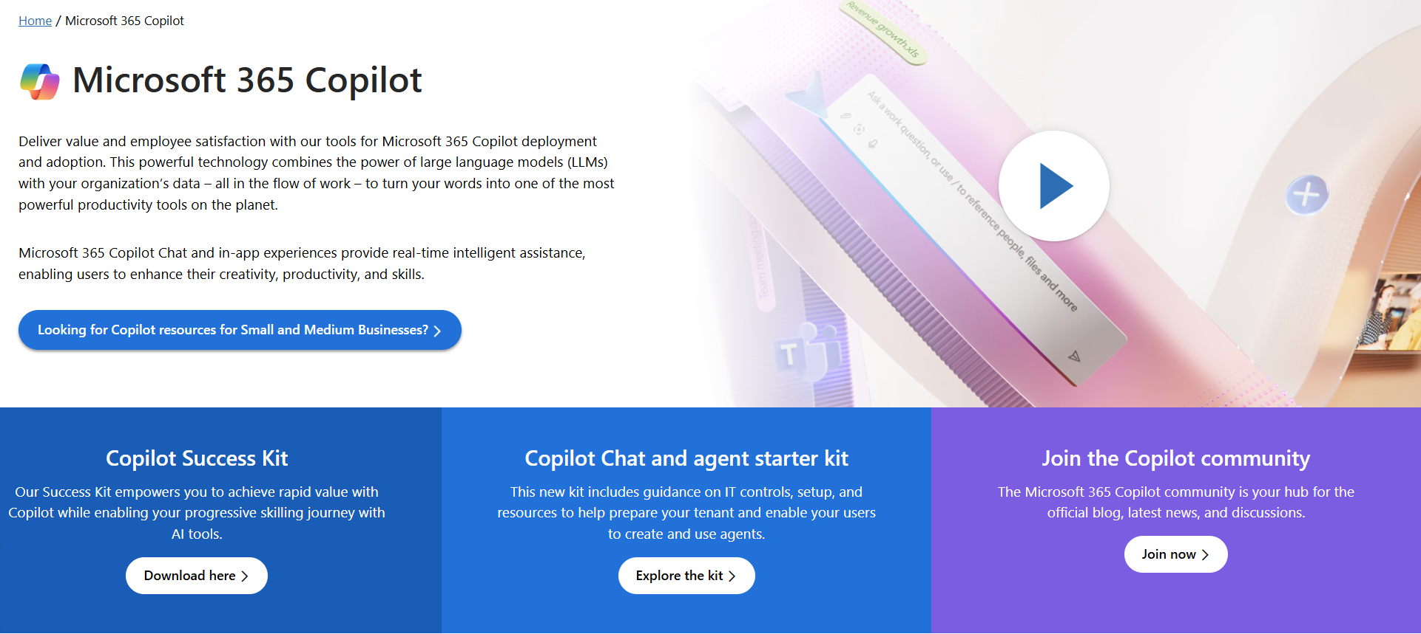
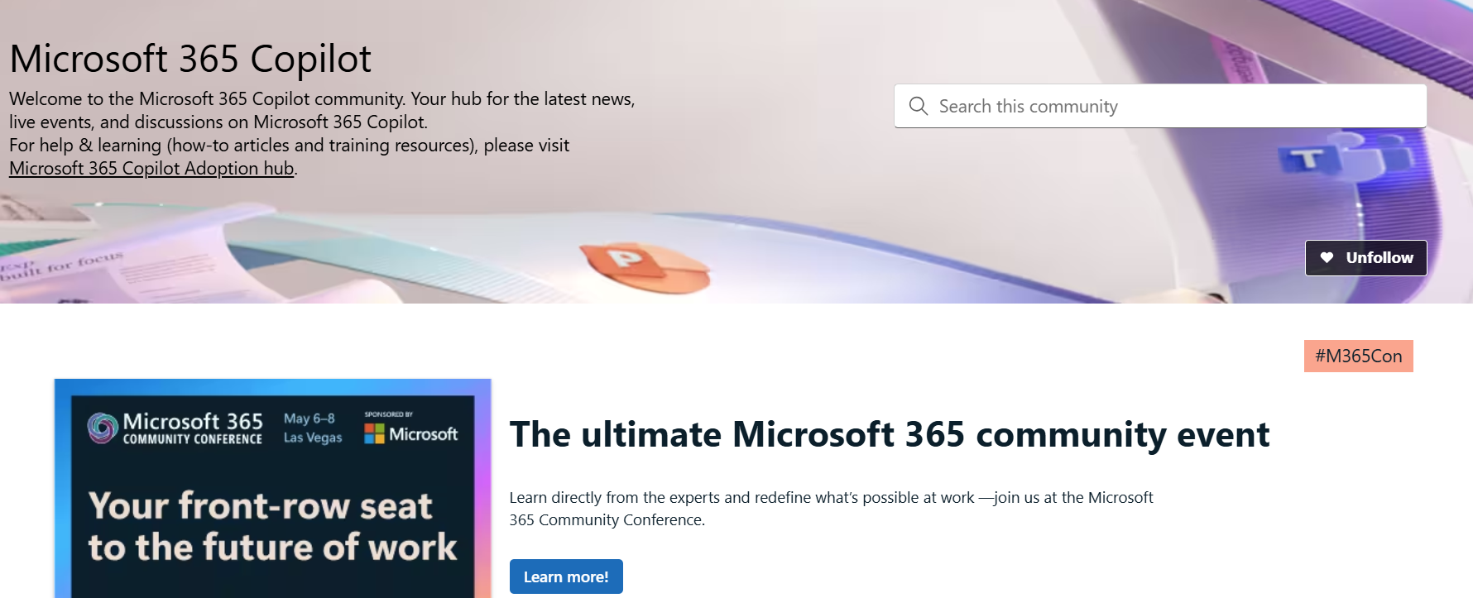
News & community content
Microsoft Community Learning aka.ms/Community/LearningChannel
Community led expert content on all your favorite Microsoft services.
Start your week with live news and event updates aka.ms/MondaysatMicrosoft
Watch live or on-demand & share our blog.
Notes:
To help you with adoption, the Copilot Readiness Hub is an open one stop shop for content, organized by role for your Copilot for Microsoft 365 journey.
You can use its recommendations to prepare and plan for your deployment, create a user experience strategy as I’ve presented today, and an adoption plan.
And as Copilot continues to evolve, keep coming back for new content that is published regularly.
You can also join the Copilot for Microsoft 365 community to get your questions answered and meet others who are leveraging Copilot for Microsoft 365 right now.

Slide 30
We have an exciting future ahead in VDI.
Notes:
Thank you.
<Speaker Guidance: Spend the last few minutes discussing or answering any questions they may have. If they have additional topics on their EBC agenda, make sure you connect with their account team to inform them which AI priorities and business outcomes resonated the most during this session. If you are in a 1:1 direct customer engagement, make sure you note what their priorities and questions were and work with the broader account teams and units to facilitate the proper hand-offs or next steps (i.e. get them into a session at the Innovation Hub/MTCs).>

