Slide 1
SOC Optimization to Get the Right Data and Right Alerts into Microsoft Sentinel and XDR
Andrea Fisher and Jon Shectman

Slide 2
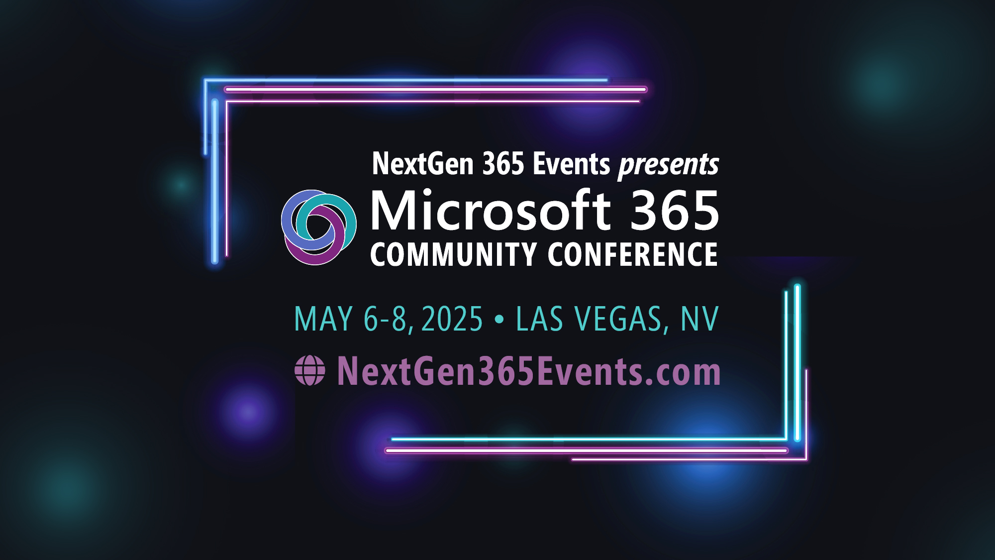
Microsoft 365 Community Conference

Slide 3



Join the event app to access:
The official event app for the
Microsoft 365 Community Conference
Event invitation code: NextGen2025
Event announcements
Personalized agenda, session details
Speaker & attendee profiles
Networking, meet-ups, messages
Event documents

Slide 4
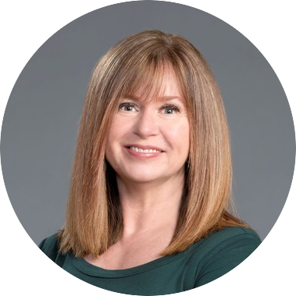

Andrea Fisher
Security Specialist
/fisherandrea
Jon Shectman
Principal Program Manager
/jonsh
Notes:
AF

Slide 5
What is SOC Optimization
A Security Information and Event Management (SIEM) is one of the greatest tools a security team has to help detect and analyze security threats. And one of the biggest costs.
But to be effective, it needs constant care and feeding. Optimizing your SIEM is the key to getting true value out of the large chunk it takes out of your security budget.
And optimization helps the incident responders be more effective.
Notes:
AF

Slide 6
Why optimize your SIEM?
    Improve threat detection
    Respond to incidents more quickly
    Better manage your resources
    Improve compliance and reporting
    Increase scalability and flexibility
Notes:
AF

Slide 7
How to optimize your SIEM?
    Confirm you are collecting the data you need to be effective
    Alert on the right activities
    Reduce noise and false positives
    Respond to the most important alerts
    Maximize the value of your data
    Stay abreast of the latest attack vectors
    Improve your protections
    Manage your costs
    Prevent burn out
Notes:
AF

Slide 8
Noise is the enemy of speed
Notes:
Jon

Slide 9
Alert Volume versus Alert Quality
Ideally, the SOC is in the top right area of this chart with a low volume of high quality (true positive) alerts
Alerts | Low Quality | High Quality
Low Volume | SOC may not have enough rules configured SOC may be missing alerts | Many rules have been configured and tuned Most rules detected are true positives
High Volume | Many alerts Many false positives SOC may not be able to keep up | Many rules have been configured Most rules detected are true positive Security may need to be improved at the source
Notes:
Jon
Tuning analytics rules results in higher quality alerts – fewer alerts and more true positives
1 The ideal position for a SOC is top right quadrant – the most frustrating position for SOC members is bottom left quadrant.
2 The top left quadrant risks falling to the trap of “no alerts, we must be good”
3 Bottom left is a problem of noise – there’s just too much for a human being’s brain to process – gems are lost in the paperclips
4 Finally, the bottom right quadrant indicates that security controls are lacking in the organization, resulting in a higher number of true positives where real security incidents are occurring
What we’re after here is a combination of two things
- High Quality rules and coverage – resulting in actionable alerts
- Low noise to fidelity ratio – not a lot of false positives

Slide 10
False Positives
Operational items
Policy concerns
Nonactionable information
Admins doing their job
Employees doing things
they should not be
TOR browser
Personal VPN
Port scans on internet facing IPs
Notes:
Jon
So where do the false positives come from? We’re really talking about the bottom of the last slide (both ‘High Volume’) quadrants
Click 1 – these may be Operational items like…
Click 2 – Policy concerns that aren’t really new or actionable but are issues for management
Click 3 – Nonactionable information – Am I concerned that there are port scans on internal IPs? Maybe? Maybe not – but not a very actionable alert.
These are all things that every SOC Manager has dealt with – we’ve seen them repeatedly in real life

Slide 11
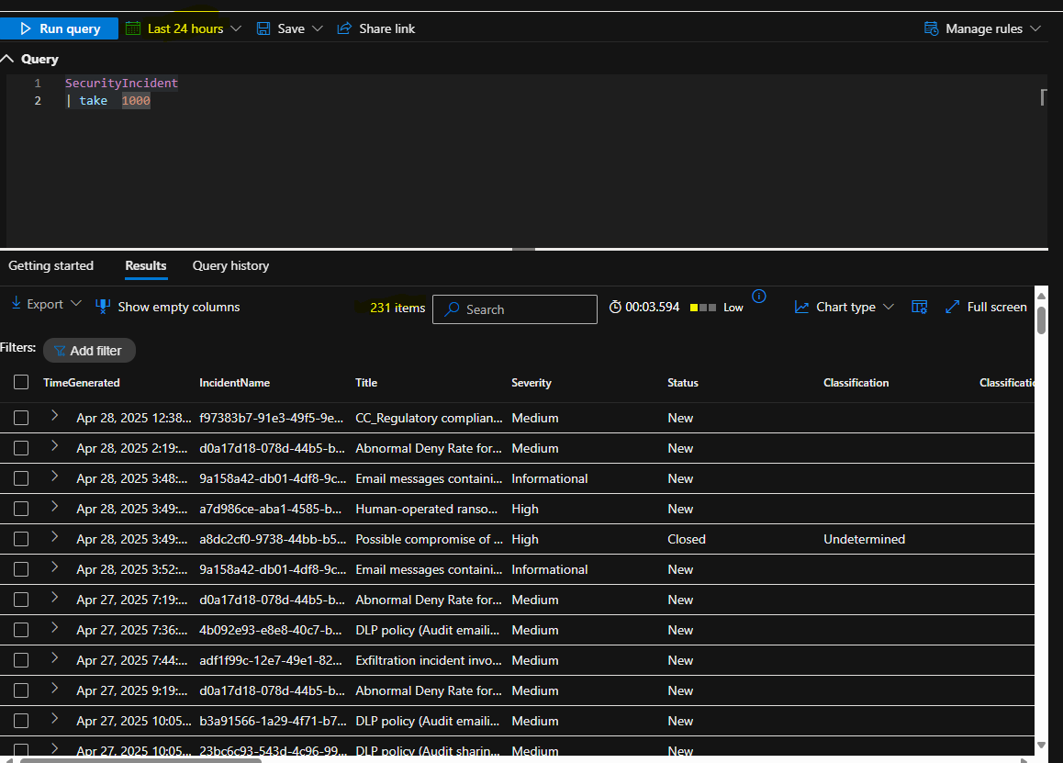
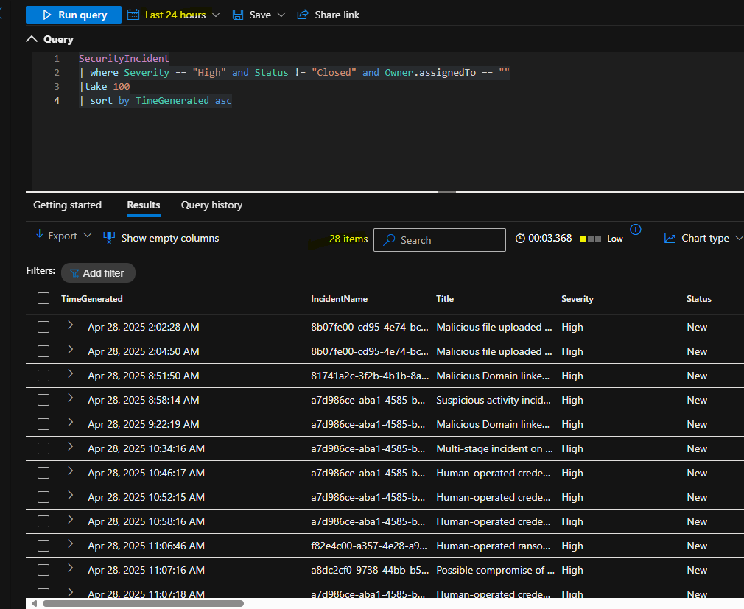
Alert Tuning
Tune alerts at the source first
Informational (and maybe Low) Alerts
Adjust analytic rules
Modify alert thresholds
Use Watchlists
XDR
Email
AV
Firewall
  Do I want them?
  Maybe?
  Setting the incident to close automatically through Automation Rules
Modify the alert KQL query manually
Modify the alert grouping to reduce volume
Disable grouping if alerts need to be remediated separately
Change alert threshold
Change frequency or look back
Modify the alert KQL query with a list
Rules should not apply to a specific subnet or user group
Notes:
Jon
First, a guiding principle – only alerts you need to see are the ones you’re going to take action on. This could mean that you don’t send the alerts to the SIEM at all or that you use automation to close them. You might ask “why would I want to auto close alerts?”. The answer would be that all telemetry is good. We love telemetry data which feeds the machine learning algorithms that most SIEMs have. Those informational and low alerts can help the machine learning identify patterns and correlate low-fidelity alerts and events across multiple products into high-fidelity and actionable incidents. They’re also useful as an historical record, or in later incident response.
So let’s delve into it more deeply:
Click 1 – Always, always tune your alert sources first. If a server is constantly pinging with alerts – work with IT (yes, you’ll have to talk with them) to fix the alerts. If they’re from Email or AV or Firewall, fix these alert sources – unless they are actionable, in which case, leave them alone.
Click 2 – Let’s turn to the SIEM – here come some Informational and Low Alerts – maybe these are the candidates for closing automatically with automation rules. If they’re not useful, fix them; if they are useful but not actionable, close them automatically
Click 3 – Here we get into adjusting analytic rules by modifying KQL queries or alert grouping. Some of this is really simple but you’d be surprised at how often this is missed. We call this “Groundhog Day” where SOC Analysts keep repeating the same actions over and over because no one asks “why.”
Click 4 – let’s look at a really simple example. Did you know there’s an Incident and also an Alert table in Sentinel? Maybe you have notification to analysts at the start of a shift. Maybe you’re sending them everything that happened in the last 24 hours as shown here. 231 items, ok? This is a pretty active SOC getting 10 Incidents or so an hour.
What if we modified that logic to return, at least starting out – only incidents from, the last 24 hours where the Severity is High, the Status is Closed, and the Owner is null (unassigned) in descending order please (oldest to newest).
Look what we have now – instead of 231 incidents – we have 28 that are really actionable. And of course, we could easily wide the aperture
Click 5 – We could Modify alert threasholds. Rule templates are often not optimized by default – customers are responsible for choosing the appropriate query frequency. It is often necessary to select a more aggressive interval than the default when enabling templates. Most rules are set to a threshold of “greater than zero”. This is equivalent to any rows returned.
Click 6 – and finally, you can use a Watchlist – which is a static list of something you upload into Sentinel. You could limit a particular query to say, high value on-premises computers only or say, particularly sensitive individuals – think maybe a CFO or her assistantin a spear fishing/whaling campaign.

Slide 12
Overall Incident tuning best practices
Use automation for quick and targeted responses to noisy rules and entities.
Consider making incidents informational and/or auto-resolving them rather than disabling rules.
Monitor response times (Mean Time to Acknowledge/Mean Time to Resolution)
Focus on high volume activity, alert grouping, and false positives.
Periodically review analytic rule closing classifications and make improvements by tweaking thresholds, grouping, and exclusions
Examine incidents forwarded from other services like and tune at the child-service level.
Notes:
Jon – click through animations

Slide 13
SOC Optimization with Sentinel + XDR

Slide 14
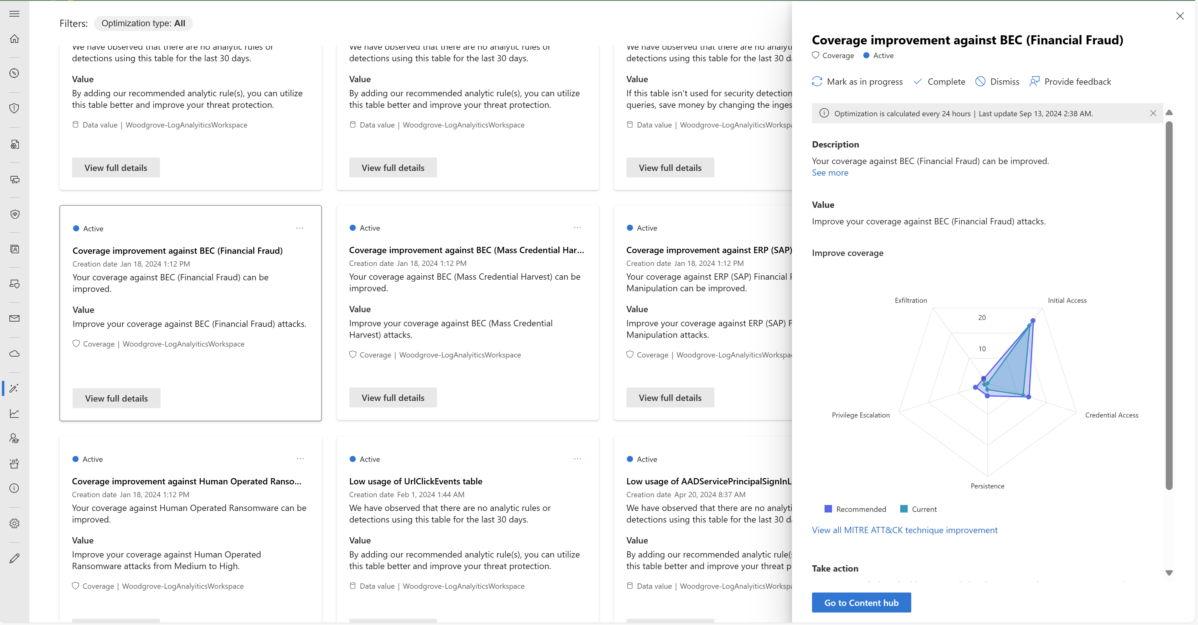
Optimize your SOC with targeted recommendations
Stay secured
Drive value
Manage cost
Notes:
AF

Slide 15

SOC Optimization features
Data value optimization recommendations
Threat-based optimization recommendations
Unused columns recommendations
Similar organizations recommendations
increase in data utilization for
ingested data with
detection or hunting
17%
increase in overall security
30%
coverage of MITRE attack matrix
Notes:
AF
SOC optimization tailored guidance, based on data you ingested, product config and risk profile. To stay secured and reduce cost.
Stay more secured by tracking MITRE attack techniques, and improving your XDR configurations
Drive value by identifying data you ingest that isn’t utilized to detection or hunting. Insights can also come from what customers similar to you are doing.
Manage costs by highlighting data that can be stored in cheaper tier, now including recommendations for Auxiliary logs.

Slide 16
Data value optimization recommendations
Type of observation | Action
The table wasn’t used by analytics rules or detections in the last 30 days but was used by other sources, such as workbooks, log queries, hunting queries. | Turn on analytics rule templates OR Move to auxiliary logs (Preview)
The table wasn’t used at all in the last 30 days. | Turn on analytics rule templates OR Stop data ingestion and remove the table or move the table to long term retention.
The table was only used by Azure Monitor. | Turn on any relevant analytics rule templates for tables with security value OR Move to a non-security Log Analytics workspace.
Notes:
AF

Slide 17
Data value optimization recommendations
No ingestion changes are recommended if a table is used for user entity behavior analysis (UEBA) or a threat intelligence (TI) matching analytics rule.
Notes:
AF

Slide 18
Unused column* optimization recommendation
Type of observation | Action
The ConditionalAccessPolicies column in the SignInLogs table or the AADNonInteractiveUserSignInLogs table is not in use. | Stop data ingestion for the column.
*Preview
Notes:
When making changes to ingestion plans, we recommend always ensuring that the limits of your ingestion plans are clear, and that the affected tables aren't ingested for compliance or other similar reasons

Slide 19
Unused column* optimization recommendation
Confirm that affected tables are not ingested for compliance or other similar reasons before changing
Notes:
AF

Slide 20
Threat-based optimization recommendations
Looks at connected logs and enabled rules to provide threat-based recommendations
Type of observation | Action
There are data sources, but detections are missing. | Turn on analytics rule templates based on the threat: Create a rule using an analytics rule template, and adjust the name, description, and query logic to suit your environment.
Templates are turned on, but data sources are missing. | Connect new data sources.
There are no existing detections or data sources | Connect detections and data sources or install a solution.
Notes:
Jon
3 areas to optimize, each with prescriptive guidance:
1. Data sources exist, but no detections – Action, turn on analytics rule to get value and coverage
2. OTOH, templates are turned on but no data sources – pretty simple, connect the required data sources (or remove the templates)
3. No existing detections or data sources for a MITRE tactic – Easiest action is to install a Solution from the Content Hub…which comprises both connectors and detection rules

Slide 21
Similar organizations recommendations
Type of observation | Action
Log sources ingested by similar customers are not connected Uses ML to identify tables based on orgs with similar ingestion trends and industry Not always present – ML dependent No customer data or log info is exposed to the analysis | Connect the suggested data sources. This recommendation doesn't include: Custom connectors Custom tables Tables that are ingested by fewer than 10 workspaces Tables that contain multiple log sources, like the Syslog or CommonSecurityLog tables
Notes:
Jon

Slide 22
Demo

Slide 23
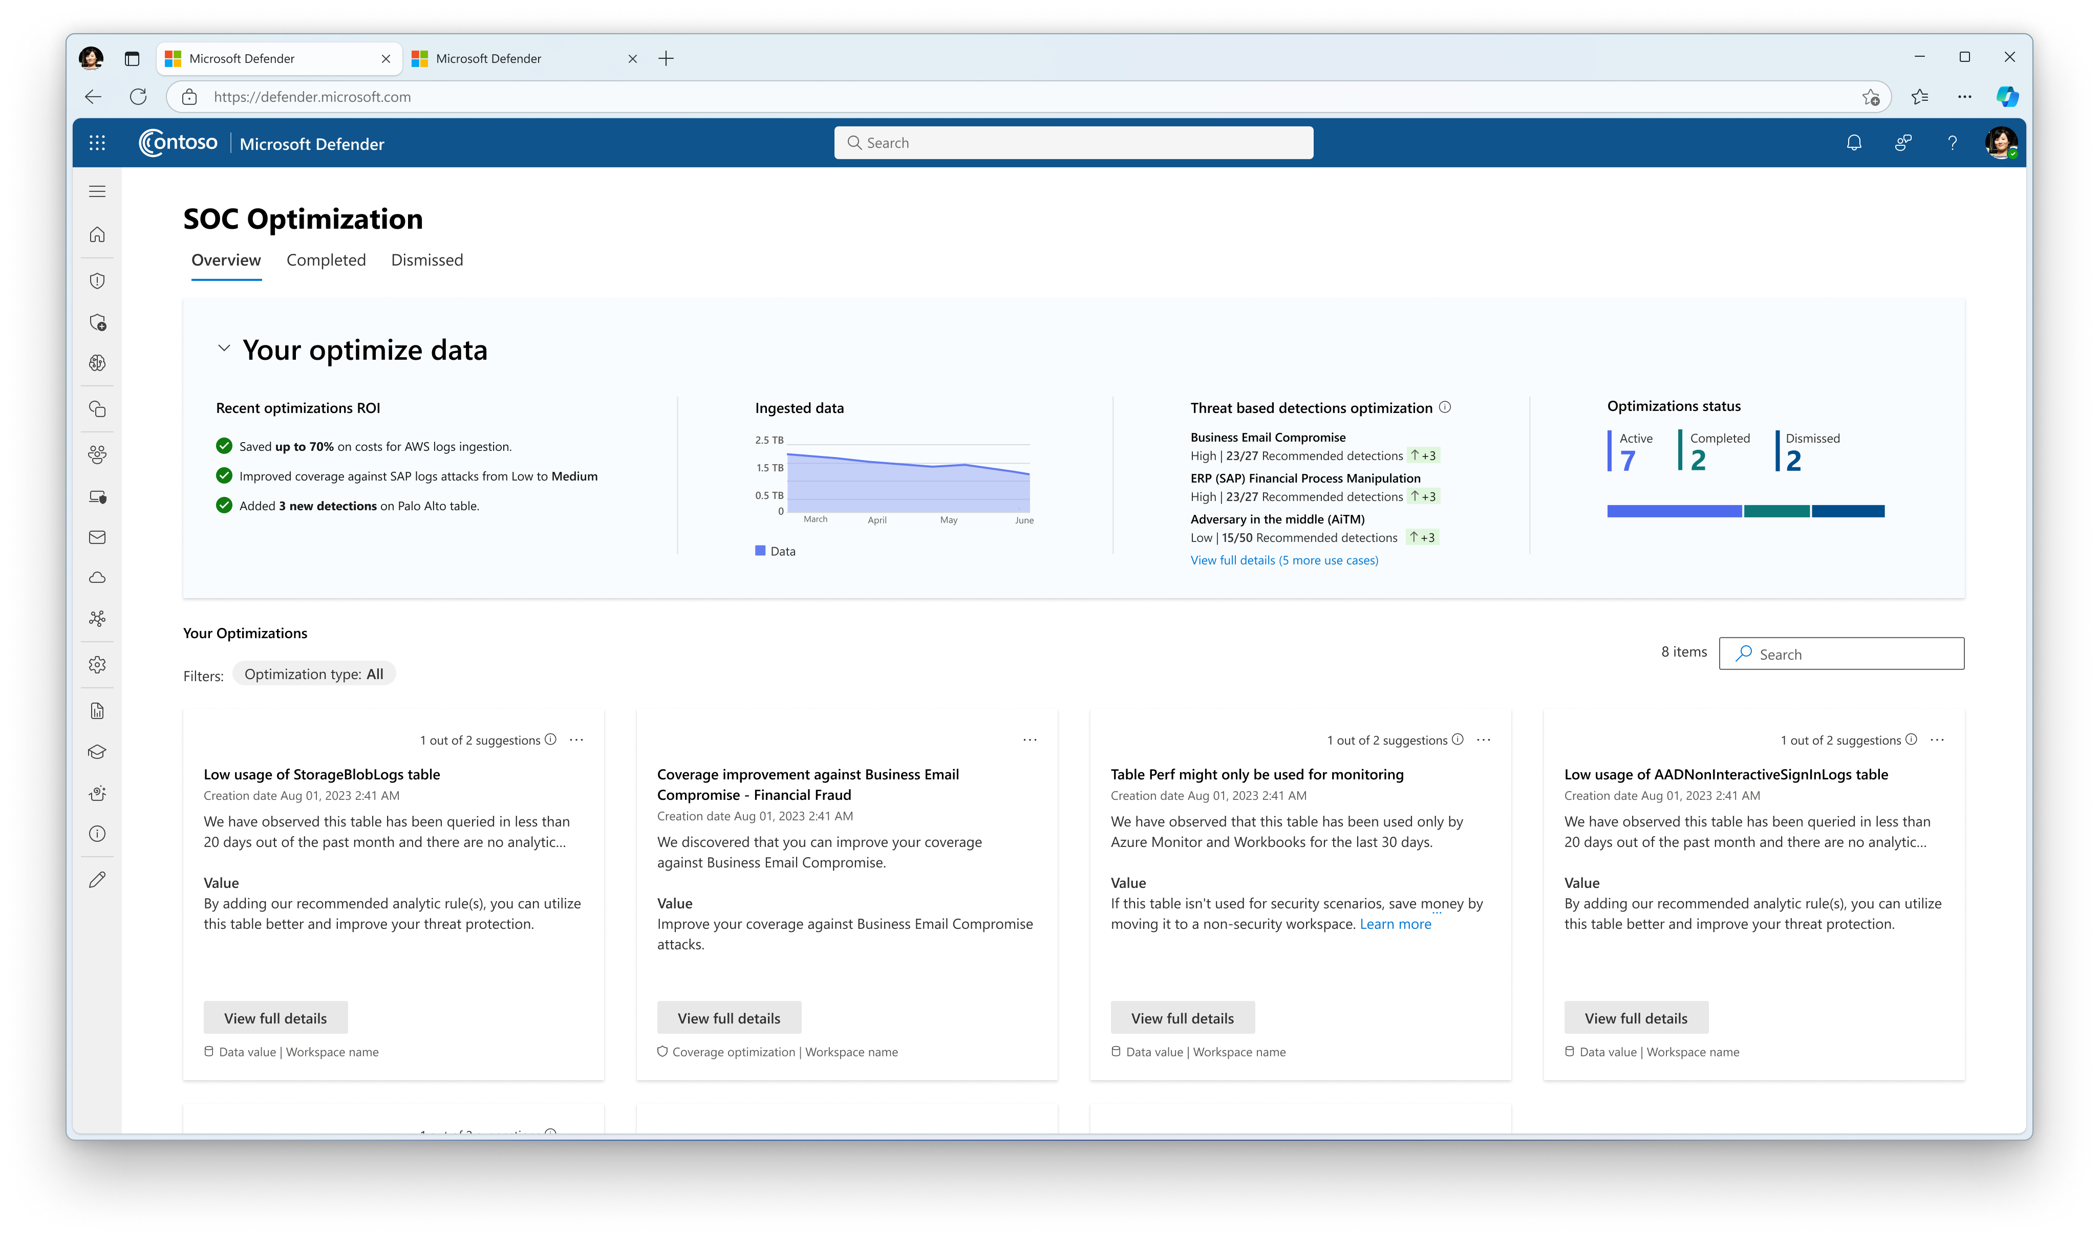

Slide 24
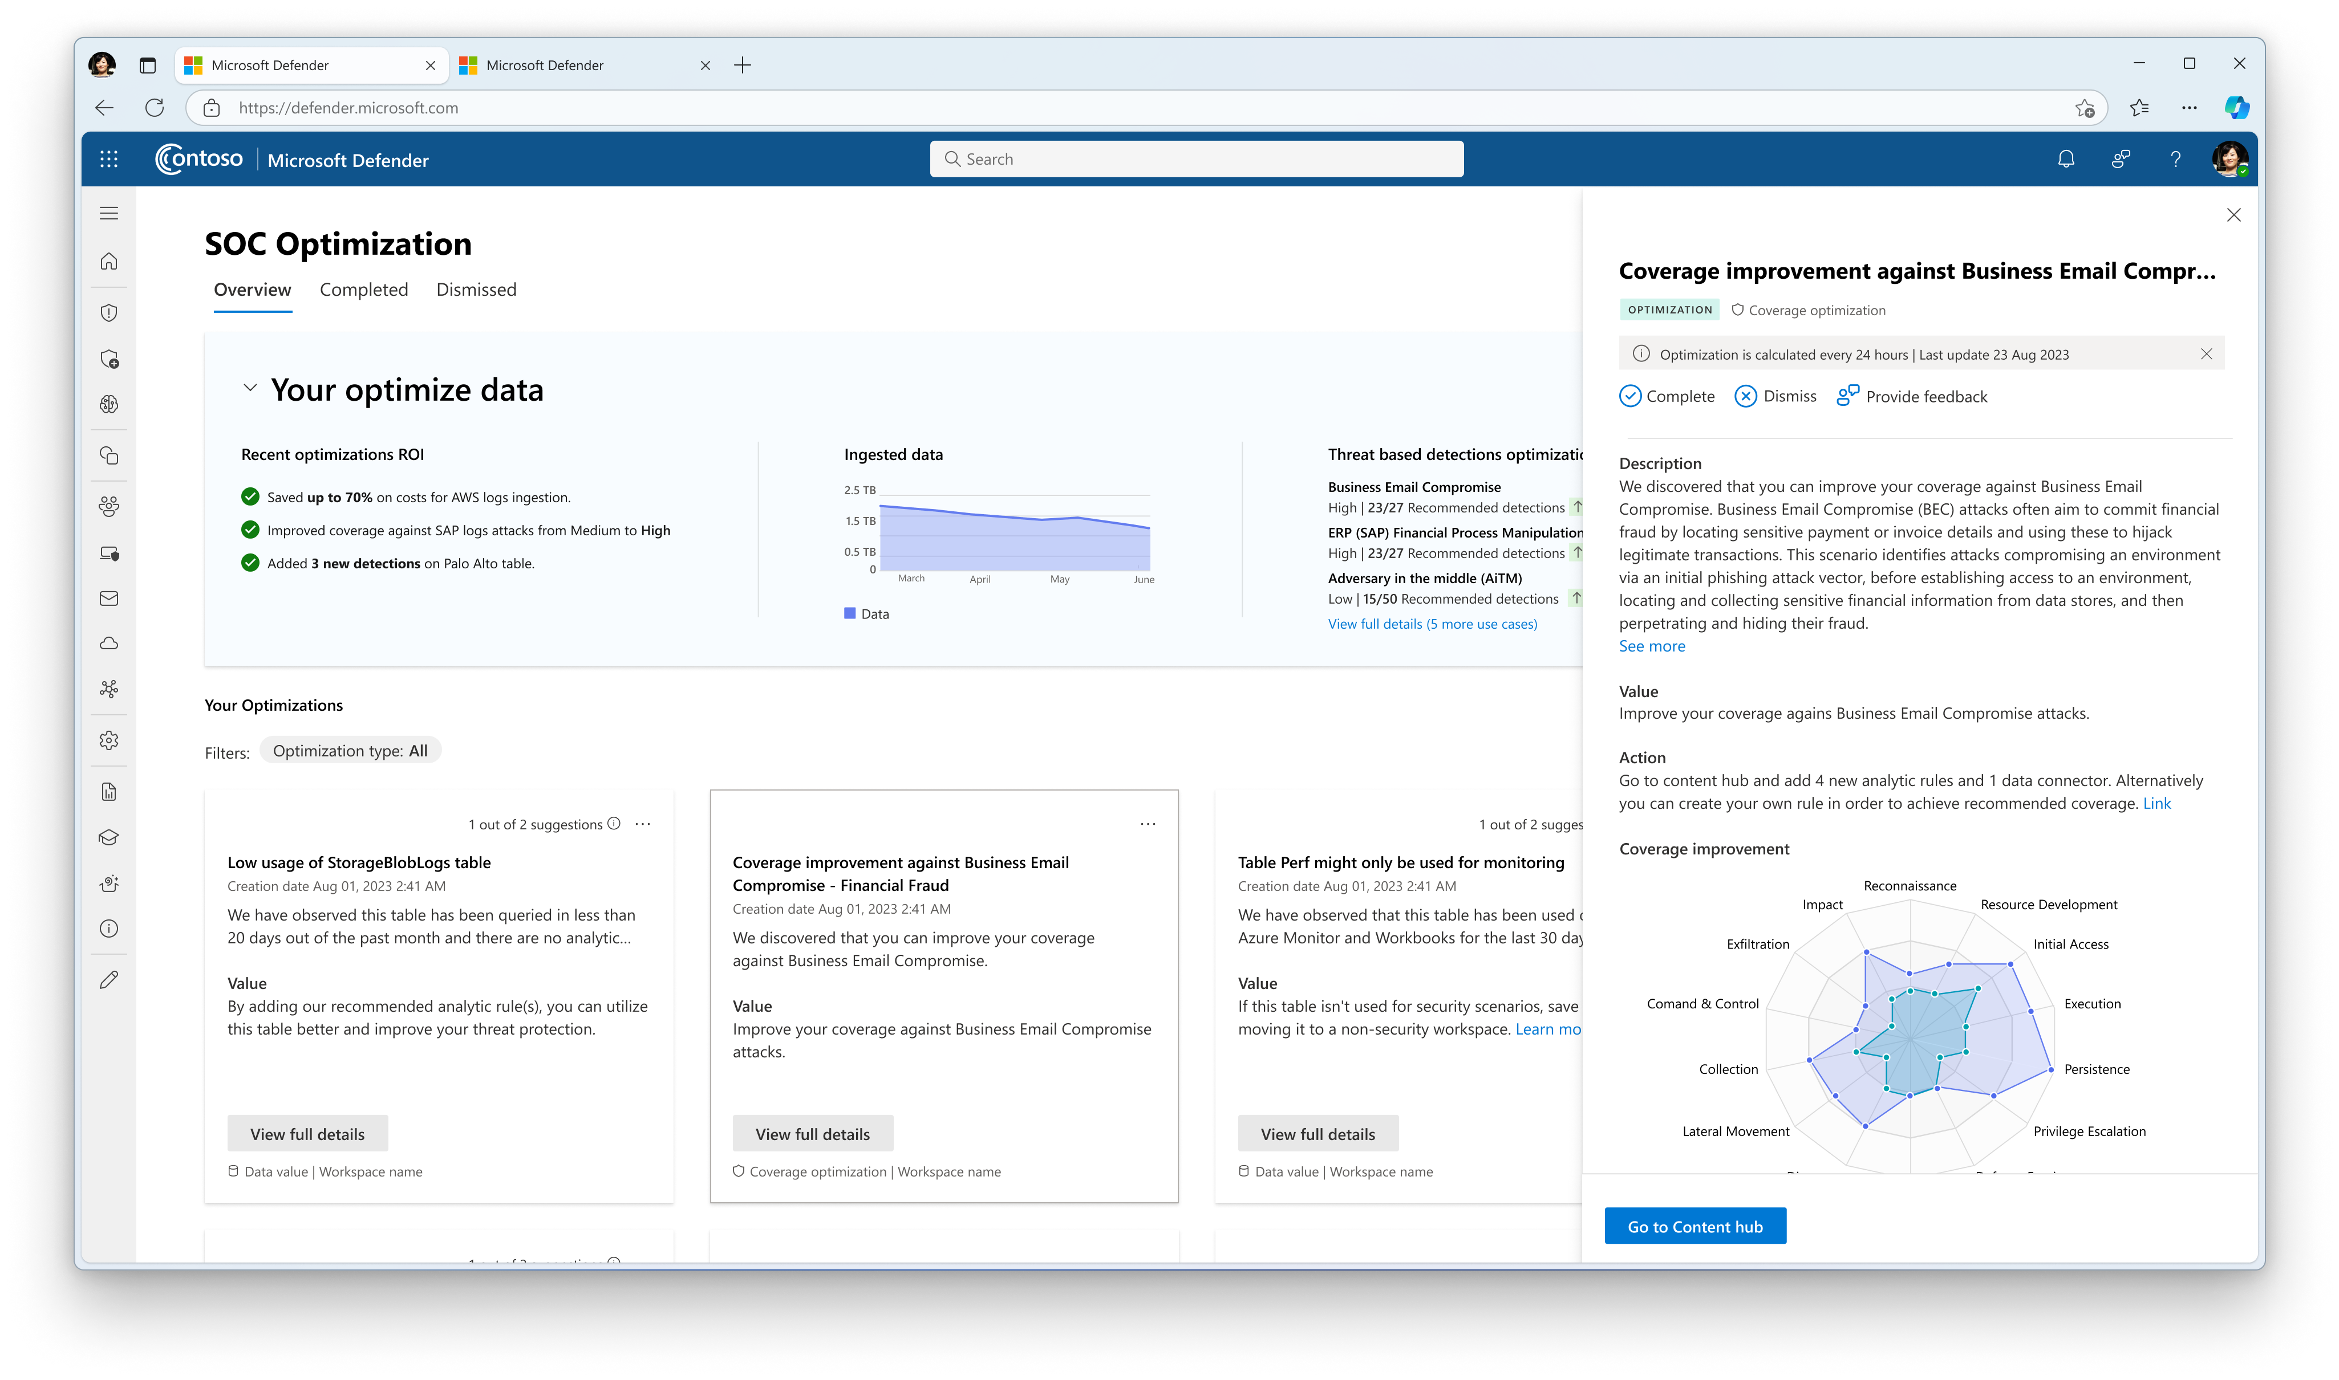

Slide 25
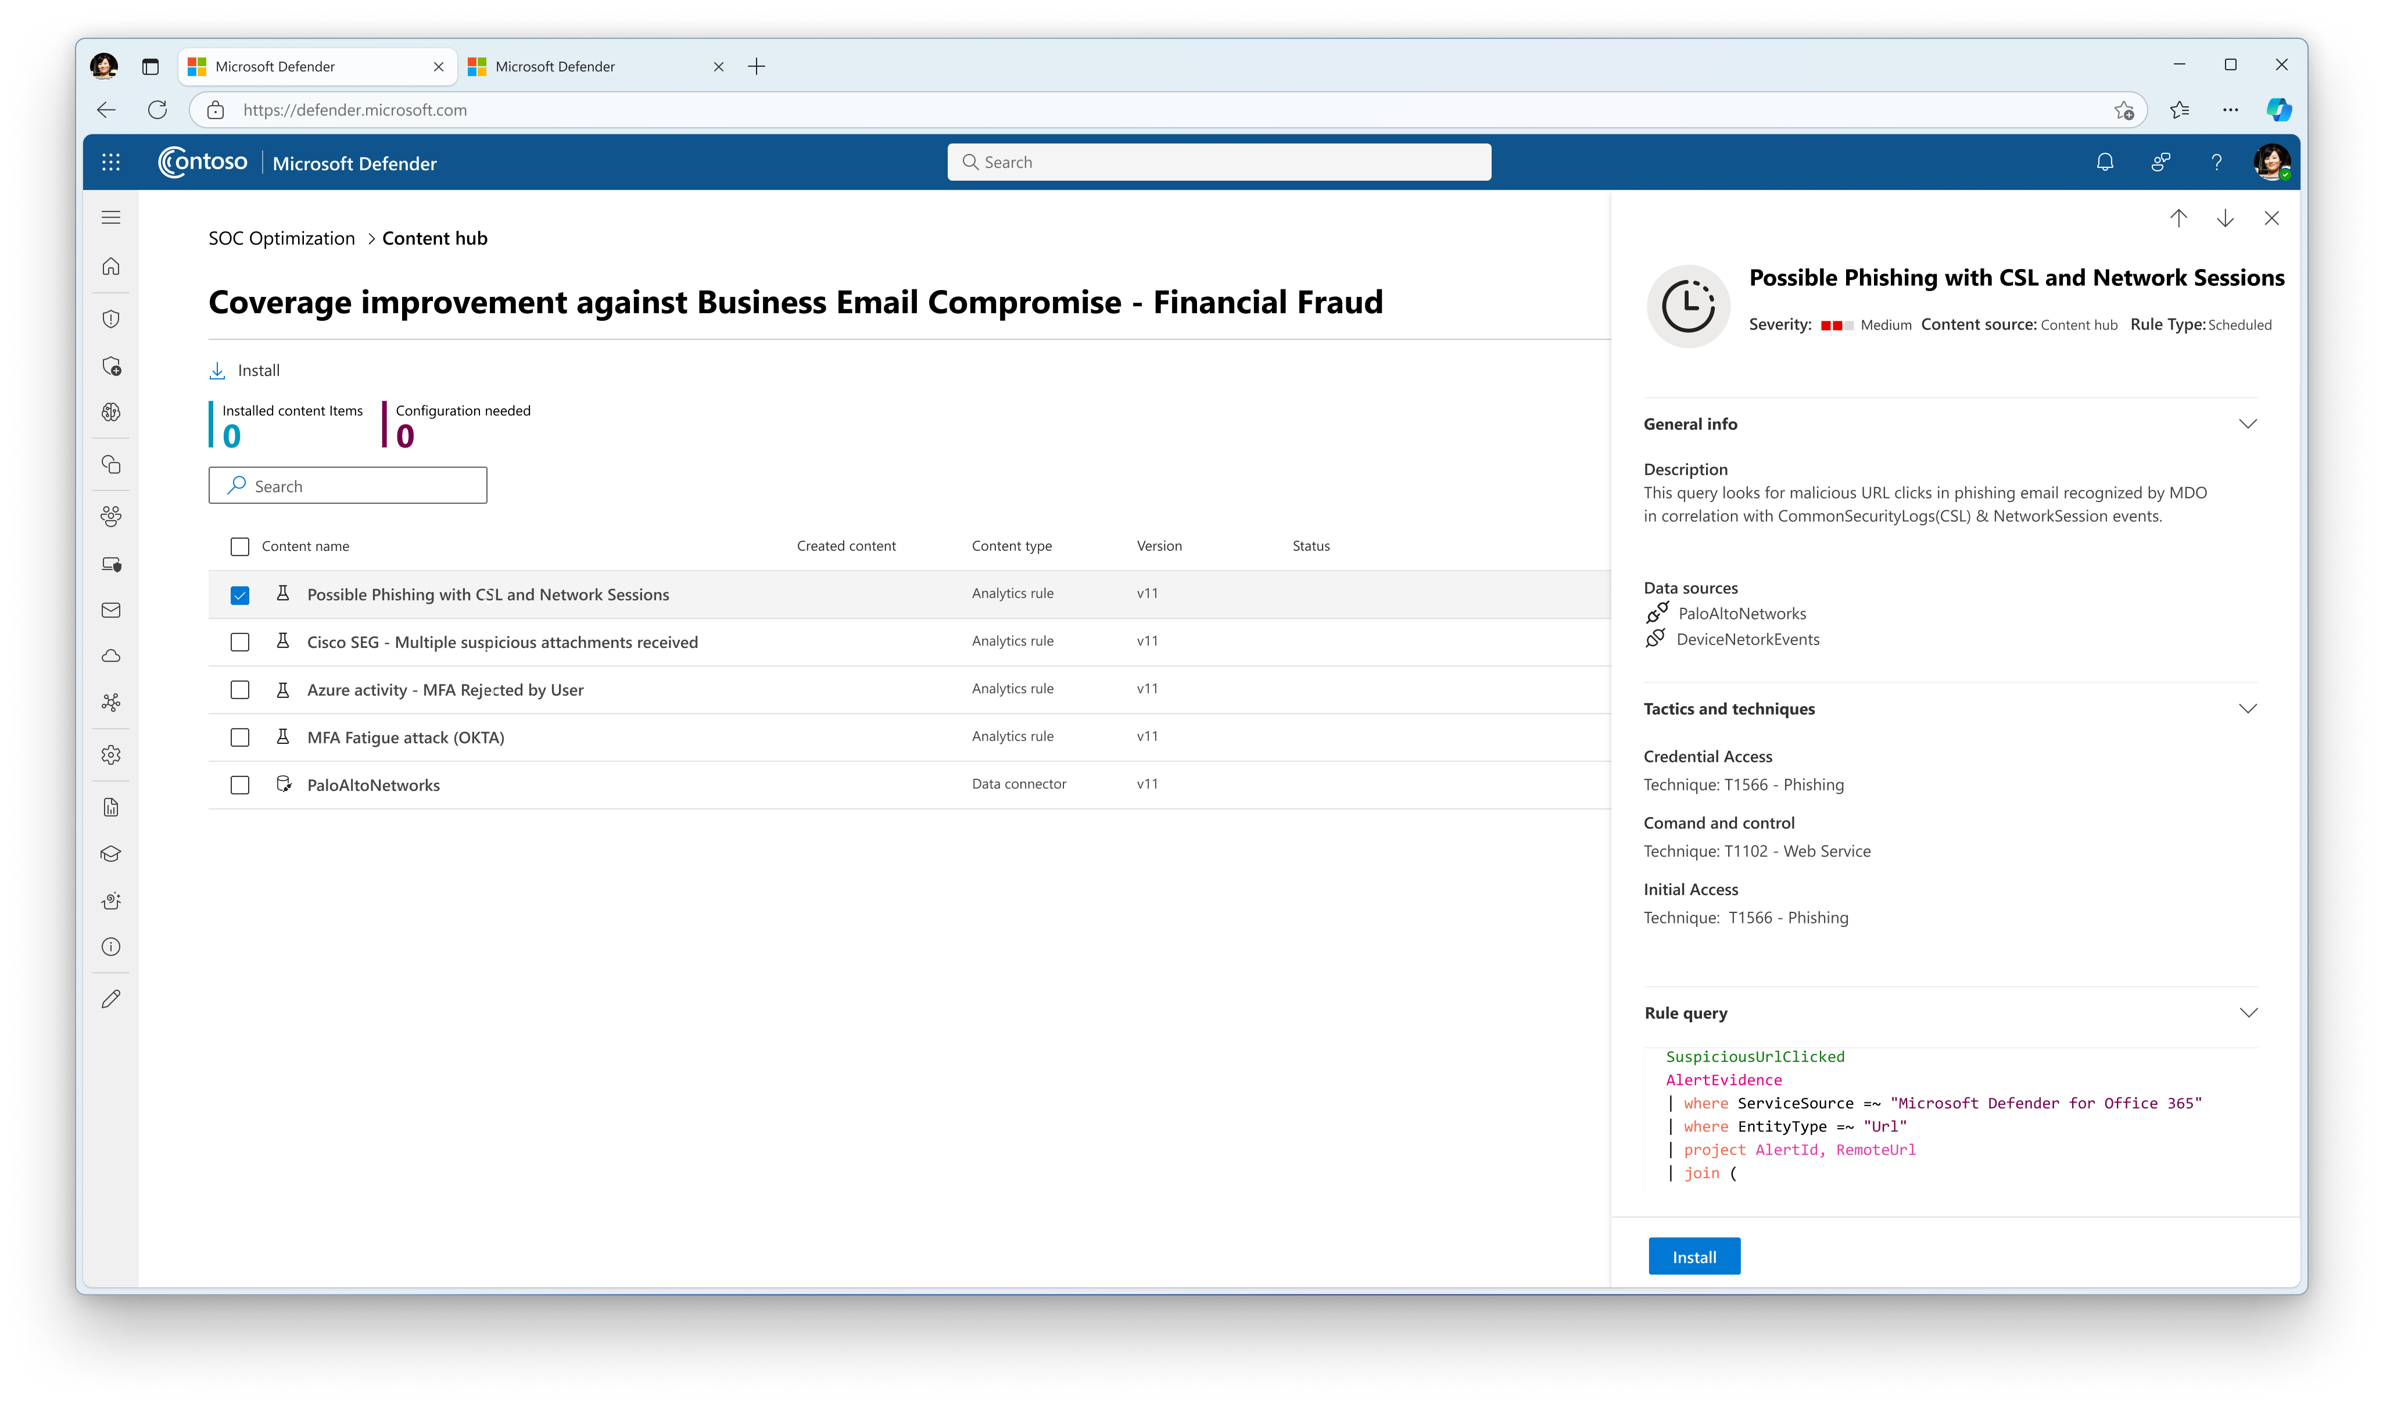

Slide 26
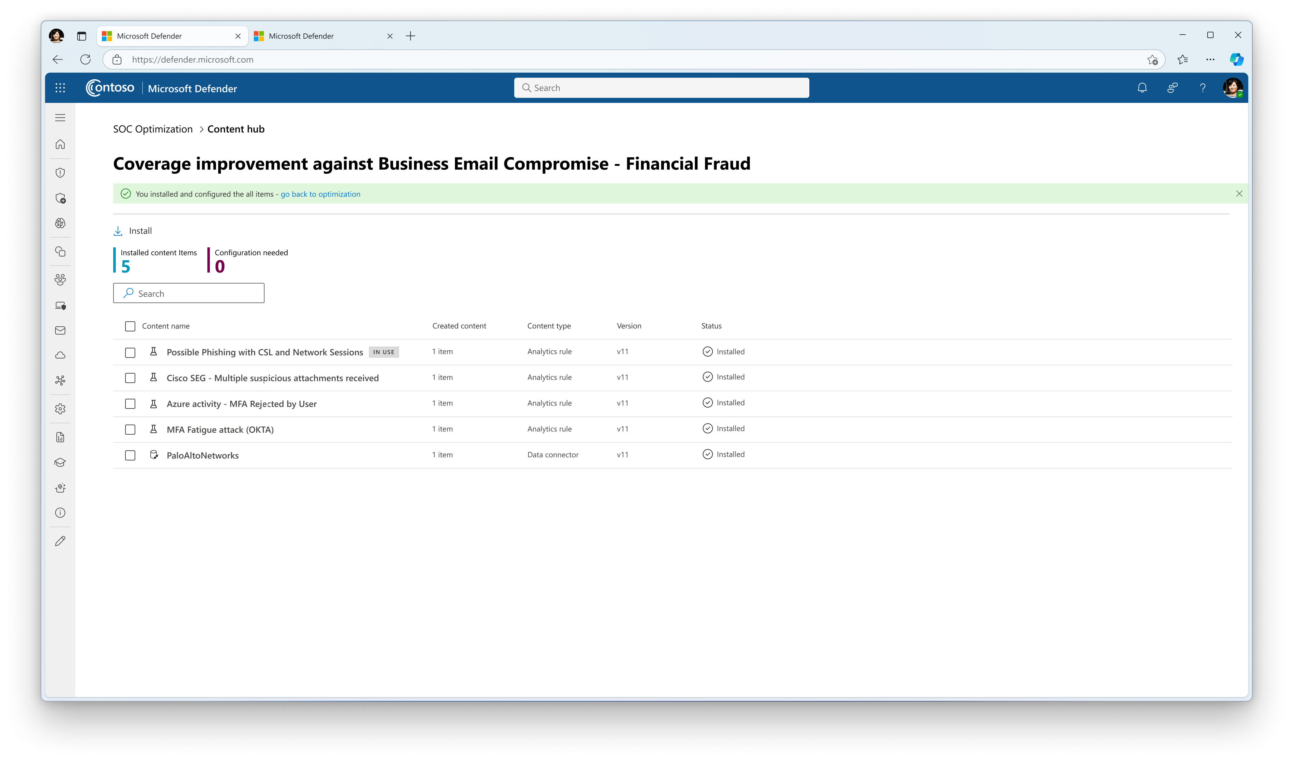

Slide 27
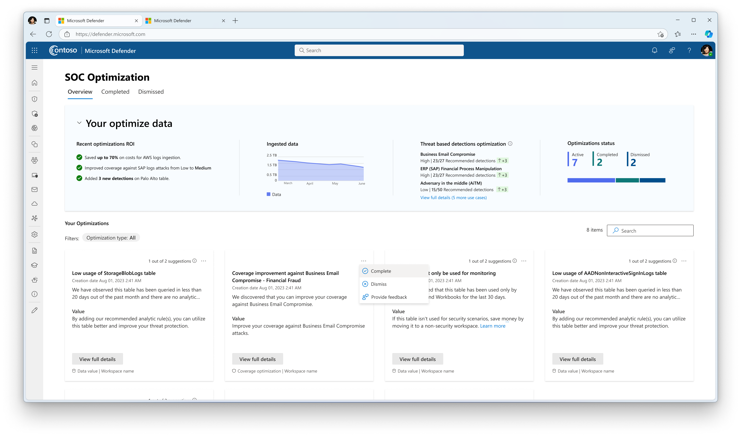

Slide 28
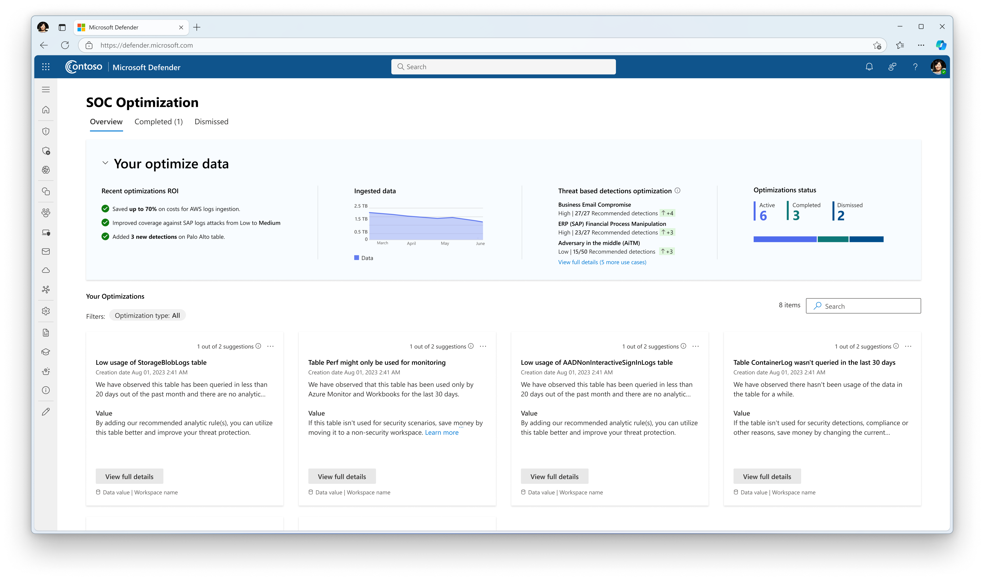

Slide 29
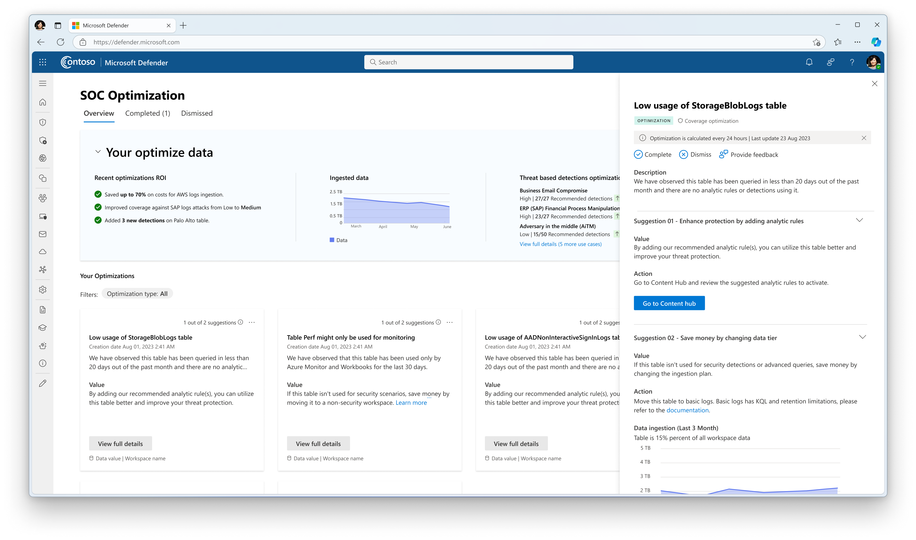
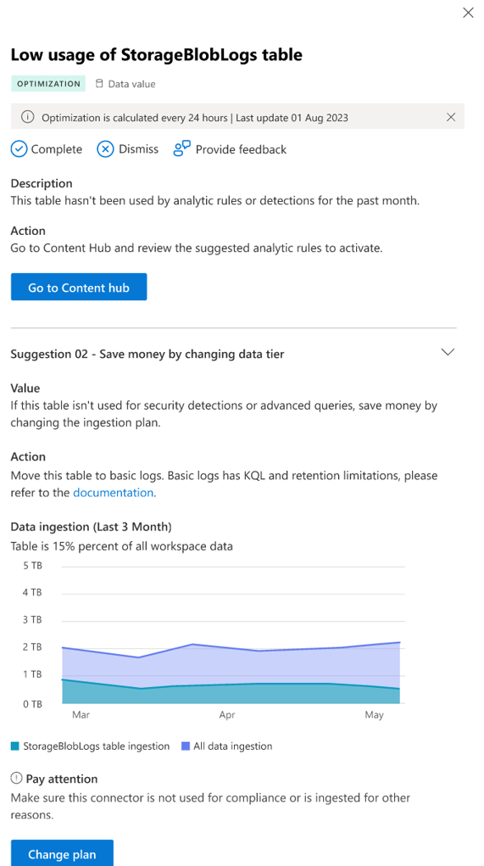

Slide 30
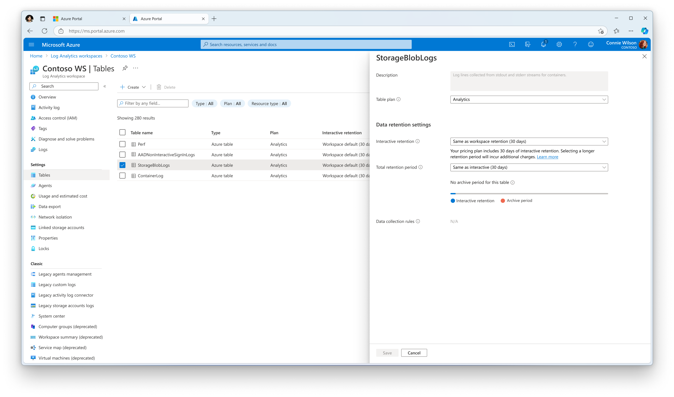

Slide 31
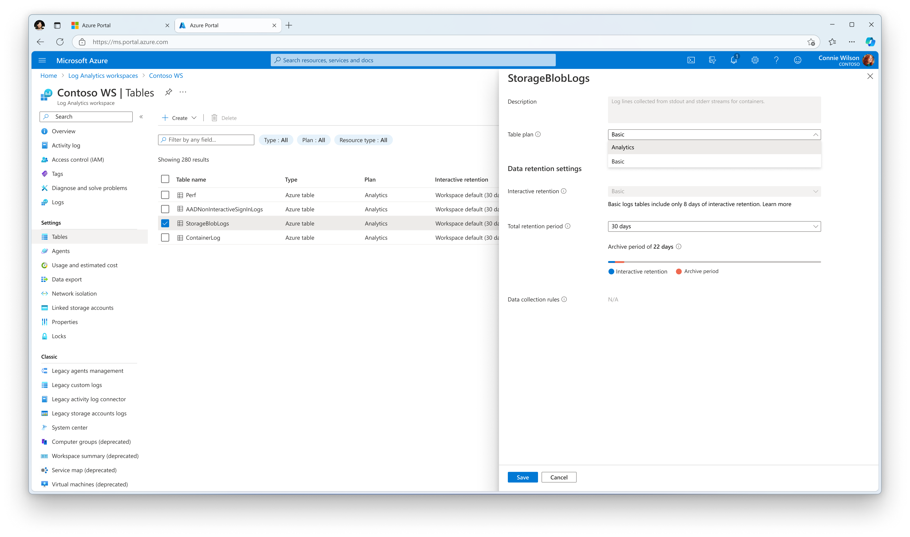

Slide 32
Demo One: SOC Opt Overview Tab
Overview – view all threat scenarios – view full threat scenario
Graph of ingestion/summary
Optimization cards and the filter – diff types
Pick one, details to browse
Good overview of the overview and then the cards at about 9’ in Javier/Michal video (link in scraps/on YouTube)
Notes:
AF
When Sentinel surfaces a recommendation, it includes impact analysis and step by step guidance.

Slide 33
Demo Two: Data Value Optimization
Drill down into several cards – long term retention, and Aux/Basic Logs
Show how to change the plan
  Can’t use Aux with 1P logs – verify
Low or no table usage – show steps up to turn it on in content hub without leaving interface
Store long term for compliance – analytics to aux/basic
Notes:
AF

Slide 34
Demo Three: Unused Columns Optimization + Blog (Alpine)
Notes:
AF

Slide 35
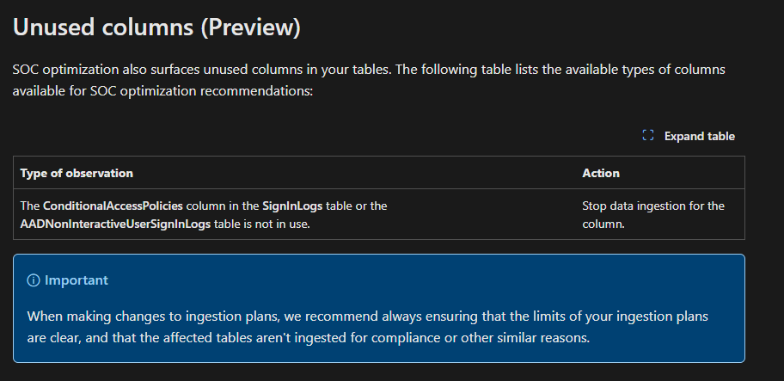
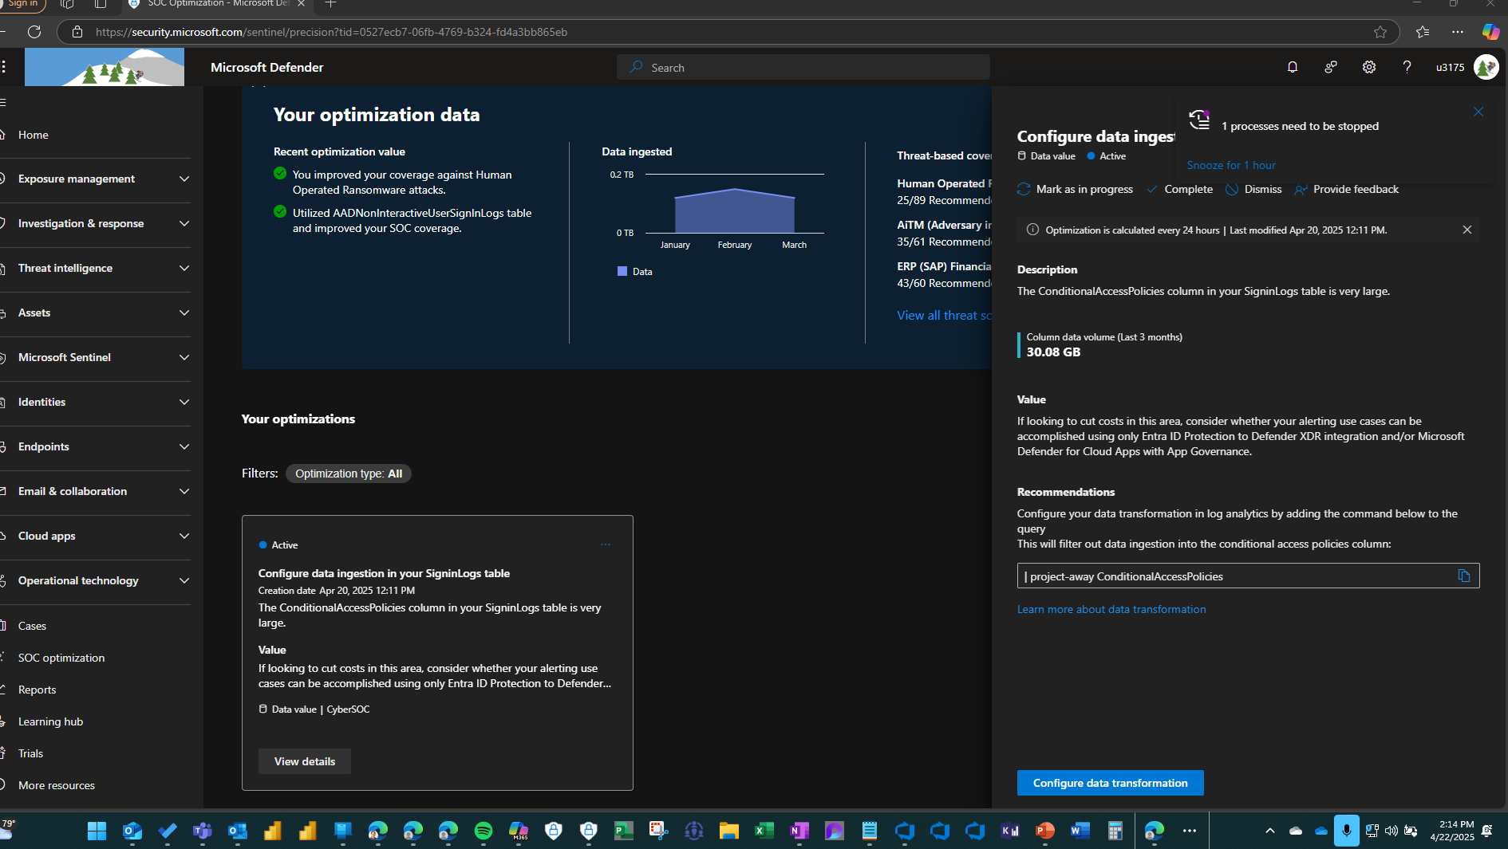
Unused Columns – Demo/show this
Notes:
AF

Slide 36
Demo Four: Coverage (Threat) Optimization
To Do – finish script/get it usable
Screengrabs for backup/fill in a few blanks from Alpine
What format for talk track – do I need one? For clicks? Just really a 1, 2, 3 where to click – could do a visual, I know the talk track
Ref:
Strangford-SocOpt.mp4 - Apr 15, 2025 - Frame.io
Pick BEC or whatever
Go into detections you can improve, etc.
Click products – and view active/inactive
Coverage (aka Threat-based) -
HuMOR is the example
Ooh cool – not just techniques but can click in to show tactics
Suggests data sources too coupled with the detections (this is pre-similar orgs)
View full threat scenarios option – beyond/not just SIEM
MITRE dashboard – from a specific threat recommendation, it’ll go filter it from that recommendation
Ooh cool – not just techniques but can click in to show tactics
Show how to go and enable a rule
View MITRE threat attack scenario
Notes:
Jon
Now let’s examine a Coverage (Threat)-Based Optimization. Let’s scroll down to one, in this case Human Operated Ransomware
Navigate to SOC Optimization
Scroll down to HuMOR – discuss HuMOR – human-operated ransomware. Basically every org is at risk here
Click on card
Here you see a specific description of the threat, the proposed value of the Optimization and the Analysis
Here the recommendation is to add X detections. These are Analytics Rules from the Content Hub.
Click on Products It also shows Products that are in scope - XXXXXXXX
Here you can see a Spider Graph based on the MITRE Attack framework that provides an overview of the present as well as the proposed detection rules. See the additional coverage you’ll get by enabling the XXX detection rules?
Once again, there’s a direct link to the Content Hub, that we’ll examine later in more detail. If you’re not familiar, the CH is where we host Solutions including Analytics Rules, where you can improve your coverage against this threat.
Click Products – there’s also a tab to visualize the product coverage. At present, this is solely MSFT products. That may change. Mouse over- you see Active products.
Click View full threat scenario – You can also view Full Threat Scenarios based on the coverage of products – including the Sentinel XXXX detections, and also additional XDR products. Here Covered means “active.”
Click on a product to list the specific product Coverage Details. There are several response actions that the Product will take. It’s there for each of them.
Click – Open in MITRE ATT&CK at the top right – you can also view these in the MITRE dashboard. It’s filtered to HuMOR/ransomware here. Here I can click on any technique and get a description, list of detections, products. I can add rules and detections, products, etc.
I can also drill down into MITRE Techniques – not solely Tactics…how…

Slide 37
Demo Five: Similar Orgs Optimization (Alpine)
Notes:
Jon

Slide 38
Demo Six: Lifecycle Management of a Recommendation(s)
Show Statuses, when they change, etc.
Notes:
AF

Slide 39
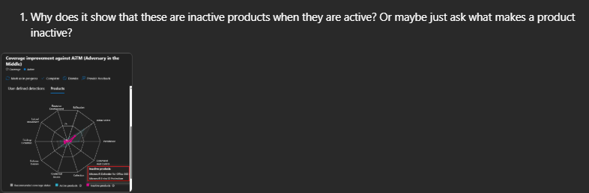
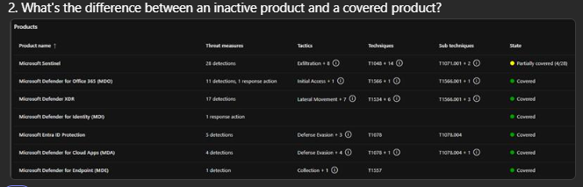
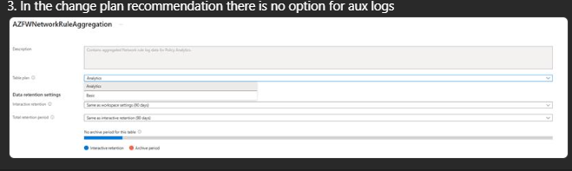
Questions/Clarification for Ron

Slide 40
Questions/Clarification for Ron OLD
No Aux Logs in the Change Plan blade? Only Analytic/Basic
  Looks like we have removed Basic pricing from the Sentinel pricing completely so this is a problem (and tangentially, Aux Logs on the pricing page has no pricing info) – Ron
Coverage/Details/Product – what is active vs inactive products – what is the action for inactive (e.g. Entra ID Protection is in Andrea’s lab already yet it appears in BEC) – Jeremy Tan per Matthew, OOF til April 28 or Ron
In a coverage card for example – State in Full Threat Scenario says Not Active for a product, but Inactive on Products portion of card – Jeremy Tan per Matthew, OOF til April 28 or Ron
Click through to Coverage improvement – a column that says “you may not have the data source”
What about a filter for Analytic Rule vs Data connector, etc.
Why does it think Andrea doesn’t have MDO installed?
It says “Not installed” for MSFT Defender for Office 365 (Preview) Data Connector(!)

Slide 41
We have an exciting future ahead.
Notes:
Thank you.
<Speaker Guidance: Spend the last few minutes discussing or answering any questions they may have. If they have additional topics on their EBC agenda, make sure you connect with their account team to inform them which AI priorities and business outcomes resonated the most during this session. If you are in a 1:1 direct customer engagement, make sure you note what their priorities and questions were and work with the broader account teams and units to facilitate the proper hand-offs or next steps (i.e. get them into a session at the Innovation Hub/MTCs).>

Slide 42
Expertise and tools for your journey
Technical expertise via our FastTrack partners
Tools, resources & training on our Adoption Hub
Events and real-world knowledge in our community
aka.ms/MicrosoftFastTrack
adoption.microsoft.com
aka.ms/TechCommunity
Notes:
Please leave this slide in for conference attendees.

Slide 43
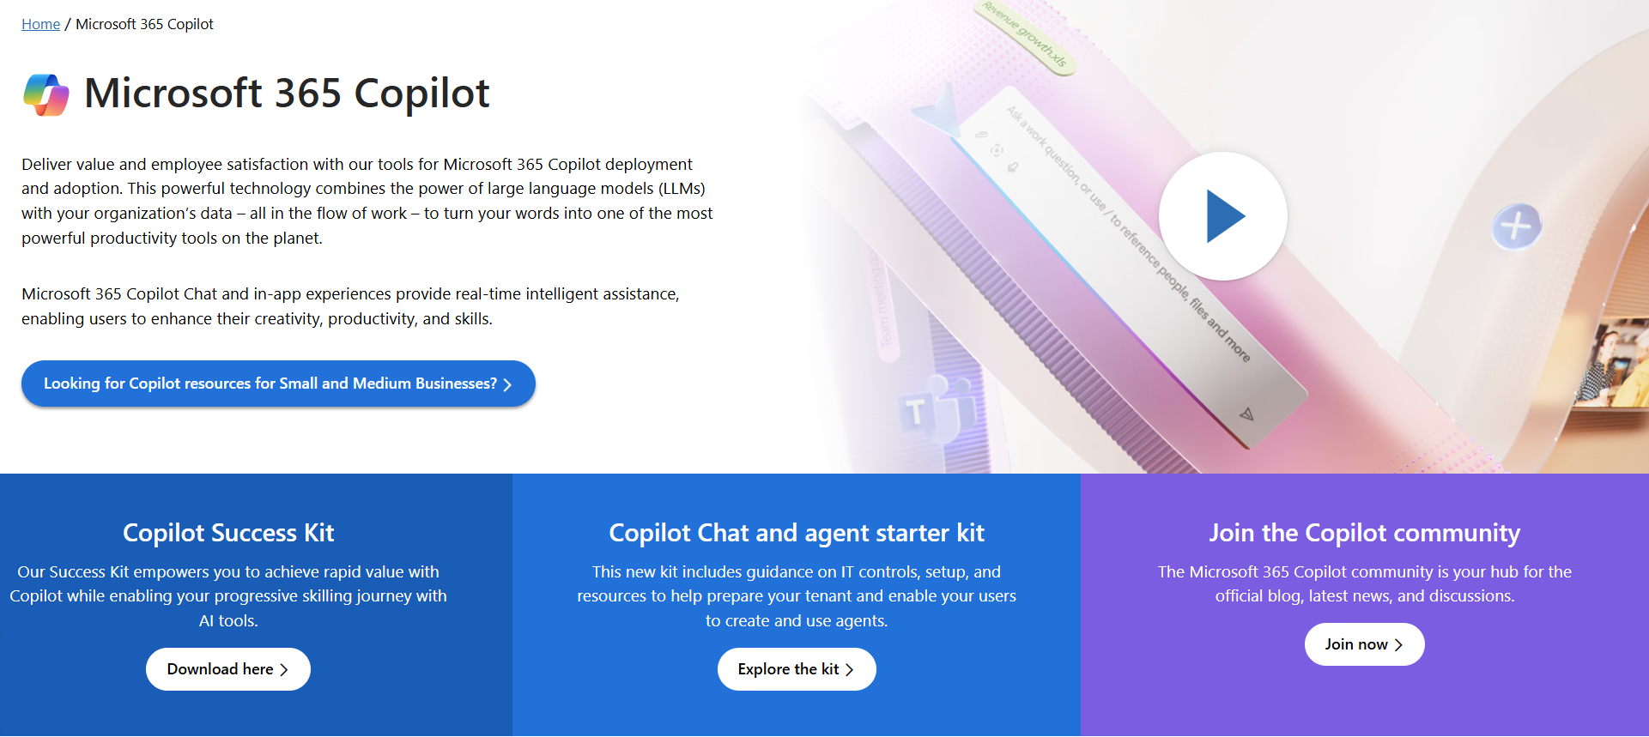
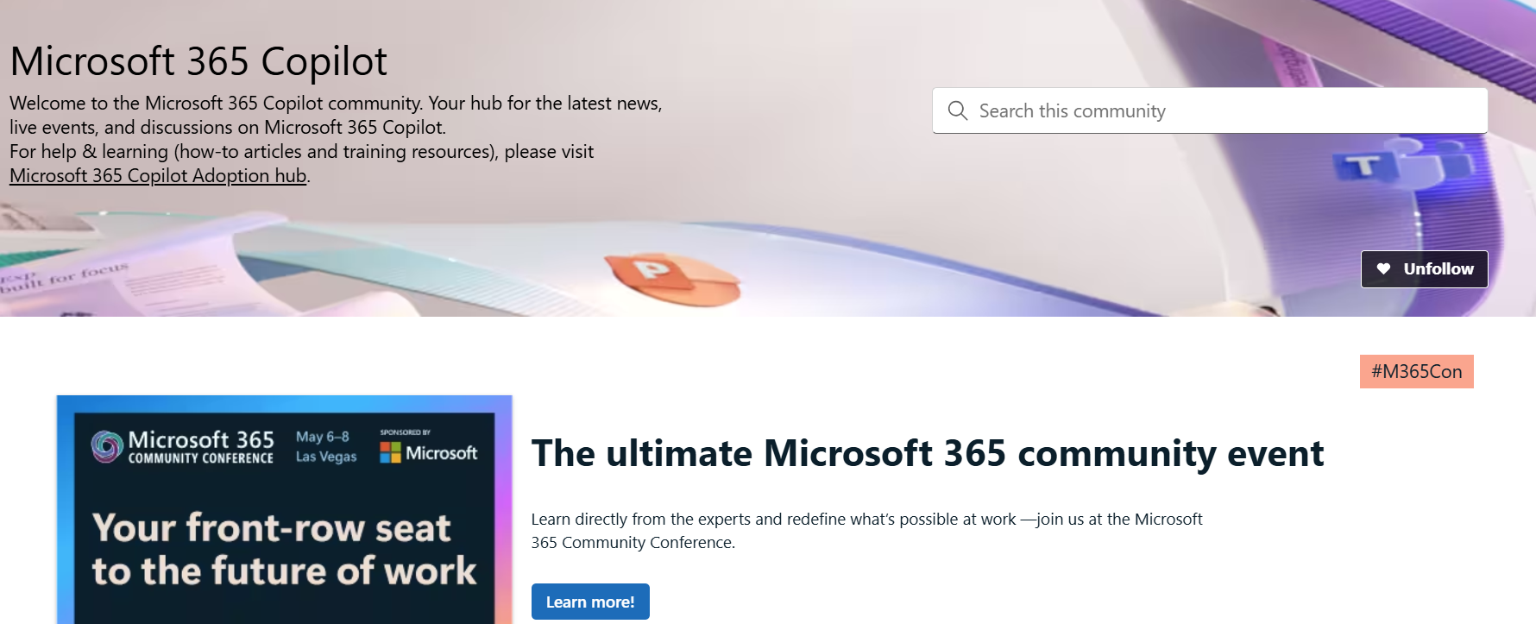
News & community content
Microsoft Community Learning aka.ms/Community/LearningChannel
Community led expert content on all your favorite Microsoft services.
Start your week with live news and event updates aka.ms/MondaysatMicrosoft
Watch live or on-demand & share our blog.
Notes:
To help you with adoption, the Copilot Readiness Hub is an open one stop shop for content, organized by role for your Copilot for Microsoft 365 journey.
You can use its recommendations to prepare and plan for your deployment, create a user experience strategy as I’ve presented today, and an adoption plan.
And as Copilot continues to evolve, keep coming back for new content that is published regularly.
You can also join the Copilot for Microsoft 365 community to get your questions answered and meet others who are leveraging Copilot for Microsoft 365 right now.

Slide 44
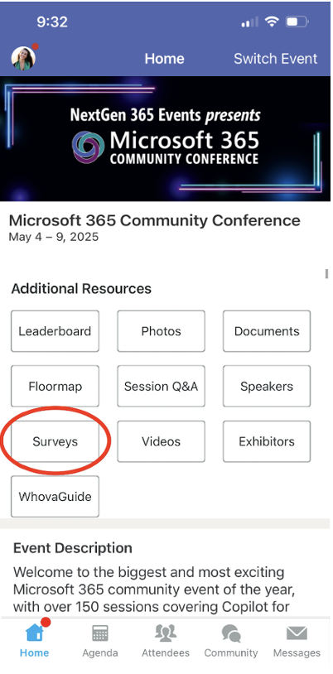
Session feedback surveys
We want to hear from YOU!
Share your feedback to make next years conference even better!
Here’s how –
Simply go to the Whova App on your smartphone.
Scroll down on the M365 Community Conference Homepage to ‘Additional Resources’ to click “Surveys’.
Click Session Feedback.
Scroll down to find this session title.
Complete the session feedback survey.
Finally, click ‘Submit’.
It’s just that easy!

Slide 45
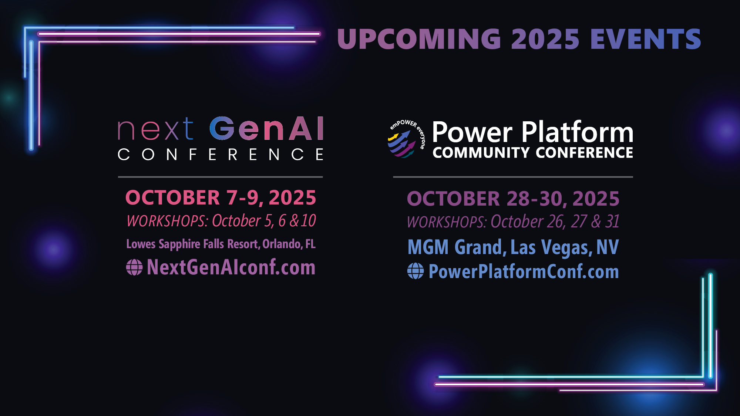

Slide 46
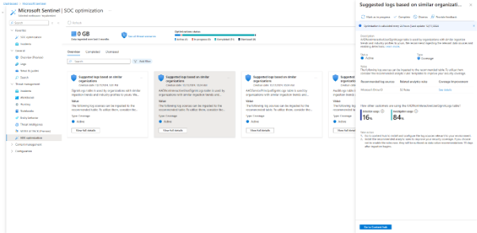
Similar Organizations (ask Nir Anchel)

Slide 47
AI-Based MITRE ATT&CK Tagging – pp to reference

Slide 48
Programmatic SOC Optimization
Use the Microsoft Sentinel recommendations API to programmatically interact with SOC optimization recommendations, helping you to close coverage gaps against specific threats and tighten ingestion rates. You can get details about all current recommendations across your workspaces or a specific SOC optimization recommendation, or you can reevaluate a recommendation if you've made changes in your environment.
For example, use the recommendations API to:
Build custom reports and dashboards. For example, see Visualize custom SOC optimization data.
Integrate with third-party tools, such as for SOAR and ITSM services
Get automated, real-time access to SOC optimization data, triggering evaluations and responding promptly to the suggestions

Slide 49
Demo Ideas
Show that it’s in both interfaces and that it’s SIEM+XDR, not only one
From Strangford-SocOpt.mp4 - Apr 15, 2025 - Frame.io – Marketing/Alex
How to navigate Overview tab
Data value Low or no table usage – show steps up to turn it on in content hub without leaving interface
Store long term for compliance – analytics to aux
Coverage BEC or something/content hub – add in analytics rules, go over MITRE
View full threat scenarios option – beyond/not just SIEM
MITRE dashboard – from a specific threat recommendation, it’ll go filter it from that recommendation
Similar Organizations
Show what that means, how, why (don’t see it in my lab b/c not identified in ML based on)

Slide 50
Demo Ideas
Show that it’s in both interfaces and that it’s SIEM+XDR, not only one
From Optimizing your SOC's threat coverage and data value – Javier/Michal (a year old)
Demo on YouTube shows Alpine Ski House – so I presume we can if needed
Good overview of the overview and then the cards at about 9’
Data Value show multiple suggestions in one card (one is turn on rules; two is or drop it down to aux) –
either reduce the cost of a table or improve its value
Mark it as completed or MSFT will see that it’s been done and resolve it
Threshold – 30 days no rules (won’t happen on day 1 for new source and also will not let it go months)
Coverage (aka Threat-based) -
HuMOR is the example
Ooh cool – not just techniques but can click in to show tactics
Suggests data sources too coupled with the detections (this is pre-similar orgs)
Can we tease future plans? (M teases Similar Orgs)
And ask audience for recommendations/wishes?
Notes:
To provide threat-based recommendations, SOC optimization looks at your ingested logs and enabled analytics rules, and compares them to the logs and detections that are required to protect, detect, and respond to specific types of attacks.

Slide 51
OK this is awesome – directly from our blog
SOC optimization reference | Microsoft Learn – they don’t cover how though (just ‘stop data ingestion from the column’)

Slide 52
Browse here for API ideas?
Use SOC optimizations programmatically | Microsoft Learn

Slide 53
Demo Six: Programmatic SOC Opt w/Workbook
If going to show the workbook, need clarity on Completed by System, but shows as Active in GUI
Use the Microsoft Sentinel recommendations API to programmatically interact with SOC optimization recommendations, helping you to close coverage gaps against specific threats and tighten ingestion rates. You can get details about all current recommendations across your workspaces or a specific SOC optimization recommendation, or you can reevaluate a recommendation if you've made changes in your environment.
For example, use the recommendations API to:
Build custom reports and dashboards. For example, see Visualize custom SOC optimization data.
Integrate with third-party tools, such as for SOAR and ITSM services
Get automated, real-time access to SOC optimization data, triggering evaluations and responding promptly to the suggestions

Slide 54
Threat-based optimization recommendations
Looks at connected logs and enabled rules to provide threat-based recommendations
Notes:
JonTo optimize data value, SOC optimization recommends adding security controls to your environment in the form of extra detections and data sources, using a threat-based approach. This optimization type is also known as coverage optimization and is based on Microsoft's security research.

Slide 55
Similar organizations recommendations
Uses advanced machine learning to identify tables are used by organizations with similar ingestion trends and industry but that are not in your workspace.
Not all workspaces get similar organizations recommendations.
The models never access or analyze the content of customer logs or ingest them at any point.
Notes:
Jon
1. It shows how other organizations use these tables and recommends to you the relevant data sources, along with related rules, to improve your security coverage.
2. A workspace receives these recommendations only if our machine learning model identifies significant similarities with other organizations and discovers tables that they have but you don't. SOCs in their early or onboarding stages are generally more likely to receive these recommendations than SOCs with a higher level of maturity.
3. No customer data, content, or End User Identifiable Information (EUII) is exposed to the analysis

