Slide 1
Secure access for your workforce with Microsoft Entra Suite
Irina Nechaeva, General Manager Microsoft Entra

Slide 2

Microsoft 365 Community Conference

Slide 3


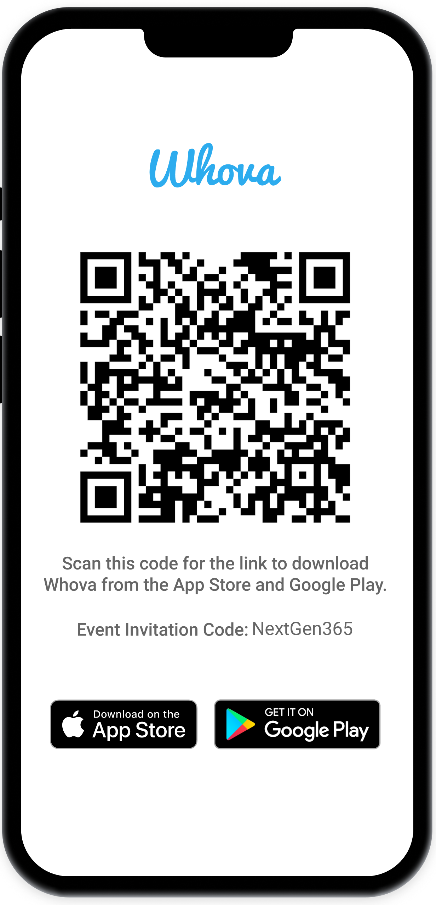
Join the event app to access:
The official event app for the
Microsoft 365 Community Conference
Event invitation code: NextGen2025
Event announcements
Personalized agenda, session details
Speaker & attendee profiles
Networking, meet-ups, messages
Event documents

Slide 4



Attacks have become more complex & sophisticated
Unaddressed internet attack paths
Unaddressed identity attack paths​
Increase in
cybercrime
Increase in
AI risks
84%
of attack paths involve internet exposure
66% ​
of attach paths involve identity compromise​
7,000
password attacks
per second in 2024
57%
of security leaders report an increase in security incidents due to AI usage
State of Multicloud Security Risk, Microsoft, 2024
Microsoft Digital Defense Report 2024
How to break the token theft cyber attack chain (2024 Microsoft blog)
Insights from the Secure Employee Access report reveal the need for unified access security (2025 Microsoft blog)
Notes:
In today's world, the number of identities and endpoints has proliferated, dramatically increasing the attack surface area. Today there are already more than 300 billion passwords in use by humans and machines.
It’s no surprise that 84% of attacks involve internet exposure and 66% involve insecure identity credentials. This makes identity the most popular attack vector and your crucial first line of defense.
Password attacks alone constitute more than 99% of the identity attacks we see. In fact, we block more than 7,000 password attacks per second.
To add to this complexity, the rise of AI means has also led to 57% of security leaders reporting an increase of security incidents from AI usage.

Slide 5










Security teams are often working in silos
Unifying Identity and
Identity and access management team
Access to all
apps & resources
Employees
AI
IaaS, PaaS, Datacenter
Locations
Identity and access management team
Network security team
Microsoft 365
Network access security
Platforms
SaaS, websites
Devices
On-premises
Notes:
Security teams are often siloed, using multiple tools, which can lead to inconsistent access policies and security gaps. On average, organizations use 5 identity access solutions from 3 different vendors and 4 network access solutions from 3 different vendors.
This fragmentation results in significant security risks. In fact, 79% of organizations with 6 or more solutions say significant breaches have increased in past year.

Slide 6




Addressing evolving threats requires a new approach
Identity and access management team
Access to all
apps & resources
Any employee
AI
IaaS, PaaS, Datacenter
Any location
Unified access security
Microsoft 365
Any platform
SaaS, websites
Any device
On-premises
Notes:
To address these threats, organizations must think about breaking the silos and unifying identity and network access security.
Unifying identity and network access controls provides several key benefits:
Improved Security: By consolidating access policies, organizations can better protect against sophisticated attacks and reduce security gaps.
Enhanced Efficiency: Streamlining tools and processes reduces complexity and operational overhead, allowing security teams to focus on strategic initiatives.
Better User Experience: Simplifying access management improves the user experience, making it easier for employees to access the resources they need without compromising security

Slide 7



















Microsoft
Entra Suite
Access to all
apps & resources
Any employee
Cloud-based & on-premises identities, groups & roles
AI
Any location
HQ, branch office, home, remote
IaaS, PaaS, Datacenter
Secure Zero Trust access
for your workforce
Any platform
Android, iOS, Linux, MacOS, Windows
SaaS, websites
Any device
Corporate & personal
On-premises
Notes:
Microsoft Entra is set to help your teams seamless unify their identity and network security strategy with the Microsoft Entra Suite. The Suite is a comprehensive family of products that secure access for any identity, from anywhere, to any app or resource across your digital estate: on-premises and across clouds.
This means securing access for your employees, customers, partners, or digital workloads to resources such as modern SaaS apps and legacy on-premises servers and file shares.
And it means protecting access to resources whether access requests come from within your corporate network or over the open internet.

Slide 8



Microsoft
Entra Suite
Secure Zero Trust access
for your workforce
Microsoft Entra Private Access
Microsoft Entra
Verified ID
Premium
Microsoft Entra Internet Access
Microsoft Entra
ID Protection
Microsoft Entra
ID Governance
Notes:
The Entra Suite includes five deeply integrated products to give you a complete solution for Zero Trust user access:
Microsoft Entra Private Access replaces legacy VPNs and extends MFA and Conditional Access to all resources.
Microsoft Entra Internet Access is our identity-centric Secure Web Gateway to protect against threats of the open Internet.
Microsoft Entra ID Governance ensures least-privilege access for any user.
Microsoft Entra ID Protection prevents identity compromise with real-time risk assessment for every sign in and every user, powered by cloud-scale machine learning.
And Microsoft Entra Verified ID, which makes it possible to verify people’s identities in real-time in a privacy-respecting way.
Because these five products work as one integrated solution, Entra Suite makes it easy to protect your employees identities and secure their access to any app or resource, regardless of where people choose to work—from the office, from home, or on the go.

Slide 9




Microsoft
Entra Suite
Converge Zero Trust
access policies
Access to all
apps & resources
Any employee
Cloud-based & on-premises identities, groups & roles
AI
Ensure least privilege access
Any location
IaaS, PaaS, Datacenter
HQ, branch office, home, remote
Improve the user experience
Any platform
Android, iOS, Linux, MacOS, Windows
SaaS, websites
Modernize your security
Any device
Corporate & personal
On-premises
Notes:
While this solution has many benefits, I’d like to highlight the top four:
It unifies the access policy engine across identities, endpoints, and networks.
It enforces least privilege access for all users to any app or resource, including AI models.
It simplifies the user experience for accessing any resource, from anywhere.
It modernizes your security, retiring legacy tools like traditional firewalls/VPNs

Slide 10






Converge Zero Trust access policy for identity and network
Continuous risk assessment and automation
Threat intelligence and telemetry
Zero Trust
policy enforcement
Identities
Applications
Network
Microsoft Entra
Conditional Access
Data
Endpoints
Infrastructure
Notes:
What makes the suite so effective is the fact its powered by our unified access policy engine.
Conditional Access is a critical component of their Zero Trust deployments. It checks numerous conditions, including location, endpoint context, and user and sign-in risk.
But often, organizations that adopted a modern networking solution also enforce another conditional access policy on the network layer.
Usually, different teams configure those policies, and different security solutions enforce them. The policies either conflict or leave gaps, and the teams don’t coordinate well with each other. This may leave some access points less protected than others.
With the Microsoft Entra Suite, security teams don’t have to choose one policy engine over the other. The Entra Suite enables one unified policy that reasons over identity, endpoint, and network!

Slide 11

Enhance Conditional Access with new conditions and controls
Signal
Decision
Enforcement
Identity/workload,
groups, roles
Security Service Edge
Security Service Edge
Continuous Access Evaluation
IaaS, PaaS, Datacenter
Apps and data
Machine
learning
Allow
Trusted &
compliant devices
Require
Unified
policies
Real-time
evaluation
engine
Microsoft 365
Block
Risk
Effective
policy
Restrict
Microsoft 365
Location
Compliant network
On-premises
Notes:
This enables powerful new capabilities.
First, we can now extend continuous access evaluation to any application. This means that for any app or resource, a change in access conditions—let’s say a change in location—will immediately revoke an active user session, without any delay or requiring any action from identity or security operations teams.
Next, it extends your Conditional Access to web traffic, legacy on-premises resources and cloud apps that aren’t yet integrated into single sign-on, for example, shadow IT apps.

Slide 12
Enhance Conditional Access with new conditions and controls
Signal
Decision
Enforcement
Identity/workload,
groups, roles
Security Service Edge
Security Service Edge
Continuous Access Evaluation
IaaS, PaaS, Datacenter
Apps and data
Machine
learning
Allow
Trusted &
compliant devices
Require
Unified
policies
Real-time
evaluation
engine
Microsoft 365
Block
Risk
Effective
policy
Restrict
Microsoft 365
Location
Compliant network
On-premises
Notes:
And Conditional Access itself is now much richer. We added a new condition, compliant network, which only allows access requests from your network to go through.
We added new resource types: on-premises apps and web traffic.
And we enabled new controls, including the ability to restrict or monitor access.
You can even require sophisticated controls like just-in-time access to external storage sites for specific user groups, such as a particular department or project team.

Slide 13
Protect access to all on-premises and SaaS resources​
Microsoft Entra
Private Access
Microsoft Entra
Internet Access
Any on-premises
app and resource
Identity-centric Zero Trust Network Access (ZTNA)
Identity-centric
Secure Web Gateway (SWG)
Any internet
app and resource
Notes:
Two products that extend Conditional Access to web traffic and on-premises apps are Microsoft Entra Internet Access and Microsoft Entra Private Access.
Microsoft Entra Internet Access is an identity-centric Secure Web Gateway that protects employees from threats of the open internet, filters out malicious or non-compliant content, and enforces Conditional Access policies on SaaS apps and internet traffic.
Microsoft Entra Private Access is a complete, identity-centric Zero Trust Network Access solution that replaces traditional VPNs. Unlike a VPN, that gives users access to your entire environment, Private Access enables granular, modern user-to-resource access controls. It even works with your legacy on-premises apps and resources. This means you can enforce MFA on that 20-year-old app that you still need to control that important piece of discontinued hardware.
And one more product that can make Conditional Access even smarter is Defender for Cloud apps, our CASB. Together with Microsoft Defender for Cloud Apps, Internet Access and Private Access deliver a complete security service edge solution from Microsoft.

Slide 14








Uniformly govern access to on-premises and cloud apps
Microsoft Entra ID
HR systems
Enterprise SaaS apps
API
Other identity providers
On-premises apps
Active Directory on-premises
Use cloud HR or other systems as a source of authority · Provision to any app—cloud or on-premises · Re-use existing on-premises connectors
Notes:
Managing user permissions is a headache for many organizations.
Different application owners use different approaches to managing access rights. Many processes are manual and disconnected from HR systems and user directories.
As a result, people often end up with access they shouldn’t have.
With Entra ID Governance, you can unify and automate how you manage access rights and lifecycle across all applications, including on-premises resources.
Plus, you can use cloud HR systems or other identity providers as a source of authority for user data.
So, if a user status changes in the HR system, that change will propagate to all systems, connected to Microsoft Entra and trigger a change to their access rights.
For example, if they move departments, they will lose access to some resources and gain access to others, depending on what they need to do their job

Slide 15
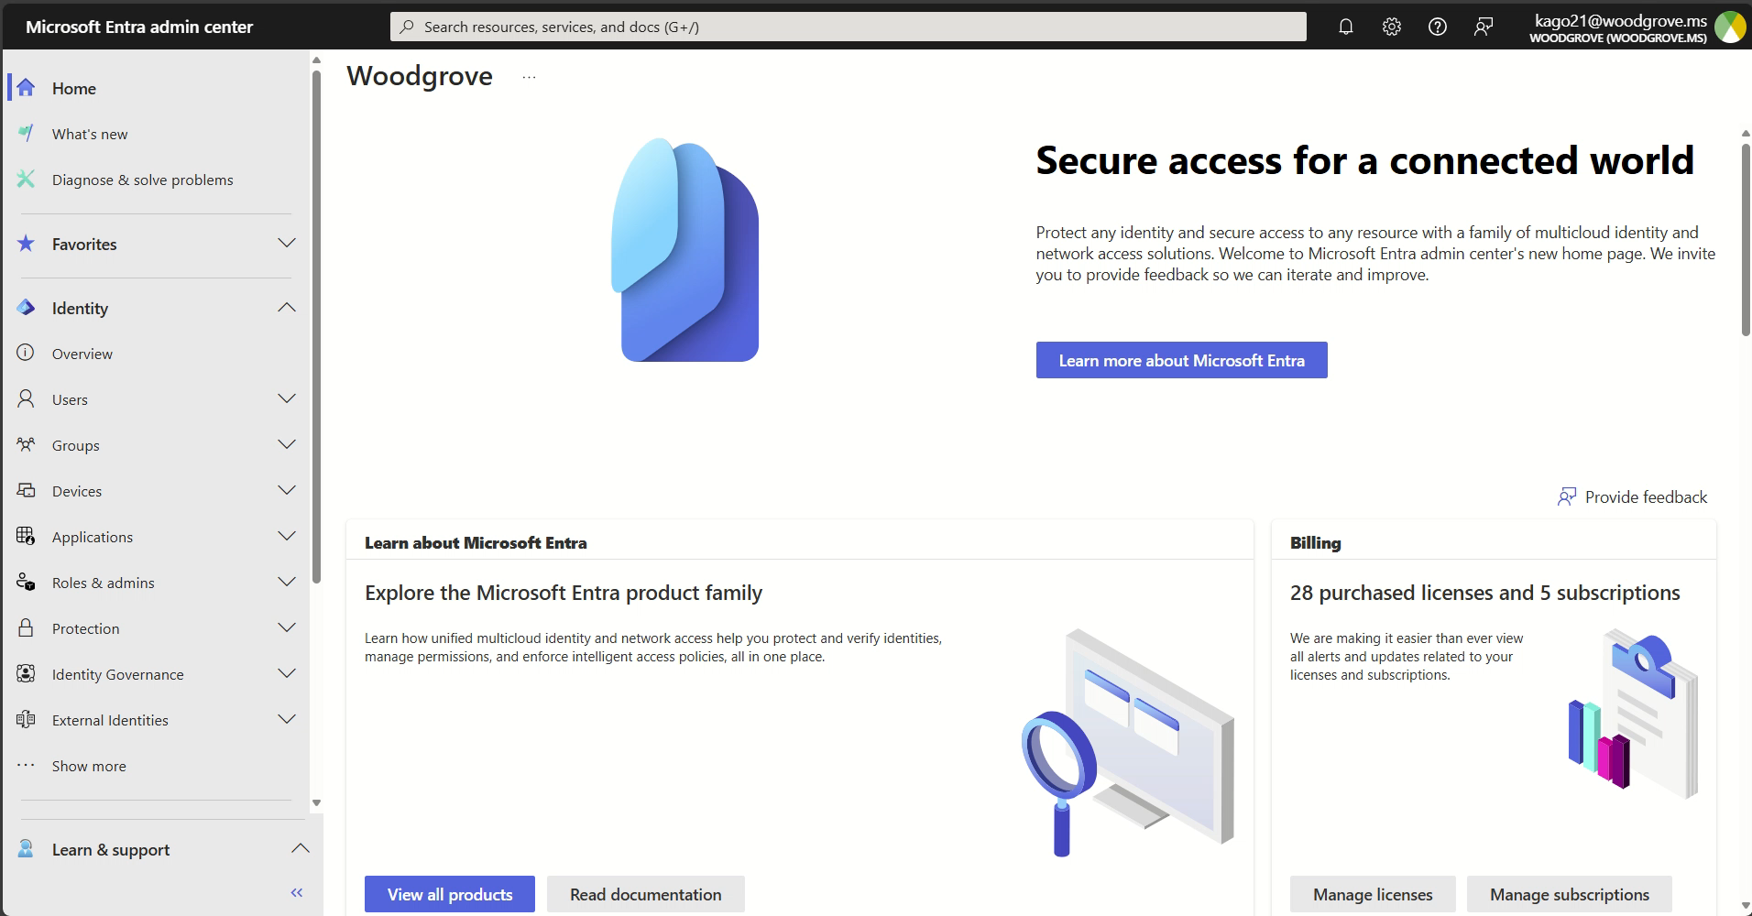
Provide only necessary access and automate access lifecycle
Grant access to the right resource in a single step · Get ML-based access recommendations · Automate identity workflows
Notes:
This brings me to one of the hero features in ID Governance: entitlement management. It allows you to create access packages for various roles, or even projects, to ensure that only the right users have access to the right access packages with the right approvals
You can maximize the power of entitlements management by combining it with Lifecycle Workflows. This way you can automate joint-move-leave scenarios, making it easy to give people access to the right access packages when they join or change roles, and to immediately revoke unnecessary access when they change roles or leave.

Slide 16





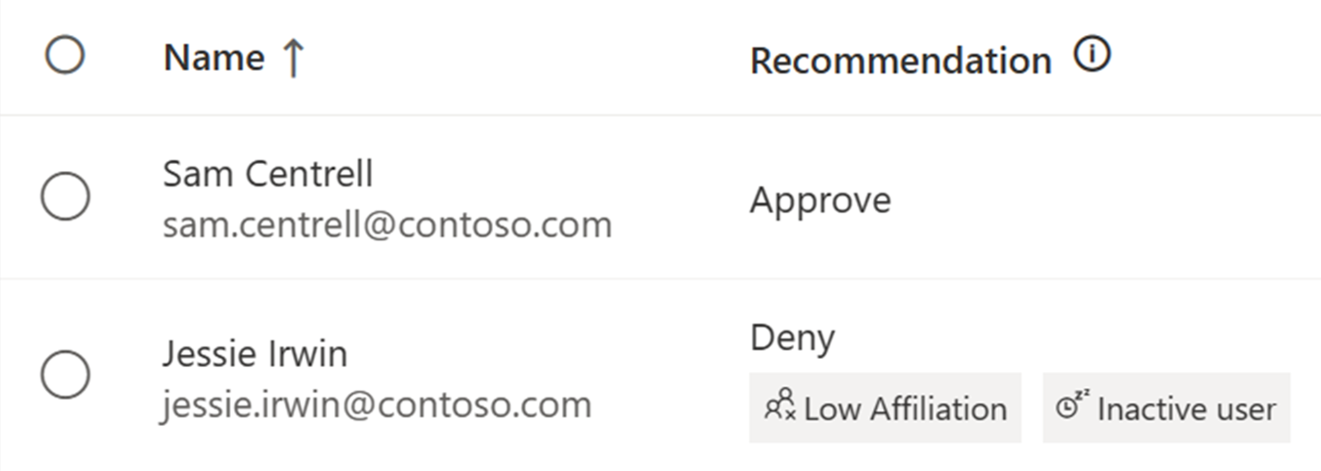

Simplify access reviews with ML-driven insights
Group affiliation calculated from organizational distance
ML-driven recommendations based on last sign-in date and group affiliation
Access Review rules
Last sign-in activity
Sam Centrell
18 days
Jessie Irwin
125 days
Inactive user detected based on last sign-in date
Notes:
An additional layer of control that you can leverage is access reviews
This means you can periodically ask people who are accountable for Teams groups, SharePoint sites, apps, or roles to review who has access and to confirm whether they still need it.
We all know how “fun” access reviews can be and how easy it can be to miss a user with holdover permissions.
To help reduce reviewer attestation fatigue, our machine learning algorithm makes intelligent recommendations and identifies any users whose access needs reassessment.

Slide 17















Extend least privilege access to web traffic and SaaS apps
Malicious and
non-compliant sites
Social media sites
External storage sites
Open GitHub repositories
Anonymous tenants
All users
Marketing Team
All users
Project X Team
All users
Known Repo
Unknown Repo
Known Tenants
Anonymous Tenants
Notes:
With Entra Suite, you can extend least privilege access to web destinations and enable scenarios that are only possible by combining identity and network security.
We’ve connected web filtering policy with Conditional Access. So now you can apply granular web filtering policies to different web destinations.
For example, you can block some web categories, let’s say gambling websites, for all users. You can enable access to other web categories, like social media, for specific groups of users if they rely on those channels to do their work. This may include marketing or customer support teams.
You can also require just-in-time access approvals for specific web destinations, for example, just-in-time access to external storage sites so that they are only available on an ‘as needed’ basis.

Slide 18



Secure access for your workforce
Microsoft Entra Suite
Streamline onboarding & identity lifecycle
Protect access to all
applications & AI
Secure & govern access to internet resources
Notes:
Let’s dive in to see how unifying identity and network access with the Microsoft Entra Suite allows your organization to streamline onboarding & identity lifecycle, protect access to all applications & AI, and secure & govern access to internet resources.
These next few demos will follow Violet Martinez, an employee at Woodgrove, through several role-based permission activities.

Slide 19


Streamline onboarding and identity lifecycle
Microsoft Entra Suite
Violet changes role within Contoso Bank from the marketing team to the finance team. On her first day, she needs access to her new team’s SharePoint, email distribution lists, and Teams channels.
Contextual
insights across
50+ categories
of organizations find managing employee lifecycle challenging
50%
Notes:
To start off, Violet has just transferred from marketing to Finance. And in her new role she’s going to have access to sensitive data, and she’ll be able to process high-value transactions. Lets take a look at how the Microsoft Entra Suite automates employee lifecycle to make sure Violet has the resources she needs for her new role.

Slide 20
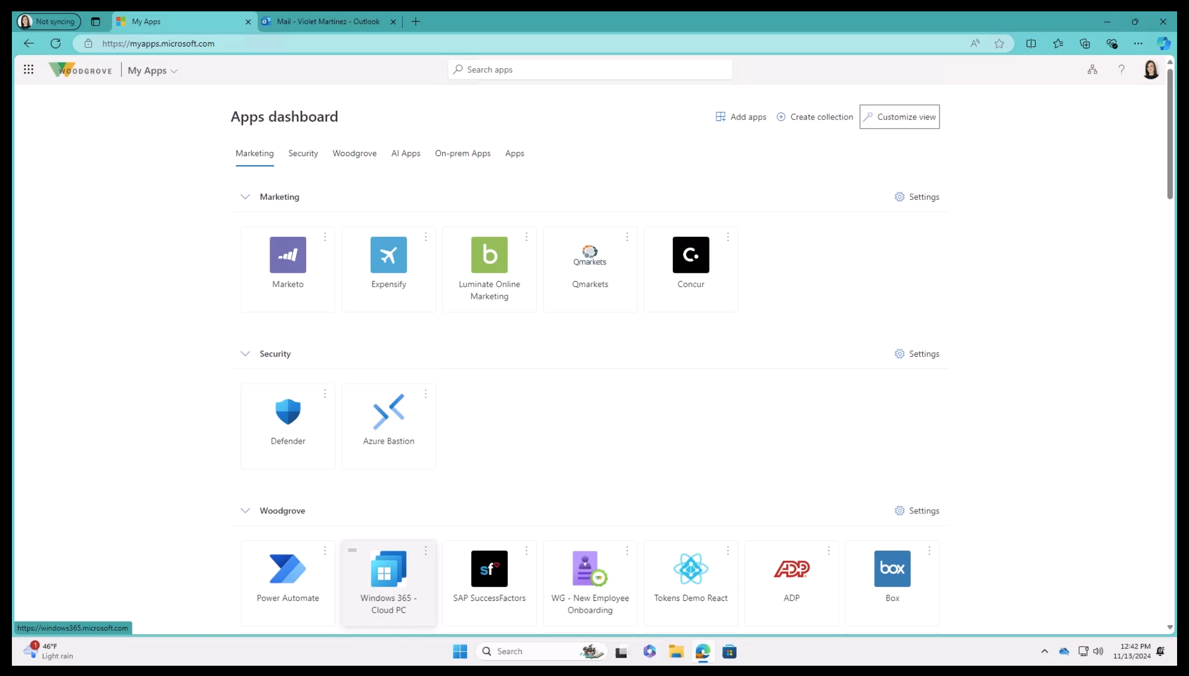
Video 1
Notes:
https://highlights.guide/clickthroughs/entra/streamlined-role-change.html?preload=1

Slide 21

Streamline onboarding and identity lifecycle
What happened
Violet received welcome email
Requested access to a new
access package
Verified her identity with Face Check
Lost access to resources she no longer needs
Products
Microsoft Entra ID Governance
Microsoft Entra Verified ID
Notes:
In this demo, we followed Violet Martinez on her first day as she transitioned from marketing to finance at Woodgrove. The process was simple and streamlined, thanks to the automated joiner-mover-leaver workflows.
Violet started by accessing her MyApps portal, where she found a welcome email from her new boss. With just a click, she landed in the MyAccess portal and requested a new access package for finance apps.
To ensure security, Violet completed a quick identity verification using Face Check with Entra Verified ID. She scanned a QR code, took a selfie, and her biometric data remained secure on her device.
After adding a business justification, her request was auto-approved. Violet now has access to finance apps and trading websites, while her marketing app access was automatically revoked.

Slide 22

Protect access to all applications and AI
Microsoft Entra Suite
Violet is traveling while working remotely for Contoso Bank and needs secure access to the company's internal servers to update software, access databases, and collaborate on sensitive projects.
Contextual
insights across
50+ categories
of organizations find it difficult to secure access to all apps for remote and hybrid workers
46%
Notes:
A few weeks have passed, and Violet is ramping up on her first project. One of her tasks is to prepare a summary of insights from the 20-year-old audit archives that are stored on a legacy fileshare…
Previously access to such file would require her to be in office, and would likely take a while to even get authorized.
But Woodgrove has enabled modern secure access to any app, from anywhere. And since this task requires focus, Violet decides to do it at home to avoid distractions.

Slide 23
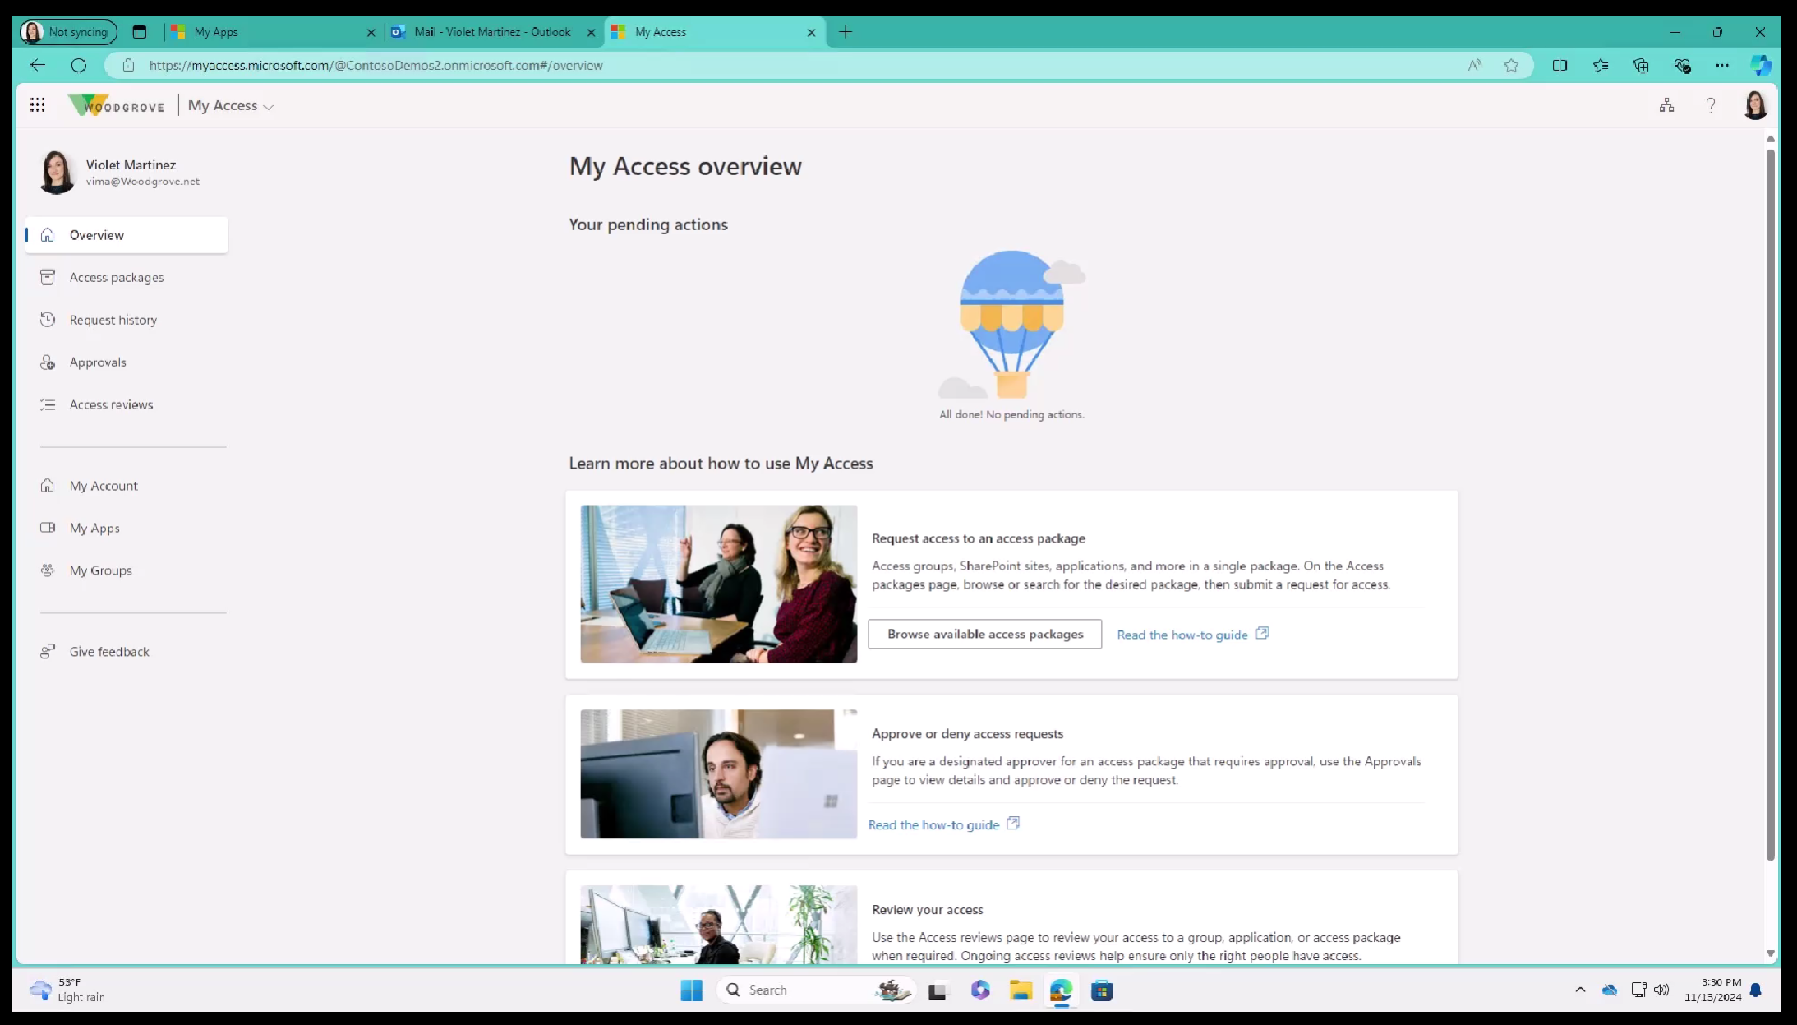
Video 2
Notes:
Microsoft Entra - Easy Remote Access

Slide 24

Protect access to all applications and AI
What happened
Violet requested access to an
access package
Accesses file share without needing
a VPN
Passkey is used to pass MF attempt
Products
Microsoft Entra Private Access
Microsoft Entra ID Protection
Microsoft Entra ID Governance
Notes:
To recap, we followed Violet Martinez as she requested access to finance audit archives at Woodgrove.
Violet started by searching for the finance audit archives package in the MyAccess portal and requested access. Her request was auto-approved in real-time based on policy.
Next, Violet opened the file share by typing in the access path, without needing cumbersome VPNs or other limitations. However, due to her frequent location changes, her user risk level was slightly elevated. Woodgrove enforced risk-based Conditional Access for finance apps, even for low-risk levels.
In response to the MFA prompt, Violet chose her passkey, scanned a QR code, and authenticated securely using her Authenticator app. Passkeys make phishing-resistant authentication simple—she clicked ‘sign-in with passkey,’ and then was granted access to the files she needed.

Slide 25


Secure and govern access to internet resources
Microsoft Entra Suite
Violet needs to share a highly sensitive financial statement document with a consultant through Dropbox.
Contextual
insights across
50+ categories
of organizations find it challenging to enforce least privilege access
46%
Notes:
Now Violet has one last thing to do.
She needs to share those audit insights and a financial statement with their consulting partner who is using Dropbox.

Slide 26
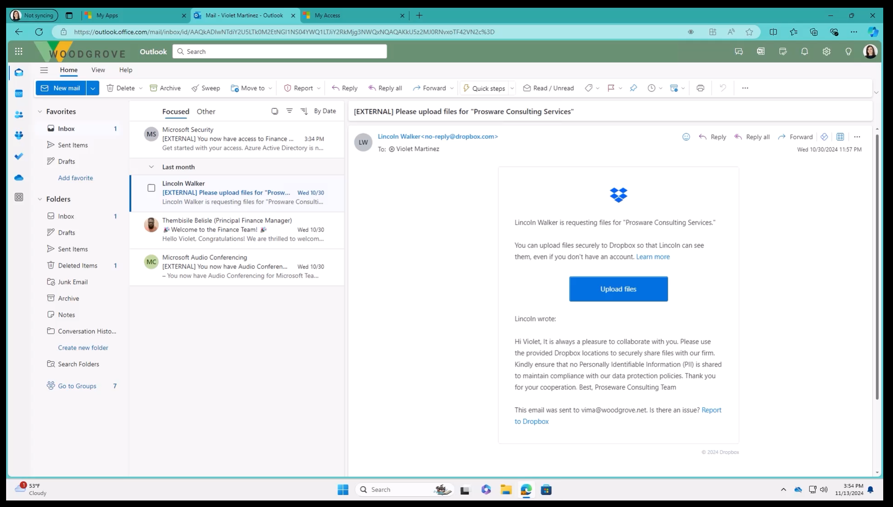
Video 3
Notes:
Secure internet access: https://highlights.guide/clickthroughs/entra/secure-internet-access.html

Slide 27


Protect access to all applications and AI
What happened
Violet received a link to
a Dropbox folder
Access was blocked and required
an exception
Access was approved temporarily
for 8 hours
Products
Microsoft Internet Access
Microsoft ID Governance
Notes:
To conclude, we watched as Violet uploaded documents to a partner’s Dropbox at Woodgrove. Thanks to the Microsoft Entra Suite, the process was simple and secure.
Violet received a secure link in her email to upload documents to the partner’s Dropbox. Initially, her access was blocked due to Woodgrove’s policy that prevents access to external storage sites to minimize data leak risks. However, because of the established relationship with the consulting firm, Woodgrove has a business exception that allows Finance employees temporary access to Dropbox based on business need.
From the MyAccess page, Violet requested just-in-time access to Dropbox for 8 hours. Her request was approved in real-time based on the business policy. Violet then accessed the partner’s secure Dropbox location and uploaded the files they were expecting.
This process involved just a couple of extra clicks for Violet, ensuring security by preventing standing access to external storage sites and providing an audit log and business justification for each point of access.

Slide 28
Recap of unified access demos
Microsoft Entra Suite
Streamline onboarding & identity lifecycle
Protect access to all
applications & AI
Secure & govern access to internet resources
Notes:
Throughout these demos we saw how the Microsoft Entra Suite unifies identity and network access, allowing Violet to have secure and simple experiences through onboarding and accessing applications regardless of her work location.
Violet's transition from marketing to finance was seamless, with automated workflows ensuring she had the necessary access while revoking permissions she no longer needed.
Then, she was able to access finance audit archives without legacy VPNs and with phishing-resistant allowing her to have secure access from anywhere.
Lastly, Violet's secure and temporary access to Dropbox for sharing sensitive documents showcase how Entra Suite allowed her to enforce just-in-time access and maintain productivity without sacrificing security.

Slide 29






Reduce your security on-premises footprint
Microsoft Entra Internet Access
Microsoft Entra Private Access
Microsoft Entra
ID Governance
Microsoft Entra Suite
Basic Secure Web
Gateway (SWG)
Firewalls
Legacy VPNs
On-premises identity governance
Paper-based
identity verification
Notes:
Microsoft Entra is designed to extend modern security controls to on-premises resources, so you can operate your hybrid environment securely and modernize your infrastructure on your own schedule.
With Entra Suite, you can secure and manage your assets from the cloud and retire multiple on-premises security tools.

Slide 30
Reduce your security on-premises footprint
Microsoft Entra Suite
Microsoft Entra Internet Access
Microsoft Entra Private Access
Microsoft Entra
ID Governance
RETIRED
RETIRED
RETIRED
RETIRED
RETIRED
Basic Secure Web
Gateway (SWG)
Firewalls
Legacy VPNs
On-premises identity governance
Paper-based
identity verification
Notes:
If you’re using traditional firewalls and VPNs, Entra Private Access can give you more granular control over access to all your private resources.
If you’re using a legacy Secure Web Gateway, Entra Internet Access delivers a better solution to protect against malicious internet traffic and other threats of open internet.
If you’re using Microsoft Identity Manager (MIM), you can transition to Entra ID Governance in stages, even reusing your existing MIM connectors for scenarios like provisioning identities from HR applications.
And finally, you can replace cumbersome paper-based identity verification processes with a real-time and privacy respecting approach, powered by Microsoft Entra Verified ID.

Slide 31
Microsoft
Entra Suite
Access to all
apps & resources
Any employee
Cloud-based & on-premises identities, groups & roles
AI
Any location
HQ, branch office, home, remote
IaaS, PaaS, Datacenter
Secure Zero Trust access
for your workforce
Any platform
Android, iOS, Linux, MacOS, Windows
SaaS, websites
Any device
Corporate & personal
On-premises
Notes:
To recap, the Microsoft Entra Suite is a complete Zero Trust user access solution that unifies access policy across identities, endpoints, and networks, enforces least privilege access to all resources, simplifies the user experience, and reduces your on-premises security solutions footprint.

Slide 32
















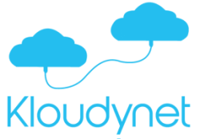





















Microsoft Entra Suite Partner Ecosystem

Slide 33




Your first 90 days
Accelerating your Zero Trust strategy with the Microsoft Entra Suite
Deploy risk-based Conditional Access
Conduct an
access review to remove unnecessary access
Try out internet traffic filtering policies
Discover on-premises apps and add them to Microsoft Entra
Automate employee onboarding with lifecycle workflows
Notes:
Here’s what you can get started to achieve with the Microsoft Entra Suite in your first 90 days:
Deploy security controls to enhance identification of risky users with Microsoft Entra ID Protection
Conduct an access review to ensure appropriate system access with Microsoft Entra ID Governance
Protect internet traffic with secure web gateway with Microsoft Entra Internet Access
Deprecate costly VPN systems through quick access with Microsoft Entra Private Access
Automate employee onboarding with lifecycle workflows with Microsoft Entra ID Governance
--------------------------------------------------------------------------------------------------------------------------------------------------------------------
[Suggested talk track:]
Here’s a glimpse at what you can get started to achieve with the Microsoft Entra Suite in your first 90 days.
One way to get started securing access for your workforce is to deploy security controls and enhance identification of risky users with Microsoft Entra ID Protection
You can also cuduct access reviews to ensure appropriate system access, and automate employee lifecycle workflows with Microsoft Entra ID Governance
With our SSE offering, composed of Microsoft Entra Internet Access and Private Access, you have a secure web gateway to internet traffic, and a zero-trust network access solution to deprecate costly VPN systems through quick access.

Slide 34

Get started with the Microsoft Entra Suite!
Come chat with our Microsoft Entra experts at booth #5744
Start your trial: aka.ms/EntraSuiteTrial
Notes:
Our experts are here all week and would love to chat with you on how the Microsoft Entra Suite can help you upgrade your identity and network access strategy. Please feel free to come up to chat after this session or come meet with us at booth #5744

Slide 35
We have an exciting future ahead.
Notes:
Thank you.
<Speaker Guidance: Spend the last few minutes discussing or answering any questions they may have. If they have additional topics on their EBC agenda, make sure you connect with their account team to inform them which AI priorities and business outcomes resonated the most during this session. If you are in a 1:1 direct customer engagement, make sure you note what their priorities and questions were and work with the broader account teams and units to facilitate the proper hand-offs or next steps (i.e. get them into a session at the Innovation Hub/MTCs).>

Slide 36
Expertise and tools for your journey
Technical expertise via our FastTrack partners
Tools, resources & training on our Adoption Hub
Events and real-world knowledge in our community
aka.ms/Microsoft/FastTrack
adoption.microsoft.com
aka.ms/TechCommunity
Notes:
Please leave this slide in for conference attendees.

Slide 37
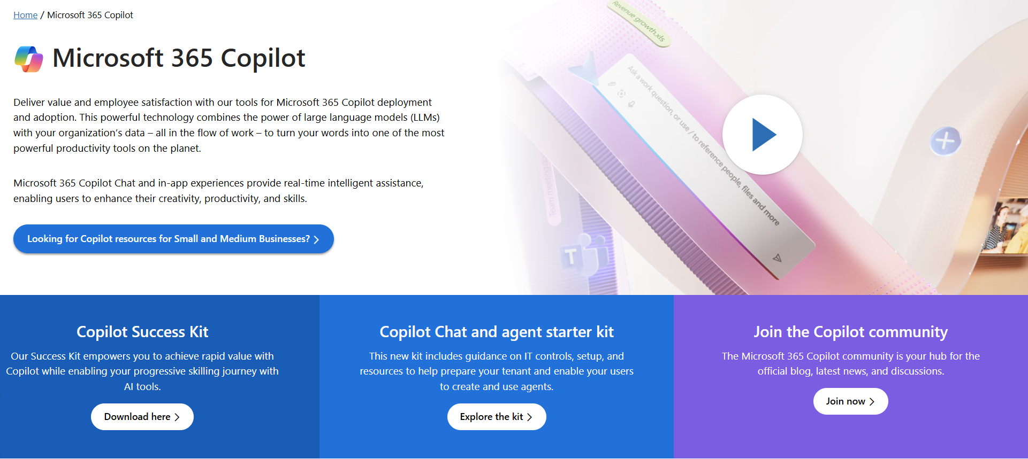
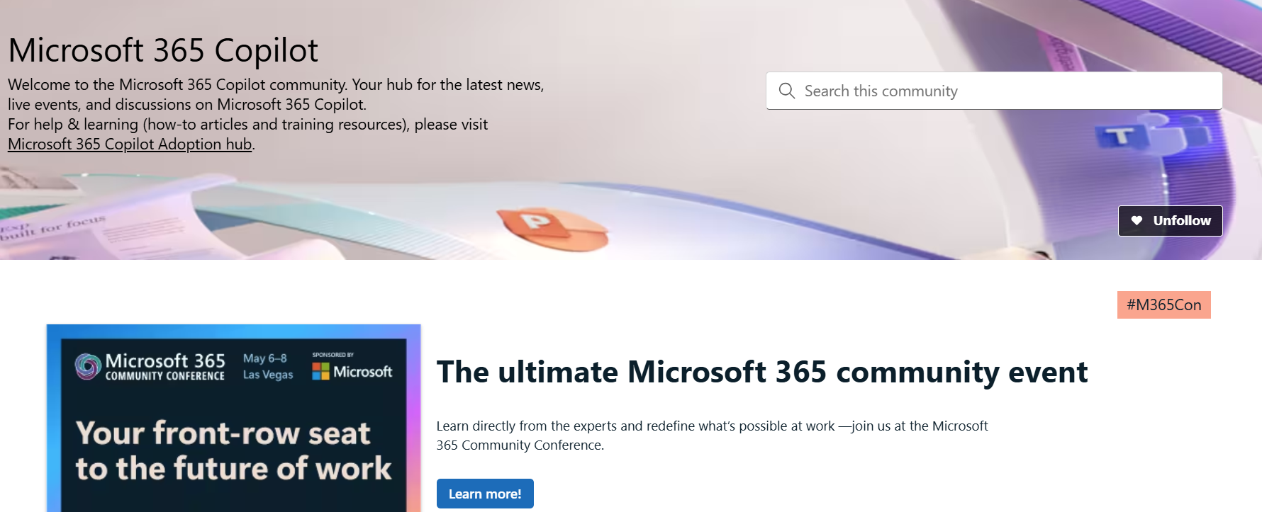
News & community content
Microsoft Community Learning aka.ms/Community/LearningChannel
Community led expert content on all your favorite Microsoft services.
Start your week with live news and event updates aka.ms/MondaysatMicrosoft
Watch live or on-demand & share our blog.
Notes:
To help you with adoption, the Copilot Readiness Hub is an open one stop shop for content, organized by role for your Copilot for Microsoft 365 journey.
You can use its recommendations to prepare and plan for your deployment, create a user experience strategy as I’ve presented today, and an adoption plan.
And as Copilot continues to evolve, keep coming back for new content that is published regularly.
You can also join the Copilot for Microsoft 365 community to get your questions answered and meet others who are leveraging Copilot for Microsoft 365 right now.

Slide 38
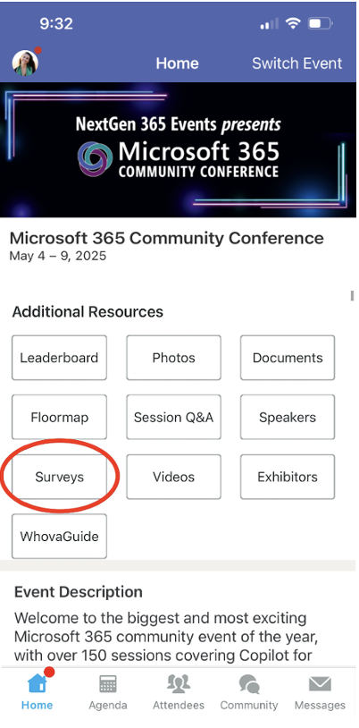
Session feedback surveys
We want to hear from YOU!
Share your feedback to make next years conference even better!
Here’s how –
Simply go to the Whova App on your smartphone.
Scroll down on the M365 Community Conference Homepage to ‘Additional Resources’ to click “Surveys’.
Click Session Feedback.
Scroll down to find this session title.
Complete the session feedback survey.
Finally, click ‘Submit’.
It’s just that easy!

Slide 39
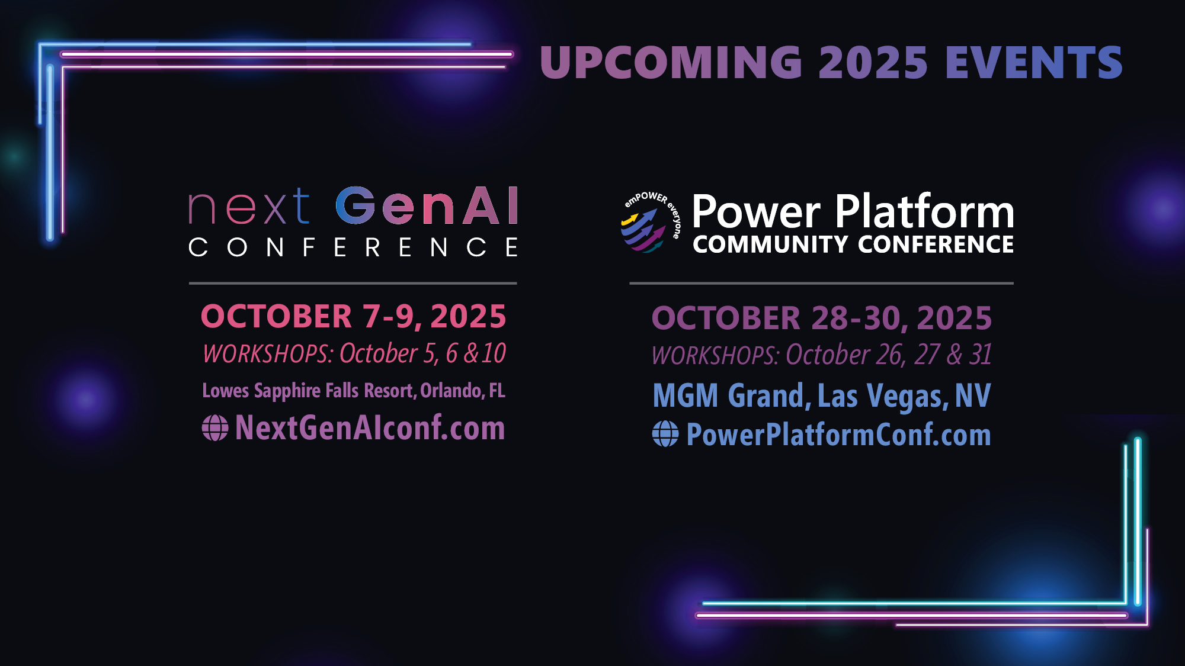

Slide 40
Closing slide

