Slide 1
Untangling this thing called AI
Copilot+ PCs | M365 Copilot | and more

Slide 2

Microsoft 365 Community Conference

Slide 3


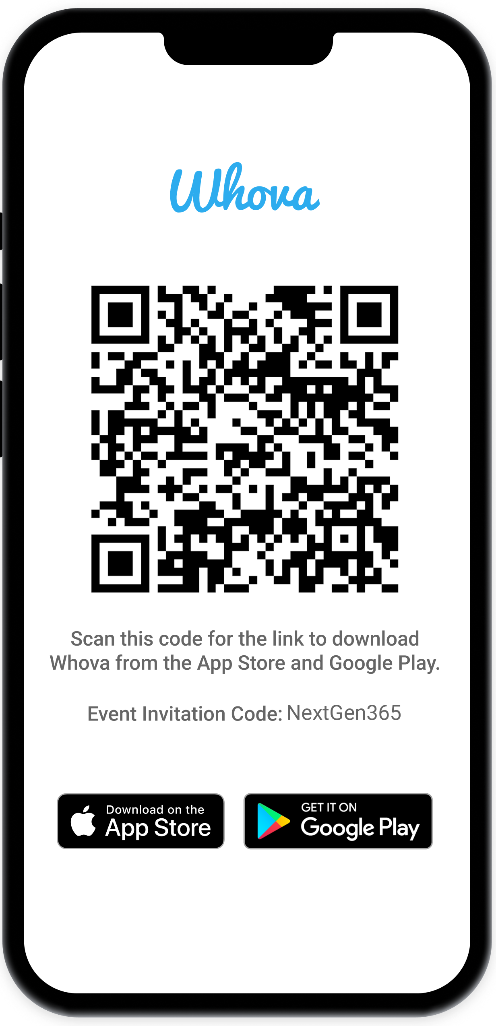
Join the event app to access:
The official event app for the
Microsoft 365 Community Conference
Event invitation code: NextGen2025
Event announcements
Personalized agenda, session details
Speaker & attendee profiles
Networking, meet-ups, messages
Event documents

Slide 4


Aria Hanson
Principal Group Product Manager
X @ariaupdated

Slide 5
Agenda
Fundamentals of AI
Security and Compliance
Data Privacy and Management
Leveraging AI for your own Applications
Develop Better with GitHub Copilot
How AI can Enable Users to Do More
M365 Copilot
Copilot+ PC features
Summary

Slide 6

Security and Compliance
All of our AI platforms are built with robust security features to ensure data protection and compliance with industry standards. This allows businesses to adopt AI solutions with confidence, knowing their data is secure.

Slide 7
AI Runs on Data
Microsoft Purview + Fabric together provide seamless data governance and management. Purview offers data cataloging, classification, and protection, while Fabric enables data storage, analysis, and integration. This integration ensures consistent application of data governance policies across the entire data estate, enhancing security, compliance, and usability.
Data Privacy and Control
Data Platform
Microsoft Purview is a comprehensive data governance, security, and compliance solution that offers a unified data catalog, data mapping, and robust security features like Data Loss Prevention (DLP) and information protection. Purview ensures that data is accessible, secure, and compliant with regulatory requirements, making it AI-ready.
Microsoft Fabric is an AI data platform that provides a unified way to manage and reason over data, regardless of where it resides. This platform ensures that data is accessible and usable for AI applications, facilitating better decision-making and insights.

Slide 8
Build your own Applications that leverage AI
01 Run Models on the Client
Windows Copilot Runtime (WCR) has a library of models that can be run using the power of the NPU in Copilot+ PCs to have your App take advantage of the local processing power for models. You can also leverage ONNX runtime to bring your own model(s) to the platform.
01
02
03
03 Run Models in the Cloud
Azure AI Foundry is an AI application server designed for building real-world, AI-native applications. It supports the development of sophisticated AI solutions that can be integrated into various business processes.
02 Hybrid (Combine both Client + Cloud)

Slide 9
Develop Better with GitHub Copilot
GitHub Copilot helps you code better by providing AI-powered code suggestions directly within your code editor. It assists with:
Code Completion: Offers real-time code completions and suggestions as you type
Function Suggestions: Suggests entire functions or code snippets based on the context of your code.
Error Reduction: Helps reduce syntax and logical errors by providing accurate code suggestions.
Learning Aid: Demonstrates how to implement various coding patterns and best practices.
Documentation: Generates comments and documentation for your code, improving readability and maintainability.
Overall, GitHub Copilot enhances productivity, reduces coding errors, and helps you learn new coding techniques.

Slide 10
Enable End Users to be More Productive
M365 + Windows

Slide 11
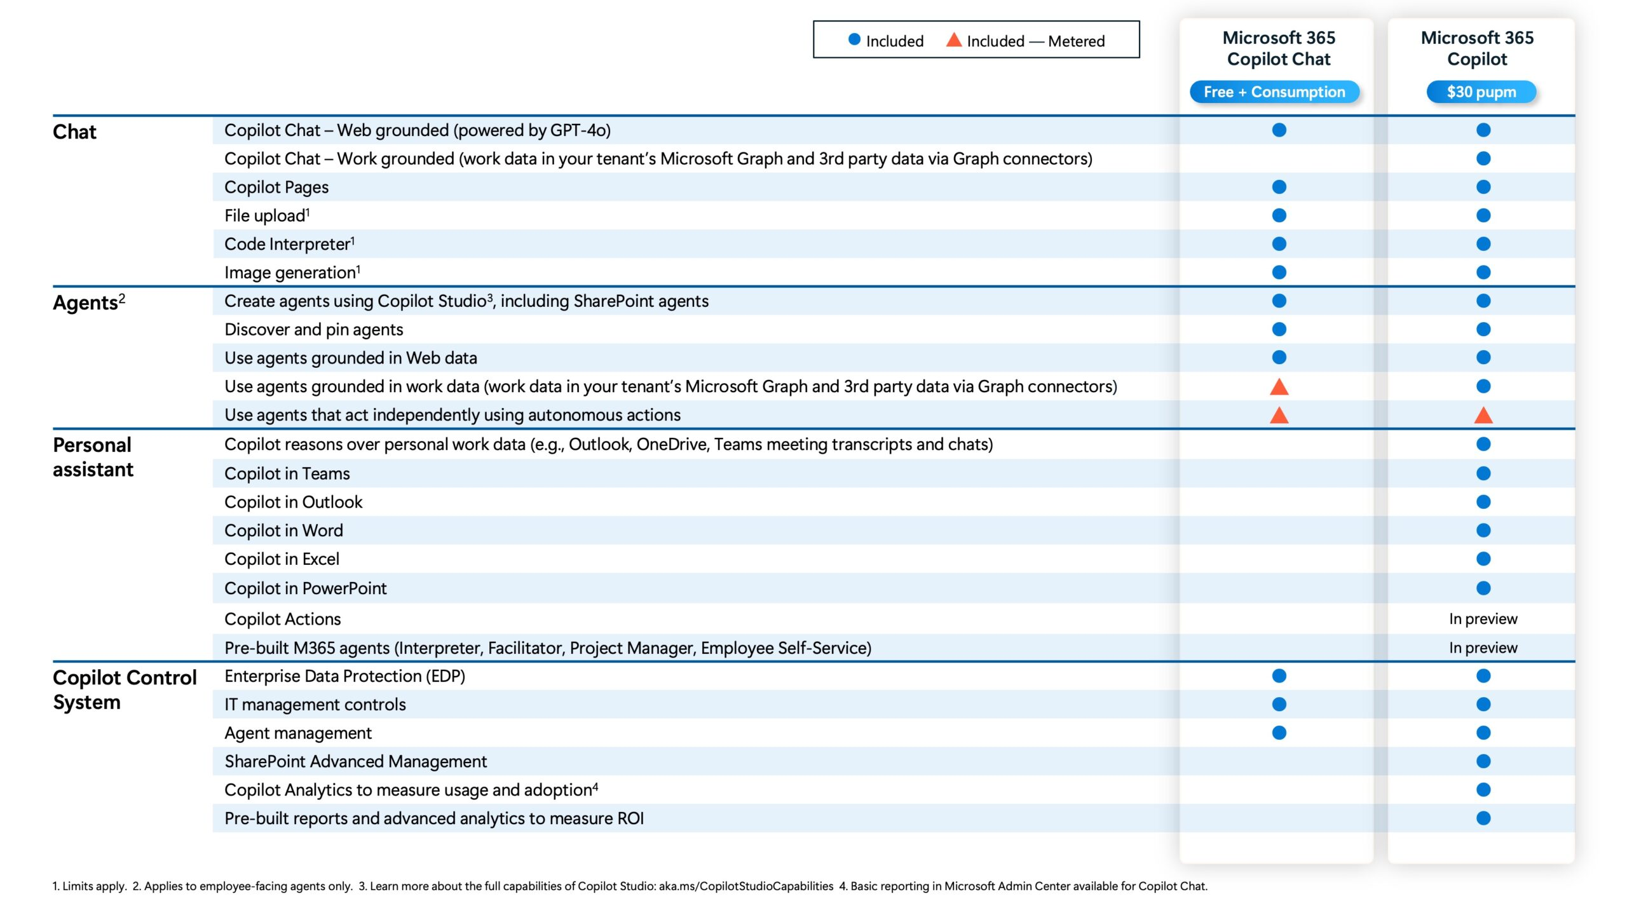
M365
Included
Only on specific hardware

Slide 12
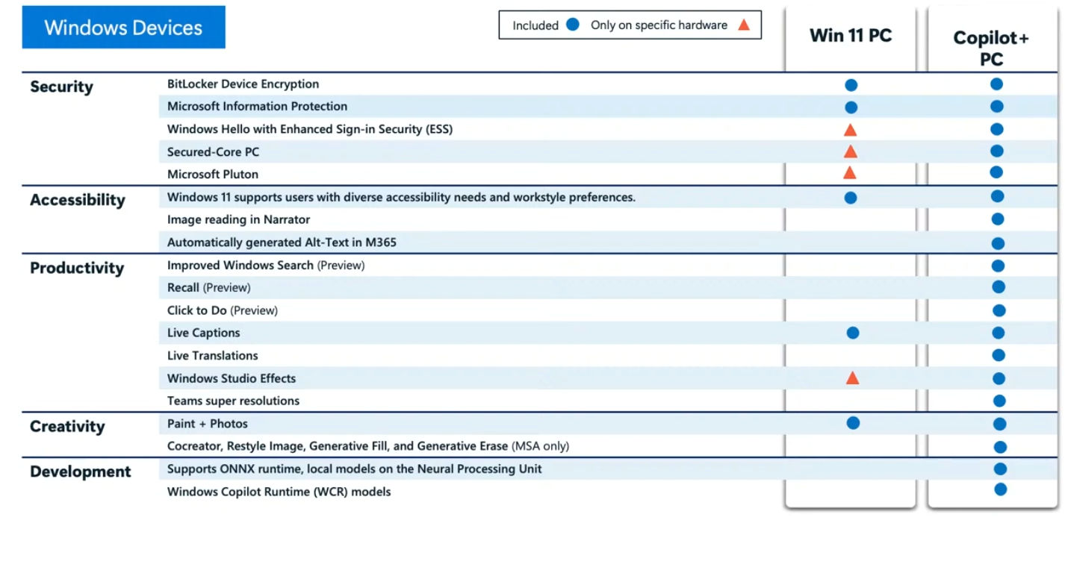

Slide 13
Let’s look at how you can use these tools in practice
M365 Copilot + Copilot+ PC
Notes:
-

Slide 14
Show
Recall
Settings (show off and management)
Intune policies to manage such
Try Bluetooth in settings spelled wrong
The AI models
Use Copilot to turn this deck into a blog
Auto Generate meetings notes with Teams

Slide 15
Overview of Microsoft AI Offerings for Commercial
 | Win 11 PC | Copilot+ PC
With M365 Copilot subscription | M365 Copilot Chat Summarize, rewrite, form table in all M365 products using the cloud Automatically generate meeting notes Create customized agents | M365 Copilot Chat Summarize, rewrite, form table in all M365 products using the cloud Automatically generate meeting notes Create customized agents Improve video resolution when talking to someone with low bandwidth in Teams
With M365 | M365 Copilot Chat | M365 Copilot Chat Improved Windows Search Enhanced Studio Effects in Teams Recall M365 integrations Improved Narrator Summarize and rewrite while keeping all data local in Outlook (Coming soon)
MSA users | Copilot | Copilot
For Developers:
With Azure AI Services | Suite of AI services and tools on the Azure cloud platform, including machine learning, cognitive services, and Azure OpenAI Service. | Suite of AI services and tools on the Azure cloud platform, including machine learning, cognitive services, and Azure OpenAI Service. Create hybrid models using the cloud power of Azure AI services and the Windows Copilot Runtime (WCR) library, ONNX Runtime Supports NPU-optimized versions of models like DeepSeek R1
With GitHub Copilot | Code completion tool that assists developers by suggesting code snippets and entire functions | code completion tool that assists developers by suggesting code snippets and entire functions

Slide 16
References
[1] The value of AI: How Microsoft’s customers and partners are creating ...
[2] Copilot for all: Introducing Microsoft 365 Copilot Chat
[3] Microsoft Outlines US$80bn AI Investment Plan for 2025
[4] The First Purview AMA of 2025 is Now On-Demand | Microsoft Community Hub
[5] Microsoft Purview data governance pricing announcement
[6] Fast-track generative AI security with Microsoft Purview
[7] Use Microsoft Purview to govern Microsoft Fabric
[8] Connect to and manage your Microsoft Fabric tenant
[9] The Microsoft Purview hub in Microsoft Fabric - Fabric administrators ...
[10] Use Microsoft Purview to govern Microsoft Fabric
[11] The First Purview AMA of 2025 is Now On-Demand | Microsoft Community Hub
[12] Microsoft Purview data governance pricing announcement
[13] Fast-track generative AI security with Microsoft Purview
[14] ONNX Runtime
P.s. this list (and most of this presentation) was created with the help of M365 Copilot – simply ask Copilot for “Resources on Microsoft AI for M365 Copilot, Copilot+ PCs, Git Hub Copilot, and more!”

Slide 17
Expertise and tools for your journey
Get Insights and shape the future of AI by joining the Windows customer connection program
Trak blogs, events and real-world knowledge in our community
aka.ms/JoinWCCP
aka.ms/TechCommunity
Notes:
Please leave this slide in for conference attendees.

Slide 18
Q & A
Notes:
Thank you.
<Speaker Guidance: Spend the last few minutes discussing or answering any questions they may have. If they have additional topics on their EBC agenda, make sure you connect with their account team to inform them which AI priorities and business outcomes resonated the most during this session. If you are in a 1:1 direct customer engagement, make sure you note what their priorities and questions were and work with the broader account teams and units to facilitate the proper hand-offs or next steps (i.e. get them into a session at the Innovation Hub/MTCs).>

Slide 19
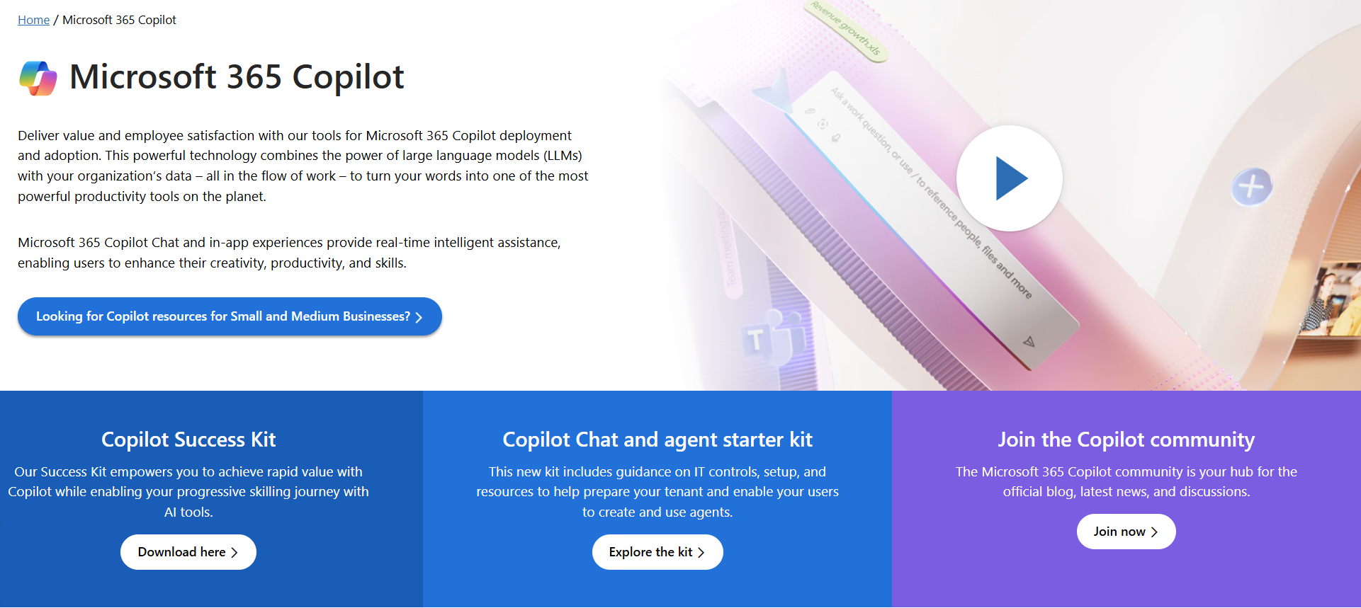
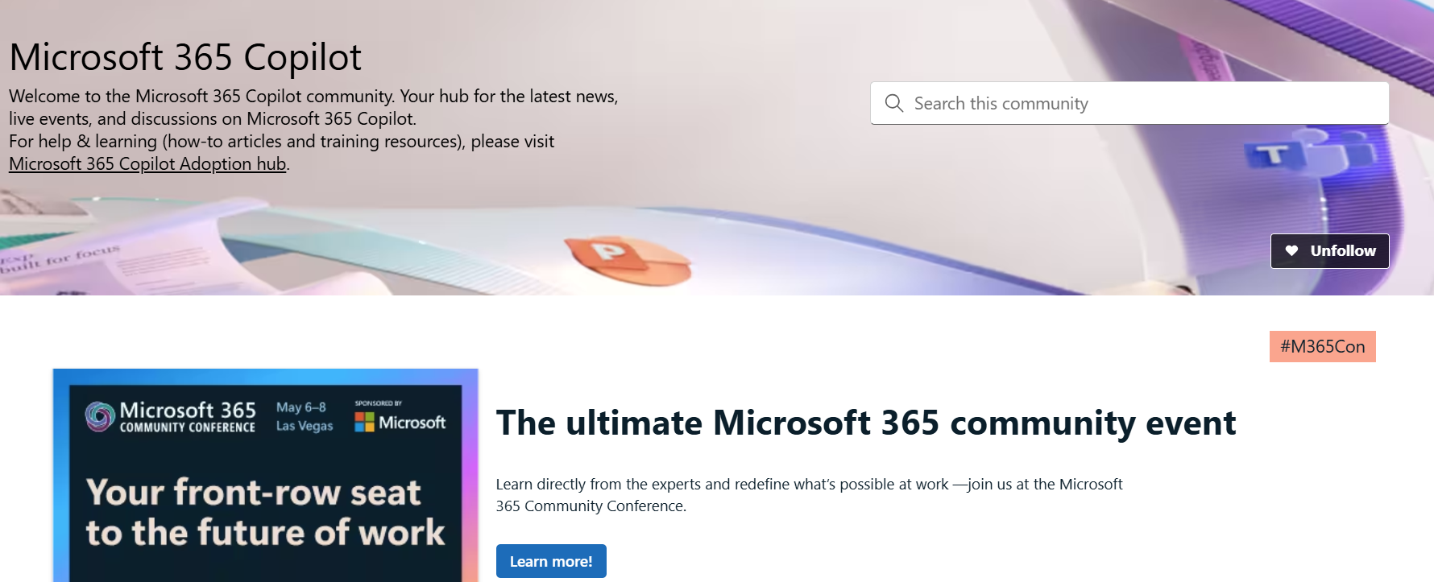
News & community content
Microsoft Community Learning aka.ms/Community/LearningChannel
Community led expert content on all your favorite Microsoft services.
Start your week with live news and event updates aka.ms/MondaysatMicrosoft
Watch live or on-demand & share our blog.
Notes:
To help you with adoption, the Copilot Readiness Hub is an open one stop shop for content, organized by role for your Copilot for Microsoft 365 journey.
You can use its recommendations to prepare and plan for your deployment, create a user experience strategy as I’ve presented today, and an adoption plan.
And as Copilot continues to evolve, keep coming back for new content that is published regularly.
You can also join the Copilot for Microsoft 365 community to get your questions answered and meet others who are leveraging Copilot for Microsoft 365 right now.

Slide 20
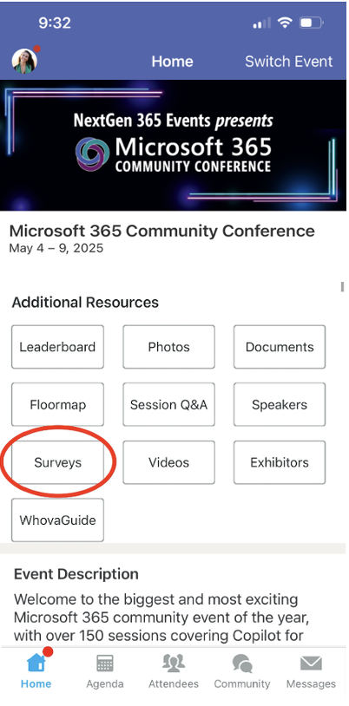
Session feedback surveys
We want to hear from YOU!
Share your feedback to make next years conference even better!
Here’s how –
Simply go to the Whova App on your smartphone.
Scroll down on the M365 Community Conference Homepage to ‘Additional Resources’ to click “Surveys’.
Click Session Feedback.
Scroll down to find this session title.
Complete the session feedback survey.
Finally, click ‘Submit’.
It’s just that easy!

Slide 21
