Slide 1
Teams apps and agents management : New tools for IT admins
Shruti Dhir
Brian Nguyen
5/8/2025

Slide 2

Microsoft 365 Community Conference

Slide 3


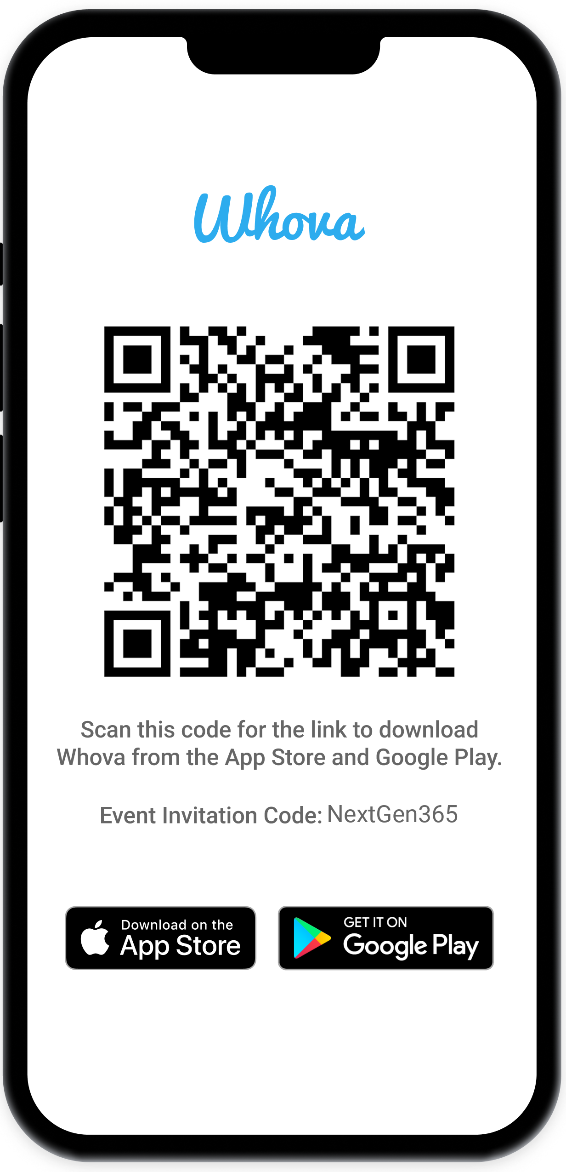
Join the event app to access:
The official event app for the
Microsoft 365 Community Conference
Event invitation code: NextGen2025
Event announcements
Personalized agenda, session details
Speaker & attendee profiles
Networking, meet-ups, messages
Event documents

Slide 4


Speakers
Shruti Dhir
Senior Product Manager, Teams
Brian Nguyen
Senior Product Manager, Teams
/brianjnguyen

Slide 5
Apps in Teams App store
Notes:
Thank you.
<Speaker Guidance: Spend the last few minutes discussing or answering any questions they may have. If they have additional topics on their EBC agenda, make sure you connect with their account team to inform them which AI priorities and business outcomes resonated the most during this session. If you are in a 1:1 direct customer engagement, make sure you note what their priorities and questions were and work with the broader account teams and units to facilitate the proper hand-offs or next steps (i.e. get them into a session at the Innovation Hub/MTCs).>

Slide 6
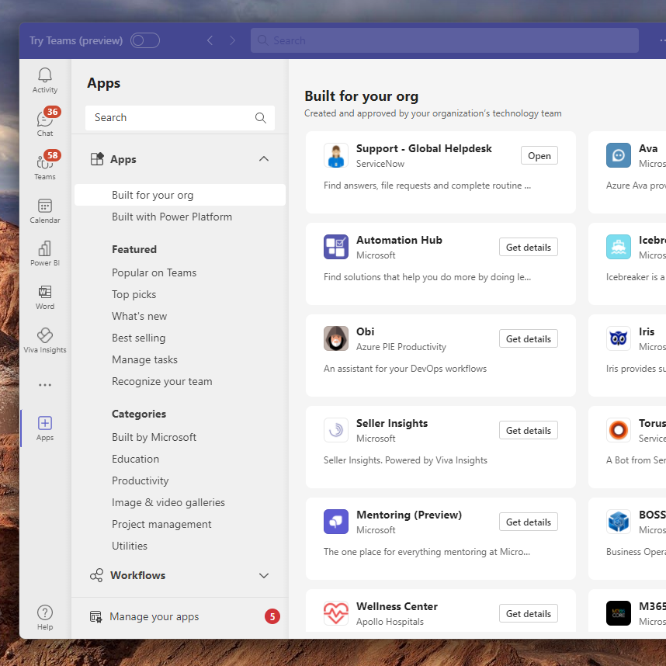
Teams app store
High-quality apps that enhance productivity, streamline workflows, and facilitate seamless cross-platform collaboration.
Includes Microsoft, third-party developers, and custom apps.
Admins manage the availability and track app usage reports from Microsoft Teams admin center

Slide 7
Evaluating Third-party apps
Notes:
Thank you.
<Speaker Guidance: Spend the last few minutes discussing or answering any questions they may have. If they have additional topics on their EBC agenda, make sure you connect with their account team to inform them which AI priorities and business outcomes resonated the most during this session. If you are in a 1:1 direct customer engagement, make sure you note what their priorities and questions were and work with the broader account teams and units to facilitate the proper hand-offs or next steps (i.e. get them into a session at the Innovation Hub/MTCs).>

Slide 8




Challenges in 3P app evaluation
What App Evaluation Looks Like Today
IT Admins spend months in the app evaluation process – understanding app trust information and evidence, following the same process for every single app.
1
Customer “1” send ISV “A” their questions, receives ISVs information
A
This pattern repeats between every customer and every ISV for every app
2
B
…
…

Slide 9
App Evaluation Landscape
IT admins are apprehensive about allowing the use of apps within their tenant
Application Security
Permissions
Penetration Testing
Operational Security
Anti-Malware, Incident Response, Firewalls, Vulnerability Scanning, Risk Management, more..
Data Handling Security and Privacy
Data Encryption (At-Rest, In-Transit), Data Retention, Data Disposal, Data Access Management, GDPR
Certifications
SOC2, PCI-DSS, ISO27001, FedRAMP

Slide 10

Making app evaluation easy
Any customer can find answers from ISVs in one place
ISVs only needs to submit answers once to reach all customers
1
A
Facilitating IT admins in the app evaluation journey, building Trust in the Microsoft 365 apps and agents Enterprise catalog
2
Microsoft
B
…
…

Slide 11
Tools for IT-admins
Notes:
Thank you.
<Speaker Guidance: Spend the last few minutes discussing or answering any questions they may have. If they have additional topics on their EBC agenda, make sure you connect with their account team to inform them which AI priorities and business outcomes resonated the most during this session. If you are in a 1:1 direct customer engagement, make sure you note what their priorities and questions were and work with the broader account teams and units to facilitate the proper hand-offs or next steps (i.e. get them into a session at the Innovation Hub/MTCs).>

Slide 12
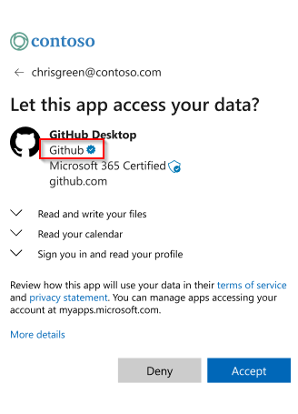



Microsoft 365 app compliance program
Publisher attested apps
Self-attestation done by developers providing customers with security, data handling, privacy, and compliance info.
Verified publisher
Microsoft 365 certified apps
Apps audited by Microsoft against industry standards and controls for security, compliance, and data handling practices.
Certified app
Verifies publishers and certifies applications
Vet applications against controls derived from industry standard security frameworks (ISO 27001, PCI DSS, SOC2, FedRamp)
Security and compliance information is published in a consistent format for customer use
Watch the App Compliance Program Video to learn more

Slide 13
New Tools for IT admins
1
Access Apps & agents trust data
2
Enable Trusted apps at scale
Enabling IT admins to access App Trust information and evidence right from Teams admin center
Ability to manage the availability of trusted and safe apps based on pre-defined rules
*Available today in Teams admin center & Microsoft 365 admin center
*Coming soon in 60-90 days (part of public roadmap)

Slide 14
1. Access Apps & agents trust data
Empowering IT admins with access to App Trust information and evidence inside Admin center. Making per-app evaluation faster, by providing answers and evidence to common questions of the IT team, as part of the App catalog.
Application Security
Operational Security
Data handling security & privacy
Certification

Slide 15
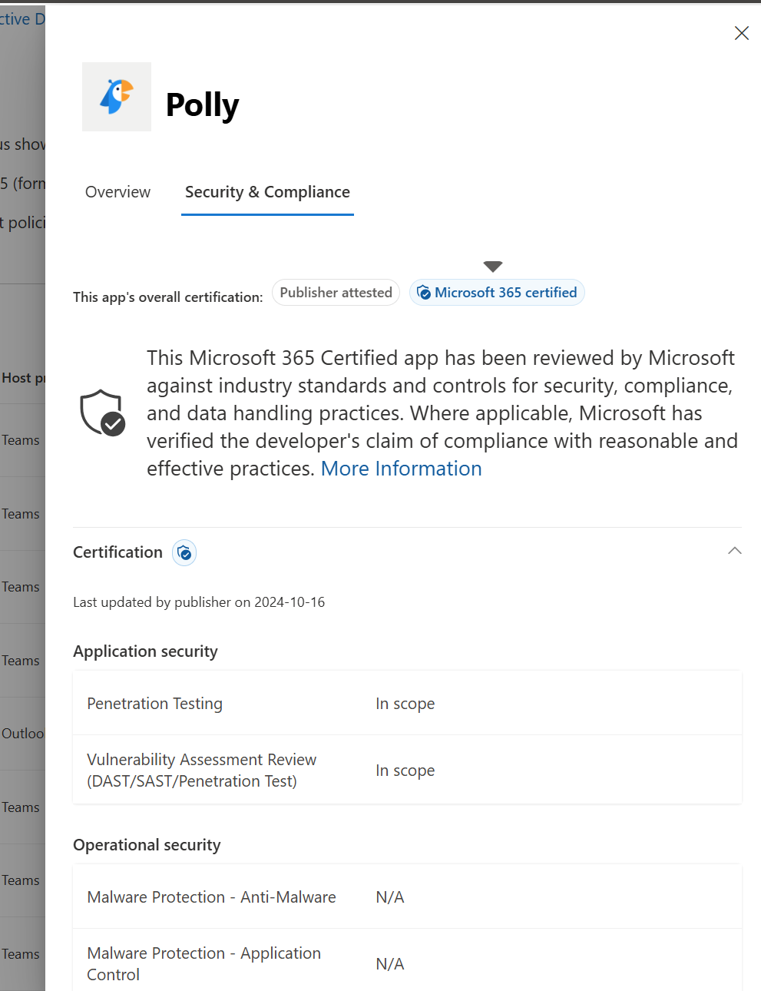
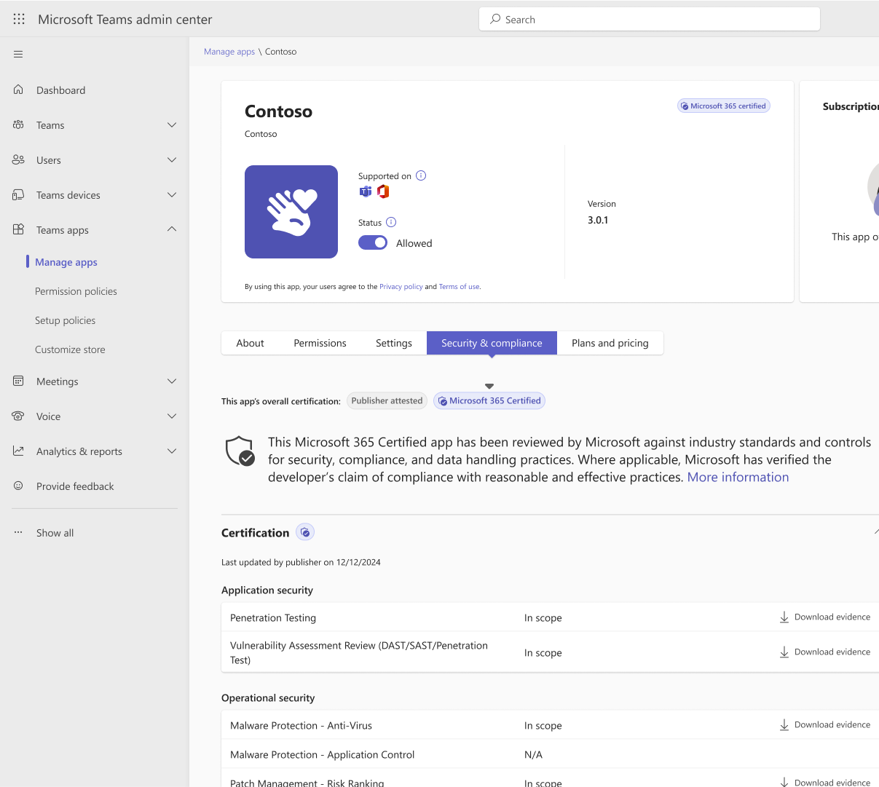
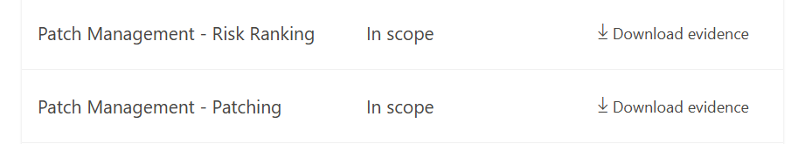
Apps and Agents Trust information and evidence
Microsoft admin center
Teams Admin Center

Slide 16
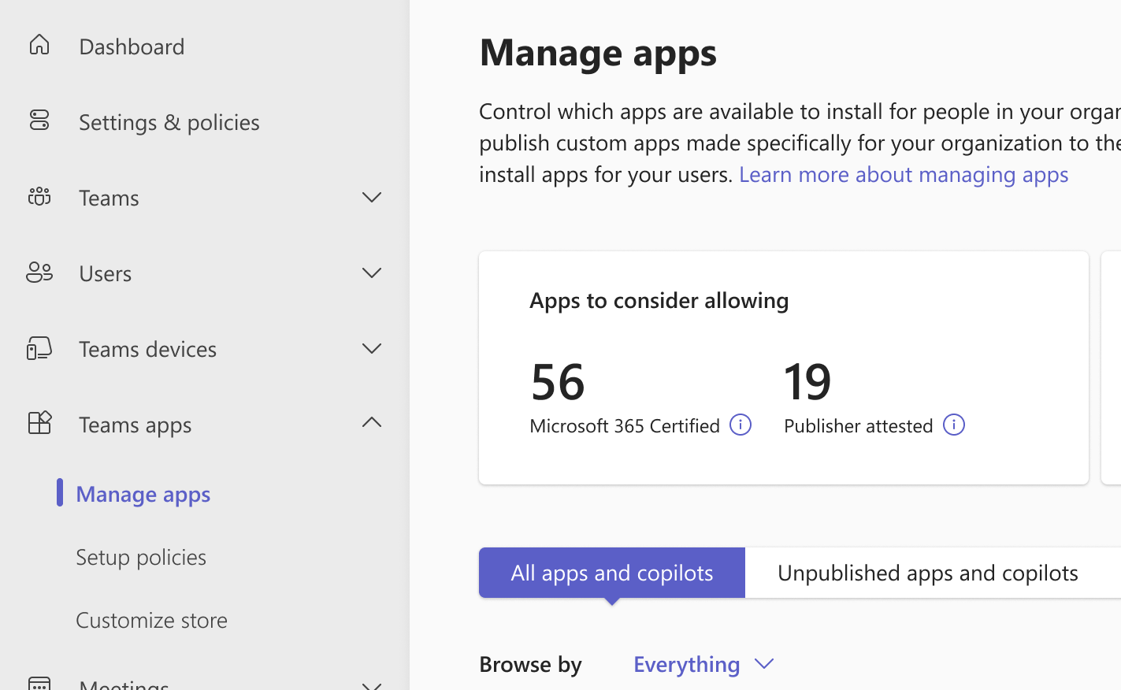
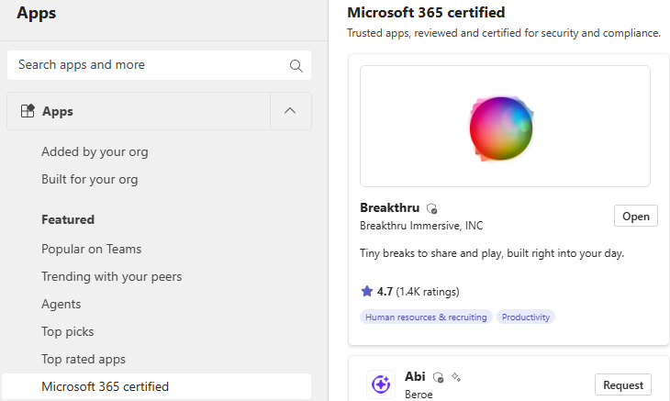
Finding Trusted apps made easy
In Teams Admin Center, find and filter on the number of Certified & Publisher attested apps
In Teams app store, find all the Microsoft 365 certified apps from featured category

Slide 17


2. Enable trusted apps at scale
Empowering IT admins to manage the availability of trusted and safe Teams apps based on predefined rules, ensuring enhanced security
Reduce Overhead
Save Time
Notes:
Please leave this slide in for conference attendees.

Slide 18
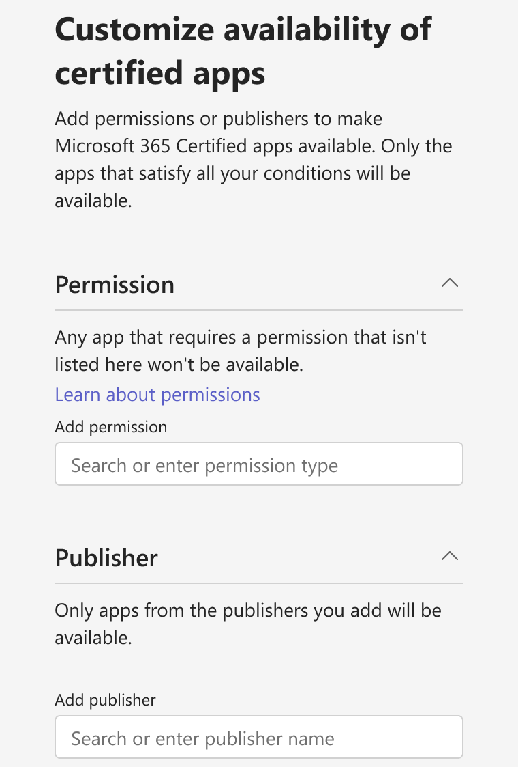
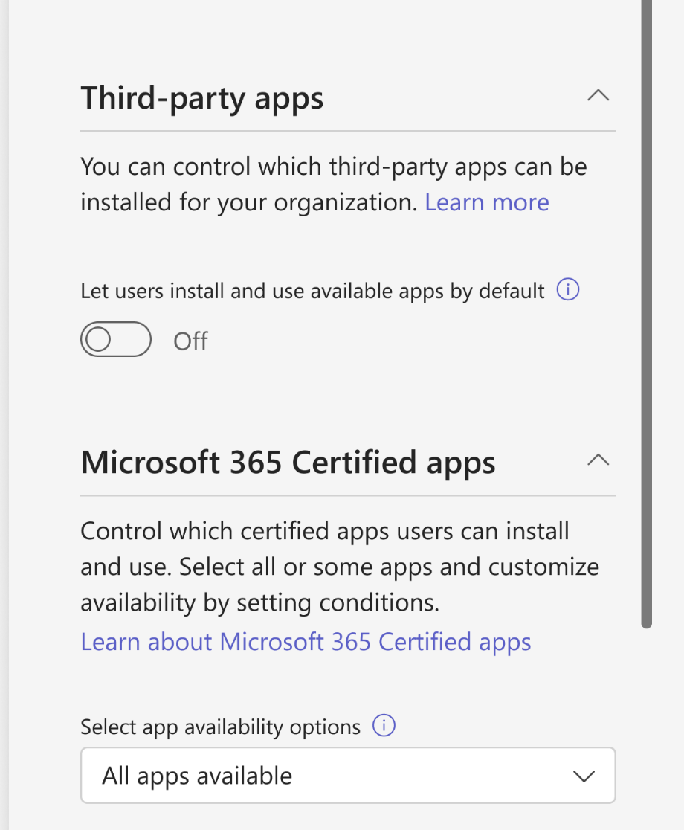
Customize availability of apps
Manage Microsoft 365 certified apps in Teams Admin Center now through a separate control
Customize the availability of these apps further based on permissions accessed and publisher names

Slide 19
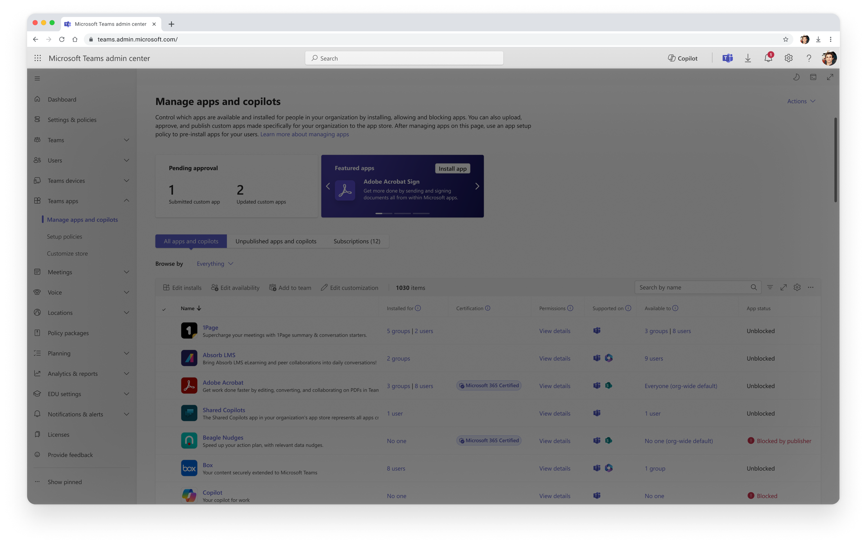

Admins can separately manage the availability of Microsoft 365 certified with a bulk control in Org-wide settings
Notes:
Announcing General Availability of Safe Links for Microsoft Teams! | Microsoft Community Hub
How Safe Links works in Teams
At a high level, here's how Safe Links protection works for URLs in Microsoft Teams:
A user starts the Teams app.
Microsoft 365 verifies that the user's organization includes Microsoft Defender for Office 365, and that the user is included in an active Safe Links policy where protection for Microsoft Teams is turned on.
URLs are validated at the time of click for the user in chats, group chats, channels, and tabs.
Set up Safe Links policies in Microsoft Defender for Office 365 - Microsoft Defender for Office 365 | Microsoft Learn

Slide 20

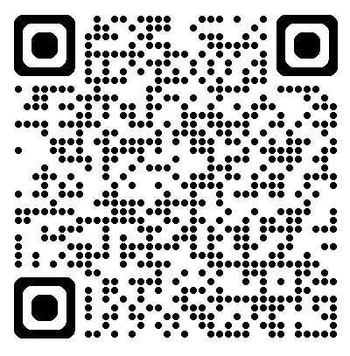
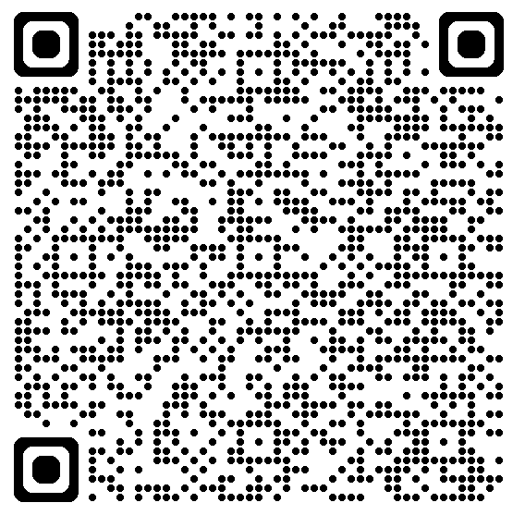
Learn more
Microsoft 365 compliance program
App Trust information & evidence
Learn about certified apps
Check out this one-stop guide to learn about the Microsoft compliance program
Learn different ways on how you can access the apps and agents trust information & evidence

Slide 21
Admin tooling App centric management
Notes:
Thank you.
<Speaker Guidance: Spend the last few minutes discussing or answering any questions they may have. If they have additional topics on their EBC agenda, make sure you connect with their account team to inform them which AI priorities and business outcomes resonated the most during this session. If you are in a 1:1 direct customer engagement, make sure you note what their priorities and questions were and work with the broader account teams and units to facilitate the proper hand-offs or next steps (i.e. get them into a session at the Innovation Hub/MTCs).>

Slide 22
App management considerations
Who has access to apps
What apps are allowed
When are apps available
Where can users access apps
Why are apps needed: user & business need
How are apps managed: Teams admin center UI or PowerShell

Slide 23
Core admin capabilities
Manage availability
Who has access to apps
What apps are allowed
Allows users to install and use apps
Install apps
Preinstall on behalf of users
Appears in the app’s supported surfaces
App bar/flyout, chat, message extensions, meetings

Slide 24
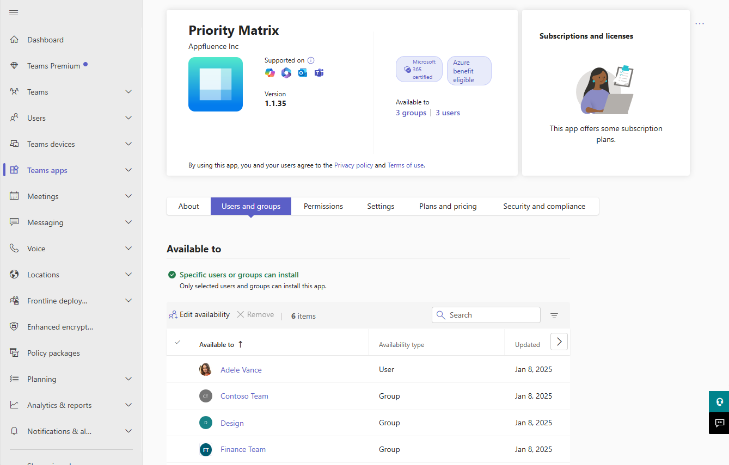
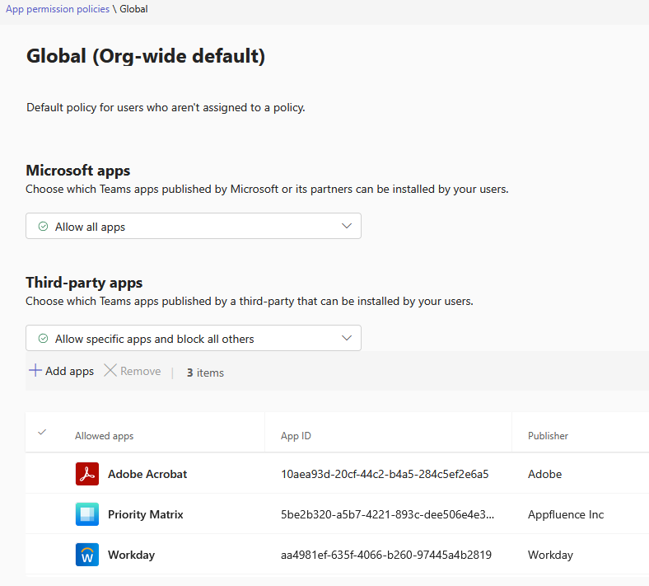
App centric management (ACM)
Overview
Simplified app availability & install management
Given an app, assign it users and groups
Why ACM?
Top customer pain point: permission policies
Permission policies don’t scale to 2,000+ apps
Every app has a different audience
Supports groups & nested groups

Slide 25
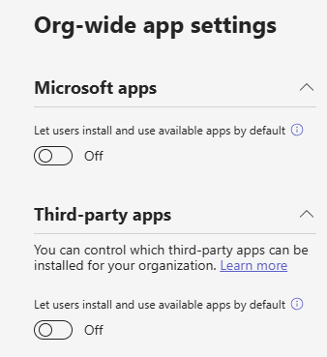
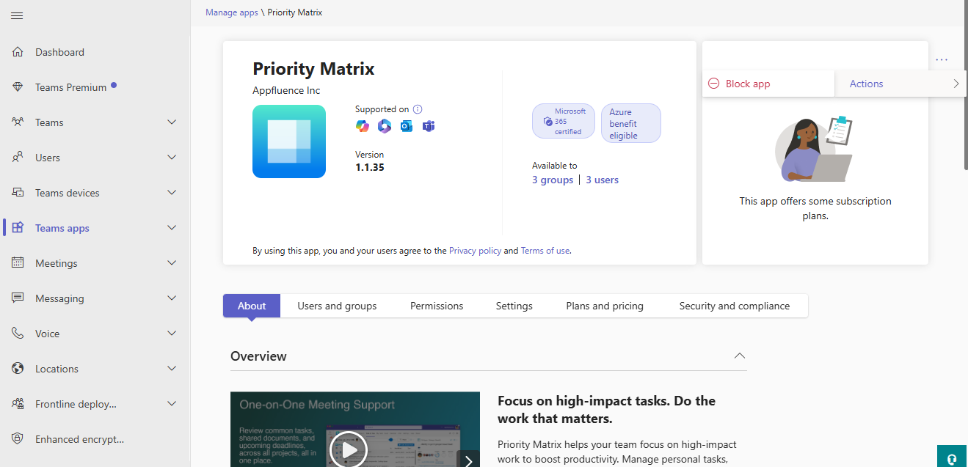
Availability simplified
3 levels of availability
Org-wide
Allow all apps by default to Everyone / No one
Per app type: Microsoft, Third-party, custom
Use when: defining the default state for all apps
App level
Block / unblock all users from using the app
Use when: quick, simple access remediation
Users & groups
Per app: allow for Everyone / Some / No one
Use when: users have been defined

Slide 26
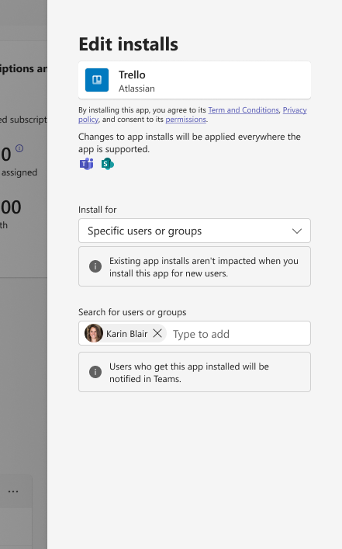
Installs simplified
Users & groups
Per app: install for Everyone / Some / No one
Use when: making it easy to find and use apps without manually installing from store

Slide 27
PowerShell cmdlets
Automate maintenance for:
Bulk app management
Employee onboarding
Comparing before/after new configurations
Manage/apply governance across multiple tenants
Monitor changes to app catalog
Custom app publication
… what else?
Available cmdlets:
Get all apps: all apps in the catalog – availability and installs
Get / update single app: manage app availability and installs
Get / update org-wide settings: manage org-wide settings
Get / update pending custom app: manage custom app publication

Slide 28
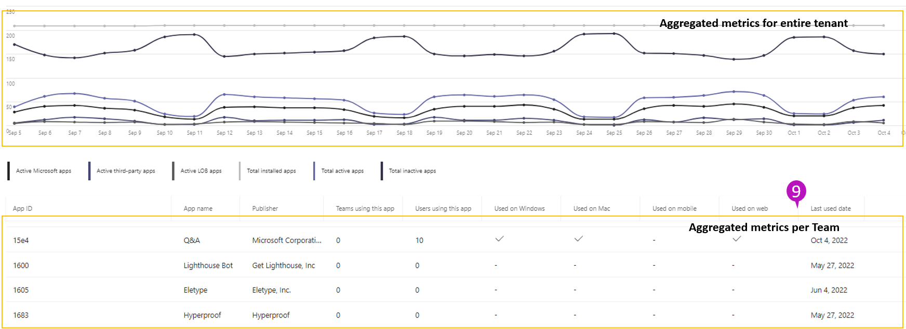
App usage report
Monitor the App usage report to understand user behavior
Review most- and least- used apps to determine maintenance needs
Consider: compare usage to the users you allowed/installed/pinned for
Share the data with your business to review employee need

Slide 29
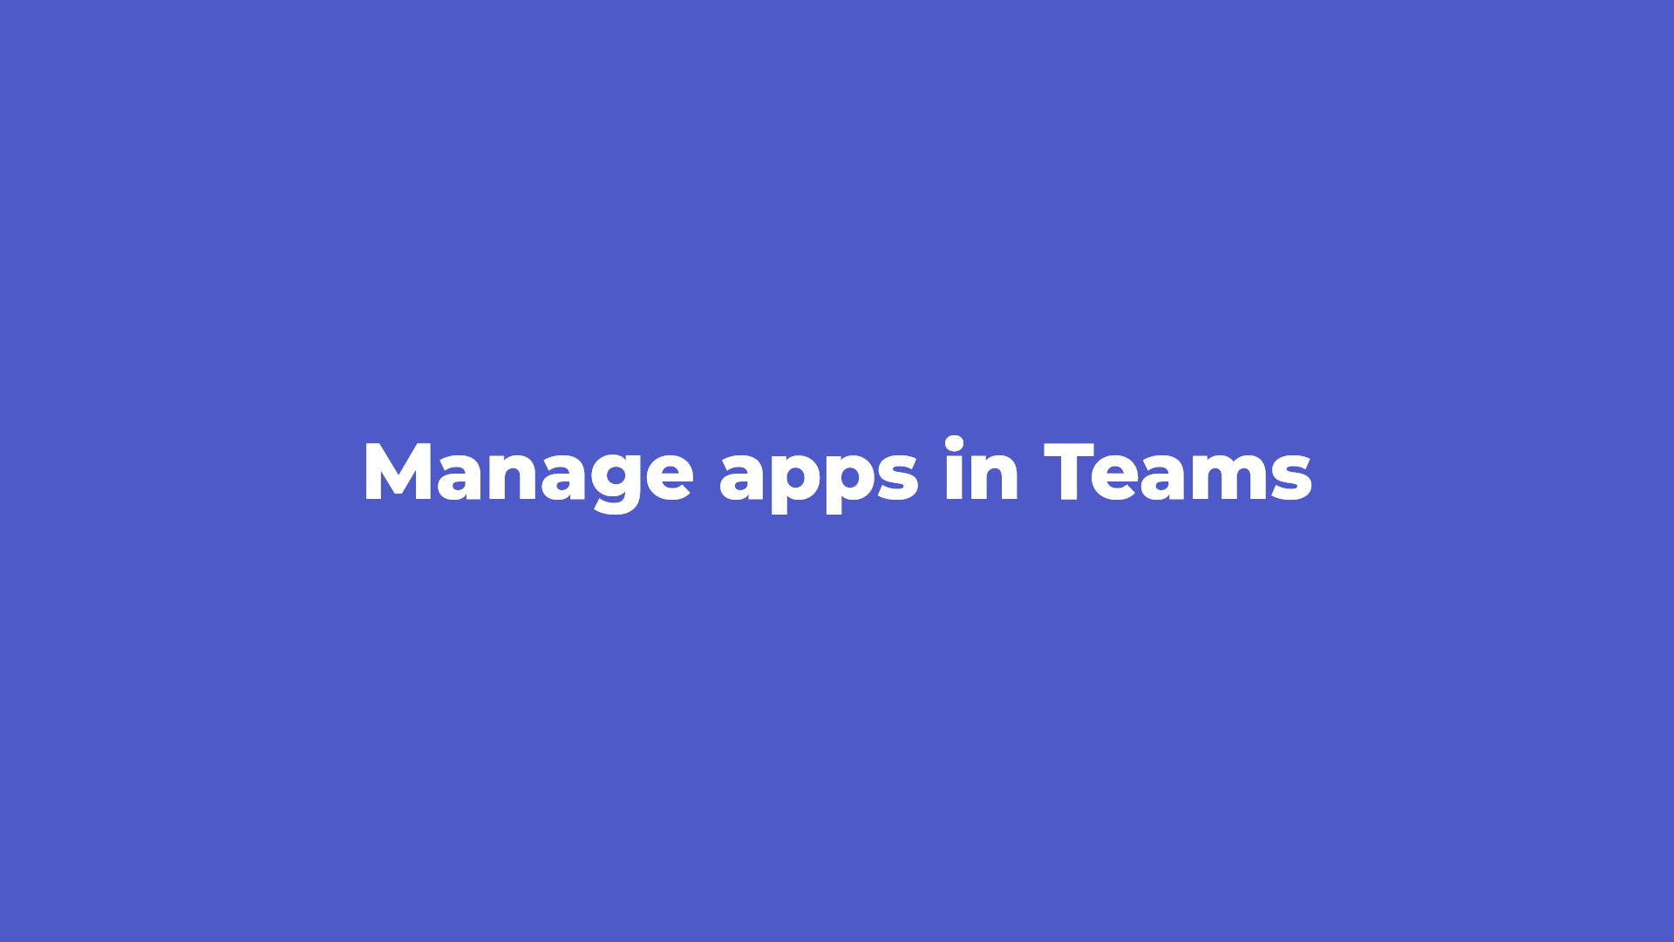
Demo

Slide 30
Q & A

Slide 31
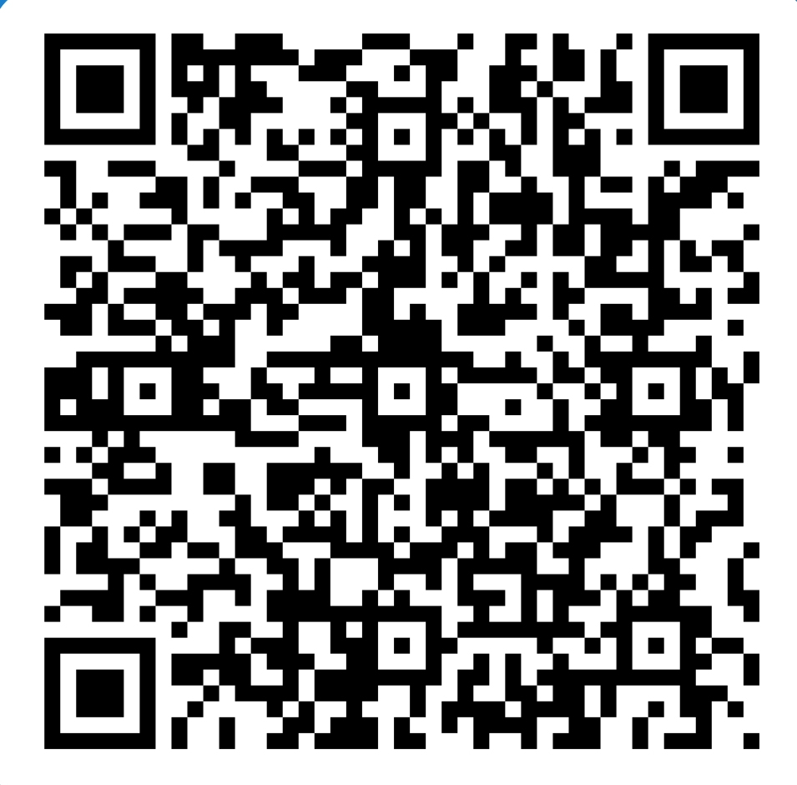
Feedback
Share your feedback
Share your feedback
Your insights help us improve Teams for small and medium businesses.

Slide 32
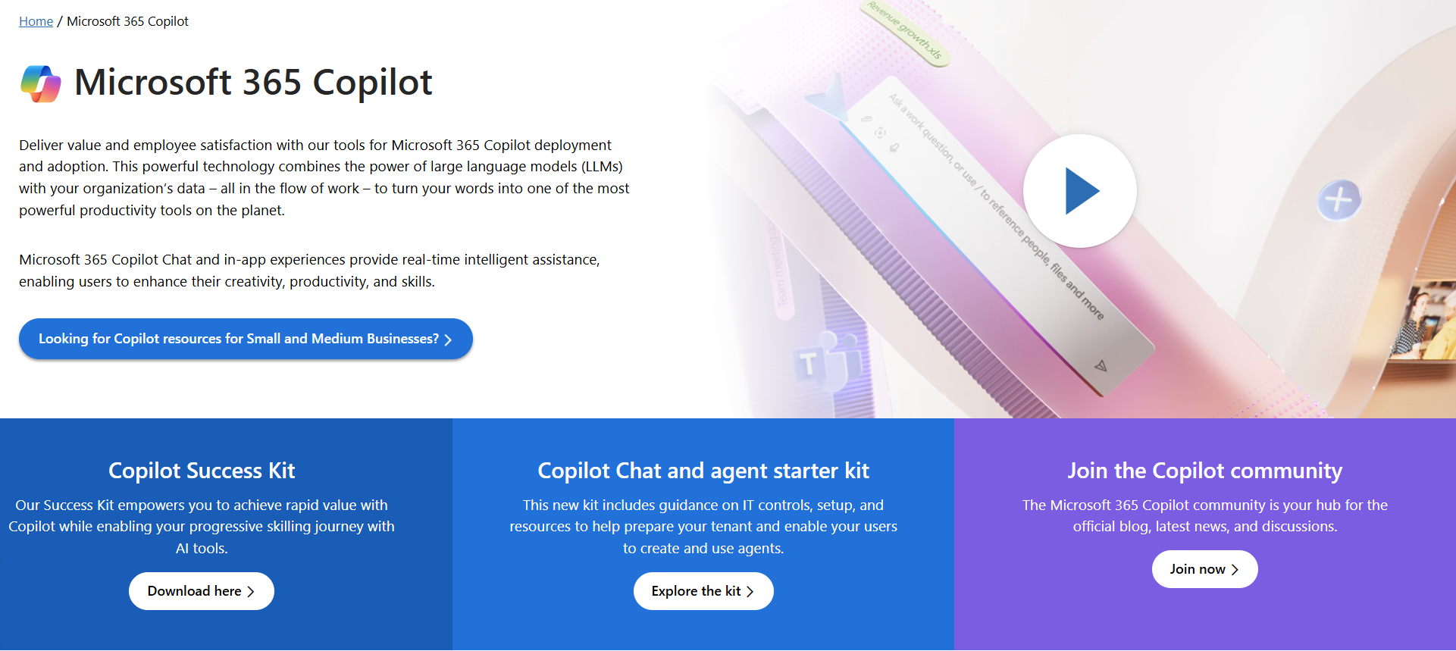
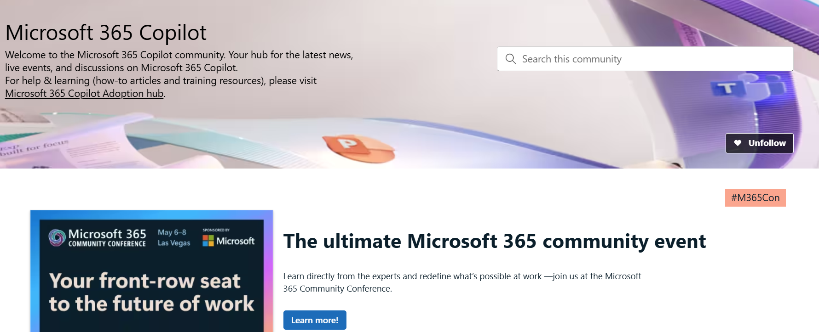
News & community content
Microsoft Community Learning aka.ms/Community/LearningChannel
Community led expert content on all your favorite Microsoft services.
Start your week with live news and event updates aka.ms/MondaysatMicrosoft
Watch live or on-demand & share our blog.
Notes:
To help you with adoption, the Copilot Readiness Hub is an open one stop shop for content, organized by role for your Copilot for Microsoft 365 journey.
You can use its recommendations to prepare and plan for your deployment, create a user experience strategy as I’ve presented today, and an adoption plan.
And as Copilot continues to evolve, keep coming back for new content that is published regularly.
You can also join the Copilot for Microsoft 365 community to get your questions answered and meet others who are leveraging Copilot for Microsoft 365 right now.

Slide 33
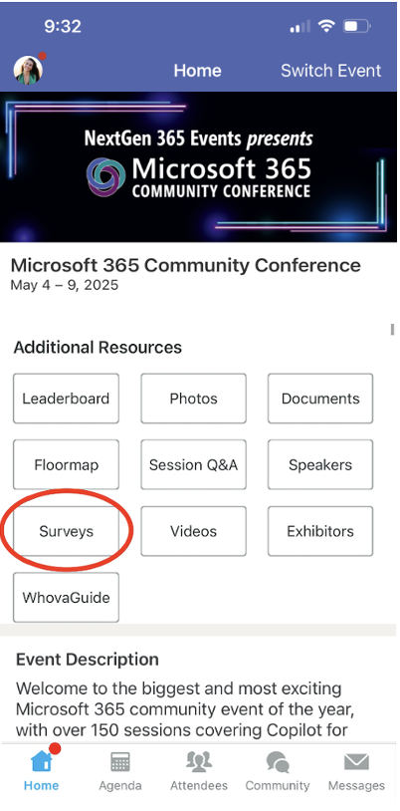
Session feedback surveys
We want to hear from YOU!
Share your feedback to make next years conference even better!
Here’s how –
Simply go to the Whova App on your smartphone.
Scroll down on the M365 Community Conference Homepage to ‘Additional Resources’ to click “Surveys’.
Click Session Feedback.
Scroll down to find this session title.
Complete the session feedback survey.
Finally, click ‘Submit’.
It’s just that easy!

Slide 34

Conference slide

