Slide 1
Modernizing Security Operations Using Security Copilot
Rod Trent
Jennifer Burdett
May 8, 2025

Slide 2
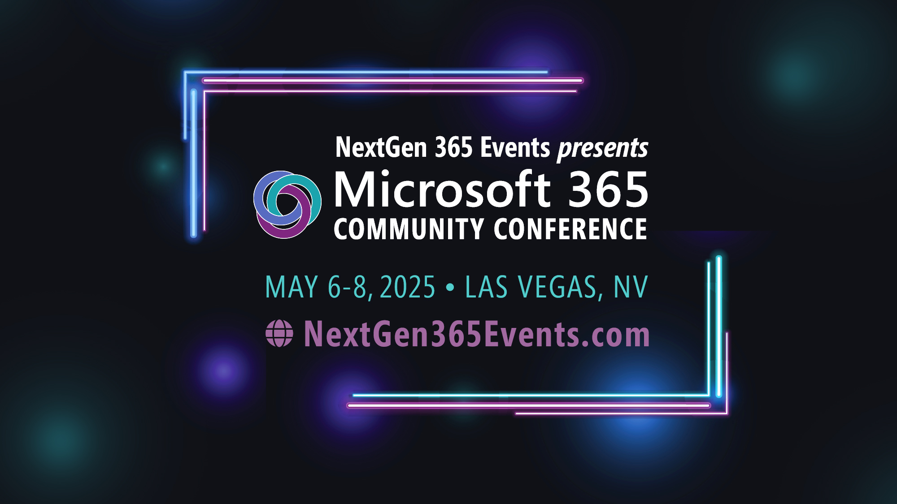
Microsoft 365 Community Conference

Slide 3


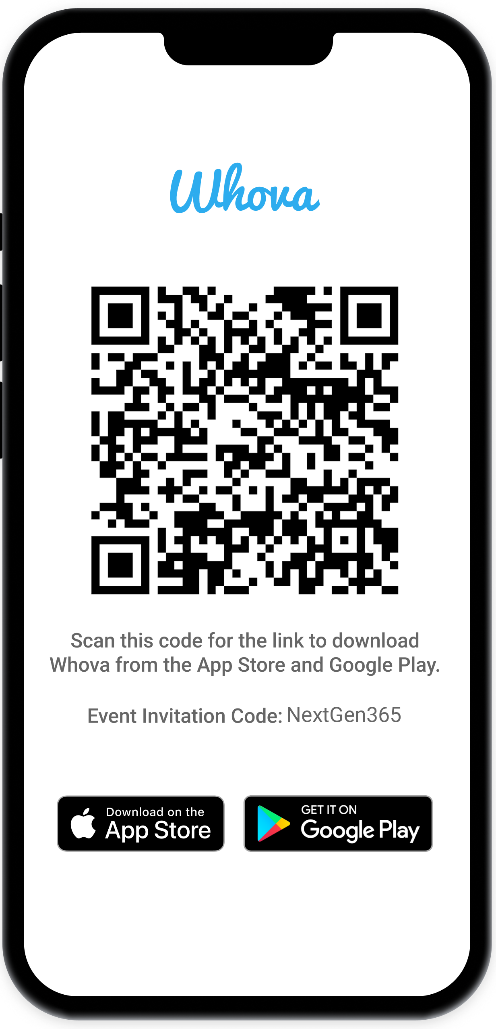
Join the event app to access:
The official event app for the
Microsoft 365 Community Conference
Event invitation code: NextGen2025
Event announcements
Personalized agenda, session details
Speaker & attendee profiles
Networking, meet-ups, messages
Event documents

Slide 4


Rod Trent
Senior Product Manager
/rodtrent
Jennifer Burdett
Principal Product Manager
/jenniferburdett

Slide 5
Agenda
1
What is Security Copilot?
2
Why it exists
3
How Security Copilot works
4
Standalone vs. embedded
5
Extensibility/Agents
6
Demo time
Notes:
Here’s today's agenda
We’ll go through the what/why/how of Security Copilot and finish up with some demos (because they’re the best bit)

Slide 6
What is Security Copilot?
Notes:
{Jennifer}
Let’s start right at the beginning to make sure we level-set and we’re all on the same page.

Slide 7


Security Copilot’s purpose Tackling industry challenges
Shortage of security expertise
Requires highly specialized skills
Operates in a siloed part of the enterprise
Tough to hire and staff talent
Complex and fragmented tooling
Esoteric systems and datasets, and domain specific languages
Tremendous amount of time, energy, and effort to harmonize workflow and process across systems
Specialties and segmentation in an enterprise emerges as a result
Notes:
Security is a complex field that demands specialized skills to handle modern challenges. Often, security professionals work in isolation from other business functions due to the nature of their tasks. Enterprises also tend to have fragmented environments with unique systems, data, and processes, making daily operations time-consuming and demanding.
Security Copilot is a cloud-based, AI-driven security assistant designed to address these issues by offering a new approach to security. It helps analysts, regardless of their specific field or expertise, to work more efficiently in a security setting, thereby transforming how cybersecurity is approached.
Before diving into the details of the platform, let's discuss what Generative Artificial Intelligence (GAI) is, and what Security Copilot does and does not do.
Generative AI and related applications are part of various data sciences. While it might be the most talked-about type of data science, it relies on deep learning, machine learning, and artificial intelligence. Let's start with an example to explain some of these underlying elements.

Slide 8
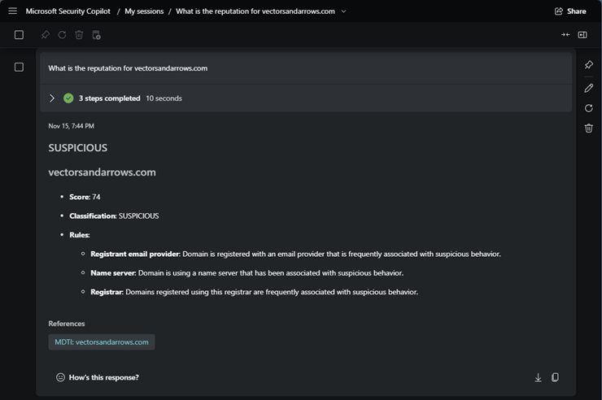

How Microsoft solves these challenges
Making AI a force multiplier
Cyber skills and promptbooks
Prompt: What is the reputation for vectorsandarrows.com?
+
Evergreen threat intelligence
+
Plugins
+
Security-specific orchestrator
+
Hyperscale infrastructure
+
with Security Copilot
OpenAI + Microsoft Security
Notes:
Our approach is not just taking an LLM and rolling with it. Microsoft is uniquely positioned to tackle the challenges of using AI in security -- we have the most advanced models available thanks to our partnership with OpenAI, but we also have an advantage because of all that Microsoft brings to the table. Our solution builds on
a hyperscale infrastructure, providing the scalability and infrastructure needed to process massive volumes of data in real-time
a security-specific orchestrator that streamlines, contextualizes, and coordinates responses across tools and teams
plugins allow seamless integration with other tools and systems, to extend and enhance the capabilities of Security Copilot
evergreen threat intelligence, informed by 78 trillion daily signals, for visibility across your whole threat landscape
cyber skills training and promptbooks (a collection of one or many prompts that can be reused to create natural language-based automation, making it accessible without requiring coding skills), coded into the product to empower teams with the knowledge and resources they need
By building on all these components, we have an AI security solution that can contextualize answers in natural language—delivering insights that are not only accurate but also tailored to securely handle sensitive information. This level of contextual understanding and security is something a generic language model just can’t provide.

Slide 9















Microsoft Threat Intelligence The industry’s largest vector coverage powered by 78T daily signals
One of the world’s largest clouds
Signal from 1.4B endpoints¹ across the planet
Graphing global internet infrastructure
+
+
1. “Microsoft by the Numbers”. Microsoft Story Labs
Notes:
There’s two things that differentiate Security Copilot from any other similar service. The first is the Threat Intelligence that’s immediately available when you provision your first Security Copilot instance. We’ll talk about the second – it’s extensibility – in a bit. But arguably Microsoft has the best Threat Intelligence in the industry and we make this available as part of Security Copilot.
Imagine a vast digital landscape where every interaction, irregularity, and hint of a potential threat leaves a trace—a signal. Microsoft Threat Intelligence gathers and analyzes data from across the globe. Here's how those 78 trillion signals help us combat cyber threats:
Signal Aggregation
Microsoft Threat Intelligence collects signals from various sources: telemetry data, security events, threat feeds, and more.
These signals cover endpoints, networks, cloud environments, and applications.
Contextual Enrichment
Each signal is enriched with metadata, such as geolocation, timestamps, user context, and threat indicators.
This enrichment turns raw data into actionable insights.
Threat Detection and Prediction
Machine learning algorithms analyze the signals to find patterns, anomalies, and emerging threats.
Predictive models identify potential risks before they become serious.
Threat Intelligence Feeds
The 78 trillion signals contribute to threat intelligence feeds.
These feeds enhance Security Copilot's understanding of threat landscapes.
Security Copilot: Your Trusted Co-Pilot
Armed with these insights, Copilot becomes more than just a tool—it's your partner in navigating the complex world of cybersecurity.
Behind every alert, block, and mitigation is the collective intelligence of 78 trillion signals, all coordinated by Microsoft Threat Intelligence.

Slide 10
Why it exists
Notes:
{Shared}
To better understand where Security Copilot exists in the realm of security tools, let’s first understand the problem it is build to solve.

Slide 11


meme
Notes:
As of now, we have around 140 copilots across various departments and functions. These copilots have been instrumental in enhancing productivity, providing support, and driving innovation within our teams.
So, why do we need a security-specific copilot? The answer lies in the increasing complexity and critical nature of security challenges we face today. Unlike general copilots, a security-specific copilot is designed to address the unique and evolving threats in the cybersecurity landscape.
In the first part of this talk, let’s delve into the key differentiators of a security-specific copilot.

Slide 12


Defenders need a new approach
Sophisticated threats
!
Siloed
Alerts volume
!
Fragmented environment
!
Slow
Security and IT teams
Compliance needs
!
!
Overwhelmed
Expert shortage
$4.9M
cost per breach*
* IBM: Cost of a Data Breach
Notes:
Today, the speed, scale, and complexity of cyberattacks are increasing rapidly. Security teams are dealing with a large number of complicated threats, numerous alerts, and an expanding array of tools to manage. They’re overwhelmed. Additionally, they must comply with regulatory standards and cope with a global shortage of around 4.7 million cybersecurity professionals, which makes their job even harder.
These challenges create silos in both technologies and teams, slowing down response times to incidents or issues and causing team members to feel overwhelmed by the workload and the lack of expertise available to address it.
And the stakes are high: the global average cost of a data breach in 2024 stands at an astounding $4.88 million dollars per incident, up 10% from last year.
* 2024 ISC2 Cybersecurity Workforce Study

Slide 13
Attackers leverage AI in creative ways
Malware generation
Customizing exploits​
Phishing and social engineering​
Command and control communication
Automated vulnerability discovery​
Password cracking​
Disguising malicious code​
Deepfakes: data, email, voice
Notes:
Gen AI has only made this worse.
But we can also look to how Gen AI better protects us and connects our security stack into a more seamless way to work.
And we know our adversaries are creative.
We know that we can use GenAI for good – to be more efficient, to be more accurate.
But AI is expanding the attack surface - Gartner estimates that by 2025, GenAI will account for 10% of all data produced. And bad actors know they can use GenAI to be more efficient and more accurate too. They will use AI in all kinds of creative and persistent ways.

Slide 14
Hands up if you’re not “officially” a security person
Notes:
Who here is an "official" security person? Great, thank you.
Now, how many of you end up doing security work for your organization, even though it's not technically part of your job description? I see a few more hands, thank you for your honesty. And how about our developers—any security champions among you? Excellent, it's wonderful to see such dedication to security.
The reality is, security isn't just the responsibility of those with "security" in their job titles. It's a crucial aspect that impacts all of us, regardless of our official roles. This is why tools like Security Copilot are so valuable. They are designed with non-security professionals in mind, providing the guidance and support you need to help safeguard your organization's assets.
So, whether you're a seasoned security expert, a developer stepping up as a security champion, or someone who finds themselves wearing multiple hats, know that Security Copilot is here to back you up. Together, we can build a more secure and resilient environment for everyone.

Slide 15


Security Copilot is not just for security folks!
Security operations
Beyond the SOC
Junior SOC analyst
Senior SOC analyst
Threat intelligence (TI) analyst
Data security admin
IT and identity admin
Cloud security admin
Accelerate investigation and remediation
Automate advanced tasks
Enrich analysis with unified TI
Proactive data security posture management
Risk investigation
Cloud risk exploration and remediation
Reverse engineer malicious scripts
Reverse engineer malicious scripts
Accelerate threat hunting
Discover protection gaps and streamline controls
Accelerate IT troubleshooting
Firewall attack summarization
Get executive summary and detailed reporting
CISO
Notes:
Security Copilot offers benefits for a variety of roles within the security field.
In security operations, both junior and senior Security Operations Center (SOC) analysts find it useful. Junior analysts appreciate features like incident summarization that speed up investigations and remediation guidance. Senior analysts can automate complex tasks such as analyzing user-reported phishing incidents and enriching incidents with additional details. Copilot can also reverse engineer malicious scripts, providing actionable insights that save time for both junior and senior analysts. A study conducted in January showed that professionals using Copilot were 12% more accurate at script analysis, while novices were 34% more accurate.
Threat Intelligence (TI) analysts can use Copilot to get enriched analysis by pulling data from the entire threat landscape, and it helps speed up threat hunting with AI-powered insights and guidance. Chief Information Security Officers (CISOs) can use Copilot for executive summaries and detailed reports tailored to both technical and nontechnical audiences.
Beyond the SOC, data security teams and IT teams also find value in Copilot. Data security administrators gain comprehensive AI-powered visibility and more accurate risk analysis. They can leverage Copilot for proactive data security posture management, identifying protection gaps, and streamlining controls with features like data loss prevention. IT teams, including identity administrators, can use Copilot for faster and more accurate risk investigation, streamlined troubleshooting, and AI-powered device insights.

Slide 16
How Security Copilot works
Notes:
{Rod}
Now let’s dig into how Security Copilot works to supply its value to those responsible for security in their organizations.

Slide 17







Prompt processing in Security Copilot
1
2
3
Analyze prompt
Source response
Compose output
“Summarize recent threat intelligence”
Plugin – MDTI
Skill – Find Threat Intelligence
“Manatee Tempest swims into networks via…”
User prompt
Logic App
Plugins
Knowledge bases
Grounding data
Sourced data
Session context
RAI (citations)
Notes:
To better understand how Security Copilot works let's walk through how the process works. It begins when a prompt is submitted, which initiates the sequence of events.
Next the Orchestrator takes up the request, determines initial context and builds plans using all available skills. This step is crucial as it sets up the framework for how the request will be handled.
Next, we see that a plan is executed on how to get the required data related to the prompt. It acts as an intermediary that refines and contextualizes information.
Moving forward, thanks to the extensibility in Security Copilot, installed and enabled Plugins are utilized to analyze all data and patterns to provide intelligent insights. This step involves deep analysis and interpretation of data.
Finally, the Security Copilot mechanism combines all data and content with the response model until we achieve our final product. The Response is then delivered back to the human user.
This entire process encapsulates how modern systems can efficiently handle requests while ensuring that each step contributes towards generating an informed and accurate response.

Slide 18






Data flow for Security Copilot
Microsoft Security trust boundary
Prompting in Microsoft Security solutions
Azure OpenAI instance is maintained by Microsoft. OpenAI has no access to the data or the model
Microsoft Defender XDR
Microsoft Sentinel
Microsoft Intune
Microsoft Security Copilot
Customer data is not stored outside the compliance boundary or used to train foundational models
Response and app commands
Large Language Model (LLM)
6
User prompt
1
Modified prompt
Plugins for Microsoft and third-party security products
3
Pre-processing
Azure OpenAI
Grounding
4
Responsible AI
2
Microsoft Security Copilot
Microsoft Defender XDR
Microsoft Intune
LLM response
3
Responsible AI checks are performed on input prompt and output results
Microsoft Defender Threat Intelligence
Microsoft Sentinel
5
Grounding
Post-processing
1
User prompts from security products are sent to Copilot
Partner plugins
Data flow
= all requests are encrypted via HTTPS)
2
Copilot accesses plugins for pre-processing
Your context and content
3
Copilot sends modified prompt to LLM
Event logs, alerts, incidents, & policies
4
Copilot receives LLM response
5
Copilot accesses plugins for post-processing
6
Copilot sends the response, and app command back to security products
Notes:
<click> User prompts from security products are directed to Copilot. These prompts may arise from various security scenarios, requiring immediate and precise handling.
<click> Upon receiving the prompts, Copilot accesses dedicated plugins for pre-processing. This stage ensures that the prompts are appropriately formatted and refined, enabling better comprehension and response.
<click> Next, Copilot sends the modified prompt to the Language Learning Model (LLM).
<click> The LLM processes the prompt, generating a relevant and accurate response based on the provided information.
<click> Once Copilot receives the response from the LLM, it accesses specific plugins for post-processing. This step ensures that the response is polished and tailored to meet the requirements of the security products, enhancing clarity and relevance. Plugins play an important role and will be covered in more depth later in the session.
<click> Finally, Copilot sends the refined response and corresponding app command back to the security products. This workflow from prompt reception to response delivery ensures that all security-related queries and commands are handled efficiently and precisely.

Slide 19
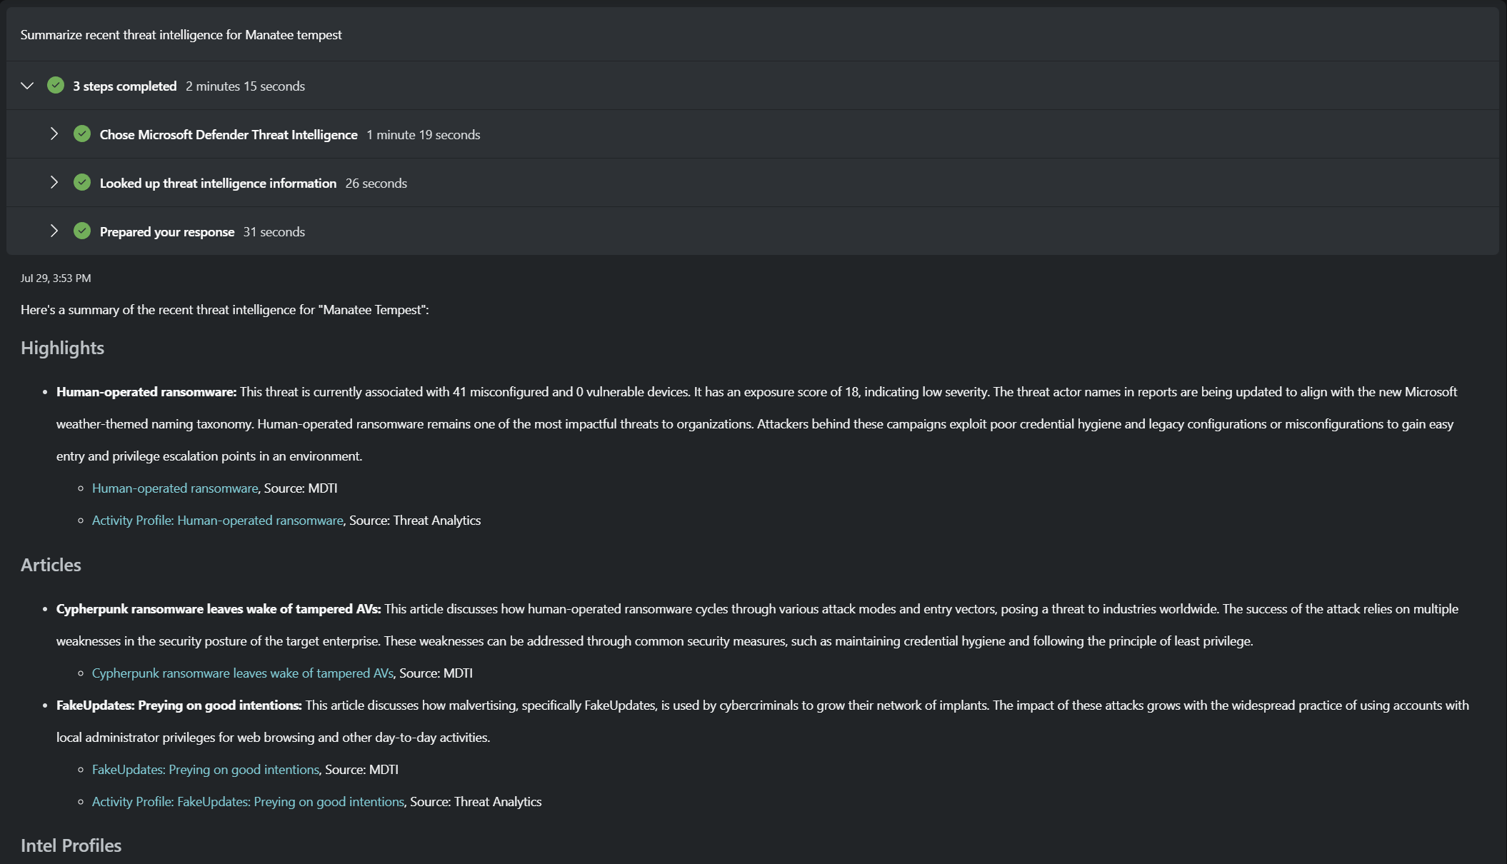
The orchestrator: threat intelligence selection
1
Analyze prompt
2
Execute plugin
3
Compose output
Notes:
For a better view of how this looks in Security Copilot itself, this is a standard workflow as defined in the Standalone experience of Security Copilot. You can see here how each step in the process is detailed in the output.

Slide 20
Microsoft Threat Intelligence The industry’s largest vector coverage powered by 78T daily signals
One of the world’s largest clouds
Signal from 1.4B endpoints¹ across the planet
Graphing global internet infrastructure
+
+
1. “Microsoft by the Numbers”. Microsoft Story Labs
Notes:
There’s two things that differentiate Security Copilot from any other similar service. The first is the Threat Intelligence that’s immediately available when you provision your first Security Copilot instance. We’ll talk about the second – it’s extensibility – in a bit. But arguably Microsoft has the best Threat Intelligence in the industry and we make this available as part of Security Copilot.
Imagine a vast digital landscape where every interaction, irregularity, and hint of a potential threat leaves a trace—a signal. Microsoft Threat Intelligence gathers and analyzes data from across the globe. Here's how those 78 trillion signals help us combat cyber threats:
Signal Aggregation
Microsoft Threat Intelligence collects signals from various sources: telemetry data, security events, threat feeds, and more.
These signals cover endpoints, networks, cloud environments, and applications.
Contextual Enrichment
Each signal is enriched with metadata, such as geolocation, timestamps, user context, and threat indicators.
This enrichment turns raw data into actionable insights.
Threat Detection and Prediction
Machine learning algorithms analyze the signals to find patterns, anomalies, and emerging threats.
Predictive models identify potential risks before they become serious.
Threat Intelligence Feeds
The 75 trillion signals contribute to threat intelligence feeds.
These feeds enhance Security Copilot's understanding of threat landscapes.
Security Copilot: Your Trusted Co-Pilot
Armed with these insights, Copilot becomes more than just a tool—it's your partner in navigating the complex world of cybersecurity.
Behind every alert, block, and mitigation is the collective intelligence of 75 trillion signals, all coordinated by Microsoft Threat Intelligence.

Slide 21
Standalone vs. embedded
Notes:
{Jennifer}
Security Copilot offers what we called “Experiences.” These experiences are two, very distinct ways of using Security Copilot and understanding the differences is important to identify which to use in various scenarios.

Slide 22
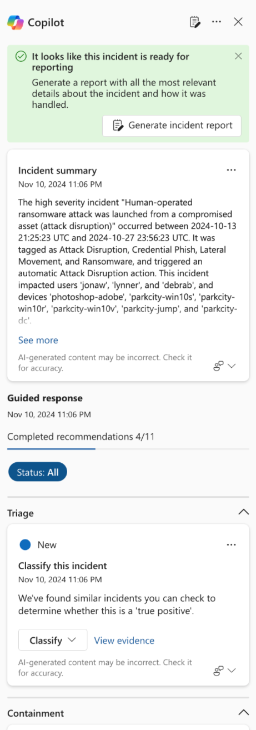
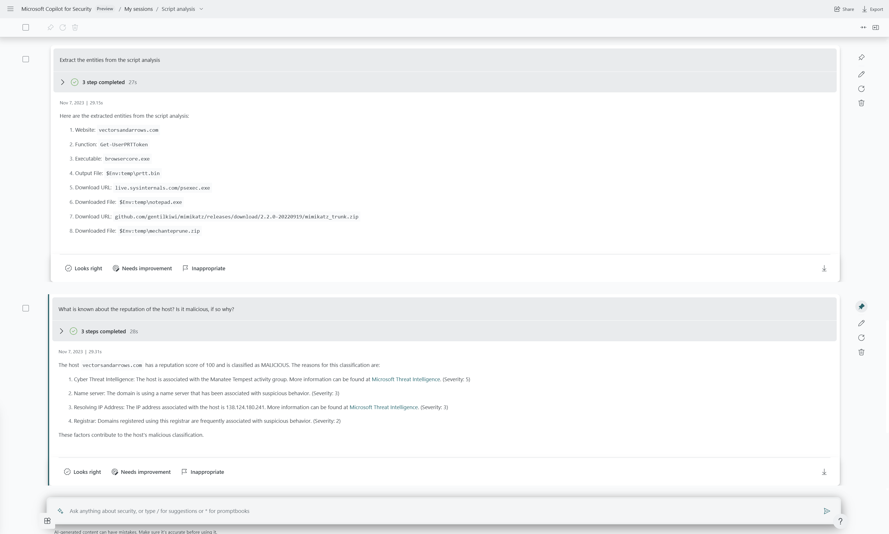
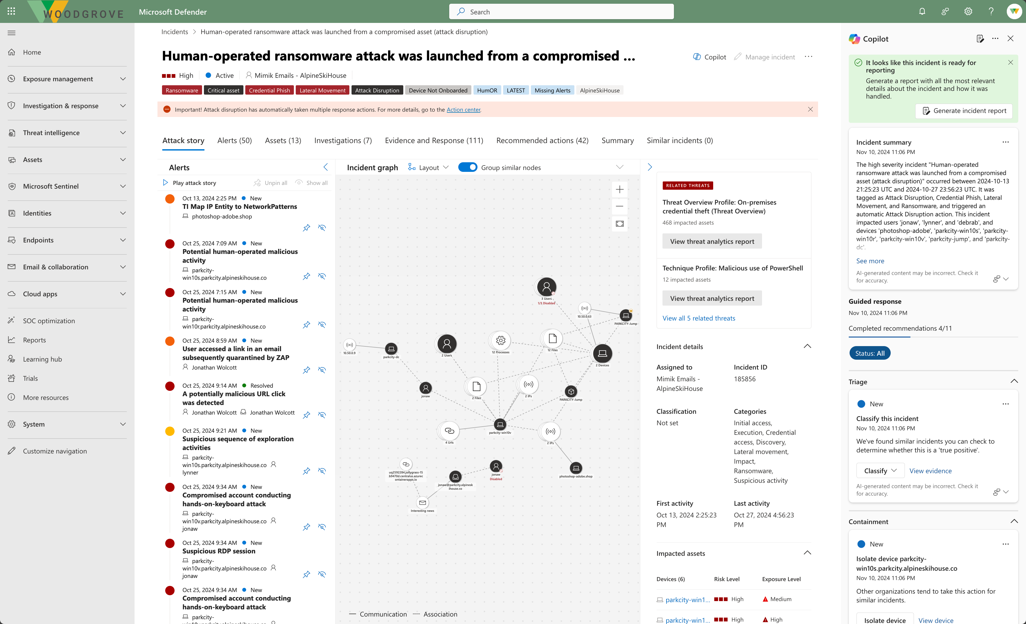
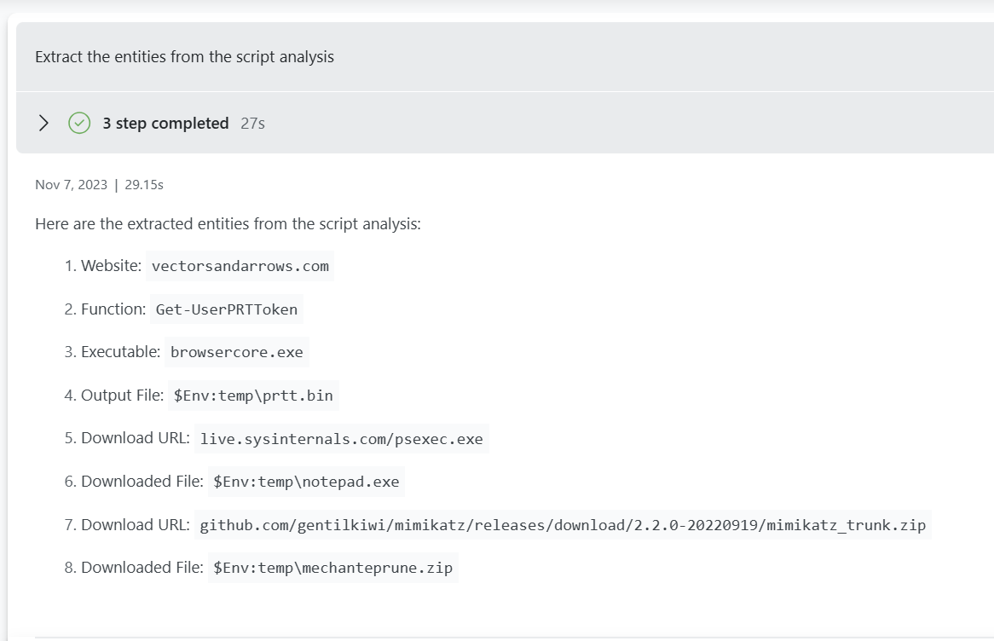
Experiences to meet you where and how you work
Standalone
Helps teams gain a broader context to troubleshoot and remediate incidents faster within Copilot itself, with many use cases in one place, enabling enriched cross-product guidance
Embedded
Offers the intuitive experience of getting Copilot guidance natively within the products that your team members already work from and are familiar with
Automation
Helps teams accelerate response with built-in and custom promptbooks as well as integration with Logic Apps
Notes:
Security Copilot can significantly improve our incident response and security workflows based on needs and specific scenarios.
In brief the Standalone Experience for Security Copilot stands alone as a powerful application. It provides teams with a broader context to troubleshoot security issues. All use cases are consolidated in one place, streamlining incident management.
And the Embedded Integration is for team members already using specific tools. It seamlessly integrates within existing workflows.
Think of it as Copilot coming to you, rather than the other way around. Cross-product guidance enriches the user experience. Benefits of the Embedded integration include:
1. Gaining insights across products, enhancing decision-making.
2. Efficiently remediating incidents without context-switching.
3. Empowering team members with intuitive security guidance.
4. Boosting productivity and reducing response times.
Remember, Security Copilot adapts to your needs, whether you prefer a standalone solution or seamless integration.

Slide 23





Experiences to meet you where and how you work
Microsoft Security solutions | Available in the standalone experience | Available as an embedded experience
Microsoft Defender XDR | ✔ | ✔
Microsoft Sentinel | ✔ | ✔ *
Microsoft Intune | ✔ | ✔
Microsoft Entra | ✔ | ✔
Microsoft Purview | ✔ | ✔
Microsoft Defender for Cloud | ✔ | ✔
*Available as part of the Unified Security Operations Platform.
Notes:
As mentioned earlier, Security Copilot is unique in its ability to provide assistive support across the Microsoft security stack, both as standalone and embedded experiences.
To recap, customers have found value with Security Copilot in:
Investigation and Response: Utilize AI-assisted insights to swiftly pivot to remediation with actionable, prioritized recommendations.
Scaled Visibility: Quickly assess security posture, identify threats, and address compliance gaps. Access contextual summaries to understand potential impacts.
Faster Troubleshooting: Gain a comprehensive understanding of device, user, access, and application status to resolve issues efficiently. Use natural language prompts to expedite the identification and remediation of policy issues.
Advanced Skills Unlocked: Empower team members to complete complex tasks with confidence with AI-powered script analysis and natural language conversion to KQL and KeyQL.

Slide 24





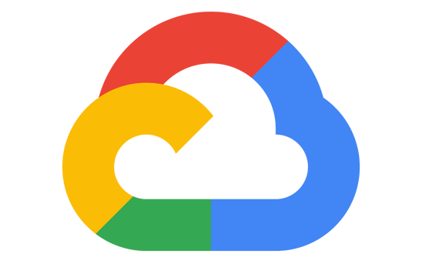







Microsoft Security Six product families integrating over 50 product categories
Multicloud
Microsoft Defender
Multiplatform
Microsoft Purview
Microsoft Sentinel
78 trillion signals
Microsoft Priva
Microsoft Entra
Microsoft Intune
Microsoft Security Copilot
Multi-AI
Notes:
Current embedded experiences include Defender XDR, Sentinel, Purview, Entra, Intune, and others with more on the way.
But even more than that, Security Copilot was developed as an extensible “security stack” that enables organizations to connect their entire environment to immediately increase Security Copilot’s intelligence around existing assets – whether they are all Microsoft tools, apps, and services or not.
Which leads to… (next slide)

Slide 25
Extensibility and Agents
Notes:
{Rod} While we generally refer to Security Copilot as a security tool, it’s actually much, much more than that. In fact, in addition to its inclusion of Microsoft’s Threat Intelligence which makes its already super security smart, it’s extensibility ensures that the intelligence is always evolving to make it personal to an organization’s requirements.

Slide 26
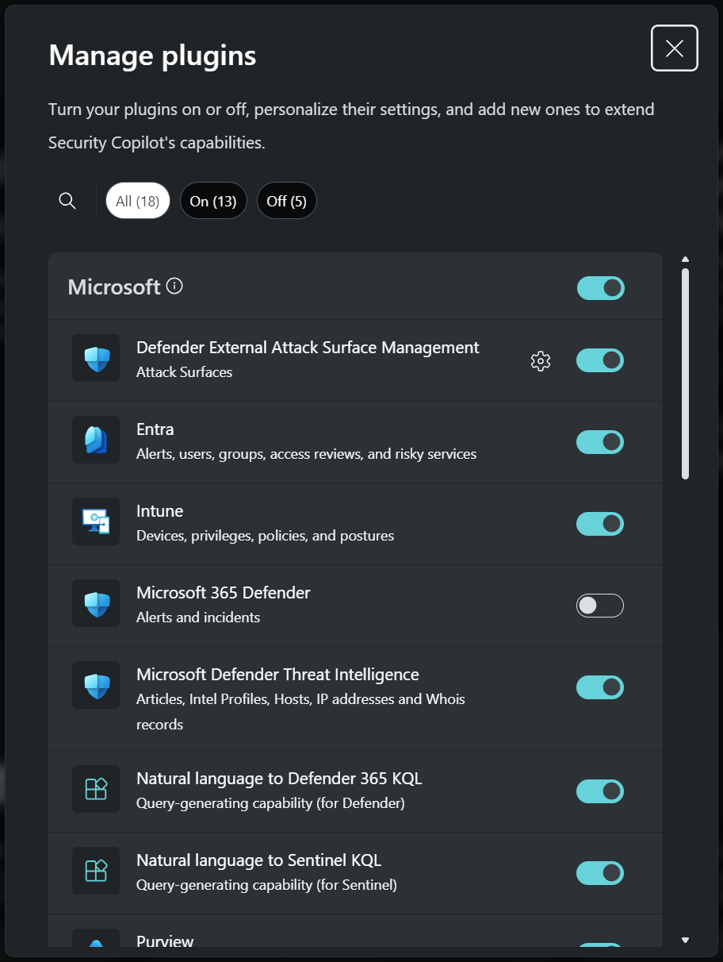
What are plugins?
Plugins are software components that allow Security Copilot to connect to external services, further extending the product’s capabilities.
Users can utilize built-in plugins from Microsoft and non-Microsoft services, or they can upload their own custom plugin.
Notes:
“Out of the box” Security Copilot includes dozens of first party and third party plugins. From Microsoft services such as Defender XDR to partner developed plugins such as Tanium or ServiceNow. Users of Security Copilot can use the built-in plugins from Microsoft and others to connect the various systems and tools that exist in their own environments, to ensure Security Copilot is spatially aware of the organization's digital assets.
Through the use of Custom Plugins, users of Security Copilot can easily develop their connections to tools, services, and data for those that don't already exist. By creating custom plugins, you can extend Security Copilot's capabilities to include functionalities specific to your organization's needs. For example, you can integrate with Azure Function Apps to execute custom code or pull data from any external data source that supports a REST-like API.

Slide 27



Extending Intelligence through custom plugins Types of custom plugins
Security Copilot supports three types of plugins
API plugins
Support for OpenAI plugin
Convert existing APIs → Copilot for Security plugins
Build custom API plugins to your business' sources
Support for data-retrieval using GET, POST
KQL plugins
Kusto Query Language (KQL) is a powerful query language to analyze large volumes of data
Find trends, anomalies, patterns, etc.
Query Kusto, Microsoft Defender, and Microsoft Sentinel
GPT plugins
Leverage latest GPT models like GPT4 32k
Expanded token context-length
Enables copious processing for large documents and/or unstructured datasets search and analysis
Notes:
Security Copilot supports three types of plugins that can be created:
API – Security Copilot supports API custom plugins, allowing users to extend its capabilities and integrate it with various external systems and services. We're announcing this week that the API capability now supports both GET and POST.
KQL – Utilizing Kusto Query Language, you can quickly create plugins that work against data that already exists in your organization.
GPT – GPT based plugins provides extra value through the ability to extend capabilities to the most current GPT models with expanded token length and working with unstructured data.

Slide 28



Knowledge bases
Azure AI search plugin
File upload
Public sources (e.g. MS Learn)
Notes:
Knowledge base integrations are another new feature with GA. Knowledge bases—or KBs— could include your company policies, incident response procedures, standard playbooks for handling phishing alerts, or report templates for communication across departments.
This one is exciting because it means Copilot can now leverage these resources within session context, giving you personalized support like never before.
For knowledge bases, there are two ways to bring in your organization’s knowledge into Copilot, through file upload and through Azure AI search. And today, we’re going to look at a scenario to leverage Azure AI search.

Slide 29

Agents to empower roles across security and IT
Microsoft Security
Partner ecosystem
Phishing Triage
Privacy Breach Response by OneTrust
Alert Triage in DLP and IRM
SecOps Tooling by BlueVoyant
Human supervised
Conditional Access Optimization
Network Supervisor by Aviatrix
Continuous learning
Vulnerability Remediation
Alert Triage by Tanium
Security and IT teams
Microsoft Security Copilot
Microsoft Security Copilot agents
Threat Intelligence Briefing
Task Optimizer by Fletch
Notes:
At launch, we are introducing 11 agents –
6 of them are built into Microsoft Security tools, and we chose these use cases based on top priorities we hear from customers
-Phishing Triage Agent in the Microsoft Defender portal
-Two Alert Triage Agents in Microsoft Purview DLP and IRM
-Conditional Access Optimizaton Agent in Microsoft Entra
-Vulnerability Remediation Agent in Microsoft Intune
-and Threat Intelligence Briefing Agent in Security Copilot standalone
In addition to these 6, we’re also announcing 5 partner-built agents
-Privacy Breach Response Agent by OneTrust
-SecOps Tooling Agent by BlueVoyant
-Network Supervisor Agent by Aviatrix
-Alert Triage Agent by Tanium
-and Task Operator Agent by Fletch
This will be a growing ecosystem all built on the Security Copilot platform
-This initial launch will go public preview by RSA timing, end of April and public preview will be available to existing Security Copilot customers

Slide 30
Demo
Notes:
Let’s dig into some demos:
If the interest is there after the last slides: Show some Plugin JSON contents. Show how easy it is to create: https://github.com/rod-trent/Copilot-for-Security/tree/main/AzureAITour/Plugins/IP-API
Standalone demo: You can use the prompts in a live Standalone experience (https://aka.ms/CfSAITour), or one of the following based on the audience…
CISO: https://7lraebk5le-u0j8etm5j9.app.highlights.guide/?tenantId=536279f6-15cc-45f2-be2d-61e352b51eef
Defender incident (accelerated): https://7lraebk5le-36wz9ospz5.app.highlights.guide/?tenantId=536279f6-15cc-45f2-be2d-61e352b51eef
Embedded demo: Use one of the following to showcase the embedded experiences:
Copilot in Intune: https://app.highlights.guide/start/e09a2bad-b3f4-4bd2-bc09-5713b8e4f2a4?guide=true&autoHide=true
Entra: https://app.highlights.guide/start/fcd64ac7-a4bf-464d-9b98-ca9152a7fd78?guide=true&autoHide=true
SAP Attack Disruption: https://app.highlights.guide/start/18fe5b1d-e208-403a-a7fa-83d2982558b9?guide=true&autoHide=true
Copilot in Defender: https://app.highlights.guide/start/f4f590f6-8937-40f9-91ec-632de546ab98?token=40f793d4-2956-40a4-b11a-6b3d4f92557f

Slide 31
Wrap up
Notes:
[Jennifer}

Slide 32

Microsoft Connection Program
The Microsoft Connection Program enables customers, partners, and Microsoft’s Most Valuable Professionals (MVPs) to directly connect with Microsoft security engineers to share their product experiences, needs, and recommendations. Microsoft uses the program to put the customer experience at the center of product development and ultimately improve our security solutions.
Help us create better products to better secure your organization or your customers.
Security solution areas covered:
CNAPP, SIEM and XDR with Defender and Sentinal
Data Security and Privacy with Purview and Priva
Modern Management with Windows and Intune
Identity and Access with Entra
Security AI with Security Copilot
Sign up today at
aka.ms/JoinCommunity
Membership benefits
Member commitments
Get early access to roadmaps and private previews Share your input before features go public Network with Microsoft engineering and fellow community members Earn digital badge recognition based on your activity in the community
Provide actionable feedback to improve security solutions Actively engage in community discussions Possess deep technical and security knowledge with Microsoft security solutions, such as roles tasked with preventing or addressing cyberattacks and improving an organization’s security posture Have a signed Confidentially Agreement with Microsoft
You can also join our Microsoft Security public community at aka.ms/SecurityCommunity to learn about public product updates, webinars, events, and other announcements. To learn more about all our communities, go to www.aka.ms/communitychoice.

Slide 33

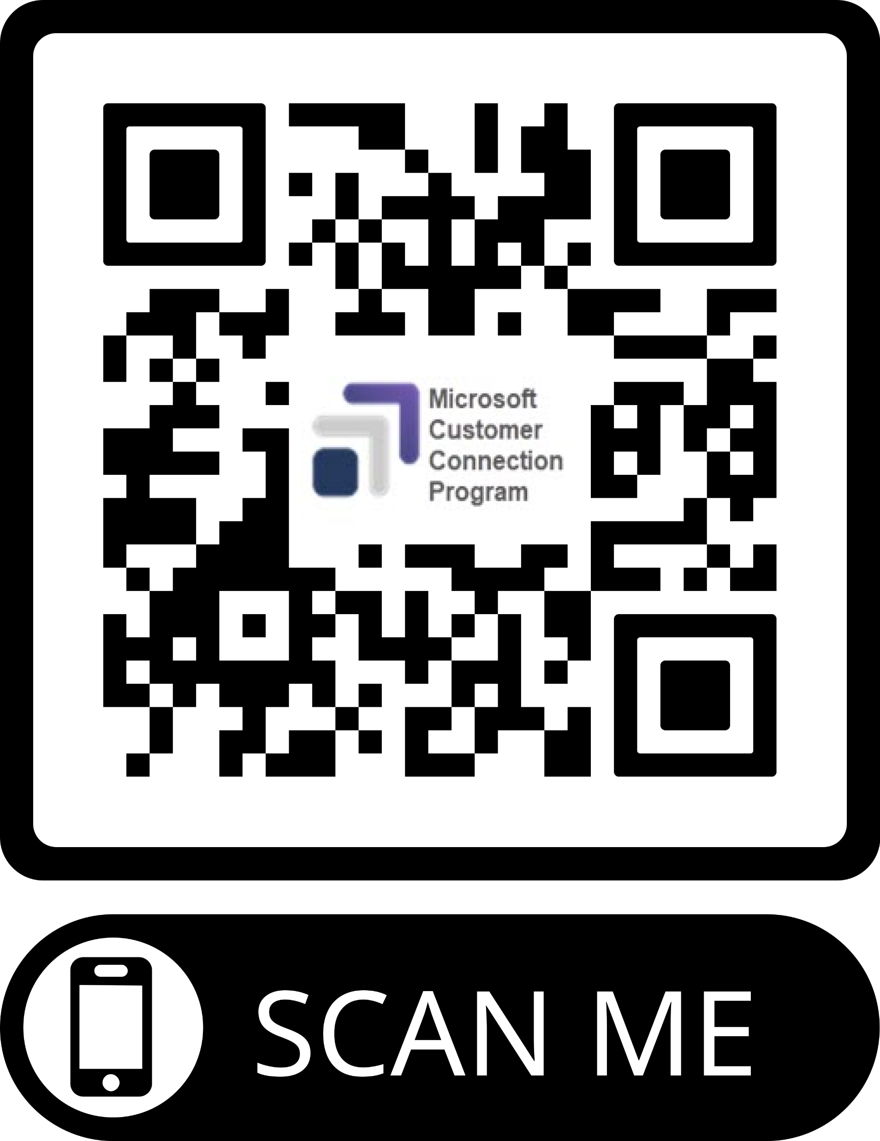





Microsoft Security Customer Connection Program (MCCP)
Help us help you better secure your organization and your customers.
Connect directly with Microsoft security engineers to share your product experiences, needs, and recommendations for current and planned products and features. Microsoft puts you at the center of product development to help create better security solutions.
1
2
3
Sign up!
aka.ms/JoinCommunity
Commit
Benefits
Engage
Community
Roadmaps and private previews
Confidentiality
Agreement
Provide
feedback
Valued Input
Exclusive Events
Networking
Badges
You can also join our Microsoft Security public community at aka.ms/SecurityCommunity to learn about public product updates, webinars, events, and other announcements.
Notes:
The Microsoft Security Customer Connection Program, or MCCP, is a vital initiative designed to enhance security solutions by fostering direct communication between organizations and Microsoft security engineers. By signing up, participants can share their experiences and insights, which are crucial for shaping future products and features. The program covers key areas such as Cloud Security, SIEM, XDR, and Compliance, ensuring a comprehensive approach to security. Membership offers significant benefits, including access to exclusive roadmaps, networking opportunities, and recognition through digital badges. However, members are expected to actively engage and provide actionable feedback, demonstrating their commitment to improving security solutions. Additionally, joining the public Microsoft Security community allows for broader engagement with product updates and events, further enriching the experience.

Slide 34
Expertise and tools for your journey
Technical expertise via our FastTrack partners
Tools, resources & training on our Adoption Hub
Events and real-world knowledge in our community
aka.ms/Microsoft/FastTrack
adoption.microsoft.com
aka.ms/TechCommunity
Notes:
Please leave this slide in for conference attendees.

Slide 35
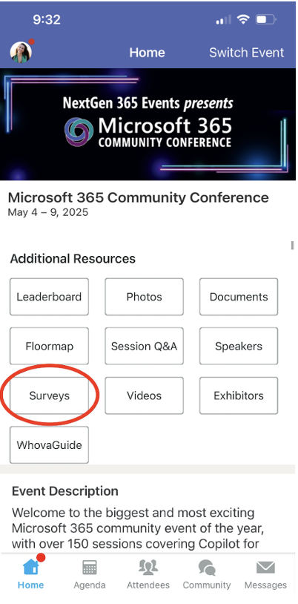
Session feedback surveys
We want to hear from YOU!
Share your feedback to make next years conference even better!
Here’s how –
Simply go to the Whova App on your smartphone.
Scroll down on the M365 Community Conference Homepage to ‘Additional Resources’ to click “Surveys’.
Click Session Feedback.
Scroll down to find this session title.
Complete the session feedback survey.
Finally, click ‘Submit’.
It’s just that easy!

Slide 36
