Slide 1

Simplified Update Management with Windows Autopatch
John Vintzel, Principal Manager, Product Management
@jvintzel
May 06, 2025

Slide 2
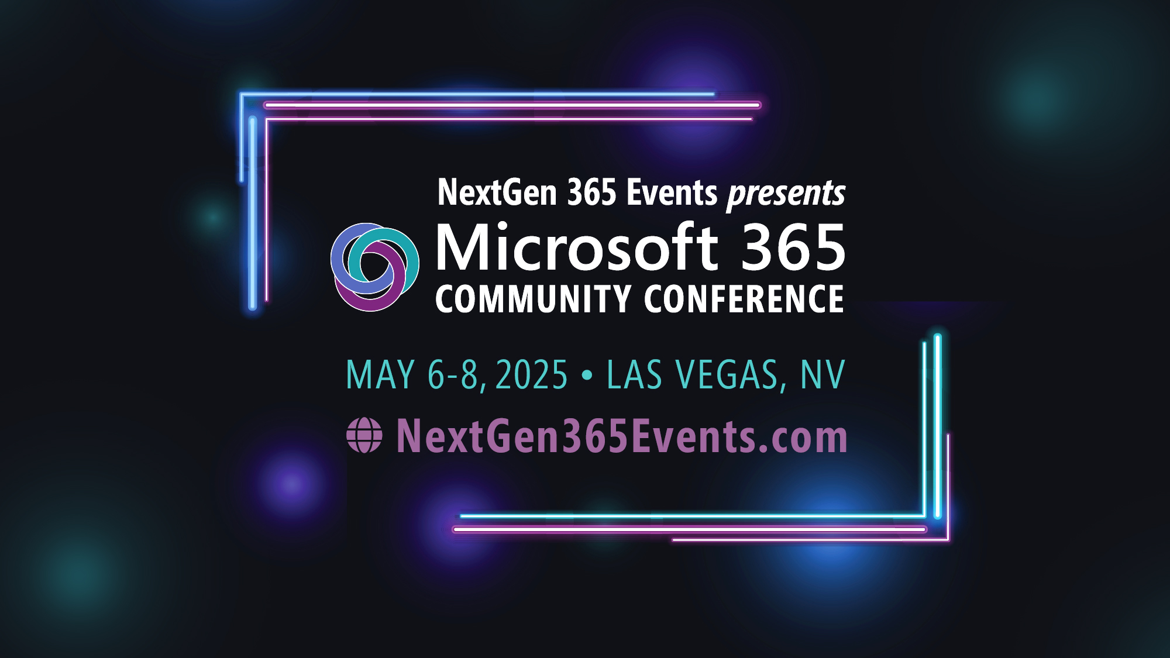
Microsoft 365 Community Conference

Slide 3



Join the event app to access:
The official event app for the
Microsoft 365 Community Conference
Event invitation code: NextGen2025
Event announcements
Personalized agenda, session details
Speaker & attendee profiles
Networking, meet-ups, messages
Event documents

Slide 4


Agenda
The Value of Windows Autopatch
Intro
Getting Started
Administration
Customization
Reporting
Support and Communications
Scenarios: Moving to Windows Autopatch

Slide 5
Windows Autopatch manages the process of applying Windows, Microsoft 365 apps, Microsoft Edge, driver and firmware updates
This service is included with all licenses available through the Volume Licensing (VL) programs. See Windows Autopatch licenses and entitlements for more details.

Slide 6





Running the latest software improves security
Cyberattacks are more sophisticated
Delaying updates increases security risk
Each data breach costs millions
Exploiting vulnerabilities in unpatched operating systems is a leading initial access technique for ransomware attacks.
It takes enterprises an average of 102 days to patch security vulnerabilities.
The global average cost of a data breach in 2024 was USD 4.9 million.
Source: Microsoft Digital Defense Report 2024
Source: Microsoft Digital Defense Report 2023
Source: Cost of a Data Breach Report 2024

Slide 7



Automated update services
Reduce time spent on patching activities by 60-80%*
Traditional approaches are vulnerable to error and strain IT resources.
A cloud-based approach frees up resources and makes it easier to stay current.
*Source: The Total Economic Impact™ of Windows 11 Enterprise: Cost Savings and Business Benefits Enabled by Windows 11 Enterprise. A Forrester Total Economic Impact™ study commissioned by Microsoft, February 2024.

Slide 8
Who can use Windows Autopatch?
Windows Education A3/A5
Windows Enterprise E3/E5
Windows Frontline F3
Microsoft 365 Business Premium
What is Windows Autopatch? | Microsoft Learn

Slide 9



Simplified endpoint management
2
Automate the process and maintain control
Windows Autopatch
2
Windows Update policies
You do the work
and have control​
Windows 10 Enterprise PC
Windows 365 Enterprise Cloud PC
Windows 11 Enterprise PC
Azure Virtual Desktop

Slide 10
Windows Autopatch
You decide how the process works
Handle everything yourself
Let Microsoft handle everything
Update tasks
Evaluate and select which updates to perform, such as drivers, Microsoft 365 apps, and feature updates.
Define and test the protocols.
Define the rollout structure and schedule.
Monitor the updates and pause or roll them back.

Slide 11
Best practices when managing updates
Customer
Windows Autopatch
Assess
Identify what operating systems, applications, drivers and firmware need to be patched using asset management tools such as Microsoft Intune or Configuration Manager.
Define roles and responsibilities, for example:
Update management team: Responsible for discovery, prioritization, testing, deployment plan.
IT operations team: Supports update management team to ensure smooth deployments and minimize end-user disruption.
Security team: Provides input on update prioritization and validation.
Simplified planning & deployment
Easy to mirror your own business targeting structure with the use of Autopatch groups
Automated deployment rollout sequences
Multi-phase release policies for feature updates
Automatic driver & firmware management
Automated release management
Enhanced device alerts for quality and feature update deployments
Policy health and remediation
Near to real time reporting
Easy to use pause and resume updates
Initial setup, Test, Deploy and Monitor
Choose scope of targeting.
Set up update policies (speed, cadence of update deployments).
Test, deploy and monitor.

Slide 12

What update types are included?
Windows
Windows Quality Updates
Windows Feature Updates
Drivers and firmware delivered through Windows Update
Microsoft 365
Microsoft 365 Apps for Enterprise Updates
Microsoft Edge

Slide 13



Windows Autopatch Pre-requisites
Supported Devices
Supported Products
Requirements
Licensing
Business Premium and A3+
Windows Enterprise E3+ and F3
Azure Active Directory Premium
Microsoft Intune
Identity and Device Management
Azure AD Join or Hybrid Azure AD Join
Connectivity
Allow service URLs
Physical Windows devices
Desktops
Laptops
Tablets
No servers
Windows 365 Cloud PCs
Enterprise only
Azure Virtual Desktops
Personal persistent machines only
Windows ARM & 64-bit
Windows 10 22H2/11 Pro
Windows 10 22H2/11 Enterprise
Windows 10 22H2/11 Pro for Workstation
Windows 10 2019 & 2021 Long-Term Servicing Channel (LTSC)*
Microsoft 365
32-bit and 64-bit M365 Apps for enterprise
* Updated on 02/20/2025 *

Slide 14
Planning for updates

Slide 15
Audience management
Windows Autopatch supports two audience management methods when targeting or scoping update deployments to devices: Microsoft Entra or Autopatch groups.
Microsoft Entra
Good targeting method to use when only testing update deployments in a few devices, example: IT department-only devices, Lab/dev devices.
Also, good option when there’s no business requirements to mirror organizational structures for a gradual/phased rollout.
Autopatch groups
Best method when you need to mirror your organization structures, followed by a business requirement for a gradual/phased rollout, example: Departments like: Marketing, HR, etc. or Branch office locations such as: Chicago, New York, etc.
Easier to manage different update deployment speed and cadences across departments and/or branch locations.

Slide 16














Autopatch Groups
Match your organizational/business structure in Autopatch
Divide your tenant by need
Up to 300 groups of rings (i.e., LOB)
Only Feature, Driver, and Quality update customizations
Demo
Operations
Finance
Marketing

Slide 17
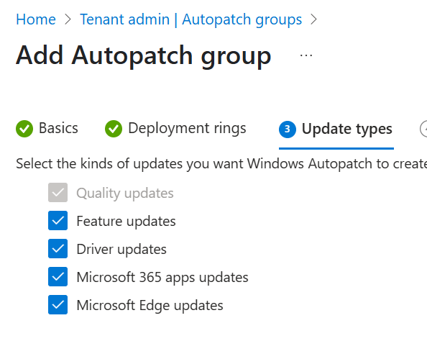
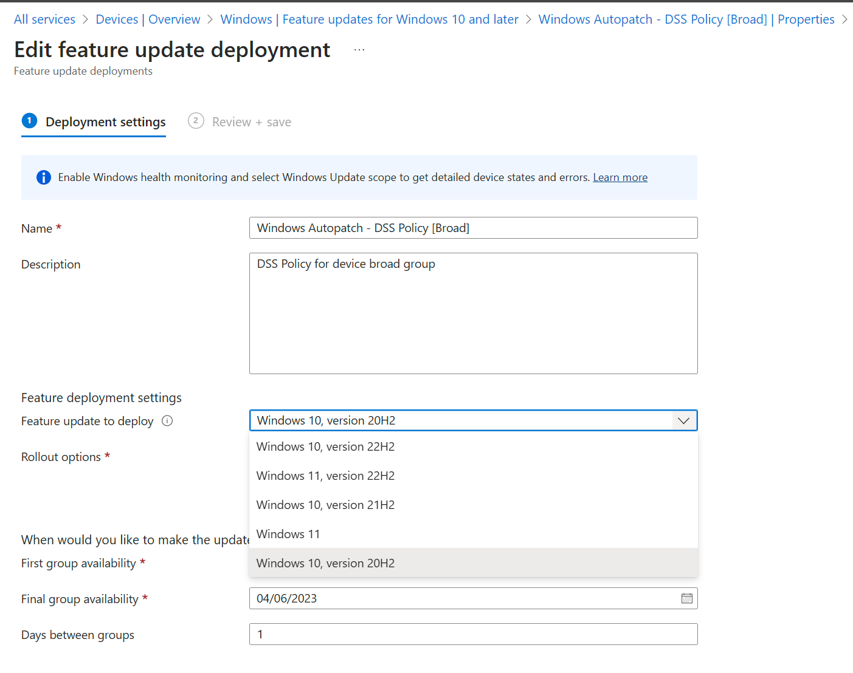
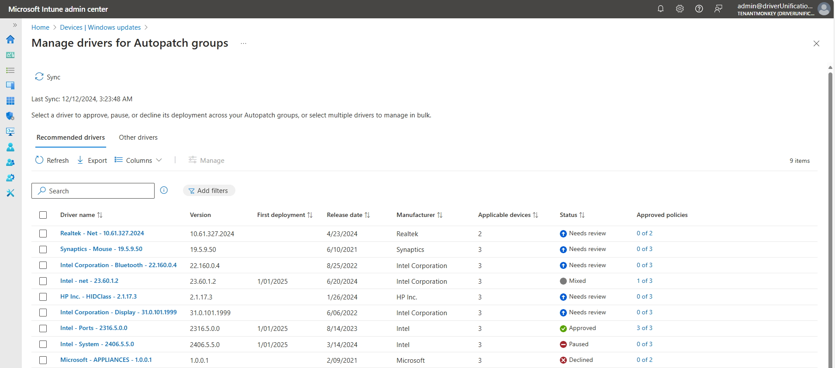
Customizing content
Quality Updates
Minimum Feature version, Update to Windows 11
Driver and Firmware management
M365 Opt-out
Edge Opt-out
Demo

Slide 18
Autopatch Groups

Slide 19
Quality update scenarios
Single Update ring policy targeting Microsoft Entra groups
Generally used when only testing quality update deployments in a few devices, example: IT department-only devices, Lab/dev devices.
Also used when there’s no business requirements to mirror organizational structures for a gradual/phased rollout.
Multiple ring policies when creating/editing Autopatch groups
Best when you need to mirror your organization structures, followed by a business requirement for a gradual/phased rollout, example: Departments like: Marketing, HR, etc. or Branch office locations such as: Chicago, New York, etc.
Easier to manage different quality update deployment speed and cadences across departments and/or branch locations.
Deadline vs. Schedule-driven deployments (Autopatch groups-only)
Deadline-driven
It’s an end user-driven that allow end users to interact with the update deployment. End users might decelerate update in some cases.
Schedule-driven
Best used for devices that can only be restarted at specific days/times.

Slide 20
Hotpatch Technology
What is hotpatching?
The ability to install security patches without a restart. Accomplished by modifying in-memory code without restarting the PC, process or applications.
Hotpatch updates
Full “Patch Tuesday” cumulative security updates that install and take effect without a restart.
Microsoft Confidential – Shared Under NDA - Information Subject to Change

Slide 21
Hotpatch Benefits
Faster Security
Improve Productivity
Cost Efficient
Fully secure without restart
Downloaded and installed in background
Non-Disruptive
High-Availability
Fast Patch Velocity
Simplify Patch Orchestration
Microsoft Confidential – Shared Under NDA - Information Subject to Change

Slide 22
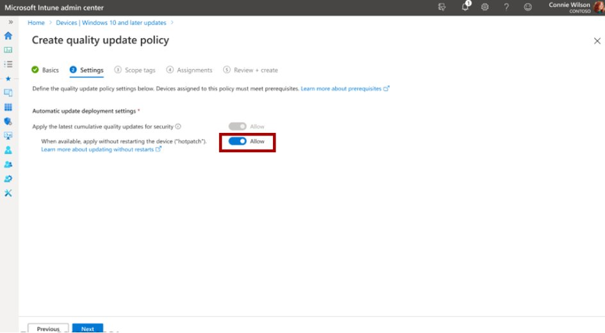
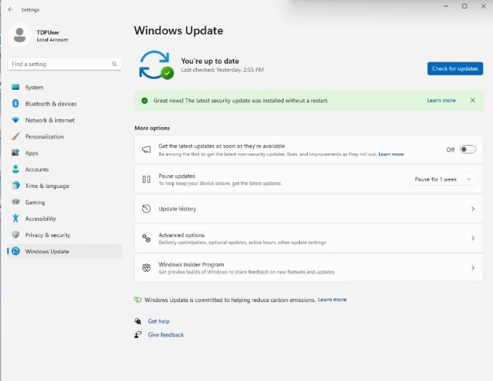
Hotpatch for Windows
Keeping customers secure and productive without interruptions
Hotpatch for Windows are Patch Tuesday security updates that install without requiring device restart.
Autopatch simplifies Hotpatch opt-in
OS security patches install without disruptions
Security updates immediately take effect upon installation — no restart required

Slide 23
Feature update scenarios
Single policy targeting Microsoft Entra groups
Generally used when only testing feature update deployments in a few devices, example: IT department-only devices, Lab/dev devices.
Also used when there’s no business requirements to mirror organizational structures for a gradual/phased rollout.
Multi-phase release targeting Autopatch groups
Best when you need to mirror your organization structures, followed by a business requirement for a gradual/phased rollout, example: Departments like: Marketing, HR, etc. or Branch office locations such as: Chicago, New York, etc.
Easier to manage different feature update deployment speed and cadences across departments and/or branch locations.
Additional deployment sequence/ordering controls for each phase of the deployment.
It gives IT admins additional layer of gradual rollout controls on top of the gradual rollout capabilities that happen at the service level.
When a device isn’t eligible to run Windows 11, install the Windows 10 feature update
Both scenarios above offer this setting so Autopatch can intelligently upgrade to the latest supported Windows OS version your device’s hardware support, without bringing additional IT admin overhead.

Slide 24
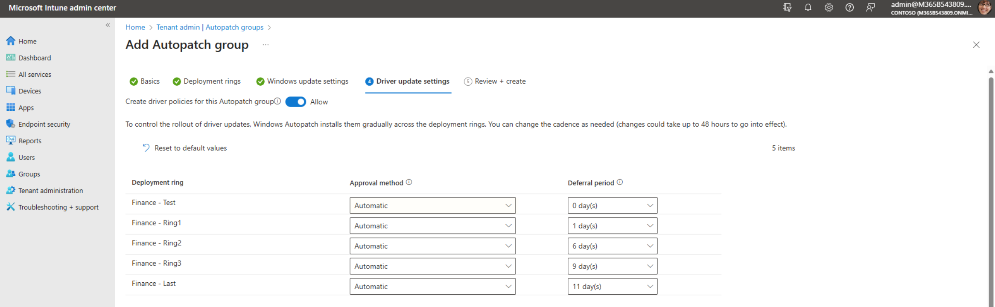

Customize driver and firmware updates
Automatic
Recommended drivers are automatically installed using Autopatch deployment ring rollout and Deferral period.
Manual
Drivers aren't installed in your environment without your explicit approval.
Demo

Slide 25
Notes on drivers and firmware
Plug and Play
Drivers are automatically installed when new hardware is detected by the OS
Once new hardware is detected and plug and play driver is installed, it becomes manageable by the IT admin
Extension drivers
Minor update to a base driver package to enhance, modify, or filter the functionality provided by the base driver
Identified by Extension in the driver's name (Example: Intel - Extension - 2219.3.0.0)
Not managed by Windows Update and not managed via Autopatch
BIOS passwords and Bitlocker
Deliver via Windows Update using Unified Extensible Firmware Interface (UEFI) Capsule update
If Secure boot is enabled, should not require suspending BitLocker or need for a BIOS password during the update process

Slide 26
Windows Autopatch + Microsoft 365 Apps
All enrolled devices are set to Monthly Enterprise Channel (MEC) for Enterprise Standard Suite
Apps deployed on the Monthly Enterprise Channel are supported for two months
Autopatch uses deferral windows to emulate progressive deployment atop Office CDN rollout
Opt-out setting allows devices to be set to other channels

Slide 27
Windows Autopatch + Microsoft Edge
Autopatch assigns a representative sample set of devices to Beta Channel for validation before broad deployment
The rest of enrolled devices are assigned to Stable Channel with new features ship about every 4 weeks
All Autopatch enrolled devices are registered for automatic progressive rollout.
Opt-out setting allows devices to be set to other channels

Slide 28
Edge and M365 apps

Slide 29
Reporting and Monitoring
Compliance and more

Slide 30
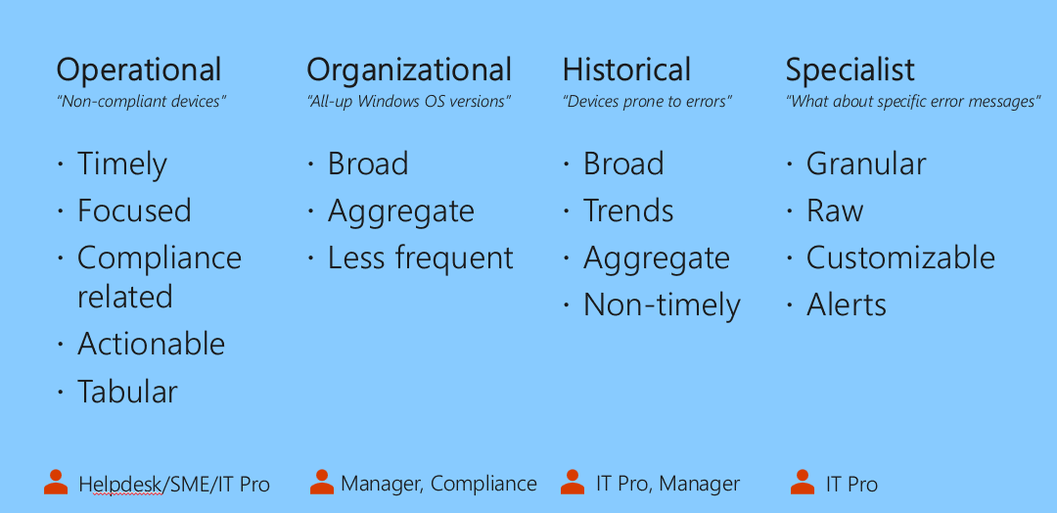
Reporting concepts
IT persona-based reporting
Feature and Quality update reports including Hotpatch information
Near real-time (4 hours latency)

Slide 31
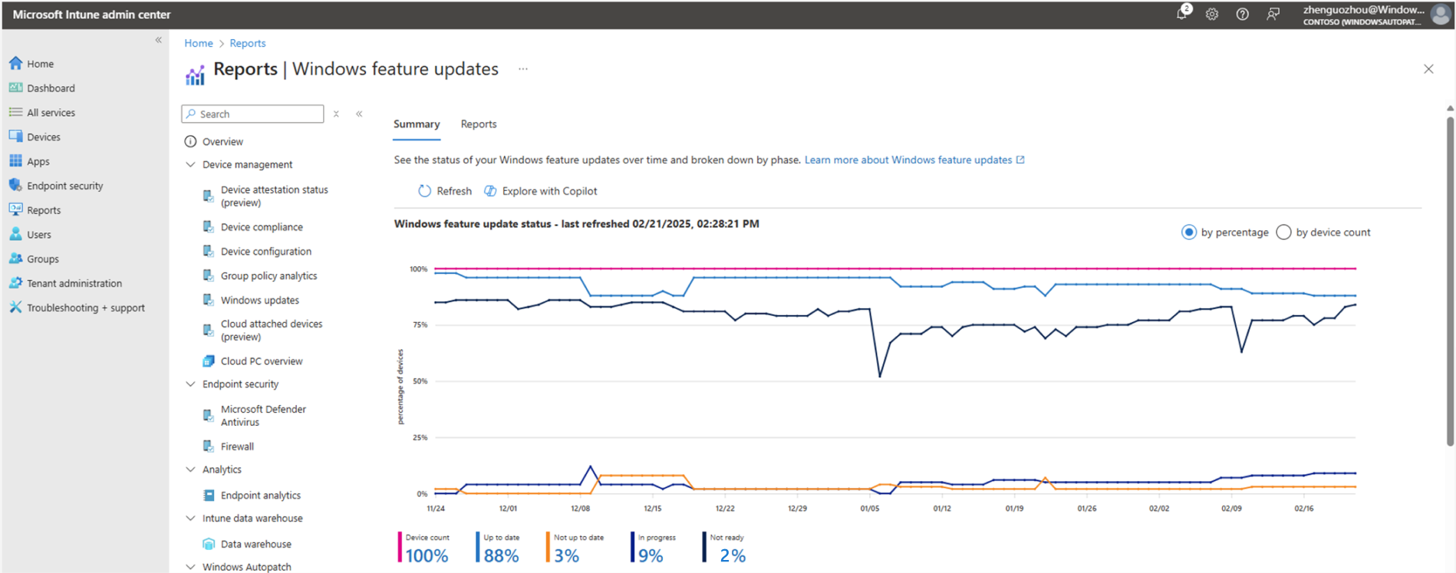
Feature updates reports
Trends and summary chart
Release and policy level breakdown
Deep filtering

Slide 32
Pausing updates
Pause driven by IT admins
Feature, Driver, or Quality updates
Pause persists
Resume at will

Slide 33
Support and Communications
Messages and ticketing

Slide 34
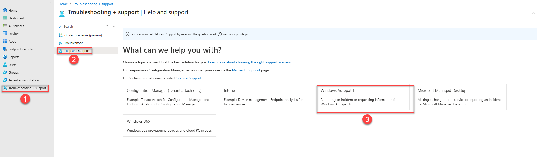
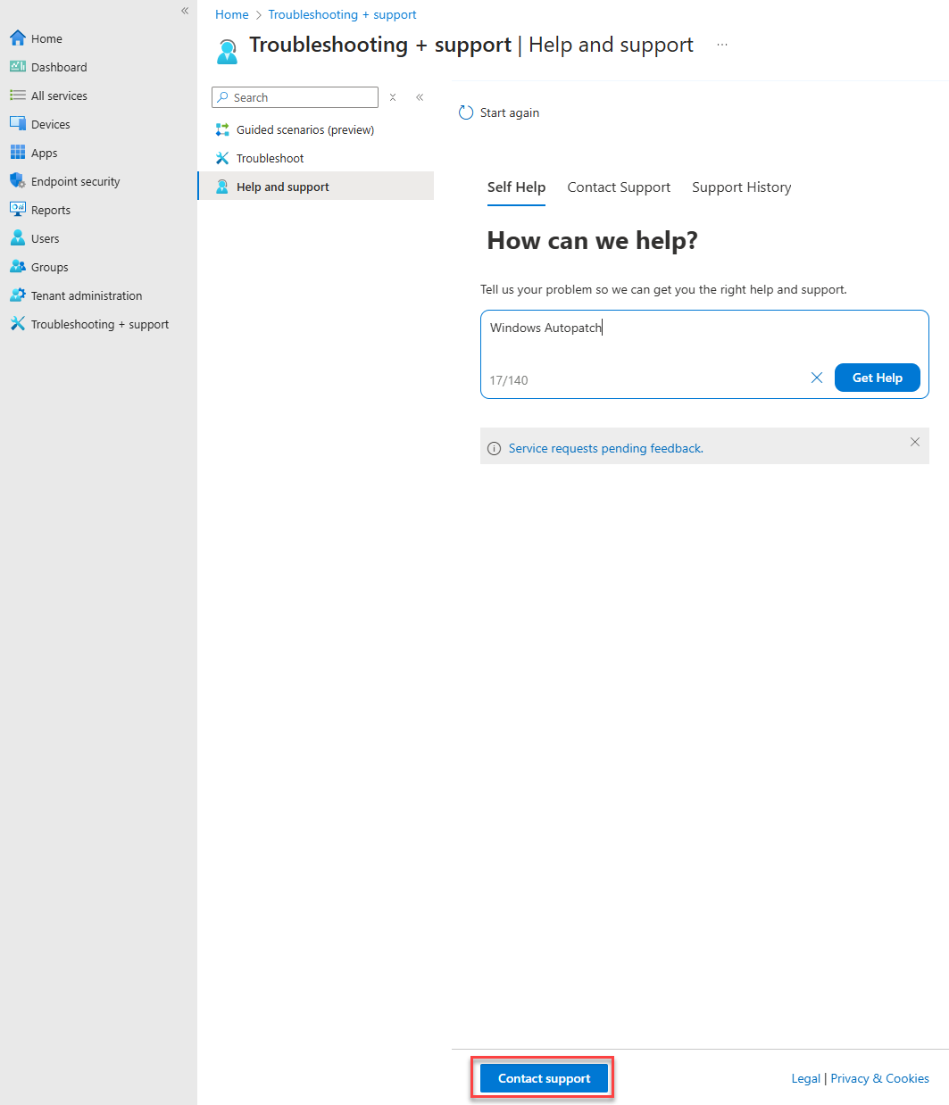
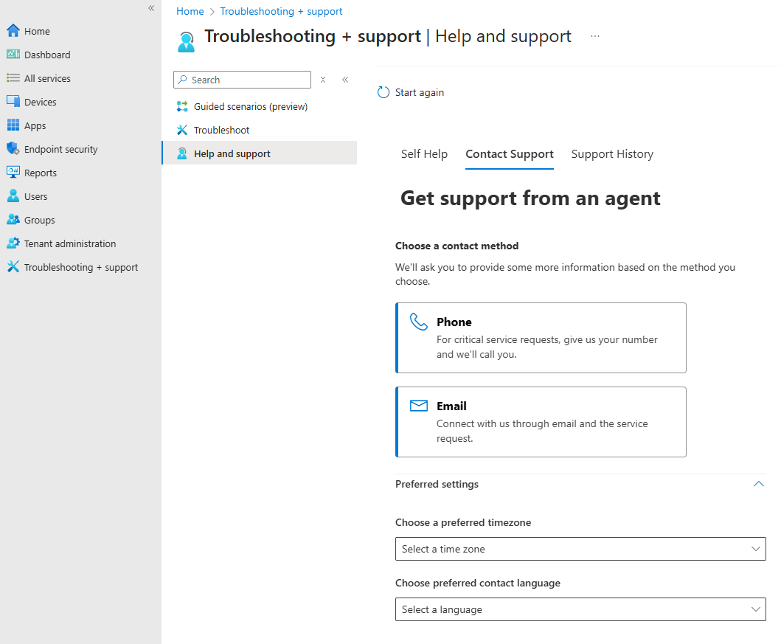
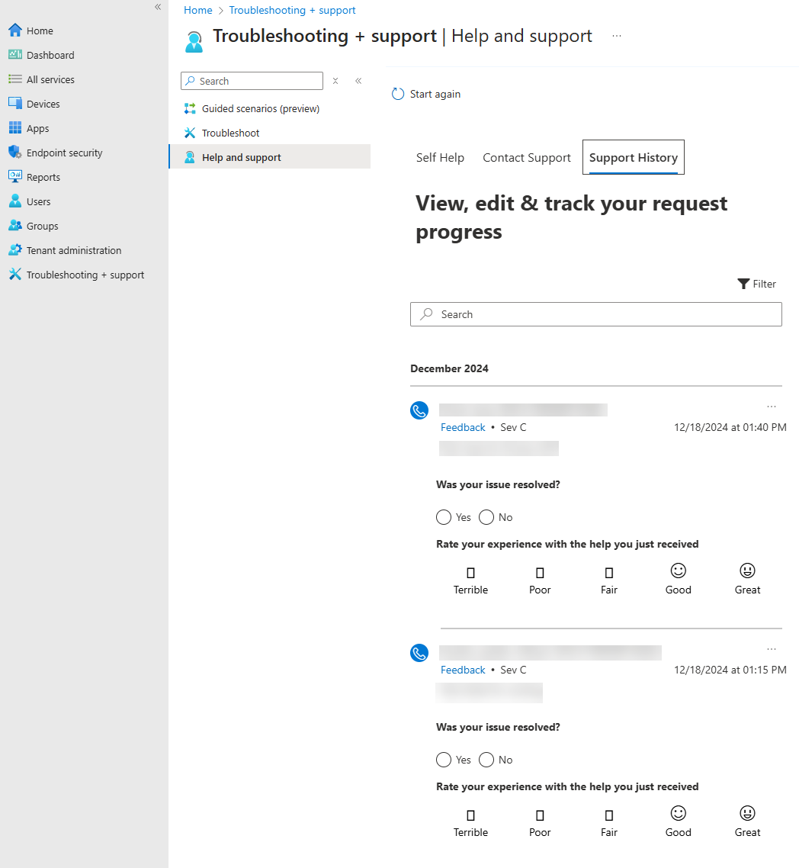
Ticketing
Self-Help
Single point of contact
Support history

Slide 35
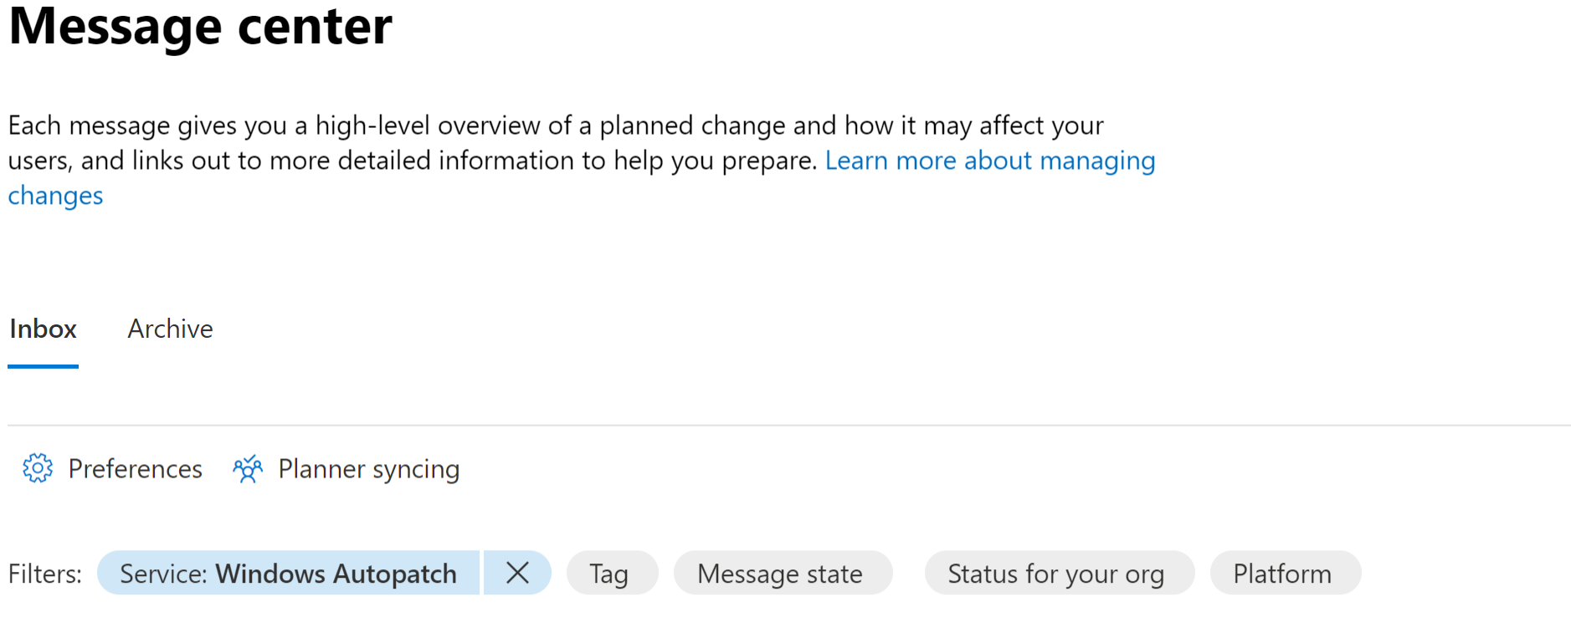
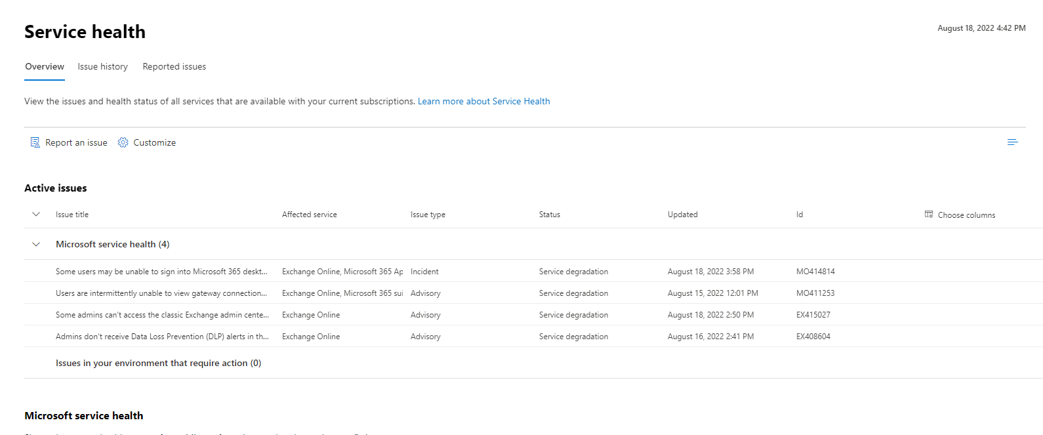
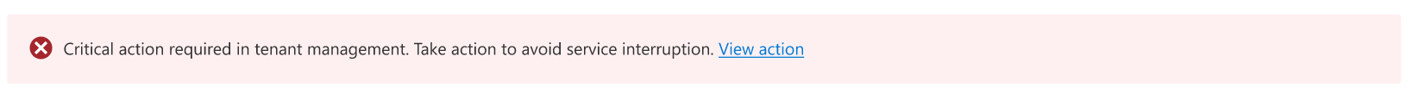
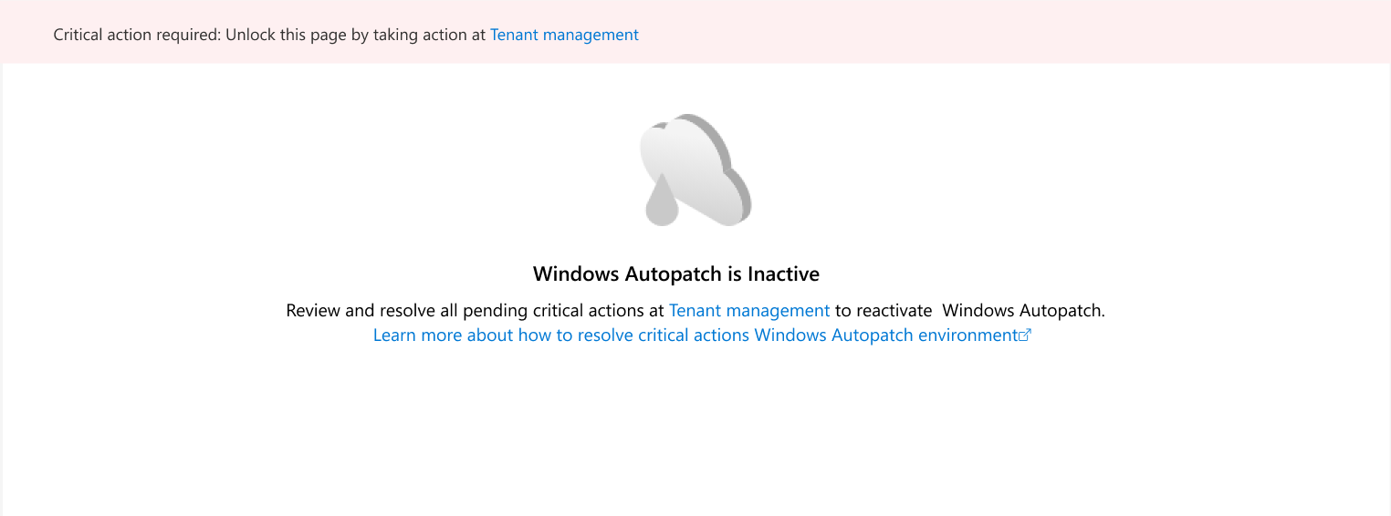
Service communication
Message Center
Update release notifications
Service feature announcements
Available via email
Service Health Dashboard
Service pauses
Known Incidents
Customer advisories
Available via Email
In-context messaging
Tenant health banners
‘Inactive state’ for licensing issues

Slide 36
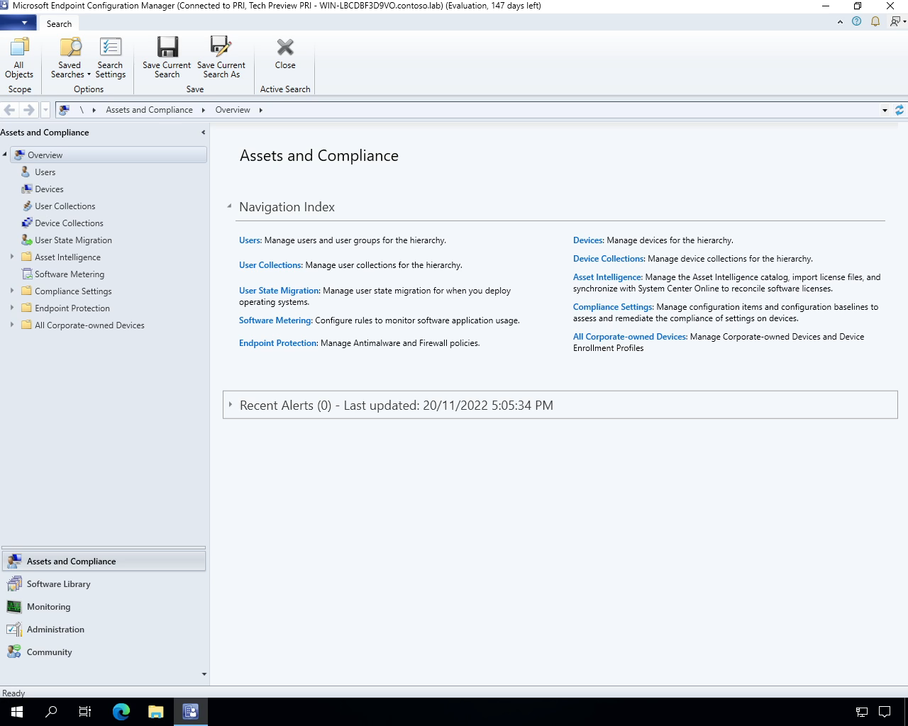
Re-assign update management from Configuration Manager to Autopatch
Phased deployment via Slider Collections
Slide the Windows Update slider

Slide 37
Re-assign update management from WSUS to Autopatch
Complete Windows Autopatch onboarding
Remove WSUS GPO policy from device
Ensure “Do not connect to any Windows Update Internet locations” is set to ’disabled’ or ‘Not Configured’

Slide 38
Expertise and tools for your journey
Get Insights and shape the future of AI by joining the Windows customer connection program
Trak blogs, events and real-world knowledge in our community
aka.ms/JoinWCCP
aka.ms/TechCommunity

Slide 39
Questions & Answers

Slide 40
We have an exciting future ahead.

Slide 41
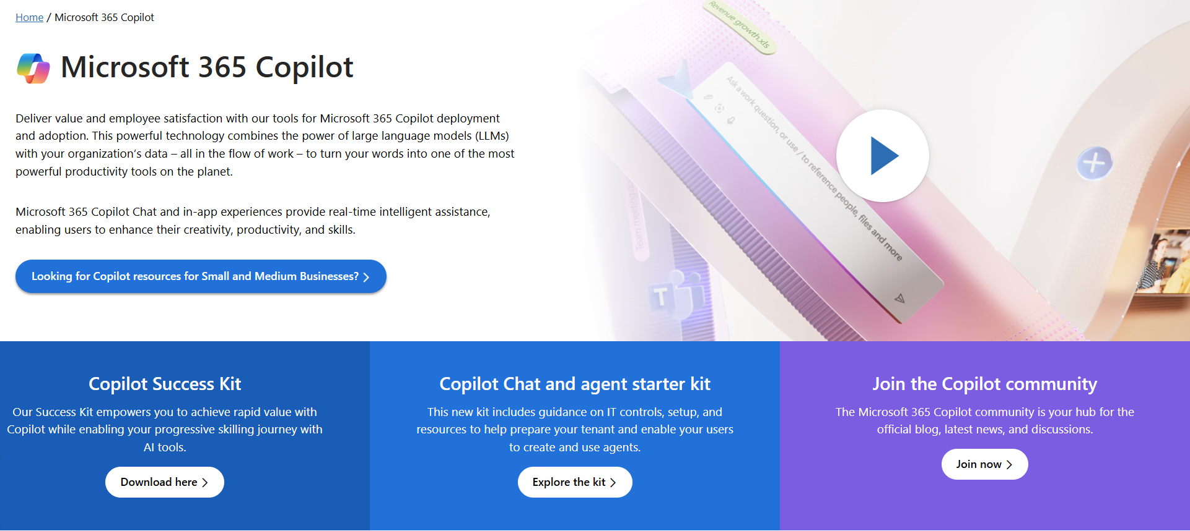
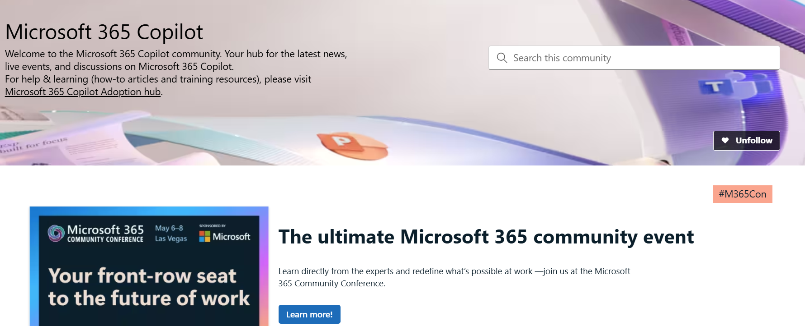
News & community content
Microsoft Community Learning aka.ms/Community/LearningChannel
Community led expert content on all your favorite Microsoft services.
Start your week with live news and event updates aka.ms/MondaysatMicrosoft
Watch live or on-demand & share our blog.

Slide 42
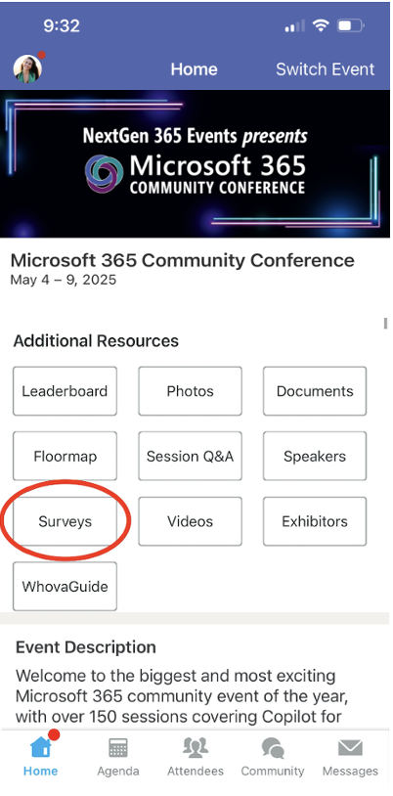
Session feedback surveys
We want to hear from YOU!
Share your feedback to make next years conference even better!
Here’s how –
Simply go to the Whova App on your smartphone.
Scroll down on the M365 Community Conference Homepage to ‘Additional Resources’ to click “Surveys’.
Click Session Feedback.
Scroll down to find this session title.
Complete the session feedback survey.
Finally, click ‘Submit’.
It’s just that easy!

Slide 43
