Slide 1
Extensibility Options to Improve Your Employee Experiences within Viva Connections and SharePoint
Luca Bandinelli – Principal PM Architect | Micorsoft
Vesa Juvonen – Principal Product Manager | Microsoft
8th of May 2025

Slide 2

Microsoft 365 Community Conference

Slide 3


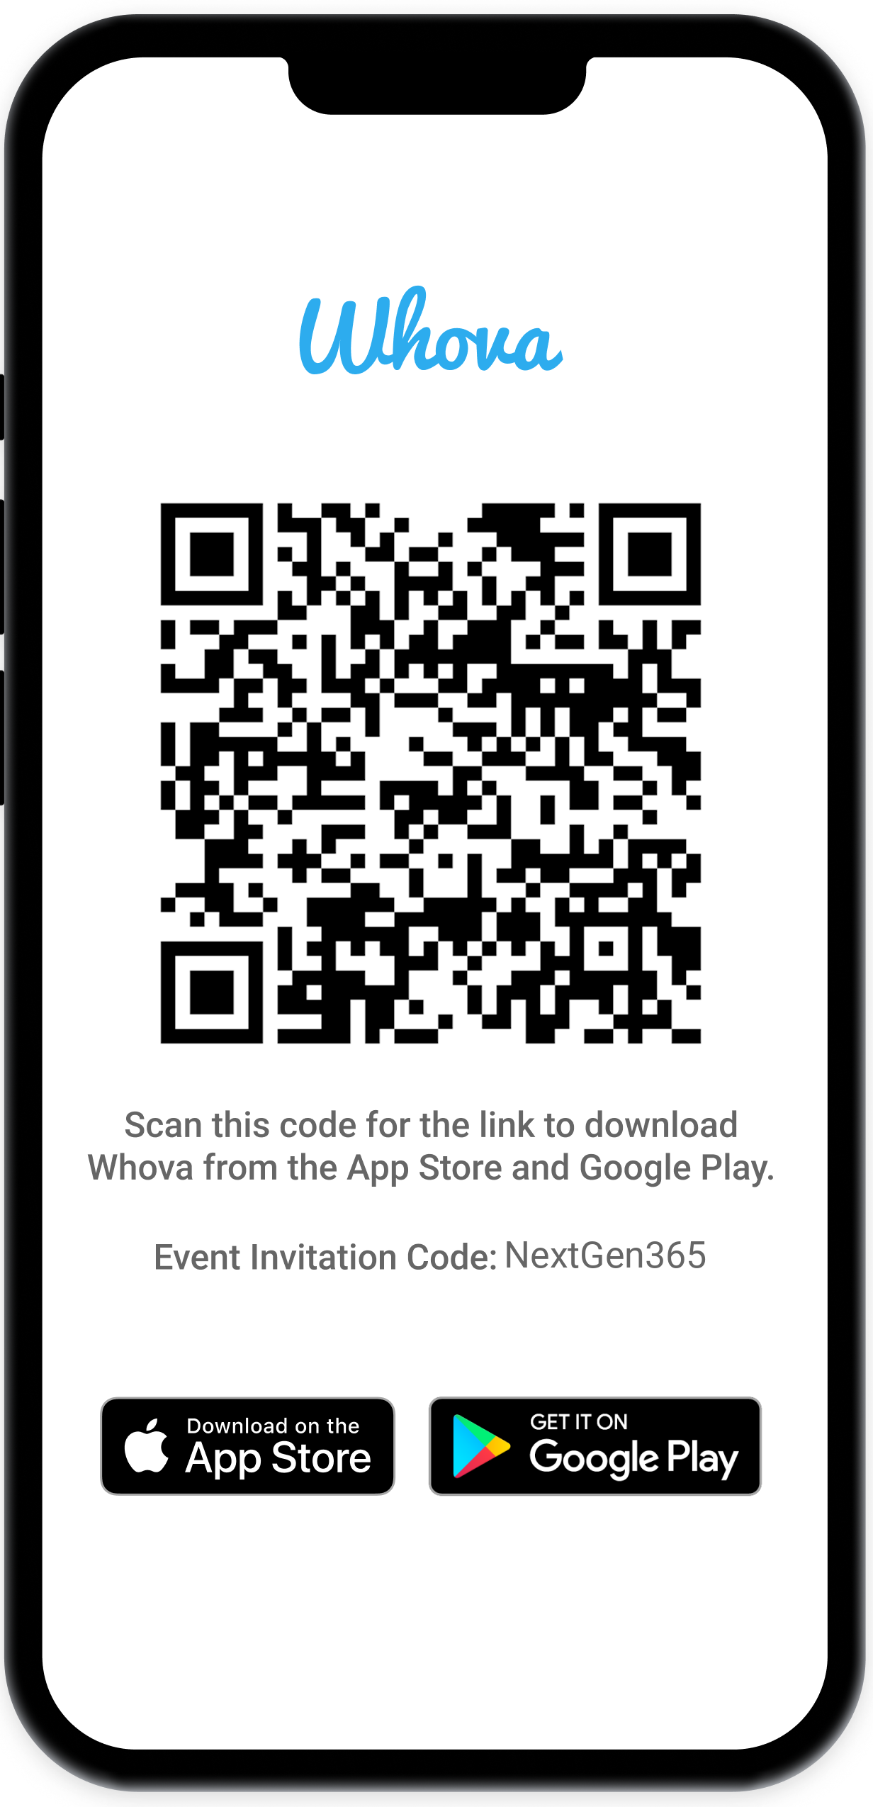
Join the event app to access:
The official event app for the
Microsoft 365 Community Conference
Event invitation code: NextGen2025
Event announcements
Personalized agenda, session details
Speaker & attendee profiles
Networking, meet-ups, messages
Event documents

Slide 4


Luca Bandinelli
PM Architect
/luca-bandinelli-37b209/
Vesa Juvonen
Principal PM
/vesajuvonen

Slide 5
Updates
10 min on the SharePoint Framework category hackathon winner

Slide 6
Updates and Thank you
Jul 2023
Sep
Oct
Nov
Dec
Jan 2024
Feb
Mar
Apr
May
Jun
Jul 2023
Sep
Oct
Nov
Dec
Jan 2024
Feb
Mar
Apr
May
Jun
KPMG and Microsoft cloud and AI alliance
Commitments to advance safe, secure, and trustworthy AI
Copilot Copyright Commitment for customers
Azure AI Content Safety Generally Available
Copilot for Microsoft 365 enterprise GA
WTI Special Report: Copilot learnings
Copilot search GA with data protection
Copilot key on AI-powered Windows PCs
Copilot lands at the Super Bowl
Microsoft’s AI Access Principles
Microsoft Orca-Math small language model
New AI-powered Surface PCs built for business
Copilot for Security generally available
Partnership with G42 to accelerate AI in UAE
GitHub Copilot Workspace in preview
Responsible AI Transparency Report
Investment in Wisconsin for AI and economic growth
Microsoft Fabric Real-Time intelligence in preview
Khan Academy and Microsoft partner to expand access to AI tools
New agent capabilities in Microsoft Copilot Studio
Microsoft Research’s Aurora, a large-scale foundation model of the atmosphere
KPMG and Microsoft cloud and AI alliance
Commitments to advance safe, secure, and trustworthy AI
Copilot Copyright Commitment for customers
Azure AI Content Safety Generally Available
Copilot for Microsoft 365 enterprise GA
WTI Special Report: Copilot learnings
Copilot search GA with data protection
Copilot key on AI-powered Windows PCs
Copilot lands at the Super Bowl
Microsoft’s AI Access Principles
Microsoft Orca-Math small language model
New AI-powered Surface PCs built for business
Copilot for Security generally available
Partnership with G42 to accelerate AI in UAE
GitHub Copilot Workspace in preview
Responsible AI Transparency Report
Investment in Wisconsin for AI and economic growth
Microsoft Fabric Real-Time intelligence in preview
Khan Academy and Microsoft partner to expand access to AI tools
New agent capabilities in Microsoft Copilot Studio
Microsoft Research’s Aurora, a large-scale foundation model of the atmosphere
Meta Llama 2 on Azure and Windows
Microsoft joins Frontier Model Forum
50 years of Microsoft
2 years of AI
Unified Microsoft Copilot experience
New steps to help protect elections, AI watermarking tools
AMD MI300X accelerated VMs in Azure
Copilot integrates multimodal, GPT-4 Turbo and DALL·E 3
AI accelerating chemistry and materials science
AI solutions in Microsoft Cloud for Sustainability
GitHub Copilot Enterprise generally available
Expanded Copilot Pro offerings, including Copilot GPT Builder
New Responsible AI tools in Azure AI
Cohere Command R+ available on Azure
Expanded Content Integrity tools
Investments in cloud and AI in Indonesia
Investments in cloud and AI in Thailand
GPT-4o available in Azure AI in preview
GitHub Copilot Extensions in private preview
Cognition AI partnership
Team Copilot in preview
Copilot+ PC available
Meta Llama 2 on Azure and Windows
Microsoft joins Frontier Model Forum
Unified Microsoft Copilot experience
New steps to help protect elections, AI watermarking tools
AMD MI300X accelerated VMs in Azure
Copilot integrates multimodal, GPT-4 Turbo and DALL·E 3
AI accelerating chemistry and materials science
AI solutions in Microsoft Cloud for Sustainability
GitHub Copilot Enterprise generally available
Expanded Copilot Pro offerings, including Copilot GPT Builder
New Responsible AI tools in Azure AI
Cohere Command R+ available on Azure
Expanded Content Integrity tools
Investments in cloud and AI in Indonesia
Investments in cloud and AI in Thailand
GPT-4o available in Azure AI in preview
GitHub Copilot Extensions in private preview
Cognition AI partnership
Team Copilot in preview
Copilot+ PC available
Bing Chat Enterprise and Microsoft 365 Copilot pricing
Moody's generative AI strategic partnership
Copilot in Windows roll out, AI-enhanced tools
Public preview of Azure AI Studio
Copilot Studio, Copilot for Sales and Copilot for Service
AFL-CIO and Microsoft AI tech-labor partnership
Copilot Pro and expanding Copilot for Microsoft 365 availability to SMBs
Tech accord to combat AI deepfakes in elections
Microsoft Copilot for Finance
NVIDIA GB200 Grace Blackwell processor on Azure
New Microsoft AI Hub in London
Microsoft’s Phi-3-mini model now available
Estee Lauder and Microsoft increase collaboration
Microsoft and OpenAI launch Societal Resilience Fund
Investment in France to accelerate AI and skilling
Microsoft Phi-3-vision model in preview
AMD MI300X accelerated VMs in Azure GA
Digital ecosystem and AI initiatives for Kenya
Microsoft and healthcare orgs expand Trustworthy & Responsible AI Network
Bing Chat Enterprise and Microsoft 365 Copilot pricing
Moody's generative AI strategic partnership
Copilot in Windows roll out, AI-enhanced tools
Public preview of Azure AI Studio
Copilot Studio, Copilot for Sales and Copilot for Service
AFL-CIO and Microsoft AI tech-labor partnership
Copilot Pro and expanding Copilot for Microsoft 365 availability to SMBs
Tech accord to combat AI deepfakes in elections
Microsoft Copilot for Finance
NVIDIA GB200 Grace Blackwell processor on Azure
New Microsoft AI Hub in London
Microsoft’s Phi-3-mini model now available
Estee Lauder and Microsoft increase collaboration
Microsoft and OpenAI launch Societal Resilience Fund
Investment in France to accelerate AI and skilling
Microsoft Phi-3-vision model in preview
AMD MI300X accelerated VMs in Azure GA
Digital ecosystem and AI initiatives for Kenya
Microsoft and healthcare orgs expand Trustworthy & Responsible AI Network
GitHub Copilot Chat beta
Microsoft Azure Maia & Microsoft Azure Cobalt chips
Phi-2, a SLM with remarkable performance
Walmart unveils new GenAI capabilities
Microsoft and Mistral AI partnership
FWD Group builds AI-driven insurance experiences
Formed new Consumer AI team
Investments in cloud and AI infrastructure in Japan
Coca-Cola AI and cloud partnership
Work Trend Index details the state of AI
Announcing Copilot+ PC
Phi-3-mini, Phi-3-small, and Phi-3-medium generally available
Cobalt 100 Arm-based virtual machines in preview
Siemens delivers AI-enhanced solutions
Hitachi and Microsoft milestone GenAI agreement
GitHub Copilot Chat beta
Microsoft Azure Maia & Microsoft Azure Cobalt chips
Phi-2, a SLM with remarkable performance
Walmart unveils new GenAI capabilities
Microsoft and Mistral AI partnership
FWD Group builds AI-driven insurance experiences
Formed new Consumer AI team
Investments in cloud and AI infrastructure in Japan
Coca-Cola AI and cloud partnership
Work Trend Index details the state of AI
Announcing Copilot+ PC
Phi-3-mini, Phi-3-small, and Phi-3-medium generally available
Cobalt 100 Arm-based virtual machines in preview
Siemens delivers AI-enhanced solutions
Hitachi and Microsoft milestone GenAI agreement
Notes:
We are making fantastic progress.
When you look at all of these announcements that we’ve made in the past year, it’s not just the pace of innovation, but it’s the pace of adoption that has been remarkable.
Together, we’ve moved from talking about AI to deploying AI at scale.

Slide 7
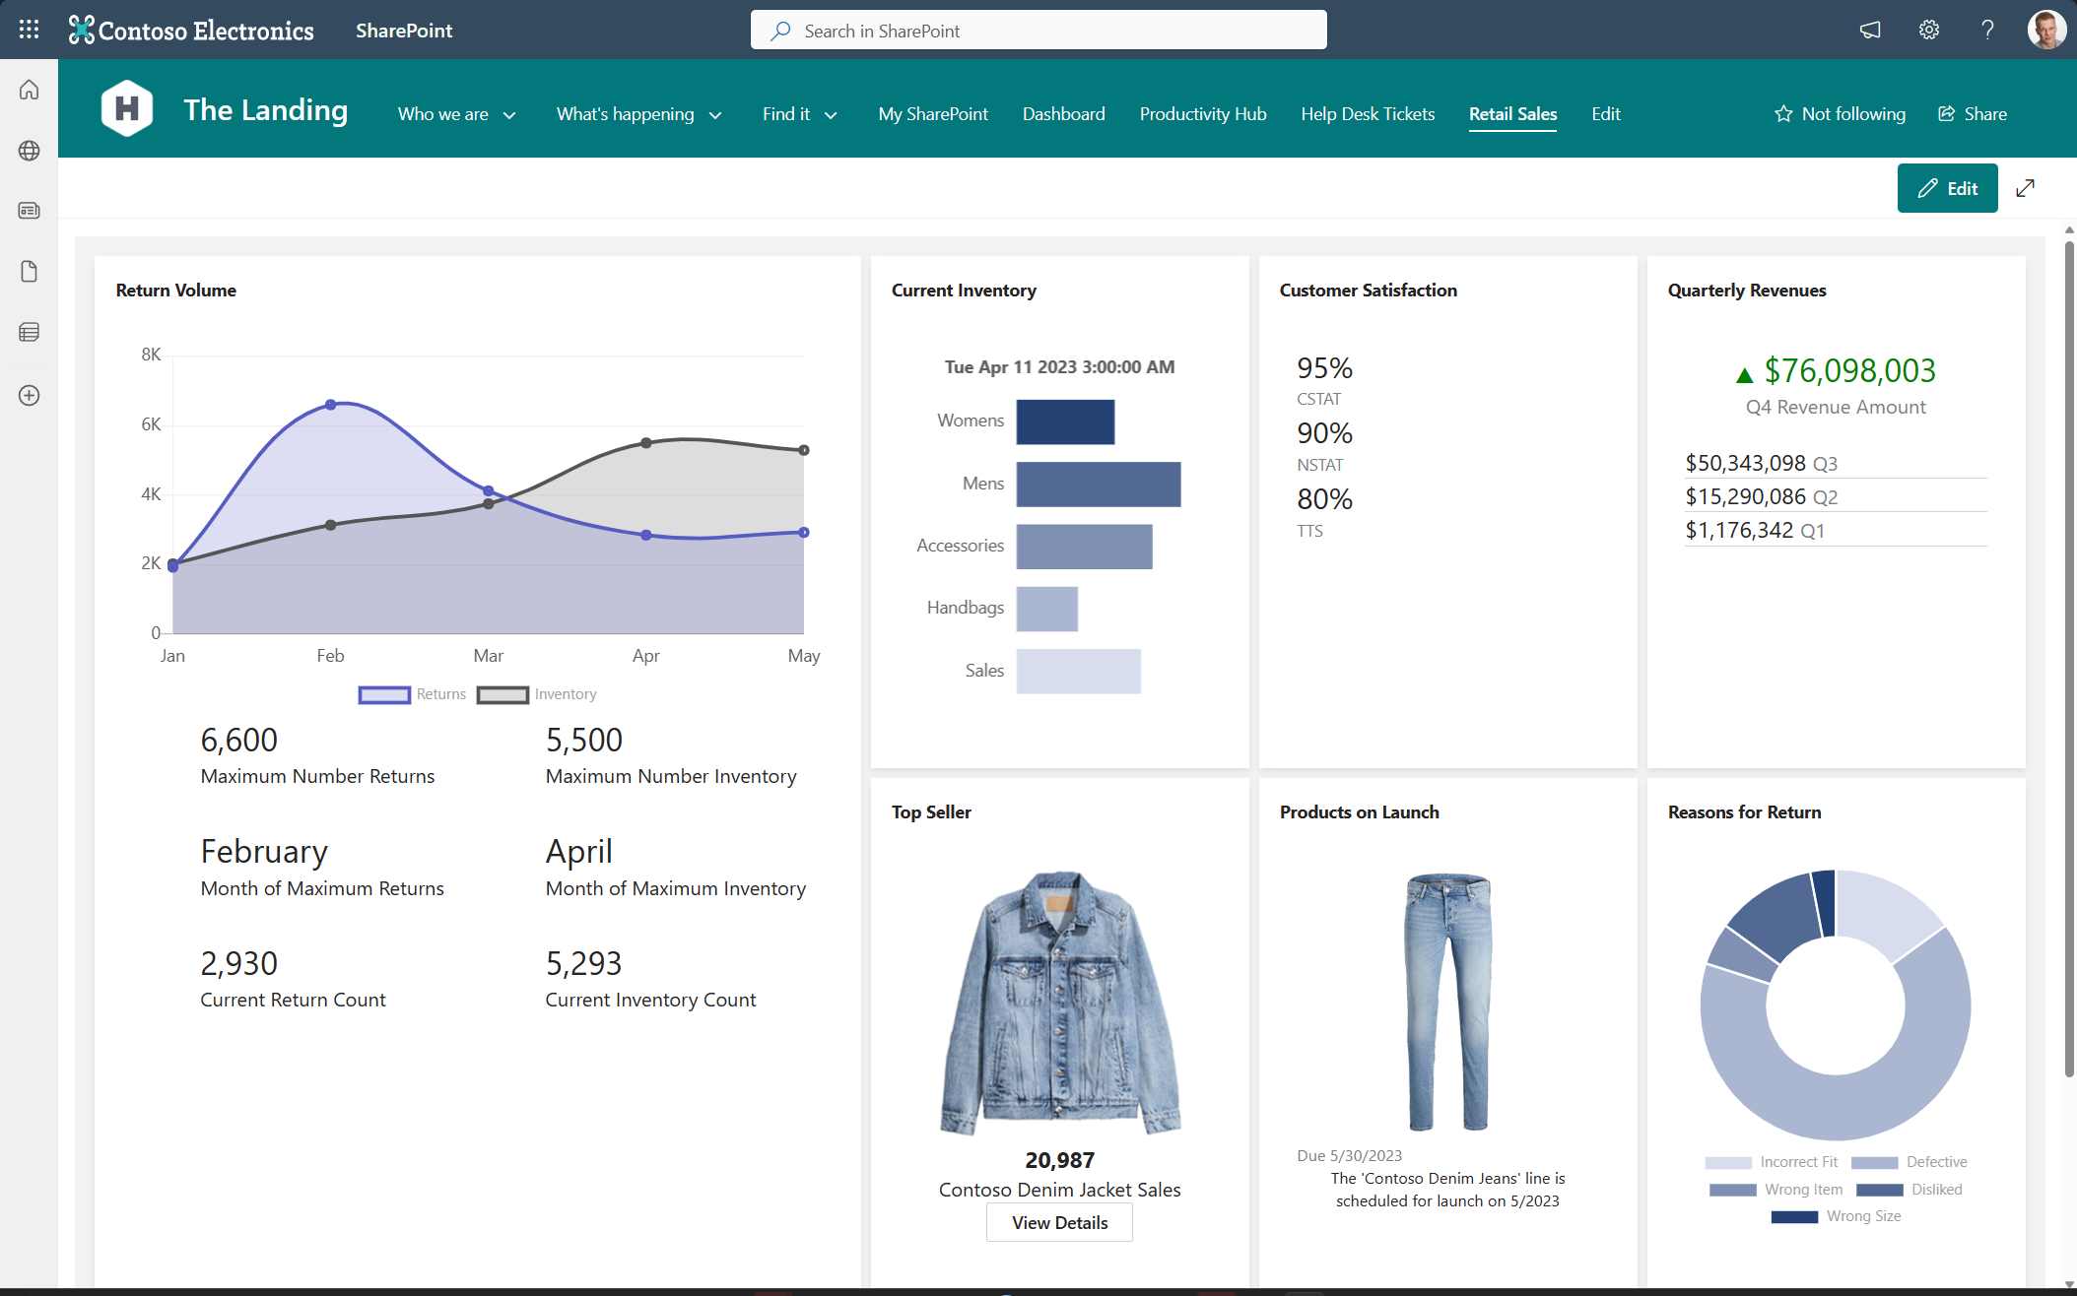


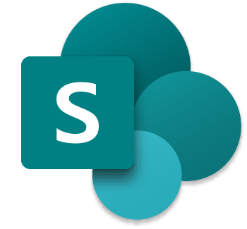




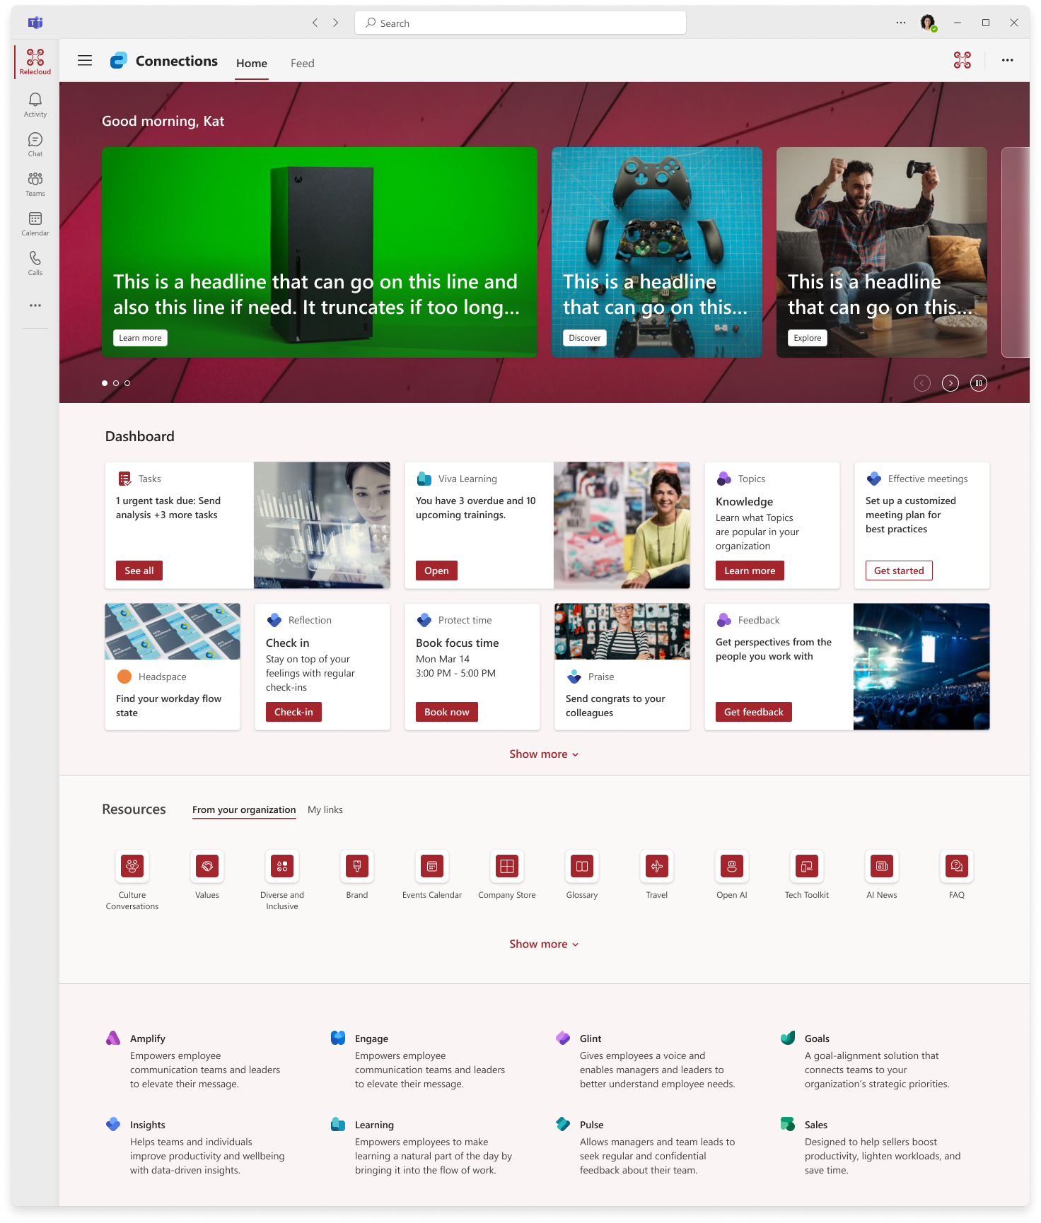
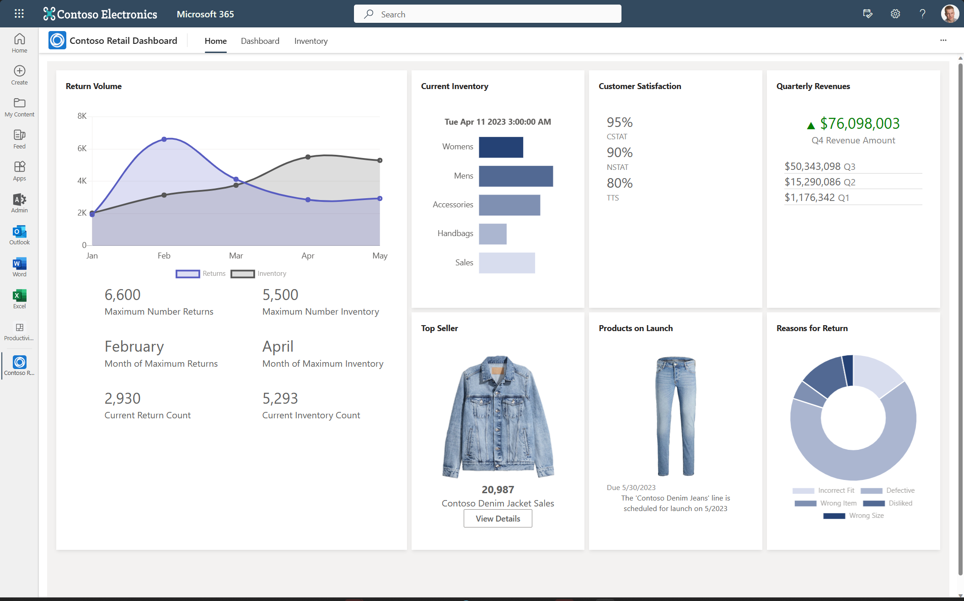
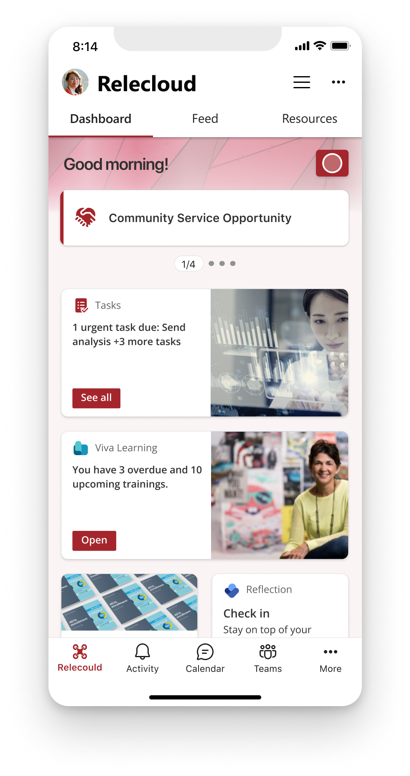
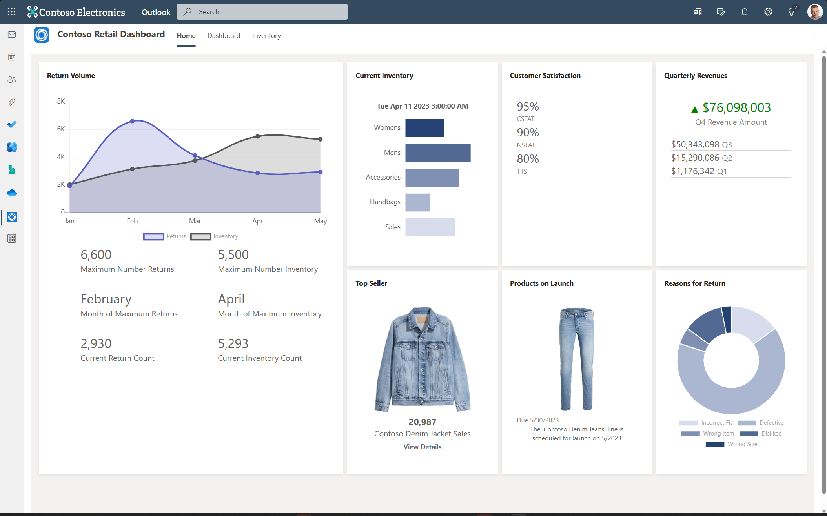
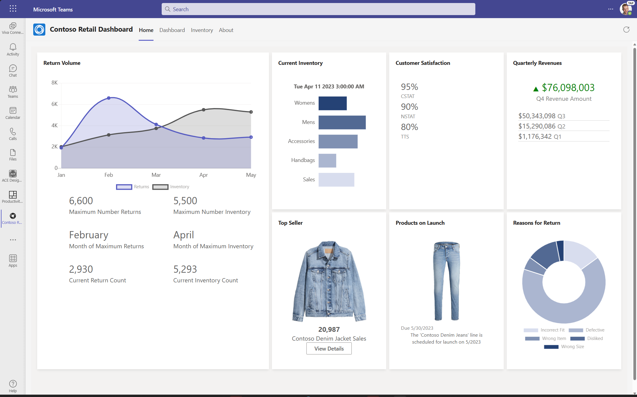
SharePoint Framework
The easiest way to develop your enterprise solutions for Microsoft 365
Content driven applications | SSO | Automatic code hosting | Industry standard tooling

Slide 8
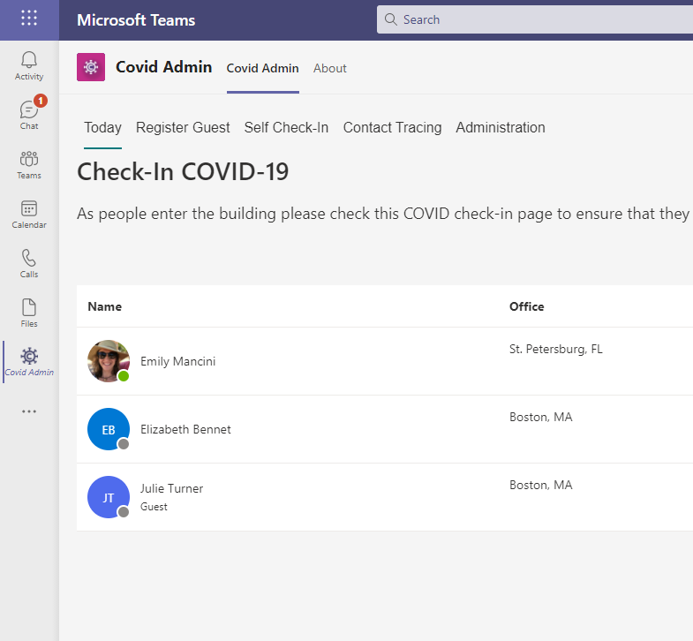
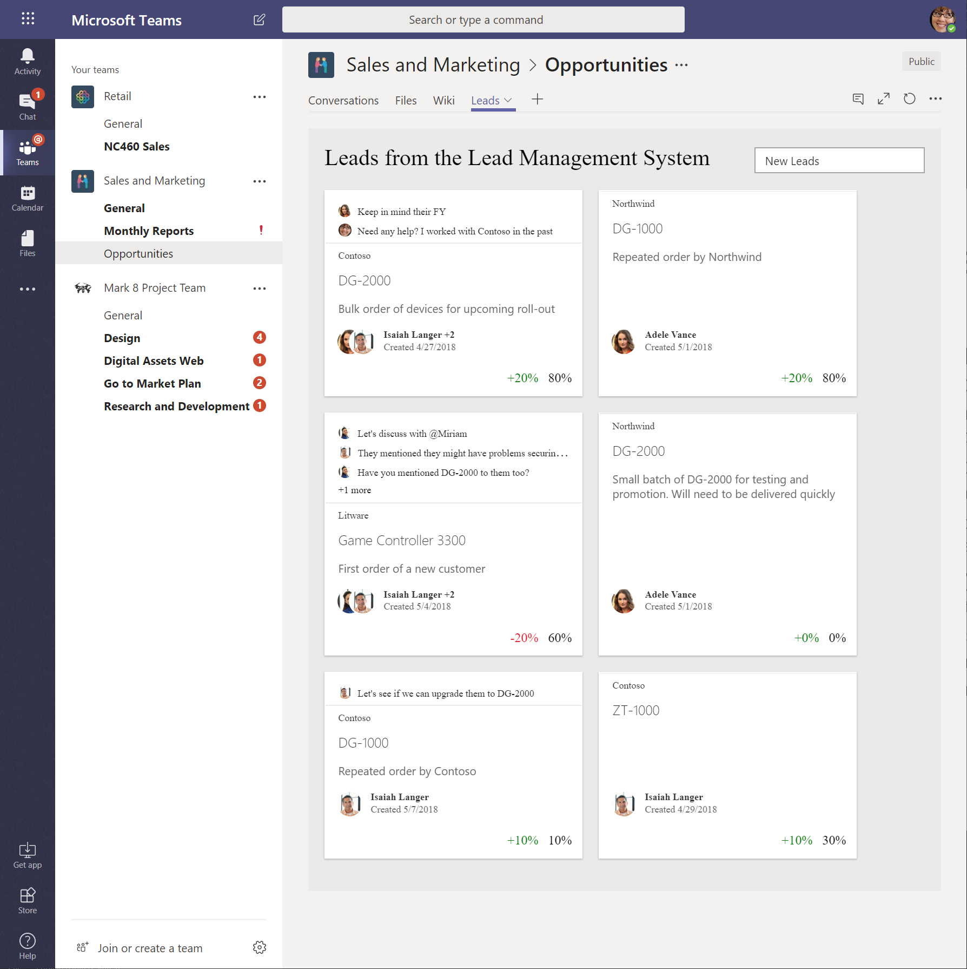
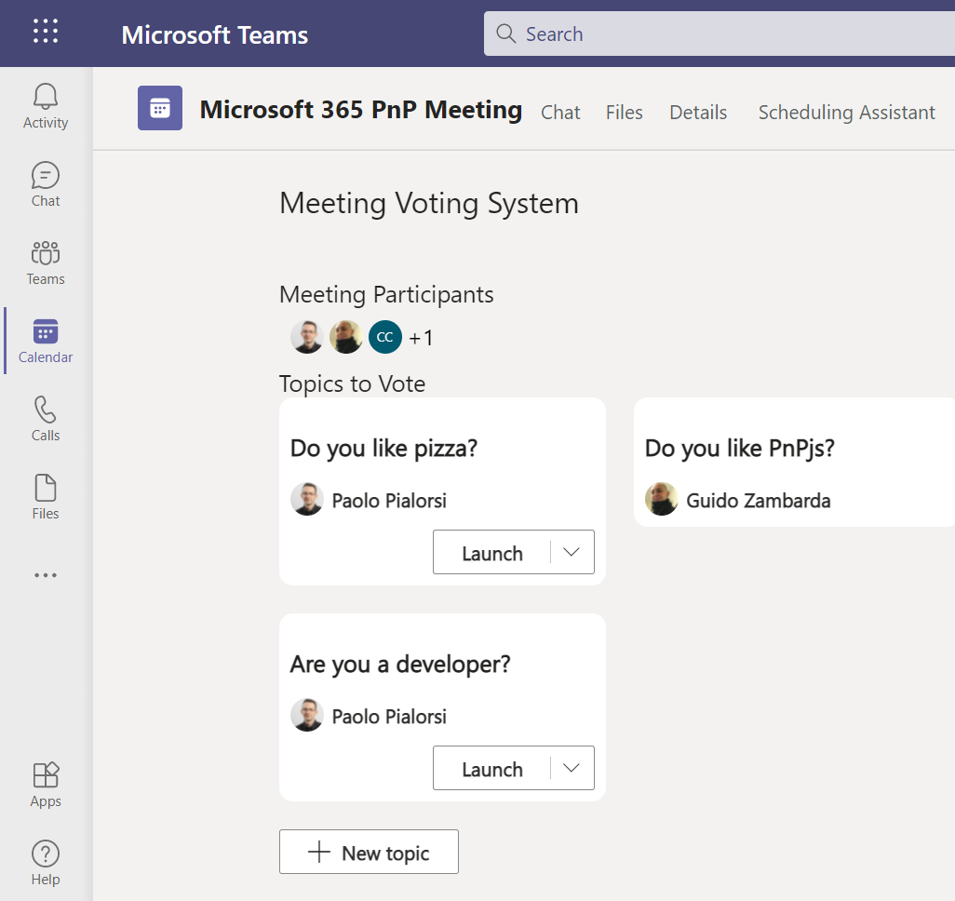
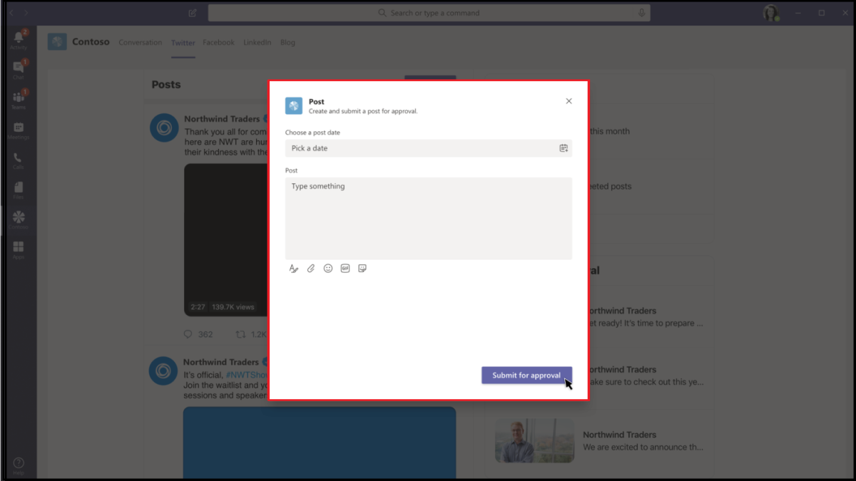
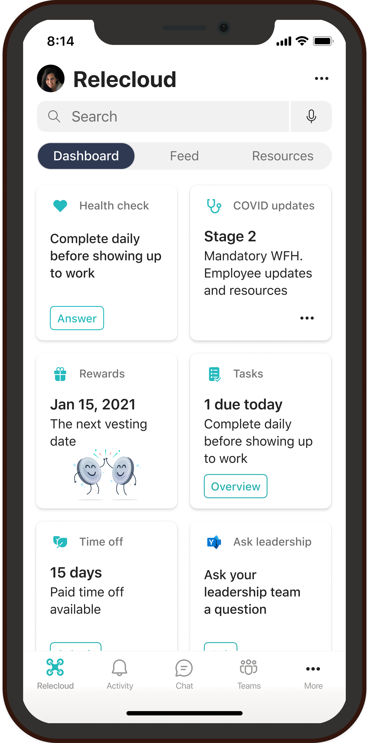
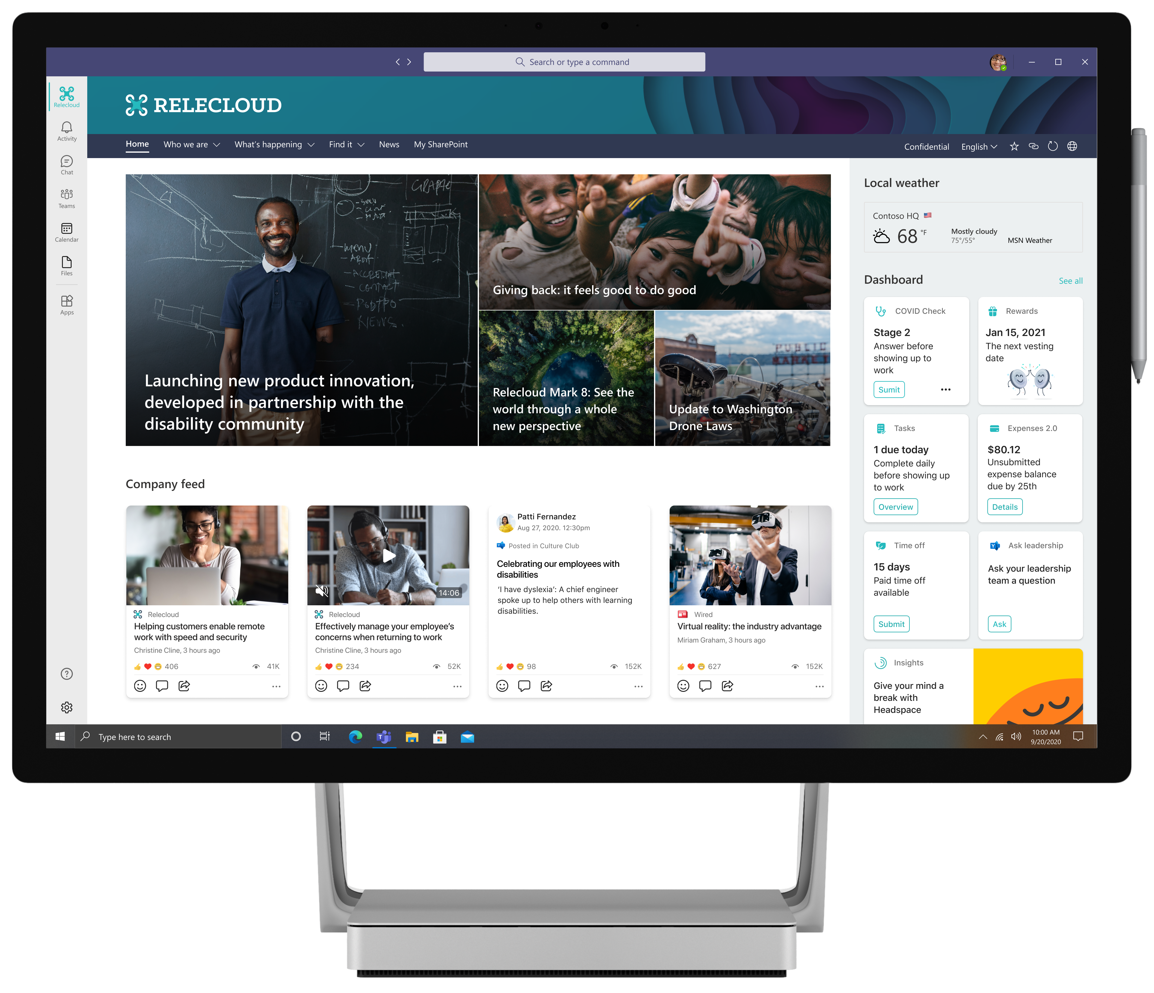
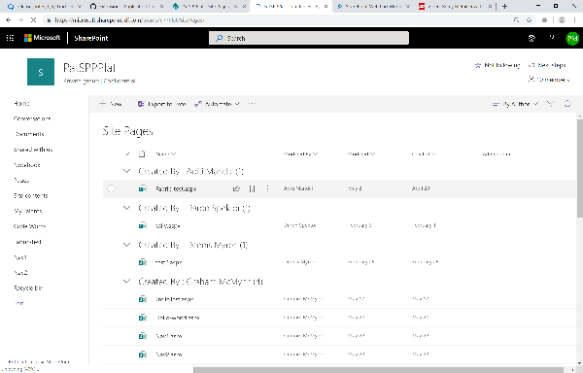
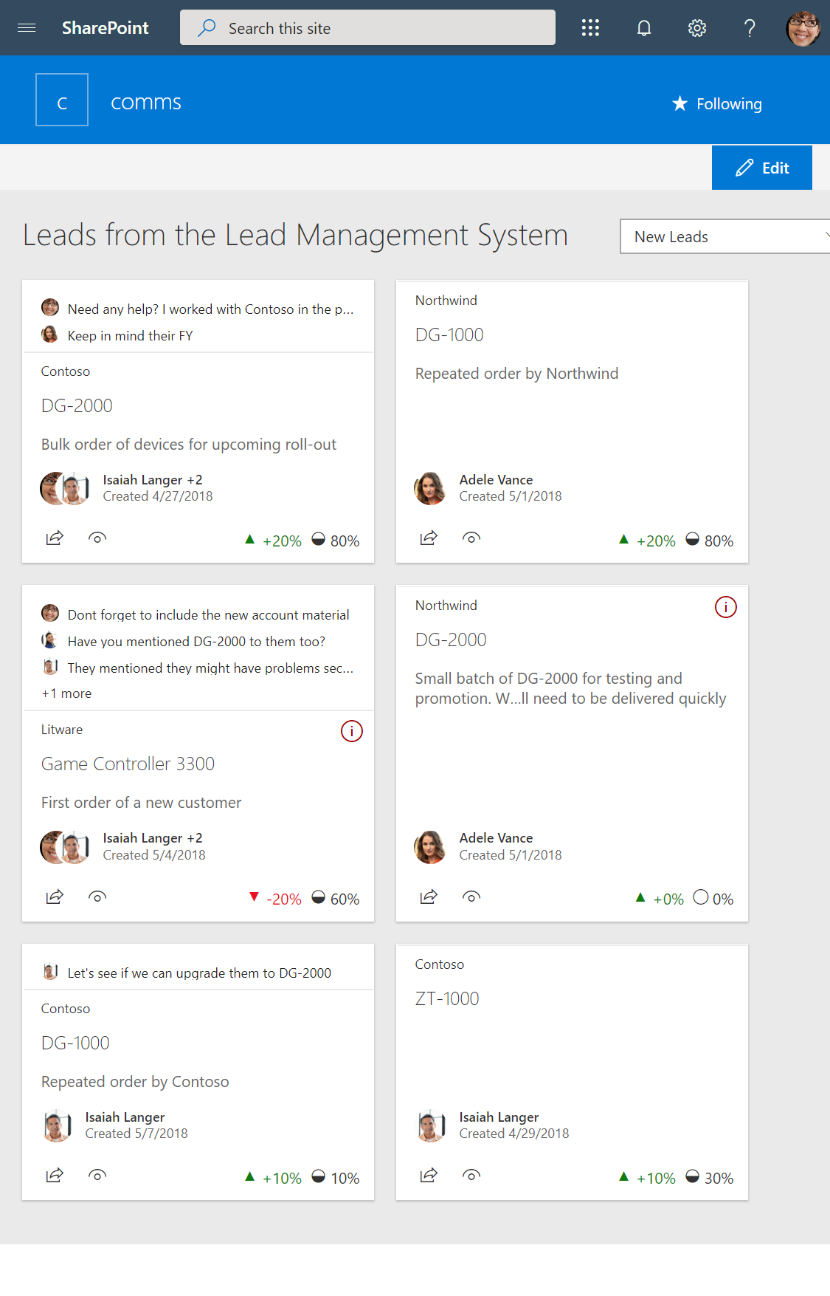
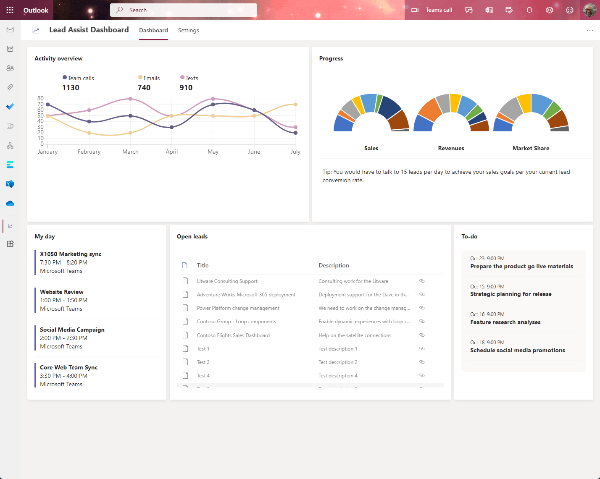
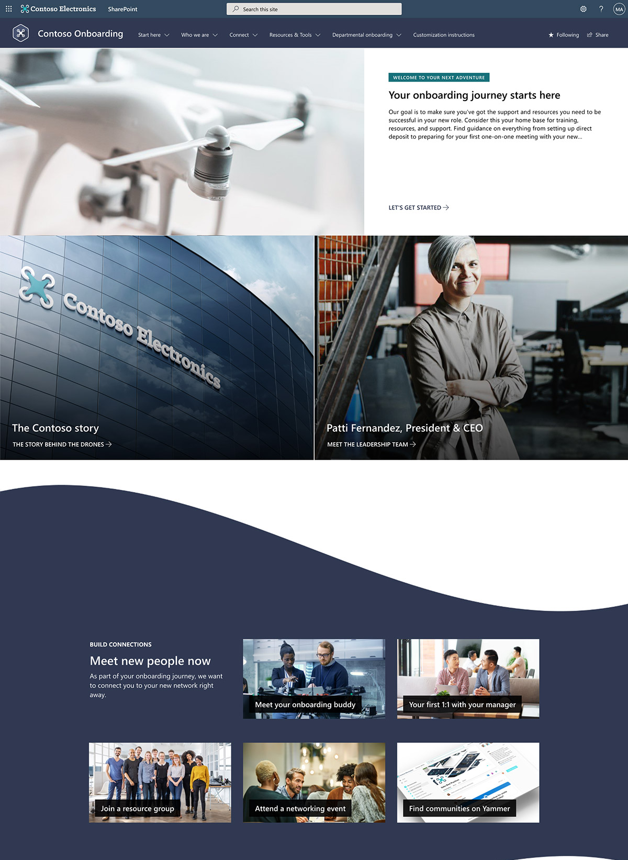
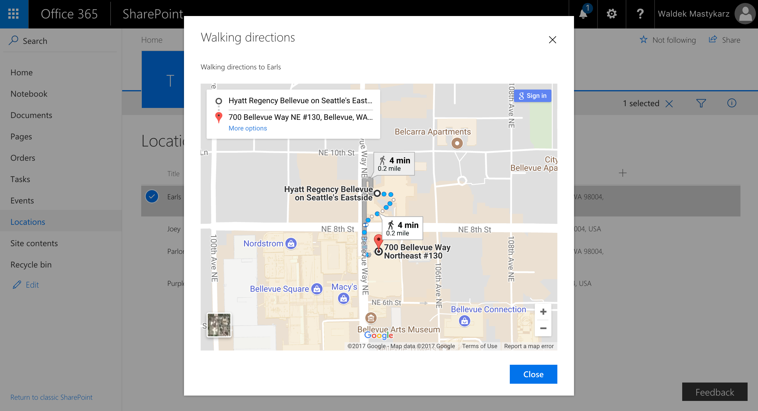
Building SPFx experiences in Microsoft 365 The easiest way to build your enterprise solutions for Microsoft Teams, Microsoft Viva, Outlook, Microsoft 365 app and SharePoint
Microsoft Viva
Microsoft Teams
SharePoint
Personal Apps
Teams tabs
Meeting apps
Messaging extensions
Cards
Web Parts
Extensions
App pages
Outlook and Microsoft 365 app (Office)
Copilot
Content driven applications | SSO | Automatic code hosting | Industry standard tooling
Notes:
We then extended the Framework to extend Teams in content driven experiences across Personal Apps, Teams Tabs and Meeting apps. This allows the entire SharePoint developer community to write content driven apps that work across mobile, web and desktop in Teams and Portals.
This year we introduced new card based extensibility allowing you to create no code apps in Viva Connections and take your existing Teams, SharePoint and Power Apps and target users in your organization with lightweight experiences through Adaptive Cards that take you to richer experiences.
Each time we add a new surface to the SharePoint framework we are honored to see more enterprise developers and ISVs show up to work with the stack. Thank you for continuing to invest your development time and dollars here.
https://devblogs.microsoft.com/microsoft365dev/announcing-general-availability-of-sharepoint-framework-1-16-enabling-spfx-across-microsoft-365-platform/

Slide 9
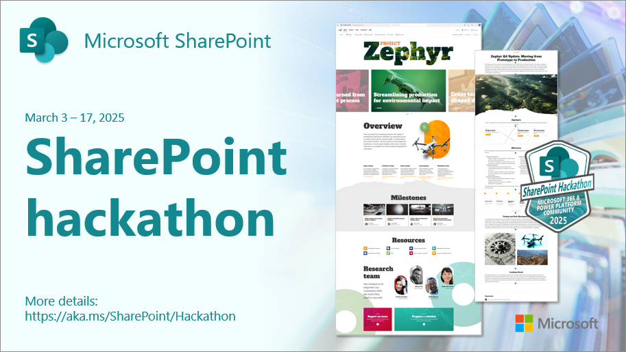
SharePoint Hackathon winner – SPFx - Apvee
demo
Notes:
Speaker: Paolo
Demo: Using Adaptive Cards in API Plugins and citations

Slide 10





Viva Connections
Company App
Employee Communication
& Community
Viva Amplify
Communications Management
Viva Engage
Community /Social
SharePoint
Intranet
Notes:
This is how we think of employee communications at Microsoft:
A company app – a central place for employees to start their day and see company news, personalized tasks whether they’re on mobile or a desktop
Community and social – A place for employees to connect, contribute, and learn from each other – and a place where leaders can connect to employees
Communications management – one hub for comms professionals to plan, write, analyze and publish campaigns to multiple channels
And finally a modern intranet
Where on this wheel is your organization focused?

Slide 11

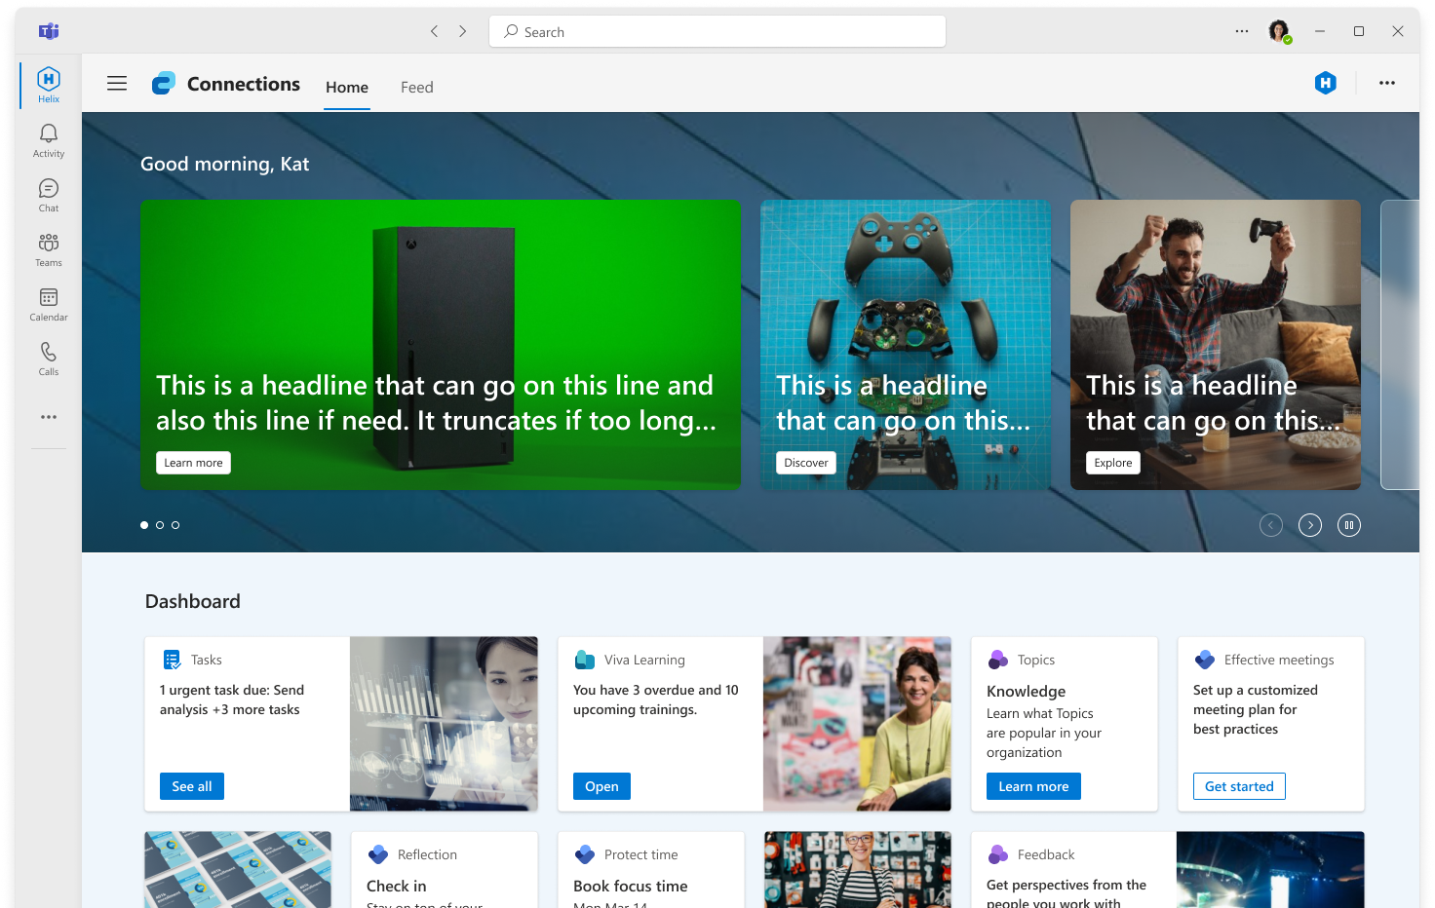
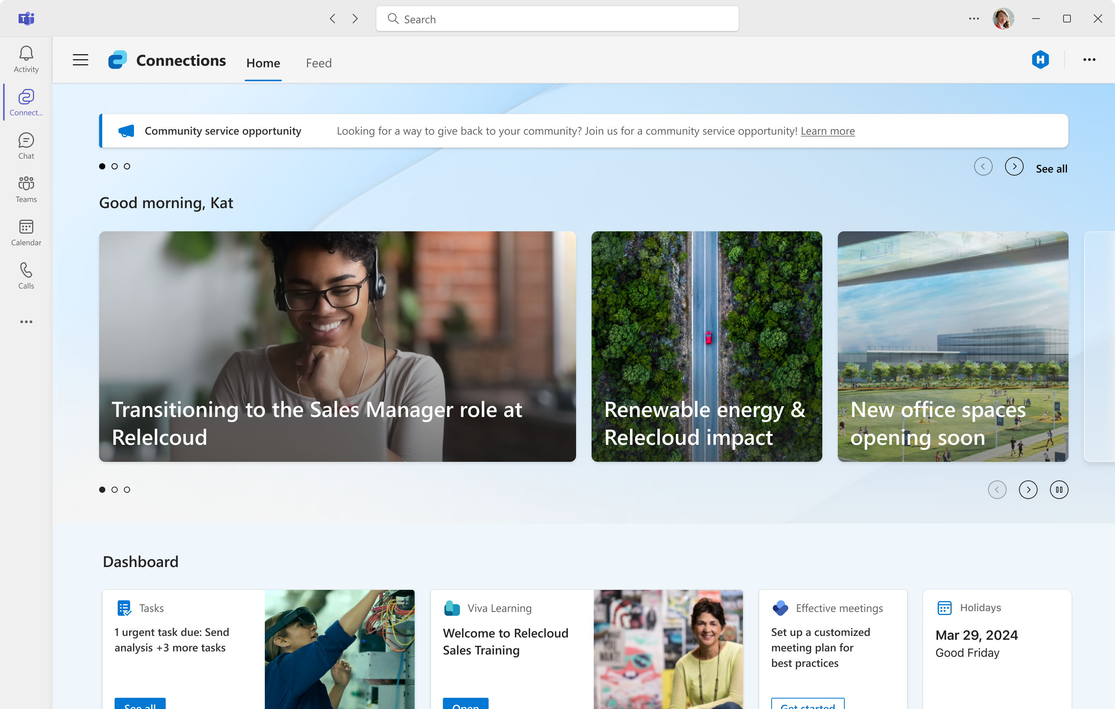
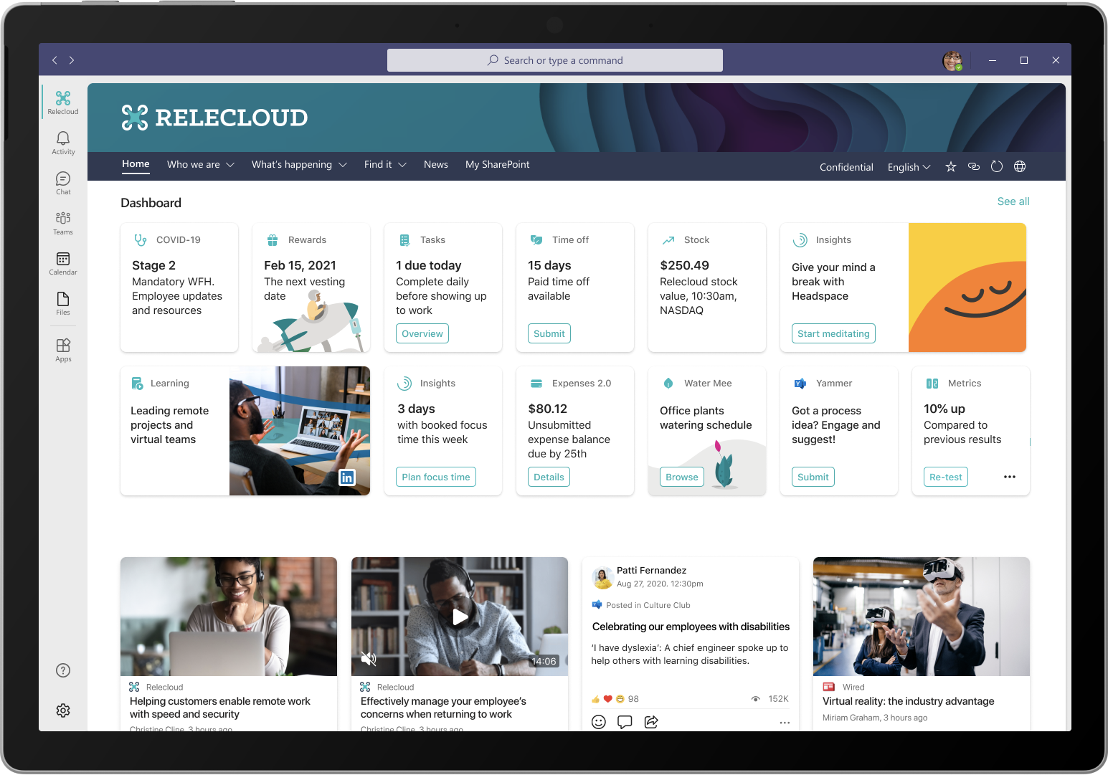
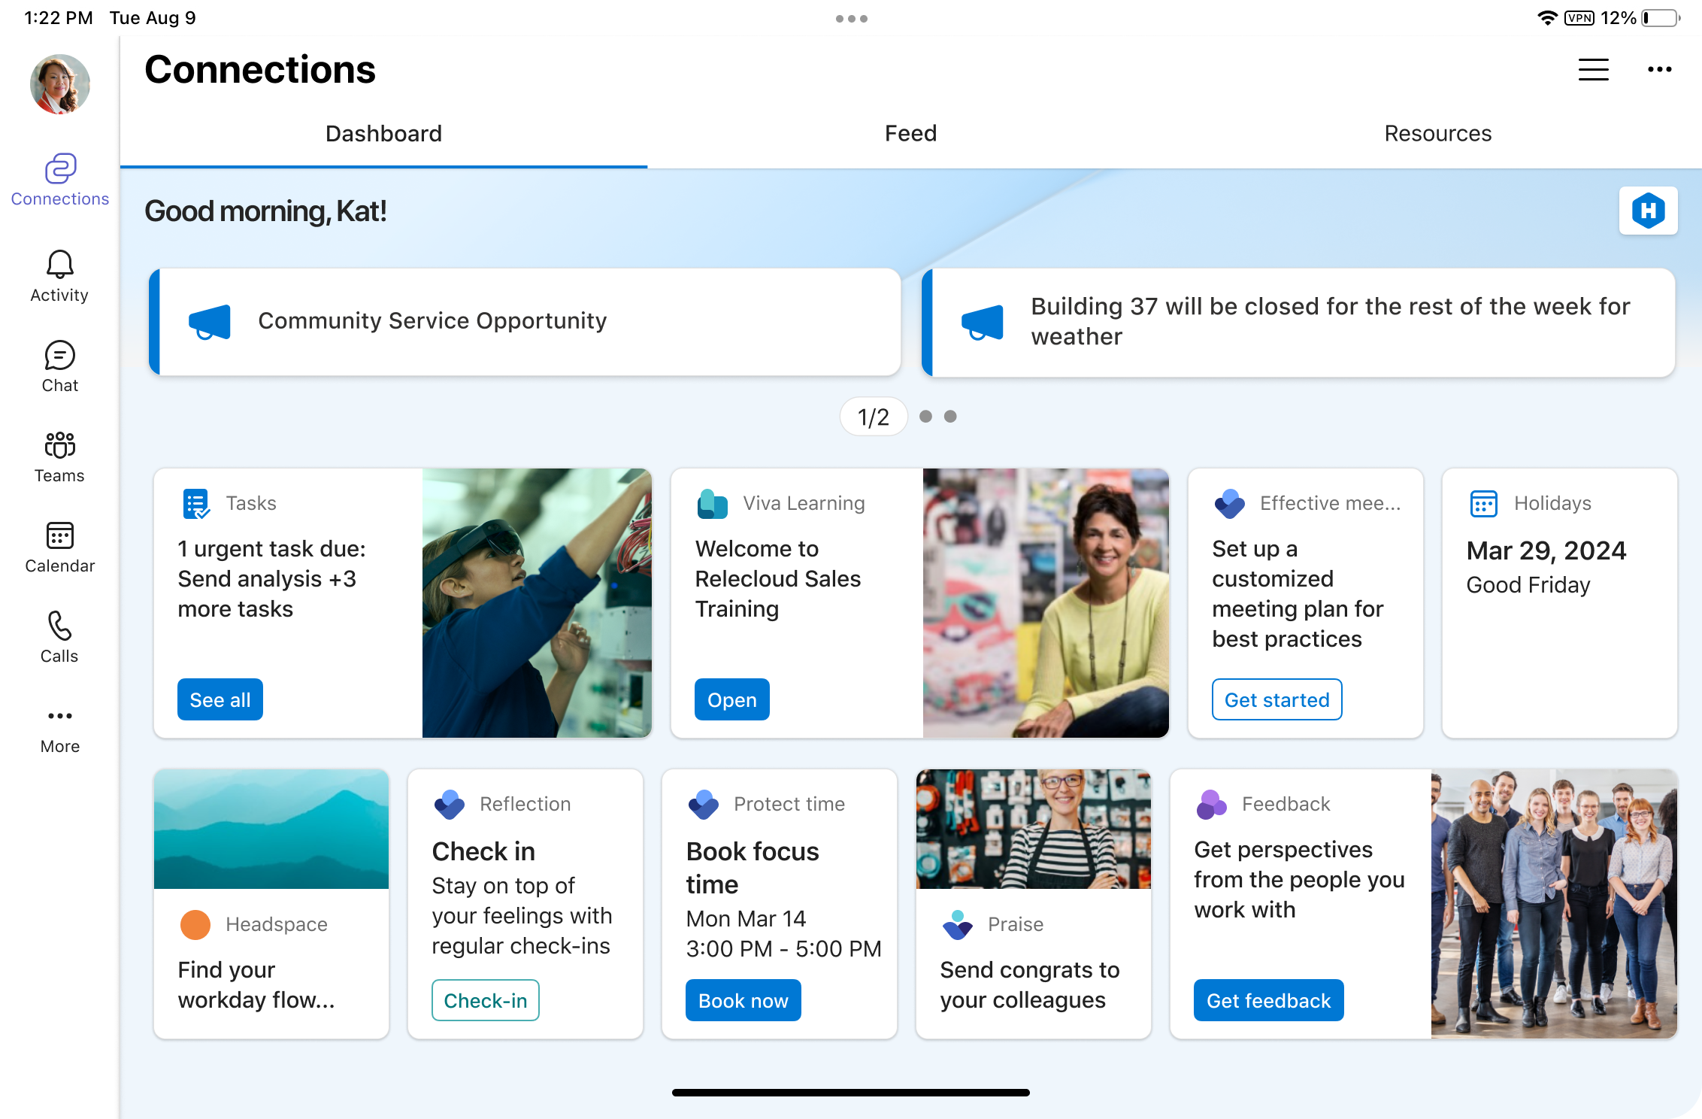
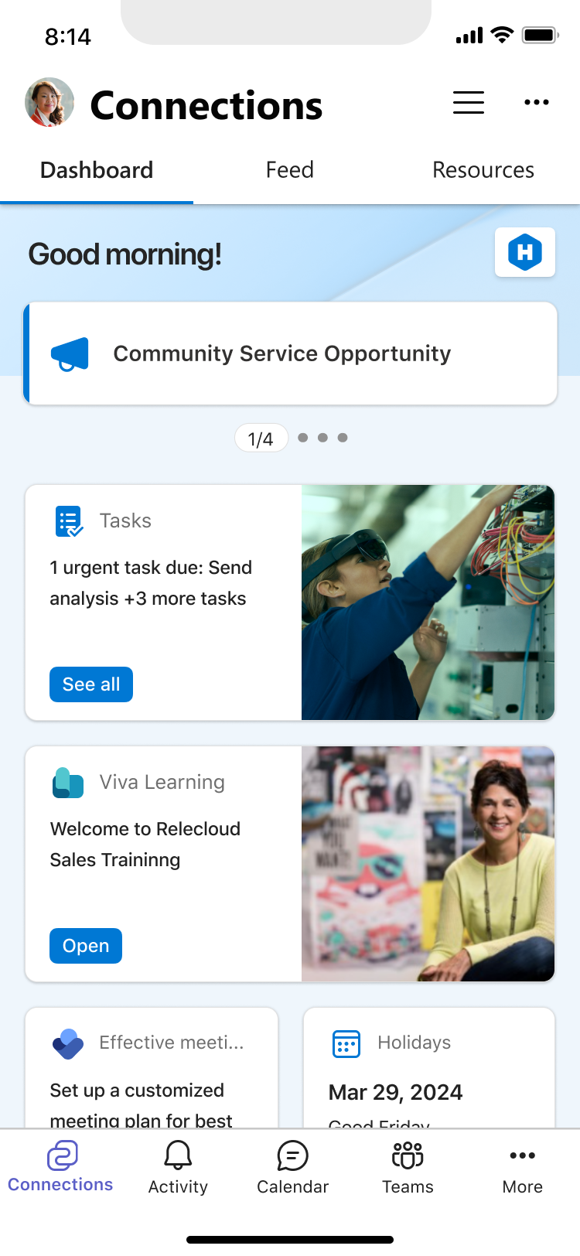

Viva Connections People centered and branded employee experience across all device types
Tools and Apps Quick action, cohesive one-stop experience for all the apps in your organization – across all device types
Customized for your organization Curated to your organization and brand, including company and team updates and relevant industry news
Personalized to the individual Helping them be informed, stay connected, and feel engaged
11

Slide 12
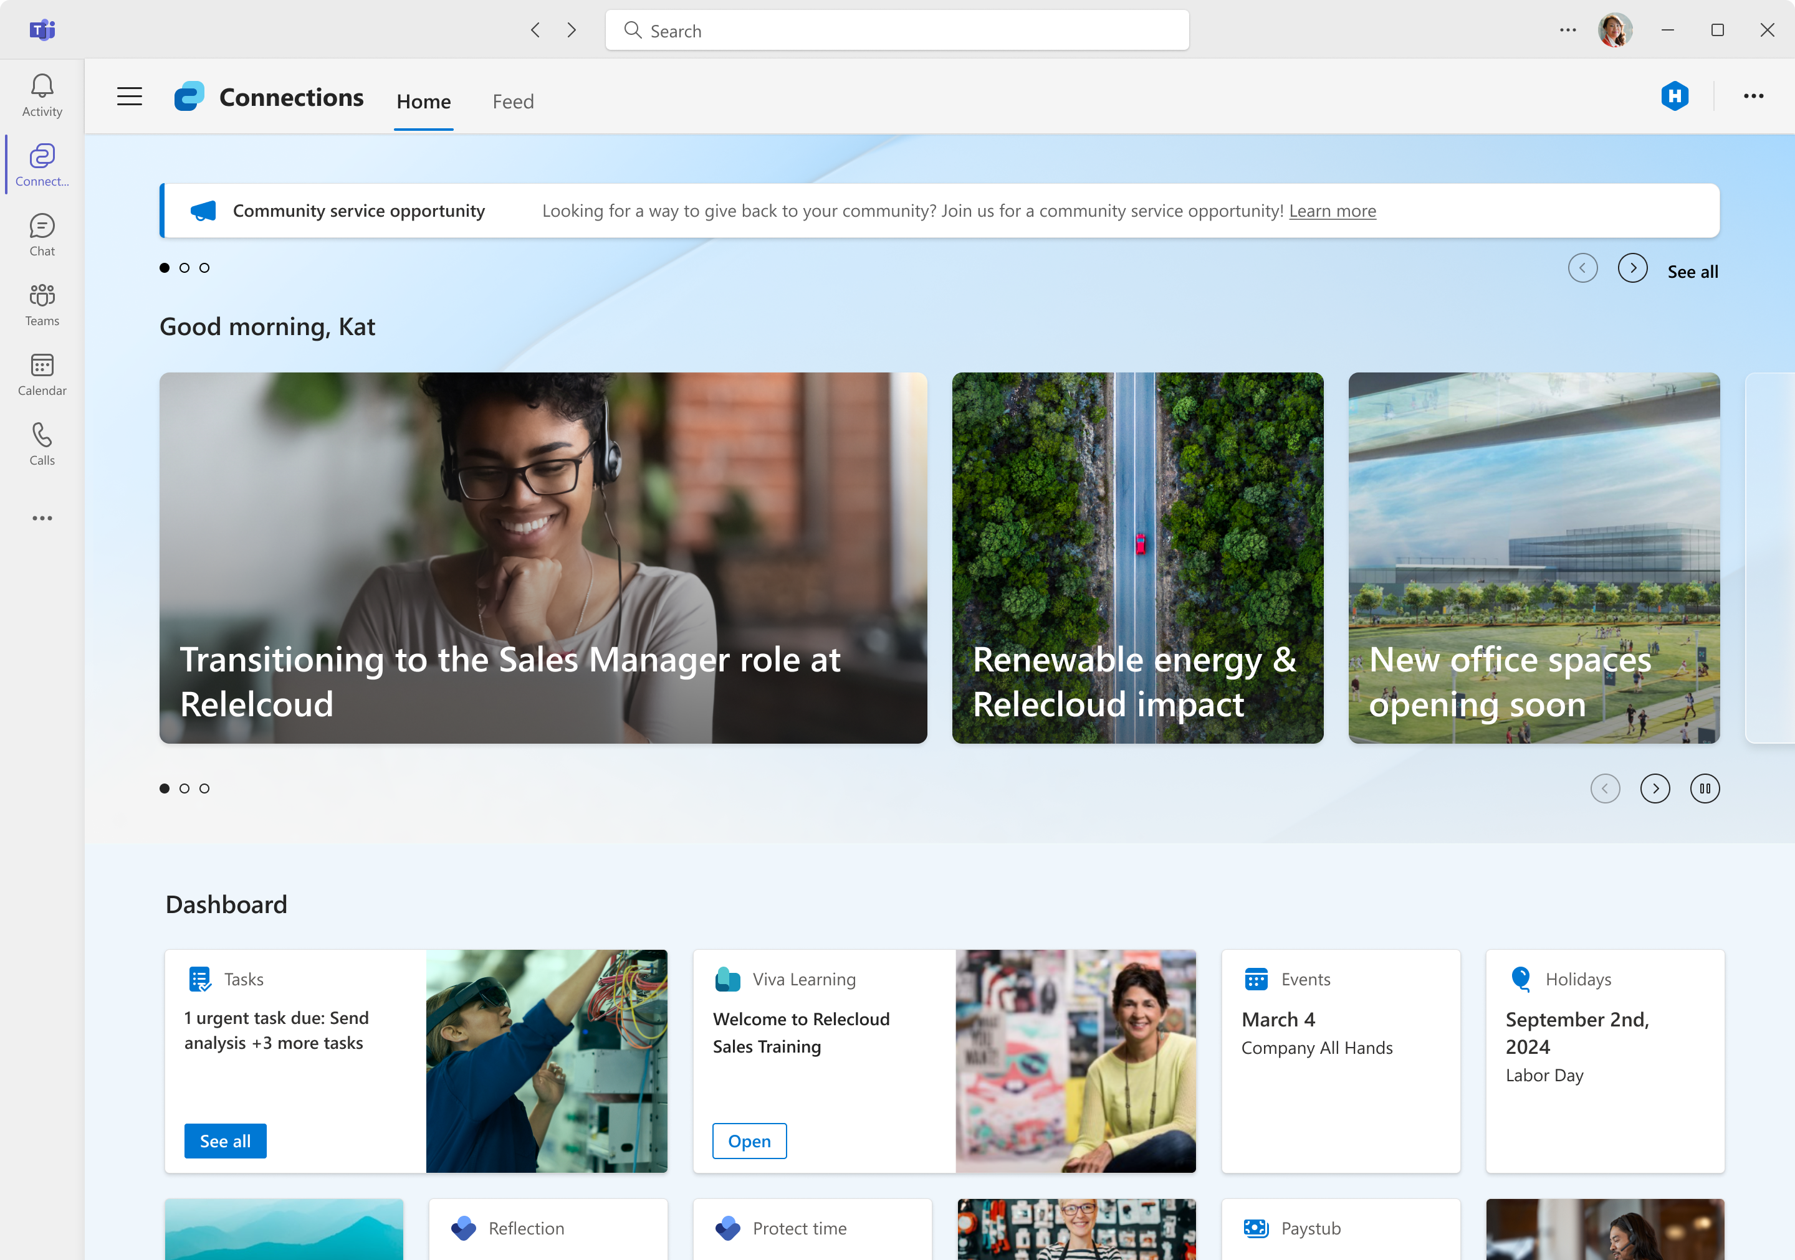

Top of Intranet & Viva Connections complement each other
How do I be a part of my company?
Personal news & community
Employee Experience centered Apps
Resources about employee support
Connection to my Intranet
^{aka.ms/VivaConnections}
Why is my Company amazing!
Pixel Perfect Storytelling
Navigate my entire company
Search my entire company
Tailored News to me
^{aka.ms/homesites}
Notes:
Desktop Browser first
Mobile First

Slide 13
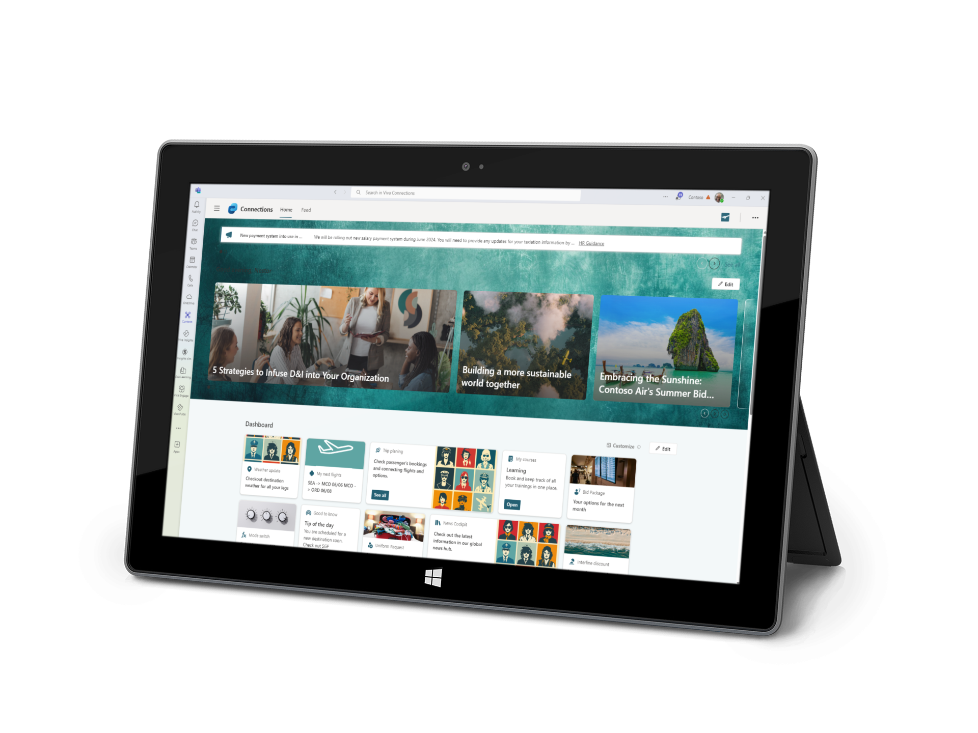
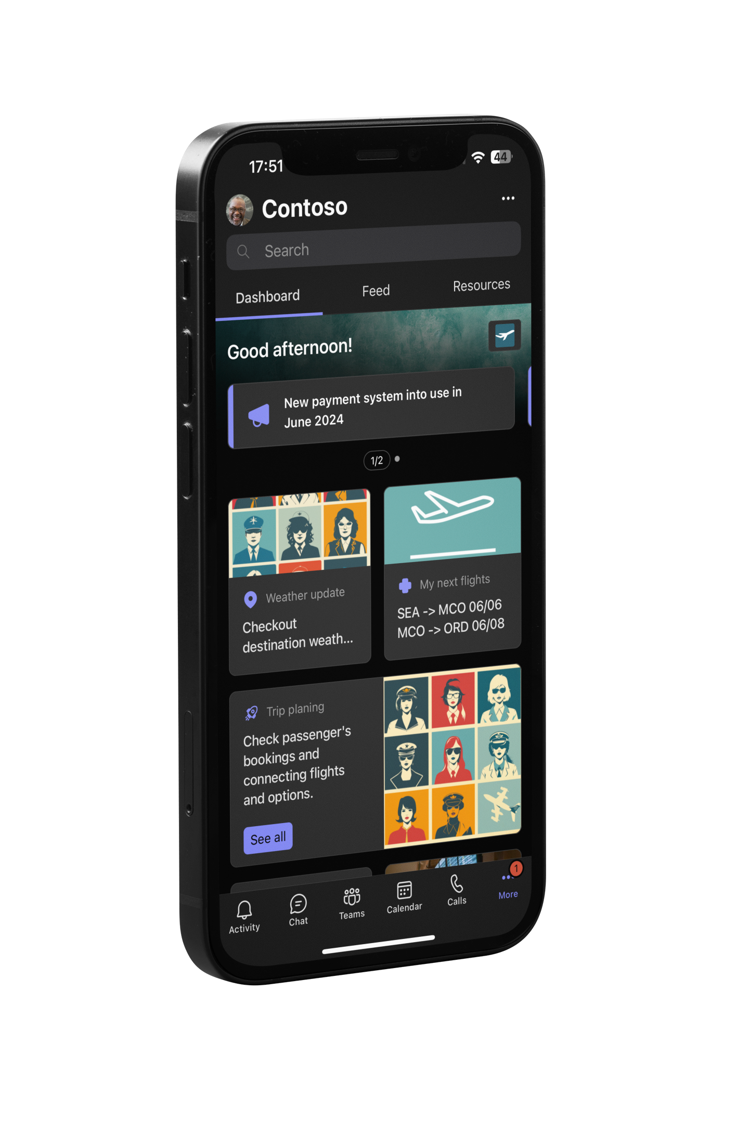
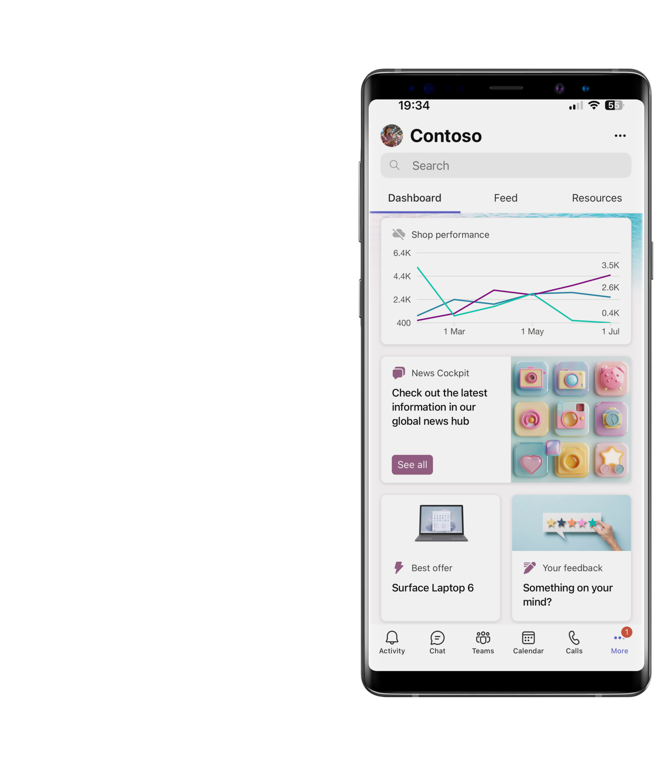
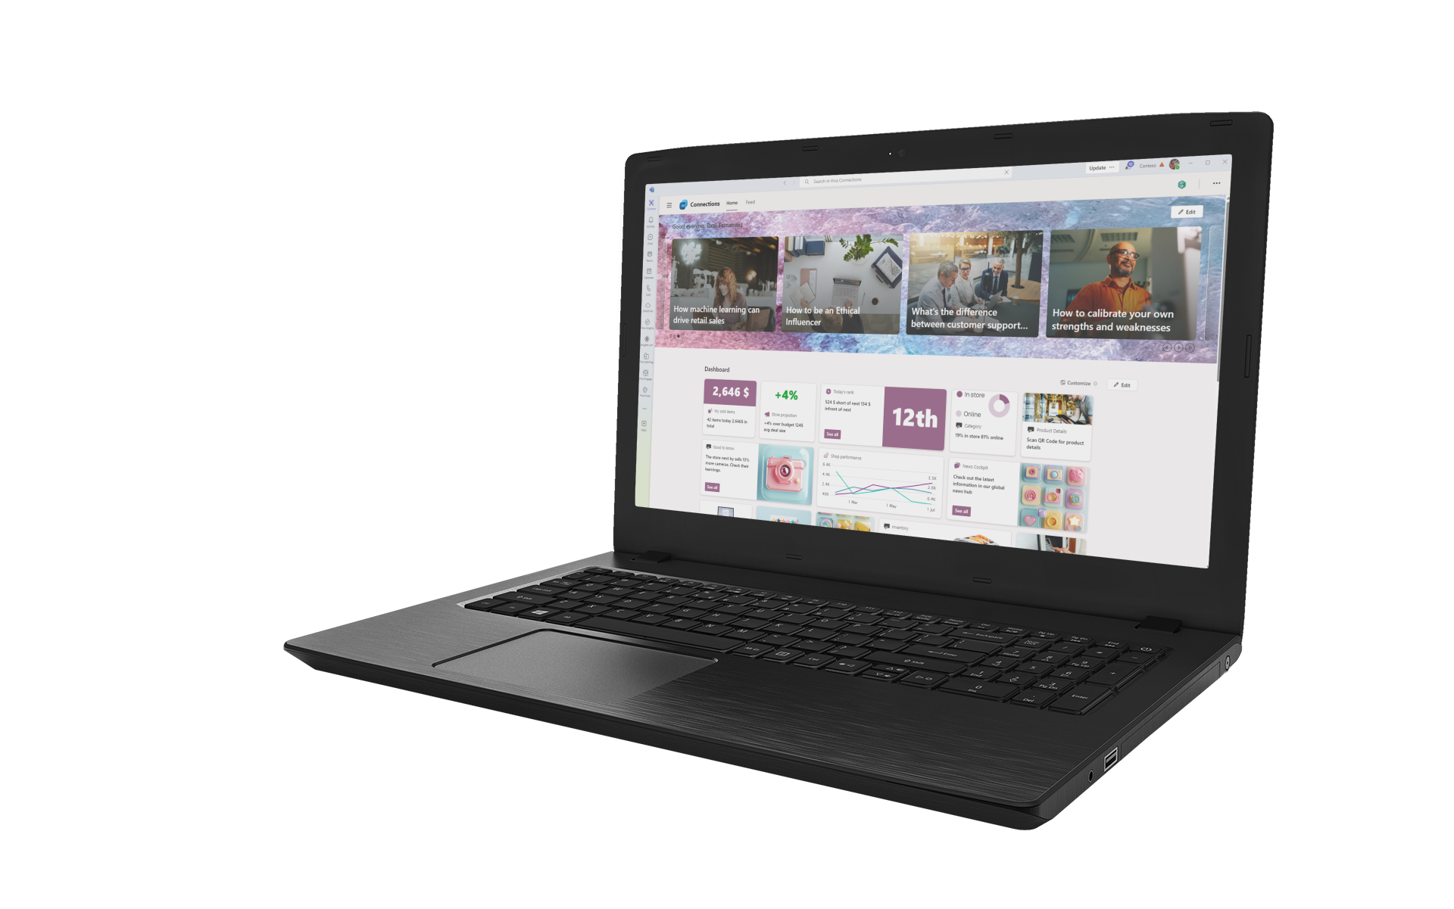
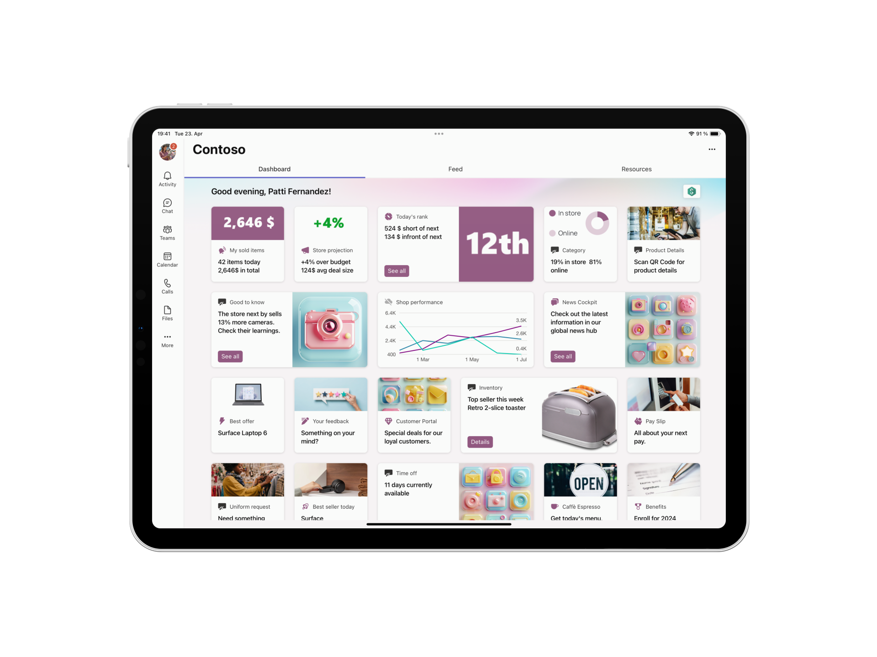
Viva Connections - Different devices – tailored experience

Slide 14
Retail example for front line workers
demo
Notes:
Speaker: Paolo
Demo: Using Adaptive Cards in API Plugins and citations

Slide 15
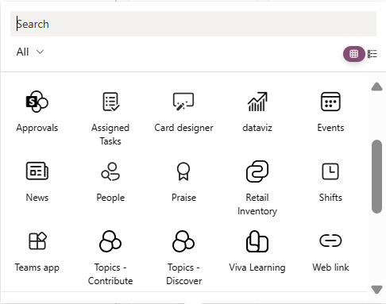
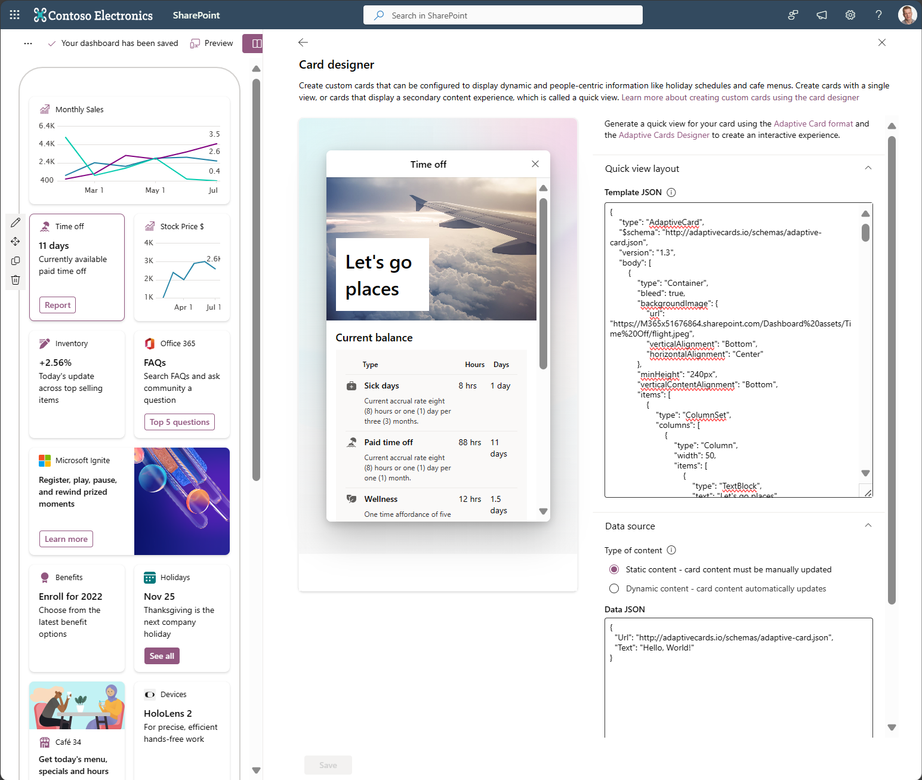
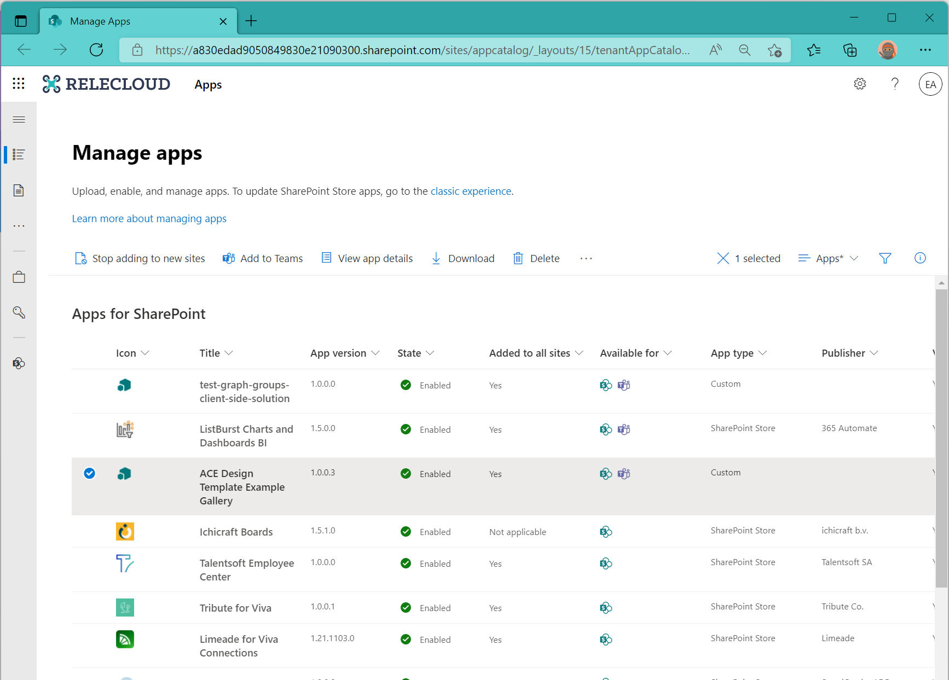
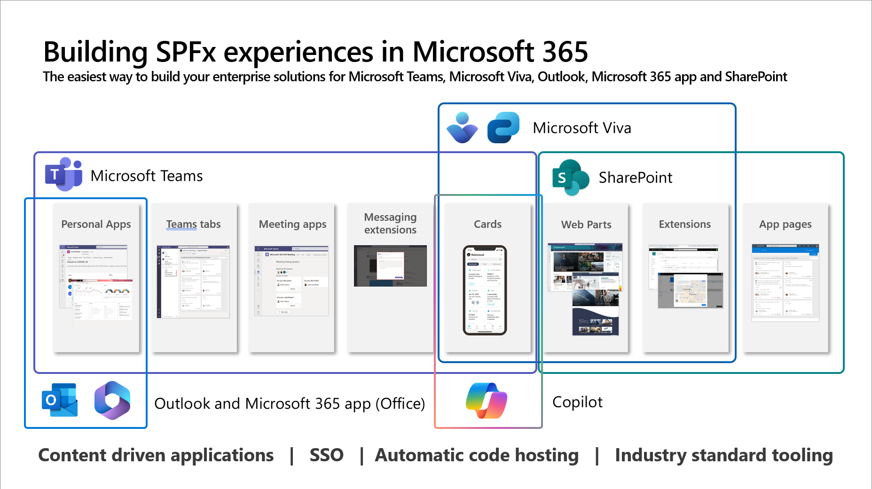
3 Models of extensibility
No Code
Low Code
Pro Code
ACE and web part picker
Link to existing Microsoft Teams or Power Platform apps
Personalized dashboard of apps for end users
Static adaptive cards
Advance API support
Power Apps support *
Building cards with SharePoint Framework
Store model for ISVs
Deploy directly to tenant level
* Work in progress – subject to change

Slide 16
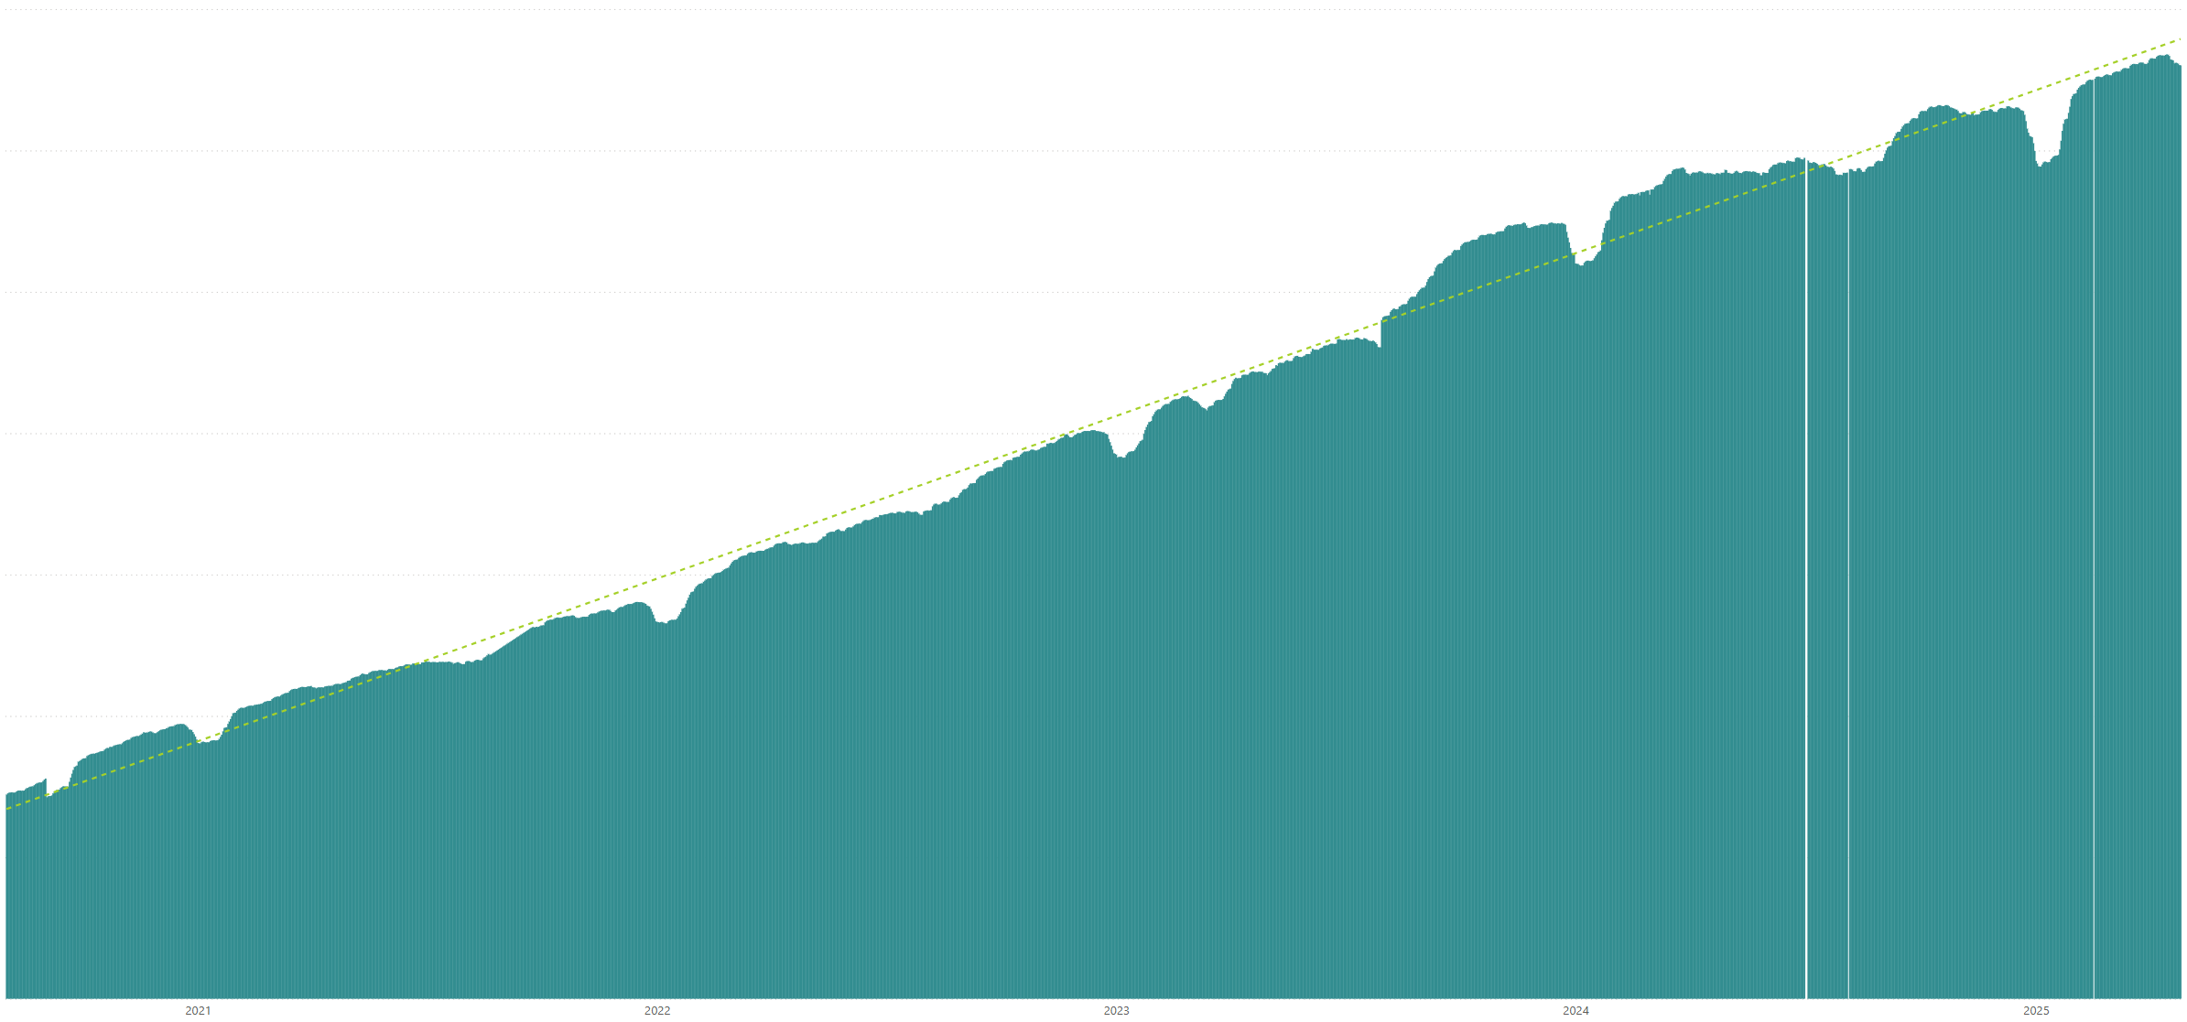
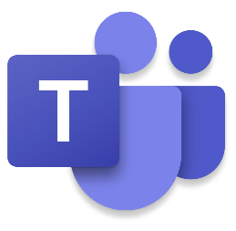

Monthly active users for custom SharePoint Framework components in M365 There are currently tens of millions of monthly active users for custom SharePoint Framework components in Microsoft 365 created by partners and customers
Jan 2021
Jan 2022
Jan 2023
Jan 2024
Jan 2025
Notes:
SPEAKER: Vesa
NEXT SLIDE: Vesa
Whatever you do, Vesa, don’t read the speaker’s notes!!!

Slide 17


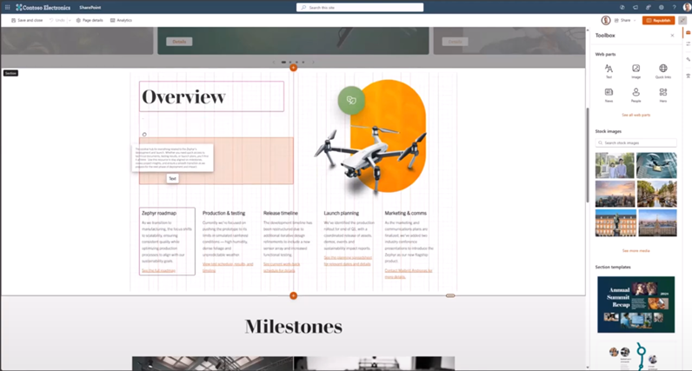
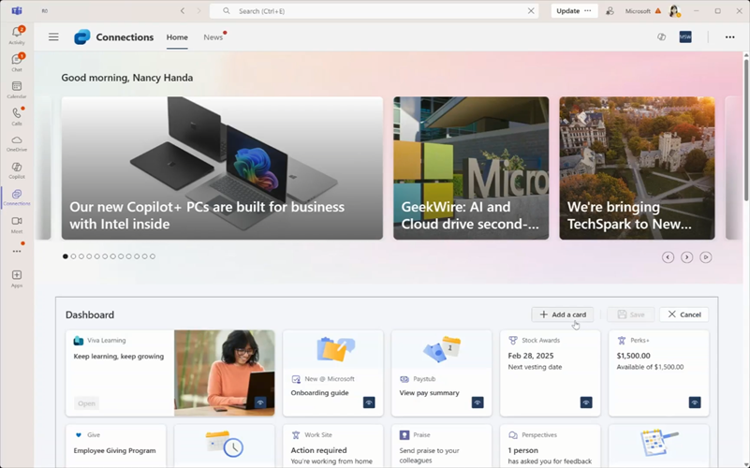


💡 Generally available since 23rd of April 2025
Latest version -SharePoint Framework 1.21

Slide 18
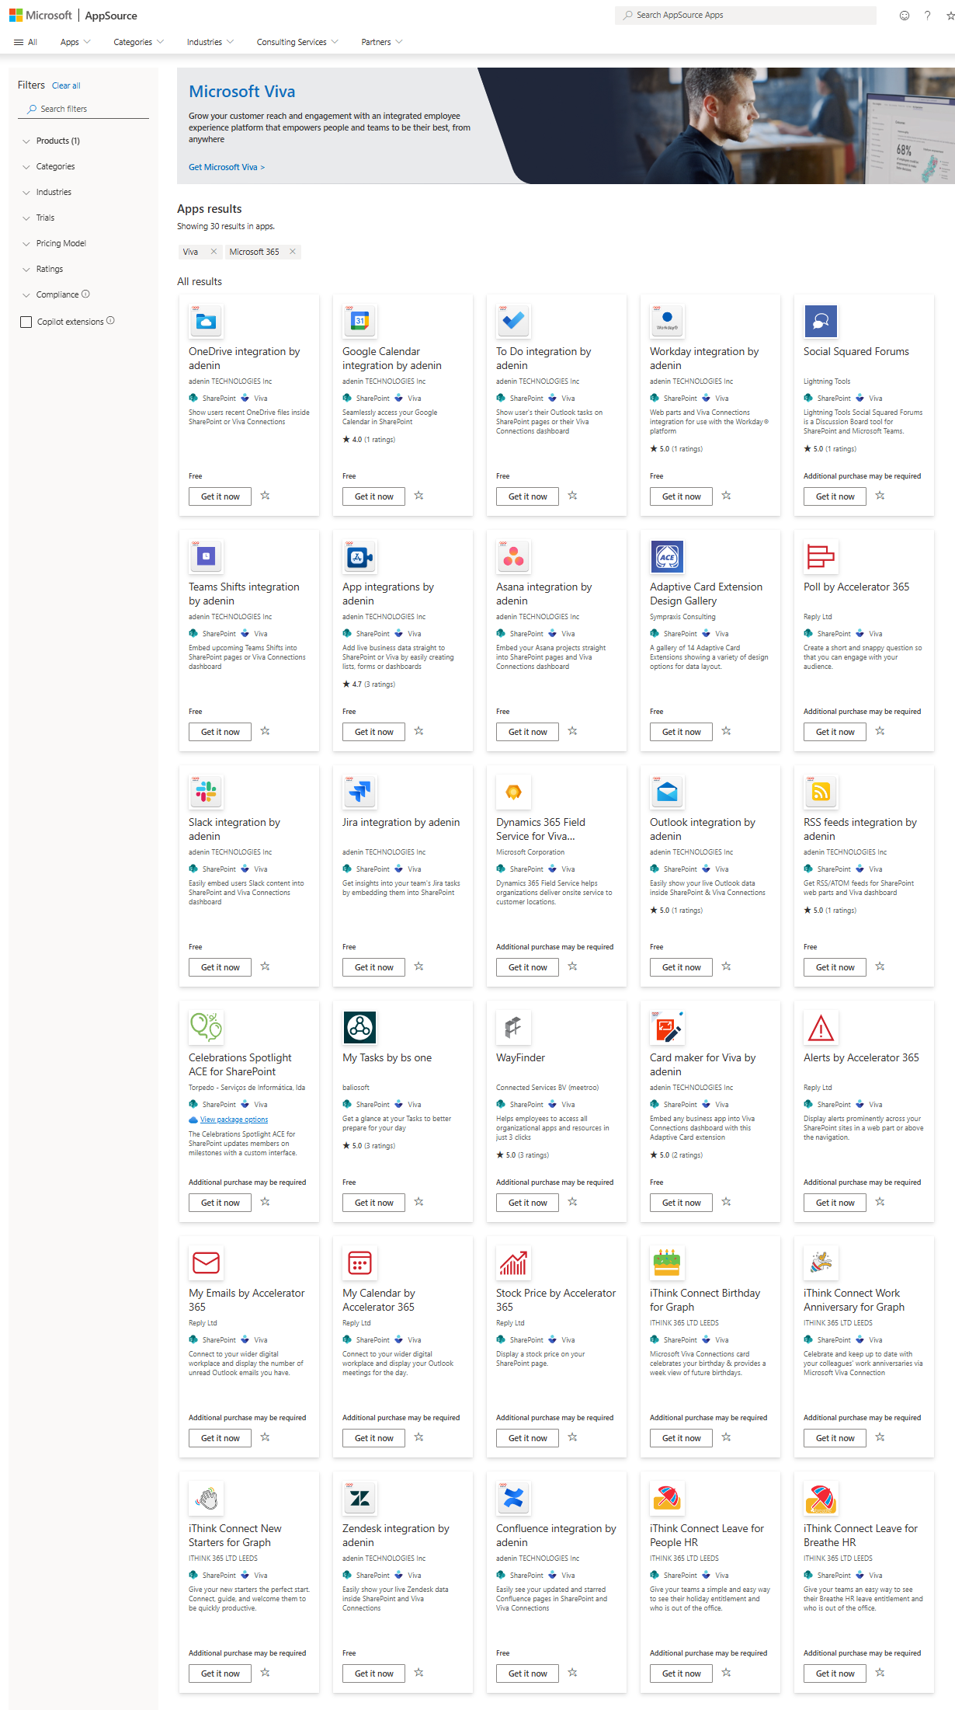
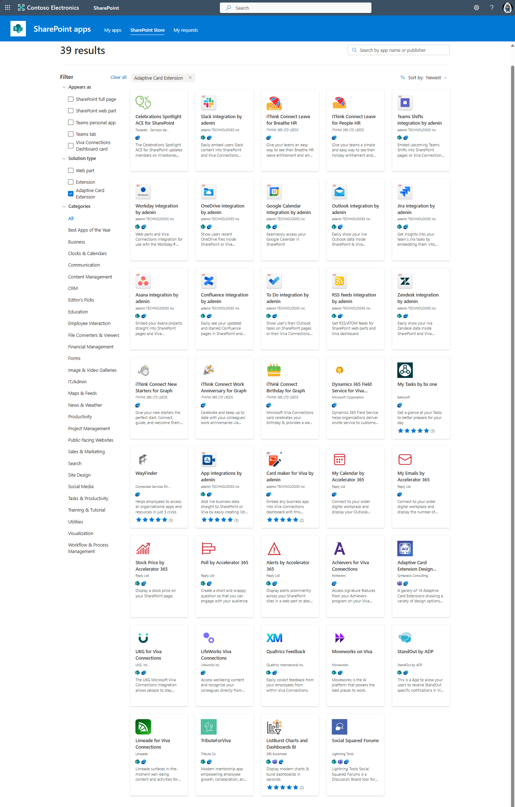
Partner solutions for Viva Connections & SharePoint – Store apps
available
ISVs and SIs have created apps which can be easily acquired and taken into use in customer tenants
Packaged solutions are provided with SPFx – with centralized IT governance with and by securely hosting the code inside of customer tenant (by default)
Easy way to include custom extensibility for the Viva Connections dashboard or add custom web parts for your SharePoint deployment
🏪

Slide 19
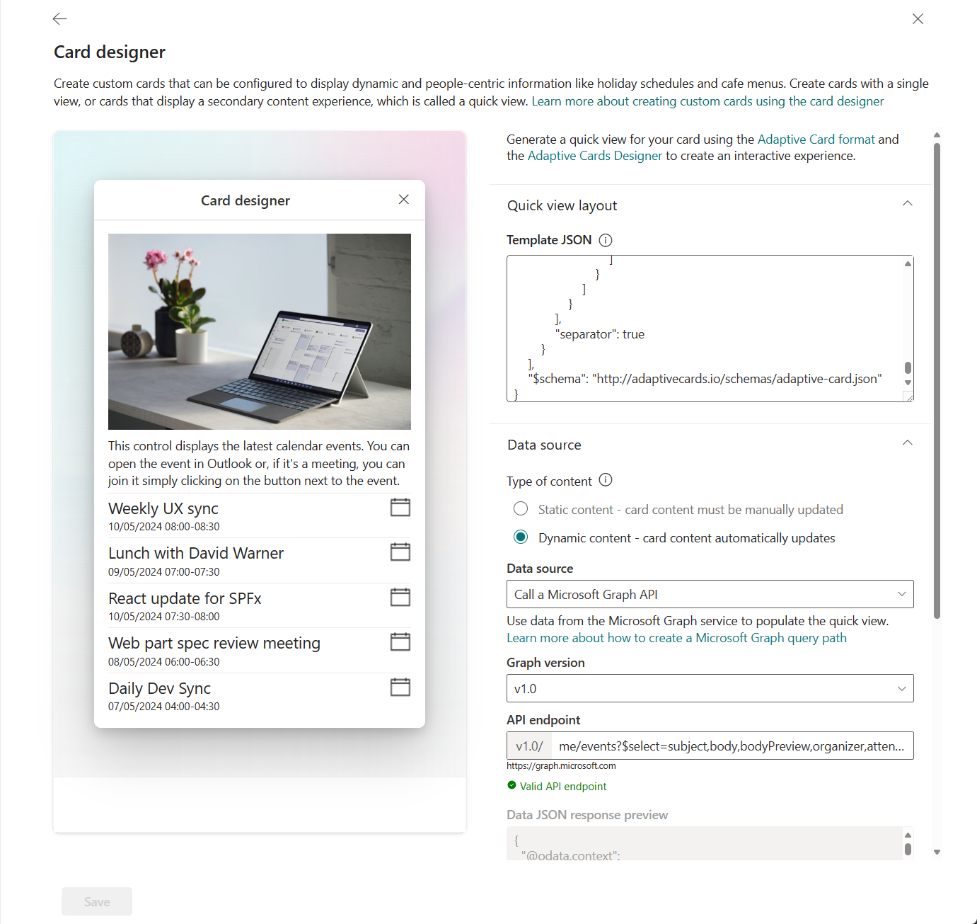
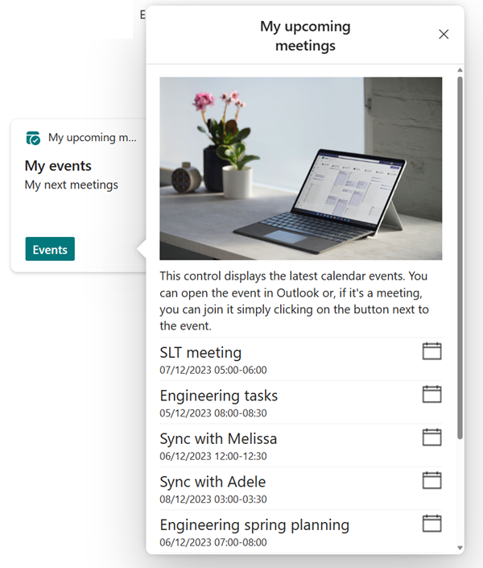
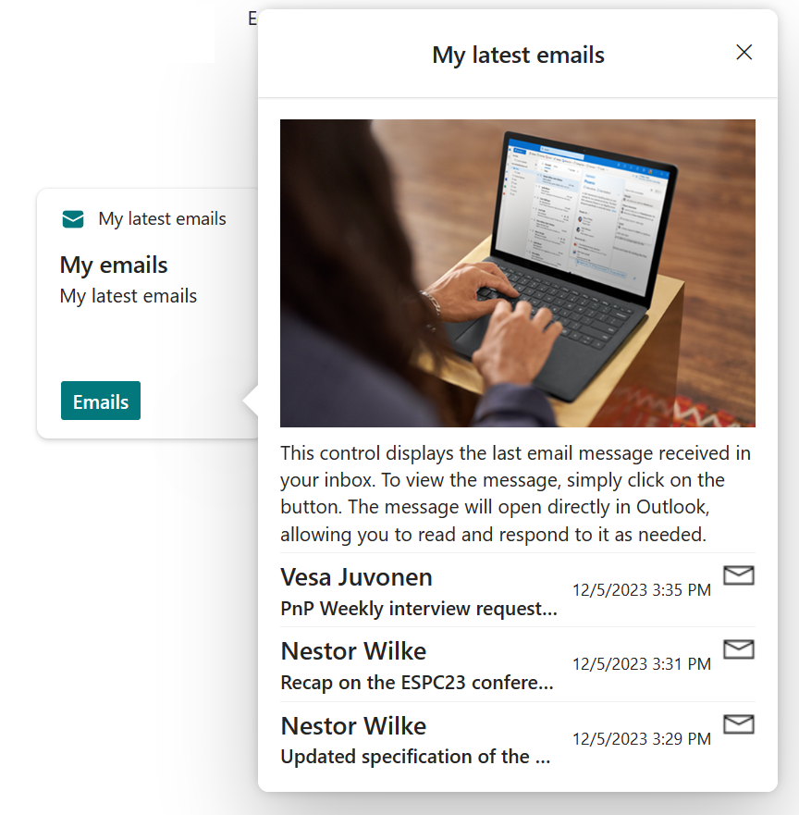
Advance API support in Card Designer v2
available
Enabled in the tenant level by administrator at tenant level – disabled by default
Card Designer can build dynamic cards powered by APIs and Adaptive Cards
Empower makers and builders to create dynamic API powered experiences without writing code – just by using the card designer UX
Only administrator approved Microsoft Graph APIs can be used by the dashboard editors – permission denied otherwise
🧝‍♀️
https://learn.microsoft.com/en-us/sharepoint/dev/spfx/viva/features/card-designer/card-designer-api-support
Notes:
https://learn.microsoft.com/en-us/sharepoint/dev/spfx/viva/features/card-designer/card-designer-api-support

Slide 20
Card designer v2 with advance capabilities
demo
Notes:
Speaker: Paolo
Demo: Using Adaptive Cards in API Plugins and citations

Slide 21
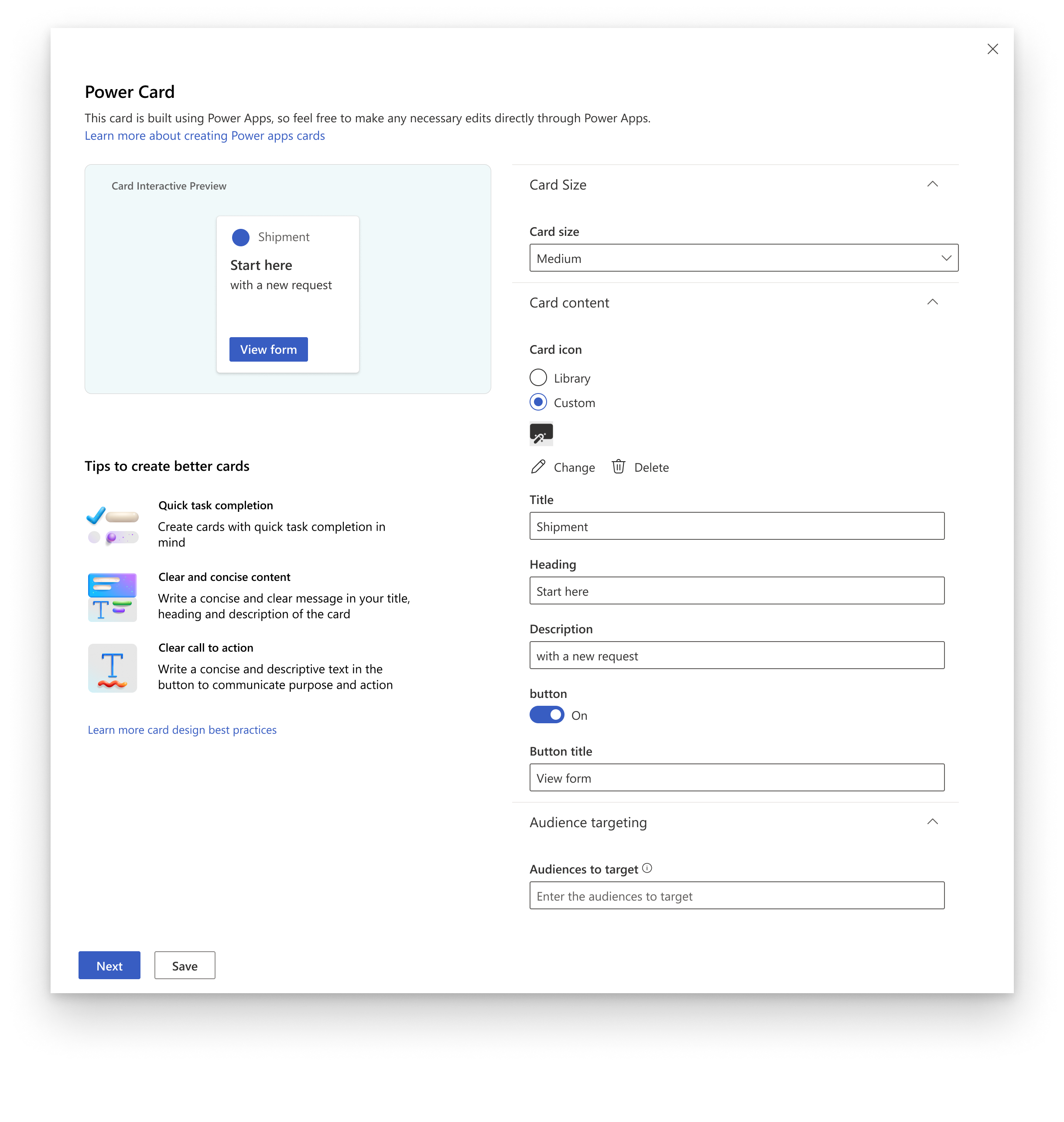
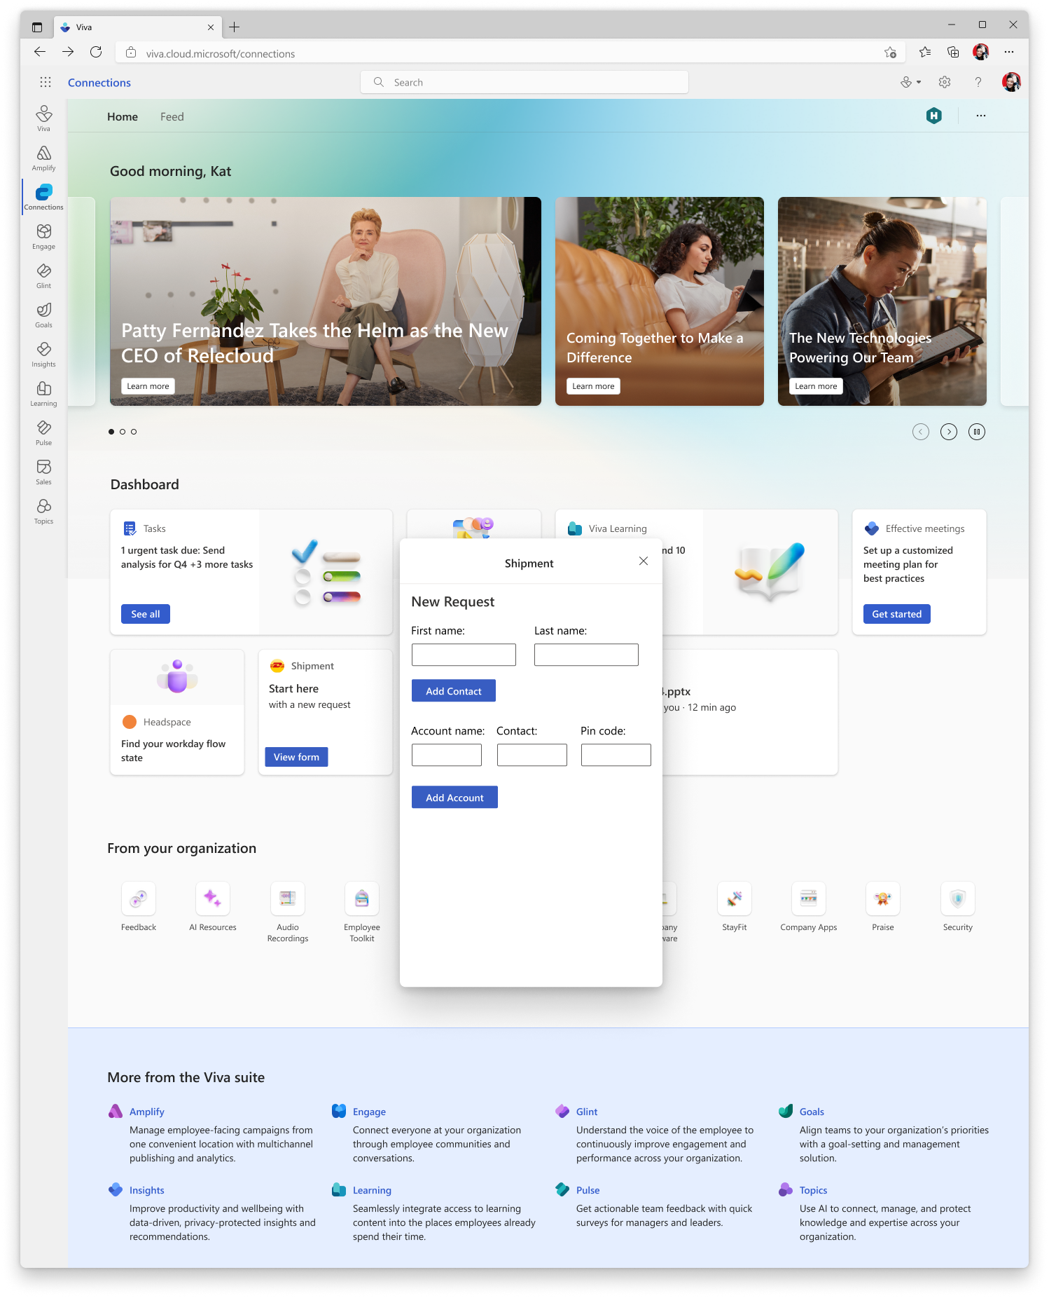
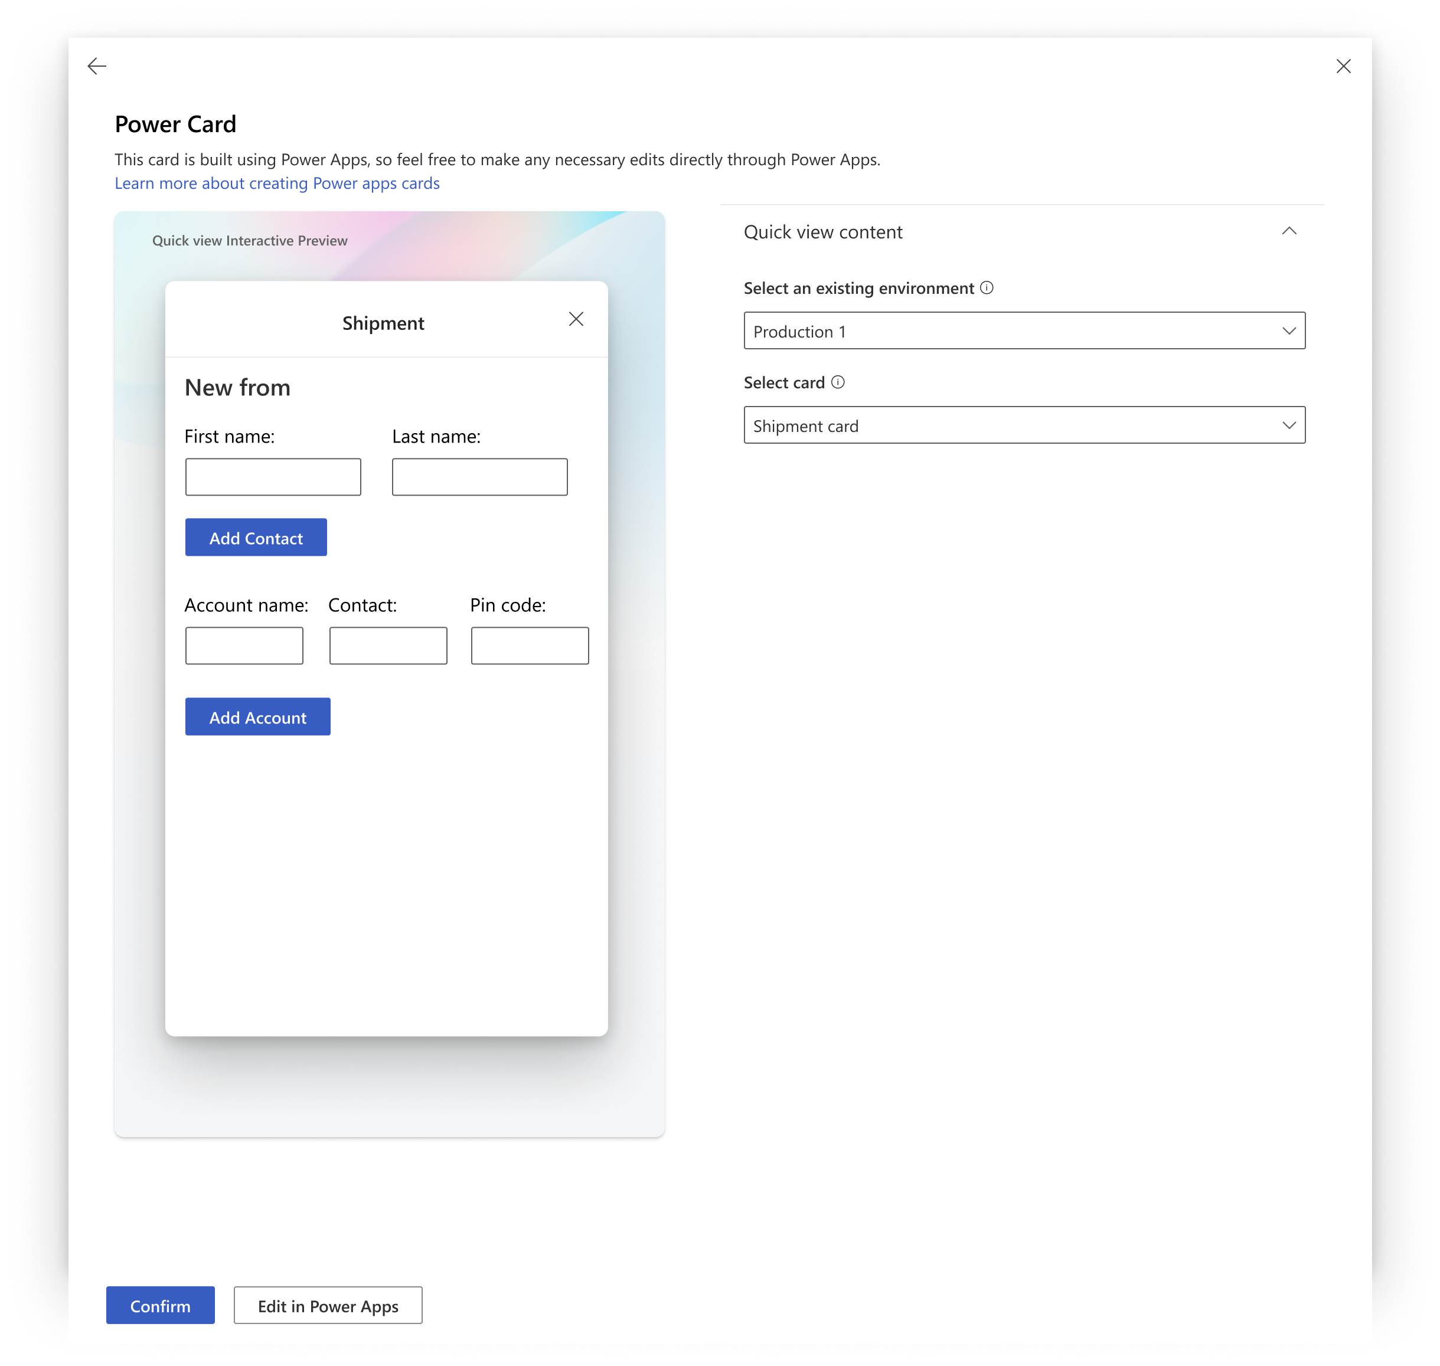


Power Apps cards support for Viva Connections
In works
Exposing Power Cards in the Viva Connections dashboard
Create a card in Power Platform and publish to be available for the dashboard designers to use in Viva Connections
Work starting with Power Cards, full Power Apps support has been discussed
🪄

Slide 22
Using Power Apps in Viva Connection & SharePoint dashboard
demo
Notes:
Speaker: Paolo
Demo: Using Adaptive Cards in API Plugins and citations

Slide 23
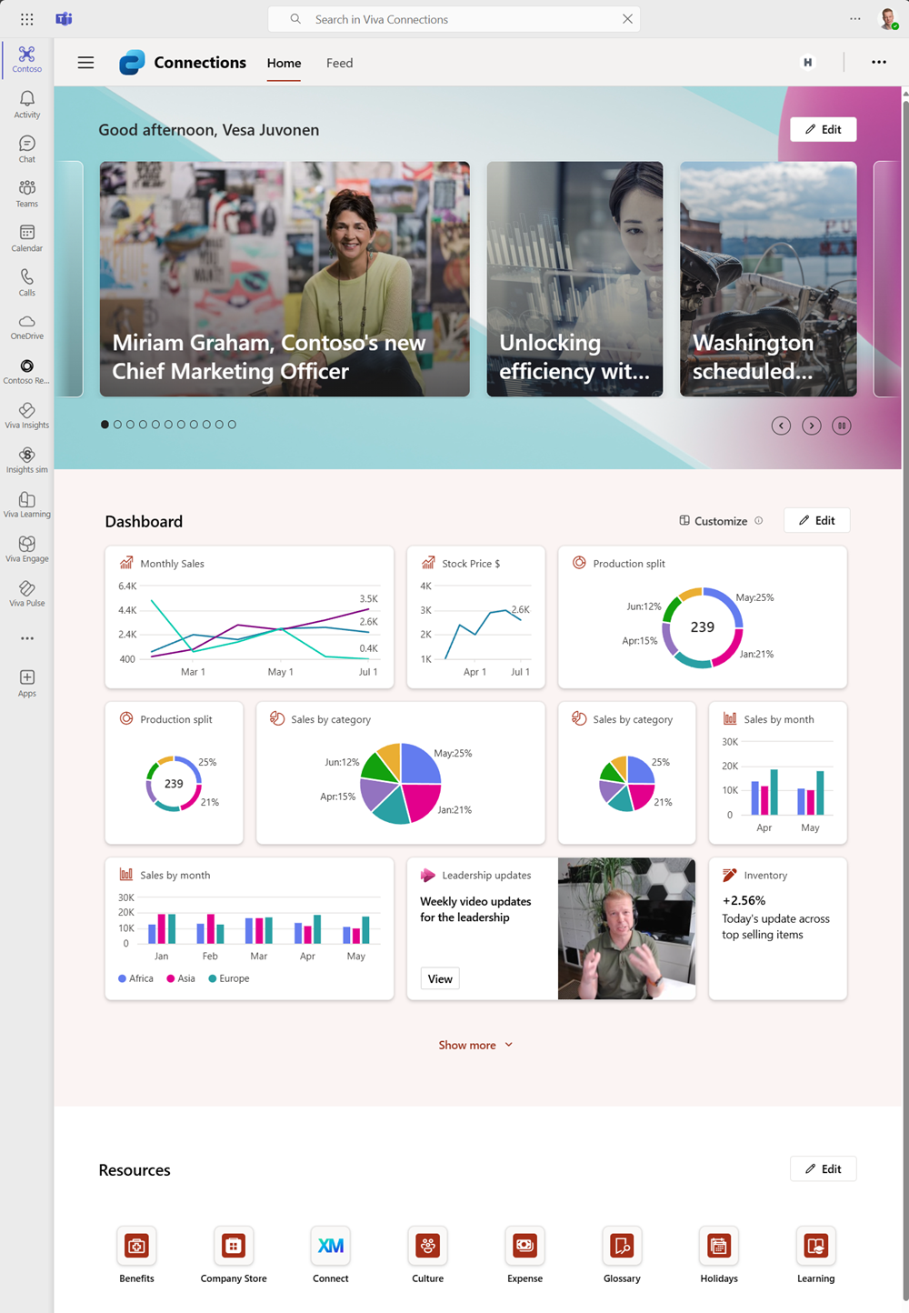
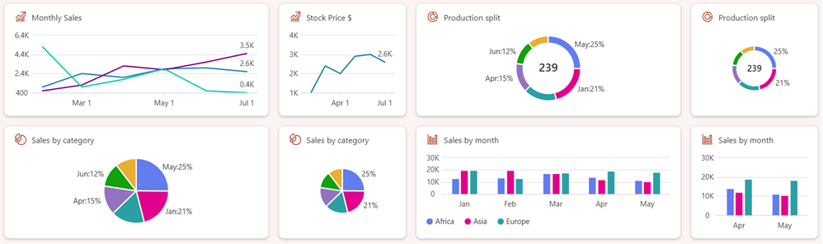
New chart card options in the SPFx 1.20
available
Bar chart, pie chart and donut chart options were included in the SPFx 1.20 release
More flexibility on rending different information in the chart format
Think about quickly viewing the status of key topics through any device – just within the Microsoft Teams
You can control the metrics, colors and details across the different data types
Generally available since September 2024
📈📊🥧🍩

Slide 24
Card visualization improvements with SPFx 1.20 – chart options
demo
Notes:
Speaker: Paolo
Demo: Using Adaptive Cards in API Plugins and citations

Slide 25
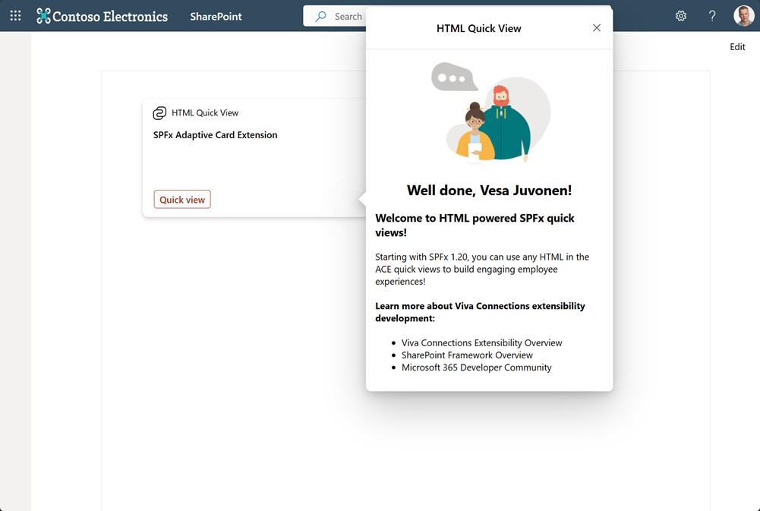


Web Quick Views – more flexibility for UX
available
Starting with the SPFx 1.20 release, you can build the Adaptive Card Extension also using HTML, not just with adaptive cards
More flexibility on the UX options – All HTML and JavaScript scenarios are supported
You can use React or any other preferred client-side implementation framework
Out-of-the-box OneDrive / Files ACE is using this pattern to provide custom tab experience which is not supported with adaptive cards
Reuse easy your web part components/controls in the ACEs and expose same capabilities through the card framework
Generally available since September 2024
🧙‍♀️

Slide 26
HTML support for the quick views within the cards
demo
Notes:
Speaker: Paolo
Demo: Using Adaptive Cards in API Plugins and citations

Slide 27




Card web part for SharePoint – expose custom dashboards for SharePoint New locations to surface the Cards – Expose the existing cards in new platform – no requirement for VC to start using
Rolling out
Can be used to surface 1-to-N cards in anywhere in SharePoint
Each web part and cards in it – are isolated instances and can be configured as needed for the business case
Similar layout as with the existing dashboard card, but no VC requirement – all ACEs which are installed in the tenant will be exposed as an option
🃏

Slide 28
Cards web part – Exposing cards across the SharePoint
demo
Notes:
Speaker: Paolo
Demo: Using Adaptive Cards in API Plugins and citations

Slide 29


Flexible layout configuration options for web parts
available
Starting with SPFx v1.21, developers can define if the web part is supported with the flexible layouts and provide default height and width values
Configuration is performed in the web part manifest
By default, all web parts are supported in the flexible layout for rendering
🤩
Notes:
SPEAKER: Vesa
NEXT SLIDE: Vesa
SharePoint Framework 1.19 release notes - https://learn.microsoft.com/en-us/sharepoint/dev/spfx/release-1.19
Related updated documentation for the 1.18 preview release:
Designing Viva Connections custom cards for your dashboard - https://learn.microsoft.com/en-us/sharepoint/dev/spfx/viva/design/designing-card
Migrate Adaptive Card Extensions to SharePoint Framework 1.18 - https://learn.microsoft.com/en-us/sharepoint/dev/spfx/viva/get-started/migrate-to-spfx-1-18
Tutorial - Create a People Search Adaptive Card Extension - https://learn.microsoft.com/en-us/sharepoint/dev/spfx/viva/get-started/build-people-search-adaptive-card-extension
New samples showcasing the new Viva Connections features:
Start a Chat Text Box input Adaptive Card Extension - https://github.com/pnp/sp-dev-fx-aces/tree/main/samples/InputCard-Start-Chat
Prompt Survey Adaptive Card Extension - https://github.com/pnp/sp-dev-fx-aces/tree/main/samples/InputCard-Prompt-Survey
People Search Adaptive Card Extension - https://github.com/pnp/sp-dev-fx-aces/tree/main/samples/InputCard-PeopleSearch

Slide 30
Flexible layout and custom web part support
demo
Notes:
Speaker: Paolo
Demo: Using Adaptive Cards in API Plugins and citations

Slide 31


End user card personalization support
available
Viva Connections will start supporting end users to add cards on their own dashboard to provide more flexibility for the provided features
Defaults to “disallow” – so not allowed for end users to use
New setting is provided for the adaptive card extension manifest to configure if the card is allowed for the end user personalization or not
👏
Notes:
SPEAKER: Vesa
NEXT SLIDE: Vesa
SharePoint Framework 1.19 release notes - https://learn.microsoft.com/en-us/sharepoint/dev/spfx/release-1.19
Related updated documentation for the 1.18 preview release:
Designing Viva Connections custom cards for your dashboard - https://learn.microsoft.com/en-us/sharepoint/dev/spfx/viva/design/designing-card
Migrate Adaptive Card Extensions to SharePoint Framework 1.18 - https://learn.microsoft.com/en-us/sharepoint/dev/spfx/viva/get-started/migrate-to-spfx-1-18
Tutorial - Create a People Search Adaptive Card Extension - https://learn.microsoft.com/en-us/sharepoint/dev/spfx/viva/get-started/build-people-search-adaptive-card-extension
New samples showcasing the new Viva Connections features:
Start a Chat Text Box input Adaptive Card Extension - https://github.com/pnp/sp-dev-fx-aces/tree/main/samples/InputCard-Start-Chat
Prompt Survey Adaptive Card Extension - https://github.com/pnp/sp-dev-fx-aces/tree/main/samples/InputCard-Prompt-Survey
People Search Adaptive Card Extension - https://github.com/pnp/sp-dev-fx-aces/tree/main/samples/InputCard-PeopleSearch

Slide 32
Card personalization support for end users
demo
Notes:
Speaker: Paolo
Demo: Using Adaptive Cards in API Plugins and citations

Slide 33


Exposing Viva Connections Cards in Microsoft 365 Copilot
In works
When there’s a card that fulfils a request, the card is used as part of the response
Cards are fully interactable from within the chat: no needs to jump to different places and interrupt user’s flow
Existing cards just work: the agent understands card’s intent by gathering information like title, description and additional content
😲

Slide 34
Viva Connections cards exposed in the in the SharePoint agents
demo
Notes:
Speaker: Paolo
Demo: Using Adaptive Cards in API Plugins and citations

Slide 35

SharePoint Framework and Viva Connection platform roadmap
RECENTLY SHIPPED
IN WORKS
FUTURE – in plans/roadmap
Viva Connections
Chart components – line, bar, pie, donut
Web Quick Views – you can expose web parts in quick views etc.
Tooling improvements –
Webpack 5
Node.js v22
TypeScript 5.x
Flexible layout support for web parts
Define font settings for 3P SPFx components using Brand Center
And more…
Viva Connections cards in SharePoint – “Card web part”
Viva Connections cards in Microsoft 365 Copilot and in ODPS Copilot
If suitable card is enabled in the Viva Connections, it’s shown for the end users
Content security policy
Configure which custom domains are supported for the tenant
Tooling updates and improvements
React 18+ support
Viva Connections extensibility improvements
SPFx and Copilot integration scenarios
Boot-up SPFx apps for SharePoint sites
Viva Amplify 3P extensibility
Self contained AI apps
Aligning to Teams packaging model
Tooling improvements
🚀
Subject to change

Slide 36
SPFx powered SP-hosted apps (internal known as SPFx Site apps) Work in Progress
In works
New type of applications for solutions that require a single page applications (SPAs) on top of SharePoint and reuse them within SharePoint but also other Microsoft 365 canvases
Aim to replace existing SharePoint hosted add-ins and bring additional functionalities
Your component runs in it owns domain
Apps have unique permissions (Entra ID app) for permission management → Enables unique permissions per app
🔮

Slide 37

What about the features within 12-24 months?
Top of mind
Lot of features and capabilities in the backlog for the platform across the different areas with now-code, low-code, pro-code and AI scenarios
Overall usage of all low-code, no-code and pro-code extensibility is growing rapidly, and we keep on investing resources based on your feedback
If you had a magic wand – no limitations – what would you want Microsoft to do here?
Please fill in https://aka.ms/spfx/feedback
🚀

Slide 38
SPFx and Viva Connections platform ideas
Please fill in https://aka.ms/spfx/feedback
💡

Slide 39


Resources for Viva Connections & SPFx platform
📖
SPFx documentation – https://aka.ms/spfx
Card Designer – https://learn.microsoft.com/en-us/sharepoint/dev/spfx/viva/design/designing-card
Pro-development with SPFx – https://aka.ms/viva/connections/extensibility

Slide 40

https://aka.ms/community/samples
2300+ samples from Microsoft and community

Slide 41

https://aka.ms/community/home

Slide 42
Thank you!🫵
🧡

Slide 43
We have an exciting future ahead.
Notes:
Thank you.
<Speaker Guidance: Spend the last few minutes discussing or answering any questions they may have. If they have additional topics on their EBC agenda, make sure you connect with their account team to inform them which AI priorities and business outcomes resonated the most during this session. If you are in a 1:1 direct customer engagement, make sure you note what their priorities and questions were and work with the broader account teams and units to facilitate the proper hand-offs or next steps (i.e. get them into a session at the Innovation Hub/MTCs).>

Slide 44
Expertise and tools for your journey
Technical expertise via our FastTrack partners
Tools, resources & training on our Adoption Hub
Events and real-world knowledge in our community
aka.ms/Microsoft/FastTrack
adoption.microsoft.com
aka.ms/TechCommunity
Notes:
Please leave this slide in for conference attendees.

Slide 45


News & community content
Microsoft Community Learning aka.ms/Community/LearningChannel
Community led expert content on all your favorite Microsoft services.
Start your week with live news and event updates aka.ms/MondaysatMicrosoft
Watch live or on-demand & share our blog.
Notes:
To help you with adoption, the Copilot Readiness Hub is an open one stop shop for content, organized by role for your Copilot for Microsoft 365 journey.
You can use its recommendations to prepare and plan for your deployment, create a user experience strategy as I’ve presented today, and an adoption plan.
And as Copilot continues to evolve, keep coming back for new content that is published regularly.
You can also join the Copilot for Microsoft 365 community to get your questions answered and meet others who are leveraging Copilot for Microsoft 365 right now.

Slide 46

Session feedback surveys
We want to hear from YOU!
Share your feedback to make next years conference even better!
Here’s how –
Simply go to the Whova App on your smartphone.
Scroll down on the M365 Community Conference Homepage to ‘Additional Resources’ to click “Surveys’.
Click Session Feedback.
Scroll down to find this session title.
Complete the session feedback survey.
Finally, click ‘Submit’.
It’s just that easy!

Slide 47


Slide 48














Wheel of Services
Notes:
SharePoint is the most flexible solution in the industry.
It has rich collaboration, workflow, and compliance capabilities.
It powers document in OneDrive and Office, to employee experiences with SharePoint sites and Viva. We’re adding new capabilities like Loop and Whiteboard and rich media with photos, stream, designer, etc.
And it powers custom applications – in your tenant or a special version of SharePoint we released for content business apps called SharePoint Embedded.

Slide 49
Our enterprise AI commitments
1
2
3
4
5
Your data is your data
Customer Copyright Commitment
Our approach to privacy and Responsible AI
Secure Future Initiative
Sustainability by design
Responsible AI principles
Notes:
And Microsoft runs on trust. We are committed to security, privacy, and compliance across everything we do, and our approach to AI is no different.
Trust has been a fundamental promise we have built into the Microsoft Cloud since the very beginning.
Data is the fuel that powers AI technology – and you need to trust what your technology partners are doing with your data.
First, your data is your data. It is not our data. It is your data. That means it is yours to own and control. Your data to choose how you want to leverage and monetize.
Your data is not used to train or enrich the foundational AI models used by others without your permission, so you don’t have to worry about anyone other than your organization benefiting from AI that is trained on your data.
And your data and AI models are protected at every step by the most comprehensive enterprise compliance and security controls in the industry.
You’re also protected through our customer copyright commitment.

Slide 50
Copilot is the UI for AI
Copilot
Agents
Copilot Control System
Notes:
At Ignite, we introduced our vision and strategy for Copilot + Agents.
It all starts with people and human ingenuity.
We envision every employee having a Copilot – their trusted AI assistant. Copilot understands you and your work context, and it provides a consistent user experience to interact with AI.
Agents augment Copilot by adding skills and knowledge to automate tasks and business processes.
Our ambition is to empower every employee with a Copilot and to transform every process with agents.
Importantly, we provide governance and controls for data protection, agent management, and the reporting needed to measure business outcomes. This is what we announced at Ignite as the “Copilot Control System”.

