Slide 1
Slide Instructions
M365 community conference template
This template has multiple slide formats as well as both a light and dark template. This pulls from our standard brand guidance for Microsoft 365 and Copilot templates. We have also included several standard Copilot presentation slides for easy access. Feel free to delete them if they are not a part of your presentation talk track.
Delete this slide before finalizing your presentation. Below is the inventory of template slides:
Please leave and show the “Expertise and Tools for your Journey”, “News & Community Content” and “Share Your Feedback” as your closing slides to share with all conference attendees.
Slide #2 – Walk in slide – optional
Slide #3 – Conf branded Session title slide – mandatory
Slide #4 – Mobile app slide – mandatory
Slide #5-8 – Standard AI Halo / Copilot slides – optional
Slide 9-10 – Copilot enablement support – mandatory if presenting on Copilot experiences
Slide #11-15 – Example template slides – optional, to delete
Slides #16-18 – Session closing slides – mandatory
Slide #19 – Upcoming conference dates - Walk out slide, requested
Last Update: 4/8/25

Slide 2
Simplifying Business Processes with SharePoint Automations
Scott Stewart, Alex Spitsyn, & Ashu Rawat
5/8/2025

Slide 3

Microsoft 365 Community Conference

Slide 4


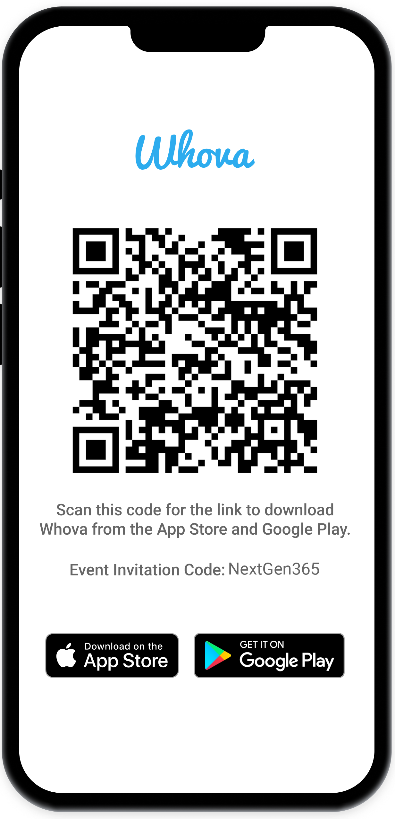
Join the event app to access:
The official event app for the
Microsoft 365 Community Conference
Event invitation code: NextGen2025
Event announcements
Personalized agenda, session details
Speaker & attendee profiles
Networking, meet-ups, messages
Event documents

Slide 5



Scott Stewart
Principal PM, SharePoint
Scott Stewart | LinkedIn
Alexander Spitsyn
Principal EM,
SharePoint
Alexander Spitsyn | LinkedIn
Ashu Rawat
Principal PM Manager, SharePoint
Ashu Rawat | LinkedIn

Slide 6
SharePoint automations landscape

Slide 7

Automation seems complex
– but it doesn’t have to be
More than
2 billion files
are added to SharePoint each day and >2 billion flows orchestrate content weekly
Automation
is locked
behind expertise and
complexity – setting up business process workflows frequently requires support from a subject matter expert
The future of automation
Will democratize to the context of your work for any SharePoint
user – novice to expert

Slide 8





Automation for all
Any M365 user should be able to easily automate common tasks across:
Files & items are created or modified, for a selected file or item
New message in a
chat or channel, I’m mentioned, keywords used, emoji is used
Email is received, new meeting is scheduled, meeting is canceled
Task status changes,
I’m assigned a task
A new work item
is created, I’m tagged
in a work item
Azure DevOps
Create new files & items, update metadata, copy & move, request approval
Post in a group chat,
channel or feed
Send an email, create
a meeting invite
Create a new task,
update a task status
Create a bug,
update a work item

Slide 9
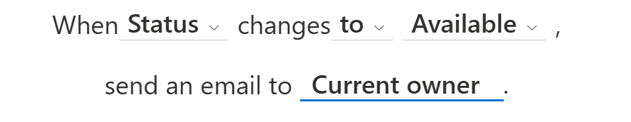
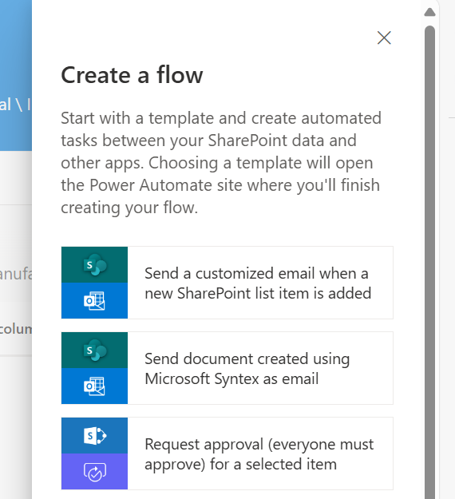
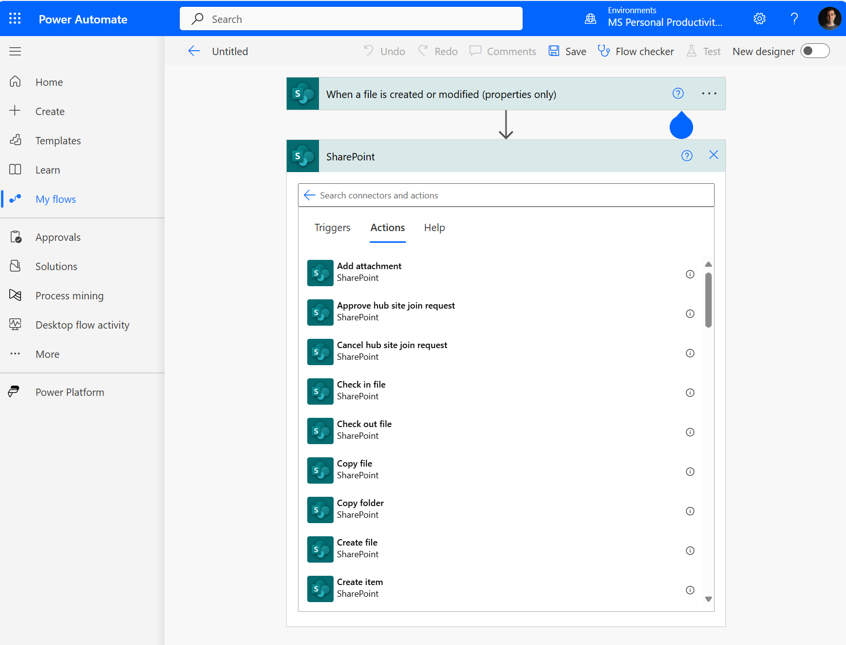
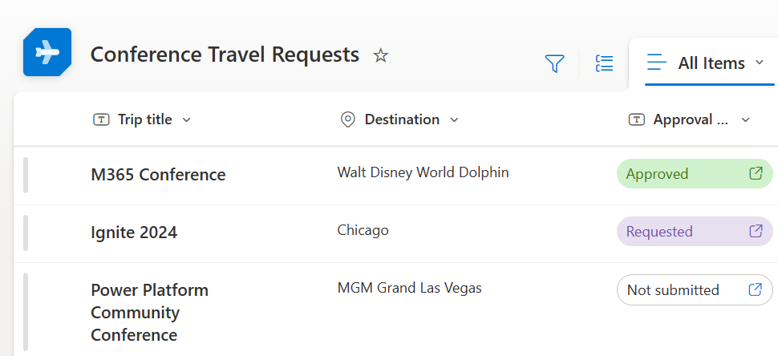
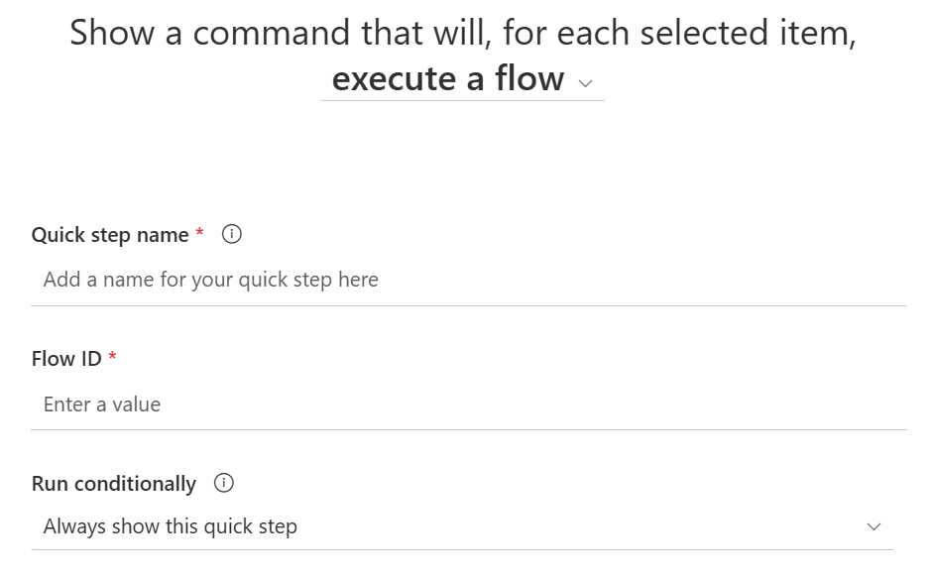
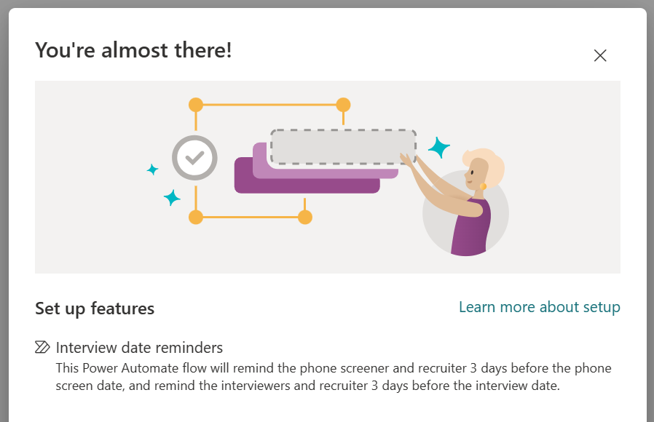
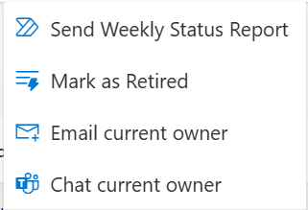
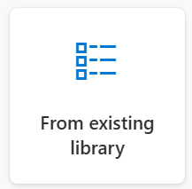
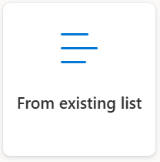
How do I create automations in SharePoint today?
OUT OF THE BOX
CUSTOMIZABLE
Rules
Simple sentence builder with limited triggers, conditions, & actions (mostly send email)
Flow templates
Start with suggested templates to pre-fill site/list info before exiting into the maker experience
Create from scratch
Advanced users can go to the flow designer to build from scratch with a desired trigger and subsequent actions
Approvals
Lightweight approval tracking that integrates with the Teams Approvals app (sourced in Power Automate)
*New* Quick Steps
Pre-defined custom commands to run in the context of a selected item/file or the entire list/library
List & library templates
1P list & library templates come with pre-configured flow solutions, these can be customized and deployed within the organization
Copy existing
Create new list or library and include existing automations

Slide 10
Session Demos

Slide 11
📂 Getting Started with Doc Library
Centralized submissions for consistent intake
Automated metadata extraction and structured categorization

Slide 12
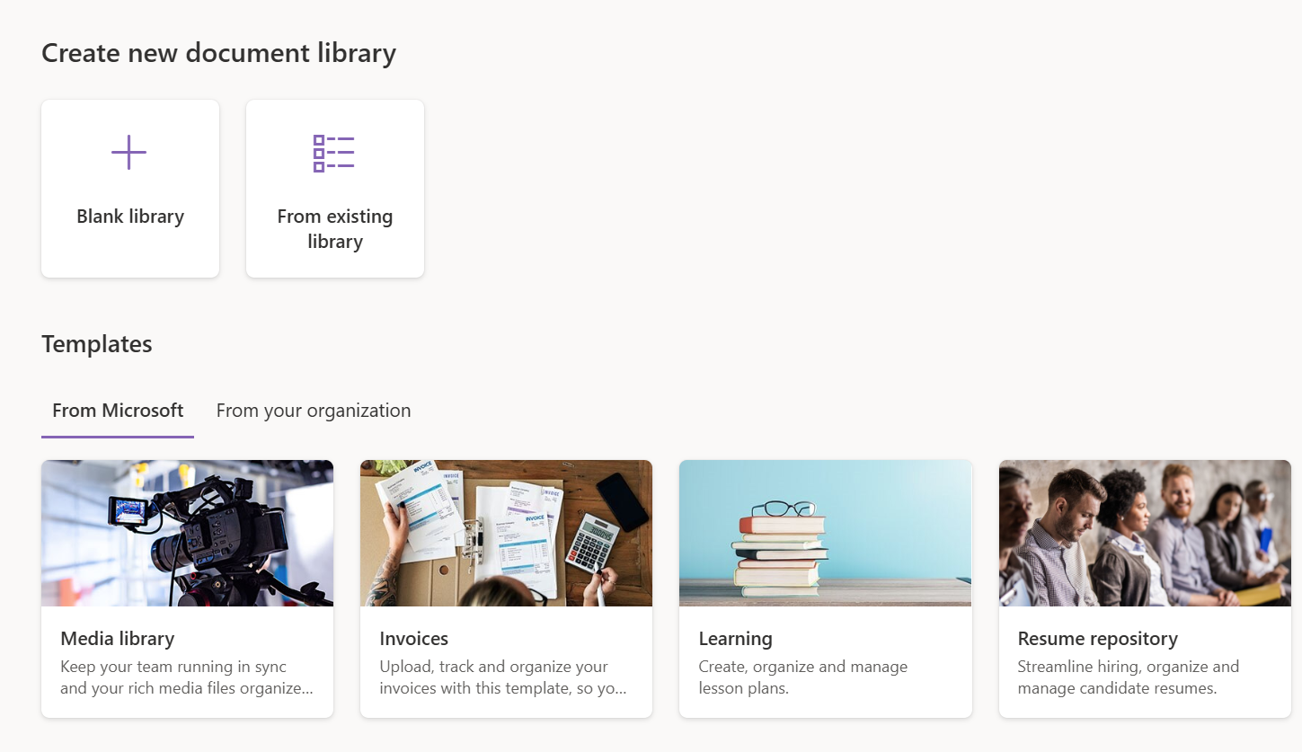
Create New Document Library
From blank or an existing library
From predefined templates (New Resume library template)

Slide 13
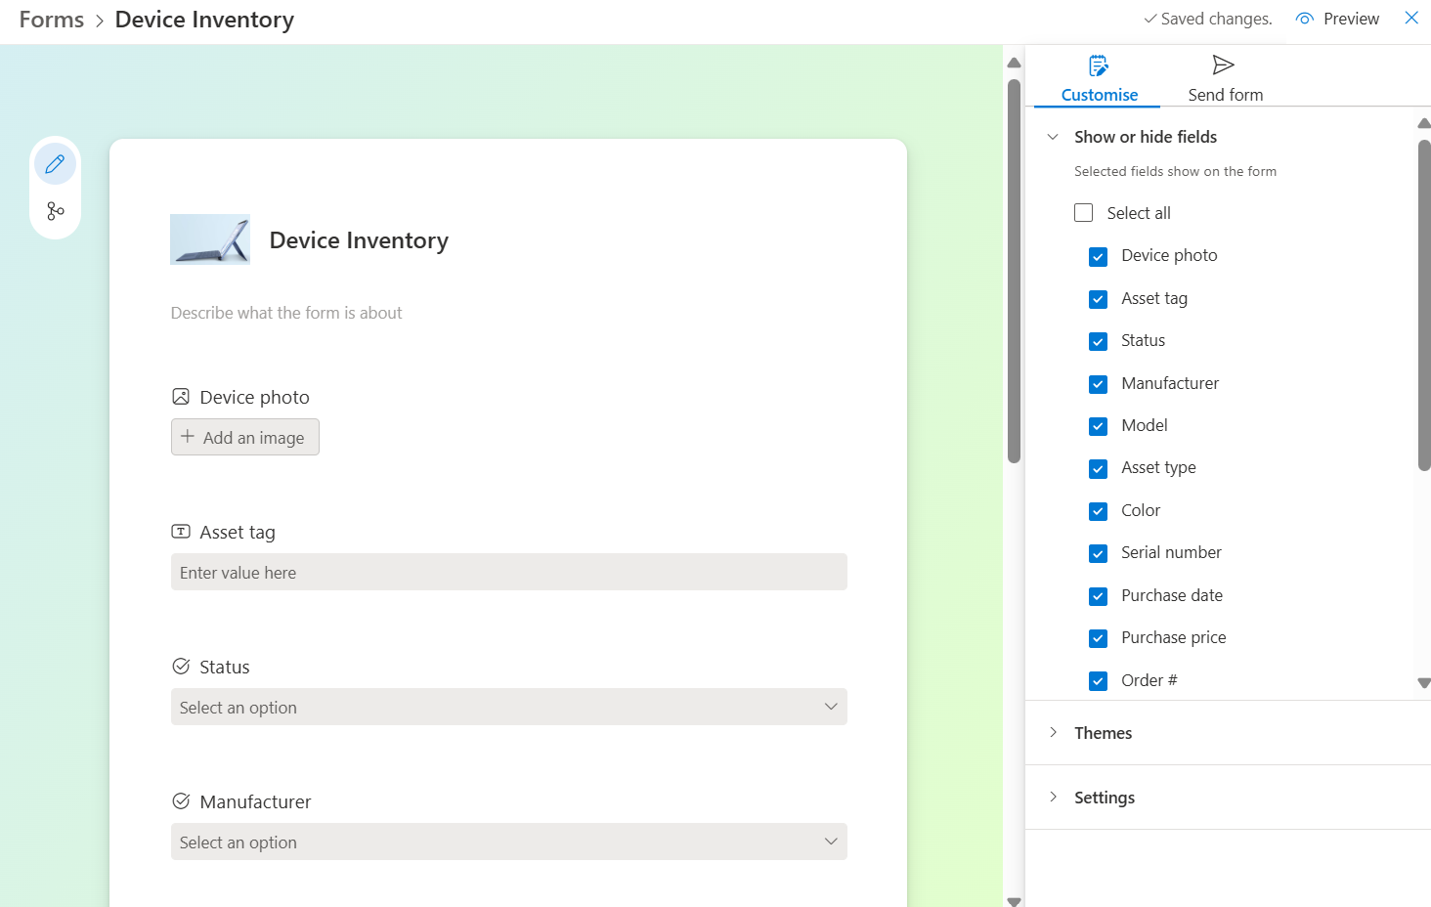
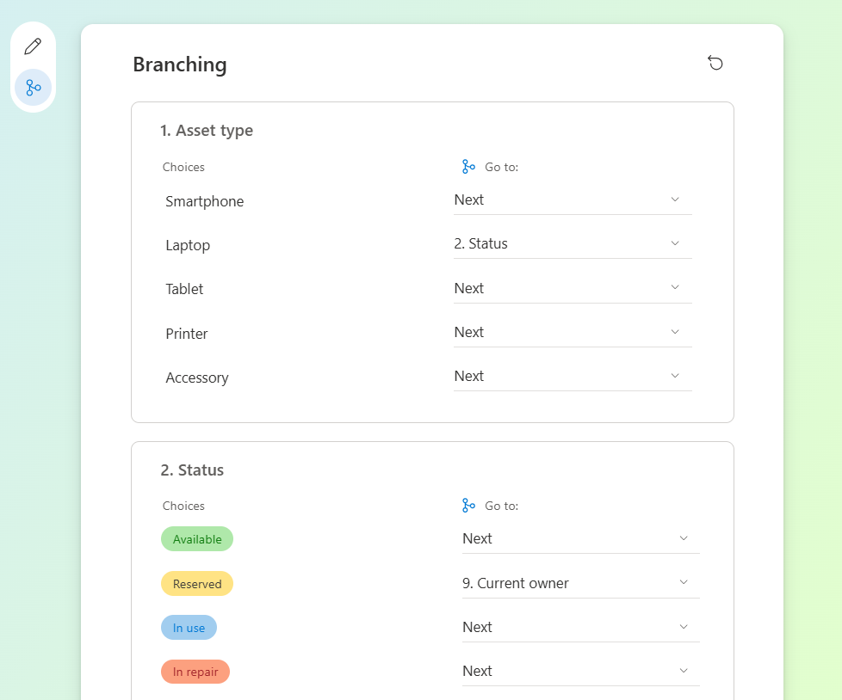
New forms experience
New
Add columns to the list
Branching & Trigger Automation

Slide 14
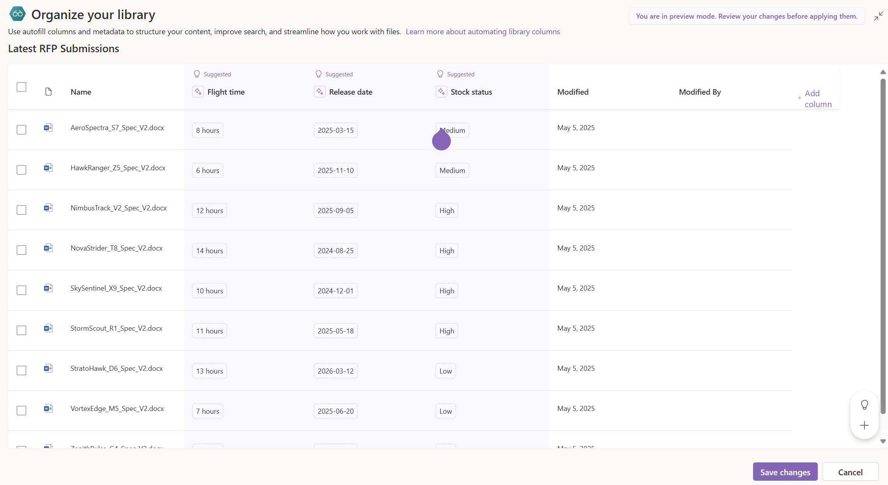
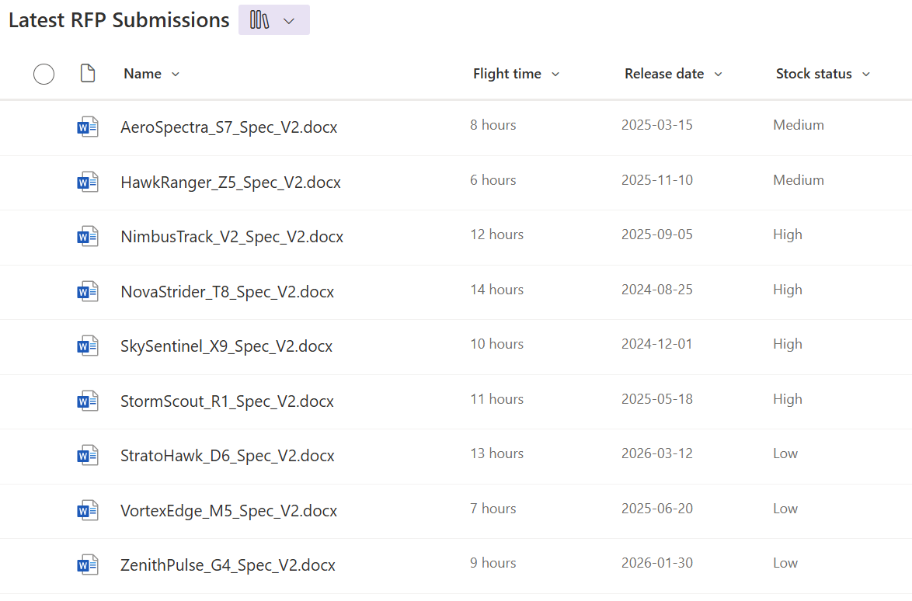
Autofill from files
New
Suggested Columns
Content extracted from documents

Slide 15
⚙️ Automating with Rules
Reduced manual input with auto-filled fields
Dynamic value assignment based on metadata
Real-time alerts to stakeholders

Slide 16
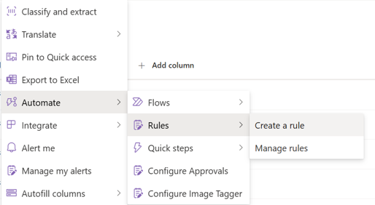
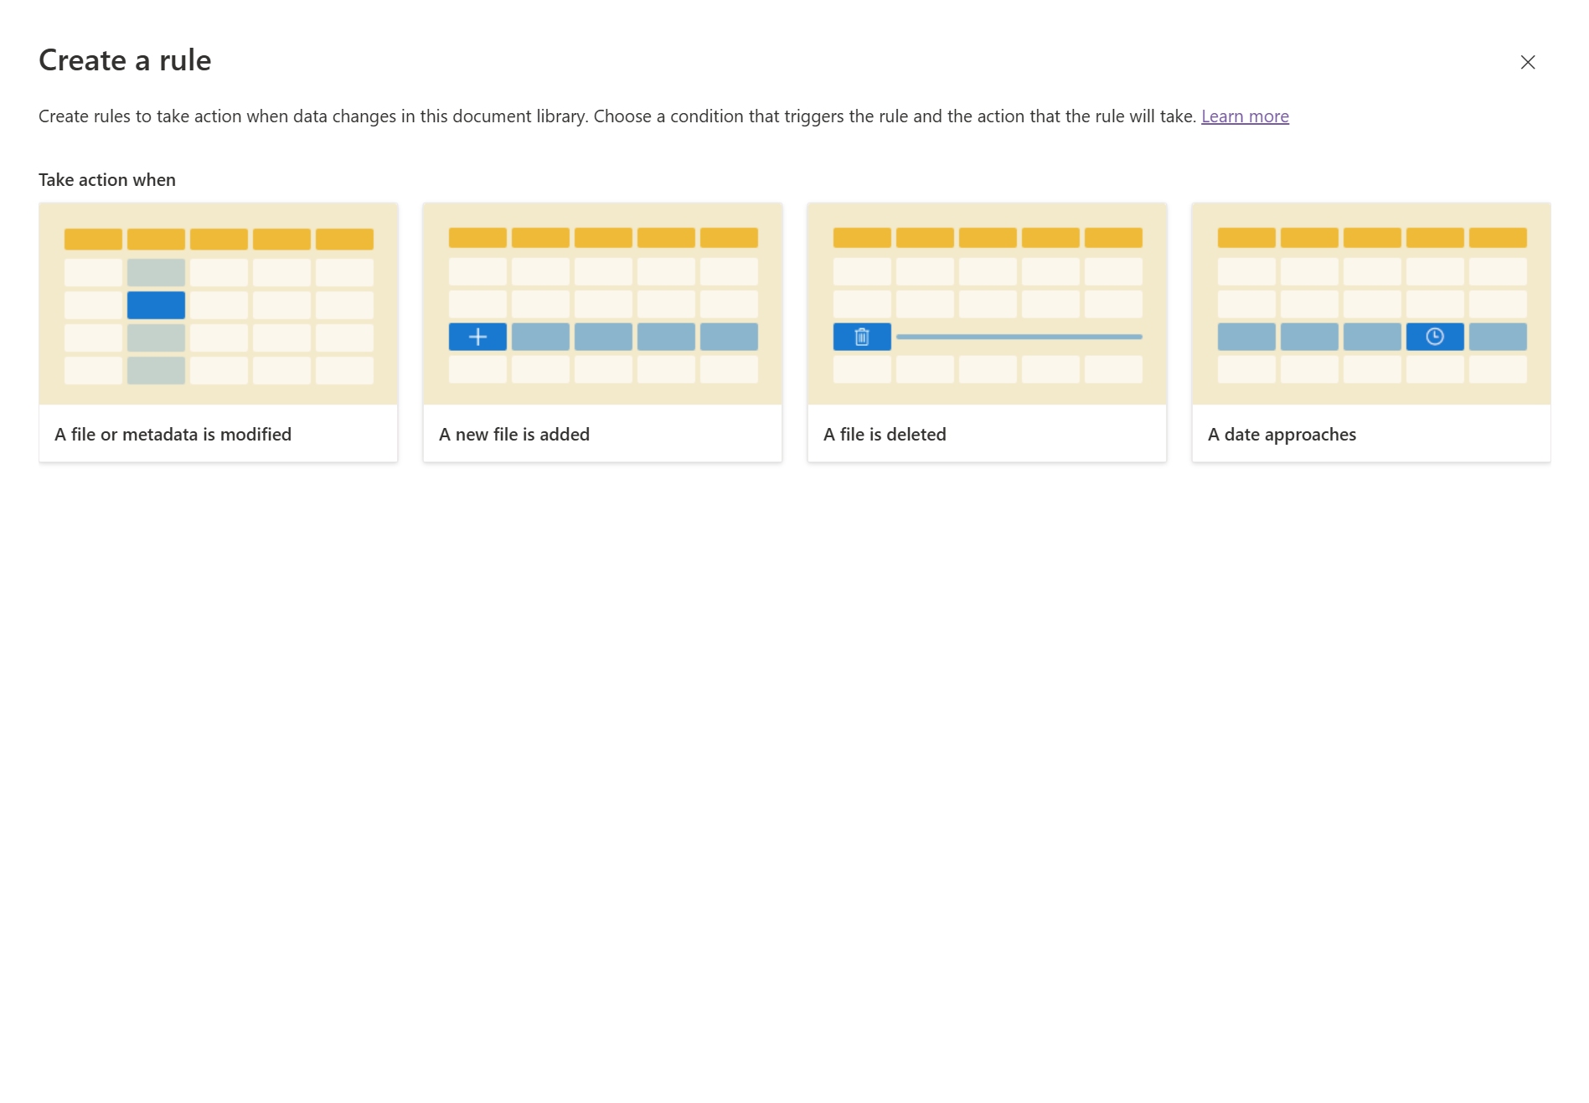
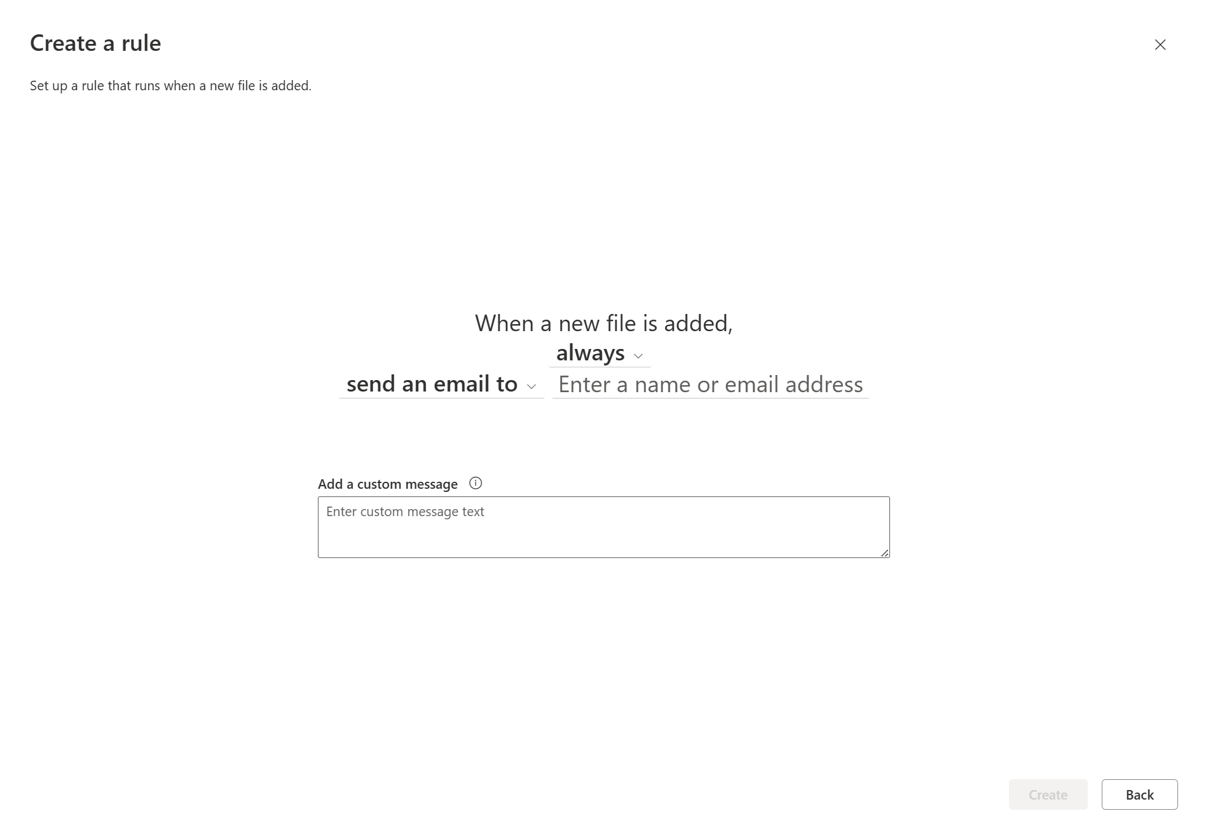
Create Rules

Slide 17
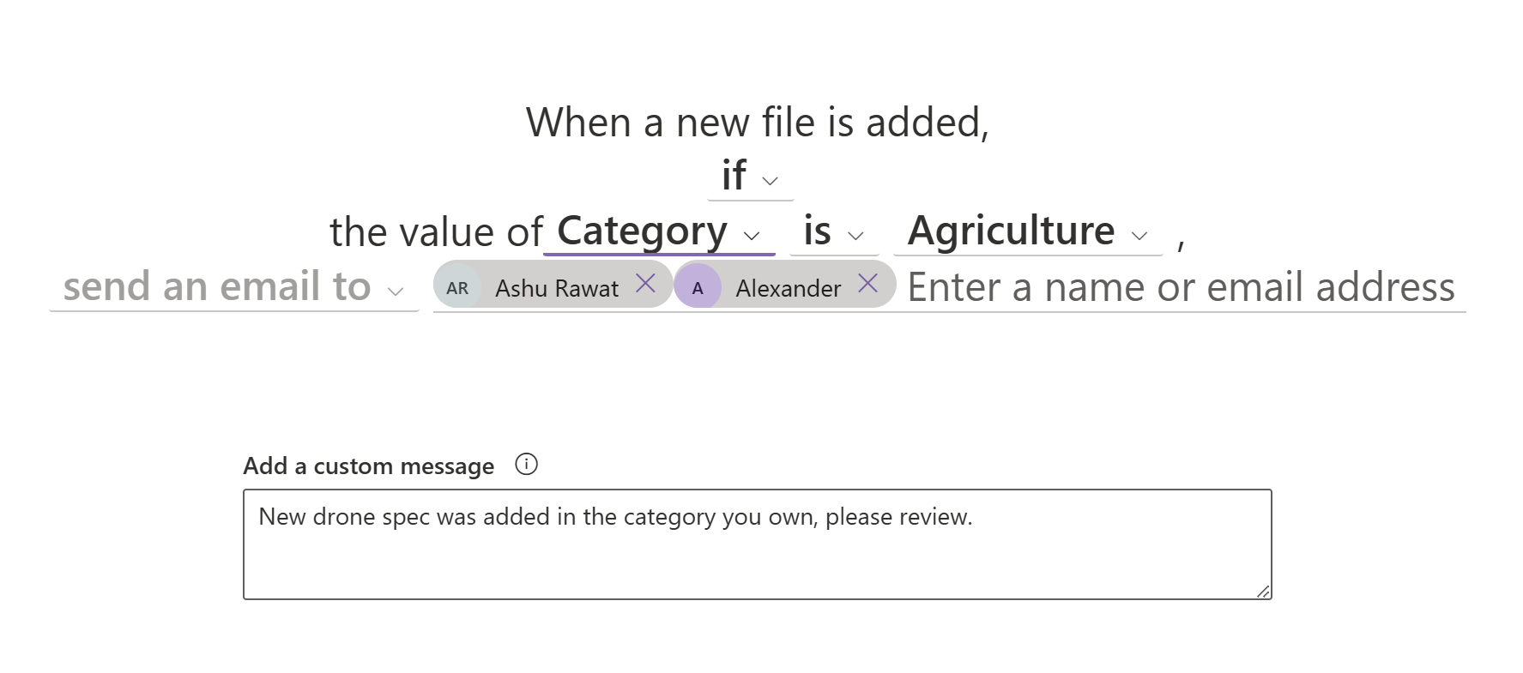
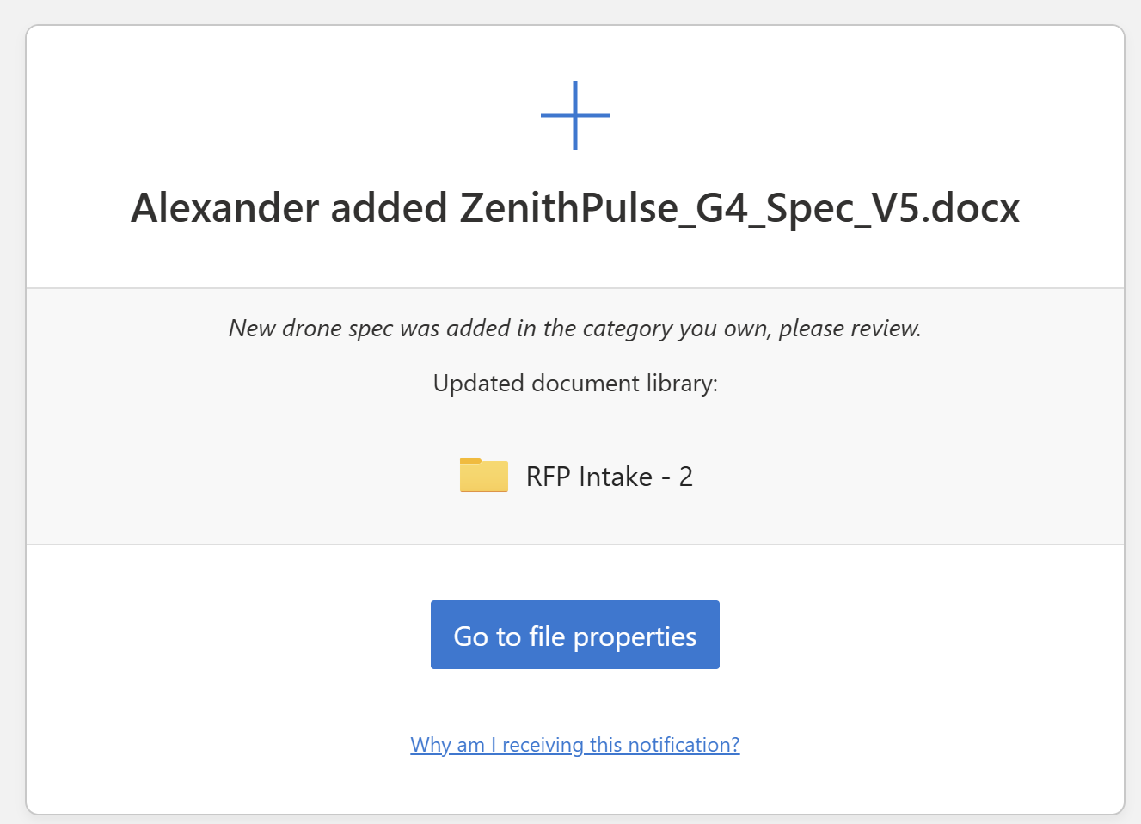
Receive Notifications from the Rule

Slide 18
📅 Managing Due Dates & Views
New
Focused task visibility per user through views
Proactive reminders for accountability

Slide 19
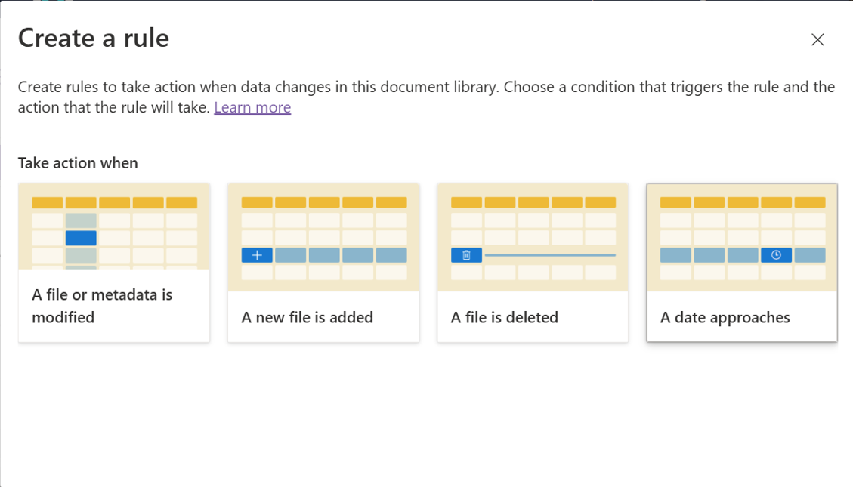
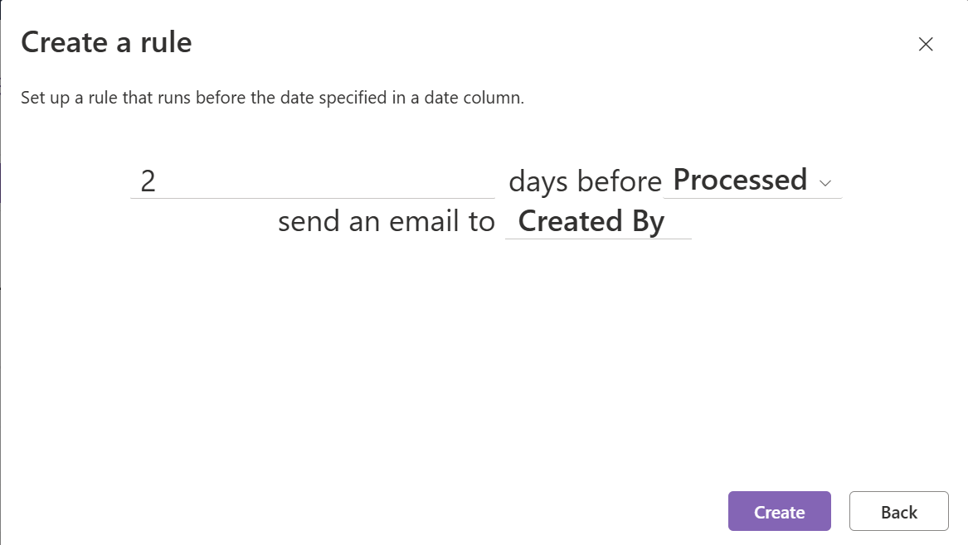
Rules – Date column and Reminder
New

Slide 20
🚀 Quick Steps
New
One-click file routing based on logic
Simple action customization for your list or library

Slide 21
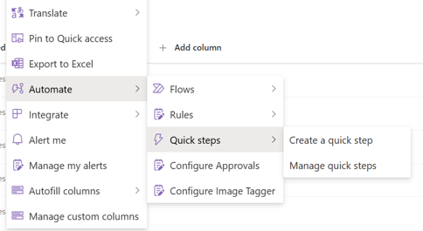
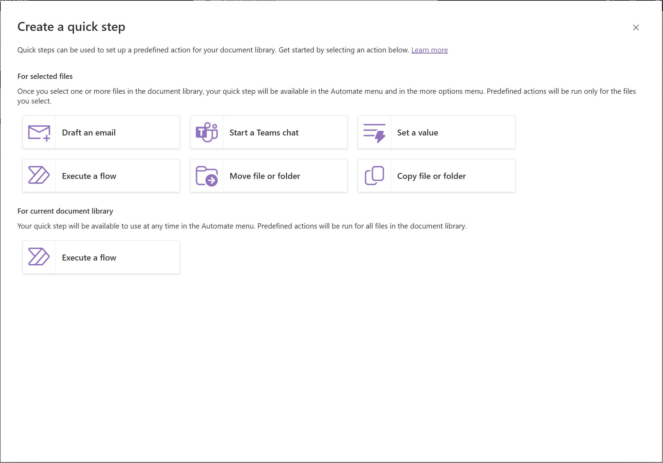
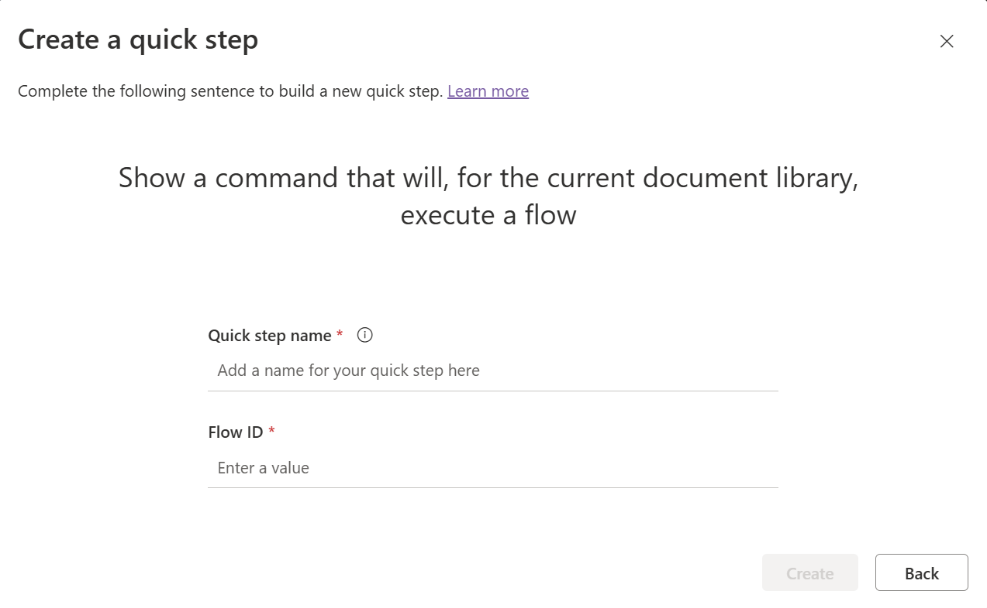
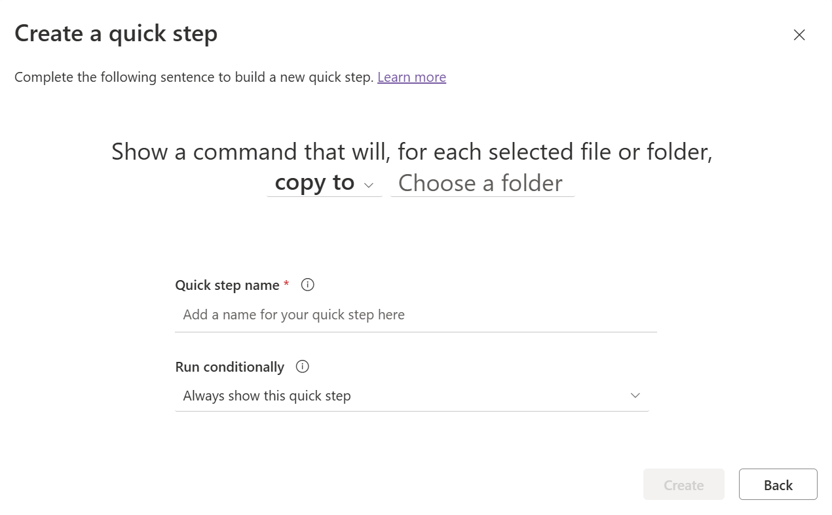
Define custom commands as Quick Steps
New
Execute a Flow
Copy File

Slide 22
Approvals
Structured, multi-stage decision flows
Fast-tracked leadership requests with no-confirmation routing

Slide 23
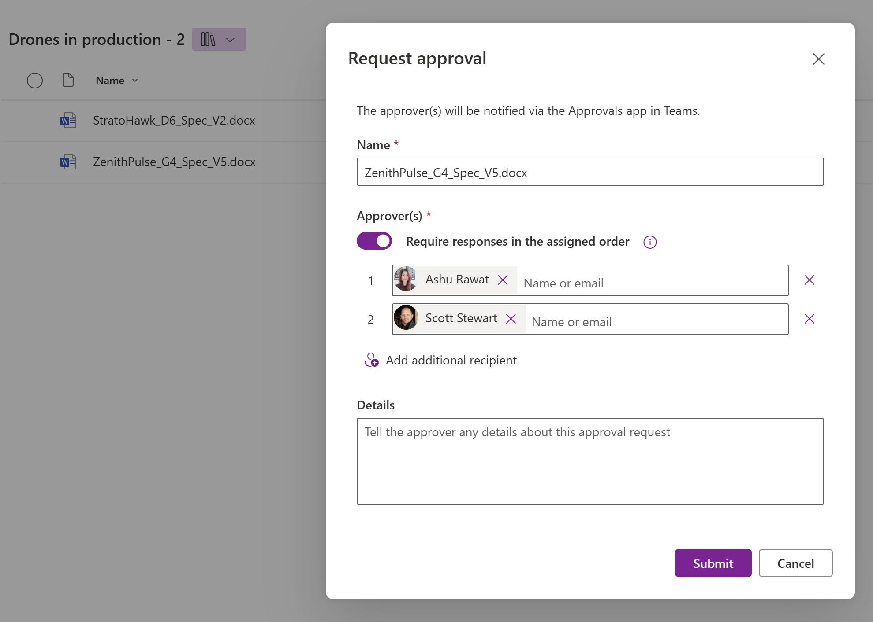
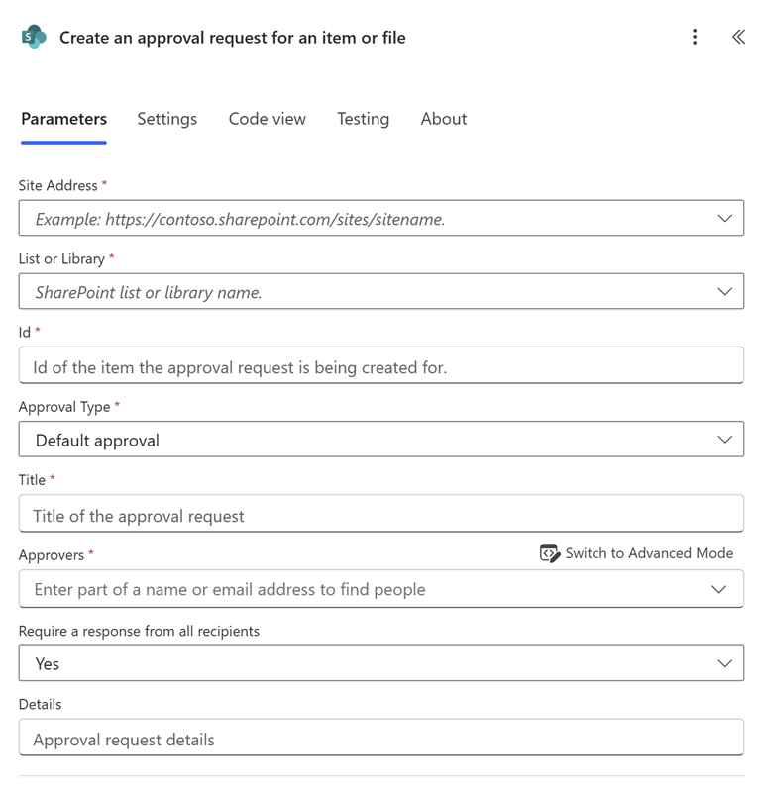
Approvals
Approvals within SharePoint
Approvals within PowerAutomate

Slide 24
SharePoint Automations Roadmap
Last 6 months
Coming in next 3 months
Coming in next 6 months
Approvals across Lists and Document Libraries
Quick Steps
execute flow action, set value, compose email, start a chat message
Site Scripts support for Approvals, Autofill, Forms, Colored Folders
Faster document processing
New Rules + Approvals triggers, conditions, & actions
New destination UX
Out of the box templates
Time-based rules
Quick Steps - copy/move actions and conditions
Custom text in rules
Forms for Document Libraries
Resume Template
AI suggested prompts
Power Platform widget and panel consolidation
Power Platform environment alignment
Rich audit details, run history, & governance controls

Slide 25
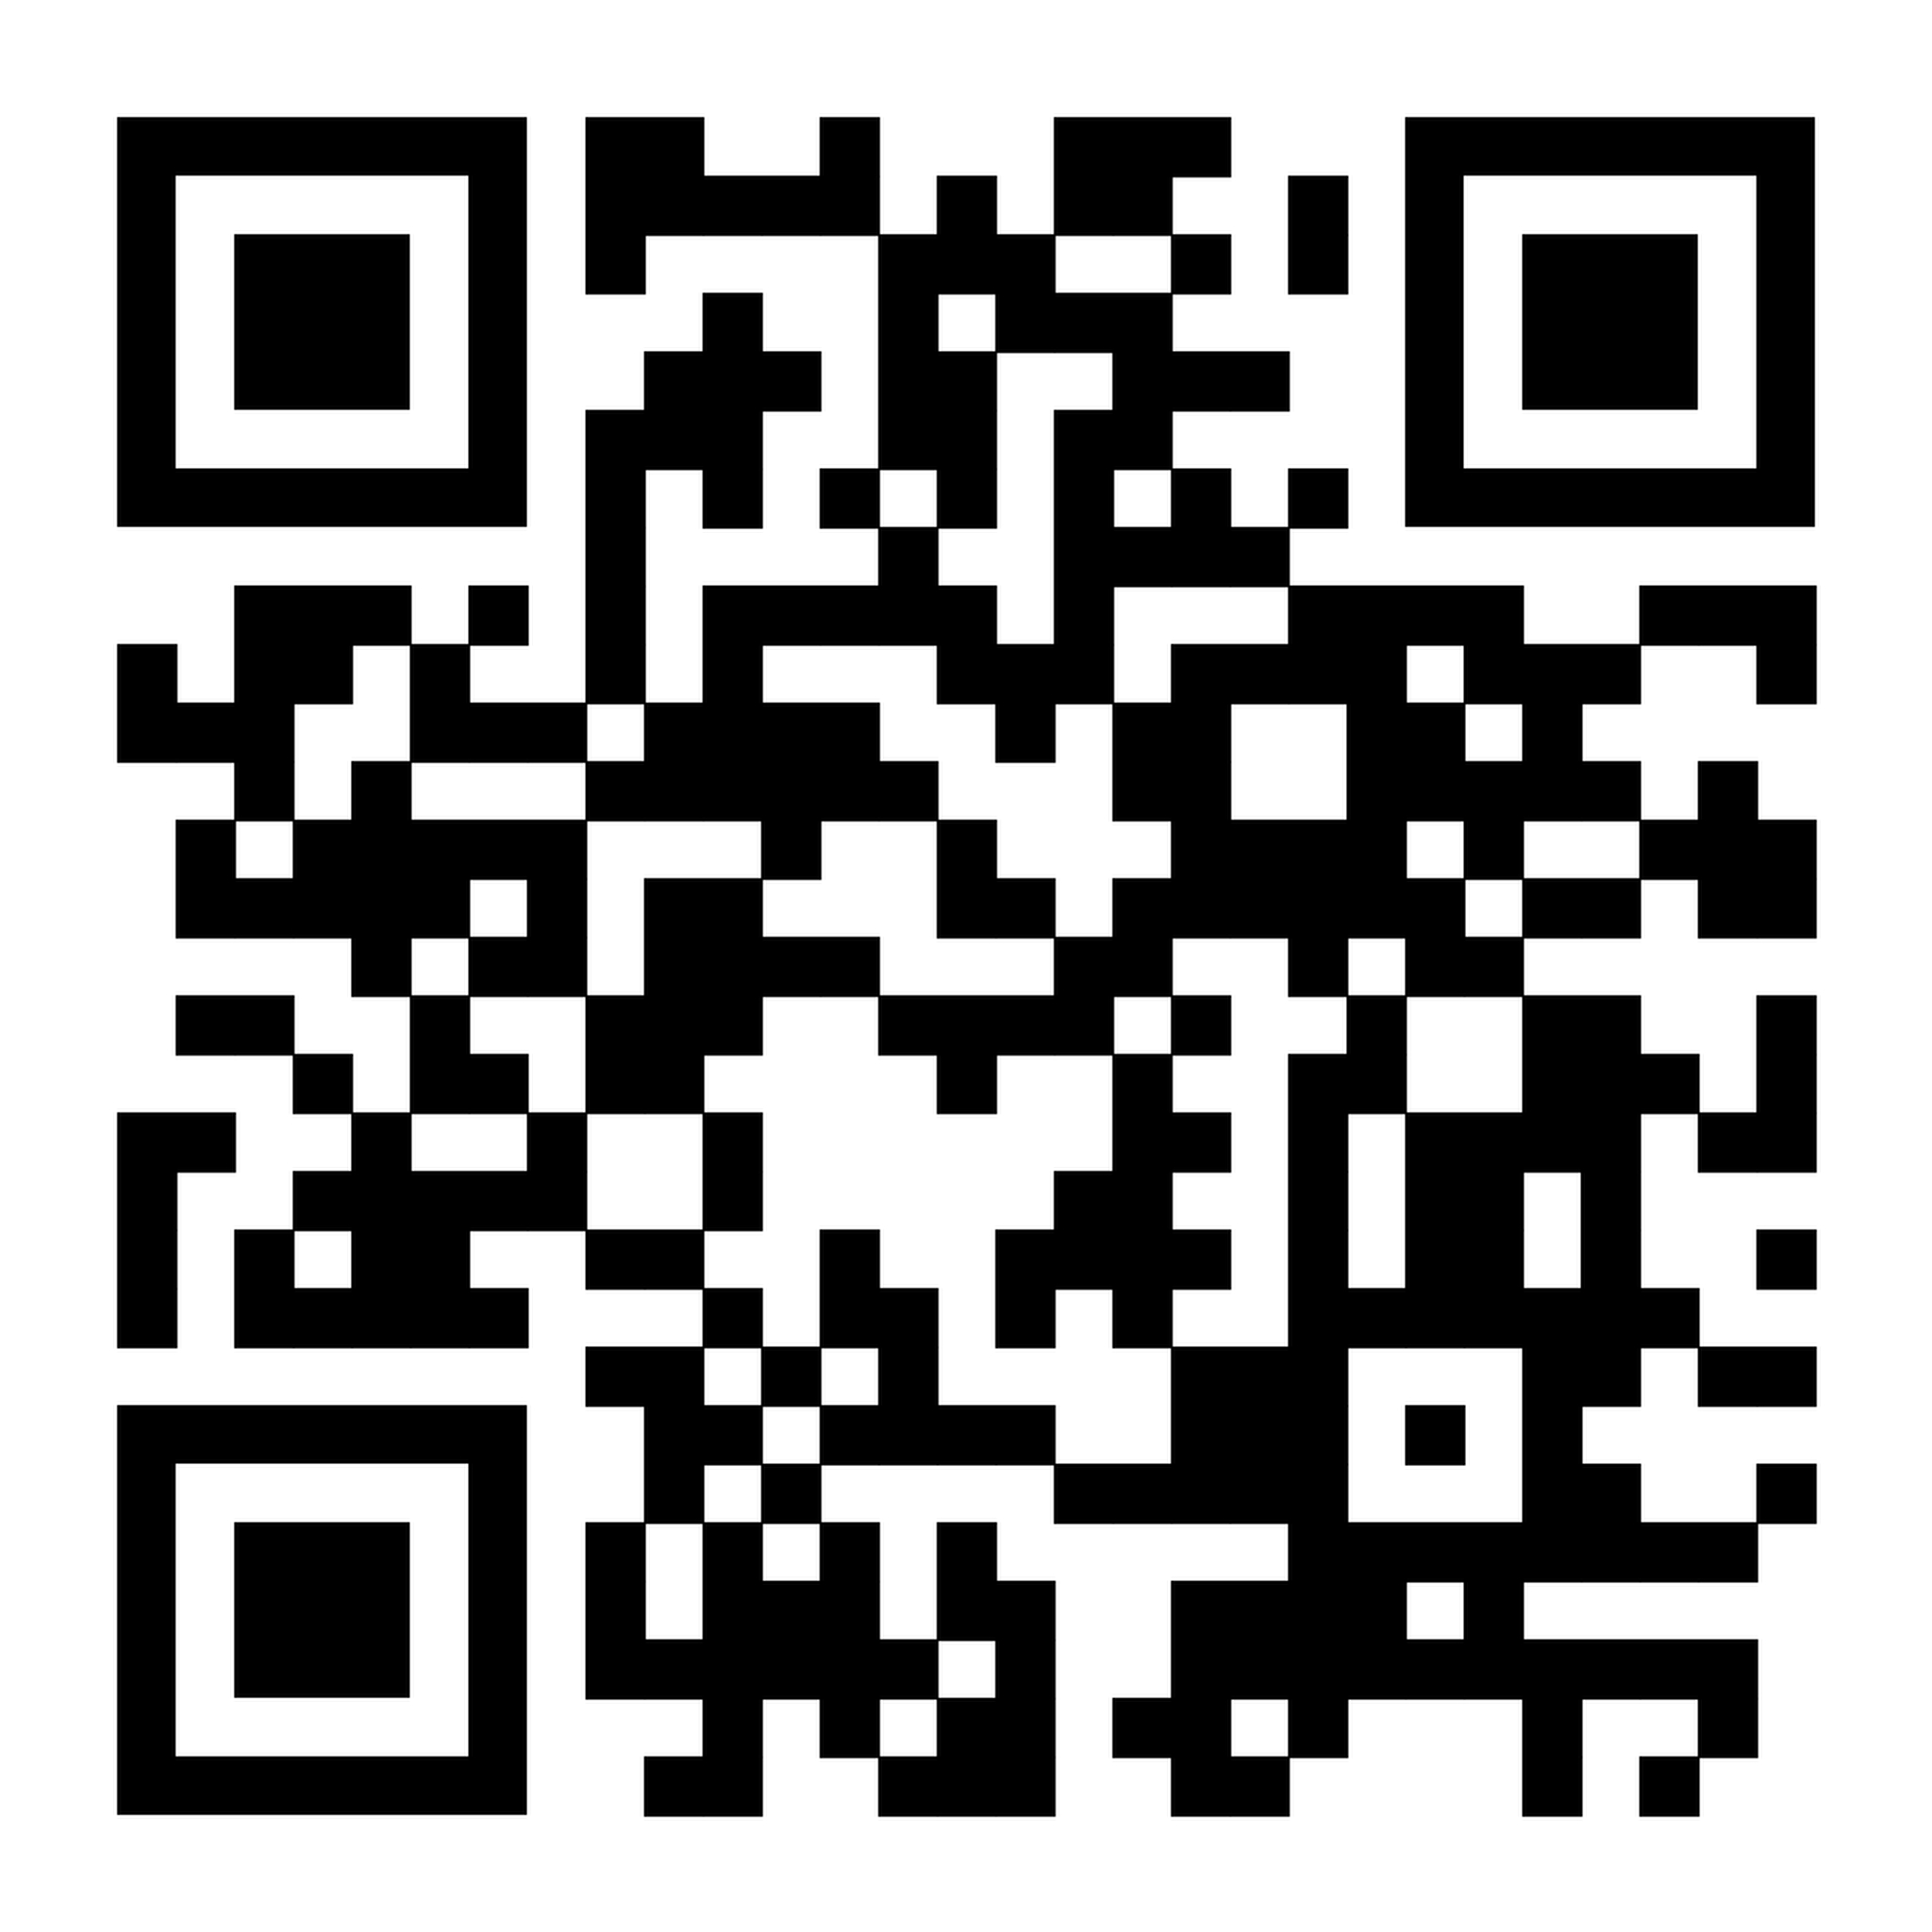
https://aka.ms/SPOAutomationSignup

Slide 26
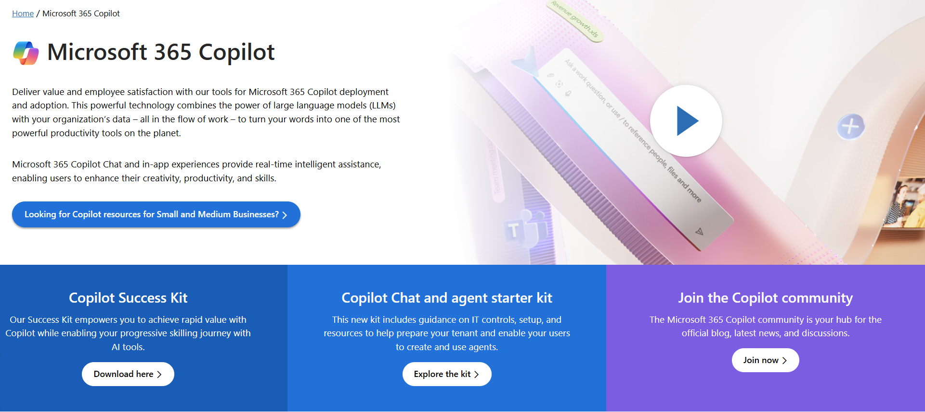
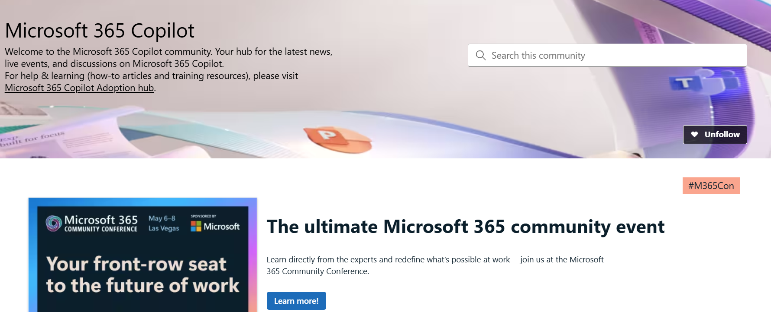
Copilot hub & community
Copilot hub on adoption.microsoft.com/copilot
Enablement and usage guidance for Microsoft Copilot.
Ask questions and get answers in our community aka.ms/M365CopilotCommunity

Slide 27
We have an exciting future ahead.

Slide 28
Expertise and tools for your journey
Technical expertise via our FastTrack partners
Tools, resources & training on our Adoption Hub
Events and real-world knowledge in our community
aka.ms/Microsoft/FastTrack
adoption.microsoft.com
aka.ms/TechCommunity

Slide 29
News & community content
Microsoft Community Learning aka.ms/Community/LearningChannel
Community led expert content on all your favorite Microsoft services.
Start your week with live news and event updates aka.ms/MondaysatMicrosoft
Watch live or on-demand & share our blog.

Slide 30
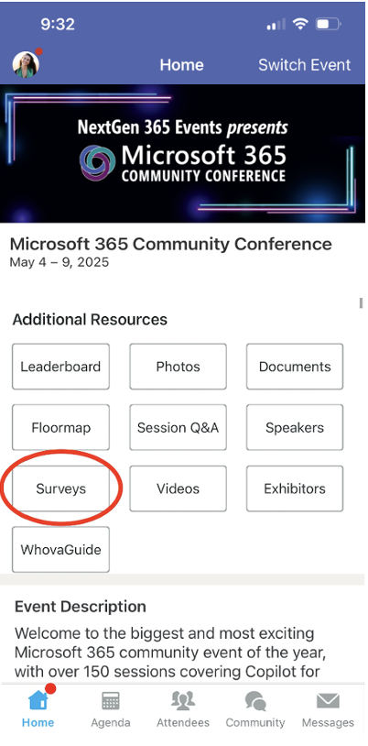
Session feedback surveys
We want to hear from YOU!
Share your feedback to make next years conference even better!
Here’s how –
Simply go to the Whova App on your smartphone.
Scroll down on the M365 Community Conference Homepage to ‘Additional Resources’ to click “Surveys’.
Click Session Feedback.
Scroll down to find this session title.
Complete the session feedback survey.
Finally, click ‘Submit’.
It’s just that easy!

Slide 31
