Slide 1
How Microsoft Does IT: Governance and Administration in the Era of Copilot
David Johnson, Principal Product Manager Architect

Slide 2

Microsoft 365 Community Conference

Slide 3


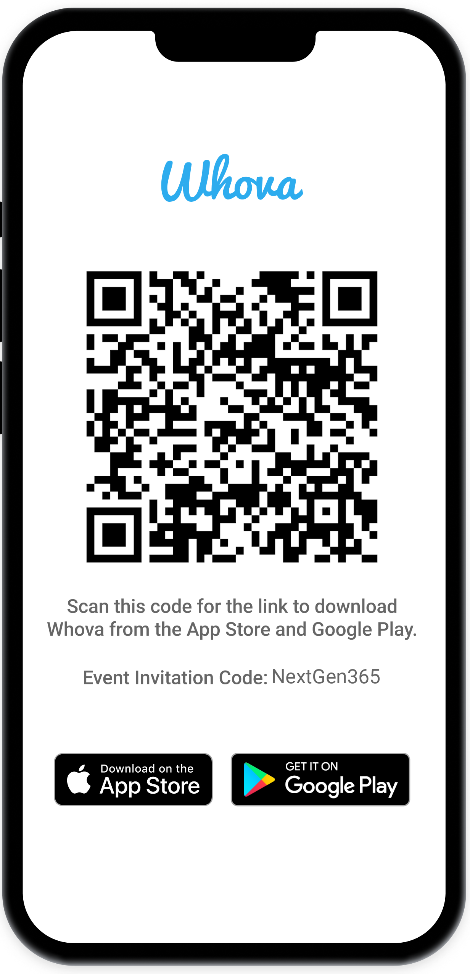
Join the event app to access:
The official event app for the
Microsoft 365 Community Conference
Event invitation code: NextGen2025
Event announcements
Personalized agenda, session details
Speaker & attendee profiles
Networking, meet-ups, messages
Event documents

Slide 4

David Johnson
David Johnson
Principal Product Manager Architect
Microsoft Digital (Microsoft’s IT organization)

Slide 5
Agenda
Microsoft’s tenant
Copilot and our data estate
SharePoint & files
Meeting polices: Enabled for Copilot
Agent Governance
Power Platform governance
App publishing
Microsoft Confidential

Slide 6
Microsoft Digital Tenant Management
Run an industry leading employee tenant at scale while empowering employees, making products better and balancing risk for the company. Microsoft Digital is a responsible custodian for the company’s data.
Tenant Management Principles
Manage services at scale, with minimum support and cost implications
Empower employees, with as much product value as possible with guardrails
Secure and protect, the tenant, its services, and created data assets
Employees work within tenant boundaries, whenever possible
MSFT tenant unique principles:
Foster product innovation, with product ringfencing, enterprise readiness guidance, and controlled risk taking
Reference customer, enable our products as a reference enterprise customer
Business
Product Group
Microsoft
Digital
MAVS
Manage
Empower
Security
Employee
Regional Compliance
Govern
Privacy and Legal

Slide 7




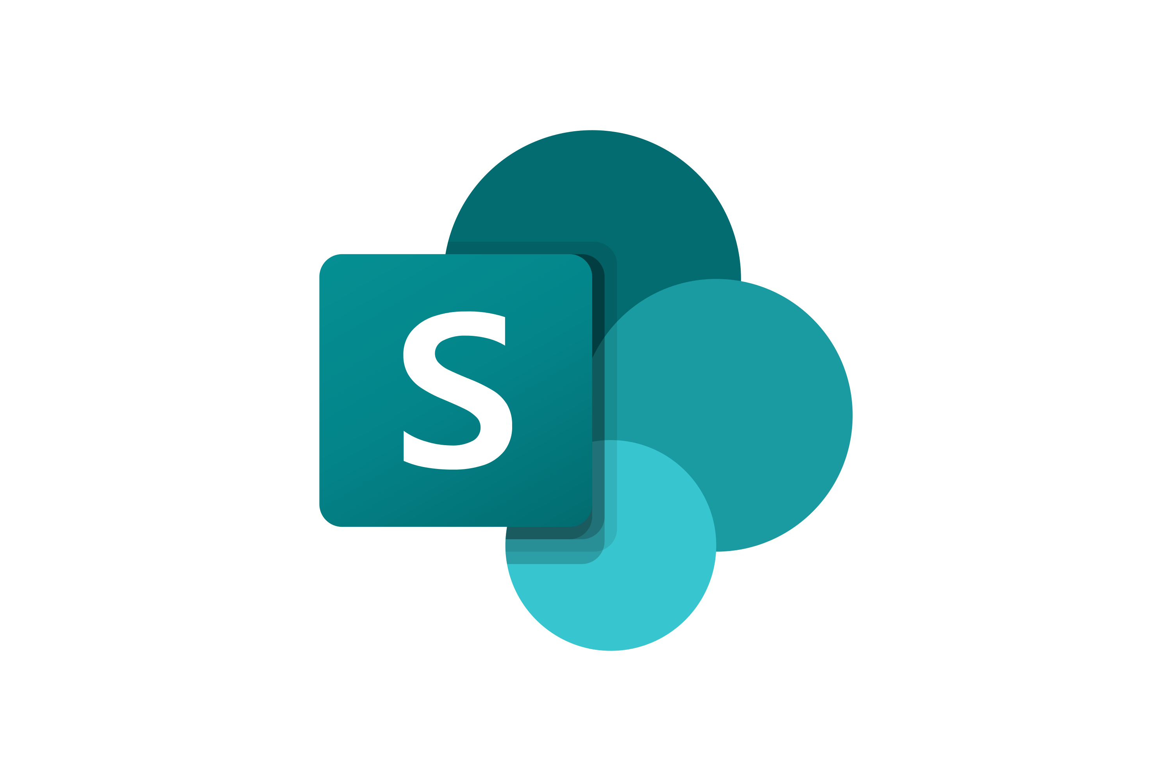





Microsoft Digital Global Landscape
830 million Team audio minutes per month
6.6M Copilot Chat Sessions monthly
465K Power Apps
752K Intune Managed Devices
603K SharePoint Sites
75K VPN Sessions daily
Employees: ~220,000
Vendors: ~105,000
Guests: ~700,000
Geography: 108 Countries
Physical Buildings: 627 globally
A/V Supported Rooms: 14,000
452K Mailboxes
376K OneDrive for work
149K Teams
13K Employees onboarded through acquisition in FY23
5K Viva Engage Communities
325K+ Employees & vendors licensed for M365 Copilot
716K FY21 Helpdesk tickets
10K Enabled M365 apps & agents
Notes:
1K published M365 apps and agents
50K viral agents

Slide 8



What We Worry About
Change Management and “right” tenant config
Managing everything employees create
App risk
How do I keep up with changes?
Where will employees push back on changes?
What impacts will changes have on my tenant’s protection?
What changes might have compliance risk?
How do I prevent sprawl?
How do I reduce employee experience confusion.
How do I prevent over exposure?
Employees want IT out of the way BUT how does IT limit risk?
How do we stay compliant?
Will I know what is going on?
What 3rd parties can I trust?
How do I contain the risk for what employees build?
How do I manage employee app catalogs to limit employee overload?
How do I protect data apps touch?

Slide 9


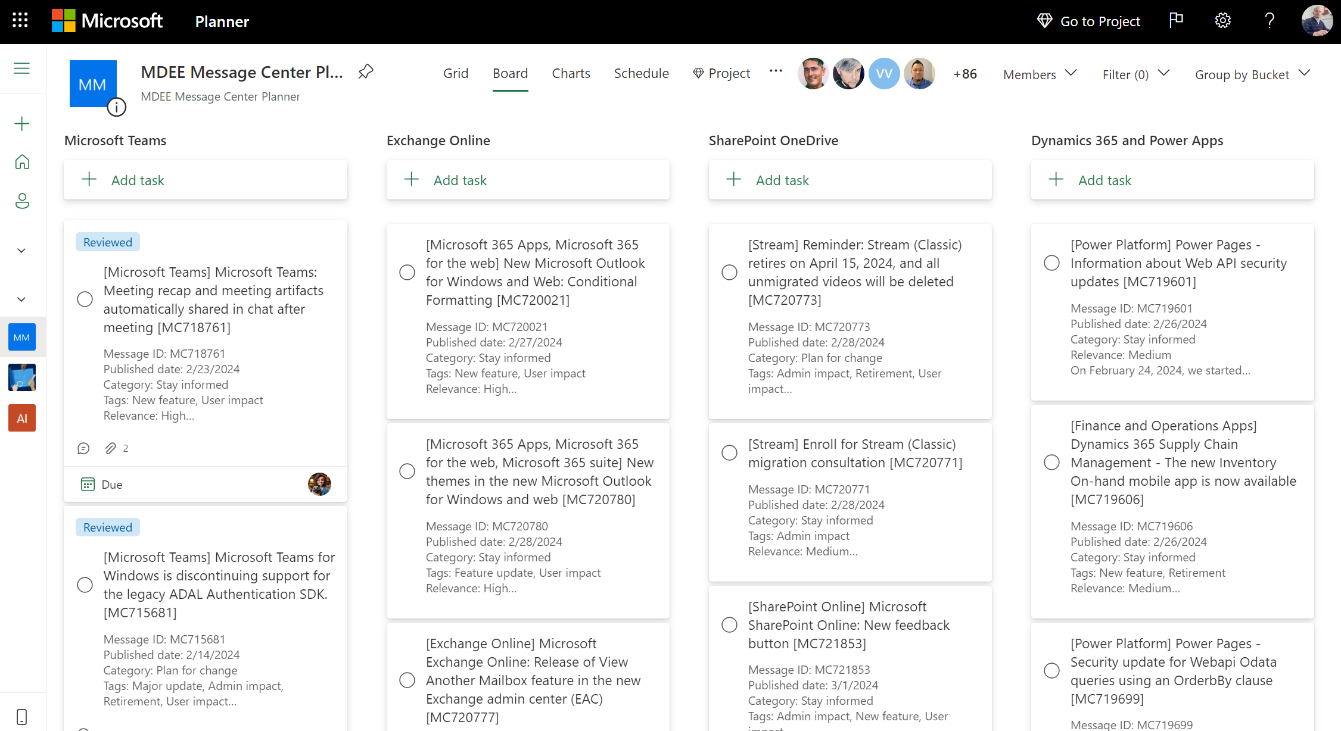
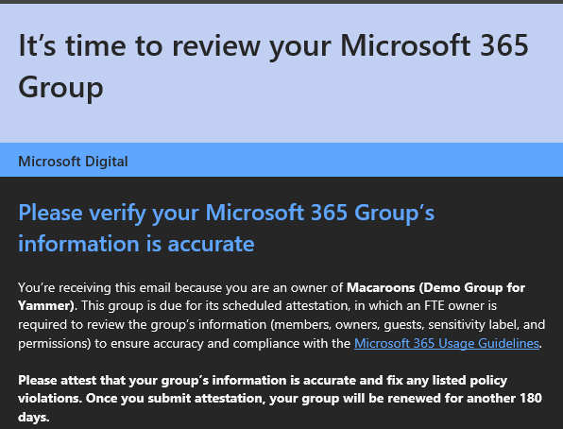
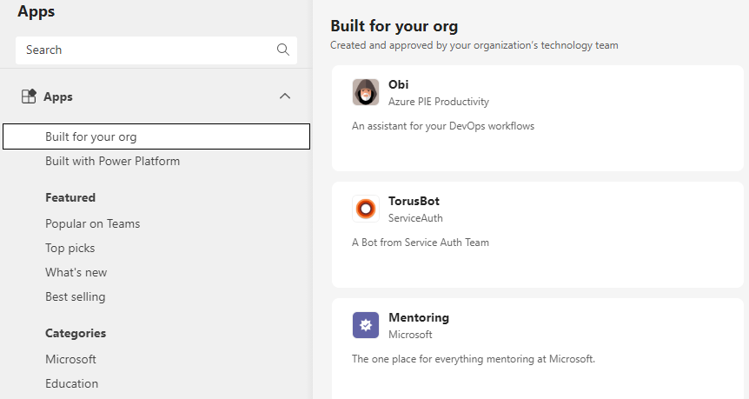
How Microsoft Governs the MSFT Tenant
Tenant Configuration and Change: Secure by default
Asset governance: Tenant hygiene and oversharing
App governance: Min viable access
100s of tenant changes/month
High risk changes identified and evaluated
All Message Center posts reviewed
Self-service Microsoft 365 Groups, SharePoint sites, Teams, Power Platform Environments
Groups, Sites, Channels and Power Platform governance
Group Membership Management
Enable Line of Business Apps to publish into app catalogs in Teams, Office client, SharePoint, Viva, AAD
Copilot plug-ins
Graph consents

Slide 10

Deploying Copilot at Microsoft
Deploying Copilot at Microsoft
Feedback loop and learnings
Implementation
Measure usage and behavior
Assess employees’ perception of Copilot
Provide multiple feedback channels
Listen attentively to employee signals
Proceed with a physical rollout
Prioritize rollout by key roles
Licensing management model
Communication and support are critical
As Customer Zero for Microsoft 365 Copilot, Microsoft Digital has played a critical role deploying, implementing, ensuring compliance, and helping our employees prepare for a new way of working.
Establish central place to go for early access guidance and readiness resources
Localize user engagement
Engage senior leaders to drive adoption and product evangelism
Proactively engage Works Councils
Setup data governance
Implement Sensitivity Labels
Proactively establish risk acknowledgement
Employee readiness and adoption
Compliance, privacy, security, and Works Councils

Slide 11


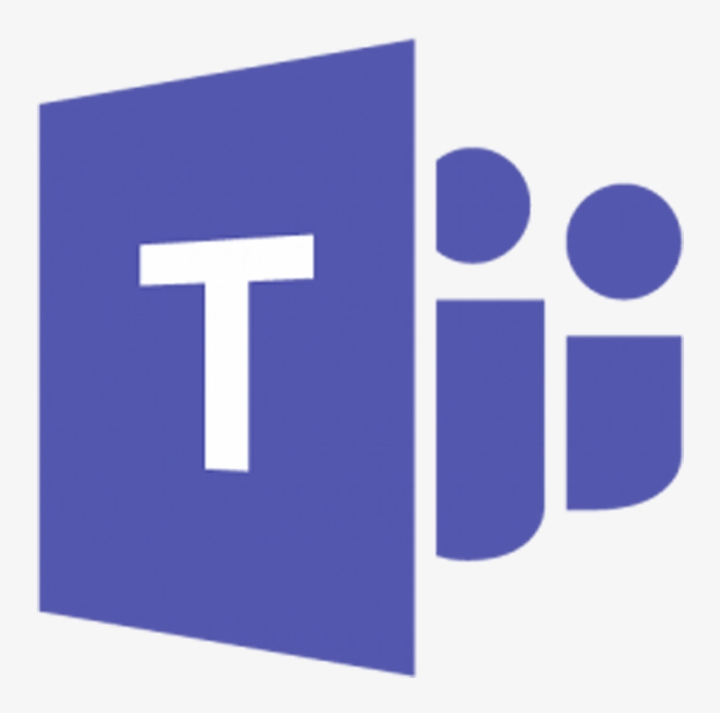


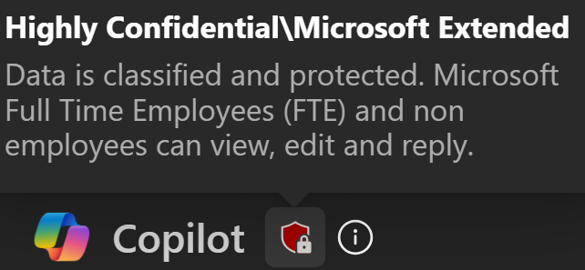
Copilot Content Protection Foundations
Copilot will only show the user what they have permission to access.
Copilot will respect Microsoft Purview Information Protection sensitivity labels.
Copilot generated items will inherit the labels applied to referenced items.
Referenced Items
File
Email
Transcription
Highly Confidential
Confidential
Unlabeled
Highly Confidential
Semantic Index
Microsoft Graph:
User’s context
Notes:
If a label is set to “block extract”, Copilot will not extract content from that file; only point to the result as a reference.
If a label allows Copy / Paste, Copilot will answer the question based on content from the file Data labelling with M365 Copilot helps you classify, understand and protect your information based on sensitivity and compliance needs. Sensitivity labels stamp a resource with metadata that tells the application how to treat it and the sensitivity of the content inside the resource.
You can apply labels manually or set up automatic labelling to ensure that data is appropriately categorized, making it easier to stay compliant and secure.
Copilot is aware of those sensitivity labels and takes them into account when responding to your queries. If you create a document using copilot which references a document with a higher level of sensitivity, your generated document or content will automatically inherit that new label because it contains that meta data or information from a source document. This ensures there is no risk of oversharing or data misclassification.

Slide 12
Ten Steps for Getting Tenant Data Governance Right with Microsoft 365 Copilot
1
Enable Self Service: Self service new workspaces with guardrails
2
Limit your number of Information Protection labels: 5 x 5
3
Intuitive labels: Labels must mean what they say
4
Capture container (group and sites) labels: Must have for all sites
5
Intelligent file default labels: Derive from container—99% case
6
Train your employees: Culture is as critical as policies
7
Trust but verify sensitivity labels: Catch the 1% case with DLP
8
Implement lifecycle management: Create a chain of accountability
9
Enabling people in my organization links: Better than large SGs
10
Extract inventory and report oversharing: Know your risk
Inside Track AI governance paper: https://aka.ms/aigovernance.

Slide 13

Empower Self-Service Workspaces with Guardrails
1
Employees are empowered to work in a secure, compliant and manageable environment that protects against data loss and oversharing risk.
Enable self-service site collection or group creation

Slide 14
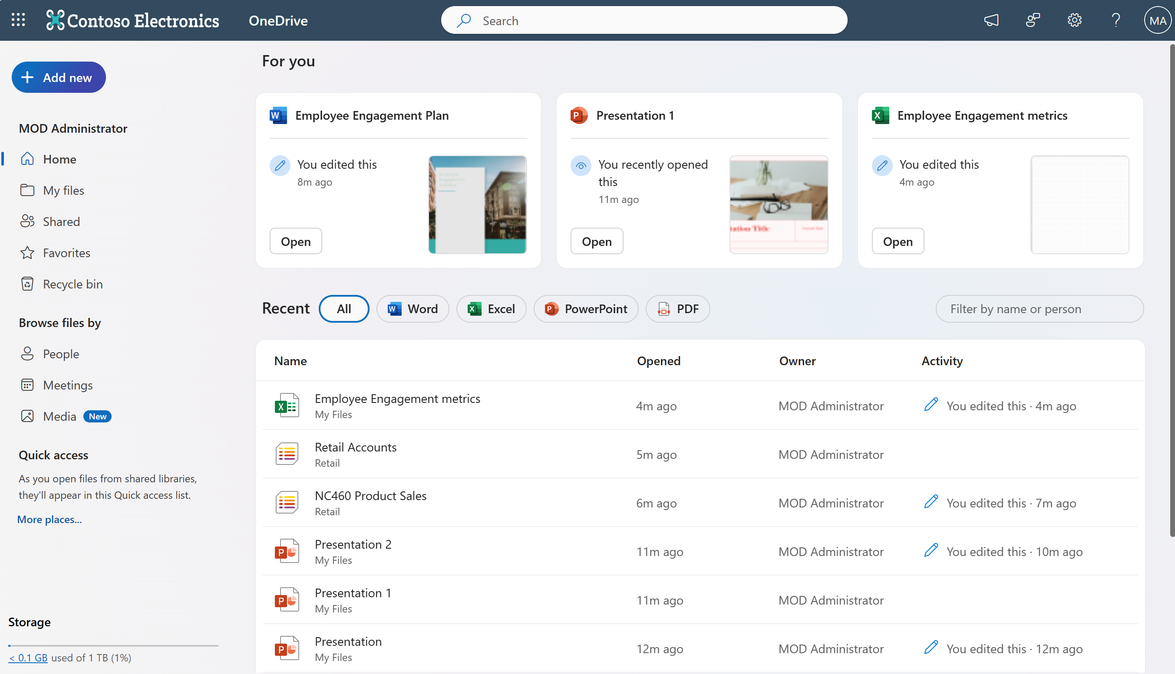

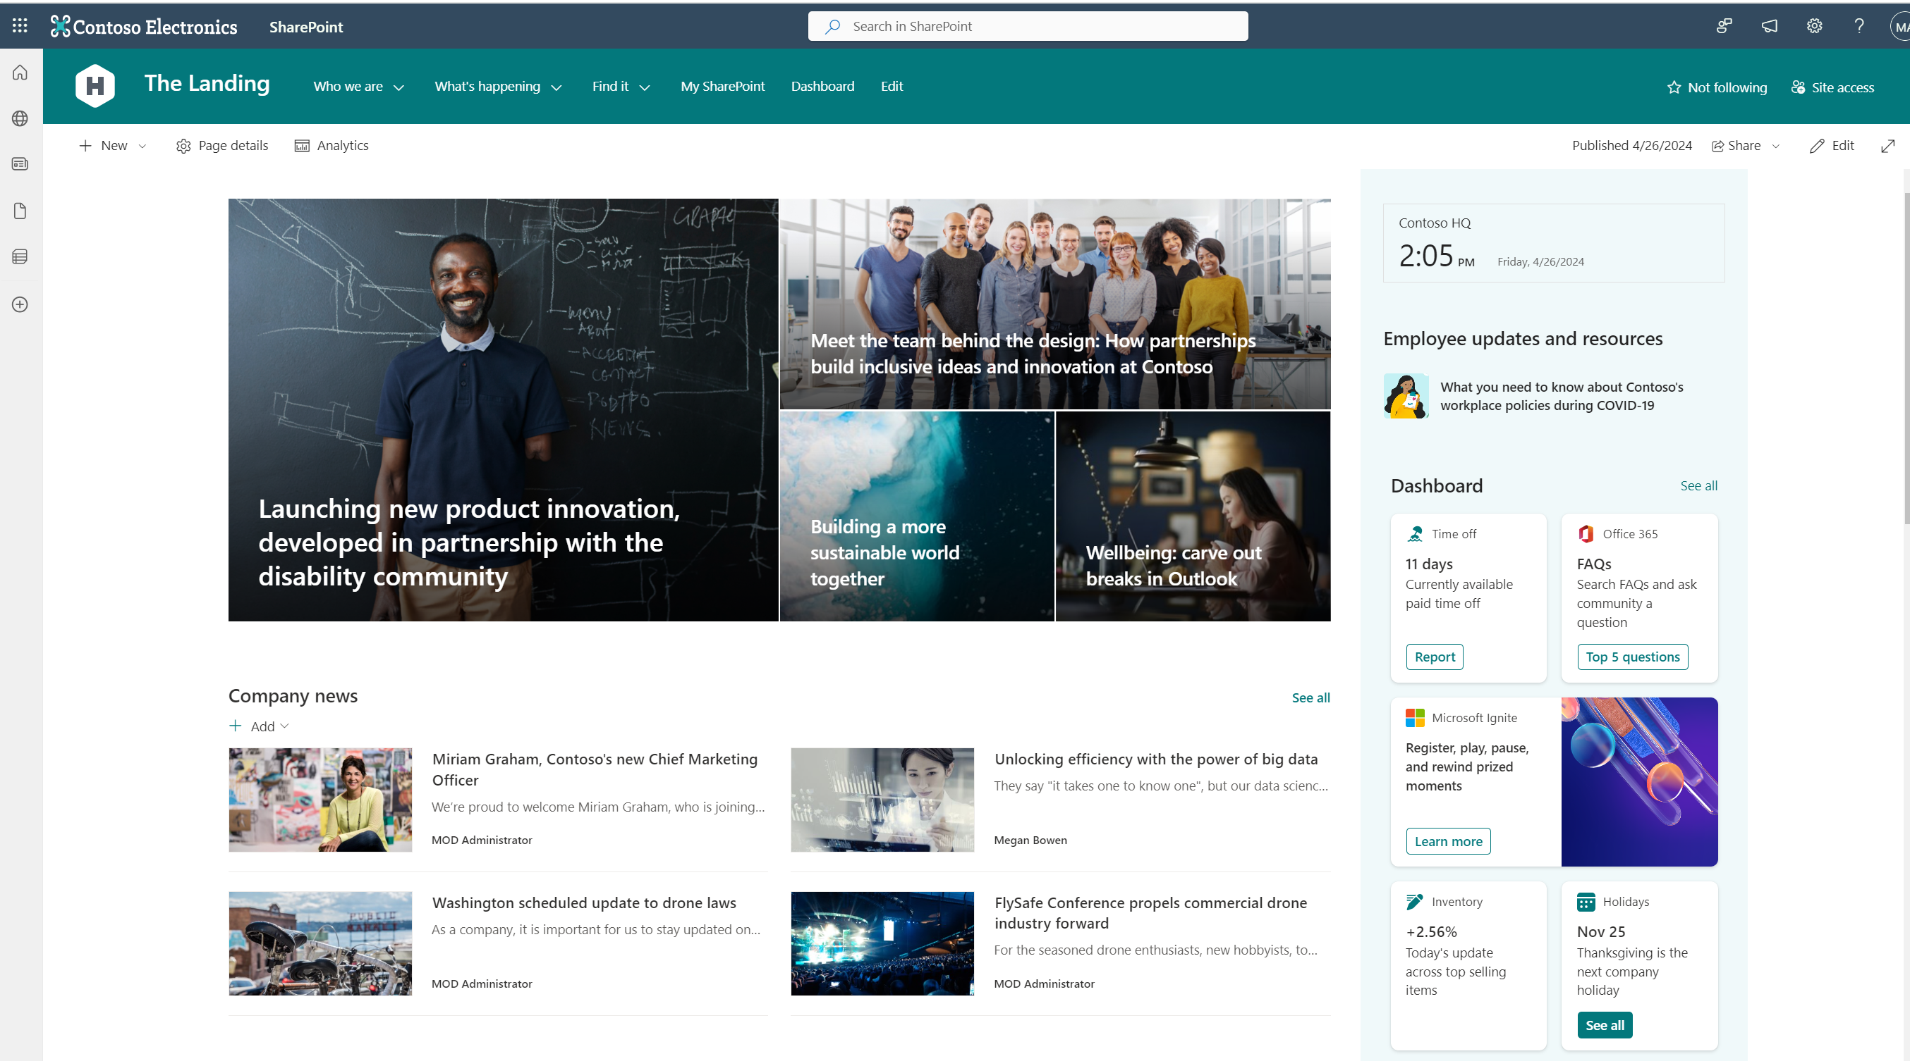
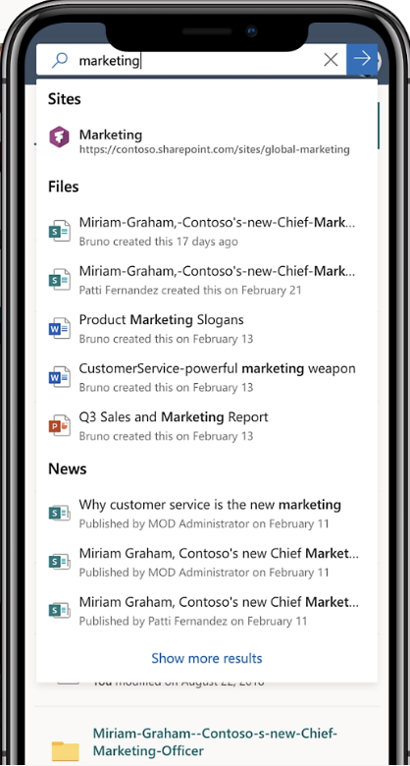
File Management: User vs. Shared Ownership
Employee files
OneDrive for work
Individual Cloud Storage
Employee and non-team file repository
Owned by individual and shared with individuals
Personal file management space - Content NOT intended for wider collaborative sharing
Lifecycle tied to account
PC folder backup sync across all devices, including web, mobile, and desktop .
Team and project files
SharePoint team sites
Collaborative Cloud Storage
Project and team file repository
Owned by team and shared with project team members
Team Collaboration, content management and communication
Any Full Time Employee (FTE) can create and own
Share project documents and collaborate with team members

Slide 15
Asset Governance: Empower Self-Service Collaboration
Employees are empowered to work in a secure, compliant, and managed environment that protects against data loss and oversharing risks
Compliance policies enforced on groups and sites
Dynamic group membership management
Microsoft Information Protection labels in tenant
Labeling is fundamental for self-service in Sites and Groups
We hold our employees accountable for what they create and own.

Slide 16

Plan your Sensitivity Labels: Make Clear and Simple
2
3
Limit your number of labels
Don’t overwhelm with choice.
Each user should see no more than 5 group (parent) labels
Each user should see no more than 5 child labels
Many more scoped labels may exist
Highly Confidential\<Division Only>
Intuitive labels
Cultural awareness is as important as policy enforcement.
Labels must mean what they say
Microsoft’s learned from mistakes here:

Slide 17
Container and File Classification
Highly confidential
The most critical data for Microsoft. Share it only with named recipients.
Confidential
Sensitive business data crucial to achieving our goals. Limited distribution.
General
Business data that is not meant for public consumption, such as daily work product. Data that can be shared internally throughout our organization.
Public
Public data is unrestricted data meant for public consumption, like publicly released source code and announced financials. Share it freely.

Slide 18
Information Protection Container Sensitivity Labels
4
 | Public | Private
Privacy | Membership to Group is open; anyone can join. “Everyone except external guest” ACL on site; content available in search to all tenant. | Only owners can add members. No-access beyond the Group Membership until someone shares or changes permissions
 | Allowed | Not Allowed
External guest policy | Owners (only) can add guests as members to group. Members can share files to “specific people” outside of tenant. | Owners are not allowed to add guest members to group No file sharing to guests
What users will see when they create or label a Team/Group/Site
Parent Label | Child Label | Container/Item Label or Both | External Guest Policy | Privacy Policy Options | Default library label | Default sharing
General |  | Both | Allowed | Private OR Public | General | People in Microsoft
Confidential
 | Internal and NDA external | Container | Allowed | Private | Confidential \ Any User | People in Microsoft
 | Internal Only | Container | Not Allowed | Private | Confidential \ MS Extended | People in Microsoft
Highly Confidential
 | Internal Only | Container | Not Allowed | Private | Highly Confidential \ MS Extended | Specific People

Slide 19
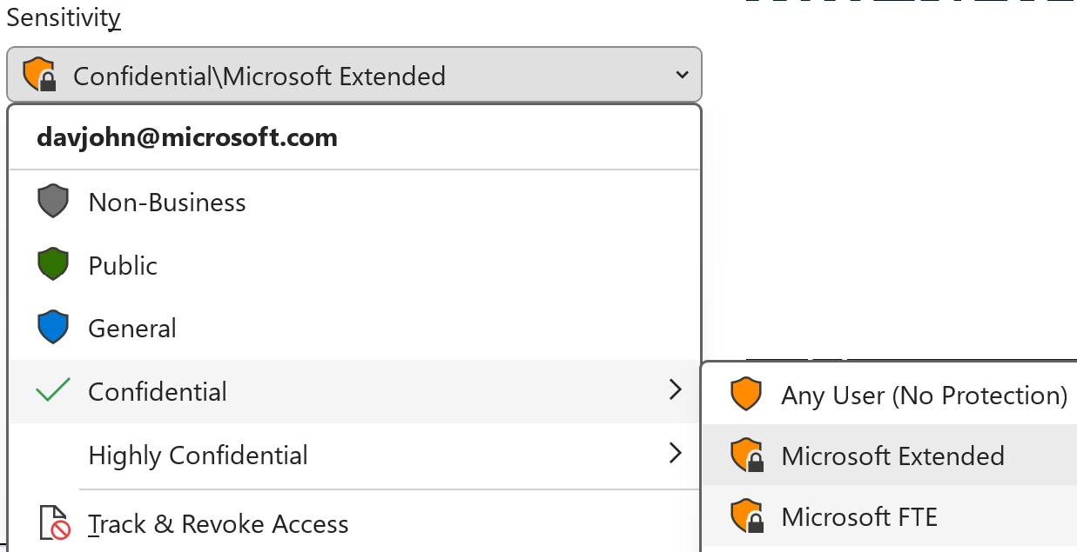
Item Sensitivity labels: Trust and set good defaults
5
Parent Label | Child Label | Container / Item Label | Permissions | Default sharing | DLP limits
Non-Business |  | Item | N/A
Public |  | Item | N/A
General |  | Both | N/A | People in Microsoft | No “Anyone”
Confidential
 | MS Extended | Item | ALL MSFT | People in Microsoft | No “Anyone”
 | MS FTE | Item | MSFTE |  | No “Anyone”
 | Recipients Only | Item |  |  | No “Anyone”
 | Any User | Item |  | People in Microsoft | No “Anyone”
Highly Confidential
 | MS Extended | Item | ALL MSFT | Specific People | No “Anyone”, No external
 | MS FTE | Item | MSFTE | Specific People | No “Anyone”, No external
 | Recipients Only | Item |  | Specific People | No “Anyone”
 | Any User | Item |  | Specific People | No “Anyone”
We are defaulting to labels with protection
SharePoint supports natively, now including User Defined Permissions labels like “Recipients Only”
More file types with protection labels
Loop components

Slide 20

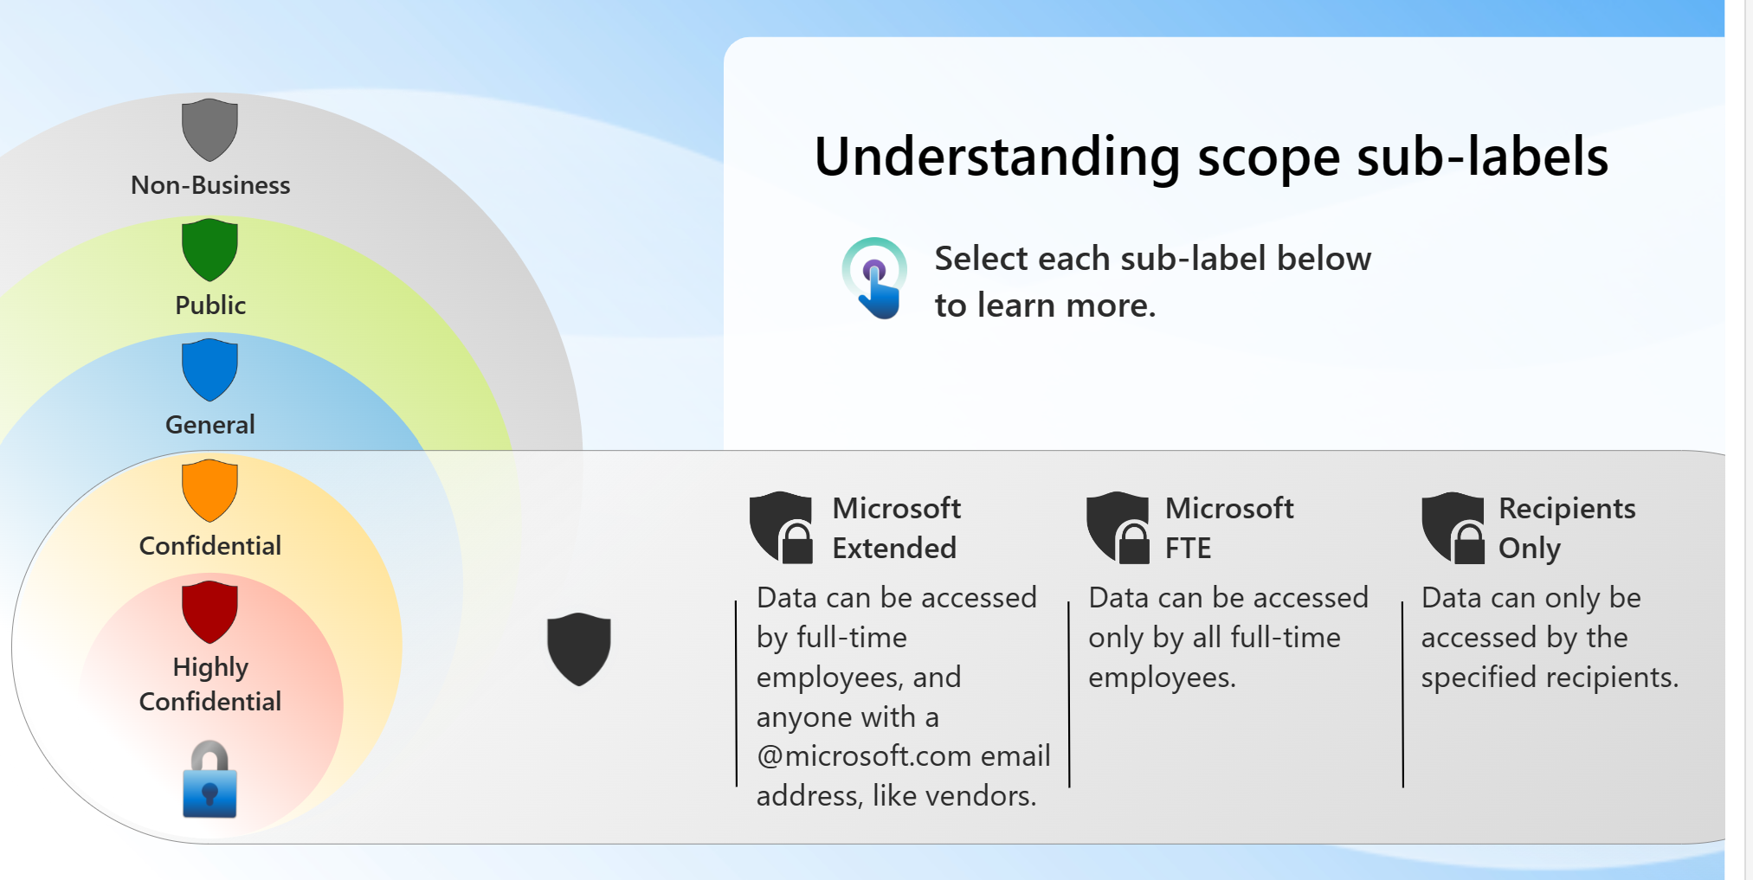
Train your Employees
6
Culture is as critical as policies
Increase accuracy
Ensure they recognize labeling cues across your productivity suite

Slide 21
Label choice
Is the data open to all of Microsoft to see?
Y
N
Is the data sensitive and if disclosed could harm Microsoft, our partners or our customers?
Should only certain named individuals be able to access?
N
N
N
Y
Y
Y
Non-Business
Public
General
Confidential + Scope*
Highly Confidential + Scope*
Data is personal and not business related
Data is for the public and shareable externally
Business data shared with trusted individuals
Sensitive business data shared with trusted individuals
Data must be secret or in some way highly critical
*SCOPE OPTIONS
Recipient Only | Visible only to the specified recipients and actions with file/email are restricted
Microsoft FTE | Visible to all full-time employees
Microsoft Extended | Visible to FTE + non-FTE
Notes:
Sensitivity labels allow you to classify and organize data based on sensitivity and compliance requirements. Labels can be applied manually or automatically, helping to enforce data protection policies and streamline data management practices. So which label should you use?
Explain sensitivity labelling decision tree & highlight link to MS Protect resources.

Slide 22
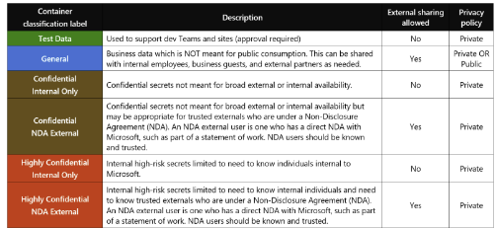
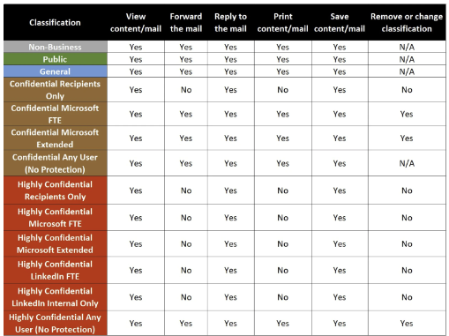
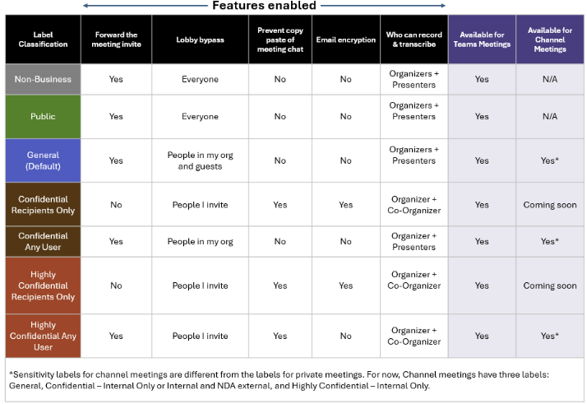
Sensitivity Labels
Container Label
Content Label
Teams Meetings Label

Slide 23
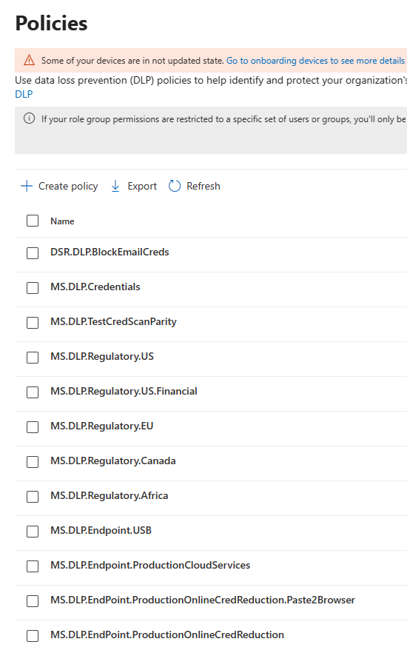
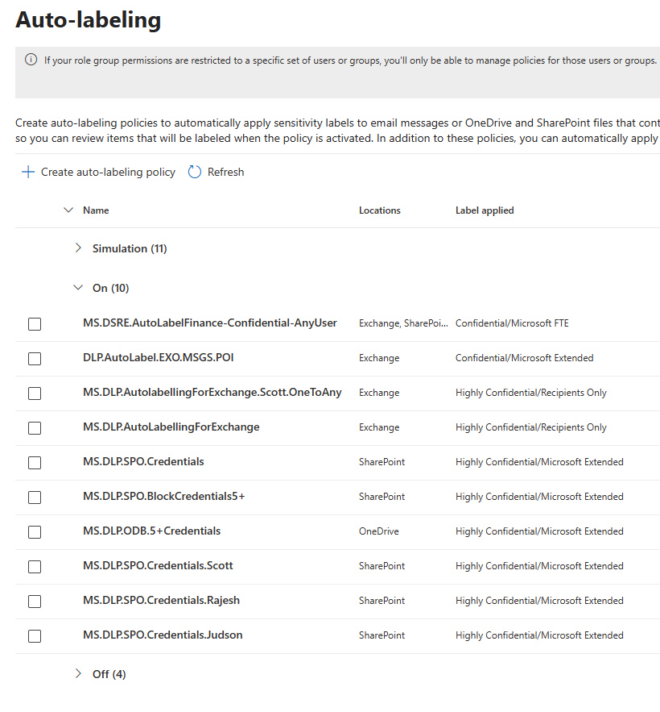
Trust but Verify Sensitivity Labels
7
Catch the 1% case with DLP
Trust your employees to apply sensitivity labels but also verify them.
Check against data loss prevention standards
Use auto-labeling and quarantining through Microsoft Purview automation.
We have exception groups where we can exempt employees.

Slide 24
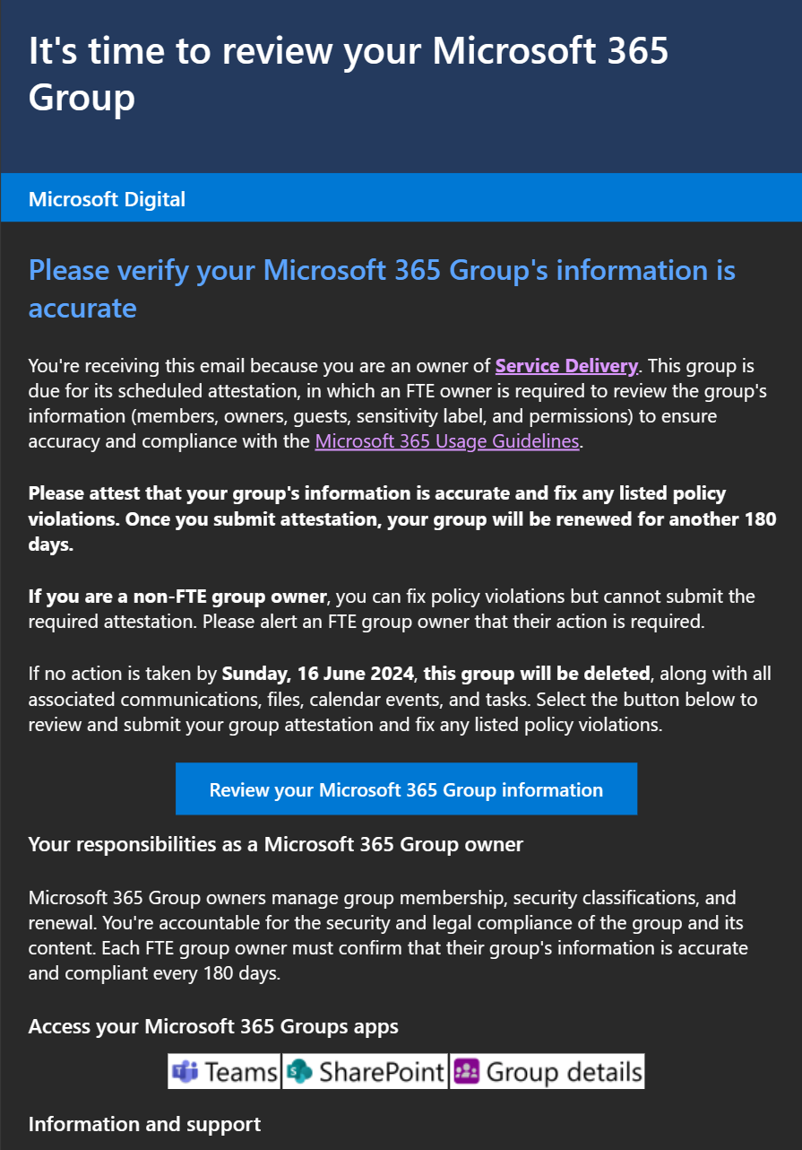
Implement Lifecycle Management and Enforce Policies
8
Enable self-service site collection & group creation
Any Full Time Employee can create
Collect sensitivity label for all containers
Set public vs. private
Guest membership & External sharing allowance
User awareness: display classification – Culture is critical
Enforce Group naming rules
Usage guideline visibility
Life cycle: 6-month expiry
Create a chain of accountability
Entra Group Expiration policy
SharePoint Premium inactive sites attestation
Custom solution: Attestation based expiration, 2 owner policies
External Membership life cycle: Enforce external renewals (SharePoint, Entra Groups)
Ownerless (Orphan) Groups

Slide 25







Rule-Based Memberships
Rule based memberships are critical to ensuring you know who has access.
In product: Entra Dynamic Groups
Custom solution: Group Membership Management (GMM)
GMM is an open-source, Azure-based solution that updates Groups’ membership. Microsoft uses GMM as a custom tool to supplement Entra’s management capabilities.
Example: Populate group based on Org structure, HR attributes, and Existing group(s)
Membership Management
Viva Connections, SharePoint
Offer employees a customized dashboard experience and
implement relevance-based information access
Outlook Groups
Empower leaders to connect with employees via email using targeted recipient criteria, including location, discipline, employee type, level, and any other relevant criteria.
Teams
Enable Teams owners to efficiently manage Teams and private channel members to facilitate effective collaboration.
Viva Engage
Provide Engage community owners with a way to manage community members and support for audience targeting groups
Copilot
Robust group membership management enhances security and safeguards Copilot-generated content within trusted circles, bolstering data protection
GMM GitHub repo is available to the public: Https://github.com/microsoftgraph/group-membership-management-tenant
Learn more for installation support: GMM inquiries <GMMinquiries@microsoft.com>

Slide 26
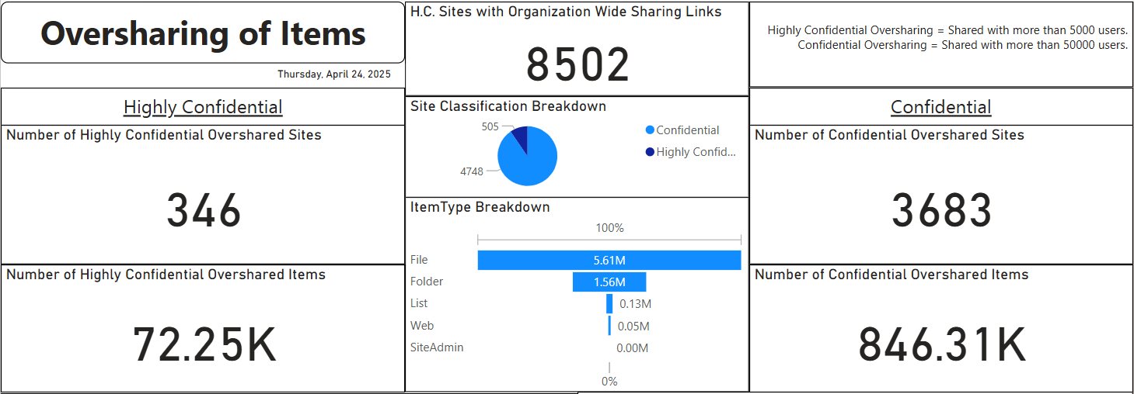
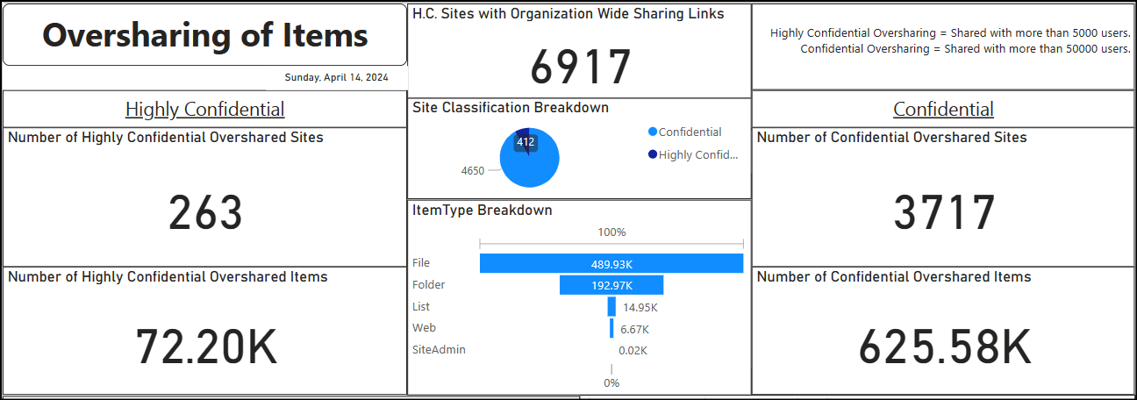
Extract Inventory and Report Oversharing: Know your Risk
10
Extract all Groups, Group Memberships, sites, files – via Microsoft Graph Data Connect.
Connect different onboarded datasets in our data estate with Microsoft Fabric.
Track how many SharePoint sites and items are overshared based on our business rules.​
Track our improvement over time as we enforce these policies on our assets.
This reporting has been built out as a published template
Oversharing for Very Large Tenants - Microsoft Community Hub
Reports now in SharePoint Advanced Management without the need for big data processing.

Slide 27

Copilot for Meetings
How do we protect?
Recording policies

Slide 28
Meeting Policies
Transcript attribution opt-out gives employees agency and reassures them that we honor their privacy.
User notices alert employees when a recording or transcription starts, allowing them the opportunity to opt out, request that the meeting go unrecorded, or leave the call.
Nuanced business guidance from legal through an internal Recording Smart Use Statement document helps employees understand the implications of recording, when not to record, and when not to speak in a recorded call.
Recommending that employees “tell and confirm” before recording empowers and supports our people to speak up when they don’t believe the meeting should be recorded or don’t feel comfortable.
Meeting labels and templates that limit who can record mean only the organizer or co-organizer can initiate recordings for meetings labeled “Highly Confidential” or special meeting types.
Only meeting organizers can download meeting recordings to keep the meeting data contained and restrict sharing.
The default OneDrive and SharePoint meeting expiration is set to 90 days to ensure we minimize the risk of data leakage or cloud storage bloat.
Related article: Enabling and Securing Microsoft Teams Meeting Data Retention at Microsoft - https://aka.ms/msd-meetingdata

Slide 29
Agent Governance

Slide 30
Copilot is the UI for AI
Copilot
Agents
Copilot Control System
Notes:
At Ignite, we introduced our vision and strategy for Copilot + Agents.
It all starts with people and human ingenuity.
We envision every employee having a Copilot – their trusted AI assistant. Copilot understands you and your work context, and it provides a consistent user experience to interact with AI.
Agents augment Copilot by adding skills and knowledge to automate tasks and business processes.
Our ambition is to empower every employee with a Copilot and to transform every process with agents.
Importantly, we provide governance and controls for data protection, agent management, and the reporting needed to measure business outcomes. This is what we announced at Ignite as the “Copilot Control System”.

Slide 31

How is generative AI changing work @ Microsoft?
Augmenting creativity & quality
Expanding productivity
Finding information & answers
Defragmenting the employee experience
Copilot is accelerating invention & enhancing expression. It can immediately generate options that save time and help our employees to express big ideas.
Copilot is helping our employees to be more productive by confronting information overload and accelerating routine tasks like producing meeting recaps or summarizing their inbox.
Copilot is our employee’s hyper-intelligent assistant that helps with research & prototyping. Enterprise knowledge that was previously locked away in siloes is now easily discoverable by all.
Copilot is Microsoft’s UI for AI. It’s helping us to defragment our environment so employees can quickly find what they need then take action.
A Whole New Way of Working (microsoft.com)
Notes:
Slide Summary:

Slide 32
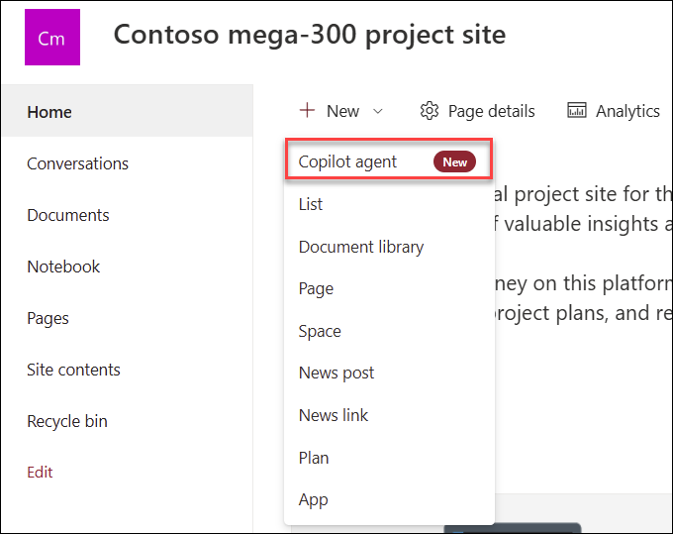
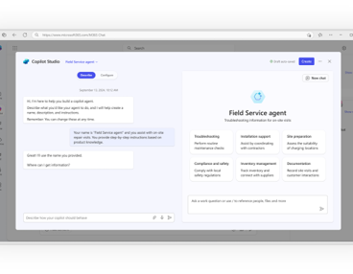
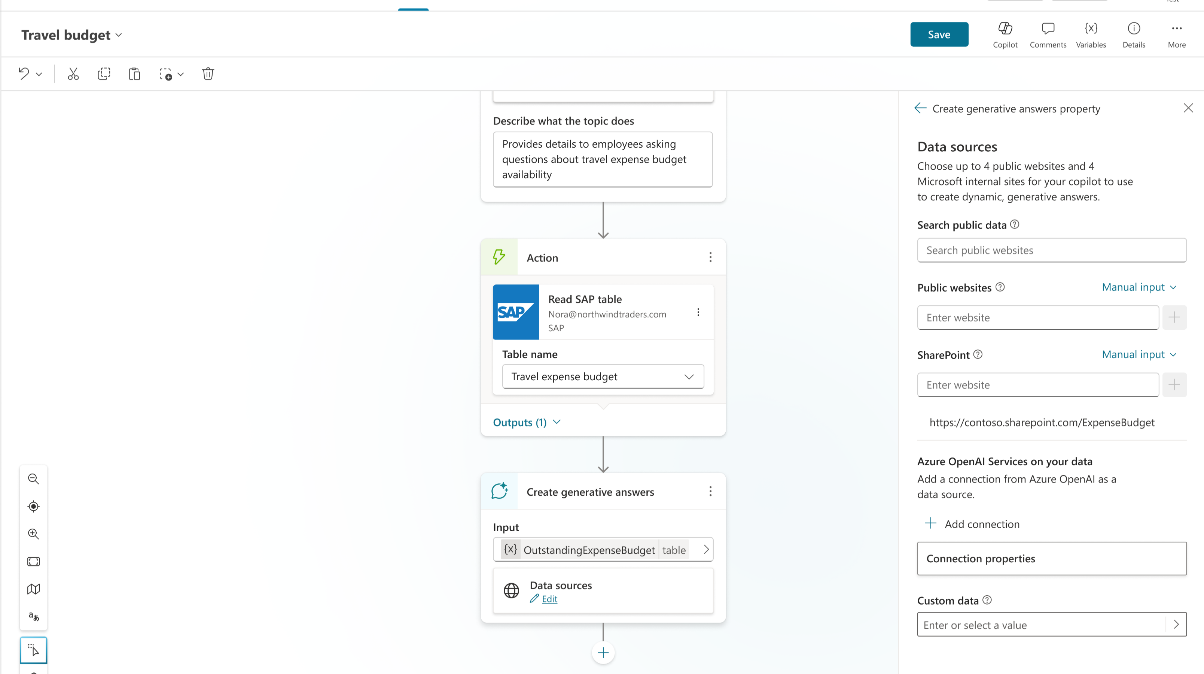
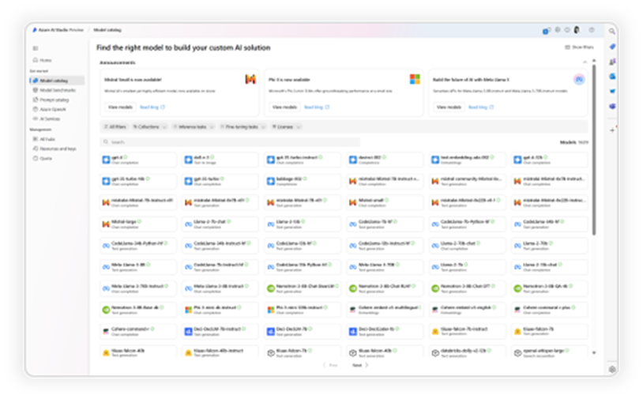




Advanced agents require more advanced governance and security
Simple agents: No IT gating
Complex agents: Same as Pro Dev apps
Simple
Advanced
SharePoint
Agent builder
Copilot Studio
Copilot Studio + Azure AI
For End Users
For End Users
For Makers
For Developers
Knowledge
Microsoft Graph
Your Business Data
Actions
Retrieval Only
Task / Autonomous
Channels
Microsoft 365 Only
Multiple Internal & External Channels
Increasing advanced governance and security needs throughout agent lifecycle
1. Development & Testing
2. Deployment
3. Optimization
Notes:
We have all heard different shades of customer pain points with our current PPAC experience and these pain points touch every single stakeholder across the organization –
The CIO, COE and Power Platform practice leads who need a better way to manage their environments, governance, visibility & policy features
The CISO who are concerned about the way security is handled across solutions
And the enterprise architects who are concerned about scalability.

Slide 33
Power Platform Governance

Slide 34



Environment Groups
Personal Productivity
Team Collaboration
Enterprise Development
Personal Developer Environments
Dataverse for Teams Environments
Sandbox &
Production Environments
Self or auto-provisioned
Single owner, no sharing
Most M365 1st party connectors allowed; certain actions blocked
Inactivity-based lifecycle
Self-provisioned
Access tied to M365 Group label
Most 1st party connectors allowed; certain actions blocked
Inactivity-based lifecycle
Request process for provisioning
Additional management policies & compliance reviews
All 1st party connectors allowed by default, custom policies by request
Attestation-based lifecycle
Lower risk
Higher risk

Slide 35
Connectors – What we Allow
Agent Builder
Personal Agents
Enterprise Agents
AI Knowledge Sources and Graph connectors allowed; data stays on-tenant
Simple agents; ungated sharing
Most 1st party connectors allowed; certain actions blocked
Single owner, no sharing
Connectors: M365 (1st Party), Power Platform, AI Knowledge Sources, Data & Analytics, DevOps, Limited Public
All 1st party connectors allowed by default, custom policies by request
Sharing limits apply on sandbox & production environments
Security & Compliance reviews to share or publish broadly
Lower risk
Higher risk

Slide 36
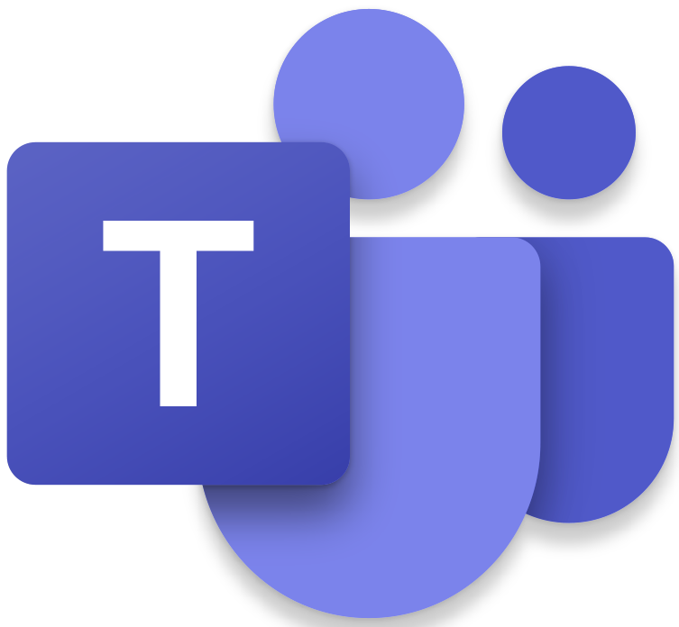



M365 App & Agent Management
Streamline and unify lifecycle management and governance process for apps, add-ins and agents across M365
Types by publisher: Microsoft, Line of Business, Third-party
Data access through Graph
New 3P apps are off by default
3P must be Microsoft 365 Certified
Licensing, procurement and 3P governance approved
Teams “Request an app” configured to IT intake form
User self-consent is disabled within the Microsoft tenant
Apps consuming Microsoft 365 Graph APIs vetted for least privilege consents
Teams Resource-Specific Consents are scoped to label
Custom (Line of Business) apps
Submitted into IT intake form
Vetted for security, privacy, RAI & accessibility impact, code reviewed when required
Deployed with SG to scope to required audience
Partner (Third-party) apps
Notes:
We’ve been actively working to break down service management silos and separate governance processes. Our approach views M365 apps, add-ins, and agents as unified capabilities that deliver value to the organization. From a governance perspective, they share a common foundation: all are designed to enhance employee productivity and business operations while securely processing and managing M365 data.
There’re few major things that we do: We protect our data by disabling user self-consent in Graph API. Each service requiring consent is validated to ensure minimal permissions. Business applications are published after thorough review. New partner apps are disabled by default and must have M365 Certification to proceed through onboarding.

Slide 37
Adopt Copilot and Agents: Essential IT Responsibilities
Data hygiene foundation so you can trust your data estate as employees build/use agents.
Empower employees to build personal agents with access to services and data sources employees already have access to – help automate and accelerate employee tasks.
Empower businesses to quickly build agents with known lower risk patterns to accelerate business.
Enable engineering teams with a smooth path to develop agents against all of the services & sources they need with a path to release to the company.
Accelerate innovation through agent and automation templates and a Center of Excellence to help businesses think through their opportunities.
Re-imagine employee experiences and task execution to simplify and optimize employee productivity.

Slide 38

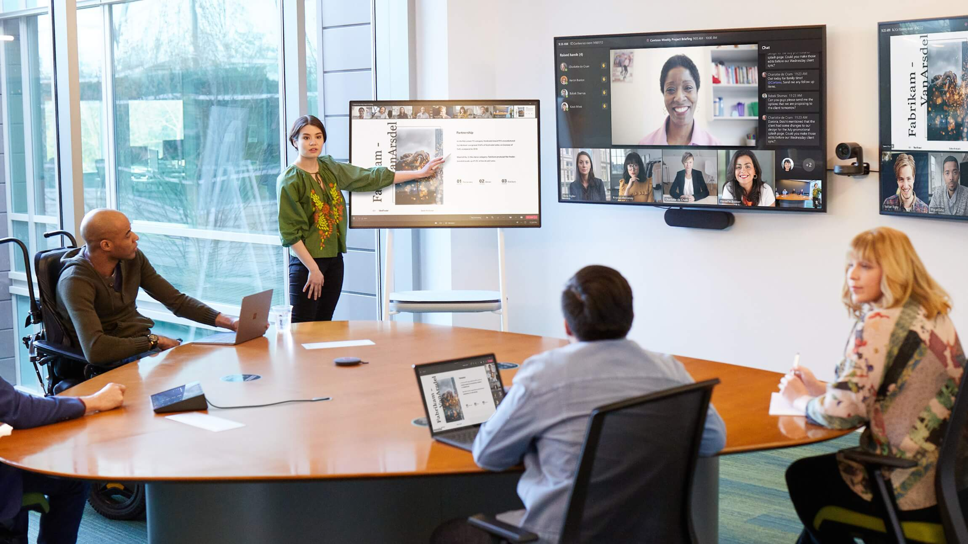


How Microsoft Does IT – Inside Track
Copilot & AI
Teams & SharePoint
Tenant Trust
Microsoft 365
How we’re tackling Microsoft 365 Copilot governance at Microsoft
How we’re embracing agents at Microsoft
Unlocking deeper AI value with Microsoft 365 Copilot extensibility
Unlocking enterprise AI extensibility at Microsoft with Copilot Studio
Deployment and adoption guide for Microsoft 365 Copilot
Powering a generational shift in IT at Microsoft with AI
Responding to the AI revolution with an AI Center of Excellence
Enabling and Securing Microsoft Teams Meeting Data Retention at Microsoft
Recapping Our Meetings at Microsoft with AI and Microsoft Teams Premium
Advancing your meetings with the Microsoft Teams Meeting Guide
Transforming how we work in Microsoft Teams Premium with Microsoft 365 Copilot
Generating Great Results: Administering Search at Microsoft
Deploying Microsoft Teams across Microsoft hinged on good governance
Enabling and securing Microsoft Teams meeting data retention
Empowering employees with the Microsoft Power Platform at Microsoft
Sensitivity Labeling Secures Meetings in Teams Premium
Microsoft creates self-service sensitivity labels in Microsoft 365
How we’re using sensitivity labels to make Microsoft more secure
How a data council is powering our unified AI data strategy at Microsoft
Transforming Data Governance at Microsoft with Purview and Fabric
A foundation for modern collaboration: Microsoft 365 bolsters teamwork
Transforming change management at Microsoft with Microsoft 365
How Microsoft moved its large meetings online with live events in Microsoft 365
Measuring employee user enablement at Microsoft with the Microsoft 365 admin center
Democratizing usage data in Microsoft 365 Admin Center
Reinventing Microsoft’s Employee Experience for a Hybrid World
Learn from the experts… https://aka.ms/insidetrack

Slide 39
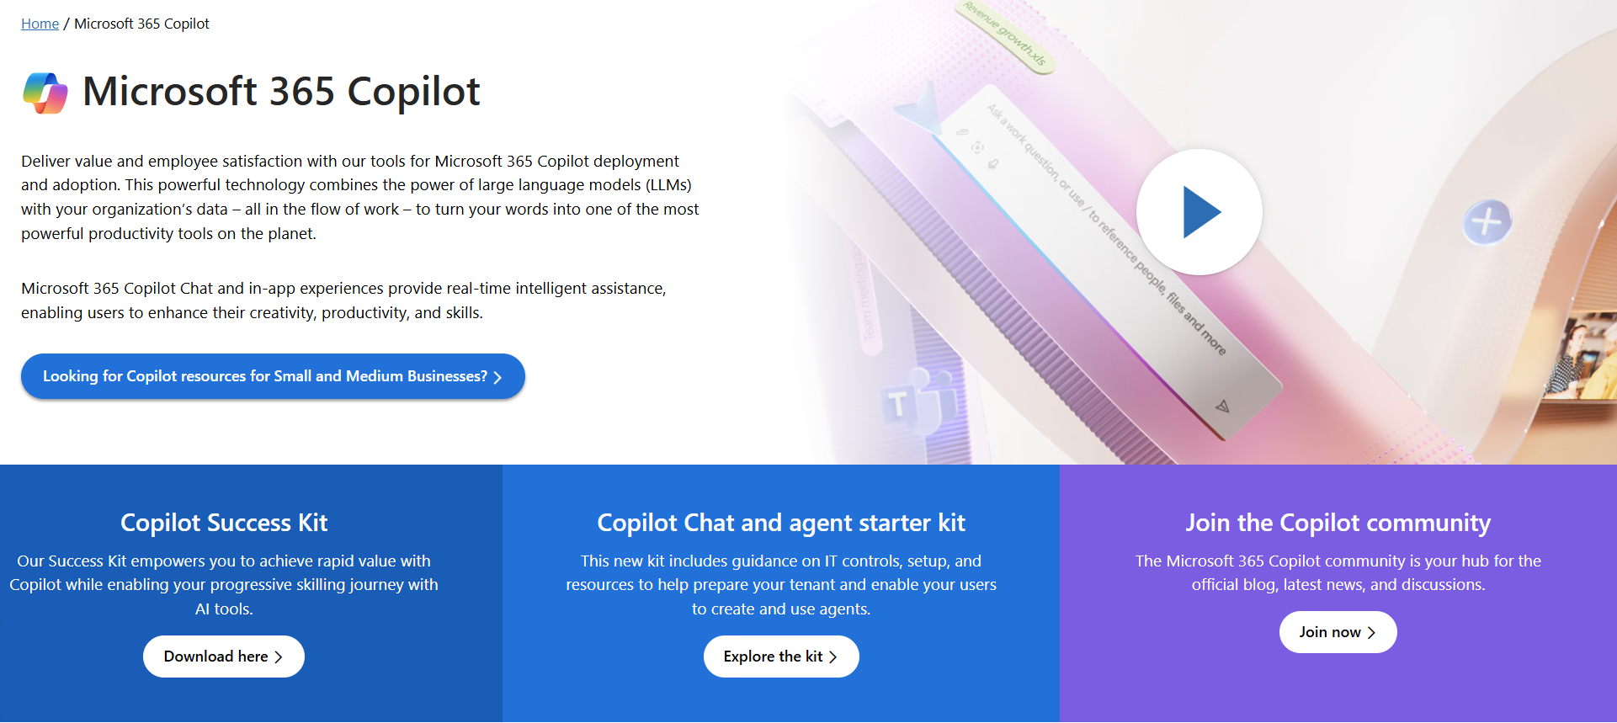
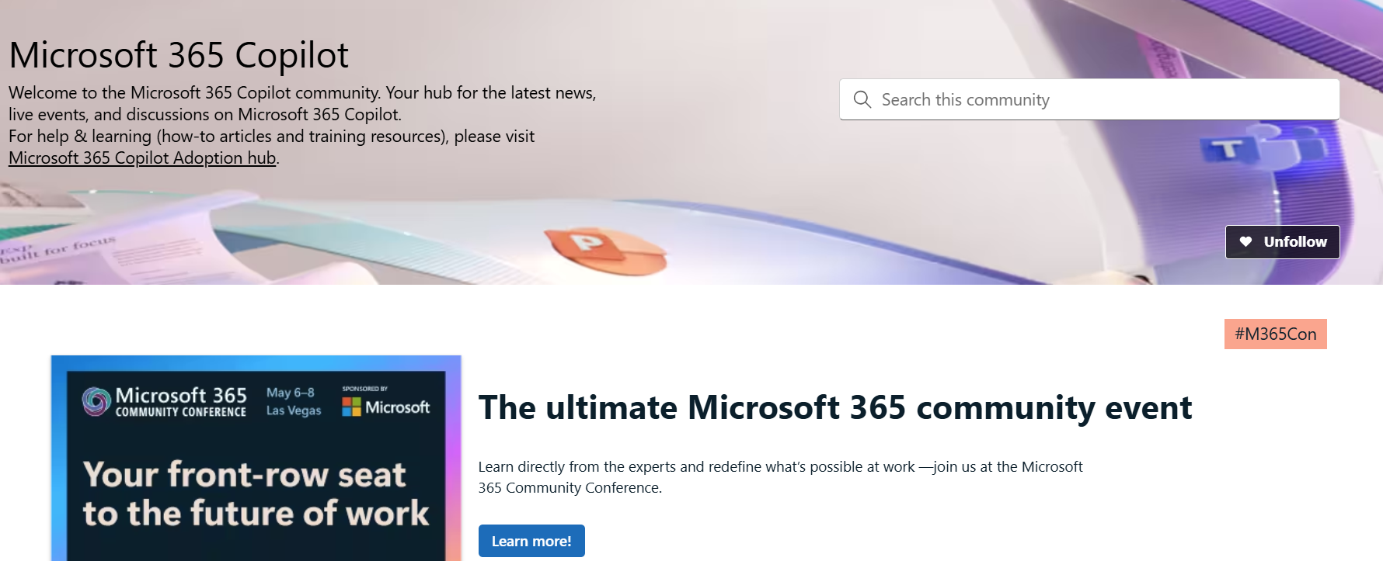
News & community content
Microsoft Community Learning aka.ms/Community/LearningChannel
Community led expert content on all your favorite Microsoft services.
Start your week with live news and event updates aka.ms/MondaysatMicrosoft
Watch live or on-demand & share our blog.
Notes:
To help you with adoption, the Copilot Readiness Hub is an open one stop shop for content, organized by role for your Copilot for Microsoft 365 journey.
You can use its recommendations to prepare and plan for your deployment, create a user experience strategy as I’ve presented today, and an adoption plan.
And as Copilot continues to evolve, keep coming back for new content that is published regularly.
You can also join the Copilot for Microsoft 365 community to get your questions answered and meet others who are leveraging Copilot for Microsoft 365 right now.

Slide 40
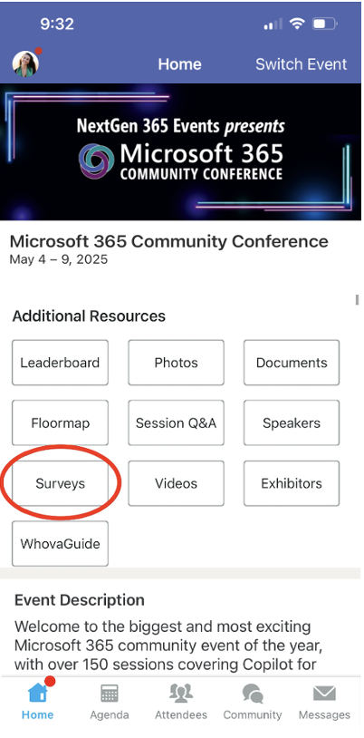
Session feedback surveys
We want to hear from YOU!
Share your feedback to make next years conference even better!
Here’s how –
Simply go to the Whova App on your smartphone.
Scroll down on the M365 Community Conference Homepage to ‘Additional Resources’ to click “Surveys’.
Click Session Feedback.
Scroll down to find this session title.
Complete the session feedback survey.
Finally, click ‘Submit’.
It’s just that easy!

Slide 41
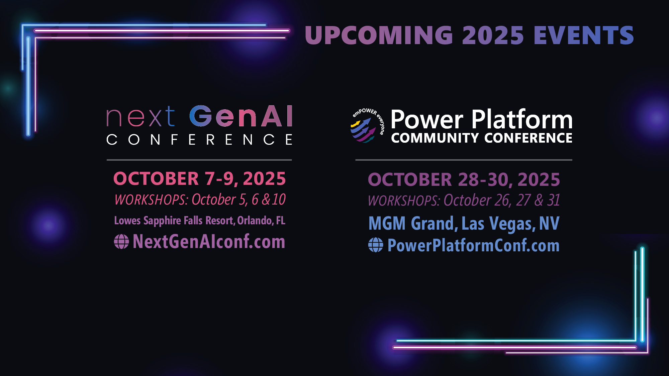
Upcoming conf

Slide 42
Our enterprise AI commitments
1
2
3
4
5
Your data is your data
Customer Copyright Commitment
Our approach to privacy and Responsible AI
Secure Future Initiative
Sustainability by design
Responsible AI principles
Notes:
And Microsoft runs on trust. We are committed to security, privacy, and compliance across everything we do, and our approach to AI is no different.
Trust has been a fundamental promise we have built into the Microsoft Cloud since the very beginning.
Data is the fuel that powers AI technology – and you need to trust what your technology partners are doing with your data.
First, your data is your data. It is not our data. It is your data. That means it is yours to own and control. Your data to choose how you want to leverage and monetize.
Your data is not used to train or enrich the foundational AI models used by others without your permission, so you don’t have to worry about anyone other than your organization benefiting from AI that is trained on your data.
And your data and AI models are protected at every step by the most comprehensive enterprise compliance and security controls in the industry.
You’re also protected through our customer copyright commitment.

Slide 43
Tenant Governance: Roles & Needs
Business
Accomplish business goals
Accelerate revenue
Limit business disruption
Employee
Make it easy for me to get my work done fast
Let me share easily, but protect my confidential data
MS Digital
Privacy & Legal
Follow retention
Support eDiscovery
Works Council
IT Admin
Manage the increasing volume of data
Keep up with changing services and threats

