Slide 1
Copilot for All - Practical AI Agent Solutions and Scenarios From Corporate to the Frontline to Transform Your Business | MS33
Connie Welsh – Sr Dir Copilot, Teams and Modern Work Solution Sales
Kensington Schmidt – Frontline Worker Global Blackbelt
Sarath Rangu – M365 Global Blackbelt
May 8, 2025

Slide 2


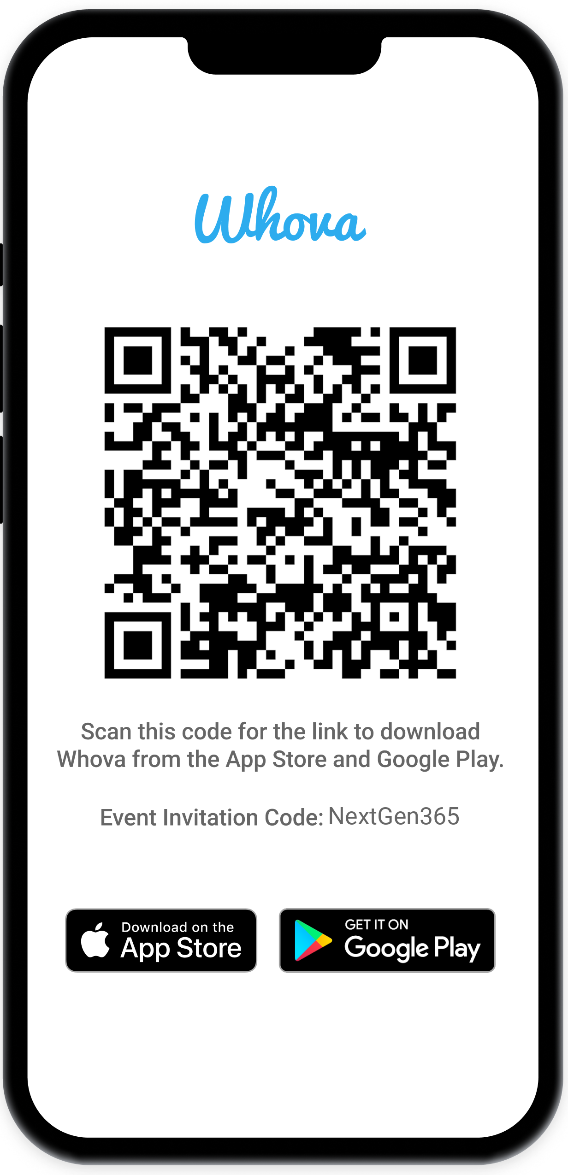
Join the event app to access:
The official event app for the
Microsoft 365 Community Conference
Event invitation code: NextGen2025
Event announcements
Personalized agenda, session details
Speaker & attendee profiles
Networking, meet-ups, messages
Event documents

Slide 3
Session Overview
Getting started! Using agents in the flow of work to improve business processes quickly and easily
Copilot is for everyone! Integrating agents in a simple, smart frontline experience above and beyond your enterprise users
See the value! Use cases from the real world across multiple industries and tangible benefits
Notes:
Connie - Opening and UI for AI - 3 mins
Kensington - Mad Men analogy 5 mins
Connie – Agents in the flow of work - 7 mins
Kensington –Agents in frontline – 25 mins
Sarath – use cases from the real world and industry – 18 mins
Connie – Close – 2 mins

Slide 4





Connie Welsh
Sr Dir – Americas Sales
/conniee
//
Kensington Schmidt
Global Black Belt
Frontline Workers
/kensingtonschmidt
Sarath Rangu
Global Black Belt
Commercial Solution Area

Slide 5
Copilot is the UI for AI
Copilot
Agents
Copilot Control System
Notes:
At Ignite, we introduced our vision and strategy for Copilot + Agents.
It all starts with people and human ingenuity.
We envision every employee having a Copilot – their trusted AI assistant. Copilot understands you and your work context, and it provides a consistent user experience to interact with AI.
Agents augment Copilot by adding skills and knowledge to automate tasks and business processes.
Our ambition is to empower every employee with a Copilot and to transform every process with agents.
Importantly, we provide governance and controls for data protection, agent management, and the reporting needed to measure business outcomes. This is what we announced at Ignite as the “Copilot Control System”.

Slide 6
Work Trend
Index 2025
We surveyed 31,000 people across
31 countries, analyzed labor and hiring trends from LinkedIn, studied Microsoft 365 productivity patterns globally—and interviewed AI startups, economists,
and academics shaping the future of work.
Notes:
Like years past, the WTI draws on a global survey, Microsoft 365 telemetry, and hiring and labor trends from LinkedIn.
But new this year are insights from in-depth conversations with AI startups, economists, scientists, and academics.
Taken together, these data and insights help us understand of how knowledge work is evolving—and what every company needs to do to adapt.

Slide 7

The Frontier Firm
Notes:
We are entering a new reality—one in which AI can reason and solve problems in remarkable ways.
This on-tap intelligence will rewrite the rules of business and transform knowledge work as we know it.
Organizations today must navigate the challenge of preparing for an AI-enhanced future. One in which AI agents will have increasing levels of capability over time that humans will need to harness as they redesign their organizations.
Human ambition, creativity, and ingenuity will continue to create new economic value and opportunity as we redefine work and workflows. As a result, a new organizational blueprint is emerging, one that blends machine intelligence with human judgment, building systems that are AI-operated but human-led.
As with the Industrial Revolution and the internet era, this transformation will take decades to show its full promise and involve broad technological, societal, and economic changes. Frontier Firms are already taking shape, and within the next 2–5 years we expect that every organization will be on their journey to becoming one.
82% of leaders say this is a pivotal year to rethink key aspects of strategy and operations.

Slide 8



Journey to the Frontier Firm
Phase 1
Human with assistant
Phase 2
Human-led agents
Phase 3
Human-led, agent-operated
Every employee has
an AI assistant that
helps them work better and faster
Agents join teams as “digital colleagues,” taking on specific tasks at human direction
Humans set direction and agents run entire business processes and workflows, checking in as needed
Notes:
Every company’s experience will be different, but we see this journey playing out in three phases: <click>
In the first phase, AI acts as an assistant, helping people do the same work better and faster. <click>
In phase 3, agents join teams as “digital colleagues,” taking on specific tasks at human direction—for instance, a researcher agent creating a go-to-market plan. <click>
And in phase 3—people set direction for agents that run entire business processes and workflows, checking in as needed.
Picture how a supply chain role may change: with agents handling end-to-end logistics, while humans guide the agent system, resolve exceptions, and manage supplier relationships. Human work isn’t replaced, it’s elevated.
This won’t be a linear journey, and many companies will be in all three phases simultaneously..

Slide 9

But what does this really mean?

Slide 10

Everything you needed to know about agents you learned from Mad Men!

Slide 11

Refresh my memory?
Mad Men is a TV series set primarily in the 1960s and early 1970s, beginning at the fictional Sterling Cooper advertising agency on Madison Avenue in Manhattan, New York City.
Centered initially on Don Draper, an ad executive, and several of his coworkers.
One key coworker was Peggy… and she is the center of our story.

Slide 12





Journey to the Frontier Firm through the lens of Peggy’s Journey on Mad Men
Phase 1
Human with assistant
Phase 2
Human-led agents
Phase 3
Human-led, agent-operated
Every Don has a Peggy that
helps them work better and faster.
She’s smart. She’s capable. Don couldn’t live without her.
She does a lot of the drudgery from paperwork to notes. She keeps Don on task.
Peggy joins the team as a copywriter.
She works on specific tasks at the direction of Don and helps build his pitches.
Don sets a direction, but Peggy runs the entire business processes and workflows, checking in as needed.
She’s even got other Peggys to help.
Notes:
Every company’s experience will be different, but we see this journey playing out in three phases: <click>
In the first phase, AI acts as an assistant, helping people do the same work better and faster. <click>
In phase 3, agents join teams as “digital colleagues,” taking on specific tasks at human direction—for instance, a researcher agent creating a go-to-market plan. <click>
And in phase 3—people set direction for agents that run entire business processes and workflows, checking in as needed.
Picture how a supply chain role may change: with agents handling end-to-end logistics, while humans guide the agent system, resolve exceptions, and manage supplier relationships. Human work isn’t replaced, it’s elevated.
This won’t be a linear journey, and many companies will be in all three phases simultaneously..

Slide 13

The moral of the story?
All of this has happened before.
All of this will happen again…
Wait, wrong show…

Slide 14


Copilot
Agents
Human augmentation
Connected to Copilot or autonomous
Private, Personal Assistant
Automates tasks and processes
People 1:1 Copilots
People 1:N Agents
Copilot Studio
Used to create or configure agents

Slide 15



Spectrum of agents
Simple
Advanced
Retrieval
Retrieve information from grounding data, reason, summarize, and answer user questions
Task
Take actions when asked, automate workflows, and replace repetitive tasks for users
Autonomous
Operate independently, dynamically plan, orchestrate other agents, learn and escalate
Generally available
Generally available
Preview
Agents vary in levels of complexity and capabilities depending on your need
Notes:
Agents exist on a spectrum. Different organizations are at different stages of their AI transformation. Some are advanced and building the next generation of agents with autonomous capabilities. Others are still building out their AI agents to focus on retrieval and task experiences bringing their knowledge and automations into their agent experiences.
These descriptions are not official technical names for your agents. They are used to describe the capabilities that your agent may possess. All agents have the same set of components; however it is down to the makers use case and complexity that dictates where it sits across this continuum.
We recognize that agents has been an industry term used over the years. In 2024, it is mostly associated with the right side of autonomy. We believe everything is an agent and that they live on a spectrum of capability.
Retrieval: Designed with specific instructions on how to behave, their personality, and their overall objectives. They follow predefined rules and guidelines set by the creators.
Task: connected to specific workflows or processes. They operate based on knowledge, skills, and rules based automation. Their primary purpose is to automate repetitive tasks.
Autonomous: Operate independently, dynamically planning and learning from the processes. They adapt to changing conditions and make decisions without constant human intervention.

Slide 16



Explore a continuum of solutions
IT Helpdesk agent
Device Refresh agent
Lead Gen agent
How do I connect to the corporate network?
Request a new laptop and send approvals via IT Service tool.
The agent has identified and researched 15 new leads for you to review.
Simple
Advanced
Project Tracker agent
Budget Management agent
Customer Support agent
What is the status of phase 2 for project X and the remaining budget?
Review outstanding open PO’s and begin financial planning.
The agent has identified new support issues and triaged to other agents.
Notes:
To reiterate, agents can sit along this spectrum. These examples showcase some of the differing levels of use cases and where they would sit.
From simple knowledge base queries, all the way to complex multi-agent workflows for service.

Slide 17
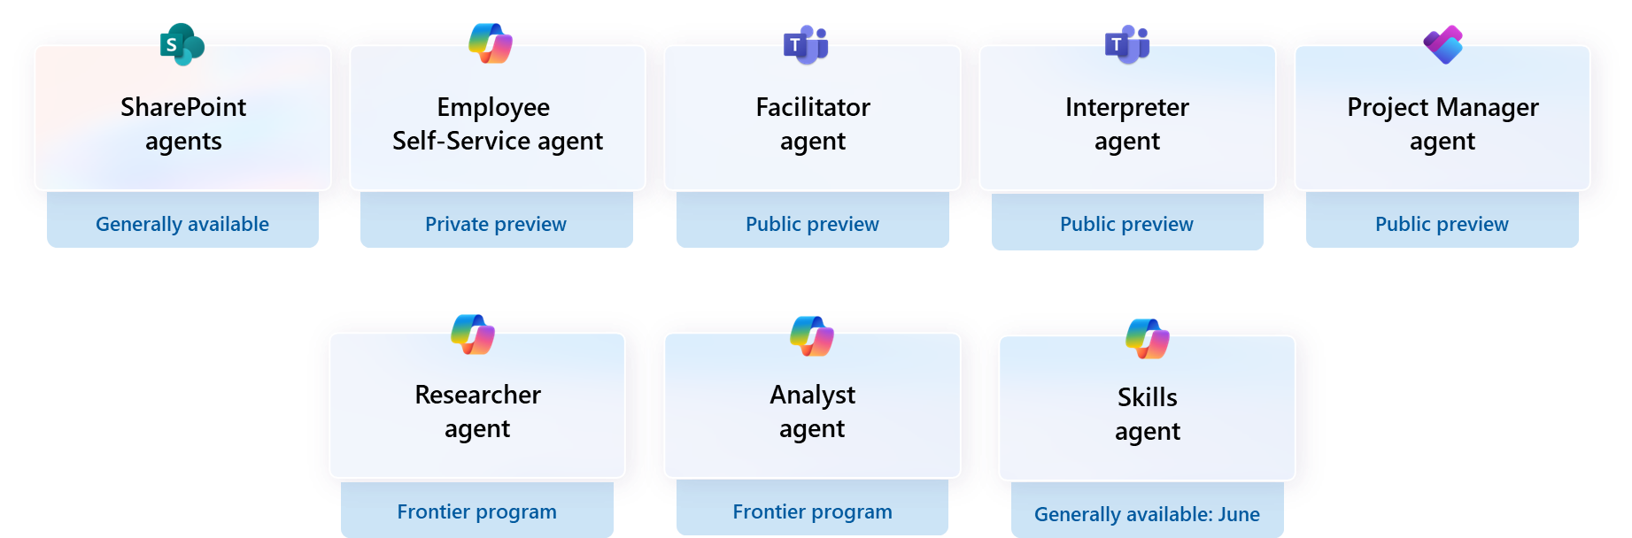
Agents in Microsoft 365

Slide 18






Our agents ecosystem
1st party
3rd party
Custom
SharePoint
agents
Interpreter
Facilitator
Project
Manager
RFP Helper
Campaign Performance
CSA Assist
Legal
Precedent
BRD/PRD Creation
Candidate Screening
Invoice Exceptions
Revenue Leak Prevention
Contract Lifecycle
Customer
Predictions
Citizen Services
Transaction
Monitoring
IT Admin
Onboarding
Litigation Strategy
Sales Agent
Sales Chat
Employee Self Service
Security
IT Helpdesk
Personalized
Upsell
Knowledge
Compliance
Customer Escalation
Technical Documentation
Employee AI
Adoption
Reporting Analysis
Balance Sheet
Reconciliation
Forecasting
Cyber threat detection
Project Status Tracker
Financial Planning
Ticket Triage
Timesheet
Fraud Detector
Resource Allocation
Copilot for Service
Sales Qualification
Supplier
Comms
Account Reconciliation
Call
Summary
Market
Research
Outreach
Conversation
Simulation
SEO Management
Leave-of-Absence
Spend Anomaly Detector
Finance Q&A
IP Protection
Sustainability
Insights
Event Planner
Loan Qualification
IT Exception Management
Employee Training
Performance Helper
Time &
Expense
Sales Order
Financial Reconciliation
Scheduling Operations
Lead
Prediction
Campaign Compliance
Contract
Review
Knowledge Metadata
User Research
& Insights
Payroll Audit
Performance Incentives
Finance Collectors
IP Creation
Telemedicine Support
Inventory Management
Regulatory Compliance
QA Testing
Contract Generation
Store
Operations
+ more
+ more
+ more
Notes:
They are going to take all kinds of shapes and sizes, and in fact we will have to broaden our mindsets into the types of solutions that agents will solve.
Today, you're thinking about agents often as what are the existing problems that I can further optimize. But as we move into the future, you're going to also
1. start seeing end user led innovation where people are solving localized small business processes with agents and fast and iterative ways and.
2. You're going to see lots of org wide transformation too. New technology applied to new problems that fundamentally change how your business grows
This is basically how we think agent development will mature, if IDCs expectation of 1B agents is to come true.
We aren’t sure enough to say which one comes after the other, but that a billion agents is a lot of agents and they’re going come from all kinds of places.

Slide 19
Transforming your organization with Copilot and agents
Commercial AI applications
Business process automation
Copilot Studio + pre-built agents
Business process automation
Copilot Studio
AI powered productivity
Microsoft 365 Copilot + Copilot Chat
AI powered productivity
Microsoft 365 Copilot + Copilot Chat
AI powered productivity
Microsoft 365 Copilot + Copilot Chat
Protect your organization with Microsoft Security
Notes:
To summarize, we discussed Microsoft 365 Copilot, Copilot Chat, and Copilot Studio. These tools enable organizational productivity and the creation of custom agents using low-code, no-code capabilities. We also covered the availability of prebuilt agents for sales, with more to come from Microsoft. Additionally, we addressed the integration of AI into productivity, ERP, and CRM solutions to create comprehensive AI business solutions.
Our goal is to provide these capabilities sequentially, starting with Copilot Chat, progressing through Copilot Studio, Microsoft 365 Copilot, prebuilt agents, and ultimately leading to complete AI business solutions that integrate AI into daily work experiences.
Everything we’ve talked about so far has been either out-of-the-box or extensible through low-code, no-code tools. We haven’t gotten professional developers involved to create specific solutions. You can gain tremendous value from using these capabilities before engaging professional developers to create bespoke solutions.

Slide 20
Getting started!
Low Value
High Complexity
High Value
High Complexity
Autonomous
Agents
Task
Agents
Low Value
Low Complexity
High Value
Low Complexity
Complexity
Retrieval Agents
Value

Slide 21

What about frontline workers?

Slide 22

Don’t worry, they get Peggys (Agents) too!

Slide 23

State of the frontline
High employee turnover
Accelerated pace of work
Ongoing supply chain disruptions
Notes:
Frontline work is not easy.
They are challenged to deliver consistent quality at an accelerated pace. With the addition of high employee turnover and continued economic uncertainty, the pressure only grows.

Slide 24
Pain Points
62%
80%
69%
of workers say they struggle with too much time spent searching
for information.
of workers think AI will
be helpful in augmenting their ability to find the right information and answers they need.
of workers would be comfortable using AI for administrative tasks.
Source: Microsoft Work Trend Index, May 2023
Notes:
But there are a few pain points that we think we can help solve for.
62% of workers say they are spending too much time spent searching for the right information to get their jobs done.
This is where AI comes in. Workers believe AI is the answer to getting information more quickly and streamlining administrative tasks.

Slide 25
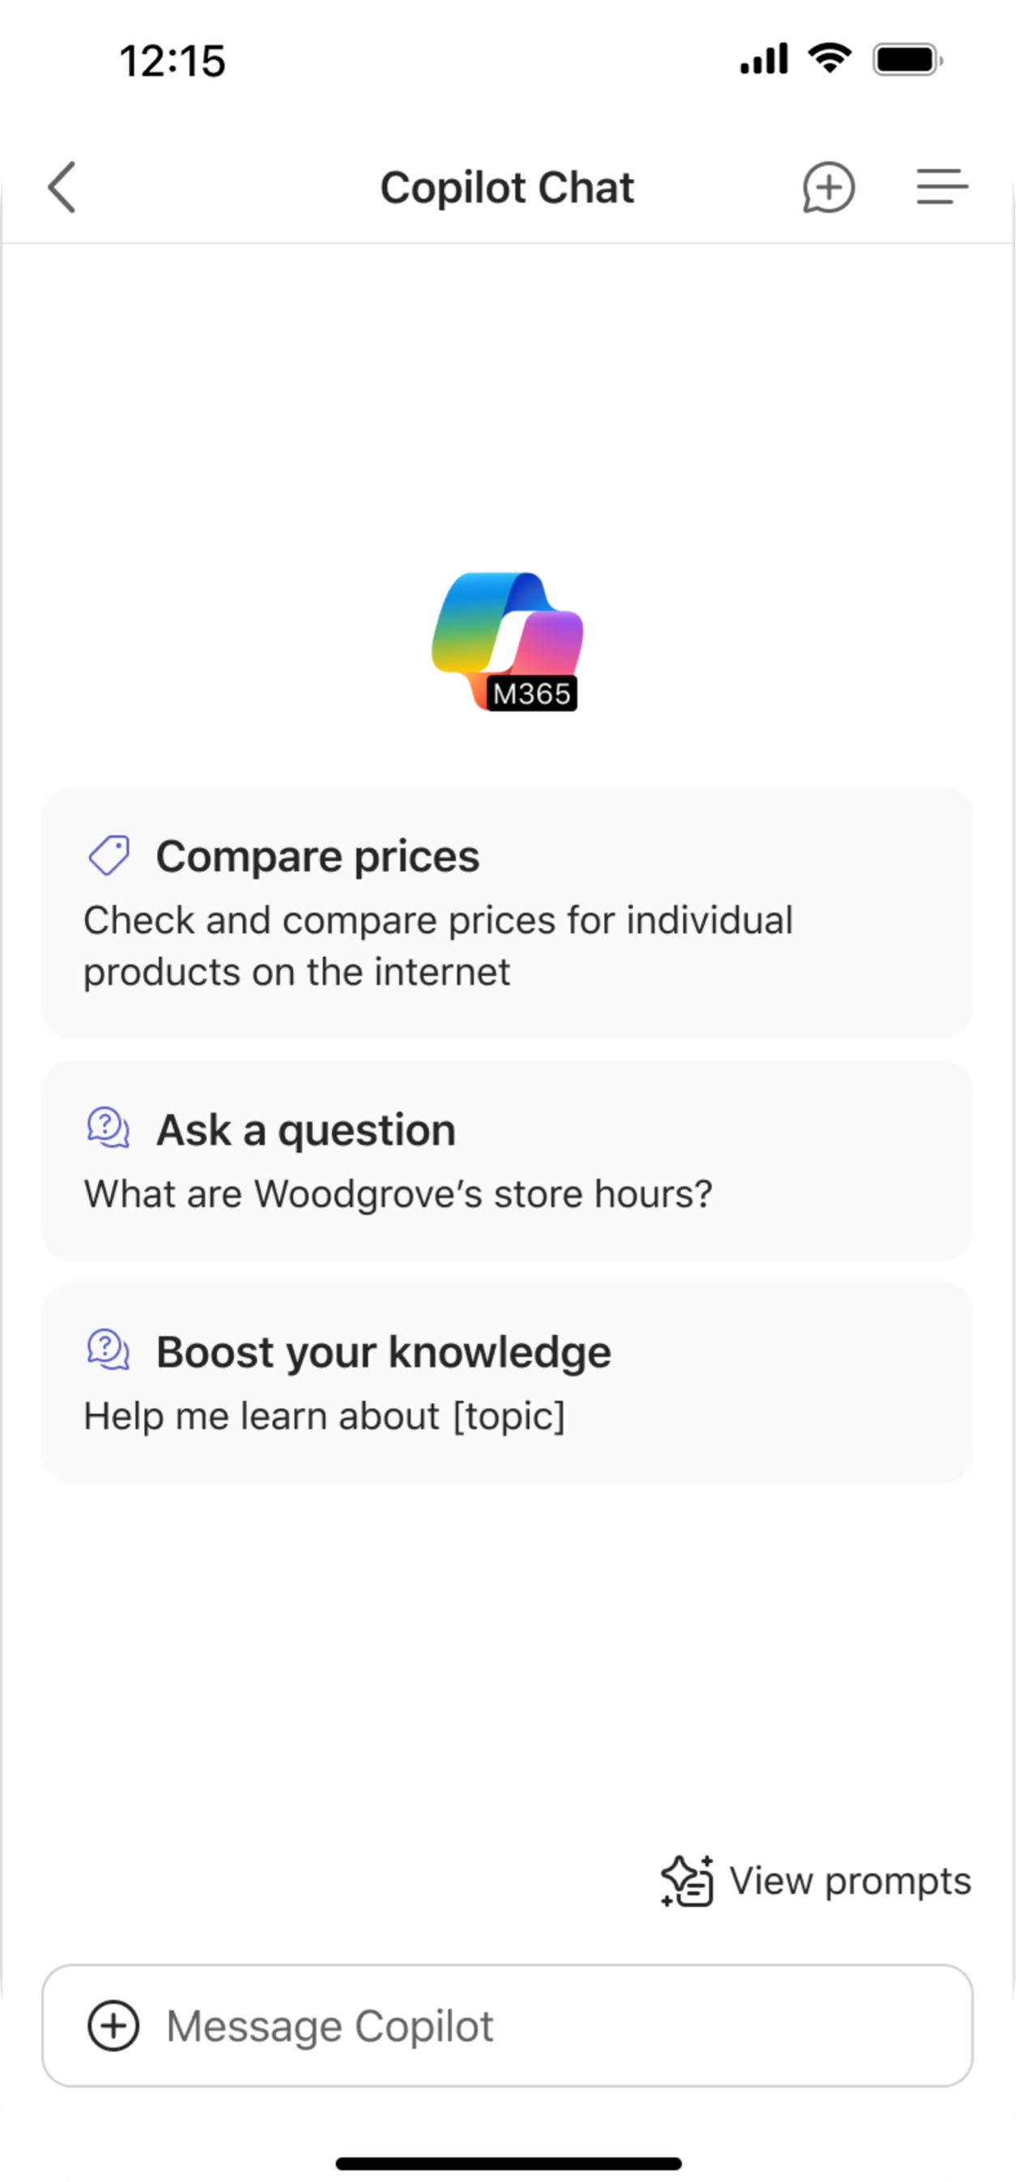
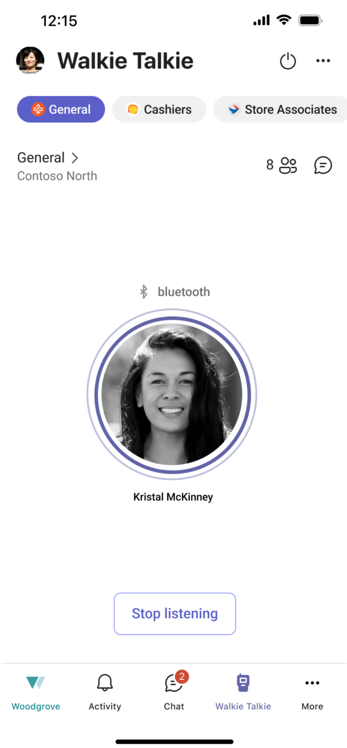
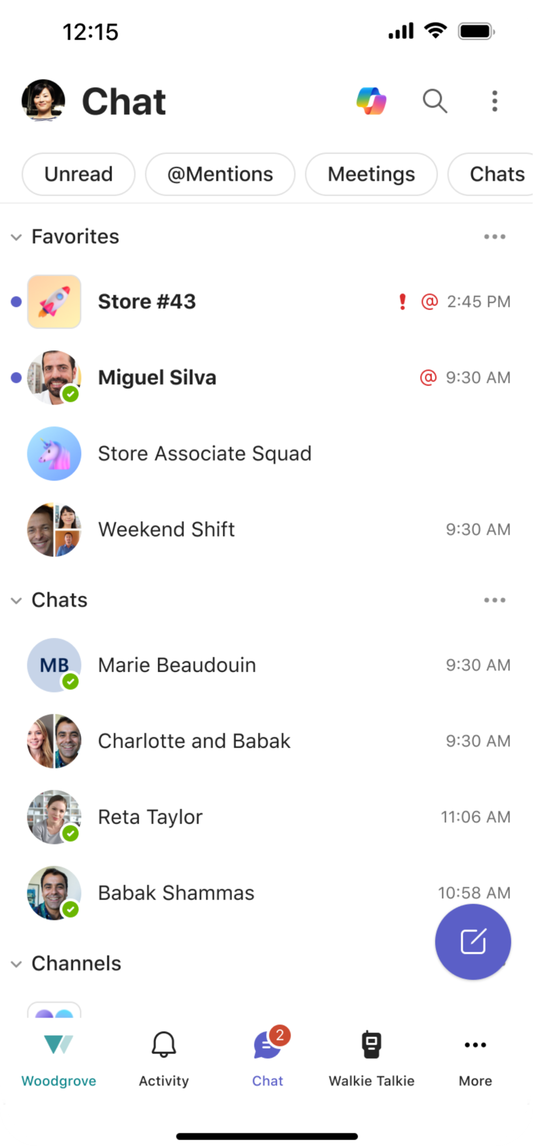
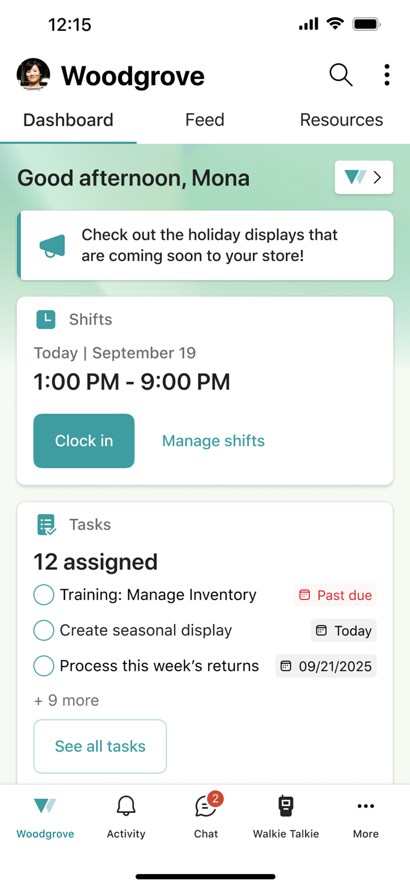
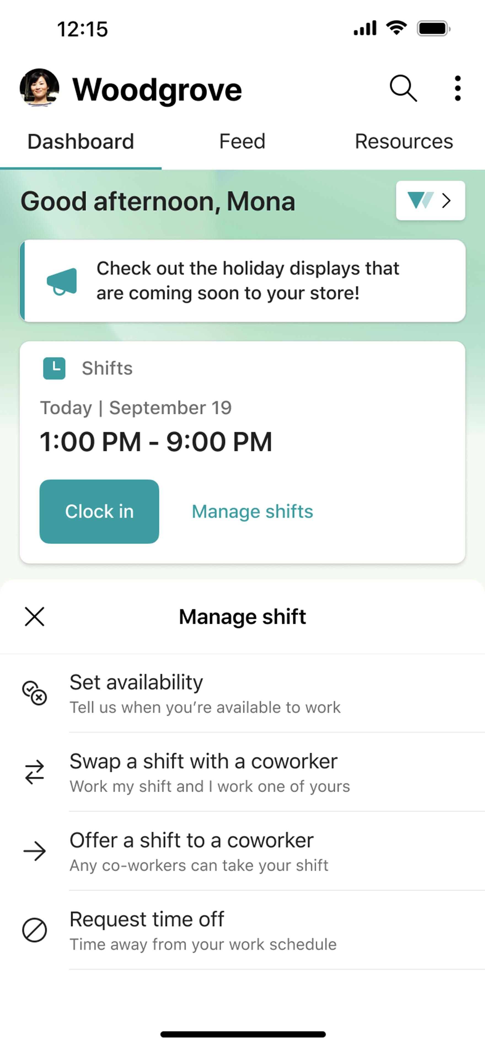
Built into your frontline dashboard
Microsoft’s unified platform for frontline work
Notes:
[BUILD SLIDE]
Copilot Chat can easily be accessed from within Microsoft’s unified platform for frontline work.
This is where Mona, a store associate, would start her day in her mobile device. In this intuitive dashboard, Mona can view an important announcement from headquarters about seasonal displays, clock in for her shift, or review the tasks assigned to her. Without leaving this view, she can even manage her shifts.
*click*
With one click, she can decide to swap her shift, request time off, or set her availability.
*click*
Maybe she’s looking for something else.
*click*
Maybe she wants to hear what her coworker Kristal is saying on Walkie Talkie.
*click*
Or maybe she wants to check the store group chat or message her manager. Or maybe she’s ready to use Copilot Chat. With one click on the Copilot icon in the top right corner of the chat view—
*click*
— Mona is able to message Copilot Chat for assistance.

Slide 26
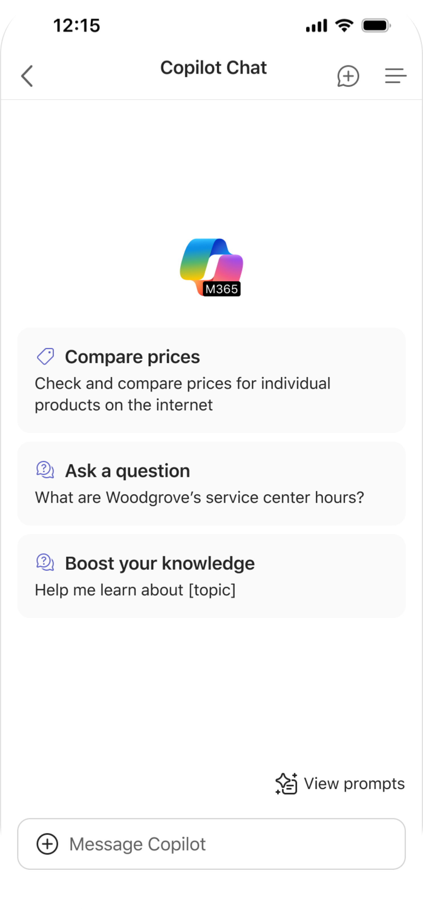
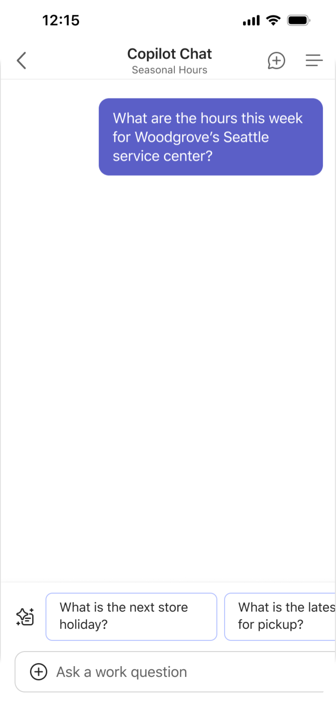
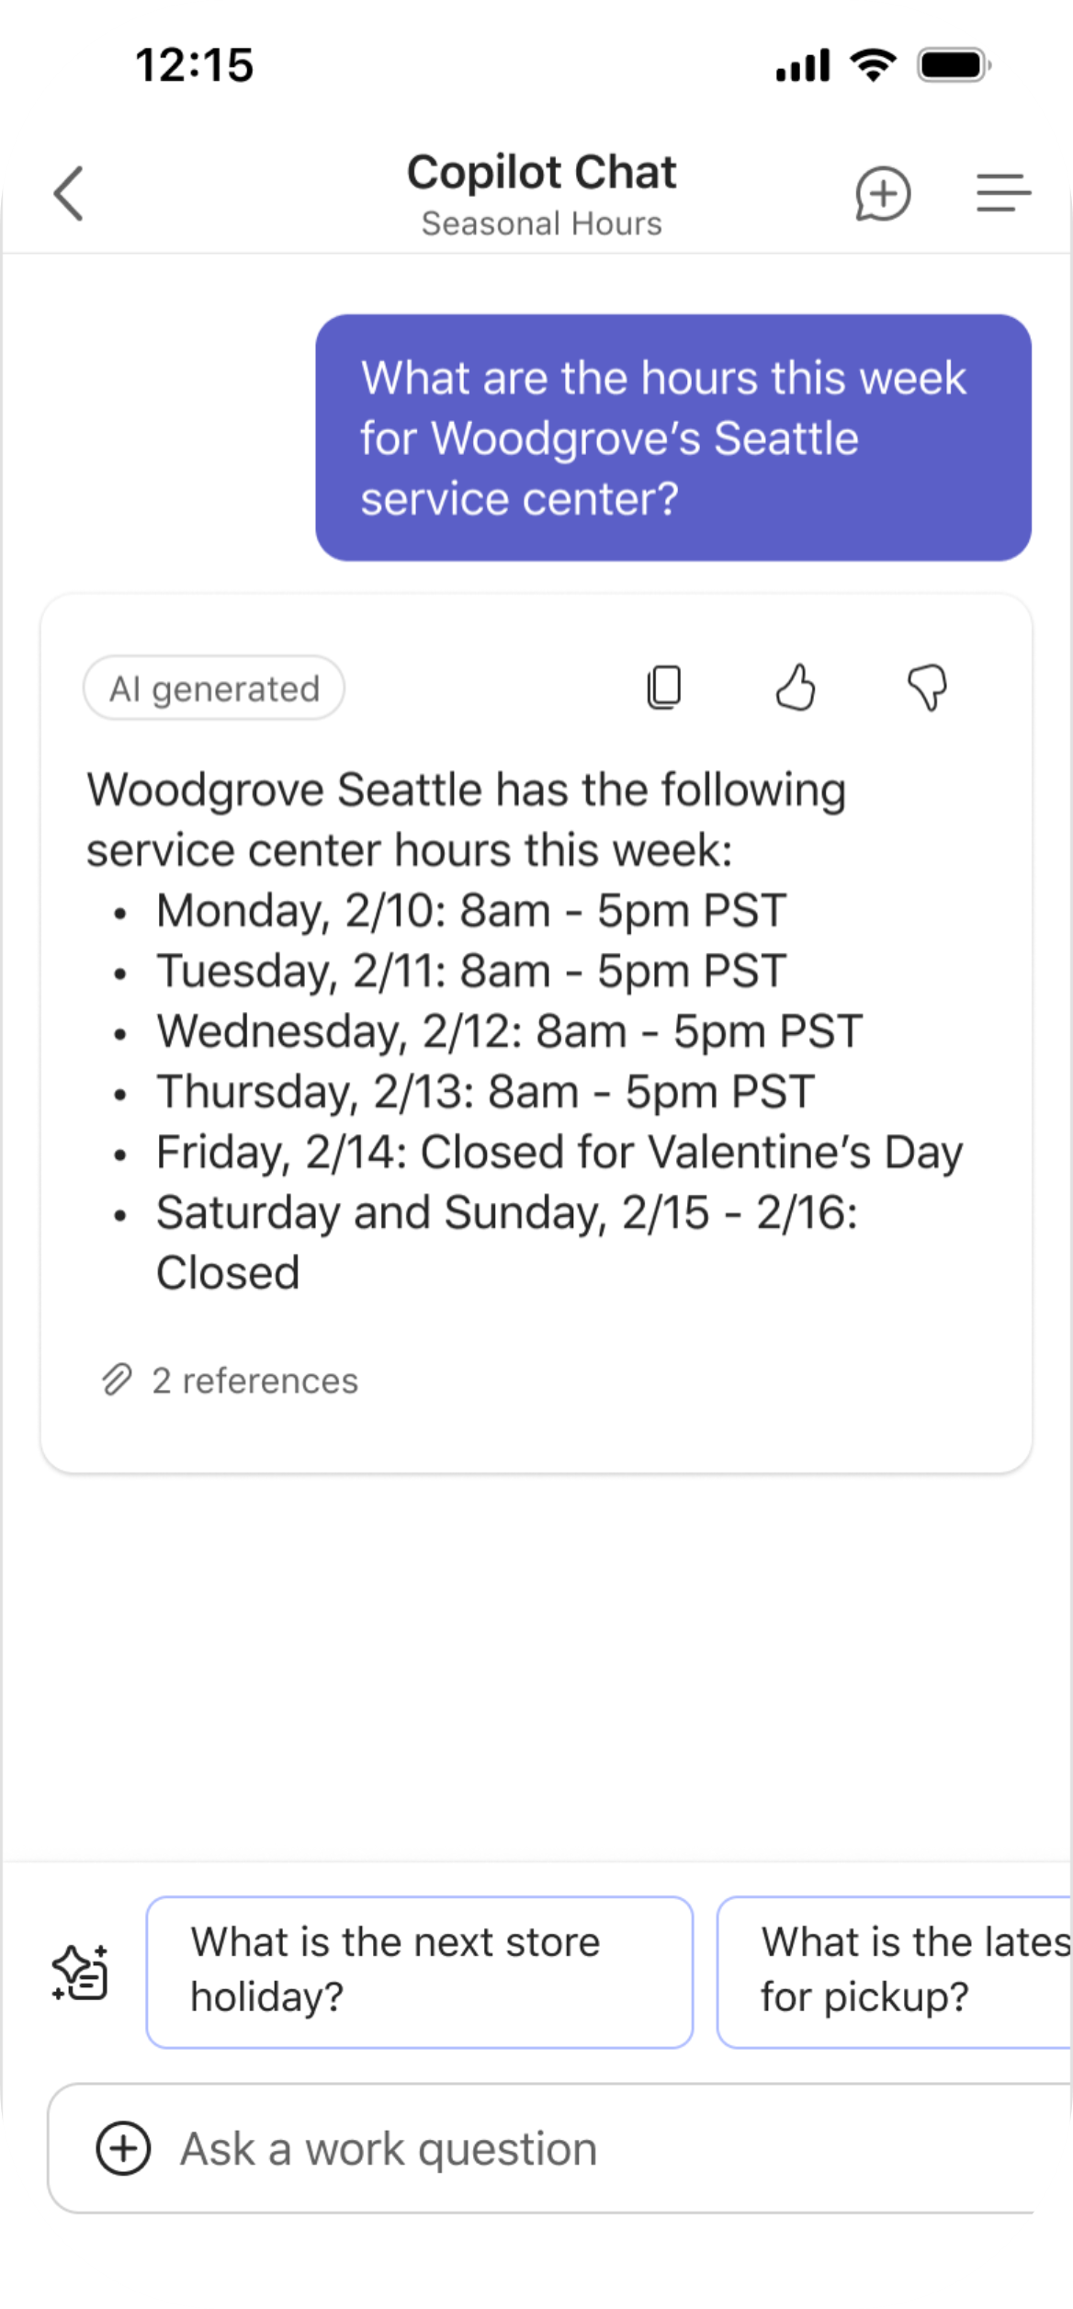
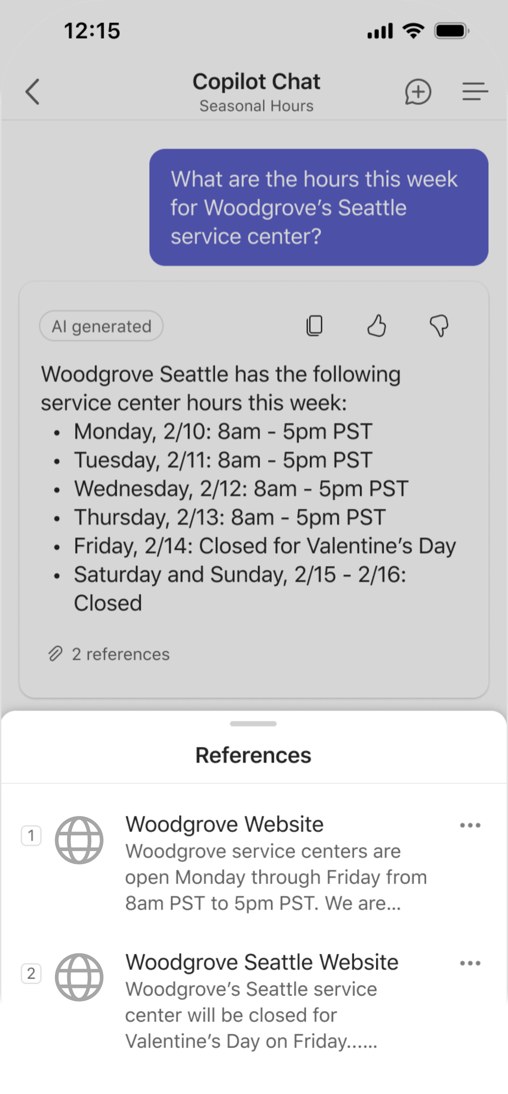

Secure answers from the latest models and the web
Service Technician
Benefits
Secure and efficient search
Does not use your data to train our AI models
Notes:
Now, what would this look like in Manufacturing. What would Mona use Copilot Chat for as a service center technician in an auto shop?
*click*
Today, Mona is curious about the service center hours since there’s a holiday this week.
*click*
She receives a quick reply with all the hours this week in one simplified view. This information was pulled from the web, which anyone can access, but if we click on the sources referenced—
*click*
— we’ll see that this information was pulled from two places. The general Woodgrove website has the general service center hours across all Woodgrove auto shops, which doesn’t account for seasonal changes. To find seasonal changes, Mona would’ve had to dig further to find seasonal hours announcement on the Seattle service center website.
Instead of clicking through the website, Mona can just write a quick question to get the exact info she’s looking for in one concise response.
*click*
Maybe you want more than just web-grounded answers.

Slide 27
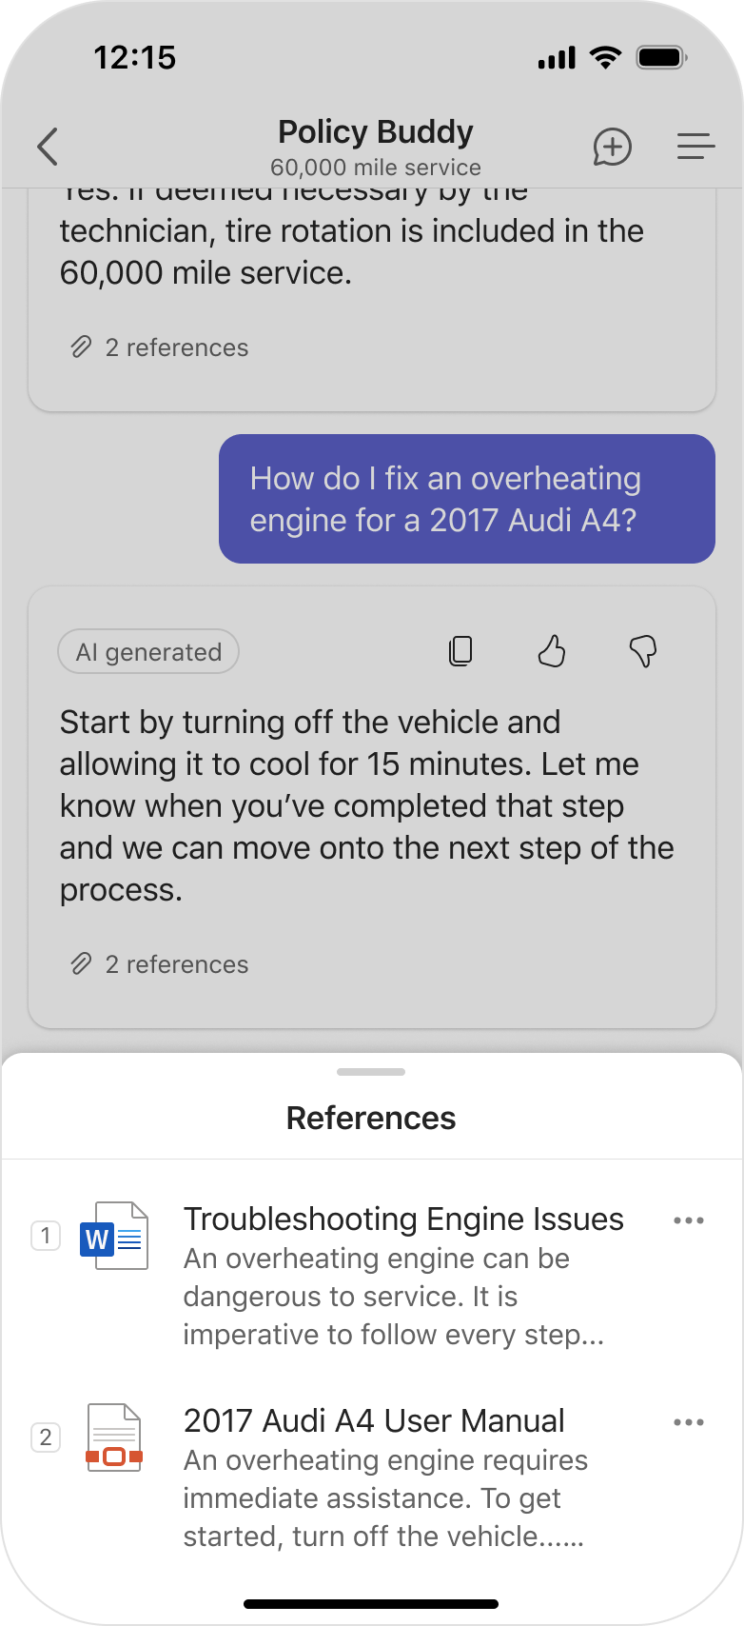
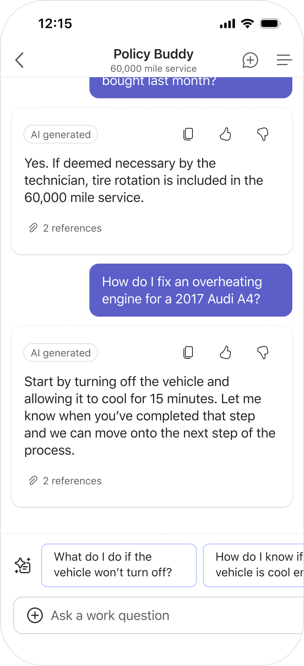
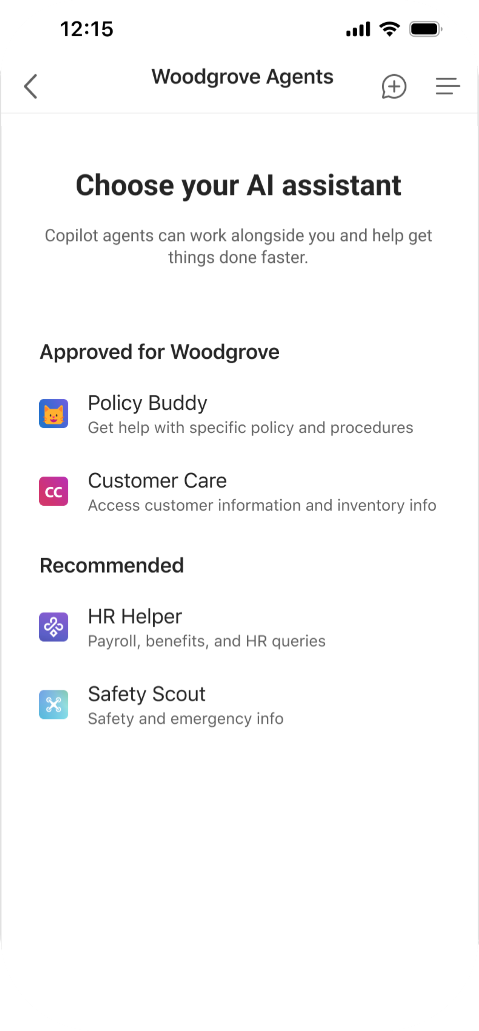
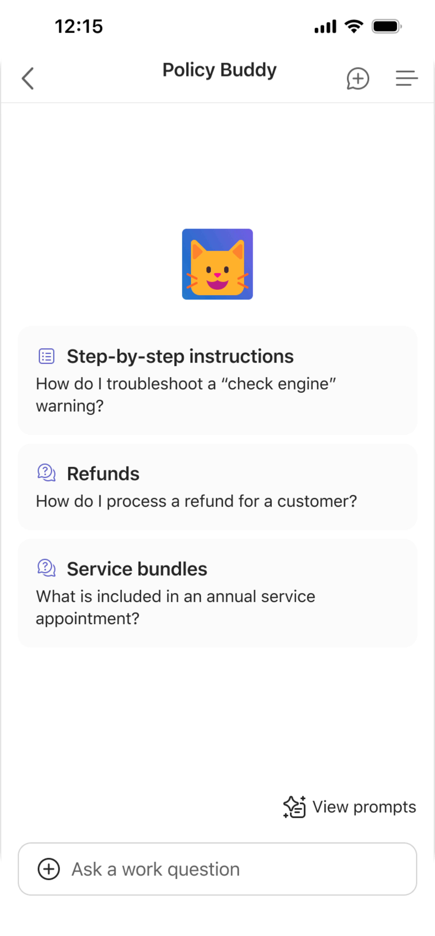
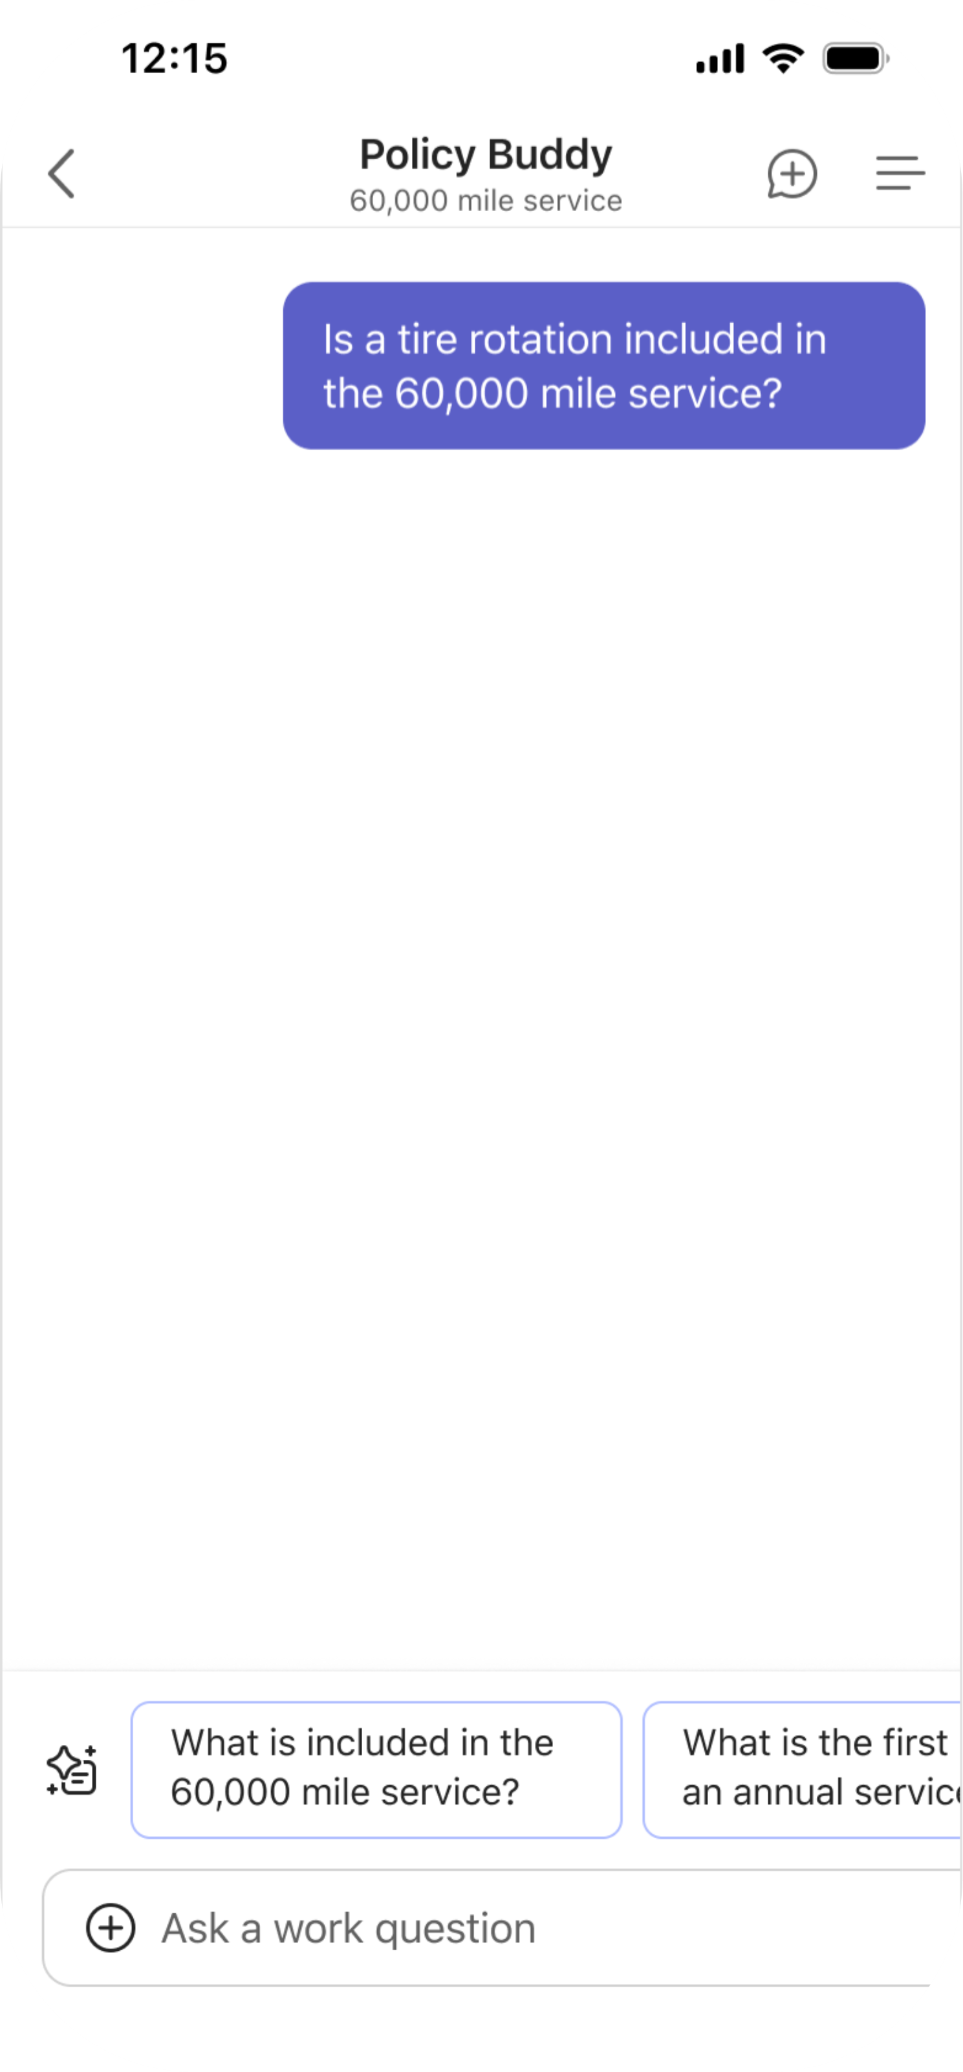
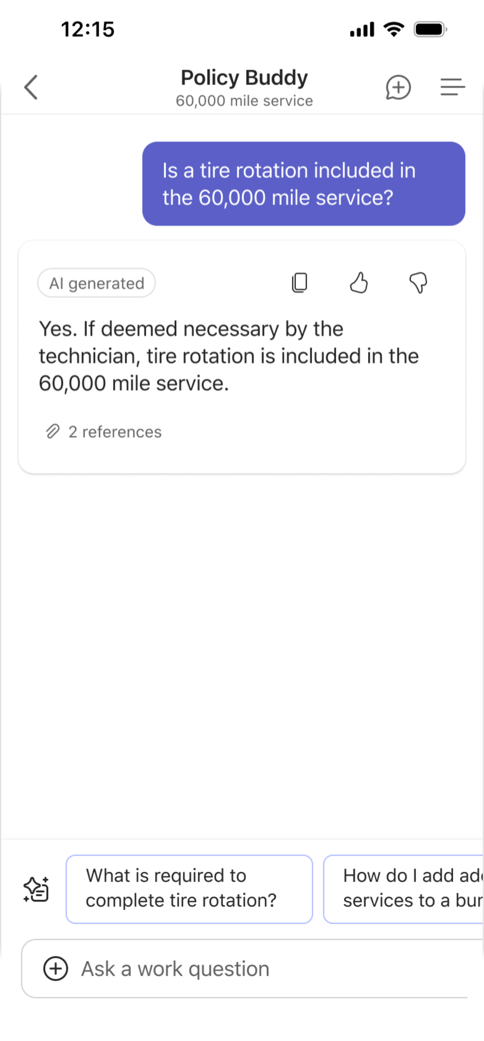
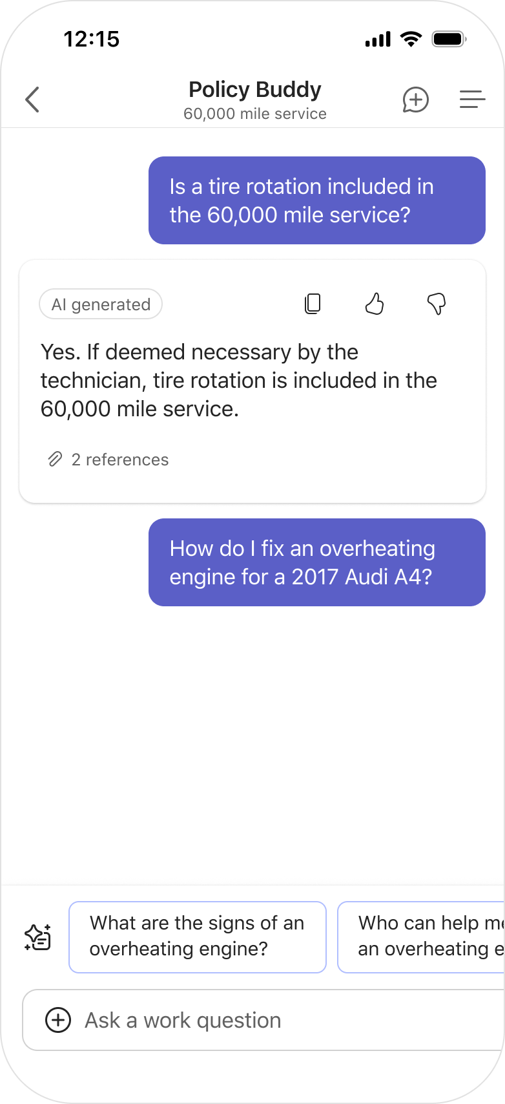
Find in-the-moment answers from internal documentation
Service Technician
Benefits
Reduced customer wait time
Faster information retrieval
Increased accuracy
Agents will be accessible via Copilot Chat in CY25 Q2
Notes:
Maybe Mona is looking for in-the-moment answers grounded in documentation. To access an agent created to answer these types of questions, Mona would just have to click the menu icon in the top right corner.
*click*
In this view, Mona can see all the Woodgrove agents she has access to. In this case, she’s going to select the top agent listed, “Policy Buddy”, to get help with specific policy and procedure questions.
*click*
This agent can help in many ways including, but not limited to, generating step-by-step instructions, helping with a refund, or clarifying service bundles. In this case, Mona has a service bundle question.
*click*
The customer has asked if a tire rotation is included in the 60,000 mile service, so Mona will pose that question to the Policy Buddy agent.
*click*
She’ll receive a response in natural, straightforward language explaining that the tire rotation is included in the service, if deemed necessary. As Mona begins her inspection of the vehicle, she notices that the engine is overheating.
*click*
She quickly asks the agent for help fixing the overheating engine.
*click*
She’ll receive a response outlining the first step: turning the vehicle off and allowing it to cool. Once she’s completed that step, she can let the agent know and receive the next set of instructions.
*click*
This information was pulled from two places. First, the 2017 Audi A4 User Manual. And second, the Troubleshooting Engine Issues procedural document published by her company. These documents can be manually uploaded or pulled directly from existing SharePoint sites.
*click*
Maybe we need to take these agents a step further.

Slide 28
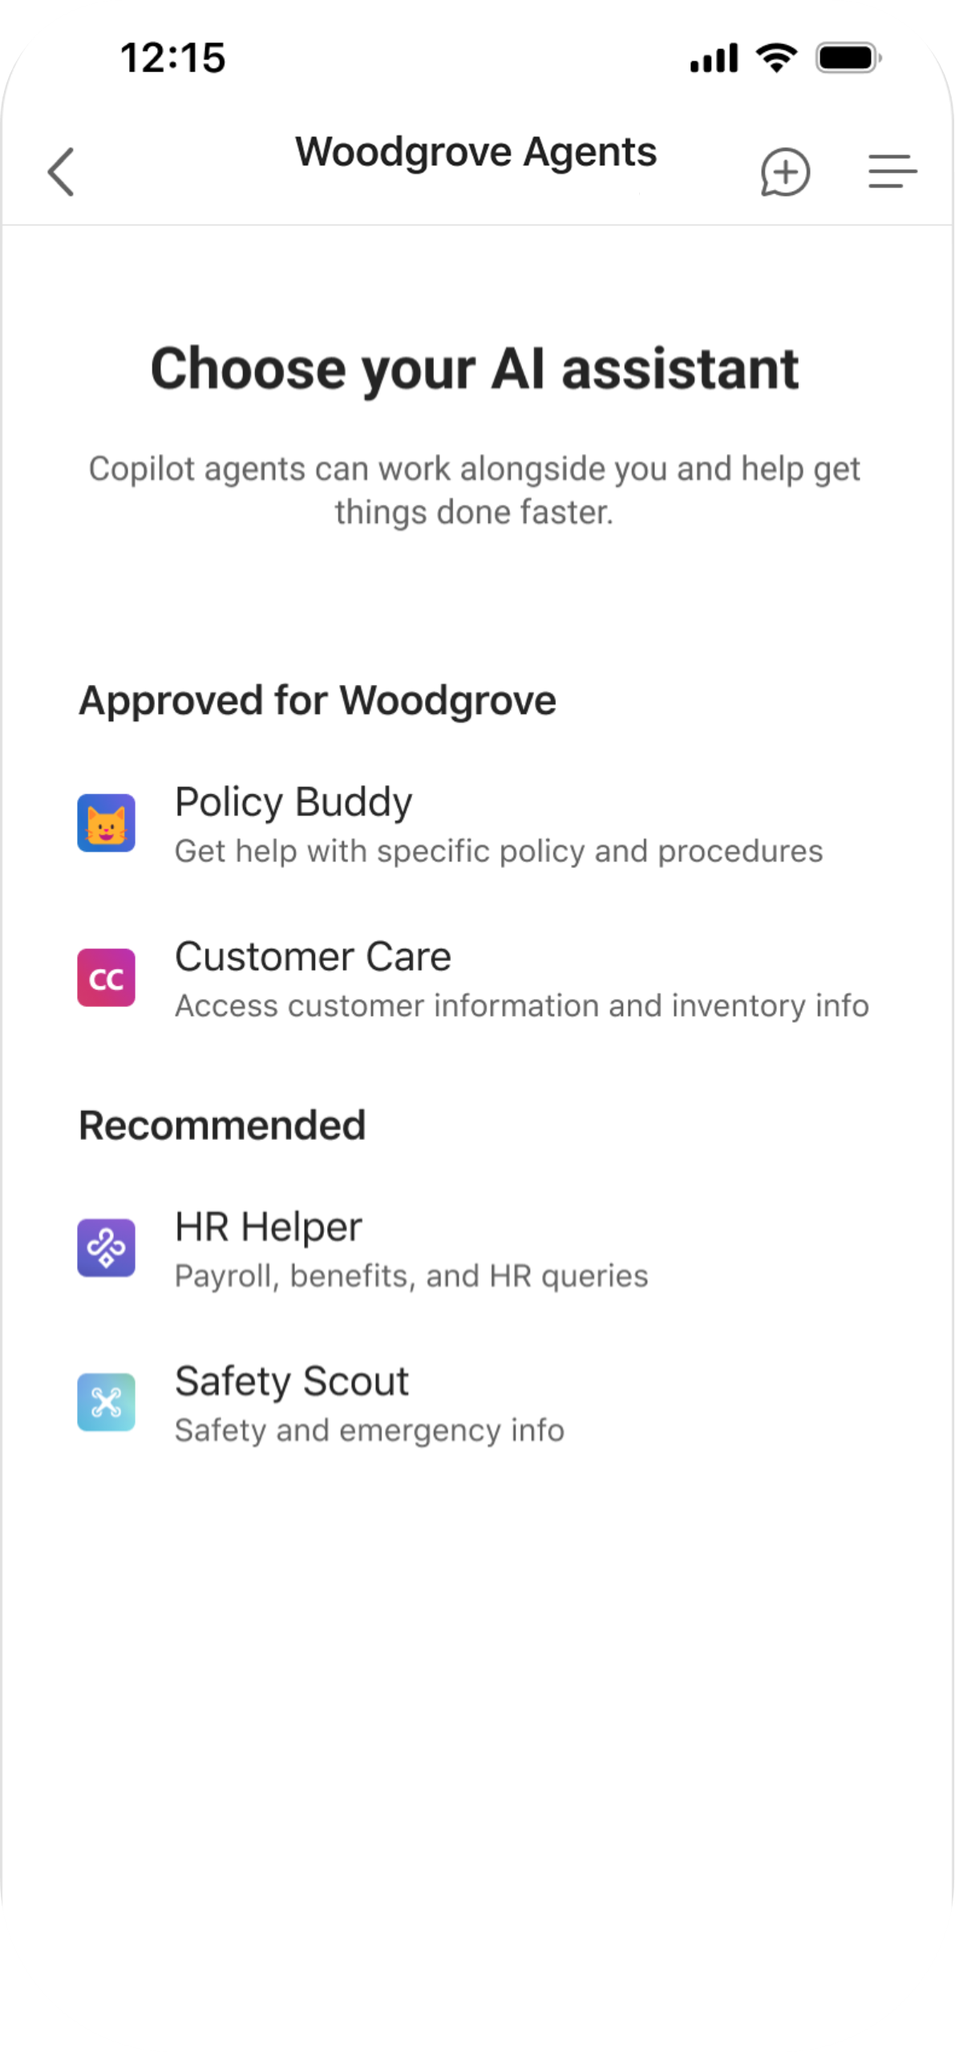
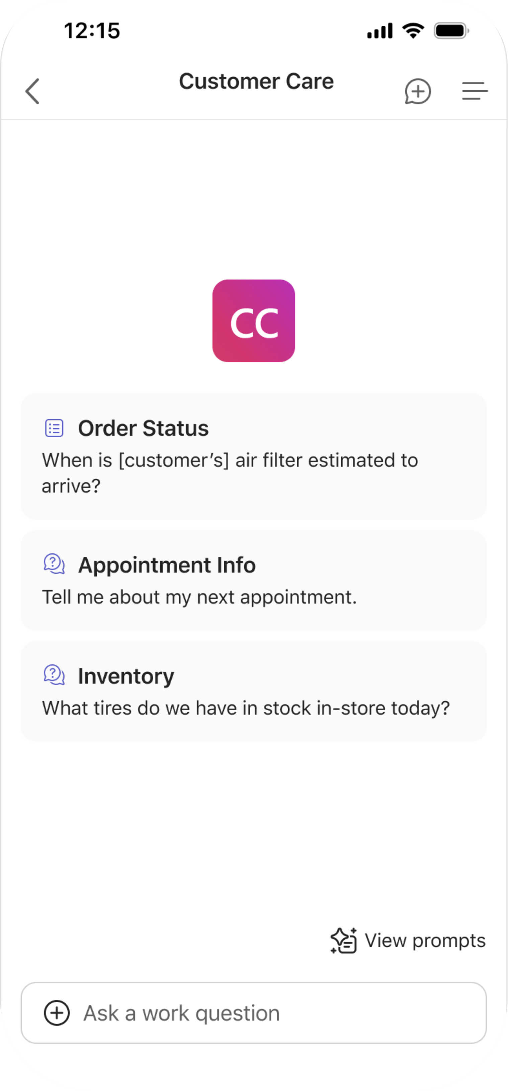
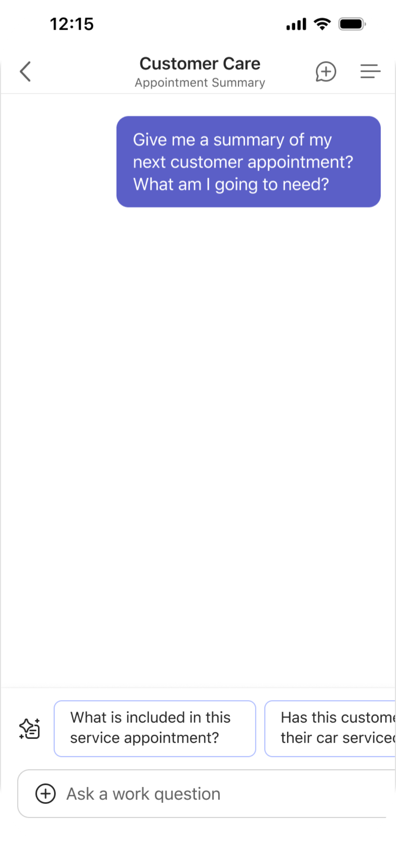
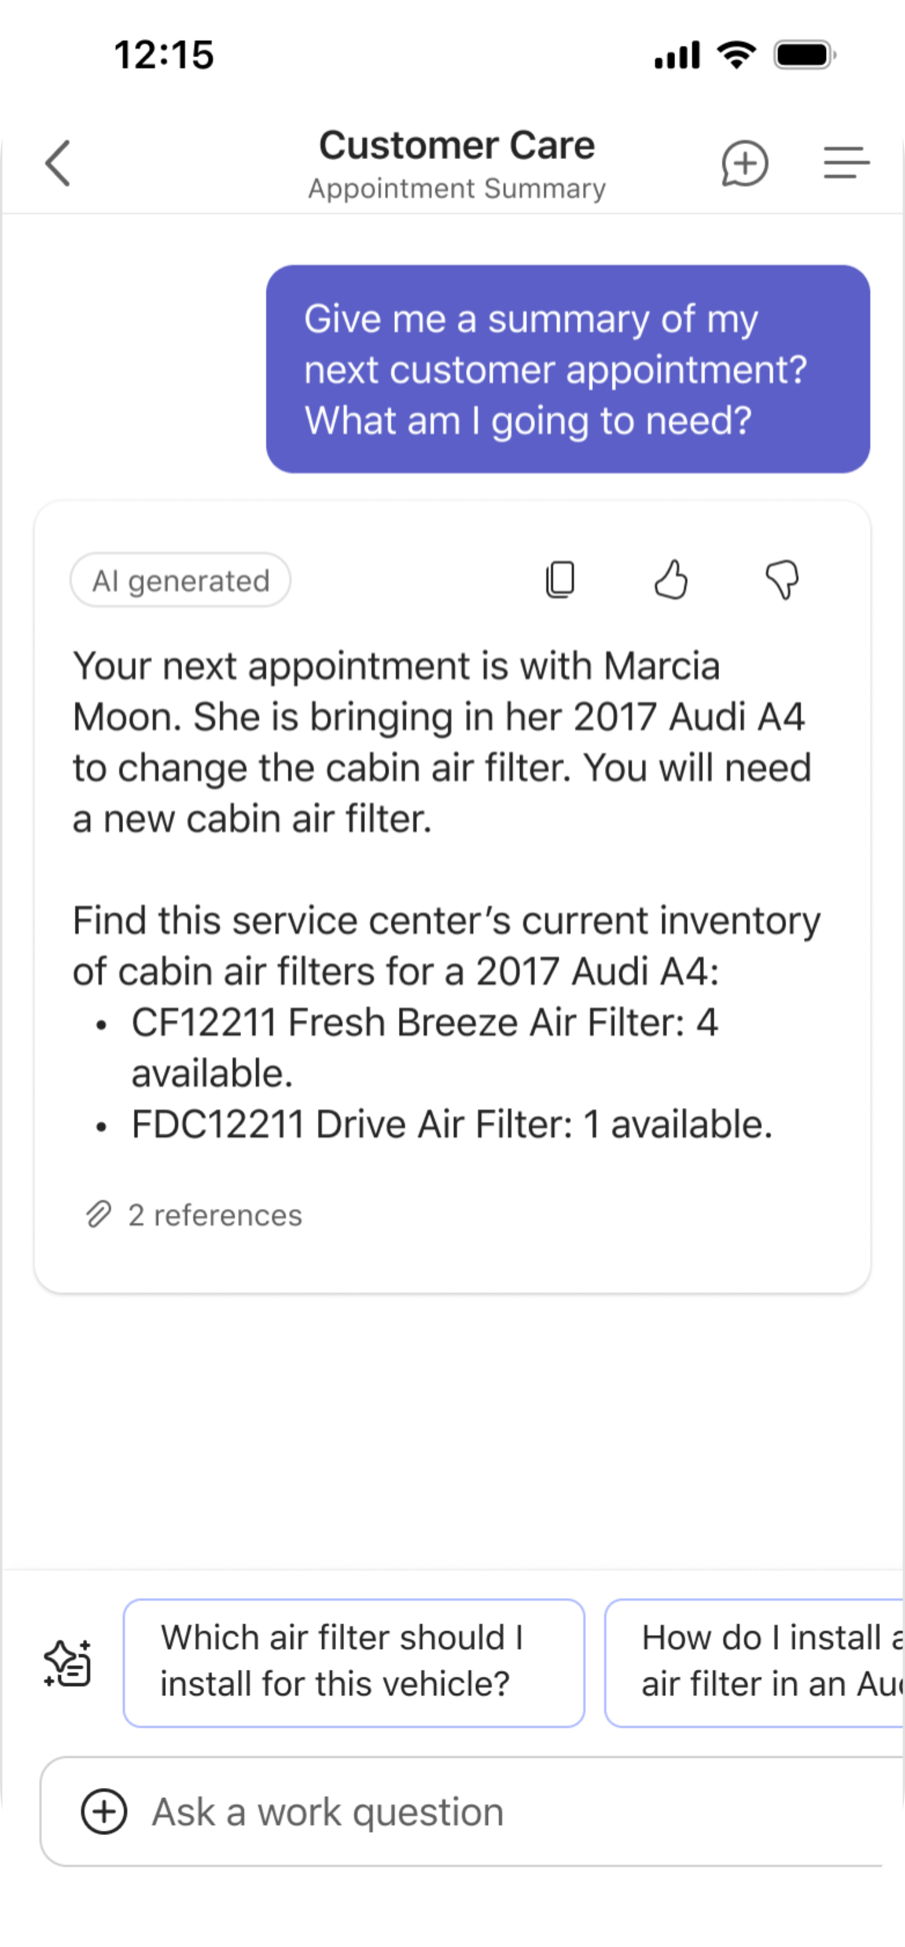
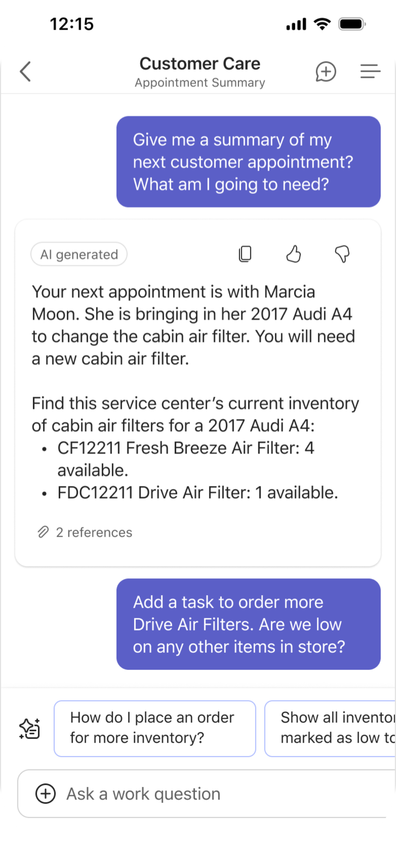
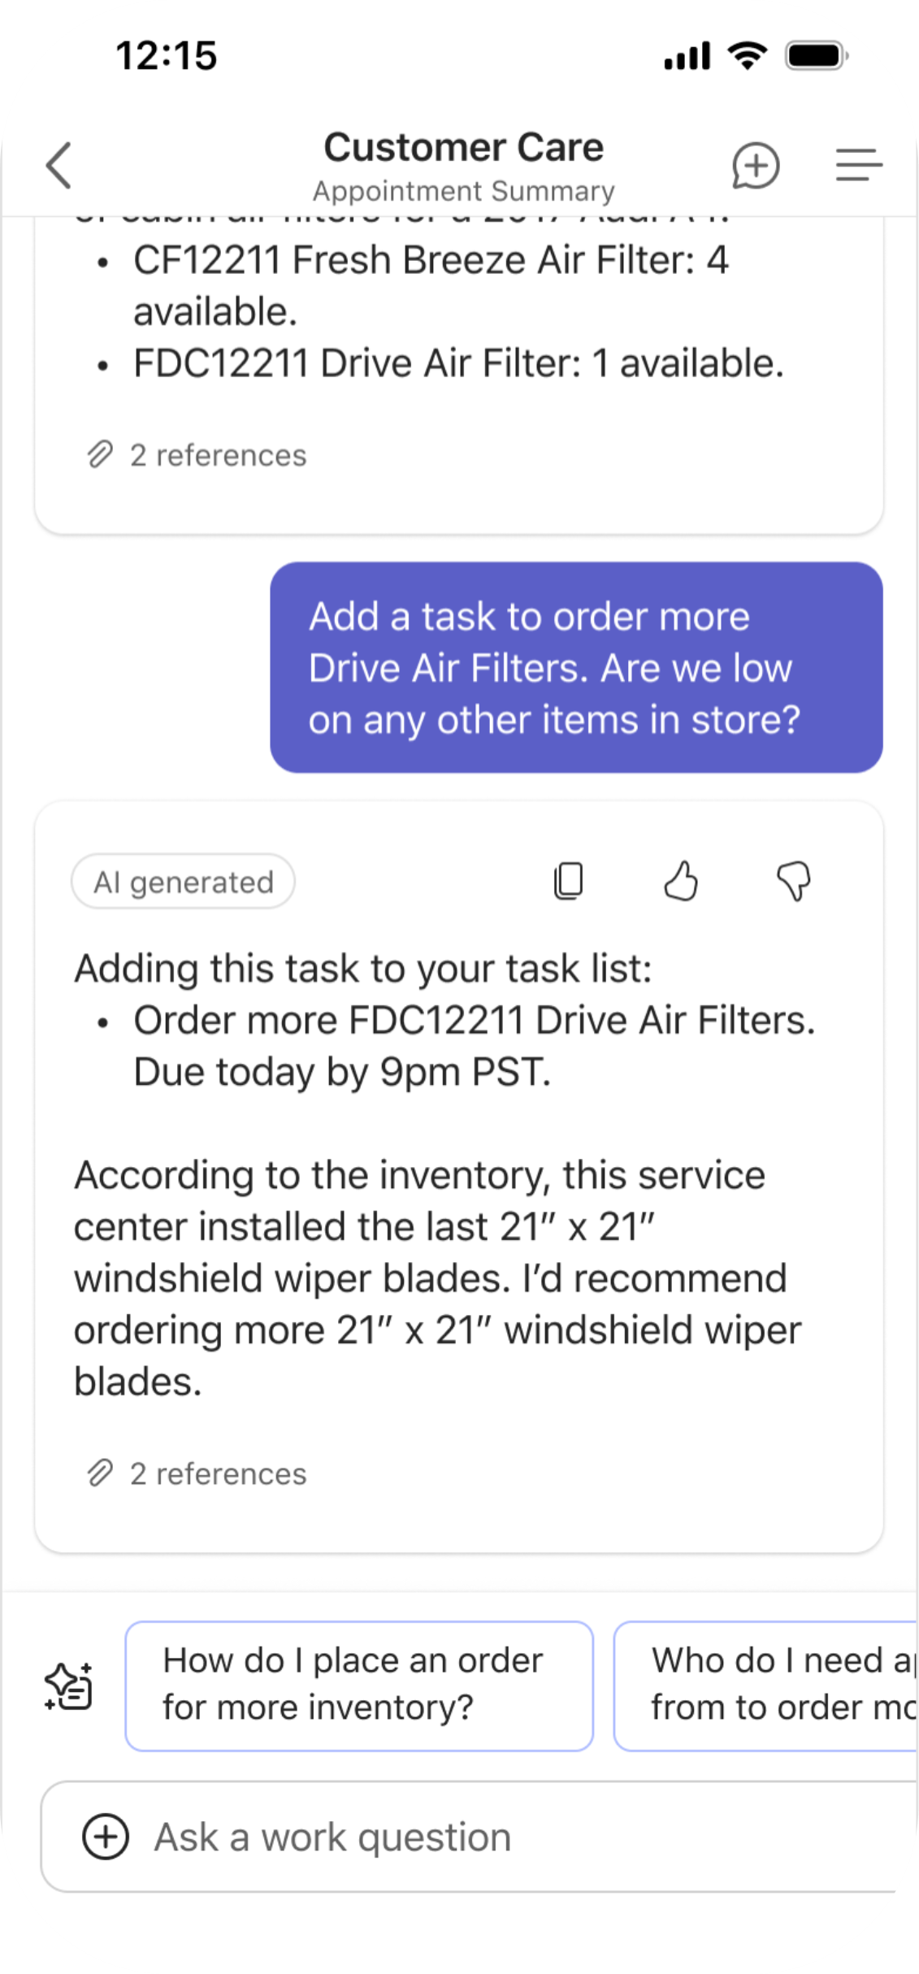
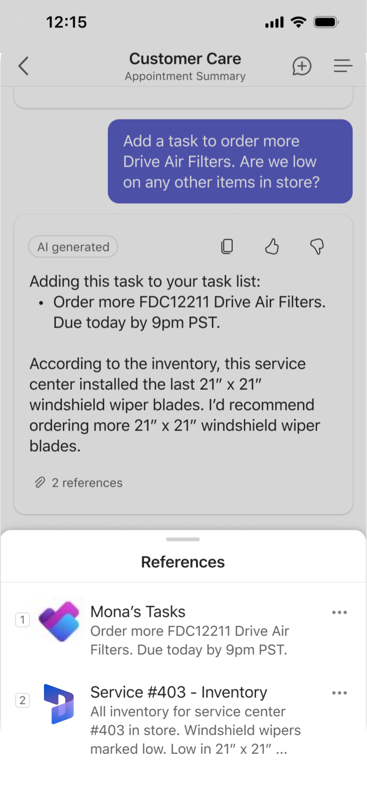
Simplify business processes by connecting to systems
Service Technician
Benefits
Higher customer satisfaction
Increased average order value
Improved sales efficiency
Agents will be accessible via Copilot Chat in CY25 Q2
Notes:
Maybe Mona is looking to simplify business processes with agents grounded in systems of record. From that agent view, Mona would click the second agent listed, “Customer Care”, to access customer and inventory information.
*click*
This agent can assist in many ways including, but not limited to, accessing the order status of a specific part for a specific customer, summarizing service appointment information, and reporting inventory info. In this case, Mona has a question about her next service appointment.
*click*
She asks for a summary of her next appointment and a list of what she’s going to need to complete the service.
*click*
The agent summarizes key appointment details, like customer name, car type, reason for service, and parts needed. Since it is an air filter change, the agent also lists the different cabin air filters in stock for that type of vehicle.
*click*
Given she plans to use the last Drive Air Filter, she asks the agent to add a task to her task list to order more. Then, she also asks if the agent would recommend ordering any other items.
*click*
The agent responds with a concise message detailing the task it has added to her task list and a recommendation of what to order more of given the low stock alert in her Inventory system.
*click*
This information was pulled from two places. First, the new task was added to the Planner app. And second, the inventory recommendation was sourced from her store’s Dynamics 365 inventory system. These are only two of many sources available to ground your agent in.

Slide 29
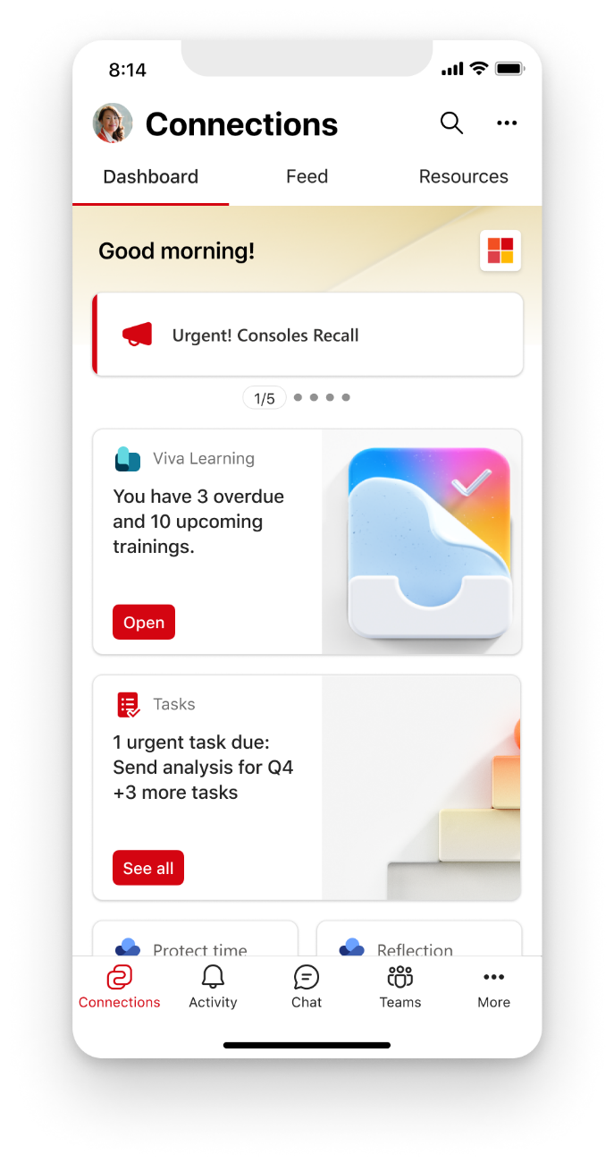
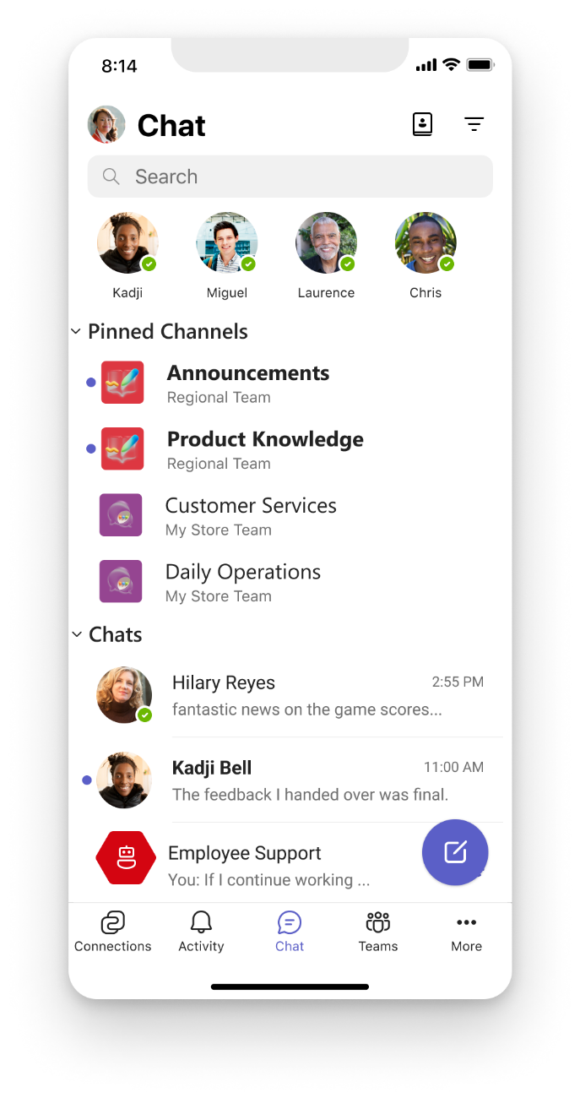
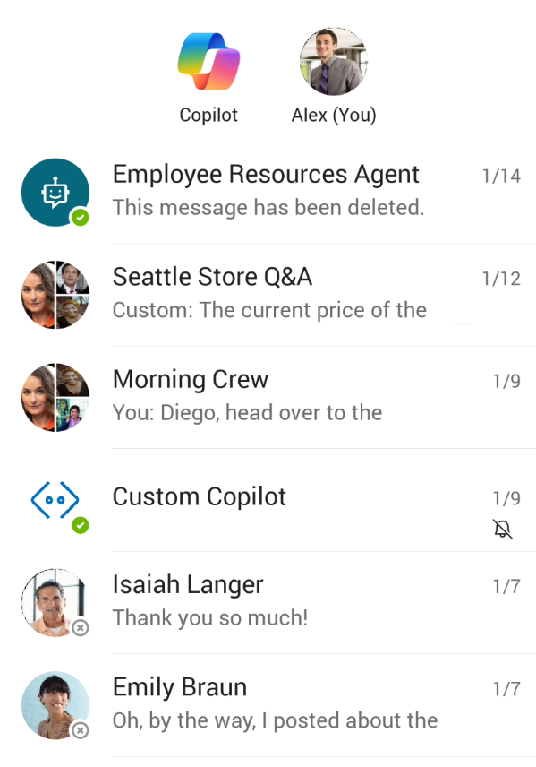




Microsoft 365 for Frontline
The smart place to work for frontline, empowered with AI
Home
Chat
Home
Urgent lettuce recall
Tasks
Copilot
Daily store checklist and 3+ more tasks
Shifts
Notes:
Microsoft Teams is the focus of Microsoft’s strategy to enable simple, smart and secure experiences for frontline workers.
This is not the knowledge worker experience that you and I are familiar with. This is a differentiated experience for your FLWs

Slide 30



Frontline worker personas across industries
Retail – Sales Associate
Healthcare - Medical Assistant
Hospitality - Front Desk Agent
Assists customers, restocks, processes returns
Administers care, tracks patient info, educates patients
Books reservations, handles complaints
Product lookup, policy reminders, quick FAQs
Medical info lookup, simplified patient language
Translation, guest communication support
“How do I check a warranty for Apple products?”
“Explain diabetes to a 10-year-old and steps to take as part of the routine”
“How to politely tell a guest that check-in is at 3 PM? In Spanish”

Slide 31



Frontline worker personas across industries
Manufacturing – Line Operator
Construction - Site Foreman
Utilities - Field Technician
Operates equipment, identifies faults
Oversees crew, ensures safety compliance
Repairs lines, reports outages, reads meters
Troubleshooting steps, safety protocols
Quick look-up of OSHA regulations, task checklists
Diagnostics, reporting help, repair checklists
“What does this sensor error code mean?”
“Summarize the PPE checklist for new hires.”
“How to reset a smart meter remotely?”

Slide 32



Frontline worker personas across industries
Logistics – Picker / Packer
Transportation - Delivery Driver
Facilities - Maintenance Staff
Picks items, packs, loads shipments
Delivers goods, communicates with dispatch
Cleans, maintains buildings, fixes equipment
Packing guidelines, product specs, location of items
Route tips, customer communication support
Cleaning protocols, chemical safety, equipment troubleshooting
“What’s the weight limit for this type of box?”
“What’s the best way to explain SLA & delivery delay?”
“How to clean up a chemical spill safely?”

Slide 33



Frontline worker personas across industries
Agriculture – Farm Worker
Aviation - Ground Crew
Telecom - Field Installer
Operates machinery, monitors crops or livestock
Loads luggage, directs planes, checks equipment
Installs service, troubleshoots issues
Crop treatment info, weather updates, equipment help
FAA regulations, weight limits, procedural checklists
Wiring diagrams, service setup guides, FAQs
“When should I spray for aphids in soybeans?”
“How to balance cargo for a regional jet?”
“How to reset a router for a customer with no tech experience?”

Slide 34
DEMO
Notes:
SharePoint is the most flexible solution in the industry.
It has rich collaboration, workflow, and compliance capabilities.
It powers document in OneDrive and Office, to employee experiences with SharePoint sites and Viva. We’re adding new capabilities like Loop and Whiteboard and rich media with photos, stream, designer, etc.
And it powers custom applications – in your tenant or a special version of SharePoint we released for content business apps called SharePoint Embedded.

Slide 35
Getting started!
Low Value
High Complexity
High Value
High Complexity
Autonomous
Agents
Task
Agents
Low Value
Low Complexity
High Value
Low Complexity
Complexity
Retrieval Agents
Value

Slide 36
Expertise and tools for your journey
Technical expertise via our FastTrack partners
Tools, resources & training on our Adoption Hub
Events and real-world knowledge in our community
aka.ms/Microsoft/FastTrack
adoption.microsoft.com
aka.ms/TechCommunity

Slide 37
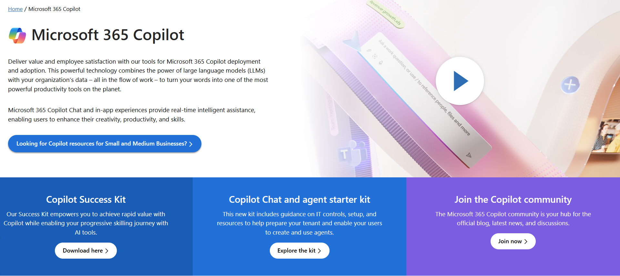
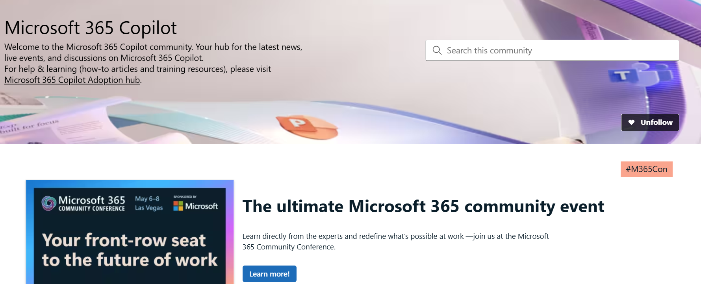
News & community content
Microsoft Community Learning aka.ms/Community/LearningChannel
Community led expert content on all your favorite Microsoft services.
Start your week with live news and event updates aka.ms/MondaysatMicrosoft
Watch live or on-demand & share our blog.
Notes:
To help you with adoption, the Copilot Readiness Hub is an open one stop shop for content, organized by role for your Copilot for Microsoft 365 journey.
You can use its recommendations to prepare and plan for your deployment, create a user experience strategy as I’ve presented today, and an adoption plan.
And as Copilot continues to evolve, keep coming back for new content that is published regularly.
You can also join the Copilot for Microsoft 365 community to get your questions answered and meet others who are leveraging Copilot for Microsoft 365 right now.

Slide 38
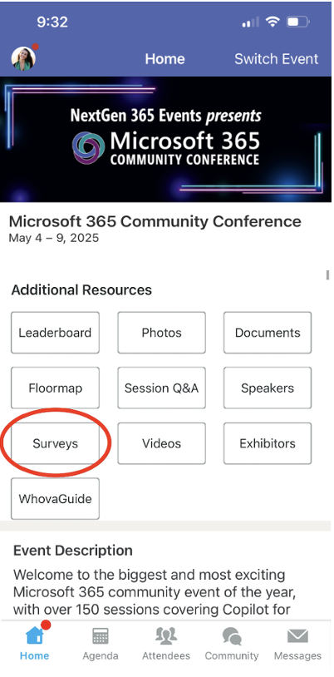
Session feedback surveys
We want to hear from YOU!
Share your feedback to make next years conference even better!
Here’s how –
Simply go to the Whova App on your smartphone.
Scroll down on the M365 Community Conference Homepage to ‘Additional Resources’ to click “Surveys’.
Click Session Feedback.
Scroll down to find this session title.
Complete the session feedback survey.
Finally, click ‘Submit’.
It’s just that easy!

Slide 39
Copilot hub & community
Copilot hub on adoption.microsoft.com/copilot
Enablement and usage guidance for Microsoft Copilot.
Ask questions and get answers in our community aka.ms/M365CopilotCommunity
Notes:
To help you with adoption, the Copilot Readiness Hub is an open one stop shop for content, organized by role for your Copilot for Microsoft 365 journey.
You can use its recommendations to prepare and plan for your deployment, create a user experience strategy as I’ve presented today, and an adoption plan.
And as Copilot continues to evolve, keep coming back for new content that is published regularly.
You can also join the Copilot for Microsoft 365 community to get your questions answered and meet others who are leveraging Copilot for Microsoft 365 right now.

Slide 40
Thank you!

Slide 41
Stages of transformation
Level 1
Level 2
Level 3
Level 4
Human-first
Humans with agents
Agents with human oversight
Agent-first without human oversight
+
Every person is
augmented by AI that understands their job
Every team includes AI agents that complete work autonomously
AI agents run entire teams,
with humans overseeing
and managing
Departments or functions operating autonomously, without regular oversight

Slide 42
Copilot
Agents
Human augmentation
Connected to Copilot or autonomous
Private, Personal Assistant
Automates tasks and processes
People 1:1 Copilots
People 1:N Agents
Copilot Studio
Used to create or configure agents

Slide 43
Agents in Microsoft 365

Slide 44
Sample

Slide 45
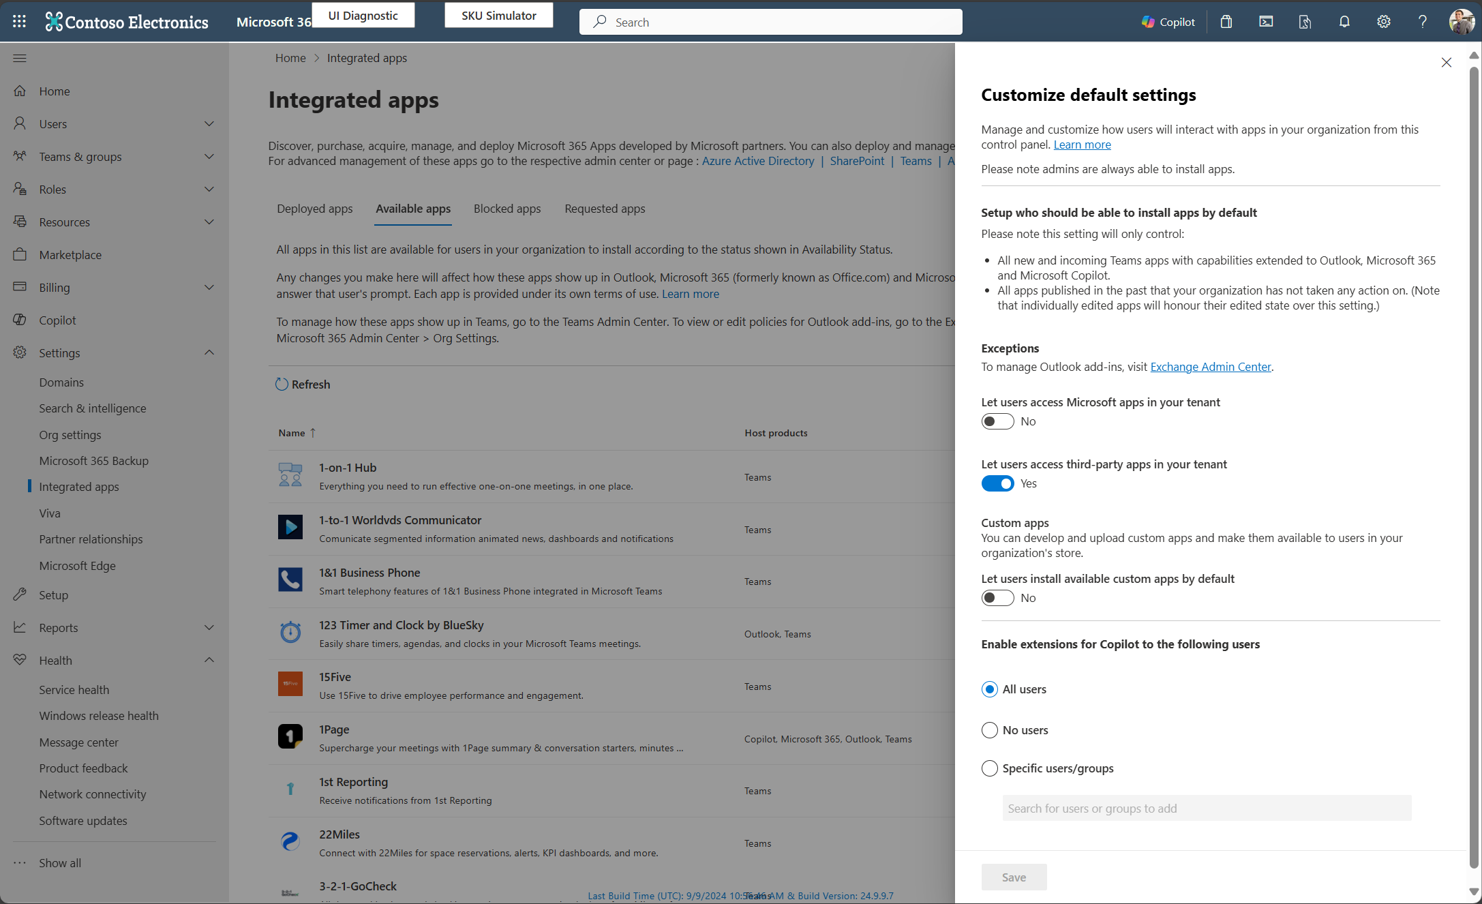
Control agent access
IT admins can go to Integrated apps section, use Copilot extensibility control all users, no users, specific groups/users to access agents.
Microsoft 365 Admin Center
Notes:
Learn more: Manage agents for Microsoft 365 Copilot in Integrated Apps - Microsoft 365 admin | Microsoft Learn
Note: This control doesn’t govern SharePoint agents.

Slide 46
Agents run on a secure and trusted platform
Data security
Access & cost controls
Measurement & Reporting
Leverage label inheritance and
data loss prevention policies
Control agent availability
and access
View core usage telemetry and track license utilization
Intelligent grounding
respects your permissions
and security controls
Control who can create and
sharing of agents
Track improvements in user productivity and compare impact across groups
Comprehensive visibility into user, data, and agent risks
Track and manage agent costs
and operational insights
Analyze Copilot & agents impact to business outcomes
Agent interactions stay in the Microsoft 365 and Azure Service Boundary and
your Microsoft 365 security, governance, compliance, and privacy policies apply

Slide 47
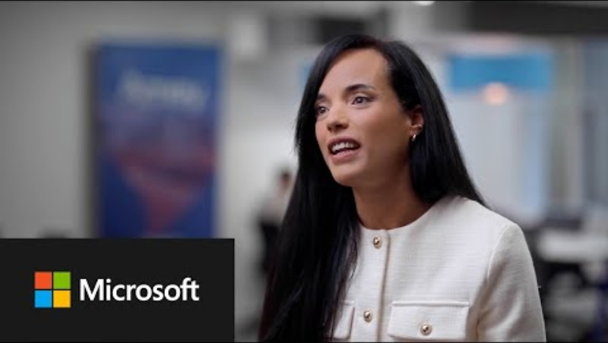
Amey a leading provider of engineering, operations, and decarbonization solutions across the United Kingdom
Notes:
It has been nice to share examples and showcase some of our product demos, but those were not real people in the real world.
So, let’s close with a real-life customer employing SharePoint agents in their frontline organization today.

Slide 48
















Designed to be THE unified platform for frontline needs
M365 for Frontline
Home
Third-party
Bring your data & build your own
4
1
Identity and device provisioning and management.
Urgent lettuce recall
and 2K+ others
Microsoft Teams
2
Home with key information and quick action cards.
Modern comms
Operational efficiency
Wellbeing & Engagement
3
3
Microsoft 365 experiences and purpose-built apps.
A single home experience
2
Daily store checklist and 3+ more tasks
4
Bring your data and apps to Teams with ready-made Third-party solutions or create your own with low-code or pro-dev approach.
1
Secure frontline Identity
Device and deployment
Notes:
This Teams for frontline is built on a foundation of simplified authentication into frontline devices – whether they are shared or personal devices.
It includes a home experience built for frontline worker needs, and key communications and collaboration capabilities. It includes out of the box purpose built apps from Microsoft around schedule and task management
It includes the ability to extend to experiences integrated by 3rd party providers or custom built to suit your unique needs.
And we have also made many investments to deploy Teams easily and quickly at scale in a manner that maps frontline workers real word to their digital world.
Let’s take a deeper look at how we are catering Teams to accomplish unique frontline needs across these pillars of simple, smart and secure.
This a home experience built for their needs, key communications and collaboration capabilities, and out of the box purpose built apps from Microsoft and the ability to extend to experiences integrated by 3rd party providers or custom built to suit your unique needs.
1. We know that the device landscape for frontline workers can lead to complexity – we are investing in simplifying authentication whether your Frontline workers use dedicated devices, shared devices, kiosks or personal devices.
2. We are also investing in scalable, yet simple deployment capabilities through the admin center to help you create the right environment for frontline workers, by mapping their digital world to their physical world.
3. We have an out of the box home experience with the cards that we think are most relevant to frontline workers, but with very little work you can customize and configure this experience as desired.
4. We continue to invest in purpose built first party solutions across targeted communication and operational capabilities like schedule and task management that can get your frontline workers off and running for their day.
The platform gives you the ability to bring in your 3P and line of business apps that can all still be delivered into a single pane of glass
And, that’s not all!! This is also the same platform that allows you to further uplevel productivity on the frontline with AI – and we will talk about that.

Slide 49





Knowledge Sources
Web
Documentation
Files
SharePoint
Industry Systems
Microsoft Graph
Dataverse
Microsoft Fabric
Azure AI Search
Custom Data
Salesforce
Azure SQL
ServiceNow
ZenDesk
and more…
Notes:
Across Copilot Chat and agents, there is a multitude of knowledge sources .
Chat is grounded in the web. But agents can expand to include documentation or industry systems, including Microsoft and non-Microsoft sources.
And the list doesn’t stop at what’s onscreen. The list is always growing.

Slide 50
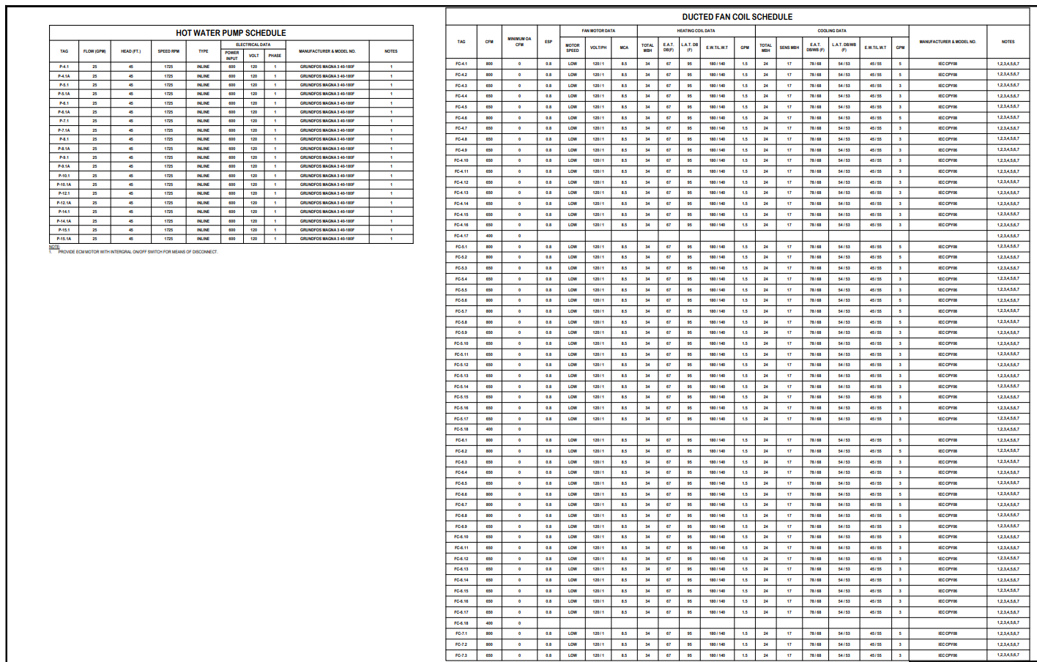
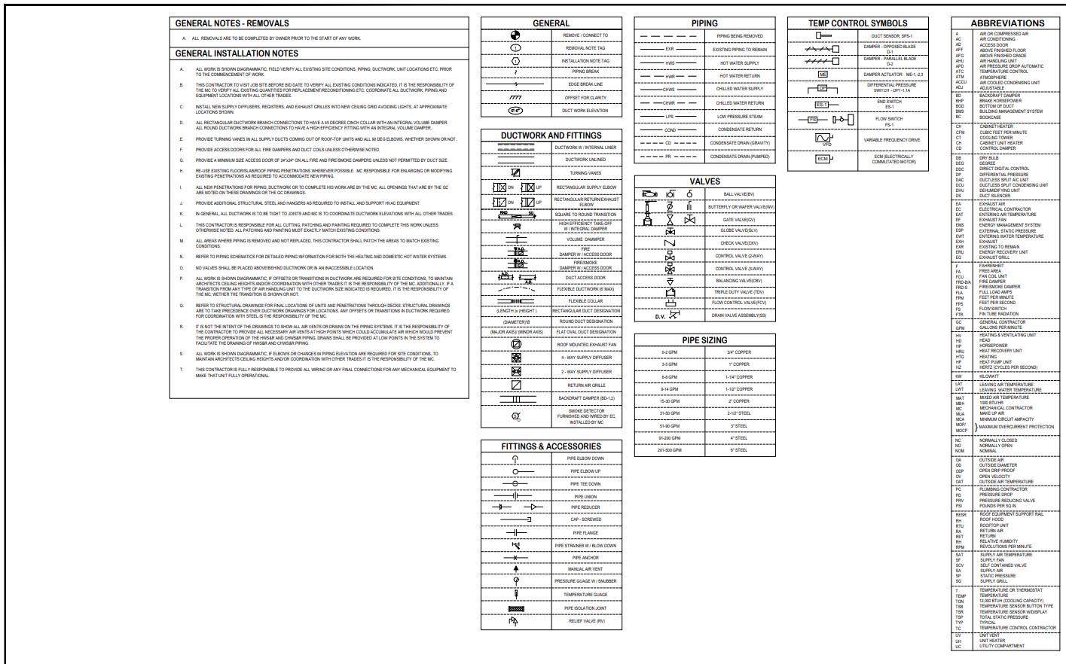
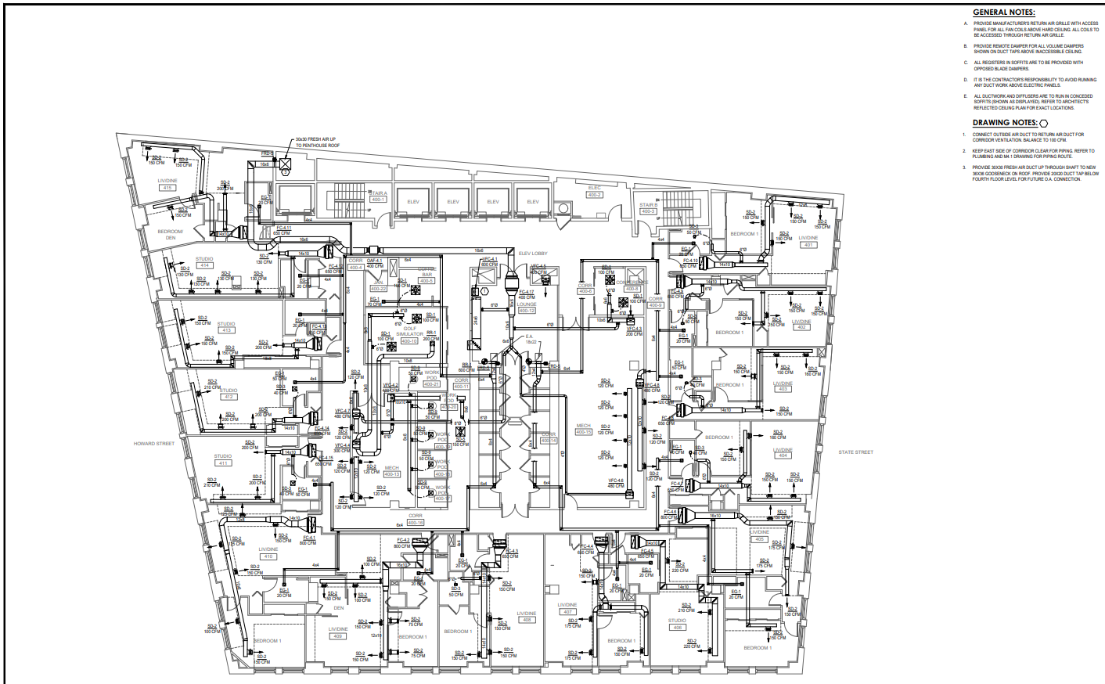
What about something more complex and visual?

Slide 51
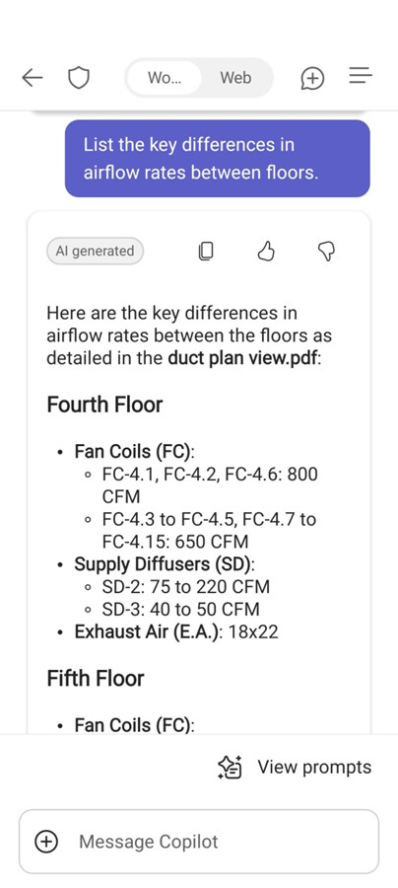
Image recognition scenarios
Construction Worker
Notes:
Maybe Mona is looking to simplify business processes with agents grounded in systems of record. From that agent view, Mona would click the second agent listed, “Customer Care”, to access customer and inventory information.
*click*
This agent can assist in many ways including, but not limited to, accessing the order status of a specific part for a specific customer, summarizing service appointment information, and reporting inventory info. In this case, Mona has a question about her next service appointment.
*click*
She asks for a summary of her next appointment and a list of what she’s going to need to complete the service.
*click*
The agent summarizes key appointment details, like customer name, car type, reason for service, and parts needed. Since it is an air filter change, the agent also lists the different cabin air filters in stock for that type of vehicle.
*click*
Given she plans to use the last Drive Air Filter, she asks the agent to add a task to her task list to order more. Then, she also asks if the agent would recommend ordering any other items.
*click*
The agent responds with a concise message detailing the task it has added to her task list and a recommendation of what to order more of given the low stock alert in her Inventory system.
*click*
This information was pulled from two places. First, the new task was added to the Planner app. And second, the inventory recommendation was sourced from her store’s Dynamics 365 inventory system. These are only two of many sources available to ground your agent in.

Slide 52
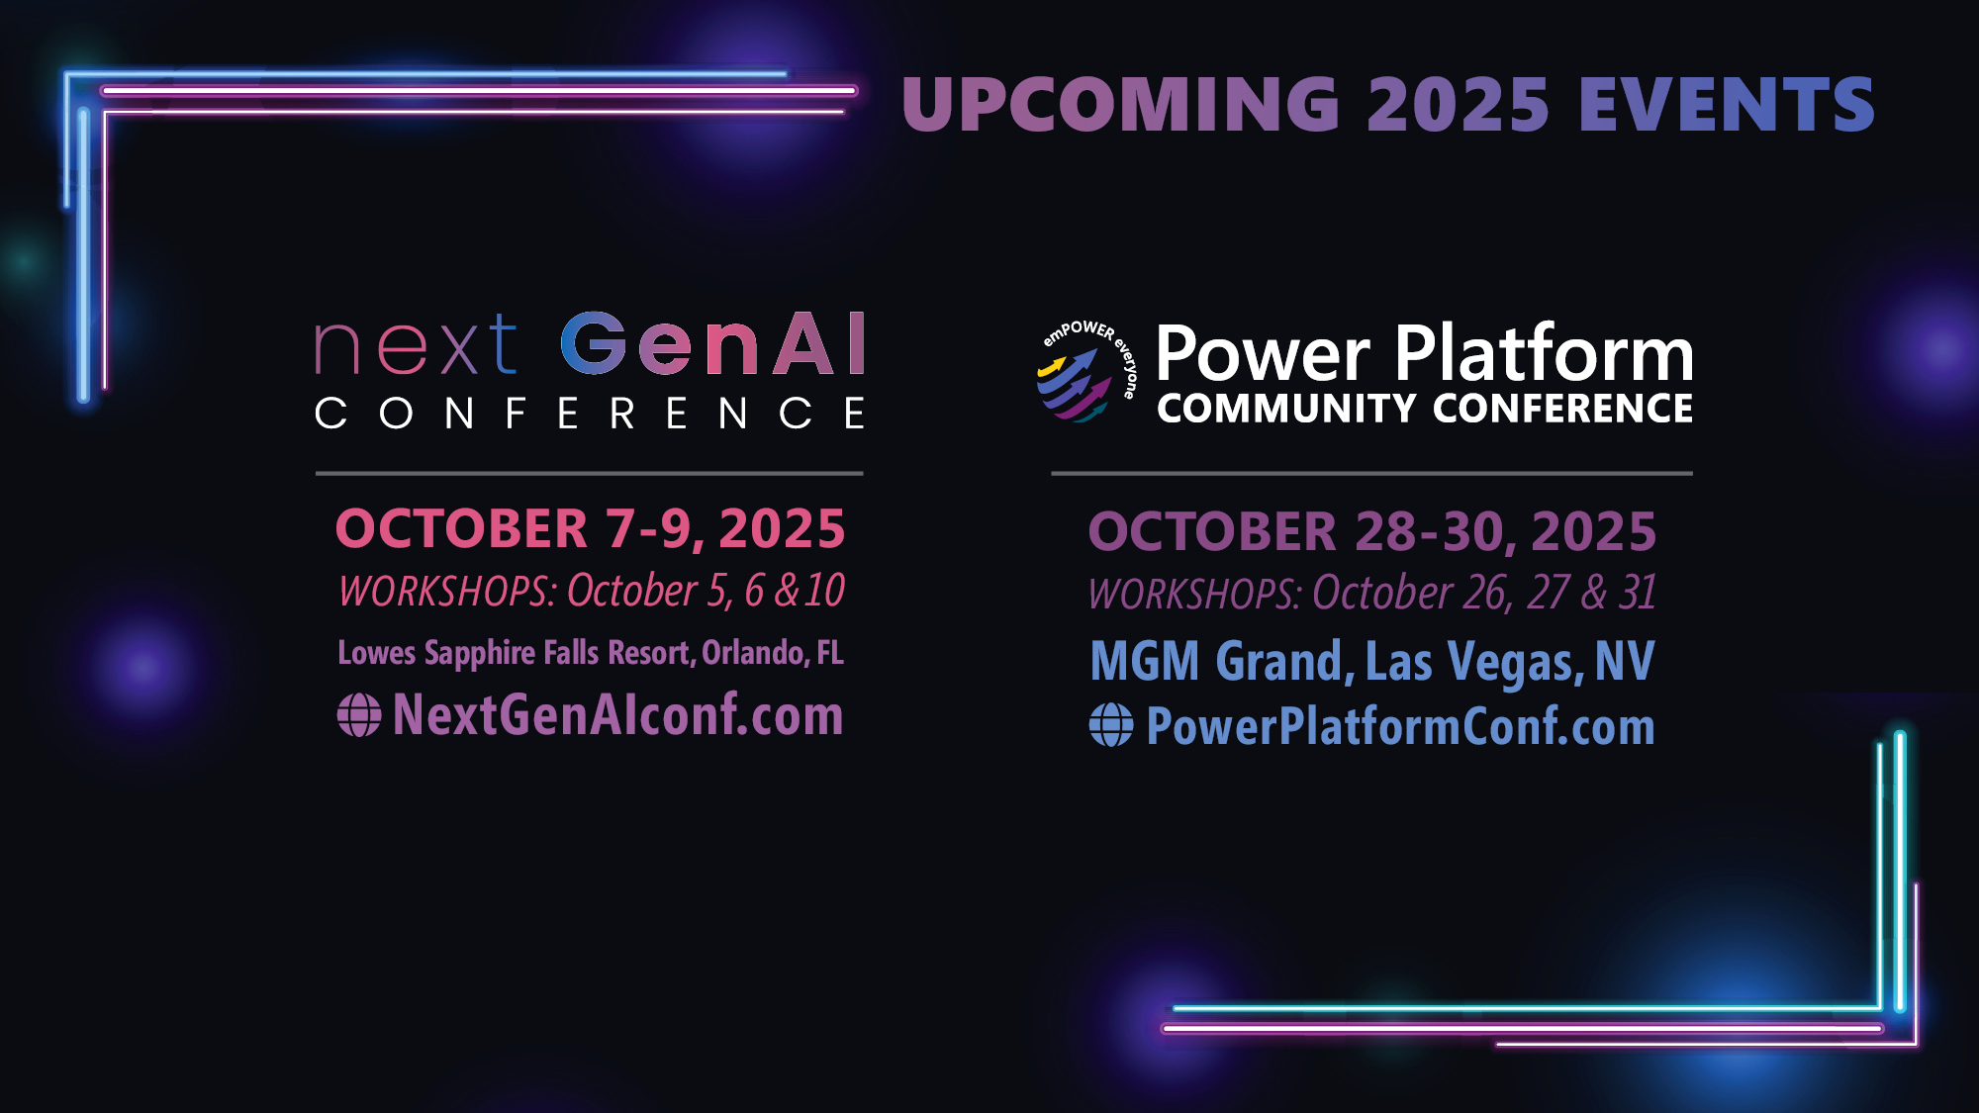

Slide 53

Microsoft 365 Community Conference

Slide 54
Updates and Thank you
    Jul 2023
    Sep
    Oct
    Nov
    Dec
    Jan 2024
    Feb
    Mar
    Apr
    May
    Jun
    Jul 2023
    Sep
    Oct
    Nov
    Dec
    Jan 2024
    Feb
    Mar
    Apr
    May
    Jun
KPMG and Microsoft cloud and AI alliance
Commitments to advance safe, secure, and trustworthy AI
Copilot Copyright Commitment
for customers
Azure AI Content Safety Generally Available
Copilot for
Microsoft 365 enterprise GA
WTI Special Report: Copilot learnings
Copilot search
GA with data protection
Copilot key
on AI-powered
Windows PCs
Copilot
lands at the Super Bowl
Microsoft’s
AI Access Principles
Microsoft
Orca-Math
small language model
New
AI-powered Surface PCs
built for
business
Copilot for Security
generally available
Partnership
with G42 to accelerate
AI in UAE
GitHub Copilot Workspace
in preview
Responsible AI Transparency Report
Investment in Wisconsin for AI and economic growth
Microsoft Fabric
Real-Time intelligence in preview
Khan Academy
and Microsoft partner to expand access to AI tools
New agent capabilities in Microsoft
Copilot Studio
Microsoft Research’s Aurora, a large-scale foundation model
of the atmosphere
KPMG and Microsoft cloud and AI alliance
Commitments to advance safe, secure, and trustworthy AI
Copilot Copyright Commitment
for customers
Azure AI Content Safety Generally Available
Copilot for
Microsoft 365 enterprise GA
WTI Special Report: Copilot learnings
Copilot search
GA with data protection
Copilot key
on AI-powered
Windows PCs
Copilot
lands at the Super Bowl
Microsoft’s
AI Access Principles
Microsoft
Orca-Math
small language model
New
AI-powered Surface PCs
built for
business
Copilot for Security
generally available
Partnership
with G42 to accelerate
AI in UAE
GitHub Copilot Workspace
in preview
Responsible AI Transparency Report
Investment in Wisconsin for AI and economic growth
Microsoft Fabric
Real-Time intelligence in preview
Khan Academy
and Microsoft partner to expand access to AI tools
New agent capabilities in Microsoft
Copilot Studio
Microsoft Research’s Aurora, a large-scale foundation model
of the atmosphere
Meta Llama 2 on Azure and Windows
Microsoft joins Frontier Model Forum
50 years of Microsoft
2 years of AI
Unified
Microsoft Copilot experience
New steps
to help protect elections, AI watermarking tools
AMD MI300X accelerated
VMs in Azure
Copilot integrates multimodal,
GPT-4 Turbo
and DALL·E 3
AI accelerating chemistry
and materials science
AI solutions
in Microsoft Cloud for Sustainability
GitHub Copilot Enterprise
generally available
Expanded
Copilot Pro offerings, including Copilot GPT Builder
New
Responsible
AI tools in
Azure AI
Cohere
Command R+ available on Azure
Expanded Content
Integrity tools
Investments in cloud and AI in Indonesia
Investments in cloud and AI in Thailand
GPT-4o available in Azure AI in preview
GitHub Copilot Extensions in
private preview
Cognition AI partnership
Team Copilot
in preview
Copilot+ PC available
Meta Llama 2 on Azure and Windows
Microsoft joins Frontier Model Forum
Unified
Microsoft Copilot experience
New steps
to help protect elections, AI watermarking tools
AMD MI300X accelerated
VMs in Azure
Copilot integrates multimodal,
GPT-4 Turbo
and DALL·E 3
AI accelerating chemistry
and materials science
AI solutions
in Microsoft Cloud for Sustainability
GitHub Copilot Enterprise
generally available
Expanded
Copilot Pro offerings, including Copilot GPT Builder
New
Responsible
AI tools in
Azure AI
Cohere
Command R+ available on Azure
Expanded Content
Integrity tools
Investments in cloud and AI in Indonesia
Investments in cloud and AI in Thailand
GPT-4o available in Azure AI in preview
GitHub Copilot Extensions in
private preview
Cognition AI partnership
Team Copilot
in preview
Copilot+ PC available
Bing Chat Enterprise and Microsoft 365 Copilot pricing
Moody's generative AI strategic partnership
Copilot in Windows
roll out,
AI-enhanced tools
Public preview of Azure AI Studio
Copilot Studio, Copilot for Sales and Copilot
for Service
AFL-CIO and Microsoft AI tech-labor partnership
Copilot Pro
and expanding
Copilot for
Microsoft 365 availability
to SMBs
Tech accord
to combat
AI deepfakes
in elections
Microsoft
Copilot for Finance
NVIDIA GB200
Grace Blackwell processor
on Azure
New
Microsoft AI
Hub in London
Microsoft’s
Phi-3-mini
model now available
Estee Lauder
and Microsoft increase collaboration
Microsoft and OpenAI launch Societal Resilience Fund
Investment in
France to accelerate AI and skilling
Microsoft
Phi-3-vision model
in preview
AMD MI300X accelerated VMs
in Azure GA
Digital
ecosystem and
AI initiatives
for Kenya
Microsoft and healthcare orgs expand Trustworthy & Responsible AI Network
Bing Chat Enterprise and Microsoft 365 Copilot pricing
Moody's generative AI strategic partnership
Copilot in Windows
roll out,
AI-enhanced tools
Public preview of Azure AI Studio
Copilot Studio, Copilot for Sales and Copilot
for Service
AFL-CIO and Microsoft AI tech-labor partnership
Copilot Pro
and expanding
Copilot for
Microsoft 365 availability
to SMBs
Tech accord
to combat
AI deepfakes
in elections
Microsoft
Copilot for Finance
NVIDIA GB200
Grace Blackwell processor
on Azure
New
Microsoft AI
Hub in London
Microsoft’s
Phi-3-mini
model now available
Estee Lauder
and Microsoft increase collaboration
Microsoft and OpenAI launch Societal Resilience Fund
Investment in
France to accelerate AI and skilling
Microsoft
Phi-3-vision model
in preview
AMD MI300X accelerated VMs
in Azure GA
Digital
ecosystem and
AI initiatives
for Kenya
Microsoft and healthcare orgs expand Trustworthy & Responsible AI Network
GitHub Copilot
Chat beta
Microsoft
Azure Maia & Microsoft Azure Cobalt chips
Phi-2, a SLM
with remarkable performance
Walmart unveils new GenAI capabilities
Microsoft and
Mistral AI partnership
FWD Group builds AI-driven insurance experiences
Formed new Consumer
AI team
Investments in cloud and AI infrastructure
in Japan
Coca-Cola AI
and cloud partnership
Work Trend Index details the
state of AI
Announcing
Copilot+ PC
Phi-3-mini,
Phi-3-small, and Phi-3-medium generally available
Cobalt 100
Arm-based virtual machines in preview
Siemens
delivers
AI-enhanced solutions
Hitachi and
Microsoft milestone GenAI agreement
GitHub Copilot
Chat beta
Microsoft
Azure Maia & Microsoft Azure Cobalt chips
Phi-2, a SLM
with remarkable performance
Walmart unveils new GenAI capabilities
Microsoft and
Mistral AI partnership
FWD Group builds AI-driven insurance experiences
Formed new Consumer
AI team
Investments in cloud and AI infrastructure
in Japan
Coca-Cola AI
and cloud partnership
Work Trend Index details the
state of AI
Announcing
Copilot+ PC
Phi-3-mini,
Phi-3-small, and Phi-3-medium generally available
Cobalt 100
Arm-based virtual machines in preview
Siemens
delivers
AI-enhanced solutions
Hitachi and
Microsoft milestone GenAI agreement
Notes:
We are making fantastic progress.
When you look at all of these announcements that we’ve made in the past year, it’s not just the pace of innovation, but it’s the pace of adoption that has been remarkable.
Together, we’ve moved from talking about AI to deploying AI at scale.

Slide 55














Wheel of Services
Notes:
SharePoint is the most flexible solution in the industry.
It has rich collaboration, workflow, and compliance capabilities.
It powers document in OneDrive and Office, to employee experiences with SharePoint sites and Viva. We’re adding new capabilities like Loop and Whiteboard and rich media with photos, stream, designer, etc.
And it powers custom applications – in your tenant or a special version of SharePoint we released for content business apps called SharePoint Embedded.

Slide 56
Getting started!
Low Value
High Complexity
High Value
High Complexity
Autonomous
Agents
Task
Agents
Low Value
Low Complexity
High Value
Low Complexity
Complexity
Retrieval Agents
Value

Slide 57
Our enterprise AI commitments
1
2
3
4
5
Your data is your data
Customer Copyright Commitment
Our approach to privacy and Responsible AI
Secure Future Initiative
Sustainability by design
Responsible AI principles
Notes:
And Microsoft runs on trust. We are committed to security, privacy, and compliance across everything we do, and our approach to AI is no different.
Trust has been a fundamental promise we have built into the Microsoft Cloud since the very beginning.
Data is the fuel that powers AI technology – and you need to trust what your technology partners are doing with your data.
First, your data is your data. It is not our data. It is your data. That means it is yours to own and control. Your data to choose how you want to leverage and monetize.
Your data is not used to train or enrich the foundational AI models used by others without your permission, so you don’t have to worry about anyone other than your organization benefiting from AI that is trained on your data.
And your data and AI models are protected at every step by the most comprehensive enterprise compliance and security controls in the industry.
You’re also protected through our customer copyright commitment.

Slide 58
Copilot is the UI for AI
Copilot
Agents
Copilot Control System
Notes:
At Ignite, we introduced our vision and strategy for Copilot + Agents.
It all starts with people and human ingenuity.
We envision every employee having a Copilot – their trusted AI assistant. Copilot understands you and your work context, and it provides a consistent user experience to interact with AI.
Agents augment Copilot by adding skills and knowledge to automate tasks and business processes.
Our ambition is to empower every employee with a Copilot and to transform every process with agents.
Importantly, we provide governance and controls for data protection, agent management, and the reporting needed to measure business outcomes. This is what we announced at Ignite as the “Copilot Control System”.

Slide 63
We have an exciting future ahead.
Notes:
Thank you.
<Speaker Guidance: Spend the last few minutes discussing or answering any questions they may have. If they have additional topics on their EBC agenda, make sure you connect with their account team to inform them which AI priorities and business outcomes resonated the most during this session. If you are in a 1:1 direct customer engagement, make sure you note what their priorities and questions were and work with the broader account teams and units to facilitate the proper hand-offs or next steps (i.e. get them into a session at the Innovation Hub/MTCs).>

Slide 64
Expertise and tools for your journey
Technical expertise via our FastTrack partners
Tools, resources & training on our Adoption Hub
Events and real-world knowledge in our community
aka.ms/Microsoft/FastTrack
adoption.microsoft.com
aka.ms/TechCommunity
Notes:
Please leave this slide in for conference attendees.

