Slide 1

Microsoft 365 Community Conference

Slide 2


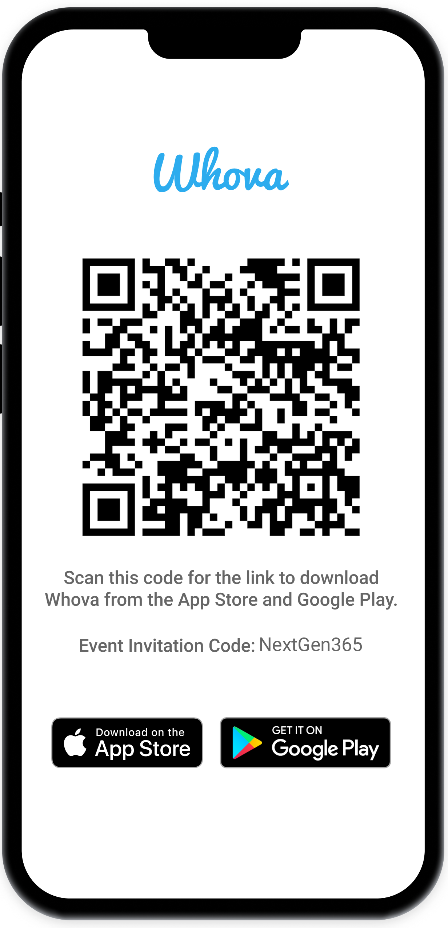
Join the event app to access:
The official event app for the
Microsoft 365 Community Conference
Event invitation code: NextGen2025
Event announcements
Personalized agenda, session details
Speaker & attendee profiles
Networking, meet-ups, messages
Event documents

Slide 3



How to Get What You Want The Art of Prompt Engineering for Copilot
Diana Phillips
Principal Partner Solution Architect
/UtahITPro
Michelle Gilbert
Principal M365 Copilot Architect, Microsoft
/michelleanngilbert

Slide 4
Updates and Thank you
Jul 2023
Sep
Oct
Nov
Dec
Jan 2024
Feb
Mar
Apr
May
Jun
Jul 2023
Sep
Oct
Nov
Dec
Jan 2024
Feb
Mar
Apr
May
Jun
KPMG and Microsoft cloud and AI alliance
Commitments to advance safe, secure, and trustworthy AI
Copilot Copyright Commitment for customers
Azure AI Content Safety Generally Available
Copilot for Microsoft 365 enterprise GA
WTI Special Report: Copilot learnings
Copilot search GA with data protection
Copilot key on AI-powered Windows PCs
Copilot lands at the Super Bowl
Microsoft’s AI Access Principles
Microsoft Orca-Math small language model
New AI-powered Surface PCs built for business
Copilot for Security generally available
Partnership with G42 to accelerate AI in UAE
GitHub Copilot Workspace in preview
Responsible AI Transparency Report
Investment in Wisconsin for AI and economic growth
Microsoft Fabric Real-Time intelligence in preview
Khan Academy and Microsoft partner to expand access to AI tools
New agent capabilities in Microsoft Copilot Studio
Microsoft Research’s Aurora, a large-scale foundation model of the atmosphere
KPMG and Microsoft cloud and AI alliance
Commitments to advance safe, secure, and trustworthy AI
Copilot Copyright Commitment for customers
Azure AI Content Safety Generally Available
Copilot for Microsoft 365 enterprise GA
WTI Special Report: Copilot learnings
Copilot search GA with data protection
Copilot key on AI-powered Windows PCs
Copilot lands at the Super Bowl
Microsoft’s AI Access Principles
Microsoft Orca-Math small language model
New AI-powered Surface PCs built for business
Copilot for Security generally available
Partnership with G42 to accelerate AI in UAE
GitHub Copilot Workspace in preview
Responsible AI Transparency Report
Investment in Wisconsin for AI and economic growth
Microsoft Fabric Real-Time intelligence in preview
Khan Academy and Microsoft partner to expand access to AI tools
New agent capabilities in Microsoft Copilot Studio
Microsoft Research’s Aurora, a large-scale foundation model of the atmosphere
Meta Llama 2 on Azure and Windows
Microsoft joins Frontier Model Forum
Unified Microsoft Copilot experience
New steps to help protect elections, AI watermarking tools
AMD MI300X accelerated VMs in Azure
Copilot integrates multimodal, GPT-4 Turbo and DALL·E 3
AI accelerating chemistry and materials science
AI solutions in Microsoft Cloud for Sustainability
GitHub Copilot Enterprise generally available
Expanded Copilot Pro offerings, including Copilot GPT Builder
New Responsible AI tools in Azure AI
Cohere Command R+ available on Azure
Expanded Content Integrity tools
Investments in cloud and AI in Indonesia
Investments in cloud and AI in Thailand
GPT-4o available in Azure AI in preview
GitHub Copilot Extensions in private preview
Cognition AI partnership
Team Copilot in preview
Copilot+ PC available
Meta Llama 2 on Azure and Windows
Microsoft joins Frontier Model Forum
Unified Microsoft Copilot experience
New steps to help protect elections, AI watermarking tools
AMD MI300X accelerated VMs in Azure
Copilot integrates multimodal, GPT-4 Turbo and DALL·E 3
AI accelerating chemistry and materials science
AI solutions in Microsoft Cloud for Sustainability
GitHub Copilot Enterprise generally available
Expanded Copilot Pro offerings, including Copilot GPT Builder
New Responsible AI tools in Azure AI
Cohere Command R+ available on Azure
Expanded Content Integrity tools
Investments in cloud and AI in Indonesia
Investments in cloud and AI in Thailand
GPT-4o available in Azure AI in preview
GitHub Copilot Extensions in private preview
Cognition AI partnership
Team Copilot in preview
Copilot+ PC available
Bing Chat Enterprise and Microsoft 365 Copilot pricing
Moody's generative AI strategic partnership
Copilot in Windows roll out, AI-enhanced tools
Public preview of Azure AI Studio
Copilot Studio, Copilot for Sales and Copilot for Service
AFL-CIO and Microsoft AI tech-labor partnership
Copilot Pro and expanding Copilot for Microsoft 365 availability to SMBs
Tech accord to combat AI deepfakes in elections
Microsoft Copilot for Finance
NVIDIA GB200 Grace Blackwell processor on Azure
New Microsoft AI Hub in London
Microsoft’s Phi-3-mini model now available
Estee Lauder and Microsoft increase collaboration
Microsoft and OpenAI launch Societal Resilience Fund
Investment in France to accelerate AI and skilling
Microsoft Phi-3-vision model in preview
AMD MI300X accelerated VMs in Azure GA
Digital ecosystem and AI initiatives for Kenya
Microsoft and healthcare orgs expand Trustworthy & Responsible AI Network
Bing Chat Enterprise and Microsoft 365 Copilot pricing
Moody's generative AI strategic partnership
Copilot in Windows roll out, AI-enhanced tools
Public preview of Azure AI Studio
Copilot Studio, Copilot for Sales and Copilot for Service
AFL-CIO and Microsoft AI tech-labor partnership
Copilot Pro and expanding Copilot for Microsoft 365 availability to SMBs
Tech accord to combat AI deepfakes in elections
Microsoft Copilot for Finance
NVIDIA GB200 Grace Blackwell processor on Azure
New Microsoft AI Hub in London
Microsoft’s Phi-3-mini model now available
Estee Lauder and Microsoft increase collaboration
Microsoft and OpenAI launch Societal Resilience Fund
Investment in France to accelerate AI and skilling
Microsoft Phi-3-vision model in preview
AMD MI300X accelerated VMs in Azure GA
Digital ecosystem and AI initiatives for Kenya
Microsoft and healthcare orgs expand Trustworthy & Responsible AI Network
GitHub Copilot Chat beta
Microsoft Azure Maia & Microsoft Azure Cobalt chips
Phi-2, a SLM with remarkable performance
Walmart unveils new GenAI capabilities
Microsoft and Mistral AI partnership
FWD Group builds AI-driven insurance experiences
Formed new Consumer AI team
Investments in cloud and AI infrastructure in Japan
Coca-Cola AI and cloud partnership
Work Trend Index details the state of AI
Announcing Copilot+ PC
Phi-3-mini, Phi-3-small, and Phi-3-medium generally available
Cobalt 100 Arm-based virtual machines in preview
Siemens delivers AI-enhanced solutions
Hitachi and Microsoft milestone GenAI agreement
GitHub Copilot Chat beta
Microsoft Azure Maia & Microsoft Azure Cobalt chips
Phi-2, a SLM with remarkable performance
Walmart unveils new GenAI capabilities
Microsoft and Mistral AI partnership
FWD Group builds AI-driven insurance experiences
Formed new Consumer AI team
Investments in cloud and AI infrastructure in Japan
Coca-Cola AI and cloud partnership
Work Trend Index details the state of AI
Announcing Copilot+ PC
Phi-3-mini, Phi-3-small, and Phi-3-medium generally available
Cobalt 100 Arm-based virtual machines in preview
Siemens delivers AI-enhanced solutions
Hitachi and Microsoft milestone GenAI agreement
Notes:
We are making fantastic progress.
When you look at all of these announcements that we’ve made in the past year, it’s not just the pace of innovation, but it’s the pace of adoption that has been remarkable.
Together, we’ve moved from talking about AI to deploying AI at scale.

Slide 5














Wheel of Services
Notes:
SharePoint is the most flexible solution in the industry.
It has rich collaboration, workflow, and compliance capabilities.
It powers document in OneDrive and Office, to employee experiences with SharePoint sites and Viva. We’re adding new capabilities like Loop and Whiteboard and rich media with photos, stream, designer, etc.
And it powers custom applications – in your tenant or a special version of SharePoint we released for content business apps called SharePoint Embedded.

Slide 6
Copilot is the UI for AI
Copilot
Agents
Copilot Control System
Notes:
At Ignite, we introduced our vision and strategy for Copilot + Agents.
It all starts with people and human ingenuity.
We envision every employee having a Copilot – their trusted AI assistant. Copilot understands you and your work context, and it provides a consistent user experience to interact with AI.
Agents augment Copilot by adding skills and knowledge to automate tasks and business processes.
Our ambition is to empower every employee with a Copilot and to transform every process with agents.
Importantly, we provide governance and controls for data protection, agent management, and the reporting needed to measure business outcomes. This is what we announced at Ignite as the “Copilot Control System”.

Slide 7
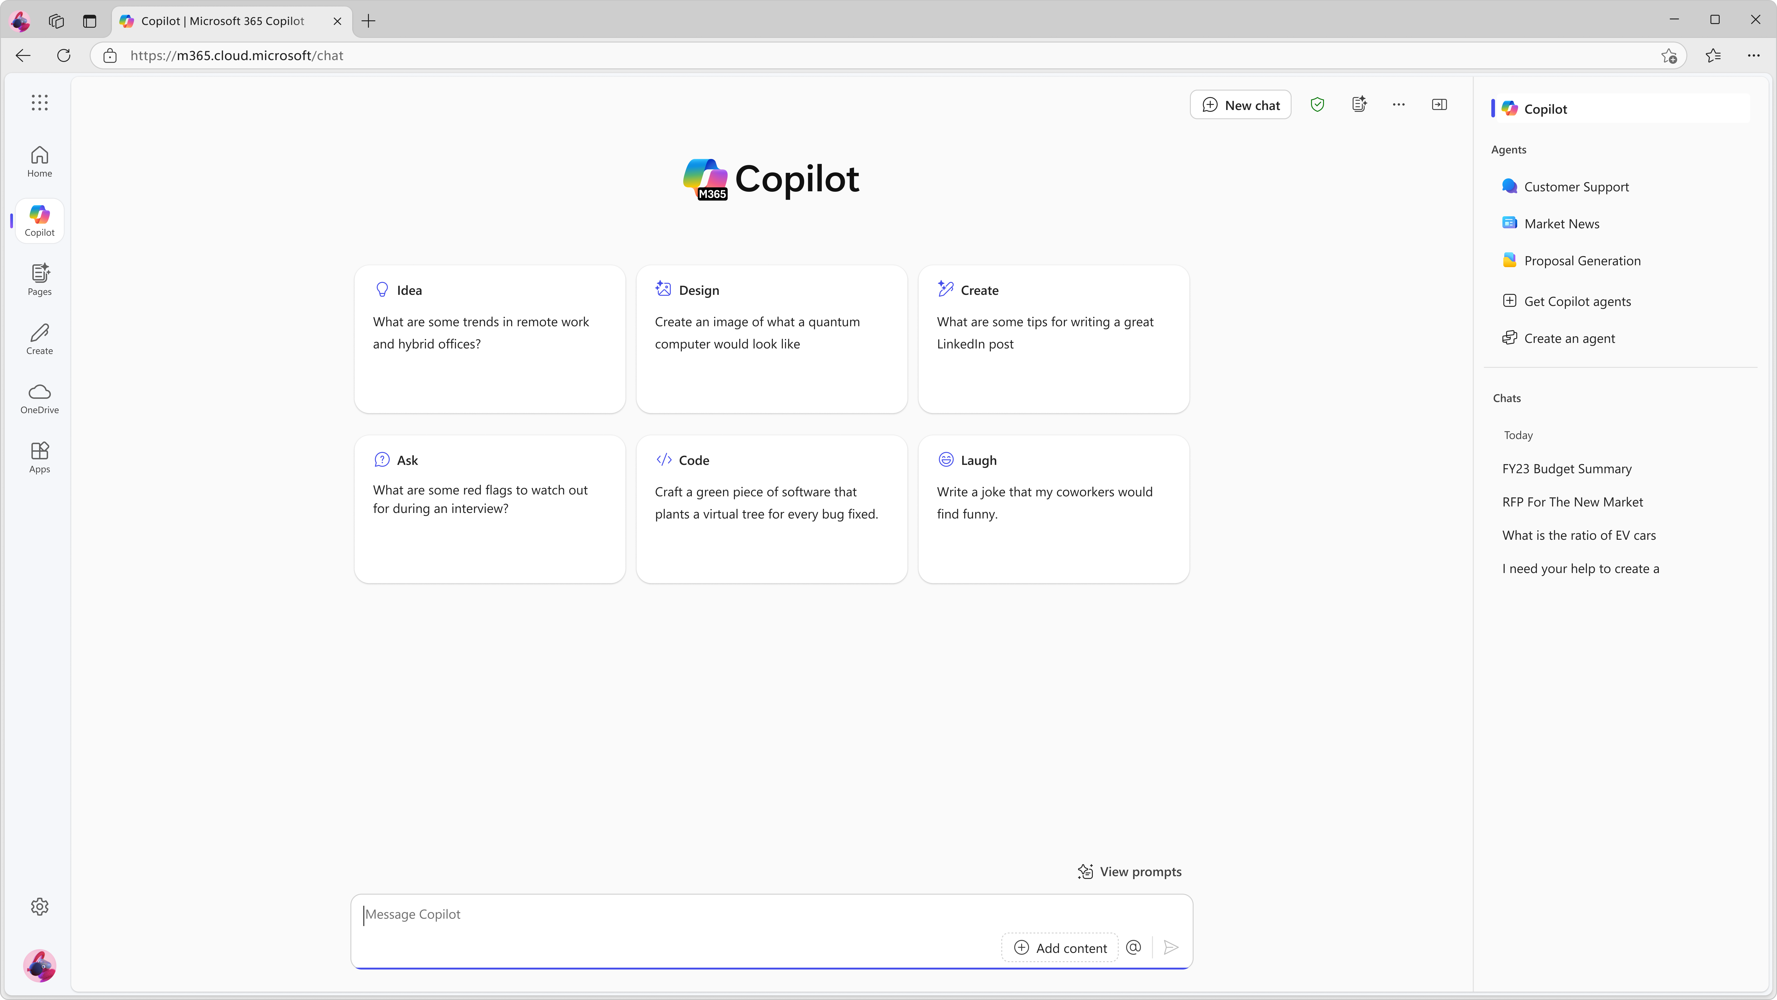

What is a Prompt?
Prompts are how you have a conversation with Copilot
A prompt is a set of instructions or questions you use to tell Copilot what you want it to do.
Get started by entering your prompt in the text box

Slide 8


What makes an effective prompt?
Less Effective
More Effective
Vague
Just a few words
No context on preferred output
Example: Summarize news about [company name].
The recap may be more vague than desired, or in a format that you were not seeking.
Specific and detailed
In full sentences, with instructions
States the tone, purpose, preferred format, etc.
Example: I work in marketing and focus on competitor research. Give me a concise summary of recent news about [company name]. Focus on announcements about new product lines. Provide the answer in two to three paragraphs and use a business tone.
But there are no ‘wrong’ prompts because natural, conversational language is welcome.
Experiment away!

Slide 9
The art and science of prompting
1. Tell Copilot what you need
Prompts are how you ask Copilot to do something for you — like creating, summarizing, editing, or transforming.
Think about prompting like having a conversation, using plain but clear language and providing context like you would with an assistant.
Learn about projects and concepts:
"What is [Project X] and who are the key stakeholders working on it?"
Edit text:
"Check this product launch rationale for inconsistencies."
Transform documents:
"Transform this FAQ doc into a 10-slide onboarding guide."
Summarize information:
"Write a session abstract of this [presentation]."
Create engaging content:
"Create a value proposition for [Product X]."
Catch-up on missed items:
"Provide a summary of the updates and action items on [Project X]."

Slide 10





How can Copilot help you with your work?
Recap a meeting
Tell me about a topic/project
Draft an email with notes and action items from meeting
Tell me what's new about topic organized by emails, chats, and files?
Summarize an email thread
Give me some ideas for …
Click on the Summarize icon
Suggest 10 compelling taglines based on file
Draft an email
Help me write…
Draft an email to [name] that informs them about Project X ..
Generate three ways to say [x]
Summarize a document
What did they say …
Give me a bulleted list of key points from file
What did person say about topic

Slide 11
How can we improve these prompts to make them more effective?

Slide 12
The art and science of prompting
2. Include the right prompt ingredients
Goal
Context
Expectations
Goal
Context
Source
Expectations
To get the best response, it’s important to focus on some of the key elements when phrasing your Copilot prompts.
Source
What response do you want from Copilot?
Why do you need it and who is involved?
Which information sources or samples should Copilot use?
How should Copilot respond
to best meet your expectations?
Notes:
Prompts are a very important concept for copilot, as this is the main mechanism for interacting with copilot
Prompts refer to the sentences or phrases you use to ask copilot to do something for you
This could be anything from summarizing, creating, editing or analyzing a piece of information
It’s very similar to having a conversation with another person, like if someone was your assistant
The first step is to get your goal across – what do you need?
Do you want to learn about a topic?
Edit or proofread existing text?
How about transforming information into a different format?
Copilot can summarize and create content for you as well, which can help you catch up with outstanding items you may have missed

Slide 13
GCSE Good Better Best Approach
Good
Better
Best
“Draft an email about a product launch.”
“You’re an IT professional. Draft and email about a product launch with three paragraphs, one expressing excitement, the second asking for leadership support, and the third sharing resources.”
“You’re an IT professional. Draft and email about a product launch with three paragraphs, one expressing excitement, the second asking for leadership support, and the third sharing resources. Include links to the appropriate support documents.
Goal
Context
Source
Expectations
Notes:
To help customers on this journey, we created The Copilot Success Kit which includes a proven collection of resources to help accelerate your organizations’ onboarding and adoption.
It includes several tools including an implementation summary guide, adoption guide for leaders, user enablement tips, and a technical readiness guide and a lot more.

Slide 14
The art and science of prompting
2. Include the right prompt ingredients
Goal
Context
To get the best response, it’s important to focus on some of the key elements when phrasing your Copilot prompts.
What response do you want from Copilot?
Why do you need it and who is involved?
Generate 3-5 bullet points
Generate 3-5 bullet points to prepare me for a meeting with Client X to discuss their “Phase 3+” brand campaign.
Generate 3-5 bullet points to prepare me for a meeting with Client X to discuss their “Phase 3+” brand campaign. Focus on Email and Teams chats since June.
Generate 3-5 bullet points to prepare me for a meeting with Client X to discuss their “Phase 3+” brand campaign. Focus on Email and Teams chats since June. Please use simple language so I can get up to speed quickly.
Which information sources or samples should Copilot use?
How should Copilot respond
to best meet your expectations?
Source
Expectations
Notes:
Let’s break this down and look at how this applies to a prompt.

Slide 15
The art and science of prompting
3. Ask yourself these questions when prompting
Consider how to make your prompts more impactful by thinking about how Copilot can help in your entire workflow.
Why am I using this prompt?
What is the context for this task.
What will I do with the output of this prompt?
Am I going to send it on to someone else? Transform it into a different format?
Can I extend Copilot’s remit to save more time
Can I ask Copilot to do a bigger task to automate more work?
Notes:
Third, we want to keep that conversation going
It’s impossible to always write the perfect prompt, so definitely follow up with more prompts until you reach the response you’re looking for
Sometimes it helps to breakdown a task into multiple steps(prompts) too, so you can verify after each step that copilot is being guided in the right direction

Slide 16
The art and science of prompting
4. Keep the conversation going
Generating content ideas
Lead with broader requests, then give specific details about the content.
Gaining insights
Ask for a summary of a specific file, then ask relevant questions to gain deeper insights.
Following up on your prompts helps you collaborate with Copilot, to gain more useful, tailored responses.
Enabling insightful meetings
Request a meeting recap, then ask for more information about what you should know​.
Translating languages
Ask Copilot to translate a sentence to one of the supported languages, then ask for more context or a regional dialect.
Storytelling assistance
Ask Copilot to write a story, then guide it by giving more specific, relevant details​.
Solving technical problems
Present a technical problem, then narrow it down, or ask for step-by-step guidance​.
Notes:
Third, we want to keep that conversation going
It’s impossible to always write the perfect prompt, so definitely follow up with more prompts until you reach the response you’re looking for
Sometimes it helps to breakdown a task into multiple steps(prompts) too, so you can verify after each step that copilot is being guided in the right direction

Slide 17
Prompting best practices

Slide 18

Keep it simple
and conversational
1
Using everyday language and a friendly tone helps Copilot understand your intent clearly.
Imagine you’re chatting with a helpful friend over coffee.

Slide 19
Be specific
and actionable
2
Clarity is key. Clearly state what you want Copilot to do.
Instead of vague requests, provide specific tasks or outcomes.

Slide 20
Know when to
avoid making
a prompt
3
Over-complication. Avoid conflicting instructions or overly complex prompts.
Assumptions. Don't assume Copilot has the context from previous interactions unless within the same session.

Slide 21
Understand
Copilot’s limitations
4
Break down complex tasks. Simplify tasks for Copilot by breaking them down into smaller, manageable steps.
Optimize for repetition. Use Copilot for repetitive tasks to save time and effort.
Random responses. Responses you get from Copilot are random. Using the same prompt multiple times can result in different responses.

Slide 22
Be polite
5
Using polite language sets a tone for the response. Generative AI also mirrors the levels of professionalism, clarity, and detail in the inputs you provide.

Slide 23
Be curious
6
Experiment! Explore different prompt structures and approaches.
Curiosity fuels creativity and helps you discover Copilot’s capabilities.

Slide 24
Test and refine
7
Like any collaboration, iterate. Adjust prompts based on results.
Test variations, observe outcomes, and fine-tune your approach.

Slide 25


Use speech to prompt
8
Leverage the built-in Windows dictation feature to streamline your Copilot prompting process. By speaking your prompts instead of typing, you can save time and enhance productivity.
Simply press Win + H to start dictating and let your ideas flow effortlessly into Copilot.
Windows logo key + H

Slide 26

Your prompt needs to tell a story about your end goal. Don’t be afraid to be verbose. Imagine you just got a new assistant!
Notes:
You can use Copilot for many things, including to help you learn, write something new for you, summarize long documents, change the way something is delivered (e.g. instead of in Word, convert it to PowerPoint), edit documents, analyze and extract information from documents, or help you catch-up on key information.

Slide 27
Switch the word "summarize" with other verbs for different results:
Try these!
Summarize: When you want a quick overview of a lengthy topic.
Paraphrase: This is useful when you want to avoid plagiarism
Reframe: Change the perspective or focus of the rewrite.
Expand: For a more comprehensive understanding of a topic.
Explain: Make the meaning of something clearer in the rewrite.
Reinterpret: Provide a possible meaning or understanding.
Simplify: Reduce the complexity of the language.
Elaborate: Add more detail or explanation to a given point.
Amplify: Strengthen the message or point in the rewrite.
Clarify: Make a confusing point or statement clearer.
Adapt: Modify the text for a different audience or purpose.
Modernize: Update older language or concepts to be more current.
Formalize: This asks to rewrite informal or casual language into a more formal or professional style. Useful for business or academic contexts.
Informalize: Use this for social media posts, blogs, email campaigns, or any context where a more colloquial style and relaxed tone is right.
Condense: Make the rewrite shorter by restricting it to key points.
Emphasize/Reiterate: Highlight certain points more than others.
Diversify: Add variety, perhaps in sentence structure or vocabulary.
Neutralize: Remove bias or opinion, making the text more objective.
Streamline: Remove unnecessary content or fluff.
Enrich/Embellish: Add more pizzazz or detail to the rewrite.
Illustrate: Provide examples to better explain the point.
Synthesize: Combine different pieces of information.
Sensationalize: Make the rewrite more dramatic. Great for clickbait!
Humanize: Make the text more relatable or personal. Great for blogs!
Elevate: Prompt for a rewrite that is more sophisticated or impressive.
Illuminate: Prompt for a rewrite that is crystal-clear or enlightening.
Enliven/Energize: Means make the text more lively or interesting.
Soft-pedal: Means to downplay or reduce the intensity of the text.
Exaggerate: When you want to hype-up hyperbole in the rewrite. Great for sales pitches (just watch those pesky facts)!
Downplay: When you want a more mellow, mild-mannered tone. Great for research, and no-nonsense evidence-based testimonials.
Glamorize: Prompt to make the rewrite more appealing.

Slide 28
Switch the word "summarize" with other verbs for different results:
Summarize: When you want a quick overview of a lengthy topic.
Paraphrase: This is useful when you want to avoid plagiarism
Reframe: Change the perspective or focus of the rewrite.
Expand: For a more comprehensive understanding of a topic.
Explain: Make the meaning of something clearer in the rewrite.
Reinterpret: Provide a possible meaning or understanding.
Simplify: Reduce the complexity of the language.
Elaborate: Add more detail or explanation to a given point.
Amplify: Strengthen the message or point in the rewrite.
Clarify: Make a confusing point or statement clearer.
Adapt: Modify the text for a different audience or purpose.
Modernize: Update older language or concepts to be more current.
Formalize: This asks to rewrite informal or casual language into a more formal or professional style. Useful for business or academic contexts.
Informalize: Use this for social media posts, blogs, email campaigns, or any context where a more colloquial style and relaxed tone is right.
Condense: Make the rewrite shorter by restricting it to key points.
Emphasize/Reiterate: Highlight certain points more than others.
Diversify: Add variety, perhaps in sentence structure or vocabulary.
Neutralize: Remove bias or opinion, making the text more objective.
Streamline: Remove unnecessary content or fluff.
Enrich/Embellish: Add more pizzazz or detail to the rewrite.
Illustrate: Provide examples to better explain the point.
Synthesize: Combine different pieces of information.
Sensationalize: Make the rewrite more dramatic. Great for clickbait!
Humanize: Make the text more relatable or personal. Great for blogs!
Elevate: Prompt for a rewrite that is more sophisticated or impressive.
Illuminate: Prompt for a rewrite that is crystal-clear or enlightening.
Enliven/Energize: Means make the text more lively or interesting.
Soft-pedal: Means to downplay or reduce the intensity of the text.
Exaggerate: When you want to hype-up hyperbole in the rewrite. Great for sales pitches (just watch those pesky facts)!
Downplay: When you want a more mellow, mild-mannered tone. Great for research, and no-nonsense evidence-based testimonials.
Glamorize: Prompt to make the rewrite more appealing.
Try these!

Slide 29
Switch the word "summarize" with other verbs for different results:
Summarize: When you want a quick overview of a lengthy topic.
Paraphrase: This is useful when you want to avoid plagiarism
Reframe: Change the perspective or focus of the rewrite.
Expand: For a more comprehensive understanding of a topic.
Explain: Make the meaning of something clearer in the rewrite.
Reinterpret: Provide a possible meaning or understanding.
Simplify: Reduce the complexity of the language.
Elaborate: Add more detail or explanation to a given point.
Amplify: Strengthen the message or point in the rewrite.
Clarify: Make a confusing point or statement clearer.
Adapt: Modify the text for a different audience or purpose.
Modernize: Update older language or concepts to be more current.
Formalize: This asks to rewrite informal or casual language into a more formal or professional style. Useful for business or academic contexts.
Informalize: Use this for social media posts, blogs, email campaigns, or any context where a more colloquial style and relaxed tone is right.
Condense: Make the rewrite shorter by restricting it to key points.
Emphasize/Reiterate: Highlight certain points more than others.
Diversify: Add variety, perhaps in sentence structure or vocabulary.
Neutralize: Remove bias or opinion, making the text more objective.
Streamline: Remove unnecessary content or fluff.
Enrich/Embellish: Add more pizzazz or detail to the rewrite.
Illustrate: Provide examples to better explain the point.
Synthesize: Combine different pieces of information.
Sensationalize: Make the rewrite more dramatic. Great for clickbait!
Humanize: Make the text more relatable or personal. Great for blogs!
Elevate: Prompt for a rewrite that is more sophisticated or impressive.
Illuminate: Prompt for a rewrite that is crystal-clear or enlightening.
Enliven/Energize: Means make the text more lively or interesting.
Soft-pedal: Means to downplay or reduce the intensity of the text.
Exaggerate: When you want to hype-up hyperbole in the rewrite. Great for sales pitches (just watch those pesky facts)!
Downplay: When you want a more mellow, mild-mannered tone. Great for research, and no-nonsense evidence-based testimonials.
Glamorize: Prompt to make the rewrite more appealing.
Try these!

Slide 30
Advanced Prompting

Slide 31
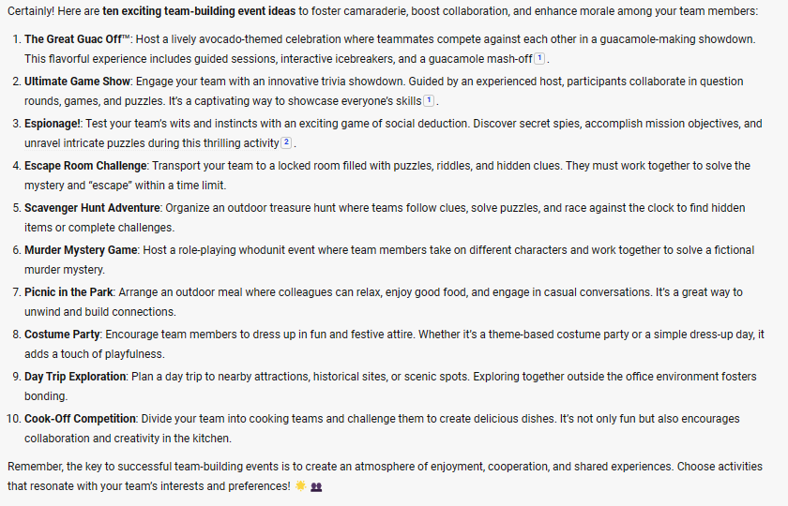
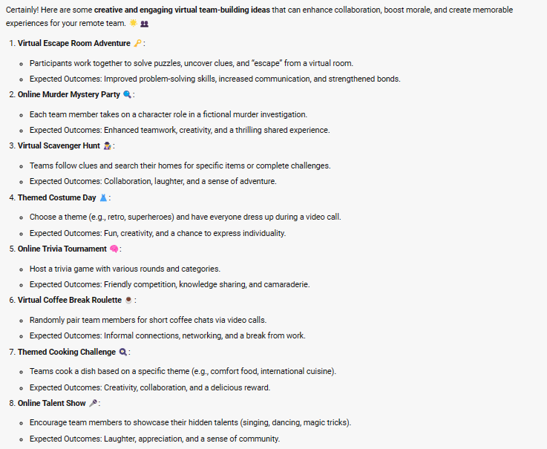
Add rich elaboration prompt example
Initial
Continued
Can you regenerate and make sure that the list contains ideas that encourage collaboration, boosts morale, and will be a memorable experience for all. Please include a brief description of each idea, and the expected outcomes for team morale and cohesion. Use bullet points and add emojis to visually represent each idea.
List 10 ideas for a fun remote team building event
Notes:
On the left I’ve given a really basic ask for what I want – some fun ideas for a fun remote team building event. The results are ok – but honestly, there is nothing particularly special and some ideas really aren’t going to work for truly remote team members.
With the guidance on the right, I’m forcing the model to go beyond just ‘fun’ but to give me results that will meet the goals I have (such as team collaboration), and want it to tell me what I can expect from the ideas it recommends. This not only forces the model to give better results back, but helps me save time reading through the ideas to narrow down what makes most sense for my team.

Slide 32


Elaboration prompt image formatted output
Initial
Continued
Create an image of a group of product people in a virtual meeting.
Regenerate the image. The focus of the image should be a view of the female speaker and a data slide.
The rest of the audience should look engaged,
and one person is giving a thumb up sign.
Notes:
Talking Points:
And finally, here it is again – this time using images. Note that the same principal applies, by specifying the details, such as the primary focus of the image, you can get exactly what you want.
This ‘best practice’ helps up your game to transform what’s in your head to what the LLM delivers as results for you.
(PAUSE a bit)
However, there are a lot of times, when we don’t know exactly what we want until we see it – and that’s ok too. That’s where the next best practice comes in.

Slide 33
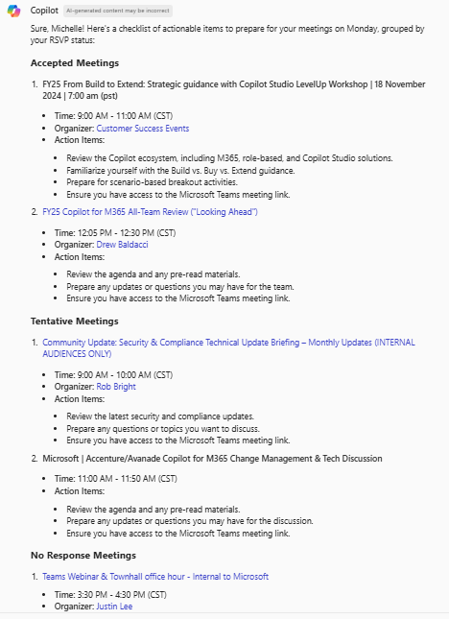

Create actionable briefs
Create a checklist of actionable items I need to do to prepare for meetings on [Monday].
Group by my RSVP status for the meeting,
starting with those I've accepted.
Tip: Support exists for both exact and relative (e.g., tomorrow afternoon) time ranges, so be specific if desired! You can also specify the format in tables.
Notes:
For things you will do often – think every day tasks – or commonly repeating jobs, it is worth the time and effort to iterate to ‘pinpoint’ the perfectly crafted prompt which will get you the ideal response every time.
The best practice here is that it will take iteration to do it well – don’t just take the first version you get with all the requirements, but use each ‘new session’ to tweak and modify piece by piece until you get it right.

Slide 34
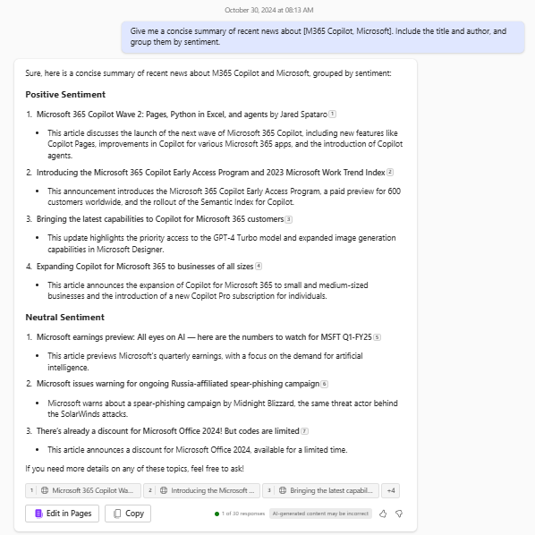
Get Rich Synopsis staying on top of news
Give me a concise summary of recent news about
[product / company].
Include the title and author,
and group them by sentiment.
Tip: Grouping by how you want to view the data helps break down the information and cognitive load.
Notes:
For things you will do often – think every day tasks – or commonly repeating jobs, it is worth the time and effort to iterate to ‘pinpoint’ the perfectly crafted prompt which will get you the ideal response every time.
The best practice here is that it will take iteration to do it well – don’t just take the first version you get with all the requirements, but use each ‘new session’ to tweak and modify piece by piece until you get it right.

Slide 35
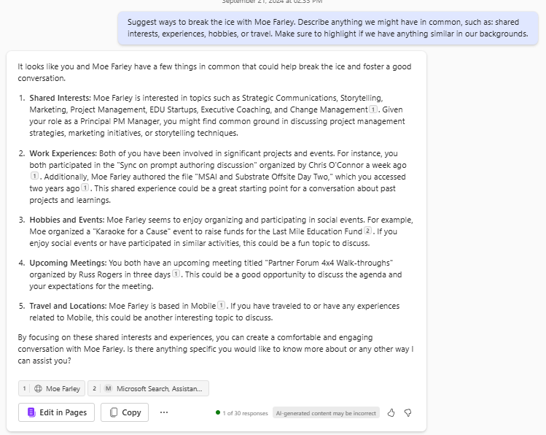
Get Personalized responses learn about people
Who is /person?
Suggest ways to break the ice with /person
Describe anything we might have in common, such as: shared interests, experiences, hobbies, or travel.
Make sure to highlight if we have
anything similar in our backgrounds.
Tip: Microsoft Graph contains lots of information about people, which can be included in a response if/as requested.
Notes:
For things you will do often – think every day tasks – or commonly repeating jobs, it is worth the time and effort to iterate to ‘pinpoint’ the perfectly crafted prompt which will get you the ideal response every time.
The best practice here is that it will take iteration to do it well – don’t just take the first version you get with all the requirements, but use each ‘new session’ to tweak and modify piece by piece until you get it right.

Slide 36
Supercharge your productivity
Hello, Microsoft Copilot! 🚀
I’m on a mission to supercharge my productivity between [START_DATE] and [END_DATE], diving into my Microsoft 365 data: emails, meetings, Teams messages, and documents. Here’s our action plan:
1. Time Allocation Overview 📊:
Create a table showing time spent across emails, meetings, Teams, and document work. Highlight key areas for efficiency gains.
2. Insights 🔍:
Wins: Identify top productive activities.
Challenges: Spot inefficiencies, like lengthy emails or unproductive meetings.
3. Action Plan 🛠️:
Inbox Management: Tips to reduce email clutter.
Effective Meetings: Strategies for purpose-driven meetings.
Teams Collaboration: Optimize message and collaboration flow.
Document Handling: Improve document organization and access.

Slide 37
Create a Sprint
Hello, Microsoft Copilot! 🌞
Let's kick off this week's sprint! I'm ready to plan my work week effectively with your help. Here's what we need to tackle:
1. Prioritize Tasks 🎯: List my key tasks for the week from my Microsoft 365 tasks and emails. Highlight top priorities and deadlines.
2. Allocate Time Blocks ⏳: Suggest a daily schedule allocating time for high-priority tasks, meetings (Calendar), and focused work sessions (Teams & documents).
3. Identify Obstacles 🚧: Based on last week's insights, pinpoint potential hurdles and suggest mitigation strategies.
4. Set Achievement Goals 🏆: Define clear, achievable goals for this sprint to measure success by Friday.
Ready to make this week a triumph with your insights and guidance. Thanks, Copilot!

Slide 38
One Prompt To Rule Them All
Hi Copilot, I'd like you to act as my Prompt engineer. Your goal is to help me craft the best possible prompt for my needs. The purpose of the prompt is that I will use it with you, Copilot.
You must follow the following process during this chat session:
1. Your first response will be to ask me what the prompt should be about. I will provide my answer, but we will need to improve it through continual iterations by going through steps two and three.
2. Based on my input, you will generate two sections.
- Revised prompt (Always provide your revised prompt. It should be clear, concise, and easily understood by you)
- Questions (Ask any relevant questions pertaining to what additional information is needed from me for you to improve the prompt).
3. We will continue this iterative process with me providing additional information to you, and you continuously updating the prompt in the Revised prompt section so I can use it.

Slide 39
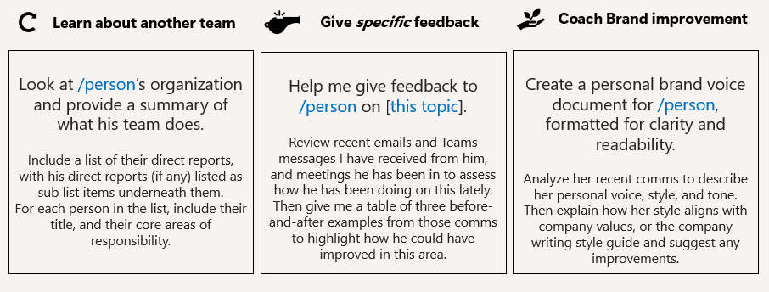
Continue Prompting Use Copilot in your day
Notes:
For things you will do often – think every day tasks – or commonly repeating jobs, it is worth the time and effort to iterate to ‘pinpoint’ the perfectly crafted prompt which will get you the ideal response every time.
The best practice here is that it will take iteration to do it well – don’t just take the first version you get with all the requirements, but use each ‘new session’ to tweak and modify piece by piece until you get it right.

Slide 40




Personalized Approaches
So, tell me what you want… what you really, really want!
I’ll tell you what I want… what I really, really want!
YOU
Notes:
Based on your role

Slide 41
Ask Questions Before Answering
I’m your thought partner
Ask Copilot to gather key details before responding, making answers more relevant.
Help me develop a content marketing plan. But first, ask me questions, considering:
Target audience [describe]
Content types [list]
Distribution channels [list]
Budget [amount]
Goals [objectives]
Roles:
Business Strategist
Project Manager
Everyone ☺
Notes:
Having Copilot ask you questions before generating a response to your main request turns Copilot into a thought partner, rather than just a responder. It ensures that Copilot has the information it needs to become an extension of critical thinking.
This approach could benefit: Business Strategists, Project Managers... Honestly? Everyone. Whether you're crafting a business strategy, planning an event, or even making personal decisions, having Copilot ask the right questions leads to better outcomes.
Imagine a project manager using this technique to structure a complex initiative or a business strategist refining a high-impact campaign.
[Read sample prompt] This approach ensures that you’re considering and conveying vital elements, so that Copilot can help create a marketing plan created with intention rather than assumption..
Call to Action:
"How might this technique transform how you approach problem-solving?"
I encourage you to reflect on situations in your own work, where havaing Copilot ask key questions upfront could elevate your results. The more you integrate this approach into your prompts, the more you unlock Copilot's full potential.
--------------
Target audience: Describe the demographics, interests, and behaviors of your target audience.
Content types: List the types of content you plan to create (e.g., blog posts, videos, infographics).
Distribution channels: List the channels you will use to distribute your content (e.g., social media, email newsletters, SEO).
Budget: Specify the total budget and allocation per channel.
Goals: Define the objectives you aim to achieve with this content marketing plan (e.g., increase brand awareness, generate leads, drive website traffic).
Additional Information: Include any other relevant details or considerations.“

Slide 42
Break Down the Answer into Complexity Levels
I’m a flexible explainer
Understand a topic more fully by using Copilot to understand aspects from different perspectives, such as beginners, intermediates, and experts.
Roles:
Educator
Trainer
Everyone ☺
Explain artificial intelligence in three ways:
For a 10-year-old (use simple analogies and examples)
For a college student (key concepts and applications)
For a data scientist (detailed breakdown of algorithms and models)
Notes:
Copilot isn’t just an information provider—it’s a flexible explainer that can tailor responses based on perspective and expertise. The ability to scale explanations according to audience needs is transformative, and AI becomes a powerful tool in making complex concepts more digestible.
Imagine using this method in different fields—medicine, finance, engineering, or even corporate strategy. Not only can this approach help you learn a new topic with ease, it can also be used as a tool for those trying to explain concepts to others. Whether you’re training employees, teaching students, or presenting to executives, structuring responses by complexity levels ensures clarity and engagement.
[Read example prompt] Each audience needs a different level of detail, examples, and terminology. With the right prompt, you can control how Copilot explains a topic in ways that are clear, accessible, and insightful for any level of understanding. Call to Action:
"Think about the most complex topic you deal with in your work. How could this prompt technique help you explain it more effectively?"
I encourage you to reflect on your own field or life in general and how you might apply this technique to learn or communicate ideas more clearly.

Slide 43

Identify Mistakes and Provide Fixes
I’m your intelligent reviewer
Leverage Copilot to find issues to improve content, code, or strategies
Review this marketing campaign. Identify 3 key mistakes that could hinder its success. For each, explain why it is problematic and suggest an alternative solution.
Roles:
Quality Assurance Specialist
Developer
Everyone ☺
Notes:
No matter what field you’re in, mistakes happen. But what if we could spot potential pitfalls before they derail your project?
With the right prompt, Copilot can act as an intelligent reviewer, pinpointing issues and suggesting improvements to elevate your content, code, or strategy.
Who might benefits? Quality Assurance Specialists, Developers… but truly, Everyone.
Imagine a marketing team using this to catch messaging flaws, a developer refining code before deployment, or an entrepreneur ensuring their business strategy is airtight. By embracing AI’s ability to analyze and correct, teams can significantly improve efficiency, creativity, and precision.
[Read prompt – note attachment] Whether it’s a flawed press release, a buggy software feature, or an inefficient business plan, asking Copilot to identify mistakes and offer fixes transforms it from a reactive tool into a proactive problem solver.

Slide 44

Identify Mistakes and Provide Fixes
I’m your intelligent reviewer
Example Response:
Mistake 1: Lack of Clear Target Audience:
Problem: Without a defined target audience, the campaign may fail to resonate with potential customers.
Alternative Solution: Conduct market research to identify and define the target audience.
Mistake 2: Ineffective Call to Action:
Problem: A weak or unclear call to action may result in low engagement and conversion rates.
Alternative Solution: Create a compelling and clear call to action that encourages immediate action.
Mistake 3: Poor Content Quality:
Problem: Low-quality content can negatively impact the brand's image and reduce the effectiveness of the campaign.
Alternative Solution: Invest in high-quality content creation and ensure it aligns with the brand's values and messaging.
Leverage Copilot to find issues to improve content, code, or strategies
Review this marketing campaign. Identify 3 key mistakes that could hinder its success. For each, explain why it is problematic and suggest an alternative solution.
Roles:
Quality Assurance Specialist
Developer
Everyone ☺
Notes:
Call to Action:
"What’s something in your work that could benefit from a second set of eyes? How might Copilot help you refine and improve it?"
I encourage you to think about areas in your own work where Copilot could serve as a quality-check partner. The ability to identify mistakes early doesn’t just save time—it boosts confidence and strengthens results.

Slide 45
Write in the Style of X
I’m your branding chameleon
Leverage the successful tone and approach of others
Write a product description for a smartwatch in the style of Nike. Use motivational language, focus on performance, and customer-centric approach. Structure it as:
Headline
Features
Call to action
Roles:
Copywriter
Brand Manager
Entrepreneur
Notes:
Emulating the style of others may be helpful while you're still trying to develop your own brand identify.
Every successful company or well-known person has a distinct tone and approach to communication.
Whether it’s Nike’s motivational energy, Apple’s sleek simplicity, or Oprah’s warm and inspiring wisdom, their words aren’t just words—they’re a brand experience.
By prompting Copilot to write in the style of a recognizable figure or company, you unlock the power of persuasive language, emotionally resonant messaging, and strategic communication—all tailored to match the voice of a brand (or two?).
Copywriters can use this technique to mimic the tone of powerhouse brands. Entrepreneurs can craft compelling product descriptions that instantly resonate with their target audience. And brand managers can refine their own company’s voice by learning from successful messaging strategies.
Whether you're refining your company’s identity or crafting compelling personal branding, mastering tone adaptation can be a game-changer.
[Read prompt - Attach a document that include your product information or basic content to be incorporated.]

Slide 46
Write in the Style of X
I’m your branding chameleon
Example Response:
Headline: "Unleash Your Potential with the Ultimate Performance Smartwatch"
Features:
Advanced Fitness Tracking: Monitor your workouts with precision and track your progress towards your fitness goals.
Heart Rate Monitoring: Keep an eye on your heart health with real-time heart rate monitoring.
GPS Navigation: Navigate your runs and hikes with built-in GPS for accurate tracking.
Long Battery Life: Stay powered up throughout the day with a long-lasting battery.
Water Resistance: Take your smartwatch anywhere, even underwater, with its water-resistant design.
Call to action: "Experience the power of performance. Get your ultimate smartwatch today and take your fitness journey to the next level."
Leverage the successful tone and approach of others
Write a product description for a smartwatch in the style of Nike. Use motivational language, focus on performance, and customer-centric approach. Structure it as:
Headline
Features
Call to action
Roles:
Copywriter
Brand Manager
Entrepreneur
Notes:
Call to Action:
"Think about a brand or public figure whose messaging resonates with you. How might adopting their tone elevate your own communication?"
I encourage you to consider the voices you admire and how you might apply this technique to your own projects. Learning from great communicators is the fastest way to become one.

Slide 47
Analyze Best Practices from Top Brands
I’m your research assistant
Copilot can help you learn from real-world success stories
Break down 3 of Microsoft's most successful product launches. Analyze:
The core strategy
Marketing techniques used
Why it was effective
How to apply these principles to a small business
Roles:
Marketing Analyst
Business Consultant
Leader
Everyone ☺
Notes:
Success leaves clues. What if you could use Copilot to uncover them and apply them to your own work? Some of the most successful companies in the world have mastered the art of strategy and innovation. For example, successful product launches weren’t just about introducing new technology or products—they were built on carefully crafted strategies that drove their success.
The power of AI lies in its ability to break down these best practices, analyze patterns, and uncover the key principles that made them effective.
Instead of reinventing the wheel, we can leverage what works and apply it to businesses of any size.
[Read prompt]
With this type of prompt, Copilot becomes a research assistant that helps distill complex strategies into actionable insights for any organization.
----------------- Learn from the success of others
The core strategy: Describe the main approach Microsoft used to ensure the product's success.
Marketing techniques used: Highlight the key marketing strategies and tactics employed.
Why it was effective: Explain the reasons behind the success of the product launch.
How to apply these principles to a small business: Provide actionable insights for small businesses to leverage these strategies.
Additional Information: Include any other relevant details or considerations.

Slide 48
Analyze Best Practices from Top Brands
I’m your research assistant
Example Response:
Windows 95 Launch:
The core strategy: Microsoft aimed to revolutionize the personal computing experience by introducing a user-friendly interface and robust features.
Marketing techniques used: Extensive advertising campaigns, including TV commercials featuring the Rolling Stones' "Start Me Up," and a global launch event.
Why it was effective: The combination of innovative features, strong marketing, and widespread media coverage created significant buzz and anticipation.
How to apply these principles to a small business: Focus on creating a unique value proposition, leverage media and influencers, and plan a memorable launch event.
Xbox Launch:
The core strategy: Microsoft entered the
Copilot can help you learn from real-world success stories
Break down 3 of Microsoft's most successful product launches. Analyze:
The core strategy
Marketing techniques used
Why it was effective
How to apply these principles to a small business
Roles:
Marketing Analyst
Business Consultant
Leader
Everyone ☺
Notes:
Call to Action:
"Think about a brand you admire. What strategies make them successful, and how might those principles apply to your own work?"
I encourage you to consider how this technique could enhance your approach—whether you’re launching a new product, refining a marketing strategy, or simply learning from the best to improve your decision-making.

Slide 49
Use a Specific Method
I’m your business consultant
Copilot can leverage industry-standard methods or models for a structured, strategic approach
Create a customer retention strategy using the RFM model. Structure it as:
Recency
Frequency
Monetary value
Include real-world examples for each step.
Roles:
Sales Manager
Operations Manager
Business Owner
Consultant
Notes:
Success isn’t random—it follows proven strategies. What if you could harness those methods with Copilot to drive better decisions?
When businesses tackle complex challenges, they often rely on industry-standard models to guide their strategies.
Whether it’s SWOT analysis, the Lean Startup methodology, or the RFM model, structured approaches help teams make informed, data-driven decisions.
The beauty of AI is that it can seamlessly apply these methods, ensuring that strategies aren't just reactive—but strategic, well-grounded, and optimized for success.
[Read prompt]
The RFM model is widely used in marketing and sales to evaluate customer engagement and spending habits.
With this prompt, Copilot can break it down step by step—analyzing how recently customers engaged (Recency), how often they purchase (Frequency), and how much they spend (Monetary Value).
But it doesn’t stop at analysis—Copilot can also generate real-world applications for each step, helping businesses shape effective retention strategies that increase loyalty, revenue, and long-term customer value.
Who can benefit from this approach? Sales Managers, Operations Managers, Business Owners… but really, anyone who wants to make data-backed decisions.
Whether refining a sales strategy, optimizing inventory management, or improving customer retention, leveraging structured models ensures smarter choices and clearer strategic direction.
-------------------
Recency: How recently customers have made a purchase. Example: Implement a loyalty program that rewards customers who have made recent purchases with exclusive offers.
Frequency: How often customers make purchases. Example: Offer subscription services or regular promotions to encourage frequent purchases.
Monetary value: The amount of money customers spend. Example: Provide tiered rewards based on spending levels to incentivize higher spending.
Additional Information: Include any other relevant details or considerations."

Slide 50
Use a Specific Method
I’m your business consultant
Copilot can leverage industry-standard methods or models for a structured, strategic approach
Example Response:
Recency: Describe how recently customers have made a purchase. Example: Implement a loyalty program that rewards customers who have made recent purchases with exclusive offers.
Frequency: Describe how often customers make purchases. Example: Offer subscription services or regular promotions to encourage frequent purchases.
Monetary value: Describe the amount of money customers spend. Example: Provide tiered rewards based on spending levels to incentivize higher spending.
Create a customer retention strategy using the RFM model. Structure it as:
Recency
Frequency
Monetary value
Include real-world examples for each step.
Roles:
Sales Manager
Operations Manager
Business Owner
Consultant
Notes:
Call to Action:
"What structured methods or models do you use in your work? How might Copilot help you apply them more effectively?"
I encourage you o think about your own industries and how AI could enhance strategic decision-making. By combining AI with structured methodologies, you unlock a powerful synergy between intelligence and execution.

Slide 51
Generate Unconventional Alternatives
I’m your creative catalyst
Copilot can help generate unique and original ideas
Give me 5 unconventional ways to increase brand awareness WITHOUT social media. Each method should be creative but feasible with an example of how it works.
Roles:
Marketing Specialist
Product Innovator
Educator
Notes:
Sometimes, the best ideas come from looking where others aren’t.
Copilot isn’t just a knowledge resource—it can be a creative catalyst that sparks unconventional, high-impact strategies to help you uncover fresh, unexpected solutions
In a world where social media dominates marketing, what if we explored alternative ways to boost brand awareness without relying on it?
[Read prompt]
By explicitly asking AI for unique but feasible ideas, this prompt shifts thinking beyond the usual playbook. It opens doors to underutilized tactics—grassroots marketing, unexpected partnerships, immersive experiences—that might otherwise go unexplored.
Who Benefits?
Marketing Specialists, Product Innovators, Educators… but really, anyone looking for fresh perspectives.
Imagine using AI to challenge norms in ANY industry—finding unconventional hiring strategies, alternative fundraising methods, or unique customer engagement techniques. The ability to generate fresh ideas on demand is invaluable.

Slide 52
Generate Unconventional Alternatives
I’m your creative catalyst
Example Response:
Host a Unique Event or Experience: Create an engaging event that attracts attention and showcases your brand. Example: A pop-up shop with interactive product demonstrations.
Collaborate with Local Businesses: Partner with local businesses to cross-promote each other's products or services. Example: A coffee shop featuring your products in their store and vice versa.
Create a Loyalty Program: Develop a loyalty program that rewards customers for repeat purchases and referrals. Example: A points-based system where customers earn rewards for every purchase and referral.
Leverage Influencer Marketing: Collaborate with influencers who align with your brand values to promote your products or services. Example: An influencer hosting a giveaway of your products to their followers.
Utilize Guerrilla Marketing: Implement unconventional marketing tactics that create buzz and attract attention. Example: Flash mobs, street art, or unexpected installations in high-traffic areas.
Copilot can help generate unique and original ideas
Give me 5 unconventional ways to increase brand awareness WITHOUT social media. Each method should be creative but feasible with an example of how it works.
Roles:
Marketing Specialist
Product Innovator
Educator
Notes:
Call to Action:
"Think about a challenge in your work where conventional methods aren’t delivering results. What new pathways might AI help you uncover?"
I encourage you to explore areas where fresh perspectives could create breakthroughs. AI isn’t just a tool—it’s a creativity accelerator that helps unlock entirely new possibilities.

Slide 53
Define a Step-by-Step Process
I’m your strategic planner
Use Copilot to turn complex tasks into clear action plans
Break down how to start a new business on Instagram into 10 clear steps with a timeline.
For each step, specify:
Necessary tools
How to measure success
Roles:
Project Manager
Operations Manager
Entrepreneur
Notes:
Big goals can feel overwhelming—until you break them down into clear, actionable steps.
Starting a business, launching a campaign, or executing a project all come with countless moving parts. Without a structured plan, it’s easy to feel stuck in uncertainty.
But when you prompt Copilot to define a step-by-step process, you transform complexity into clarity—mapping out every stage of execution to create a structured, strategic pathway toward success.
Who Benefits?
Project managers can use this technique to structure workflows. Operations managers can apply it to process optimization. Entrepreneurs can turn ambitious goals into realistic roadmaps that move ideas from concept to execution. But, this method can be used for ANY complex process by anyone who wants to turn ideas into action—whether it’s launching a product, building or preparing for a major event. Copilot becomes your strategic planner, breaking down complexity into manageable, actionable steps.
[Read prompt] This prompt doesn’t just generate general advice—it maps out the specific process, ensuring every step has a defined action, required tools, and measurable success markers.

Slide 54
Define a Step-by-Step Process
I’m your strategic planner
Example Response:
Create an Instagram Business Account:
Necessary tools: Instagram app, business email.
How to measure success: Account setup completion.
Define Your Business Niche and Target Audience:
Necessary tools: Market research tools, customer personas.
How to measure success: Clear definition of niche and target audience.
Develop a Content Strategy:
Necessary tools: Content calendar, graphic design tools.
How to measure success: Content calendar completion and engagement metrics.
Set Up Your Profile:
Necessary tools: High-quality images, brand logo, bio.
How to measure success: Profile completion and follower growth.
Create High-Quality Content:
Necessary tools: Camera, photo editing software.
How to measure success: Content quality and
Use Copilot to turn complex tasks into clear action plans
Break down how to start a new business on Instagram into 10 clear steps with a timeline.
For each step, specify:
Necessary tools
How to measure success
Roles:
Project Manager
Operations Manager
Entrepreneur
Notes:
Call to Action:
"What major goal are you working on right now? How might breaking it into AI-guided steps make it more achievable?"
I encourage you to reflect on challenges you may face and how structured AI-generated guidance could streamline your approach. The ability to define clear, measurable steps isn’t just useful—it’s essential for success.

Slide 55


Leverage these ideas to create your own prompts!
Notes:
We hope you’ve learned something new during today’s session and will walk away more empowered to create your own amazing prompts!

Slide 56
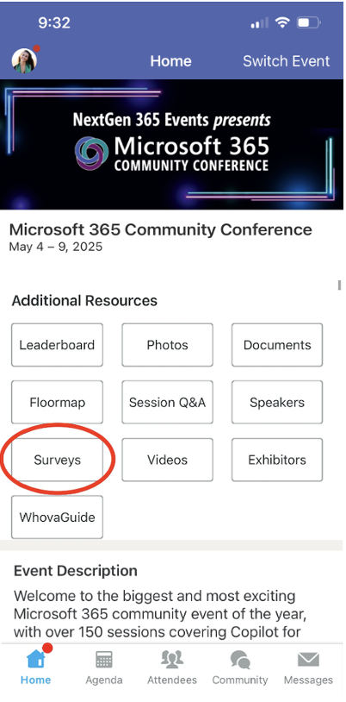
Session feedback surveys
We want to hear from YOU!
Share your feedback to make next years conference even better!
Here’s how –
Simply go to the Whova App on your smartphone.
Scroll down on the M365 Community Conference Homepage to ‘Additional Resources’ to click “Surveys’.
Click Session Feedback.
Scroll down to find this session title.
Complete the session feedback survey.
Finally, click ‘Submit’.
It’s just that easy!
Notes:
If you found this session helpful or have suggestions on how we can make it even better, please take a minute to let us know by completing the session survey.

Slide 57
We have an exciting future ahead
Notes:
Thank you.
<Speaker Guidance: Spend the last few minutes discussing or answering any questions they may have. If they have additional topics on their EBC agenda, make sure you connect with their account team to inform them which AI priorities and business outcomes resonated the most during this session. If you are in a 1:1 direct customer engagement, make sure you note what their priorities and questions were and work with the broader account teams and units to facilitate the proper hand-offs or next steps (i.e. get them into a session at the Innovation Hub/MTCs).>

Slide 58
Expertise and tools for your journey
Technical expertise via our FastTrack partners
Tools, resources & training on our Adoption Hub
Events and real-world knowledge in our community
aka.ms/Microsoft/FastTrack
adoption.microsoft.com
aka.ms/TechCommunity
Notes:
Please leave this slide in for conference attendees.

Slide 59
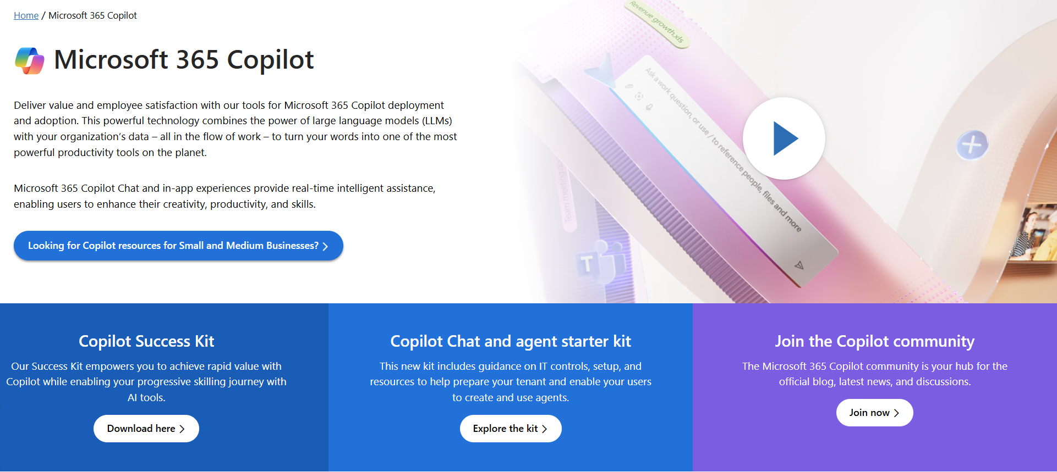
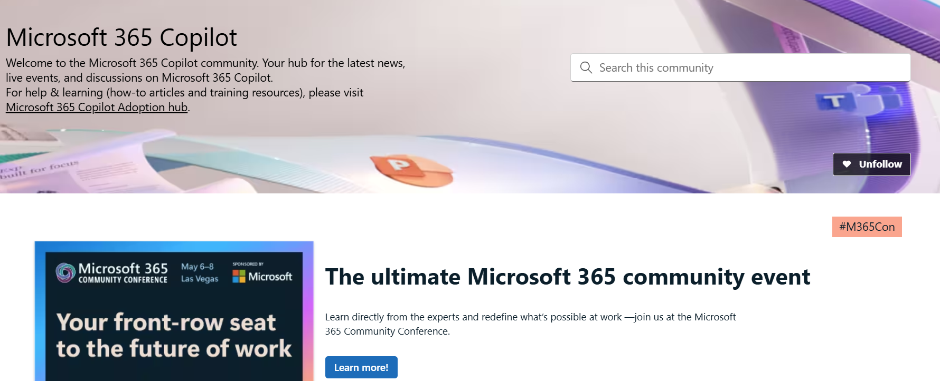
Copilot hub & community
Copilot hub on adoption.microsoft.com/copilot
Enablement and usage guidance for Microsoft Copilot.
Ask questions and get answers in our community aka.ms/M365CopilotCommunity
Notes:
To help you with adoption, the Copilot Readiness Hub is an open one stop shop for content, organized by role for your Copilot for Microsoft 365 journey.
You can use its recommendations to prepare and plan for your deployment, create a user experience strategy as I’ve presented today, and an adoption plan.
And as Copilot continues to evolve, keep coming back for new content that is published regularly.
You can also join the Copilot for Microsoft 365 community to get your questions answered and meet others who are leveraging Copilot for Microsoft 365 right now.

Slide 60
News & community content
Microsoft Community Learning aka.ms/Community/LearningChannel
Community led expert content on all your favorite Microsoft services.
Start your week with live news and event updates aka.ms/MondaysatMicrosoft
Watch live or on-demand & share our blog.
Notes:
To help you with adoption, the Copilot Readiness Hub is an open one stop shop for content, organized by role for your Copilot for Microsoft 365 journey.
You can use its recommendations to prepare and plan for your deployment, create a user experience strategy as I’ve presented today, and an adoption plan.
And as Copilot continues to evolve, keep coming back for new content that is published regularly.
You can also join the Copilot for Microsoft 365 community to get your questions answered and meet others who are leveraging Copilot for Microsoft 365 right now.

Slide 61
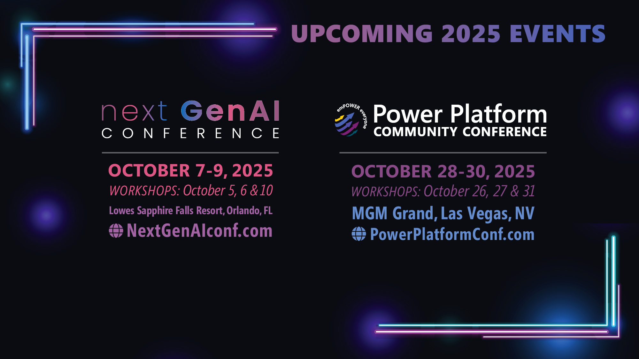
Upcoming 2025 Events

