Slide 1
GEEC Out Part 1 Insights and Strategies for Global Executive and Employee Communications at Microsoft
John Cirone
Amy Morris

Slide 2

Microsoft 365 Community Conference

Slide 3


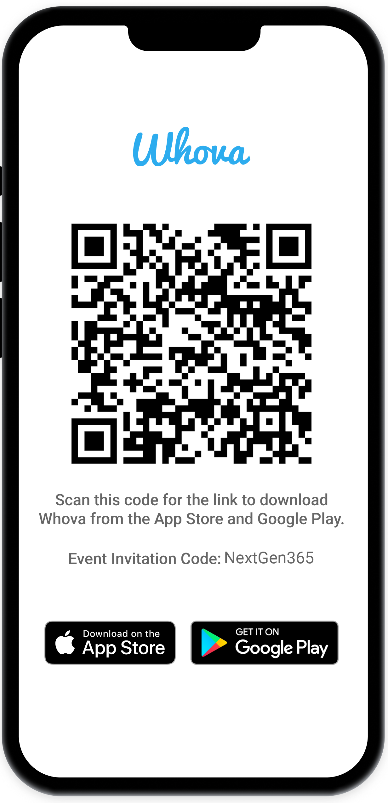
Join the event app to access:
The official event app for the
Microsoft 365 Community Conference
Event invitation code: NextGen2025
Event announcements
Personalized agenda, session details
Speaker & attendee profiles
Networking, meet-ups, messages
Event documents

Slide 4
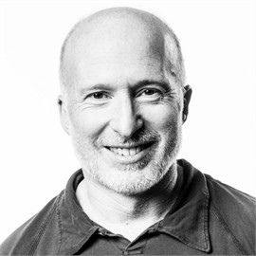


John Cirone
Senior Director of Global Employee & Executive Comms
Amy Morris
Director of Global Employee & Executive Comms
linkedin.com/in/johncirone
linkedin.com/in/Amy-Morris

Slide 5
Transforming Employee Communications: 7 Learnings from Microsoft’s Journey

Slide 6


Slide 7
7 learnings

Slide 8

A moment of change
1
Image generated in Microsoft Copilot Visual Creator

Slide 9
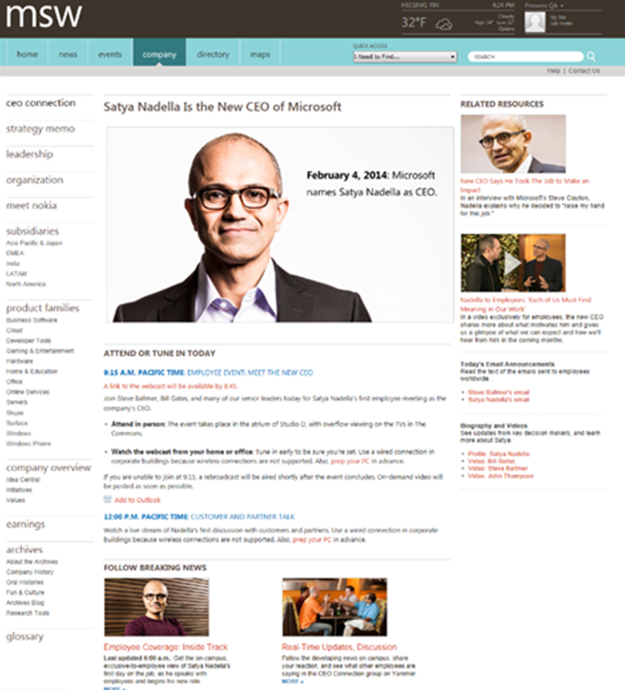
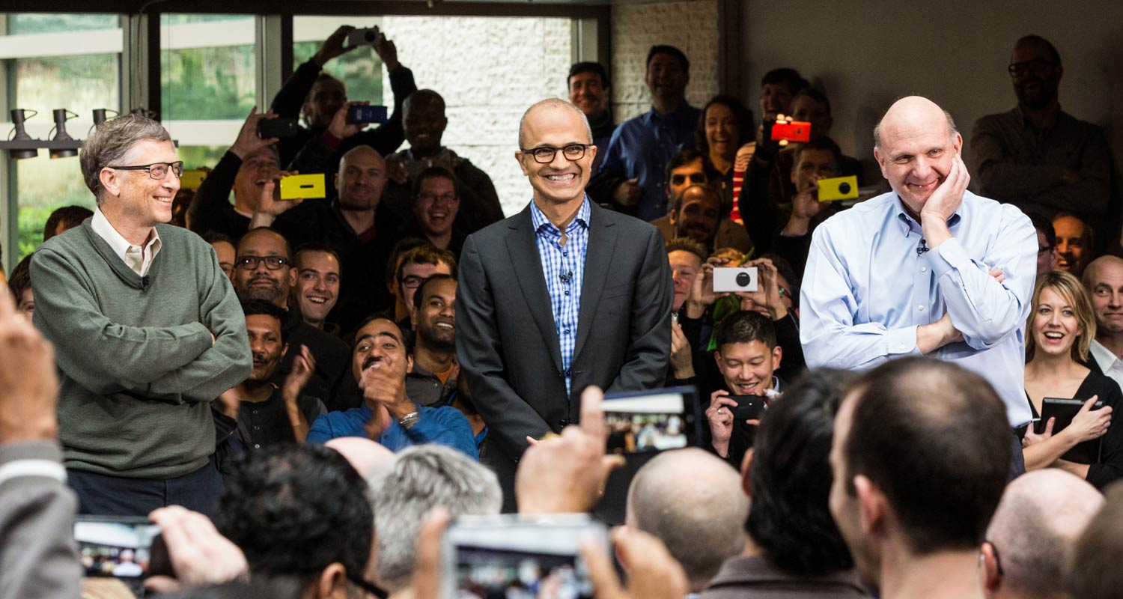
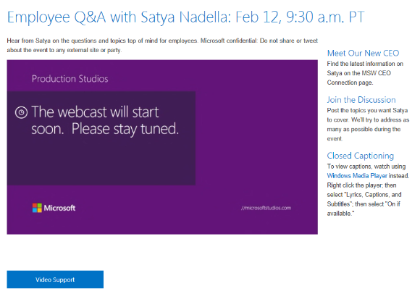
A New CEO

Slide 10
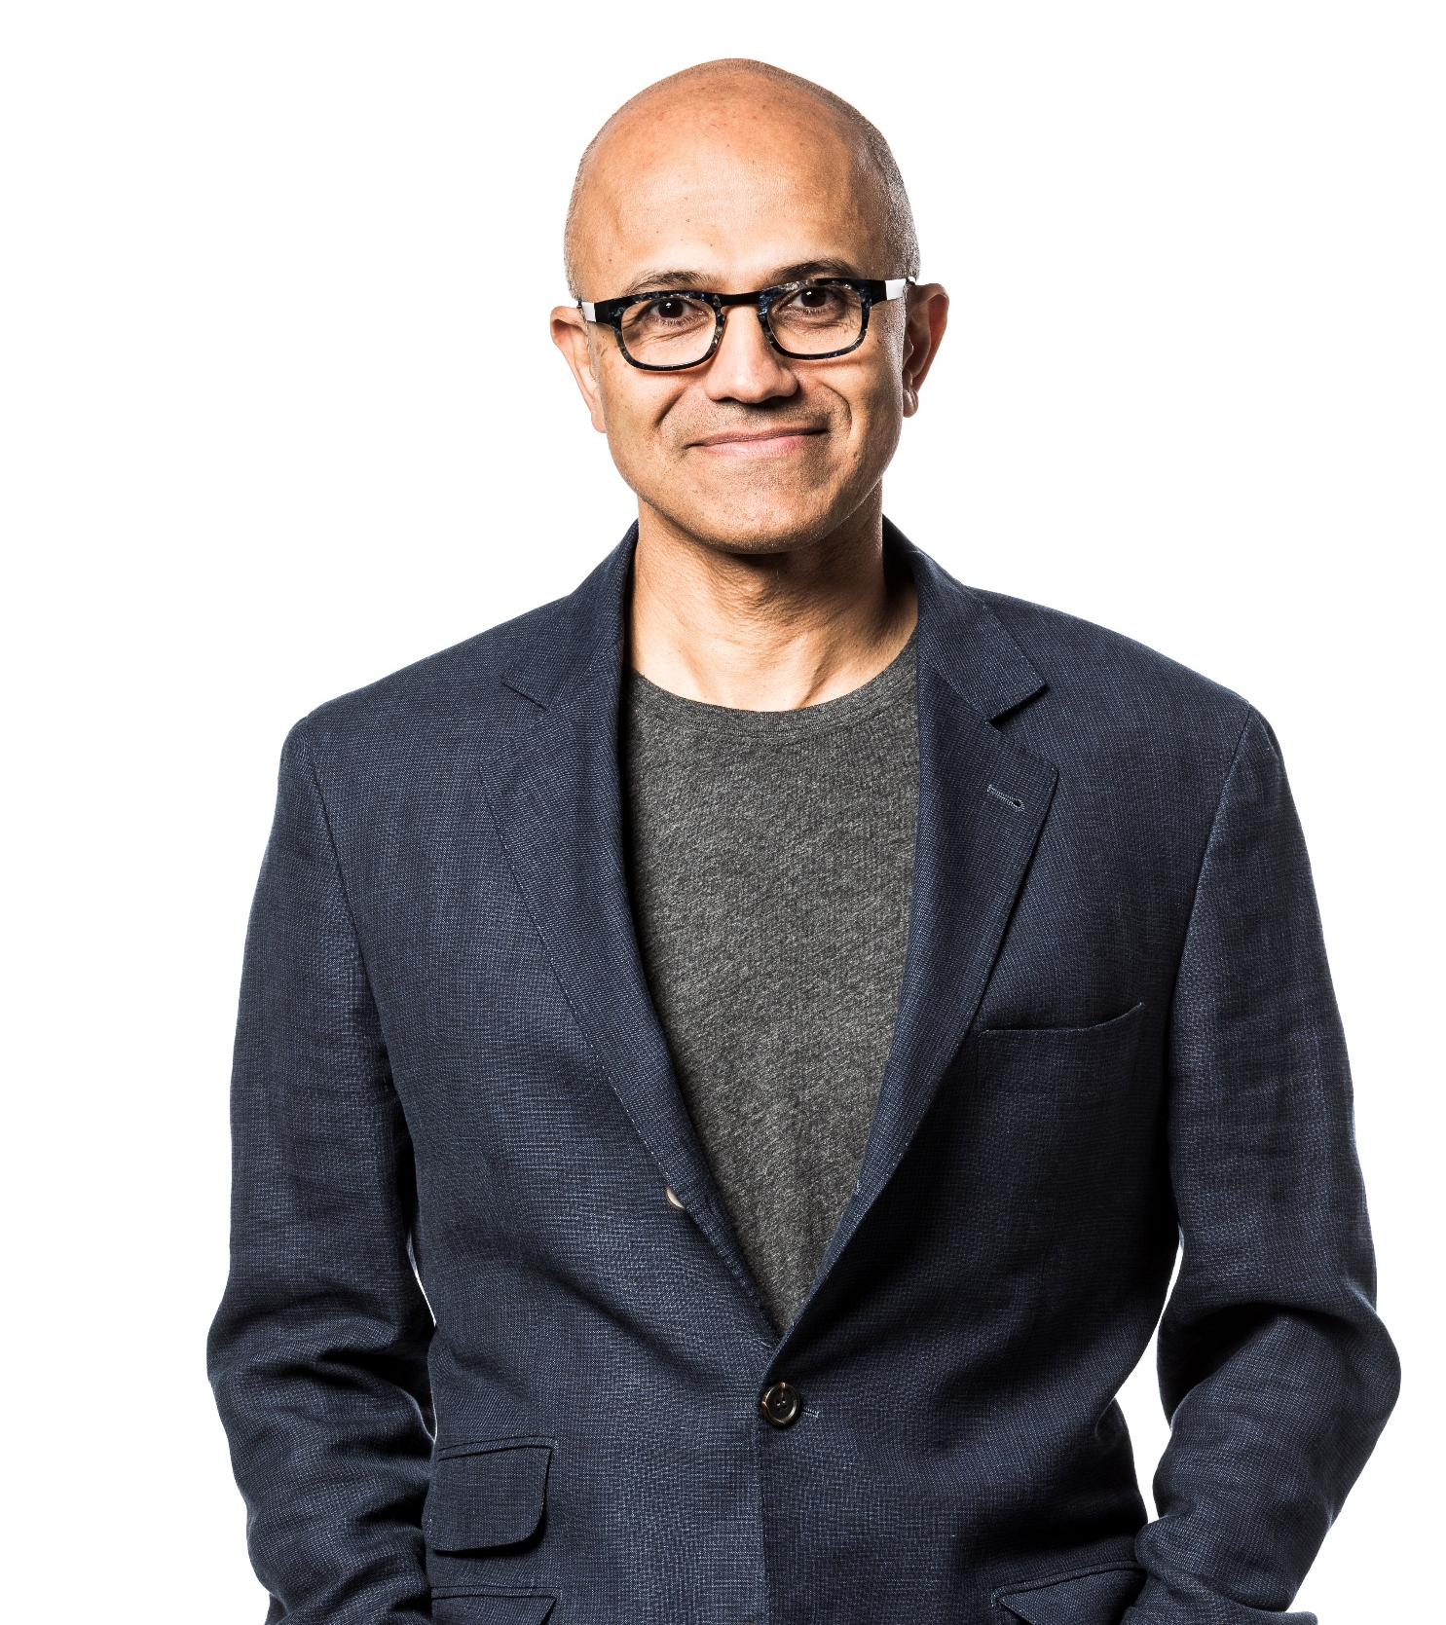
Satya Nadella
With a Foreword by Bill Gates
Microsoft’s CEO
Hit refresh
The Quest to rediscover Microsoft’s Soul and Imagine a better Future for everyone

Slide 11
A decade of change
Internal communications are more important than ever in influencing employee perceptions.
2013
Present
External media coverage
Co-workers
Employee Events
Stock Price/Financial Reporting
Industry Analysts
Communications from Senior Leaders
CEO Communications/Steve Ballmer
Family and Friends
My manager
Internal communications from my senior leaders
CEO/Satya Nadella
My manager
Internal communications from other senior leaders across Microsoft
My team meetings
Co-workers
Communications from HR
External Media Coverage
Flagship Events (e.g., Build, Inspire, Ignite, etc.)

Slide 12
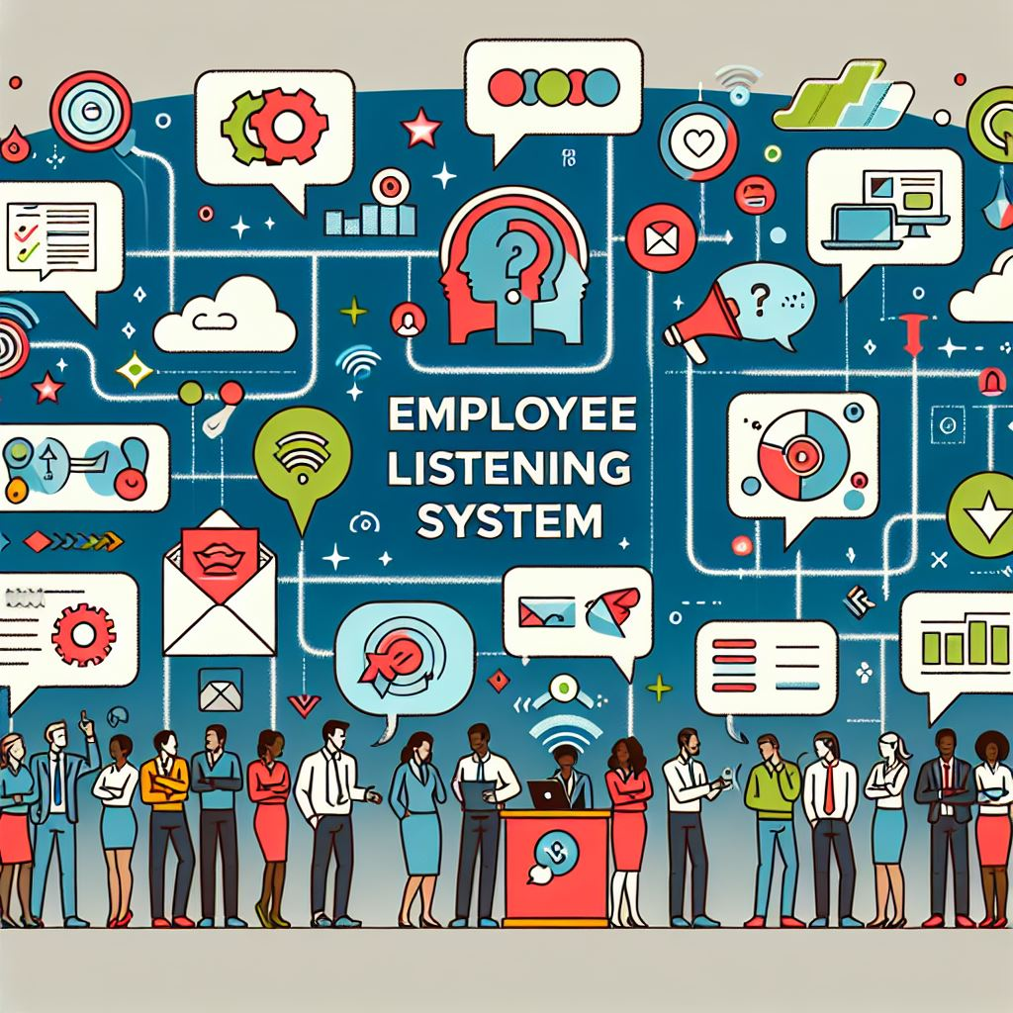
Evolving our approach to listening
2
Image generated in Microsoft Copilot Visual Creator

Slide 13





Microsoft’s employee listening ecosystem
Push
Monitor
Lifecycle Surveys
Onboarding, Exit and Internal Mobility surveys.
Viva Insights
Email & calendar, Meta-data.
Video views, website stats.
Daily Signals
Continuous listening 2,500 random invites every biz day.
Social listening
Monitors internal social sentiment and engagement levels on Viva Engage and Blind.
Monitored daily and reported on weekly. More frequent monitoring & reporting when needed.
Employee and Leadership Signals
Employee engagement survey Administered 2x/year.
Programmatic Surveys
Performance & Development, Benefits, Real Estate & Facilities, Comms, etc.
External Signals
Regular external news and external social channels including Twitter, Facebook, Instagram, etc. (as frequent as-needed).
Feedback
Manager, Leader and Peer feedback.
Tier 1 HR Support
Employee inquiries addressed by HR.

Slide 14

Scaling our impact
3
Image generated in Microsoft Copilot Visual Creator

Slide 15
Managing communications at the CEO level
Employees (200K+)
Public
Partners (2K+)
Managers (28K+)
Executive Staff (400+)
Office of the CEO (10)
Senior Leadership (18)
Satya Nadella
Communities: GEEC | HR | COS

Slide 16

Global Employee & Executive Comms Mission
We believe that employees are the best ambassadors.
We create communications and experiences to keep them informed, engaged,
and proud to be at Microsoft.

Slide 17
Internal Communications
Core and common internal comms responsibilities include culture, D&I, all-hands and leader digital communications.
Year over year change
+12
-5
-1
-5
+3
Internal
-16
-6
-11
--
--

Slide 18
External Communications
Core and common external comms responsibilities include speechwriting, identifying speaking opportunities for leaders, and exec social.
Year over year change
+4
+3
-2
0
External
--
-5
--
-10
-9

Slide 19

The pandemic and a changing workforce
4
Image generated in Microsoft Copilot Visual Creator

Slide 20


Quote
43% of leaders say relationship-building is greatest challenge with hybrid/remote work and employees feel less included, have weaker relationships with their team, and at greater risk of attrition.”
2022 Work Trend Index

Slide 21

The importance of two-way dialogue
5
Image generated in Microsoft Copilot Visual Creator

Slide 22




Leaders with high overall comms scores…
Prioritize authenticity and intentionally build trust
Optimize for opportunities to build connection
Drive clarity around strategy
Lean into thought leadership

Slide 23
Trust emerges as most impactful driver to overall leader and employee comms satisfaction
Microsoft builds trust in its communications with employees.
Top driver for “Microsoft does a good job communicating with employees”
My leader has earned my trust and confidence in their leadership.
Top driver for “My leader does a good job communicating with employees”

Slide 24
IMPORTANCE
Communicate authentically
Address topics in a timely manner
How do leaders build trust?
Foster an environment of open communication
Listening to what employees care about
*Summarizing top positive sentiment verbatims rom the Q: What do you value most from your leader’s comms?

Slide 25
Elevating the most impactful voices through the most impactful channels
Where do employees go to learn about key topics like strategy and culture?
VOICES THAT MATTER MOST*
MOST IMPACTFUL COMMS CHANNELS
Internal communications from my SLT leader
Org Town Halls/AMA
Internal Communications from Satya Nadella and other senior leaders
Emails from my leader
Viva Engage – top 3 channel for a third of employees
My manager
Corporate events
External press
*Percentage of employees who selected the voices below as one of their top three choices.

Slide 26

Balance risk vs. reward
6
Image generated in Microsoft Copilot Visual Creator

Slide 27
Proactive vs. Reactive
Proactive strategy
Reactive strategy / digital safety
Two-way dialogue between employees & leaders
Foster culture and community
Prioritize news and information
Listening / monitoring
Employee activism
Content moderation

Slide 28
Unprecedented Global Decline for Employer Trust
2025 Edelman Trust Barometer
Percent of employees who trust
GLOBAL 22
-
0
+
Significant change
Distrust
(1–49)
Neutral
(50=59)
Trust
(60–100)
I trust my employer to do what is right
-3 pts
Change,
2024 to 2025
-2
-2
-2
-2
-3
-6
-7
-2
-7
-3
-7
-1
-5
-5
-1
+3
-2
-2
-5
+2
-4
-4
-6
-3
-7
-6
+4
-1
2018
2025
2025 Edelman Trust Barometer. TRU_INS. Below is a list of institutions. For each one, please indicate how much you trust that institution to do what is right. 9-point scale; top 4 box, trust. General population, 22-mkt avg. Attribute only shown to those who are an employee of an organization (Q43/1). Year-over-year changes were tested for significance using a t-test set at the 99%+ confidence level. Respondents in Canada who took the survey in French were recontacted between December 12 and 17, 2024 to address a translation issue affecting this question. For more details, please see the Technical Appendix.

Slide 29

Create space to experiment and learn
7
Image generated in Microsoft Copilot Visual Creator
Notes:
.

Slide 30
Generative AI technology is here
Time to reach 100M users
100M
Mobile phones 16 years
50M
Internet 7 years
ChatGPT 3 months
Facebook 4.5 years
0
1
2
3
4
5
6
7
8
9
10
11
12
13
14
15
16
Years
Source: Microsoft Research

Slide 31
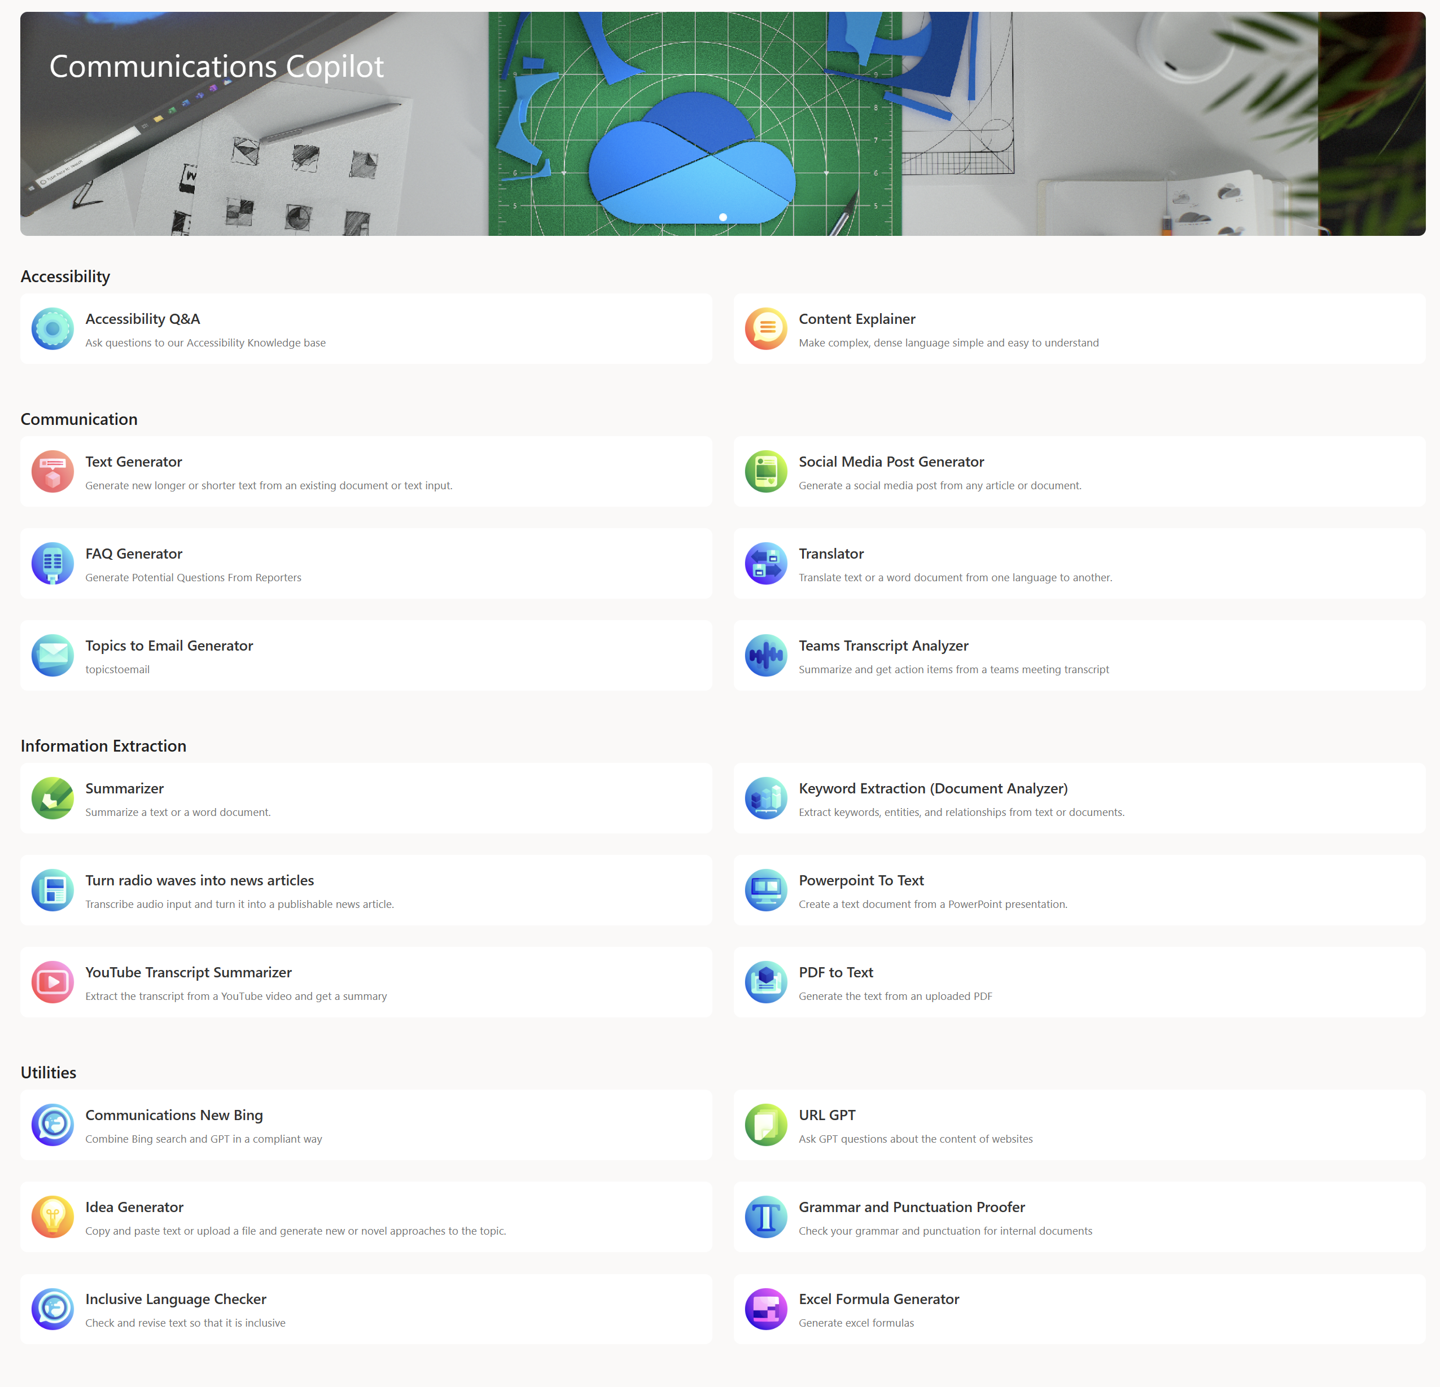
Communications Copilot
An in house, experimental suite of tools for communicators for common tasks

Slide 32
The (simplified) journey of an internal communications campaign
Receive notice of upcoming benefits announcement
Gather info & project requirements
Create comms strategy & campaign plan
Review plan with stakeholders and leadership
Revise plan based on feedback
Write & design content and communications
Send comms for stakeholder review
Revise based on review
Engage with internal influencer communities
Stage content & submit promos for publication
Send content to internal influencer communities
Launch content & activate campaign
Monitor feedback & respond as needed
Refine comms based on feedback
Analyze & compile metrics report
Report results to stakeholders

Slide 33
The (simplified) journey of an internal communications campaign
Receive notice of upcoming benefits announcement
Gather info & project requirements
AI
Create comms strategy & campaign plan
Review plan with stakeholders and leadership
AI
AI
AI
Revise plan based on feedback
Write & design content and communications
Send comms for stakeholder review
Revise based on review
Engage with internal influencer communities
Stage content & submit promos for publication
Send content to internal influencer communities
Launch content & activate campaign
Monitor feedback & respond as needed
AI
AI
Refine comms based on feedback
Analyze & compile metrics report
Report results to stakeholders

Slide 34
Dream State: The (simplified) journey of an internal communications campaign
Receive notice of upcoming benefits announcement
Gather info & project requirements
AI
Create comms strategy & campaign plan
Review plan with stakeholders and leadership
AI
AI
AI
AI
Revise plan based on feedback
Write & design content and communications
Send comms for stakeholder review
Revise based on review
Engage with internal influencer communities
Automation
Automation
Stage content & submit promos for publication
Send content to internal influencer communities
Launch content & activate campaign
AI
AI
AI
AI
Monitor feedback & respond as needed
Refine comms based on feedback
Analyze & compile metrics report
Report results to stakeholders
⏱️Reduce time required for campaigns by ~40%

Slide 35







A day in the life of John Cirone and Amy Morris Employee Communications Strategy at Microsoft
8:00 am
8:15 am
9:00 am
John and Amy start their day by checking media coverage for the company. They use Copilot to get a snapshot of what headlines, outlets and journalists are driving coverage of the company.
John checks email and reviews emails that have come in overnight from colleagues and teams around the world. He uses Outlook to quickly summarize key topics in his inbox.
Amy drafts a blog post and announcement for a new employee benefit using emails and HR change management plans as source documents.
John and Amy are members of the GEEC Team
Copilot
Copilot in Outlook
Copilot in Word
Insight and preparation for the day ahead before meeting with internal teams and media outlets.
Summarize all the emails from around the world that came in overnight.
Creativity and getting beyond “writers blocks” to get to a first draft that can be refined and shared with others.
7:00 pm
2:00 pm
11:00 am
Over dinner, Amy asks Copilot for help planning an itinerary for an upcoming family trip with her 12-year-old daughter.
Amy ideates on a leader social media post to support an announcement using Copilot to provide multiple versions for different platforms in the tone and style of the company’s existing channels.
John prepares an executive for an Ask Me Anything event, using Copilot to anticipate the likely questions an employee may ask based on the current news and employee sentiment trends.
Copilot on Mobile with Voice
Copilot
Copilot in Teams
Planning and Fun. Get answers to questions and plan events or trips with relevance and engagement.
Brand alignment. This step ensures that social media content is not only crafted with precision but also maintains the authenticity of our brand.
Proactively prepare for the types of questions that are likely to be asked, enabling the spokesperson to respond confidently and thoughtfully.

Slide 36
7 learnings from Microsoft’s journey
1
Capitalize on key moments of change
5
The importance of two-way dialogue
2
Evolving our approach to listening
6
Balance risk vs. reward
3
Scale your impact
7
Create space to experiment and learn
4
The changing workforce

Slide 37

Skate to where the puck is going
Image generated in Microsoft Copilot Visual Creator

Slide 38
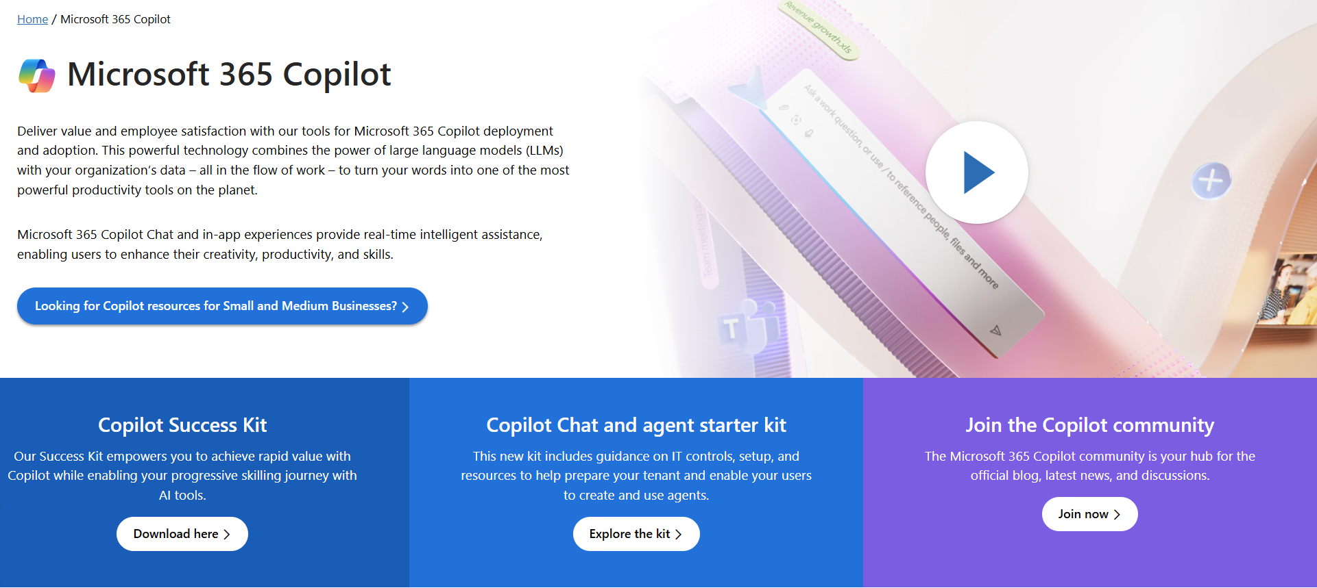
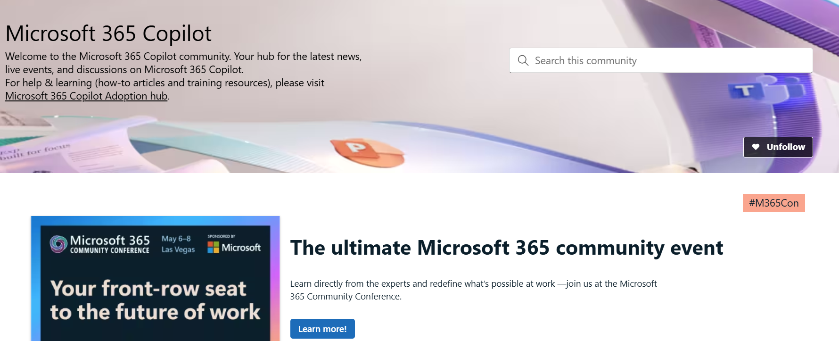
News & community content
Microsoft Community Learning aka.ms/Community/LearningChannel
Community led expert content on all your favorite Microsoft services.
Start your week with live news and event updates aka.ms/MondaysatMicrosoft
Watch live or on-demand & share our blog.
Notes:
To help you with adoption, the Copilot Readiness Hub is an open one stop shop for content, organized by role for your Copilot for Microsoft 365 journey.
You can use its recommendations to prepare and plan for your deployment, create a user experience strategy as I’ve presented today, and an adoption plan.
And as Copilot continues to evolve, keep coming back for new content that is published regularly.
You can also join the Copilot for Microsoft 365 community to get your questions answered and meet others who are leveraging Copilot for Microsoft 365 right now.

Slide 39















































May 6–8 Las Vegas
SPONSORED BY
Comms & Coffee meet up
Join us for an informal gathering to take selfies, group photos and meet other attendees while getting energized for the day.
Wednesday, May 7th 9 – 10 am
Community Lounge atrium space on the 3rd level

Slide 40
Learn & connect
COMMUNICATIONS
Attend
Modern Communications blog aka.ms/ModernEmployeeComms
Employee Communications Blog
https://aka.ms/CorpCommsBlog
Coffee & Comms meet up
Wednesday, May 7th 9- 10 AM @ Community Lounge
Viva Connections: Building an Employee App for Your Organization with SharePoint & Viva
Wednesday, 7 May @ 10 AM
What’s New and What’s Next for Microsoft Viva Communications & Communities
Wednesday, 7 May @ 4 PM
The Intranet of Tomorrow: Beautiful, Flexible and AI Ready
Thursday, 8 May @ 10:45 AM
GEEC Out Part 1: Insights and Strategies for Global Executive and Employee Communications at Microsoft Tuesday, 6 May @ 12:15 PM
GEEC Out Part 2: An Insider’s View of Communications, Change and Culture at Microsoft Tuesday, 6 May @ 2:45 PM
Reimagining Communications and Employee Engagement in the Age of AI Tuesday, 6 May @ 4 PM
Managing Channels, News and Noise with Viva Engage, SharePoint, Teams and Outlook Tuesday, 6 May @ 10 AM
Driving Change and Culture: Activating Leaders, Managers, and Employees with Viva Engage Tuesday, 6 May @ 11:20 AM
Hosting Company-Wide, Divisional and Community Meetings and Events with Viva Engage and Microsoft Teams Thursday, 8 May @ 2 PM
Copilot for Communicators Tuesday, 6 May @ 10:45 AM
Communicators on Communications: Success Stories and Insights Thursday, 8 May @ 12 PM
Panel of Peers: Communications, Strategies, Best Practices and Lessons Learned Thursday, 8 May @ 2:30 PM

Slide 41
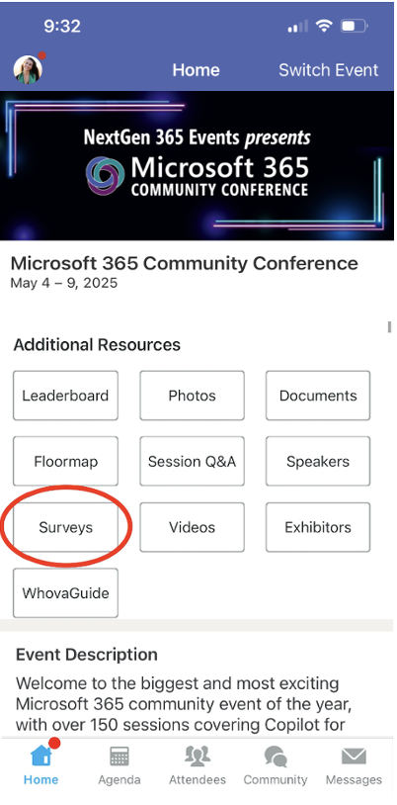
Session feedback surveys
We want to hear from YOU!
Share your feedback to make next years conference even better!
Here’s how –
Simply go to the Whova App on your smartphone.
Scroll down on the M365 Community Conference Homepage to ‘Additional Resources’ to click “Surveys’.
Click Session Feedback.
Scroll down to find this session title.
Complete the session feedback survey.
Finally, click ‘Submit’.
It’s just that easy!

Slide 42
