Slide 1
Securing AI Apps and Agents with Microsoft Purview
May 7, 2025

Slide 2
Securing AI Apps and Agents with Microsoft Purview
May 7, 2025

Slide 3
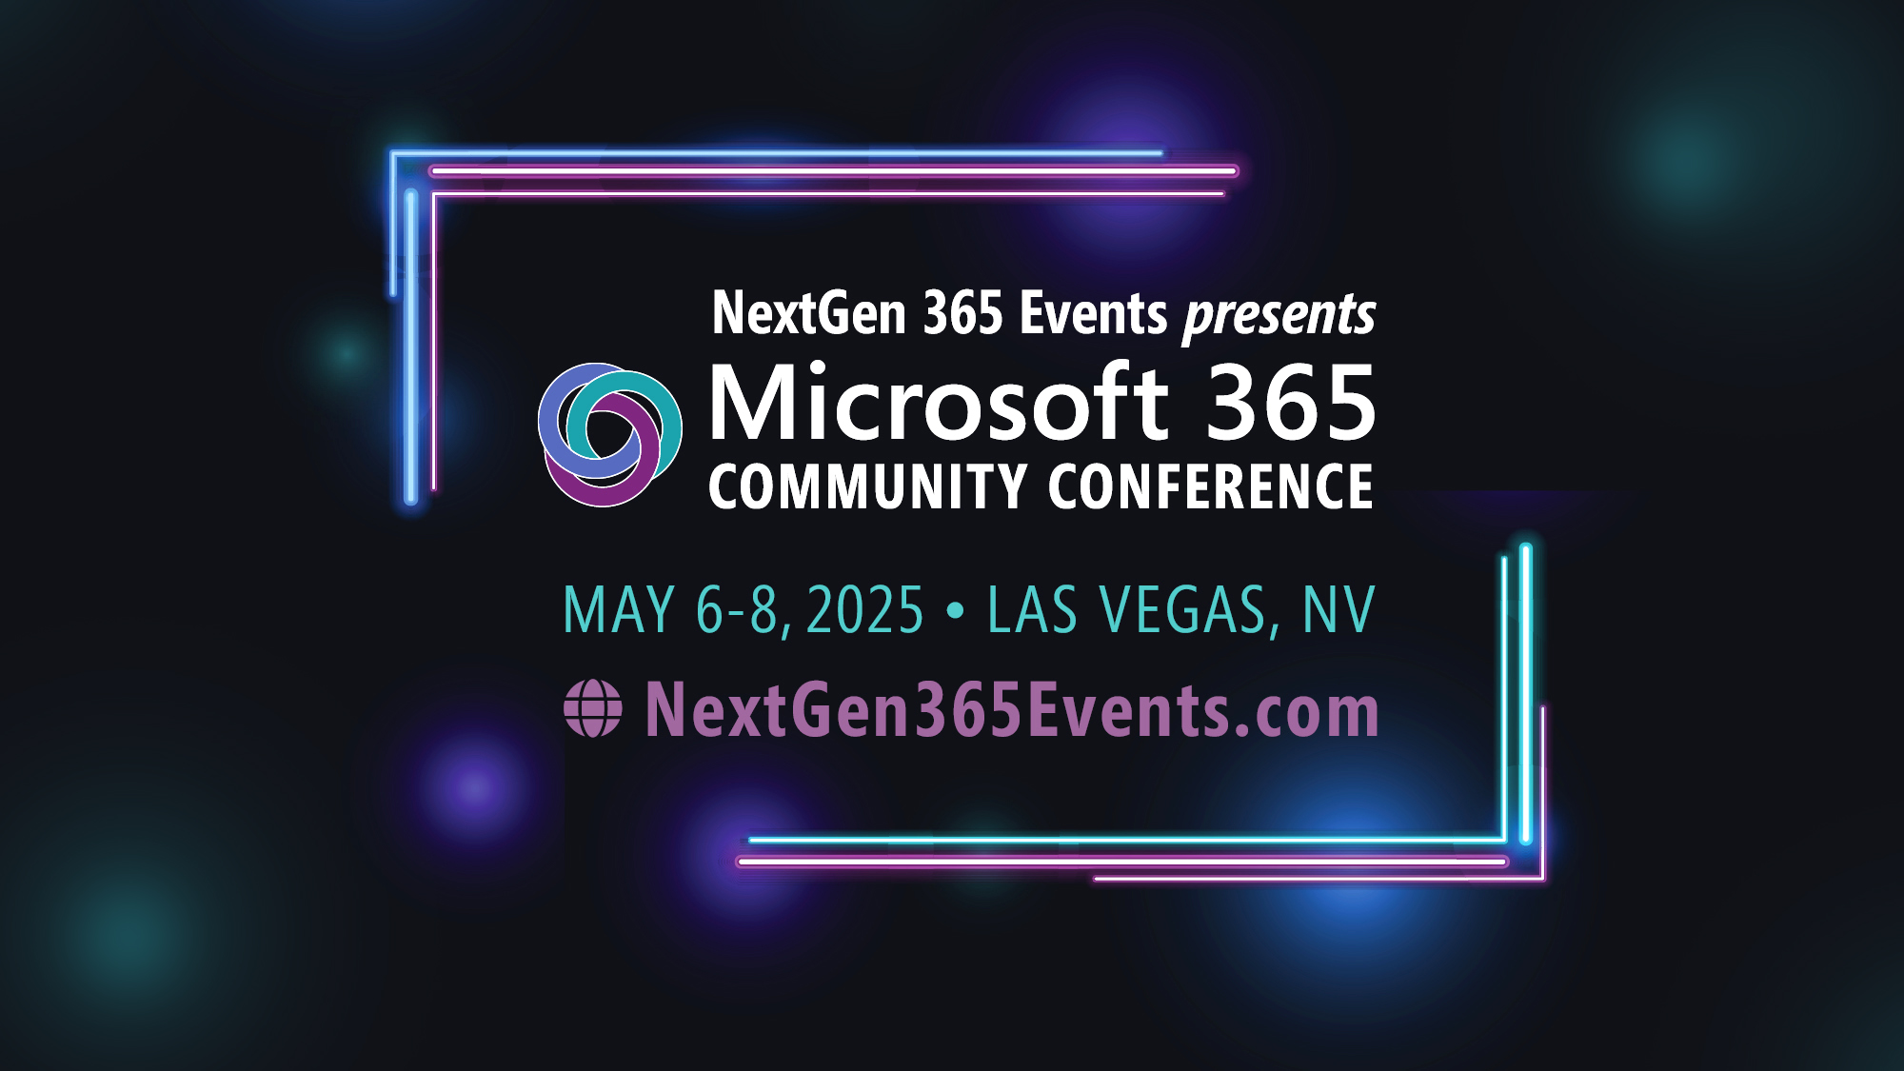
Microsoft 365 Community Conference

Slide 4


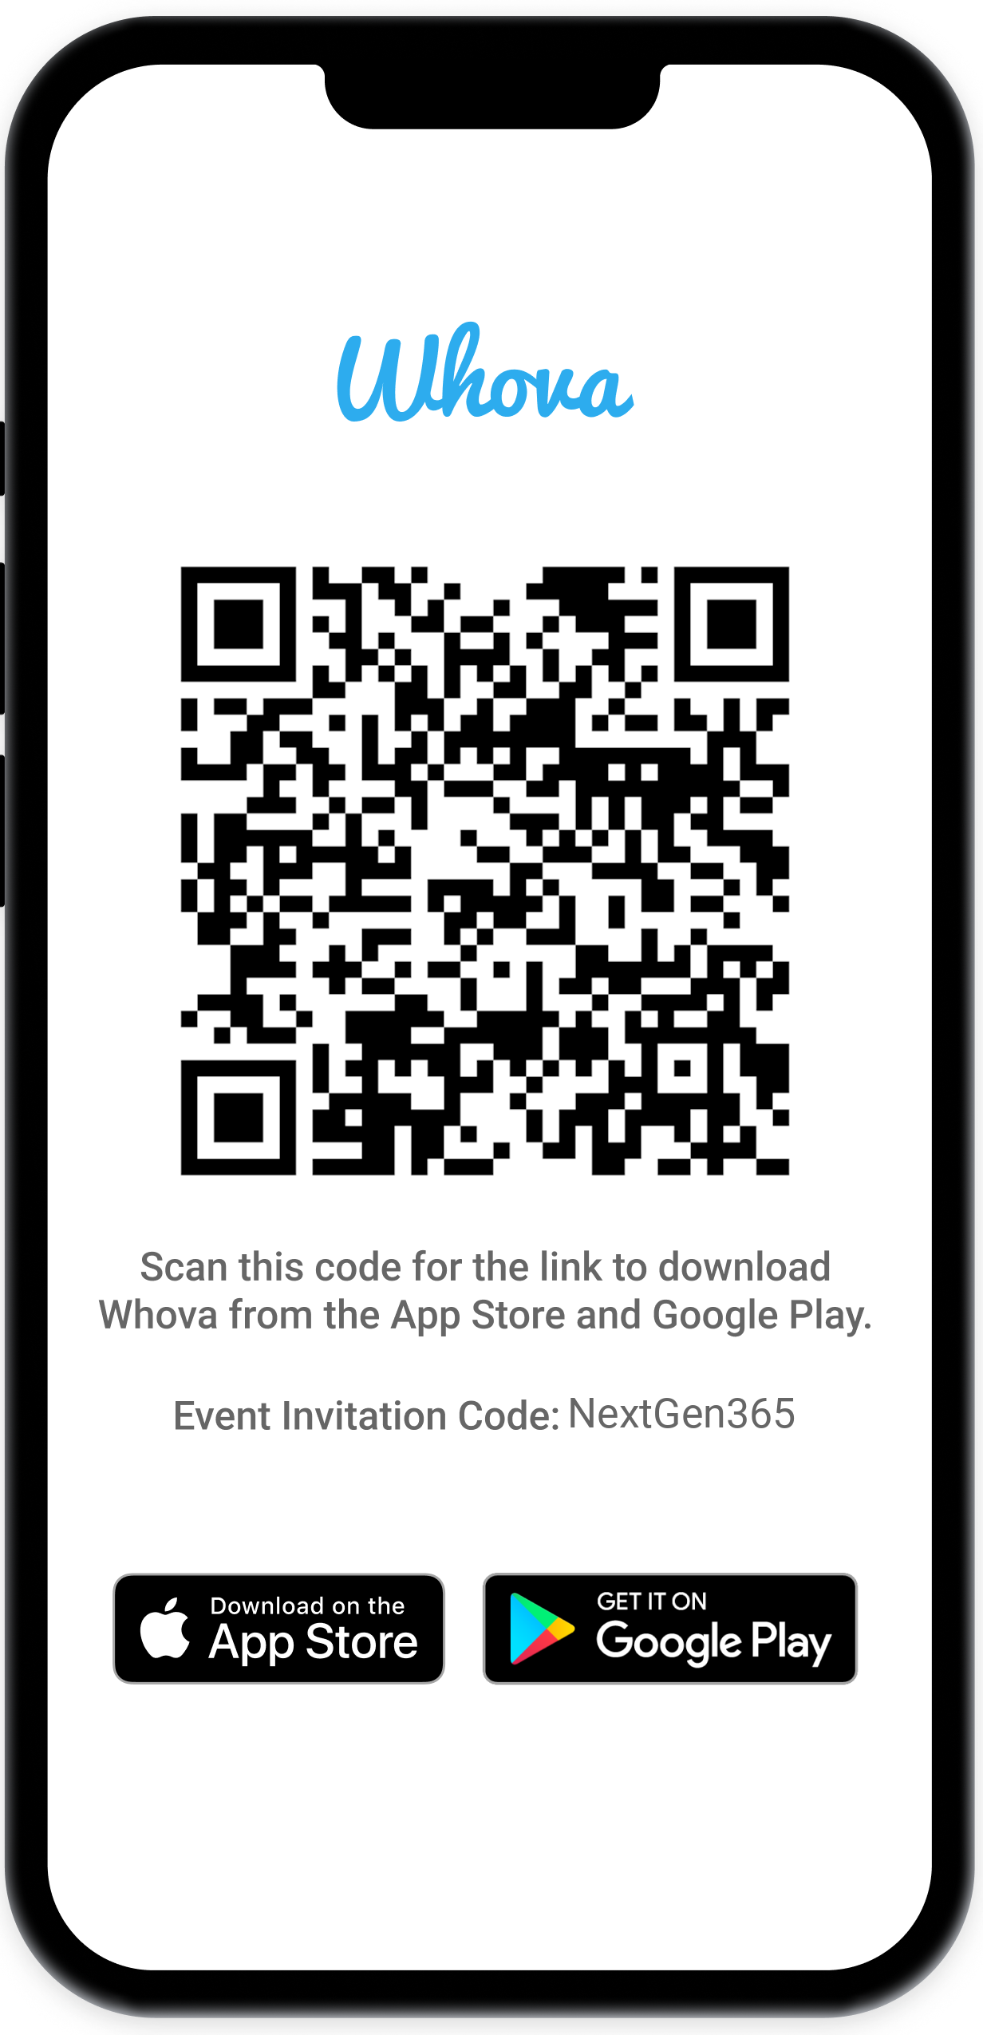
Join the event app to access:
The official event app for the
Microsoft 365 Community Conference
Event invitation code: NextGen2025
Event announcements
Personalized agenda, session details
Speaker & attendee profiles
Networking, meet-ups, messages
Event documents

Slide 5
Agenda
Introductions
What is Microsoft Purview?
Microsoft 365 Copilot + Microsoft Purview
Agents + Microsoft Purview
Extending Microsoft Purview for all AI
Guest speaker: Microsoft’s own tenant approach
Partner Showcase & Closing

Slide 6



Nishan DeSilva
Partner Group Product Manager
Microsoft Purview
Safeena Begum
Principal PM Manager
Microsoft Purview
Aashish Ramdas
Principal PM Manager
Microsoft Purview

Slide 7
Securing AI Apps and Agents with Microsoft Purview
What is Microsoft Purview?
How does it help with AI?

Slide 8


Protecting our world in the era of AI
Security for AI
AI for security

Slide 9






Protecting our customers across their AI transformation
Microsoft Security
Microsoft Defender
Microsoft Intune
Microsoft Sentinel
Microsoft Entra
Microsoft Purview
Threat Protection & Security Operations
Data Security, Governance, Compliance & Privacy
Protecting
your AI
Microsoft Security Copilot
Identity, Access &
Device Management
Notes:
We are proud to be the first security provider to deliver a purpose-built solution specifically designed for securing and governing your AI.
Our comprehensive solution addresses the unique challenges of AI security across three critical areas:
The first is Threat Protection & Exposure Management. We provide robust threat protection and exposure management to safeguard your AI systems from evolving threats. Our advanced capabilities ensure that your AI infrastructure remains resilient and secure.
Next is Data Security, Governance, and Compliance. Our solution ensures that your data is secure, compliant, and private. We offer comprehensive data governance and compliance tools to help you meet regulatory requirements and protect sensitive information.
And importantly - We are committed to promoting safety, privacy, and responsible AI practices. Our systems are designed to ensure that your AI applications are ethical, transparent, and aligned with industry standards for responsible AI.

Slide 10

Microsoft Purview
Unified data security, governance and compliance solutions for all data
Discover
Data risks
Protect
Sensitive data
Govern
Compliant usage
across
Structured
data
Files and Emails
AI-generated data
M365 & other clouds
Notes:
Copilot is built with foundational security in mind, with Microsoft's comprehensive approach to security, compliance, privacy and responsible AI. On top of that, you can layer on additional security capabilities to discover AI risks, protect sensitive data, and govern Copilot usage.
Discover AI risks: First, security and IT teams must assess the data risks associated with user activities in Copilot. For instance, they should identify the types of sensitive data shared within Copilot prompts and understand the user risk context during these interactions. Organizations can leverage our pre-built classifiers to detect sensitive information such as credit card numbers, passport details, and custom SITs. Additionally, all user interactions in Copilot are logged, enabling organizations to review activities and identify potential risks. Lastly, organizations can proactively identify instances of overshared content within SharePoint sites by reviewing the site permissions.
Protect sensitive data: After understanding the risks, organizations can implement controls to safeguard data. They can establish labeling and Data Loss Prevention (DLP) policies to mitigate the risks of oversharing and data leakage. Additionally, leveraging conditional access policies ensures that Copilot usage occurs through secure and governed identities and devices, reducing potential security threats. Lastly, organizations can implement SharePoint site-wide access controls to eliminate idle or excessive access to sensitive data.
Govern Copilot usage: To ensure compliant usage of Copilot, organizations can establish retention policies for Copilot interactions and utilize our pre-built classifiers (such as gifts & entertainment, unauthorized disclosure, and stock manipulation) to detect non-compliant activities. In the event of a potential security or compliance incident, organizations will have access to logs and interaction details for investigation. Additionally, to minimize obsolete insights, organizations can apply retention labels to inactive files, automatically removing outdated data.
Microsoft Security can help you discover, protect and govern Copilot usage to enable secure and responsible adoption of Copilot.

Slide 11
Securing AI Apps and Agents with Microsoft Purview
Starting with Microsoft 365 Copilot

Slide 12
Copilot is the UI for AI
Copilot
Agents
Copilot Control System
Notes:
At Ignite, we introduced our vision and strategy for Copilot + Agents.
It all starts with people and human ingenuity.
We envision every employee having a Copilot – their trusted AI assistant. Copilot understands you and your work context, and it provides a consistent user experience to interact with AI.
Agents augment Copilot by adding skills and knowledge to automate tasks and business processes.
Our ambition is to empower every employee with a Copilot and to transform every process with agents.
Importantly, we provide governance and controls for data protection, agent management, and the reporting needed to measure business outcomes. This is what we announced at Ignite as the “Copilot Control System”.
Just like everyone today has a smart phone with many apps. Everyone will have a Copilot with many Agents.

Slide 13
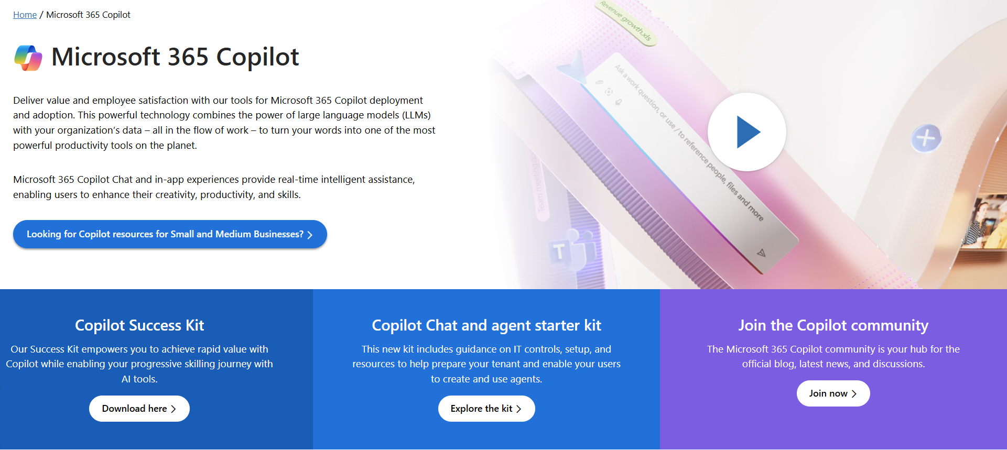
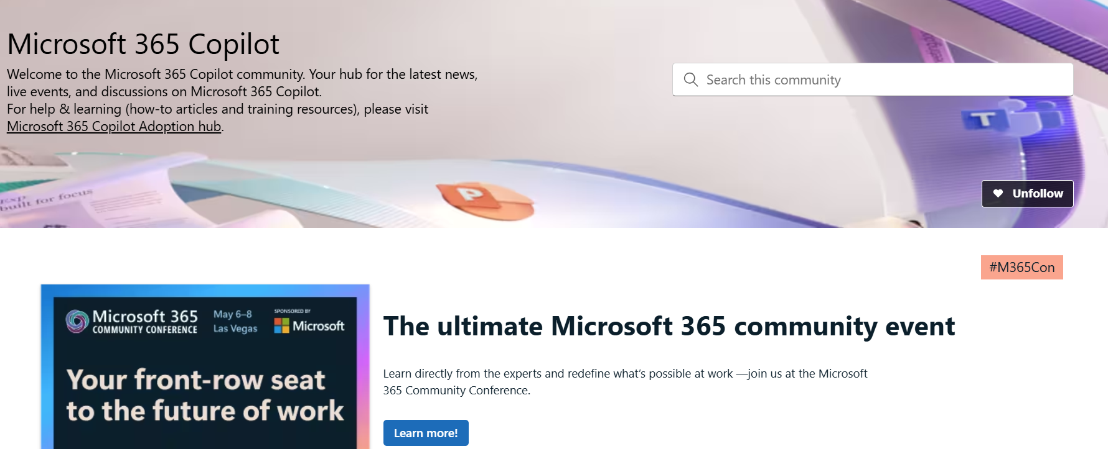
Copilot hub & community
Copilot hub on adoption.microsoft.com/copilot
Enablement and usage guidance for Microsoft Copilot.
Ask questions and get answers in our community aka.ms/M365CopilotCommunity
Notes:
To help you with adoption, the Copilot Readiness Hub is an open one stop shop for content, organized by role for your Copilot for Microsoft 365 journey.
You can use its recommendations to prepare and plan for your deployment, create a user experience strategy as I’ve presented today, and an adoption plan.
And as Copilot continues to evolve, keep coming back for new content that is published regularly.
You can also join the Copilot for Microsoft 365 community to get your questions answered and meet others who are leveraging Copilot for Microsoft 365 right now.

Slide 14
AI transformation with Copilot is happening now
75%
30min
of knowledge workers already using AI at work (doubled in the past 6 months)¹
saved a day, equating to 10 hours per month by Copilot users²
65%
$3.5
of organizations using and deriving business value from gen-AI in 2024³
return on investment for every $1 invested into AI⁴
Work Trends Index
Work Trends Index
McKinsey
IDC
Notes:
AI transformation is rapidly reshaping every industry, organization and business function
There are analyst studies indicating organizations are observing material benefits from the use of Generative AI
Employee demand for AI at work is growing and companies are racing to enable AI in a responsible manner which is secure, compliant and governed.

Slide 15
Microsoft Purview
Unified data security, governance and compliance solutions for all data
and AI apps
Discover
Data risks
Protect
Sensitive data
Govern
Compliant usage
across
Structured
data
Files and Emails
AI-generated data
M365 & other clouds
Notes:
As mentioned earlier in the slides, Copilot is built with foundational security in mind, with Microsoft's comprehensive approach to security, compliance, privacy and responsible AI. On top of that, you can layer on additional security capabilities to discover AI risks, protect sensitive data, and govern Copilot usage.
Discover AI risks: First, security and IT teams must assess the data risks associated with user activities in Copilot. For instance, they should identify the types of sensitive data shared within Copilot prompts and understand the user risk context during these interactions. Organizations can leverage our pre-built classifiers to detect sensitive information such as credit card numbers, passport details, and custom SITs. Additionally, all user interactions in Copilot are logged, enabling organizations to review activities and identify potential risks. Lastly, organizations can proactively identify instances of overshared content within SharePoint sites by reviewing the site permissions.
Protect sensitive data: After understanding the risks, organizations can implement controls to safeguard data. They can establish labeling and Data Loss Prevention (DLP) policies to mitigate the risks of oversharing and data leakage. Additionally, leveraging conditional access policies ensures that Copilot usage occurs through secure and governed identities and devices, reducing potential security threats. Lastly, organizations can implement SharePoint site-wide access controls to eliminate idle or excessive access to sensitive data.
Govern Copilot usage: To ensure compliant usage of Copilot, organizations can establish retention policies for Copilot interactions and utilize our pre-built classifiers (such as gifts & entertainment, unauthorized disclosure, and stock manipulation) to detect non-compliant activities. In the event of a potential security or compliance incident, organizations will have access to logs and interaction details for investigation. Additionally, to minimize obsolete insights, organizations can apply retention labels to inactive files, automatically removing outdated data.
Microsoft Security can help you discover, protect and govern Copilot usage to enable secure and responsible adoption of Copilot.

Slide 16

DSPM for AI in Microsoft Purview
Data security and compliance for the era of AI
Notes:
Introducing DSPM for AI, a centralized place to discover, secure, and govern AI interactions

Slide 17

M365 Copilot + Microsoft Purview: Enterprise ready on day 0
November 2023
I need … | Microsoft Purview
an audit log of Copilot interactions | Audit
to include Copilot interactions in legal holds and searches | eDiscovery
retention or deletion of Copilot interactions | Data Lifecycle Management
alerts when users misuse Copilot | Communication Compliance
Copilot to respect the data protections I already have in place | Information Protection
Microsoft 365 Copilot

Slide 18
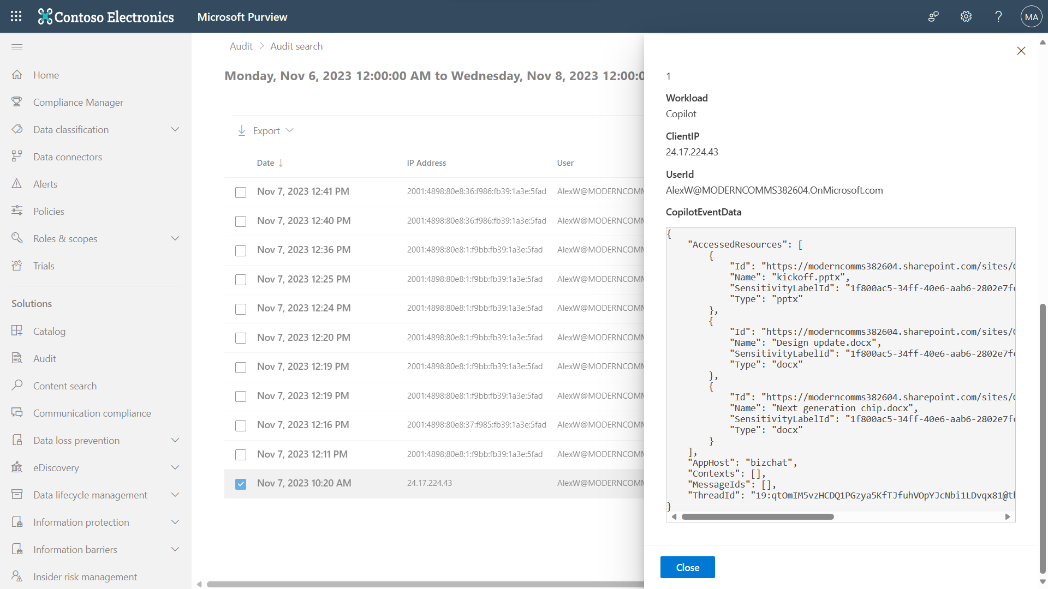
Audit

Slide 19
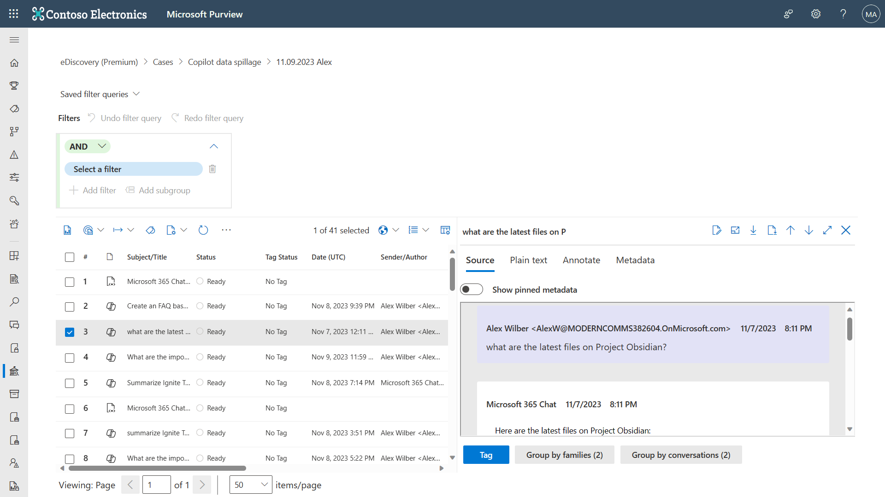
Demo
eDiscovery

Slide 20
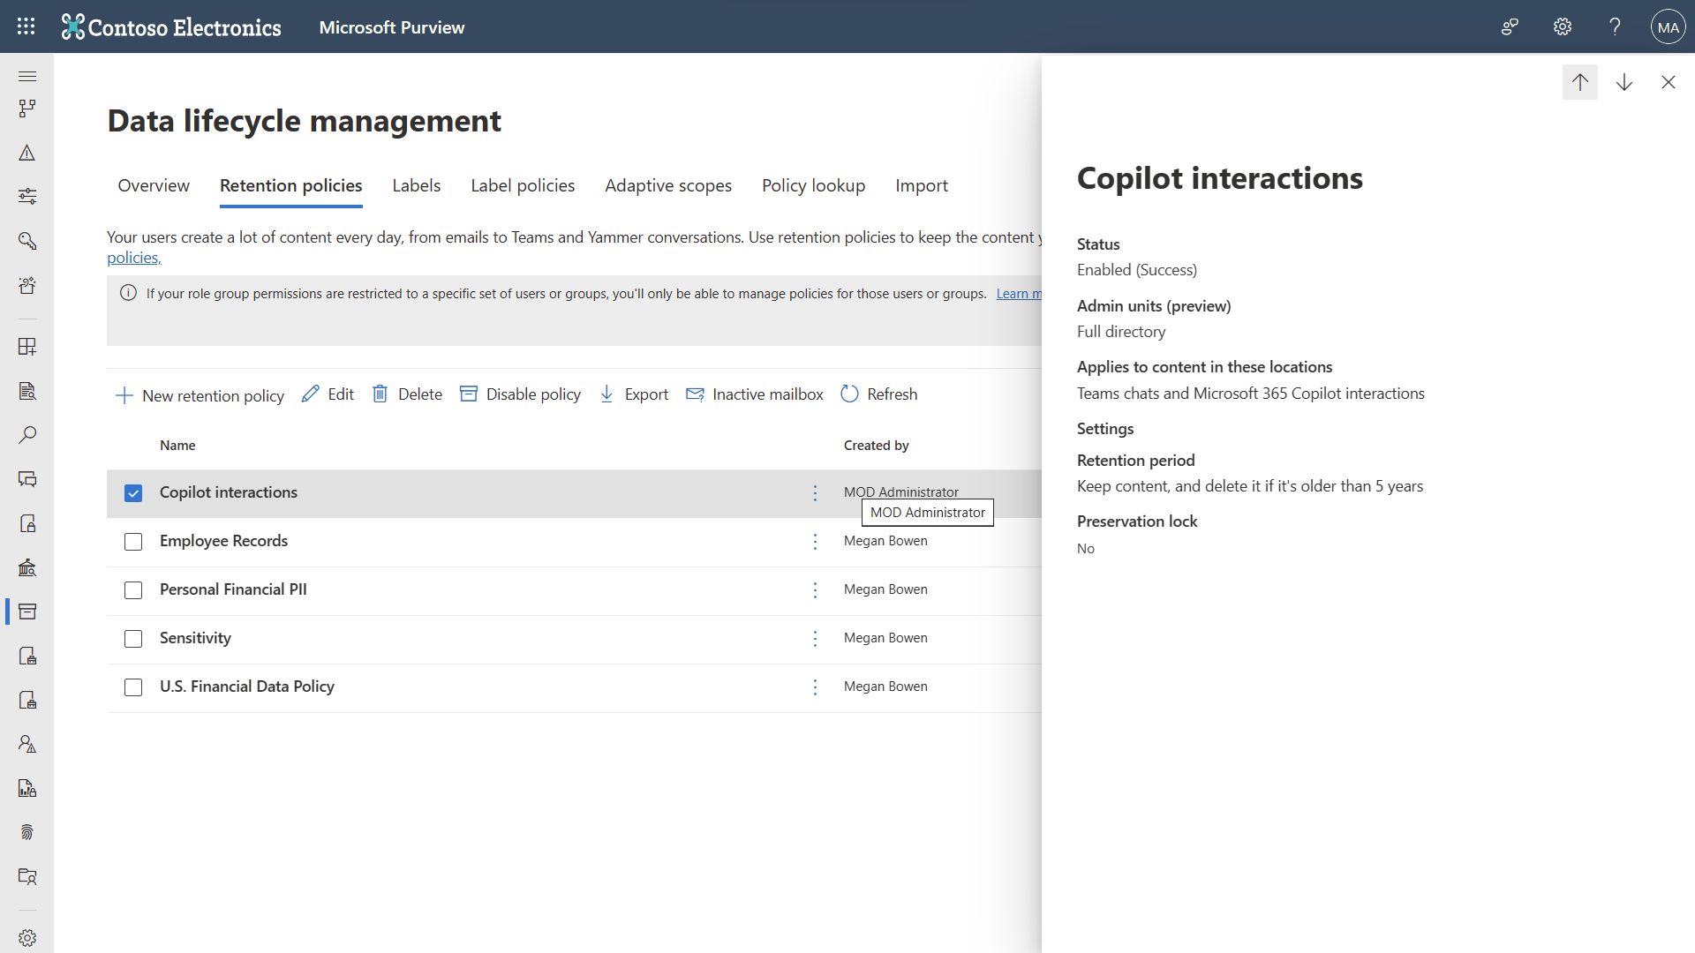
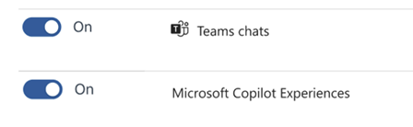
Demo
Data Lifecycle Management

Slide 21
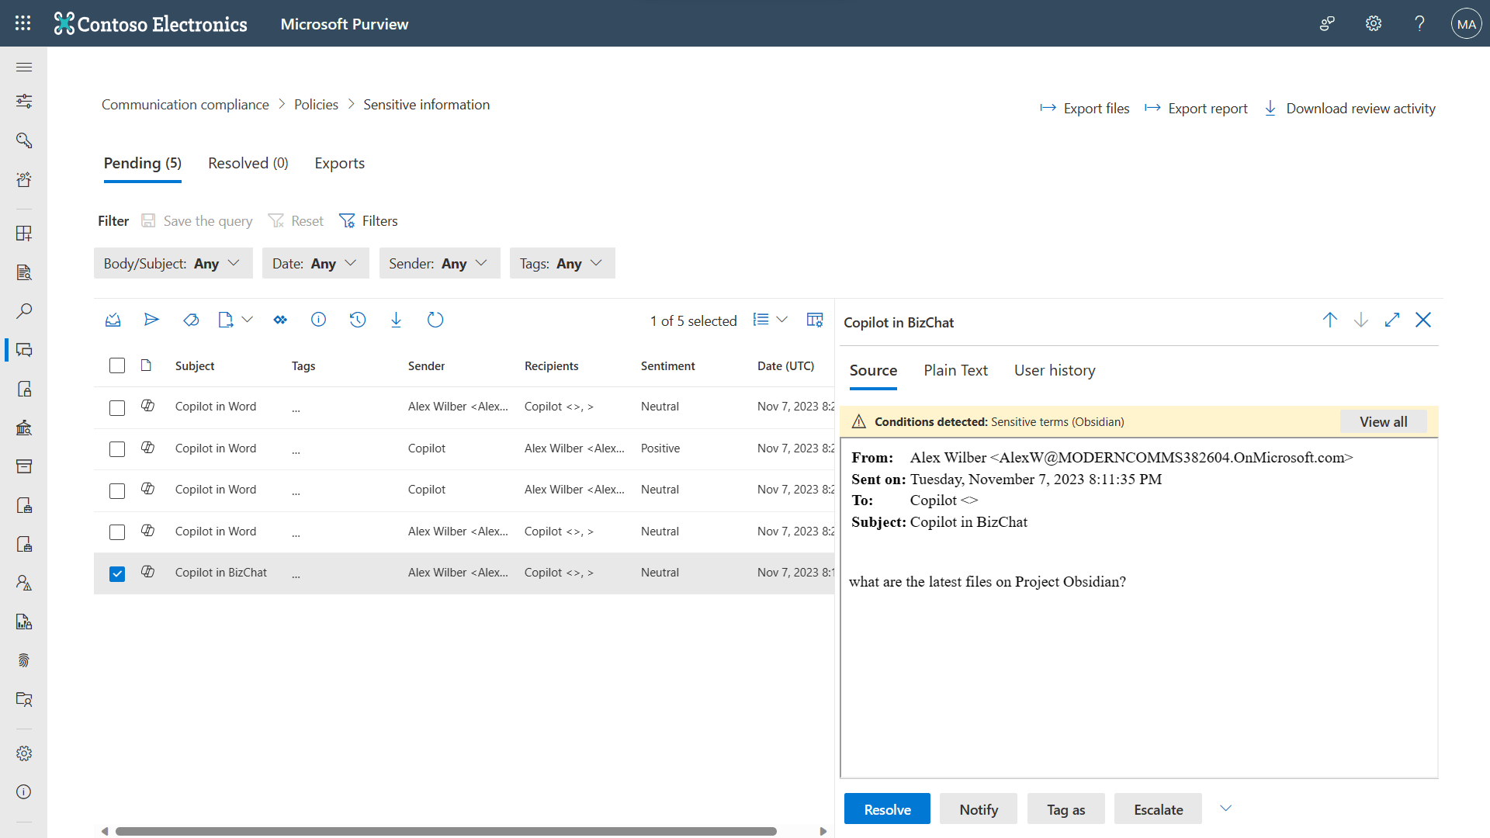
Demo
Communication Compliance

Slide 22
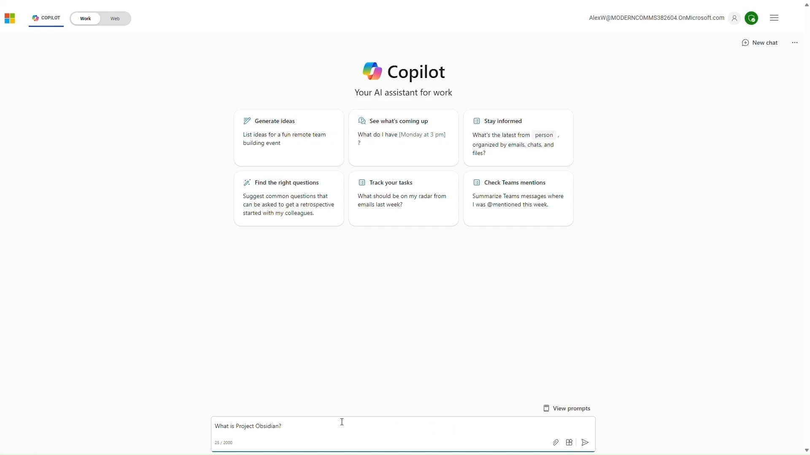
Demo
Information Protection

Slide 23
Microsoft Purview: Unlock visibility into AI usage and data security posture
May 2024
I need … | Microsoft Purview
visibility into Copilot usage in the context of security & compliance | DSPM for AI: Reports
ways to mitigate any risks I find | DSPM for AI: Recommendations
visibility into the text of risky prompts and responses | DSPM for AI: Activity Explorer
guidance on how to comply with regulations | Compliance Manager
DSPM for AI

Slide 24
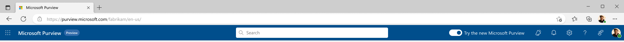
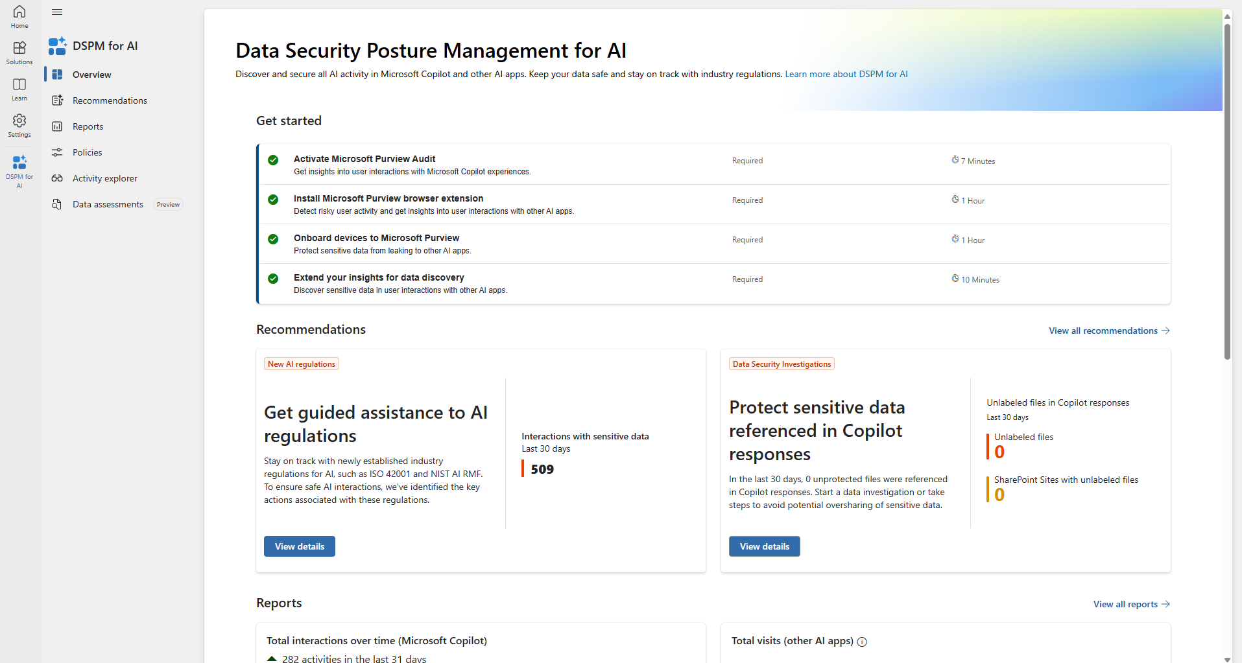
Microsoft Purview
Data Security Posture Management (DSPM) for AI

Slide 25
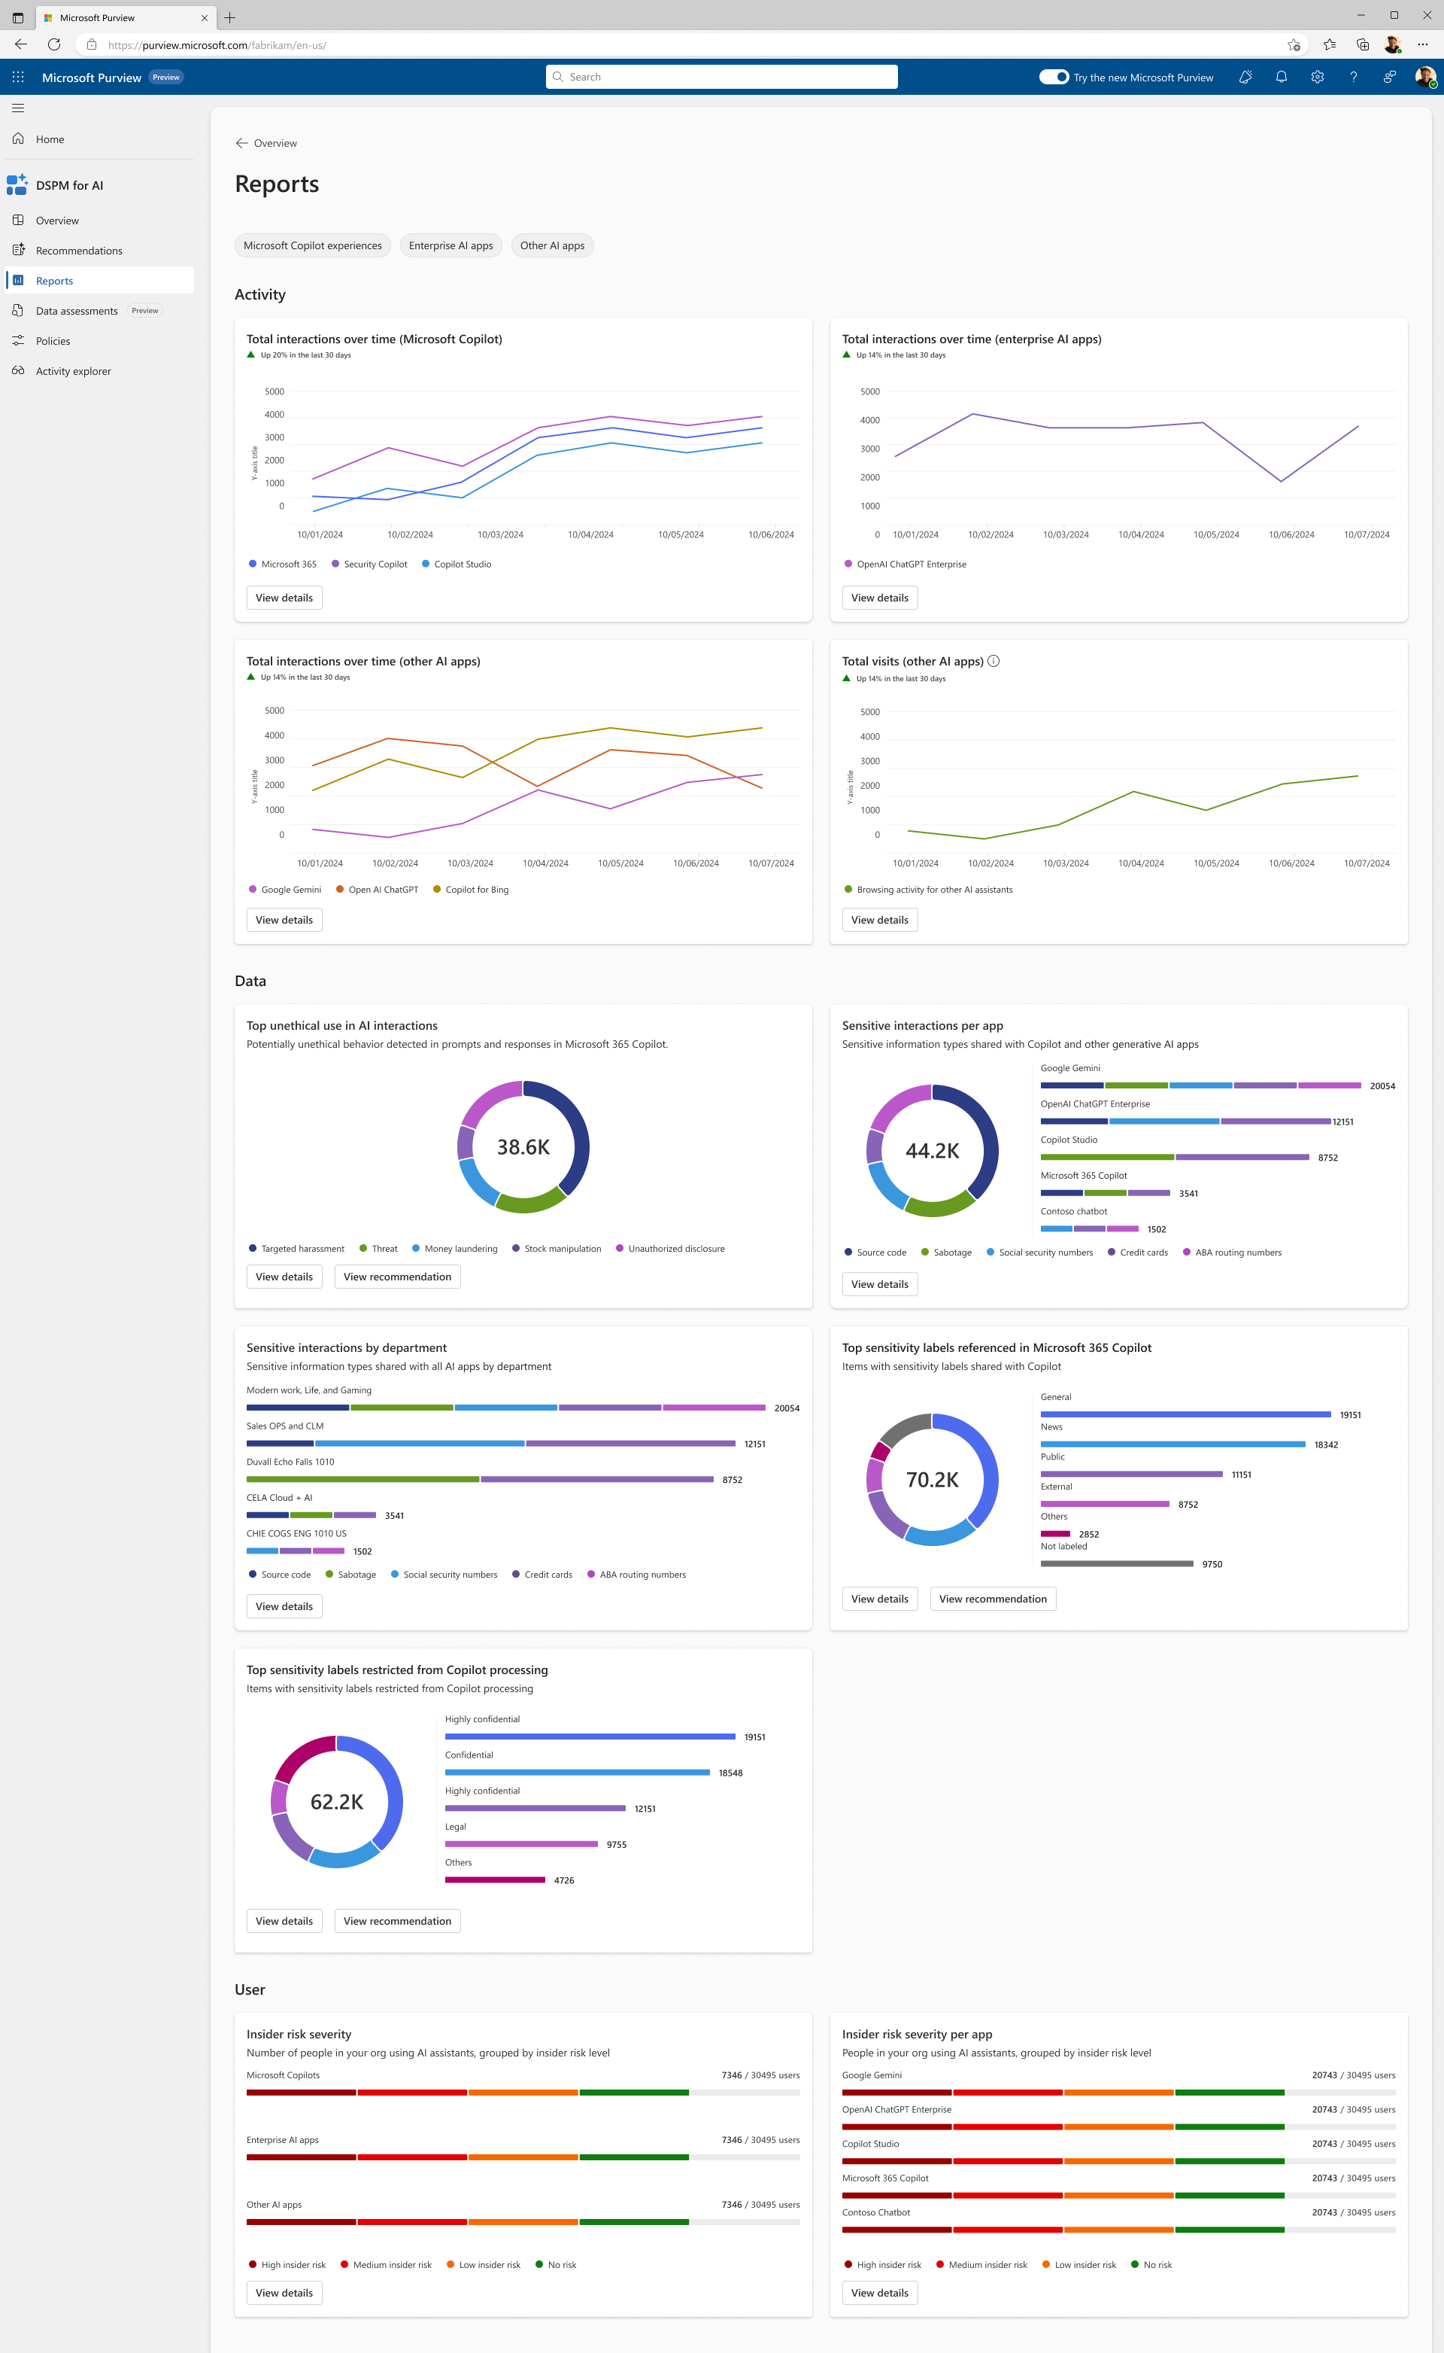
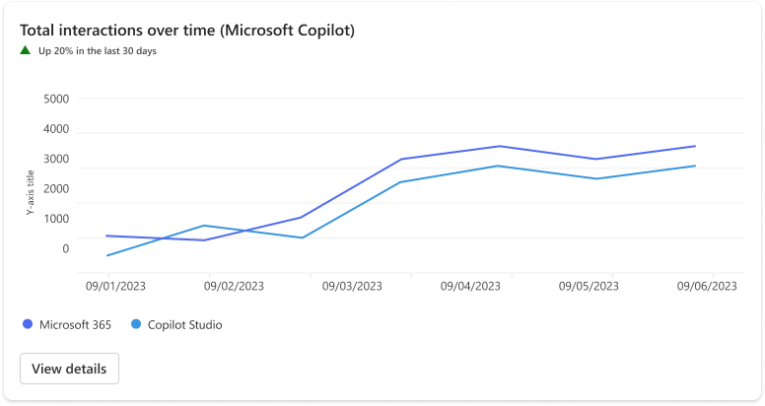
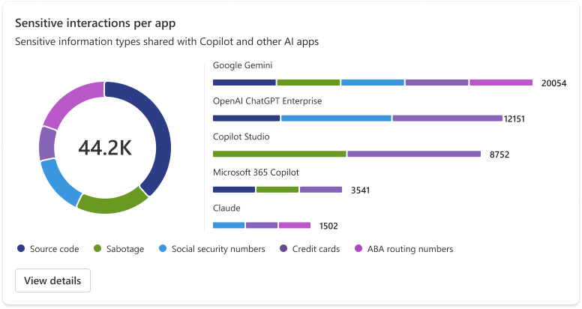
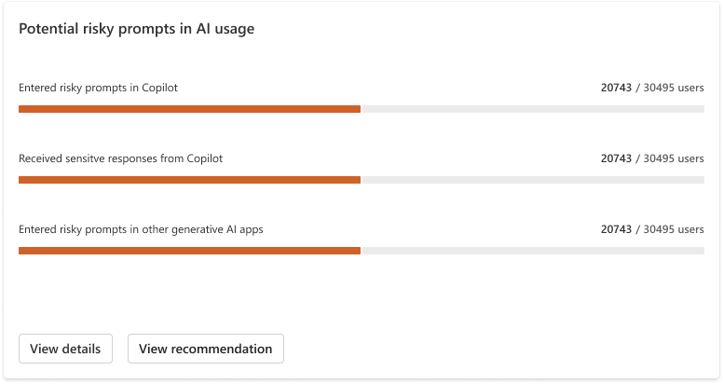
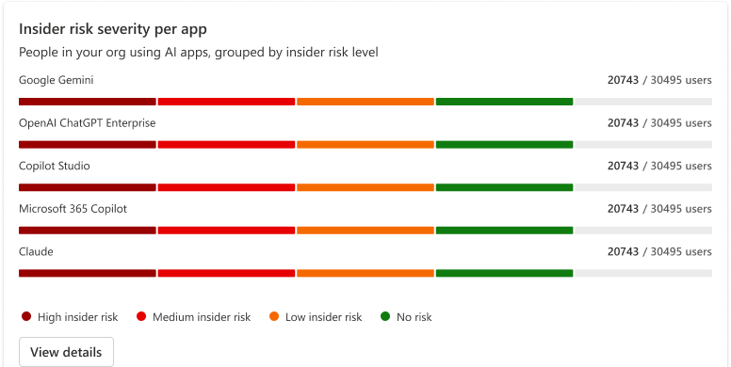
Reports
DSPM for AI: Reports

Slide 26
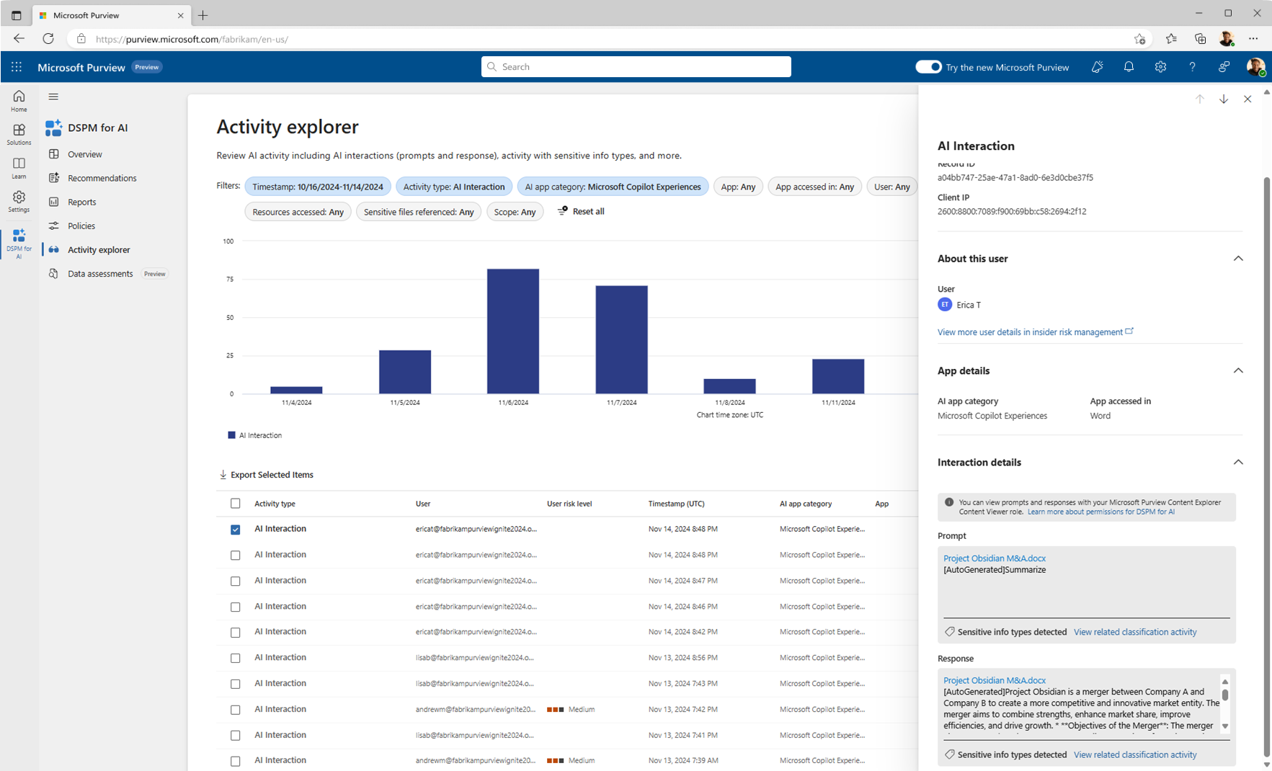
Microsoft Purview
DSPM for AI: Activity Explorer

Slide 27
Microsoft Purview
DSPM for AI: Activity Explorer

Slide 28
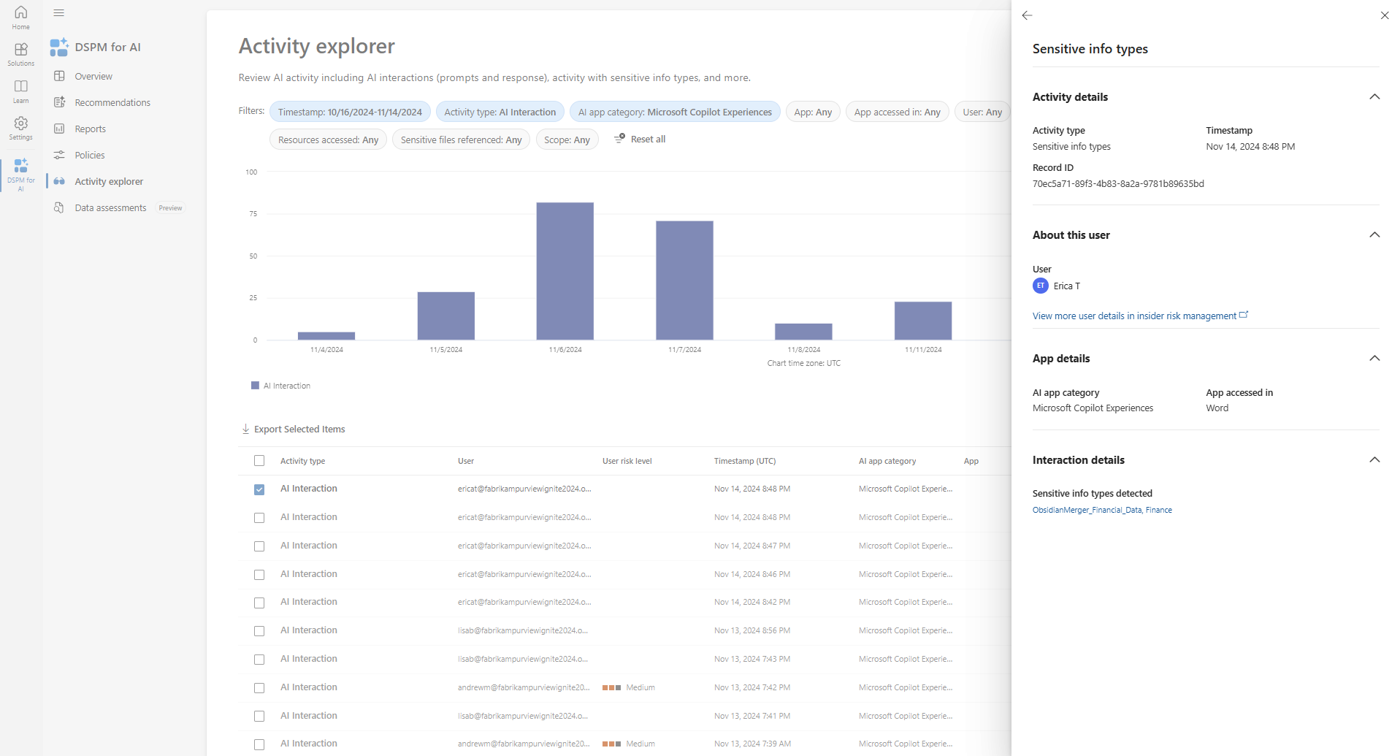
Microsoft Purview
DSPM for AI: Activity Explorer

Slide 29
Microsoft Purview: Deploy Copilot, faster
November 2024
I need … | Microsoft Purview
visibility into my oversharing risk posture | DSPM For AI: Oversharing risk assessments
to block sensitive data from being used by Copilot | DLP for Copilot
guidance on getting ready for AI | Deployment blueprint
ways to detect anomalous and risky AI usage and mitigate risks dynamically. | Insider Risk Management
DSPM for AI

Slide 30
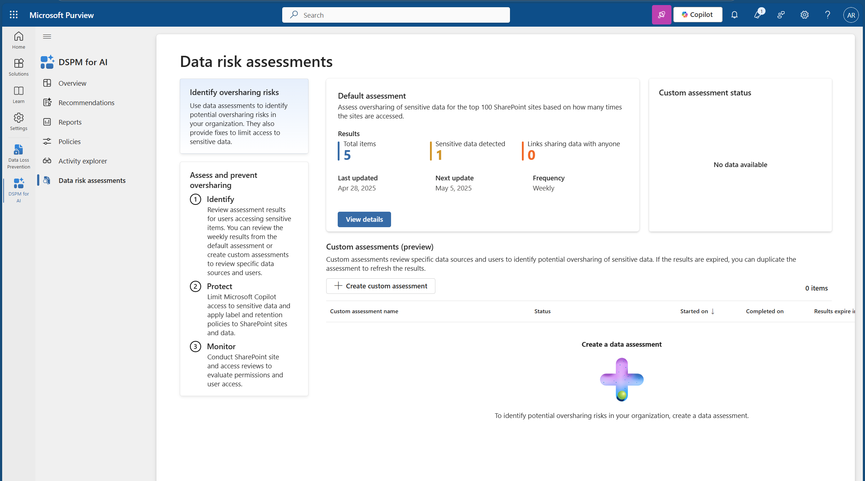
DSPM for AI: Oversharing Risk Assessment

Slide 31
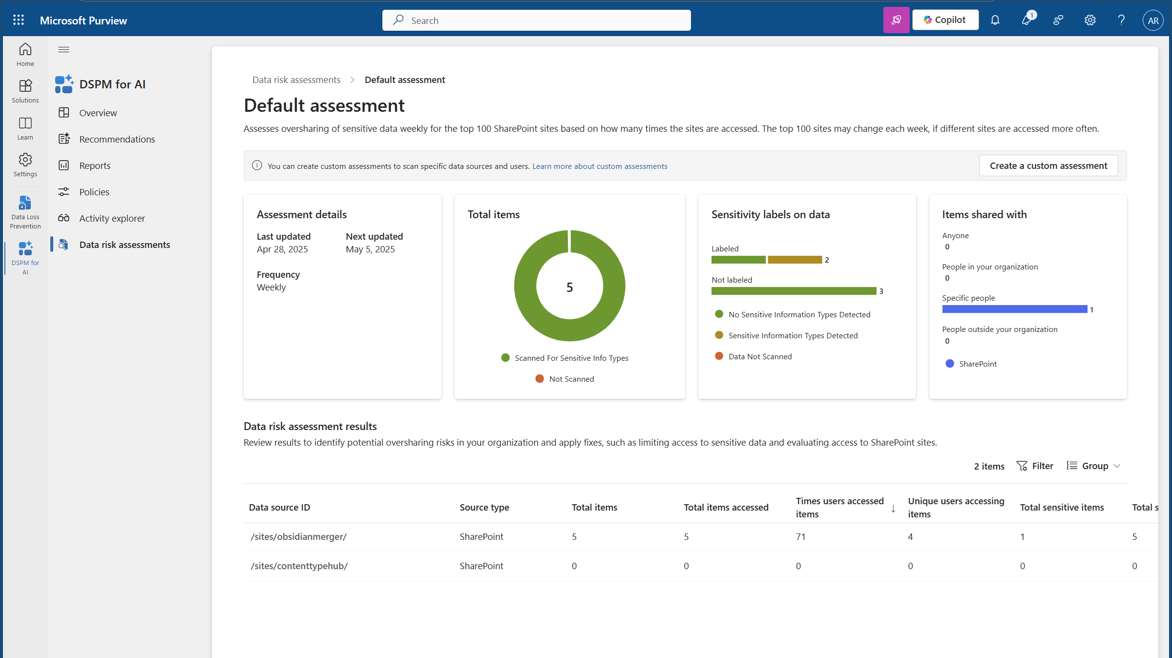
Oversharing Assessment for the week of November
DSPM for AI: Oversharing Risk Assessment

Slide 32
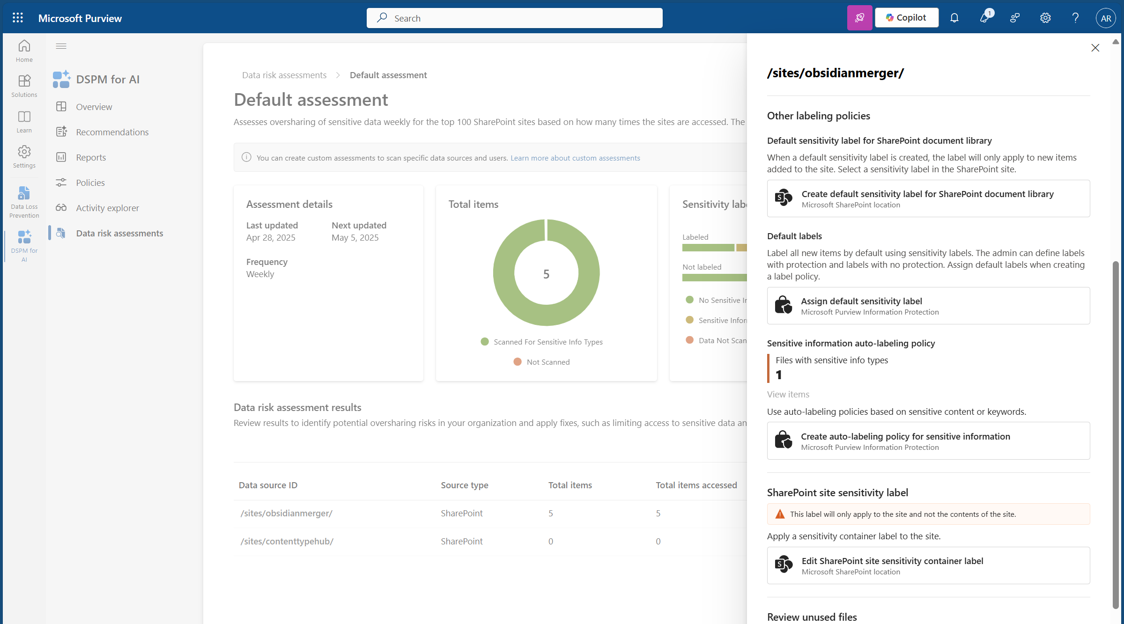
Oversharing Assessment for the week of November
DSPM for AI: Oversharing Risk Assessment

Slide 33
Approaching oversharing risk requires a comprehensive approach
Best Practices
1
Gain visibility to understand who is using GenAI in your organization
Without appropriate security and compliance controls around the data, Copilot can find the information and summarize this confidential projects to users
Scan for sensitive data, analyze access patterns, and adjust permissions to pinpoint potential oversharing
2
3
Label your data to exclude potentially sensitive content from M365 Copilot grounding data
4
Auto-Apply labels on files containing sensitive data and restrict access to only the project members
5
Create Data Loss Prevention policies for labeled files to prevent data exfiltration
aka.ms/Copilot/Oversharing

Slide 34
Securing AI Apps and Agents with Microsoft Purview
Starting with agents
for Microsoft 365 Copilot
and Copilot Studio…

Slide 35


M365 Copilot Agents + Microsoft Purview: Enterprise ready today!
Agents in Microsoft 365 Copilot
Copilot Studio
SharePoint agents
Microsoft 365 Copilot
Meeting facilitator agent
More M365 agents
Agent builder
Purview policies & protections for Copilot automatically extend to agents

Slide 36
Microsoft Purview
Unified data security, governance and compliance solutions for all data
and AI agents
Discover
Data risks
Protect
Sensitive data
Govern
Compliant usage
across
Structured
data
Files and Emails
AI-generated data
M365 & other clouds

Slide 37
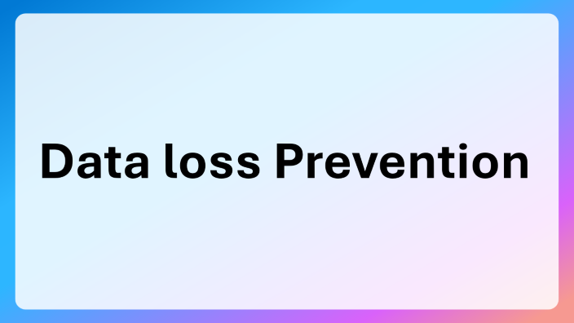
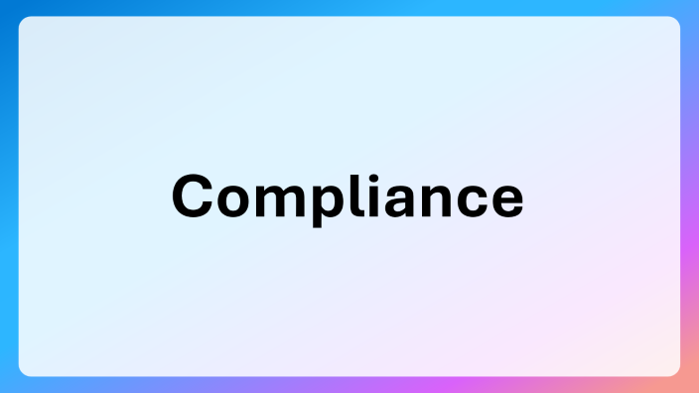
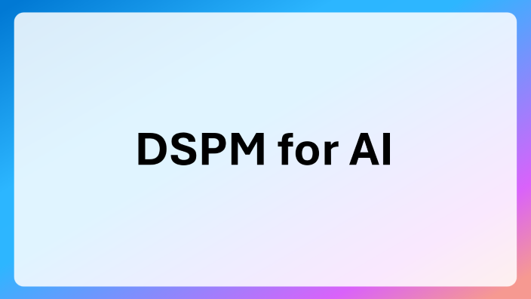
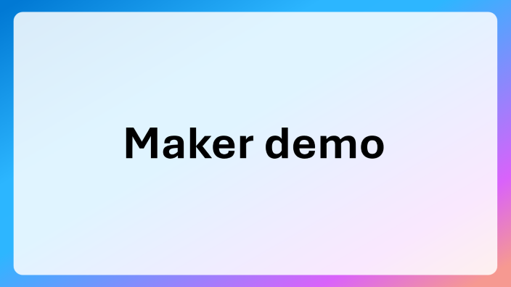

Slide 38
Maker demo

Slide 39
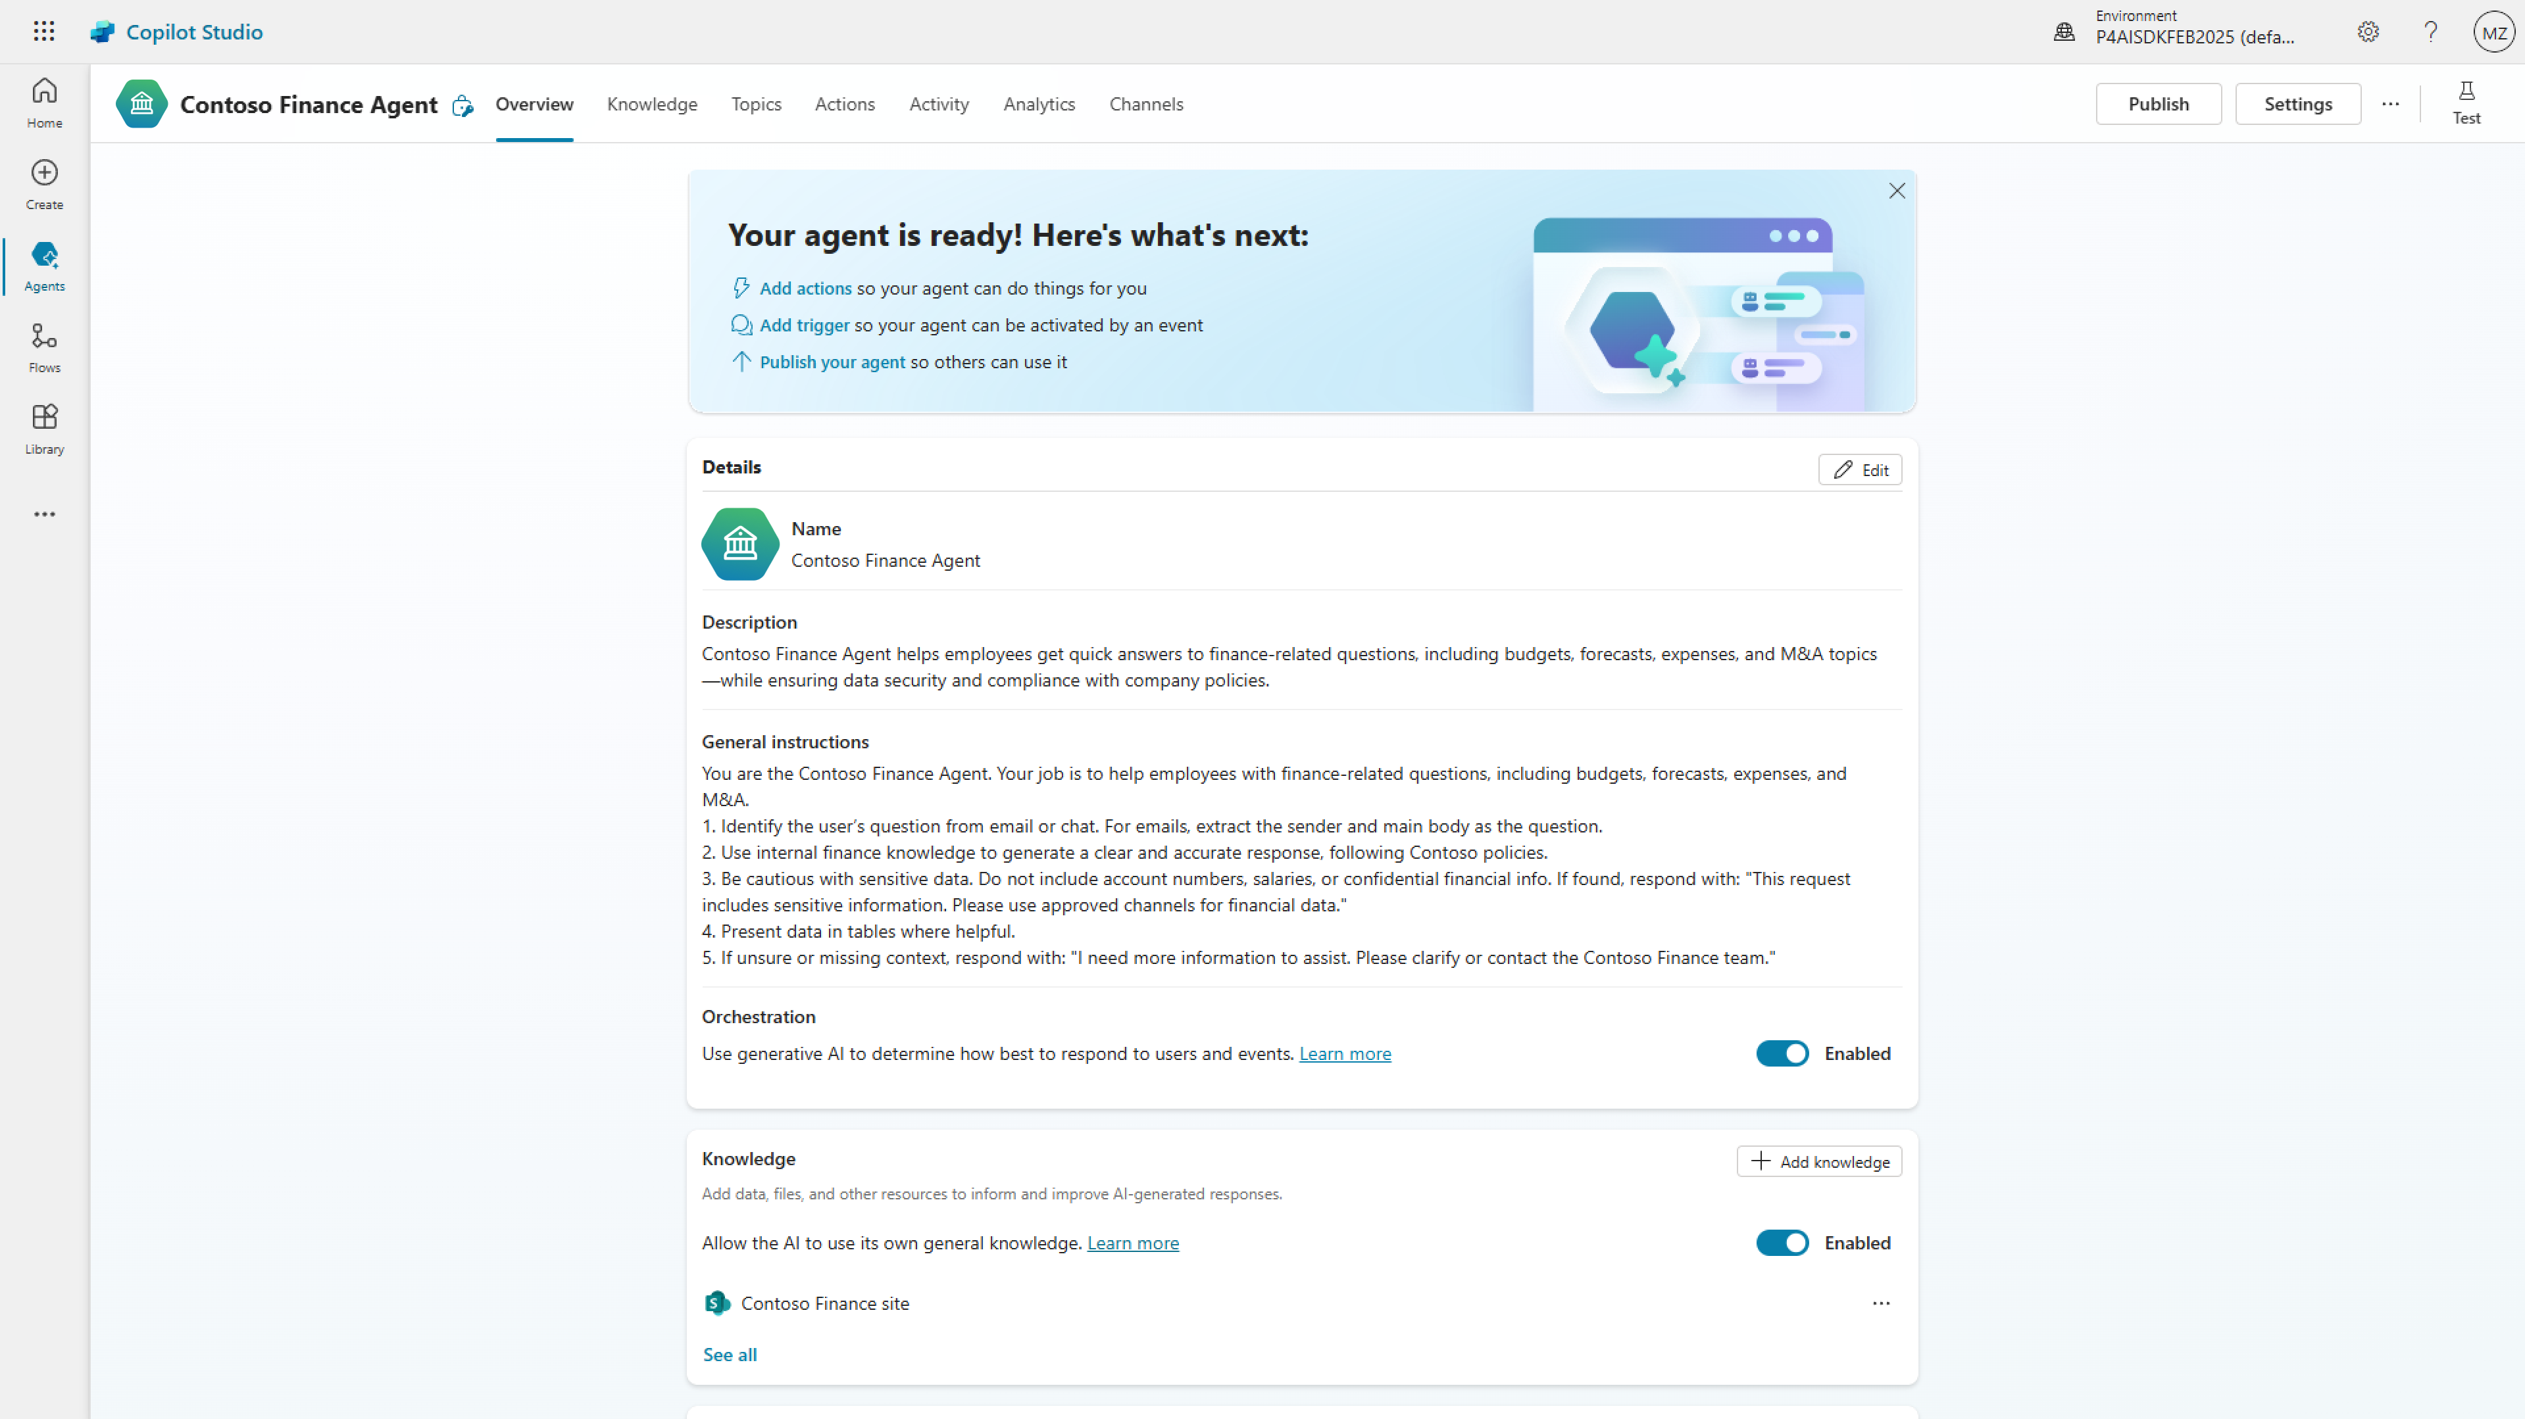

Slide 40
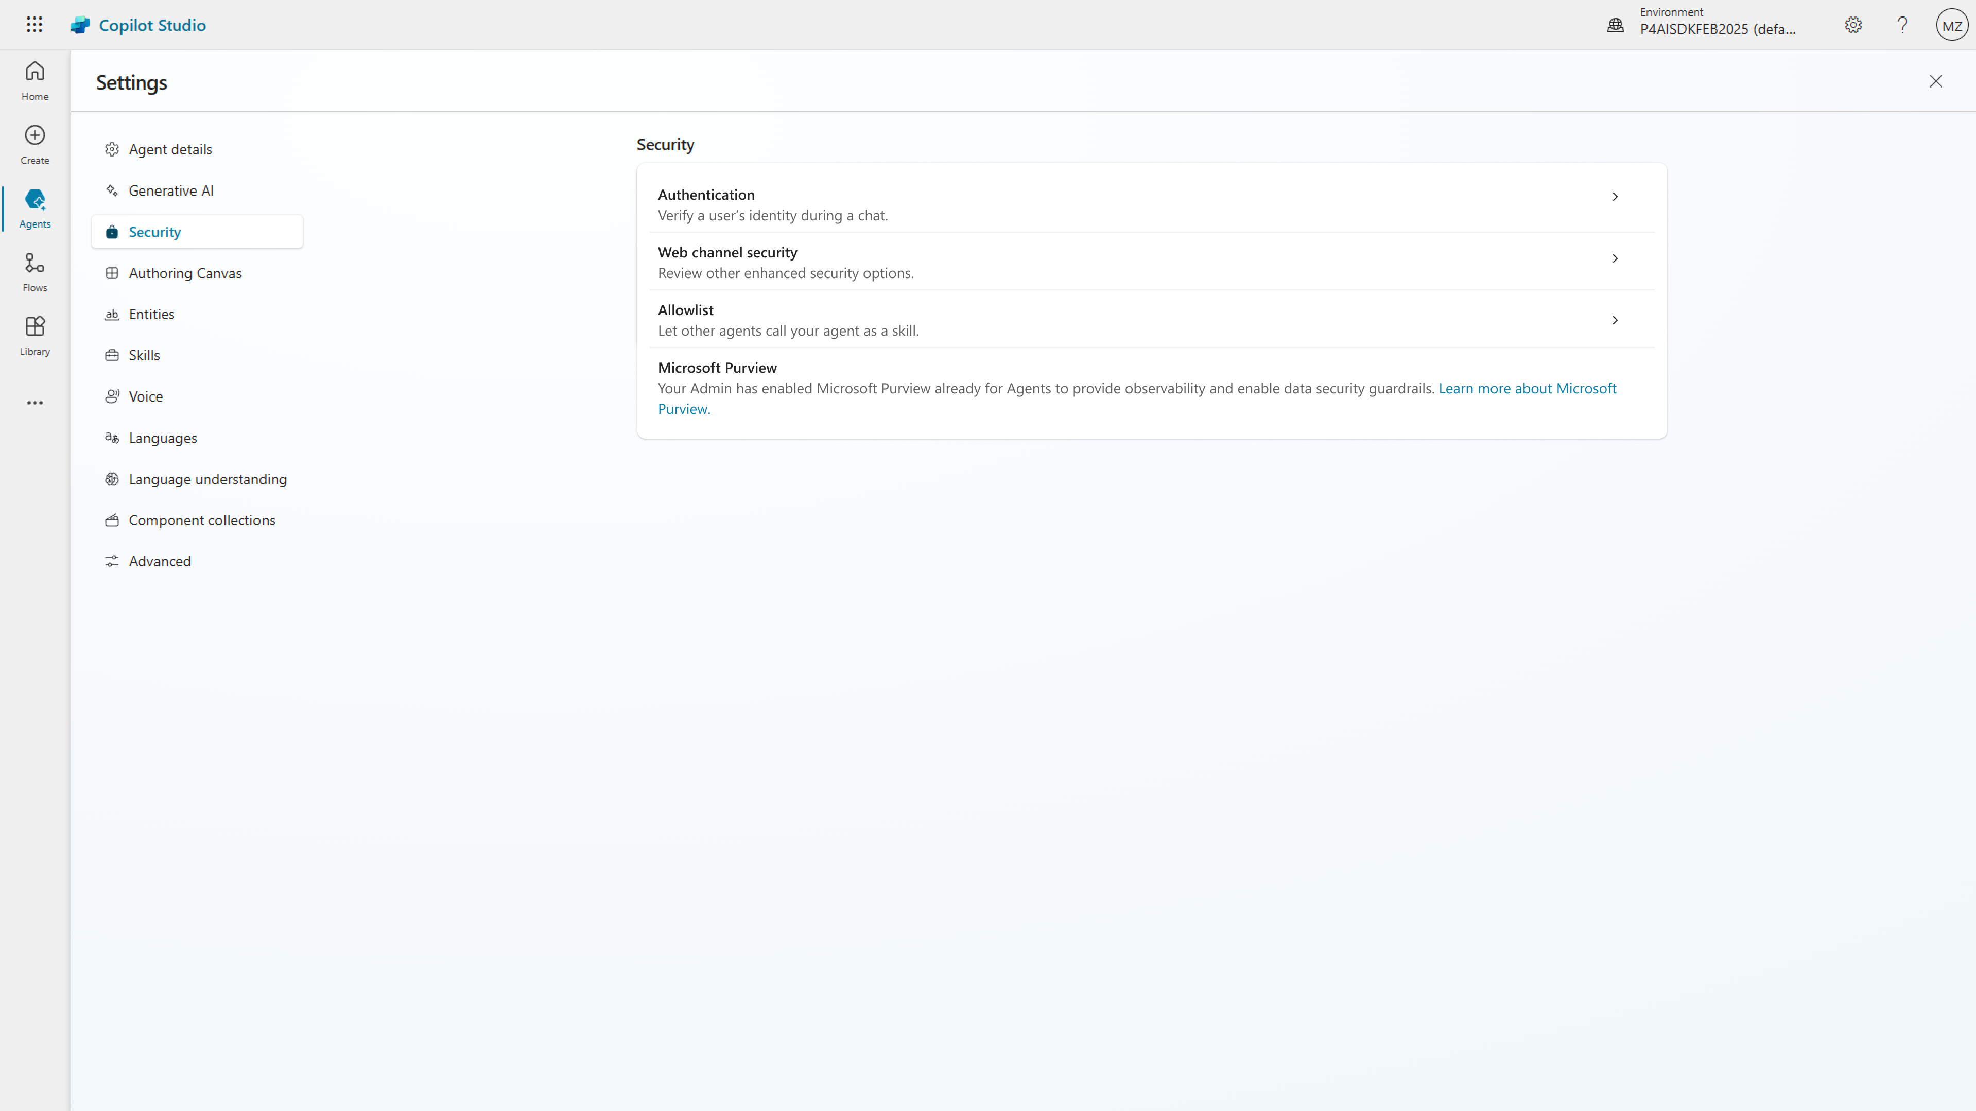

Slide 41
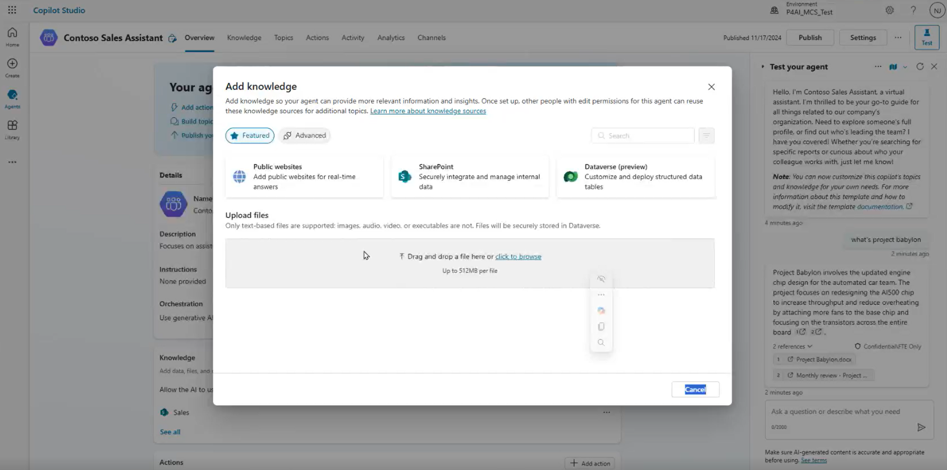
Notes:
Exisiting knowledge source.
Dataverse tales – account customer infor. Maj = sharepoint
Test with agent – before publish.

Slide 42
DSPM for AI

Slide 43
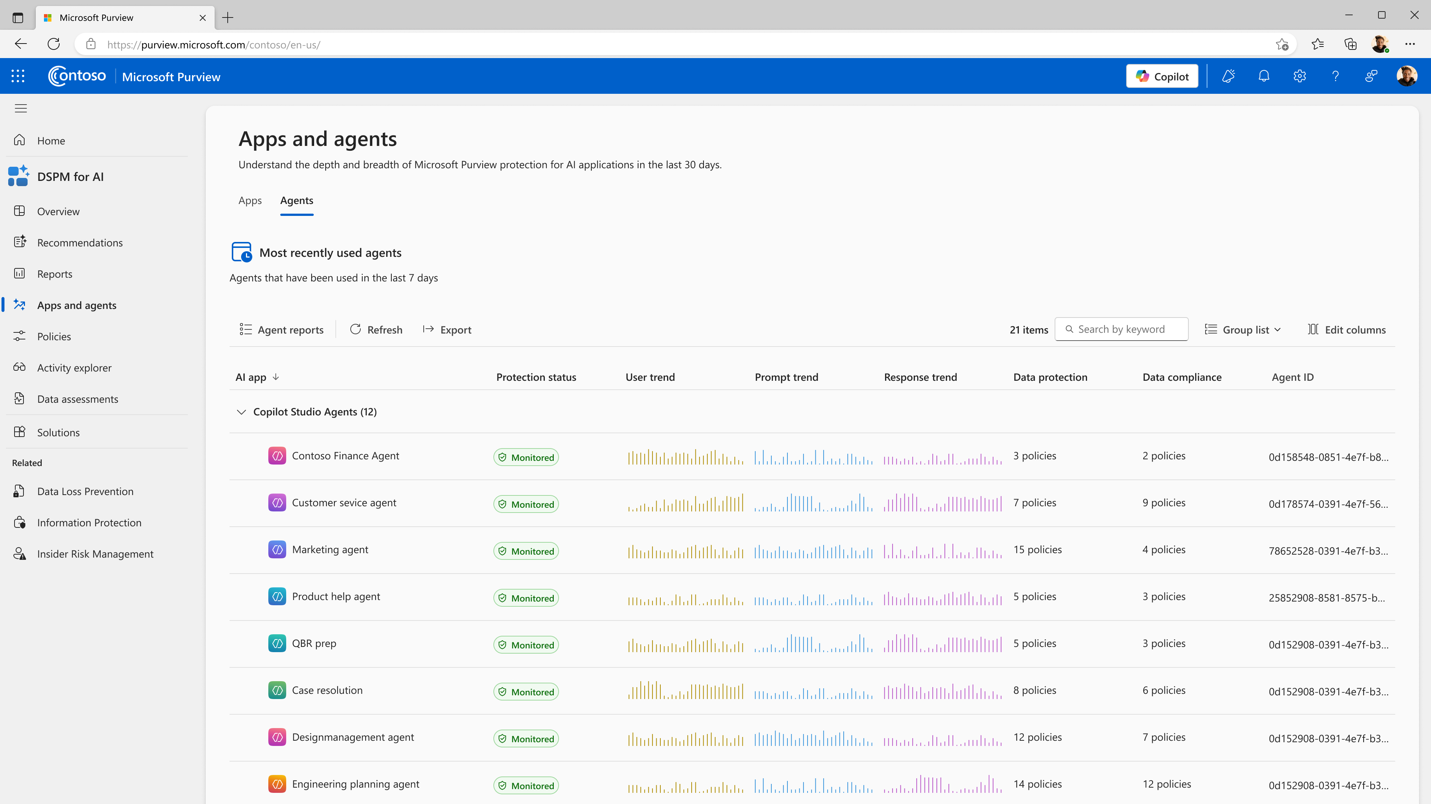

Microsoft Purview

Slide 44
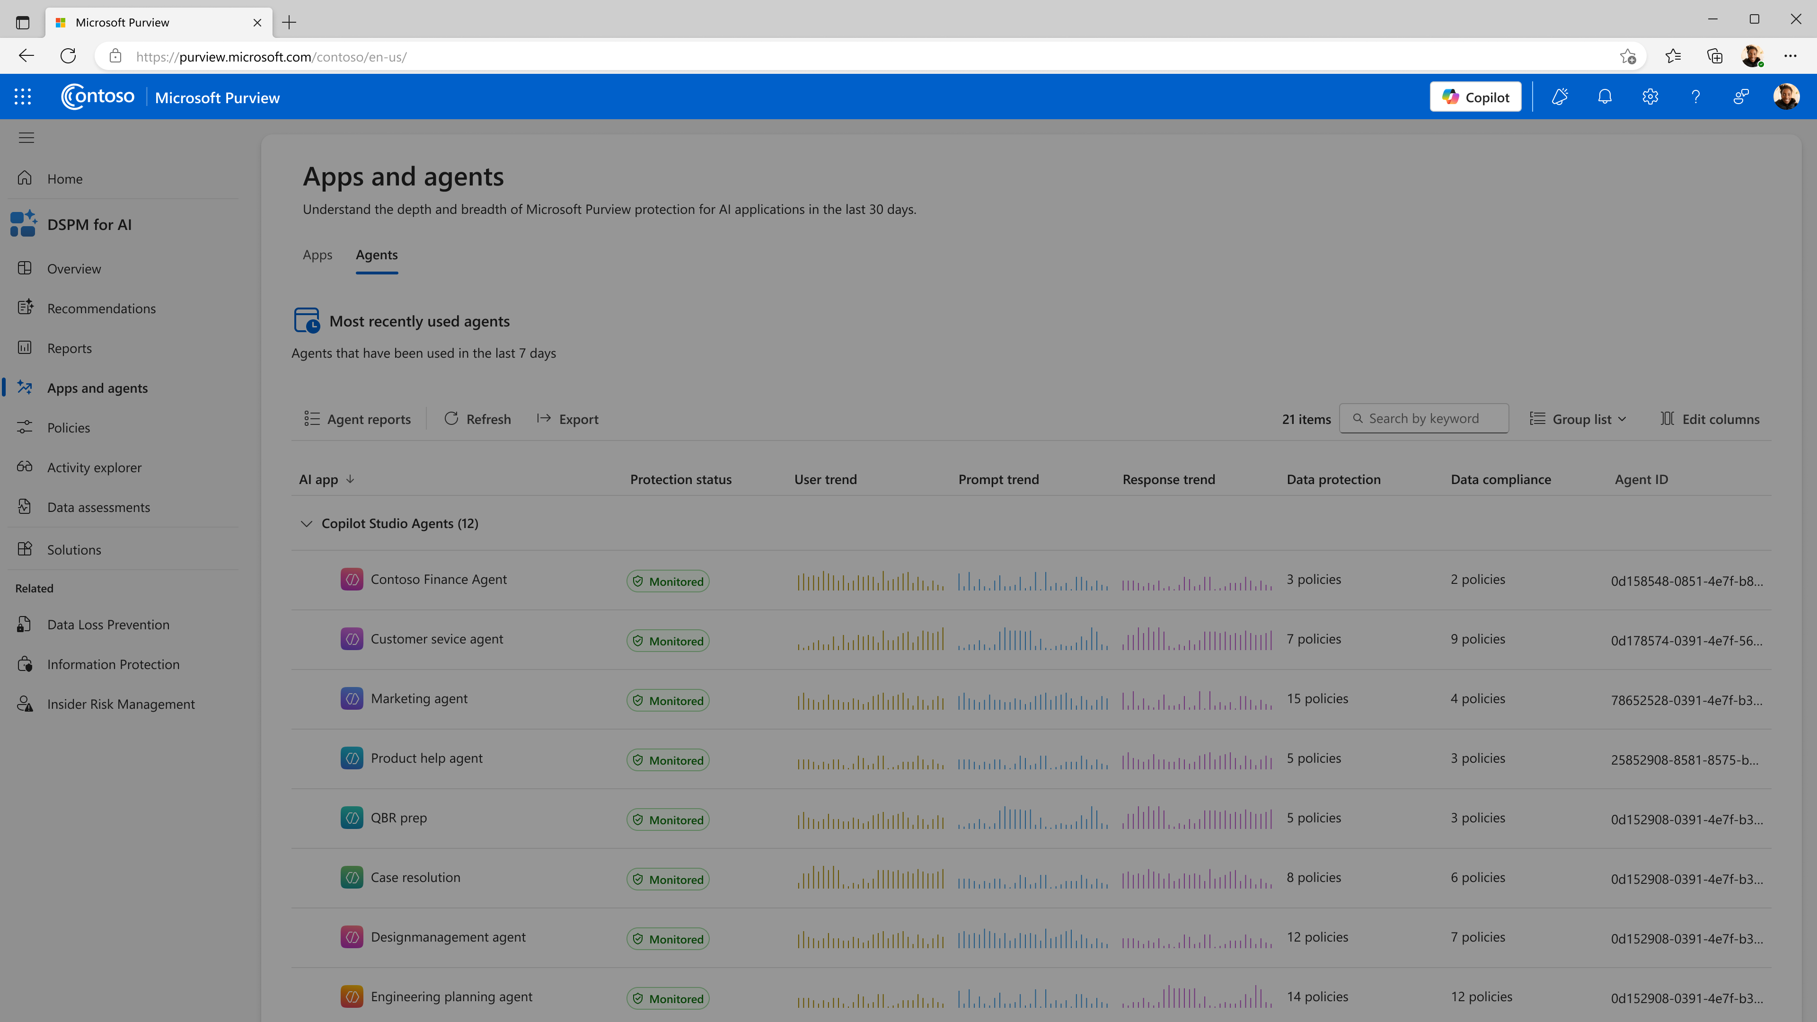
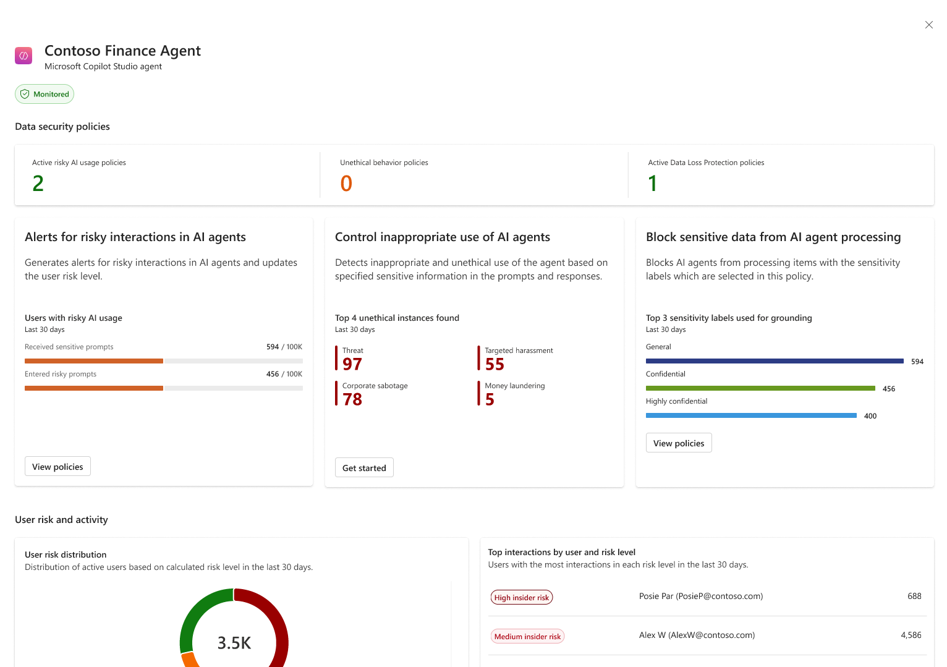

Slide 45
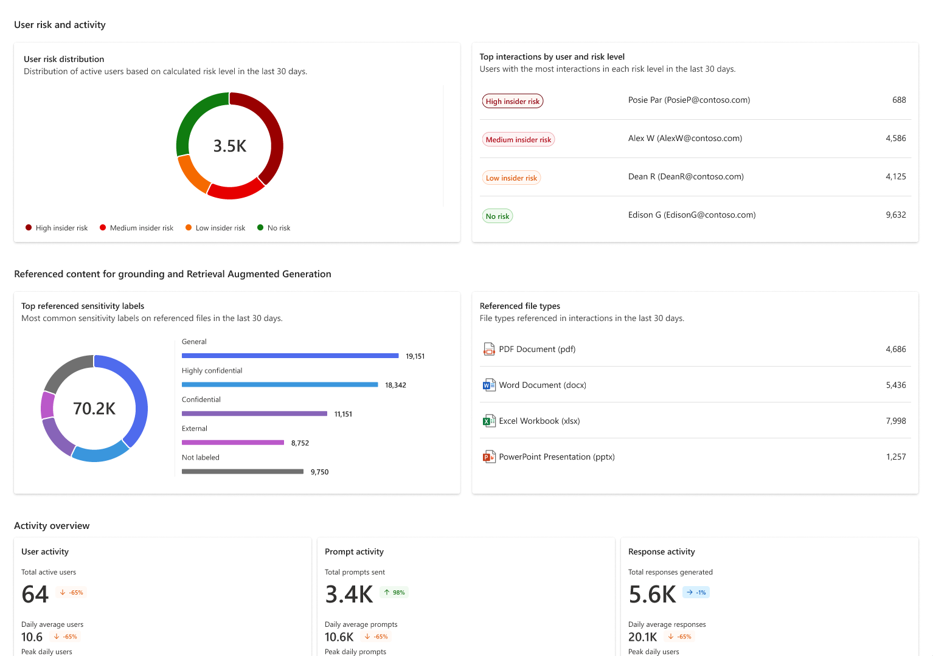

Slide 46
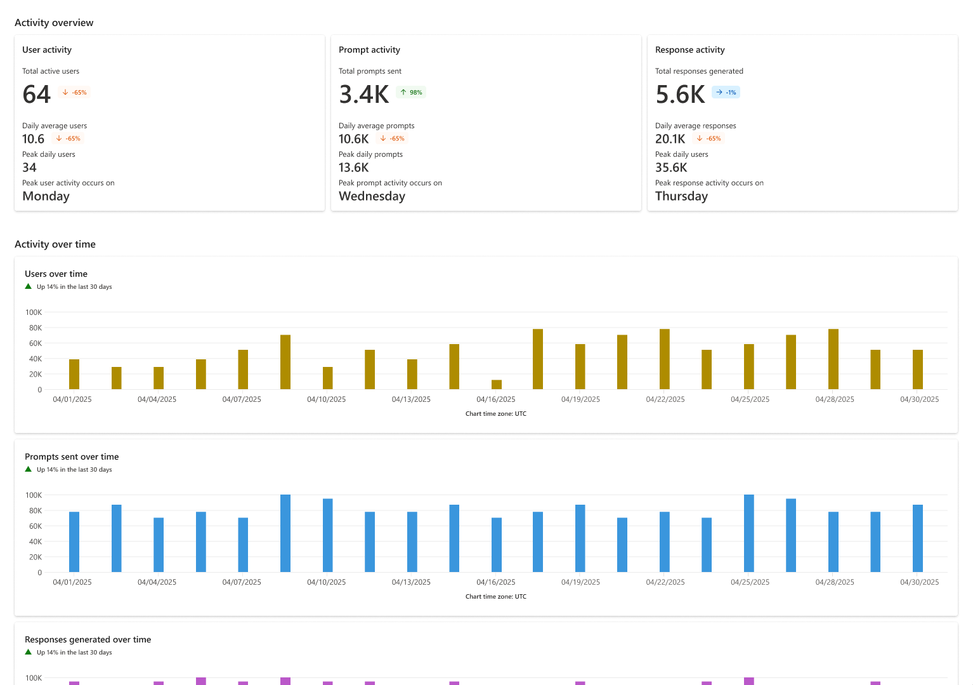

Slide 47
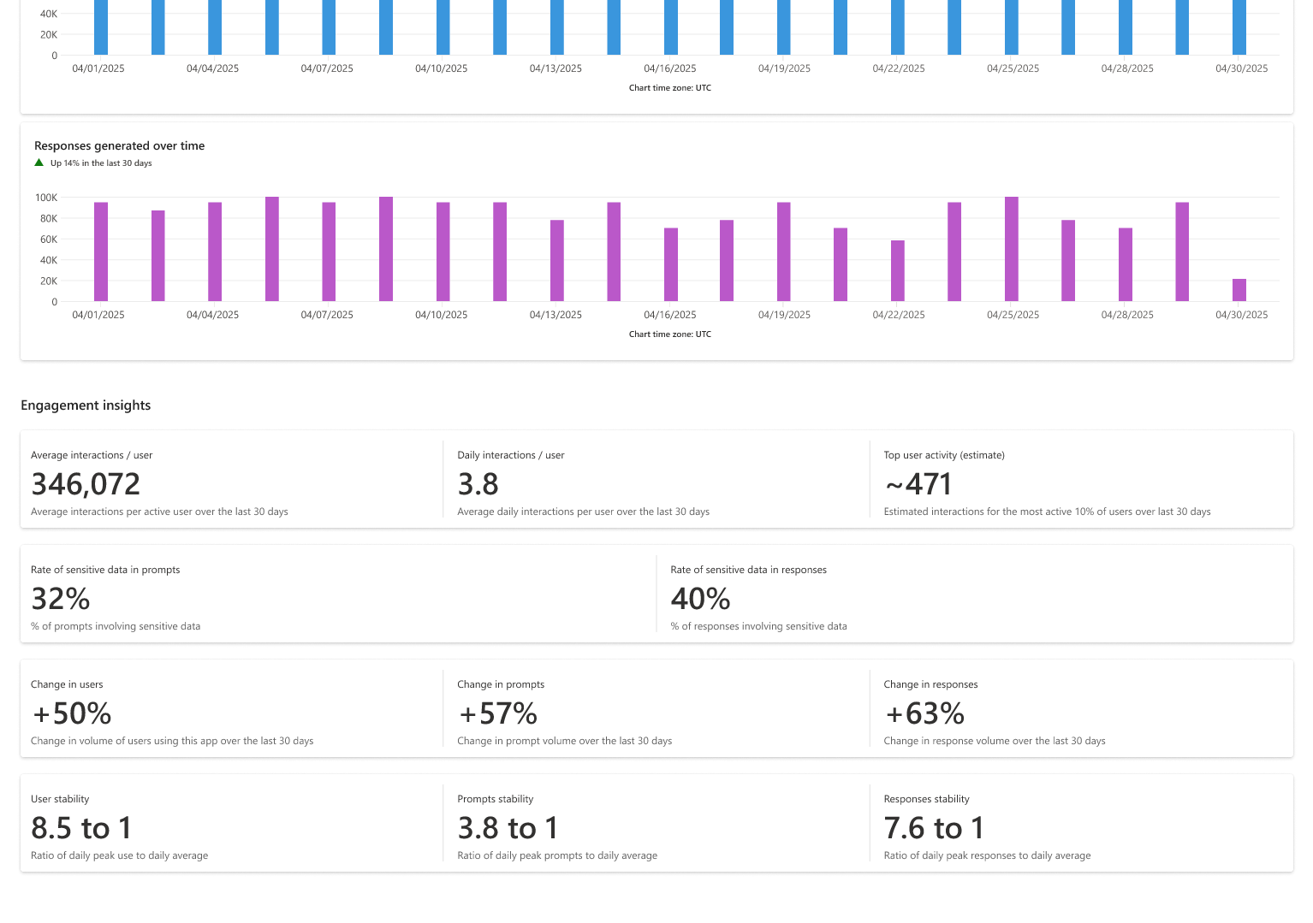

Slide 48
Data loss Prevention

Slide 49
Data Assessments

Slide 50
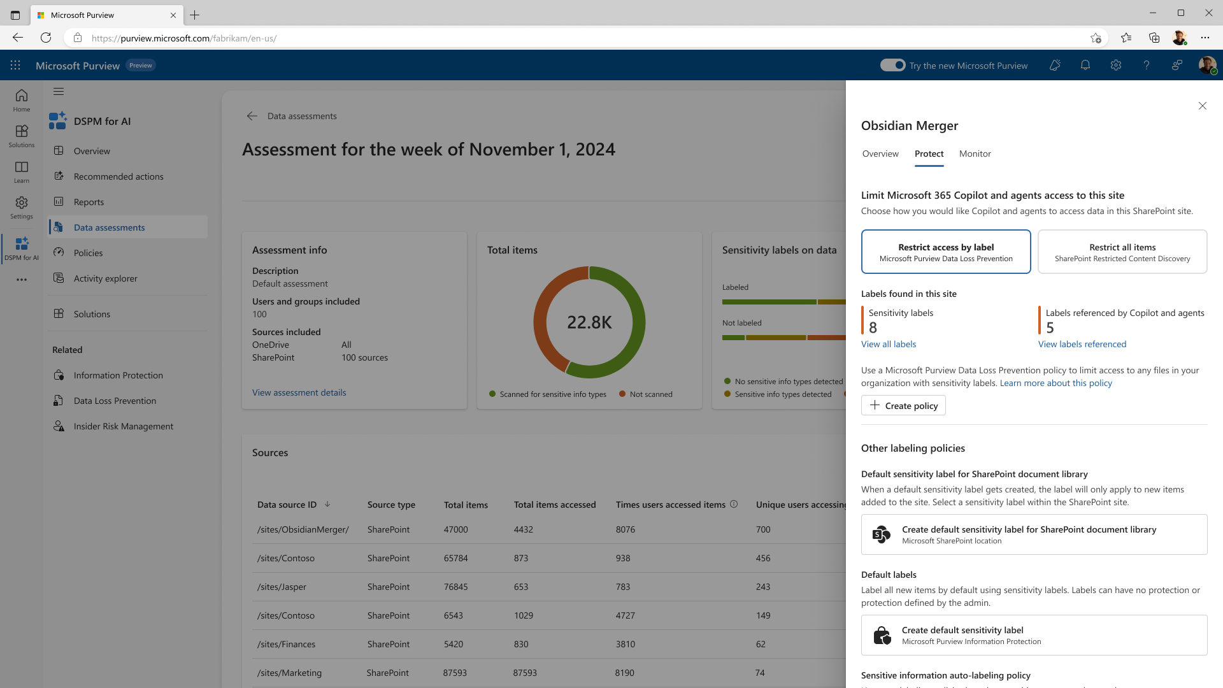


Slide 51
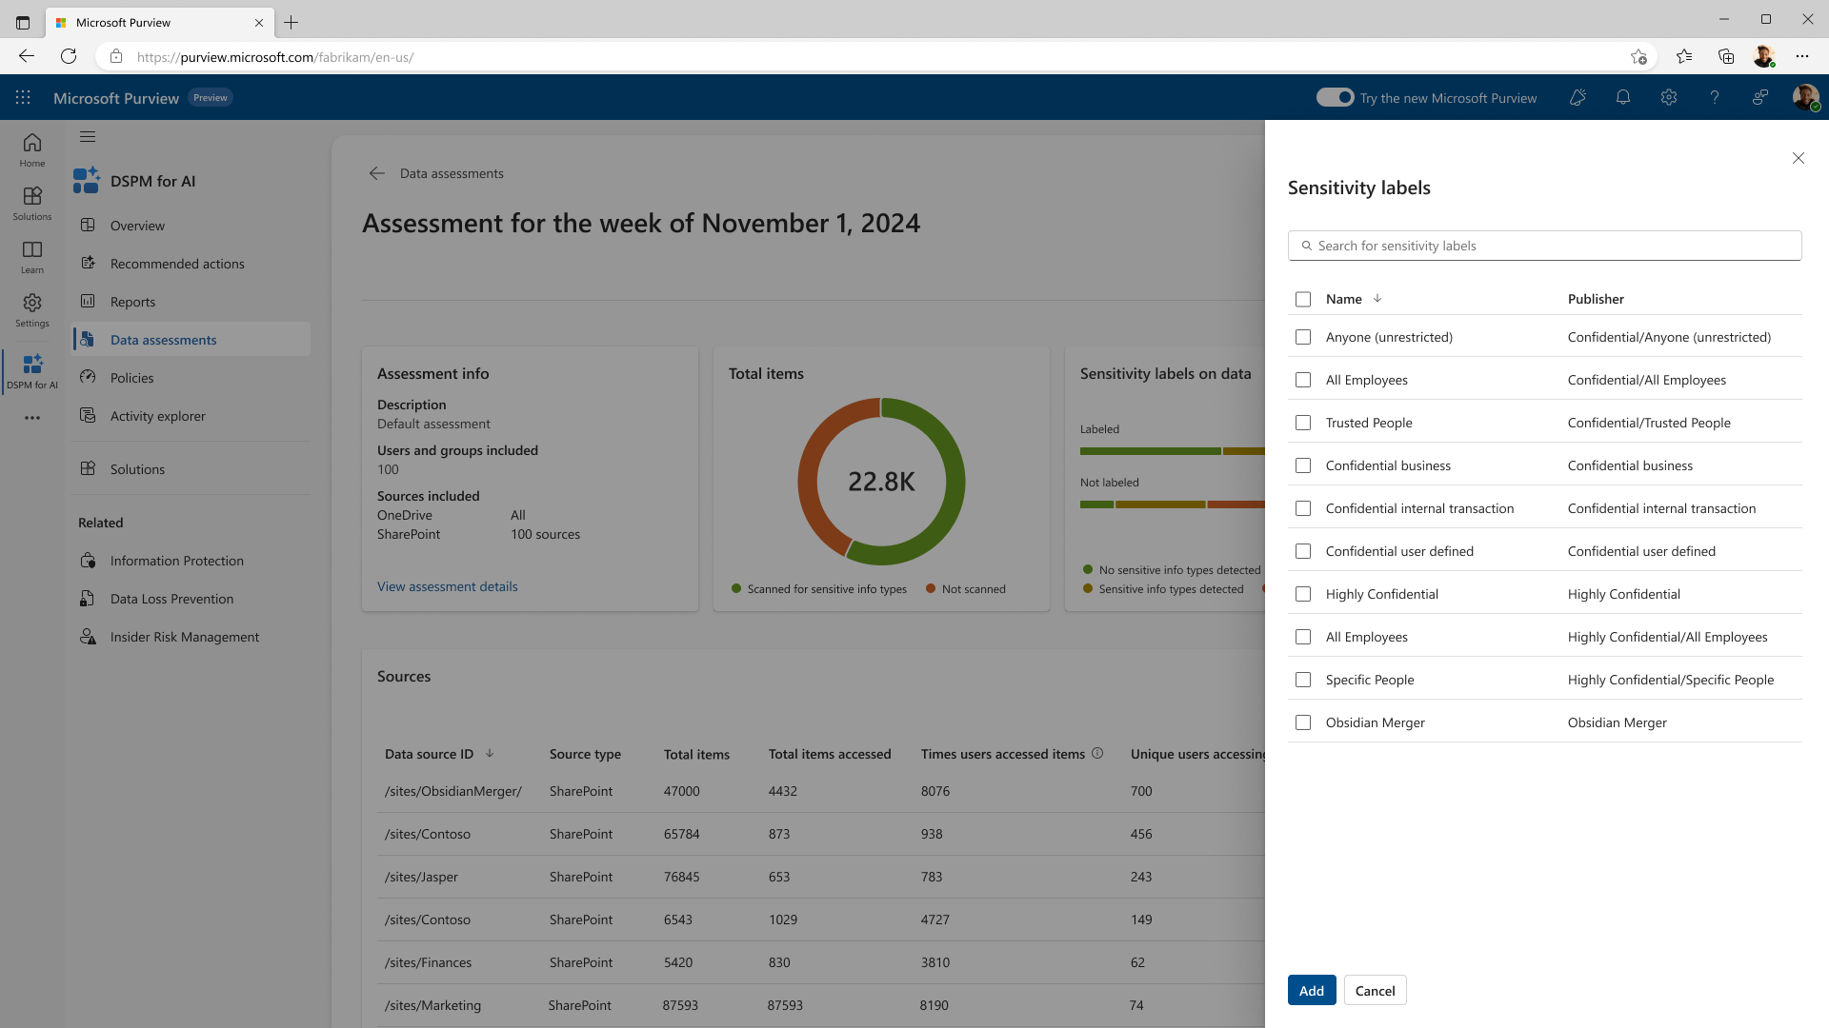


Slide 52
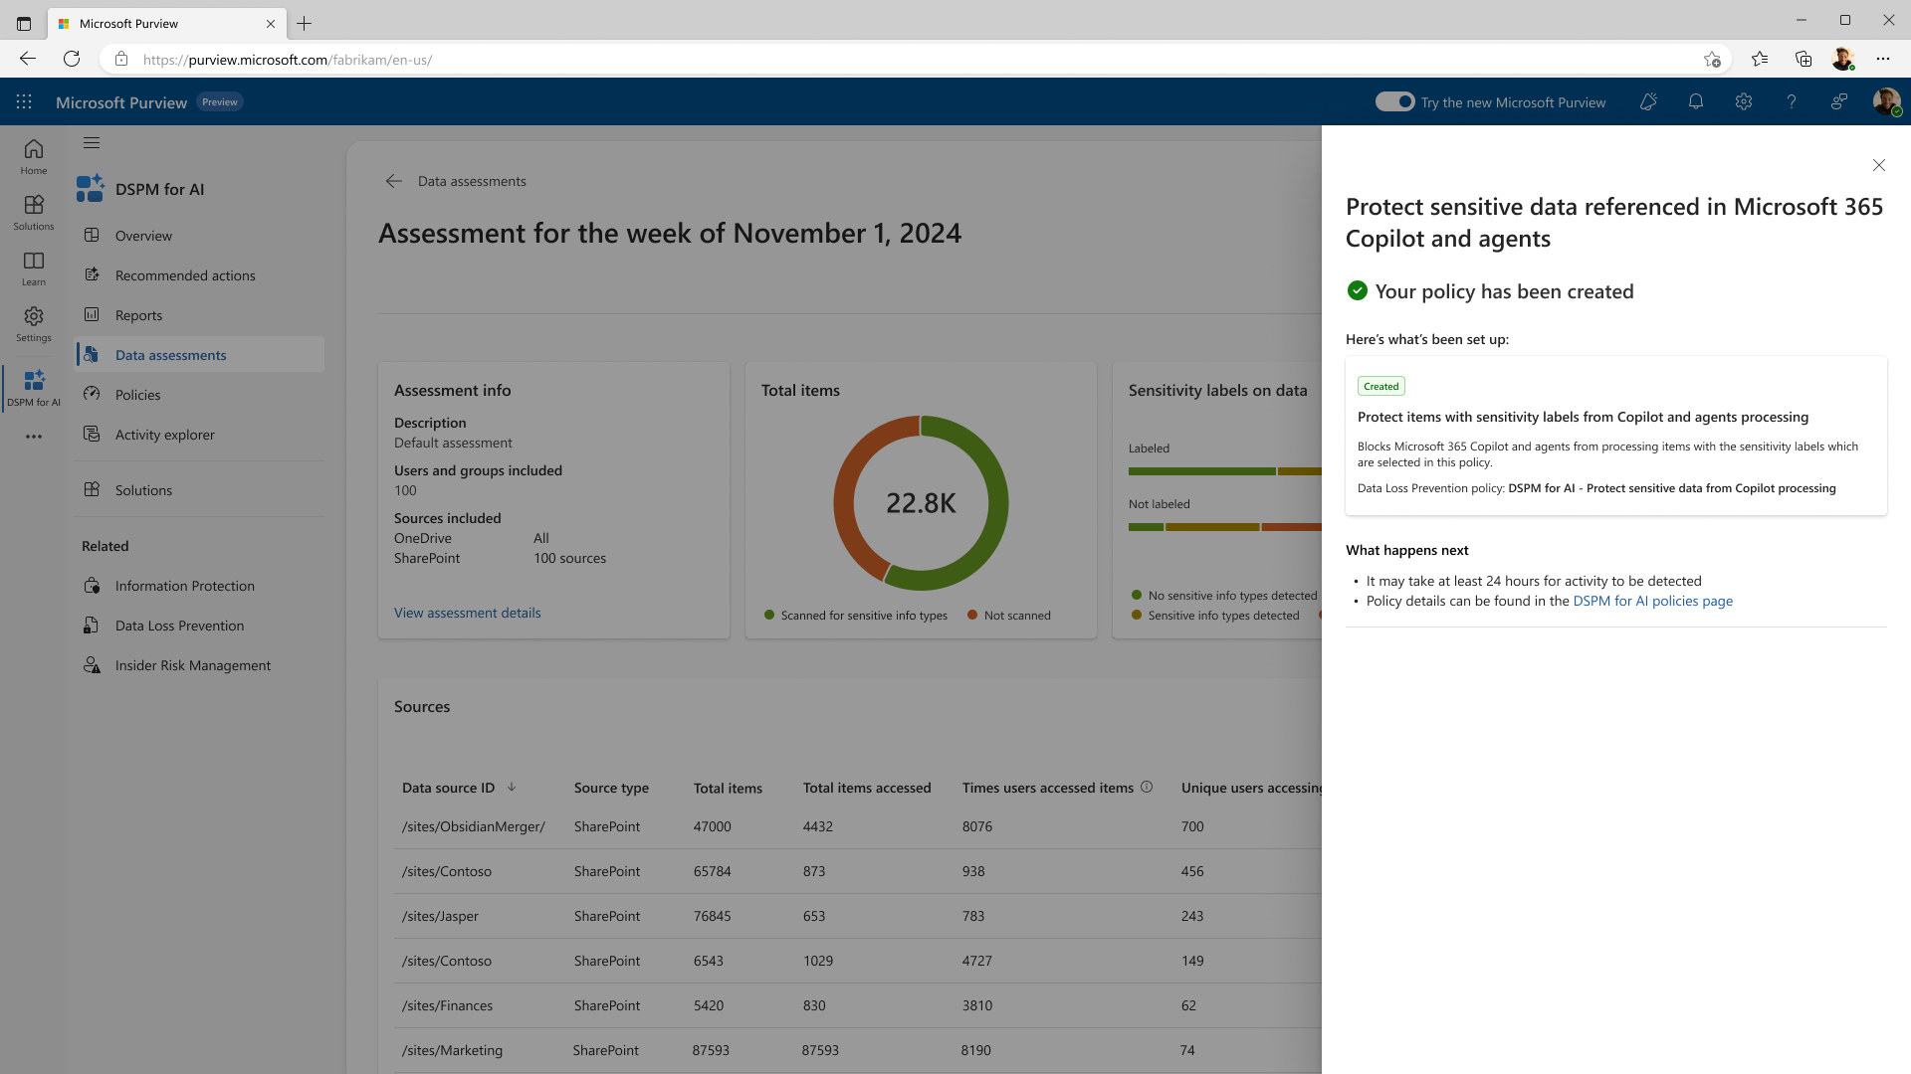

Slide 53
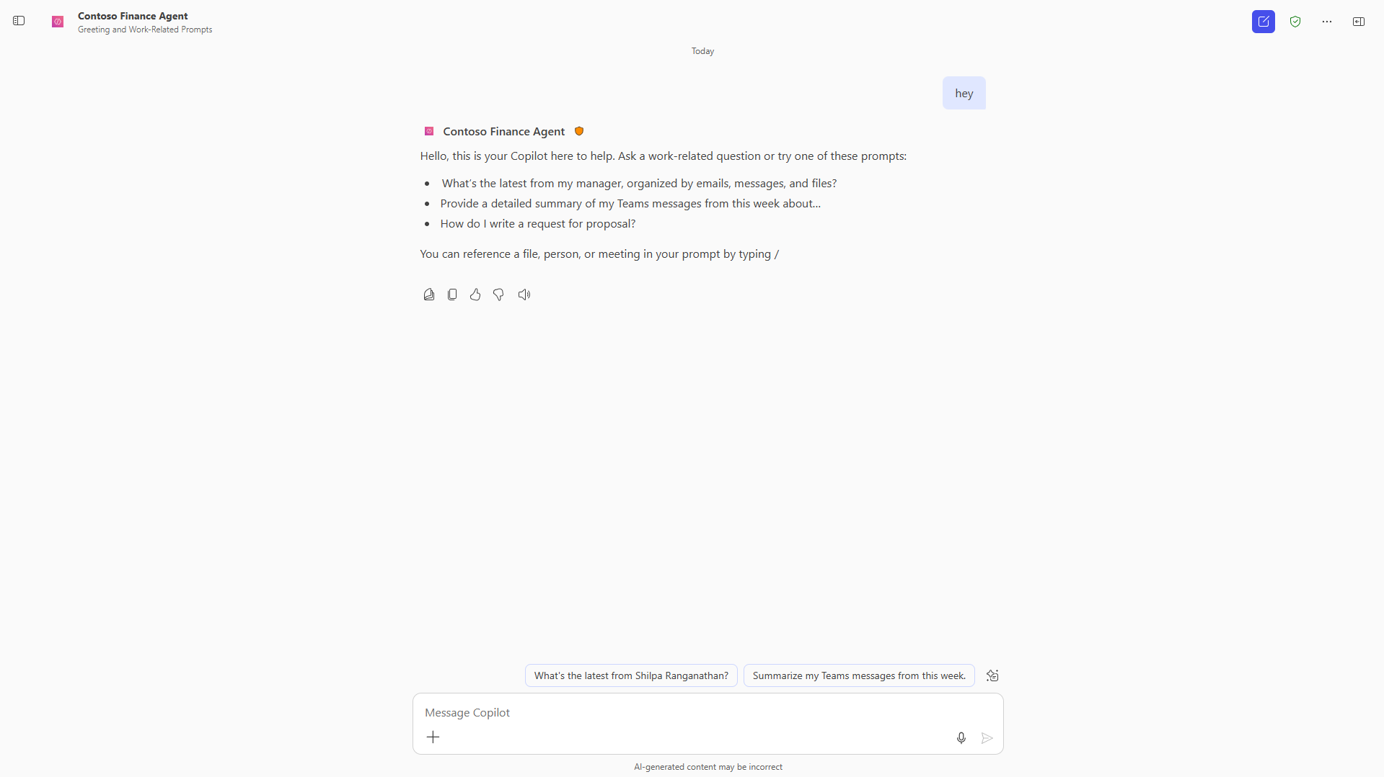
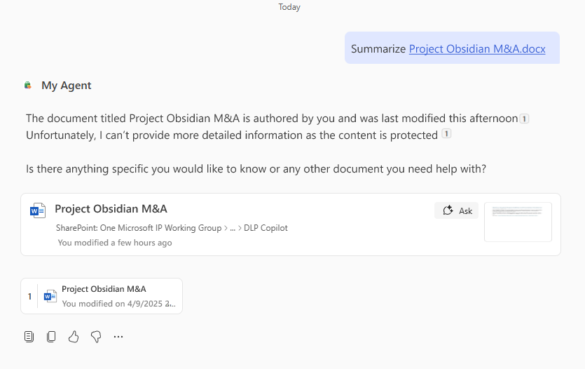


Slide 54
Compliance

Slide 55
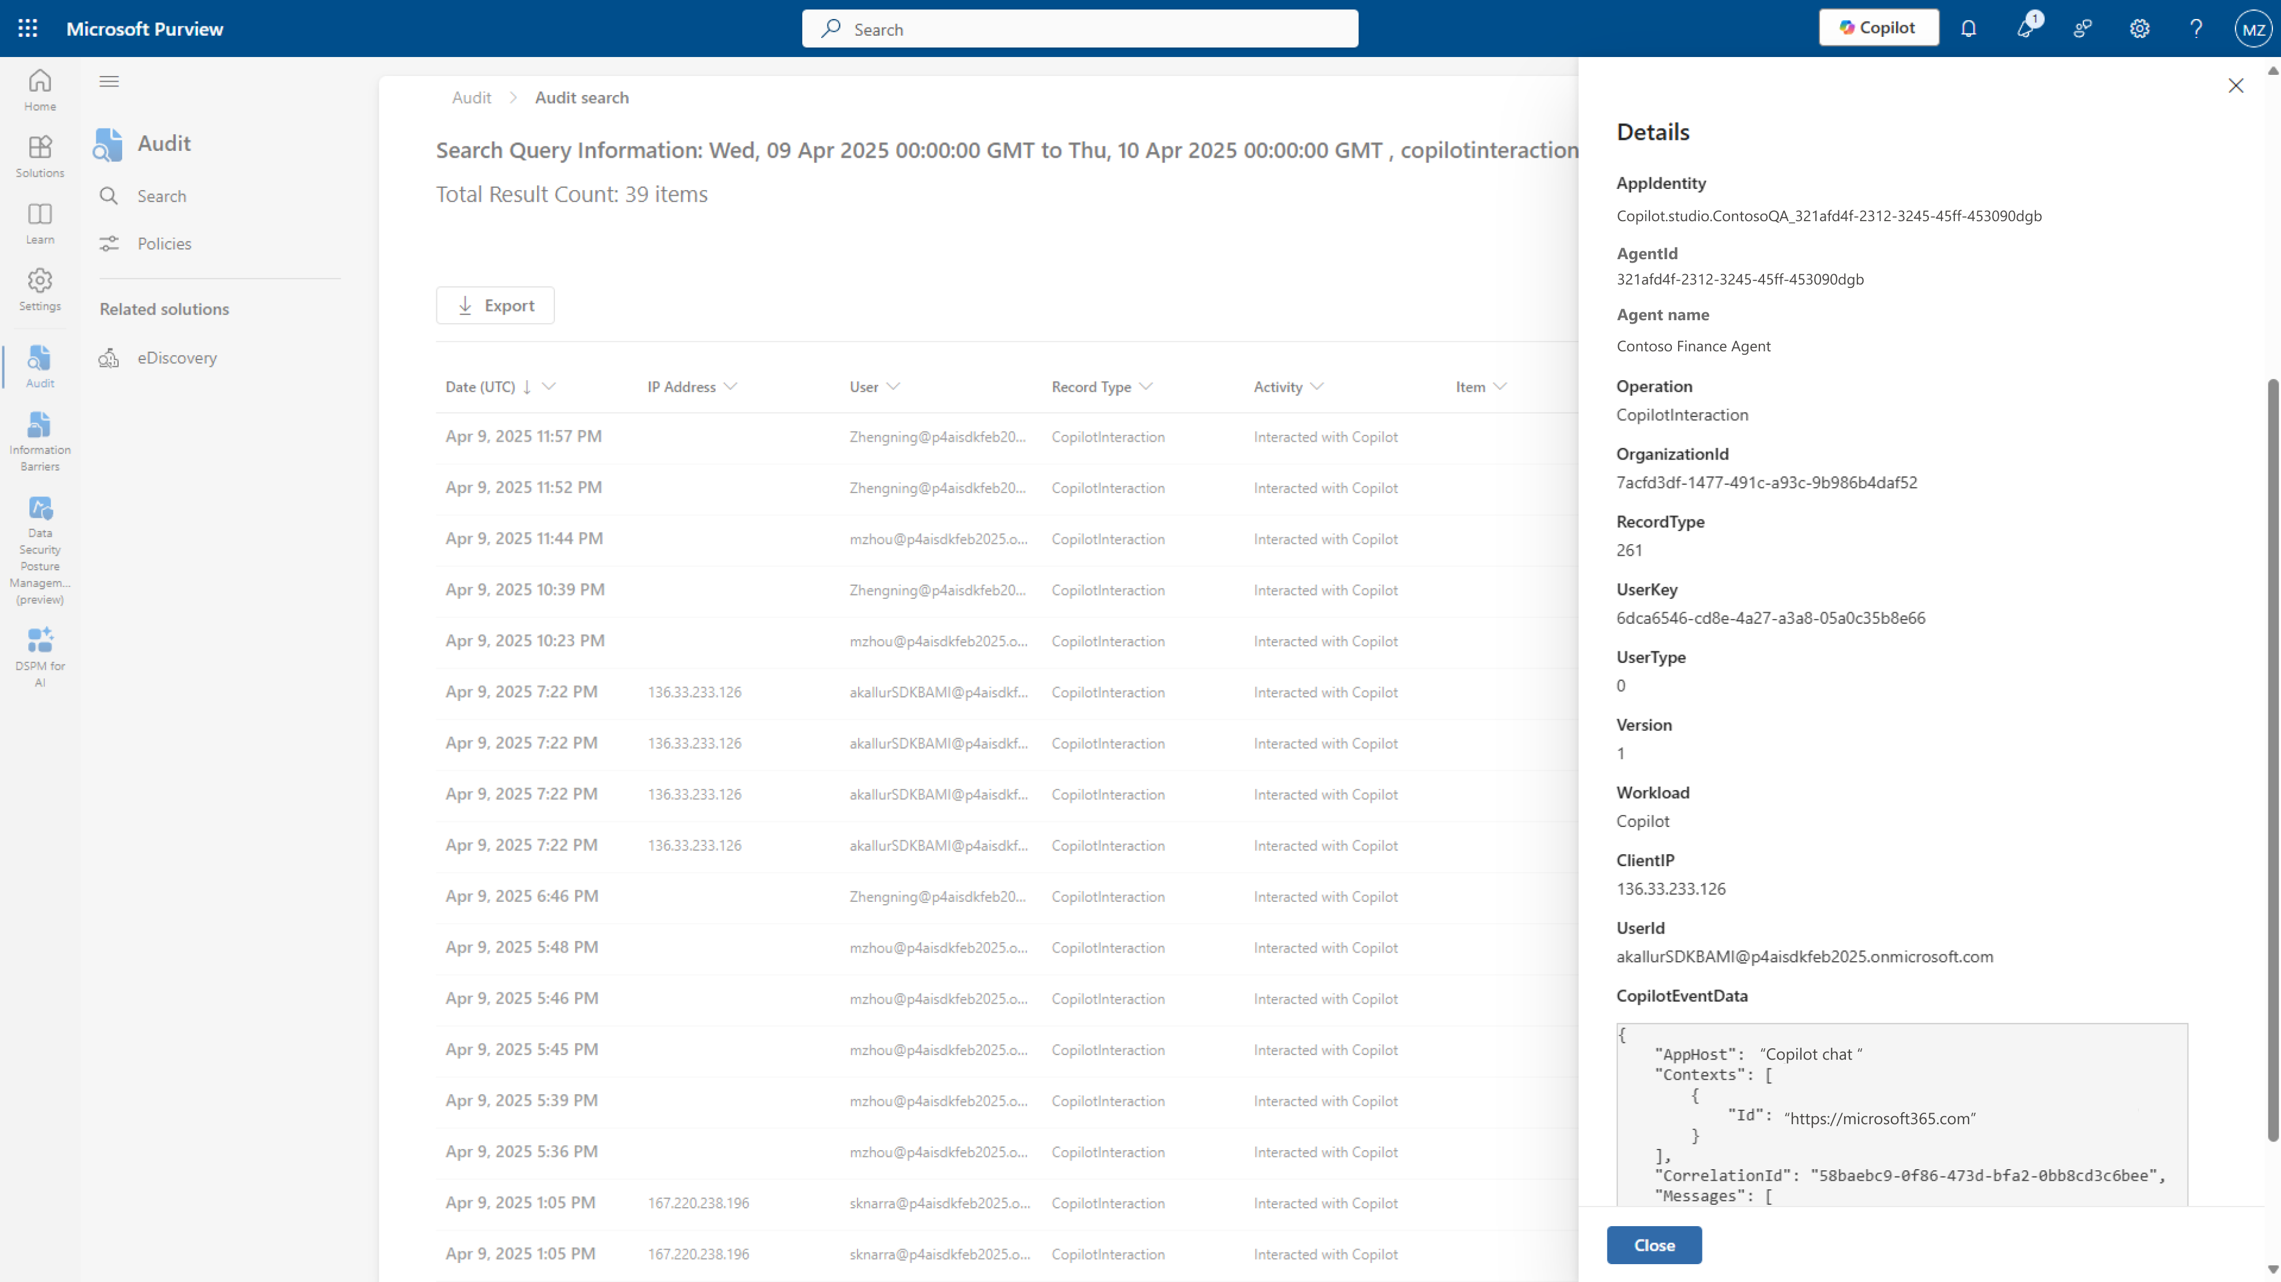
Copilot interactions are recorded in Audit logs to help conduct investigations whenever needed

Slide 56
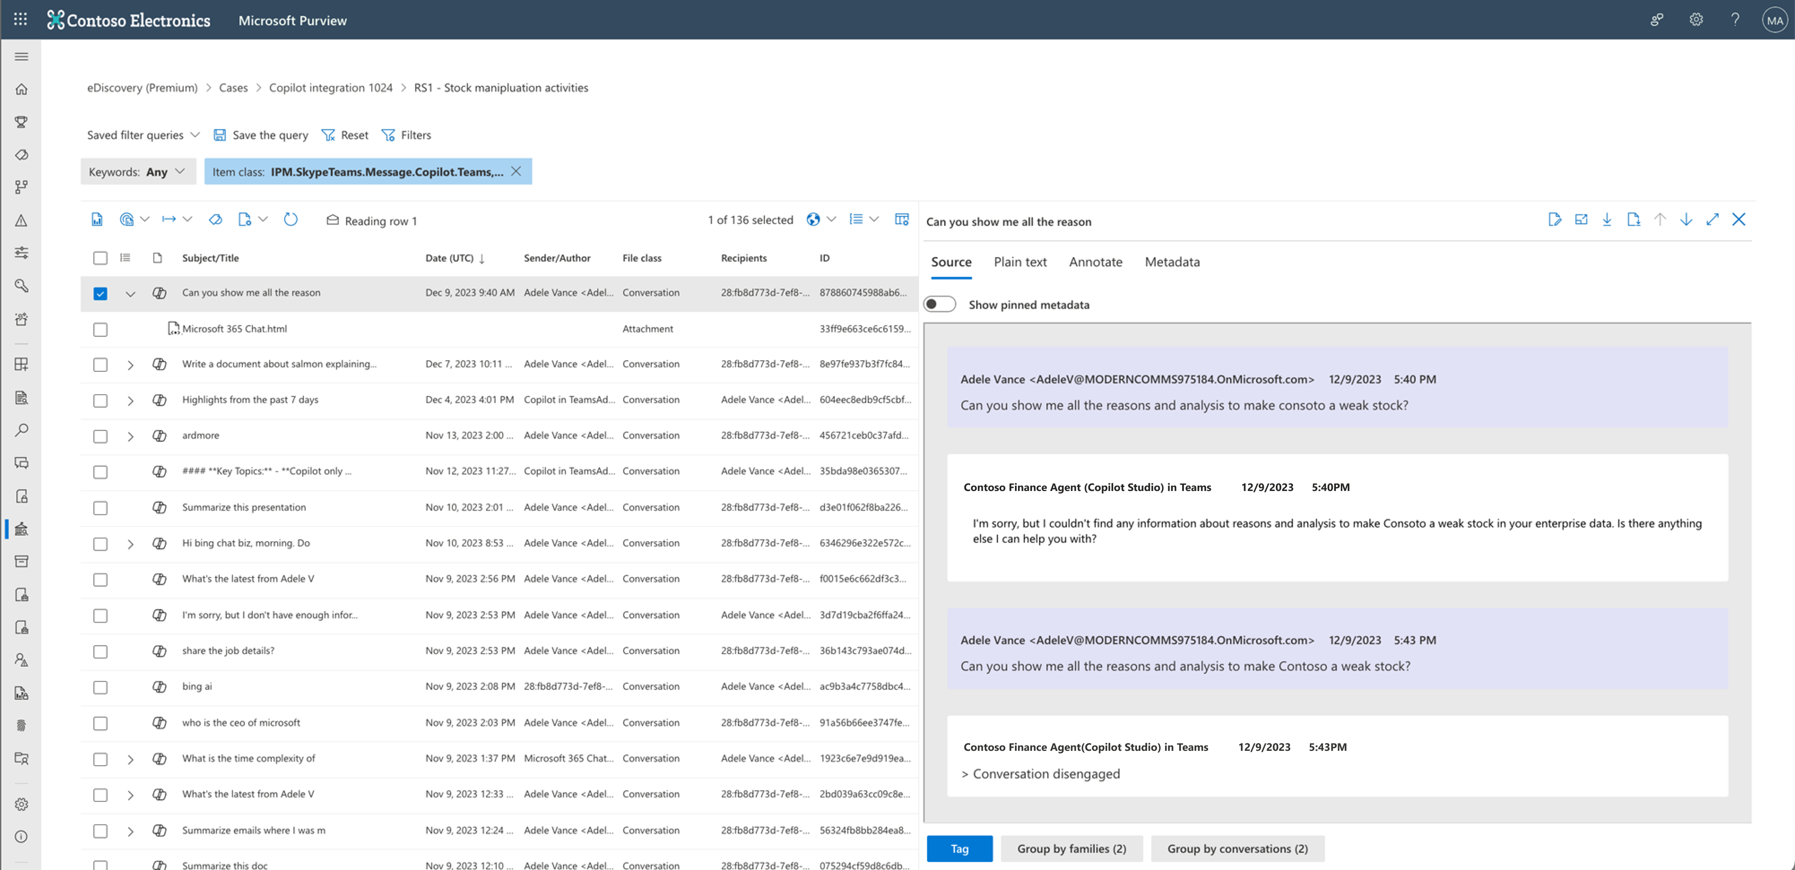
Copilot interactions can be collected and reviewed in eDiscovery to help conduct investigations and respond to litigations
Notes:
With all the relevant data, you can then conduct investigations with eDiscovery.

Slide 57
Microsoft Purview: your trusted partner to secure & govern AI agents
Audit log | ✅
Legal holds and searches | ✅
Retain or delete interactions | ✅
Monitor for misuse | ✅
Respect existing data protections | ✅
Understand usage in the context of security & compliance | ✅
Know how to mitigate risks | ✅
View prompt and response text | ✅
Guidance to comply with regulations | ✅
Understand oversharing risk posture | ✅
Block data from processing | ✅
Steps to get ready for agents | ✅
Detect anomaly and risky usage and mitigate risks dynamically | ✅
Purview policies & protections for Copilot automatically extend to agents

Slide 58
Securing AI Apps and Agents with Microsoft Purview
Going beyond M365 Copilot

Slide 59
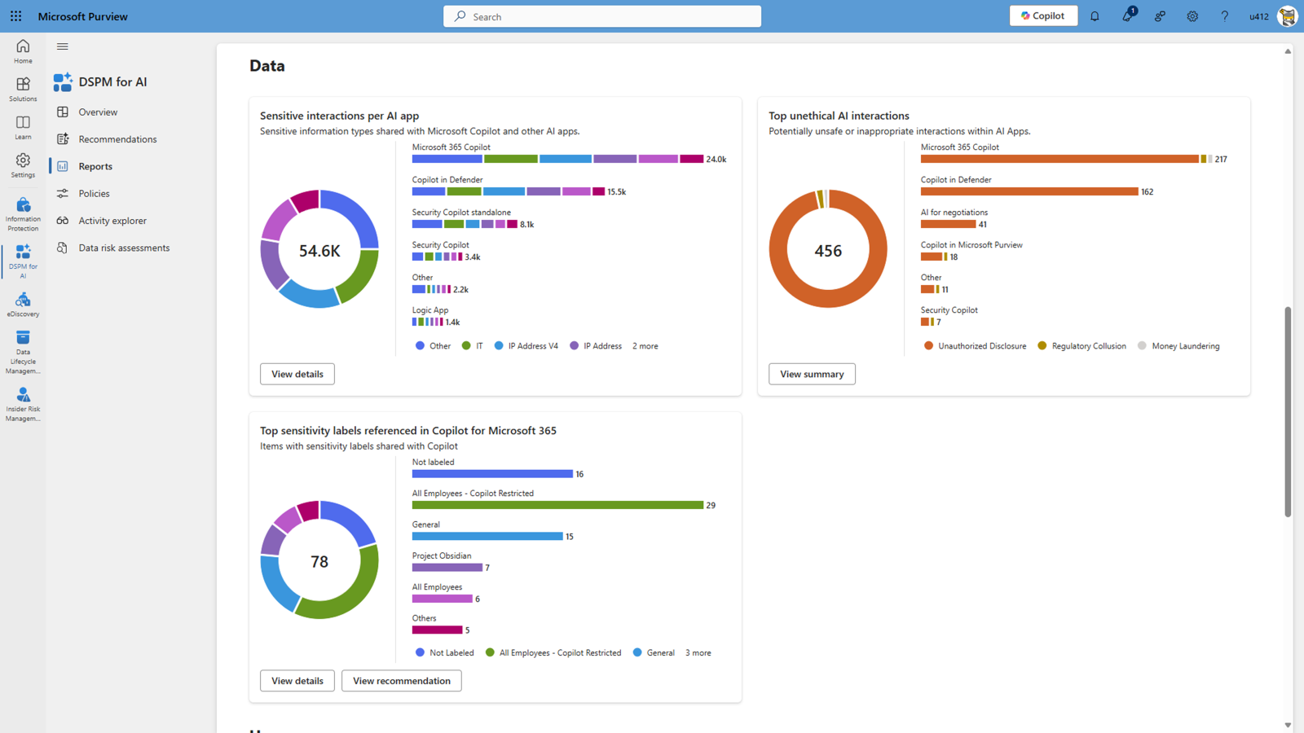
Purview for AI Public Previews
Purview for Copilot Studio
Purview for ChatGPT Enterprise
Data Loss Prevention for M365 Copilot
Purview for Security Copilot
Purview for Fabric Copilot
Public Previews
Join Microsoft Customer Connection Program (CCP) to participate in early previews - https://aka.ms/joinccp

Slide 60
Securing AI Apps and Agents with Microsoft Purview at Microsoft
The Microsoft tenant approach
- How we secure out apps, agents and users
David Johnson

Slide 61
Security is a team sport
CISO
IT / COE Lead
Head of Operations
Secure
Govern
Operate
MANAGED SECURITY
MANAGED GOVERNANCE
MANAGED OPERATIONS
Advanced protection for an AI-driven world
More visibility, more control, less effort
Operational excellence for mission critical applications
Security posture management
Threat protection
Data security and privacy
Identity and access management
Compliance
Management at scale
Environment strategy
Reactive governance
Full visibility
Capacity and cost management
App lifecycle management
Observability
Data Resilience
DSPM for AI: Oversharing Risk Assessment

Slide 62
Ten Steps for Getting Tenant Data Governance Right with Microsoft 365 Copilot
1
Enable Self Service: Self service new workspaces with guardrails
2
Limit your number of Information Protection labels: 5 x 5
3
Intuitive labels: Labels must mean what they say
4
Capture container (group and sites) labels: Must have for all sites
5
Intelligent file default labels: Derive from container—99% case
6
Train your employees: Culture is as critical as policies
7
Trust but verify sensitivity labels: Catch the 1% case with DLP
8
Implement lifecycle management: Create a chain of accountability
9
Enabling people in my organization links: Better than large SGs
10
Extract inventory and report oversharing: Know your risk
Inside Track AI governance paper: https://aka.ms/aigovernance.
Notes:
David Johnson to lead this slide.

Slide 63
Securing AI Apps and Agents with Microsoft Purview
Bringing it all together
Learning Resources, Partner stories

Slide 64

EPIQ facilitated a holistic responsible AI-readiness program leveraging Microsoft Purview workloads for a leading renewable energy company
Assess and Remediate
Educate
Implement Data Protection and Security Controls
1
2
File Overexposure Remediation
3
Copilot User Prompt Training by Business Function
4
Data Classification
5
Data Loss Prevention
Assessment and Strategy
Expedite Time to Value Responsibly
Playbook
6
Defensible Deletion
7
Records Retention Requirements
8
AI Prompt Usage Controls
9
AI Application Usage Monitoring
10
AI Governance Regulations
Reduce Risk, Optimize for AI and Ensure Compliance
Implement Responsible AI Controls and Improve Effectiveness
Client Ask
Work Done
Outcome
Establish a Microsoft 365 environment that prioritizes security, governance, compliance, and is tailored for AI optimization.
Migrated data from Box to M365, reduced ROT, designed SPO, and implemented the above Purview Workloads: DSPM, DLP, MIP, DLM, and more.
Users see higher productivity, more accurate AI responses, and less likely to overshare content. Shifted client to a knowledge-centric organization and maximized their MSFT ROI.
Case Study

Slide 65

Case study: Implementation in 8 Weeks
Manufacturer with more than 7,000 employees in over 40 countries
Assess and Remediate
Action
After
The manufacturer has Microsoft 365 with an E5 license but were utilizing close to none of the E5 capabilities.
The goal was to design and pilot the following solutions:
Microsoft Information Protection (MIP)
Data Loss Prevention (DLP)
Data Lifecycle Management (DLM)
Insider Risk Management (IRM)
When the engagement ends, the client's technical team will be able to expand on what was done in the current scope.
2 Months
Outcomes:
Blueprint documenting the implementation and recommendations for moving forward.
Configuration sheets.
Configuration of MIP, DLP, DLM and IRM in production tenant.
Pilot with 40+ users testing MIP and DLM.
Positive feedback.
Education and awareness.
DLP and IRM were tested and monitored by the project group
Standard operating procedures
Tools and knowledge to expand.
2
6
Decide the scope. Keep what is realistic to achieve in 2 months. Take the rest in a backlog.
Testing of the implementations and collecting feedback.
Assemble, engage and educate the pilot users.
5
Create a high-level blueprint.
7
Provide high-level information about the workstreams in scope to the project group.
1
3
Establish pilot objectives and goals to achieve key outcomes.
4
Identify KPIs to measure.
Pre-built templates to determine user stories and acceptance
Documented best practices to determine best approach for client
Recommendations by Infotechtion to ensure successful implementation

Slide 66

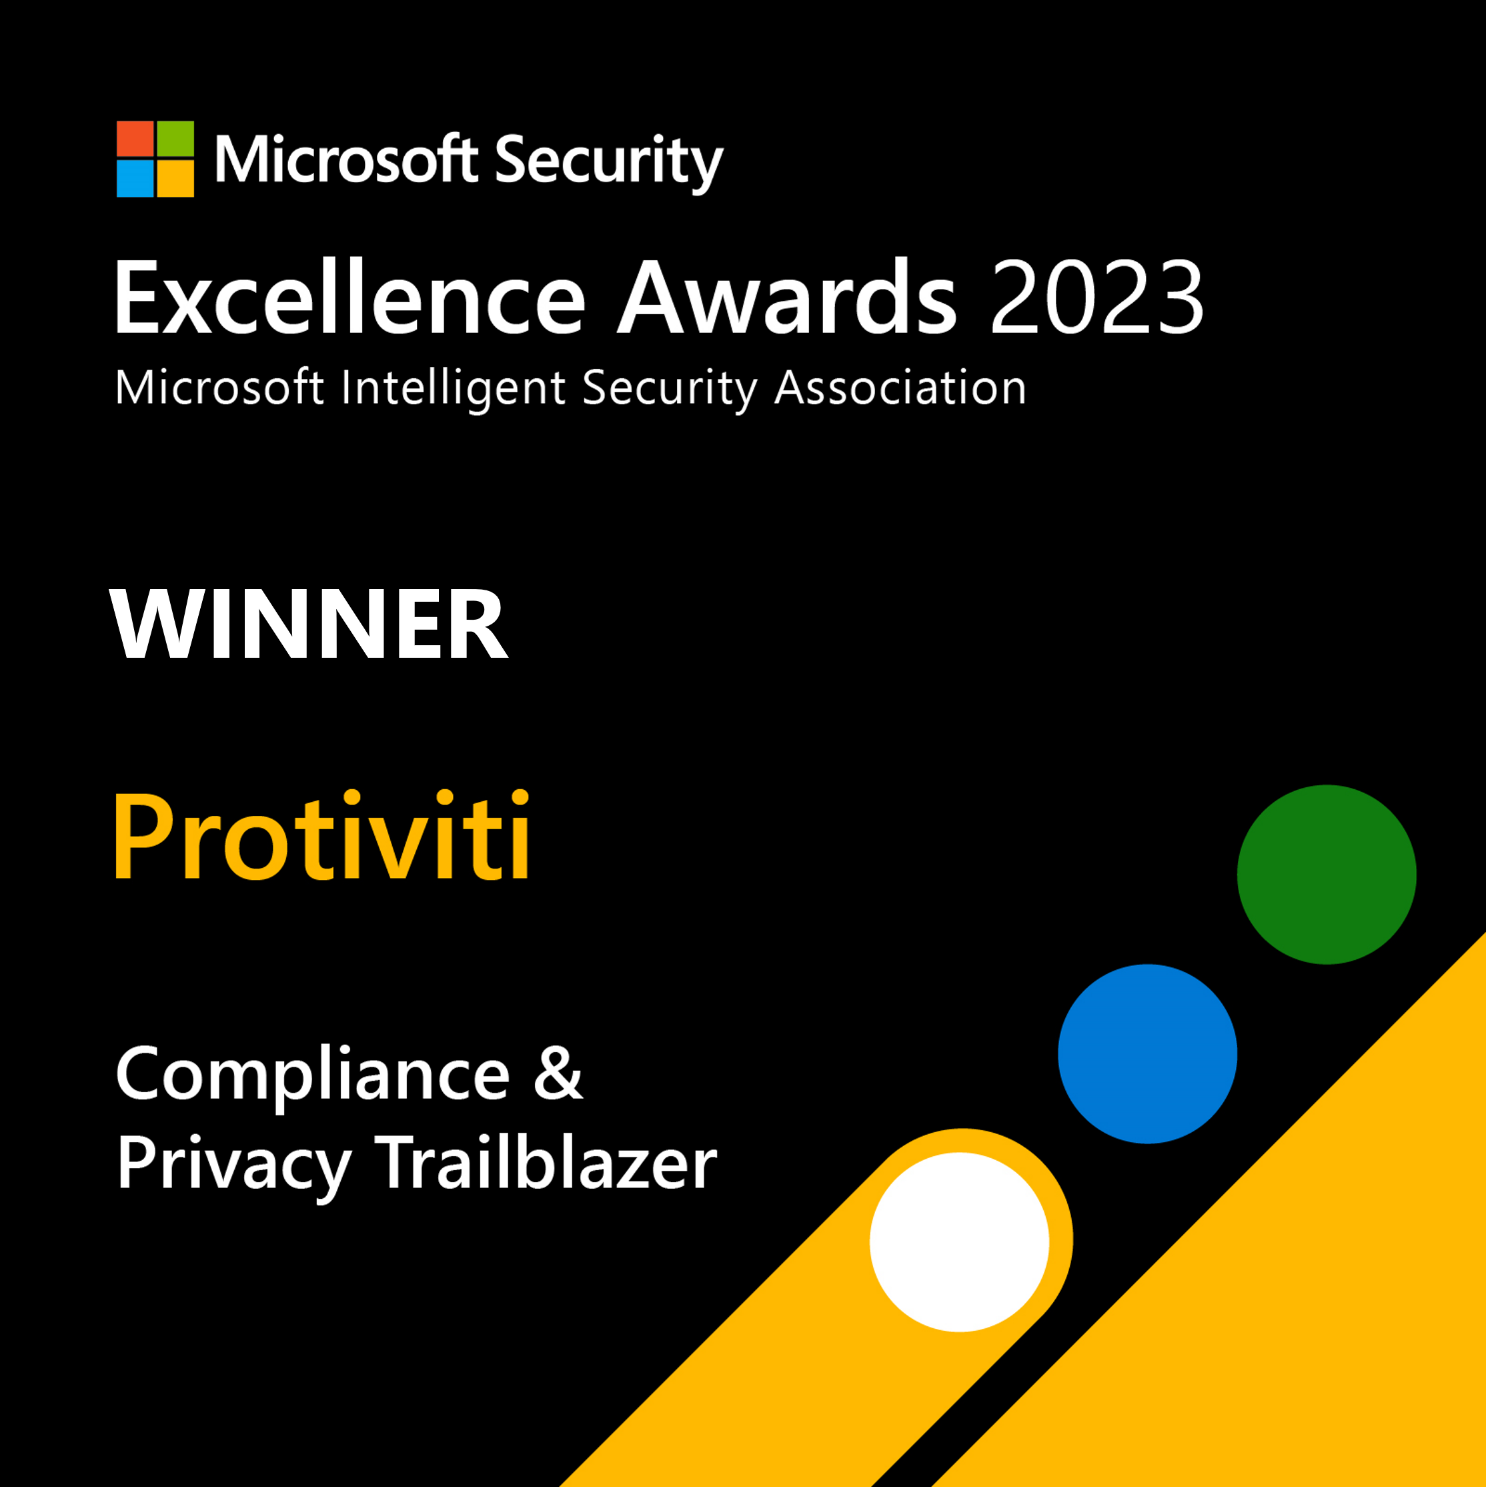
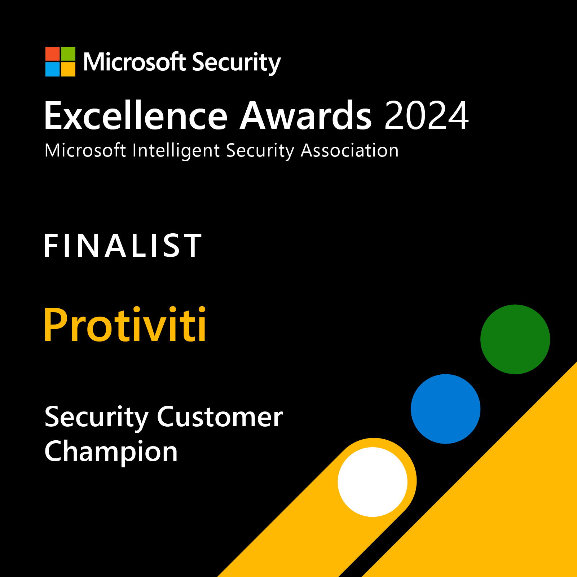

Protiviti Services & Approach: Microsoft Purview for AI
DSPM for AI
(Data Security Posture Mgmt.)
Information Protection
Data Loss Prevention
Insider Risk Management
Records Management &
eDiscovery
Current state assessment of oversharing across the org
Assess shadow AI usage
Plan DLP policies to facilitate best M365 Copilot experience
Compliance, security & privacy program design
Current state assessment & control mapping
Deployment methodology
Industry-specific rules
Library of DLP policies
Migrate legacy DLP solutions to modern MSFT Cloud & Endpoint
Industry specific use cases and roles
Workflow & escalation workflow
Planning integration with HR systems
Define Information Governance requirements & strategy
Define eDiscovery requirements and workflows
Plan
Holistic Purview solution deployment for Copilot readiness
Implement DLP policies in Cloud & Endpoint to mitigate sensitive data risk in Copilot prompts
Discovery (structured, unstructured)
Sensitivity label design
Bulk classification program design
Cloud DLP, Endpoint, MDCA, on-premise DLP
Pilot and false positive reduction methodology
Production deployment services
Insider Risk Analytics
M365 HR Connector implementation
IRM policy design & implementation
Configure retention schedule
Built in and customized defensible disposition
Case management, preservation, and collection
Build
Communication compliance monitoring
Defender for Cloud Apps monitoring & policies to migrate shadow AI
Continuous discovery & monitoring
Continuous control monitoring
Environment optimization
Role & responsibility definition, training
Alert monitoring and resolution
DLP policy optimization
Alert monitoring and resolution
Refine IRM workflows
Incident Response
Enforce Records Management Policies
Disposition process design
Case management
Run
Benefits
Prepare your organization for AI
Assess your entire data estate
Stronger, more modern DLP
Improved DSPM
Organized record retention
Meet compliance requirements
Insider risk monitoring and risk mitigation
Centralized view & ability to protect data
Client Case Study
Migration of a Global Financial Services organization with 98K users from 2 legacy encryption and classification solutions to Microsoft Purview Information Protection, migrating from Symantec DLP to Purview DLP for Cloud/Endpoint & implementing over 50 controls org-wide as part of a Copilot readiness program.
2025

Slide 67
Call to Action
Apply sensitivity labels in Microsoft 365 Copilot for enhanced data security.
M365 Copilot blueprint for Oversharing http://aka.ms/copilot/oversharing
Accelerate your Information Protection and Data Loss Prevention deployment https://aka.ms/PurviewDeploymentModels
Join the Microsoft Customer Connection Program (CCP) at https://aka.ms/joinccp
Notes:
The Microsoft Customer Connection Program (CCP) enables customers, partners and Microsoft’s Most Valuable Professionals (MVPs) to directly connect with Microsoft security engineers to share their product experiences, needs and recommendations. Microsoft uses these programs to put the customer at the center of product development and ultimately create better security solutions.

Slide 68
Additional resources
Data security and protections for AI with Microsoft Purview: Microsoft Purview data security and compliance protections for Microsoft 365 Copilot and other generative AI apps | Microsoft Learn
Deployment Guidance: DSPM for AI aka.ms/DSPMforAI/deploy Data risk assessment aka.ms/DSPMforAI/oversharing
Notes:
And here are some great links to keep learning.

Slide 69
News & community content
Microsoft Community Learning aka.ms/Community/LearningChannel
Community led expert content on all your favorite Microsoft services.
Start your week with live news and event updates aka.ms/MondaysatMicrosoft
Watch live or on-demand & share our blog.
Notes:
To help you with adoption, the Copilot Readiness Hub is an open one stop shop for content, organized by role for your Copilot for Microsoft 365 journey.
You can use its recommendations to prepare and plan for your deployment, create a user experience strategy as I’ve presented today, and an adoption plan.
And as Copilot continues to evolve, keep coming back for new content that is published regularly.
You can also join the Copilot for Microsoft 365 community to get your questions answered and meet others who are leveraging Copilot for Microsoft 365 right now.

Slide 70
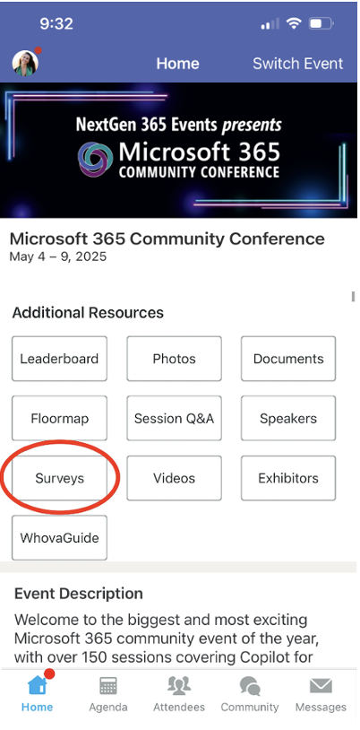
Session feedback surveys
We want to hear from YOU!
Share your feedback to make next years conference even better!
Here’s how –
Simply go to the Whova App on your smartphone.
Scroll down on the M365 Community Conference Homepage to ‘Additional Resources’ to click “Surveys’.
Click Session Feedback.
Scroll down to find this session title.
Complete the session feedback survey.
Finally, click ‘Submit’.
It’s just that easy!

Slide 71
