Slide 1
Leveraging Employee Feedback for AI Transformation
Mark Straetmans
Principal Product Manager, Microsoft Viva

Slide 2
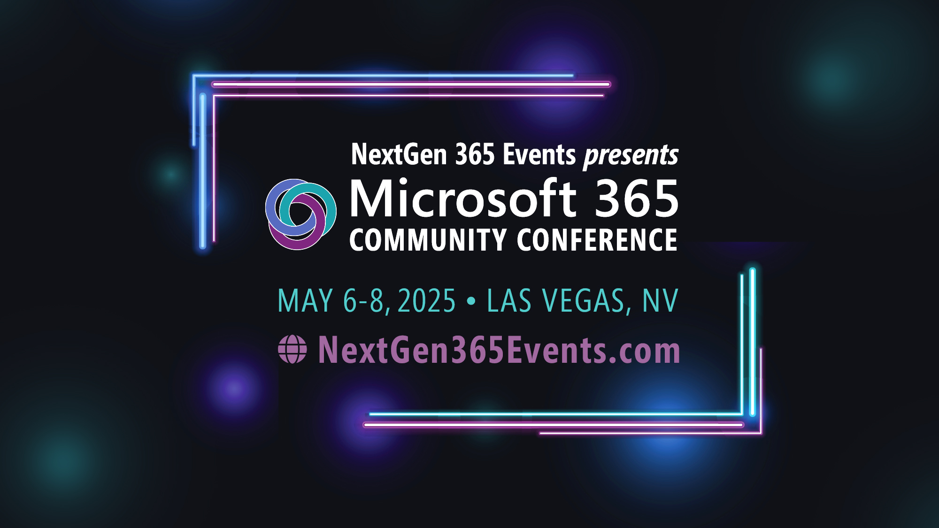
Microsoft 365 Community Conference

Slide 3

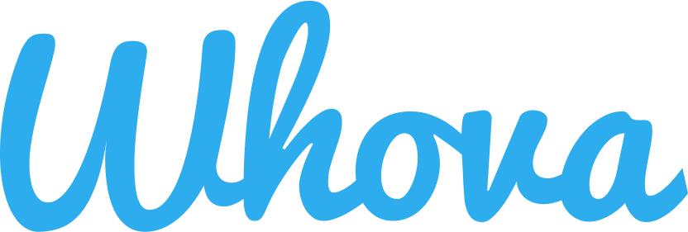
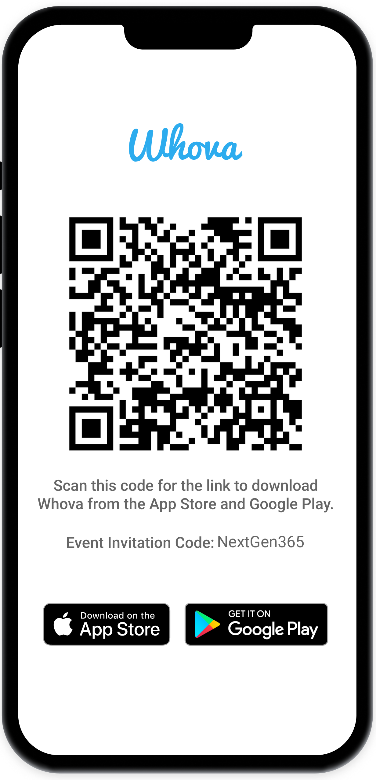
Join the event app to access:
The official event app for the
Microsoft 365 Community Conference
Event invitation code: NextGen2025
Event announcements
Personalized agenda, session details
Speaker & attendee profiles
Networking, meet-ups, messages
Event documents

Slide 4




The New Seismic Shift at Work:
AI Reinvention
Enrich culture
Empower
people
Reshape processes
Accelerate performance

Slide 5
Generative AI has come to work
75%
78%
of people are already using
AI at work
of AI users bring their own AI tools to work
2024 Work Trend Index Annual Report from Microsoft and LinkedIn: AI at Work Is Here. Now Comes the Hard Part
Notes:
Most businesses are not starting their AI transformation from the ground floor. People are already using AI in the workplace.
Microsoft's 2024 Work Trend Index Report found that 75% of global knowledge workers are using AI at work - a rate that's nearly doubled over the last six months. The volume of data, emails and chats that employees have to deal with on a daily basis has accelerated beyond their ability to process it all. This intense pace of work is overwhelming, so they see AI as a tool to keep up with their jobs and spend more time on strategic and creative work.
Because knowledge workers are so eager to reap the productivity rewards from AI, the WTI survey found that 78% of employees are bringing their own AI tools to work – known as BYOAI. When they don't have guidance or clearance from leaders, employees are taking matters into their own hands. It’s even more common at small and medium-sized companies (80%). And it’s not just Gen Z—BYOAI cuts across all generations.

Slide 6
…but leaders remain uncertain on how to quantify value
79%
60%
59%
believe AI is
a business
imperative
lack a plan
and vision to
implement AI
worry about
quantifying AI
productivity gains
Notes:
However, despite it's widespread usage, leaders are uncertain on how to get the most out of their AI investments or quanitfy the value

Slide 7


Microsoft Viva
Accelerate your AI workforce transformation
Communications
Leadership engagement
Onboarding, DEI, and communities
Omnichannel employee campaigns
Corporate comms and analytics
Measurement
Skilling
Behavioral and collaboration analytics
Prebuilt reports and custom analysis
Employee surveys and action taking
Personalized learning and academies
Inferred skills, reports,
Organizational knowledge and experts
Copilot in Viva • Built into Microsoft 365 • Trusted Platform
Notes:
This is where Viva comes in. Viva is a suite of employee experience apps that cover key areas of transformation: measurement, communications, and skilling. I work within the measurement pillar where we help customers quantify the employee experience and, specific to our topic today, provide data-driven insights into their AI transformation journey

Slide 8
The employee experience is key to your organization realizing the value of AI investments
Access
Usage
Scenarios
Efficacy
Skills
Clarity
Vision
Adoption
ROI
Time
Productivity
Value
Empowerment
Engagement
Resources
Notes:
The employee experience is key to your organization realizing the value of AI investments both from gaining initial traction and adoption through realizing the return on your investment.
Adoption: in particular, if you are piloting, making sure the right people have access, know what high value scenarios to look towards, have the skills to leverage the new technology, and understand the organization's vision for AI
And to know surprise, what we've learned is that the greater the adoption, the greater the ROI. However, when looking at ROI, you're looking at different components of the employee experience. Certainly are people more productive is a significant ROI measure but we often see other aspects of the employee experience that can be positively impacts by AI transformation that tell a larger, more holistic story of impact

Slide 9
Employee engagement by AI access
Organizations
that invest in AI
have better
employee experience outcomes
Productive teams
Engaged employees
Resilient business
Source: Microsoft Viva People Science, AI Transformation Readiness Research, April 2024
Notes:
20-30% higher sentiment related to learning, thriving and productivity when Copilot usage is 6 months, compared to 3 months
Those who use Copilot at least once every week are more likely to say they are thriving and take initiative to stay productive*
In fact, one can argue that the employee experience is fundamentally become the most important part of your business transformation.
The connection between engaged employees and better business performance is well established. But we continue to do research in this space, to better understand how organizations are transforming in the era of AI.
It turns out, forward looking organizations, those who have invested deep into their people, talent strategies and employee experience initiatives, are actually far better positioned to REAP the benefits of AI
AND organizations who invest early in AI technologies see greater success in employee experience indicators, such as team productivity, employee engagement, and business resilience.

Slide 10



Engaged employees
realize greater value from AI
Engaged Employees
All other Employees
87%
85%
80%
AI allows me to complete tasks faster
AI helps me be more productive
AI helps me make better decisions
66%
63%
55%
      Source: Microsoft Viva People Science, The State of AI Change Readiness, August 2024
Notes:
Engaged employees realize greater value from AI in fact up to a 25% point difference across individual outcomes such as efficiency, productivity and improved decision making
Stat details:
Engaged AI users – are employees that responded favorable to Glint's eSat item – How happy are you working at <COMPANY_NAME>?
Based on the State of AI readiness study – surveyed 1800 enterprise professionals globally
The three items presented are part of a set of questions we call Realized individual value of AI

Slide 11
% selected
In a recent study, IT leaders reported Employee feedback was the most
valuable data type for AI
transformation
Which of the following types of gen AI transformation data is which do you consider most valuable? (Select up to 4 that you would find most important, whether or not they are currently collected).
Notes:
When looking at the data IT leaders do collect, we see that survey data is the least valued for IT core responsibilities, yet employee feedback is considered to be the most valuable data for AI Transformation.
Because understanding the total, holistic impact of AI is important and currently hard to do, IT leaders are relying on employee feedback to paint that fuller picture of what's changing.
This tension stems from the scalability of capturing that feedback in a large, quantitative way while still being open to collecting the nuanced details of personal experiences that they weren't explicitly knowing to look for.
[This is also a challenge we see in HR leaders creating their engagement surveys.... not knowing what to ask and turning to ambient listening]

Slide 12
What can we learn from high performing organizations (HPOs)?

Slide 13
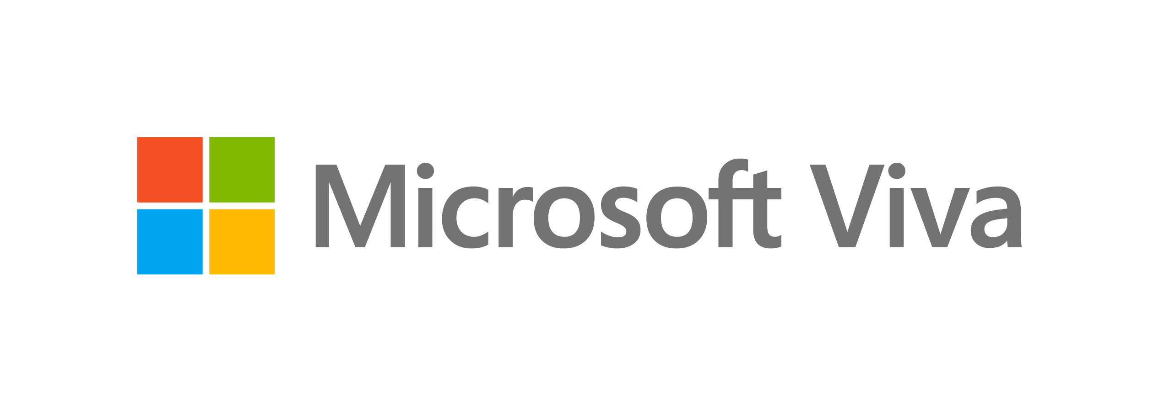

What can we learn from HPOs?
What HPOs Teach Us about AI Readiness
A high-performing organization is defined as an organization that continually exceeds expectations including outcomes like achieving financial goals, delivering innovative products and services to their customers, and growing their business ahead
of competitors.
These organizations are capitalizing on AI to reimagine the
employee experience.
Employees at HPOs are...
1.8x
more likely to say that AI will distinguish their organization as an employer of choice
1.9x
more likely to say they fully support AI transformation and are eager to contribute to its success
Source: Microsoft Viva People Science,
AI Transformation Readiness Research, April 2024
Notes:
In a Microsoft survey of global business leaders, 17% of respondents fell into the HPO category, as indicated by their organization “always” demonstrating 6 or more of the following indicators of performance:
Financial goals consistently reached
Growing ahead of competitors
Delivers innovative products/services
Culture is resilient
Teams are highly productive
Teams collaborate effectively
Individuals are engaged
Low voluntary attrition
Leaders are trustworthy
Employees go above and beyond

Slide 14




HPOs in the
Age of AI
What HPOs Teach Us about AI Readiness
Transformation vs. Adoption
Microsoft research shows that HPOs are further along on their journey toward AI transformation than their peers.​
AI Access for Experimentation
Leader-sponsored Vision for AI Transformation
The Change Experience Gap
Agile Change Management
Employee Experience
Notes:
Our research shows that HPOs are further ahead on creating an adoption strategy for AI and beginning their journey toward AI transformation than their peers.
HPOs are doing four things better than typical organizations: providing AI Access for Experimentation, setting a Leader-sponsored Vision for AI Transformation, closing The Change Experience Gap, and Agile Change Management.

Slide 15

HPOs Start with AI Access
What HPOs Teach Us about AI Readiness
ACCESS
Employees at HPOs use AI at work more frequently than their peers, and more of the AI tools they use are provided by their organization. This offers opportunities to experiment together and learn how AI can be most beneficial for the organization. ​
Source: Microsoft Viva People Science,
AI Transformation Readiness Research, April 2024
Notes:
HPOs are getting ahead of the BYOAI phenomenon by giving employees more access to generative AI than their peers.
Employees at HPOs are more likely to report that the AI tools they use at work are provided by their organization. This offers opportunities to experiment together and learn how AI can be most beneficial for the organization.
As a result, employees at HPOs are more likely to agree that AI will boost revenue (85% vs. 49%), distinguish their organization as an employer of choice (80% vs. 45%), and help them reach new customers and markets (85% vs. 50%).
Employees at HPOs are 1.7x as likely to say that AI is critical for their organization to be successful.
ICs at HPOs have an average of +35 favorability scores on questions about the organizational value of AI – meaning they are much further along in seeing the bigger picture than ICs at typical organizations.

Slide 16

Leaders Need to Share a Vision for AI Transformation
VISION
Generative AI in our workplace is critical for my organization to be successful.
Leaders are significantly more likely to see the value of AI to the organization than managers and individual contributors, and that gap is more pronounced in typical organizations than HPOs. It’s critical for leaders to communicate a compelling vision for AI transformation to bring employees along on the journey.
Across the board, Managers and ICs are progressively less likely than leaders to see the value of AI to their organization.
Source: Microsoft Viva People Science,
AI Transformation Readiness Research, April 2024
Notes:
Leaders at HPOs are channeling individual excitement around AI toward large-scale organizational goals by communicating a vision of AI transformation and the benefits it will provide the business.
Employees at all levels are excited about generative AI, but independent contributors (ICs) tend not to see it in terms of its potential impact on their organization, only on their own work, illustrating the gap between “what’s in for me” and “what’s in it for us.”
While about half of ICs see the value of integrating AI in their work, only 28% see it as critical to their organization's success—43 percentage points less than leaders.
The transformational power of AI will only be realized when the whole organization is bought in.
ICs at HPOs are more likely to be more motivated to integrate generative AI into their work (65% HPO ICs vs. 37% non-HPO ICs).
ICs at HPOs are also more likely to feel excited about a future where the technology is accessible to everyone in their organization (65% HPO ICs vs. 39% non-HPO ICs)

Slide 17

Leaders Need to Close the Change Experience Gap
What HPOs Teach Us about AI Readiness
EXPERIENCE GAP
Communication
Measurement
Skilling
85% of leaders believe their organization communicates consistently during change; only 55% of individual contributors agree.
83% of leaders feel included in decisions about change that affects their job; only 44% of individual contributors agree.
86% of leaders have good opportunities to improve skills, learn and grow during change; only 64% of individual contributors have this experience.
There is a significant gap between how leaders think their employees experience organizational change and how those employees actually experience change.
Focusing on communication, skilling, and measurement helps leaders close the experience gap and take an agile approach to change management in order to drive AI transformation. ​
Source: Microsoft Viva People Science,
AI Transformation Readiness Research, April 2024
Notes:
What the Experience Gap means when it comes to Communication: If leaders don’t feel they are over-communicating, they are probably not communicating enough. Leaders should consider campaigns, omnichannel approaches, and how to leverage managers to reinforce messaging.
What the Experience Gap means when it comes to Measurement: Leaders should consider how they are capturing employee sentiment before, during, and after change and how they are implementing this feedback into the way they are rolling out the change and supporting employees.
What the Experience Gap means when it comes to Skilling: Ongoing learning will be a must. Democratize access to upskilling and SME expertise through expert communities. These can be built by ‘AI Champions’ who have energy and excitement for the use of gen AI at work.

Slide 18


An Agile Approach to AI Transformation
What HPOs Teach Us about AI Readiness
Iterative Adjustment
Iterative Adjustment
AGILE CHANGE
Change Cycle
Change Cycle
Change Cycle
Agile change management focuses on flexibility, collaboration, and iterative progress, allowing organizations to adapt quickly to incremental changes to ensure successful and long-lasting transformation.
AI Transformation
During times of change, employees at HPOs are...
1.6x
as likely to feel included on decisions
1.5x
as likely to say management is receptive to feedback
1.5x
as likely to say they are able to
practice and explore how the
change impacts them and
their work
Source: Microsoft Viva People Science,
AI Transformation Readiness Research, April 2024
Notes:
Much of what will drive successful organizational change with generative AI is likely what has always driven successful organizational change.
Studying how HPOs approach change helps us understand how leaders can drive Agile Change to drive the broad AI adoption that enables real transformation.
Agile change consists of:
Small, directionally correct changes: Agile change takes the approach of small steps to get to the larger goal. Breaking down the bigger vision into small changes in the right direction helps to make the change less daunting and provides room to re-route or change the vision as needed.
Collaborative co-building: Agile change calls on the collective wisdom of those going through the change to determine the path that makes most sense. Ongoing feedback is key to moving in the direction that will yield the most value and adoption.
Ongoing iteration: Agile change is flexible and not beholden to the path originally outlined. There is space for changes based on the feedback given and the changing context in which the change is being implemented.

Slide 19
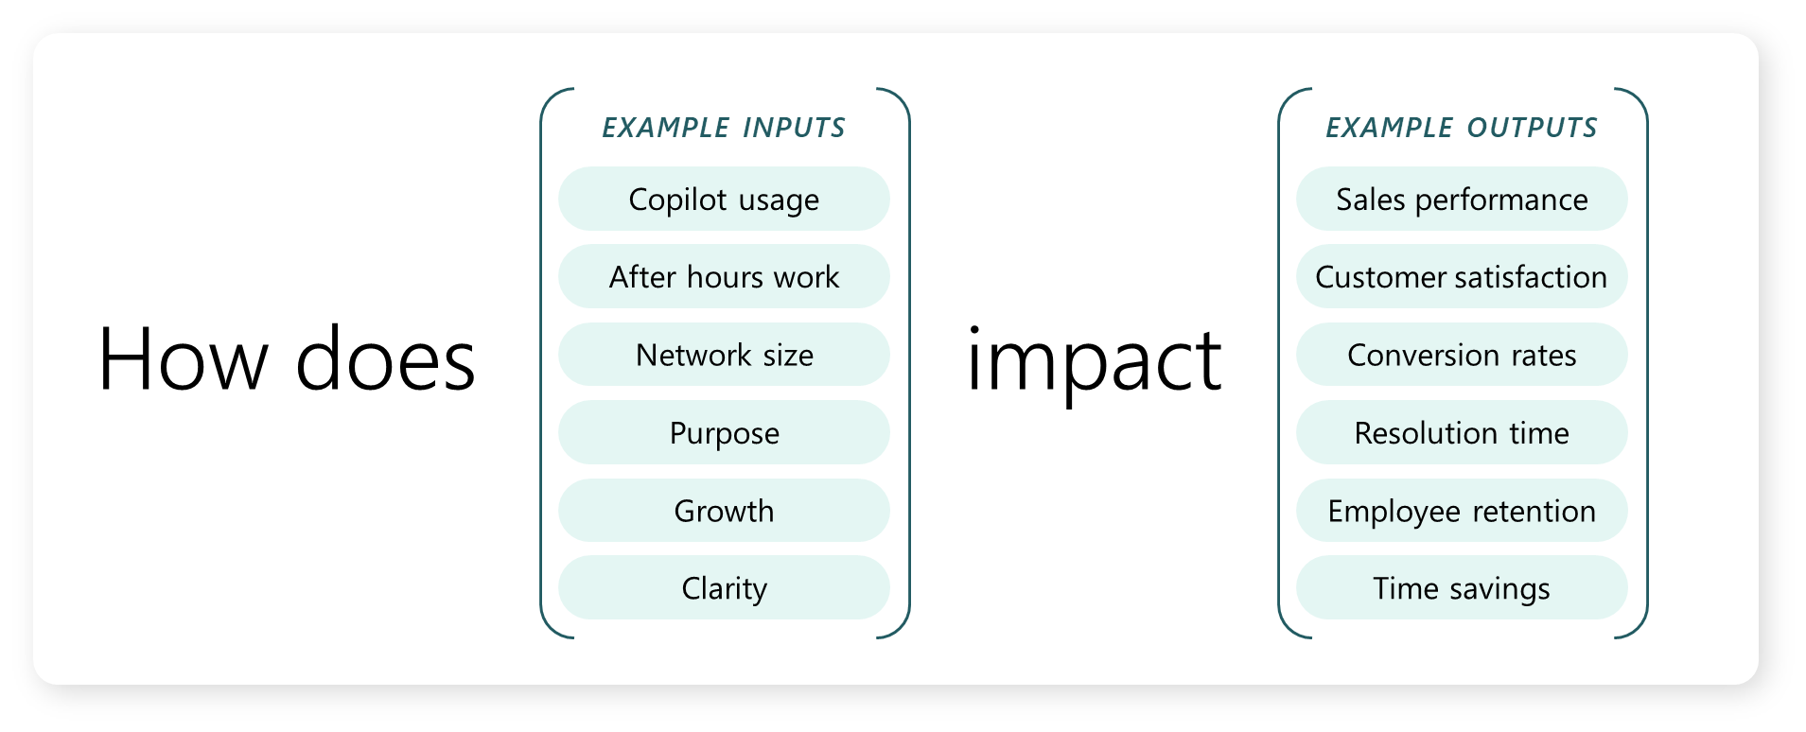
AI transformation requires new ways of understanding work and measuring business outcomes
Notes:
This all brings us back to what we measure to inform our transformation cycles, demonstrate roi, and set their organization's people up for success. And the biggest gap we consistently see today is including employee feedback and the broader employee experience in the measurement strategy

Slide 20
The Opportunity for Transformational Leadership
HR
IT
Workforce Impact
Job design
Org design
Reskilling & upskilling
Org change management
Learning culture
Technology Adoption
Data security
Privacy
Tech readiness
Accessibility
Infrastructure
Tech change management
Success metrics
Responsible AI use-cases
Where to automate vs. augment
Holistic change management
​Working together with IT, HR leaders can use AI to reimagine the employee experience and drive organization-wide transformation.
Notes:
This era of change presents HR leaders with an unprecedented opportunity to drive organizational transformation.
It gives leaders the ability not just to improve processes, but to reinvent them.
HR and IT leaders can use AI to reimagine the employee experience and drive organization-wide transformation. Each function brings specialized skill sets that uniquely positions them to help identify the highest impact functional areas for AI transformation. HR brings perspectives on job design, org design, and more, which ensures they can play a role in deploying AI for the greatest workforce impact, while IT brings capabilities in data security, privacy, and tech readiness to name a few, positioning them to drive successful technology adoption.
Together, HR and IT can maximize the power of AI to revolutionize the employee experience and accelerate progress toward HPO goals.
Start with your employee experience priorities and learn how you can use AI to reimagine how your organization addresses those priorities—it will not only drive progress toward HPO goals, but also help pave the way for successful AI adoption.

Slide 21
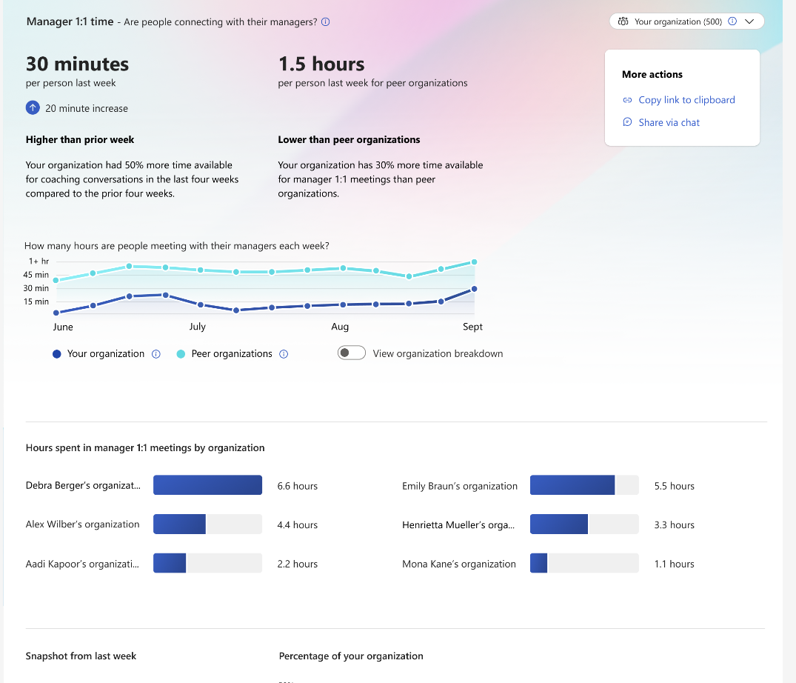
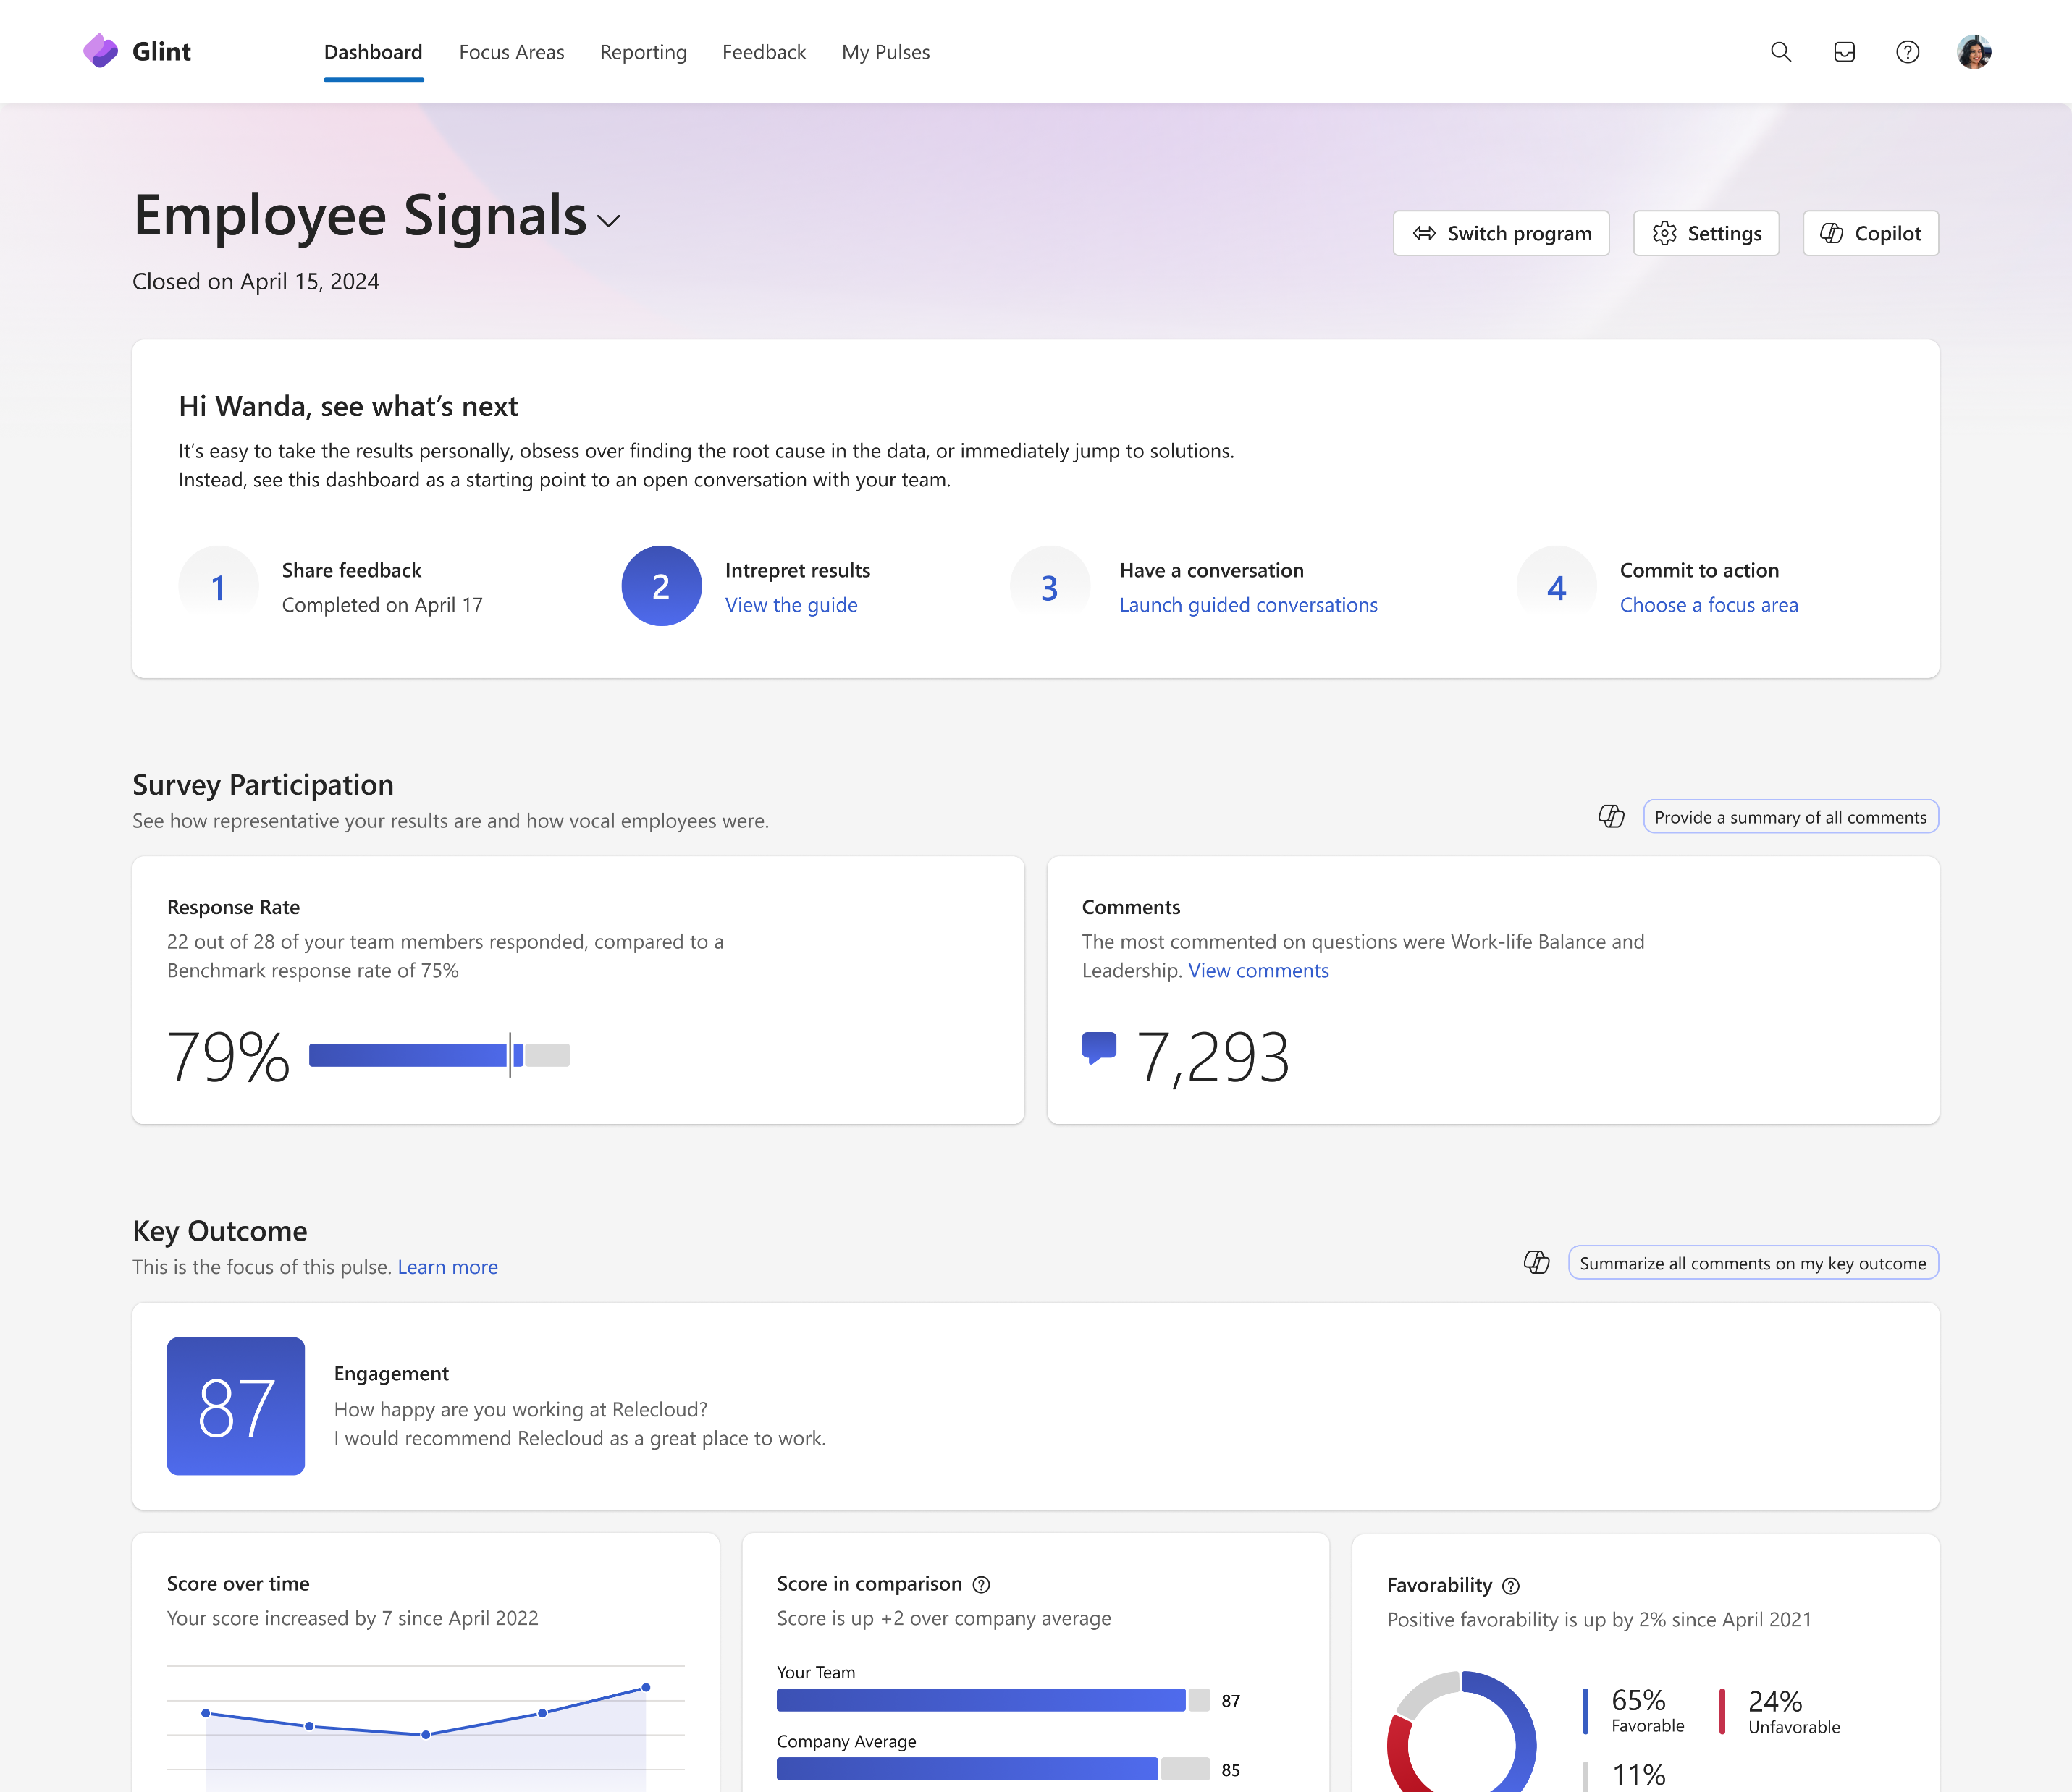
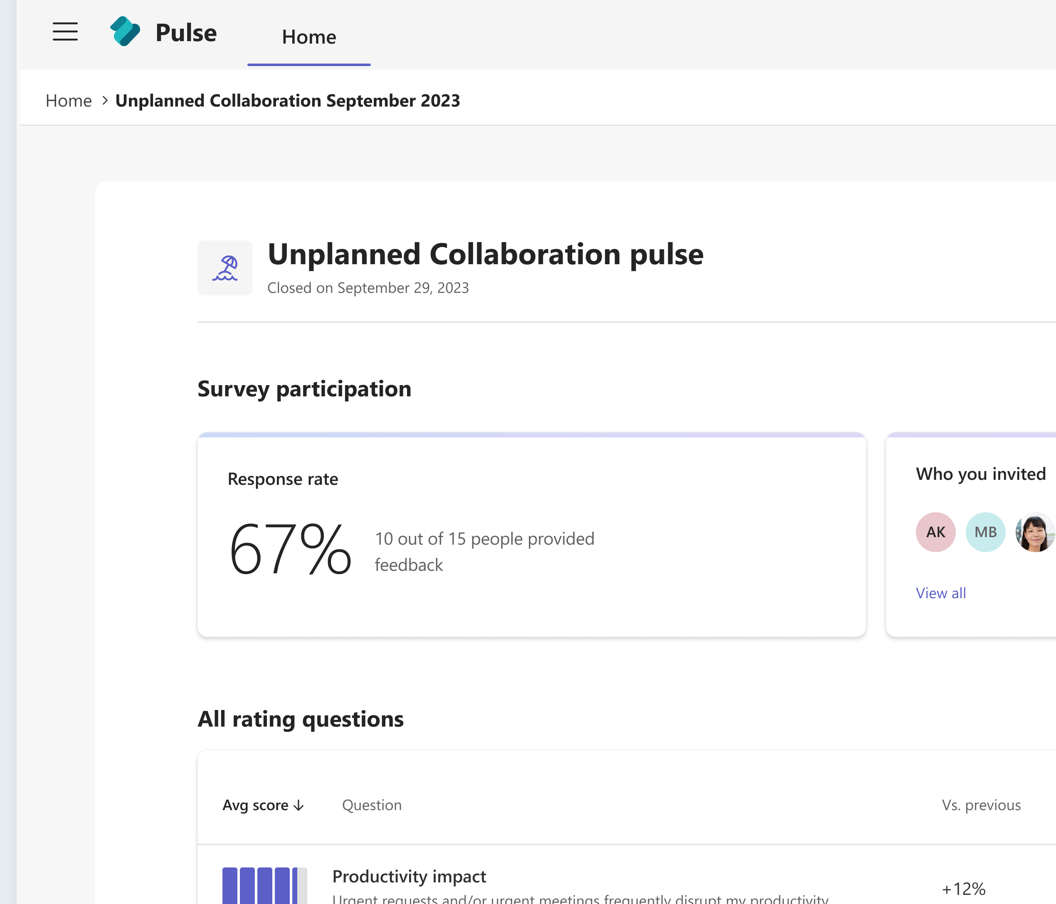



Workplace Analytics & Feedback in Microsoft Viva
How work is being done
How employees feel
Flexible feedback
Gain privacy-protected visibility into workplace patterns
Capture the voice of the employee across the organization
Empower leaders and departments to solicit feedback for specific needs and use cases
Viva Insights
Viva Glint
Viva Pulse
Notes:
Our workplace analytics and employee feedback bundle brings together three powerful solutions to help listen, analyze, and empower managers, including:
Viva Glint - Capture the voice of the employee and take action to improve engagement throughout the employee journey (org-wide surveying)
Viva Insights - Gain visibility into workplace patterns to streamline decision making and enhance business performance (workplace analytics)
Viva Pulse - Empower managers to quickly solicit feedback from employees with pulses in Microsoft Teams and on the web (team pulses)

Slide 22
Case Study

Slide 23
Microsoft's HRBI AI Strategy: Treating AI Adoption as a Journey
Starting small, showing impact, and getting buy in for bigger impact
AI Vision and Strategy
AI & Copilot Usage
Realized Individual Value
of AI
(RIVA)
Internal AI Implementation Phases*
Planning & Implementing
Scaling
Realizing
¹Source: The AI Strategy Roadmap: Navigating the stages of value creation, Azure AI, April. 2024.
Notes:
Our external research has shown that HPOs are good at connecting the dots between Vision and Value – and at each of these phases of implementation is related to a specific expected outcome for employees starting with a deep understanding of the AI Vision and Strategy during the planning and implementation phases, going to translating this to broad usage and experimentation with AI as orgs move from implementation to scaling. And finally, in the realization phase, we need to see users of the technology getting tangible value.
The highest-level takeaway is that as Microsoft moves from the implentation + scaling phases into the realizing phase, and employees are starting to see tangible value from AI usage. However, while we have done a great job at setting and communicating our AI Vision & Strategy, there is room to grow in terms of enhancing the quality and quantity of AI + Copilot Usage.
In looking into this, we explored the each of these phases and the pathways through which we can help employees move through them, starting with..

Slide 24
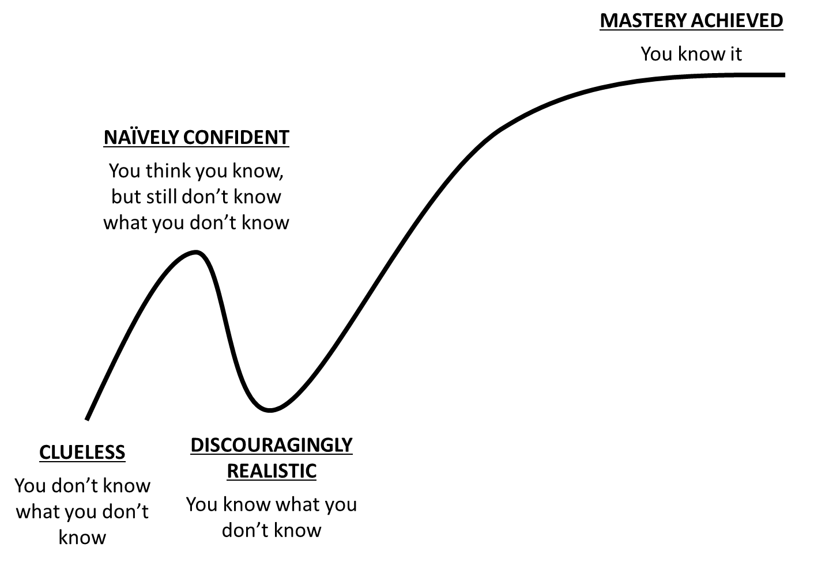
With enough use over time, employees start to see the value in AI usage, both in their thriving and perceptions of productivity
Stages of AI engagement
AI Mastery = Time + Practice
The longer you use Copilot, the more its benefits accumulate
20-30% higher sentiment related to learning, thriving, and productivity when Copilot usage is 6 months, compared to 3 months.
Factors like diverse ties, external network size, and uninterrupted hours were positively related to AI Learning.*
*based on HRBI’s causal models
Growing expertise and value
Naïve Confidence
Thriving & Productivity
Those who use Copilot at least once every week are more likely to say they are thriving and take initiative to be productive.
Learning what you didn’t know
Learning
Those who use Copilot at least once every 2 weeks are more likely to say they have opportunities to learn and are actively learning about AI.
Notes:
This is a slide you have likely seen before: in our last deep dive, we saw that Copilot usage was related to higher thriving and productivity
And looking at this a bit deeper, we saw that with greater use, employees move from the ‘learning’ part of AI engagement to actually reaping the thriving and productivity benefits of it.
Specifically, we found that using copilot at least once every 2 weeks is related to higher sentiment on learning related items, using it once a week is related to higher scores on thriving and productivity.
And this intensifies over time – with the sentiment being 20-30% higher when Copilot was used for 6 months compared to 3
Lastly, from our causal models we see that factors like diverse ties, external network size, and uninterrupted hours lead to higher AI Learning sentiment– underscoring the value of interacting with new and different people + having dedicated time to focus on it. – talk about causal effect
This cycle, we had more data to look deeper into what these perceptions of value look like or where this sense of value might be coming from

Slide 25
Adoption and ROI Learnings
1
2
3
Leaders and managers are critical to driving adoption
Focus on “bright spots”, not averages
AI boosts employee thriving and performance
4
5
6
Role specific training accelerates adoption
Synchronous, social learning creates a contagion effect
AI benefits improve/compound over time
Notes:
Over this past year, since our study came out with have also been working closely with our product teams and customers who are rolling out AI solutions and we are seeing some trends in what is working well.
Managers are critical
Focus on "bright spots" not averages
AI boosts employee thriving and performance (which Ketaki will dive much deeper into!)
Role specific training can help make adoption more 'real' and relevant for employees
Synchronous, social learning creates a strong community and contagion effect with adoption
(and last, but surely not least
------
Leaders and managers are critical to driving adoption: internal and external studies have show that leader and manager role modeling, use and support of copilot are related to higher usage/adoption in employees – Finestra – “if it’s driven by the CEO, it’s strategic, it touches each part of the business, and it gets enough weight to be pushed through.”
Focus on bright spots, not averages: our analyses have shown averages can hide a more nuanced picture of usage. “Bright Spots” – the ideal Copilot persona – can be defined in terms of either volume (high average weekly actions) or consistency/habituality (% of active weeks)
AI boost employee thriving and performance: those that use copilot at least once every week more likely to say they are thriving and productive.
Role specific enablement accelerates adoption: a specific study showed that training usage nearly doubled after role specific training.
Synchronous, social learning creates a contagion effect: various studies have shown that shared experimentation, synchronous and social learning accelerates adoption in organizations. This includes leveraging community channels to share learnings and tips, or hands on synchronous learning activities like hackathon and workshops. We also see super users tend to have larger networks and be higher intensity collaborators.
AI usage isn’t binary— understanding frequency, depth and breadth matters for enablement: We’ve learned that looking at usage in a single dimensions doesn’t tell the full story on adoption, understanding frequency (how often), depth(for what) and breadth (in what tools) of usage paints a more complete picture on an organizations adoption journey and impact on Ex helping change leaders target enablement and help drive upskilling and mastery
ALT to 6 - AI upskilling requires uninterrupted time for learning: internal analysis show that uninterrupted time is a diver of AI learning sentiment. Meaning employees that have more uninterrupted time are actively dedicating time to upskill and apply AI to their work. The item was (“I am actively learning ways to apply AI to my work.”)
ALT to 6: AI benefits on Ex improve/compound over time: There is up to 20-30% higher sentiment on learning, thrive and performance after 6 vs 3 months of copilot usage.
-----
Alt:
Super users are highly connected and collaborate extensively [ADS/BVA study]*
Synchronous, social learning creates a contagion effect [HRBI/ Alexia +Marketing/Viva impact data]
Confidence in copilot increases satisfaction [ADS]
Copilot usage reduces time on emails and meetings [ADS] *
Ex benefits of AI increased over time better sentiment outcomes at 6 vs 3 months [HRBI] // There is an adoption acceleration point at 12-16 weekly copilot action [ADS]
Uninterrupted time is an important driver of AI learning sentiment [HRBI]
Manager and team usage fuels broader adoption [HRBI] / Manager and leader usage is critical to adoption [Alexia/Marketing]
AI usage isn’t binary, frequency, depth and breadth matter [HRBI/BVA/PS] meaning its not about simply whether they use it or not but how often, how many interactions and across how many tasks/apps gives insight to various patterns of value usage
AI Mastery = Time + Practice [HRBI]
Increase in MAU when measuring and monitoring copilot usage [ Viva impact on copilot Jan 118% (Vs 57%) MAU growth when using copilot dashboard)
Increase in MAU when leveraging social communities (copilot community) and learning academies (copilot academy) [ Viva impact on copilot 21% (Vs 17%) MAU growth for community and 41% (vs36%) for copilot academy]

Slide 26
Q&A

Slide 27
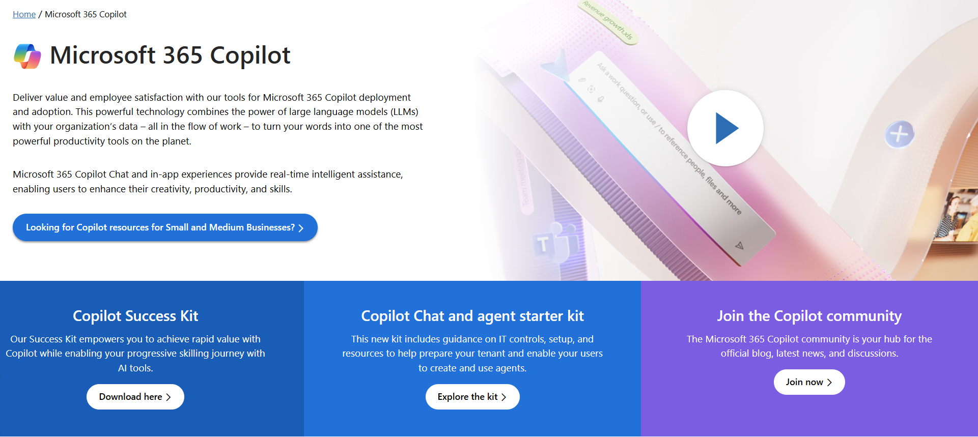
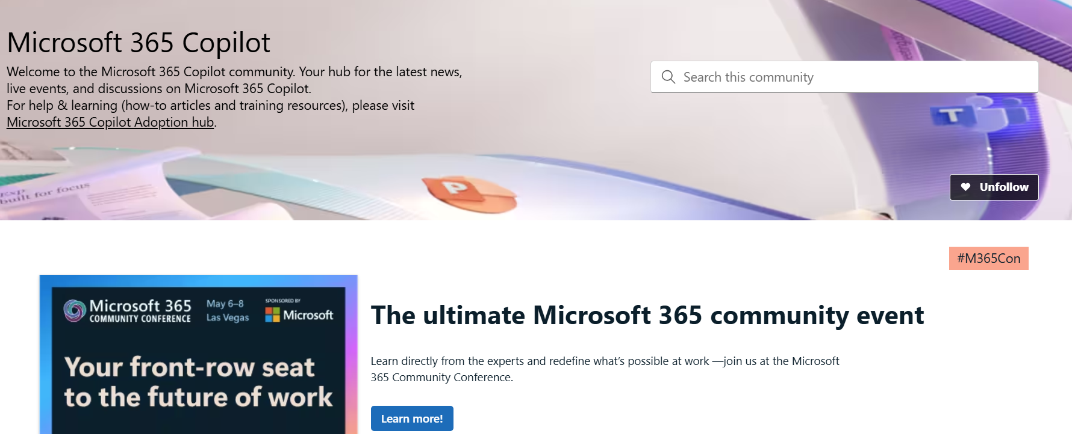
News & community content
Microsoft Community Learning aka.ms/Community/LearningChannel
Community led expert content on all your favorite Microsoft services.
Start your week with live news and event updates aka.ms/MondaysatMicrosoft
Watch live or on-demand & share our blog.
Notes:
To help you with adoption, the Copilot Readiness Hub is an open one stop shop for content, organized by role for your Copilot for Microsoft 365 journey.
You can use its recommendations to prepare and plan for your deployment, create a user experience strategy as I’ve presented today, and an adoption plan.
And as Copilot continues to evolve, keep coming back for new content that is published regularly.
You can also join the Copilot for Microsoft 365 community to get your questions answered and meet others who are leveraging Copilot for Microsoft 365 right now.

Slide 28
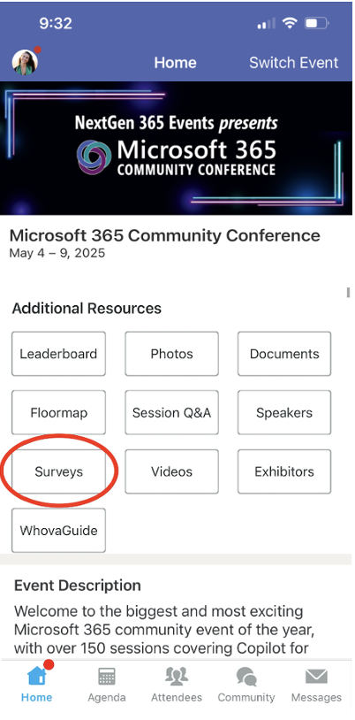
Session feedback surveys
We want to hear from YOU!
Share your feedback to make next years conference even better!
Here’s how –
Simply go to the Whova App on your smartphone.
Scroll down on the M365 Community Conference Homepage to ‘Additional Resources’ to click “Surveys’.
Click Session Feedback.
Scroll down to find this session title.
Complete the session feedback survey.
Finally, click ‘Submit’.
It’s just that easy!

Slide 29
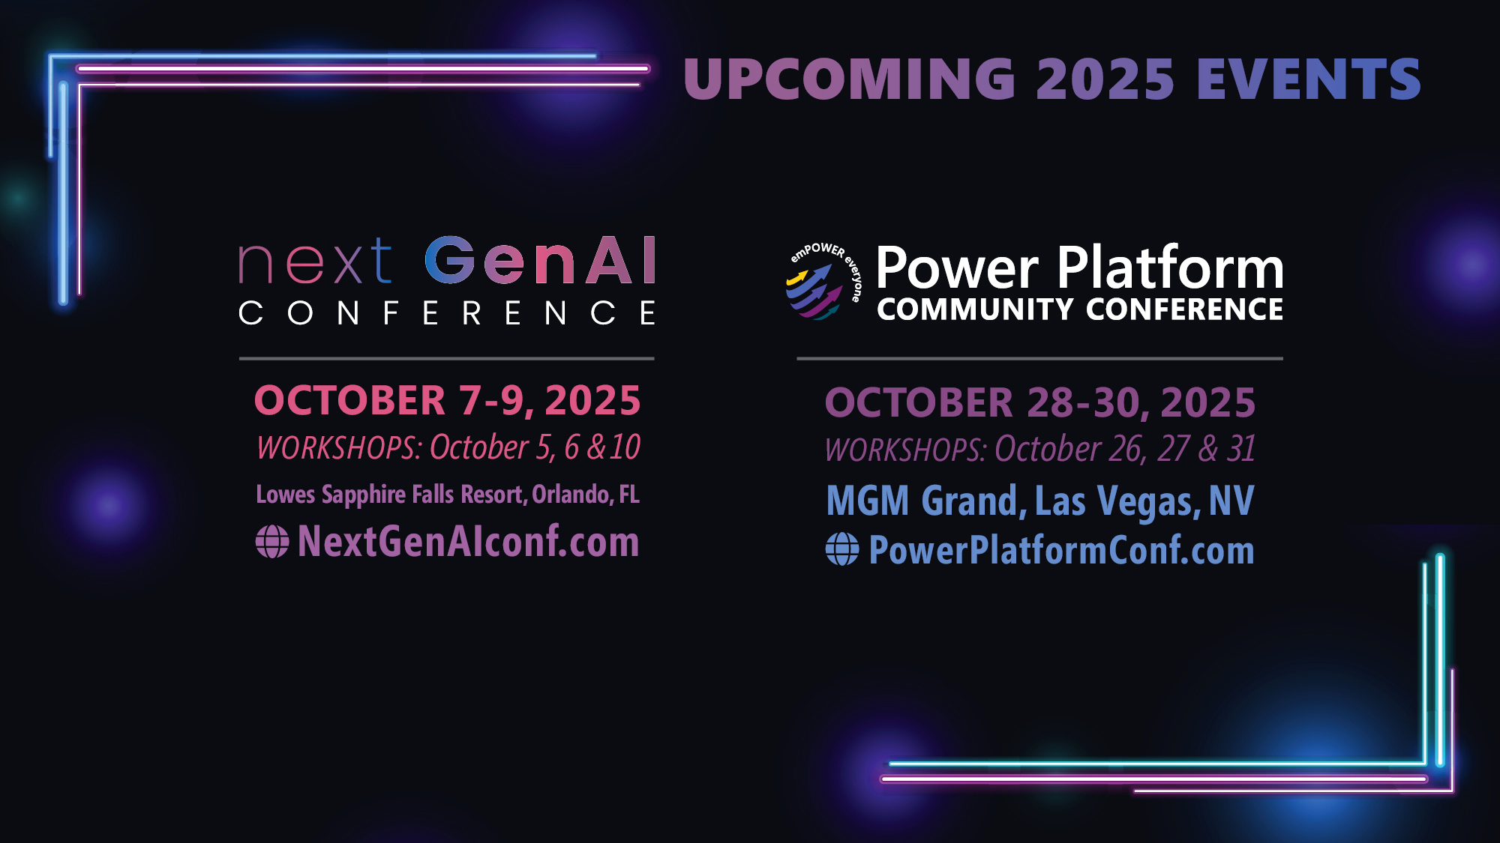

Slide 30
Thank you!

Slide 31
Appendix

Slide 32


Measuring adoption
Adoption goal:
Understand how the target population is experiencing Copilot and identify actions to improve implementation, usage, and value.
Using Viva measurement apps to measure Copilot implementation adoption
Description
Recommendation
Copilot analytics helps you answer:
What changes and patterns are there in Copilot usage?
In which apps and how is Copilot being used the most?
Copilot Analytics
Leverage the Adoption tab in Copilot Dashboard to compare Copilot usage by app and activity, along with group, organization, and functional drop filters.
Viva Insights
Glint provides enterprise-view helps you answer: What opinions and feelings are employees experiencing about Copilot adoption?
Review the Playbook appendix for Adoption survey item suggestions.
Integrate Copilot adoption items into the regular Glint survey cadence.
Analyze how Copilot sentiment varies across functions to uncover which groups perceive the most value from AI adoption and why.
Viva Glint*
Pulse helps you answer for target groups:
What is the Copilot implementation progress with specific teams, cohorts, and pilot groups?
What localized actions are needed to best address challenges at the team level?
Review the Playbook appendix for the Viva Pulse Adoption template.
Deploy pulse surveys to specific teams to gauge progress and learn where and how groups may need additional attention or interventions to help accelerate adoption.
Create a cadence for survey deployment to track progress, either at a specific time (e.g., monthly) or at critical moments (e.g., feature additions).
Viva Pulse
*Survey feedback can also be collected using your enterprise survey provider.
Notes:
Once implementation has started – typically after sufficient Copilot communications, access to resources, and training have been provided - it is now critical to assess how well target groups are embracing and incorporating Copilot in their work.
Timely Adoption measurements help the organization adjust its approach and support to increase chances of success. This includes recognizing, rewarding, and amplifying best practices that align with adoption goals at all levels.
Some Considerations to discuss with customers:
For Insights – When reviewing Insights adoption metrics, customers may find that Copilot uptake is slower for certain user cohorts at first. Rather than re-assign their Copilot licenses, instead, consider sending out a Pulse survey to understand points of resistance and how to support those who may need more help. Creating new behaviors takes time and re-assigning licenses too early can be detrimental to building lasting Copilot habits.
For Glint – As cohort group usage picks up and is approaching your Copilot adoption goals over time, consider switching out some or all your readiness questions in Glint with adoption questions. Think about collecting responses to Glint adoption questions over a few timepoints to monitor and examine overall workforce Copilot sentiment trends.
For Pulse - Findings collected with Pulse will only be visible to the person sending out the survey. If you decide to empower several local change champions to use Pulse, remember you will not get a centralized or aggregated view. Rather than keeping critical employee feedback siloed, think about how you might encourage local change champions to share out these local adoption insights and needs more broadly across cohorts to facilitate Copilot implementation at scale.

Slide 33
Measuring impact
Impact goal: Recognize the value Copilot has created for different levels in the organization and how ongoing changes are reenforcing new habits and enhancing organizational outcomes. Lessons learned are applied to other areas of the business to create a compounding effect over time.
Using Viva measurement apps to measure Copilot implementation impact
Description
Recommendation
Insights helps you answer:
What is the difference in ongoing impact measurements vs. baseline data?
Copilot Analytics
Leverage the Impact tab in Copilot Dashboard to view Copilot actions by productivity categories, Copilot assisted hours, and correlations between Copilot usage and various behavioral patterns.
Leverage the Copilot Business Outcome Report to explore the relationship between Copilot usage and key KPIs, estimate the potential Copilot-assisted value for your organization.
Viva Insights
Glint helps you answer:
Was there an impact on sentiment data and scores from the most recent Glint to baseline survey data?
Review the Playbook appendix for Impact survey item suggestions.
Use reporting and analytics capability within Glint to group Copilot opinion responses by different population cuts, such as organizational function.
Assess how Copilot attitudes and self-reported value realization of Copilot for tasks has changed over time.
Viva Glint*
Pulse helps you answer for target groups:
How does perceived Copilot impact look for a specific team, cohort, or pilot group?
Review the Playbook appendix for the Viva Pulse Impact template.
Use the Pulse Impact template to see how, when, and where specific teams are deriving value from using Copilot.
Send the Impact survey again (e.g., quarterly) to help ensure each cohort sustains the initial gains they realize from using Copilot.
Viva Pulse
*Survey feedback can also be collected using your enterprise survey provider.
m – Microsoft Learn, Copilot Impact Survey template in Viva Glint.
Notes:
Once a given target group has had sufficient time to upskill, adjust to, and adopt Copilot changes, the organization can begin measuring the “Impact” of Copilot implementation for that team. As different cohorts will reach this point at different times, measuring impact will be an ongoing activity. Measuring Impact includes assessing outcomes like satisfaction, creativity, and productivity improvements at the job role level, process efficiency gains and KPIs at the functional level, and value created, return on investment, and other important business goals at the enterprise level.
The Copilot implementation journey involves agility and iteration that will continue to change at a rapid pace. Various goals and desired outcomes may evolve over time requiring a continuous measurement approach to assess impact across multiple time horizons given team, functional, and organizational objectives. As the Copilot journey unfolds, customers should monitor impact at various levels in the organization to identify lessons learned that accelerate adoption and optimize intended outcomes.
Some Considerations to discuss with customers:
For Insights – Comparing Copilot's impact across different functions might help customers customize Copilot implementation plans and their measurements to ensure maximum value by job role and process. However, be careful not to make conclusions about a given cohort and/or use case without seeing sufficient long-term trends and patterns in the group’s data to be sure.
For Glint – As different cohorts will have embraced Copilot at different rates, continue to leverage the Glint survey to measure enterprise-wide Copilot goal achievement and impact over multiple time horizons, rather than just one point-in-time. If not, customers may be missing critical sentiment trends and patterns about the Copilot implementation.
For Pulse - Plan ahead and determine which impact measures you want aggregated across the enterprise using Glint, and which measures can be left at the local level using Pulse. For example, Pulse is great for change leaders, local champions, or managers to quickly assess the impact of their initiatives across teams and uncover learnings that can be immediately applied at scale.

Slide 34
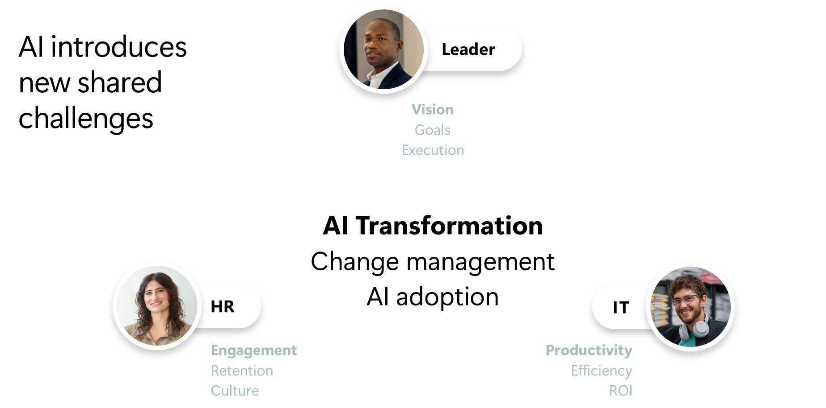

Slide 35

“Thriving employees are what will give organizations a competitive advantage in today’s dynamic economic environment.”
Satya Nadella
Chairman and CEO, Microsoft-September 22, 2022
Notes:
One thing is clear – energized/empowered employees are key to sustaining a competitive advantage for every organization; enabling companies to remain resilient amidst this uncertain business environment. ​
​
Companies need a new approach. ​
​
Leaders now more than ever need to balance employee interests with it takes to be successful, align people’s work around what matters/has impact, and a culture that activates the collective workforce for their peak performance and productivity that ultimately creates real business impact.
Microsoft’s cultural evolution is a prime example of how an organization of 200k+ employees leveraged a robust employee engagement strategy to foster a competitive advantage and ingrain a “growth mindset” culture.
https://hbr.org/2022/06/why-microsoft-measures-employee-thriving-not-engagement

Slide 36




Microsoft Viva
Accelerate your AI workforce transformation
Communications
Leadership engagement
Onboarding, DEI, and communities
Omnichannel employee campaigns
Corporate comms and analytics
Viva Connections • Viva Engage • Viva Amplify
Measurement
Skilling
Behavioral and collaboration analytics
Prebuilt reports and custom analysis
Employee surveys and action taking
Personalized learning and academies
Inferred skills, reports,
Organizational knowledge and experts
Viva Insights • Viva Glint • Viva Pulse
Viva Learning • Skills in Viva • Answers in Viva
Copilot in Viva • Built into Microsoft 365 • Trusted Platform
Notes:
First, Microsoft Viva can help you communicate new initiatives and directions across your organization, connect leaders with employees, and enable employees to build communities and share their expertise.
Next, Microsoft Viva can help you enable employees with the skills, knowledge, and resources they need to achieve their goals and deliver impact.
And finally, Microsoft Viva delivers employee surveys and signals to help you understand how employees are feeling, as well as behavioral and collaboration analytics to understand how employees are working. This is not a one-step process. With Viva, you can create a feedback flywheel to continuously iterate and improve the way that work gets done.
And best of all, Viva is built on Teams and Microsoft 365, is easily customizable and extensible, and is enhanced with next-generation AI.

Slide 37
Workplace Analytics & Feedback in Microsoft Viva
How work is being done
How employees feel
Flexible feedback
Gain privacy-protected visibility into workplace patterns
Capture the voice of the employee across the organization
Empower leaders and departments to solicit feedback for specific needs and use cases
Viva Insights
Viva Glint
Viva Pulse
Notes:
Our workplace analytics and employee feedback bundle brings together three powerful solutions to help listen, analyze, and empower managers, including:
Viva Glint - Capture the voice of the employee and take action to improve engagement throughout the employee journey (org-wide surveying)
Viva Insights - Gain visibility into workplace patterns to streamline decision making and enhance business performance (workplace analytics)
Viva Pulse - Empower managers to quickly solicit feedback from employees with pulses in Microsoft Teams and on the web (team pulses)

Slide 38

Embracing AI Is Tied to Better People and Business Outcomes
AI Reinvention: The Next Seismic Shift at Work
Employee Experience by AI Access
Employees who have full employer-provided access to AI tools score higher on employee experience indicators: Productive Teams, Resilient Business, and Engaged Employees. These are the key indicators of a High-Performing Organization (HPO).
Productive Teams
Resilient Business
Engaged Employees
Source: Microsoft Viva People Science,
AI Transformation Readiness Research, April 2024
HPO Pillars
Notes:
Our data suggests a relationship between AI adoption and a positive employee experience.
Employee experience outcomes are much higher for people who have been fully provided gen AI tool access by their organization. This is especially true for the top Viva Glint measures of Employee Engagement: eSat (how happy are you working at your company) and Recommend (I am willing to recommend my company). We also know there is a large body of evidence showing the connection between people outcomes like employee engagement, and business outcomes like stock price. When we see better people outcomes, we tend to see better business outcomes. The New Performance Equation in the Age of AI (microsoft.com) (April, 2023)
In our research, these experiences also improves meaningfully with increased frequency of AI use – with those using AI more frequently also seeing better experience outcomes on productivity, resilience, and engagement.
The most compelling part? Our research has found three common pillars that define HPOs (Productive Teams, Resilient Businesses, and Engaged Employees). We see higher employee experience scores in those categories for employees who have full access to AI and are frequent users.
With these AI and employee experience relationships, it's no surprise that we also see HPOs are leading their peers in offering far more AI access to their employees and working toward broad adoption.
Note: While tempting to assume a directionality, the only thing we can infer from this is that there is a relationship between AI usage and EX – meaning AI usage may drive better experiences or better experiences may drive these critical employee outcomes.

Slide 39
During a year of economic instability, the most engaged orgs performed twice as well financially than those with low engaged employees
$10K
Most engaged
$9K
S&P 500
-15%
$8K
-20%
$7K
-35%
Portfolio
value
Least engaged
Portfolio return on engagement
22 Jan
22 Feb
22 Mar
22 Apr
22 May
22 Jun
22 Jul
22 Aug
22 Sep
22 Oct
22 Nov
22 Dec
23 Jan
Source: 2023 Glint longitudinal study of 3,005,848 employees at 226 public organizations listed on U.S. financial exchanges
Notes:
Our Microsoft Viva People Science Team recently studied 226 organizations with more than 3 million employees over the past year. All 226 are public companies on U.S. financial exchanges.
We looked at how their employee engagement scores correlate with the firms financial performance. And what we found was striking:
Companies with the most engaged employees performed twice as well financially as those with low engaged employees.
2022 was a tough year for the global stock market.
Yet the highly engaged organizations were higher performing, more resilient, and less vulnerable to unfavorable market conditions.
______________________________________________________________________
Note to sellers on interpreting this chart:
The left axis reflects the dollar value over time if you invested $10,000 spread across the most/least engaged companies at the start of 2022. In other words, how would the value of that investment have changed over the course of 2022?
The -15% / -35% are the percentage change in that dollar value over the course of 2022 (for example, if you invested $10K at the start of the year, it would have become $8.5K if invested across high engaged companies, but only $6.5K if invested in the least engaged ones).
The entire market suffered in 2022; the S&P500 declined 20%. Although preferred framing would be engagement = increase, not decrease, we have to anchor this story in what happens during challenging economic times, not what happens in a typical economic year or bull market.
Highly-engaged organizations performed better not only than low-engaged orgs, but also better than the average organization (using S&P500 as a proxy for ‘average’), independent of whether there’s a ‘-‘ sign in front of the total return or not.
This suggests that organizations with higher employee engagement were more resilient and less vulnerable to unfavorable market conditions.

Slide 40





Engaged employees impact business success
Business
success
Diversity &
inclusion
Employee
retention
Business productivity
Employee
wellbeing
60%
28%
12x
5x
3x
higher profit margins
higher belonging scores
less likely to
leave company
higher market
cap per employee
lower rates of employee burnout
Glint June 2017 longitudinal study Microsoft Internal: Viva People Science Research, February 2023
Notes:
We have years and year of research/data that shows companies who invest in Employee Engagement – outperform those who don’t.
In fact, over the years, we have participated in research that analyzed our customers in the top quartile vs bottom quartile of engagement scores – top customers had higher scores related to stock growth, less likely to leave, lower burnout rates, increase in productivity. ​
​
Additionally – under NDA our upcoming WTI research [Glint Report] reveals that investing in culture, people strategies and the employee experience has a resounding impact to the overall financial performance, resilience, and productivity of companies during a difficult post-pandemic period. Organizations with a highly engaged workforce report feelings of being more heard and valued. They have a greater sense of belonging, execute work with strong clarity and focus, and feel more confident in their senior leadership team than those with a less engaged workforce. During turbulent times, focusing on people is a leading indicator of success.
---------------------------------------------------
Glint conducted and published a longitudinal study in collaboration with Dr. Charles Scherbaum, Assoc. Professor of Psychology at Baruch College, CUNY (Glint June, 2017). The study looked at data collected over the course of a year and included over 500,000 employees from 75 companies across 15 industries.
A few of the results of the research are summarized here. In short, we found that:
• Glint customers in the Top Quartile vs. the Bottom Quartile of Engagement scores (Glint’s Engagement Index and eSat) had 35% higher Glassdoor scores (overall company ratings of 4.2 vs 3.1),
• Glint customers in the Top Quartile vs. the Bottom Quartile on Engagement scores saw 42% higher 52-week change in stock price. The two drivers most correlated with the increase in stock price were Empowerment and Growth
NOTE - Our Viva Value calculator uses a few metrics related to sales and customer retention
American Productivity and Quality Center APQC estimates a potential 1.3% improvement in customer retention rate based on a peer best: 97.0% versus a peer average of 95.7%.
Increasing sales requires effort from the entire company across product development, marketing, and sales. APQC database benchmarking for median and top-quartile conversion rate is 27% and 32% with a difference of 5%.

Slide 41
But employees don’t feel heard
I am
not being
asked.
I am not seeing the feedback.
What can I
do with this feedback.
43%
80%
75%
of employees can confidently say their company solicits employee feedback at least once a year.
of managers do not think
their companies are collecting feedback often enough.
of business decision makers do not think the collected feedback is actionable enough.
2022, Microsoft Work Trends Index
Notes:
The challenge however, for many organizations is that there is a disconnect between employees feeling heard and leaders feeling they can act on the feedback.
Organizations struggle to help their people be happier and more successful at work. This is largely due to 3 reasons:
Episodic feedback – long feedback cycles fail to reflect how employees are doing and what they need to succeed NOW.
Restricted Involvement – Transformative, sustainable change requests BOTH tops down and bottoms up change
Infrequent action – Everyone in the organization should be impowered with the insights and actions needed to do their best work ​
In an era of modern work - timely, actionable employee insights are critical to gaining and maintaining a competitive edge.
Our vision is directly driven off this disconnect: to provide employees in the flow of their work different ways to provide their opinions, ideas, and feedback and take that and turn it into actionable recommendations for everyone in the organization.

Slide 42


Viva for Measurement
Workplace analytics and employee feedback to improve how work gets done
Behavioral and collaboration analytics
Pre-built reports and custom analysis
Employee surveys and action taking
Copilot impact on productivity, engagement and business value
Viva Insights
Viva Glint
Viva Pulse
Notes:
And lastly, let’s talk about Measurement.
During large change management efforts, It is imperative that leaders have access to meaningful insights into how work gets accomplished across complex, fast-based business. The ability to spot opportunities in real time to improve outcomes, seeing the unique patterns of your top performers and applying those best practices across the organization, and understanding the impact of work on employees, business goals, and the customer experience.
Microsoft Viva delivers workplace analytics, employee feedback, and goal management solutions to help you improve how work gets done.
With Microsoft Viva:
Use workplace intelligence data to get a deeper understanding of productivity and behaviors that impact engagement, hybrid work and operational processes
Leverage advanced tools to generate custom insights tailored to specific business challenges.
Run organization-wide engagement survey programs that enables you to understand and improve the employee experience

Slide 43
Workplace Analytics & Feedback in Microsoft Viva
How work is being done
How employees feel
Flexible feedback
Gain privacy-protected visibility into workplace patterns
Capture the voice of the employee across the organization
Empower leaders and departments to solicit feedback for specific needs and use cases
Viva Insights
Viva Glint
Viva Pulse
Notes:
Our workplace analytics and employee feedback bundle brings together three powerful solutions to help listen, analyze, and empower managers, including:
Viva Glint - Capture the voice of the employee and take action to improve engagement throughout the employee journey (org-wide surveying)
Viva Insights - Gain visibility into workplace patterns to streamline decision making and enhance business performance (workplace analytics)
Viva Pulse - Empower managers to quickly solicit feedback from employees with pulses in Microsoft Teams and on the web (team pulses)

Slide 47
We have an exciting future ahead.
Notes:
Thank you.
<Speaker Guidance: Spend the last few minutes discussing or answering any questions they may have. If they have additional topics on their EBC agenda, make sure you connect with their account team to inform them which AI priorities and business outcomes resonated the most during this session. If you are in a 1:1 direct customer engagement, make sure you note what their priorities and questions were and work with the broader account teams and units to facilitate the proper hand-offs or next steps (i.e. get them into a session at the Innovation Hub/MTCs).>

Slide 48
Expertise and tools for your journey
Technical expertise via our FastTrack partners
Tools, resources & training on our Adoption Hub
Events and real-world knowledge in our community
aka.ms/Microsoft/FastTrack
adoption.microsoft.com
aka.ms/TechCommunity
Notes:
Please leave this slide in for conference attendees.

