Slide 1

Microsoft 365 Community Conference

Slide 2
Boost your productivity with the Microsoft 365 Companion
May 7, 2025

Slide 3


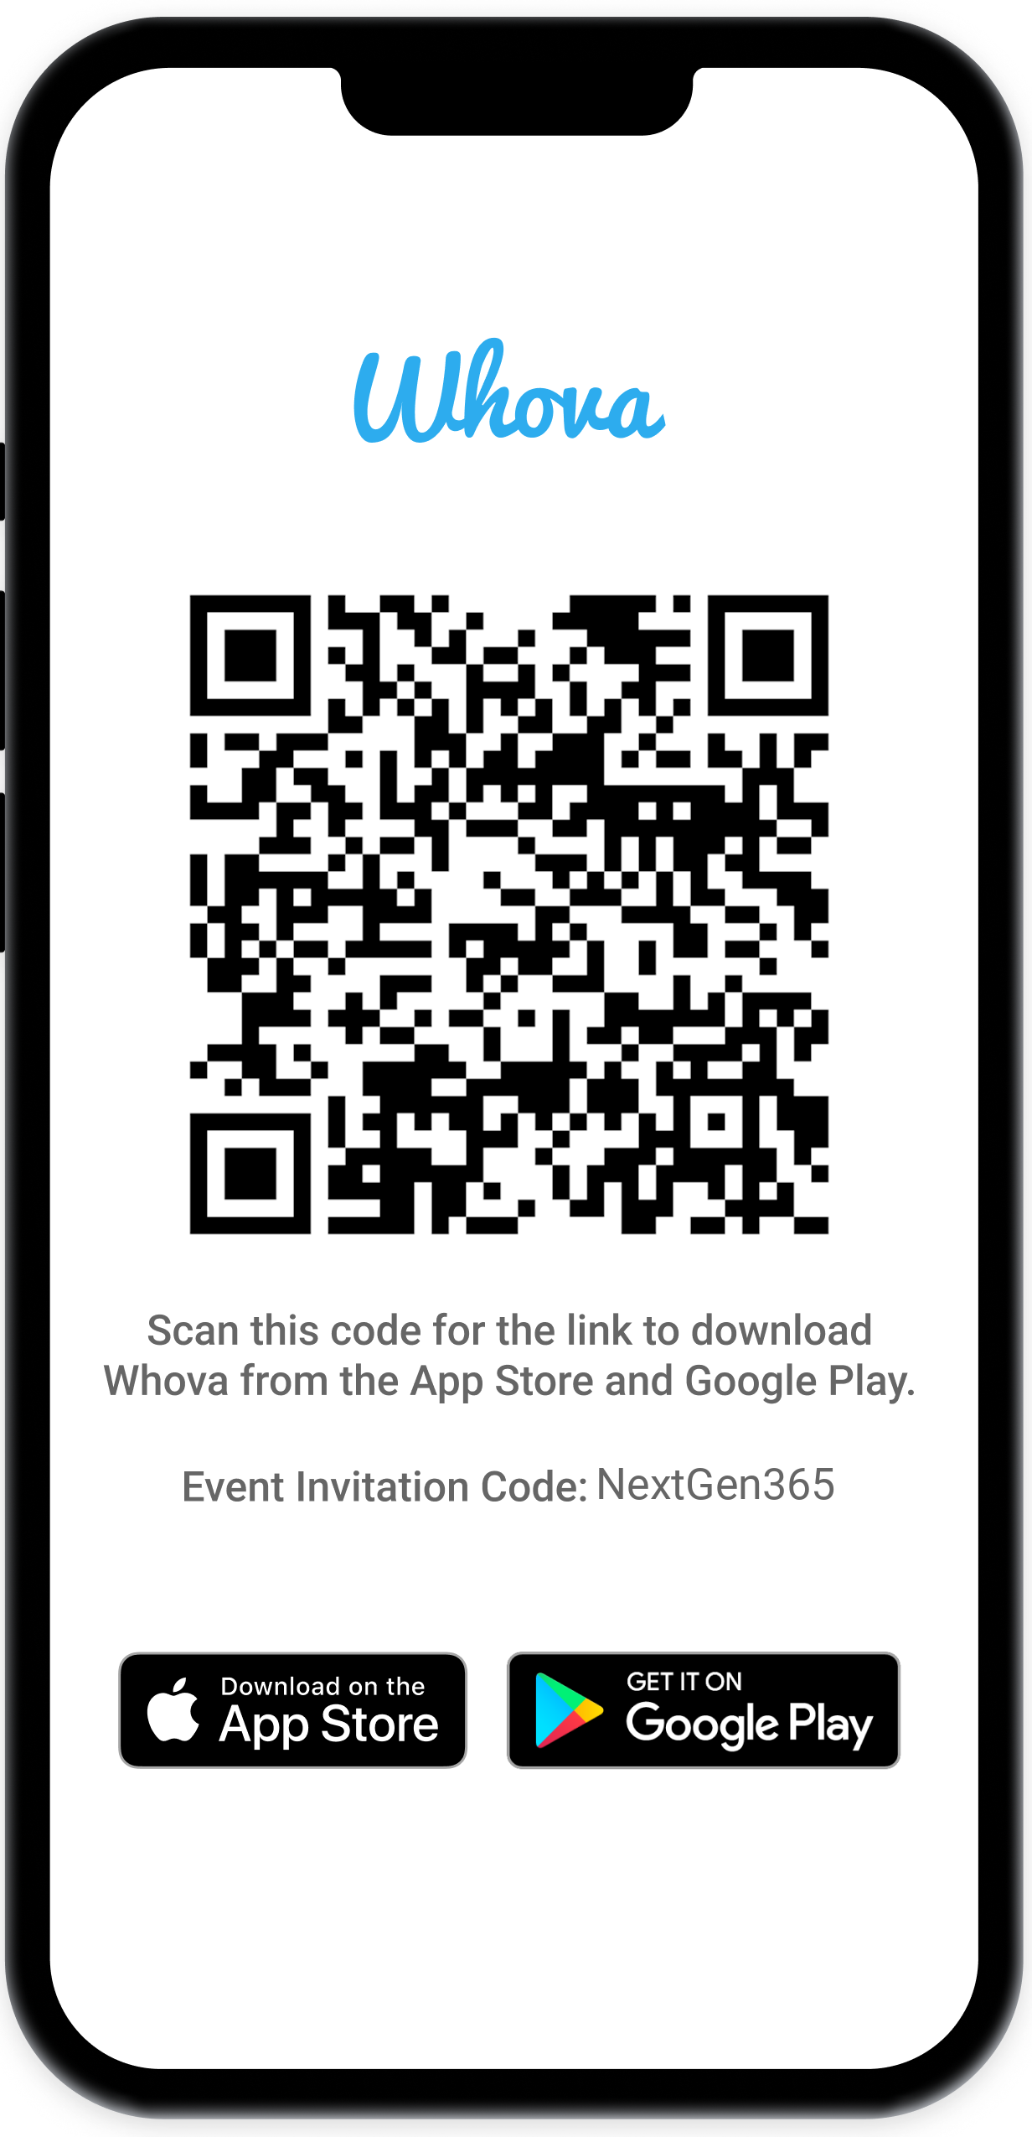
Join the event app to access:
The official event app for the
Microsoft 365 Community Conference
Event invitation code: NextGen2025
Event announcements
Personalized agenda, session details
Speaker & attendee profiles
Networking, meet-ups, messages
Event documents
Notes:
Please leave this slide in for conference attendees.

Slide 4

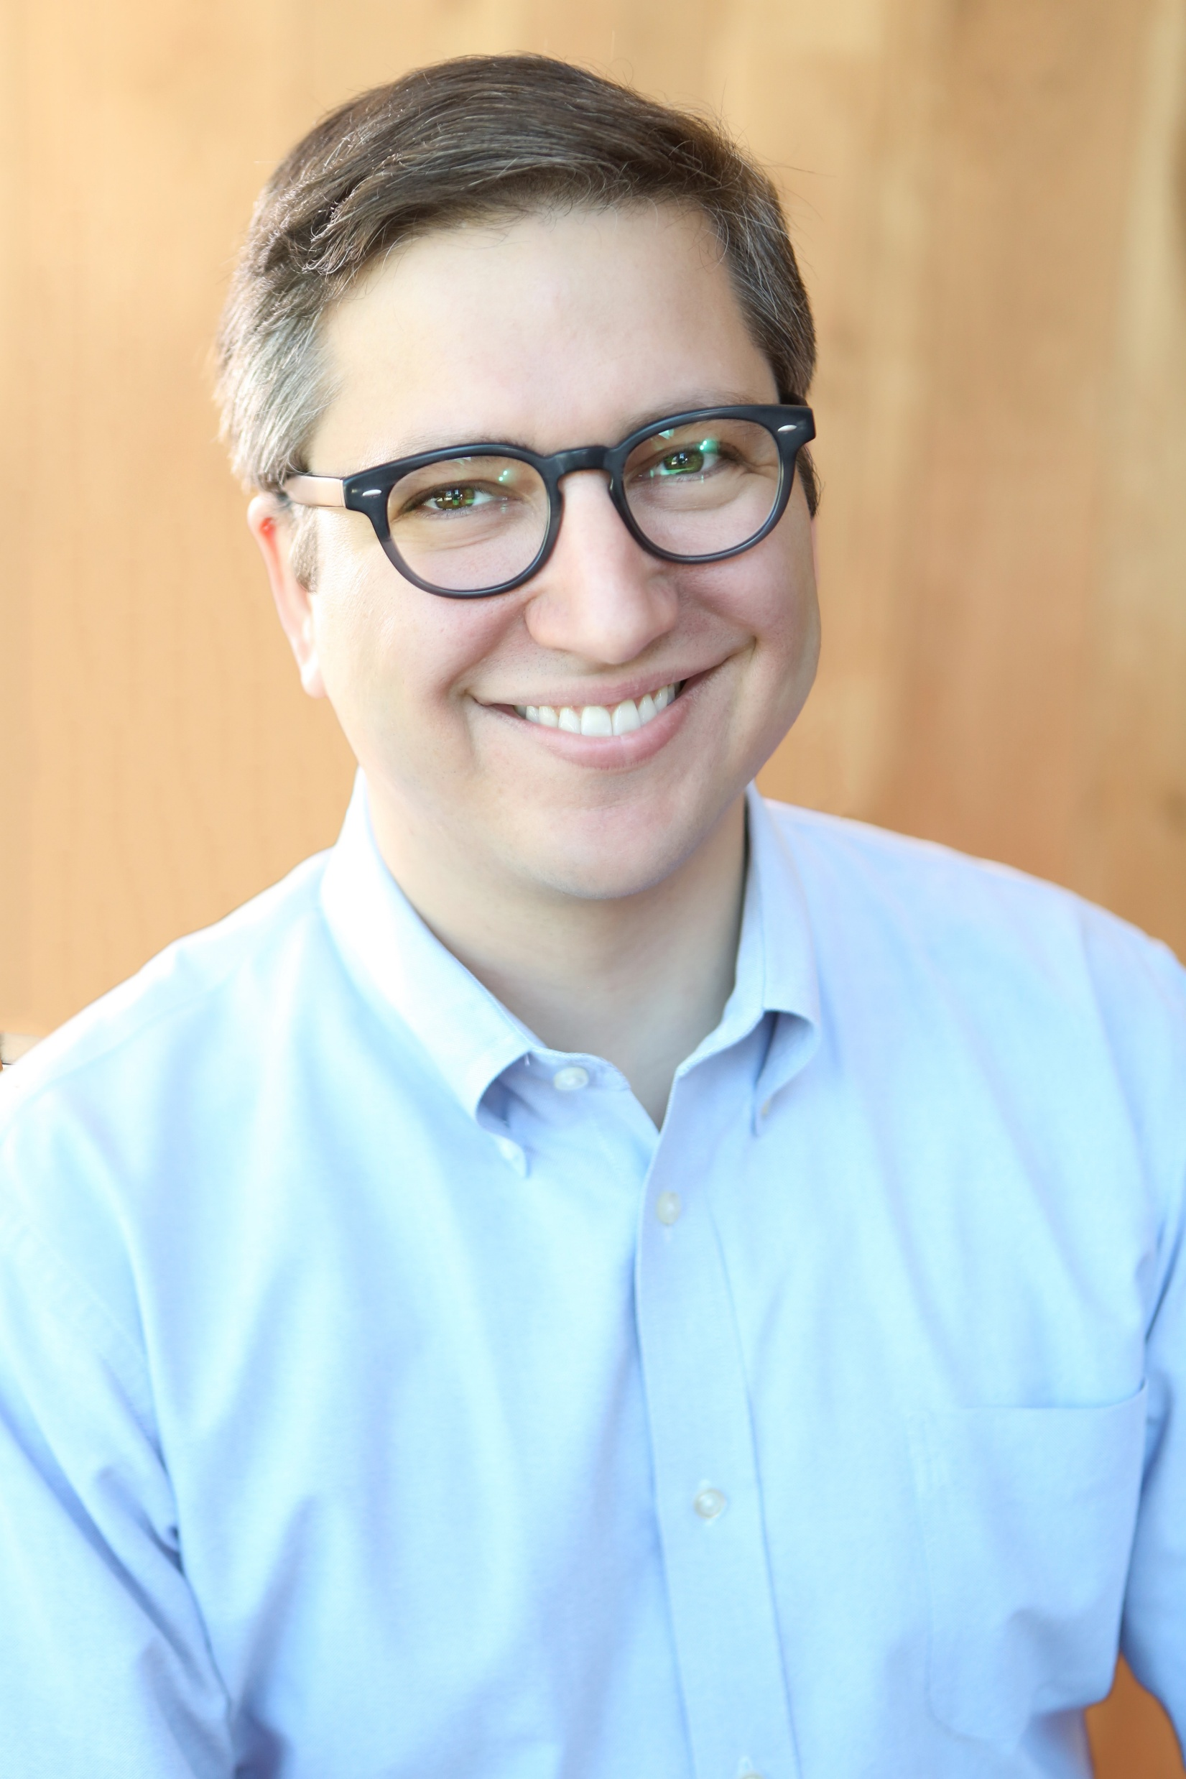
Shilpa Patel
Product Manager II, M365 Core Experiences
/shilpapatel1123
Hal Bond
Principal Product Manager, M365 Core Experiences
/halbond

Slide 5
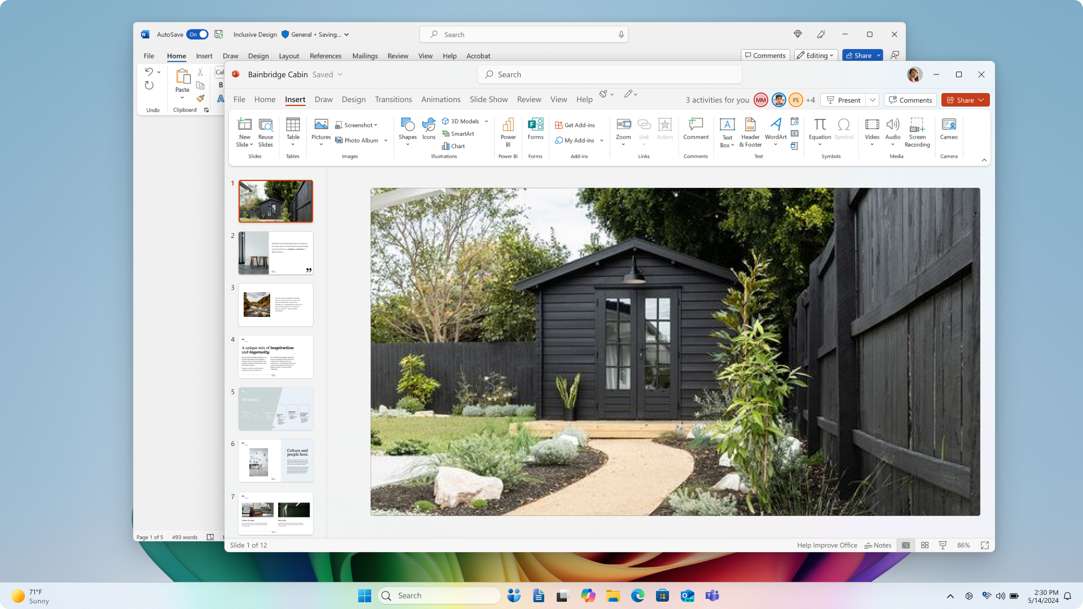
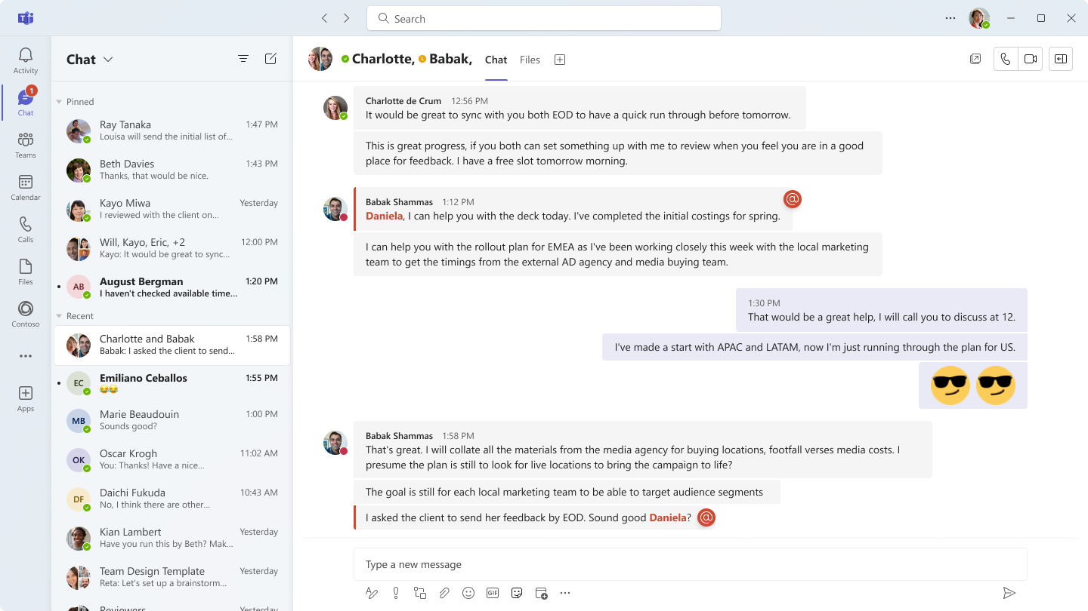
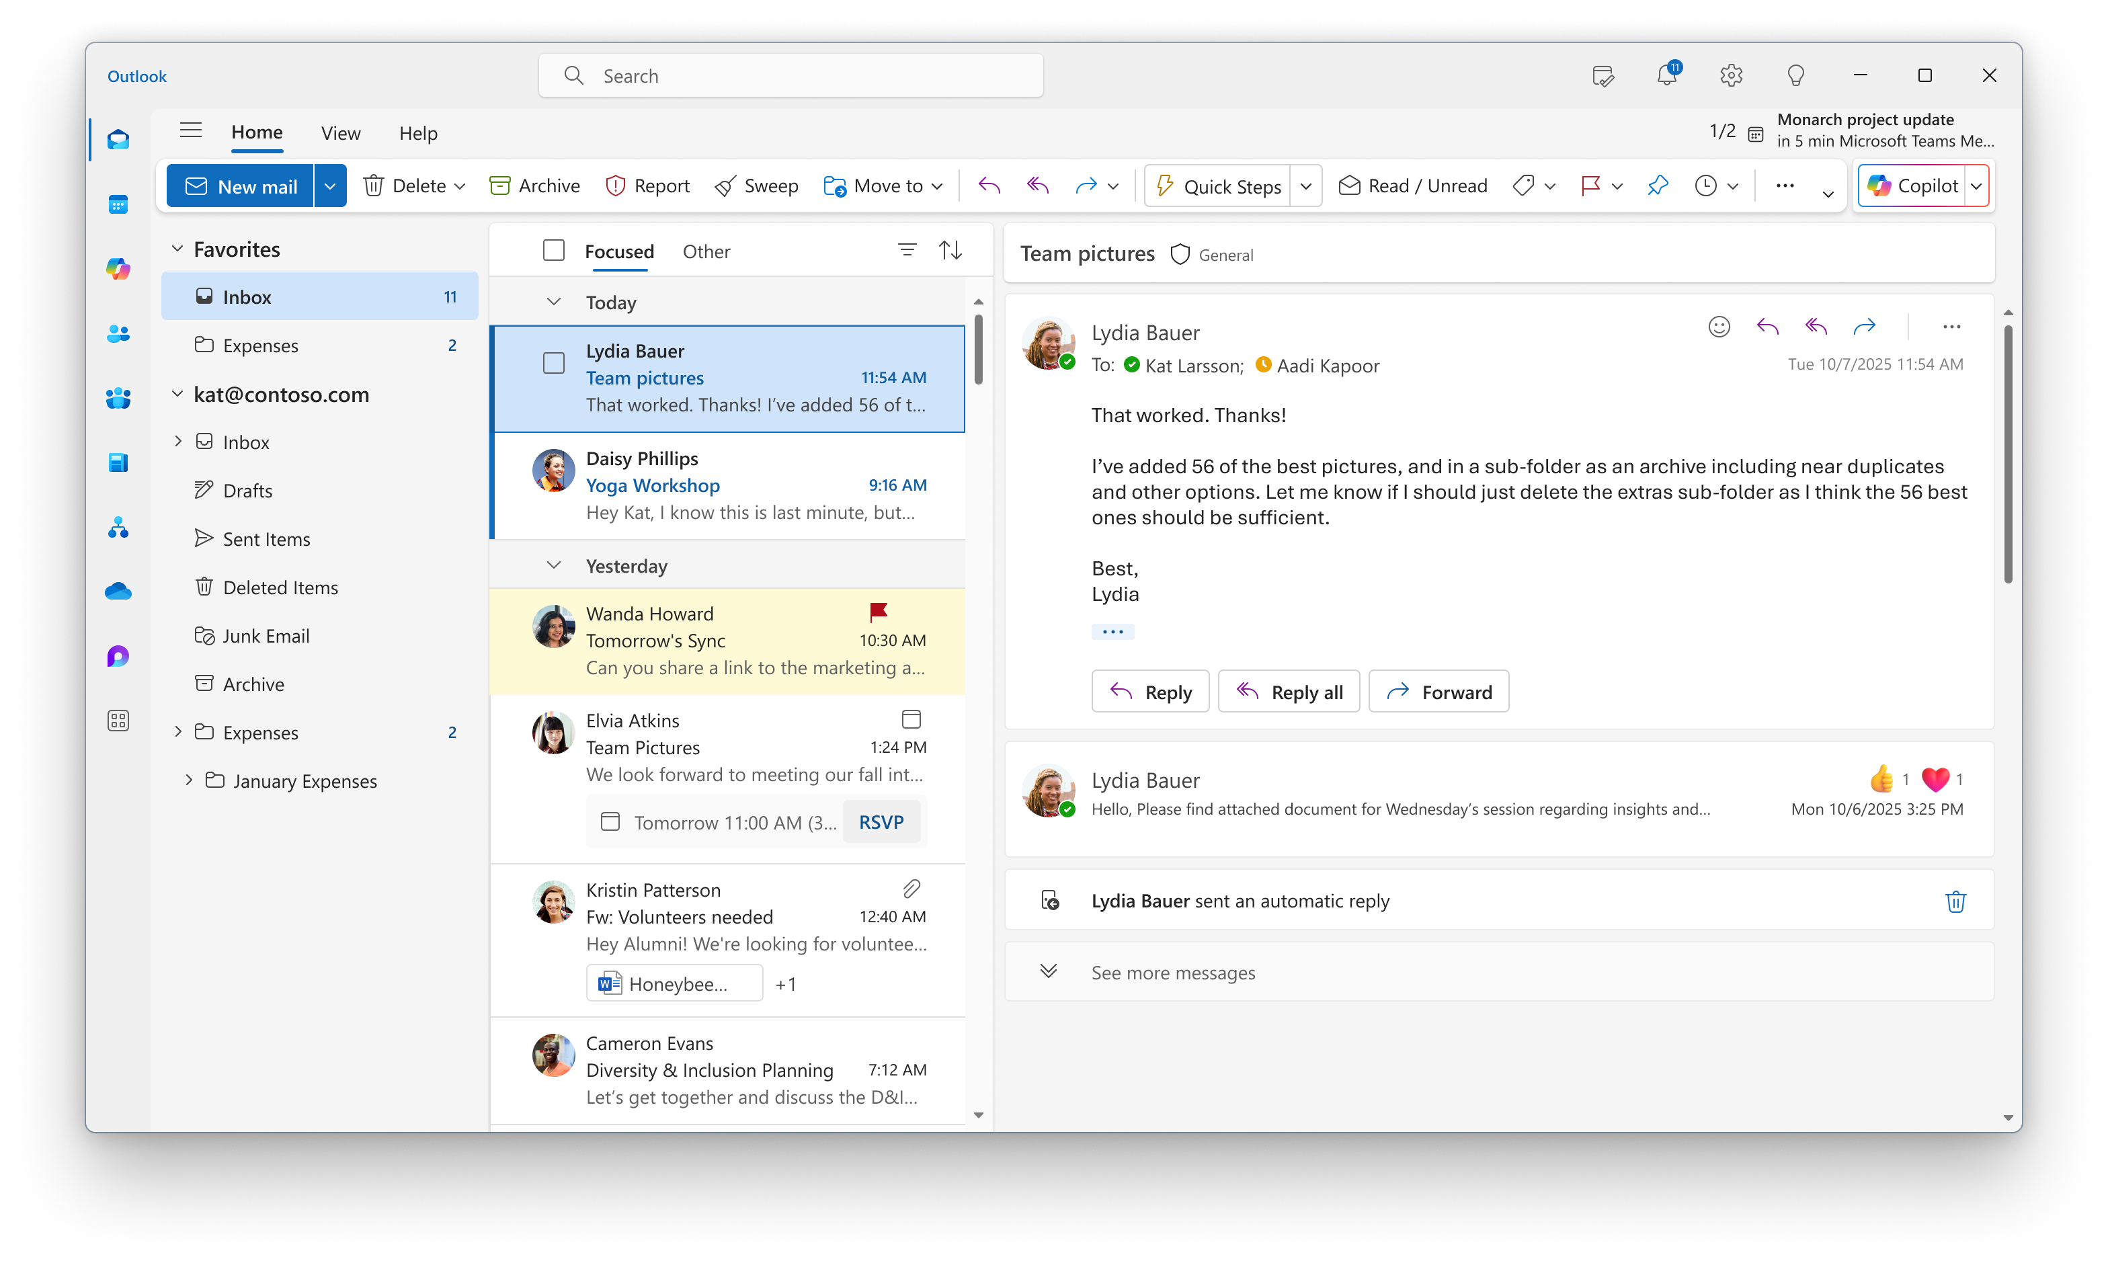


Notes:
Add in Teams frame
Show lots of urgent messages
Just have to respond to this one thing
Ah okay so I open teams and I do this then that then wait a second what was I supposed to be doing here?

Slide 6
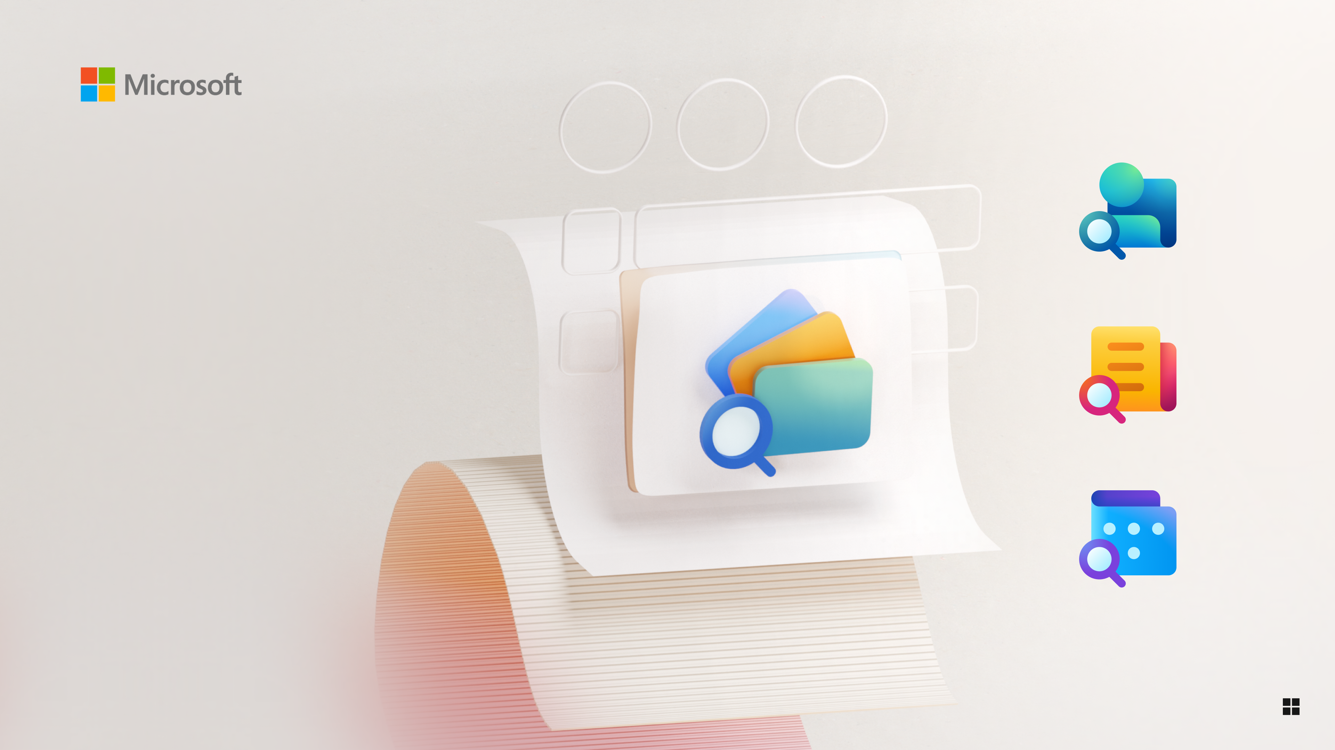
Microsoft 365
Companion
Microsoft 365 Companion
Notes:
* Can edit ☺
Allude to the Companion icon

Slide 7
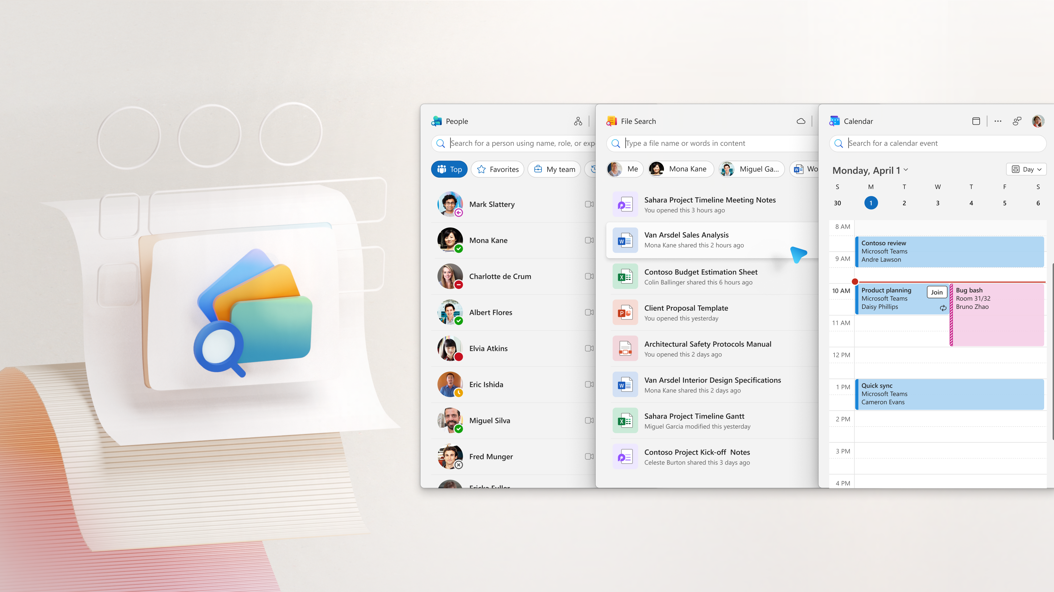
Microsoft 365 Companion
Your shortcut to people, files, and your calendar. One click. No distractions.

Slide 8

People
Your fast and simple people finder. One click, no distractions.

Slide 9

File Search
Your fast and simple file finder. One click, no distractions.

Slide 10
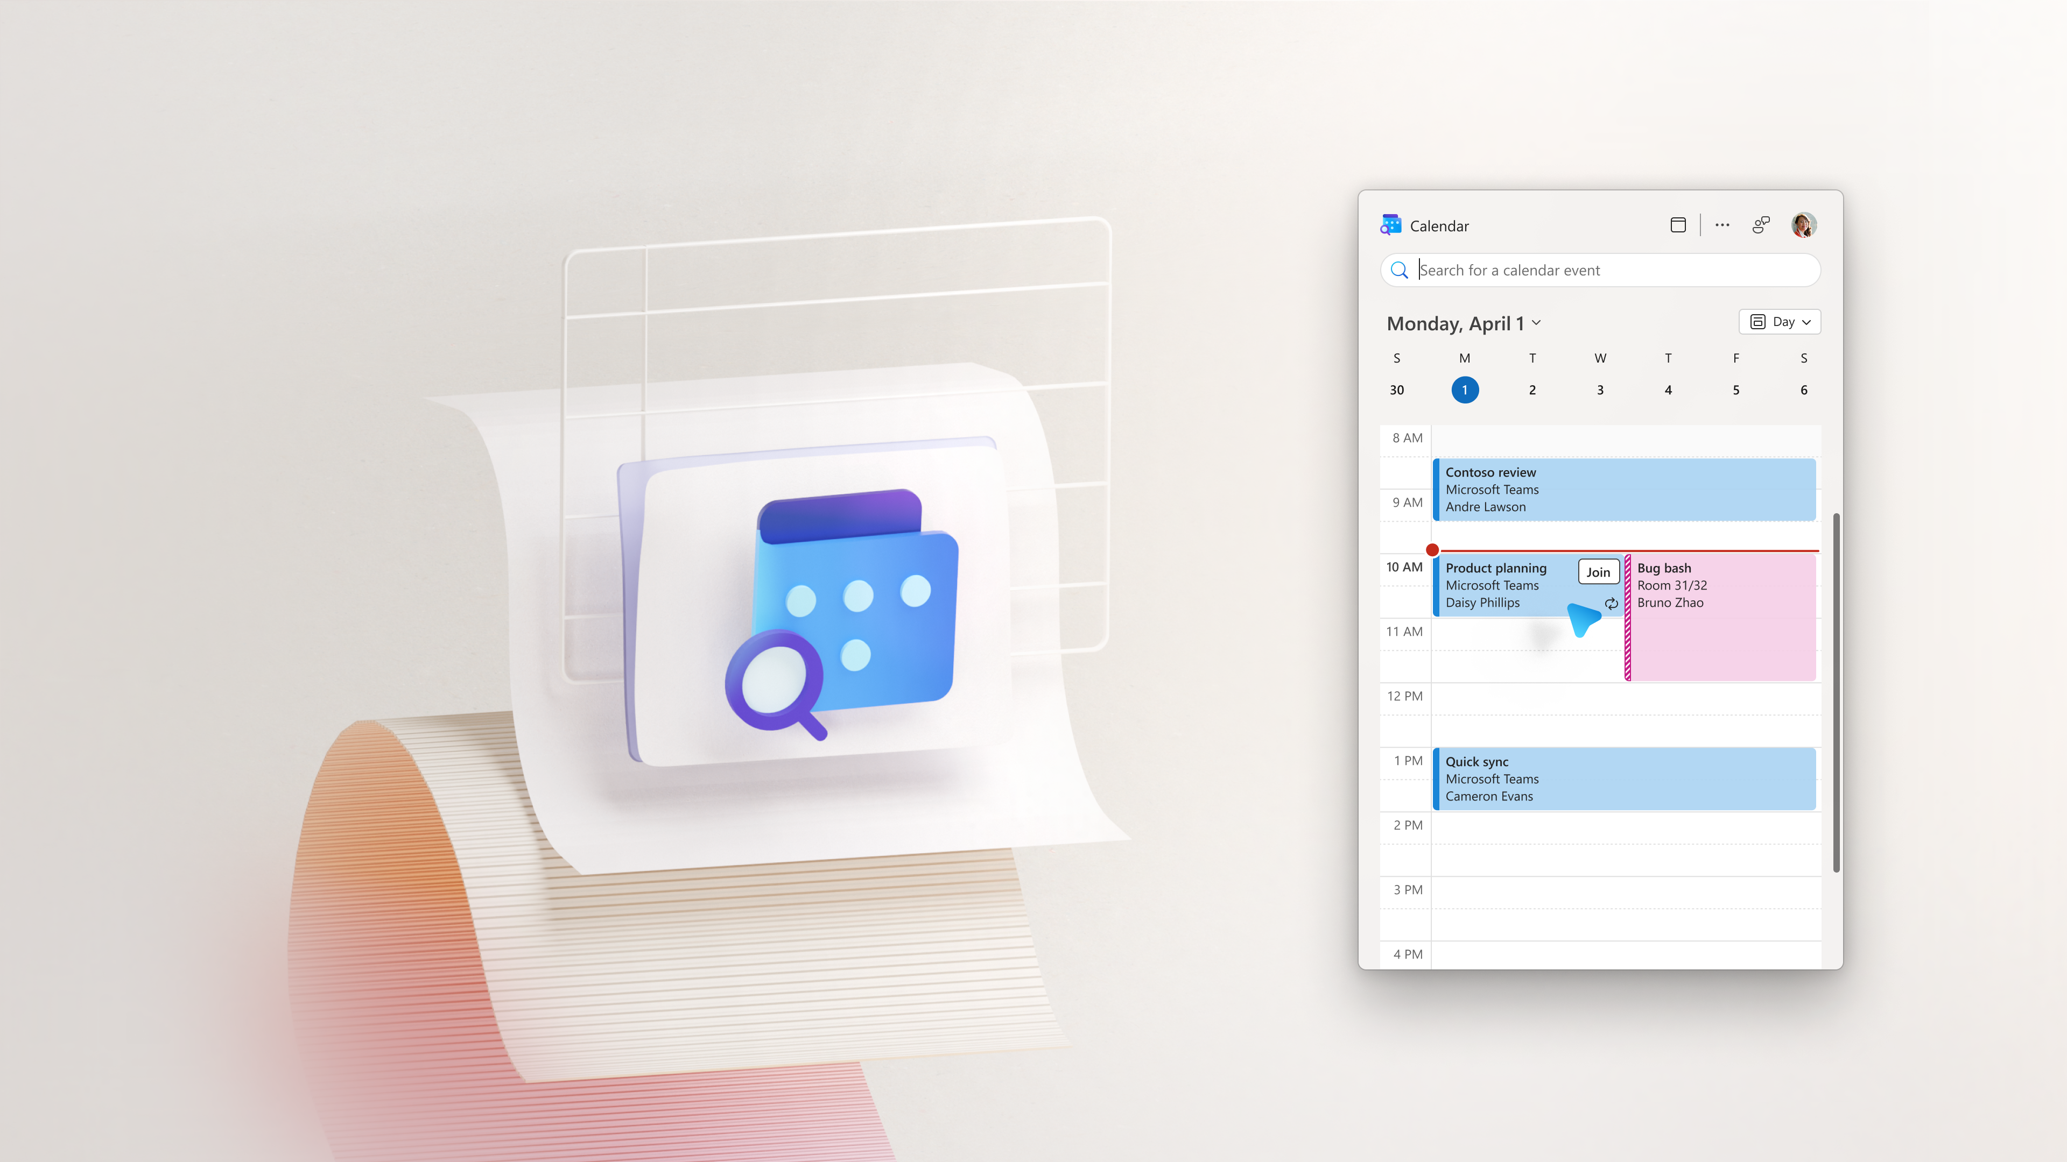
Calendar
Your fast and simple calendar viewer. One click, no distractions.

Slide 11
DEMO

Slide 12
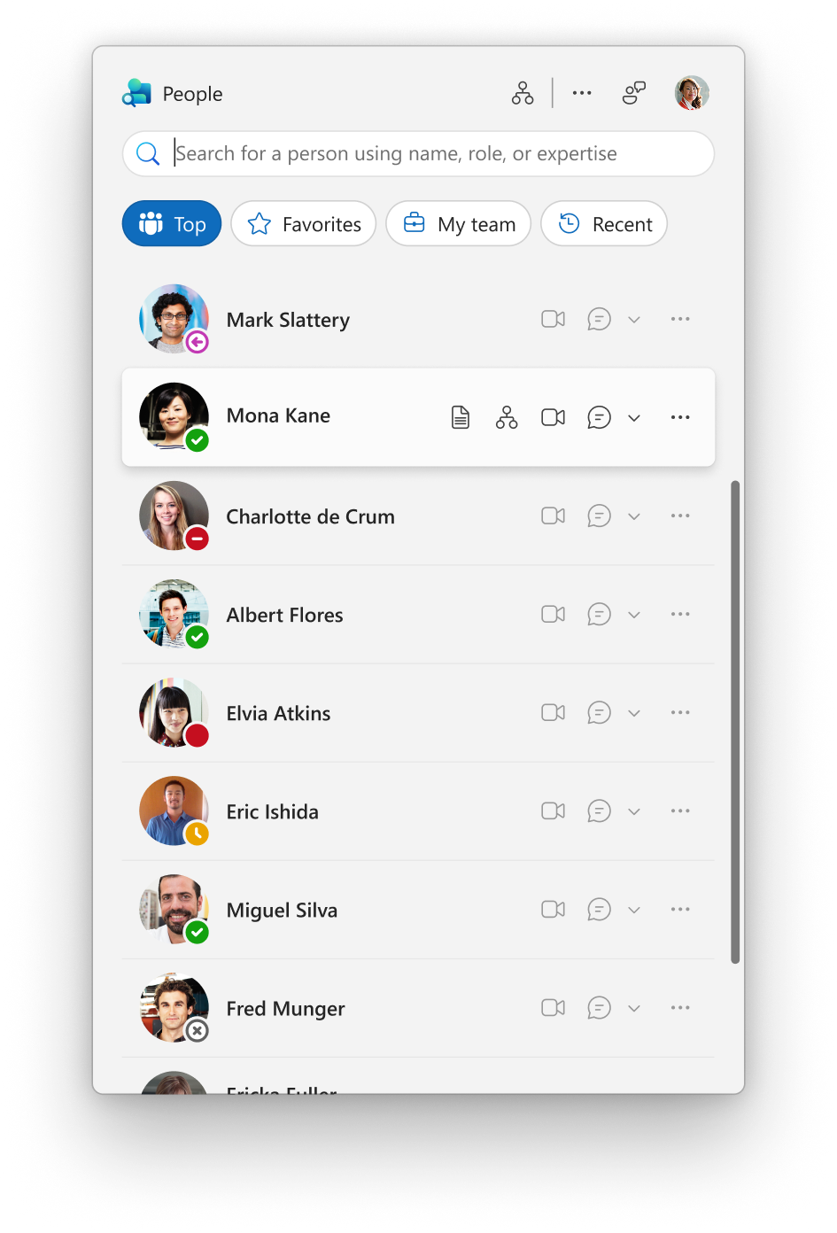
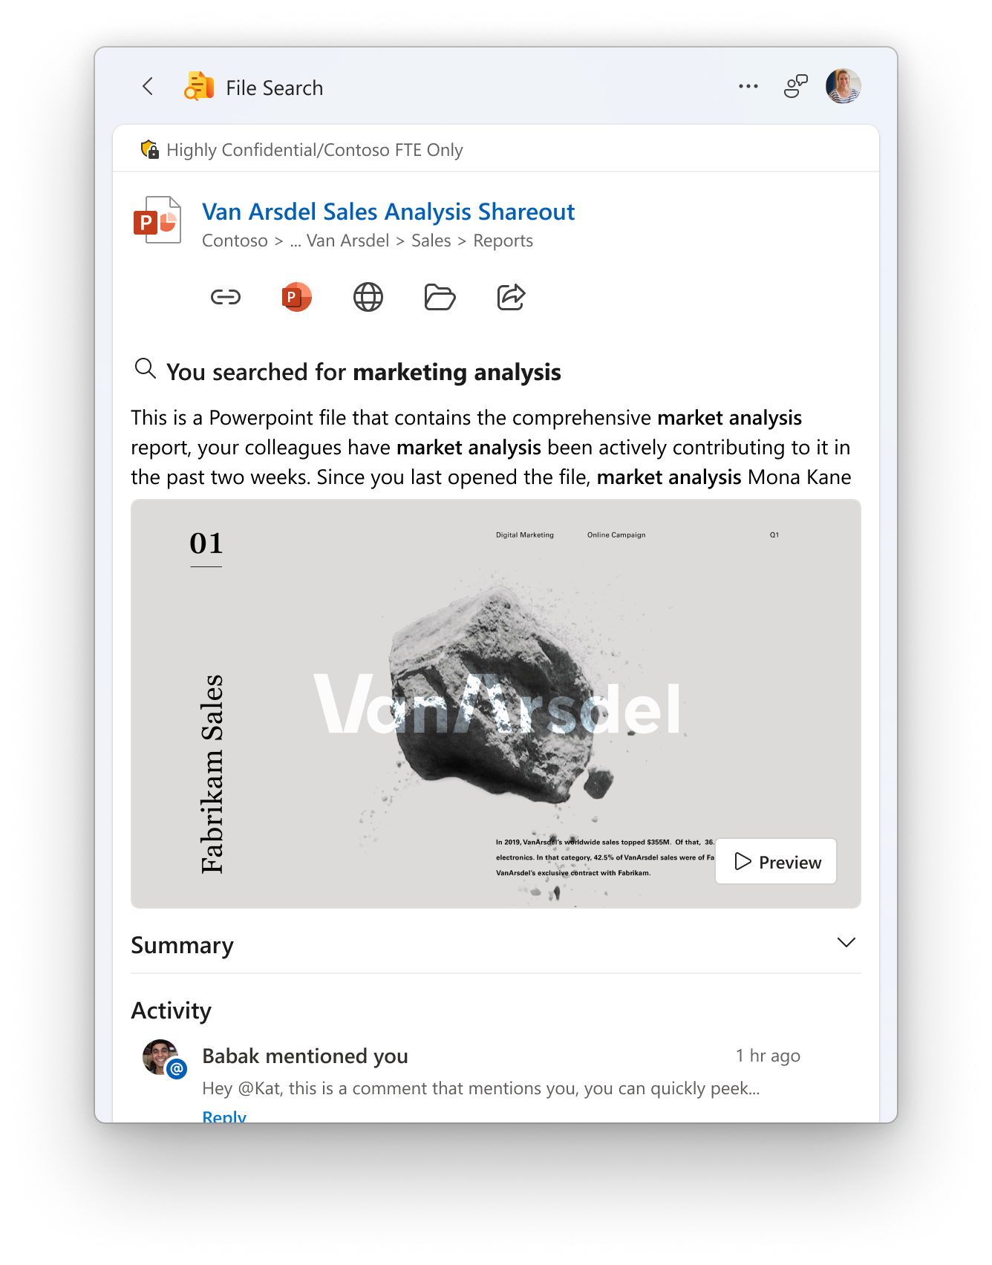
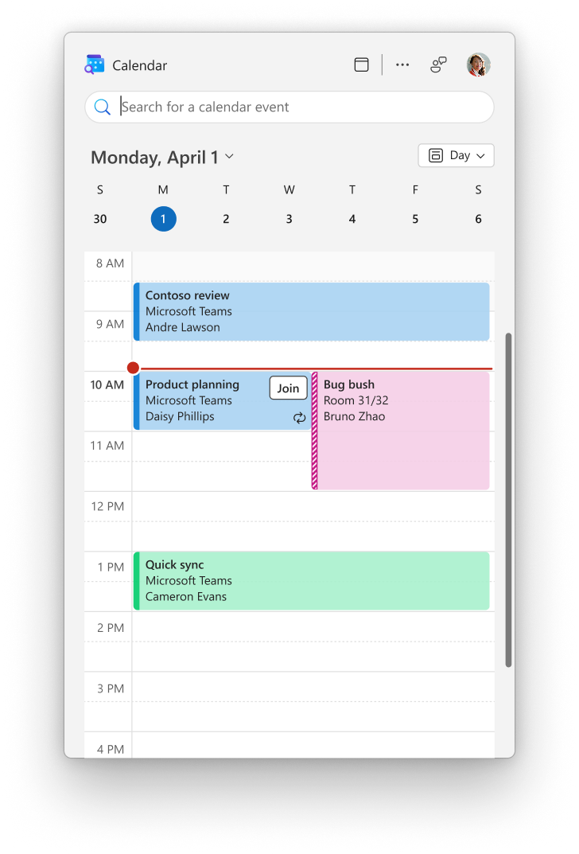
The Road Ahead

Slide 13
How do I get these apps?
Phases | Deployment Mechanism | Target Date
Phase 0: Early Adopters | Manual deployment | NOW
Phase 1: Preview | Microsoft 365 Insiders channels | Beta NOW Current late-May
Phase 2: General Availability | Standard office deployment tools | Coming soon
Notes:
* Can edit ☺

Slide 14
Learn More!
aka.ms/TryM365Companion

Slide 15
Microsoft 365 Companion
Your shortcut to people, files, and your calendar. One click. No distractions.

Slide 16
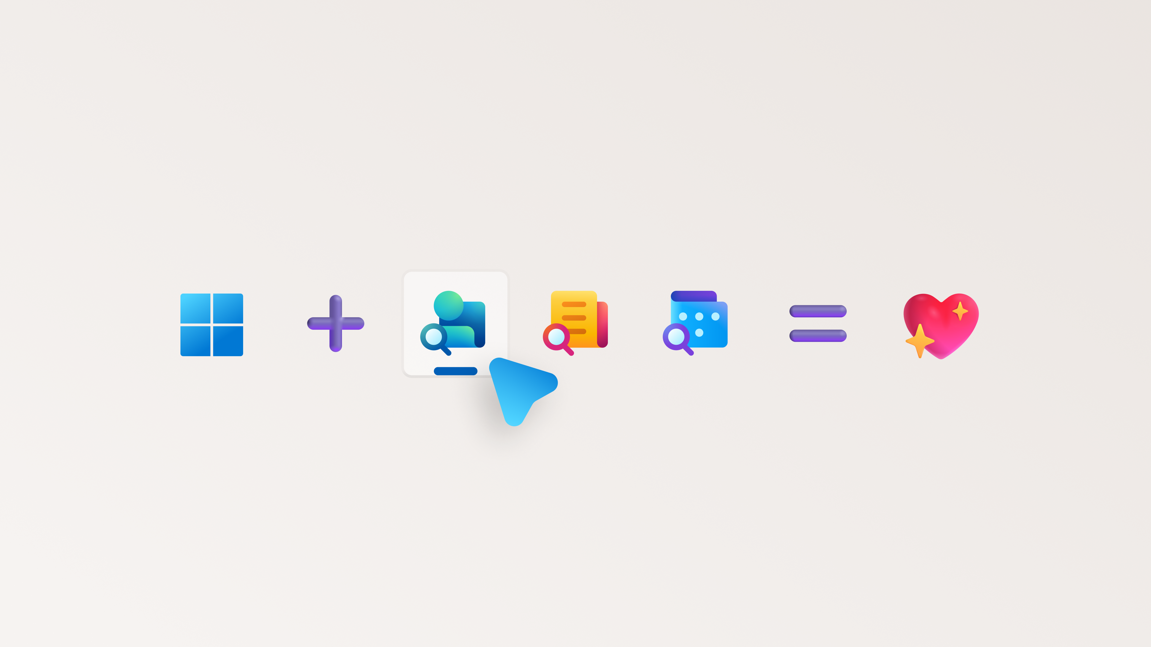

Notes:
* Can edit ☺

Slide 17

Join Us for Q&A!
Come try the apps yourselves!
When: 4:30 PM – 5:00 PM
Where: Community Lounge, MGM Conference Center Level 3, near the Premier Ballroom
aka.ms/TryM365Companion

Slide 18
Expertise and tools for your journey
Technical expertise via our FastTrack partners
Tools, resources & training on our Adoption Hub
Events and real-world knowledge in our community
aka.ms/Microsoft/FastTrack
adoption.microsoft.com
aka.ms/TechCommunity
Notes:
Please leave this slide in for conference attendees.

Slide 19
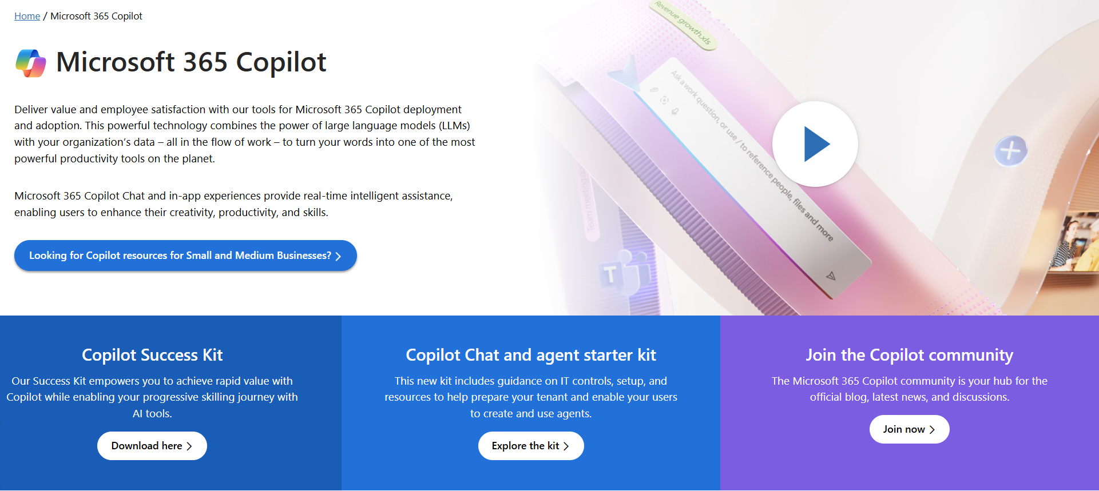
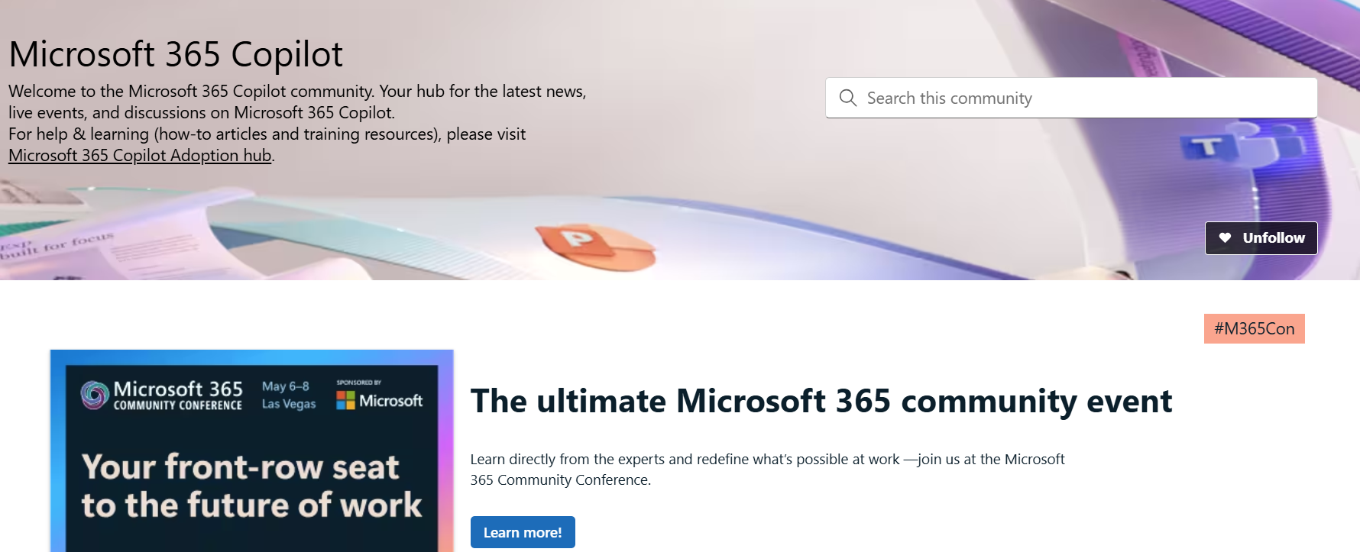
News & community content
Microsoft Community Learning aka.ms/Community/LearningChannel
Community led expert content on all your favorite Microsoft services.
Start your week with live news and event updates aka.ms/MondaysatMicrosoft
Watch live or on-demand & share our blog.
Notes:
Please leave this slide in for conference attendees.

Slide 20
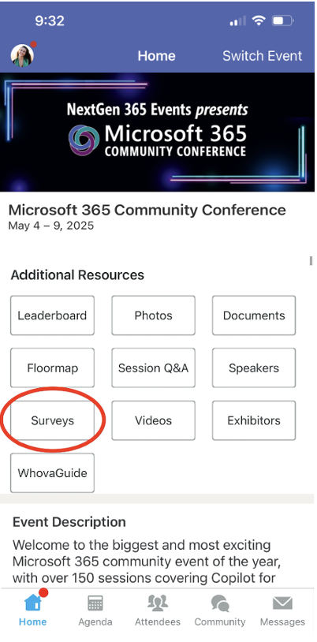
Session feedback surveys
We want to hear from YOU!
Share your feedback to make next years conference even better!
Here’s how –
Simply go to the Whova App on your smartphone.
Scroll down on the M365 Community Conference Homepage to ‘Additional Resources’ to click “Surveys’.
Click Session Feedback.
Scroll down to find this session title.
Complete the session feedback survey.
Finally, click ‘Submit’.
It’s just that easy!
Notes:
Please leave this slide in for conference attendees.

Slide 21

Notes:
Please leave this slide in for conference attendees.

