Slide 1
Forms for Lists & Document Libraries
Sahil Baid & Vaibhav Verma
6 May 2025

Slide 2


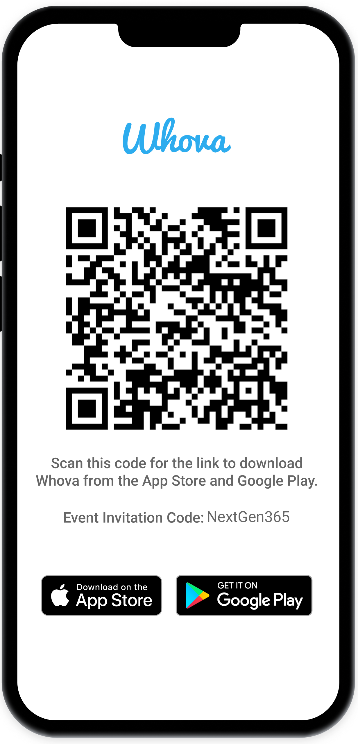
Join the event app to access:
The official event app for the
Microsoft 365 Community Conference
Event invitation code: NextGen2025
Event announcements
Personalized agenda, session details
Speaker & attendee profiles
Networking, meet-ups, messages
Event documents

Slide 3
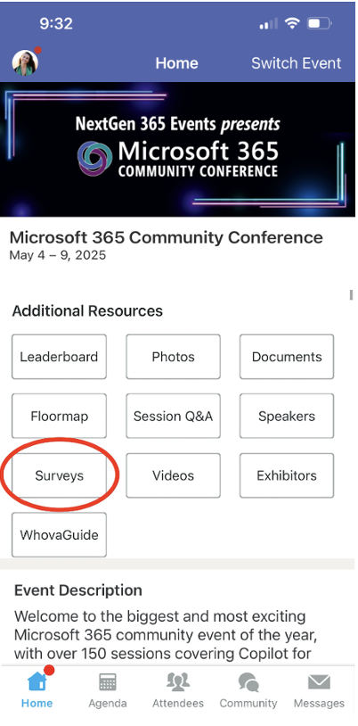
Session feedback surveys
We want to hear from YOU!
Share your feedback to make next years conference even better!
Here’s how –
Simply go to the Whova App on your smartphone.
Scroll down on the M365 Community Conference Homepage to ‘Additional Resources’ to click “Surveys’.
Click Session Feedback.
Scroll down to find this session title.
Complete the session feedback survey.
Finally, click ‘Submit’.
It’s just that easy!

Slide 4
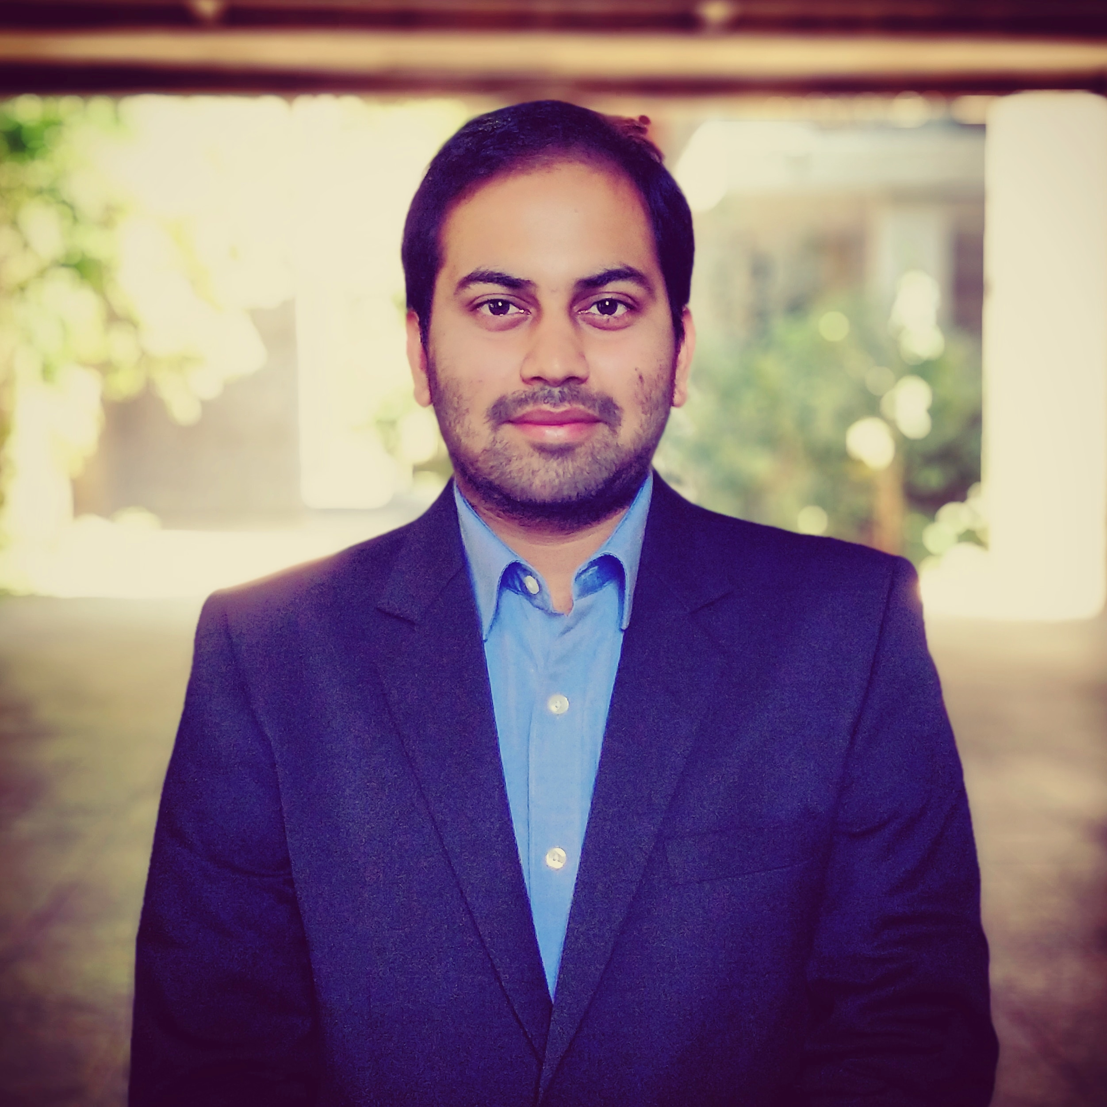

Sahil Baid
Senior Product Manager
/baidsahil
Vaibhav Verma
Senior Product Designer
/vaibhavverma3001

Slide 5
Have you ever struggled with collecting documents and related information from a large audience?

Slide 6
Here are the top issues faced by users
De-centralized collection
Inconsistent metadata
Lack of customization

Slide 7
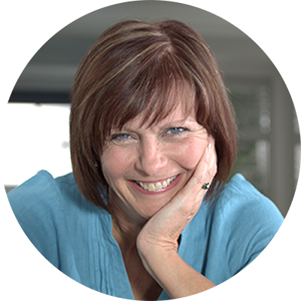
Meet Erika Fuller
Finance manager at ReleCloud
“I am responsible for collecting and processing employee expenses in my organization”

Slide 8


How Erika keeps things moving
Employees send their expense invoices
Erika collates the invoices and other details at one place
Processes the invoices for reimbursement

Slide 9
Introducing Forms for Document libraries!
Let’s see this in action →

Slide 10
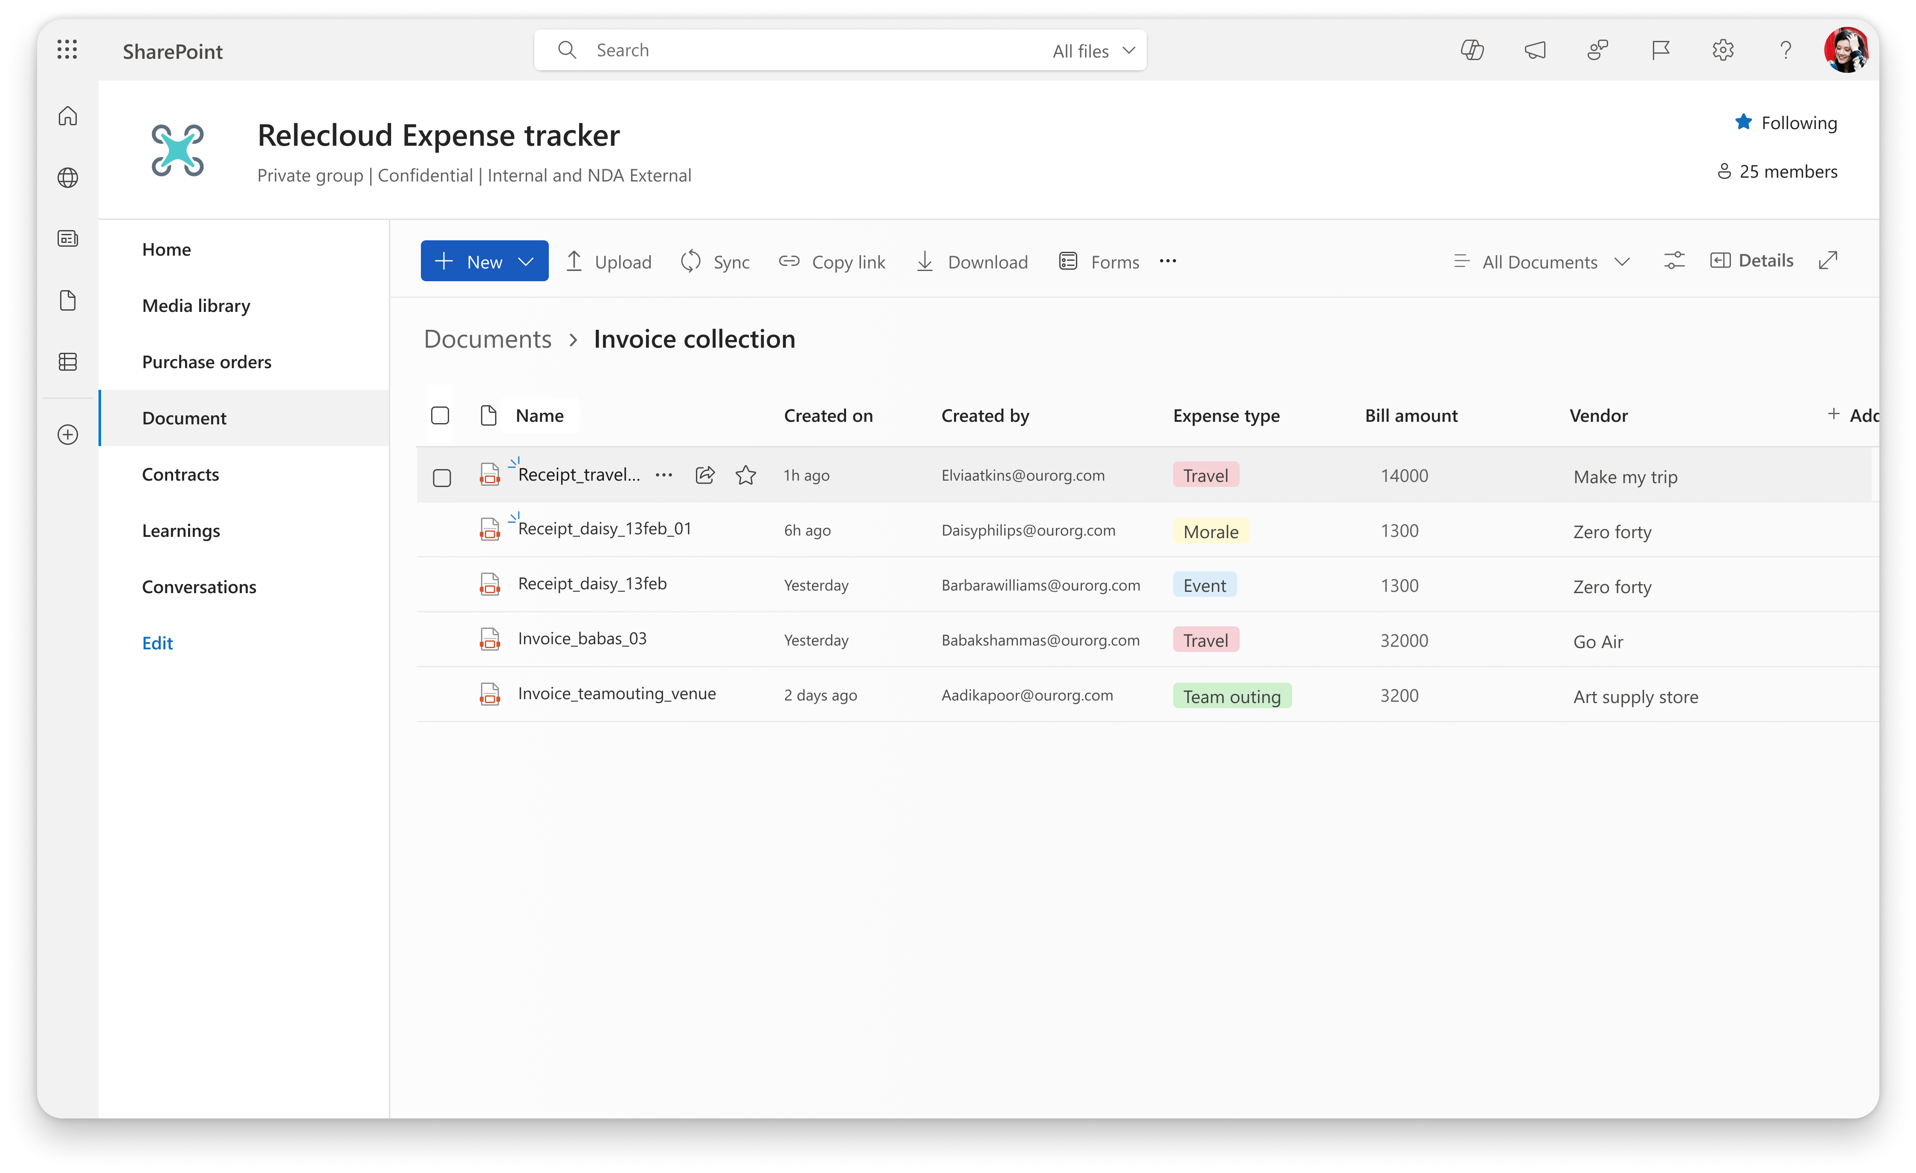

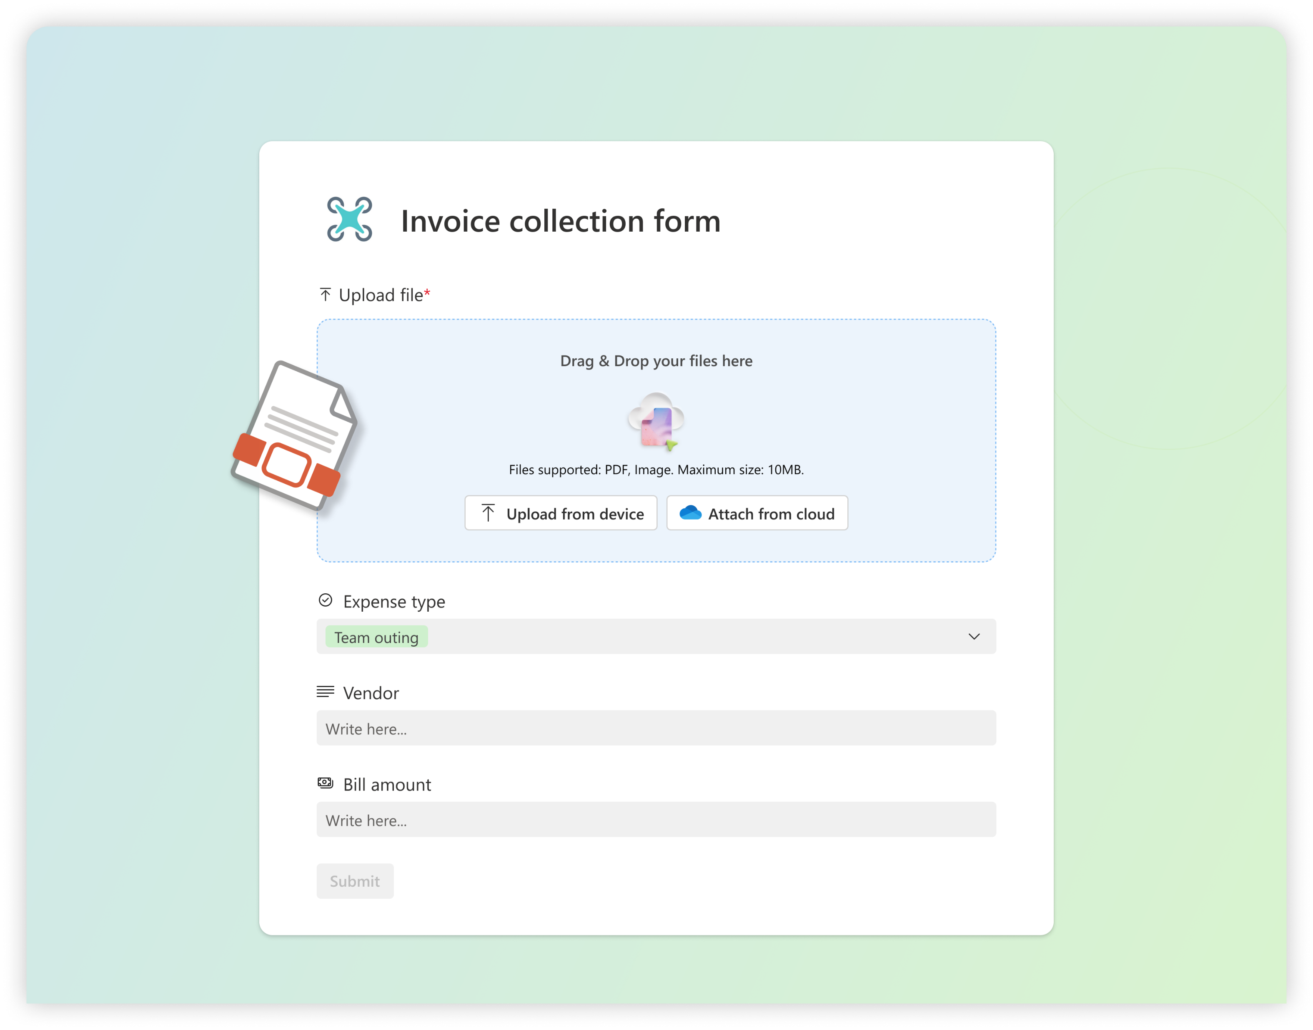
Key benefits
Easy to setup
OOB within Libraries
Structured collection of files & metadata
Highly customizable form
No direct access required to upload
Enables workflow automations

Slide 11



Roadmap
Released
Conditional branching
Form scheduling
Notification for new form responses
Logo, Attachments, Image, Location and Lookup fields
Enhanced creation experience
Rolling this season
Forms for Document Libraries
MMD fields for forms
One response per person and anonymous responses
Forms unfurling in Teams
Issue Tracker app in Teams
Top of mind
Improving View tabs UX
Lists AI/Agents
External sharing of forms
Default values for forms
Edit responses after form submissions

Slide 12
Join us for tomorrow's Round Table session
Imagining AI Agents with Microsoft Lists
Wednesday, 7May 8AM to 8:45AM
at Cedar Ball Room 251
Notes:
Thank you.
<Speaker Guidance: Spend the last few minutes discussing or answering any questions they may have. If they have additional topics on their EBC agenda, make sure you connect with their account team to inform them which AI priorities and business outcomes resonated the most during this session. If you are in a 1:1 direct customer engagement, make sure you note what their priorities and questions were and work with the broader account teams and units to facilitate the proper hand-offs or next steps (i.e. get them into a session at the Innovation Hub/MTCs).>

Slide 13
Thank you! We have an exciting future ahead…
Notes:
Thank you.
<Speaker Guidance: Spend the last few minutes discussing or answering any questions they may have. If they have additional topics on their EBC agenda, make sure you connect with their account team to inform them which AI priorities and business outcomes resonated the most during this session. If you are in a 1:1 direct customer engagement, make sure you note what their priorities and questions were and work with the broader account teams and units to facilitate the proper hand-offs or next steps (i.e. get them into a session at the Innovation Hub/MTCs).>

Slide 14
Slide Instructions
M365 community conference template
This template has multiple slide formats as well as both a light and dark template. This pulls from our standard brand guidance for Microsoft 365 and Copilot templates. We have also included several standard Copilot presentation slides for easy access. Feel free to delete them if they are not a part of your presentation talk track.
Delete this slide before finalizing your presentation. Below is the inventory of template slides:
Please leave and show the “Expertise and Tools for your Journey”, “News & Community Content” and “Share Your Feedback” as your closing slides to share with all conference attendees.
Slide #2 – Walk in slide – optional
Slide #3 – Conf branded Session title slide – mandatory
Slide #4 – Mobile app slide – mandatory
Slide #5-8 – Standard AI Halo / Copilot slides – optional
Slide 9-10 – Copilot enablement support – mandatory if presenting on Copilot experiences
Slide #11-15 – Example template slides – optional, to delete
Slides #16-18 – Session closing slides – mandatory
Slide #19 – Upcoming conference dates - Walk out slide, requested
Last Update: 4/8/25

