Slide 1
Admin Tips to Get the Most Out of Teams Apps
Brian Nguyen, Shruti Dhir
5/6/25

Slide 2

Microsoft 365 Community Conference

Slide 3


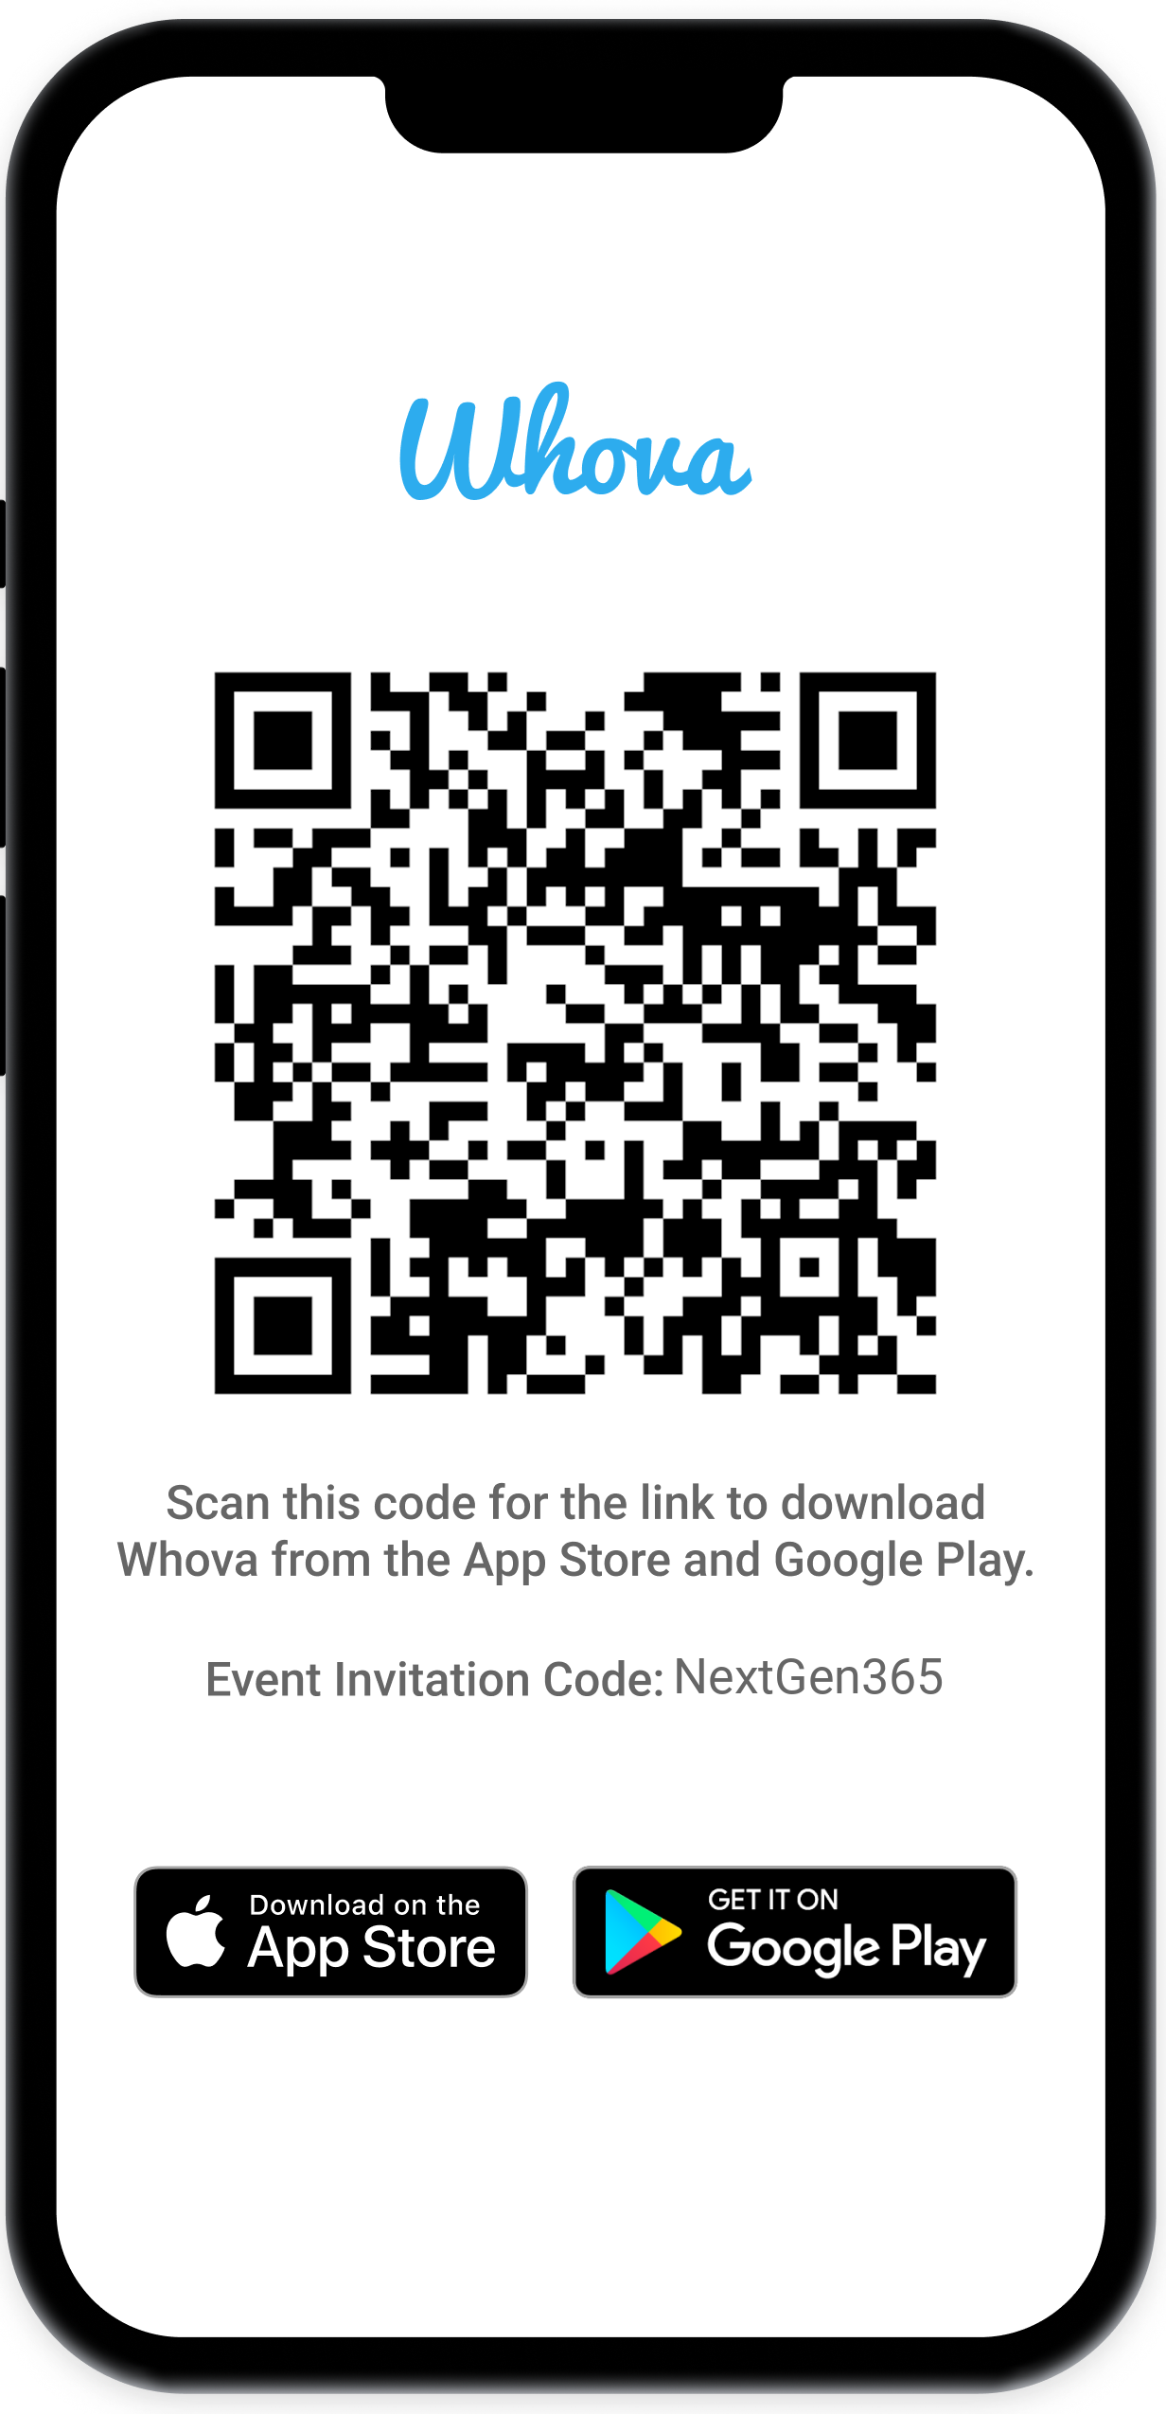
Join the event app to access:
The official event app for the
Microsoft 365 Community Conference
Event invitation code: NextGen2025
Event announcements
Personalized agenda, session details
Speaker & attendee profiles
Networking, meet-ups, messages
Event documents

Slide 4


Speakers
Shruti Dhir
Senior Product Manager, Teams
/shrutidhir
Brian Nguyen
Senior Product Manager, Teams
/brianjnguyen

Slide 5
Apps in Teams

Slide 6
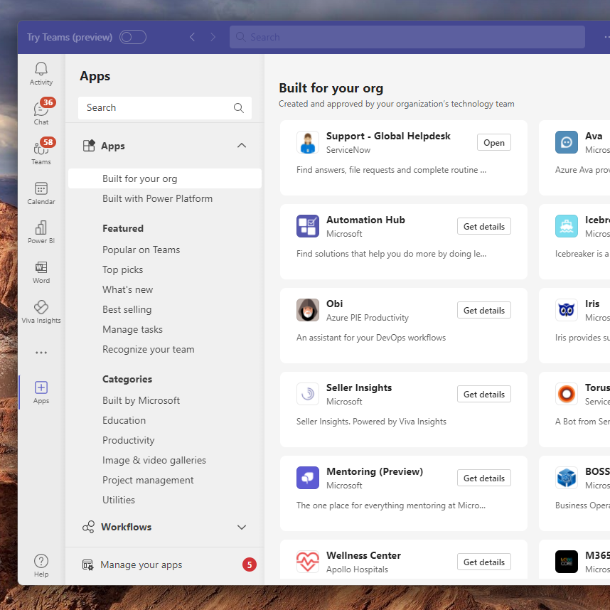
Teams app store
High-quality apps that enhance productivity, streamline workflows, and facilitate seamless cross-platform collaboration.
Includes Microsoft, third-party developers, and custom apps.
Admins manage the availability from Teams admin center

Slide 7
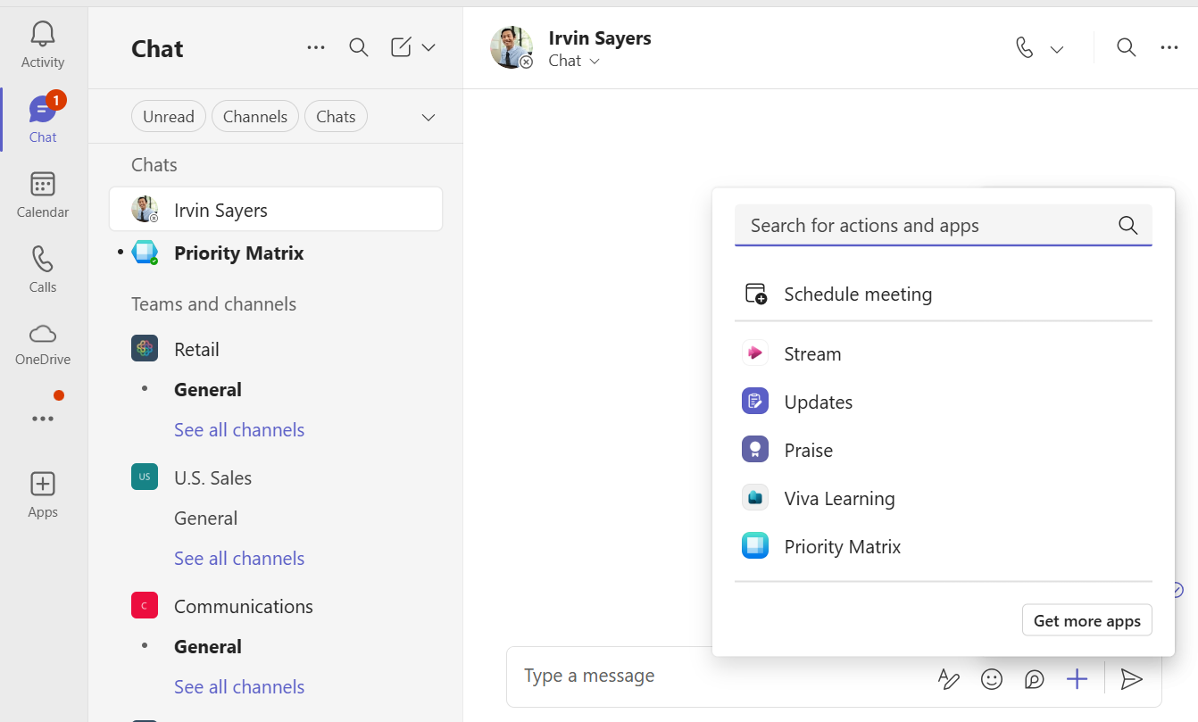
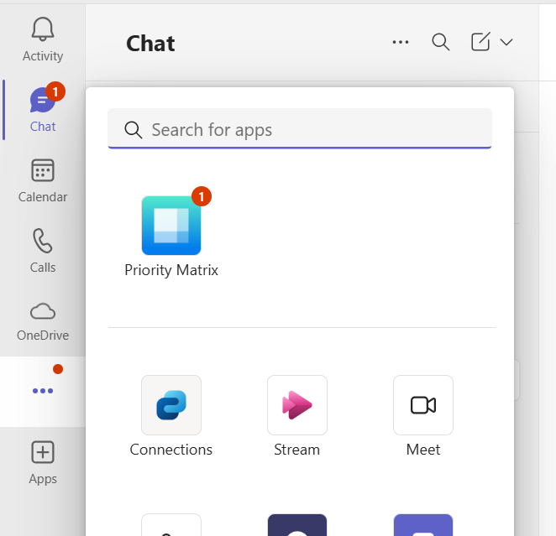
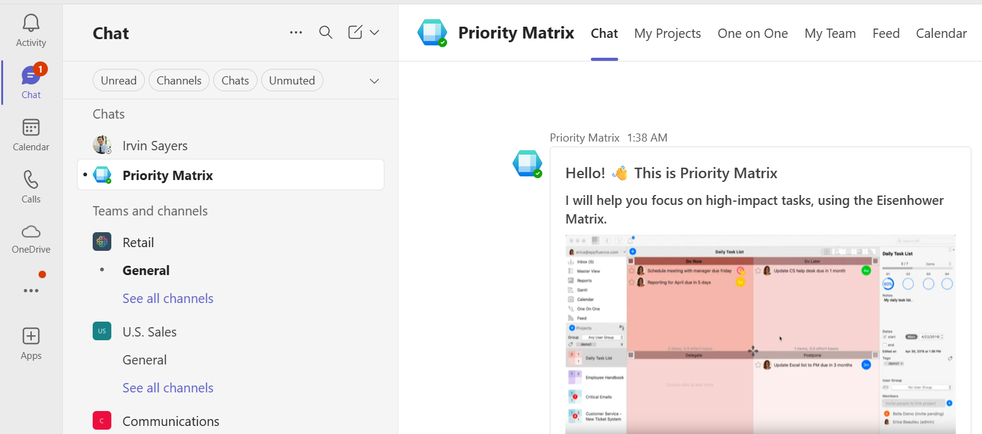
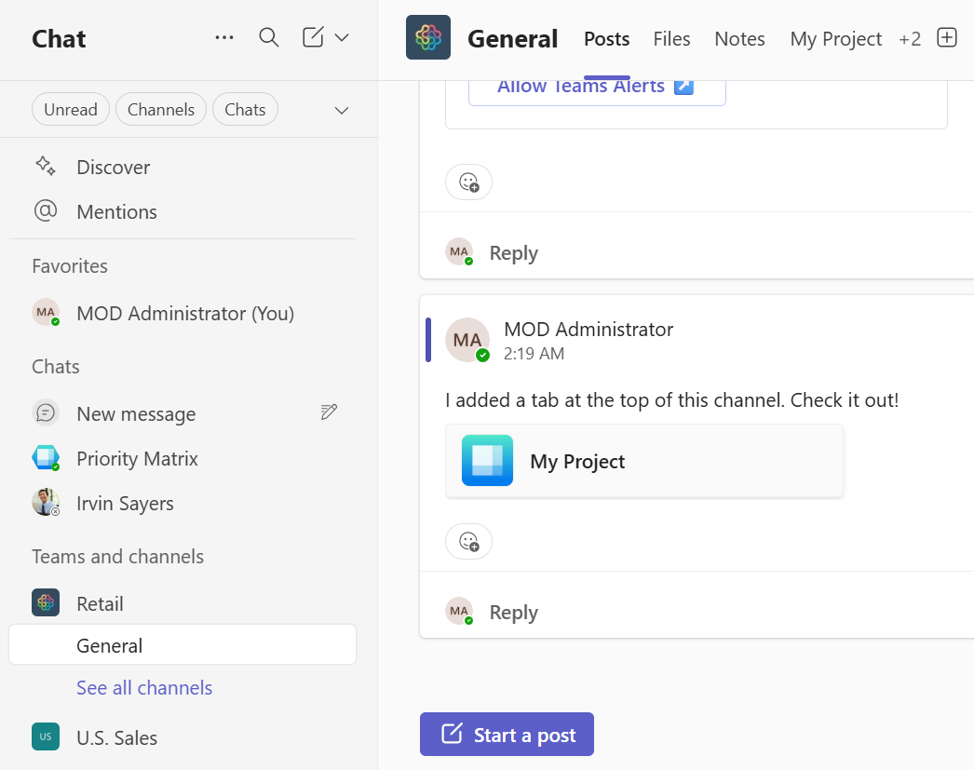
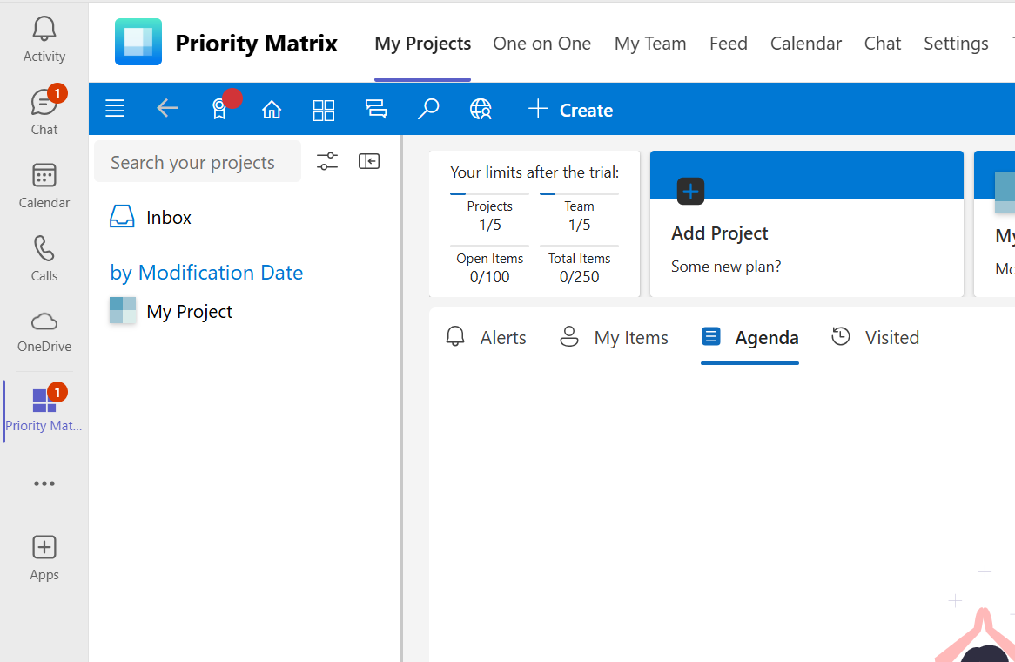
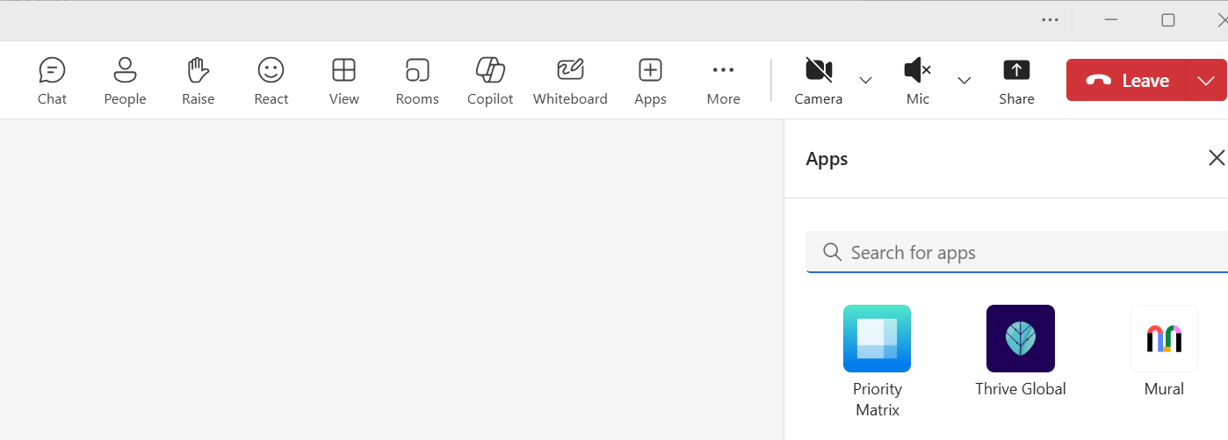
Using apps in Teams
Once installed, the app appears in its supported surfaces for users in their flow of work
Message extension
Personal app flyout
Chat bot
Channel
Personal app
Meeting extension

Slide 8
App management scenarios

Slide 9
Top admin scenarios
Business unit request
Marketplace for users
Streamline user workflows
Enable internal tooling
Drive usage & awareness
Company purchased licenses
Employee onboarding
Subsidiaries, guests, external users
Manage apps in bulk
Monitoring, business reporting
What else?

Slide 10
Desired management outcomes
Apps can be trusted
The right users can access the right apps
Users can use apps in their flow of work
Users find the apps are useful
Automate maintenance through scripting
… what else?

Slide 11
Apps can be trusted

Slide 12
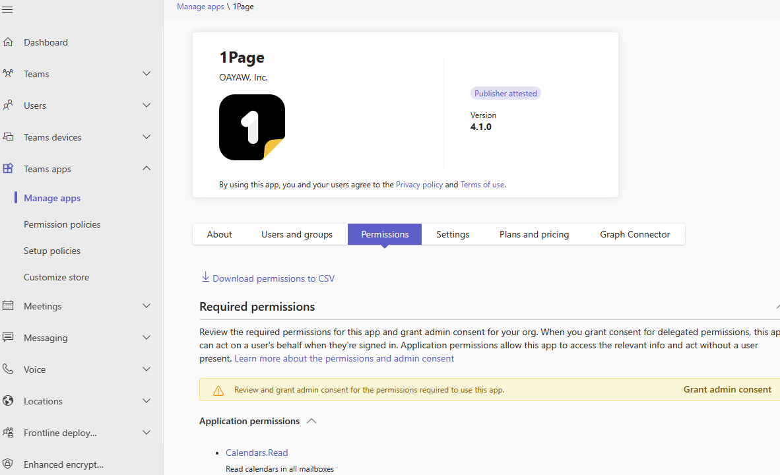
Admins can VIEW if the app has been consented or not.
Single CLICK to consent to all AAD Permissions

Slide 13
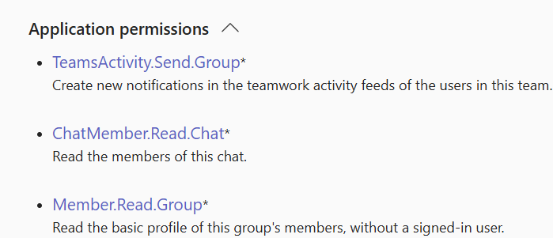
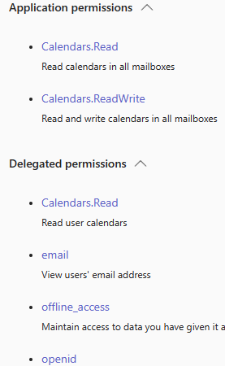
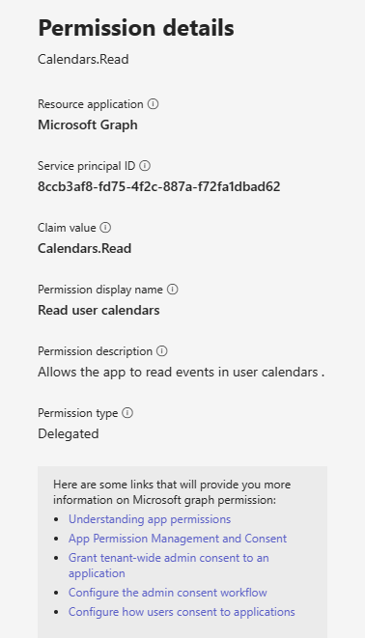
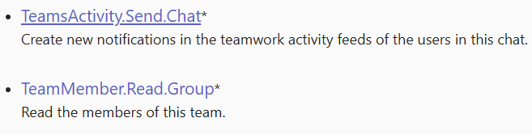

Accessing Permissions made easy
In Teams Admin Center, VIEW & DOWNLOAD all permissions that are required by the App, including Graph and RSC
Permissions categorized by type – application, delegated
Learn more details about each permissions

Slide 14
The right users can access the right apps

Slide 15
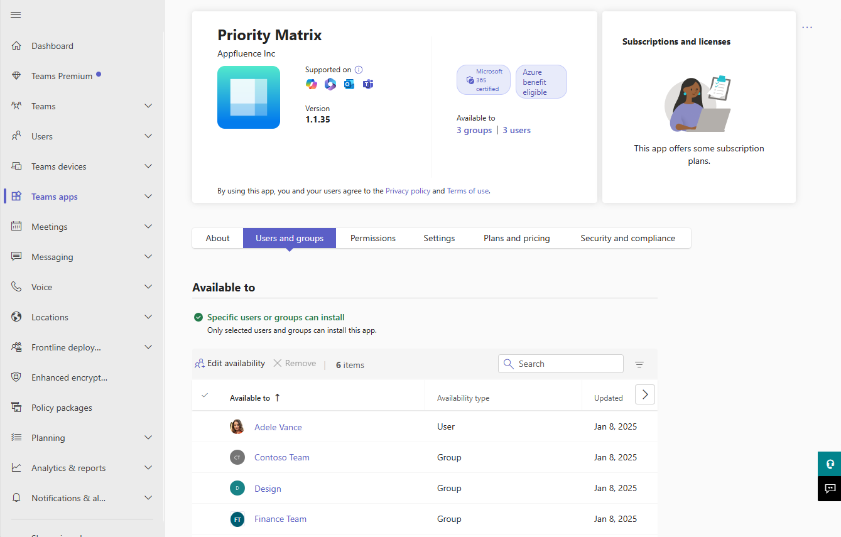
App centric management (ACM)
Overview
Simplified app availability & install management
Given an app, assign it users and groups
Availability
Who has access to which apps
Allows users to install and use apps
Manage org-wide (all users & apps), app level (block/unblock), users & groups per app (everyone, some, no one)

Slide 16
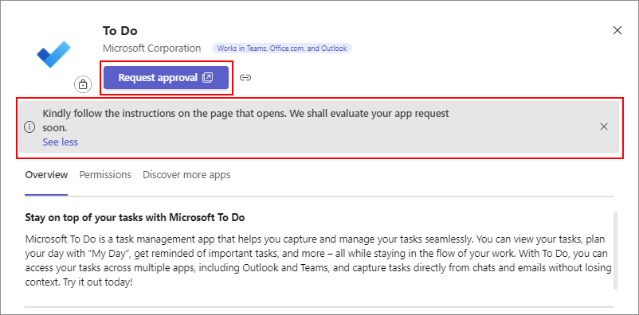
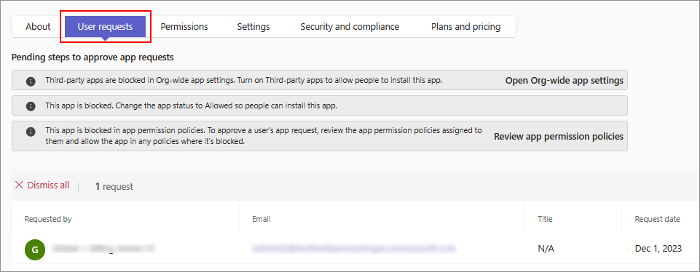
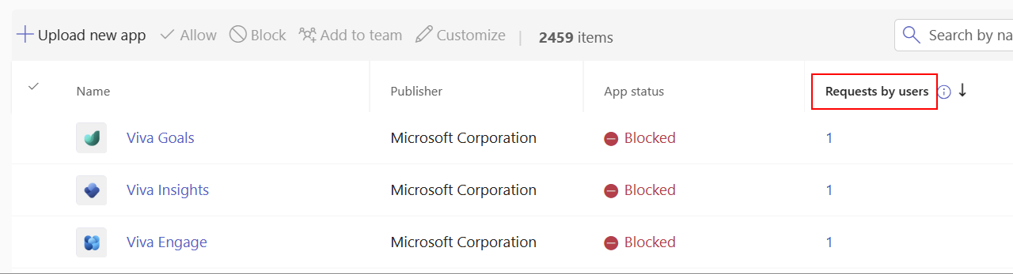
User requests for blocked apps
If you’ve blocked some apps, learn about user demand through user requests
Users request for admin approval from the store
Admins can provide custom instructions to follow company intake process
Admins can review pending requests, approve by making the app available, and publish

Slide 17
Users can use apps in their flow of work

Slide 18
Installing through ACM
For each app: install for Everyone / Some / No one
App appears in all supported surfaces
Easy for users to find and use apps without manually installing from the store
Yields higher usage than just allowing in store

Slide 19
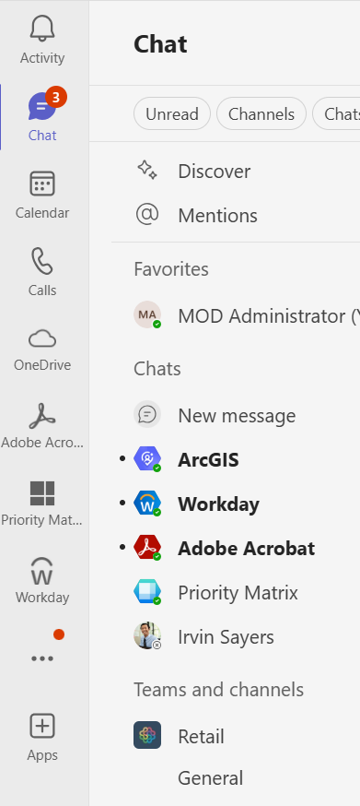
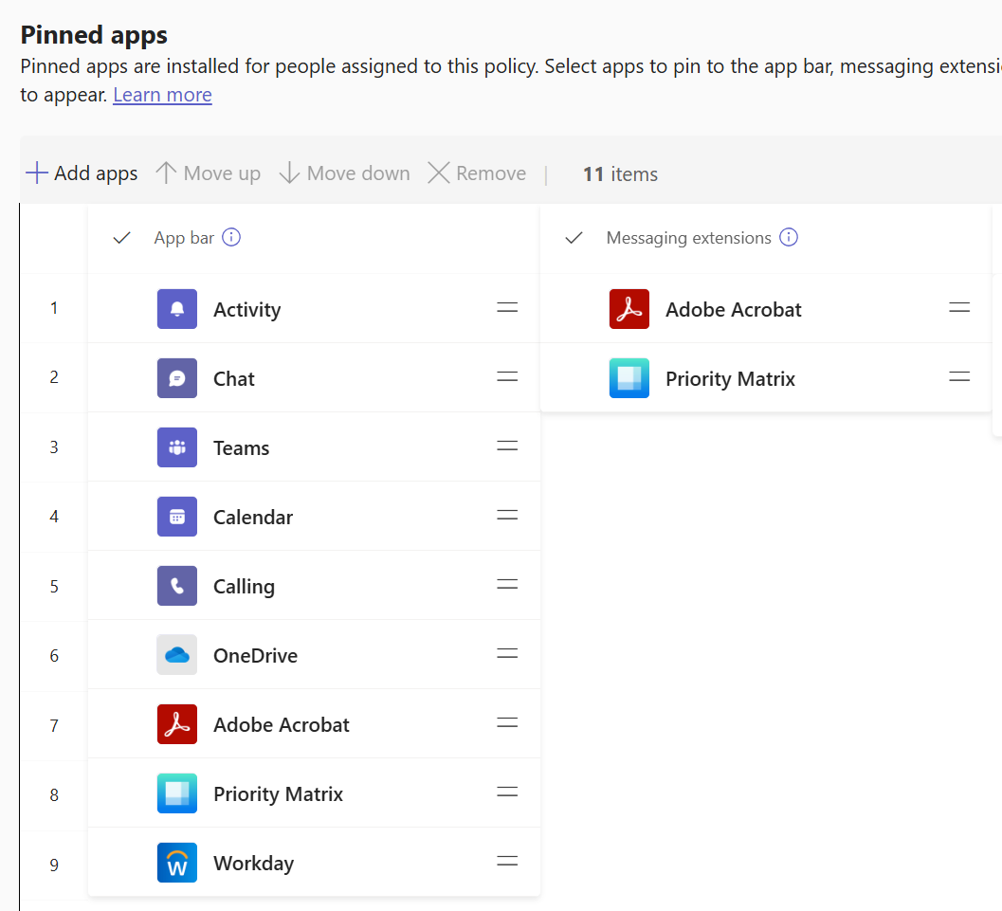
Pinning
Prepin apps on behalf of users to the app bar, message extensions, meetings with App setup policies
Pinned apps are the most prominent for user discovery
Yields higher usage than allowing / installing

Slide 20
Users find the apps are useful

Slide 21
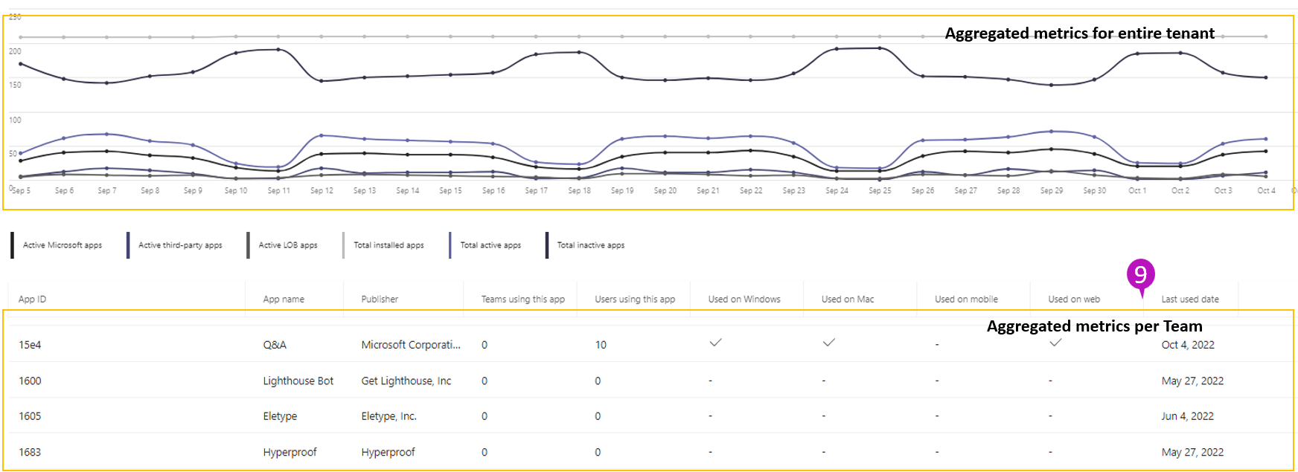
App usage report
Monitor the App usage report to understand user behavior
Consider: compare usage to the users you allowed/installed/pinned for
Review most- and least- used apps to determine maintenance needs
Share the data with your business to review employee need

Slide 22
Automate maintenance through scripting

Slide 23
PowerShell cmdlets
Automate maintenance for:
Bulk app management
Employee onboarding
Comparing before/after new configurations
Manage/apply governance across multiple tenants
Monitor changes to app catalog
Custom app publication
… what else?
Available cmdlets:
Get all apps: all apps in the catalog – availability and installs
Get / update single app: manage app availability and installs
Get / update org-wide settings: manage org-wide settings
Get / update pending custom app: manage custom app publication

Slide 24
Q&A
Notes:
Thank you.
<Speaker Guidance: Spend the last few minutes discussing or answering any questions they may have. If they have additional topics on their EBC agenda, make sure you connect with their account team to inform them which AI priorities and business outcomes resonated the most during this session. If you are in a 1:1 direct customer engagement, make sure you note what their priorities and questions were and work with the broader account teams and units to facilitate the proper hand-offs or next steps (i.e. get them into a session at the Innovation Hub/MTCs).>

Slide 25

Join us for Thursday’s Breakout session
Teams apps and agents management: new tools for IT admins
Thursday, 8 May 10:45AM to 11:45AM
at Premier Ballroom 319
Notes:
Thank you.
<Speaker Guidance: Spend the last few minutes discussing or answering any questions they may have. If they have additional topics on their EBC agenda, make sure you connect with their account team to inform them which AI priorities and business outcomes resonated the most during this session. If you are in a 1:1 direct customer engagement, make sure you note what their priorities and questions were and work with the broader account teams and units to facilitate the proper hand-offs or next steps (i.e. get them into a session at the Innovation Hub/MTCs).>

Slide 26
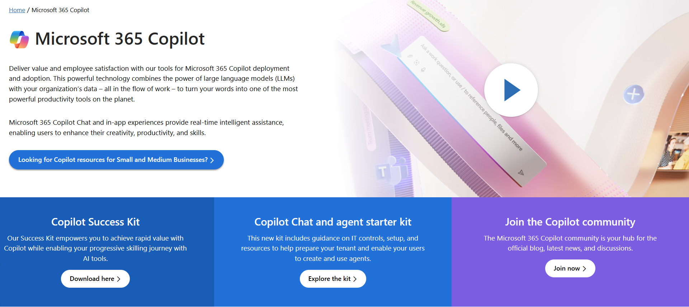
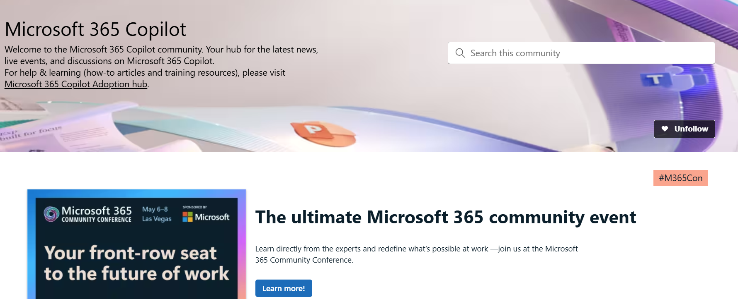
News & community content
Microsoft Community Learning aka.ms/Community/LearningChannel
Community led expert content on all your favorite Microsoft services.
Start your week with live news and event updates aka.ms/MondaysatMicrosoft
Watch live or on-demand & share our blog.
Notes:
To help you with adoption, the Copilot Readiness Hub is an open one stop shop for content, organized by role for your Copilot for Microsoft 365 journey.
You can use its recommendations to prepare and plan for your deployment, create a user experience strategy as I’ve presented today, and an adoption plan.
And as Copilot continues to evolve, keep coming back for new content that is published regularly.
You can also join the Copilot for Microsoft 365 community to get your questions answered and meet others who are leveraging Copilot for Microsoft 365 right now.

Slide 27
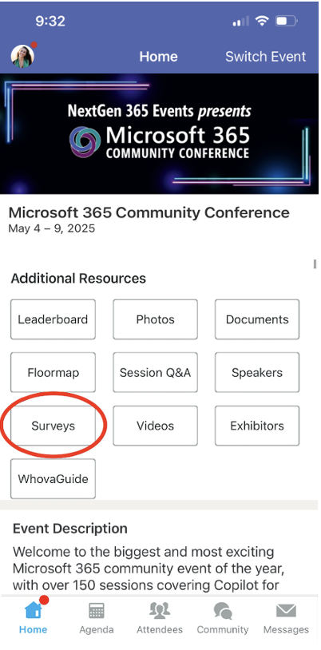
Session feedback surveys
We want to hear from YOU!
Share your feedback to make next years conference even better!
Here’s how –
Simply go to the Whova App on your smartphone.
Scroll down on the M365 Community Conference Homepage to ‘Additional Resources’ to click “Surveys’.
Click Session Feedback.
Scroll down to find this session title.
Complete the session feedback survey.
Finally, click ‘Submit’.
It’s just that easy!

Slide 28


