Slide 1
What’s new in SAM: Governing Copilot and Agent Permissions

Slide 2

Microsoft 365 Community Conference

Slide 3

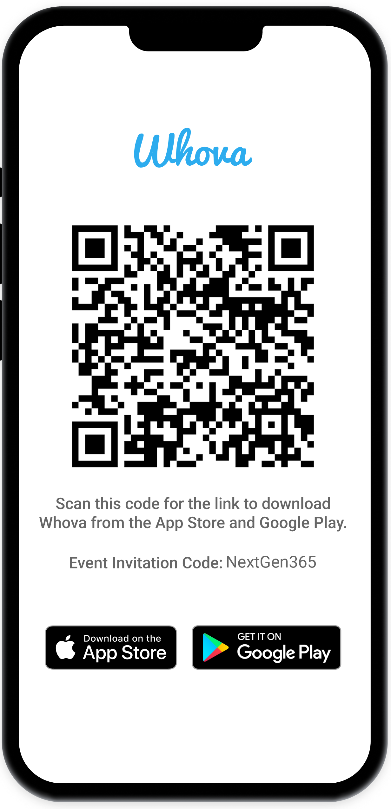
Join the event app to access:
The official event app for the
Microsoft 365 Community Conference
Event invitation code: NextGen2025
Event announcements
Personalized agenda, session details
Speaker & attendee profiles
Networking, meet-ups, messages
Event documents

Slide 4

Dave Minasyan
Principal Product Manager
SharePoint & OneDrive

Slide 5












SharePoint

Slide 6



Pillers of governance in SharePoint and OneDrive
Powered by SharePoint Advanced Management
Reduce Sprawl
Control Oversharing
Manage Lifecycle
Identify patterns and potential issues with reporting and receive actionable recommendations
View reports that identify sites that contain potentially overshared or sensitive content
Review and monitor changes you've made to a SharePoint site's properties
Run automated, rule-based policies to manage and retire inactive sites and their content
Enforce stringent access conditions when users access SharePoint sites with access policies
Use broad reports to review changes to SharePoint site properties
Create and leverage AI-powered policies and reports to govern content at scale
Prevent sites and content from being discovered with restricted content discovery control
Leverage policies to ensure proper content ownership and manage unused content across the organization
SharePoint Advanced Management is available as a standalone offer (3 PUPM) for customers without a Copilot license

Slide 7

SAM is included with Copilot

Slide 8
Reduce Sprawl
Control Oversharing
Manage Lifecycle
Content Management Assessment + AI Insights
Inactive Site policy
Agent Insights
Site Lifecycle Policies
Site Attestation Policy
Customizable Email
Target policy on specific sites
Site Ownership Policy
Delegated Restricted Content Discovery
Data Access Governance
Sites/files permissioned to “specific user”
Sites/files permissioned to “specific group”
Permission state report (Sites, ODBs, Files)
Everyone Except External Users insights
Site Access Review
Recent Admin Actions
Restricted Content Discovery (RCD)
Agents and Sites
Change history
Restricted access control (RAC)
Sites, OneDrive
Extend SharePoint Permission
with Sensitivity labels
Block download policies
Sites, Files, Teams
Enterprise application insights
Copilot integration in SharePoint Admin Center + SAM

Slide 9
Reduce Sprawl
Control Oversharing
Manage Lifecycle
Content Management Assessment + AI Insights
Inactive Site policy
Agent Insights
Site Lifecycle Policies
Site Attestation Policy
Customizable Email
Target policy on specific sites
Site Ownership Policy
Delegated Restricted Content Discovery
Data Access Governance
Sites/files permissioned to “specific user”
Sites/files permissioned to “specific group”
Permission state report (Sites, ODBs, Files)
Everyone Except External Users insights
Site Access Review
Recent Admin Actions
Restricted Content Discovery (RCD)
Agents and Sites
Change history
Restricted access control (RAC)
Sites, OneDrive
Extend SharePoint Permission
with Sensitivity labels
Block download policies
Sites, Files, Teams
Enterprise application insights
Copilot integration in SharePoint Admin Center + SAM

Slide 10
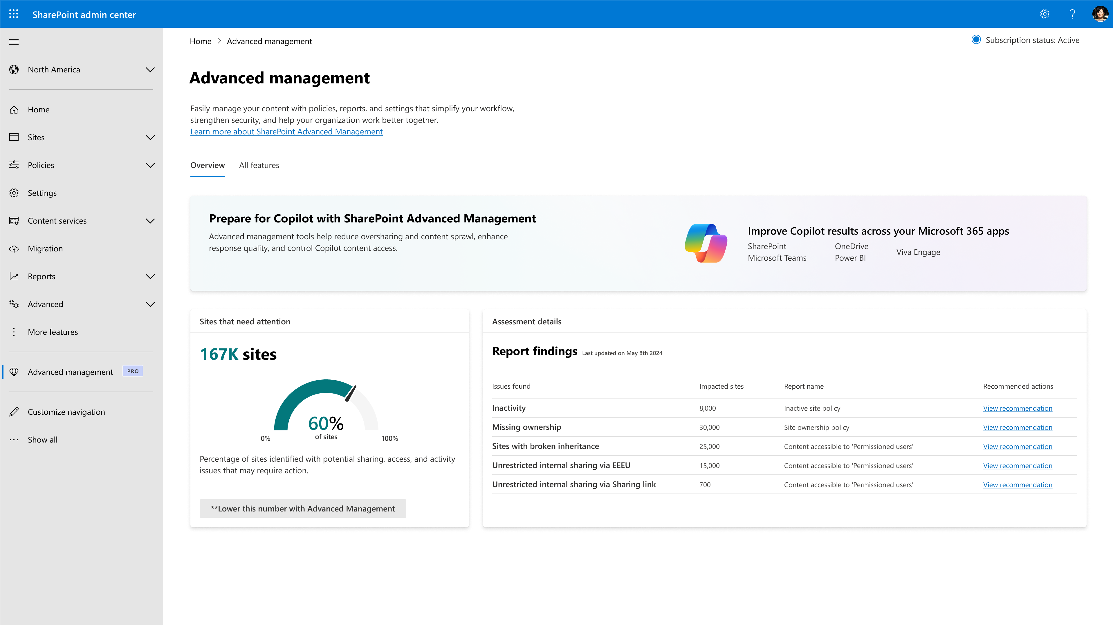
Content Management Assessment
Check your SharePoint and OneDrive state
What does it do?
A built-in tool to evaluate and improve content management within SharePoint.
Helps identify content risks, ensure compliance, and maintain data integrity.
Benefits:
Comprehensive Tenantwide Insights
Provides a detailed report on governance state.
Actionable Solutions
Links problem areas to SAM features for quick resolution.
Boosts Efficiency
Reduces manual assessments and expert involvement.
Helps Define Copilot Readiness
Establishes a clear governance roadmap for Copilot success.
Private Preview in H1

Slide 11
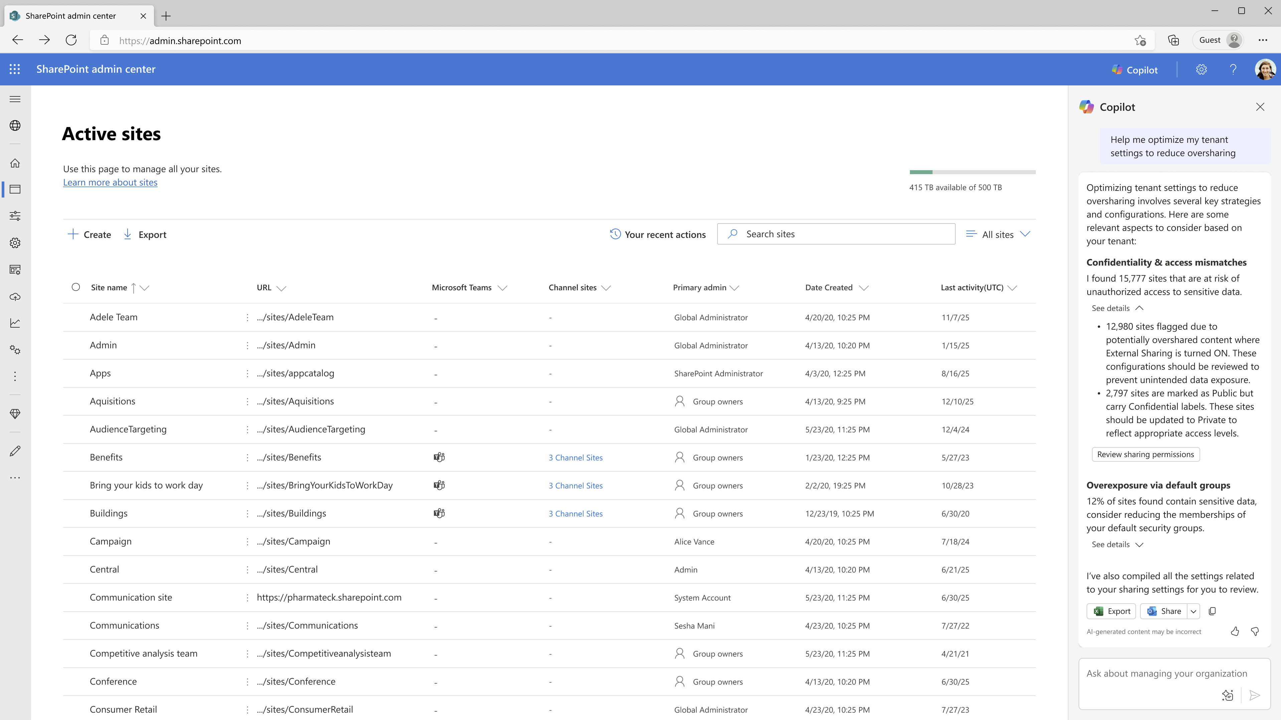
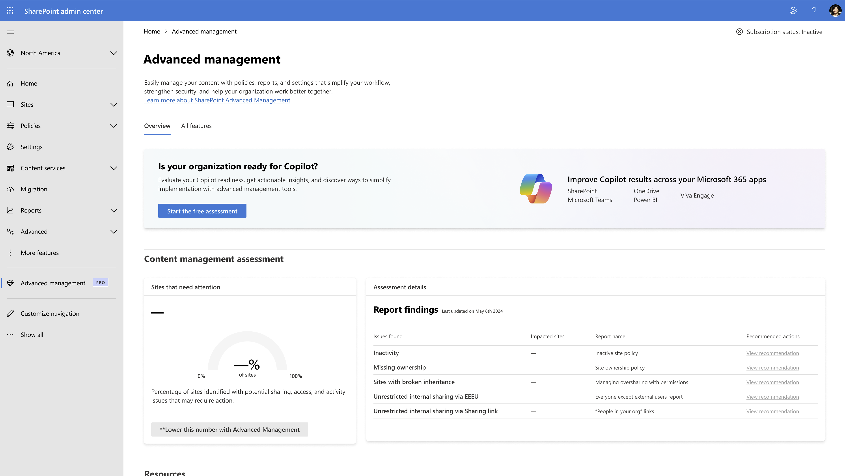
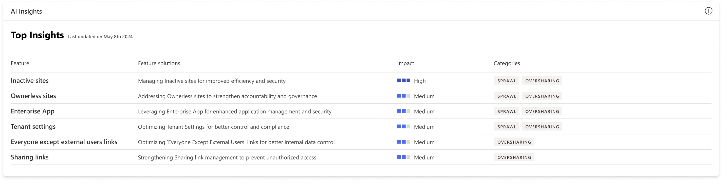

Slide 12
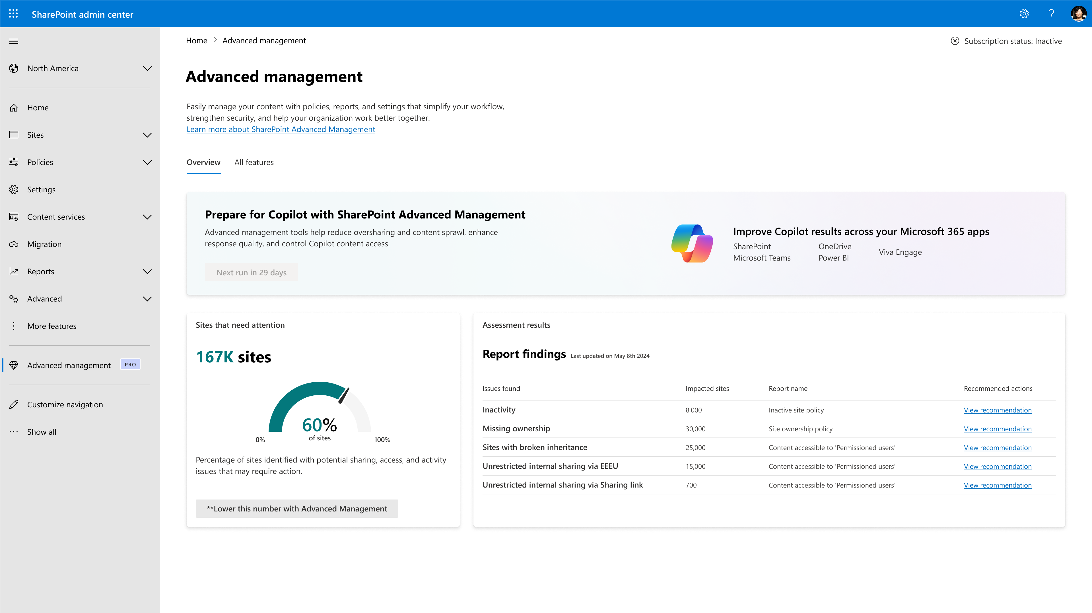

Slide 13
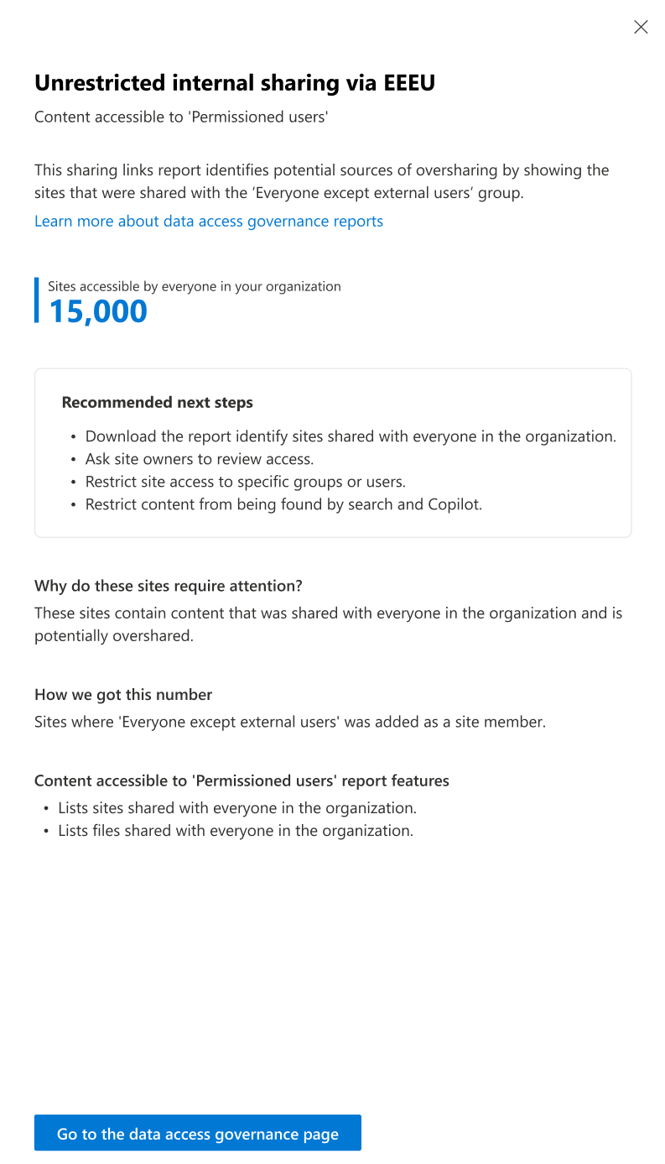

Slide 14
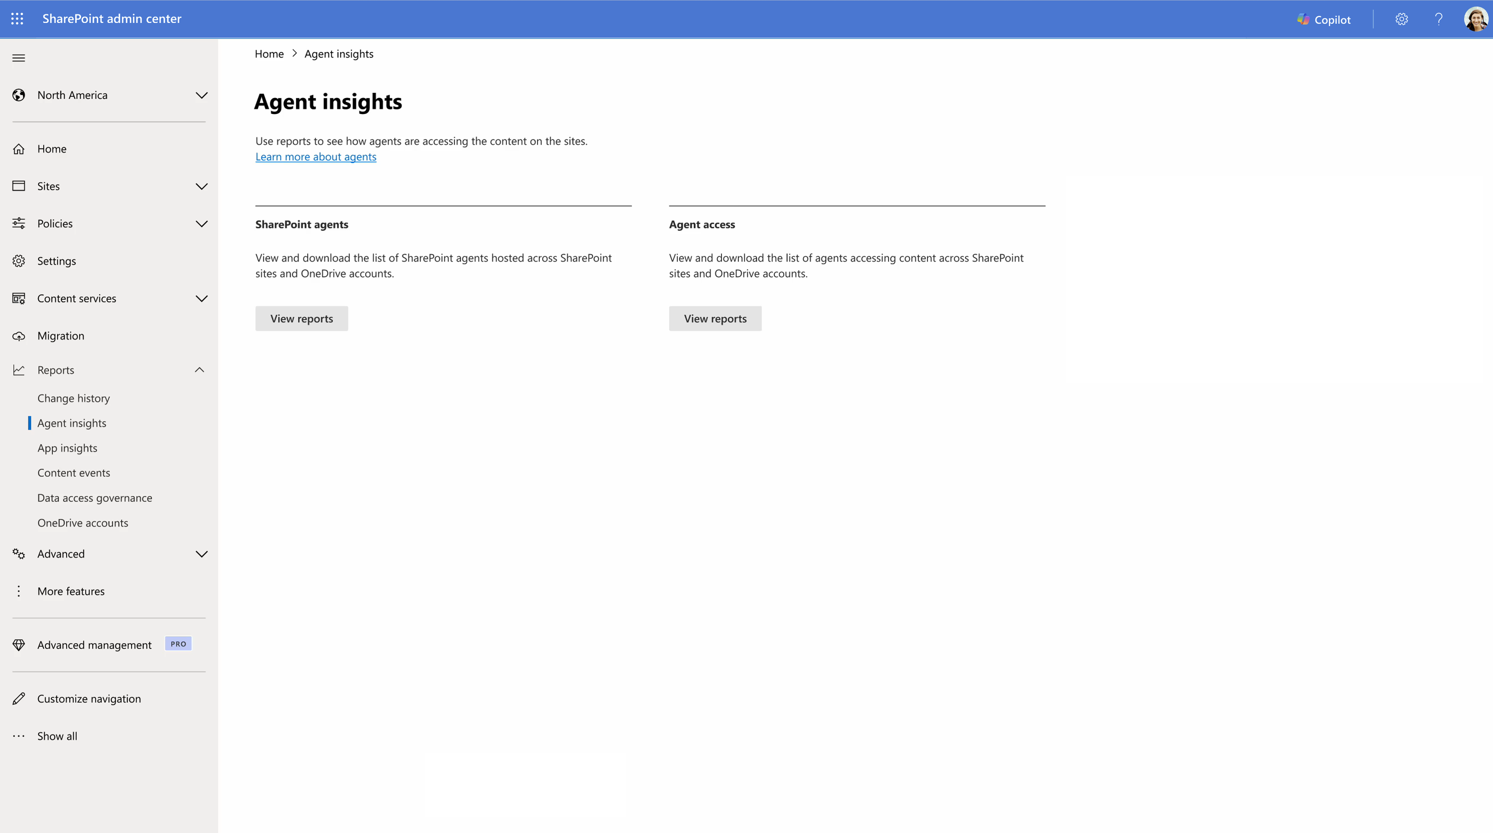
Agent Insights
Oversee and manage Agent access
What does it do?
Admins can run insights report to view how agents are interacting and accessing SharePoint sites and OneDrive accounts. Further, they can take governance actions to manage these agents.
Benefits:
1. To analyze the sites that host SharePoint agents.
2. To prevent oversharing, apply Restricted Site Access (RAC)
or Restricted Content Discovery (RCD) on these sites.
SharePoint Agent Insights rolling out to GA
Agent Access Insights in progress

Slide 15
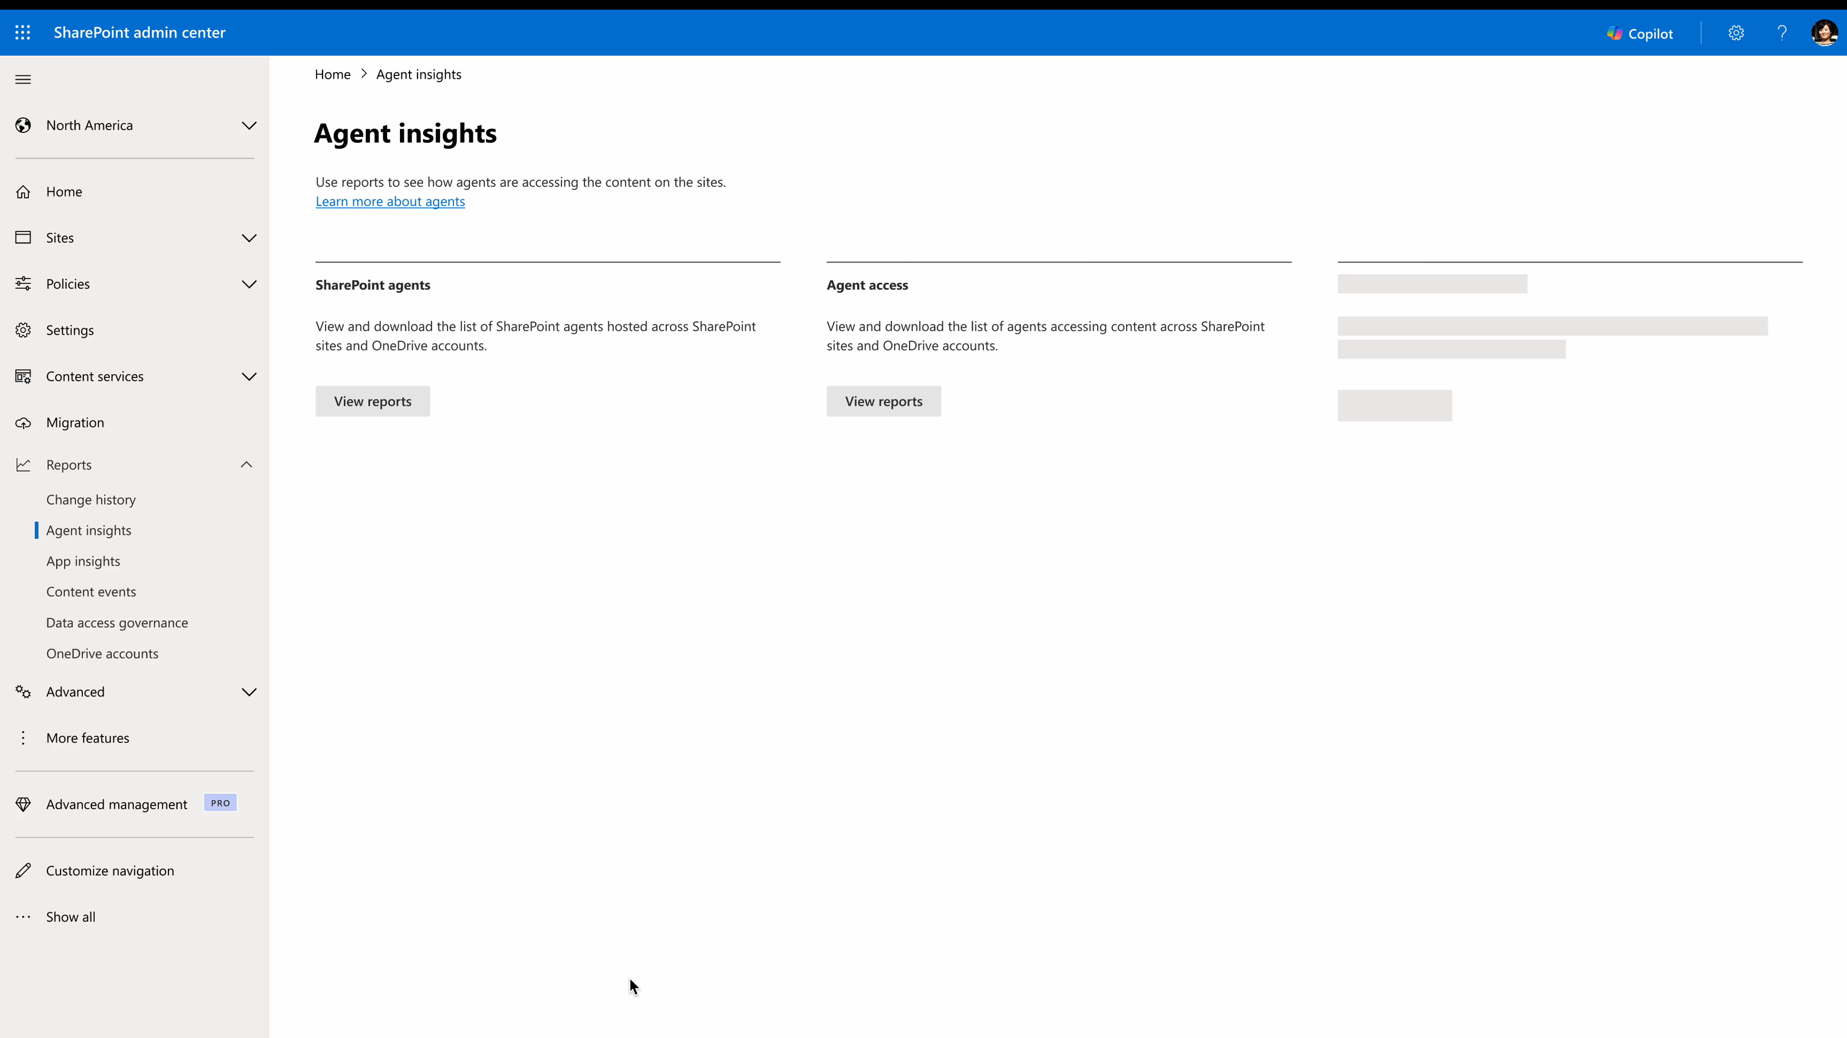

Slide 16
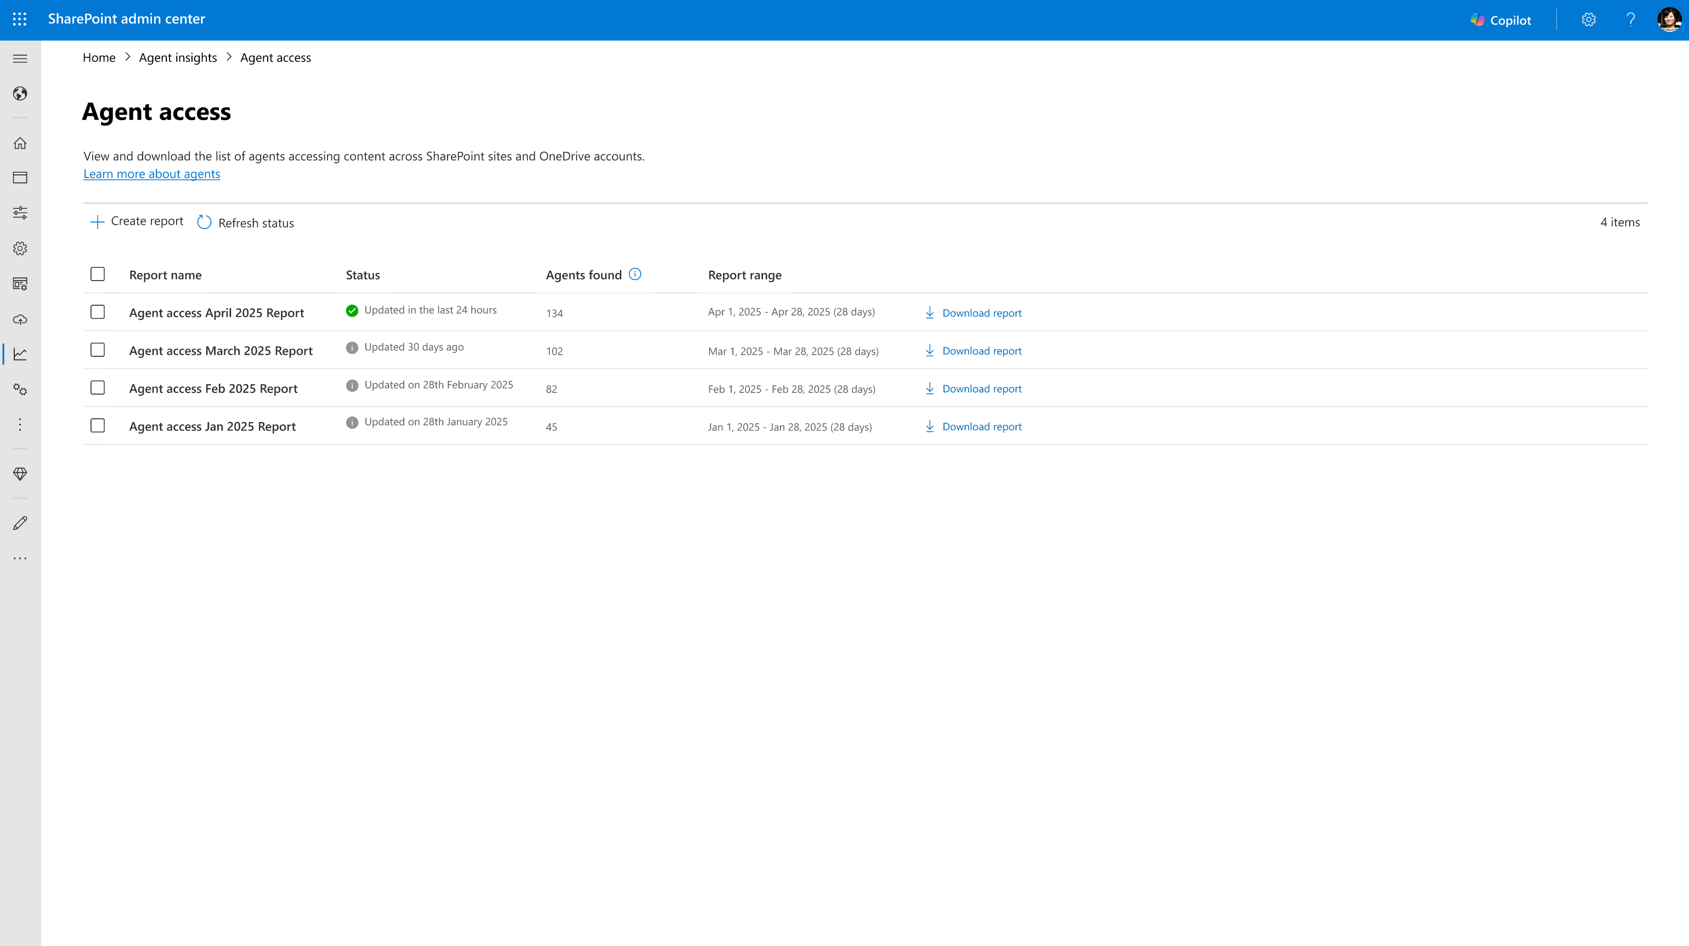

Slide 17
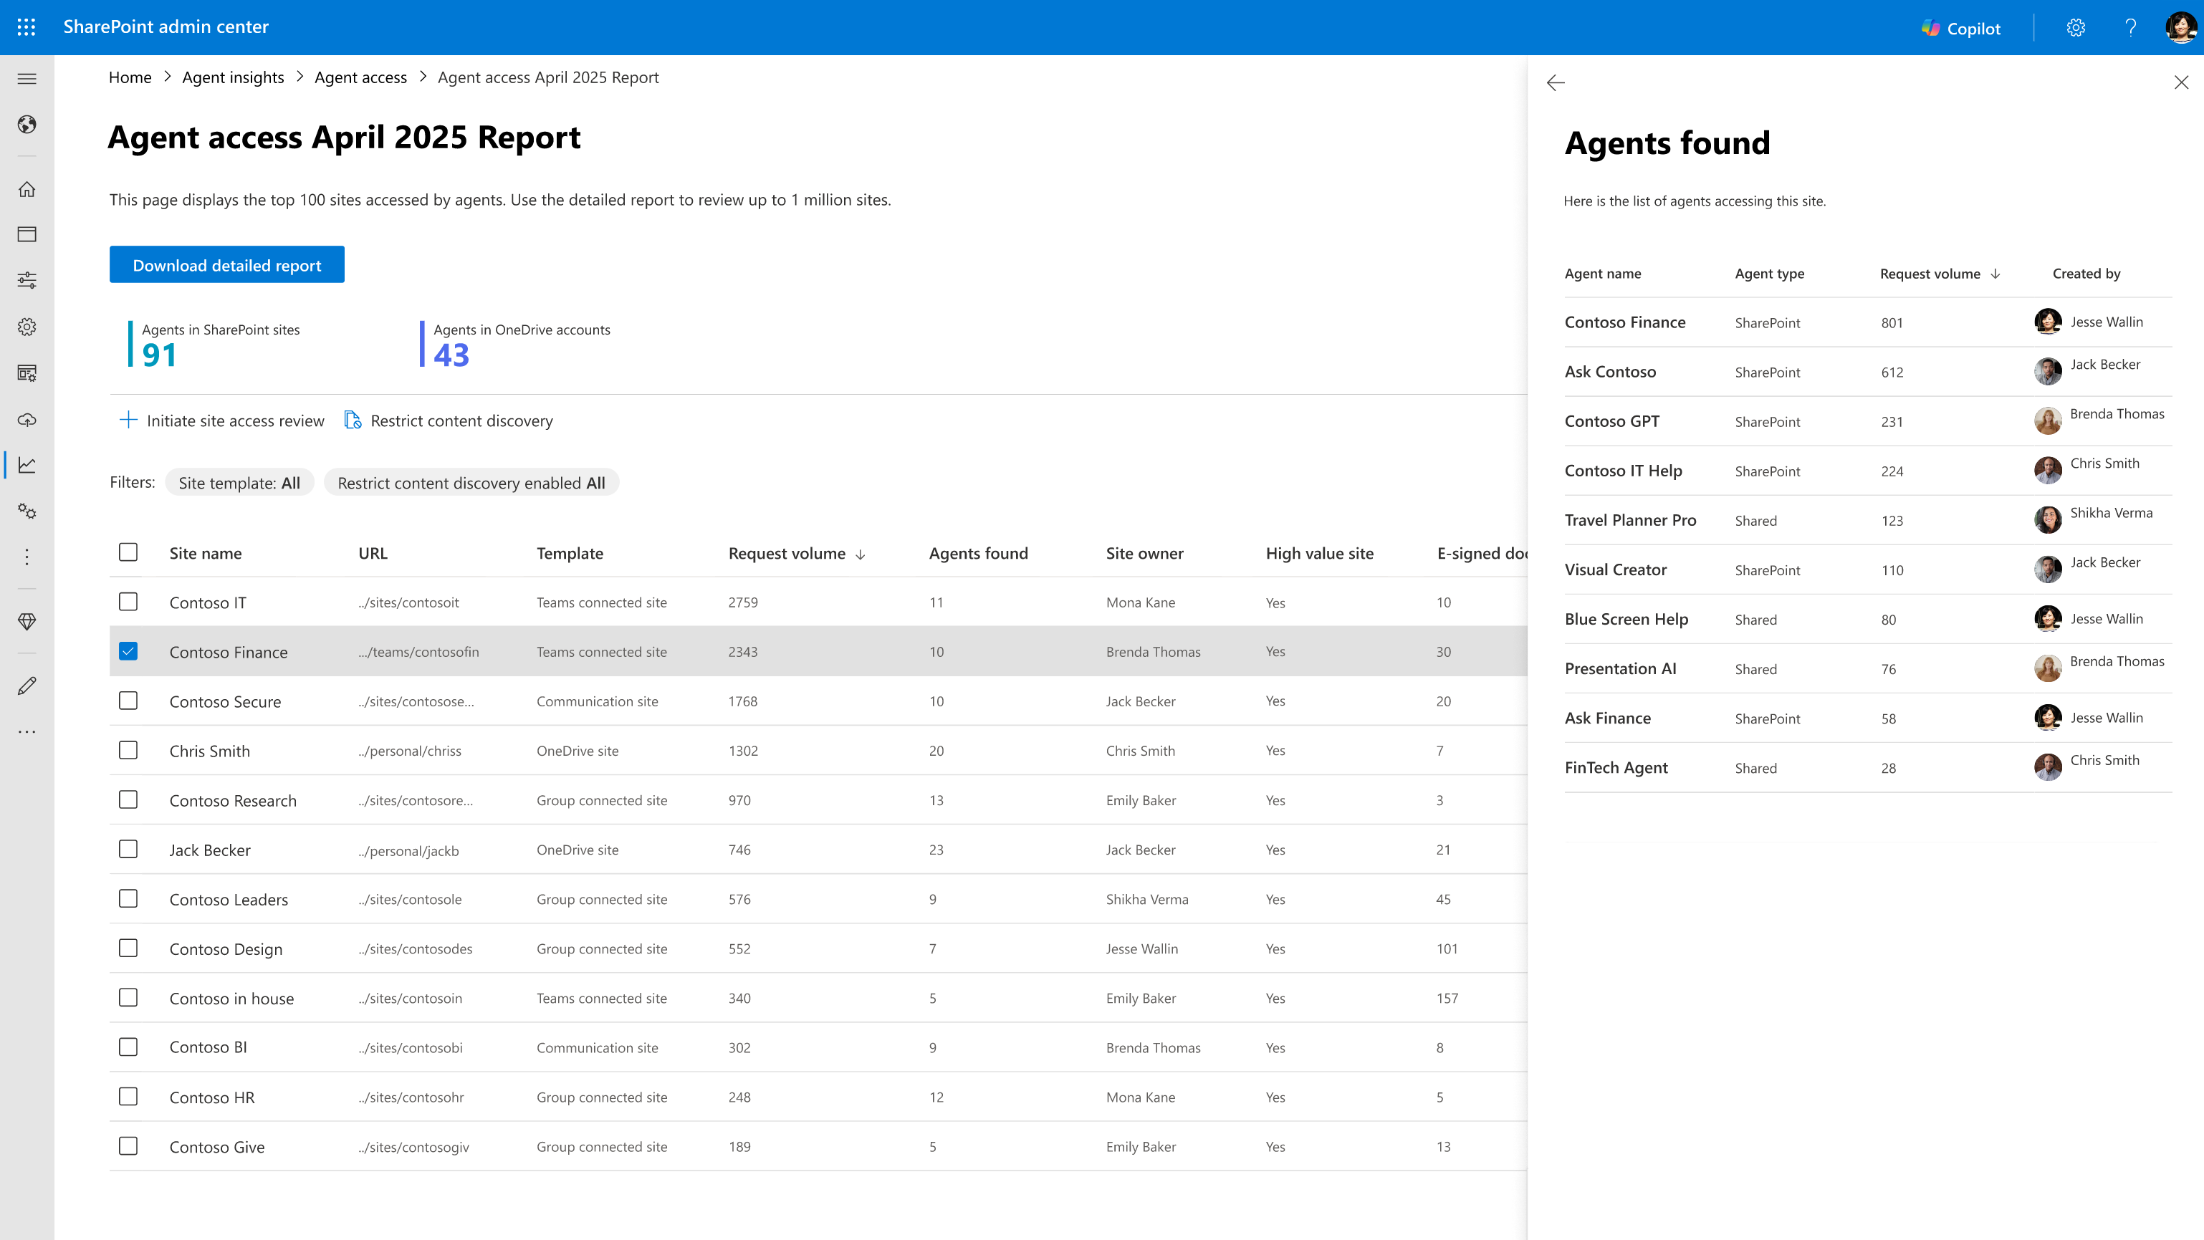

Slide 18
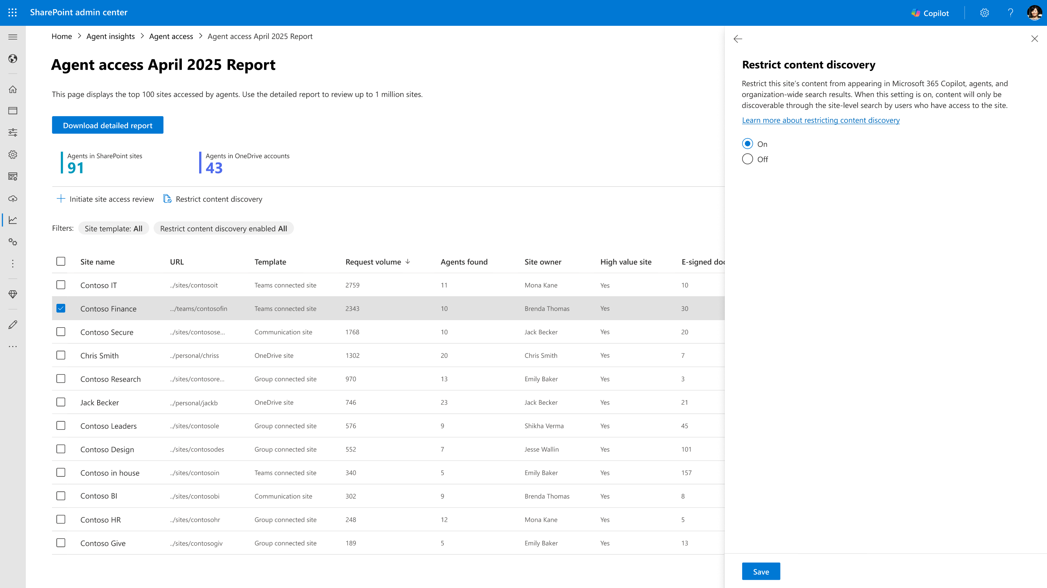

Slide 19
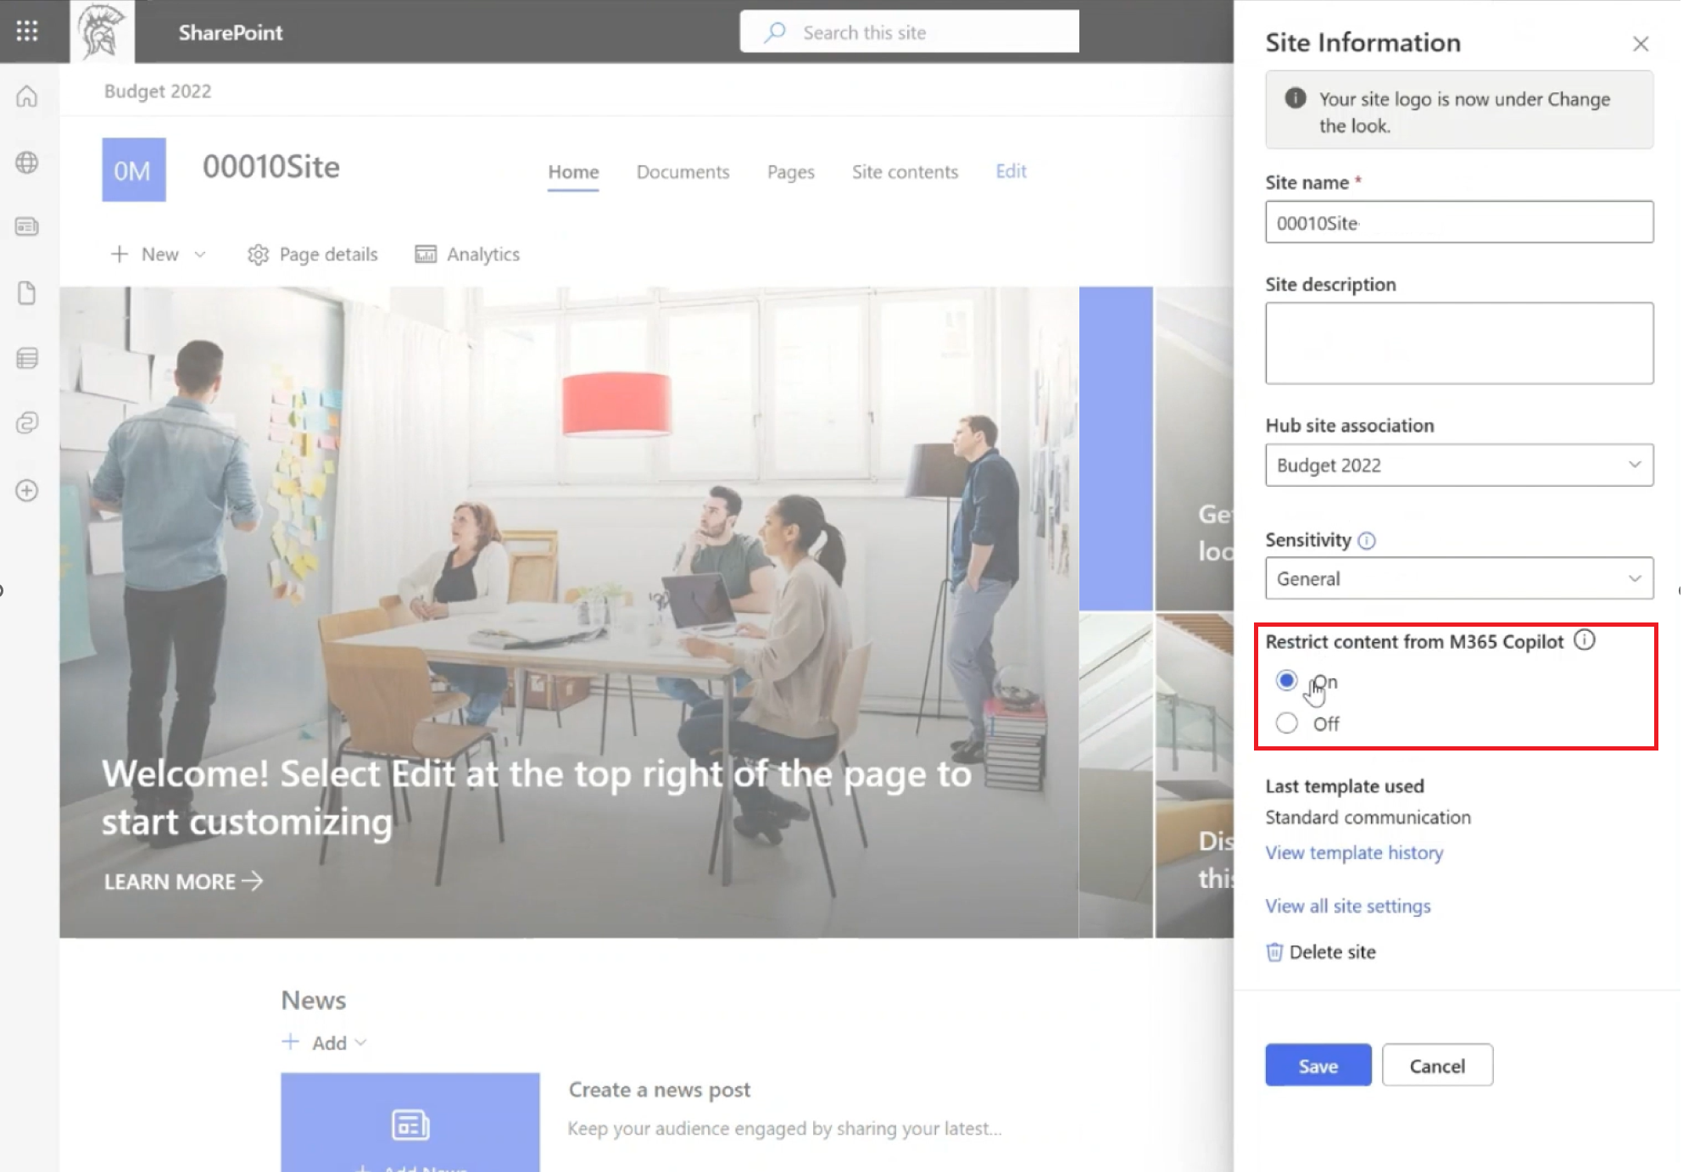
Restricted Content Discovery (RCD) + Delegation
Advanced discoverability control to exclude sites from Copilot and Agents
What does it do?
Limit SharePoint sites to be discoverable by Copilot and Agents.
What’s New
Restricted Content Discovery for SPO admins (v1).
SPO admins can delegate RCD management to Site Admins! *
V1 Generally available
*Enhancement is in Private Preview

Slide 20
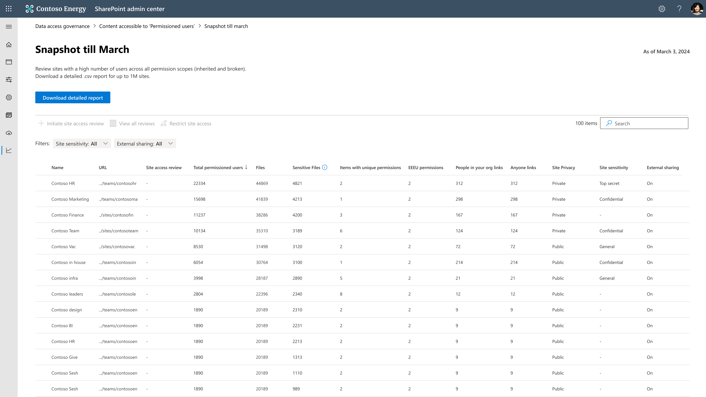
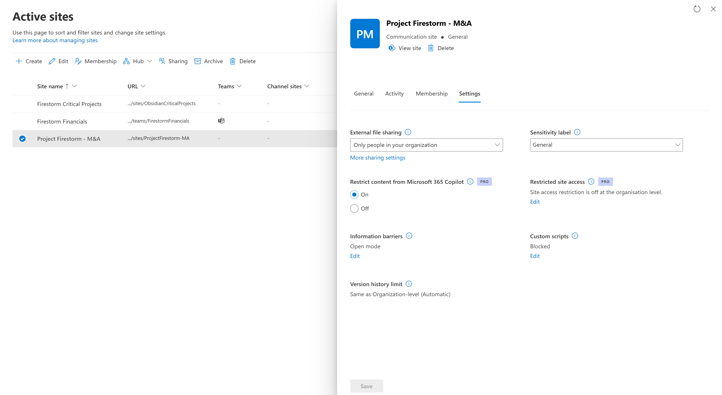
Notes:
Drill in slide. How many minutes?
Total permissioned users.

Slide 21
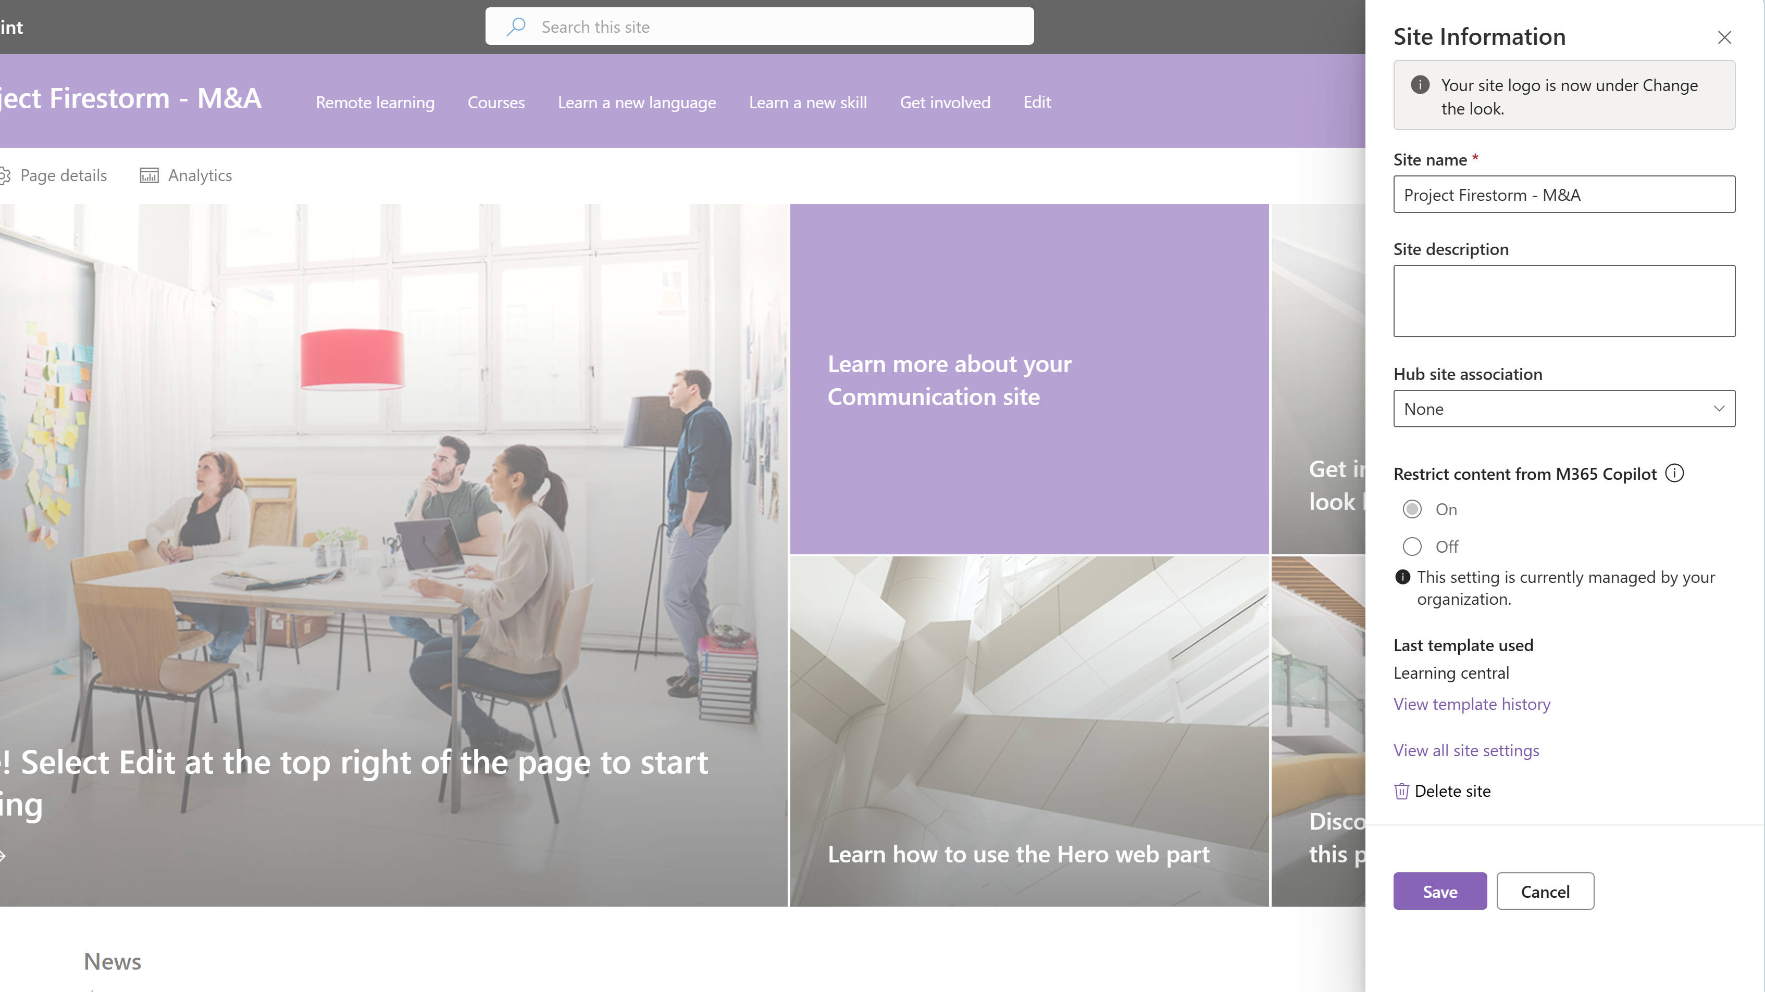
Notes:
RCD experience for Site admins and owners.
Drill in slide. How many minutes?
Total permissioned users.

Slide 22
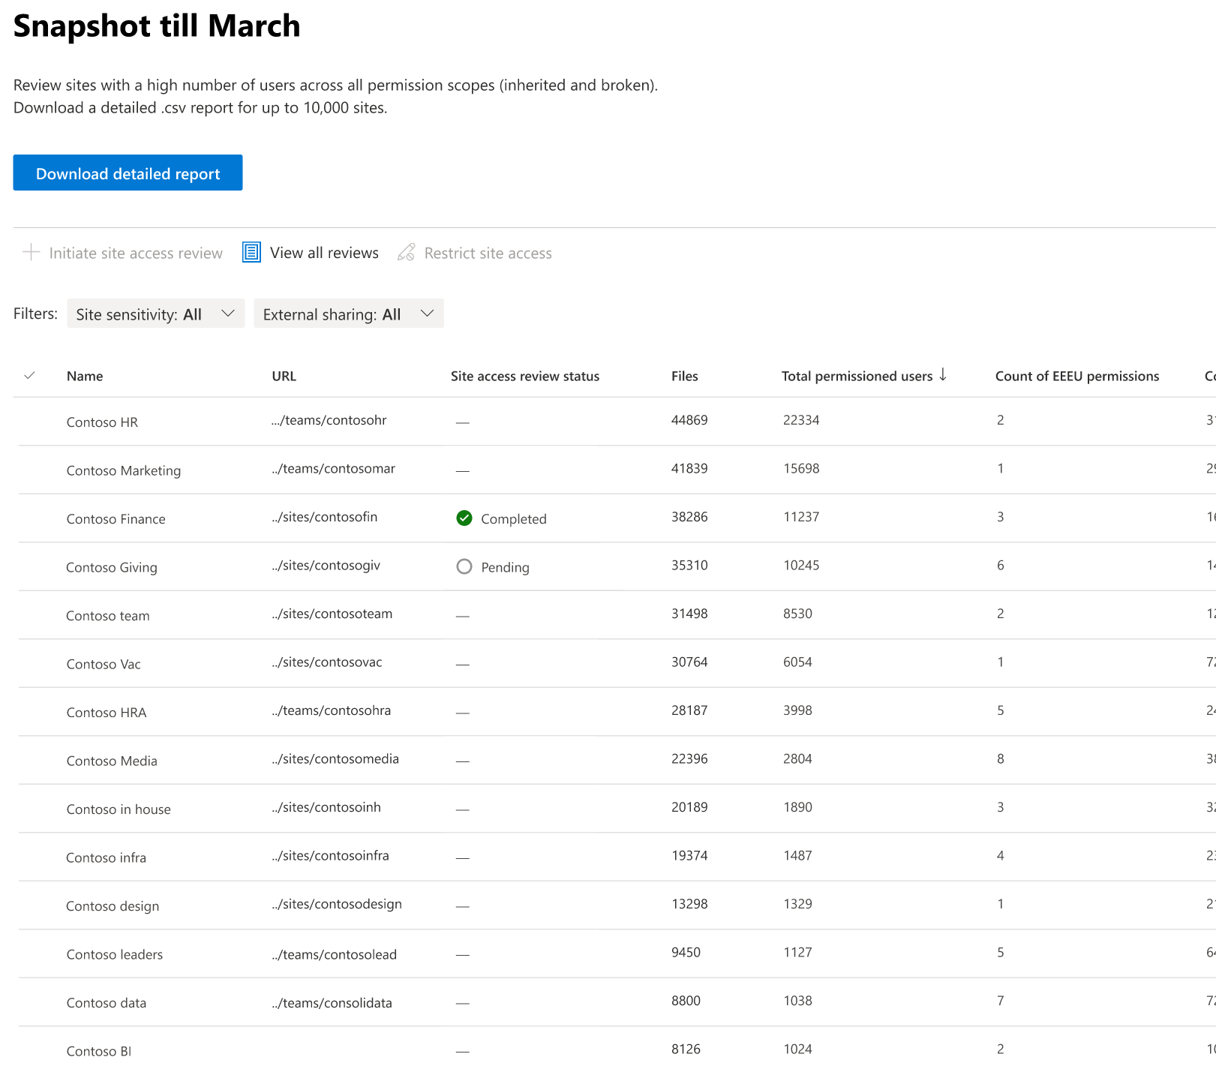
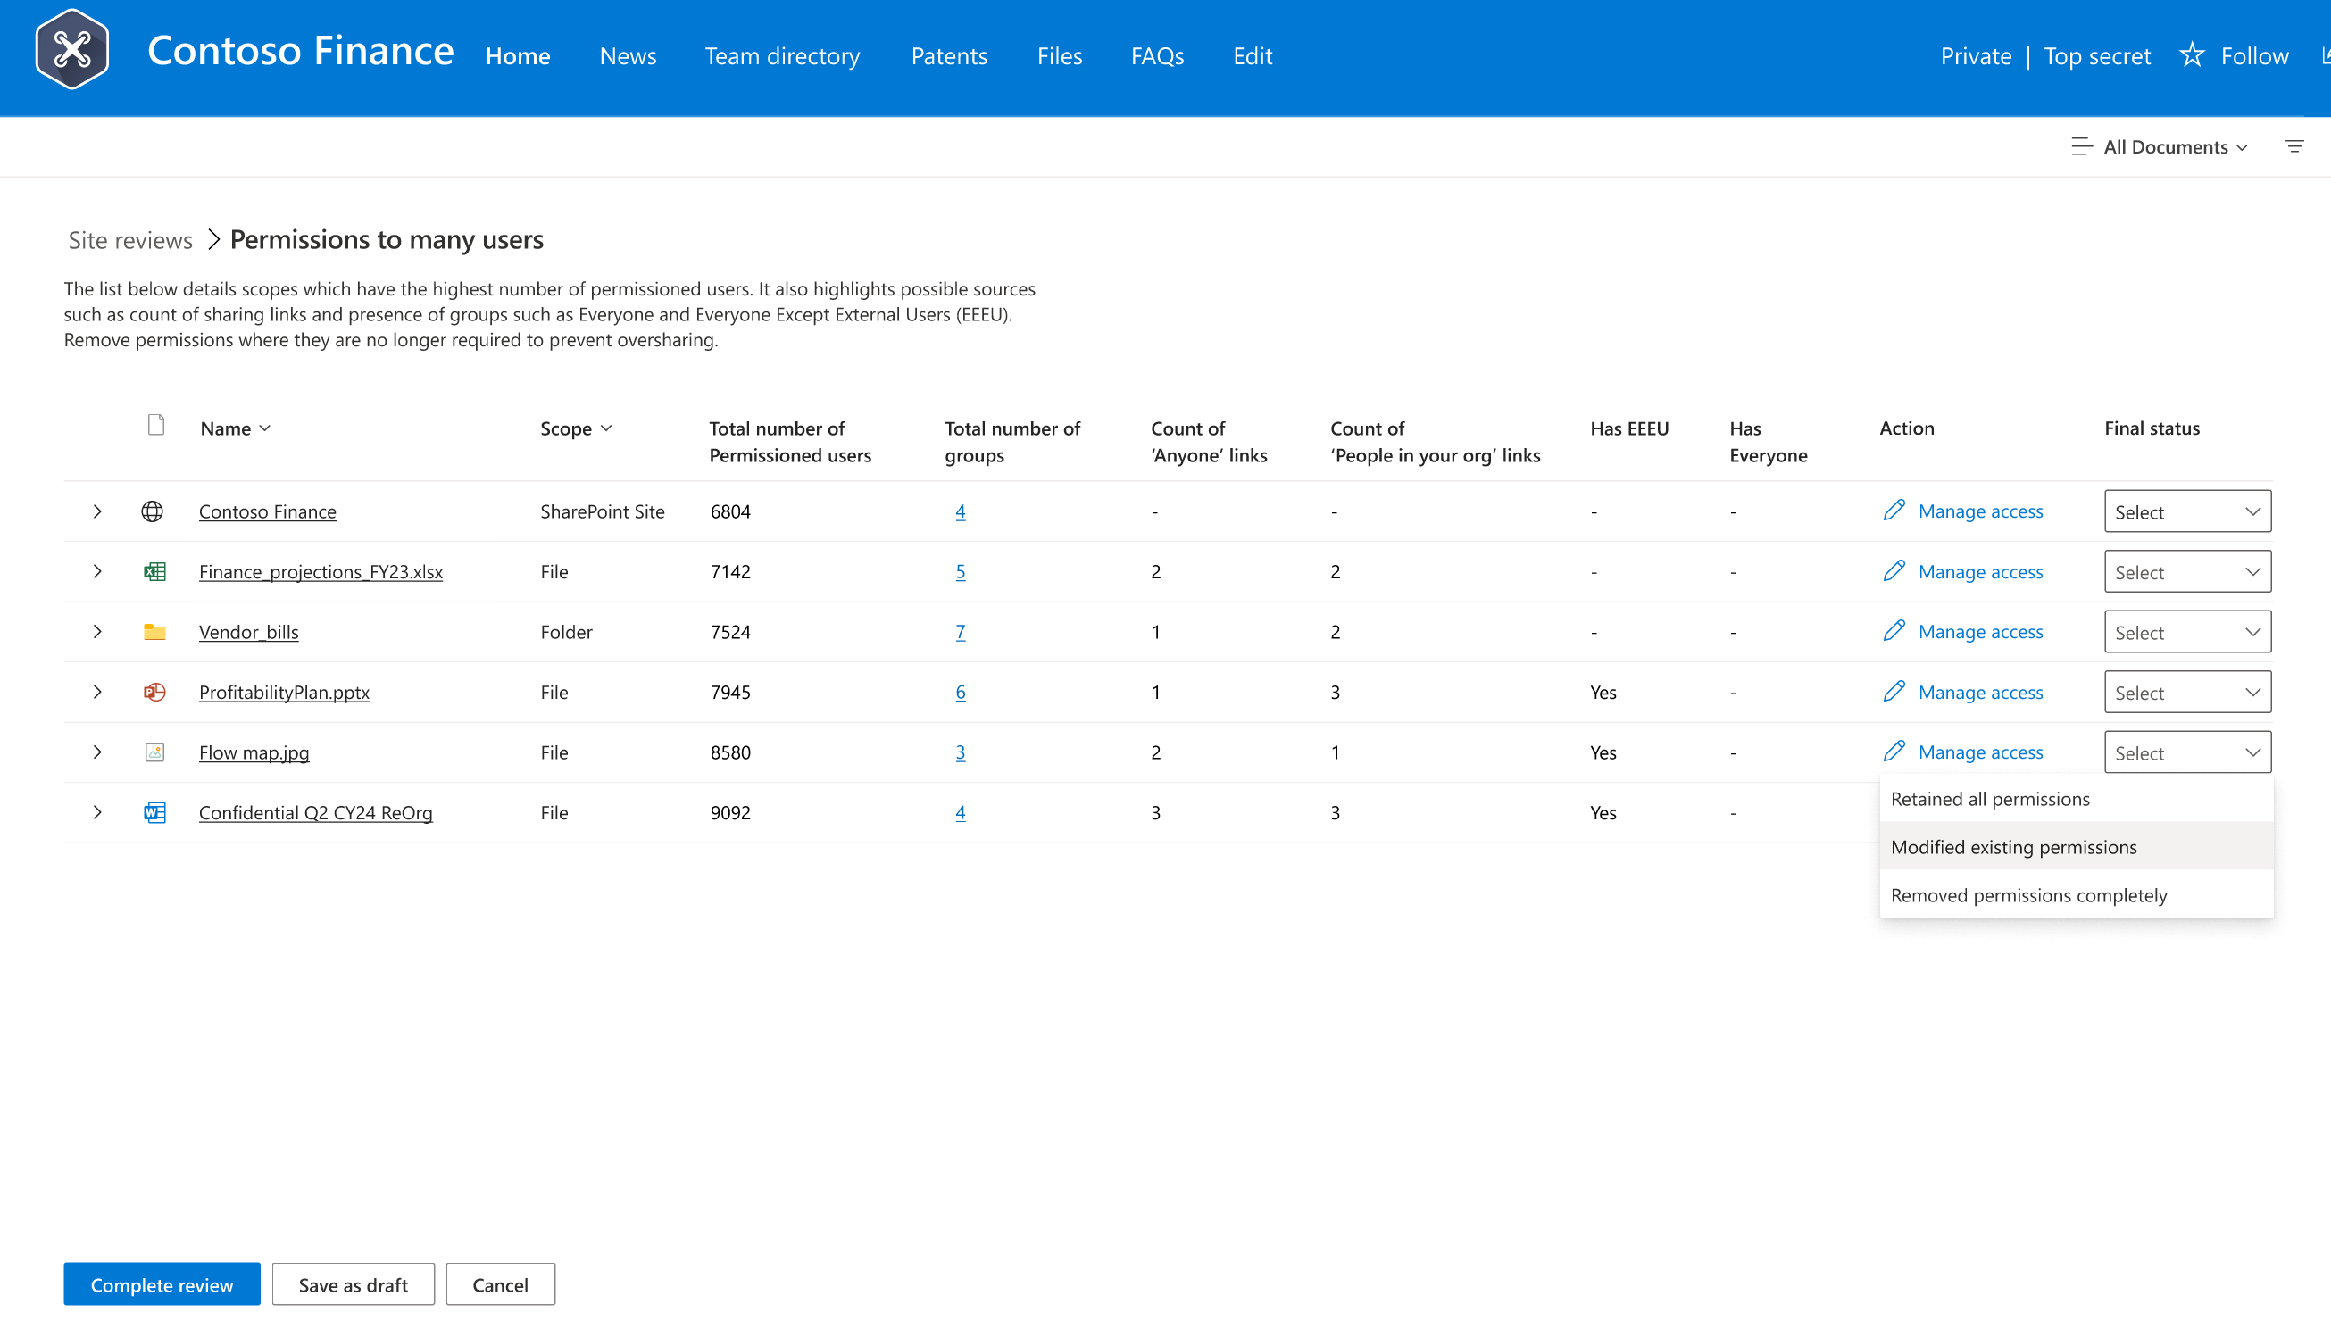
Oversharing control: Permission State Report with Actions
Gain Control Over Site Permissions and Overshared Content
What does it do?
Comprehensive permission report for entire tenant (SharePoint sites and OneDrives) – supports ~1M sites
Detect root causes of oversharing (broken inheritance, sharing links, EEEUs, site privacy and more)
Focus on critical permissions by user count and
large groups
Filter with sensitivity, privacy, external sharing
Downloadable report, with insights from AI analytics
Actions:
Site Access Review for site owners with file level details
Easily discover files exposed via EEEU, large groups, sharing links and rectify permissions accordingly
Broken inheritance, Sharing links, EEEU domain group
PowerShell Generally available
UX Coming to Private Preview in CYH10

Slide 23
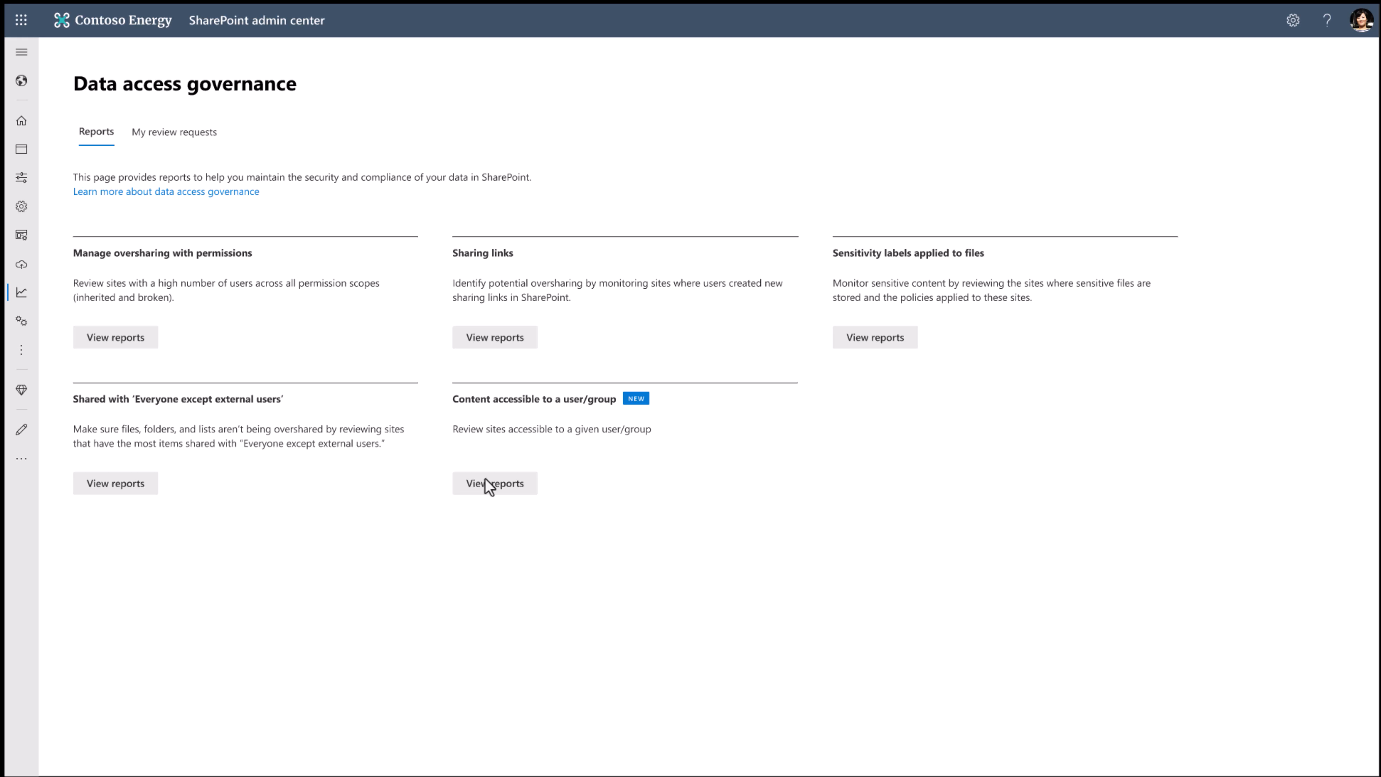

Slide 24
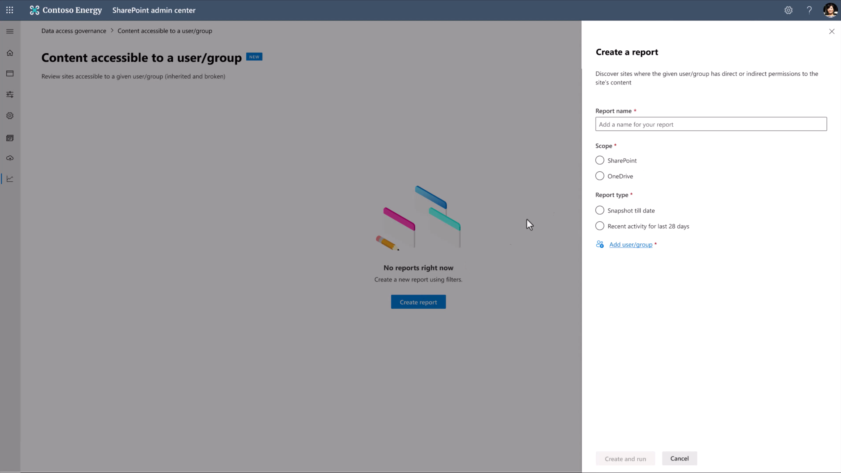

Slide 25
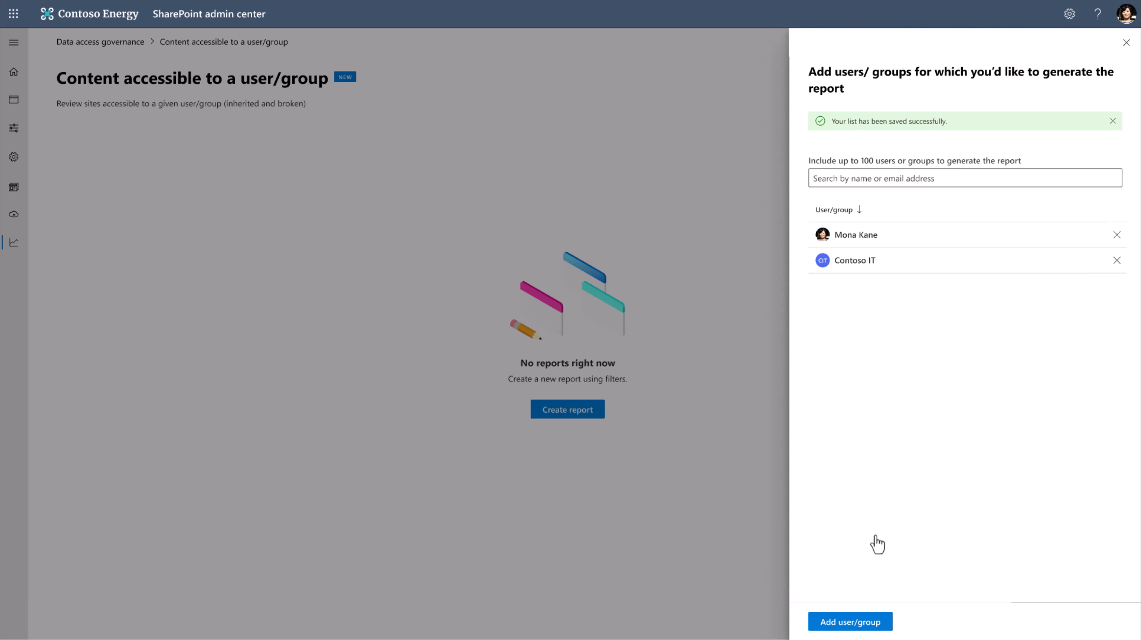

Slide 26
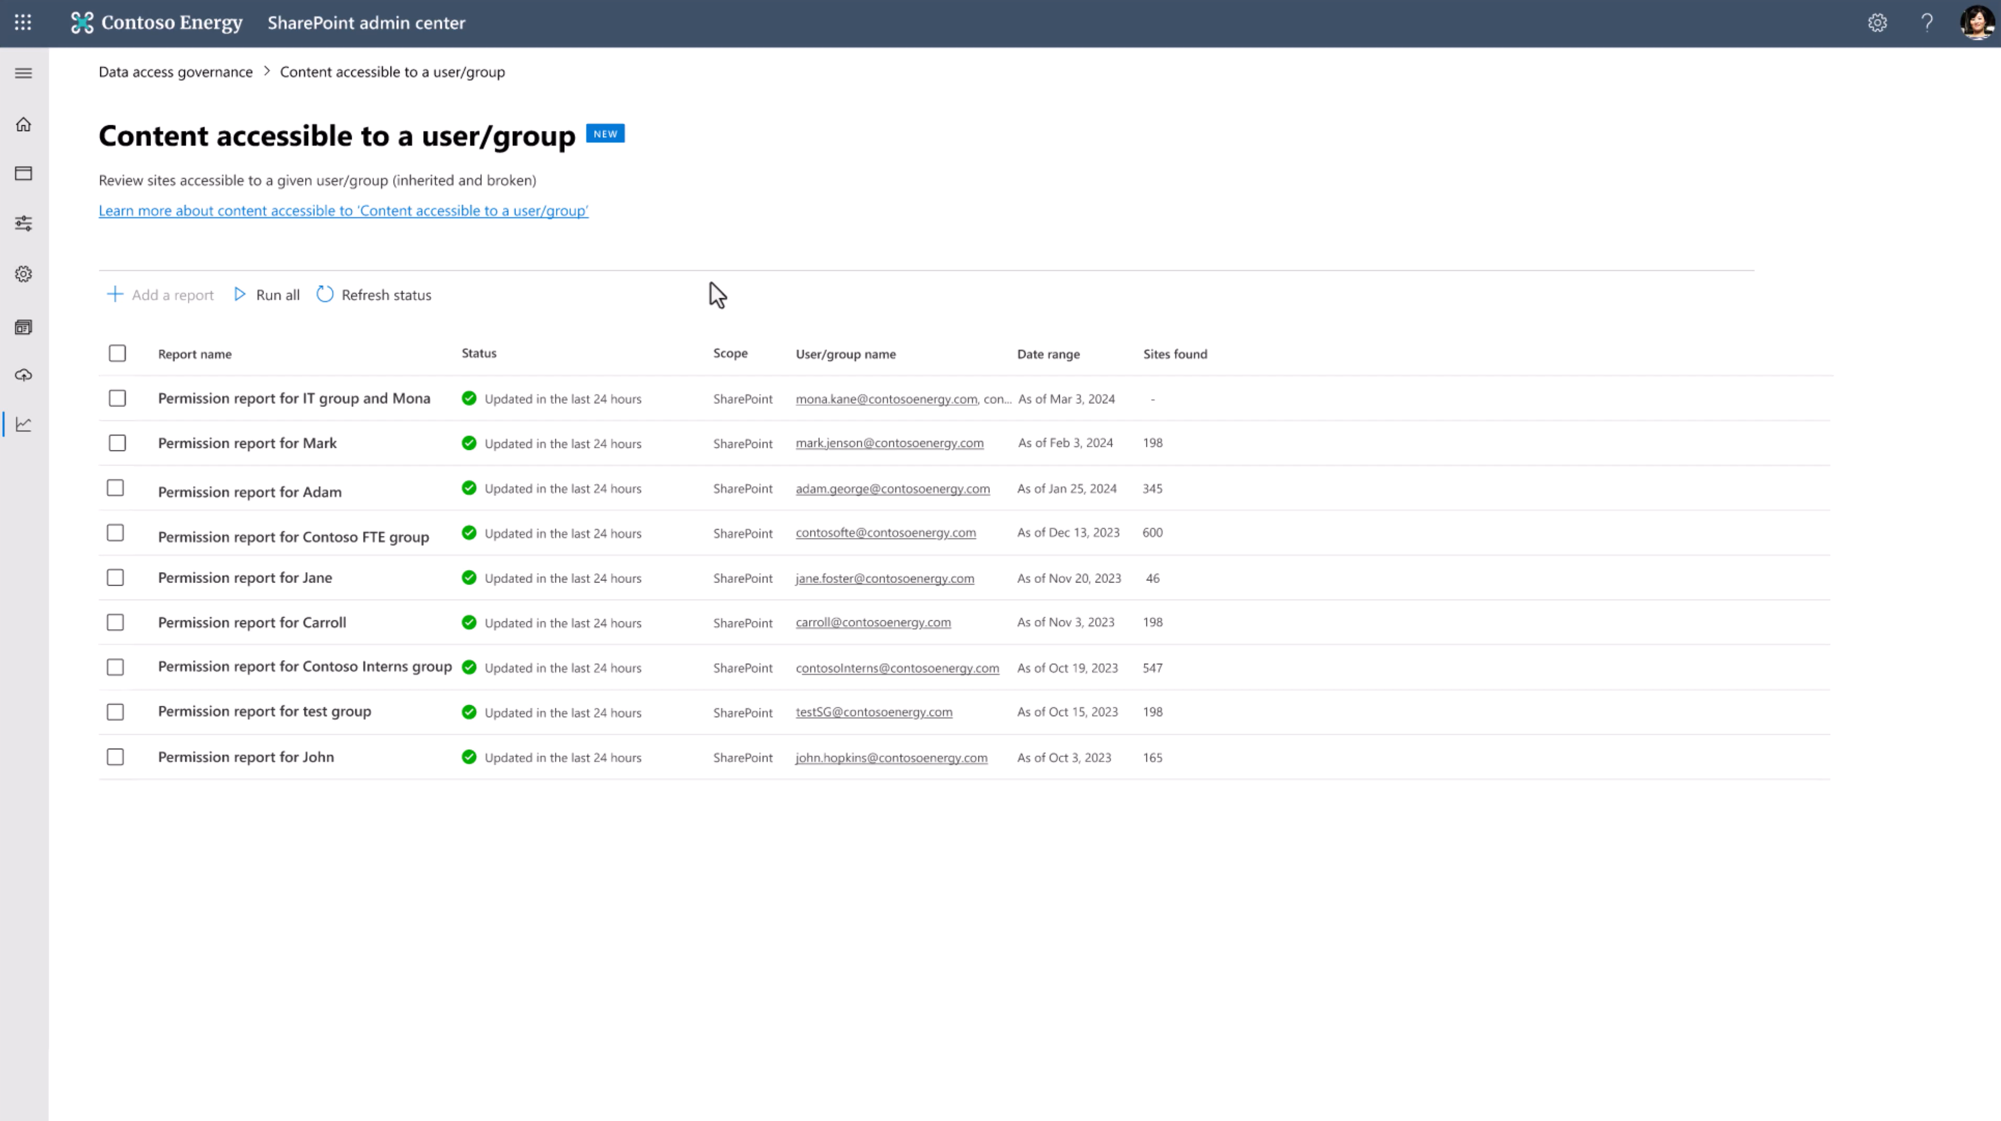

Slide 27
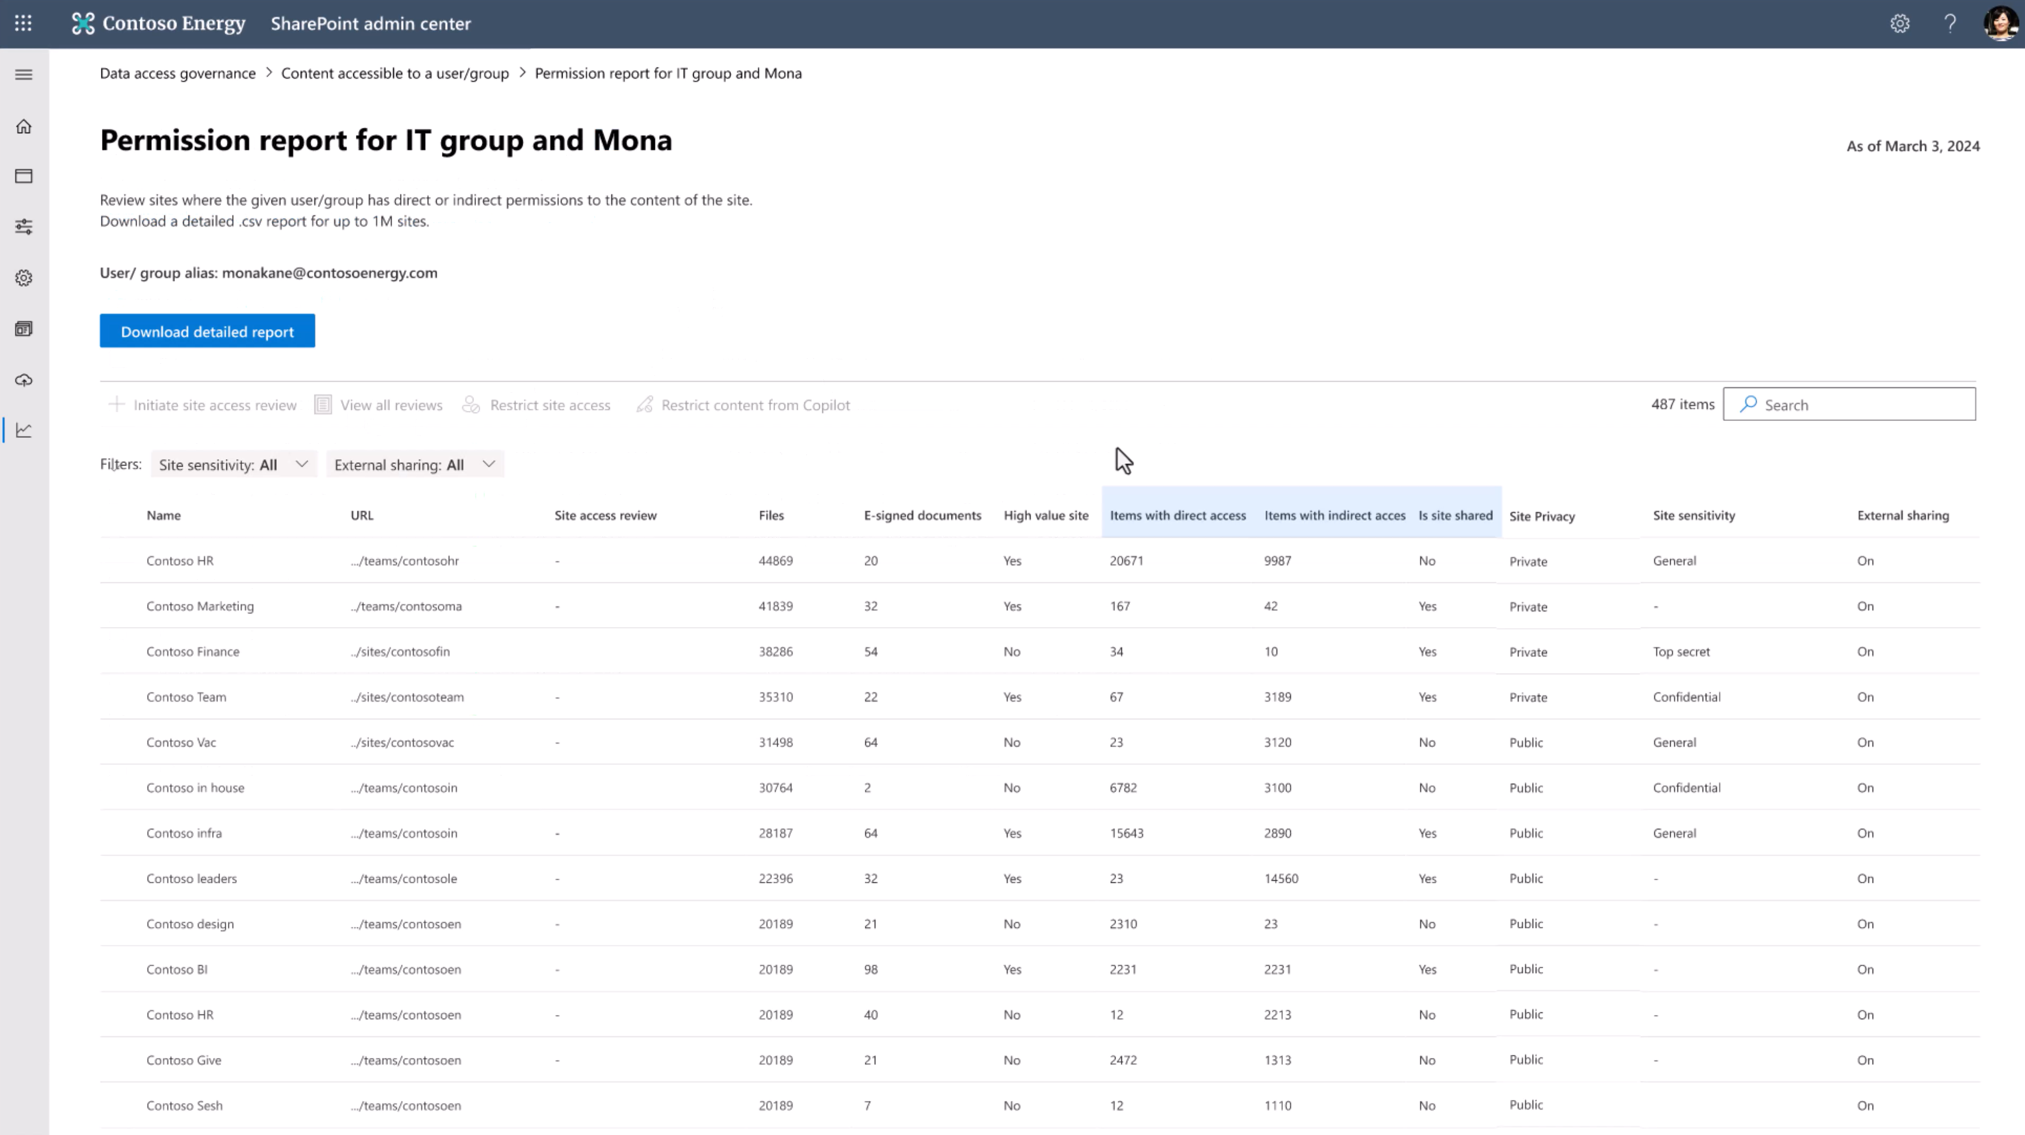
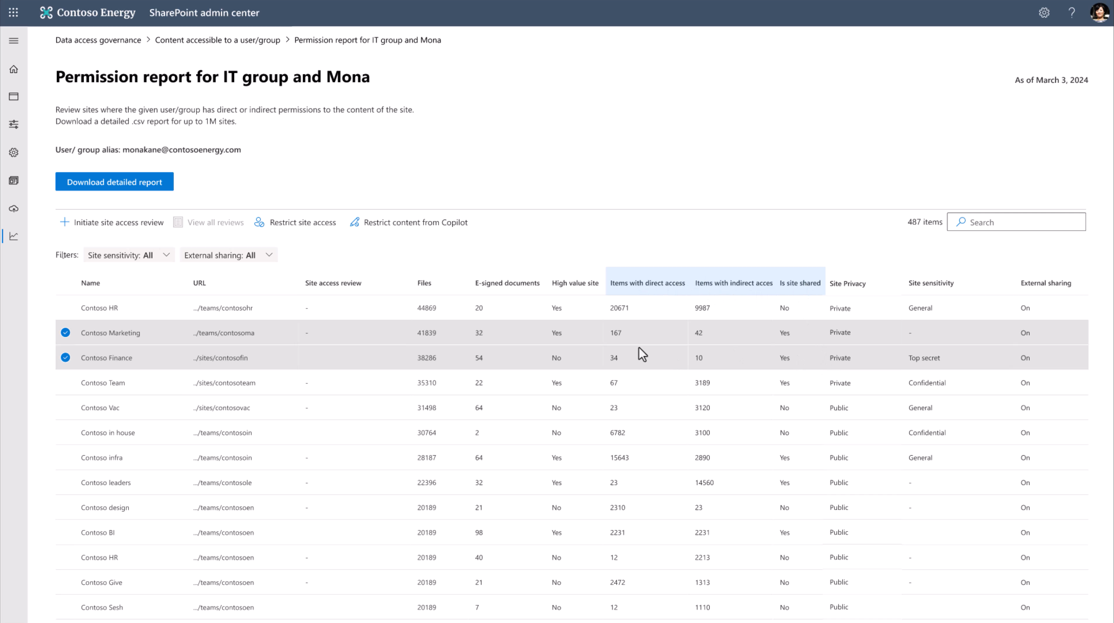

Slide 29
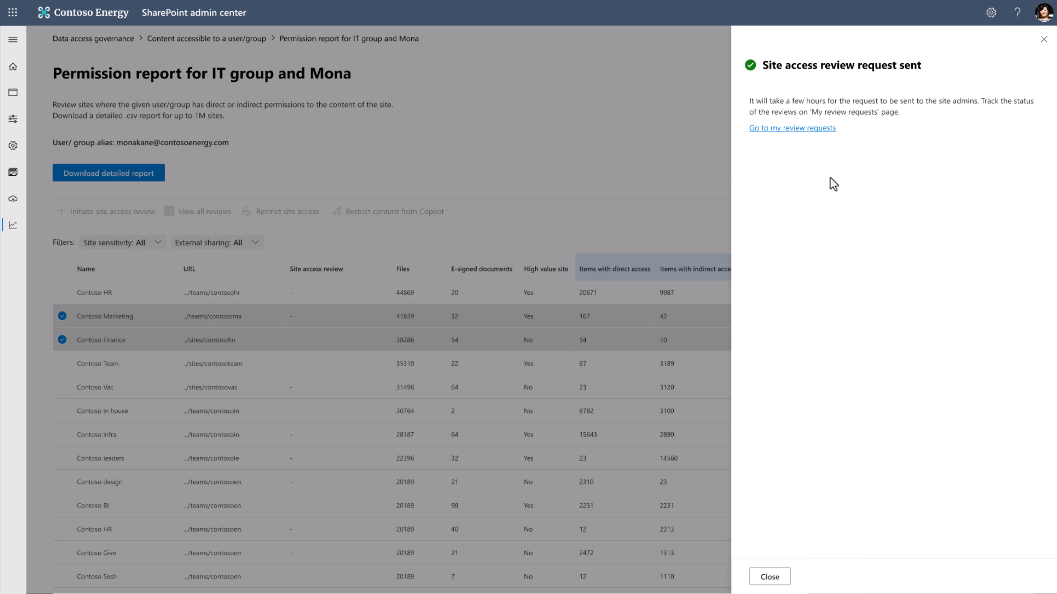

Slide 30
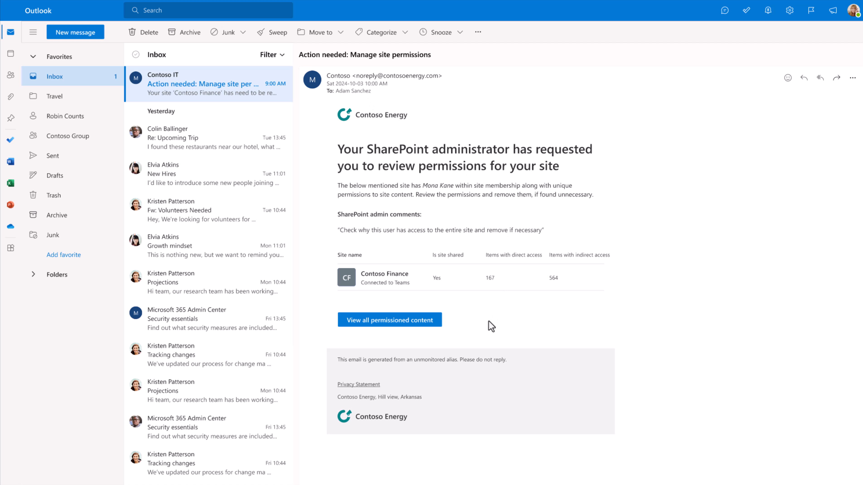

Slide 31
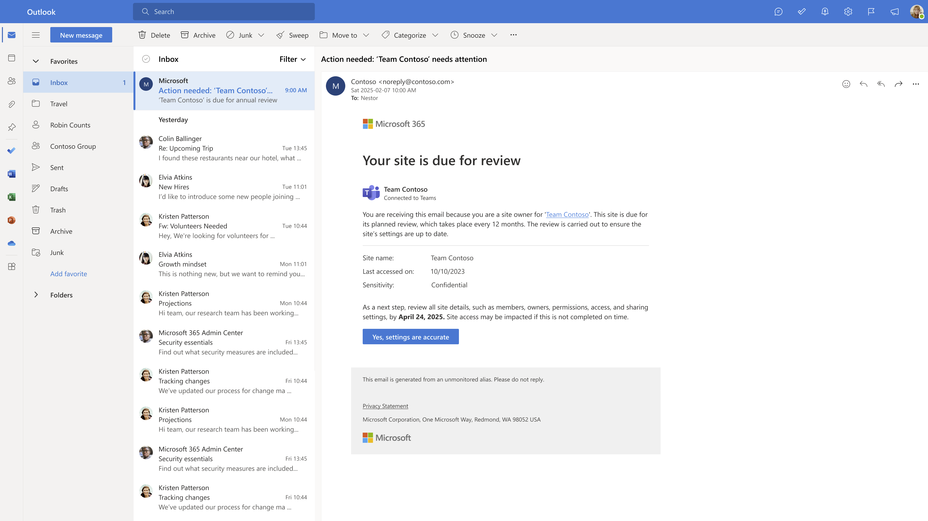
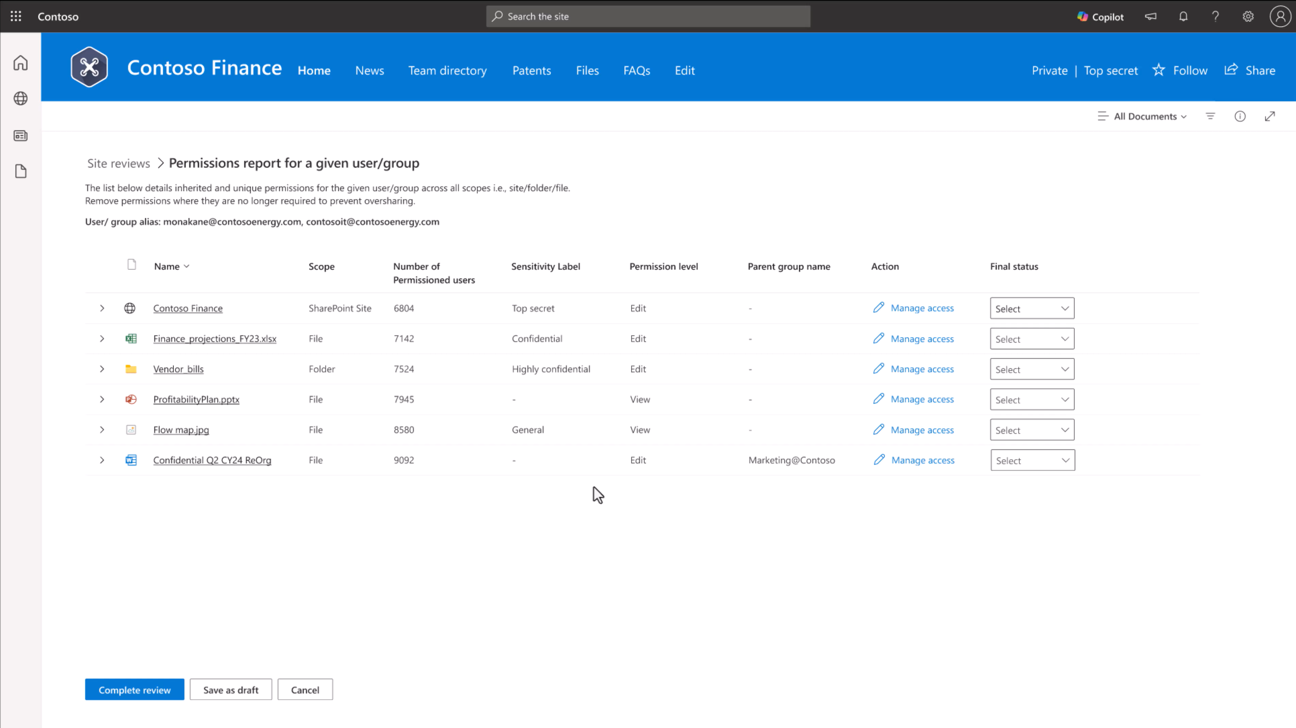

Slide 32
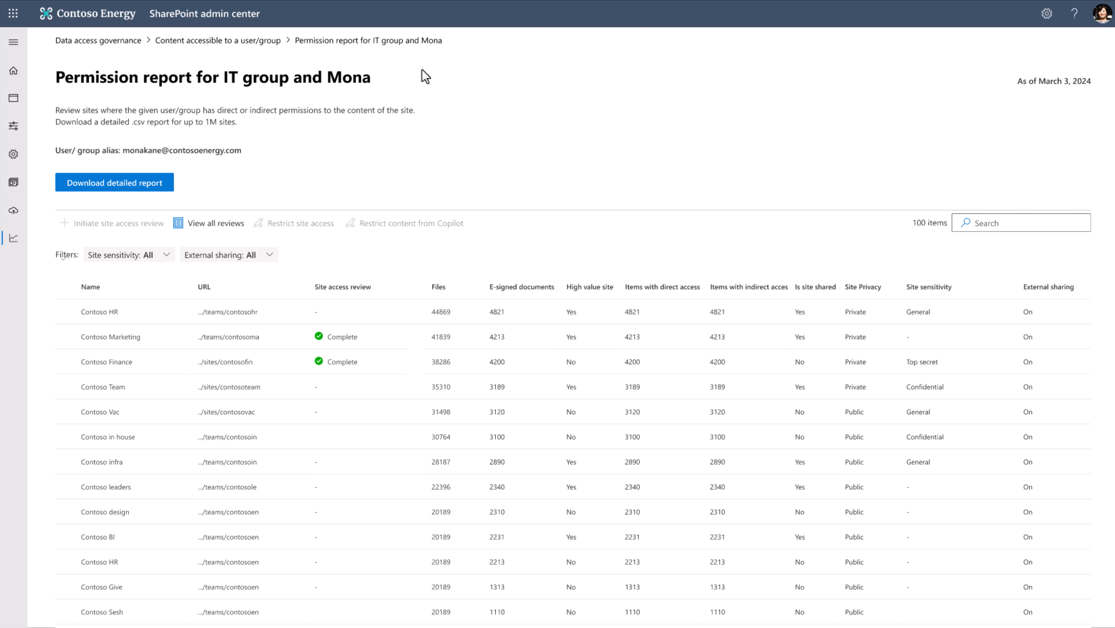

Slide 33
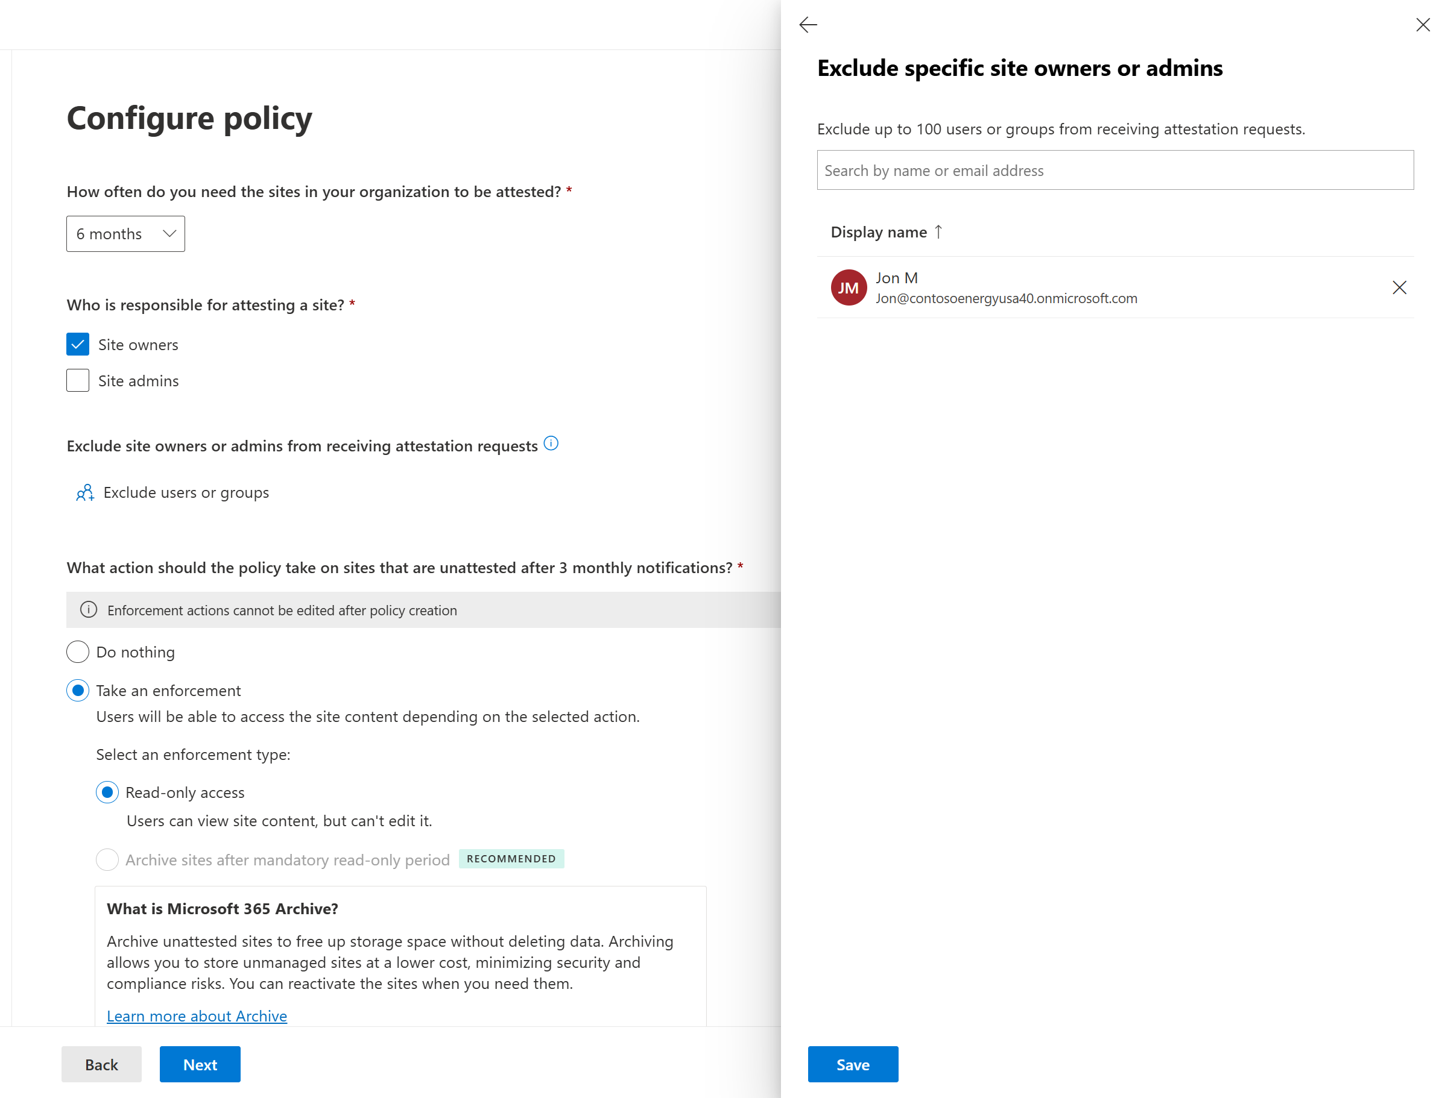
Site Lifecycle Management: Site Attestation Policy
Prevent sites from becoming stale, inactive or ownerless
Maintain Healthy State:
With a site attestation policy, you can ensure your sites are secure and compliant by reducing the risk of unmanaged sites.
Scalable Actions:
Configure this policy to enable automated and periodic review of site’s settings, such as ownership, members, permissions, and sharing settings.
Automate tasks like:
Generating monthly reports of sites due for attestation
Sending attestation reminders to site owners or administrators
Acting on sites not attested after three reminders
Private Preview in April

Slide 34
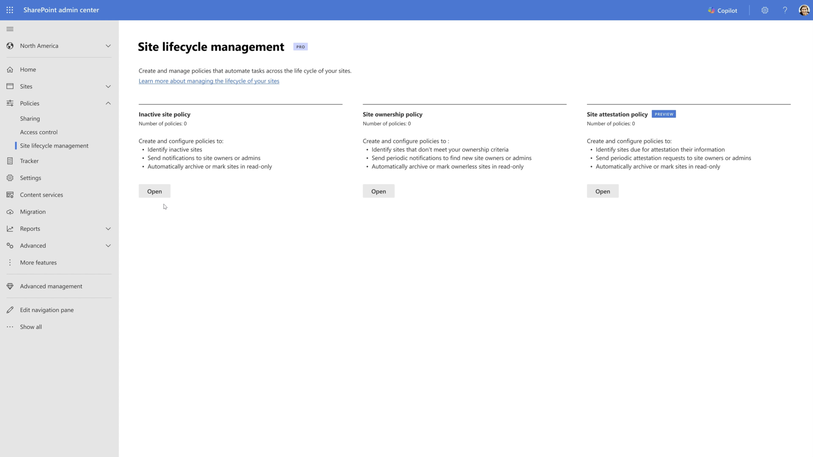

Slide 35
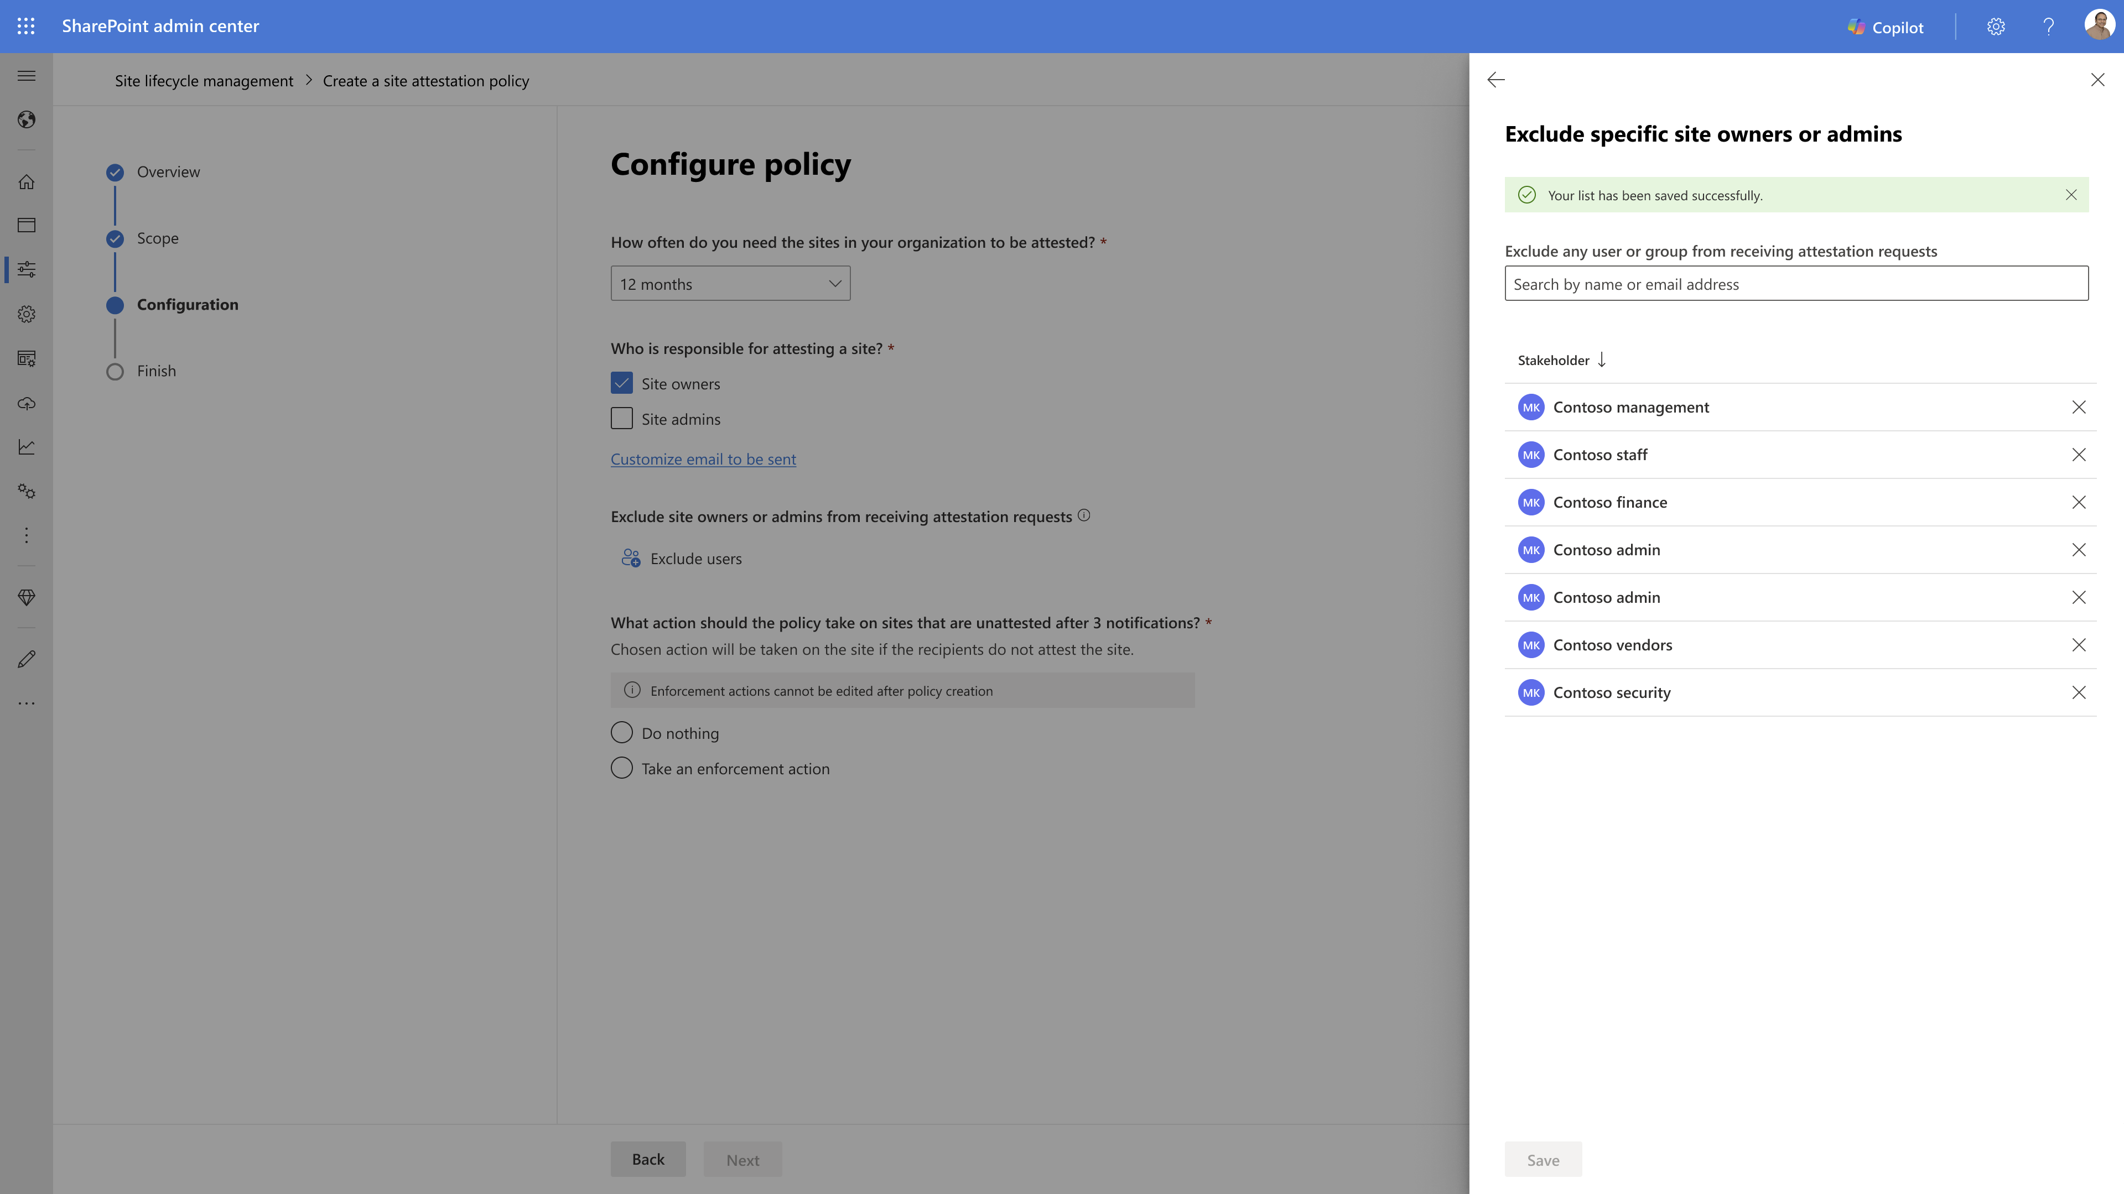

Slide 36
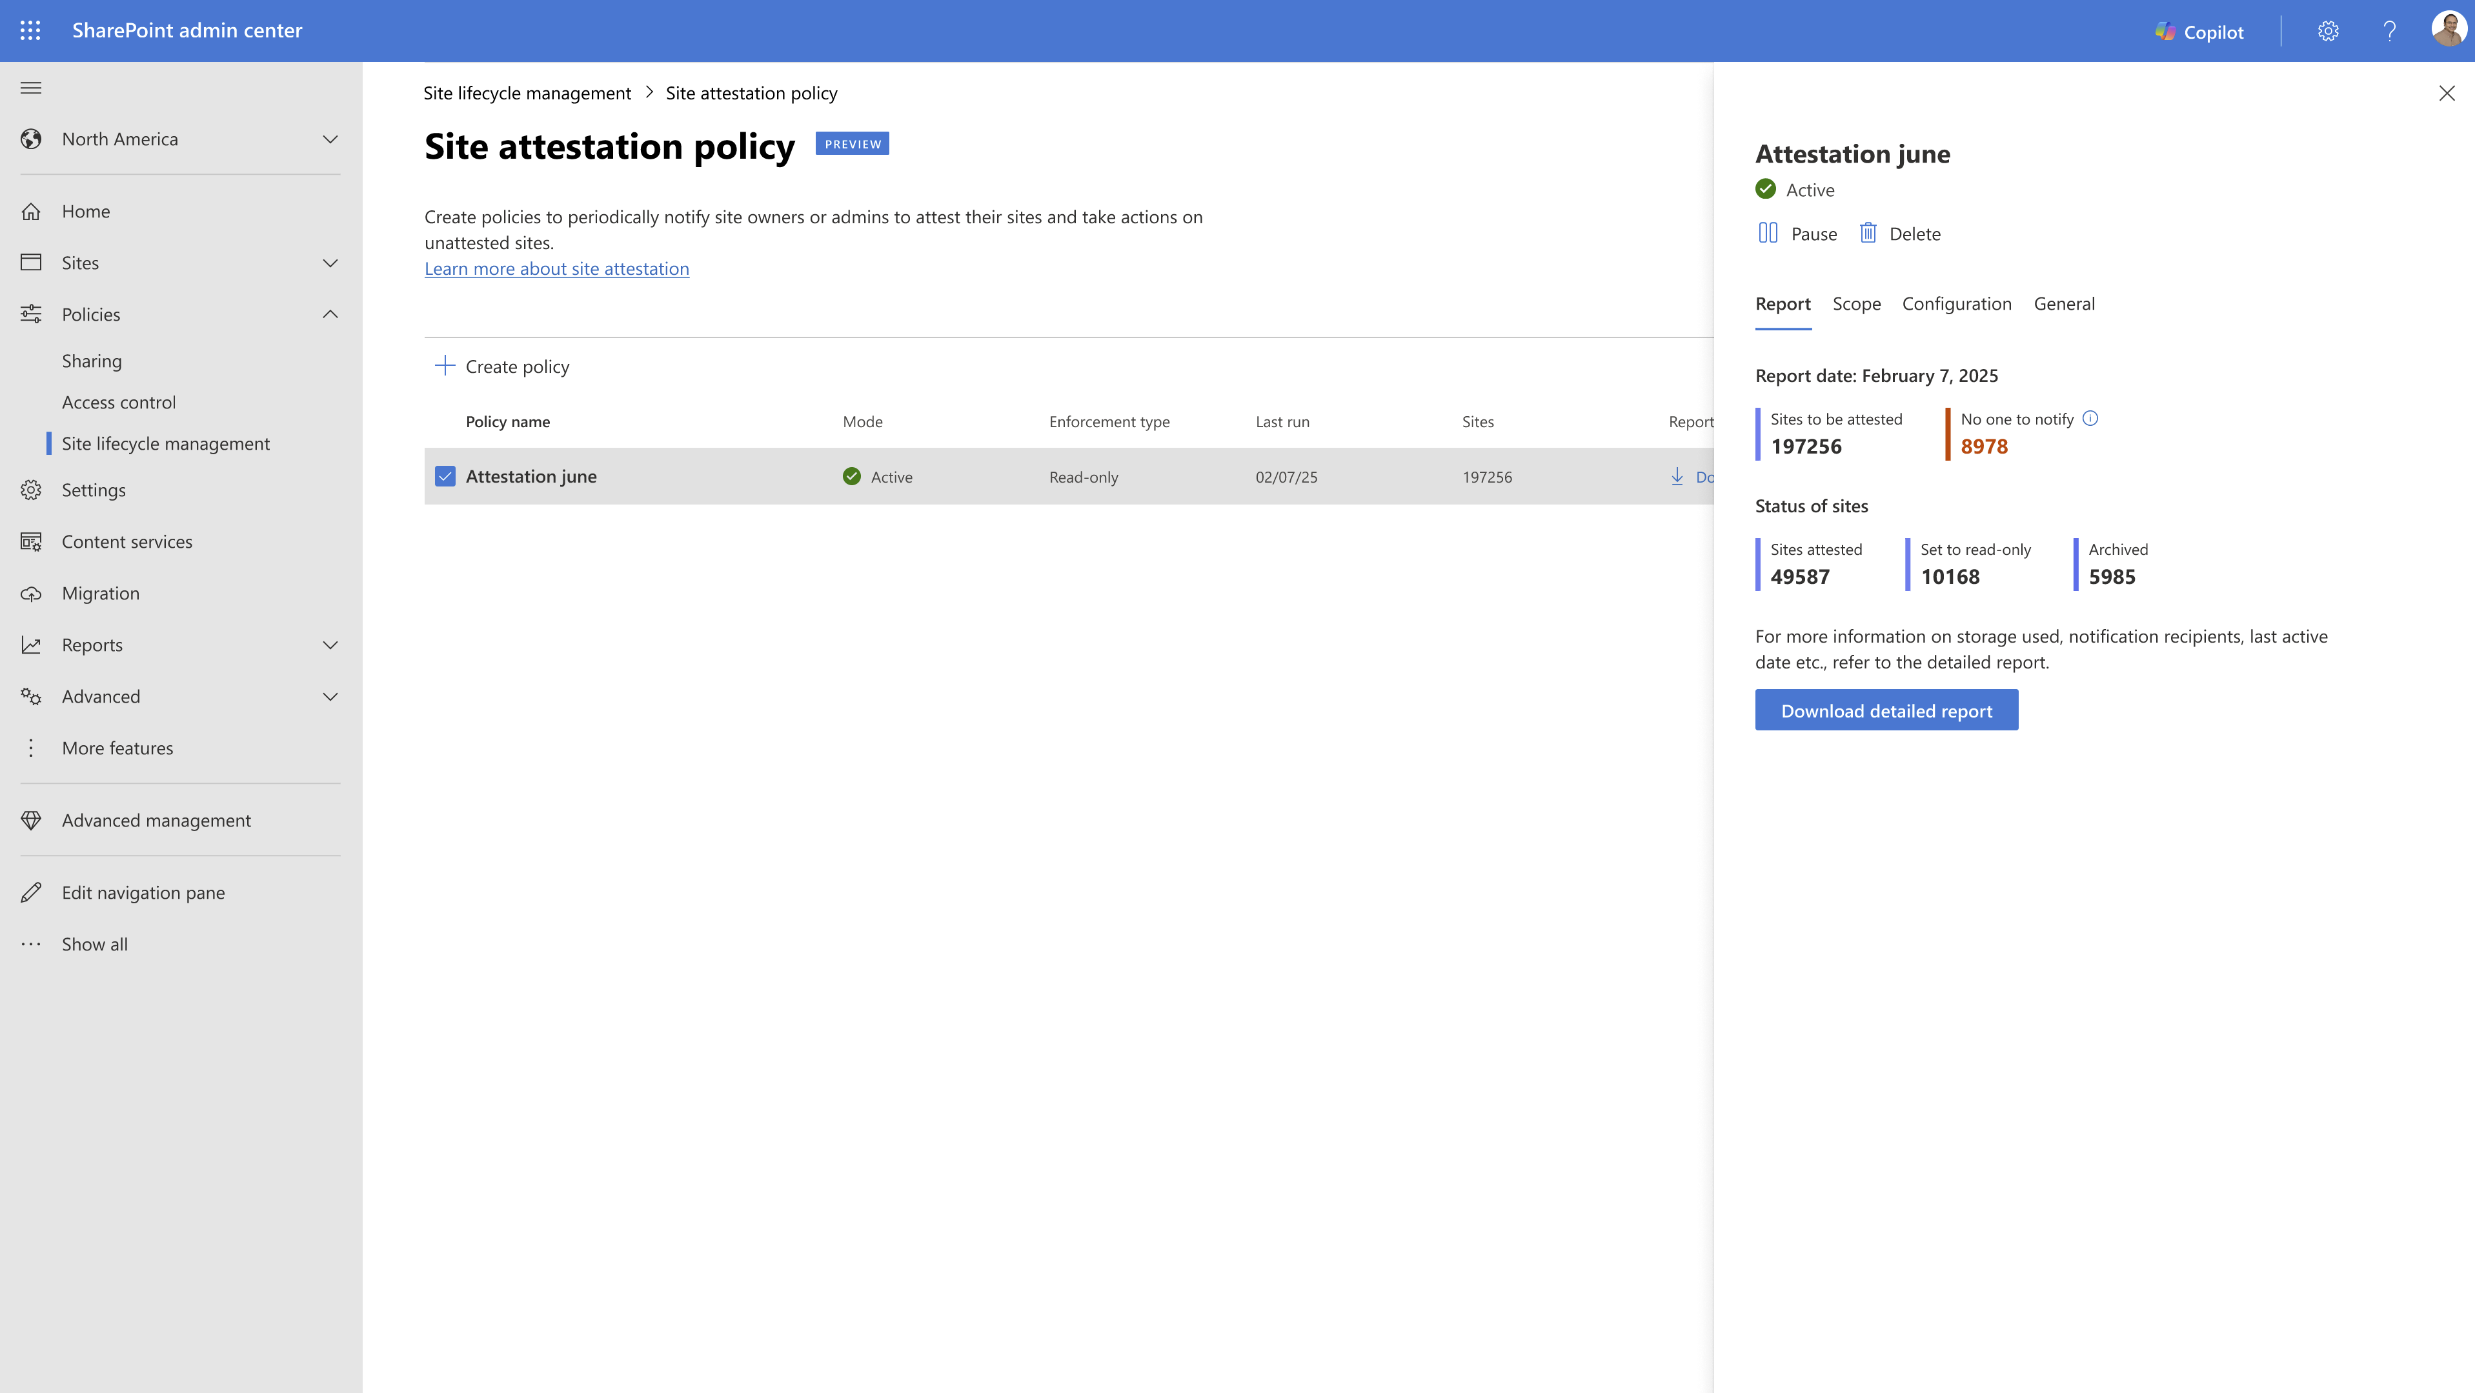

Slide 38
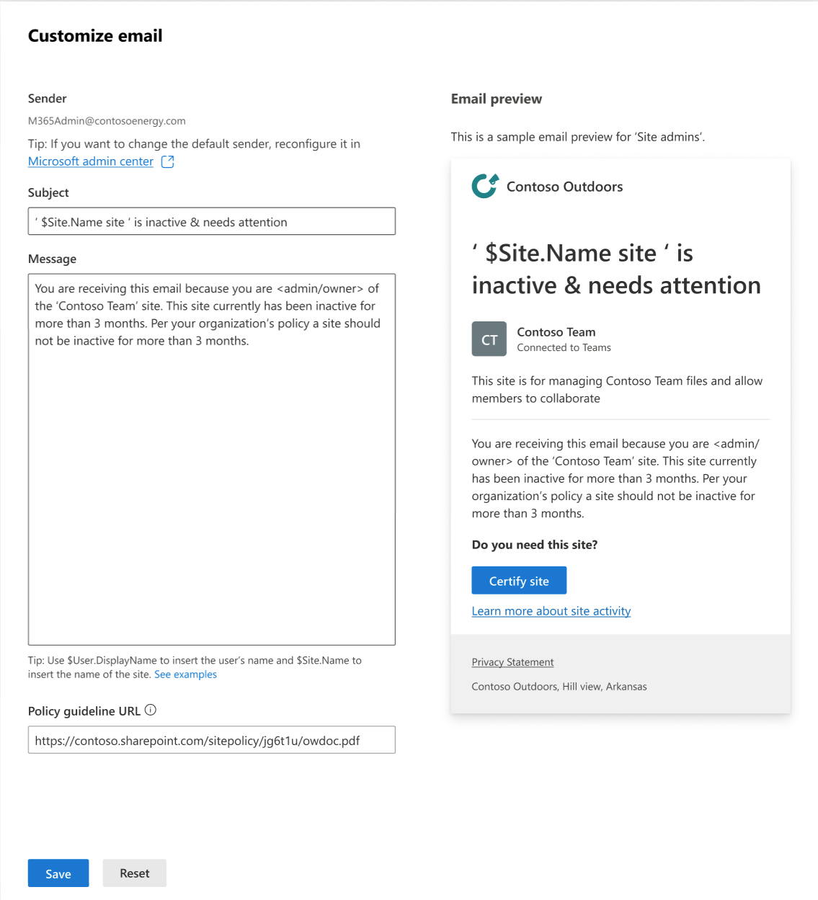
SLM policy: Send custom emails
Customize emails as per your organization requirements
Improve policy impact with email customization:
Allows the admins to customize the content of emails sent from Site Lifecycle Management (SLM) policies.
Helps increase email response efficiency and engagement with their SharePoint sites
Key features:
Sender being organization's configured email address.
Ability to use organization's headers and footers in place of the standard MSFT headers and footers.
Customized header, subject, body of the email to garner enough attention from site owners/admins.
Private Preview for inactive sites policy in H1

Slide 39
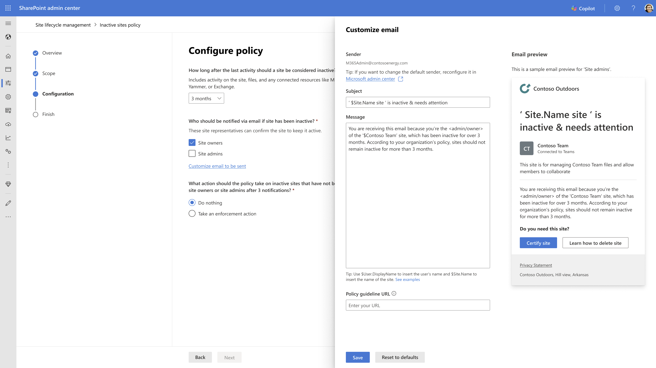

Slide 40
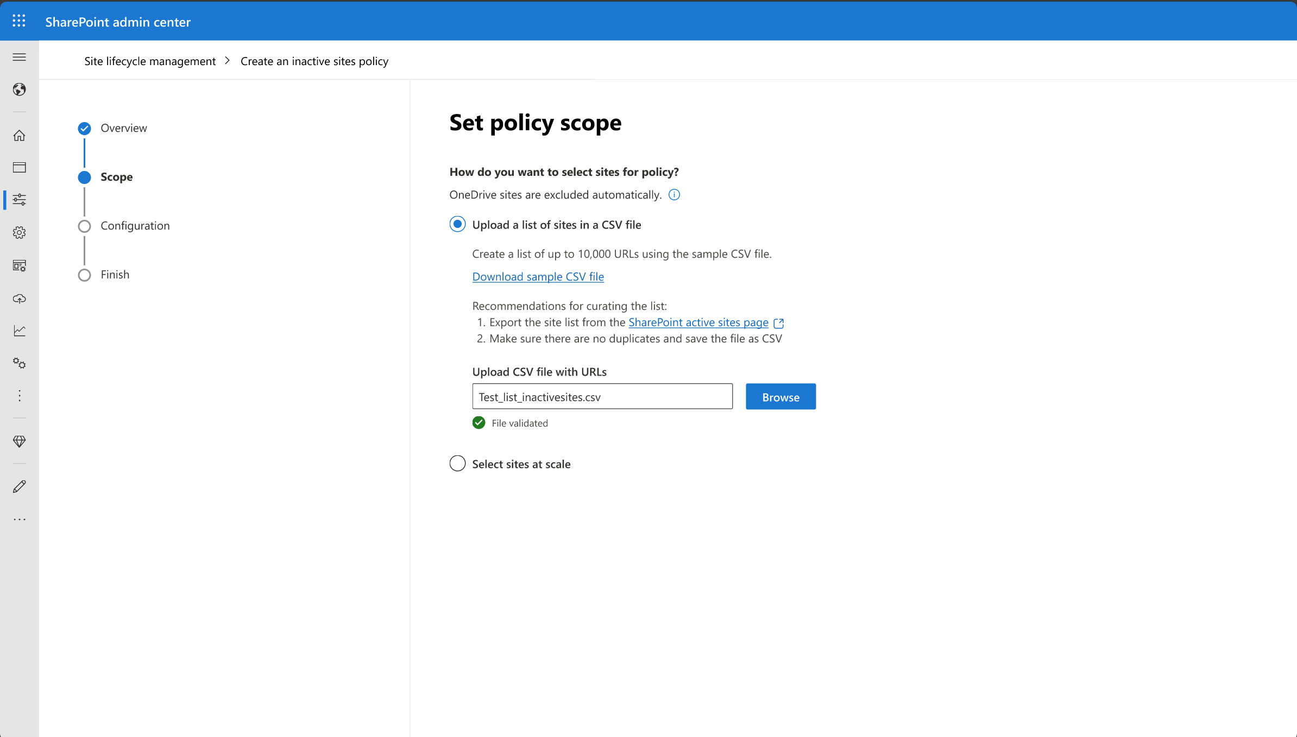
SLM Policy: Custom inclusion of sites
Create a policy for a pre-defined set of sites
Improved ease of use with custom policy scope:
Create policies for a pre-defined set of sites to either validate or prioritize management of high priority sites.
Allows customers to test policies on a smaller set of sites quickly before applying them on a larger scale.
Key features:
Inclusion of the target sites up to 10K using CSV file
Shorter time to run site lifecycle management policies
Provision of detailed statistics to help understand the potential impacts of using enforcement actions.
Generally available in H1

Slide 41
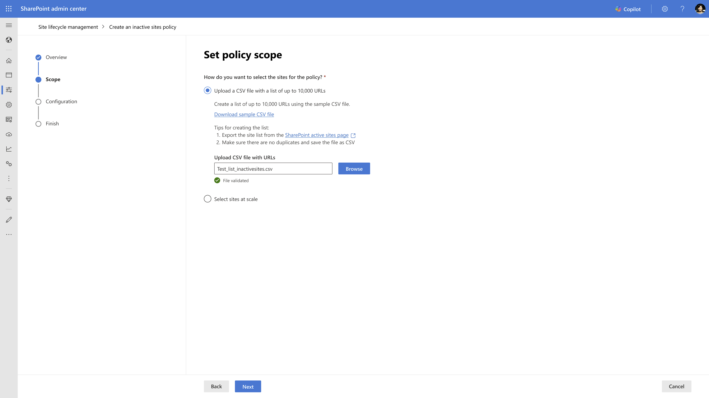

Slide 42
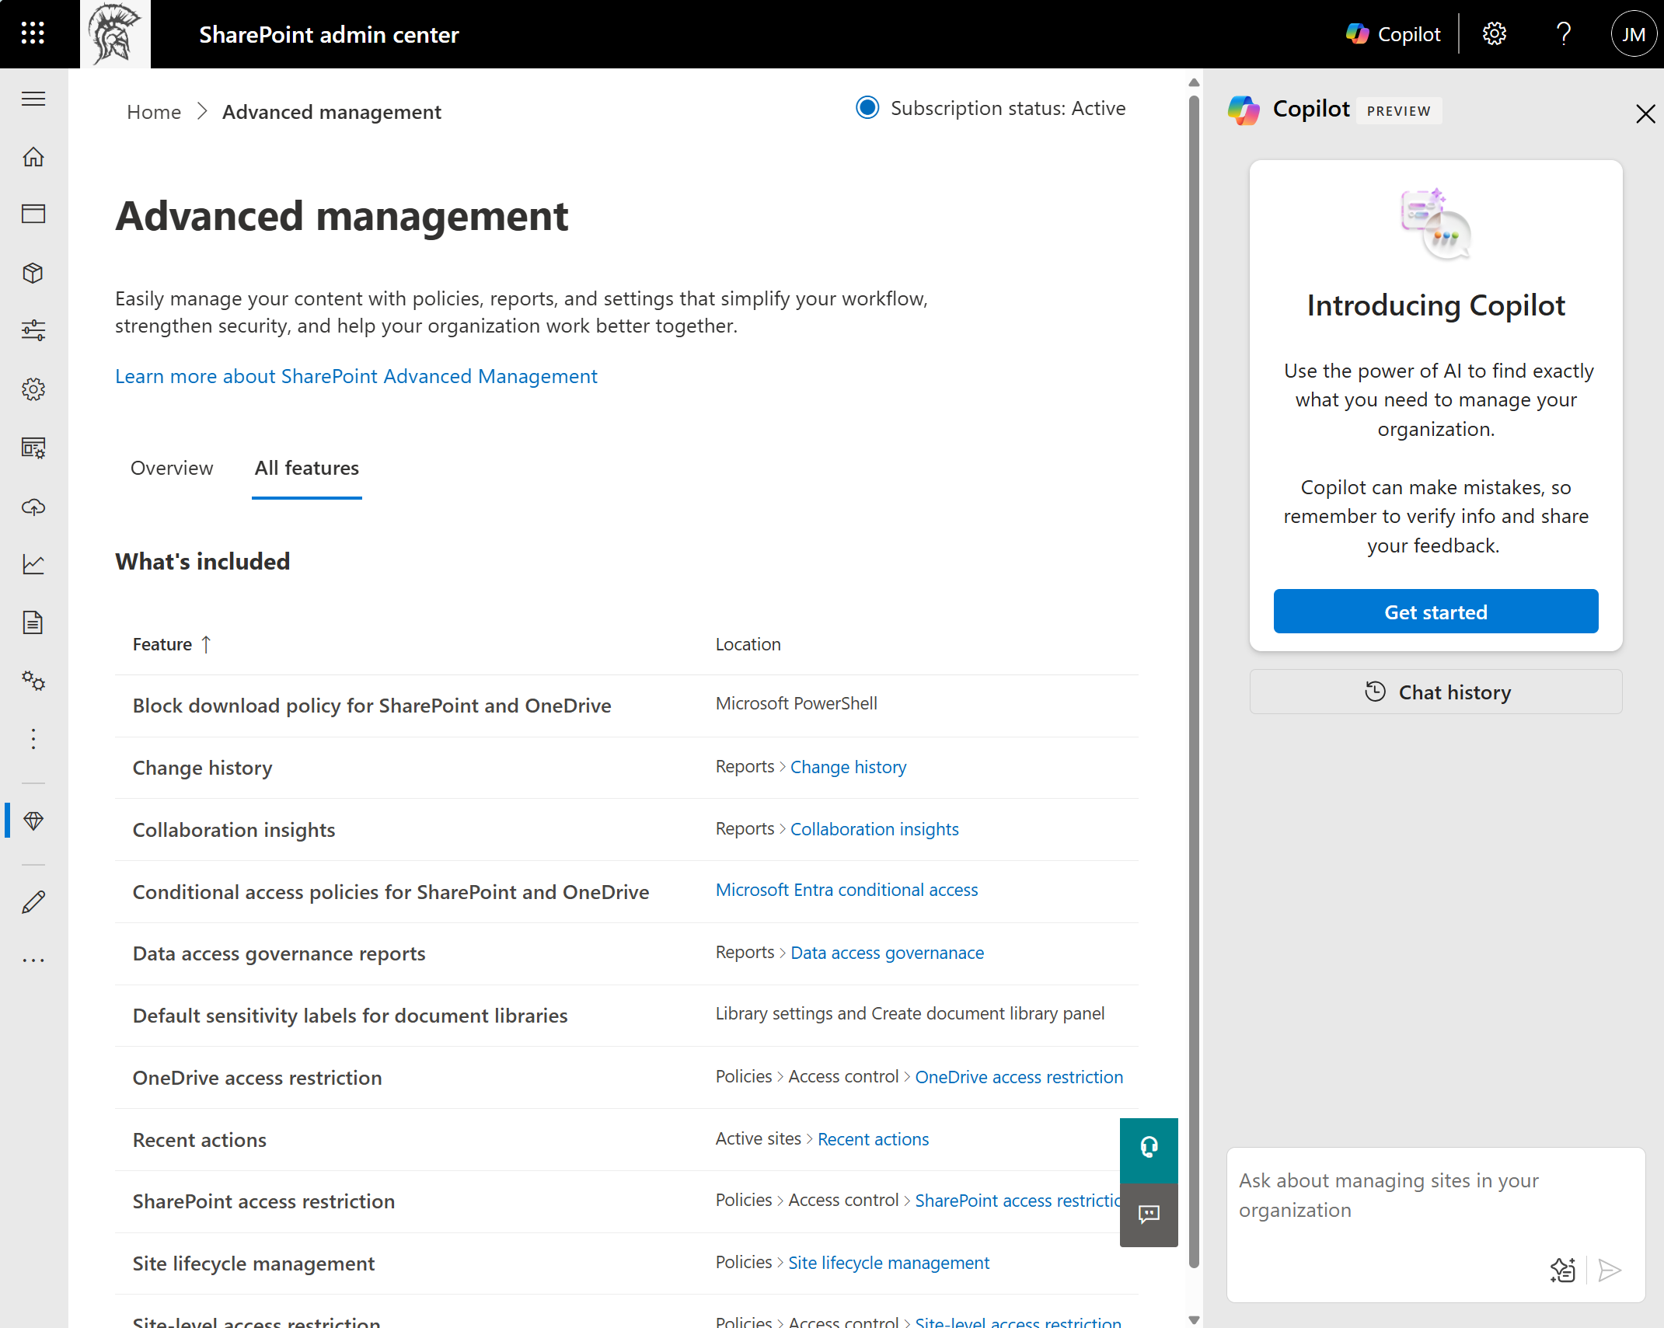
SAM integration with Copilot
Do more things more efficiently
What does it do?
Copilot in SharePoint Admin Center will empower admins to work more efficiently and maximize the value of both existing and upcoming capabilities.
Benefits:
Discover & Educate
Providing admins with insights, best practices, and guidance on available tools and governance strategies.
Find
Quickly locating specific settings, configurations, or site details to improve efficiency.
Review
Offering a clear, consolidated view of tenant settings and their impact, enabling data-driven decision-making.
In-Context Bulk Actions
Enabling admins to perform bulk updates efficiently without navigating multiple tools or screens.
Private Preview

Slide 44
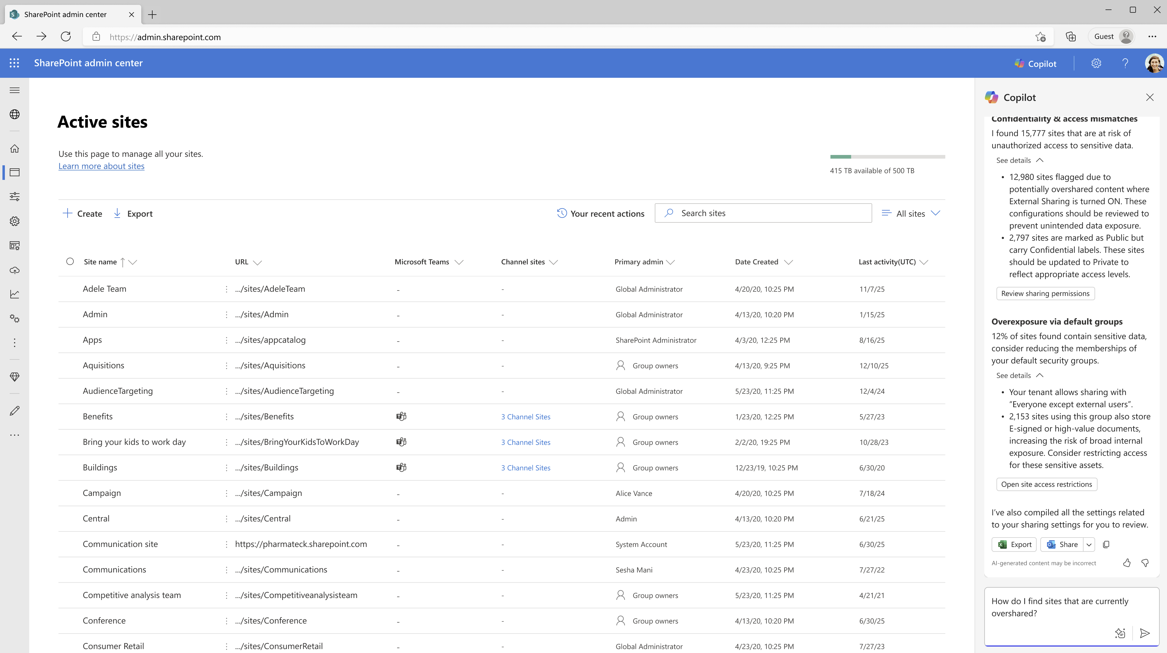

Slide 45
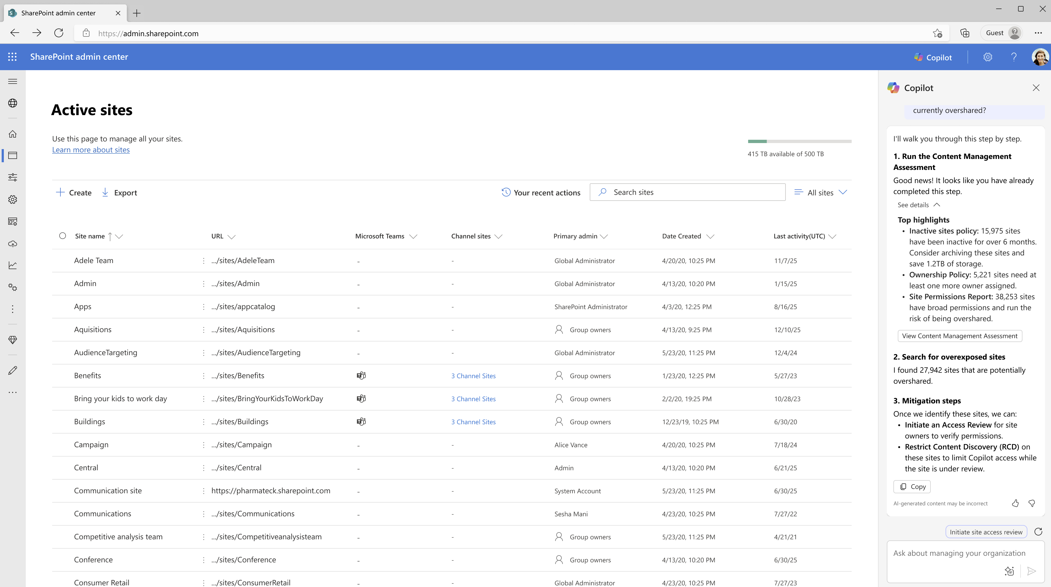


Slide 46
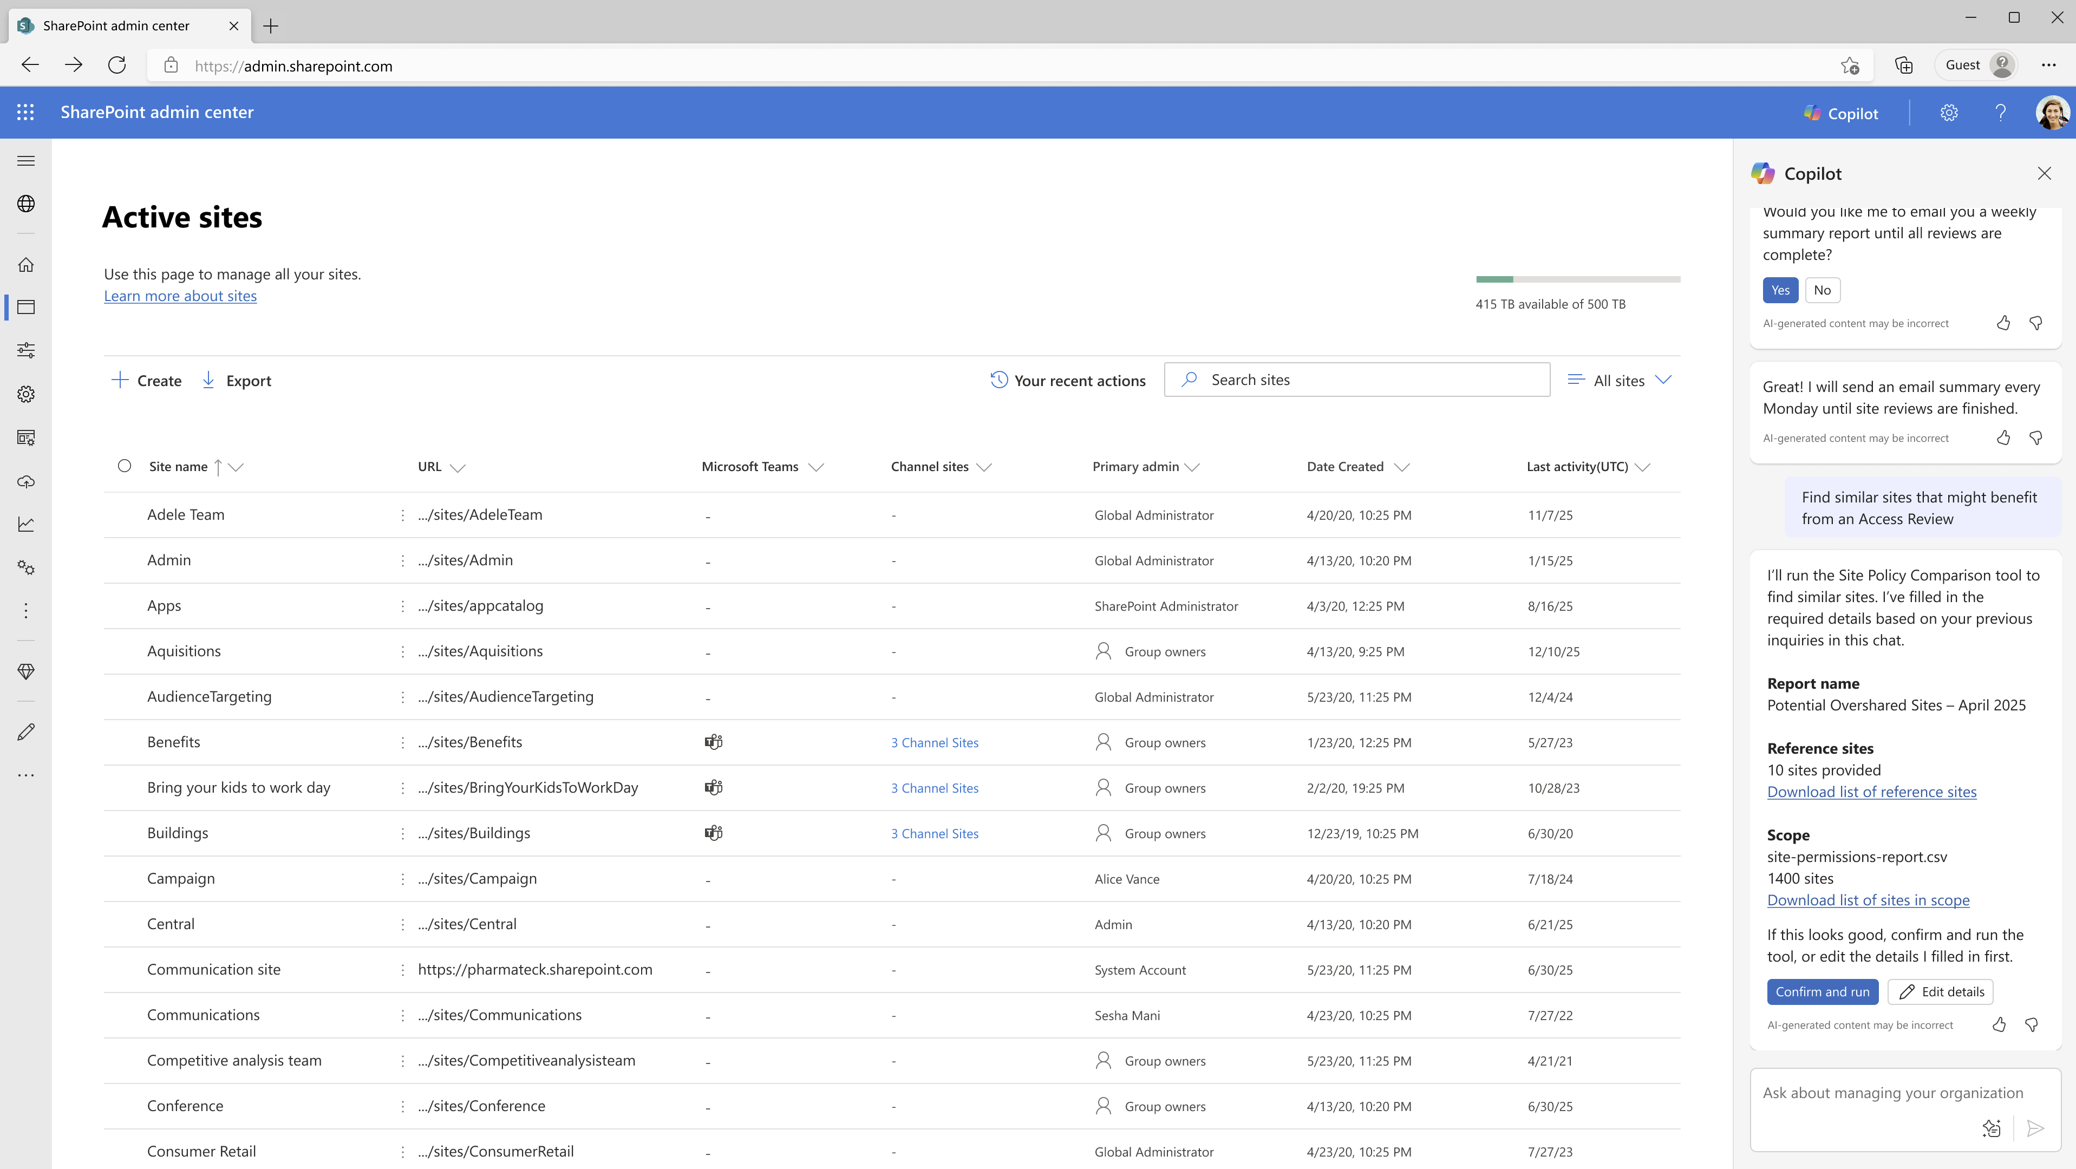

Slide 47
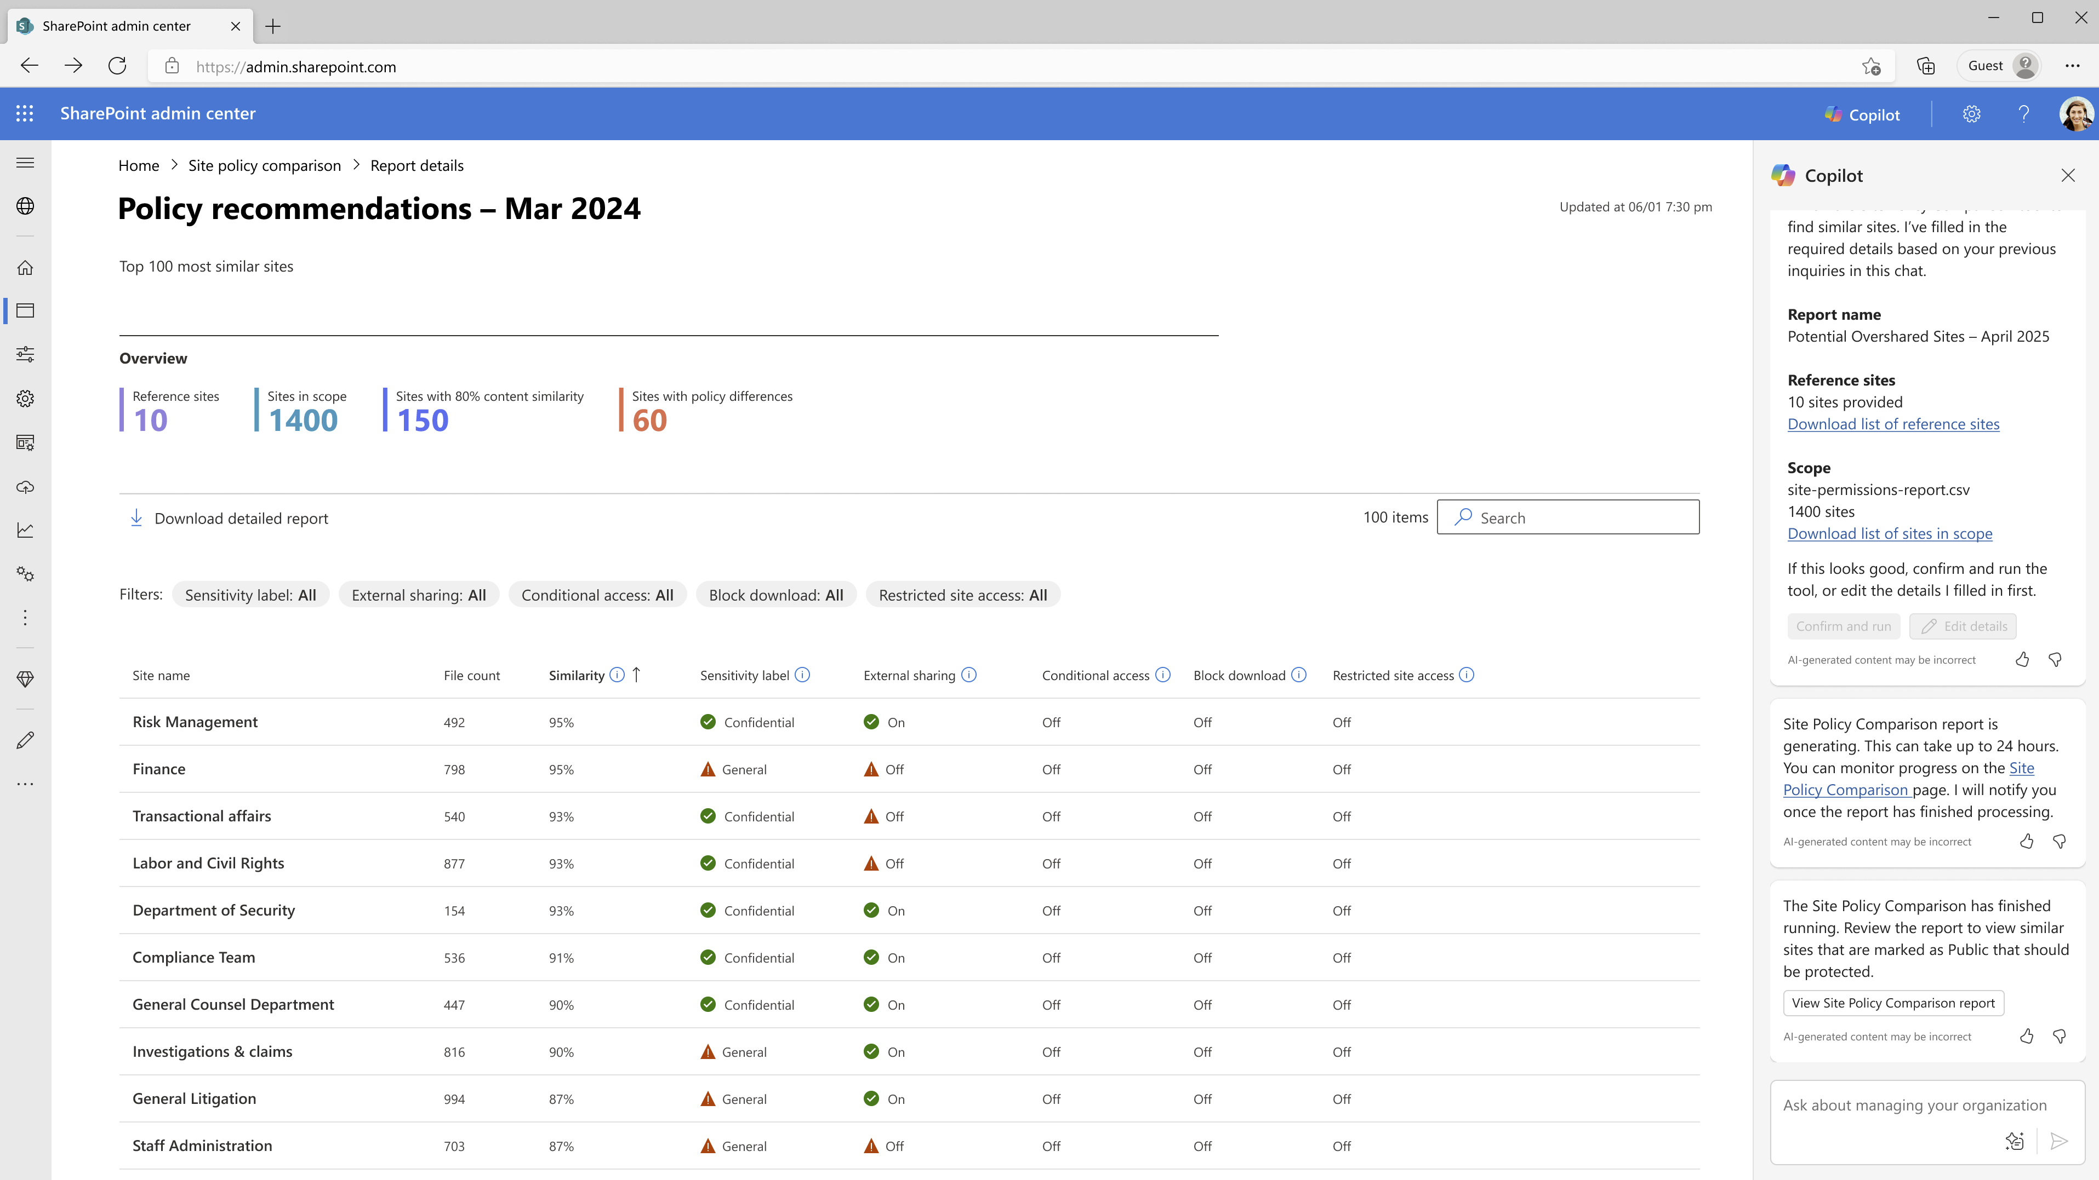

Slide 48
LLM Powered Governance Capabilities
Licensing TBD

Slide 49
Reduce Sprawl
Control Oversharing
Manage Lifecycle
Content Management Assessment + AI Insights
Inactive Site policy
Agent Insights
Site Lifecycle Policies
Site Attestation Policy
Customizable Email
Target policy on specific sites
Site Ownership Policy
Delegated Restricted Content Discovery
AI Driven Semantic Site Matching
Data Access Governance
Sites/files permissioned to “specific user”
Sites/files permissioned to “specific group”
Permission state report (Sites, ODBs, Files)
Everyone Except External Users insights
Site Access Review
Recent Admin Actions
Restricted Content Discovery (RCD)
Agents and Sites
Change history
Restricted access control (RAC)
Sites, OneDrive
Extend SharePoint Permission
with Sensitivity labels
Block download policies
Sites, Files, Teams
Enterprise application insights
Copilot integration in SharePoint Admin Center + SAM

Slide 50
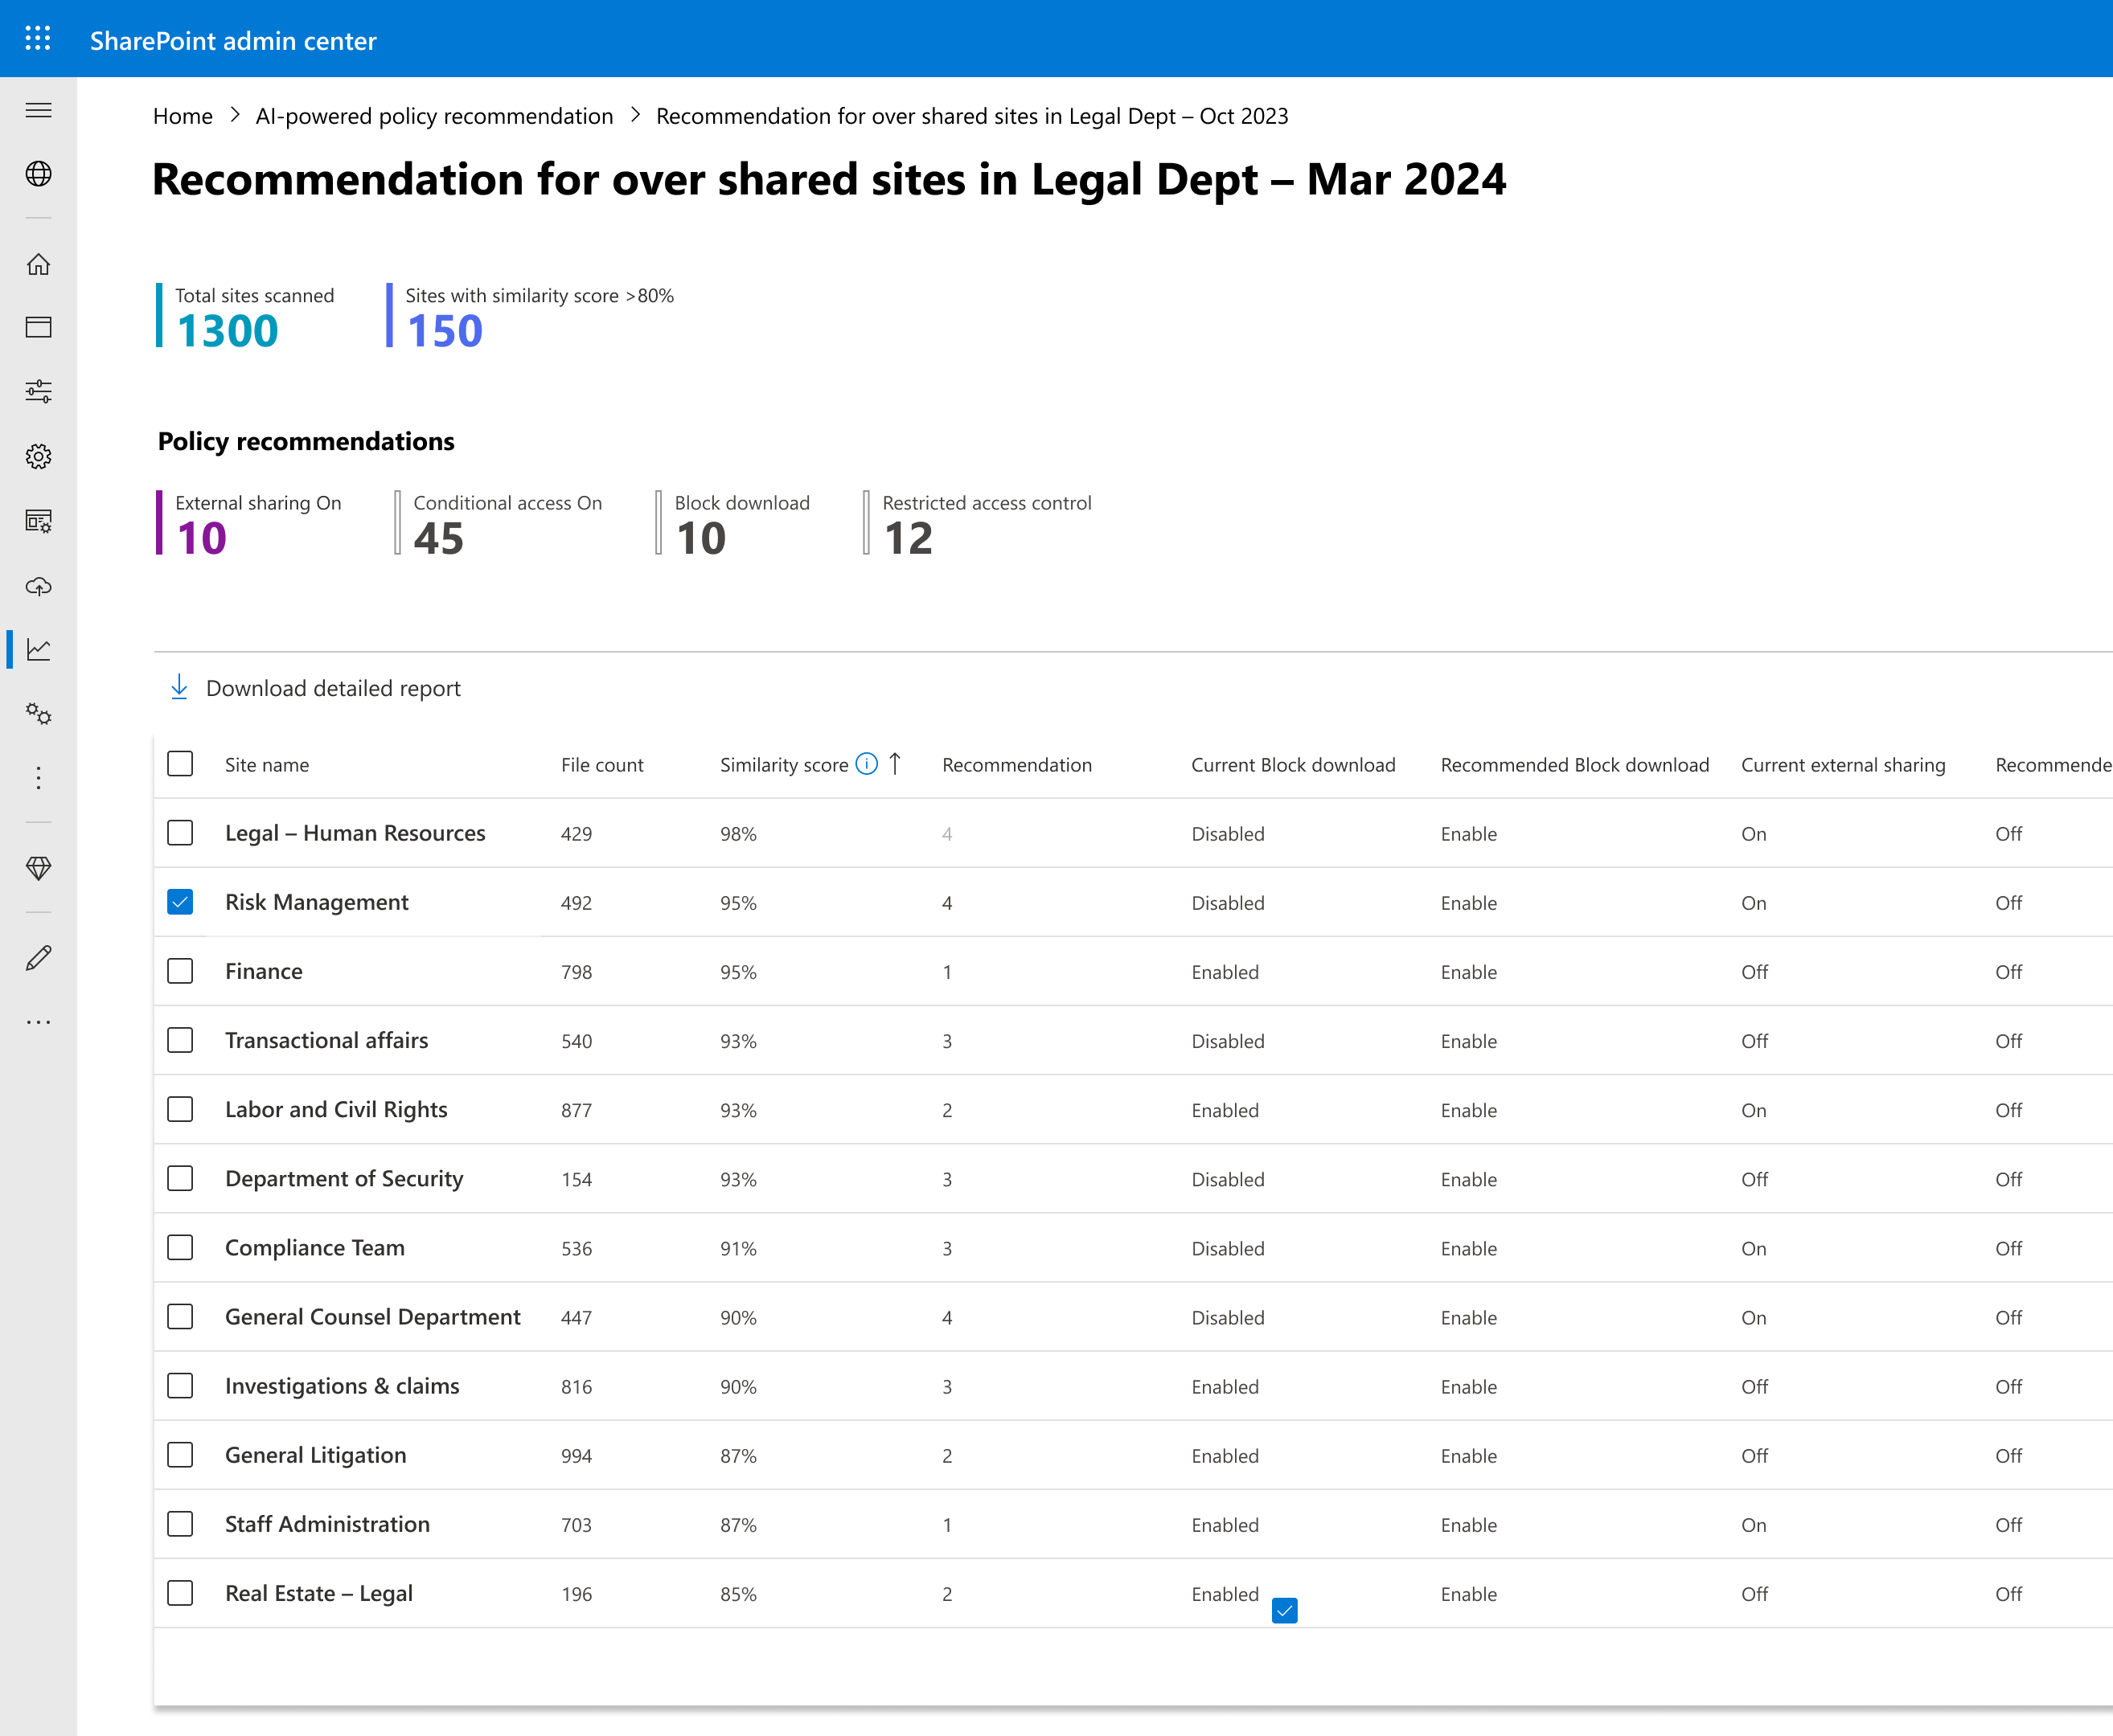
AI driven semantic matching of sites: For Admin
Semantically compare contents at scale
Admin: “…analyze my SharePoint content and recommend ways to protect SIMILAR content… ”
Scalable Actions:
Admin provides as input, a list of sites with documents that are “similar”, like sales, legal
Service finds all sites that semantically match the input
Service provides policy recommendation for matched sites
Private Preview
Notes:
Sanjoyan

Slide 51
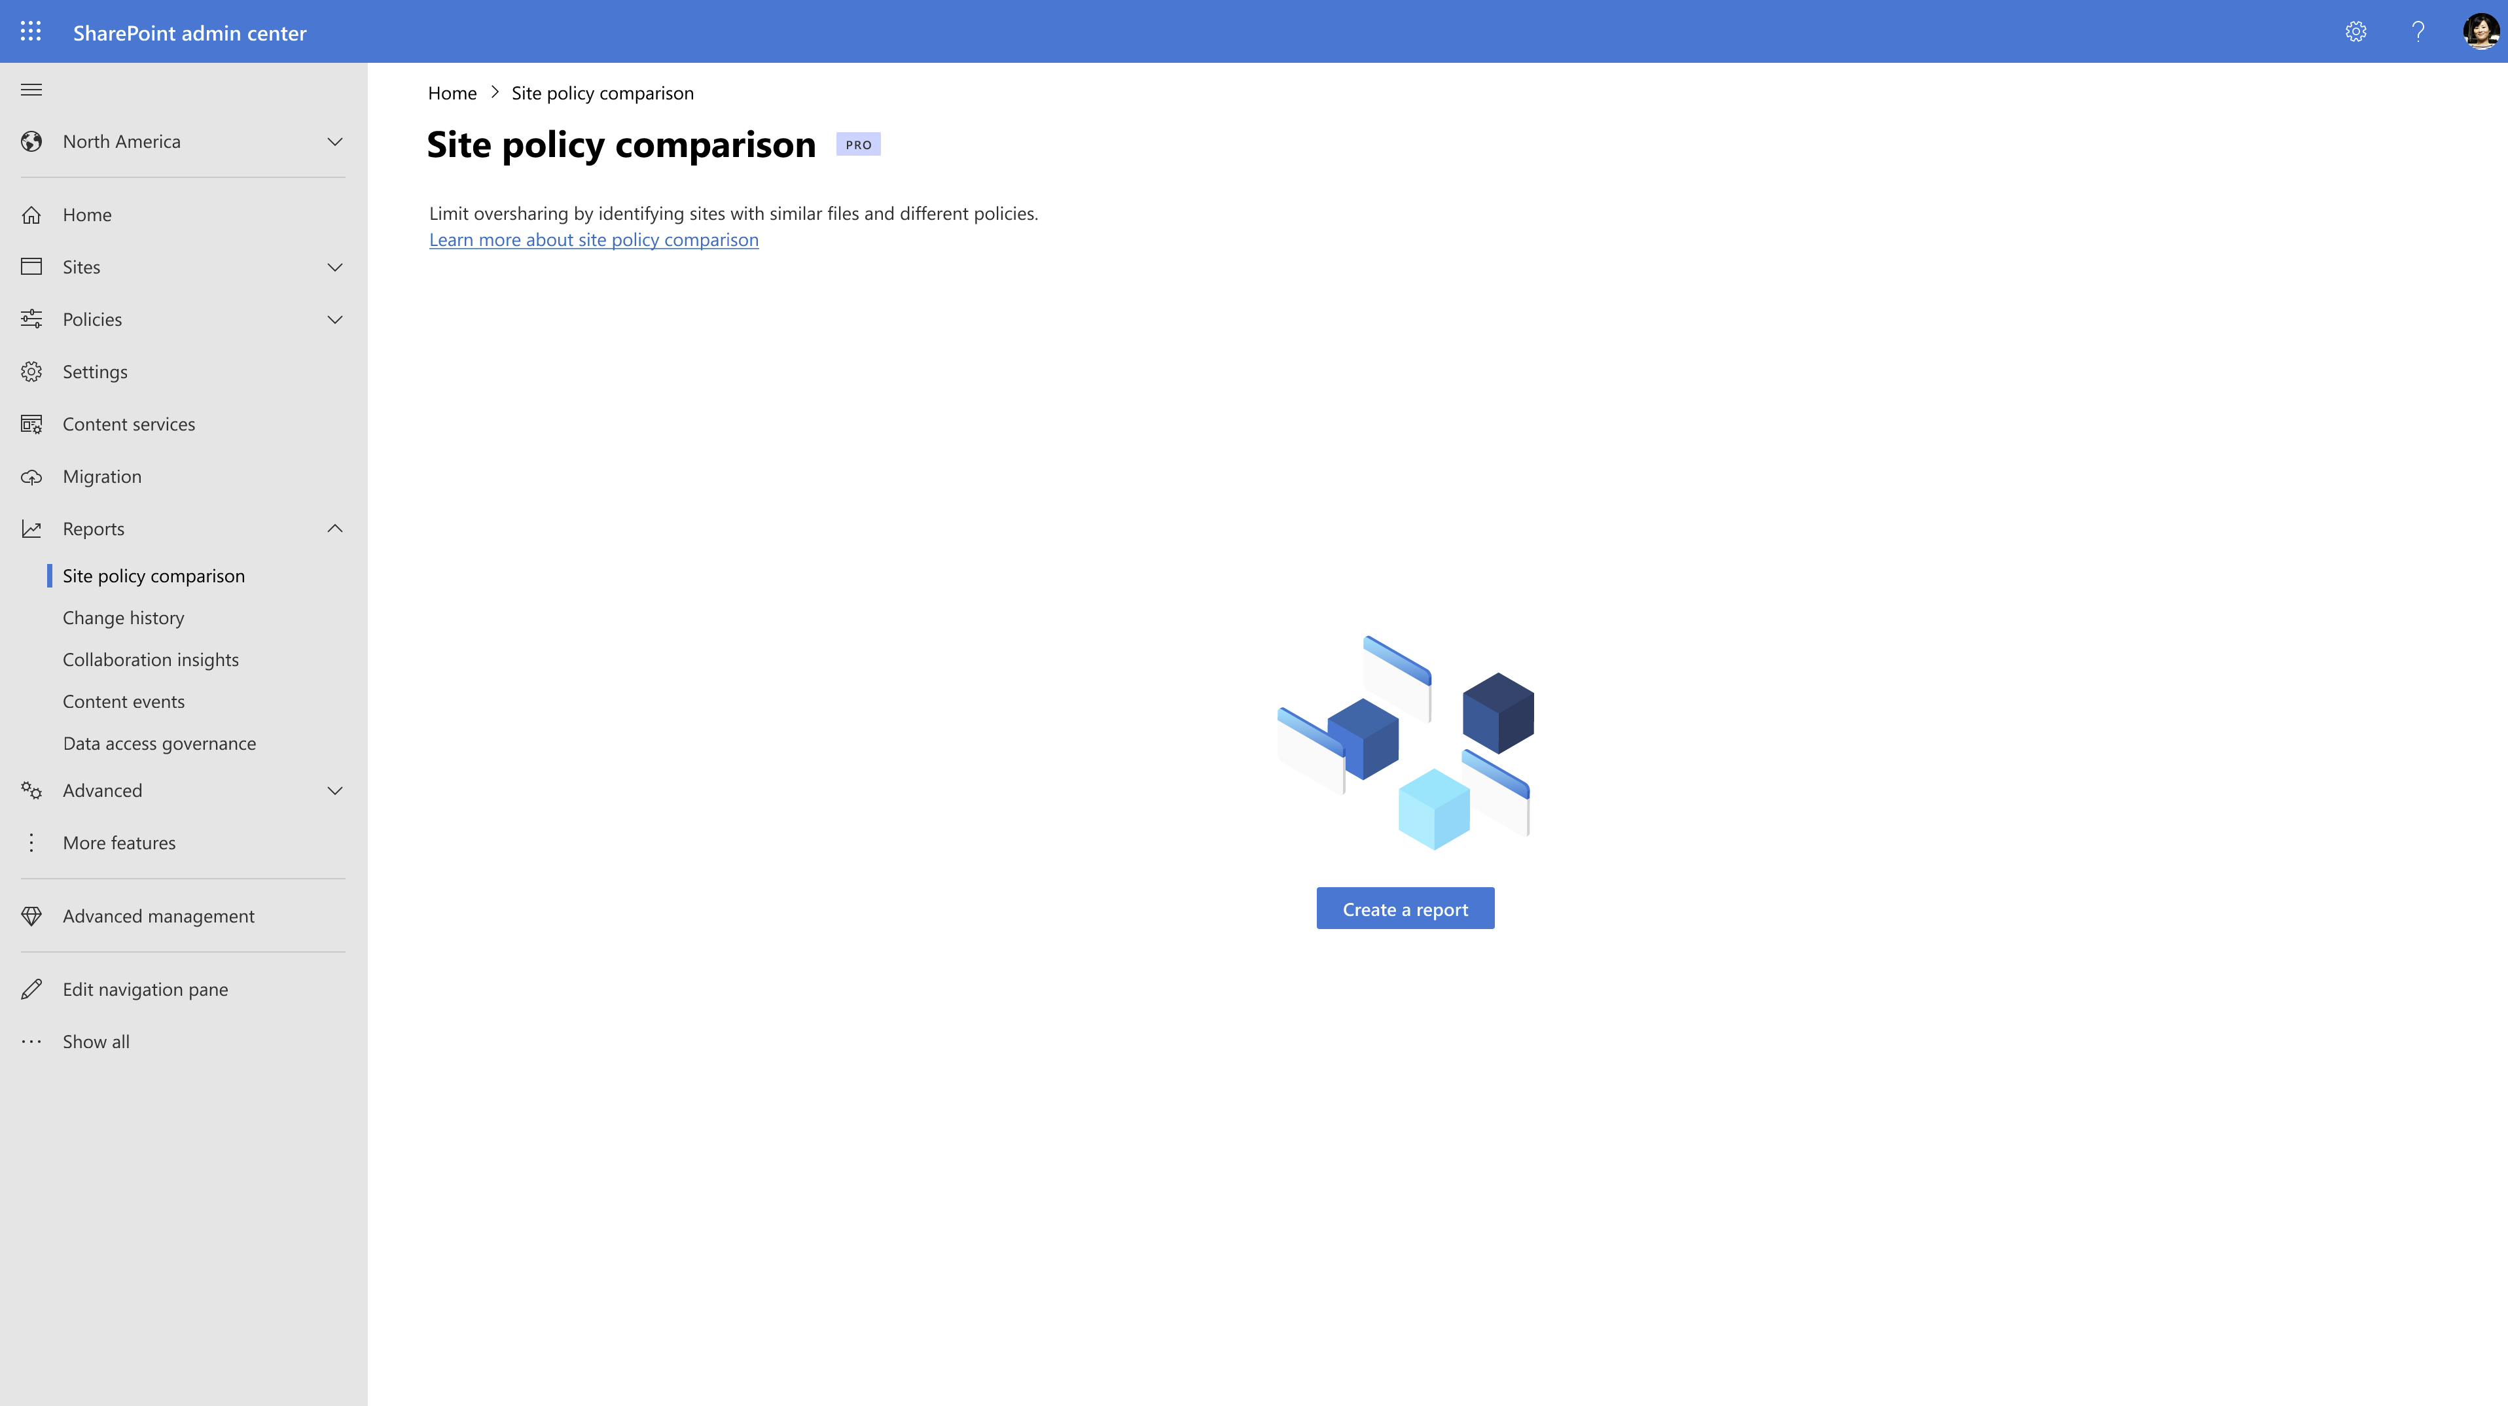

Slide 52
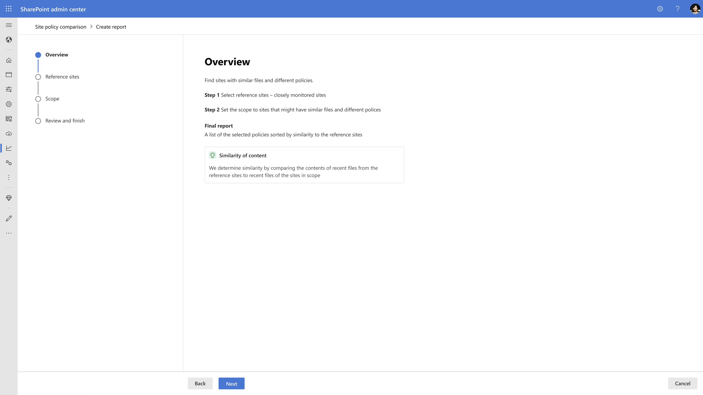

Slide 53
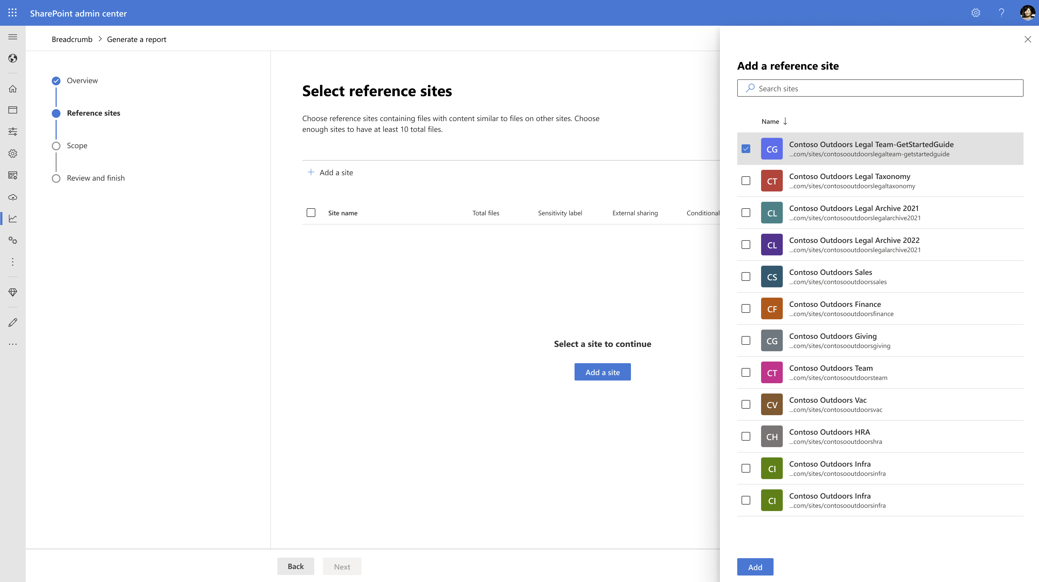

Slide 54
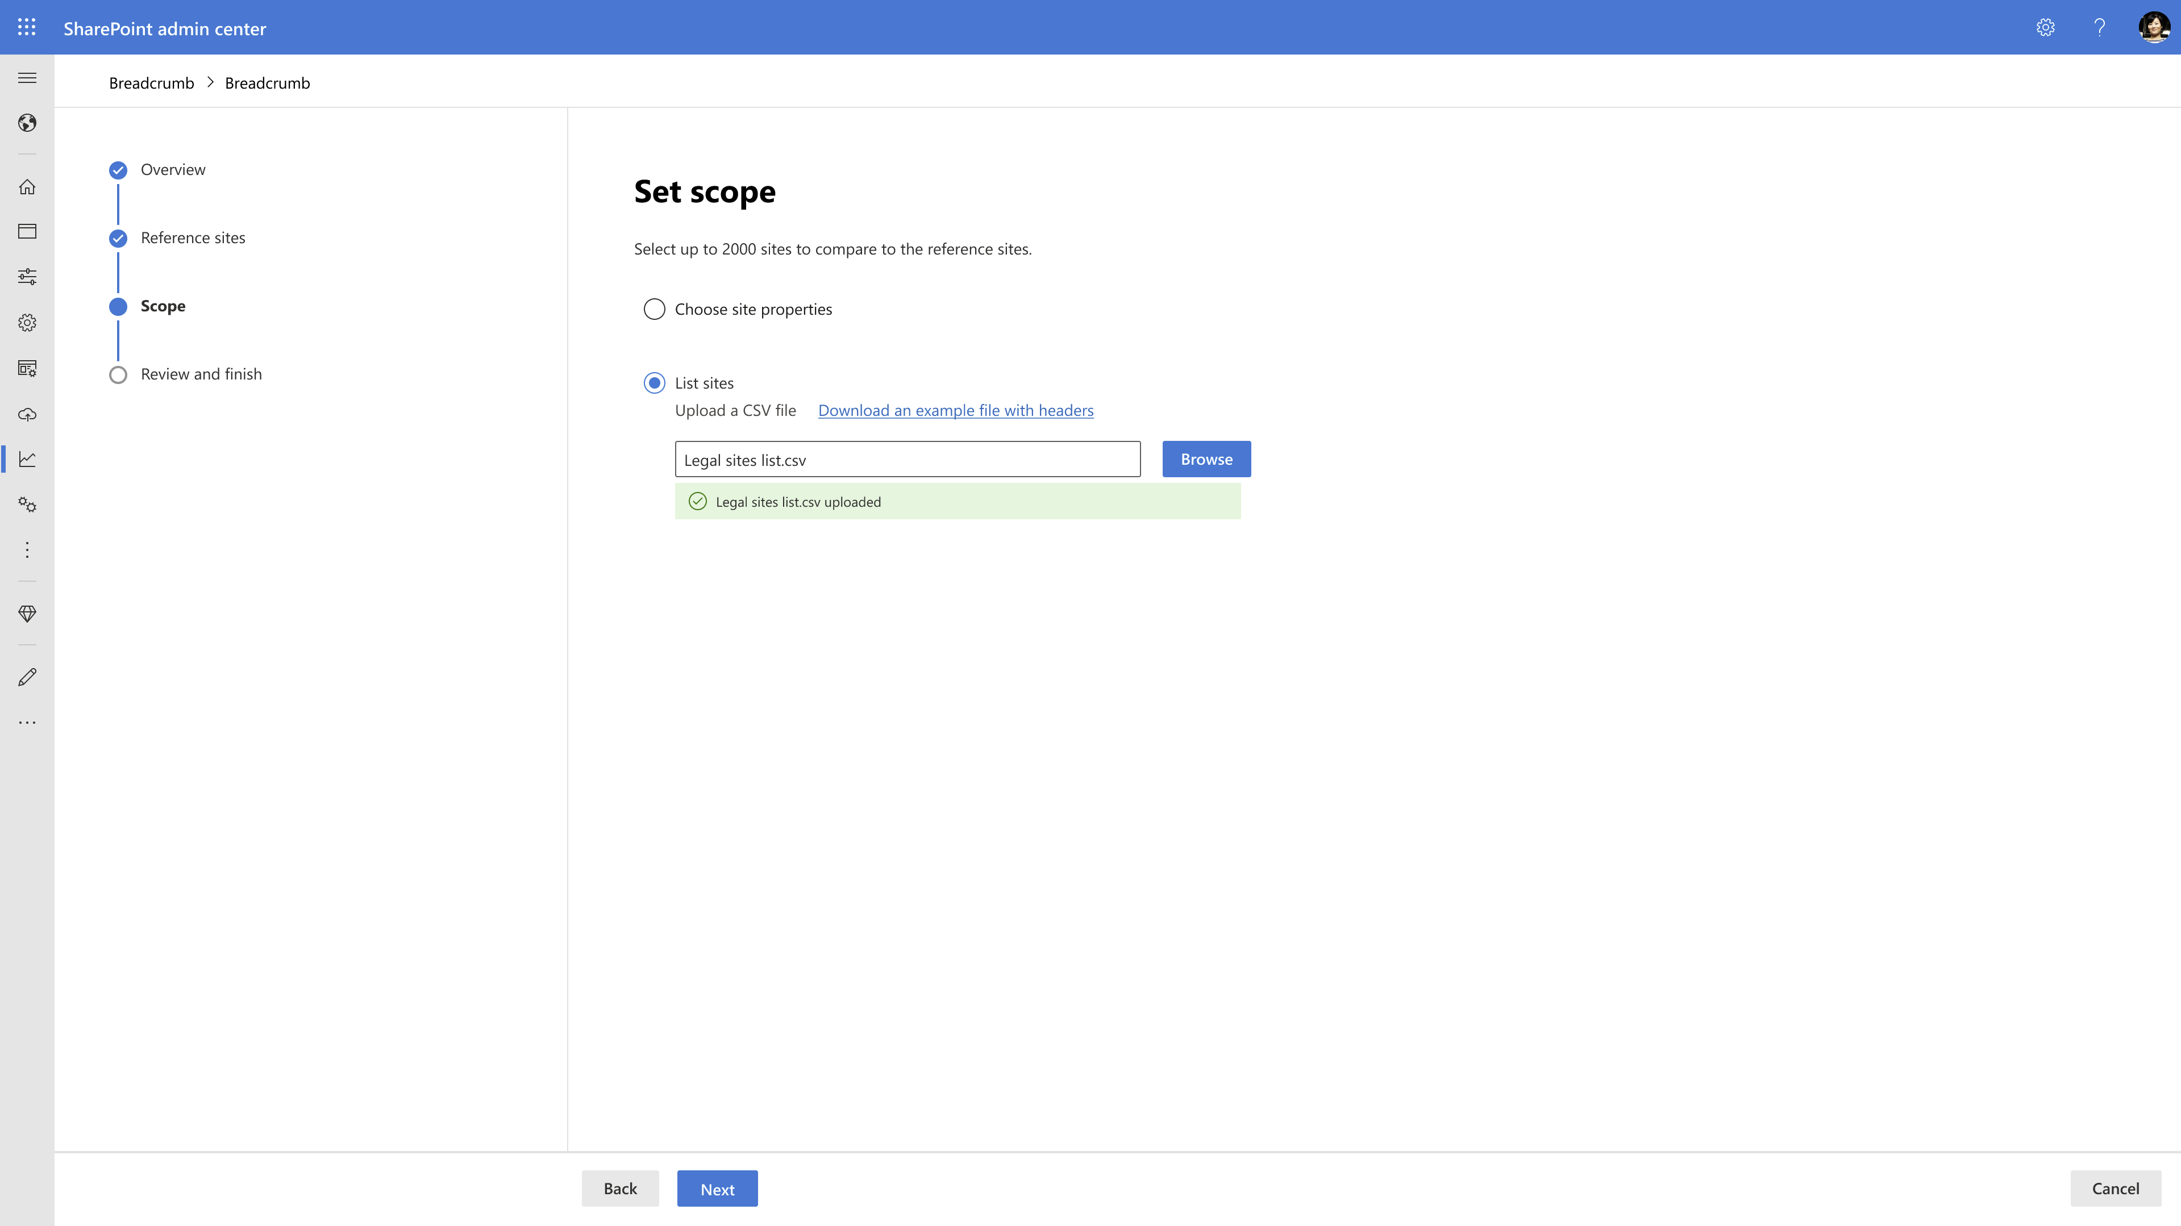

Slide 55
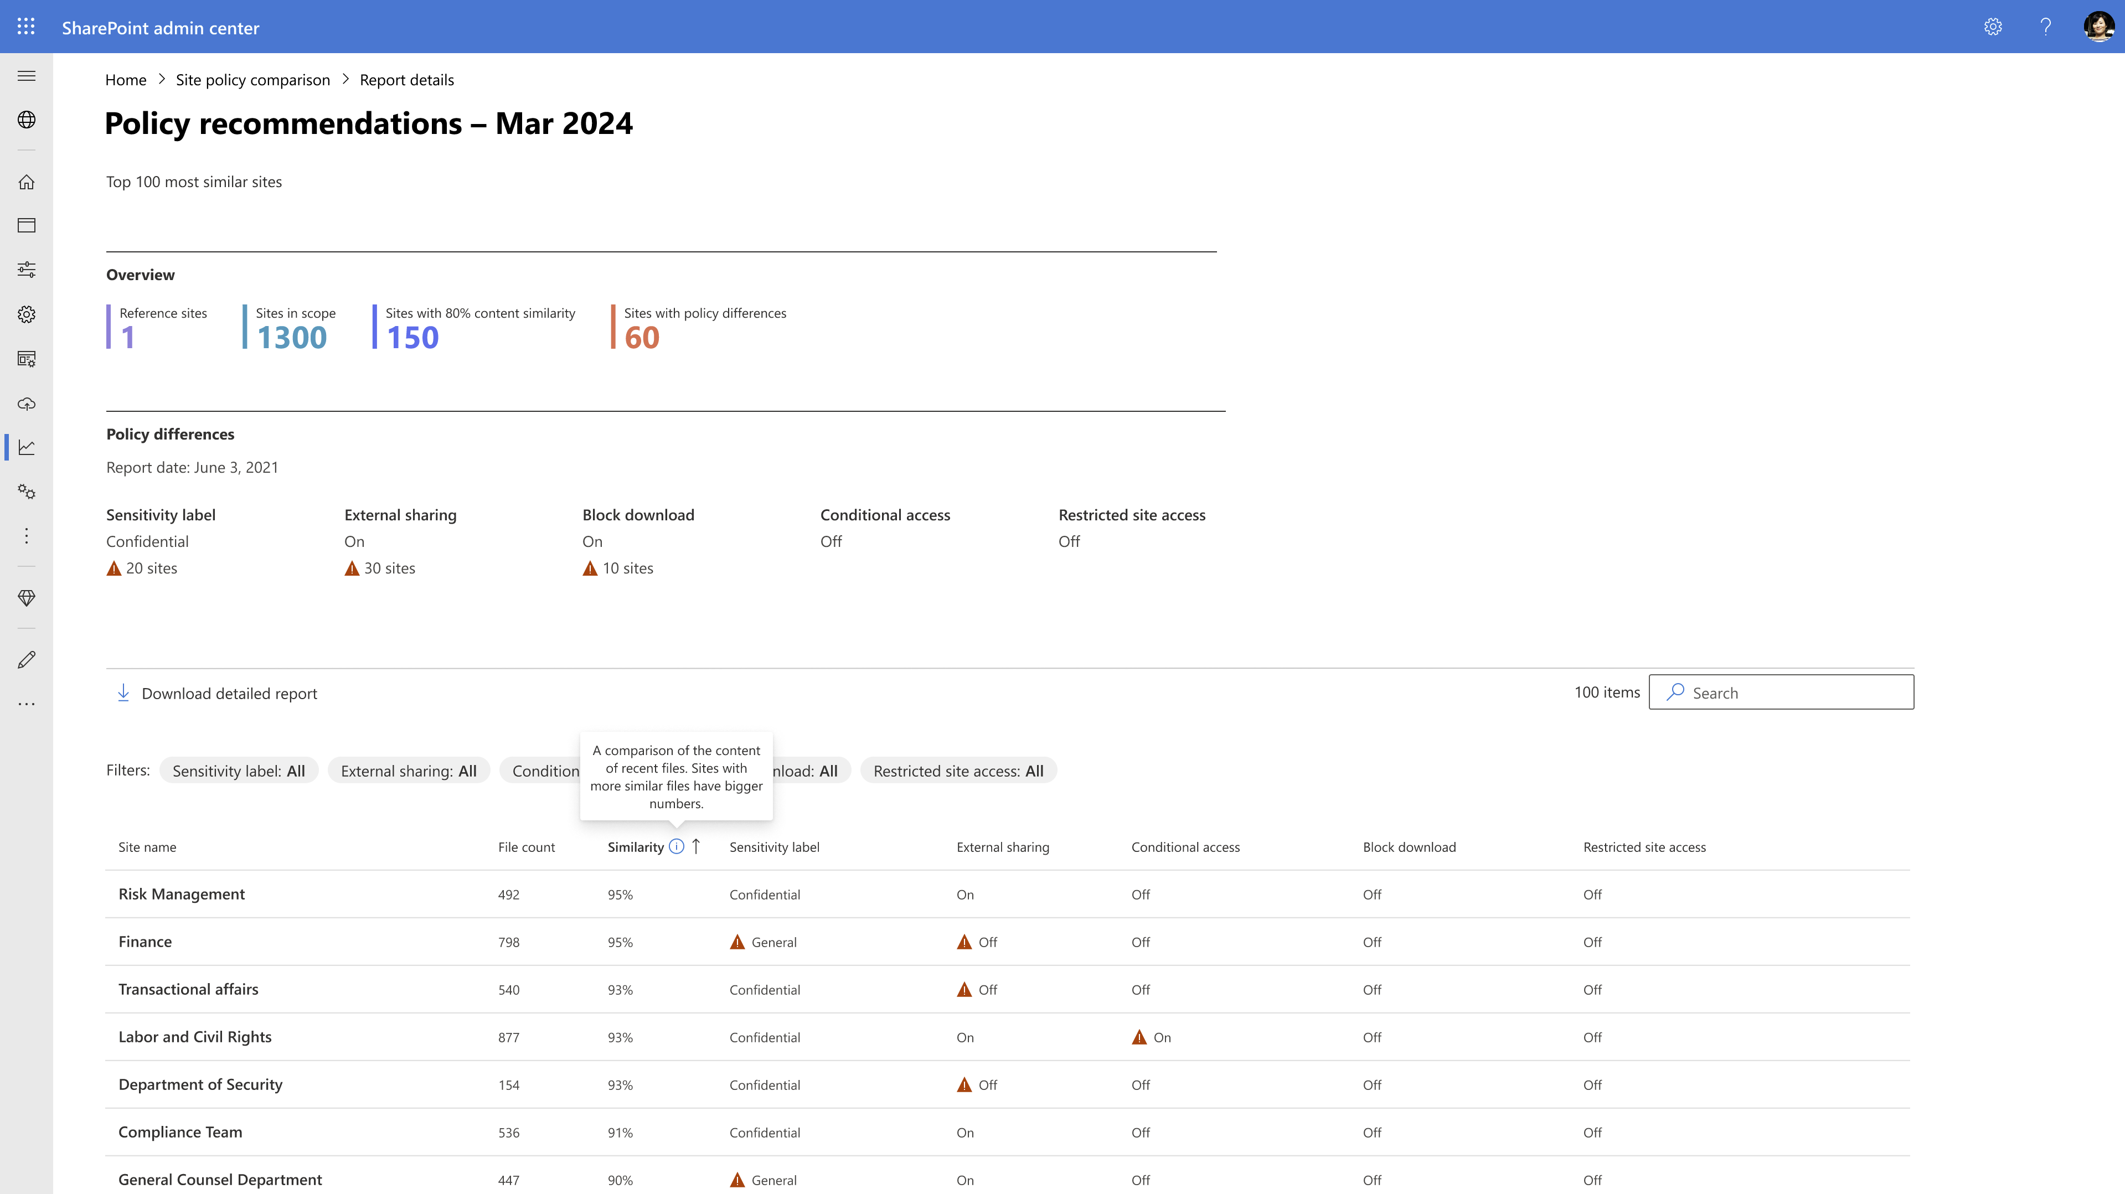

Slide 56
We have an exciting future ahead.
Notes:
Thank you.
<Speaker Guidance: Spend the last few minutes discussing or answering any questions they may have. If they have additional topics on their EBC agenda, make sure you connect with their account team to inform them which AI priorities and business outcomes resonated the most during this session. If you are in a 1:1 direct customer engagement, make sure you note what their priorities and questions were and work with the broader account teams and units to facilitate the proper hand-offs or next steps (i.e. get them into a session at the Innovation Hub/MTCs).>

Slide 57
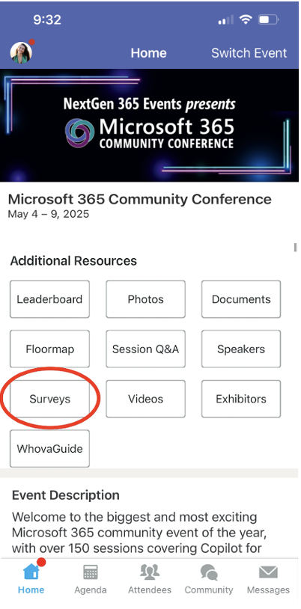
Session feedback surveys
We want to hear from YOU!
Share your feedback to make next years conference even better!
Here’s how –
Simply go to the Whova App on your smartphone.
Scroll down on the M365 Community Conference Homepage to ‘Additional Resources’ to click “Surveys’.
Click Session Feedback.
Scroll down to find this session title.
Complete the session feedback survey.
Finally, click ‘Submit’.
It’s just that easy!

Slide 58
