Slide 1
Driving Better News Engagement with the Copilot Charged Enterprise News Reader
DC Padur
May 7th, 2025

Slide 2

Microsoft 365 Community Conference

Slide 3


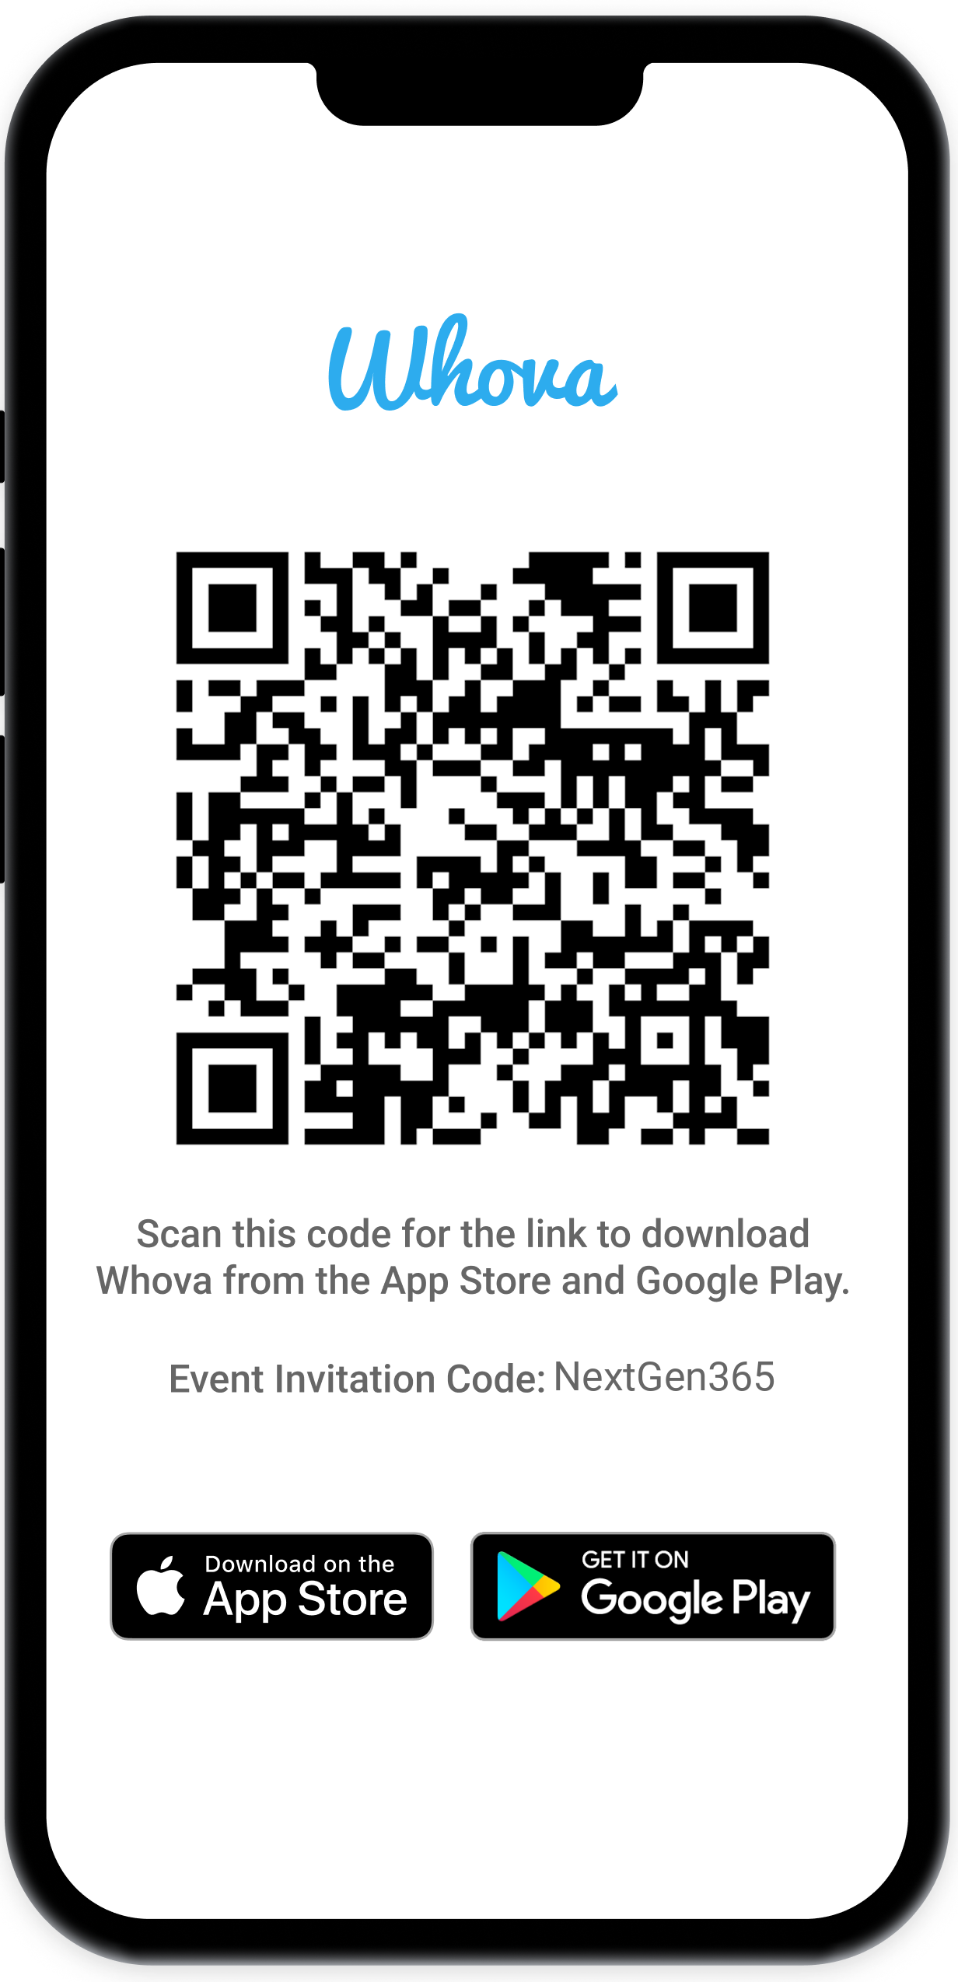
Join the event app to access:
The official event app for the
Microsoft 365 Community Conference
Event invitation code: NextGen2025
Event announcements
Personalized agenda, session details
Speaker & attendee profiles
Networking, meet-ups, messages
Event documents

Slide 4


DC Padur
Principal PM
dcpadur

Slide 5
Agenda
Copilot charged News reader for your intranet.
Influence the news feed for all your users.
Get more done with Graph API for SharePoint news!

Slide 6
All demo, no slides!

Slide 7
Microsoft Graph API for SharePoint Pages - RECAP
Available in V1.0:
For creating or editing a page/news post, we support 14 Microsoft provided web parts + any third-party web part.
Read only actions, delete and publish operations can be performed on pages/news posts with any web part.
Validation of payload and client-side error improvements.
Text Web part | Image | Image Gallery | Button
Call to Action | Divider | Document embed | Link preview
Quick links | People | Bing maps | Spacer
YouTube embed | Org chart
Available in beta:
Custom page template support – List, create, create from edit, delete
News link support – List, create, edit, delete
https://aka.ms/pagesapi

Slide 8
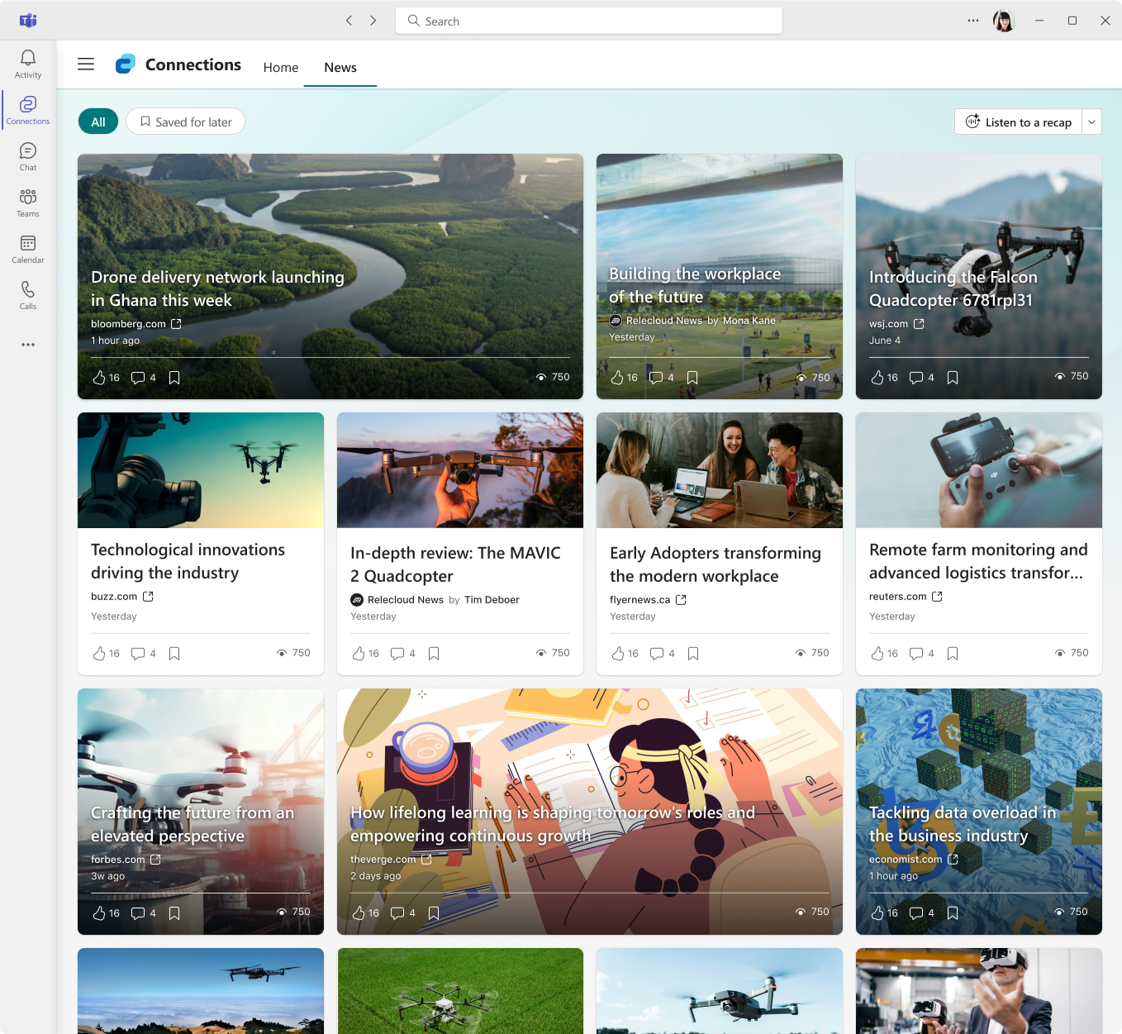
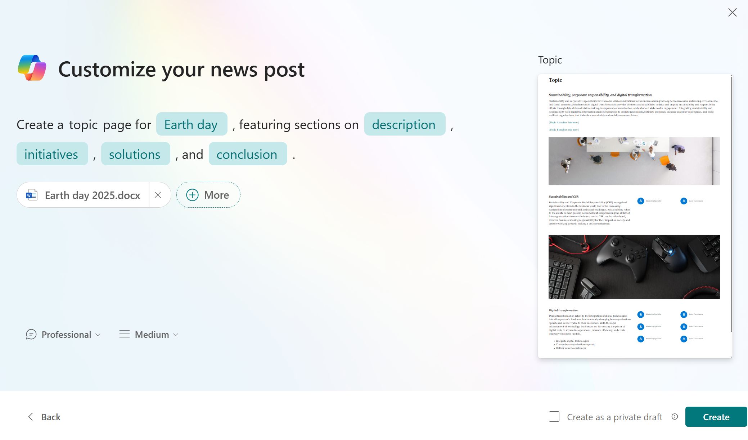
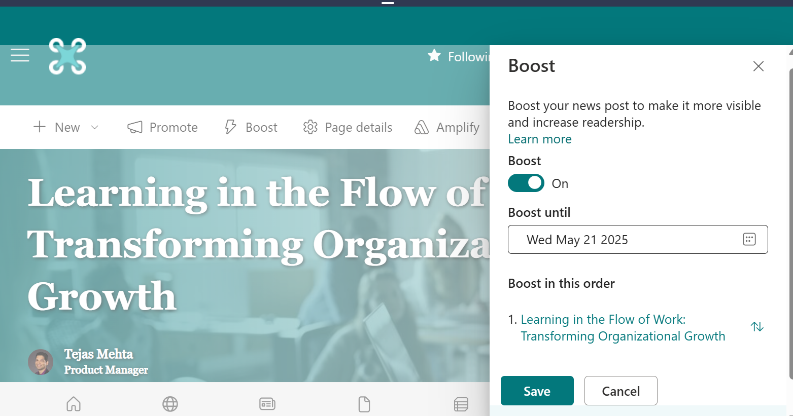

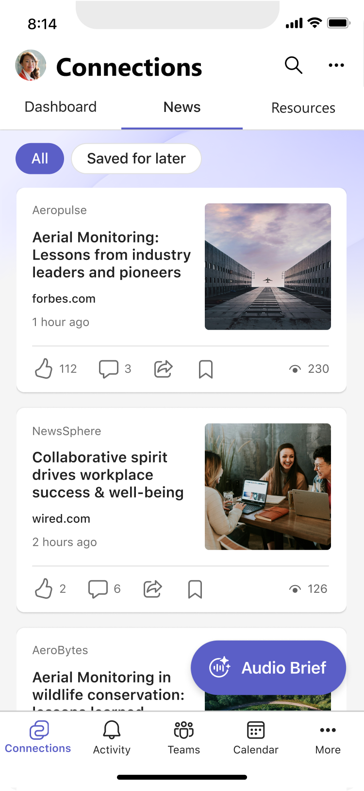
Leverage SharePoint News - keep intranet fresh and drive engagement
News reader in Teams!
Copilot powered News creation
Boost responsibly!
Do more with Pages Graph API
http://aka.ms/pagesapi

Slide 9
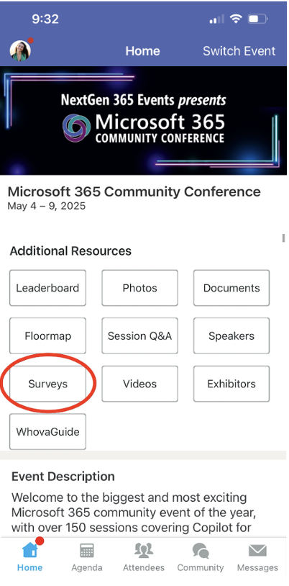
Session feedback surveys
We want to hear from YOU!
Share your feedback to make next years conference even better!
Here’s how –
Simply go to the Whova App on your smartphone.
Scroll down on the M365 Community Conference Homepage to ‘Additional Resources’ to click “Surveys’.
Click Session Feedback.
Scroll down to find this session title.
Complete the session feedback survey.
Finally, click ‘Submit’.
It’s just that easy!

Slide 10
We have an exciting future ahead.

Slide 11
Expertise and tools for your journey
Technical expertise via our FastTrack partners
Tools, resources & training on our Adoption Hub
Events and real-world knowledge in our community
aka.ms/Microsoft/FastTrack
adoption.microsoft.com
aka.ms/TechCommunity

Slide 12
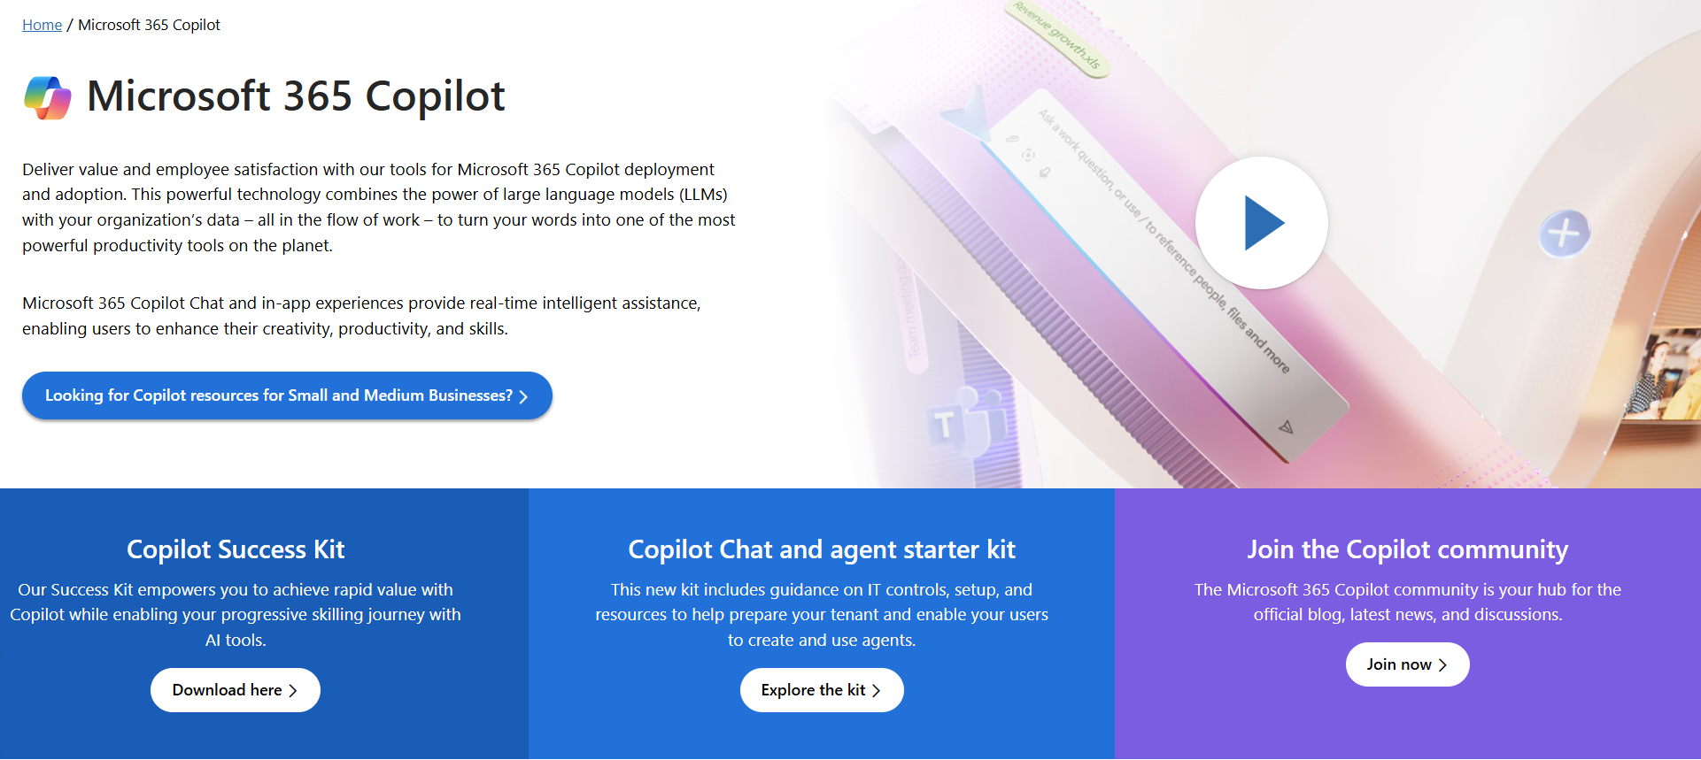
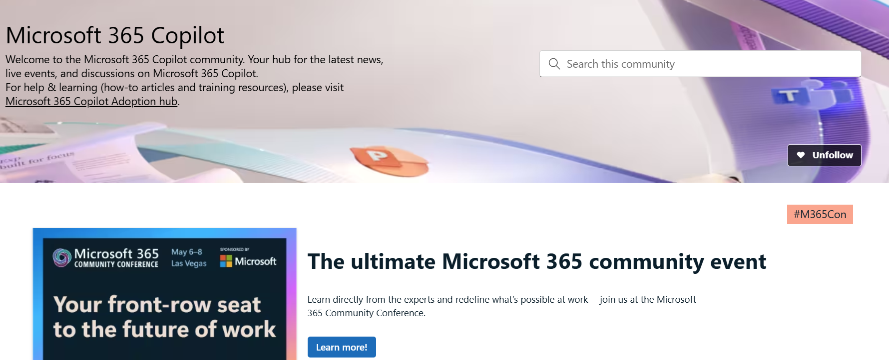
News & community content
Microsoft Community Learning aka.ms/Community/LearningChannel
Community led expert content on all your favorite Microsoft services.
Start your week with live news and event updates aka.ms/MondaysatMicrosoft
Watch live or on-demand & share our blog.

