Slide 1
Maximize your collaboration in chats and channels in Microsoft Teams – LT23
Roshin Lal Ramesan, Principal Group Product Manager
Derek Snook, Principal PM Manager

Slide 2

Microsoft 365 Community Conference

Slide 3


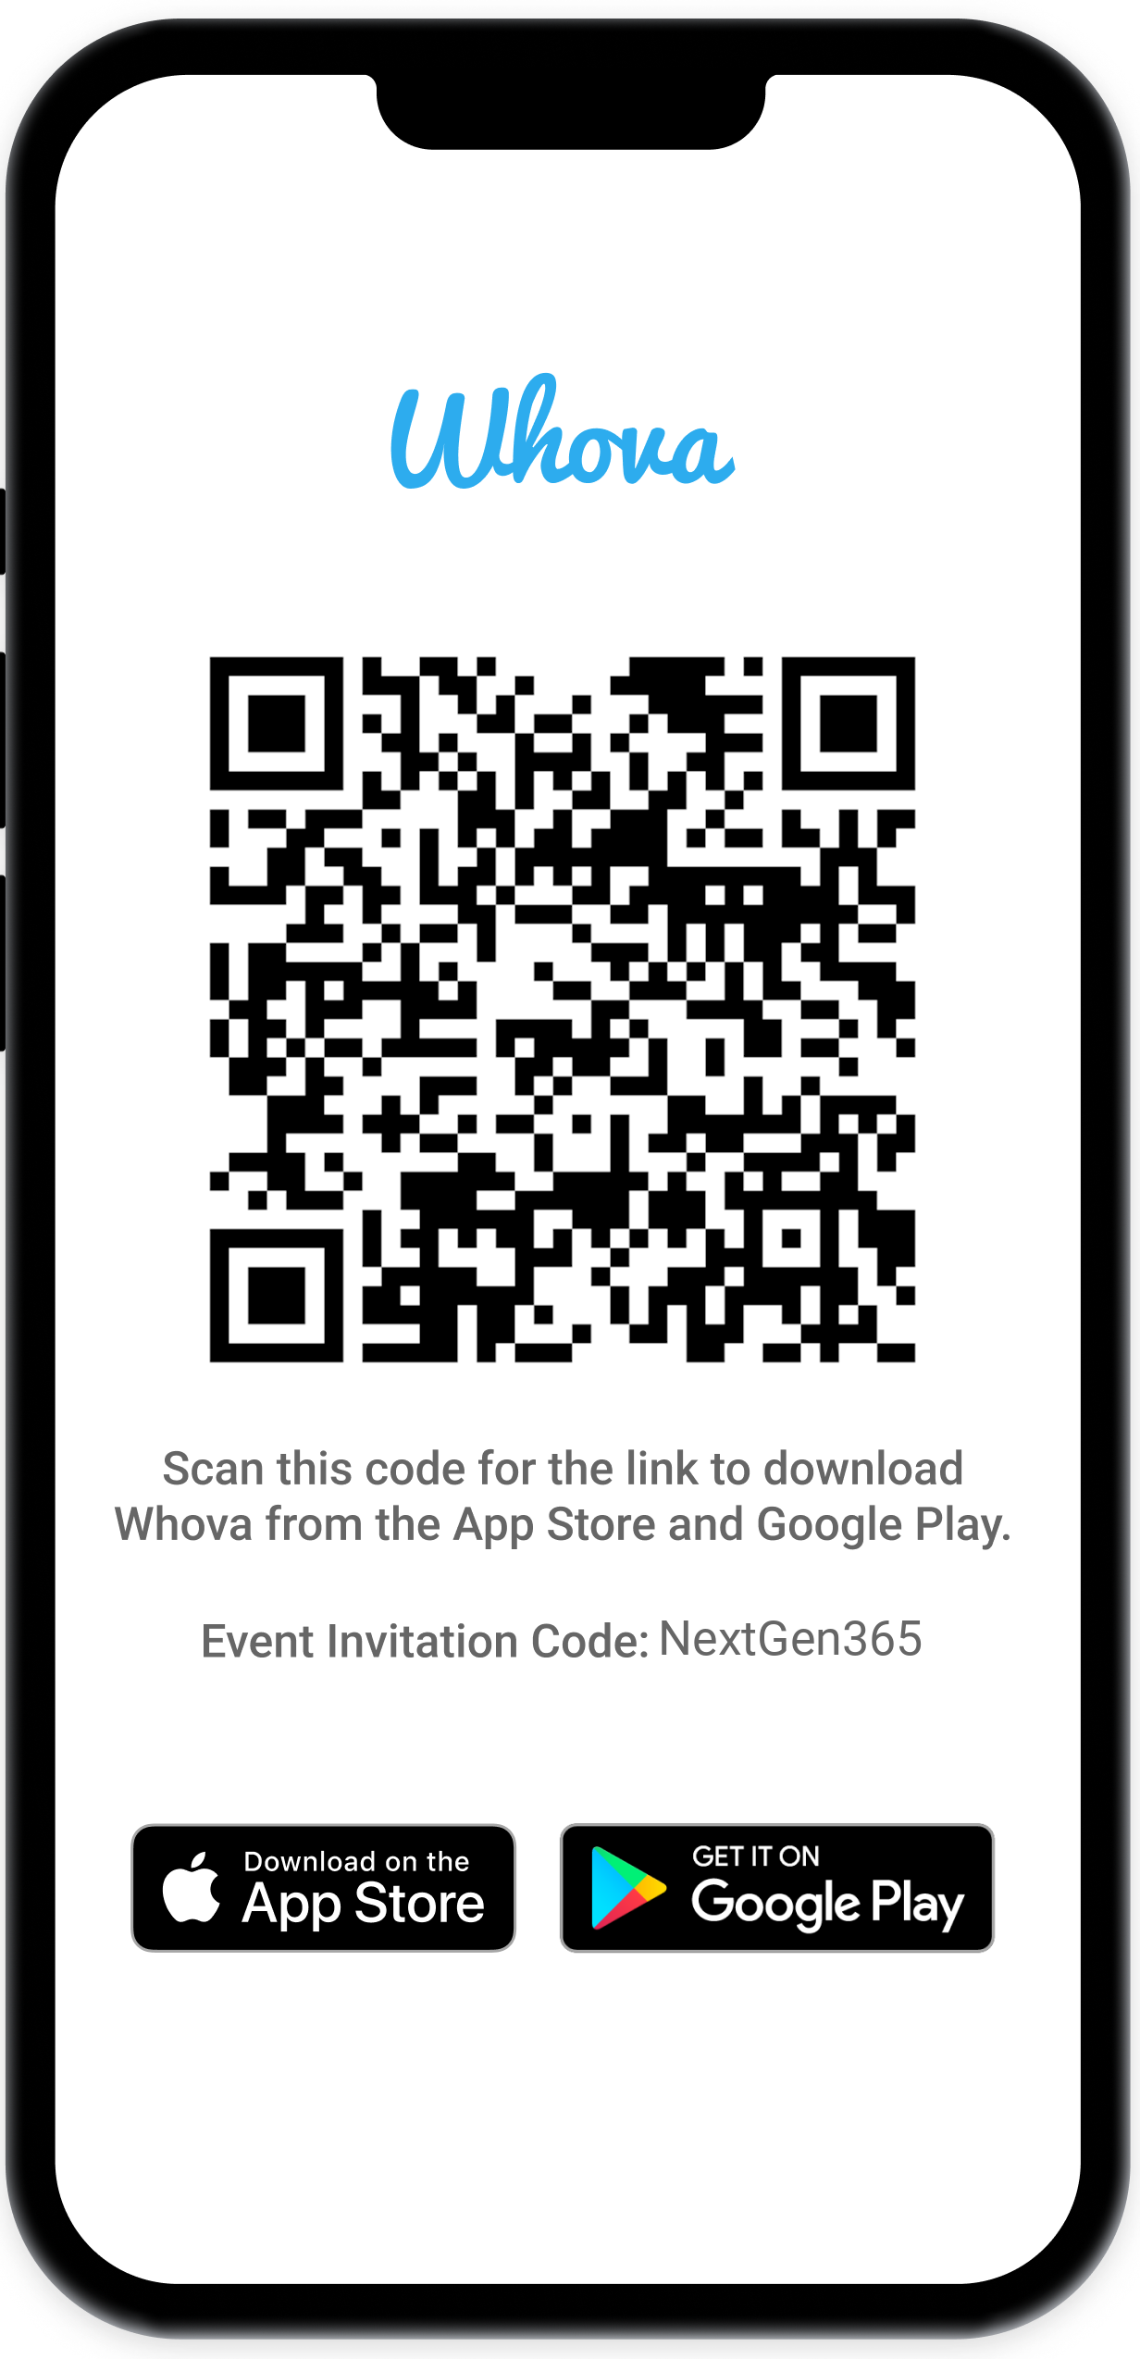
Join the event app to access:
The official event app for the
Microsoft 365 Community Conference
Event invitation code: NextGen2025
Event announcements
Personalized agenda, session details
Speaker & attendee profiles
Networking, meet-ups, messages
Event documents

Slide 4


Roshin Lal Ramesan
Principal Group Product Manager
www.linkedin.com/in/roshinlal
Derek Snook
Principal PM Manager
www.linkedin.com/in/dereksnook

Slide 5

Microsoft Teams
1
2
3
Faster
Simpler
Smarter
Surface for next-generation AI
All platforms
Notes:
We want Teams to be faster, simpler and smarter.
The new Teams released in 2023 is twice as fast while using half the memory.
The new chats and channels experience is simpler, helping users stay on top and catch up on all their communication and collaboration in one place.
And Teams is getting smarter, with Copilot, intelligent recap, facilitator and more.

Slide 6

Too hard to…
Stay on top
Collaborate effectively
Stay focused
Notes:
What we hear from our customers is that there is so much going on that even if they try hard to focus, they tend to miss out on important things.
They always feel they are playing catch-up.
Today, we will be looking at how everyone can stay on top of all their conversations and collaborate more efficiently – in Teams.

Slide 7
Principles
Simple by default, powerful on demand
Better collaboration in fewer places
Stay in the flow
Notes:
Here are the key principles in the design of Teams.
First: We want to offer a simple product, that can be even more powerful when users ask for it. We want to let users customize their experience to suit the way they work. We serve a very large user base across many industries, and “one size” definitely does not fit all.
Second: We want to promote better collaboration in fewer places. This will help users to catch up and to better stay on top of their discussions. It will reduce the fragmentation that often happens today.
Third: We want users to be productive by staying in the flow of work, reducing context-switching, and have Teams adapt to the way our users work.

Slide 8
Role of chats and channels
Chats and Channels are collaboration spaces
Chats are meant for transient, lightweight conversations with smaller groups of people.
Channels are meant for durable workgroup collaboration around projects and topics.
Channels are discoverable and manageable, with lifecycle and membership governance
Channels have shared resources compared to chat.
Channels have centralized ownership, governance, lifecycle & management capabilities
Notes:
To meet these goals, we need to make channels the preferred destination for collaboration.
Chats are great for quick, lightweight back and forth with smaller groups of people.
Channels are meant for durable collaboration.
Many organizations such as yours set short retention policies on chats, 60 or 90 days. If critical business decisions are made in chats, this information is lost, deleted when that period ends. Files uploaded to chats could get deleted if user leaves the organization and their OneDrive folder is deleted.
Channels provide the shared collaboration workspaces that all workgroups can thrive in. But we have work to do to make it so.

Slide 9
The new chat and channels experience
Notes:
The New chat and channels experience is now available to everyone in the commercial cloud – we completed rollout last month, and it’s helping millions stay on top of what’s important and collaborate more efficiently than ever.
Here’s a quick video.

Slide 10
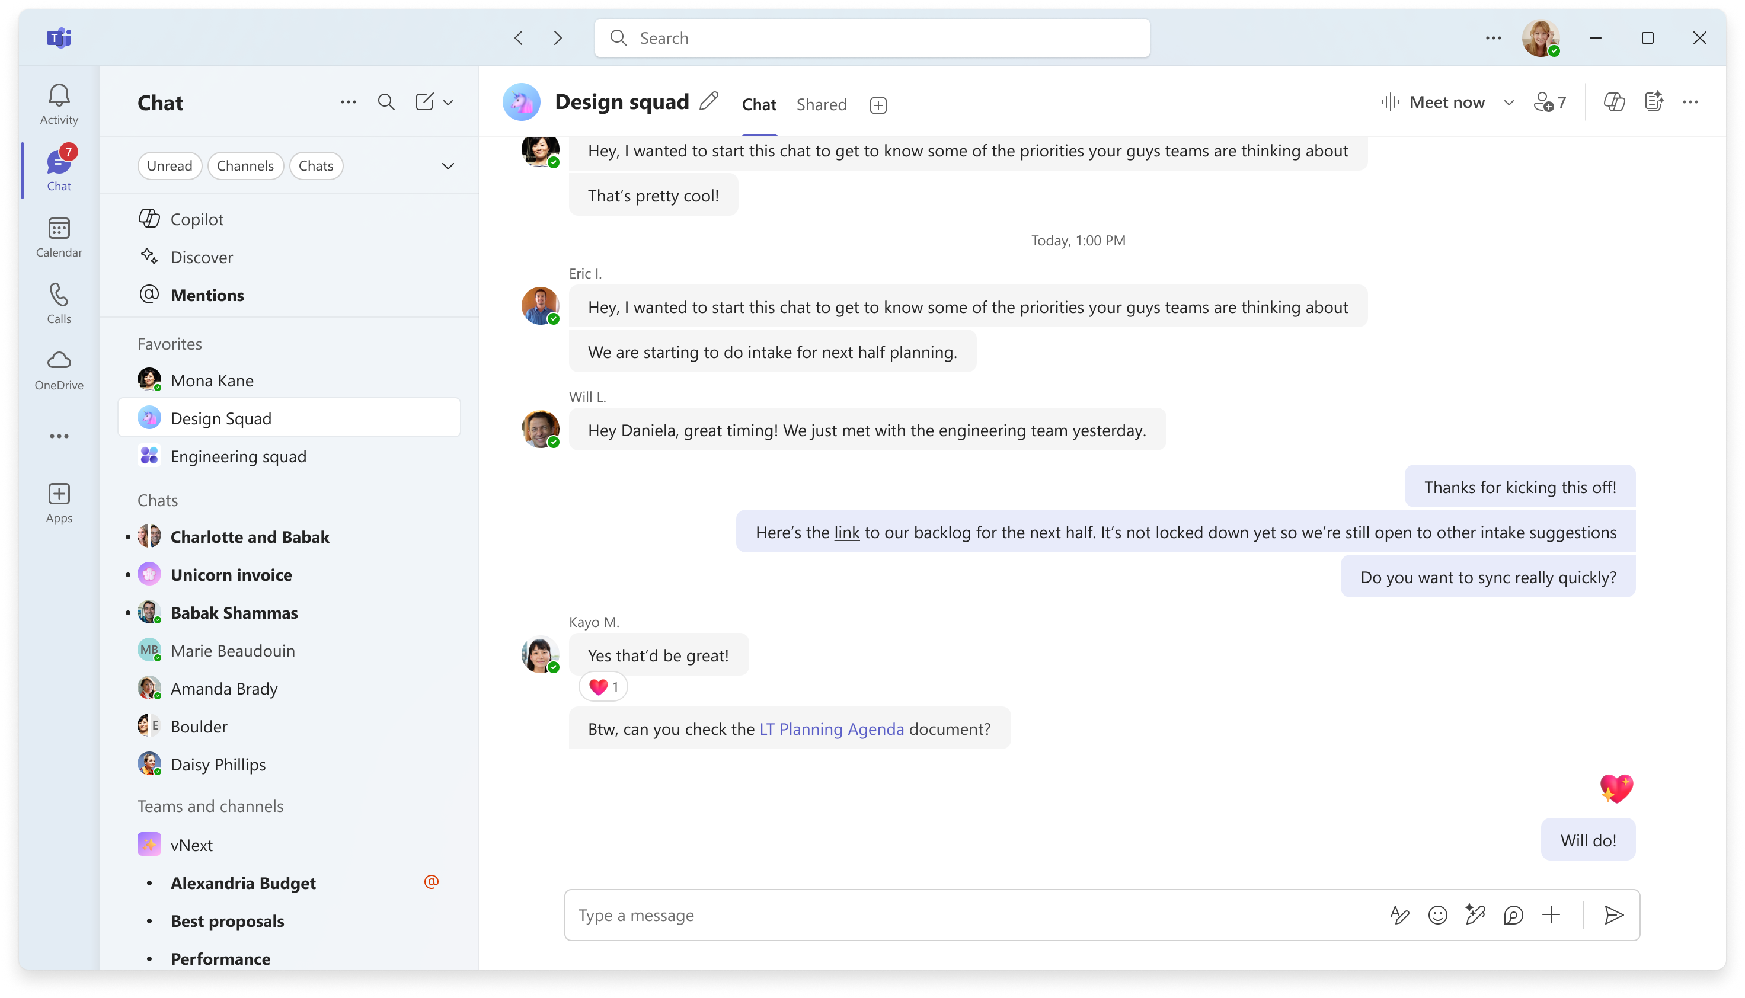
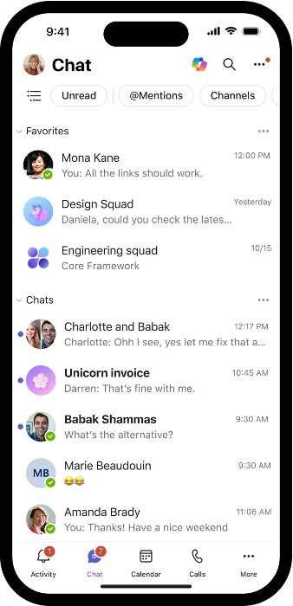
New chat and channels experience
Notes:
Stay on top of all your conversations and collaboration – let me demo the new experience and share my top tips for making the most of the new, transformative capabilities.
===
Let me break down what you saw.
Your chats and channels are one together, making it so much easier to stay on top of all your conversations in one place.
Filtering, search, new message – all these experiences now include chats or channels, so you don’t need to remember whether the conversation you are looking for is in a chat or a channel.
You can now organize all of your chats and channels into sections – use the default favorite section which brings together all your existing pinned chats and channels or create your own.
And what we are showing you here today is not just videos or concept mocks, this is the new Teams experience that millions of customers in public preview are using today.
Let me turn it over to Upasana who is going to demo these capabilities live.

Slide 11
Demo
Notes:
The New chat and channels experience is now available to everyone in the commercial cloud – we completed rollout last month, and it’s helping millions stay on top of what’s important and collaborate more efficiently than ever.
Here’s a quick video.

Slide 12
Stay on top of chats and channels, all in one place
The new experience brings chat, teams, and channels into one place under Chat.

Slide 13
The new Favorites section brings a user’s previously pinned chats and channels together. The rest of a user’s chats are here, in order of message recency. Teams and channels are below chats, organized in the same order as the Teams view.
Organize conversations

Slide 14
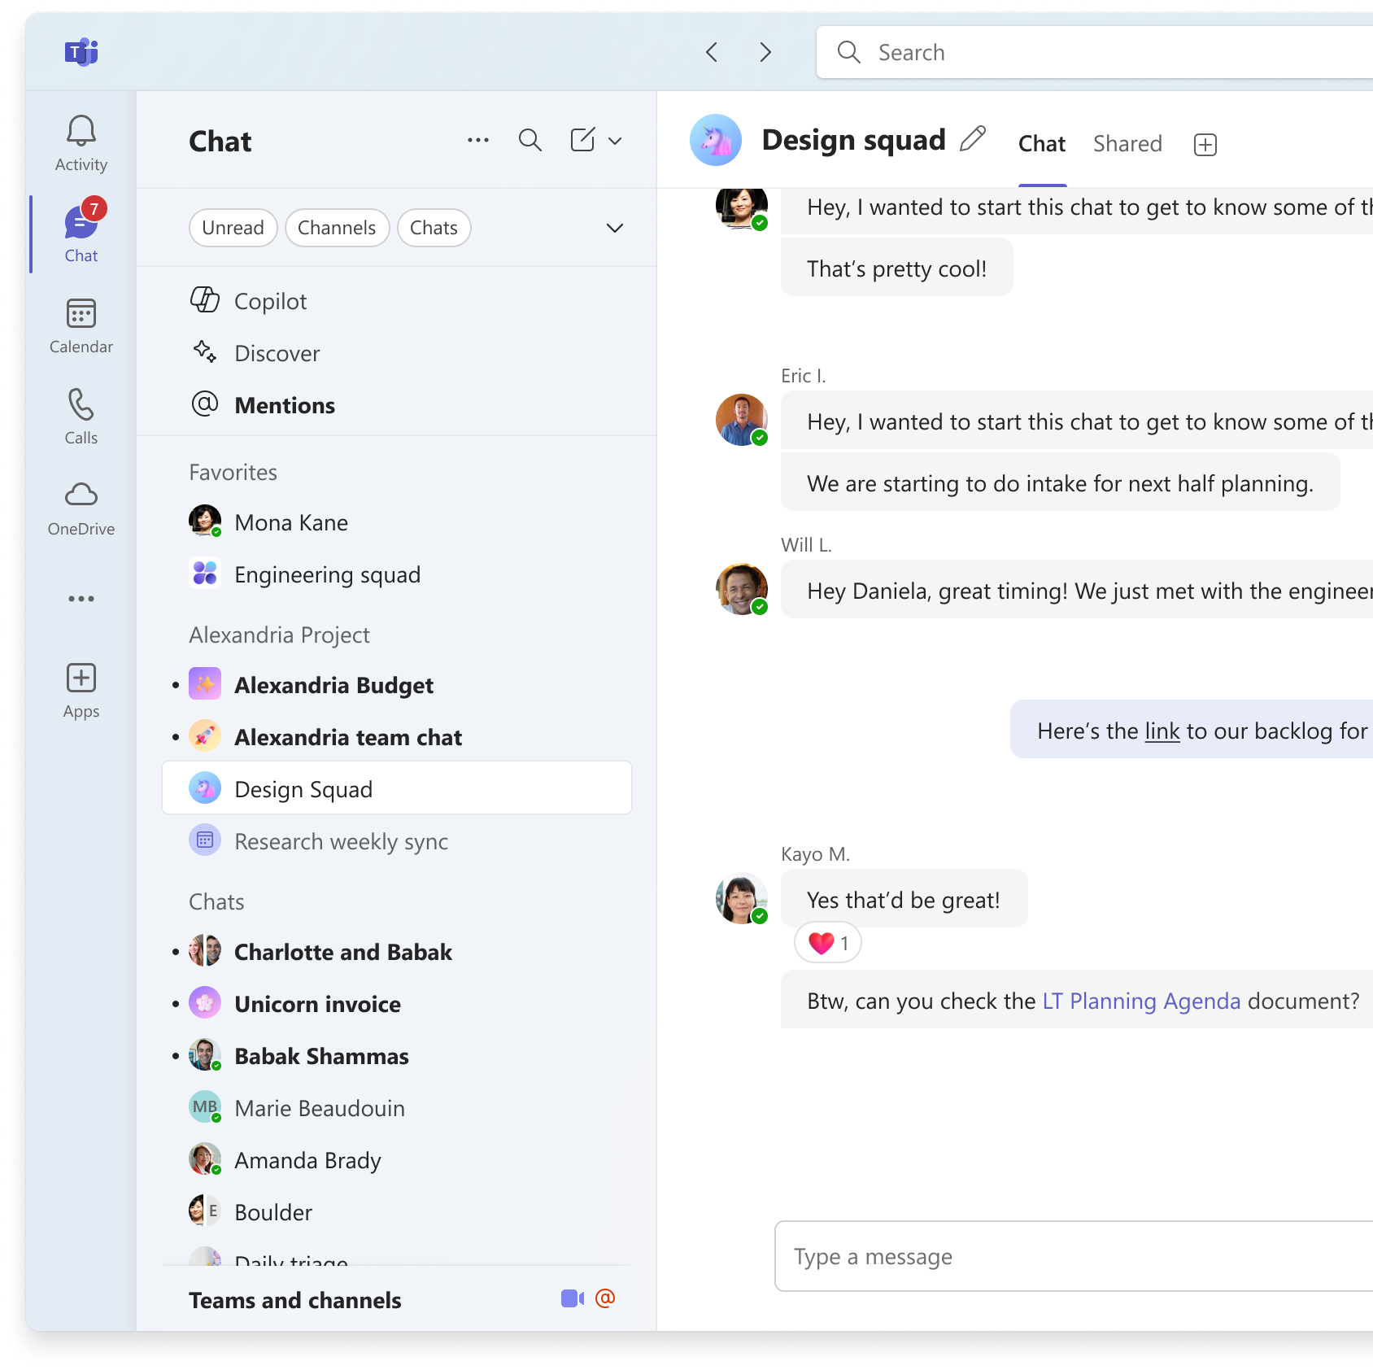
Organize conversations
With custom sections, users can bring all relevant conversations on a project or topic together into one place, across chats, channels, meetings, Teams bots, or AI agents.

Slide 15
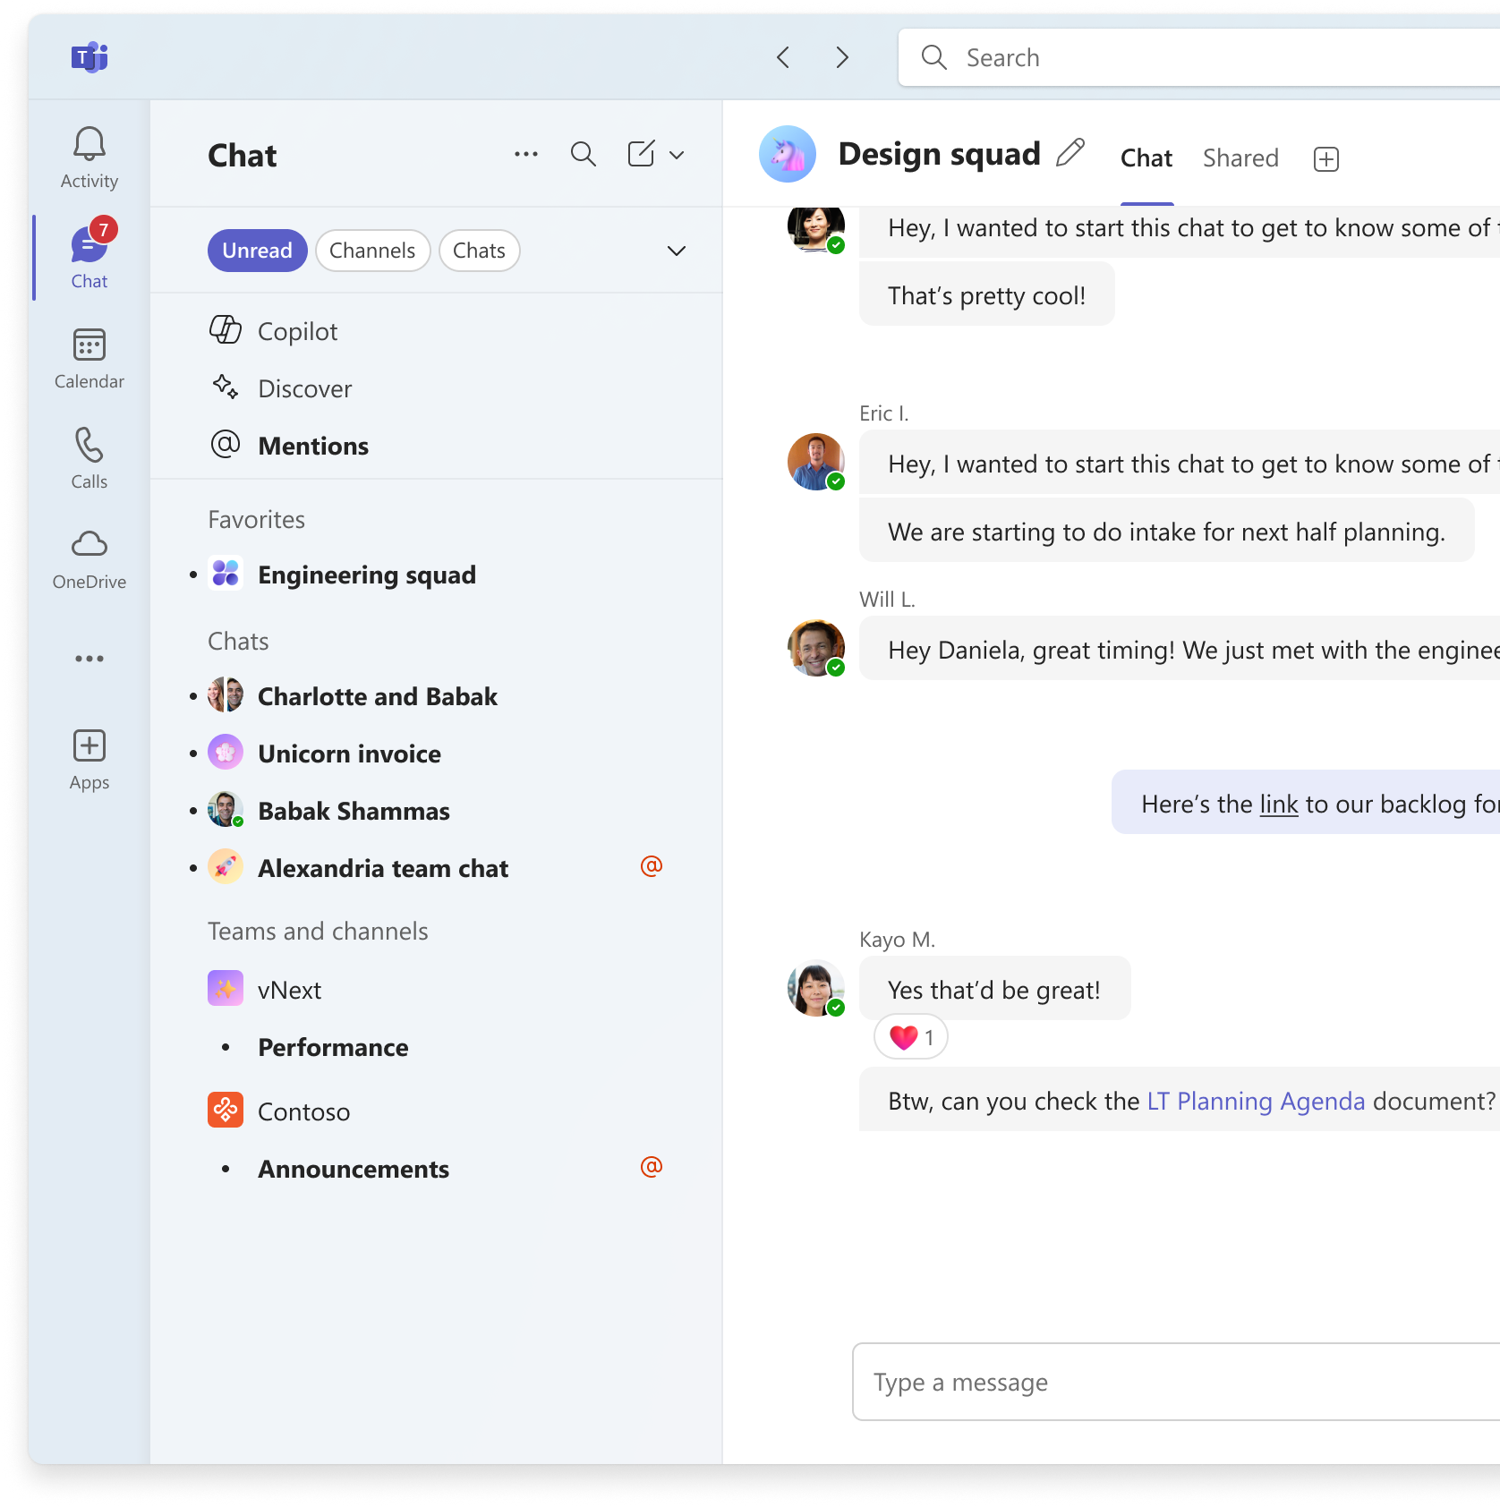
New filters help users prioritize messages with a single click, for example unread, channels, or meeting conversations. Users can select unread alongside one of channels, chats, or meeting chats filters to narrow down further.
Effectively triage messages

Slide 16
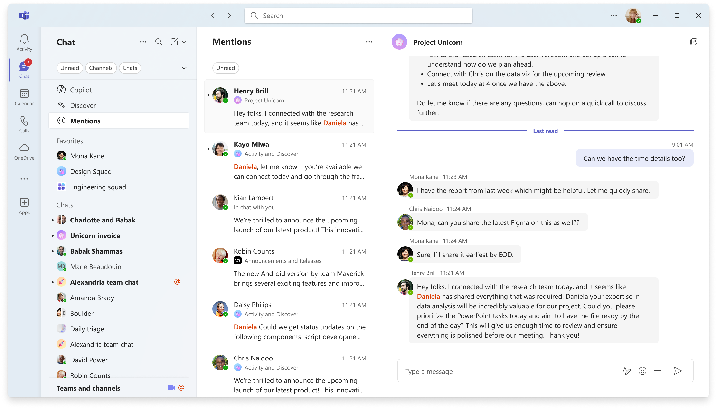
Effectively triage messages
The new @Mentions view gathers all personal mentions into a single interactive list.

Slide 17

Click the quick navigation bar for teams and channels to instantly scroll to the Teams and channels section.
Navigate quickly

Slide 18
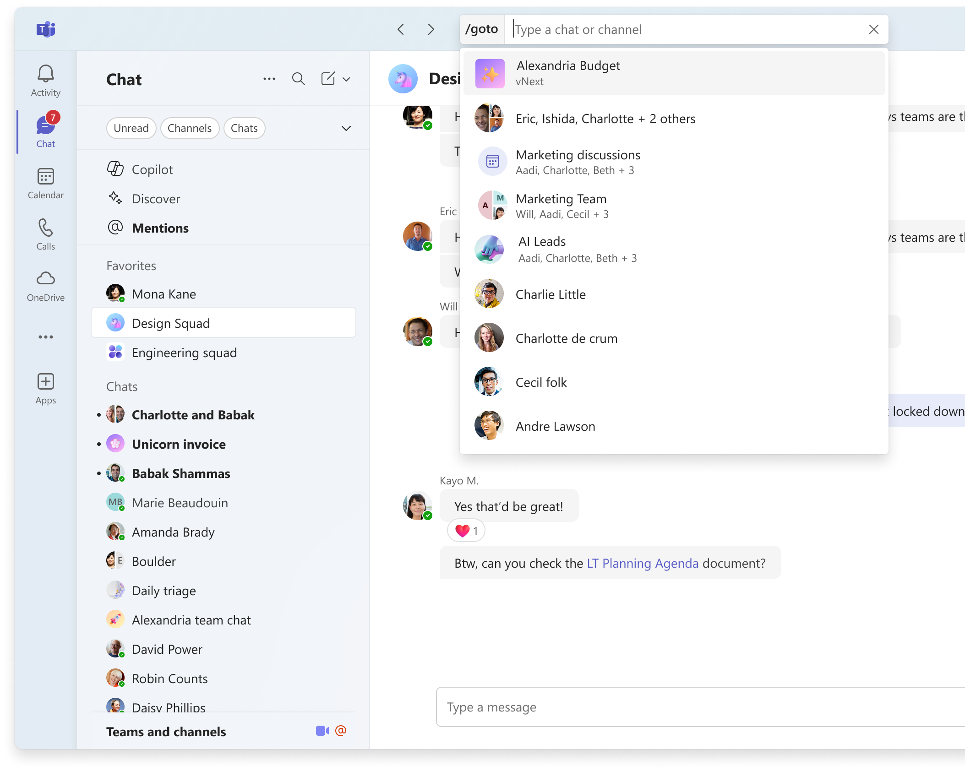
Save time when communicating
The new keyboard shortcut for go to, Ctrl+G (Cmd+G on Mac), narrows search to just chats and channels and takes users quickly to a specific conversation.

Slide 19
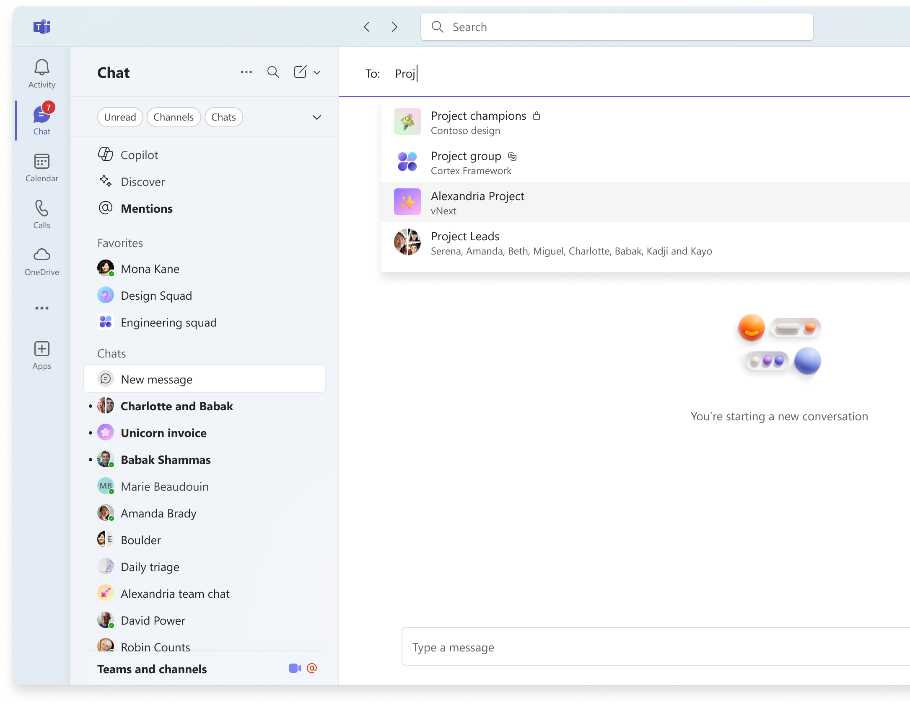
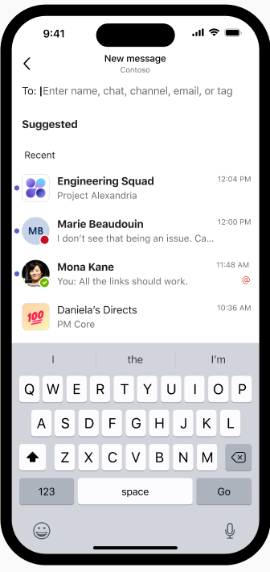
Save more time when communicating
Users can start a message to any chat or channel from the new message feature. Access new message quickly with the keyboard shortcut Ctrl+N (Cmd+N on Mac).

Slide 20
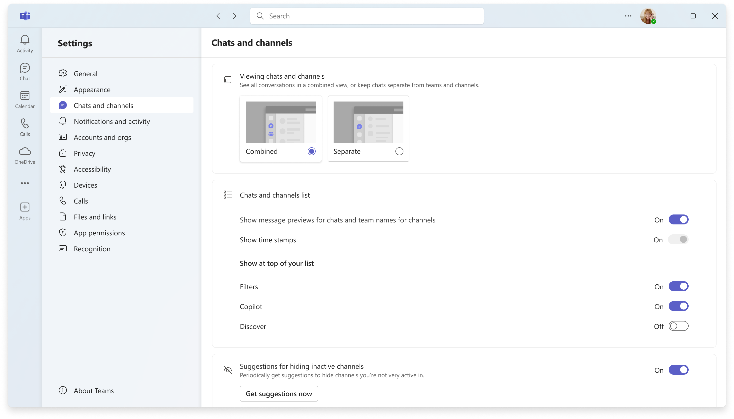
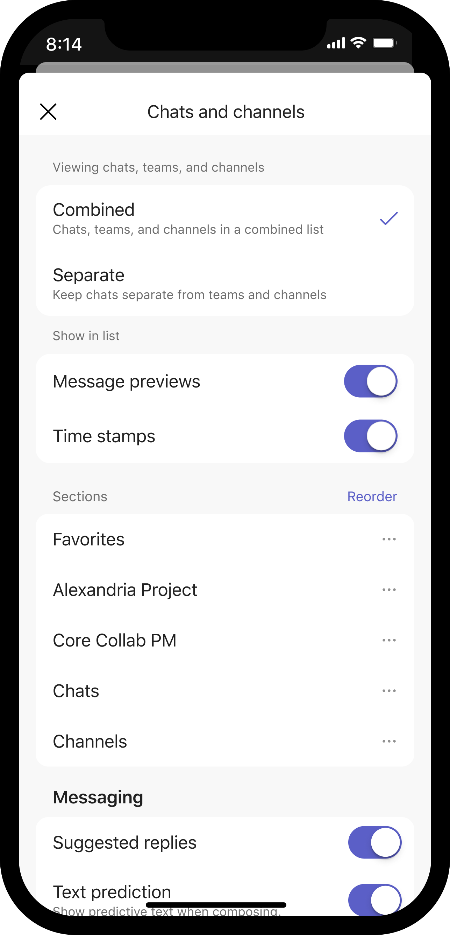
Every user has a unique way of working. Customize Teams chat and channels to align with personal workflows with new controls.
Customize the experience

Slide 21
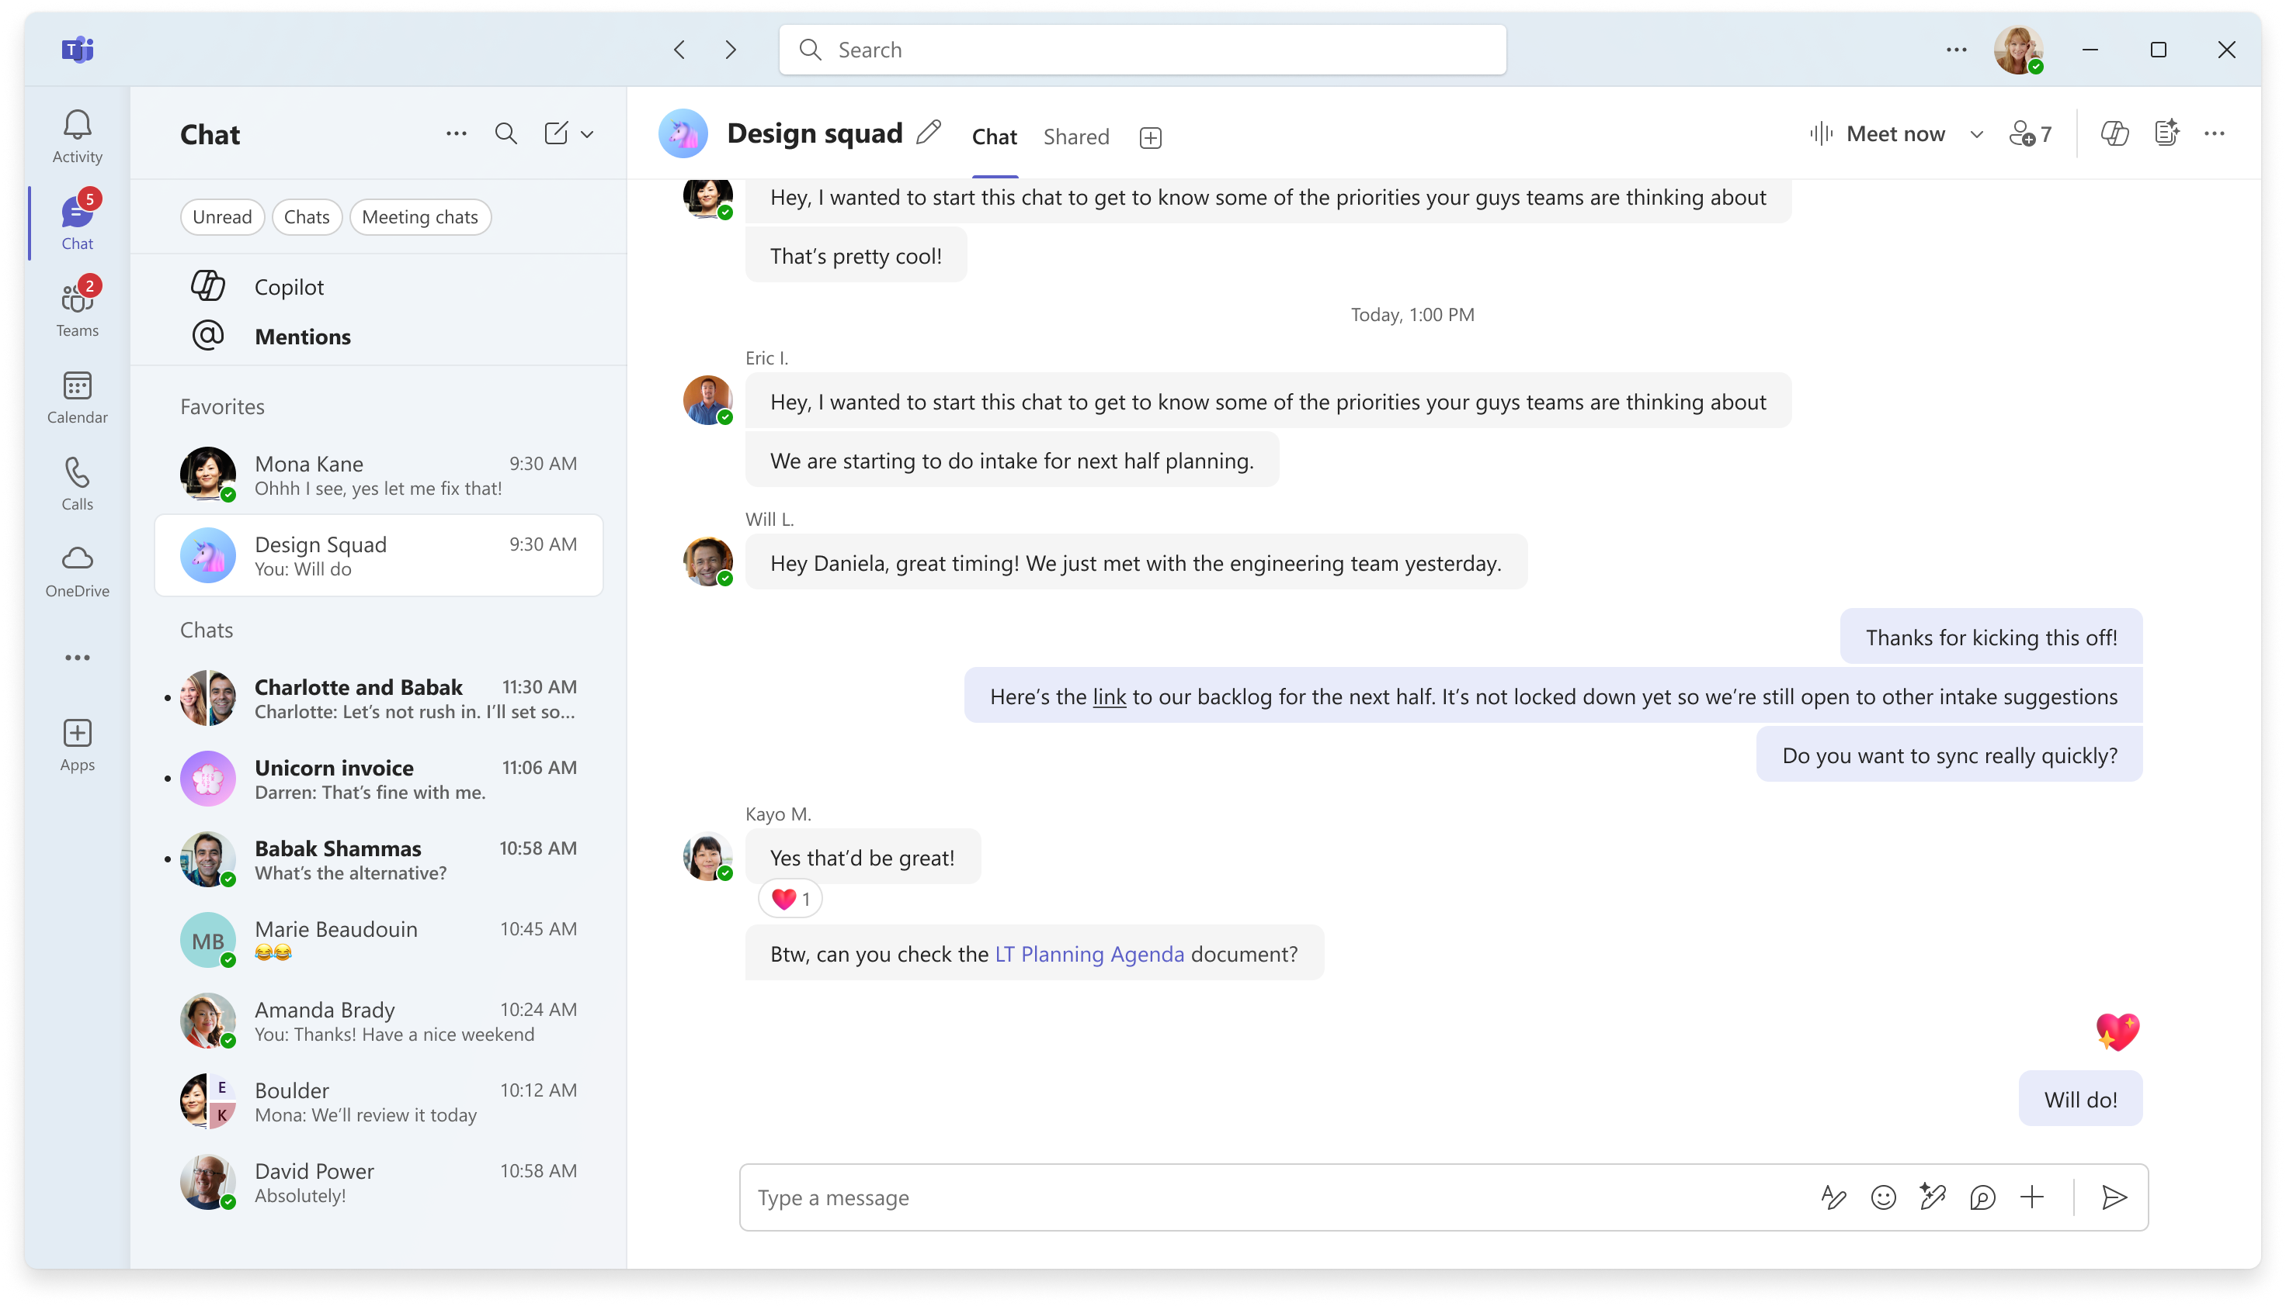
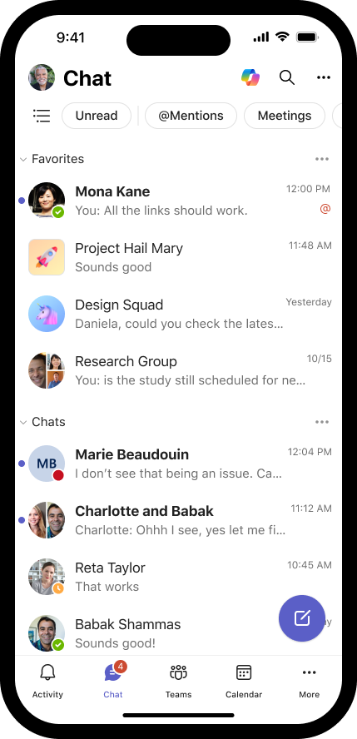
When using the separate Chat and Teams views, users get the benefits of the new filters and the @Mentions view to triage and organize their list, as well as the new message and go to commands navigate quickly across conversations in chats or channels.
Separate Chat and Teams views

Slide 22
Optimized for mobile
With the Teams mobile app, users’ sections, and organization are synced with desktop. Filters and the @Mentions view are right here to for quick triage anytime. The view toggle next to the filters lets users switch between organizing the list by sections or in order of recent messages.

Slide 23
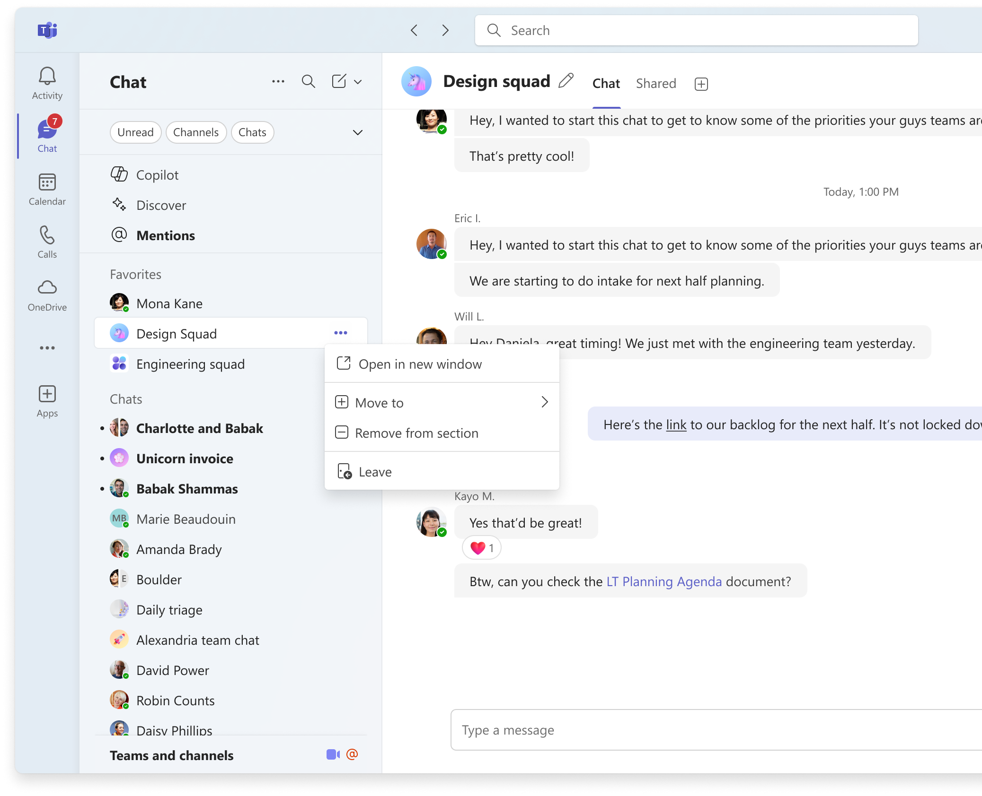
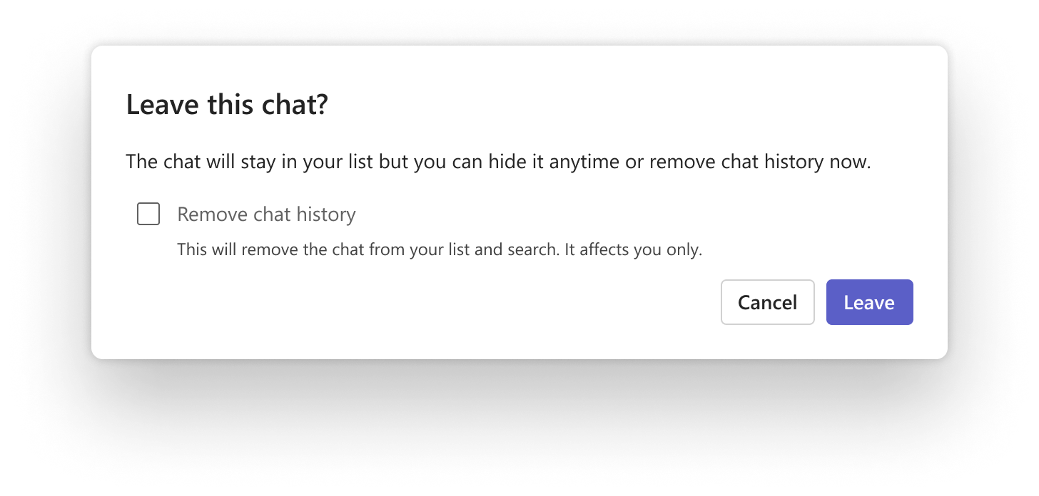
To clarify the behavior of actions for chats, instead of the Delete action for group, meeting or 1:1 chats, in group chats and meeting chats, users can remove the chat and chat history by using Leave. Users will be asked if they want to keep or remove chat history. Removing chat history will function as Delete did before, removing the chat history from their list. ⁠In 1:1 chats, users can remove the chat from the chat list and remove chat history for themselves with the Remove chat history action.
Removing chats and chat history (formerly Delete chat)

Slide 24
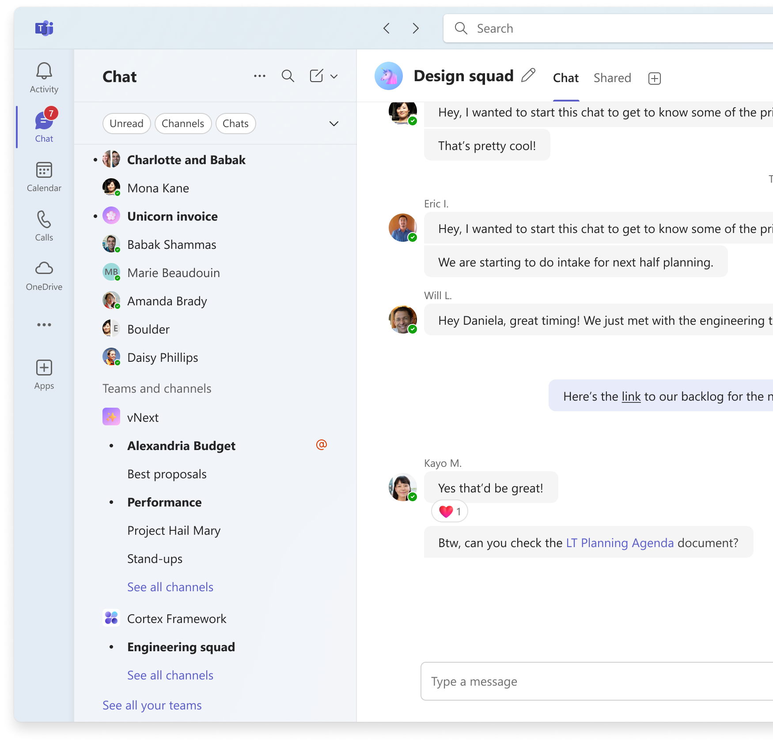
To focus on the channels most important to the user, the teams and channels list shows all teams with at least one shown (non-hidden) channel. Instead of the “Hidden teams” section from before, teams that were hidden but contain at least one shown channel are displayed as collapsed at the bottom of the list. Teams with no shown channels are not displayed in the list. Users can find a list of all channels in a team, including hidden channels, by clicking on See all channels in the team’s list. To view all teams, including those with no shown channels, click See all your teams at the bottom of the list. From this view, selecting a team and choosing to Show a channel will also display its team in the list. Teams can be removed from the list by using the Hide all channels option from the team’s More options “…” menu in the list.
Your teams and channels

Slide 25
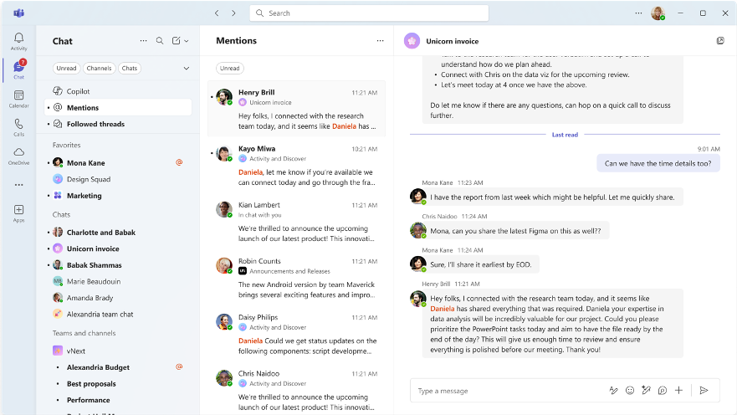
New chat and channels experience

Slide 26

Resources Microsoft 365 blog https://aka.ms/Teams/NewCCAnnouncement and Tech Community blog Microsoft Adoption https://aka.ms/Teams/NewChatChannels w/ Champions, IT Pro, Admin guide, User guide, and community events.
Notes:
There are several resources to help end users, champions, IT Pros and admins transition and make the most of the new chat and channels experience.
Follow these links to learn more and access these resources.

Slide 27
We have an exciting future ahead.
Notes:
Thank you.
<Speaker Guidance: Spend the last few minutes discussing or answering any questions they may have. If they have additional topics on their EBC agenda, make sure you connect with their account team to inform them which AI priorities and business outcomes resonated the most during this session. If you are in a 1:1 direct customer engagement, make sure you note what their priorities and questions were and work with the broader account teams and units to facilitate the proper hand-offs or next steps (i.e. get them into a session at the Innovation Hub/MTCs).>

Slide 28
Expertise and tools for your journey
Technical expertise via our FastTrack partners
Tools, resources & training on our Adoption Hub
Events and real-world knowledge in our community
aka.ms/Microsoft/FastTrack
adoption.microsoft.com
aka.ms/TechCommunity
Notes:
Please leave this slide in for conference attendees.

Slide 29
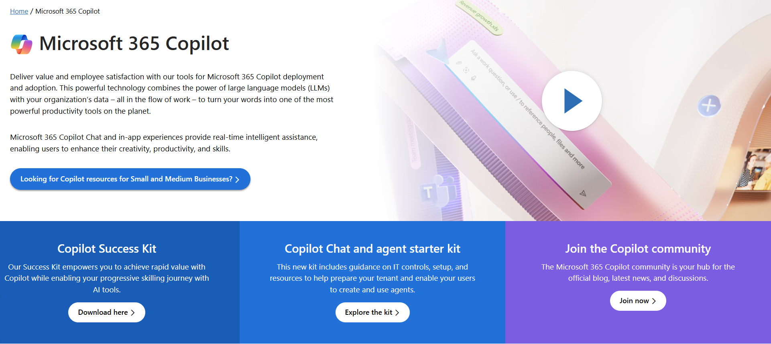
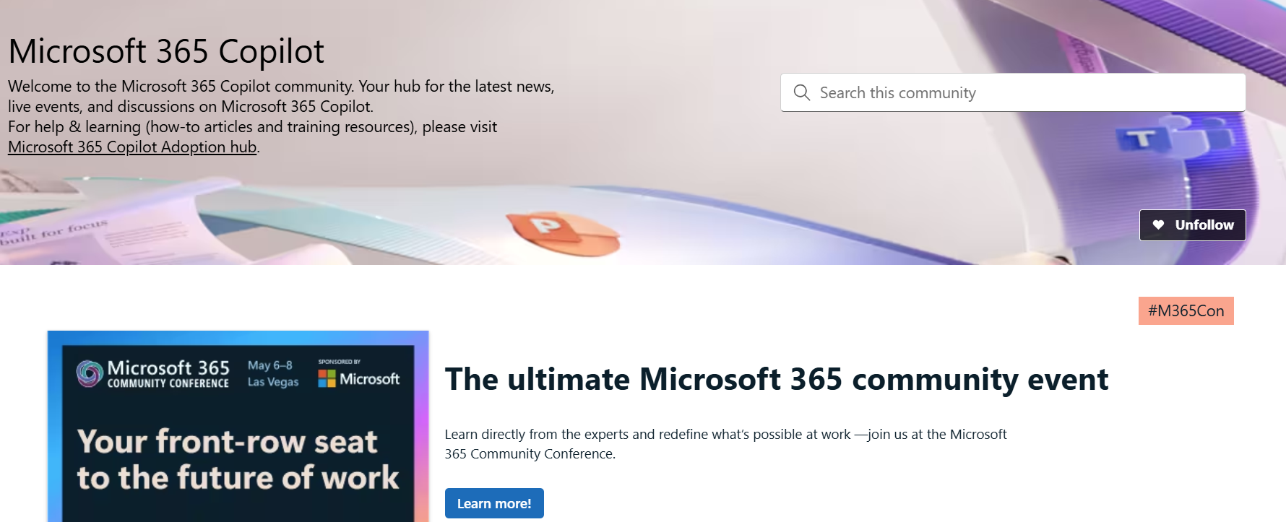
News & community content
Microsoft Community Learning aka.ms/Community/LearningChannel
Community led expert content on all your favorite Microsoft services.
Start your week with live news and event updates aka.ms/MondaysatMicrosoft
Watch live or on-demand & share our blog.
Notes:
To help you with adoption, the Copilot Readiness Hub is an open one stop shop for content, organized by role for your Copilot for Microsoft 365 journey.
You can use its recommendations to prepare and plan for your deployment, create a user experience strategy as I’ve presented today, and an adoption plan.
And as Copilot continues to evolve, keep coming back for new content that is published regularly.
You can also join the Copilot for Microsoft 365 community to get your questions answered and meet others who are leveraging Copilot for Microsoft 365 right now.

Slide 30
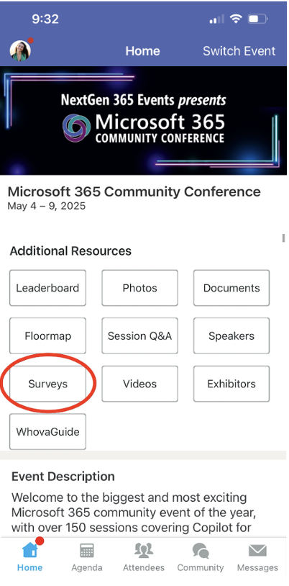
Session feedback surveys
We want to hear from YOU!
Share your feedback to make next years conference even better!
Here’s how –
Simply go to the Whova App on your smartphone.
Scroll down on the M365 Community Conference Homepage to ‘Additional Resources’ to click “Surveys’.
Click Session Feedback.
Scroll down to find this session title.
Complete the session feedback survey.
Finally, click ‘Submit’.
It’s just that easy!

Slide 31


