Slide 1
Building a Career with the Help of Community
Heather Cook, Principal PM, Microsoft Customer Advocacy Group

Slide 2


Slide 3


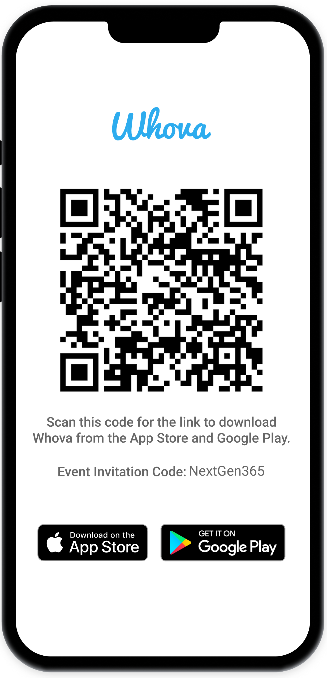
Join the event app to access:
The official event app for the
Microsoft 365 Community Conference
Event invitation code: NextGen2025
Event announcements
Personalized agenda, session details
Speaker & attendee profiles
Networking, meet-ups, messages
Event documents

Slide 4
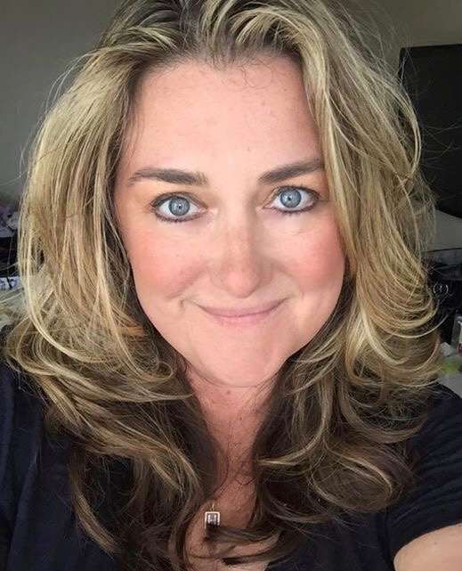
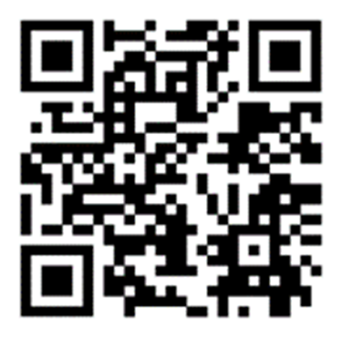
Heather Cook
@heddamaven
Aka.ms/HeatherCookLinkedIN

Slide 5

Participating in the Microsoft Community
Get involved in user group meetups
Meet product group members
Ask and answer questions in community forums
Notes:
The Microsoft Community is a great place to connect with other users and learn more about Microsoft's products. Attend meetups and get to know other users and product group members. You can also ask and answer questions in the community forums.

Slide 6
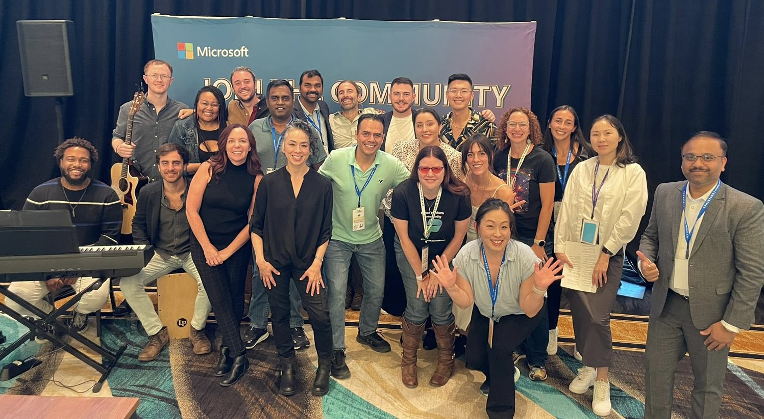
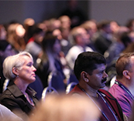
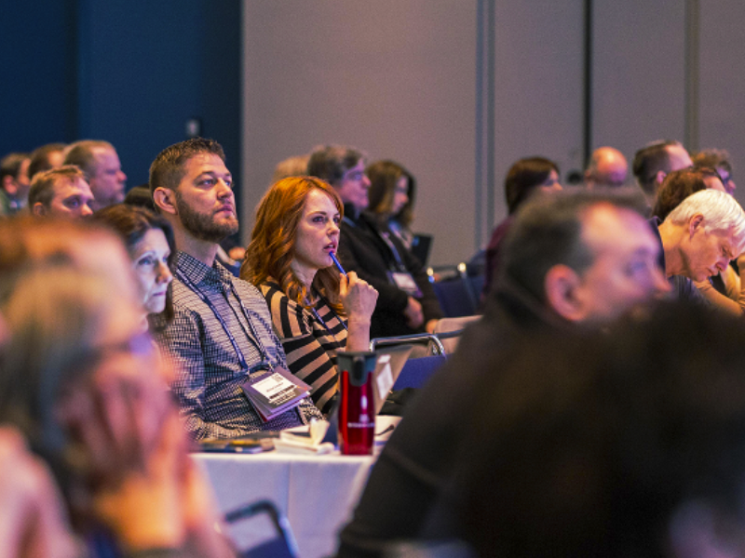



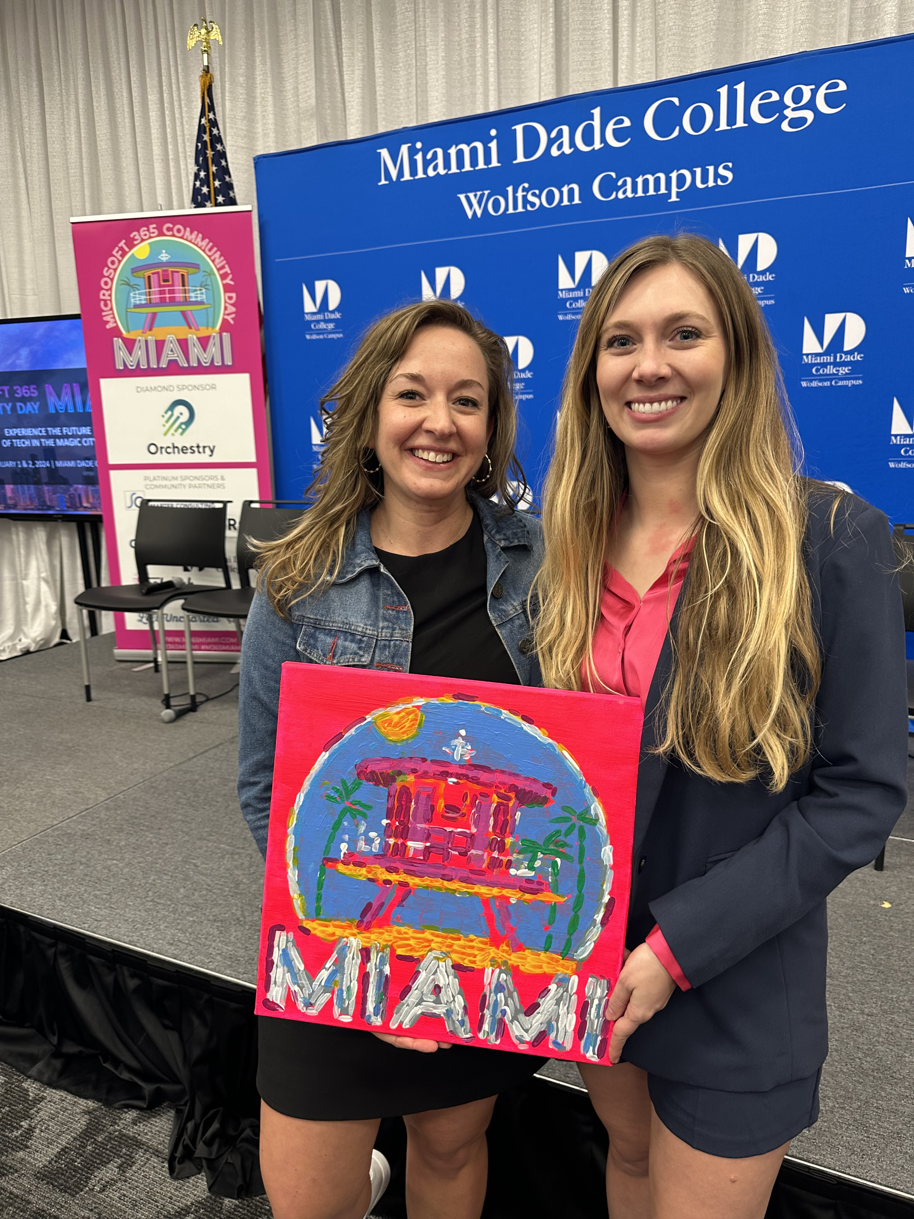
Join the Microsoft Global Community Initiative
Local. Regional. Global.
Your voice |
Your events
| Microsoft Support
Monthly Mixers. Training. Connections.
Info: https://aka.ms/MGCI
Sign up: https://aka.ms/MGCISignUP

Slide 7

Mentorship

Slide 8

Fact
We are always learning from each other.
All of us, no matter what stage in our careers have an opportunity to be and have a mentor or a coach.

Slide 9

Build your Board

Slide 10

Your “board of directors”
Career mentors
Trusted advisors
Inspirational connections
BFFs or besties (best friends)

Slide 11

Perpetual Learning

Slide 12

The Importance of Power Skills
Power skills help individuals work collaboratively in a professional environment
Power skills are essential for success in the modern job market
Power skills contribute to diversity and inclusion in workplaces
Notes:
Power skills are a broad range of capabilities that help individuals work collaboratively in a professional environment. They include communication, problem-solving, and leadership skills, among others. Power skills are essential for success in the modern job market, where teamwork and collaboration are increasingly important. By developing their power skills, individuals can contribute to a more diverse and inclusive workplace, where everyone has the opportunity to succeed.

Slide 13
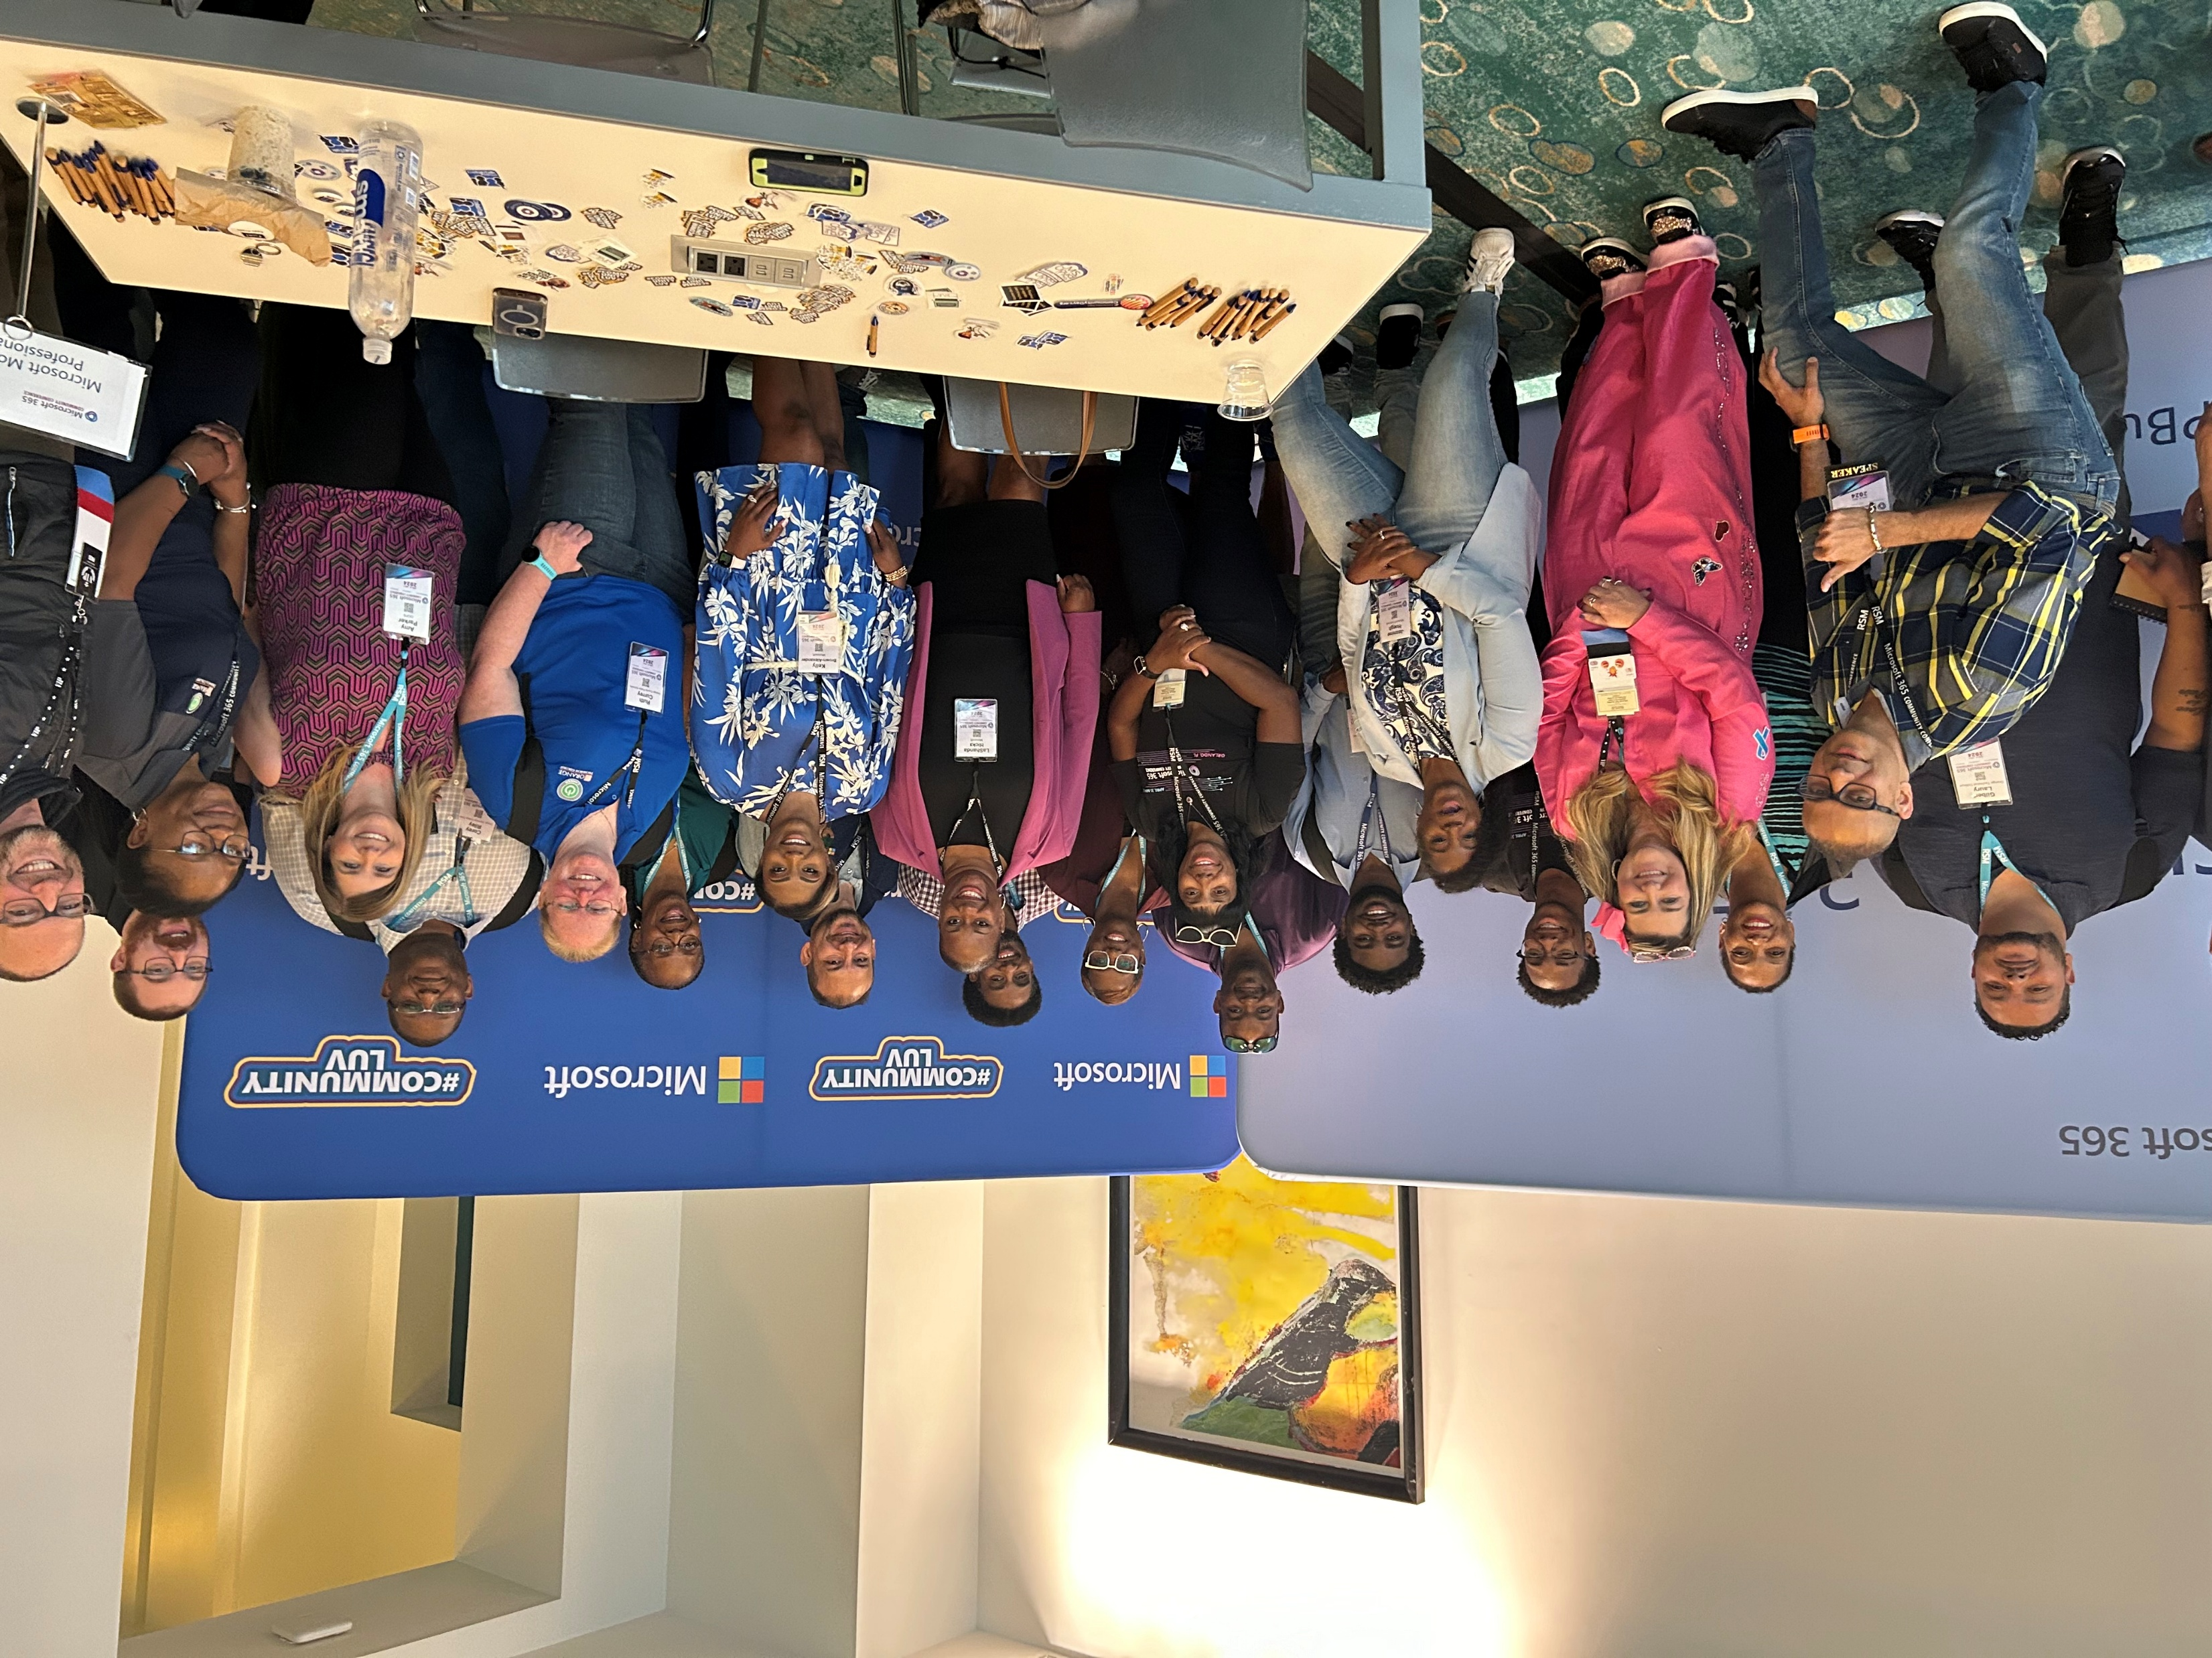
You are in the right place
You will accelerate your
Connections
Learning
Confidence
Belonging
By showing up.

Slide 14
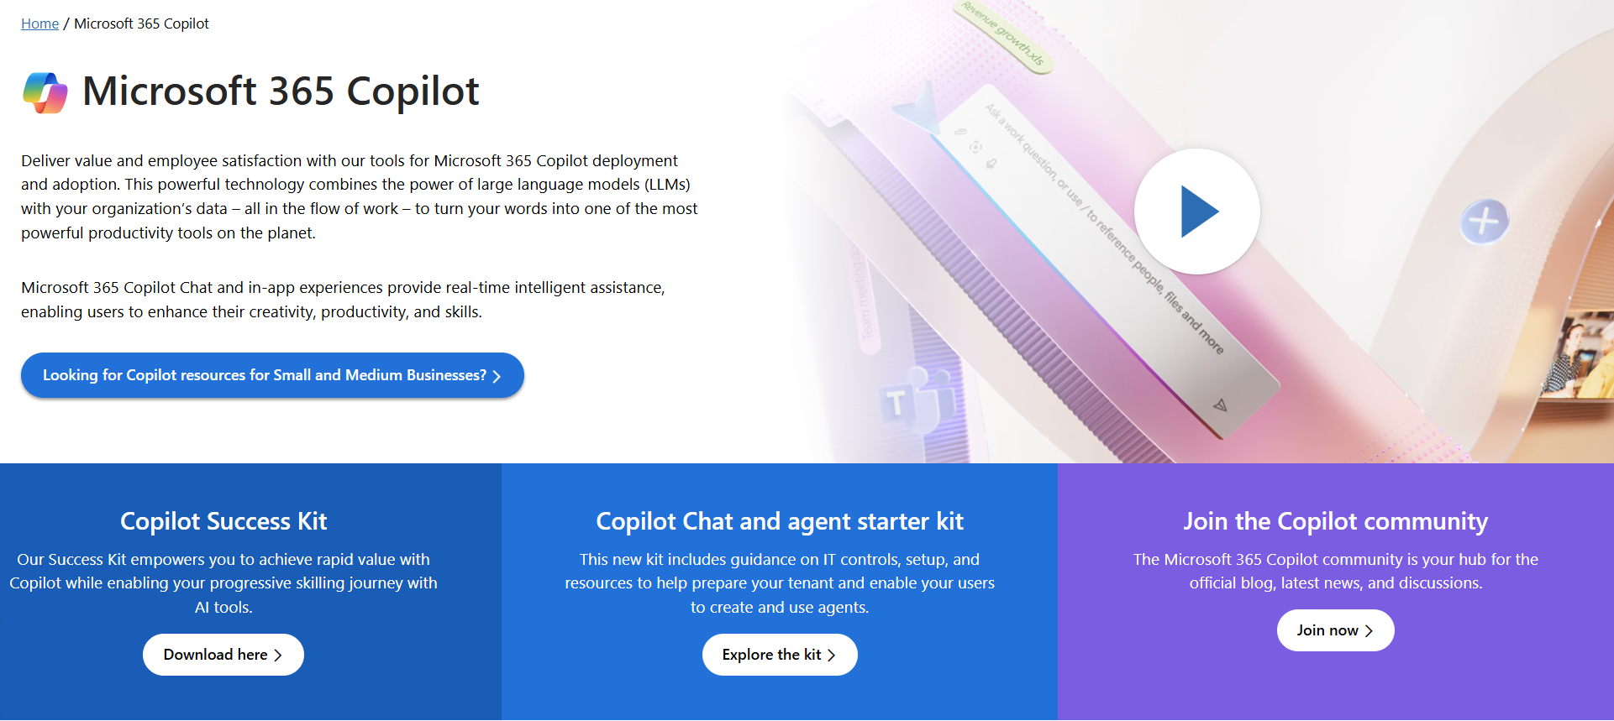
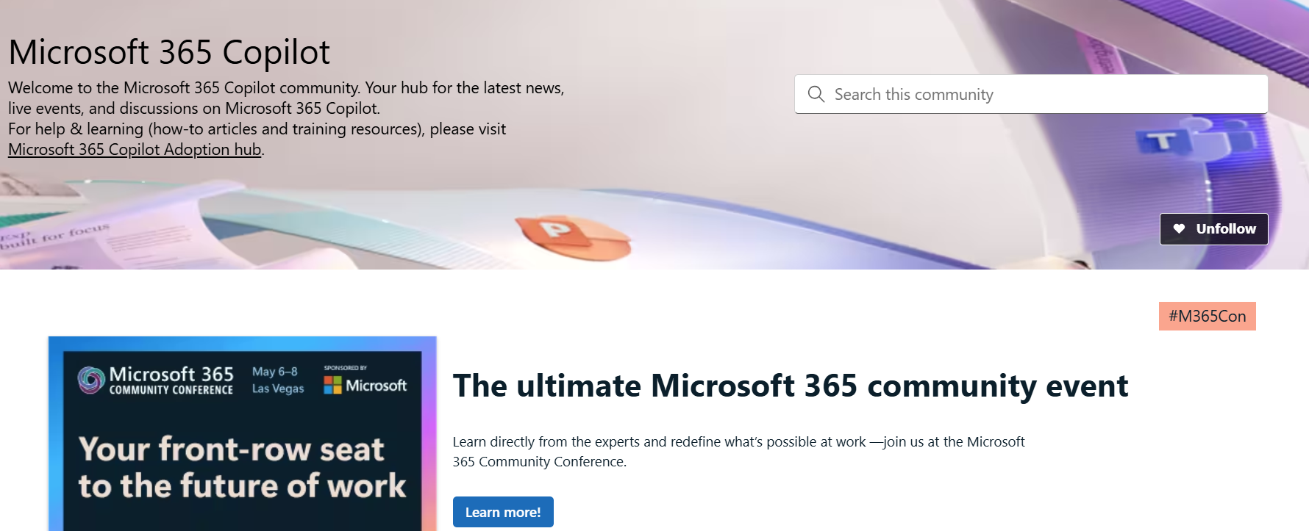
Copilot hub & community
Copilot hub on adoption.microsoft.com/copilot
Enablement and usage guidance for Microsoft Copilot.
Ask questions and get answers in our community aka.ms/M365CopilotCommunity
Notes:
To help you with adoption, the Copilot Readiness Hub is an open one stop shop for content, organized by role for your Copilot for Microsoft 365 journey.
You can use its recommendations to prepare and plan for your deployment, create a user experience strategy as I’ve presented today, and an adoption plan.
And as Copilot continues to evolve, keep coming back for new content that is published regularly.
You can also join the Copilot for Microsoft 365 community to get your questions answered and meet others who are leveraging Copilot for Microsoft 365 right now.

Slide 15
Expertise and tools for your journey
Technical expertise via our FastTrack partners
Tools, resources & training on our Adoption Hub
Events and real-world knowledge in our community
aka.ms/Microsoft/FastTrack
adoption.microsoft.com
aka.ms/TechCommunity
Notes:
Please leave this slide in for conference attendees.

Slide 16
News & community content
Microsoft Community Learning aka.ms/Community/LearningChannel
Community led expert content on all your favorite Microsoft services.
Start your week with live news and event updates aka.ms/MondaysatMicrosoft
Watch live or on-demand & share our blog.
Notes:
To help you with adoption, the Copilot Readiness Hub is an open one stop shop for content, organized by role for your Copilot for Microsoft 365 journey.
You can use its recommendations to prepare and plan for your deployment, create a user experience strategy as I’ve presented today, and an adoption plan.
And as Copilot continues to evolve, keep coming back for new content that is published regularly.
You can also join the Copilot for Microsoft 365 community to get your questions answered and meet others who are leveraging Copilot for Microsoft 365 right now.

Slide 17
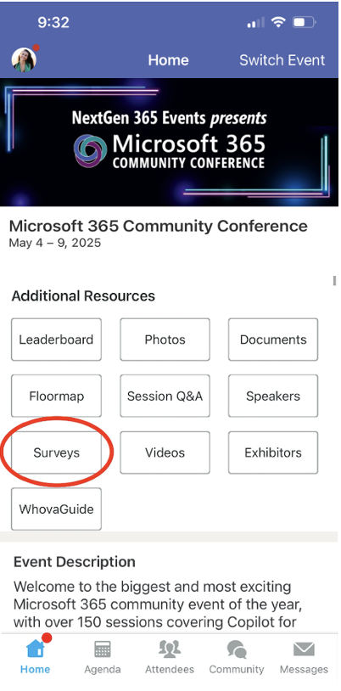
Session feedback surveys
We want to hear from YOU!
Share your feedback to make next years conference even better!
Here’s how –
Simply go to the Whova App on your smartphone.
Scroll down on the M365 Community Conference Homepage to ‘Additional Resources’ to click “Surveys’.
Click Session Feedback.
Scroll down to find this session title.
Complete the session feedback survey.
Finally, click ‘Submit’.
It’s just that easy!

Slide 18


