Slide 1
Copilot Success Kit deep dive
Jessie Hwang, Customer Experience PM
Microsoft 365 Customer Advocacy Group
Content manager for adoption.microsoft.com
May 2025

Slide 2

Microsoft 365 Community Conference

Slide 3

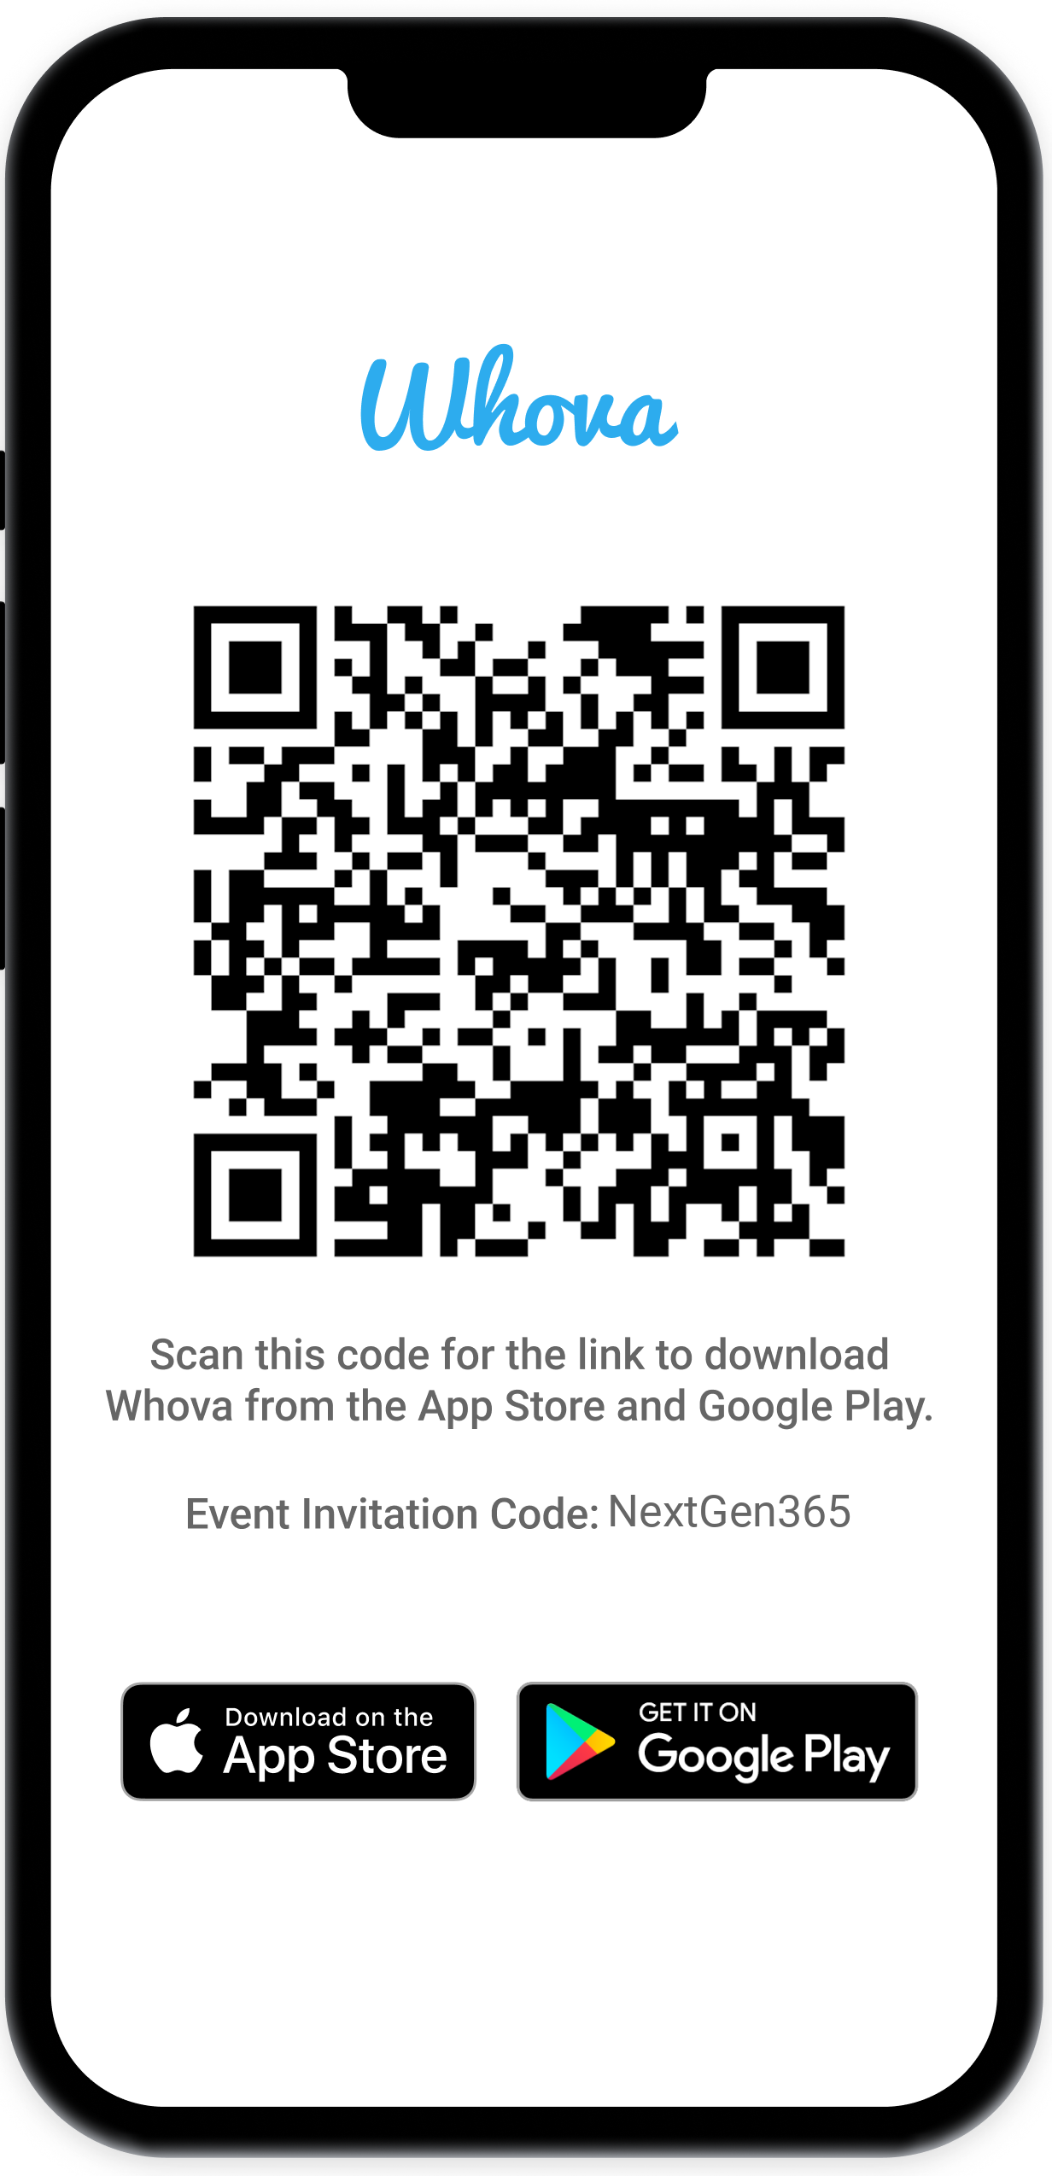
The official event app for the
Microsoft 365 Community Conference
Event invitation code: NextGen2025
Join the event app to access:
Event announcements
Personalized agenda, session details
Speaker & attendee profiles
Networking, meet-ups, messages
Event documents

Slide 4

Jessie Hwang
Customer Experience PM,
Microsoft 365 Customer Advocacy Group
/jessiehwang
Notes:
Jessie Hwang is the content curator and manager for adoption.microsoft.com.

Slide 5
Updates and Thank you
Jul 2023
Sep
Oct
Nov
Dec
Jan 2024
Feb
Mar
Apr
May
Jun
Jul 2023
Sep
Oct
Nov
Dec
Jan 2024
Feb
Mar
Apr
May
Jun
KPMG and Microsoft cloud and AI alliance
Commitments to advance safe, secure, and trustworthy AI
Copilot Copyright Commitment for customers
Azure AI Content Safety Generally Available
Copilot for Microsoft 365 enterprise GA
WTI Special Report: Copilot learnings
Copilot search GA with data protection
Copilot key on AI-powered Windows PCs
Copilot lands at the Super Bowl
Microsoft’s AI Access Principles
Microsoft Orca-Math small language model
New AI-powered Surface PCs built for business
Copilot for Security generally available
Partnership with G42 to accelerate AI in UAE
GitHub Copilot Workspace in preview
Responsible AI Transparency Report
Investment in Wisconsin for AI and economic growth
Microsoft Fabric Real-Time intelligence in preview
Khan Academy and Microsoft partner to expand access to AI tools
New agent capabilities in Microsoft Copilot Studio
Microsoft Research’s Aurora, a large-scale foundation model of the atmosphere
KPMG and Microsoft cloud and AI alliance
Commitments to advance safe, secure, and trustworthy AI
Copilot Copyright Commitment for customers
Azure AI Content Safety Generally Available
Copilot for Microsoft 365 enterprise GA
WTI Special Report: Copilot learnings
Copilot search GA with data protection
Copilot key on AI-powered Windows PCs
Copilot lands at the Super Bowl
Microsoft’s AI Access Principles
Microsoft Orca-Math small language model
New AI-powered Surface PCs built for business
Copilot for Security generally available
Partnership with G42 to accelerate AI in UAE
GitHub Copilot Workspace in preview
Responsible AI Transparency Report
Investment in Wisconsin for AI and economic growth
Microsoft Fabric Real-Time intelligence in preview
Khan Academy and Microsoft partner to expand access to AI tools
New agent capabilities in Microsoft Copilot Studio
Microsoft Research’s Aurora, a large-scale foundation model of the atmosphere
Meta Llama 2 on Azure and Windows
Microsoft joins Frontier Model Forum
50 years of Microsoft
2 years of AI
Unified Microsoft Copilot experience
New steps to help protect elections, AI watermarking tools
AMD MI300X accelerated VMs in Azure
Copilot integrates multimodal, GPT-4 Turbo and DALL·E 3
AI accelerating chemistry and materials science
AI solutions in Microsoft Cloud for Sustainability
GitHub Copilot Enterprise generally available
Expanded Copilot Pro offerings, including Copilot GPT Builder
New Responsible AI tools in Azure AI
Cohere Command R+ available on Azure
Expanded Content Integrity tools
Investments in cloud and AI in Indonesia
Investments in cloud and AI in Thailand
GPT-4o available in Azure AI in preview
GitHub Copilot Extensions in private preview
Cognition AI partnership
Team Copilot in preview
Copilot+ PC available
Meta Llama 2 on Azure and Windows
Microsoft joins Frontier Model Forum
Unified Microsoft Copilot experience
New steps to help protect elections, AI watermarking tools
AMD MI300X accelerated VMs in Azure
Copilot integrates multimodal, GPT-4 Turbo and DALL·E 3
AI accelerating chemistry and materials science
AI solutions in Microsoft Cloud for Sustainability
GitHub Copilot Enterprise generally available
Expanded Copilot Pro offerings, including Copilot GPT Builder
New Responsible AI tools in Azure AI
Cohere Command R+ available on Azure
Expanded Content Integrity tools
Investments in cloud and AI in Indonesia
Investments in cloud and AI in Thailand
GPT-4o available in Azure AI in preview
GitHub Copilot Extensions in private preview
Cognition AI partnership
Team Copilot in preview
Copilot+ PC available
Bing Chat Enterprise and Microsoft 365 Copilot pricing
Moody's generative AI strategic partnership
Copilot in Windows roll out, AI-enhanced tools
Public preview of Azure AI Studio
Copilot Studio, Copilot for Sales and Copilot for Service
AFL-CIO and Microsoft AI tech-labor partnership
Copilot Pro and expanding Copilot for Microsoft 365 availability to SMBs
Tech accord to combat AI deepfakes in elections
Microsoft Copilot for Finance
NVIDIA GB200 Grace Blackwell processor on Azure
New Microsoft AI Hub in London
Microsoft’s Phi-3-mini model now available
Estee Lauder and Microsoft increase collaboration
Microsoft and OpenAI launch Societal Resilience Fund
Investment in France to accelerate AI and skilling
Microsoft Phi-3-vision model in preview
AMD MI300X accelerated VMs in Azure GA
Digital ecosystem and AI initiatives for Kenya
Microsoft and healthcare orgs expand Trustworthy & Responsible AI Network
Bing Chat Enterprise and Microsoft 365 Copilot pricing
Moody's generative AI strategic partnership
Copilot in Windows roll out, AI-enhanced tools
Public preview of Azure AI Studio
Copilot Studio, Copilot for Sales and Copilot for Service
AFL-CIO and Microsoft AI tech-labor partnership
Copilot Pro and expanding Copilot for Microsoft 365 availability to SMBs
Tech accord to combat AI deepfakes in elections
Microsoft Copilot for Finance
NVIDIA GB200 Grace Blackwell processor on Azure
New Microsoft AI Hub in London
Microsoft’s Phi-3-mini model now available
Estee Lauder and Microsoft increase collaboration
Microsoft and OpenAI launch Societal Resilience Fund
Investment in France to accelerate AI and skilling
Microsoft Phi-3-vision model in preview
AMD MI300X accelerated VMs in Azure GA
Digital ecosystem and AI initiatives for Kenya
Microsoft and healthcare orgs expand Trustworthy & Responsible AI Network
GitHub Copilot Chat beta
Microsoft Azure Maia & Microsoft Azure Cobalt chips
Phi-2, a SLM with remarkable performance
Walmart unveils new GenAI capabilities
Microsoft and Mistral AI partnership
FWD Group builds AI-driven insurance experiences
Formed new Consumer AI team
Investments in cloud and AI infrastructure in Japan
Coca-Cola AI and cloud partnership
Work Trend Index details the state of AI
Announcing Copilot+ PC
Phi-3-mini, Phi-3-small, and Phi-3-medium generally available
Cobalt 100 Arm-based virtual machines in preview
Siemens delivers AI-enhanced solutions
Hitachi and Microsoft milestone GenAI agreement
GitHub Copilot Chat beta
Microsoft Azure Maia & Microsoft Azure Cobalt chips
Phi-2, a SLM with remarkable performance
Walmart unveils new GenAI capabilities
Microsoft and Mistral AI partnership
FWD Group builds AI-driven insurance experiences
Formed new Consumer AI team
Investments in cloud and AI infrastructure in Japan
Coca-Cola AI and cloud partnership
Work Trend Index details the state of AI
Announcing Copilot+ PC
Phi-3-mini, Phi-3-small, and Phi-3-medium generally available
Cobalt 100 Arm-based virtual machines in preview
Siemens delivers AI-enhanced solutions
Hitachi and Microsoft milestone GenAI agreement
Notes:
We are making fantastic progress.
When you look at all of these announcements that we’ve made in the past year, it’s not just the pace of innovation, but it’s the pace of adoption that has been remarkable.
Together, we’ve moved from talking about AI to deploying AI at scale.

Slide 6













Wheel of Services
Notes:
SharePoint is the most flexible solution in the industry.
It has rich collaboration, workflow, and compliance capabilities.
It powers document in OneDrive and Office, to employee experiences with SharePoint sites and Viva. We’re adding new capabilities like Loop and Whiteboard and rich media with photos, stream, designer, etc.
And it powers custom applications – in your tenant or a special version of SharePoint we released for content business apps called SharePoint Embedded.

Slide 7
Our enterprise AI commitments
1
2
3
4
5
Your data is your data
Customer Copyright Commitment
Our approach to privacy and Responsible AI
Secure Future Initiative
Sustainability by design
Responsible AI principles
Notes:
And Microsoft runs on trust. We are committed to security, privacy, and compliance across everything we do, and our approach to AI is no different.
Trust has been a fundamental promise we have built into the Microsoft Cloud since the very beginning.
Data is the fuel that powers AI technology – and you need to trust what your technology partners are doing with your data.
First, your data is your data. It is not our data. It is your data. That means it is yours to own and control. Your data to choose how you want to leverage and monetize.
Your data is not used to train or enrich the foundational AI models used by others without your permission, so you don’t have to worry about anyone other than your organization benefiting from AI that is trained on your data.
And your data and AI models are protected at every step by the most comprehensive enterprise compliance and security controls in the industry.
You’re also protected through our customer copyright commitment.

Slide 8
Copilot is the UI for AI
Copilot
Agents
Copilot Control System
Notes:
At Ignite, we introduced our vision and strategy for Copilot + Agents.
It all starts with people and human ingenuity.
We envision every employee having a Copilot – their trusted AI assistant. Copilot understands you and your work context, and it provides a consistent user experience to interact with AI.
Agents augment Copilot by adding skills and knowledge to automate tasks and business processes.
Our ambition is to empower every employee with a Copilot and to transform every process with agents.
Importantly, we provide governance and controls for data protection, agent management, and the reporting needed to measure business outcomes. This is what we announced at Ignite as the “Copilot Control System”.

Slide 9
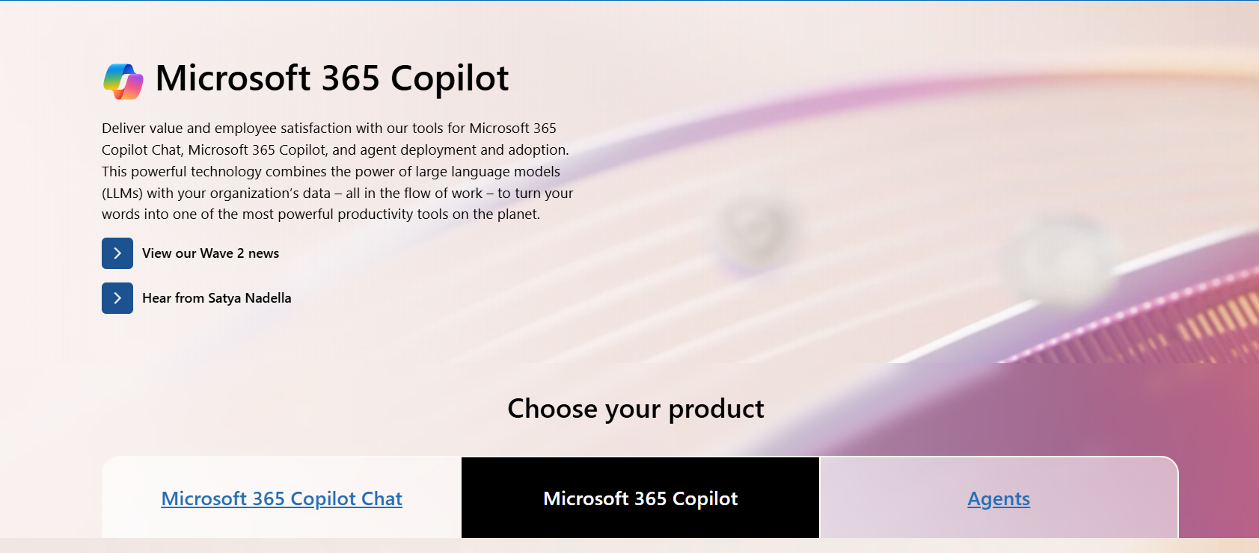
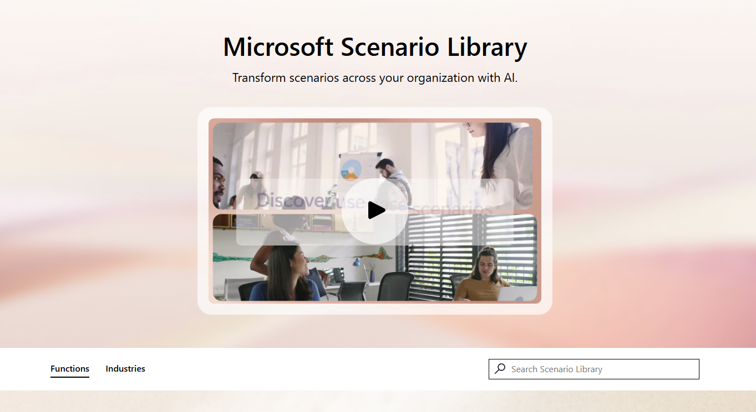
Explore the redesigned Copilot hub and Scenario Library
adoption.microsoft.com/copilot
New “Choose your product” filter includes Copilot Chat and agents
Product filter dynamically filters the resources below to only show what’s relevant to that product
Simplified and streamlined UI for existing sections
News, community, and events have been consolidated into one section
Easier to get to the scenarios that help you get work done
Notes:
The Microsoft 365 Copilot hub was redesigned for the Copilot Wave 2: Spring announcements moment on April 23, 2025. As part of this redesign, the Scenario Library was also updated to match the look and feel.

Slide 10
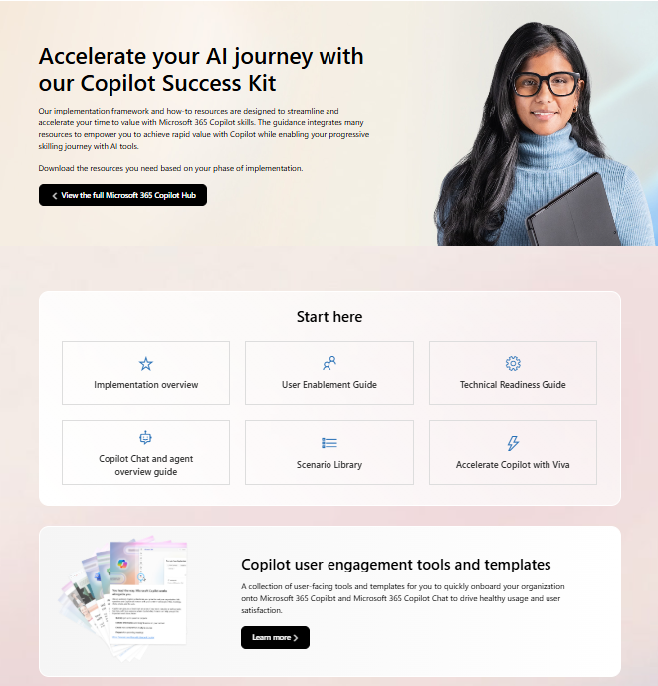
Copilot Success Kit
Download what you need at aka.ms/Copilot/SuccessKit.
Primary assets:
Implementation overview – a summary guide for leaders to get up to speed fast
User Enablement Guide – use to drive human change in your organization and includes shared activities with the Technical Readiness team
Technical Readiness Guide – use to ensure your organization is ready for AI and Copilot and includes shared activities with the User Enablement team
Scenario Library – interactive library to understand more use cases and share with users to help them find their own “ah ha” moments
Viva for Copilot – if you have Viva, use this to help accelerate your deployment and adoption
User engagement tools and templates – email templates, flyers, training event-in-a-box, and more
Separate Copilot Chat and agent success kits
Notes:
See next slide for more details on the user engagement tools and templates.

Slide 11
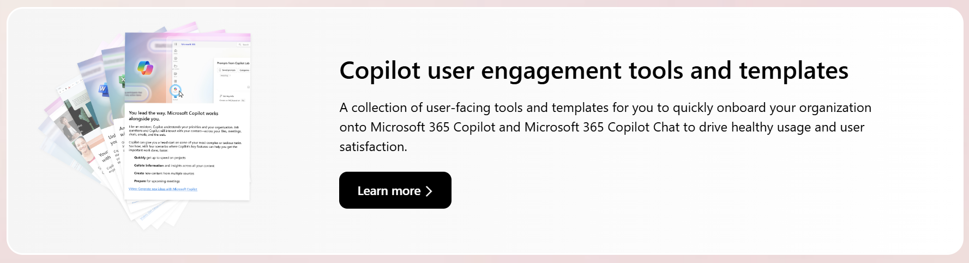
User engagement tools and templates
User-facing tools, templates, training handouts, and kits to quickly onboard your organization to Copilot and Copilot Chat, and to drive healthy usage and user satisfaction. Click aka.ms/Copilot/UserEngagementTools to learn more.

Slide 12
What’s in the full kit?
Primary resources
Implementation Summary Guide for Leaders
User Enablement Guide
Technical Readiness Guide
Scenario Library (interactive website)
Accelerate Copilot enablement with Microsoft Viva Guide
Additional resources
NEWLY UPDATED: Adoption planning checklist
Guide to engaging functional business leaders
Technical Readiness: Modern management of Microsoft 365 Apps (also included in the Technical Readiness Guide)
Stakeholder Management worksheet
Engage your users – tools and templates
NEW: License allocation guide
NEW: Digital swag

Slide 13
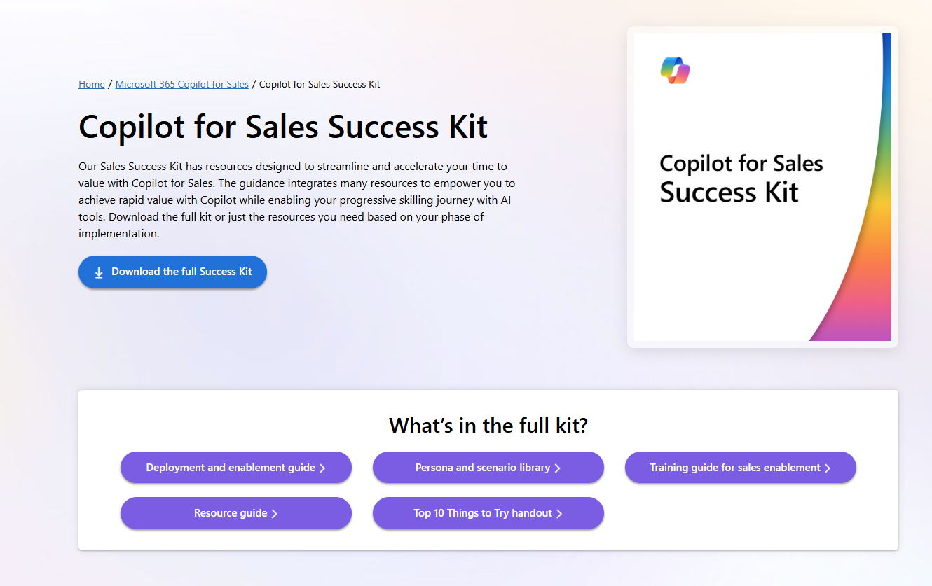
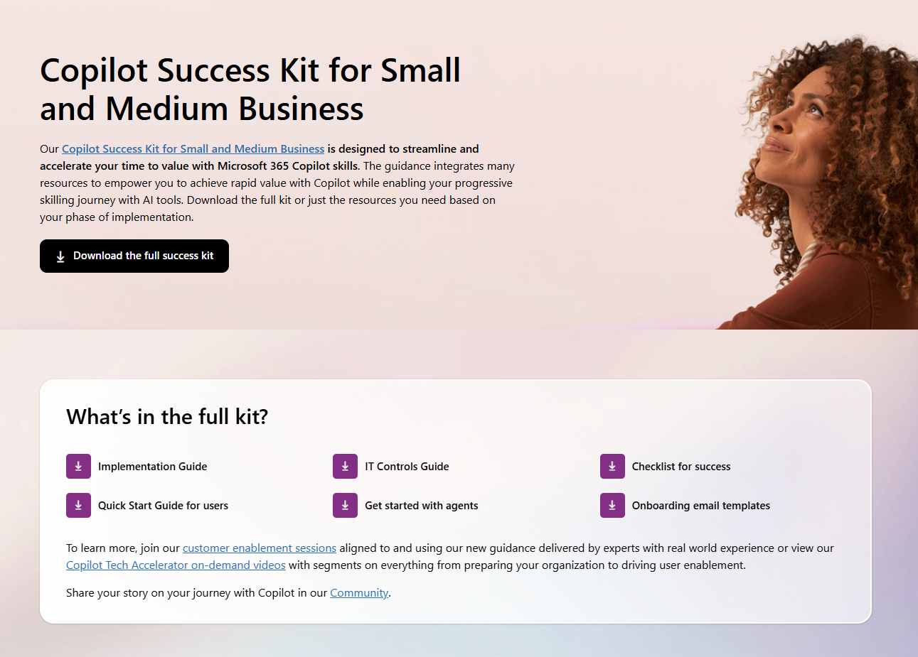
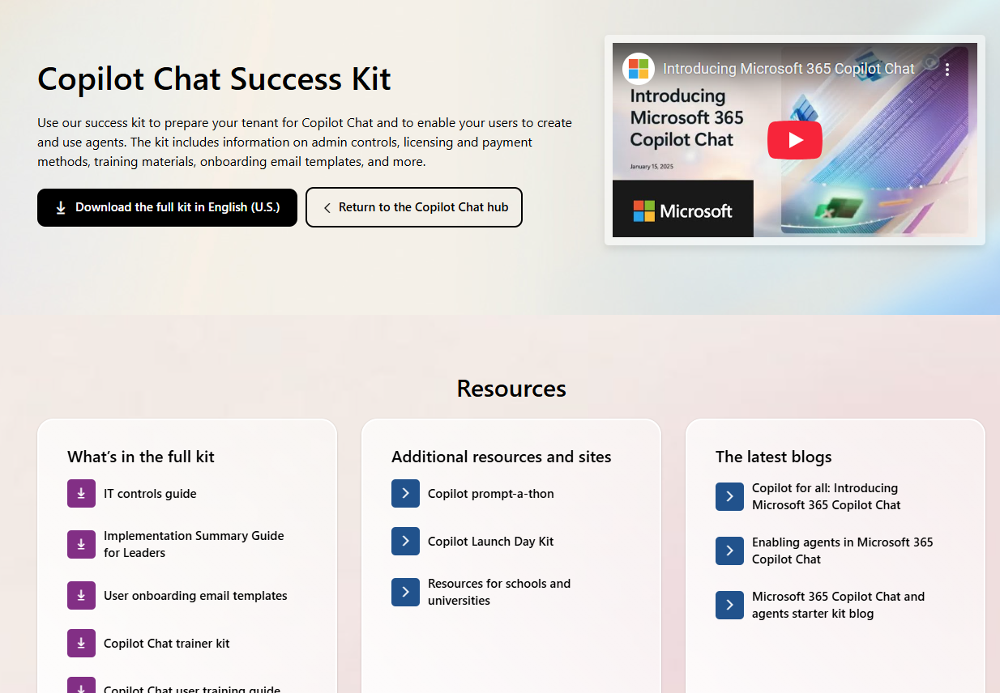
More success kits
Check out more success kits and enablement resources on adoption.microsoft.com.
Copilot for Sales
Copilot for small and medium business
Copilot Chat Success Kit
Agent Success Kit

Slide 14
We have an exciting future ahead.
Notes:
Thank you.
<Speaker Guidance: Spend the last few minutes discussing or answering any questions they may have. If they have additional topics on their EBC agenda, make sure you connect with their account team to inform them which AI priorities and business outcomes resonated the most during this session. If you are in a 1:1 direct customer engagement, make sure you note what their priorities and questions were and work with the broader account teams and units to facilitate the proper hand-offs or next steps (i.e. get them into a session at the Innovation Hub/MTCs).>

Slide 15
Expertise and tools for your journey
Technical expertise via our FastTrack partners
Tools, resources & training on our Adoption Hub
Events and real-world knowledge in our community
aka.ms/Microsoft/FastTrack
adoption.microsoft.com
aka.ms/TechCommunity
Notes:
Please leave this slide in for conference attendees.

Slide 16
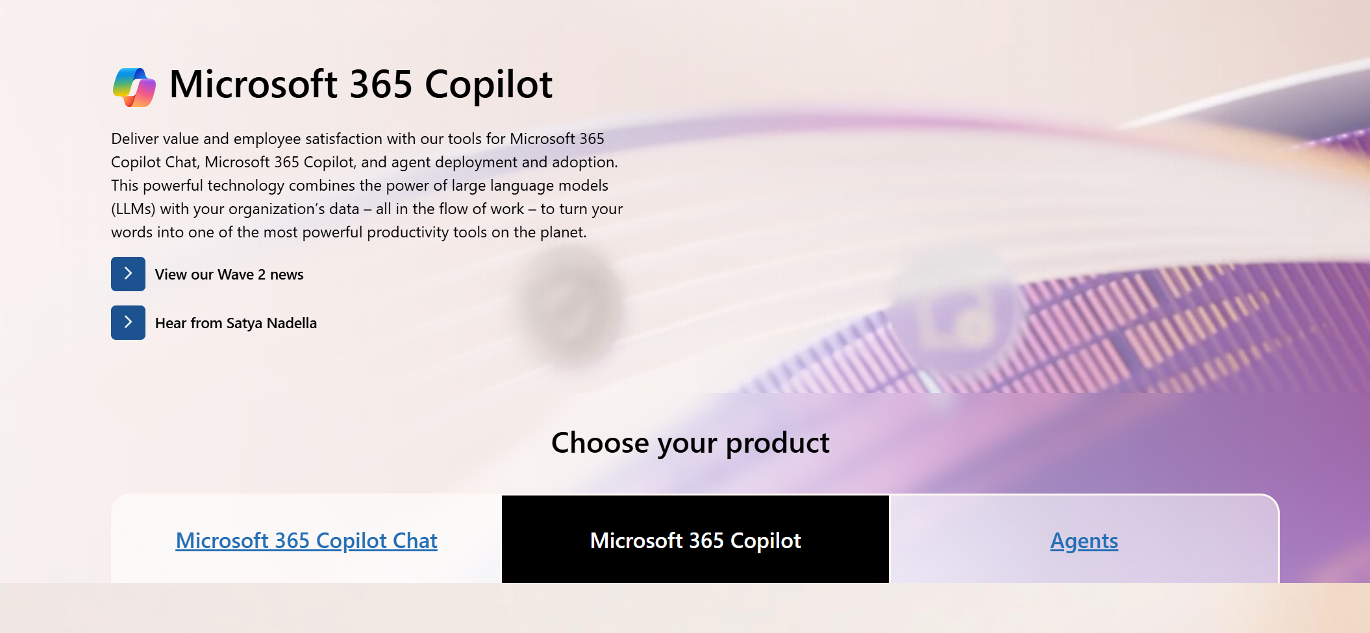
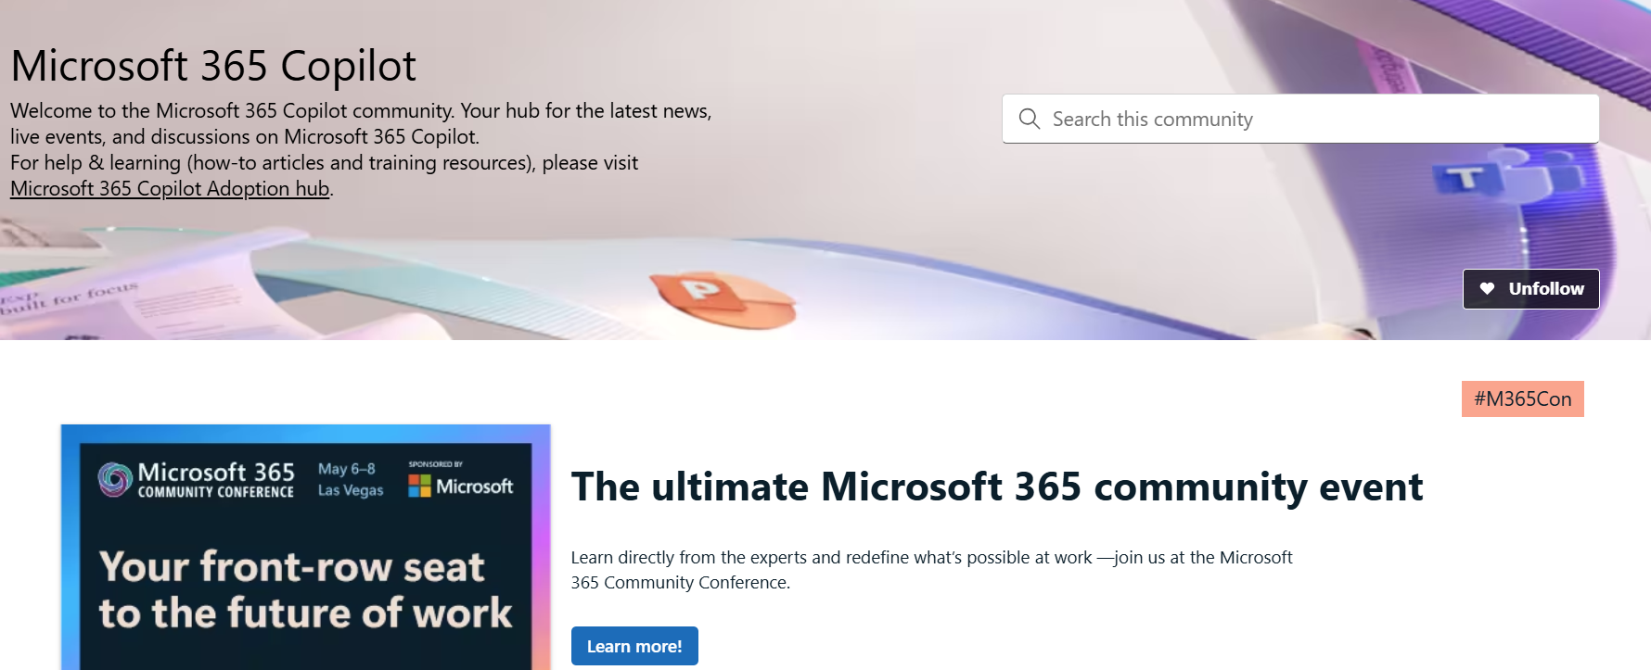
Copilot hub & community
Copilot hub on adoption.microsoft.com/copilot
Enablement and usage guidance for Microsoft Copilot.
Ask questions and get answers in our community aka.ms/M365CopilotCommunity
Notes:
To help you with adoption, the Copilot Readiness Hub is an open one stop shop for content, organized by role for your Microsoft 365 Copilot journey.
You can use its recommendations to prepare and plan for your deployment, create a user experience strategy as I’ve presented today, and an adoption plan.
And as Copilot continues to evolve, keep coming back for new content that is published regularly.
You can also join the Microsoft 365 Copilot community to get your questions answered and meet others who are leveraging Microsoft 365 Copilot right now.

Slide 17
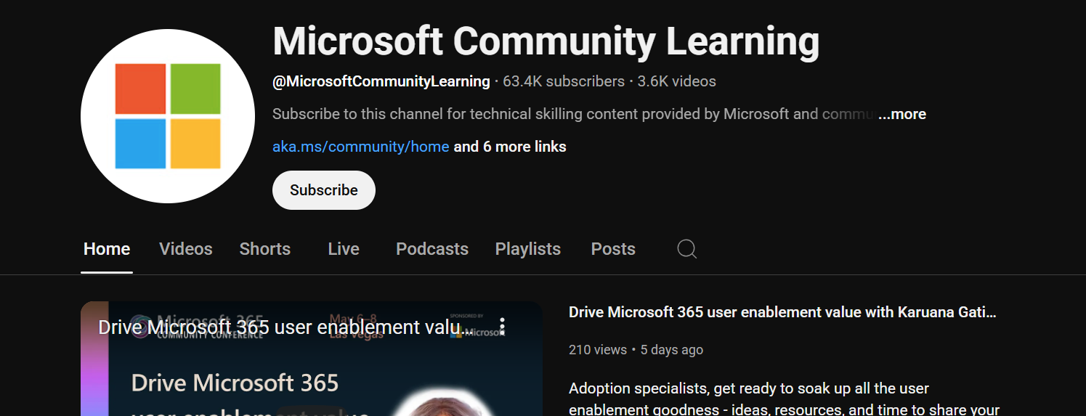
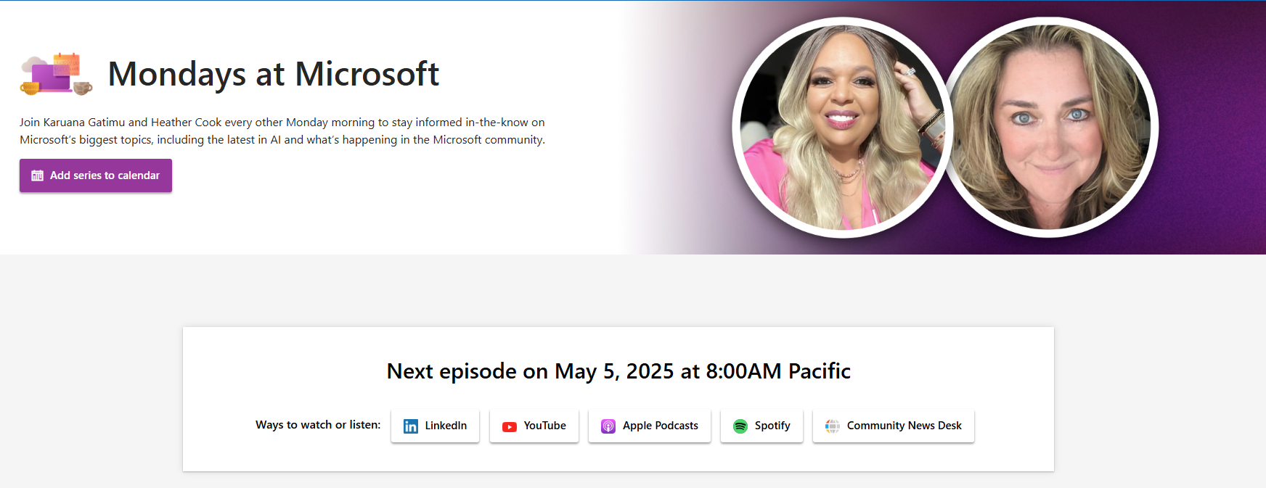
News & community content
Microsoft Community Learning aka.ms/Community/LearningChannel
Community led expert content on all your favorite Microsoft services.
Start your week with live news and event updates at aka.ms/MondaysatMicrosoft.
Watch live or on-demand & share our blog.
Notes:
To help you with adoption, the Copilot Readiness Hub is an open one stop shop for content, organized by role for your Copilot for Microsoft 365 journey.
You can use its recommendations to prepare and plan for your deployment, create a user experience strategy as I’ve presented today, and an adoption plan.
And as Copilot continues to evolve, keep coming back for new content that is published regularly.
You can also join the Copilot for Microsoft 365 community to get your questions answered and meet others who are leveraging Copilot for Microsoft 365 right now.

Slide 18
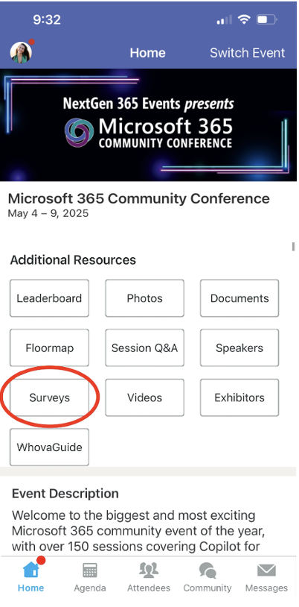
Session feedback surveys
We want to hear from YOU!
Share your feedback to make next years conference even better!
Here’s how –
Simply go to the Whova App on your smartphone.
Scroll down on the M365 Community Conference Homepage to ‘Additional Resources’ to click “Surveys’.
Click Session Feedback.
Scroll down to find this session title.
Complete the session feedback survey.
Finally, click ‘Submit’.
It’s just that easy!

Slide 19
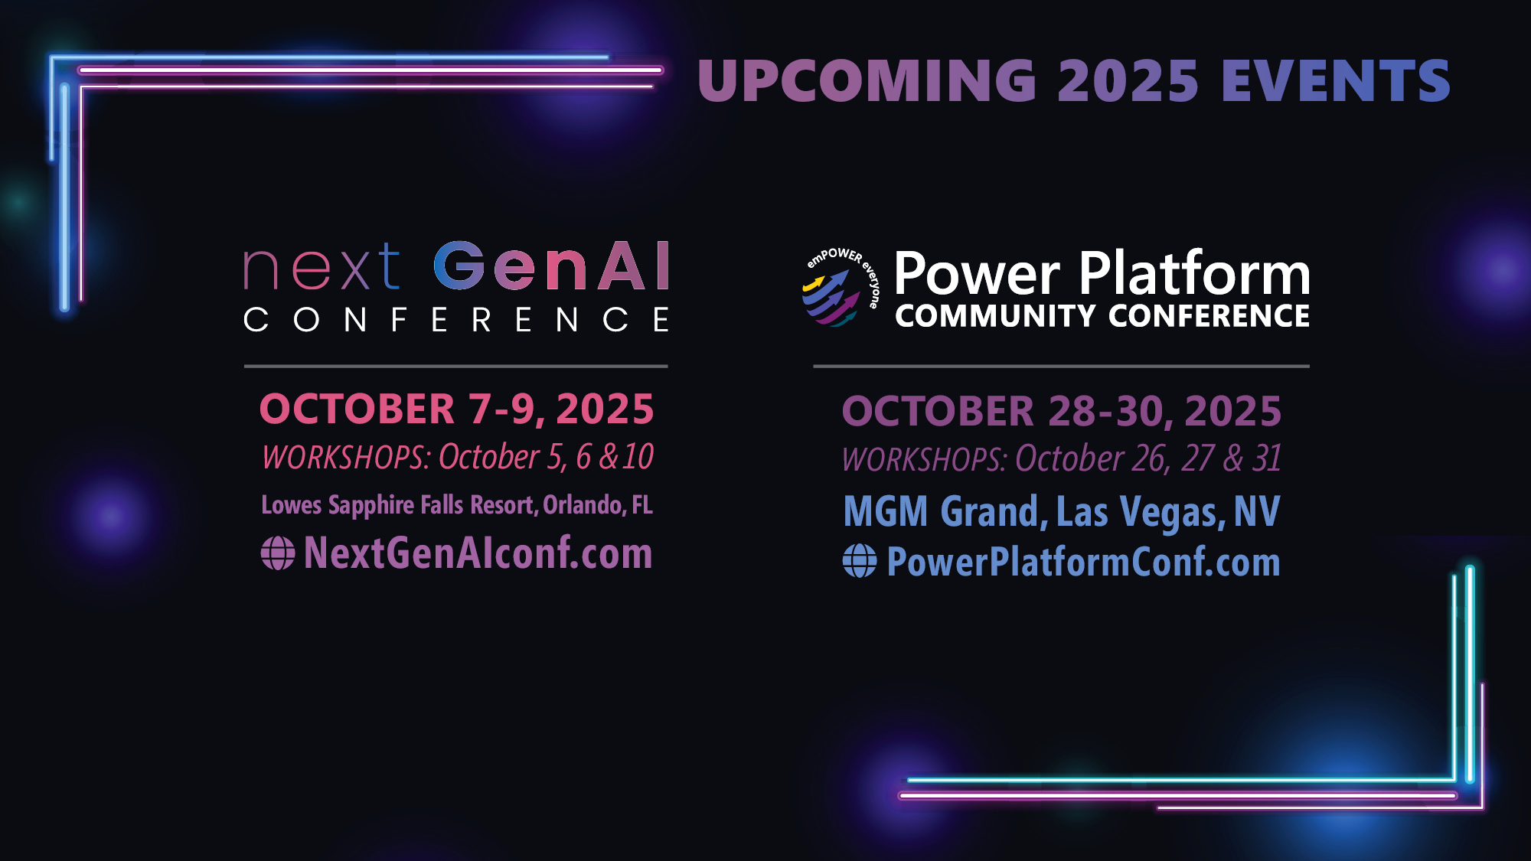
Upcoming 2025 events

