Slide 1
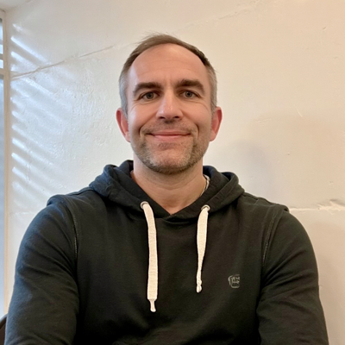
The APPocolypse
Reimagining Apps and Work in the Age of AI Agents
Josh Ledgard - Principal Product Manager - Office AI
5/6/2025

Slide 2
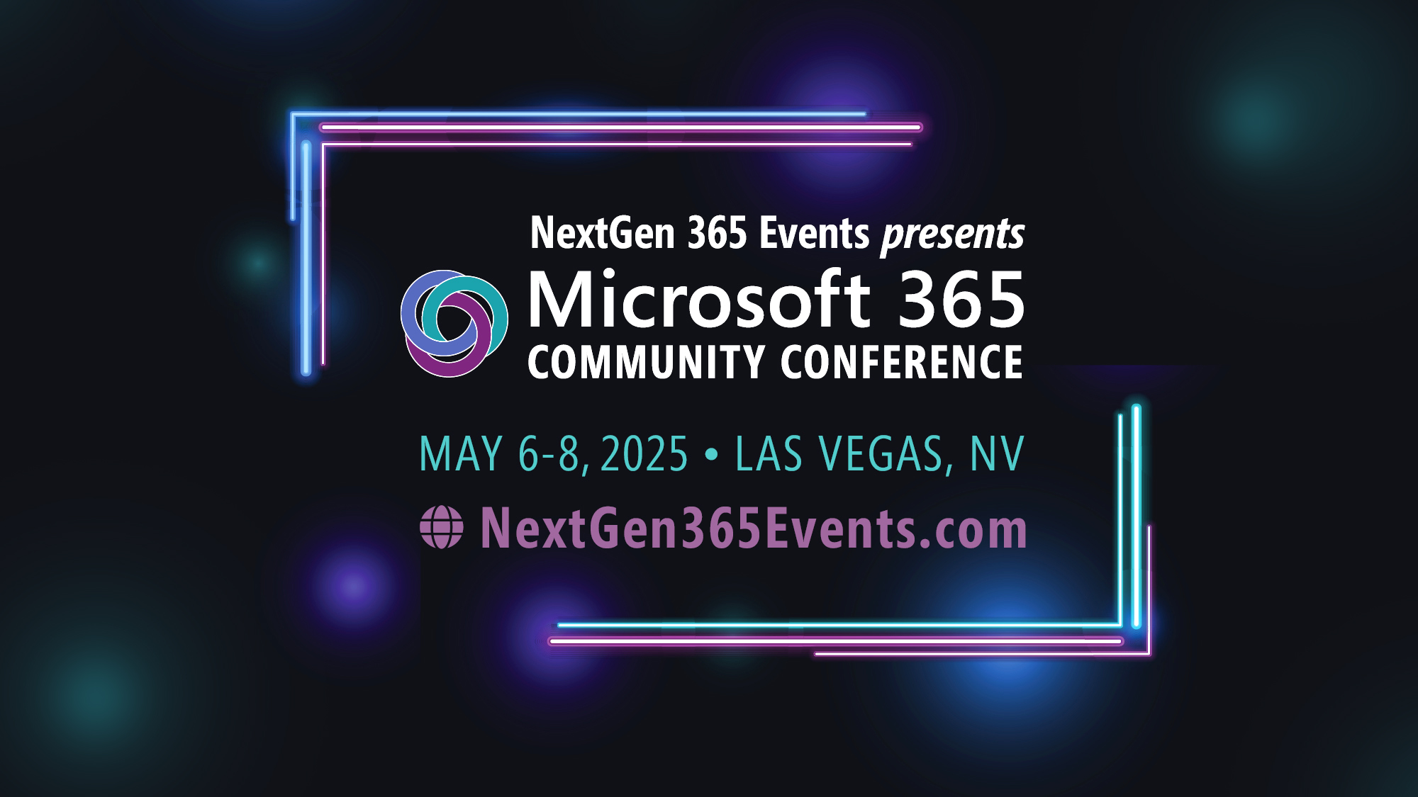
Microsoft 365 Community Conference

Slide 3

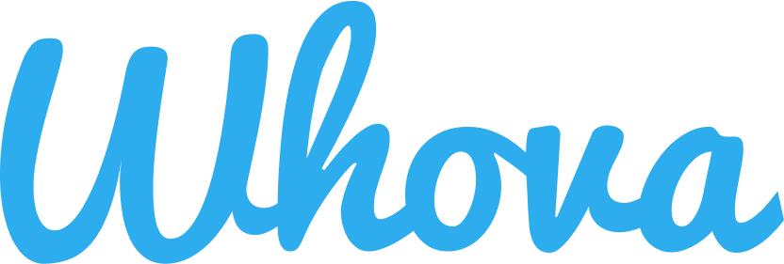
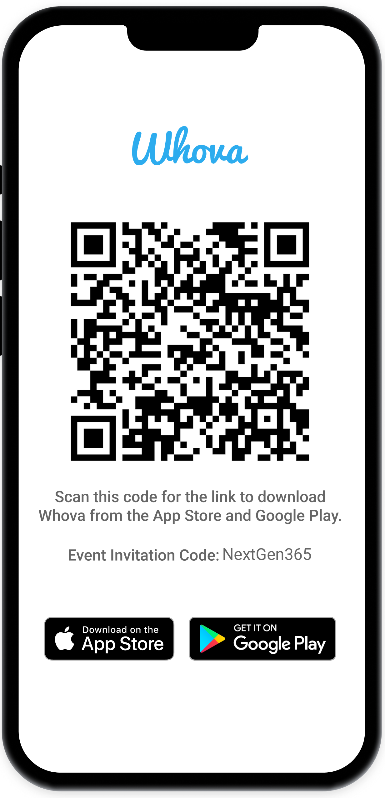
Join the event app to access:
The official event app for the
Microsoft 365 Community Conference
Event invitation code: NextGen2025
Event announcements
Personalized agenda, session details
Speaker & attendee profiles
Networking, meet-ups, messages
Event documents

Slide 4
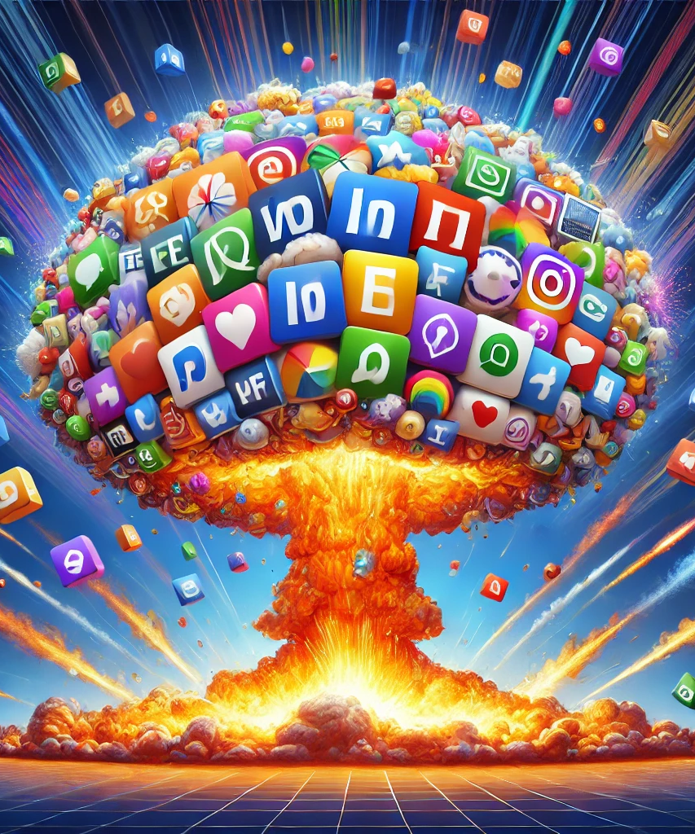
Trending Now
Simpler Creation = Hyper Personalization
Most Apps (today) are Non-Personalized Data Stores
“AI Era” Apps will seamlessly blend data, custom UX, with personalized Agents
Notes:
Here are three takeaways from this talk.
READ THEM
These tends actually started a long time before AI.
They are cultural and meant to fill a need for personalized experiences for consumers and businesses.

Slide 5

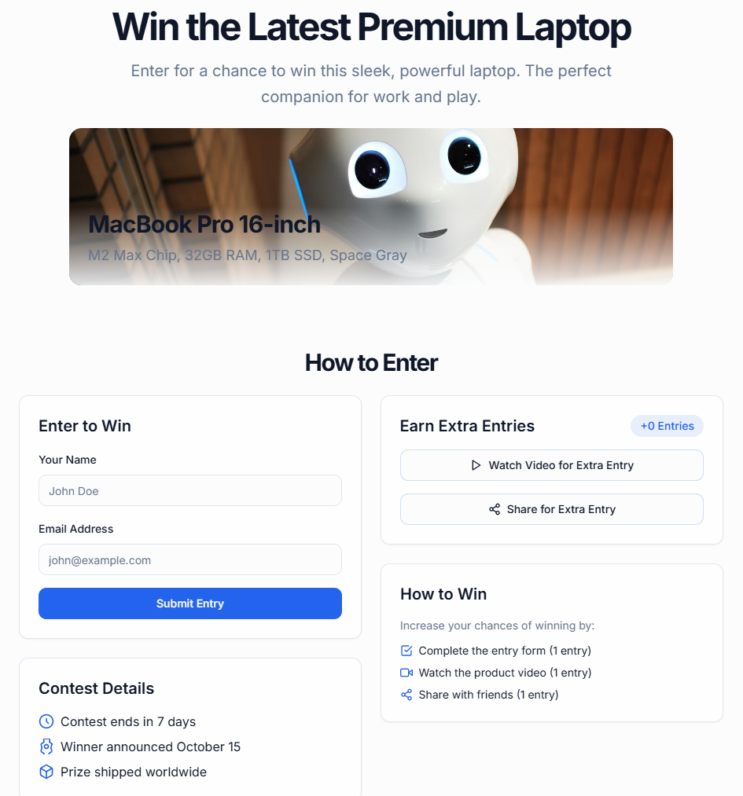
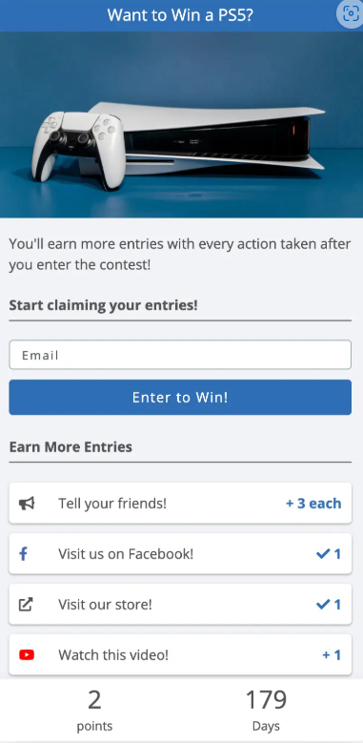
I was also an app Founder…
~10 Minutes of AI Prompting
10+ Years Bootstrapped
SaaS for creating referral contests
VS
Notes:
I could see AppOcolypse coming. The writing was on the wall a year ago. I was also a founder that spent over 10 years running a niche SaaS startup called KickoffLabs that focused on referral-based marketing contests.
Things seemed pretty great until a year ago. I spent a few minutes playing with AI coding – that’s only gotten better since – and was able to hack together a DIY version that solved a lot of the jobs to be done with minimal effort on the part of the marketing team. It didn’t do everything in 10 minutes… but it was a good enough alternative. This is going to start happening to every Micro-SaaS out there and also consume larger applications.

Slide 6
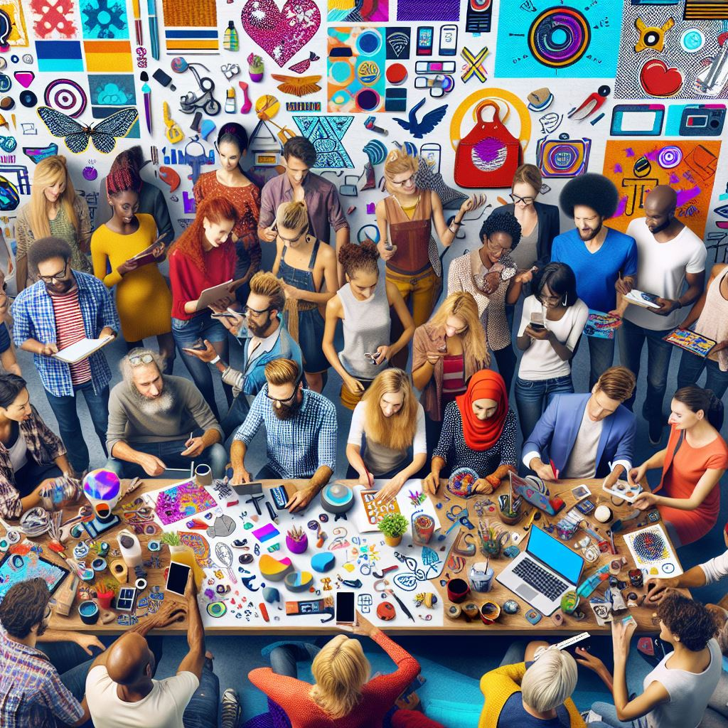
The rise of Personalization
Notes:
Lets talk about the rise of personalization.

Slide 7
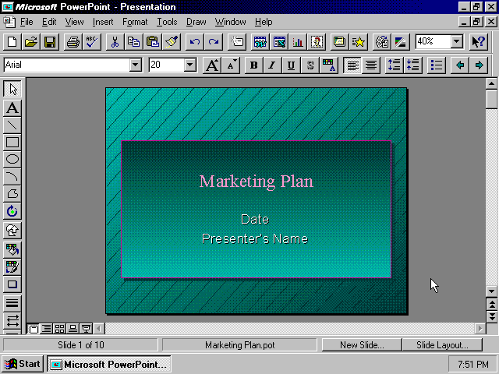
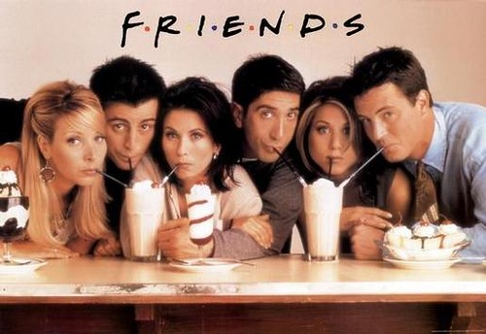
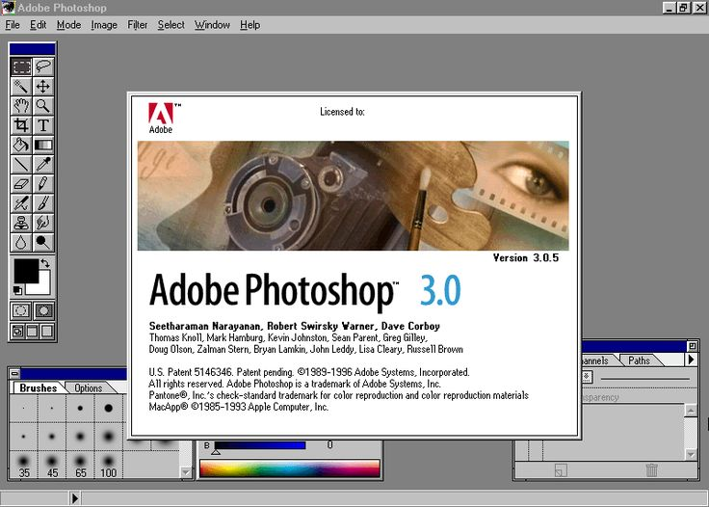

Simple Creation = Hyper Personalization
1995: Monoculture
Personalization
Ease of Creation
Notes:
I’m old enough to remember the monoculture that existed in 1995. It was hard to create software and content was hard to produce. We had only a handful of apps we all knew how to use and everyone could talk about the same TV shows.

Slide 8
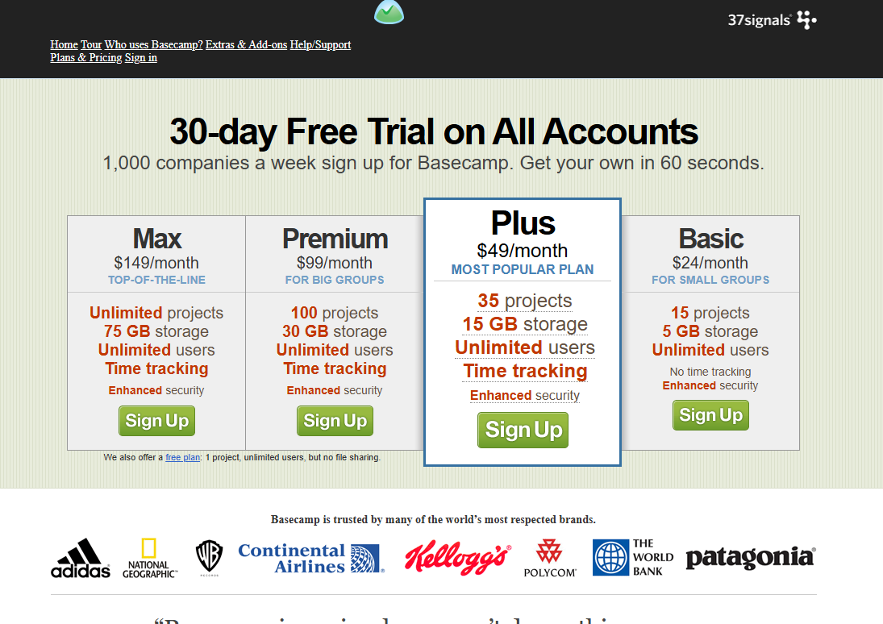
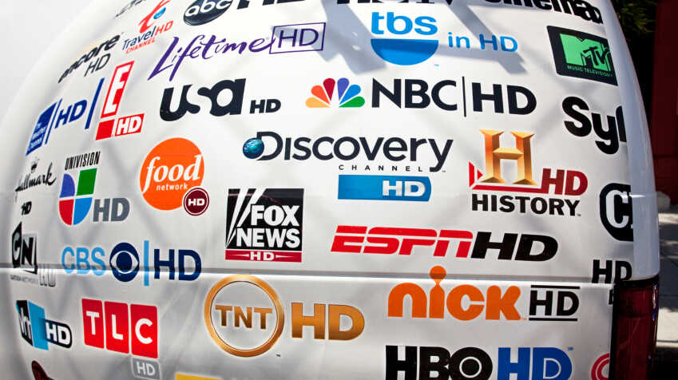
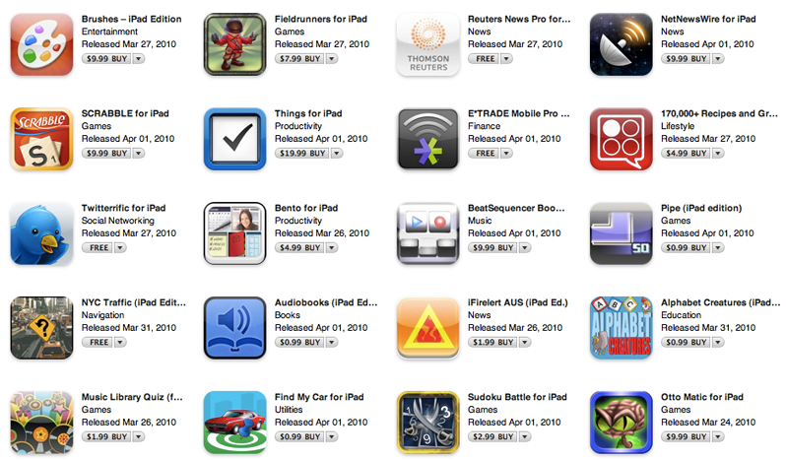
Simple Creation = Hyper Personalization
2010: Hundreds of Channels
Personalization
Ease of Creation
Notes:
Fast forward 15 year later. Software shifted to the cloud and it was dramatically easier to create web and even mobile experiences. That led to the rise of the SaaS era of software where you started to see tools created for specific businesses cases. * work tracking FOR agencies. * Consumer photo filters.
You saw an explosion of content with hundreds of channels and the dawn of streaming for the long tail.

Slide 9
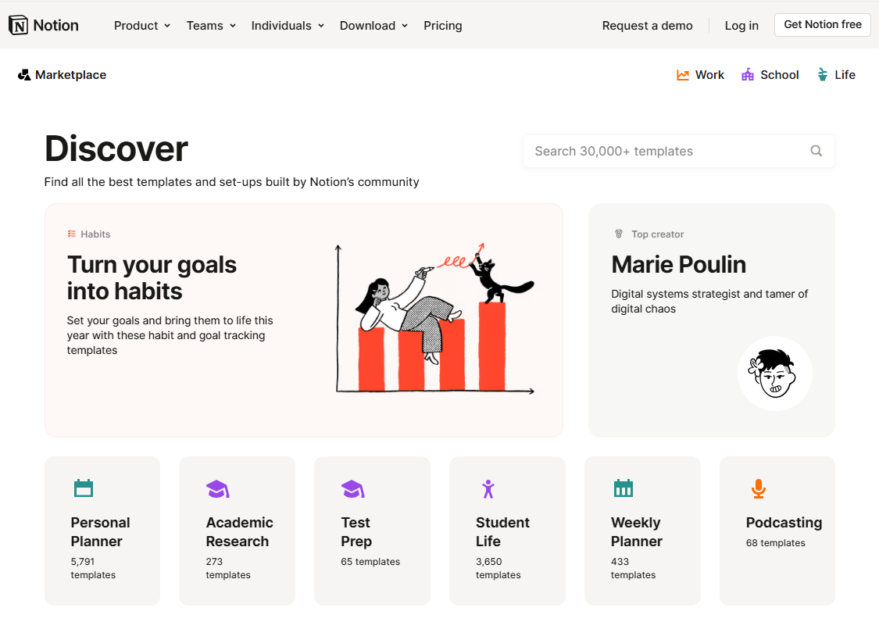
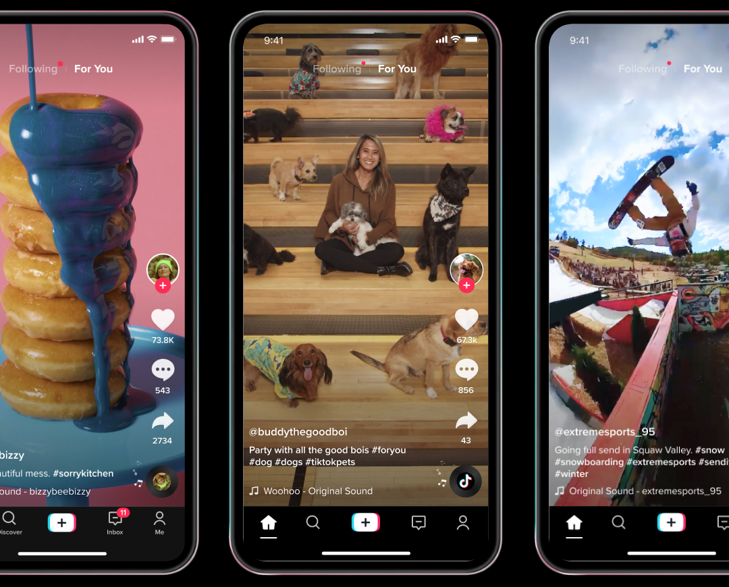
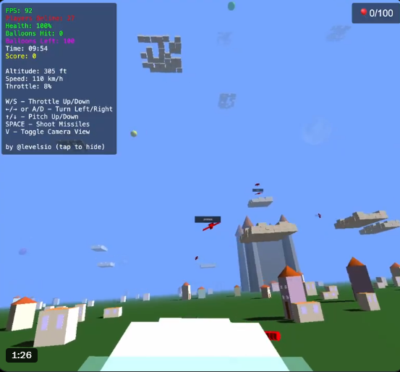
Simple Creation = Hyper Personalization
2025: Created for Me
Personalization
Ease of Creation
Notes:
Another 15 years brings us to today. Technology marches on and it’s easier than ever to create. The best SaaS software has to build a community around personalization and integrate AI on a flexible canvas. User generated content consumes more entertainment hours than traditional media. And this “flying Minecraft” multiplayer app was built by ONE PERSON using Claude in under a week. Software and content has entered the “For Me and My Business Era”.

Slide 10
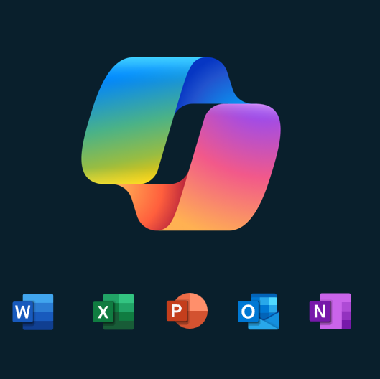
SAAS Apps Today
Notes:
What does that mean for us?
Where are we?

Slide 11
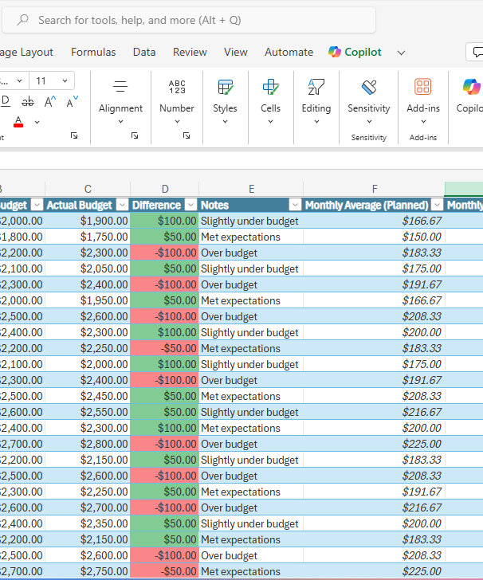
Apps Still live in the monoculture
Static & transitory.
Temporary data stores
Optimized for human creation, transformation, and story telling
Not easily personalized for JTBD
Notes:
Apps still live in the monoculture. More importantly - they are static representations of transitory data. What do I mean by that? Excel makes it easy for ME, a human to read and consume a bunch of data. But that was never the job.
As a business owner I just needed to know what I should be stocking next quarter.
These tables aren’t required to answer that question. The files and formats of them are not relevant or easily customized today for my use case as the store manager.

Slide 12
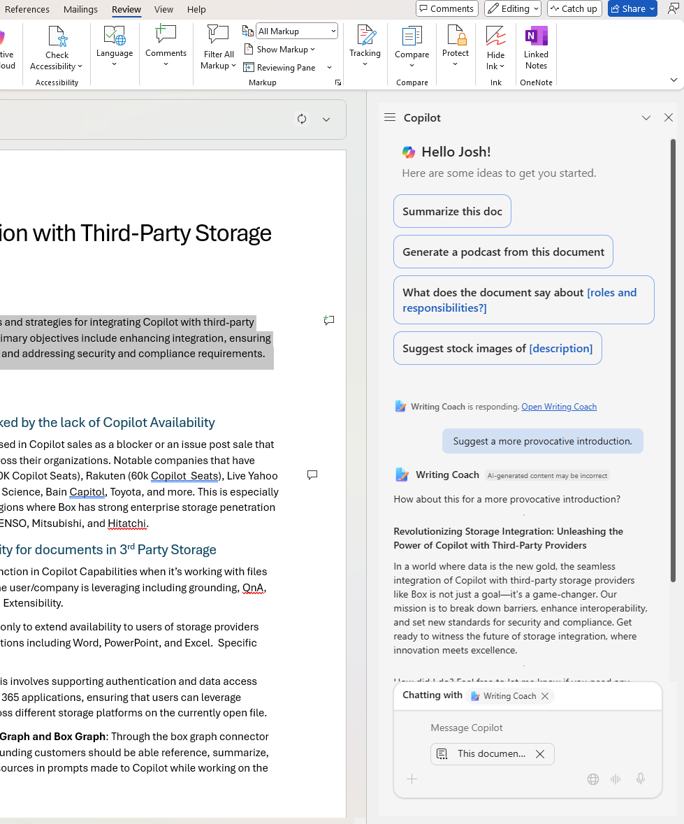
AI is bolted on to existing workflows
Have to remember to use it
Optimized for current tasks and workflows
Forgetful: Doesn’t remember what I’m doing or my goals
Notes:
We moved first to bolt AI onto existing workflows. That’s great, but lets not pat ourselves on the back. A lot of the work I see is focused on answering the question: “How could AI speed up what I’m doing today” We’re adapting AI to OUR existing work patterns rather than using the strengths of this tool to transform HOW we work.

Slide 13
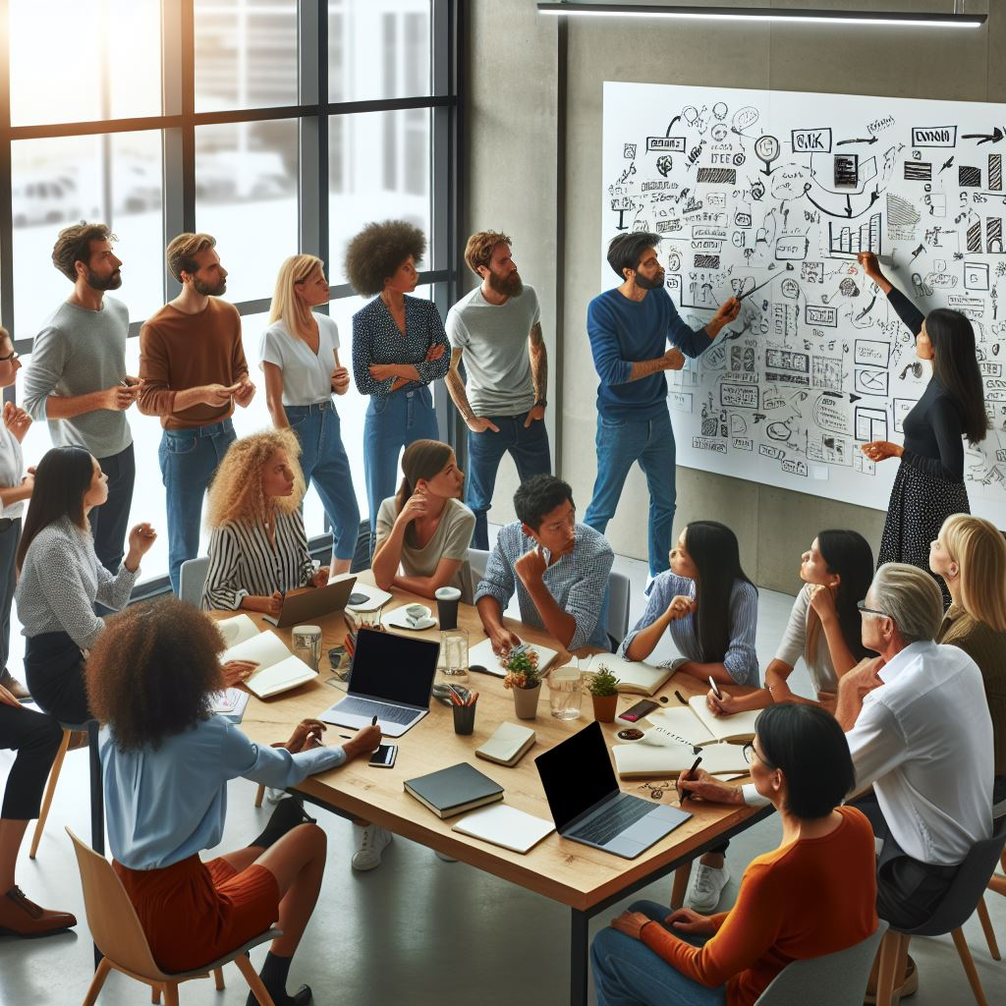
Thinking Different
Lead by example and change work instead of AI
Notes:
I’m asking you to start thinking differently. Lead by example and look for opportunities to Change WORK instead of AI.
What do I mean?

Slide 14
write questions & prototypes not specs
Customer Meetings
Questions designed to walk through detailed JTBD
Generate with Copilot
Synthesis to turn those jobs to be done into personas and detailed scenarios
Crew Meeting
Spec review without the spec.
Generative Specs w. Copilot
Query transcripts to generate feature specifications
Bonus: Generative Prototypes
Discuss spec contents.
Turn specs & screenshots into interactive prototypes.
AI can help you generate questions to ask at each stage.
Leverage AI synthesis on a large scale across meeting transcripts.
People guide and bring their in-depth expertise, POV, and review to the process.
Notes:
AI is amazing at synthesizing large set of text… like meeting transcripts… and transforming them into usable artifacts. * Recently working on a feature – recorded customer conversations * Used those conversations to outline Jobs to be done using Copilot. * Held a “spec review” without the spec and walked the team through brainstorming what was required to do those jobs.
Opened App Chat in Word and started asking it to answer questions in order to fill in my “spec”

Slide 15
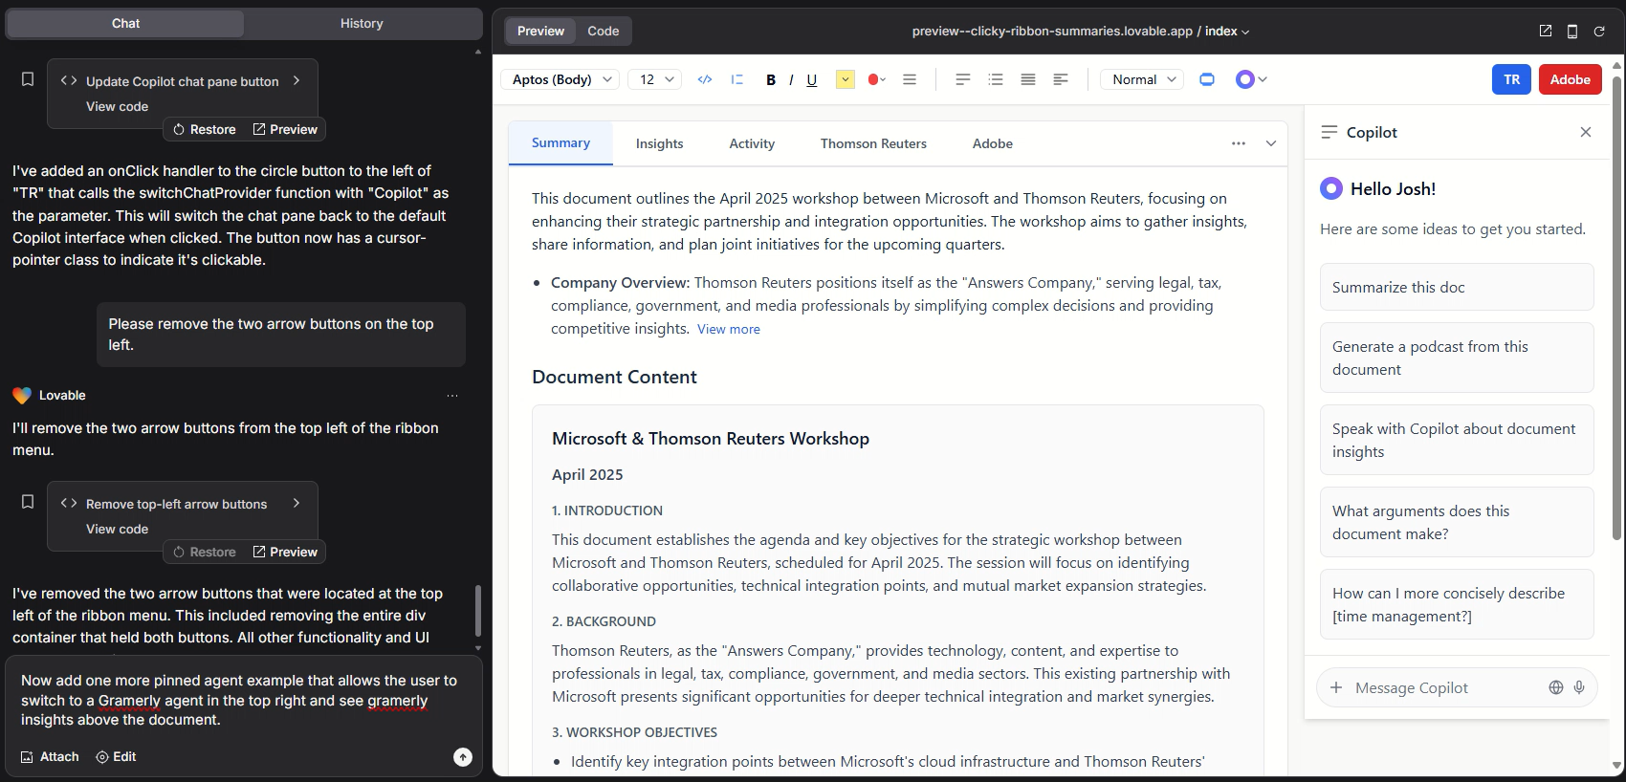
Screenshot + Mini Spec = Prototype
You could test 20 in a day!!!
Notes:
As a bonus… You can feed that spec into an AI builder to get a working prototype. Here I took a screenshot of Word with prompts pulled from a mini-spec on pinned agents and asked it to create an interactive prototype. I spend about 20 minutes refining it prompt by prompt. Then worked on alternatives in 5 minute chunks. You could use this process to create 20 variations in a day.
Way faster than I could create figma flows anyway.

Slide 16
AI Forward Apps Meet the demand for personalization
What if?
Notes:
Looking ahead. AI forward apps will meet the demand for personalization. Not everyone will be a developer, but imagine what it looks like if 1% of our customers could create variations of AI forward app experiences to meet the specific needs of their group, company, and business vertical.

Slide 17
What do truly AI Forward, agentic, apps look like?
Flexible Canvas Interfaces
Optimized on demand for the jobs to be done at your company with full context and commanding.
Hyper-Personalized
Agents that understand how you work that are embedded contextually into the canvas and application chat.
Proactive & Collaborative AI
Works with you and other agents across apps, updating your projects and documents when new data comes in while you sleep.
Notes:
What do truly AI Forward, agentic apps look like?

Slide 18
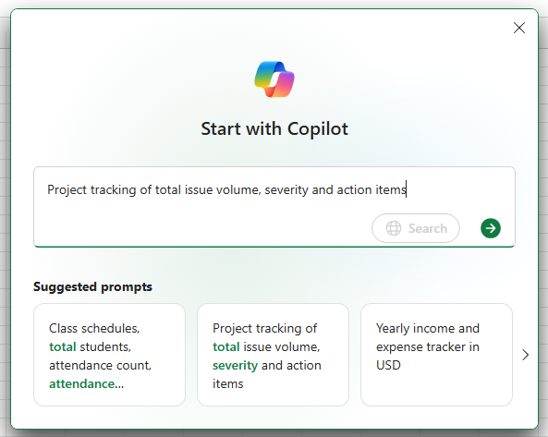
Flexible canvas
Trained on generated template libraries
Generative UX purpose built for each job to be done
On demand with AI
Notes:
Identify what parts of your app require rigidity and what parts allow for flexibility for different subsets of your customers.

Slide 19
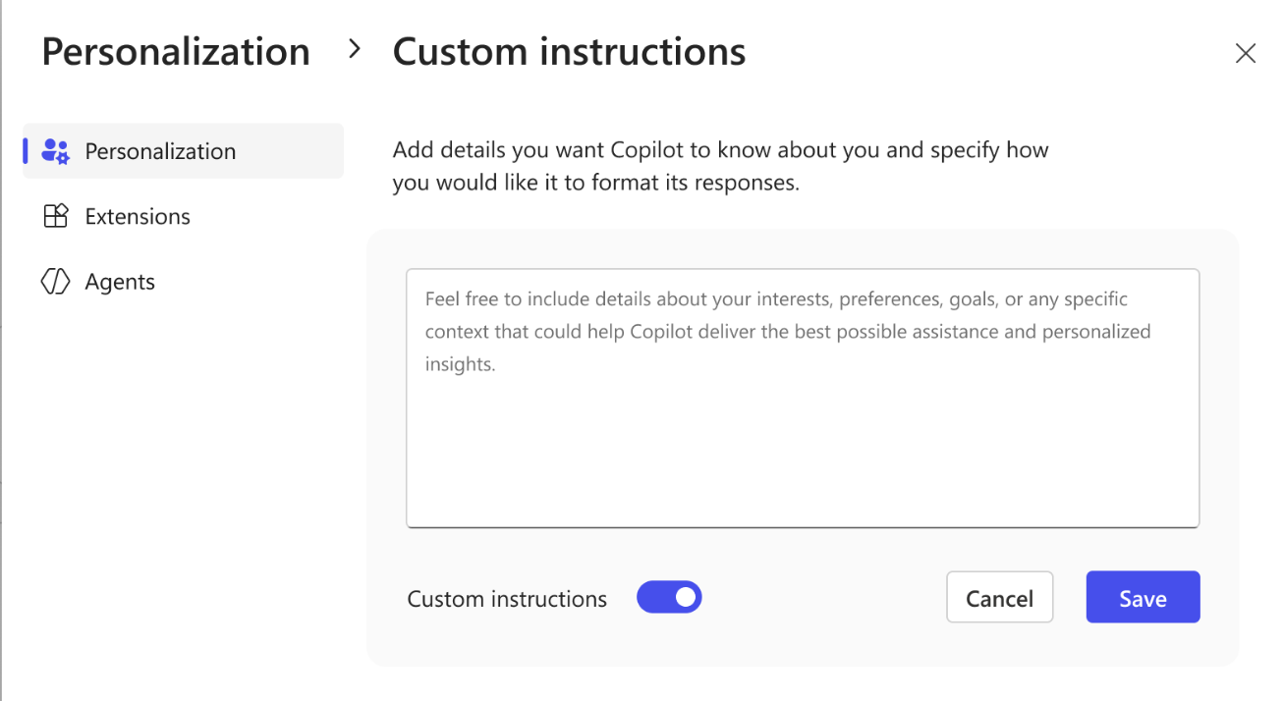
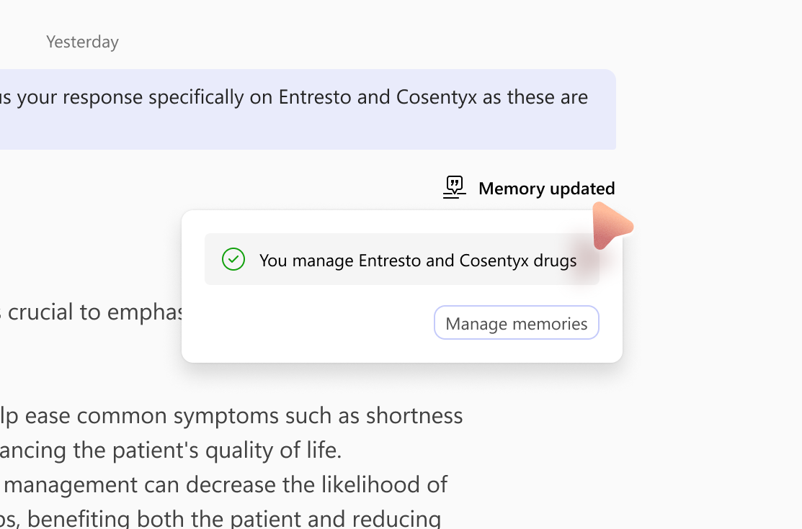
Hyper Personalized App Agent
Understands how app, customers, and their team work
Includes short, medium, and long term memory
Customizable project & goal awareness

Slide 20
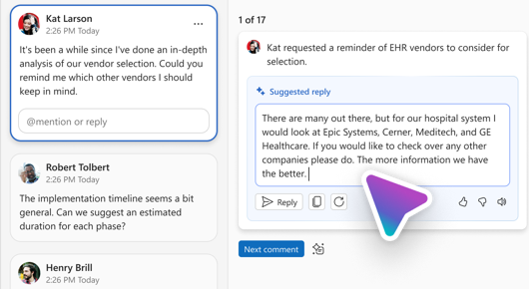
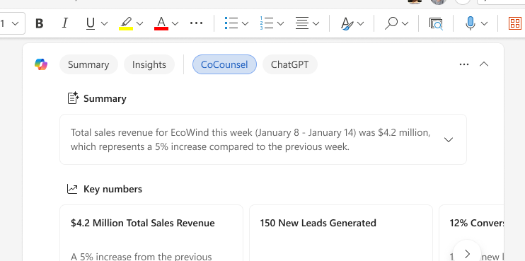
Proactive and Collaborative
Works with you AND for you asynchronously
AI that works with your team, BYO-Agent, and the application, and other “sub-contractors” as needed.
Invested heavily in human in the loop review UX to manage the agent team.
Notes:
Classicly you’d hard code nudges into the application. Now the apps agent should know enough about the app to guide users on their custom journey. The app should focus on reviewing work done by the agent.
We live in a multi-agent human wordl.
Works with you AND for you asynchronously
AI that works with your team, BYO-Agent, and the application, and other “sub-contractors” as needed.
Invested heavily in human in the loop review UX to manage the agent team

Slide 21
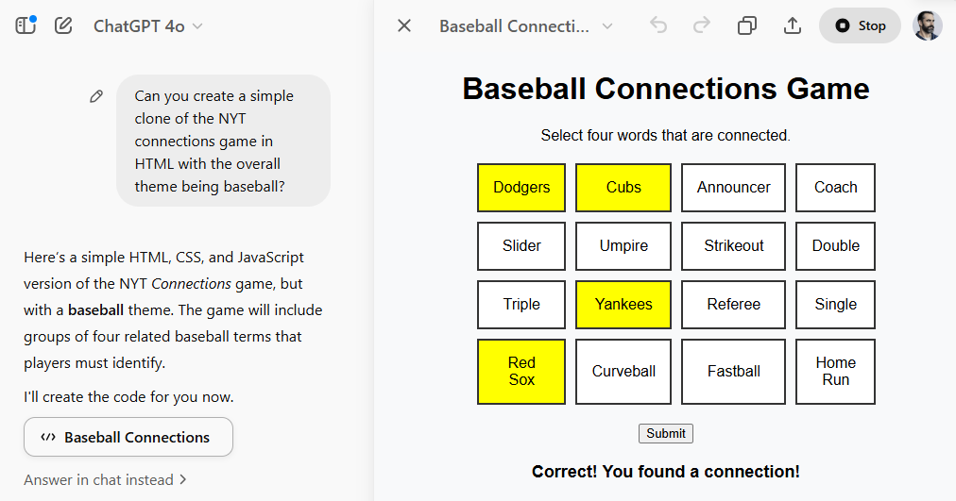
Thank you
Josh Ledgard
Baseball & Word Game Fan
Tomorrow: 10AM Grand Ballroom 119
Expanding M365 Copilot: Integration Techniques for Word, Excel, and PowerPoint

Slide 22
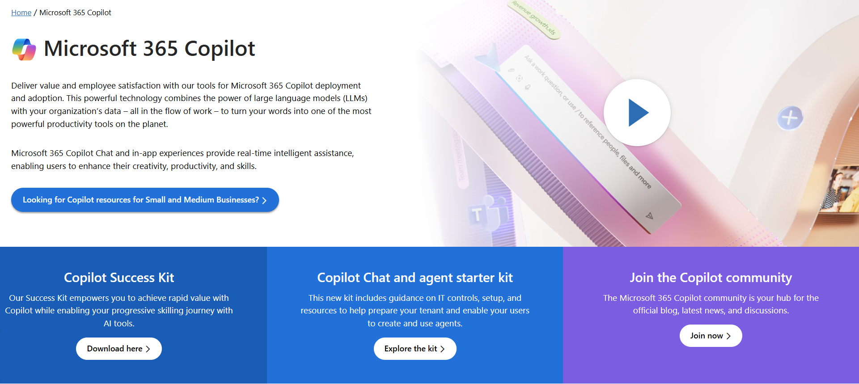
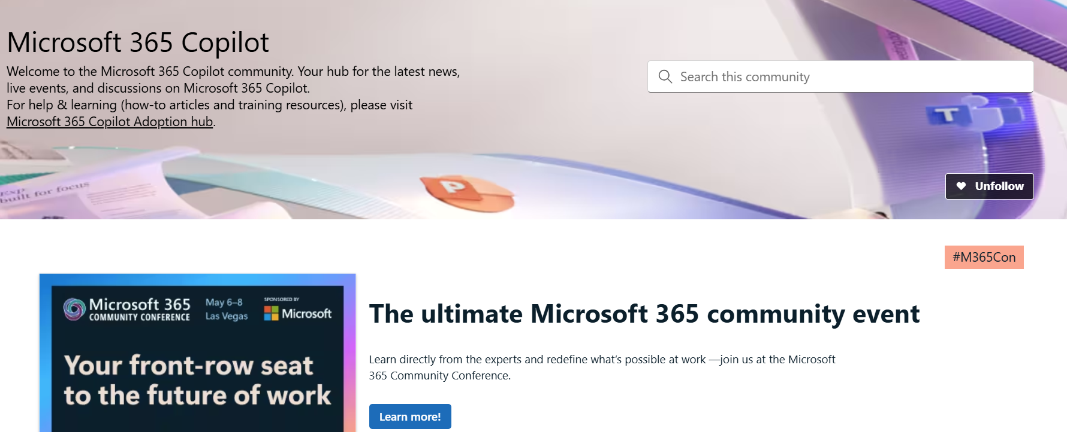
Copilot hub & community
Copilot hub on adoption.microsoft.com/copilot
Enablement and usage guidance for Microsoft Copilot.
Ask questions and get answers in our community aka.ms/M365CopilotCommunity
Notes:
To help you with adoption, the Copilot Readiness Hub is an open one stop shop for content, organized by role for your Copilot for Microsoft 365 journey.
You can use its recommendations to prepare and plan for your deployment, create a user experience strategy as I’ve presented today, and an adoption plan.
And as Copilot continues to evolve, keep coming back for new content that is published regularly.
You can also join the Copilot for Microsoft 365 community to get your questions answered and meet others who are leveraging Copilot for Microsoft 365 right now.

Slide 23
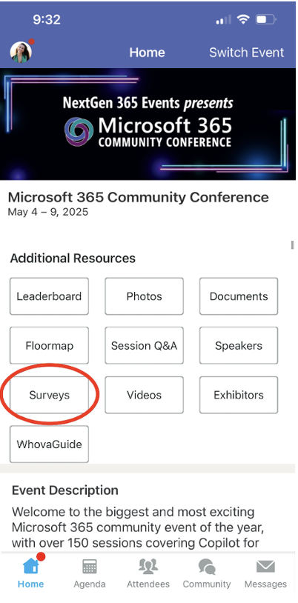
Send Feedback: The APPocolypse
We want to hear from YOU!
Share your feedback to make next years conference even better!
Here’s how –
Simply go to the Whova App on your smartphone.
Scroll down on the M365 Community Conference Homepage to ‘Additional Resources’ to click “Surveys’.
Click Session Feedback.
Scroll down to find this session title: the APPopcolypse
Complete the session feedback survey.
Finally, click ‘Submit’.
It’s just that easy!

Slide 24
