Slide 1
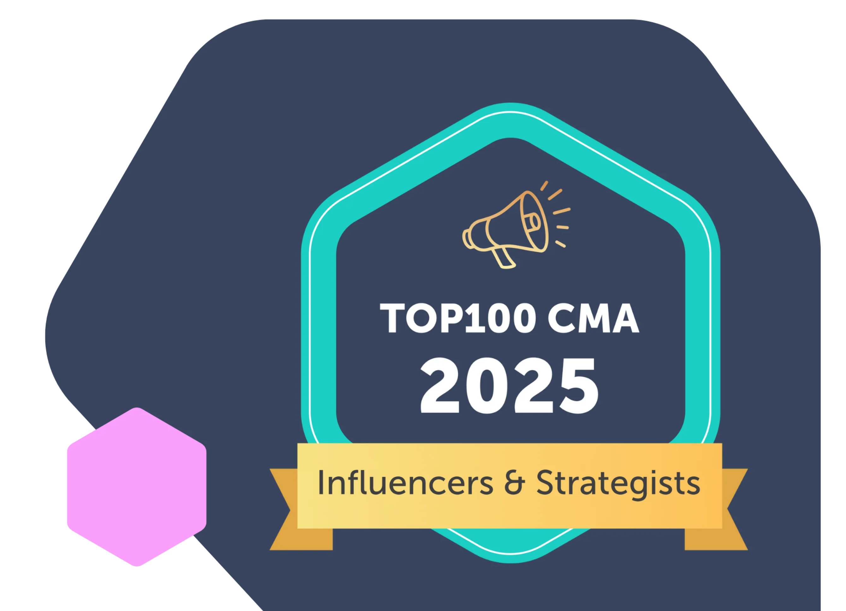

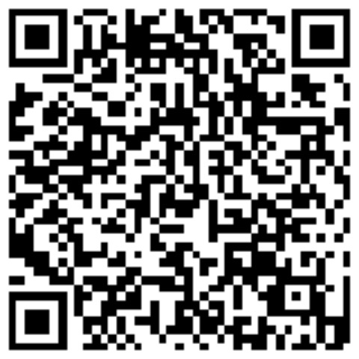
Managing your Brand for Career Advancement
Karuana Gatimu
Director
Microsoft 365 Customer Advocacy Group
Connect with Me
May 7, 2025

Slide 2
Own Your Story
Use AI to make a plan
Build your tribe
TOOLS MATTER
CREATE CONNECTION
Notes:
Example Prompt to make a plan from Karuana’s demo with skills relevant to her career. Update for your skill set:
Write me a public branding plan for an african american worman in tech with a background in digital media production, Microsoft products, business process improvement and product adoption

Slide 3
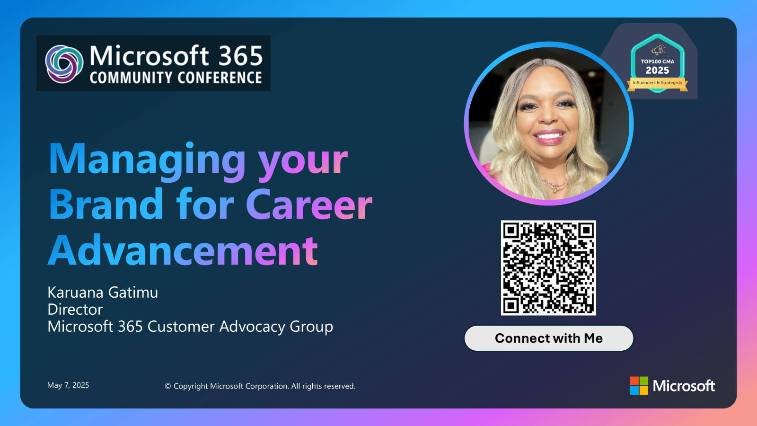
Anatomy of a Slide
Recent headshot
Recent Award
Regular talk on consistent topic
Single, simple way to connect
Name | Title
On
EVERYTHING
LinkedIn Profile
Bing
Google
Copilot

Slide 4
Develop your Self Awareness
Confidence
Community
Determination
Advisors
Authenticity
Mission
Build over time. Small acts equal large gains.
Be yourself! Finding your voice is essential to your growth!
Where is your community?
Who sees you as an influencer already?
Who do you go to for guidance?
Do you have trusted advisors?
How do you recover from perceived setbacks?
©Karuana Gatimu, 2017, 2025
p
Develop your Public Brand
Create Personal Meaning
Notes:
Evaluate your leadership journey

Slide 5
We have an exciting future ahead.
Make it Yours.

Slide 6
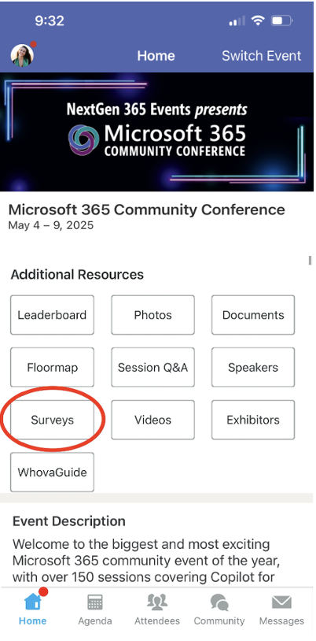
Session feedback surveys
We want to hear from YOU!
Share your feedback to make next years conference even better!
Here’s how –
Simply go to the Whova App on your smartphone.
Scroll down on the M365 Community Conference Homepage to ‘Additional Resources’ to click “Surveys’.
Click Session Feedback.
Scroll down to find this session title.
Complete the session feedback survey.
Finally, click ‘Submit’.
It’s just that easy!

Slide 7


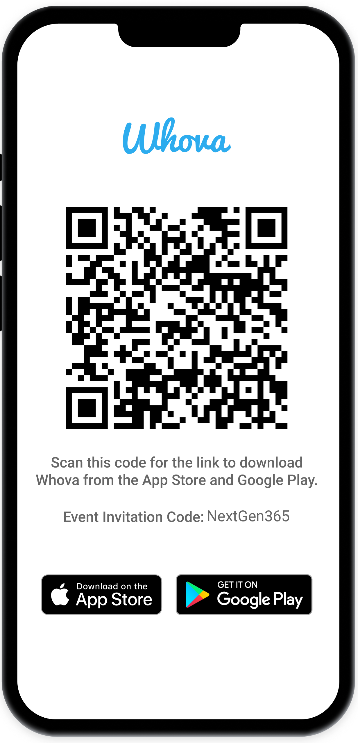
Join the event app to access:
The official event app for the
Microsoft 365 Community Conference
Event invitation code: NextGen2025
Event announcements
Personalized agenda, session details
Speaker & attendee profiles
Networking, meet-ups, messages
Event documents

Slide 8
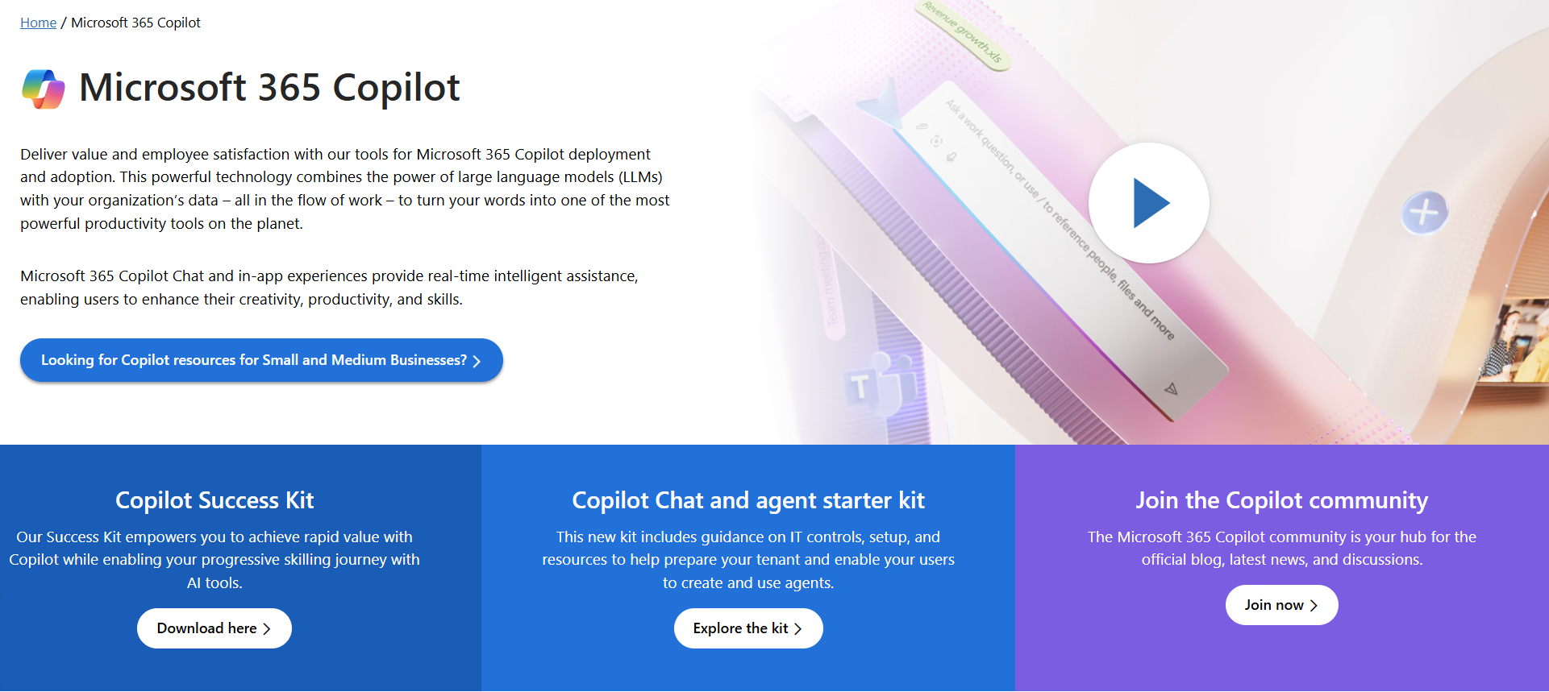
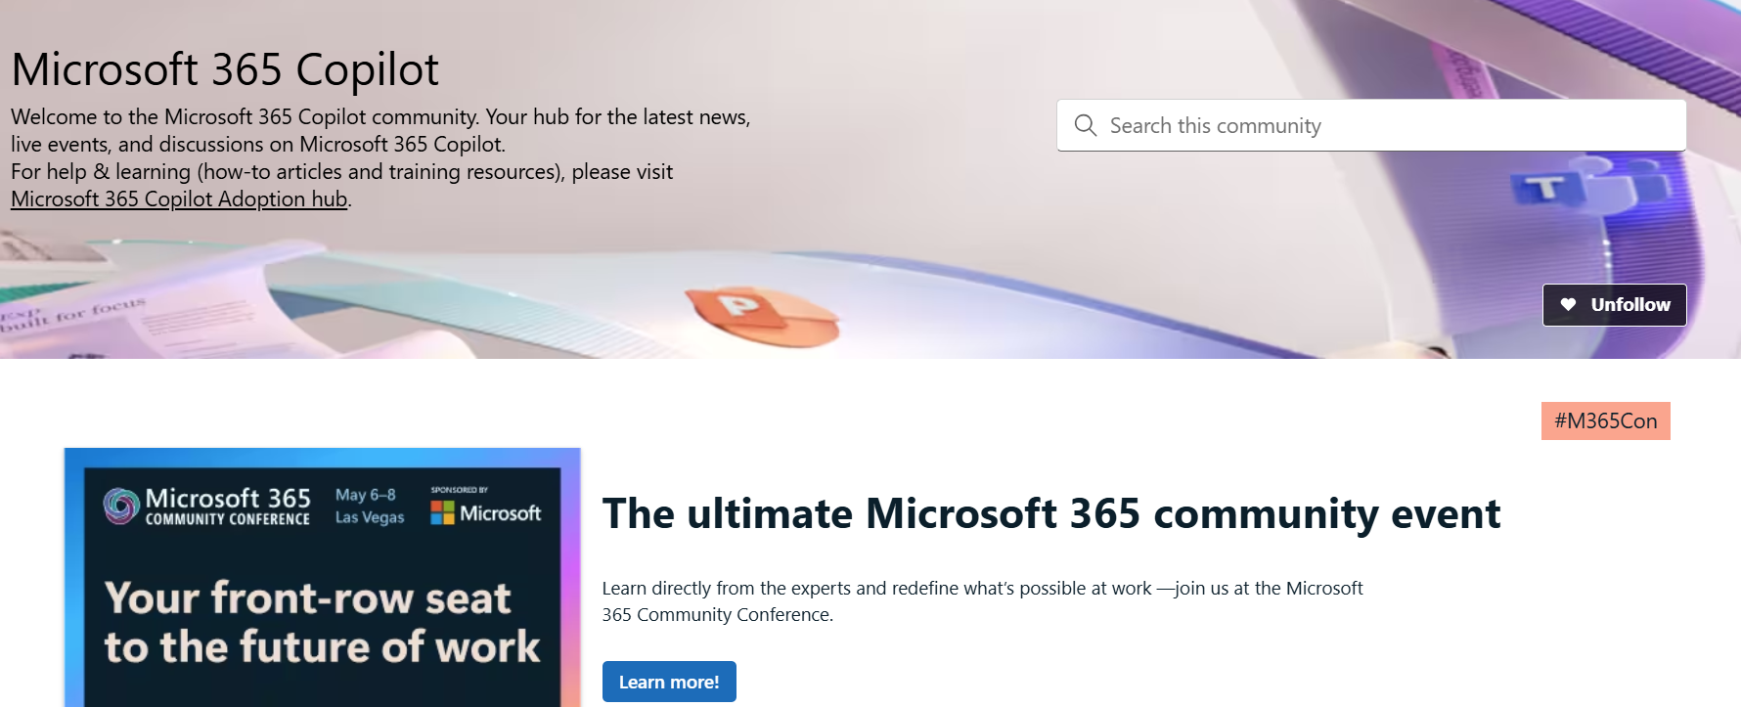
News & community content
Microsoft Community Learning aka.ms/Community/LearningChannel
Community led expert content on all your favorite Microsoft services.
Start your week with live news and event updates aka.ms/MondaysatMicrosoft
Watch live or on-demand & share our blog.
Notes:
To help you with adoption, the Copilot Readiness Hub is an open one stop shop for content, organized by role for your Copilot for Microsoft 365 journey.
You can use its recommendations to prepare and plan for your deployment, create a user experience strategy as I’ve presented today, and an adoption plan.
And as Copilot continues to evolve, keep coming back for new content that is published regularly.
You can also join the Copilot for Microsoft 365 community to get your questions answered and meet others who are leveraging Copilot for Microsoft 365 right now.

