Slide 1
Unlocking Career Advancement: Mentorship Strategies and Allyship
Miranda Jones
Director CXPM OneDrive and SharePoint
Microsoft

Slide 2

Microsoft 365 Community Conference

Slide 3



Join the event app to access:
The official event app for the
Microsoft 365 Community Conference
Event invitation code: NextGen2025
Event announcements
Personalized agenda, session details
Speaker & attendee profiles
Networking, meet-ups, messages
Event documents

Slide 4
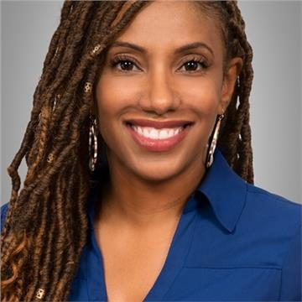
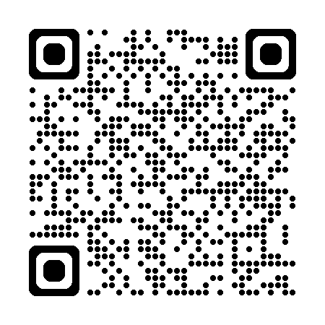
Miranda Jones
Director CXPM for OneDrive and SharePoint

Slide 5
Agenda
The Importance of Mentorship
The Power of Allyship
Combining Mentorship and Allyship
What next?

Slide 6
The Importance of Mentorship
"Mentorship is not about creating a new you. It’s about helping you become the best version of yourself."
- Sheryl Sandberg
Notes:
Any successful person and they’ll talk to you about mentors they’ve had along the way
Whether you’re early in career, well established or looking to make the next “leap” having a mentor or a set of mentors is key to success

Slide 7

What is Mentorship?
Mentorship is a professional relationship in which an experienced individual (the mentor) provides guidance, support, and advice to a less experienced person (the mentee).
This relationship is designed to help the mentee develop skills, gain knowledge, and navigate their career path more effectively.
Notes:
What is Mentorship?
Experienced individual provides guidance, support, encouragement and advice to someone less experienced.
Kevin Kruse is the creator of the Leading for Employee Engagement eLearning program for managers. and author of the bestselling book, Employee Engagement 2.0.

Slide 8

Benefits of Mentorship
Guidance and Advice: Mentors provide valuable insights and advice based on their own experiences, helping mentees navigate their career paths more effectively.
Goal Setting: Mentors can assist mentees in setting realistic and achievable career goals and provide guidance on how to reach them.
Skill Development: Through mentorship, mentees can identify and develop the skills needed for advancement, with mentors offering feedback and support.
Confidence Building: A mentor's encouragement and belief in a mentee's abilities can significantly boost the mentee's confidence and self-esteem.
Notes:
Many benefits to having a great mentor
Confidence Building is a benefit that we don’t talk about enough. Yesterday I had the privilege of participating in a Women in Tech round table discussion and the topic of impostor syndrome came up. How do you combat it
We discussed several strategies including leveraging allies and mentors
Mentors especially can provide the confidence boost…when you think you can’t a trusted mentor can encourage you that you can.
Different than a cheerleader or best friend, mentor’s encouragement is grounded in their belief in your professional abilities
<<Share my story with Lauren>>
Guidance and Advice: Mentors provide valuable insights and advice based on their own experiences, helping mentees navigate their career paths more effectively.
Skill Development: Through mentorship, mentees can identify and develop the skills needed for advancement, with mentors offering feedback and support.
Networking Opportunities: Mentors can introduce mentees to their professional networks, opening doors to new opportunities and connections.
Confidence Building: A mentor's encouragement and belief in a mentee's abilities can significantly boost the mentee's confidence and self-esteem.
Goal Setting: Mentors can assist mentees in setting realistic and achievable career goals, and provide guidance on how to reach them.
Role Modeling: Mentors serve as role models, demonstrating the behaviors and attitudes that lead to success.
Organizational Insight: Mentors can offer insights into the organization's culture and politics, helping mentees understand how to navigate the workplace effectively.
Accountability: Regular check-ins with a mentor can help mentees stay focused and accountable for their career development.
Long-Term Relationship: A strong mentor-mentee relationship can last throughout a career, providing ongoing support and guidance.

Slide 9
Types of Mentorship
Formal
Corporate Mentorship Programs
Professional Associations
Academic Mentorship
Leadership Development Program
Informal
Casual Workplace
Peer Mentorship
Networking Events
Advisory Relationships
Notes:
Multiple ways to engage with mentor and mentorship and I encourage you to leverage all of these
If you’re company has formal programs, explore options
Professional organizations – early in my career I found great mentorship via NSBE and SWE
Informal is equally important – Identify someone you admire in the workplace, networking events such as this one, LinkedIn
Formal Mentorship Examples
Corporate Mentorship Program: Structured programs within organizations where mentors and mentees are matched based on specific criteria.
Professional Associations: Industry associations often have formal mentorship programs to support career development.
Academic Mentorship: Universities and colleges often have formal mentorship programs to support students' academic and career goals..
Leadership Development Programs: Programs designed to develop future leaders within an organization through structured mentorship.
Informal Mentorship Examples
Casual Workplace Mentorship: Unstructured, spontaneous mentorship that occurs naturally in the workplace.
Peer Mentorship: Colleagues at similar career stages support each other through shared experiences.
Networking Events: Informal mentorship that begins through networking at industry events or conferences.
Online Communities and Social Media: Engaging with mentors through online platforms and social media.
Advisory Relationships: Seeking occasional advice from a trusted advisor without a formal mentorship agreement.

Slide 10

Create a Successful Partnership
Find Right Match
Set Clear Expectations
Maintain Engagement
Establish Communication Style
Give and Receive Feedback
Notes:
Mentor + Mentee relationship is a partnership
Mentor + Mentee must work together and be aligned
Relationship is how you succeed
Challenges in mentorship:
1. Finding the Right Match
Challenge: Ensuring a good fit between mentor and mentee can be difficult. Mismatched expectations or personalities can hinder the relationship.
Solution: Use structured matching processes and consider compatibility in terms of goals, communication styles, and professional backgrounds
3. Setting Clear Expectations
Challenge: Unclear or unrealistic expectations can lead to frustration. Mentors might expect too much progress too quickly, or mentees might expect too much guidance.
Solution: Establish clear goals and expectations at the beginning of the relationship. Regularly revisit and adjust these as needed
4. Maintaining Engagement
Challenge: Keeping both parties engaged over time can be challenging, especially if initial enthusiasm wanes.
Solution: Regular check-ins and setting short-term goals can help maintain momentum. Celebrating small successes can also keep both parties motivated
5. Communication Issues
Challenge: Miscommunication or lack of communication can derail the mentorship process.
Solution: Encourage open, honest, and frequent communication. Use various communication tools and methods to stay connected
7. Dealing with Feedback
Challenge: Both giving and receiving feedback can be difficult. Mentors might struggle with how to provide constructive criticism, and mentees might find it hard to accept it
Solution: Create a culture of trust where feedback is seen as a tool for growth. Use specific, actionable, and balanced feedback to help mentees improve

Slide 11
The Power of Allyship
"The most important thing you can do is be an ally. It’s not enough to be against discrimination; you need to be proactive in creating an inclusive environment."
-Tim Cook

Slide 12

What is Allyship
Allyship is the practice of using one's privilege and influence to support and advocate for marginalized or underrepresented groups.
It involves recognizing and addressing inequalities and actively working to create a more inclusive and equitable environment.
Notes:
Importance in Creating Inclusive Workplaces:
Promotes Diversity and Inclusion: Allyship helps to foster a culture where diversity is valued and inclusion is practiced. Allies can help ensure that all voices are heard and respected.
Reduces Bias and Discrimination: By standing up against biases and discriminatory practices, allies contribute to a fairer workplace.
Enhances Team Cohesion: Inclusive environments where allyship is practiced tend to have higher levels of trust and collaboration among team members.
Drives Innovation: Diverse teams that feel supported and included are more likely to bring different perspectives and ideas, driving innovation and creativity
Using your influence to support and advocate for underrepresented groups
Using your voice to give a seat at the table for those who don’t yet have a seat

Slide 13
How Allyship Can Help Break Down Barriers and Open Up Opportunities
Increased Visibility:
Allies can help underrepresented colleagues gain visibility by advocating for their inclusion in high-profile projects and meetings.
Access to Networks:
By introducing underrepresented colleagues to their professional networks, allies can open doors to new opportunities and connections.
Support and Sponsorship:
Allies can act as sponsors, actively promoting and endorsing the career advancement of underrepresented colleagues.
Creating Equitable Opportunities:
Allies work to ensure that all employees have equal access to resources, opportunities, and support, helping to level the playing field.
Breaking Down Systemic Barriers:
By challenging and changing discriminatory practices and policies, allies help to remove systemic barriers that hinder the progress of marginalized groups.

Slide 14
Combining Mentorship and Allyship
“When you've worked hard, and done well, and walked through that doorway of opportunity, you do not slam it shut behind you. You reach back and give other folks the same chances that helped you succeed”
- Michelle Obama
Notes:
Mentorship = Me
Allyship = We
Me: How can I be prepared for the opportunities available to me/ How can I help prepare someone
We: How can I make opportunities available to all, how can I create inclusive polices and practices for all

Slide 15

Mentorship + Allyship = Empowered and Inclusive Workplaces
Create Inclusive Leadership Pipelines
Provide Comprehensive Support
Enhance Visibility and Opportunities
Foster Culture of continuous Learning
Notes:
Creating Right experience + Right opportunity
Creating Inclusive Leadership Pipelines
Mentorship: Mentors provide guidance and support to help mentees develop their skills and advance their careers.
Allyship: Allies advocate for underrepresented groups, ensuring they have equal opportunities for leadership roles.
Example: A mentor might help a mentee prepare for a leadership position, while an ally ensures that the mentee is considered for the role by advocating for diverse candidates
Providing Comprehensive Support
Mentorship: Mentors offer personalized advice and share their experiences to help mentees grow.
Allyship: Allies provide broader support by standing up for colleagues and promoting a culture of inclusion.
Example: A mentor might help a mentee develop specific skills, while an ally ensures that the mentee feels safe and supported in the workplace
Enhancing Visibility and Opportunities
Mentorship: Mentors can introduce mentees to key networks and opportunities within the organization.
Allyship: Allies can amplify the achievements of underrepresented colleagues and ensure they receive recognition.
Example: A mentor might help a mentee get involved in high-visibility projects, while an ally highlights the mentee’s contributions in meetings and to senior leaders
Fostering a Culture of Continuous Learning
Mentorship: Mentors encourage mentees to pursue continuous learning and professional development.
Allyship: Allies create an environment where learning from diverse perspectives is valued and encouraged.
Example: A mentor might recommend courses or training programs, while an ally ensures that these opportunities are accessible to everyone, regardless of their background

Slide 16

Increase Women in Leadership
Mentorship: A senior executive mentored a mid-level female engineer, providing guidance on career development and leadership skills.
Allyship: The company’s leadership team, implemented policies to ensure gender diversity in leadership roles.
Outcome: The mentee not only advanced to a senior leadership position but also became a mentor herself, creating a cycle of support and empowerment

Slide 17
What’s Next?
“The secret of getting ahead is getting started.”
- Mark Twain

Slide 18

Build Your Career Dream Team
Mentors
  An experienced professional who provides guidance, shares knowledge, and helps you navigate your career path.
Allies
  Someone who supports you by standing up for your rights and promoting an inclusive work environment.
Sponsors
  Someone who advocates for you, opens doors to new opportunities, and helps you advance within the organization.
Trusted Advisors
  An individual wit deep expertise who provides strategic advice and helps you make informed decisions
Peer Allies
  A colleague at a similar career stage who offers mutual support, shares experiences, and collaborates on professional development.
Cheerleader
  A friend or family member who offers emotional support, encouragement, and motivation, helping you stay positive and focused.
Notes:
What do you do, where do you start
Build your career dream team, Karuana calls this building your “board of directors”
Just as a board of directors is responsible for keeping a company on track and accountable your dream team should be made up of people wo can do that for your career
We’ve talked about mentors and Allies but here are some other types of people you need to surround yourself with:
Sponsors – different than Allies (we vs. me) sponsor is all about “you” can be same person as Mentor or Ally but doesn’t have to be
A Career Dream Team is composed of various roles that collectively provide comprehensive support, guidance, and opportunities for growth. key roles that can make up this team:
Mentor: An experienced professional who provides guidance, shares knowledge, and helps you navigate your career path.
Ally: Someone who supports you by standing up for your rights and promoting an inclusive work environment.
Sponsor: Someone who advocates for you, opens doors to new opportunities, and helps you advance within the organization.
Trusted Advisor: An individual wit deep expertise who provides strategic advice and helps you make informed decisions
Peer Ally: A colleague at a similar career stage who offers mutual support, shares experiences, and collaborates on professional development.
Cheerleader: A friend or family member who offers emotional support, encouragement, and motivation, helping you stay positive and focused.
By incorporating these diverse roles into your Career Dream Team, you'll have a well-rounded support system that can help you achieve your professional goals and navigate the complexities of your career.

Slide 19

For Mentees
Identify your goals and what you need from a mentor
Be intentional about finding the right kind of mentor and mentorship style for your needs
Speak up when you need help
Be receptive to feedback and willing to learn
This Photo by Unknown Author is licensed under CC BY-SA
Notes:
Being a mentee is an opportunity to learn and grow. Identify your goals and make an action plan to achieve them. Speak up when you need help, and be open to feedback and willing to learn. A good mentor can help you with your career goals and give you the tools to succeed.

Slide 20

For Mentors
Every mentor/mentee relationship is different regarding style, time commitment, and approach.
Set up, agree upon and communicate what success looks like for the mentee
Participate in active listening, knowing when to give and when to wait to give advice
Share your mistakes, learnings and achievements
Look for classes, opportunities, and connections for your mentee
Notes:
Mentorship is a 2 way street
Stay engaged and be available
Your role is to educate, encourage and support
Be vulnerable, share your mistakes, lessons learned

Slide 21

For Allies
Stay Informed
Keep up-to-date with issues related to diversity, equity, and inclusion.
Speak Up
Support policies and initiatives that promote diversity and inclusion within the organization.
Amplify Voices
Ensure that the contributions of underrepresented colleagues are recognized and valued.
Provide Support
Offer your time and resources to support colleagues in their professional development.
Create Opportunities
Advocate for diverse hiring practices and ensure that recruitment processes are fair.
Build Inclusive Cultures
Demonstrate inclusive behavior in your daily interactions and encourage others to do the same.

Slide 22
Thank You!

Slide 23
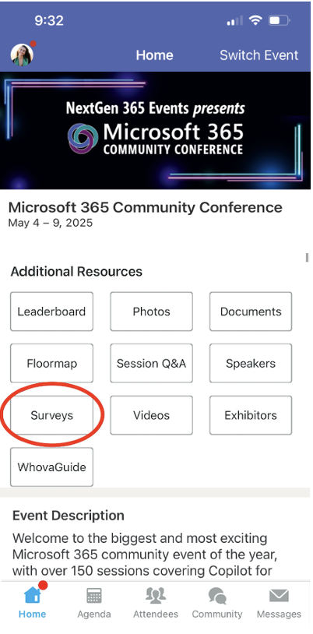
Session feedback surveys
We want to hear from YOU!
Share your feedback to make next years conference even better!
Here’s how –
Simply go to the Whova App on your smartphone.
Scroll down on the M365 Community Conference Homepage to ‘Additional Resources’ to click “Surveys’.
Click Session Feedback.
Scroll down to find this session title.
Complete the session feedback survey.
Finally, click ‘Submit’.
It’s just that easy!

Slide 24
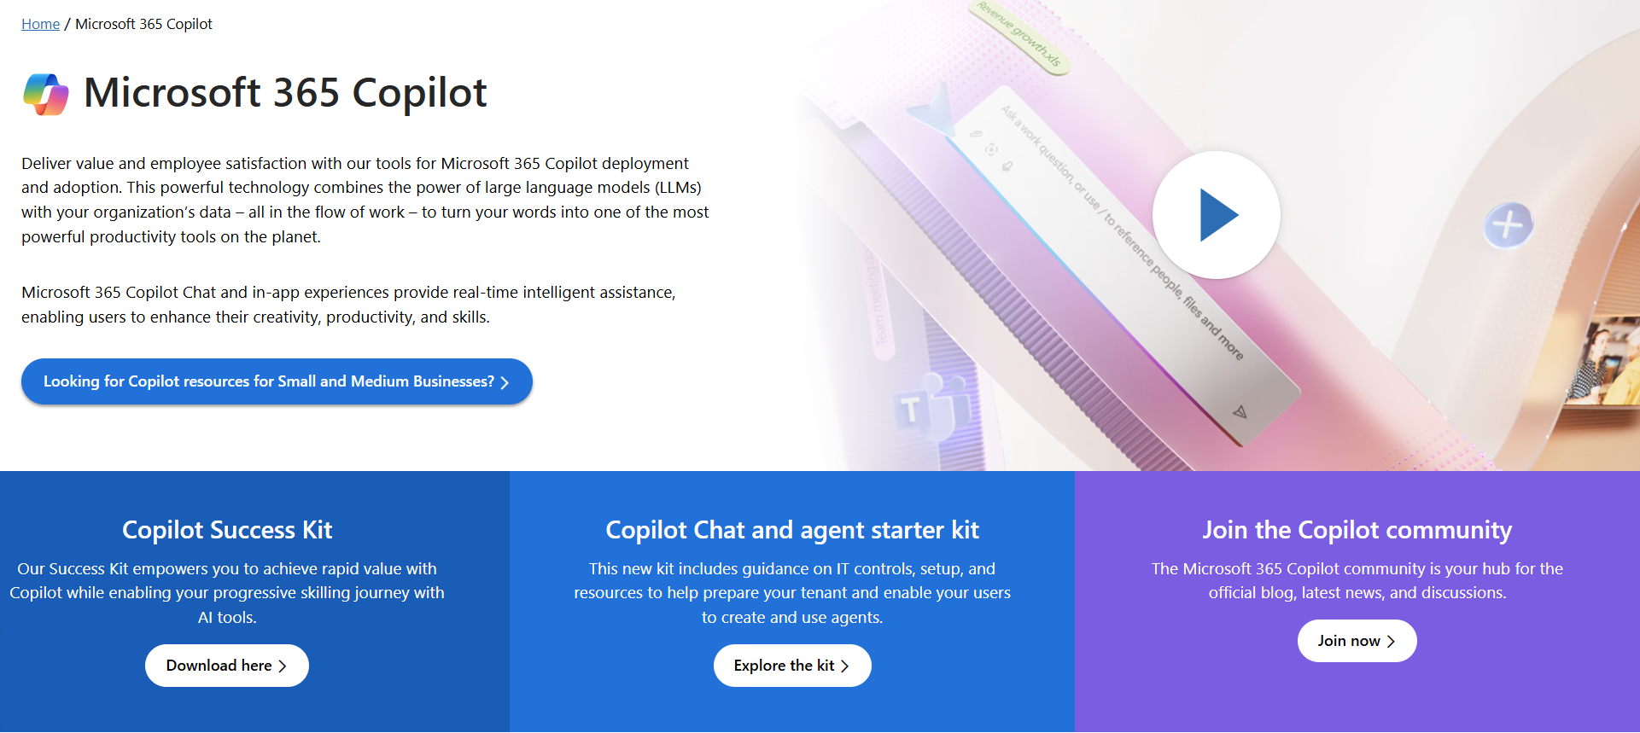
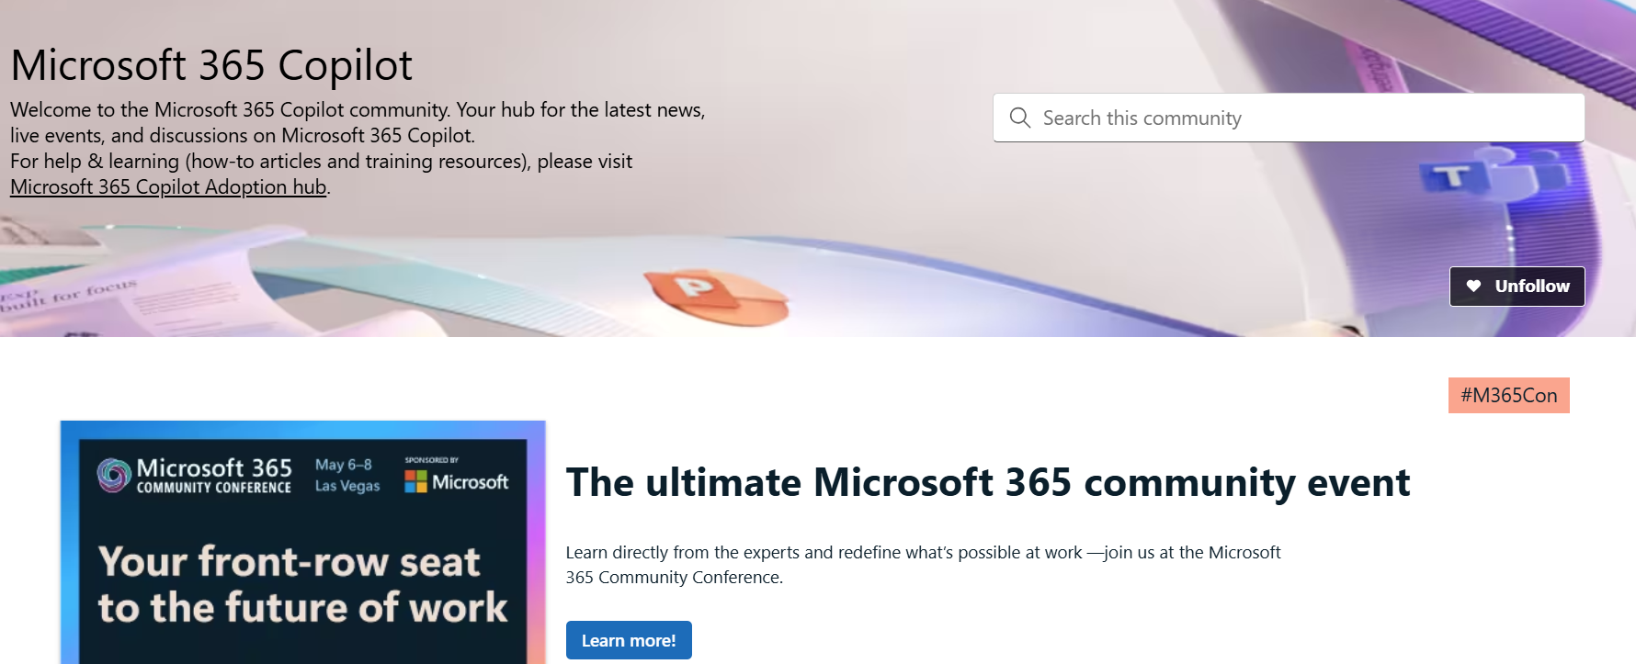
Copilot hub & community
Copilot hub on adoption.microsoft.com/copilot
Enablement and usage guidance for Microsoft Copilot.
Ask questions and get answers in our community aka.ms/M365CopilotCommunity
Notes:
To help you with adoption, the Copilot Readiness Hub is an open one stop shop for content, organized by role for your Copilot for Microsoft 365 journey.
You can use its recommendations to prepare and plan for your deployment, create a user experience strategy as I’ve presented today, and an adoption plan.
And as Copilot continues to evolve, keep coming back for new content that is published regularly.
You can also join the Copilot for Microsoft 365 community to get your questions answered and meet others who are leveraging Copilot for Microsoft 365 right now.

Slide 25
News & community content
Microsoft Community Learning aka.ms/Community/LearningChannel
Community led expert content on all your favorite Microsoft services.
Start your week with live news and event updates aka.ms/MondaysatMicrosoft
Watch live or on-demand & share our blog.
Notes:
To help you with adoption, the Copilot Readiness Hub is an open one stop shop for content, organized by role for your Copilot for Microsoft 365 journey.
You can use its recommendations to prepare and plan for your deployment, create a user experience strategy as I’ve presented today, and an adoption plan.
And as Copilot continues to evolve, keep coming back for new content that is published regularly.
You can also join the Copilot for Microsoft 365 community to get your questions answered and meet others who are leveraging Copilot for Microsoft 365 right now.

Slide 26


