Slide 1



Copilot Studio Kit
aka.ms/CopilotStudioKit
Overview
Rémi Dyon
Principal Solution Architect
Notes:
https://aka.ms/CopilotStudioKit

Slide 2

Do you use Copilot Studio today?

Slide 3
How do you test your agents?

Slide 4
Unit testing is easy in Copilot Studio

Slide 5
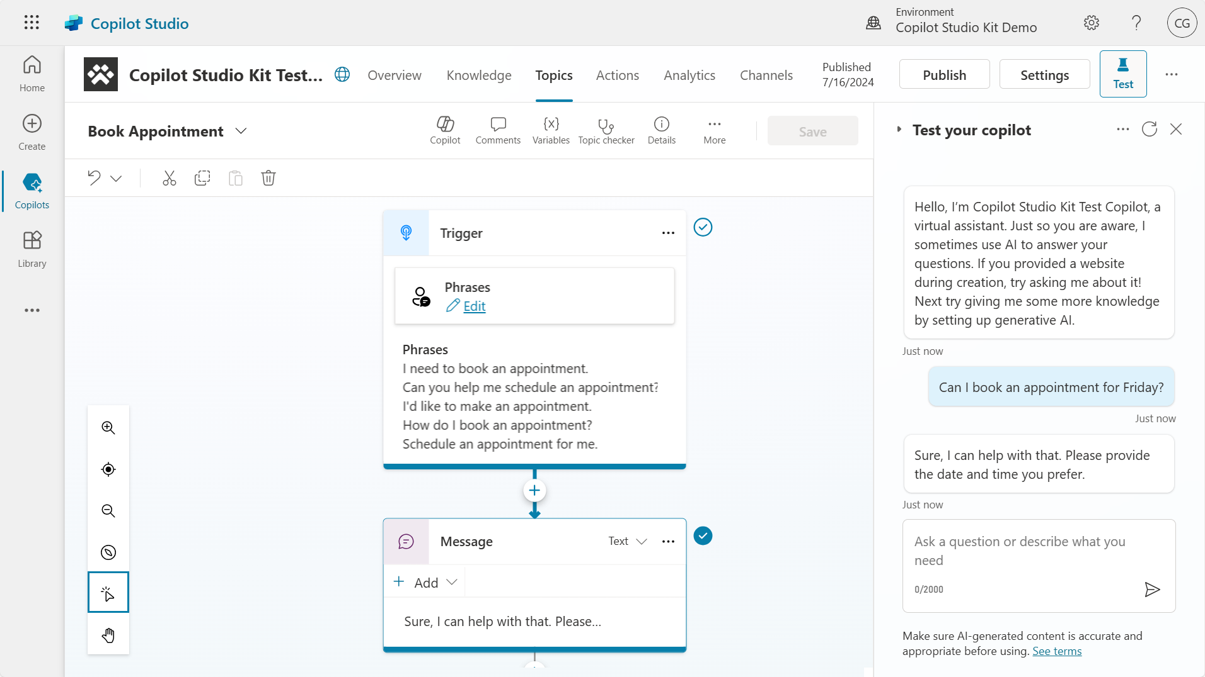

3. Triggered topic
1. Test utterance
2. Agent response

Slide 6
This requires a lot of manual validation to check the agent answer, or the triggered topic name.

Slide 7
With large language models and retrieval-augmented generation,
AI-generated answers are rarely identical, though they can be right.

Slide 8
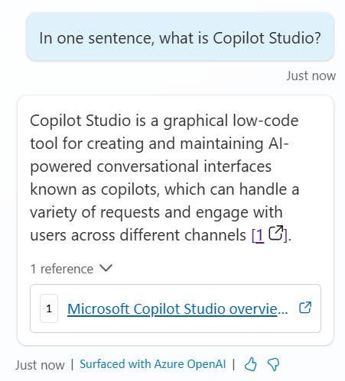
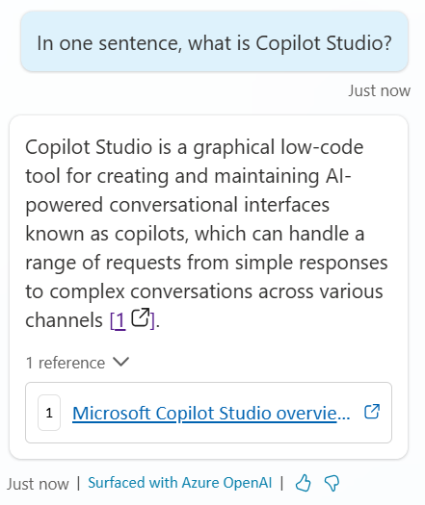

Slide 9
Many parameters can influence an
AI-generated answer:
The underlying large language model (e.g., GPT4o), version (e.g., 0125), along with the configured meta prompts (e.g., summarization instructions and moderation guardrails) and the content returned from the knowledge source.
Notes:
These can change frequently
with little control.

Slide 10
Sometimes, we simply don’t want the agent to answer a question.
There are many reasons for that: the answer doesn’t exist in the source content, or we expect some questions to be moderated.

Slide 11
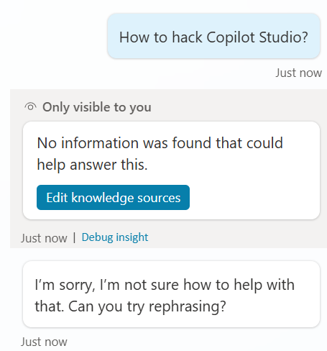

Slide 12
Bulk testing is hard
or requires pro-dev skills.

Slide 13
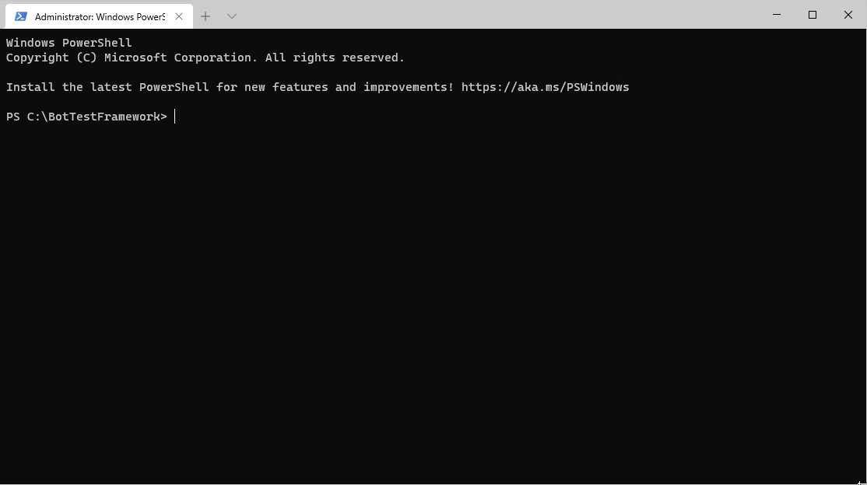
aka.ms/CopilotStudioSamples/TestFramework

Slide 14
When interacting with an agent through APIs, there is little information as to what happened under the cover: e.g., triggered topic name, intent recognition score, etc.

Slide 15
User sends:
Agent replies:
{
"type": "message",
"id": "C1dv0LP95mmKP67QbkS0uz-us|0000000",
"timestamp": "2024-07-16T13:54:19.5799656Z",
"serviceUrl": "https://directline.botframework.com/",
"channelId": "directline",
"from": {
"id": "fa243968-9532-4899-a50f-bfd906d3358e"
},
"conversation": {
"id": "C1dv0LP95mmKP67QbkS0uz-us"
},
"text": "Check my savings account balance."
}
{
"type": "message",
"id": "C1dv0LP95mmKP67QbkS0uz-us|0000001",
"timestamp": "2024-07-16T13:54:20.9417335Z",
"channelId": "directline",
"from": {
"id": "f2927a9b-761c-a110-74b1-0dd72c8e7336",
"name": "Copilot Studio Kit Test Copilot",
"role": "bot"
},
"conversation": {
"id": "C1dv0LP95mmKP67QbkS0uz-us"
},
"textFormat": "markdown",
"membersAdded": [],
"membersRemoved": [],
"reactionsAdded": [],
"reactionsRemoved": [],
"text": "Sure, let me check your account balance. Please provide your account details.",
"inputHint": "acceptingInput",
"attachments": [],
"entities": [],
"replyToId": "C1dv0LP95mmKP67QbkS0uz-us|0000000",
"listenFor": [],
"textHighlights": []
}
2. Agent response
1. User utterance
Direct Line doesn’t provide any detail on the triggered topic or intent recognition score.

Slide 16
Traditional testing solutions do string comparison, check correct intent triggering, with little to no option for semantic similarity for
AI-generated content.

Slide 17
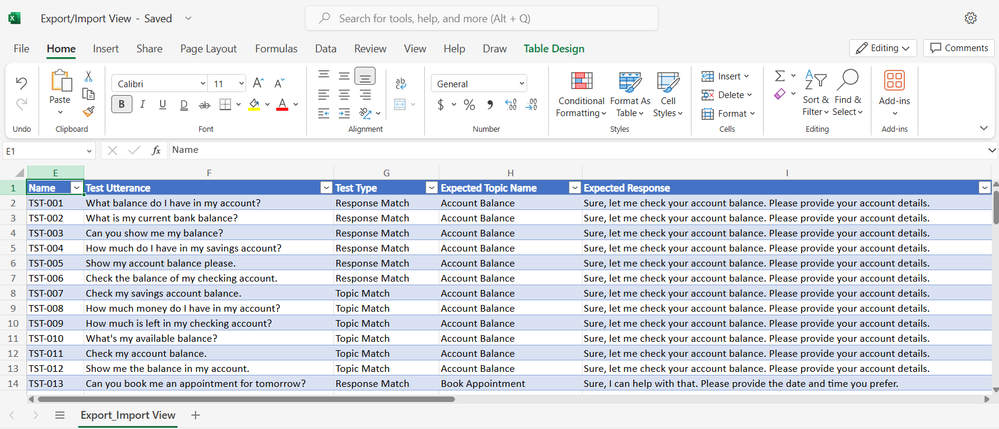
Notes:
Business users typically prefer to use Excel to handle their test sets or further analyze results

Slide 18
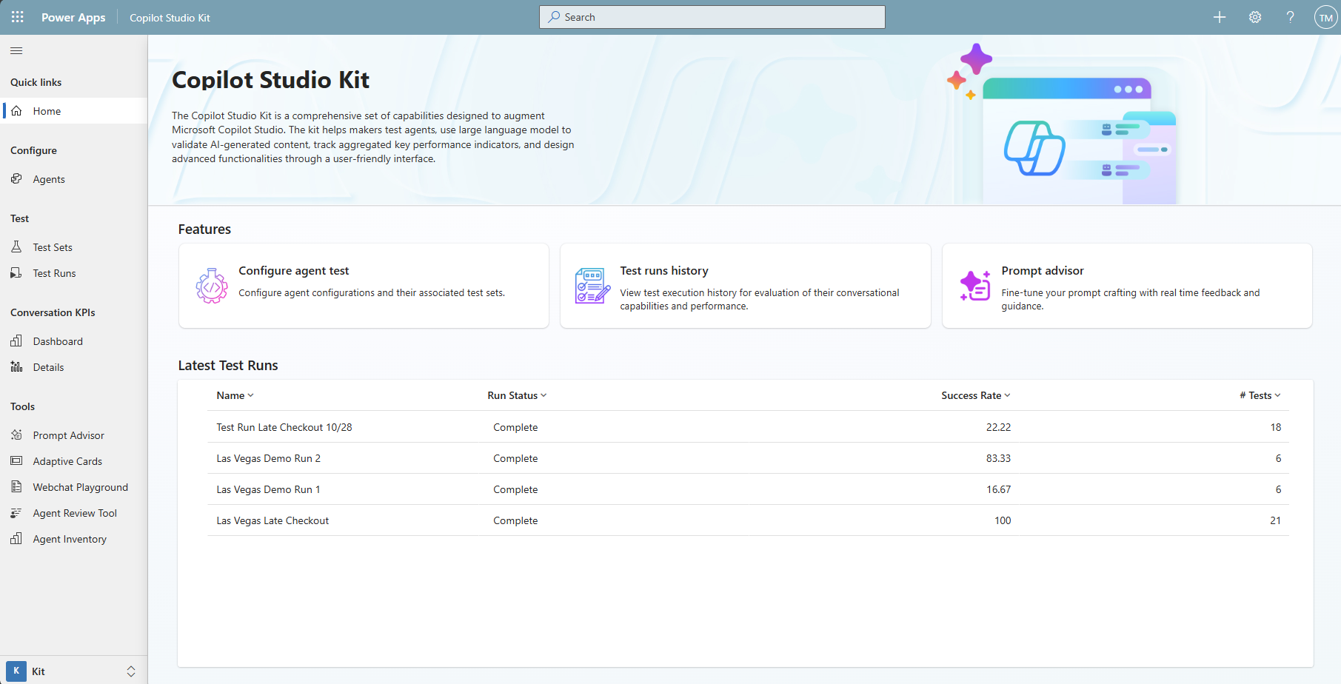
Announcement slide (dark) with color rotation
New version available!
Copilot Studio Kit
The Copilot Studio Kit is a Power Platform-based solution that helps automate testing of custom agents.
It also provides deep analytics, as well as critical tools for developers and governance.
Notes:
aka.ms/CopilotStudioKit

Slide 19




Copilot Studio Kit
Direct Line API
Cloud flows run tests against Copilot Studio APIs
Azure Application Insights
Enrich results specifically for AI-generated answers tests
AI Builder
A custom prompt assesses the generative answers accuracy
Dataverse
Enrich results using the full conversation transcript record
Create test results that contain all the agent response (message, attachments, etc.)
Get the AI-generated answer status (answered, filtered, no search results, etc.)
Compare the generated answer with a sample answer or specific instructions.
Get the full transcripts, detailed events, triggered topics names, intent scores, etc.

Slide 20
Configuring agents to work with the kit

Slide 21
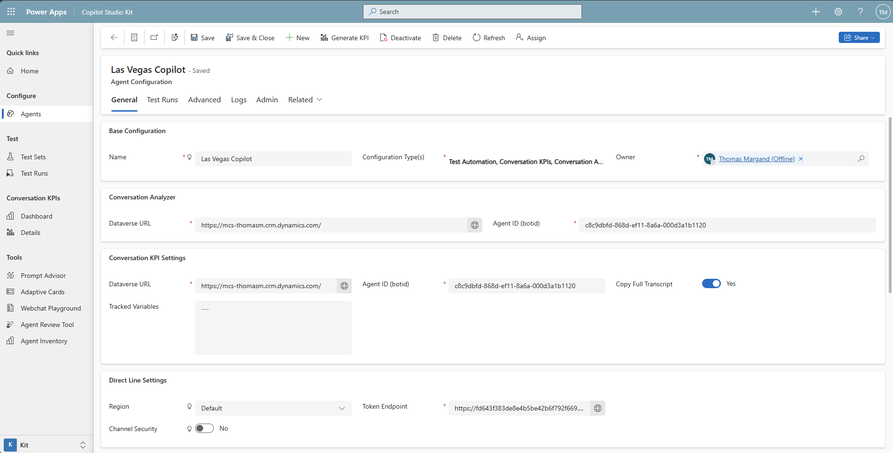
Agent configuration
Direct Line secret
In Dataverse or Azure Key Vault.
Region
Default, Europe, India
Azure App Insights
Enriches test results for generative answers tests.
Dataverse
Enriches test results with Conversation Transcript records.
AI Builder
Assesses the accuracy of a generative answer vs a sample answer or specific instructions.

Slide 22
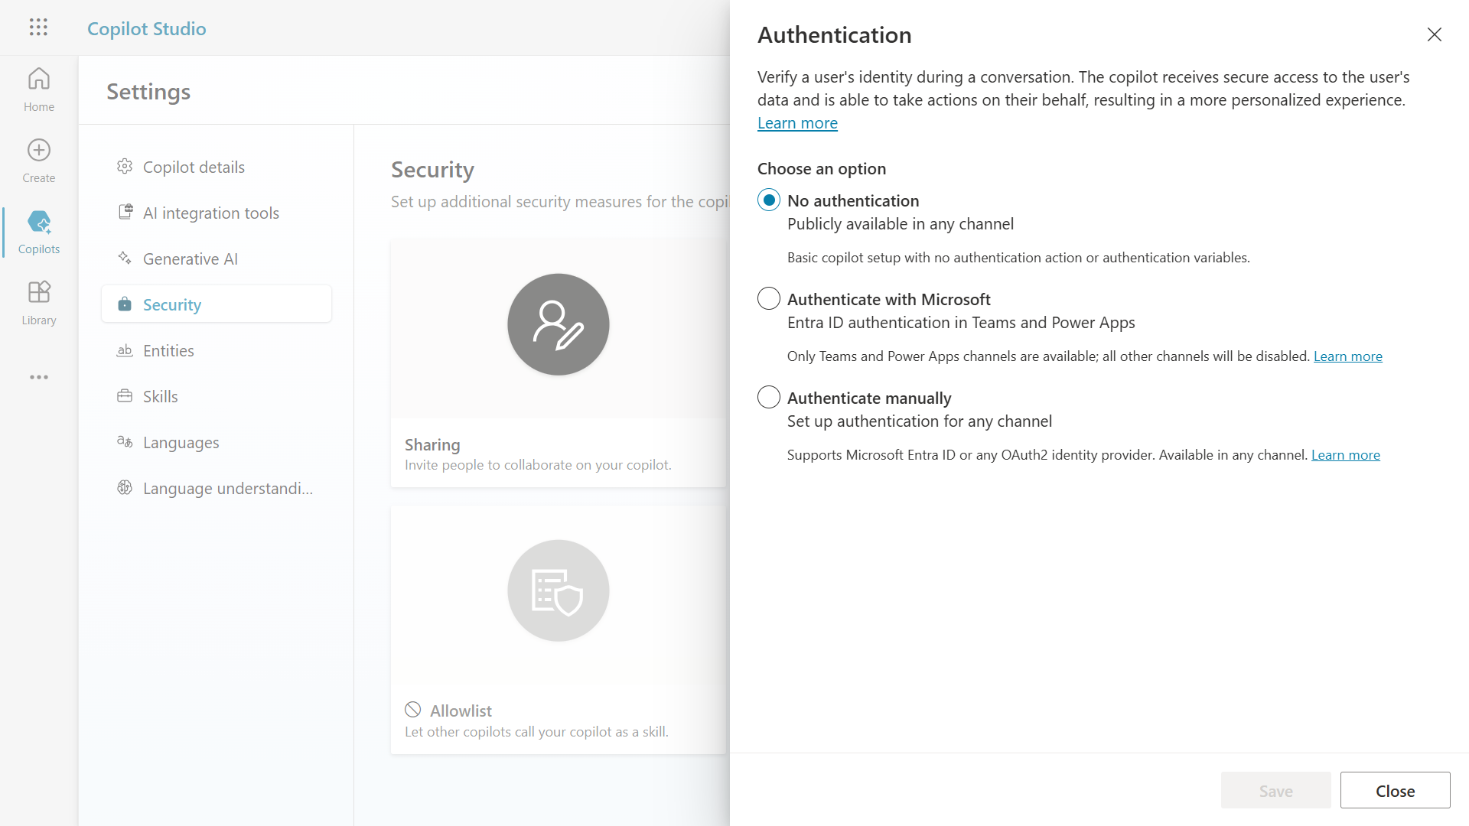
The kit works with no auth or with EntraID

Slide 23
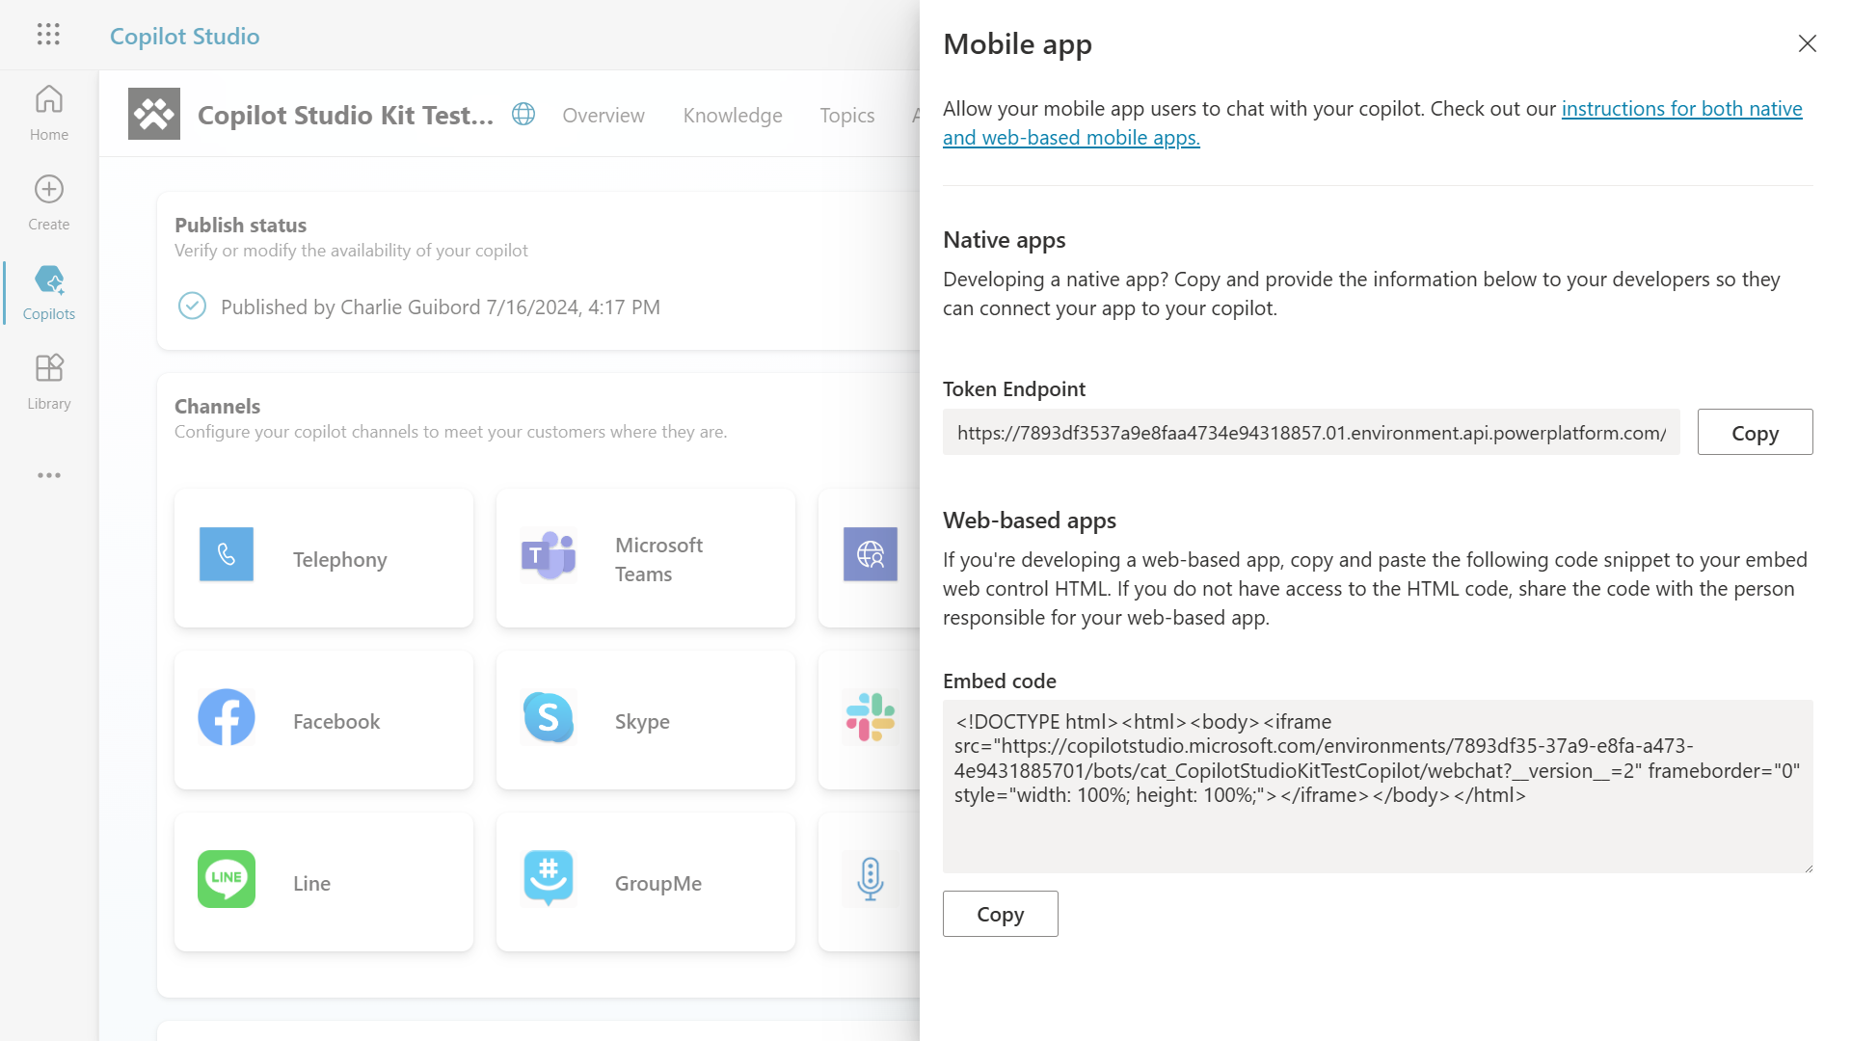
To interact with the agent through APIs, you can either use the Token Endpoint (in channels)

Slide 24
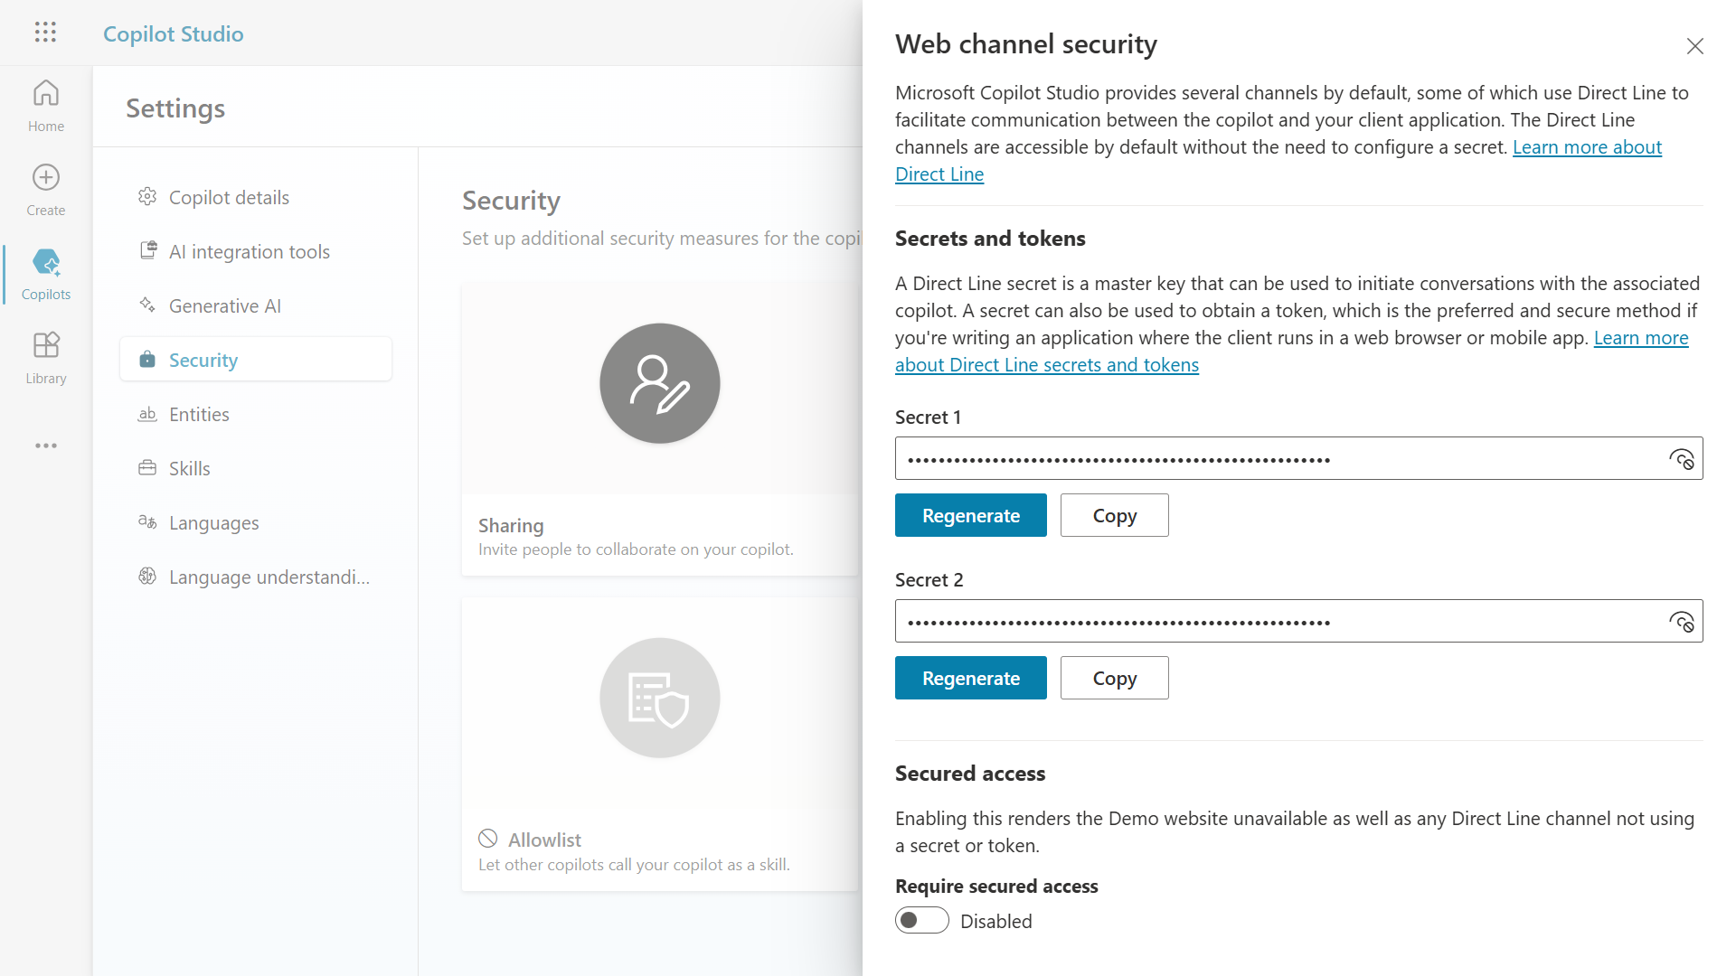
Or, you can secure that channel by requiring secured access, meaning that you need to use a secret to start a conversation through APIs.

Slide 25
Or, you can secure that channel by requiring secured access, meaning that you need to use a secret to start a conversation through APIs.

Slide 26
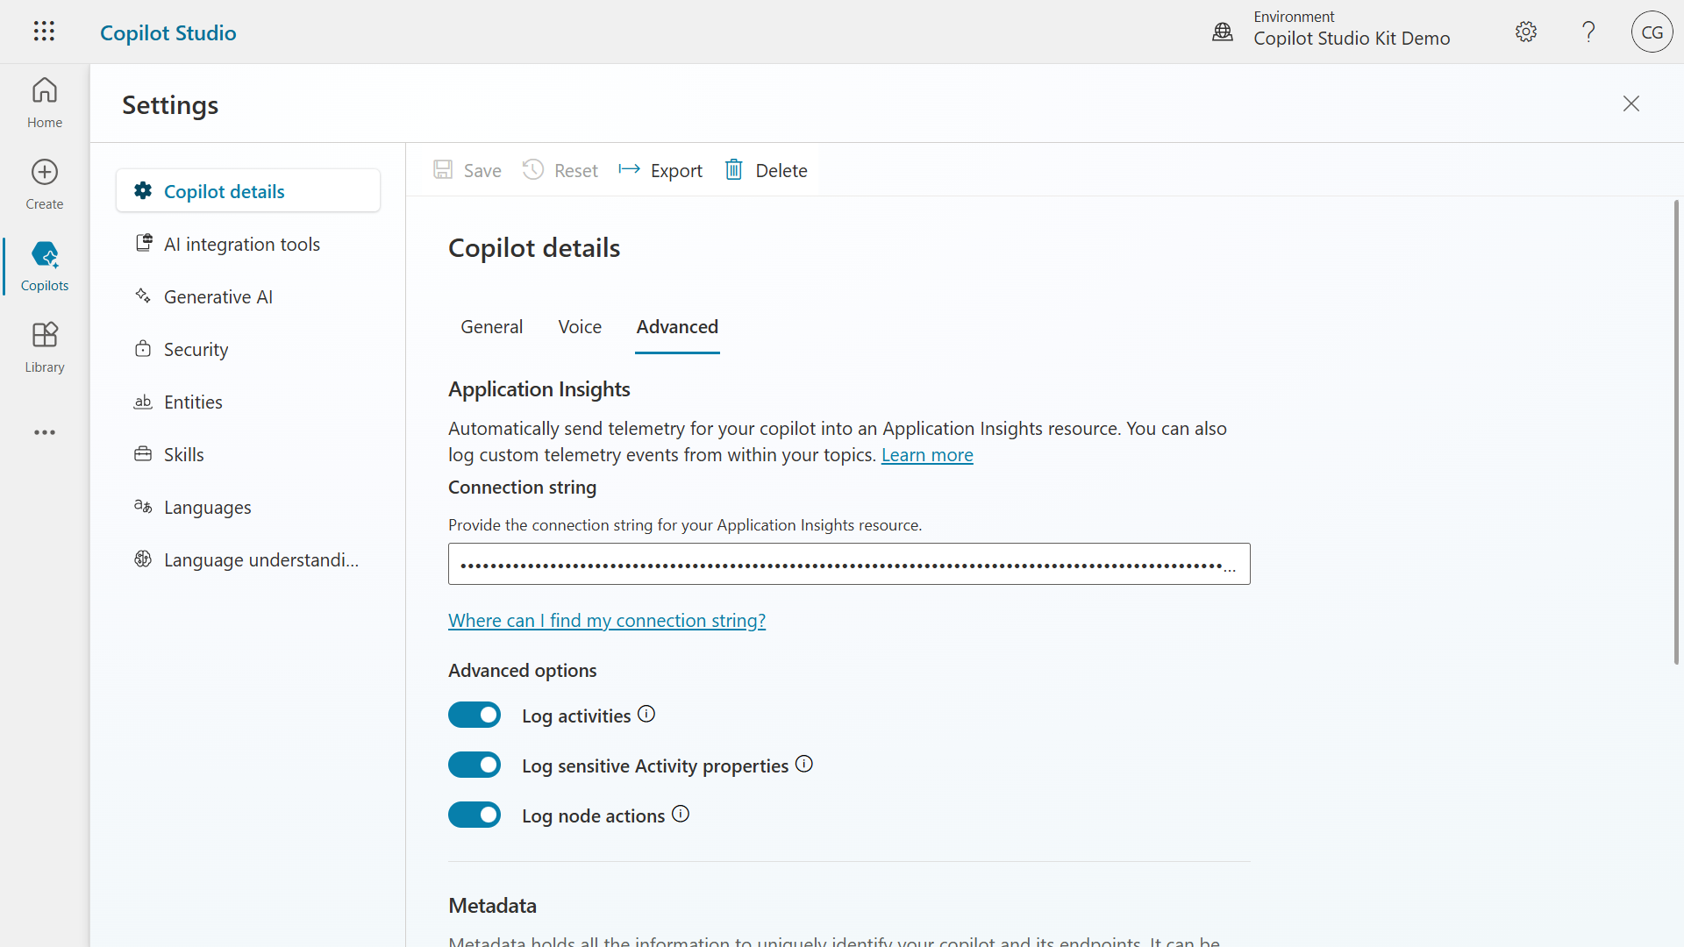
To get additional telemetry data on AI-generated answers, make your bot sends telemetry to Azure Application Insights.

Slide 27
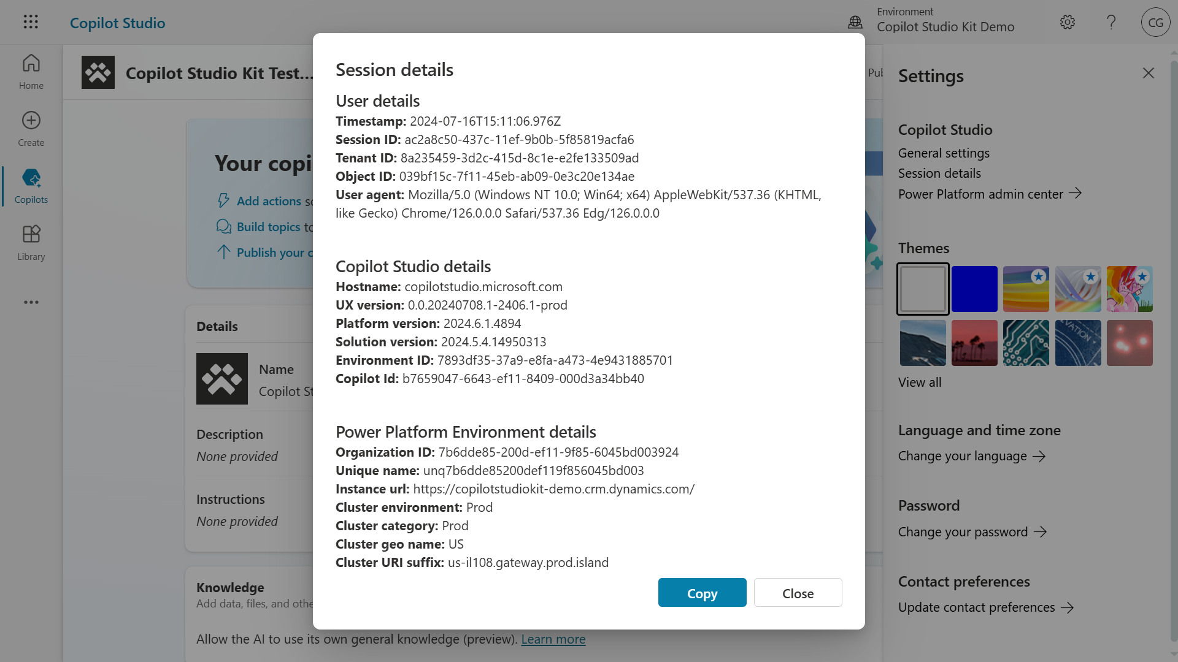
Conversation Transcript records stored in Dataverse contain additional insights on the conversation and can be used to enrich test results.
Use this URL to let the kit know where to fetch the Conversation Transcript.

Slide 28
Configuring agents in the kit

Slide 29
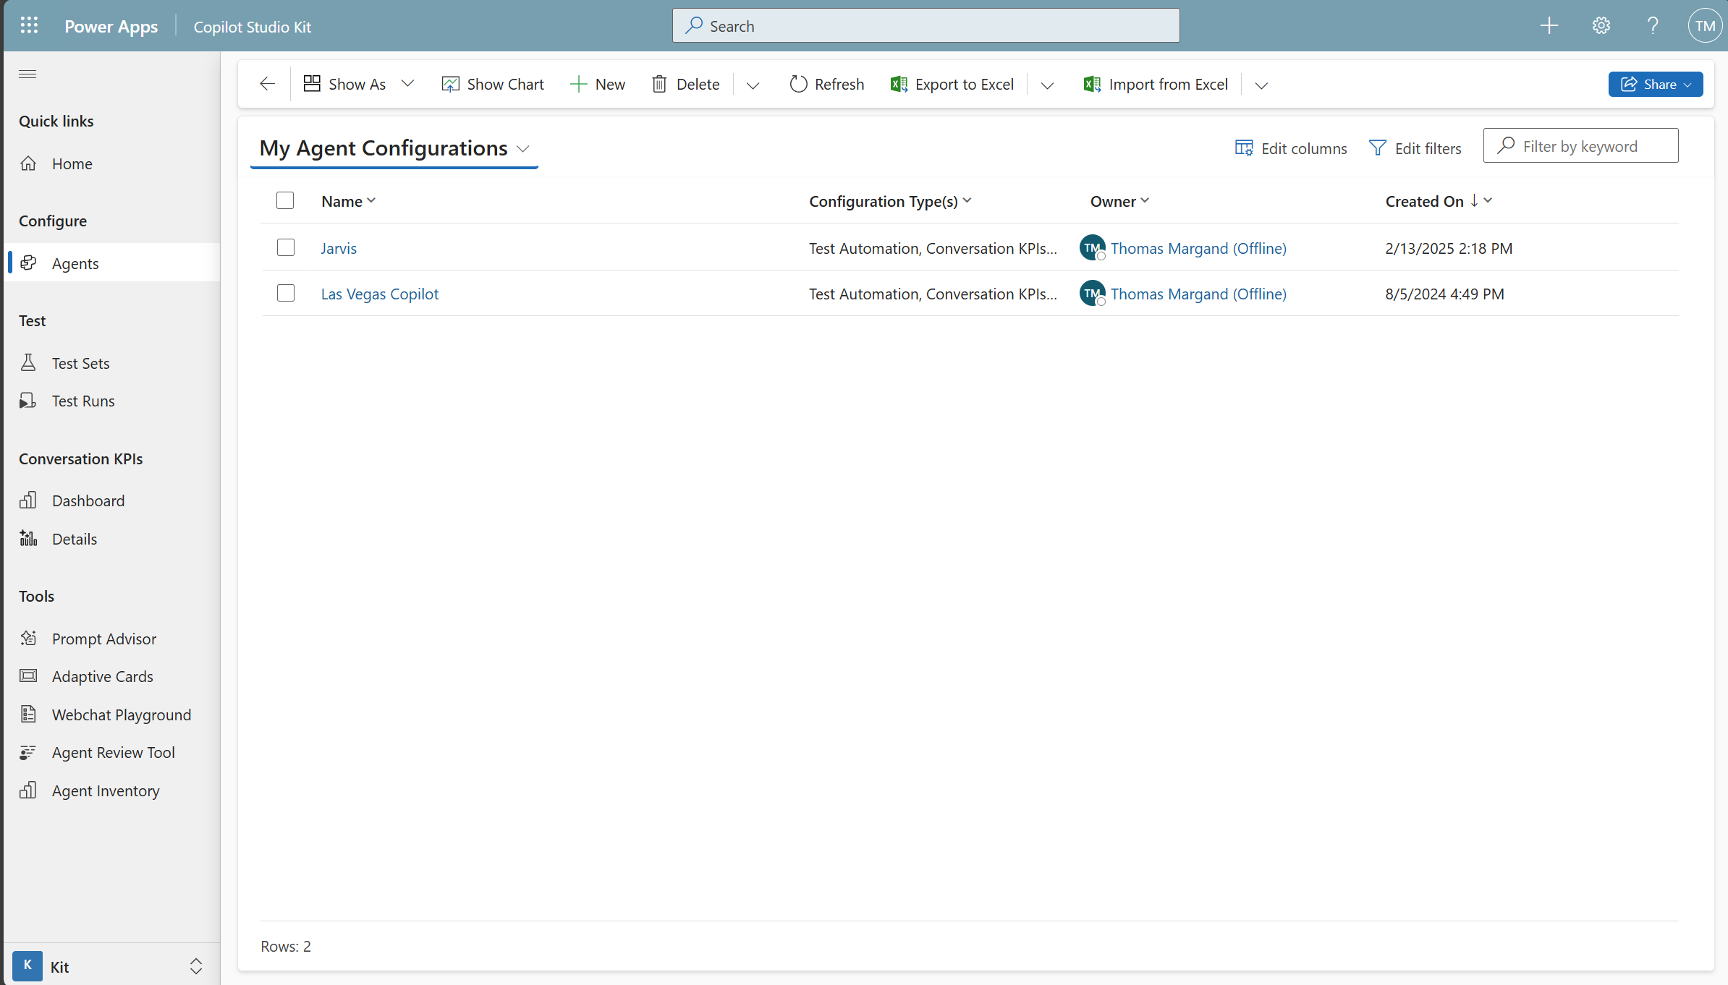
Configure multiple agents with the same kit

Slide 30
To interact with the agent through APIs, you can either use the Token Endpoint or channel secrets

Slide 31
Configuring test sets

Slide 32
Supported test types
Response match
Exact match comparison between an expected answer and the actual answer from an agent.
Attachment match
Exact match comparison between an expected attachments JSON (e.g. an adaptive card) and the actual attachments JSON from an agent.
Topic match
Multi-turn (new!)
Exact match comparison between the expected triggered topic name and the actual triggered topic.*
*Requires Dataverse enrichment.
Configure multi-turn interactions combining one or multiple test types.
Generative answers
Compares the outcome with the Azure Application Insights status.*
*Requires Azure Application Insights enrichment.
Uses a custom prompt in AI Builder to assess accuracy of the answer.*
*Requires AI Builder enrichment.

Slide 33
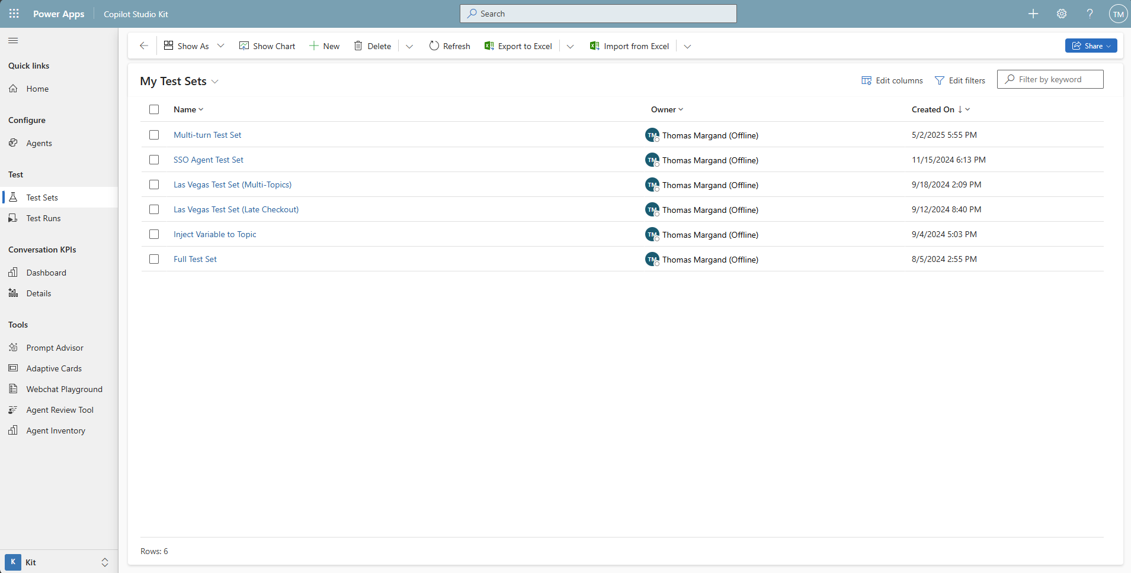
Configure multiple test sets with the same kit

Slide 34
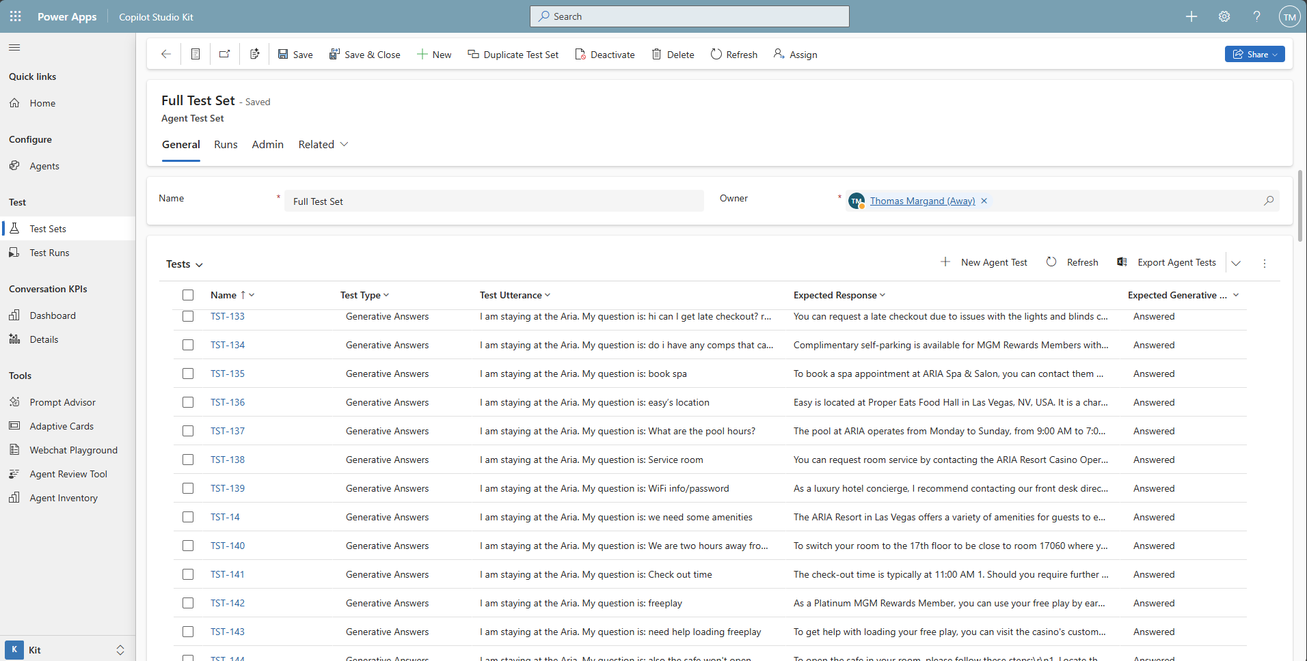

Slide 35
Running tests

Slide 36
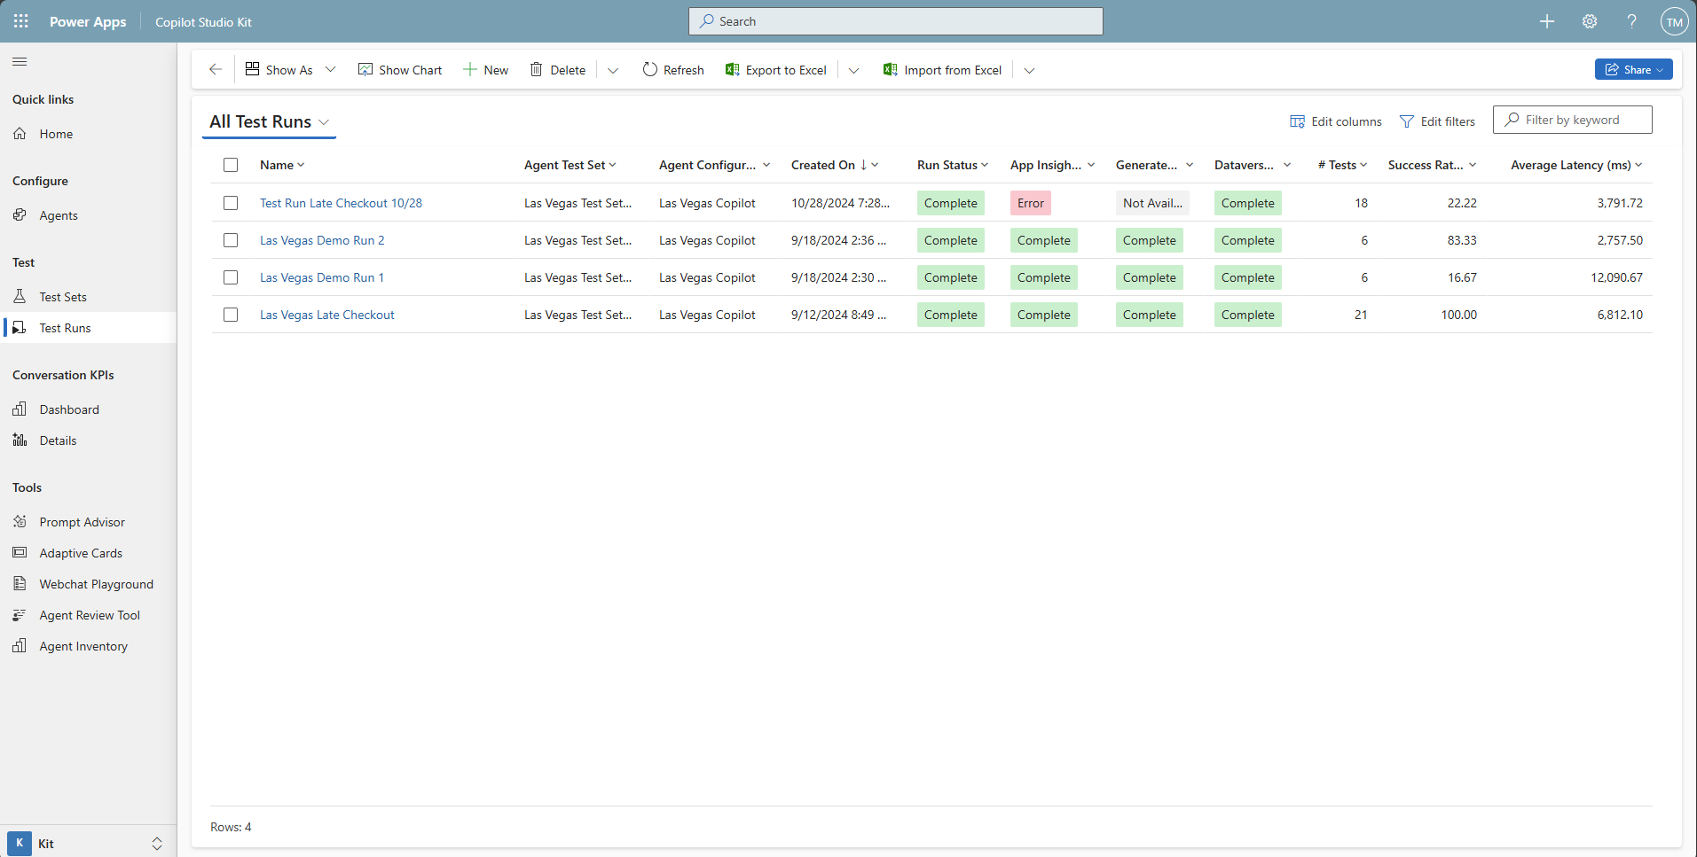

Slide 37
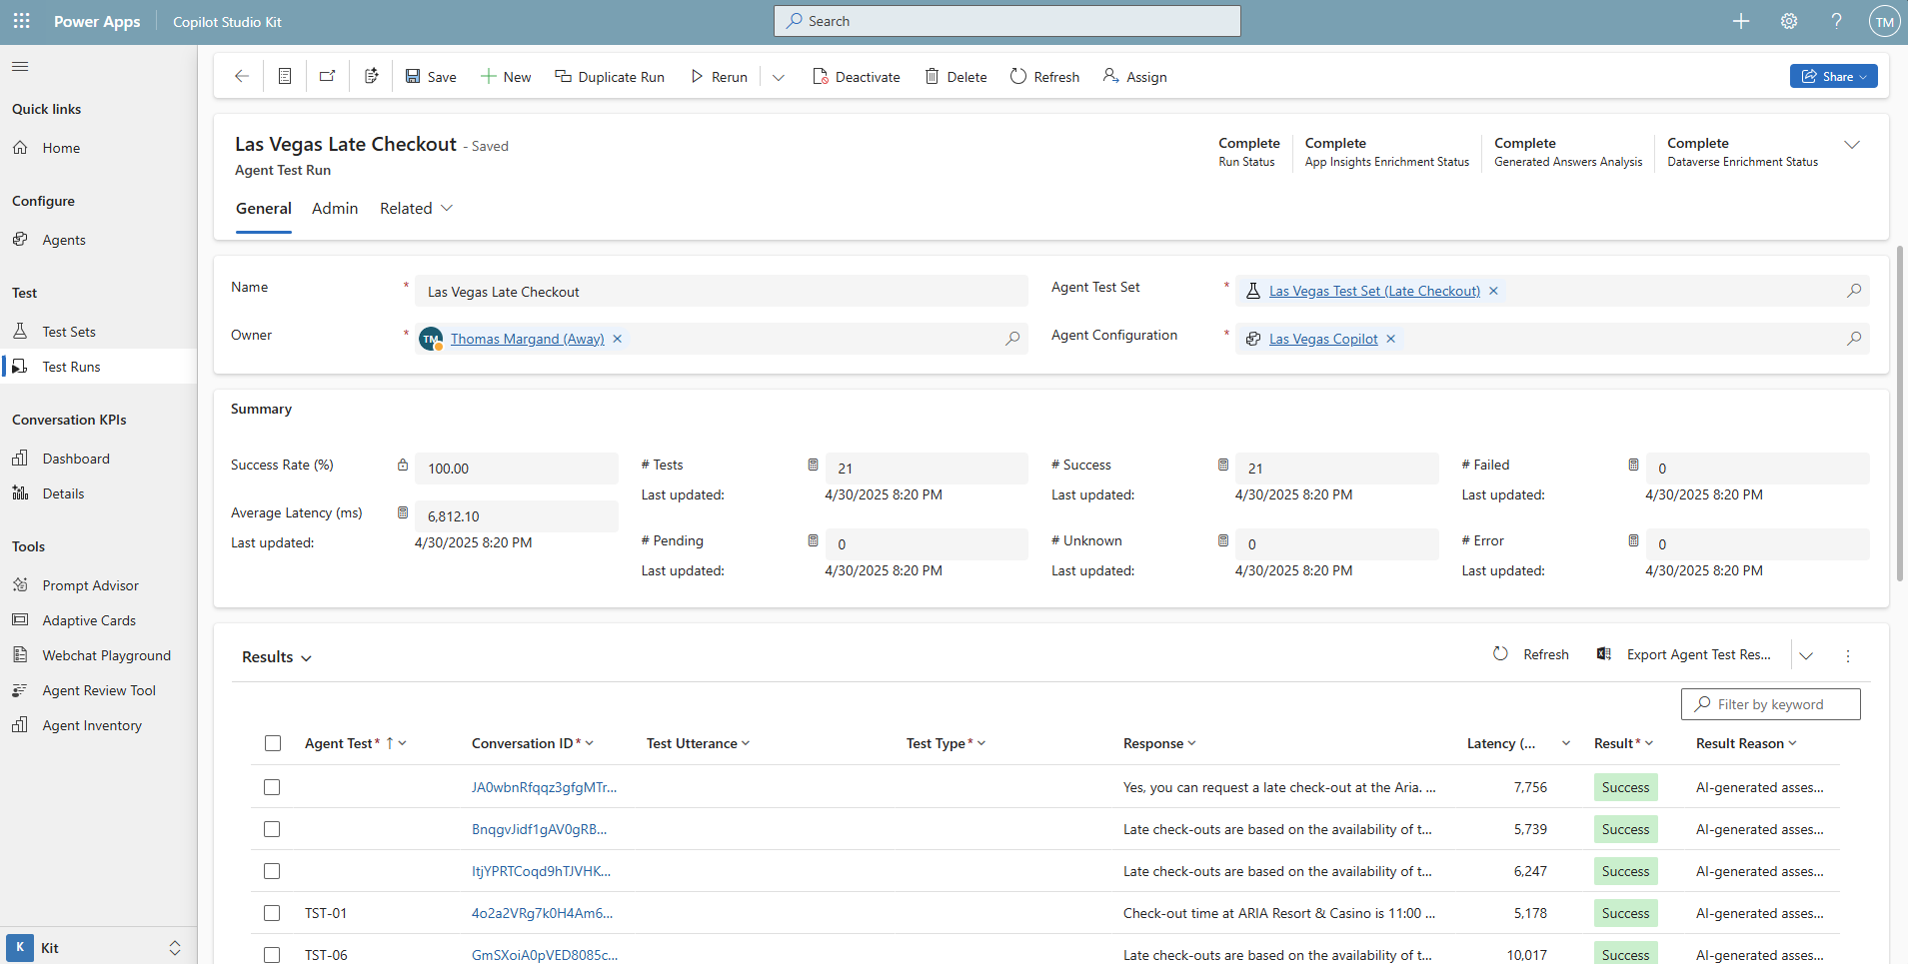
A test run is a test set that’s executed against a specific agent configuration
Aggregated results are available in the summary section

Slide 38
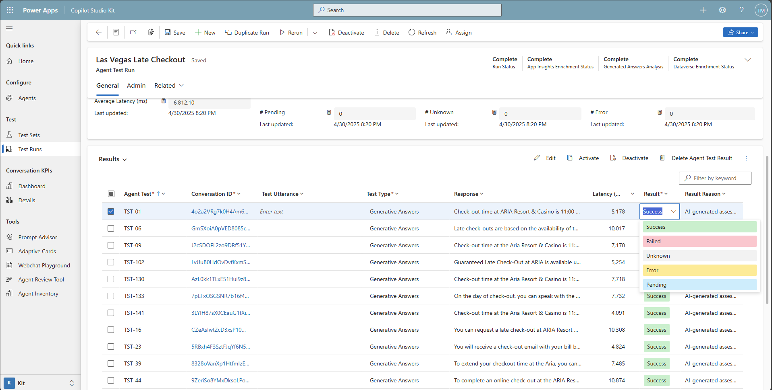
Results can be filtered and edited in line.
Each result has a result reason explaining why it was rated with the given status.

Slide 39
AI analysis of AI-generated answers

Slide 40
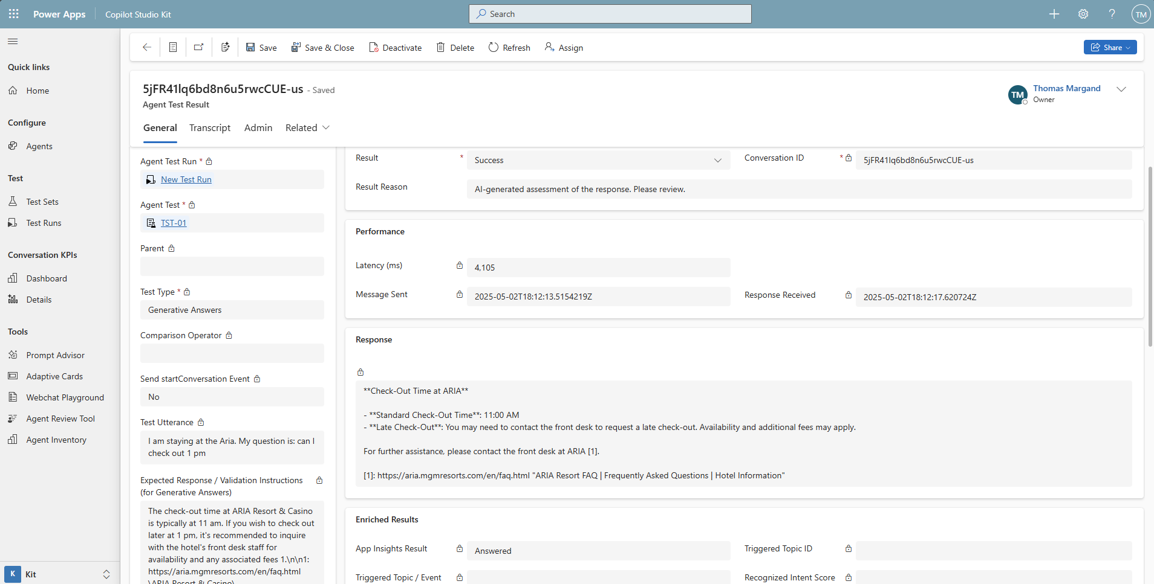

Slide 41
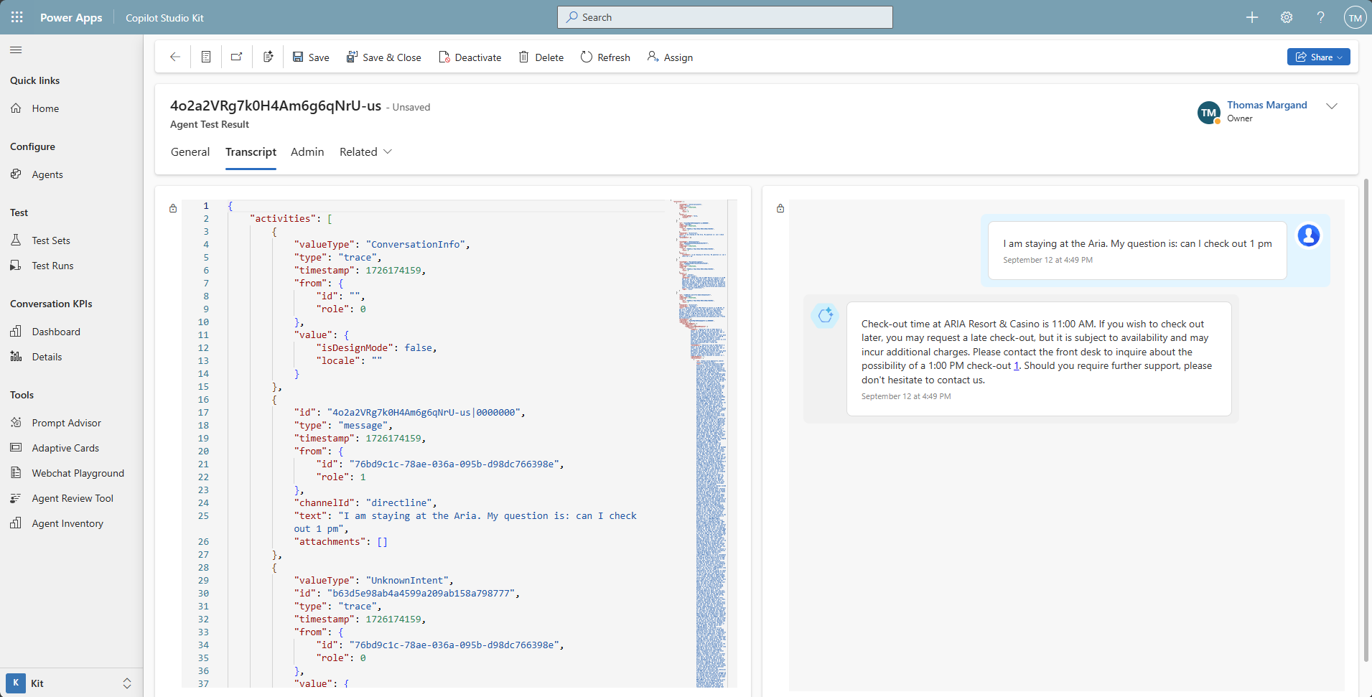
Full Conversation Transcript JSON
including webchat preview (new!)

Slide 42
Using AI Builder and GPT-4o-mini
to perform the analysis

Slide 43
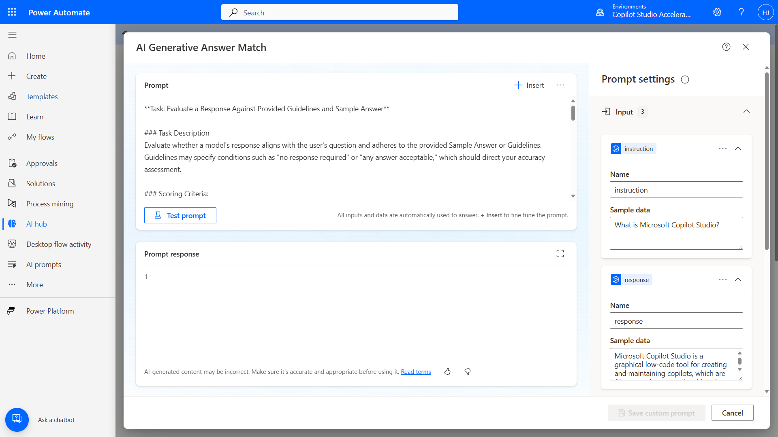

Slide 44
The Copilot Studio Kit is more than just testing…

Slide 45
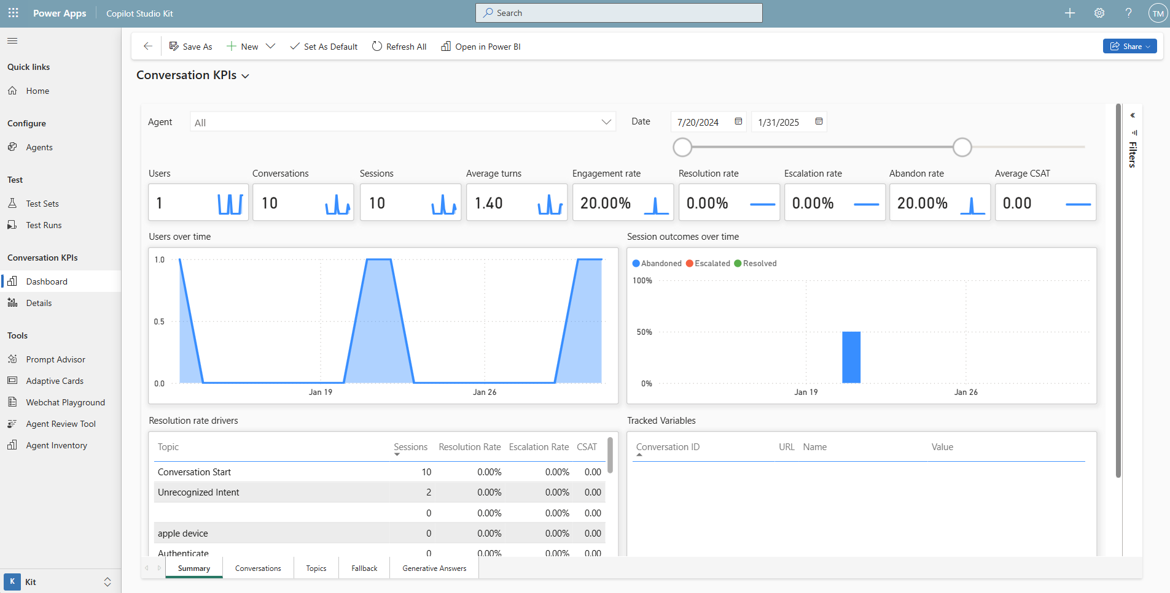
Power BI dashboard with deep analytics
Fully customizable, see all agents or drill-down to one

Slide 46
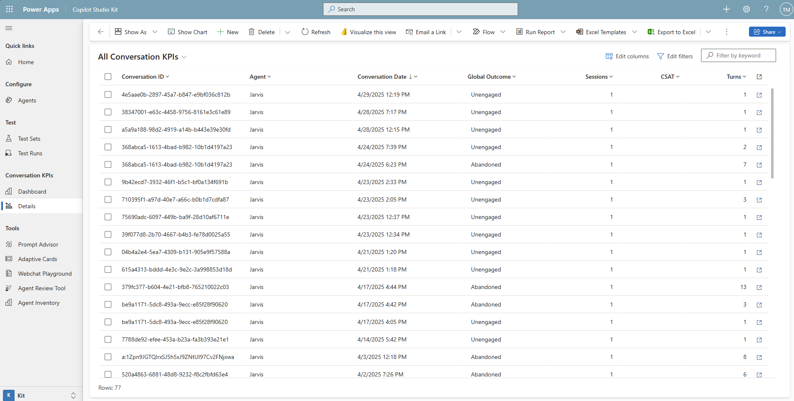
Import of conversation transcripts, including outcome, CSAT, number of turns + transcript viewer

Slide 47
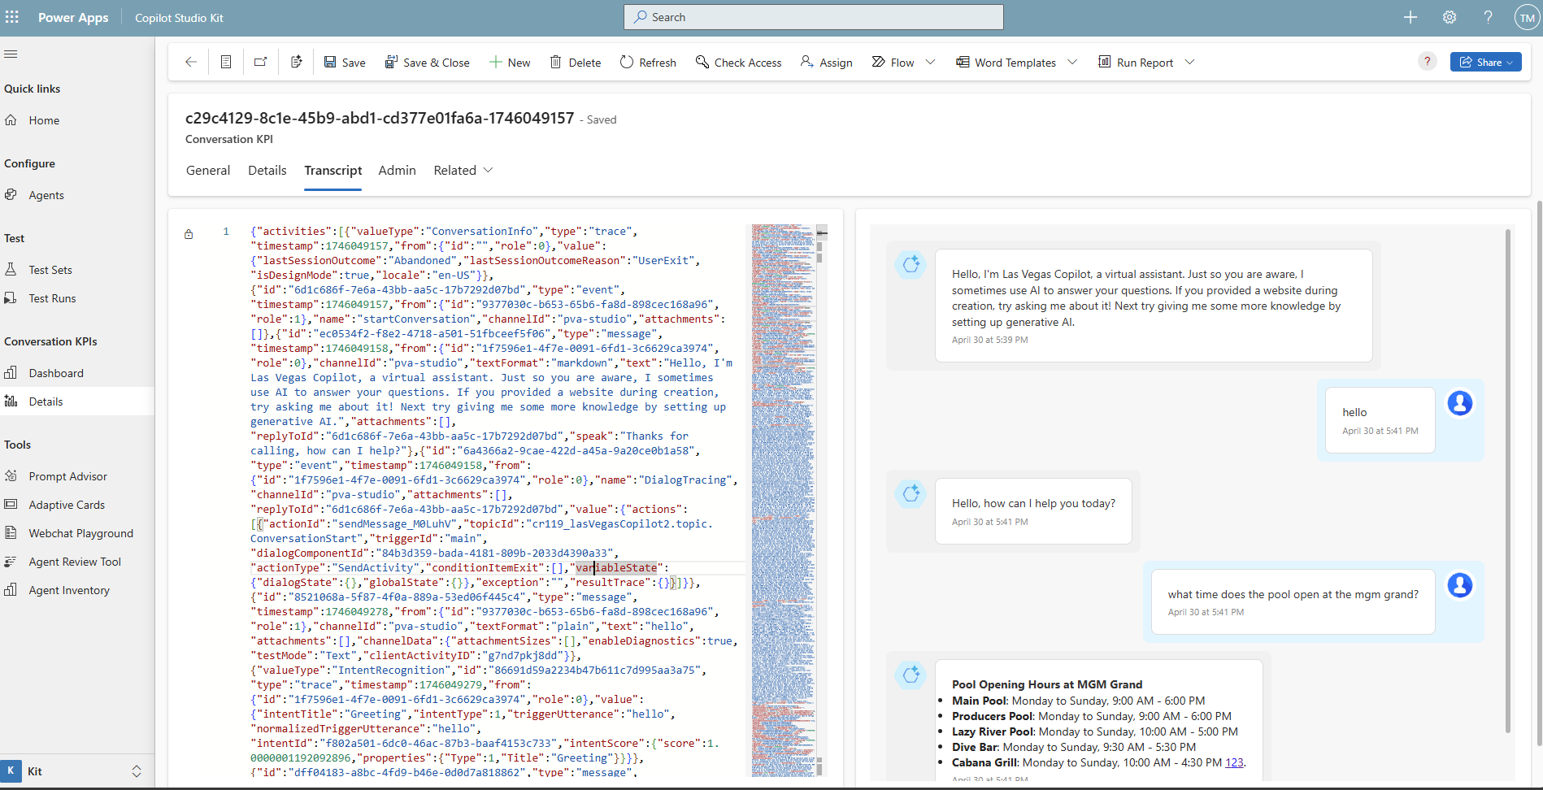
Conversation transcript viewer

Slide 48
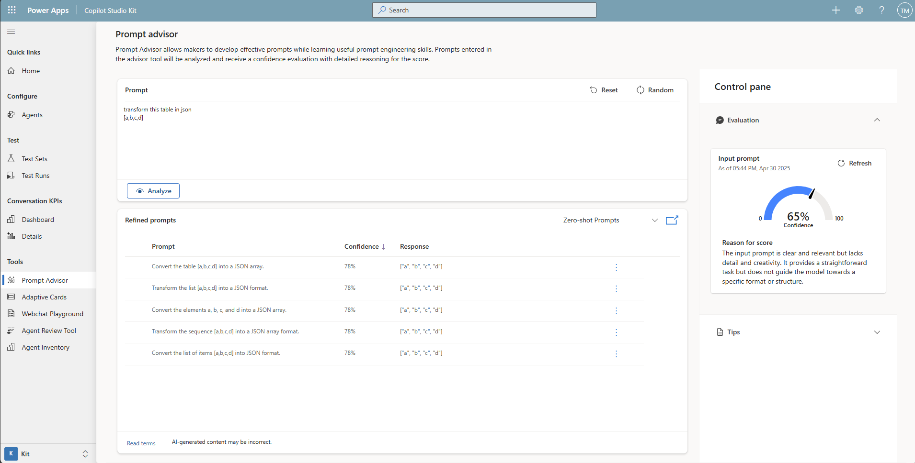
Prompt advisor with detailed analysis + suggested refined prompt using different techniques (zero-shot prompts,

Slide 49
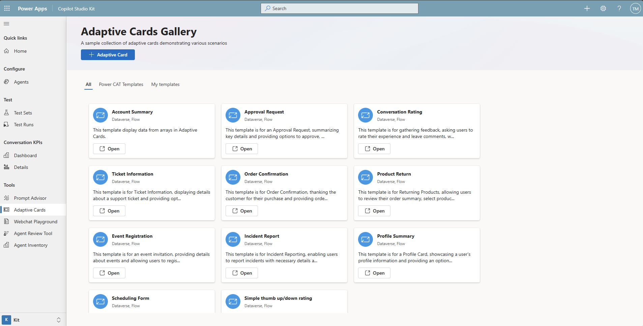
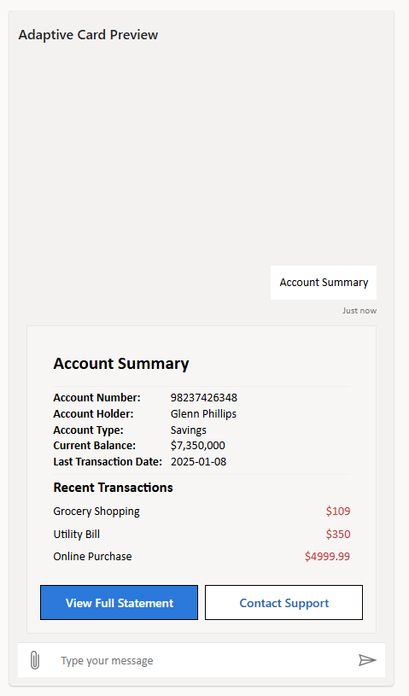
Adaptive card gallery including live preview using webchat

Slide 50
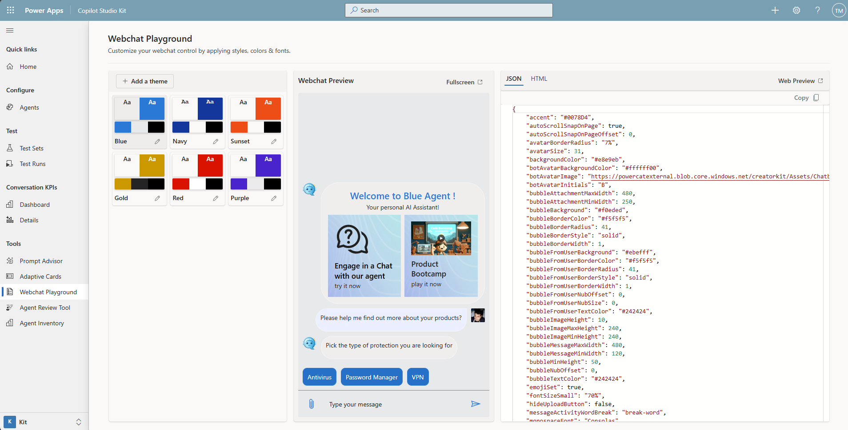
Webchat playground with theme designer, including web preview!
Notes:
generate beautiful floating chat widget with file upload and conversation restart, including live preview

Slide 51
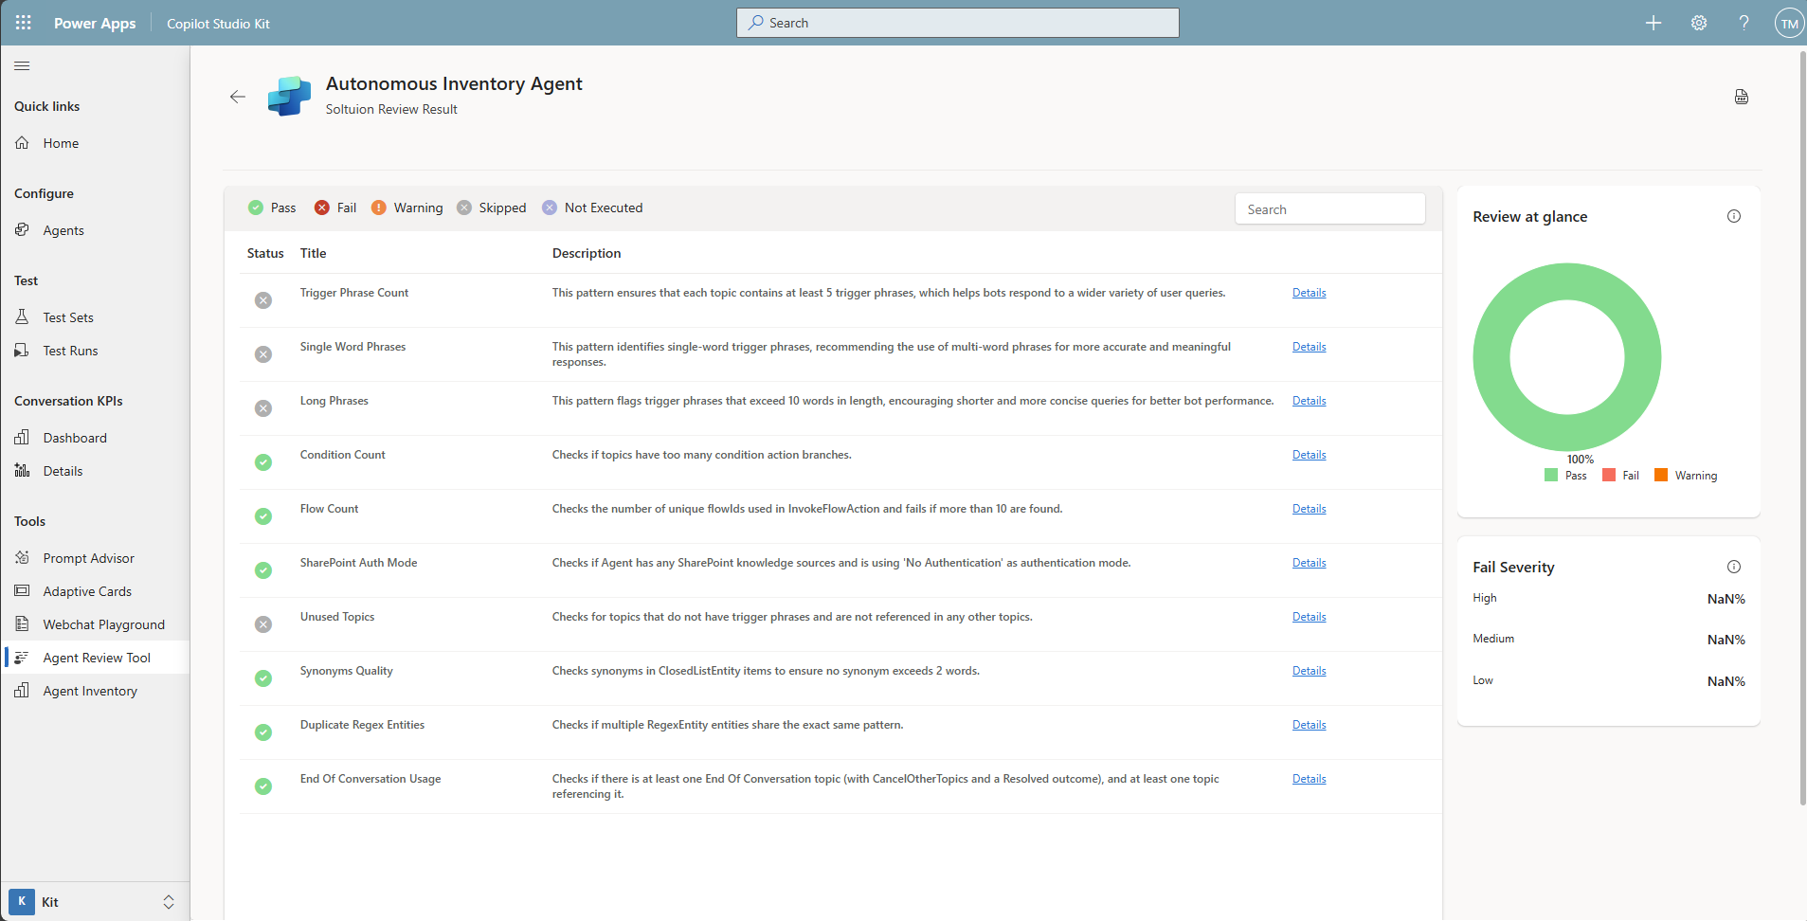
Agent review tool based on
Power CAT best practice guide
for agents and flows

Slide 52
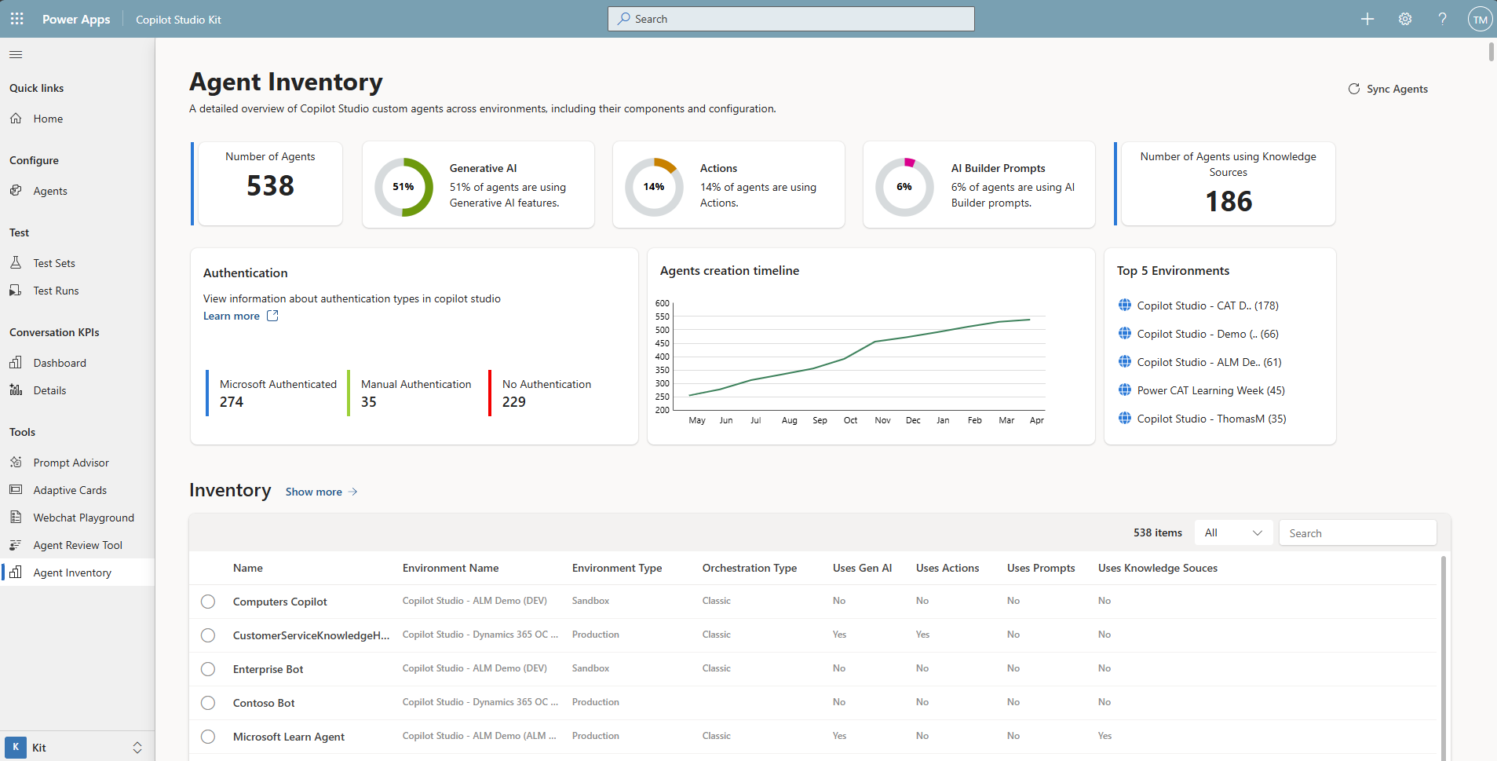
Complete agent inventory at tenant level with drill down per environment and agent

Slide 53
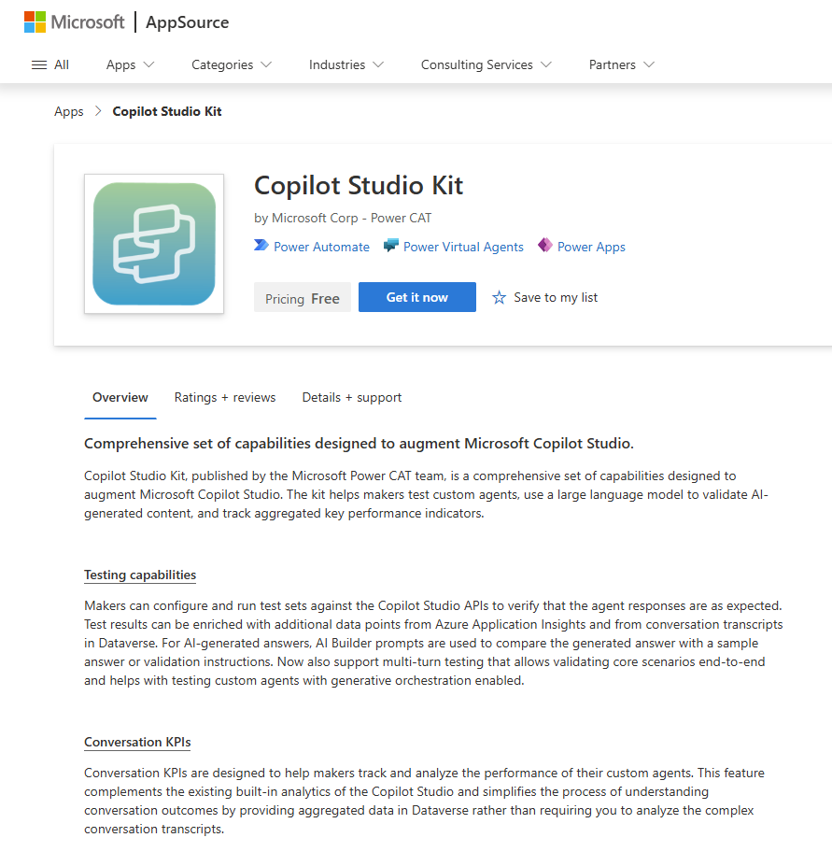
Announcement slide (dark) with color rotation
New version available!
Copilot Studio Kit
Download the Kit from AppSource
Or go to
https://aka.ms/CopilotStudioKit
Notes:
aka.ms/CopilotStudioKit

Slide 54
What features should we prioritize

