Slide 1
SharePoint Embedded
Steve Pucelik – Sr Product Manager

Slide 2

Microsoft 365 Community Conference

Slide 3


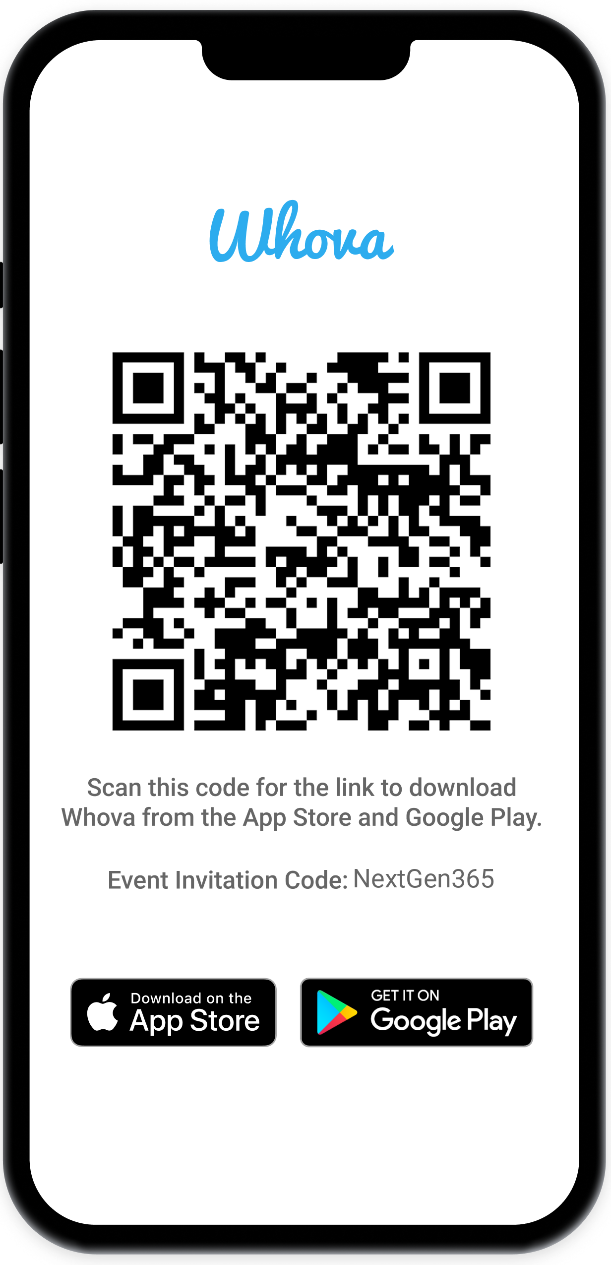
Join the event app to access:
The official event app for the
Microsoft 365 Community Conference
Event invitation code: NextGen2025
Event announcements
Personalized agenda, session details
Speaker & attendee profiles
Networking, meet-ups, messages
Event documents

Slide 4

Steve Pucelik
Sr Product Manager
/stevepucelik

Slide 5
Reflect on you last customer solution
Did one of these topics get discussed?
Copilot
Compliance
Collaboration
Core Storage
Documents added to SharePoint Embedded are natively ready for Copilot using components you add to your app
Comprehensive set of solutions designed to help organizations govern, protect, and manage data across their entire data estate
A one-click native collaboration, preview, and sharing experience for docs stored as part of any app. No configuration needed
Dedicated storage partitions within your Microsoft 365 tenant, providing secure and isolated containers for documents

Slide 6

AI ready document management
Managing documents in your custom app is complicated.
Users are demanding AI capabilities in their flow of work.
Support security and compliance
Governance is not an option. Use the Purview investments you already have
One click Collaboration
Use the Microsoft Office integration experience natively in your app

Slide 7






SharePoint Embedded
AI document platform
∂
∂
∂
Innovation
Choice
Trust
Collaborate on documents at scale
Native AI capabilities across your app’s unstructured data
Graph APIs for faster throughput
Components for your app
Use your preferred development language or Power Platform
Integrate with LOB apps
Azure AI Foundry Models
Open source/custom models
Entra ID security protection
Purview compliance with sensitivity labels, DLP, audit and eDiscovery integration
M365 threat protection

Slide 8





AI Native
Automatic Vectorization, chunking and semantic indexing
Rich document intelligence and understanding
High quality grounding data
Copilot Platform and orchestration
Rich GenAI capabilities to deliver intelligent apps
Extend with models from Azure AI Foundry or BYO - Model

Slide 9

Collaboration
Full Office Application Support
Real-time co-authoring
Secure file sharing
@mention and comments
Bring the power of the full Office suite to content in your apps
Aligning use cases to business outcomes

Slide 10
Security and Compliance
Integrated with Entra ID
eDiscovery, Audit
Sensitivity Labelling
DLP
Govern with Microsoft Purview
Multi-geo support

Slide 11
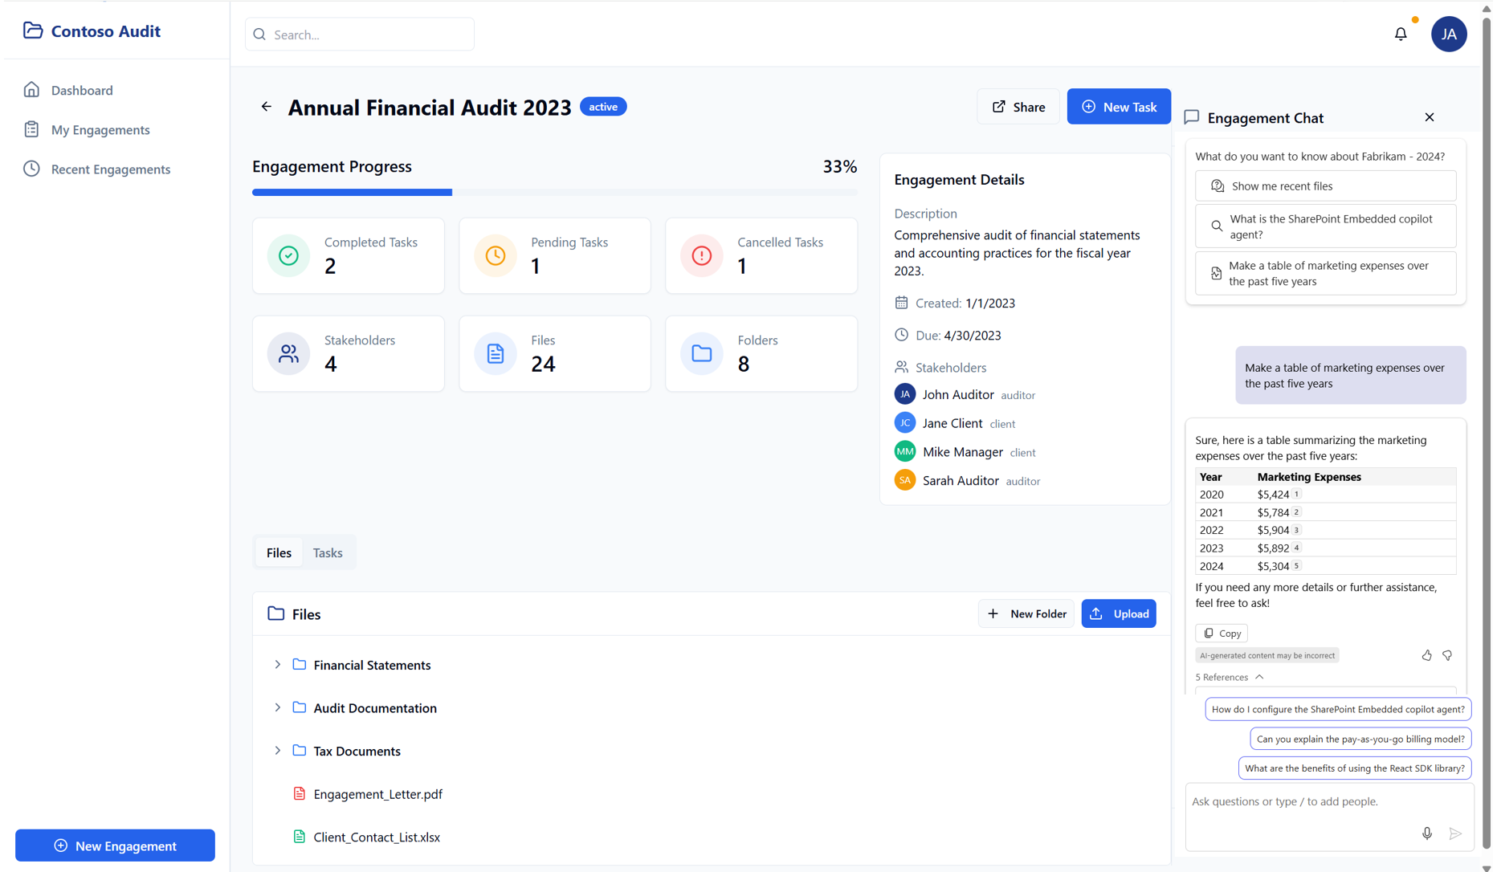

Slide 12


How it works
Graph API driven document management for your application on an AI native platform
You design the user experience
Isolated storage for files and documents inside your M365 compliance boundary.
Core technology powering Microsoft Loop, Designer, Copilot Pages, Declarative Agents, and a whole lot more.
Pay as You Go Service. MACC eligible
Any App
Microsoft 365 Tenant Boundary
M365 App APIs
Graph APIs
SharePoint
OneDrive
SharePoint Embedded
Microsoft 365 Storage Platform

Slide 13
AI apps are transforming many industries…
Claims Processing
Health Records
Statements
Pharma Research
Origination
Clinical Studies
Customer Onboarding
Plant Safety
Mortgage Documents
Insurance
Healthcare
Design Documents
Investor Services
Consumer Products
FSI
Manufacturing
Audit
FOI Process
Tax
General Services
Legal
Government
Grant Processing
Professional Services
Notes:
All these capabilities can be leveraged across industries to bring to life many different use cases that drive success.
Whether through the creation of unique chatbot experiences that help customers find information they need, identifying and summarizing key data to help employees be more productive, or analyzing large quantities of data to isolate potential risks, intelligent apps help companies create value and gain competitive advantage…
3rd party reports: Digital and AI leaders outcompete | McKinsey
The state of AI in early 2024: Gen AI adoption spikes and starts to generate value | McKinsey

Slide 14

Get started for free
1
2
3
Learn
Configure
Create
Review the Microsoft Learn documents
Get started with our You Tube series
Install the Visual Studio Code plugin
Create a trial container type
Use one of our sample apps
Get familiar with the API
aka.ms/start-spe

Slide 15
Thank You!
Notes:
Thank you.
<Speaker Guidance: Spend the last few minutes discussing or answering any questions they may have. If they have additional topics on their EBC agenda, make sure you connect with their account team to inform them which AI priorities and business outcomes resonated the most during this session. If you are in a 1:1 direct customer engagement, make sure you note what their priorities and questions were and work with the broader account teams and units to facilitate the proper hand-offs or next steps (i.e. get them into a session at the Innovation Hub/MTCs).>

Slide 16
