Slide 1
Fast time to value with Viva Connections
DC Padur, Tejas Mehta
May 8, 2025

Slide 2

Microsoft 365 Community Conference

Slide 3


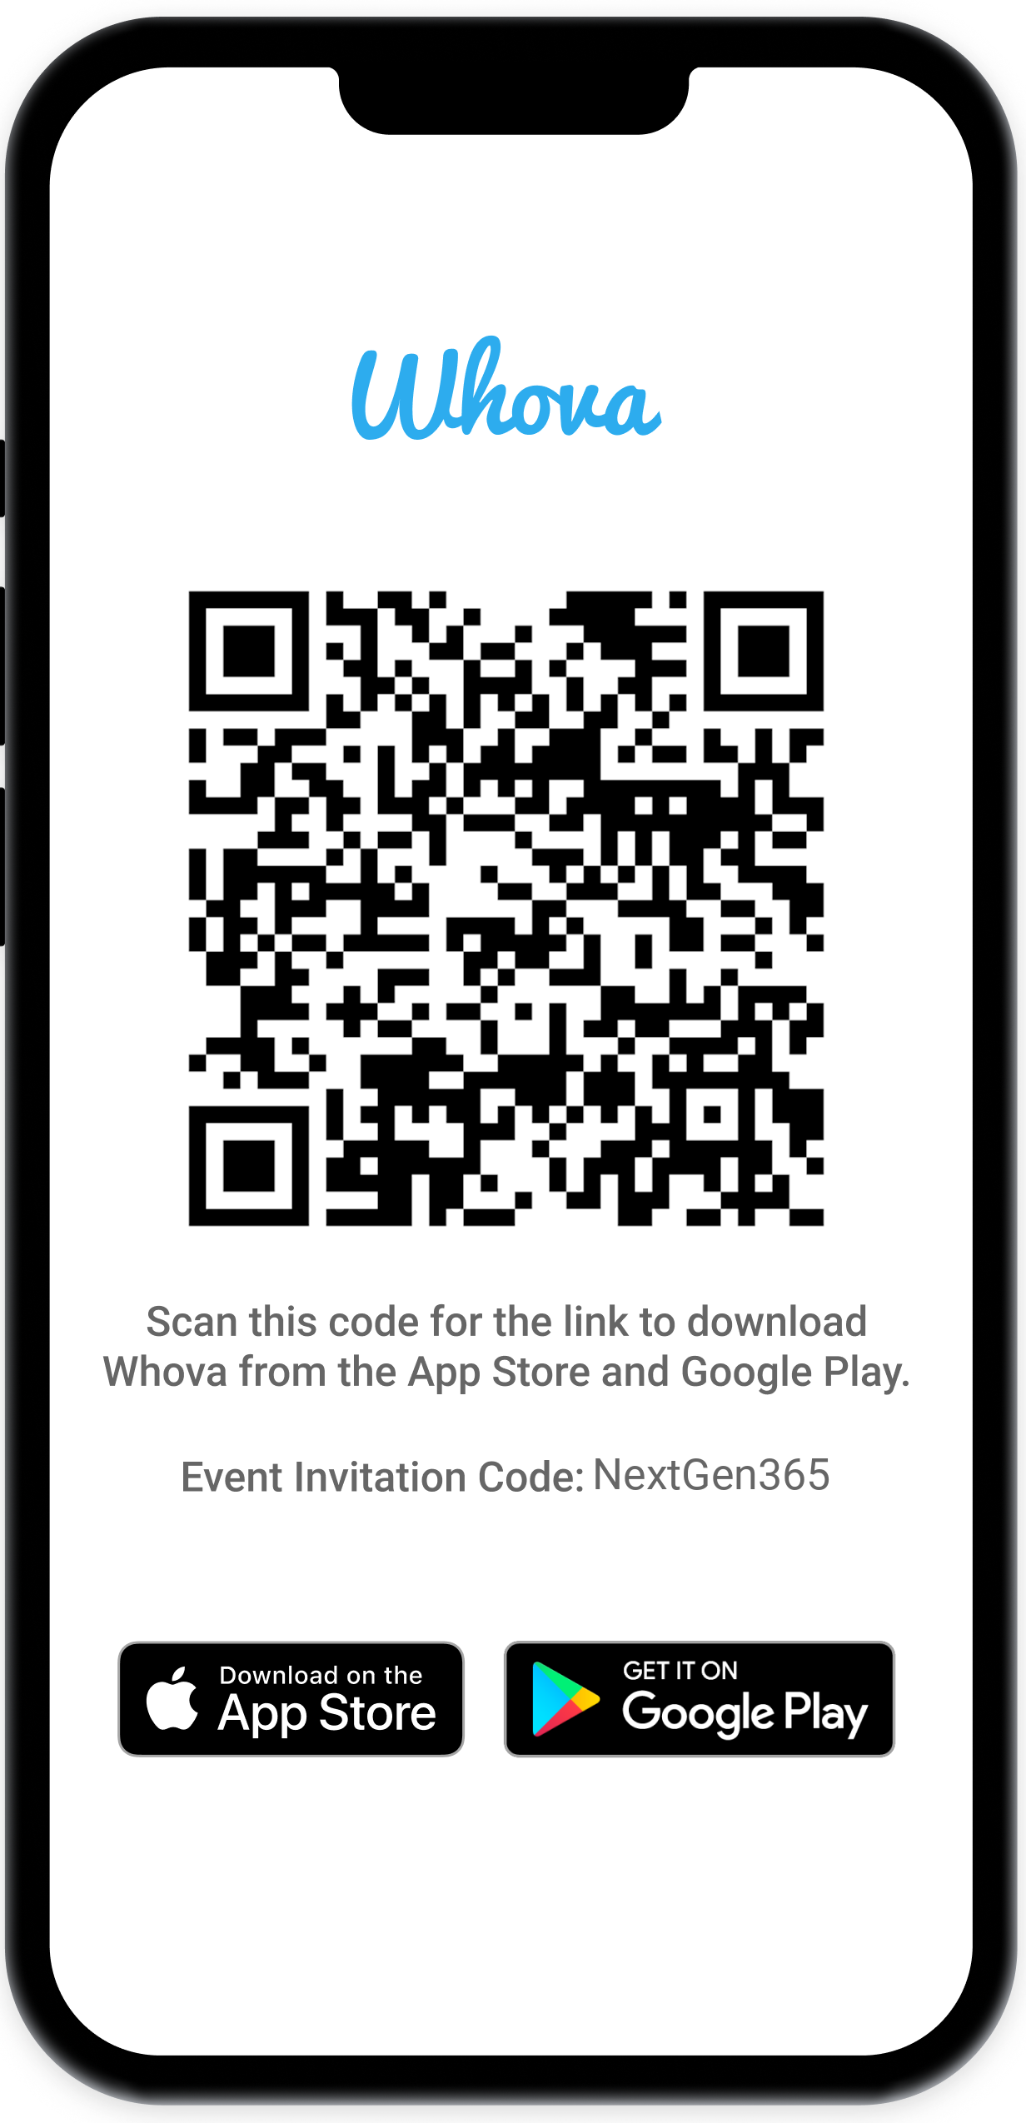
Join the event app to access:
The official event app for the
Microsoft 365 Community Conference
Event invitation code: NextGen2025
Event announcements
Personalized agenda, session details
Speaker & attendee profiles
Networking, meet-ups, messages
Event documents

Slide 4
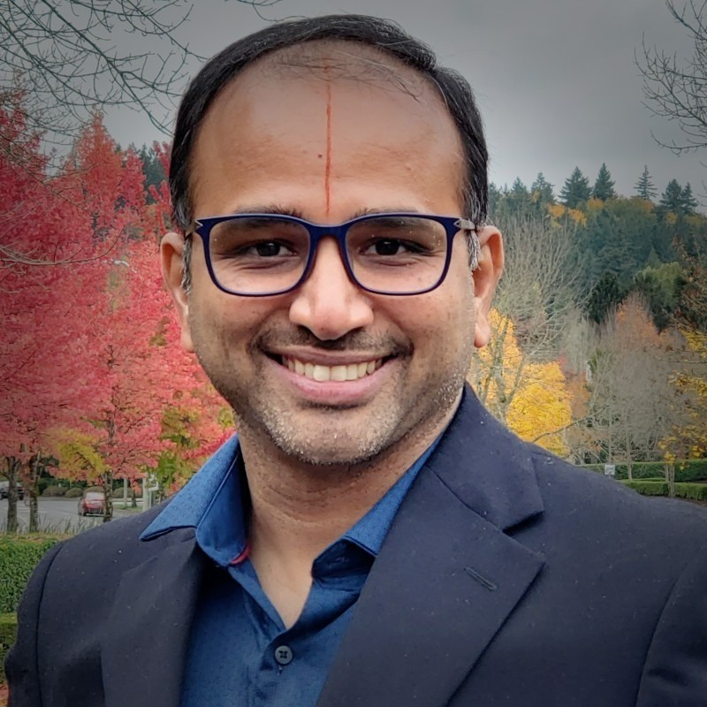
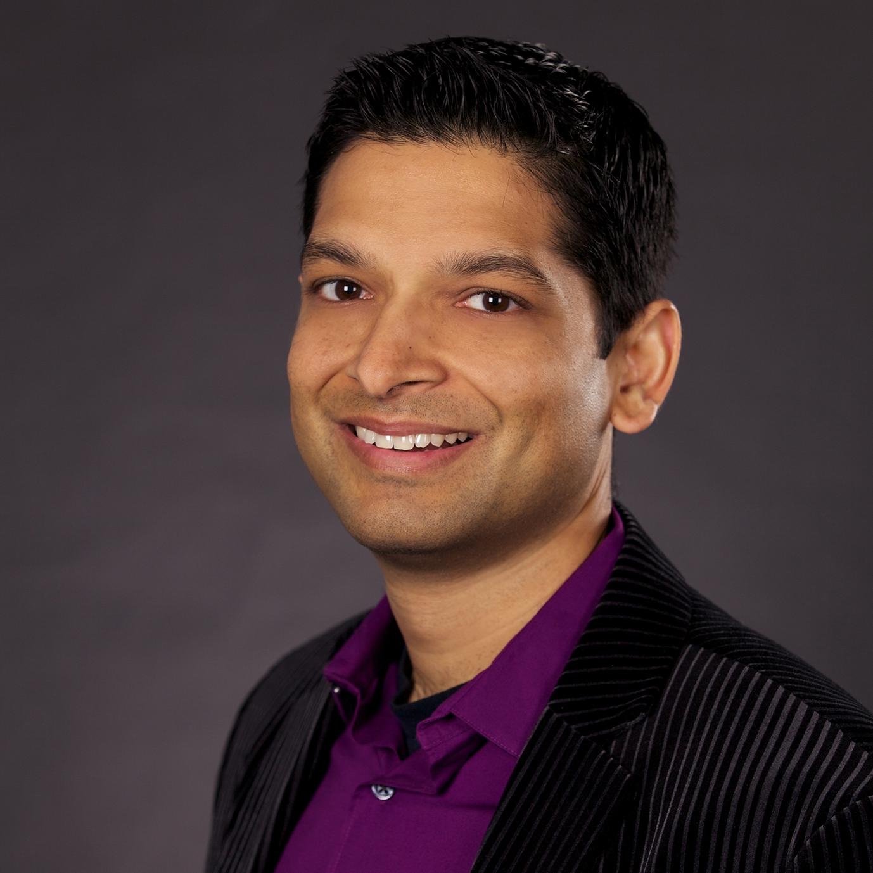

DC Padur
Principal PM
dcpadur
Tejas Mehta
Principal PM
tpmehta

Slide 5
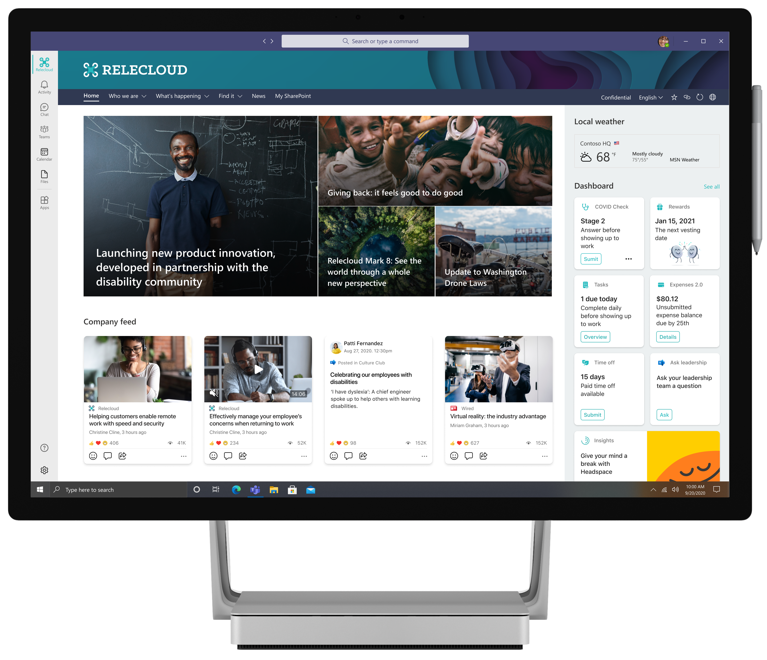
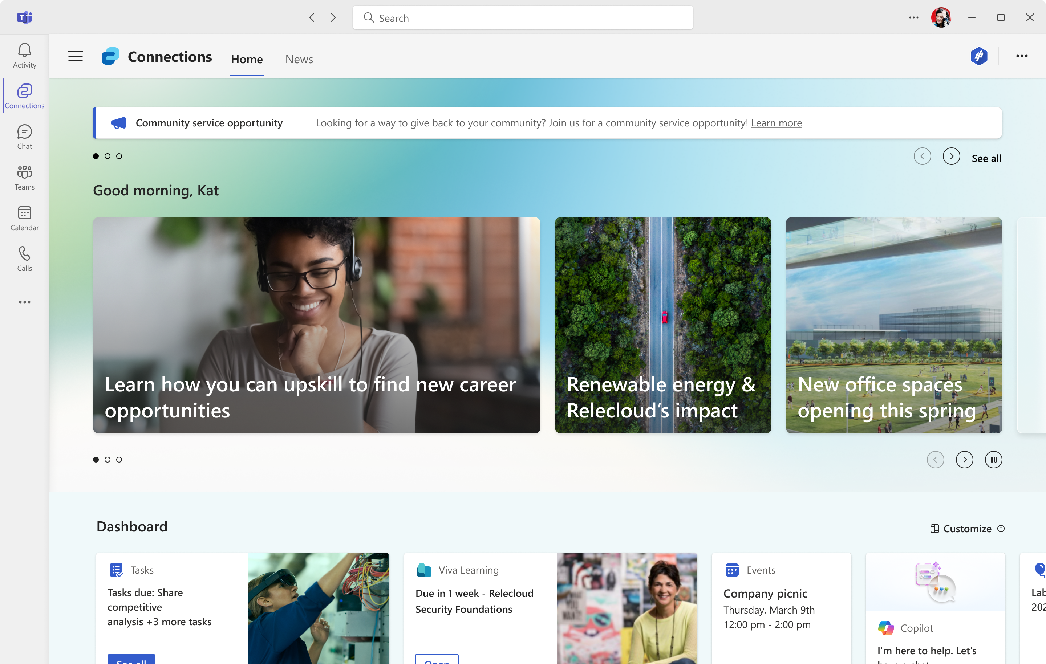
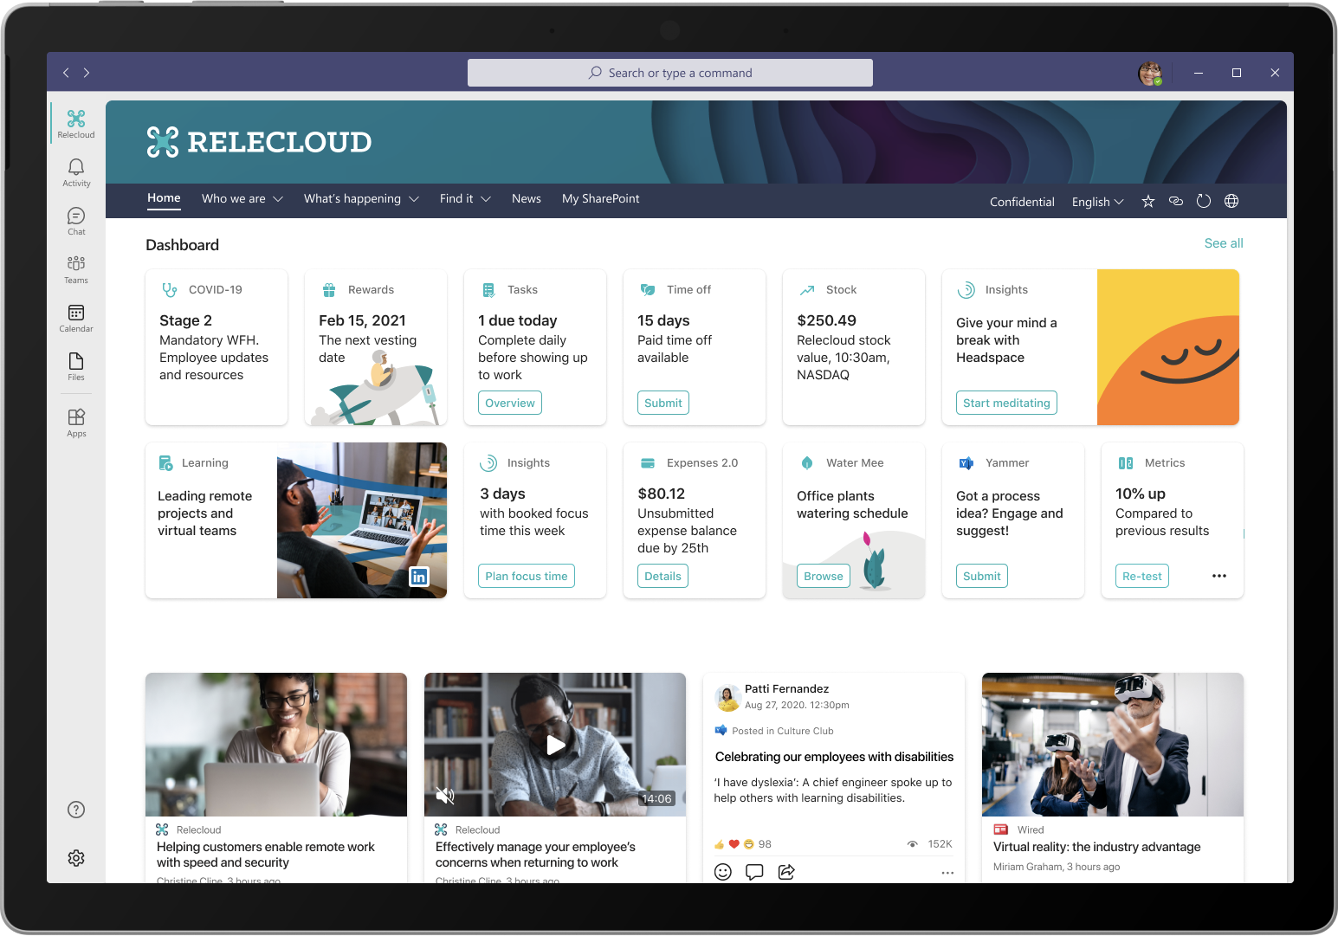
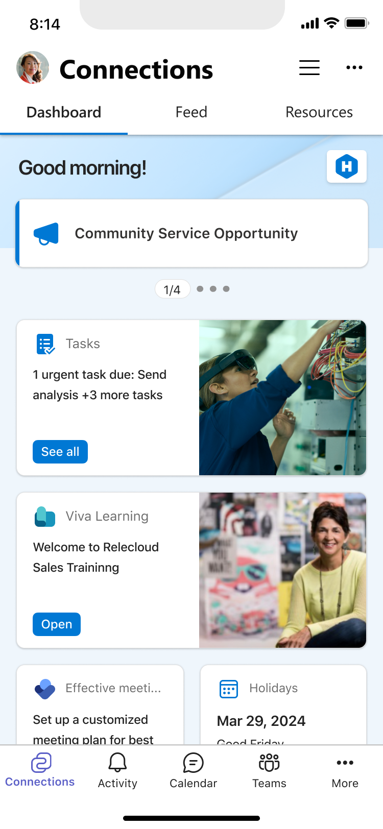
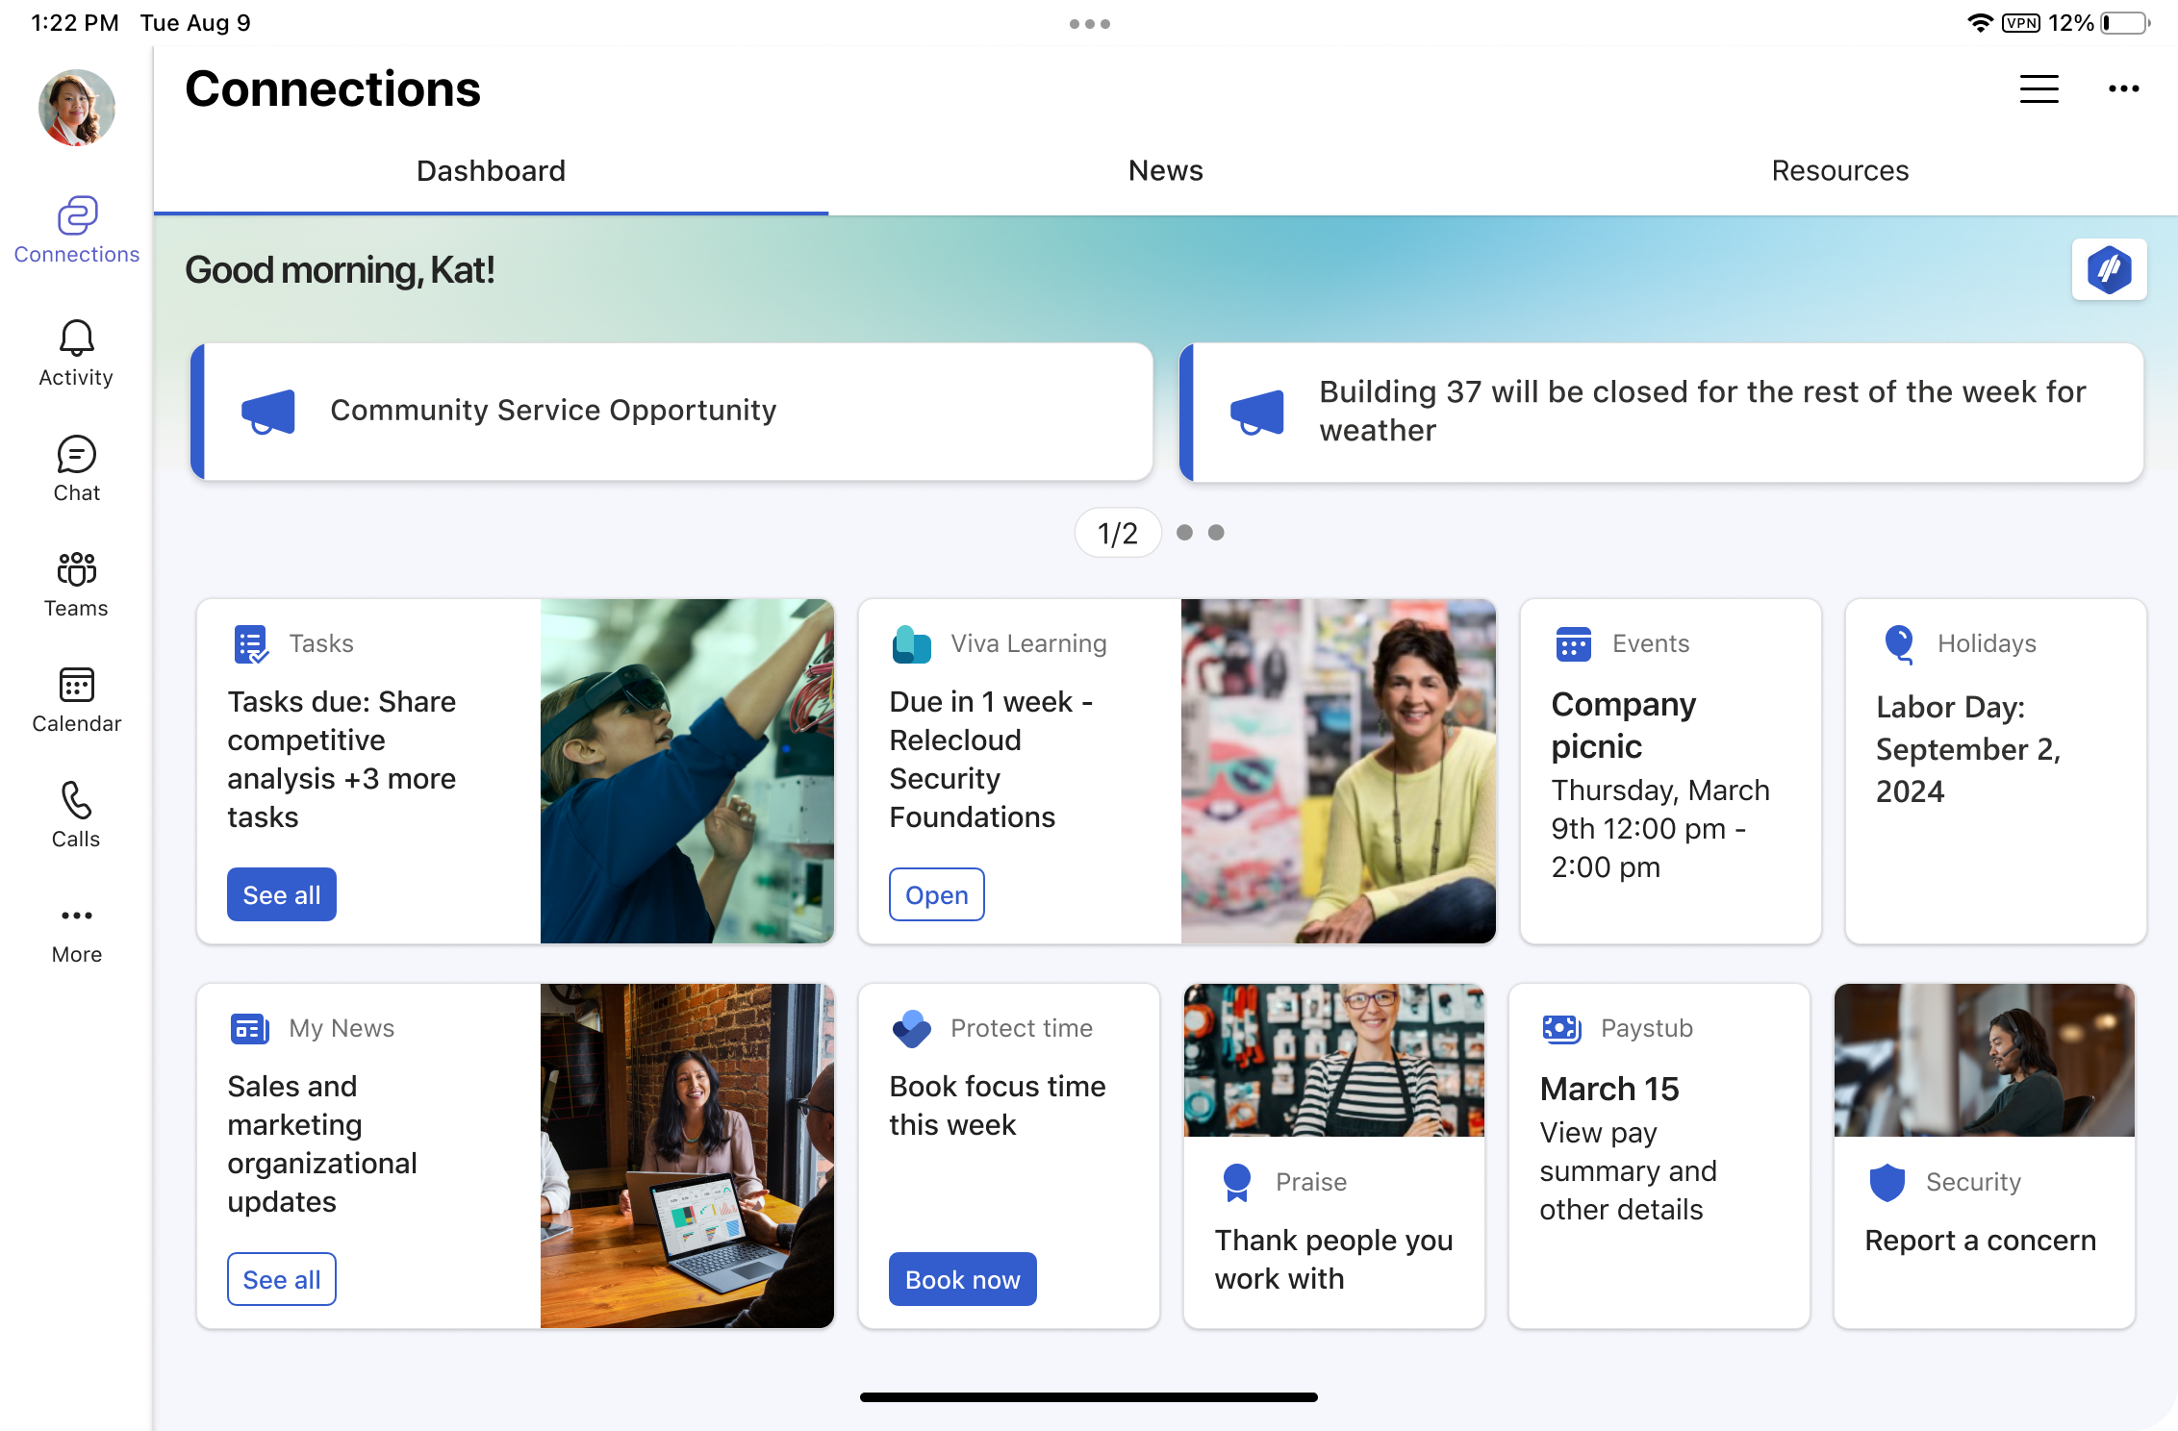
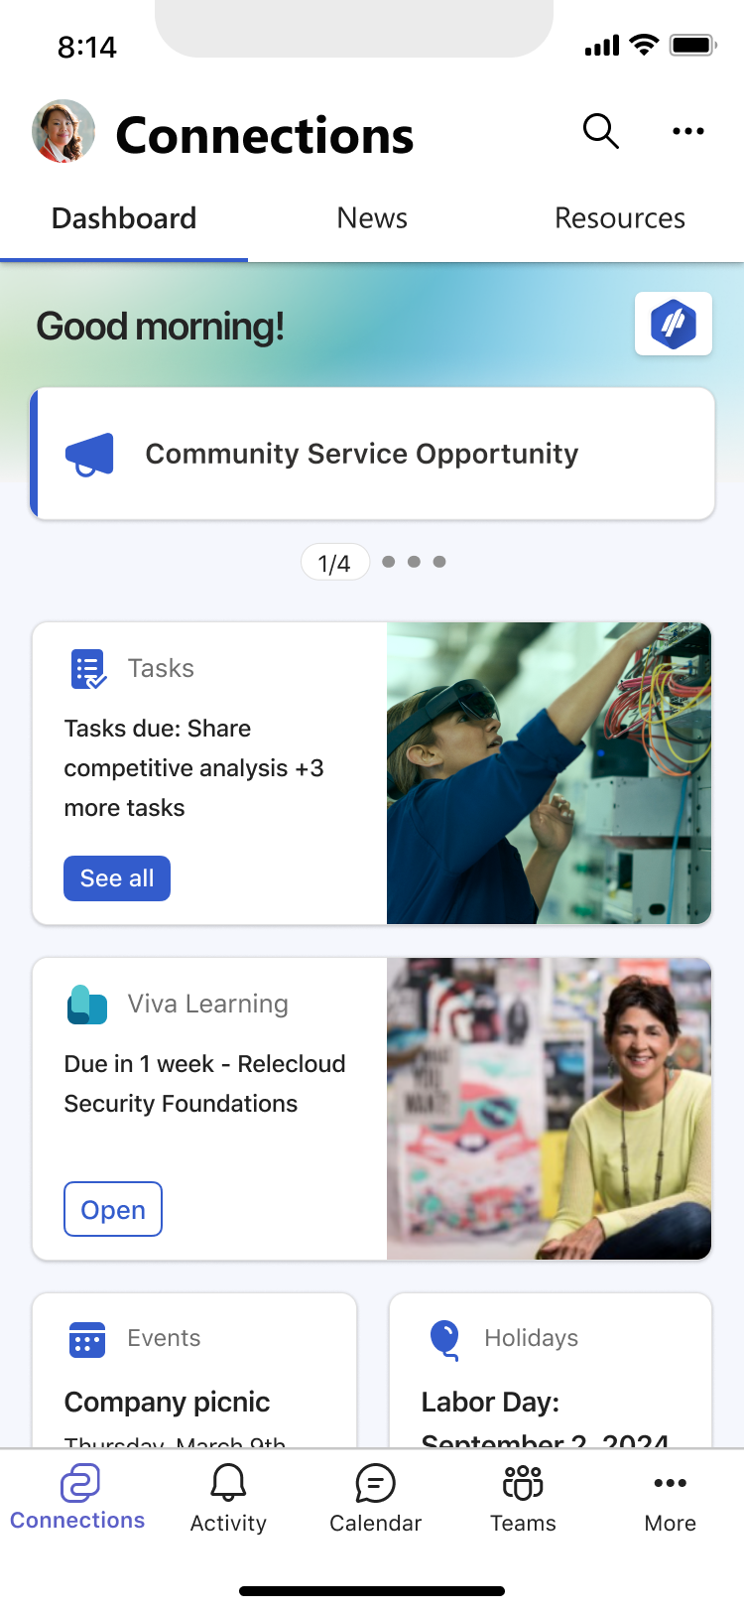
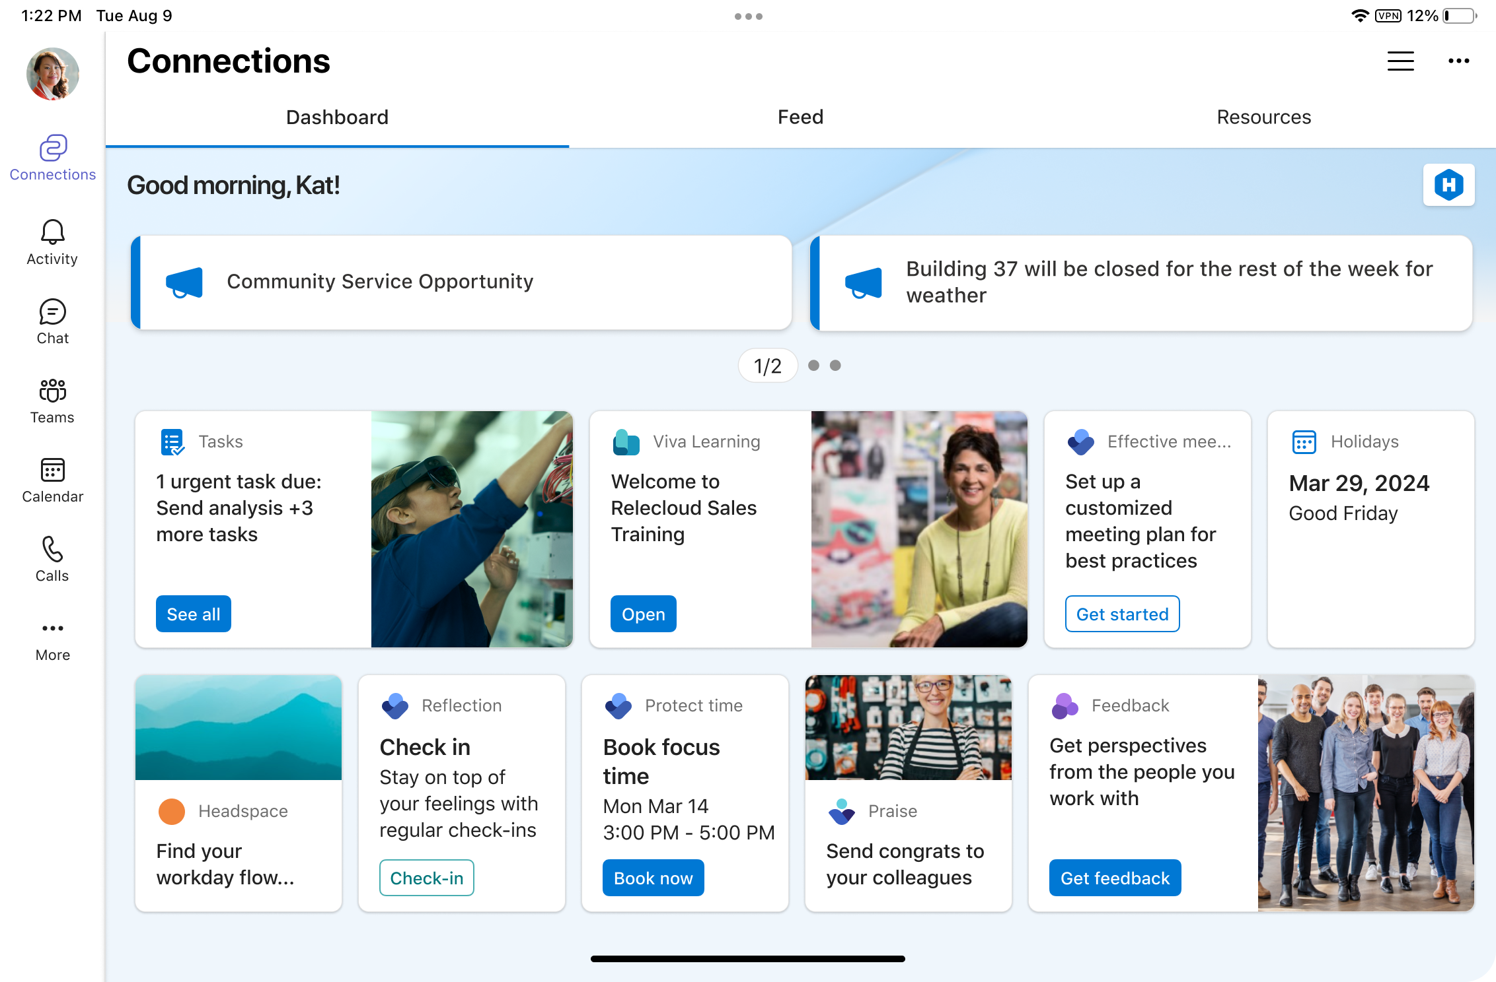

Viva Connections People centered and branded employee experience across all device types
Tools and Apps Quick action, cohesive one-stop experience for all the apps in your organization – across all device types
Customized for your organization Curated to your organization and brand, including company and team updates and relevant industry news
Personalized to the individual Helping them be informed, stay connected, and feel engaged

Slide 6
Demo time!

Slide 7

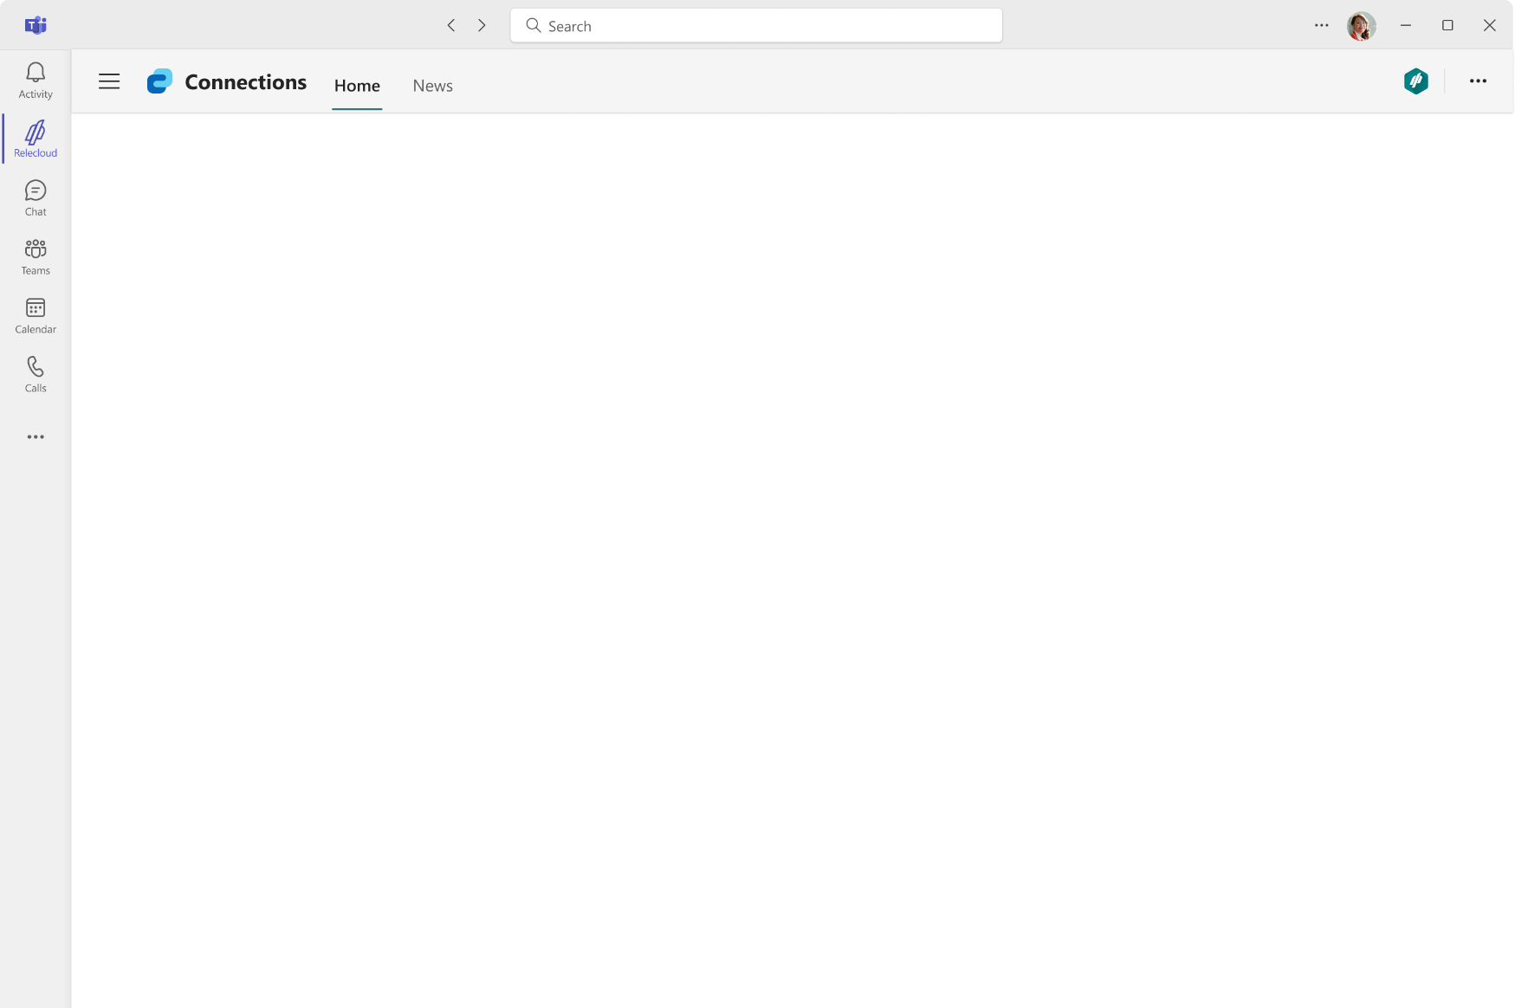
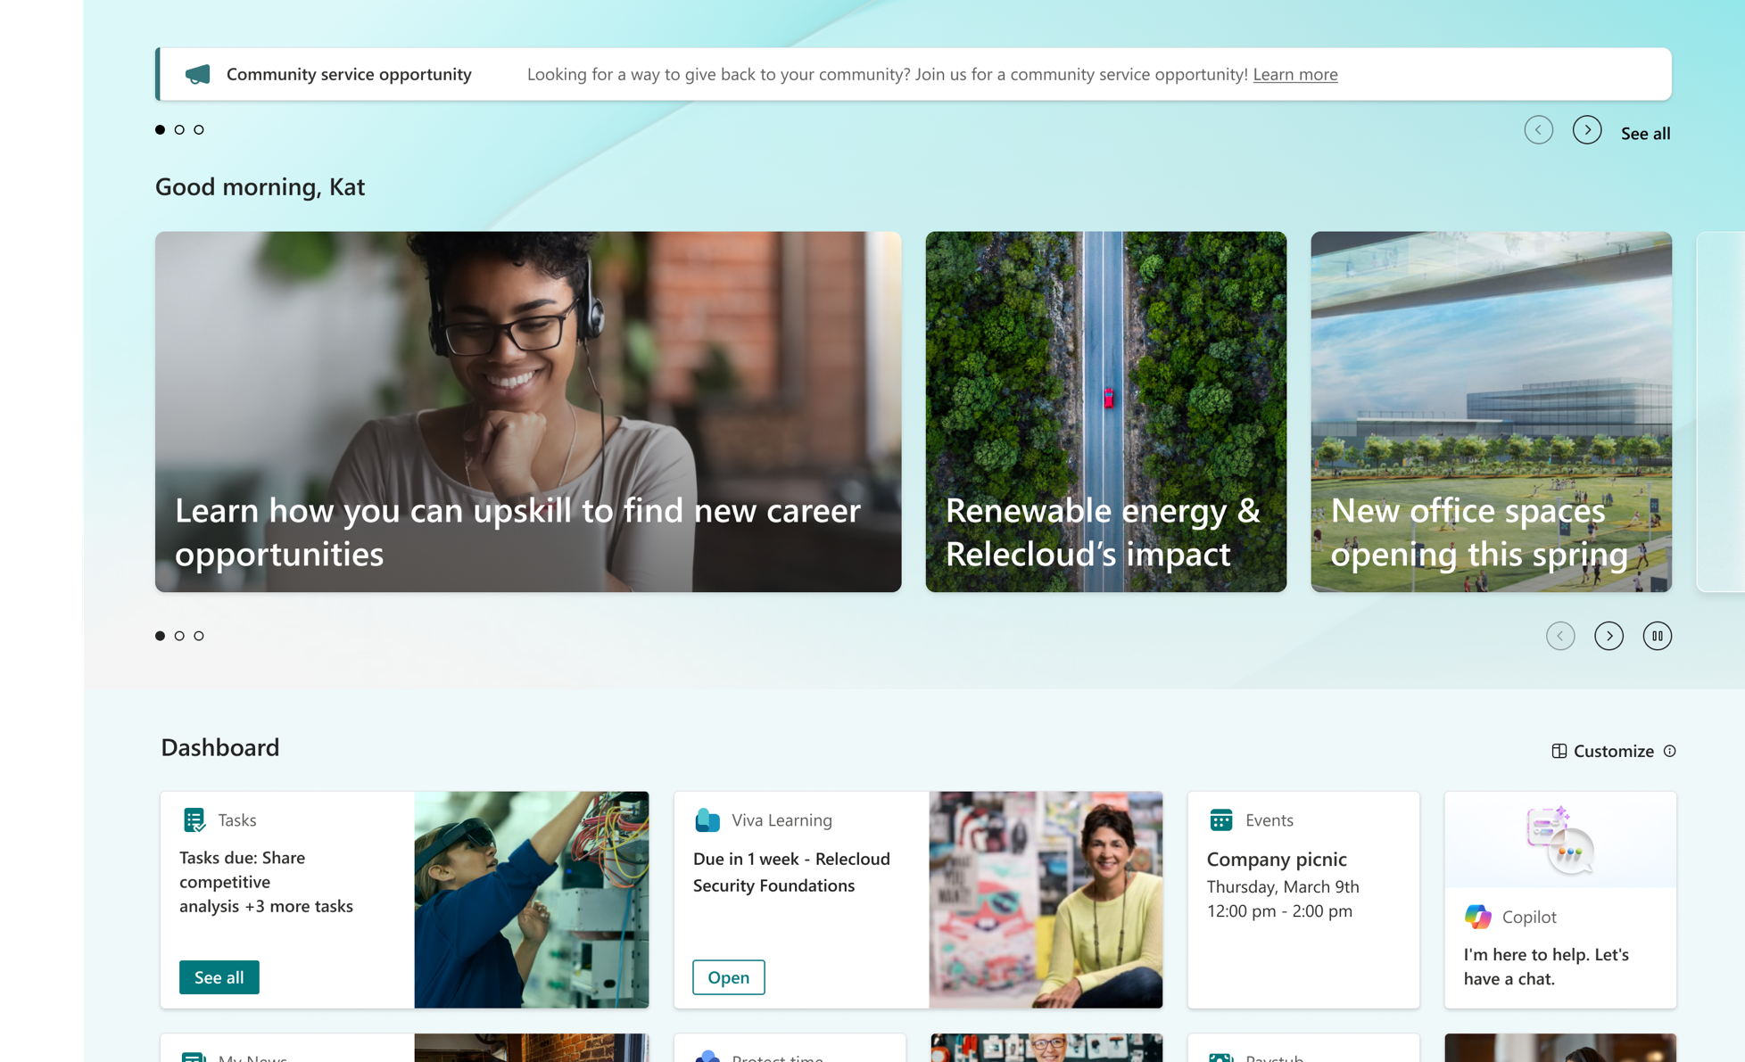
Wrapping up – Calls to Action
Build dashboards
Publish news
Curate resources

Slide 8
We have an exciting future ahead.

Slide 9
Expertise and tools for your journey
Technical expertise via our FastTrack partners
Tools, resources & training on our Adoption Hub
Events and real-world knowledge in our community
aka.ms/Microsoft/FastTrack
adoption.microsoft.com
aka.ms/TechCommunity

Slide 10
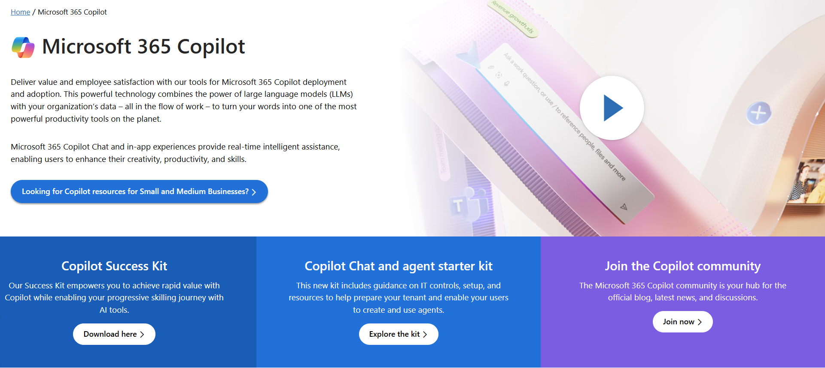
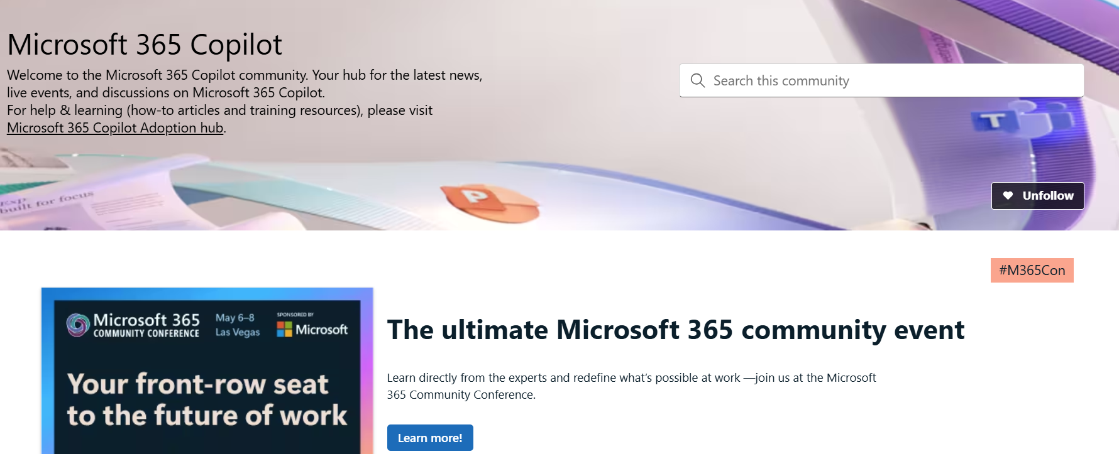
News & community content
Microsoft Community Learning aka.ms/Community/LearningChannel
Community led expert content on all your favorite Microsoft services.
Start your week with live news and event updates aka.ms/MondaysatMicrosoft
Watch live or on-demand & share our blog.

Slide 11
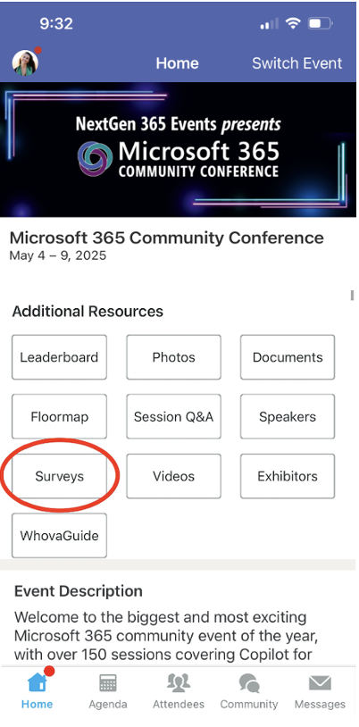
Session feedback surveys
We want to hear from YOU!
Share your feedback to make next years conference even better!
Here’s how –
Simply go to the Whova App on your smartphone.
Scroll down on the M365 Community Conference Homepage to ‘Additional Resources’ to click “Surveys’.
Click Session Feedback.
Scroll down to find this session title.
Complete the session feedback survey.
Finally, click ‘Submit’.
It’s just that easy!

Slide 12


