Slide 2
Microsoft 365 innovation in the era of AI
Jeff Teper
President, Collaborative Apps & Platforms, Experiences + Devices
Microsoft Corporation

Slide 3
President, M365 Collaborative Apps & Platforms
Jeff Teper

Slide 4
Thank you

Slide 5

The best community in technology

Slide 6
Our priorities
Security & Fundamentals
1
2
3
Core
Microsoft 365
Teams
Windows & Surface
Microsoft 365 Copilot
Core
Microsoft 365
Teams
Windows & Surface
Core
Microsoft 365

Slide 7
Our priorities
Security & Fundamentals
1
2
3
Core
Microsoft 365
Teams
Windows & Surface
Microsoft 365 Copilot
Core
Microsoft 365
Teams
Windows & Surface
Core
Microsoft 365

Slide 8

Our priorities
Security & Fundamentals
1
2
3
Core
Microsoft 365
Teams
Windows & Surface
Microsoft 365 Copilot
Core
Microsoft 365
Teams
Windows & Surface
Core
Microsoft 365
+ Agents
SharePoint
Platform for AI

Slide 9
Our priorities
Core
Microsoft 365
Teams
Windows & Surface
2
Microsoft 365 Copilot
Microsoft 365 Copilot + Agents
+ Agents
Teams
Teams
3
SharePoint
Platform for AI

Slide 10
Microsoft 365 Copilot + Agents
Teams
SharePoint
Platform for AI

Slide 11

Copilot is the UI for AI
Copilot
Copilot Studio
Agents
Copilot Control System

Slide 12
Corporate Vice President, Microsoft 365
Nicole Herskowitz

Slide 13



Work Trend Index 2025
31,000 people
31 countries
Microsoft 365 & LinkedIn research
New
AI startups, economists, and academics
aka.ms/2025WorkTrendIndex

Slide 14

The Frontier Firm

Slide 15
Employees at Frontier Firms say their company is thriving
71%
37%
Frontier Firm workers
Worldwide workers
Source: Microsoft Work Trend Index Survey 2025, 71% (n = 844), 37% (n = 30,636).

Slide 16
The Emerging Frontier Firm
1
2
3
You can buy intelligence on tap
Human-agent teams will upend the org chart
Every employee becomes an agent boss

Slide 17
The Emerging Frontier Firm
1
2
3
You can buy intelligence on tap
Human-agent teams will upend the org chart
Every employee becomes an agent boss

Slide 18
The Emerging Frontier Firm
2
1
3
Human-agent teams will upend the org chart
You can buy intelligence on tap
Every employee becomes an agent boss

Slide 19
The Emerging Frontier Firm
3
1
2
Every employee becomes an agent boss
You can buy intelligence on tap
Human-agent teams will upend the org chart

Slide 20
Most leaders see agents as the way to scale
The Emerging Frontier Firm
82%
of leaders are confident they’ll use digital labor to expand workforce capacity
1
2
3
You can buy intelligence on tap
Human-agent teams will upend the org chart
Every employee becomes an agent boss
Today
12 months
18 months
Source: Microsoft Work Trend Index Survey 2025 (n = 8,051).

Slide 22
Demo

Slide 23
Microsoft 365 Copilot + Agents
New
Teams
Copilot memory
Analyst agent
Researcher Agent
Copilot Notebooks
Copilot Search
SharePoint
Create
Platform for AI

Slide 24

Microsoft 365 Copilot + Agents
Teams
SharePoint
Platform for AI

Slide 25
Microsoft 365 Copilot + Agents
Teams
SharePoint
Platform for AI

Slide 26
320M+
monthly active Teams users
20M+ PSTN-enabled
Teams Phone users
1M+
Teams Rooms licenses
10,000+ Organizations using
Teams Premium

Slide 27

Microsoft Teams The AI-powered platform
Secure
Simple
Smart

Slide 28
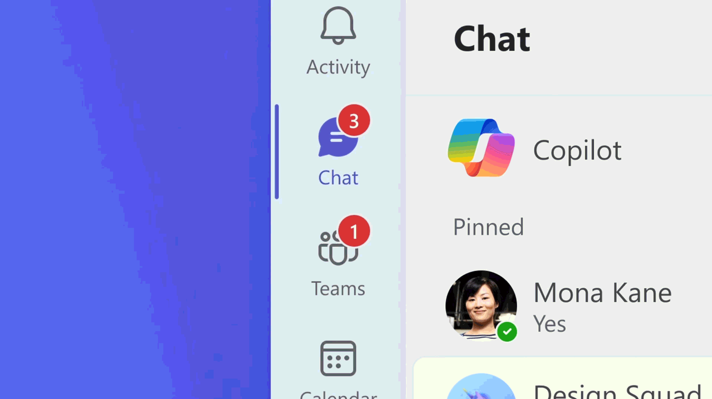
Core Teams UX Enhancements

Slide 29
Demo
Melissa Torres
Principal PM Manager, Collaborative Apps & Platforms
Microsoft Corporation

Slide 30

Microsoft 365 Copilot + Agents
Teams
SharePoint
Platform for AI

Slide 31
Microsoft 365 Copilot + Agents
Teams
SharePoint
Platform for AI

Slide 32
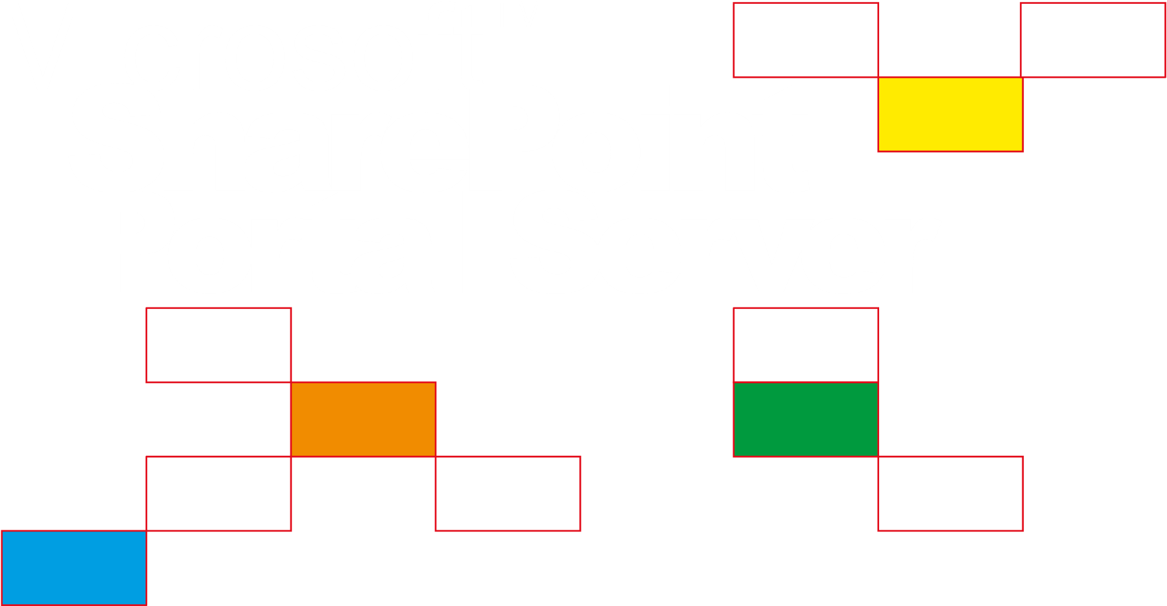

Slide 33
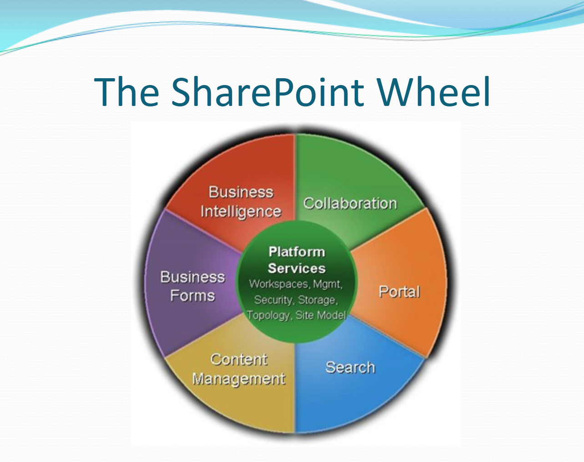

Slide 34











SharePoint

Slide 35
>1bn
users of the SharePoint platform

Slide 36
SharePoint in the era of AI
Collaboration
Communication
Automation
Knowledge

Slide 37
Demo
Melissa Torres
Principal PM Manager, Collaborative Apps & Platforms
Microsoft Corporation

Slide 38
Microsoft 365 Copilot + Agents
Teams
SharePoint
3a
Platform for AI

Slide 39
Microsoft 365 Copilot + Agents
3a
Teams
SharePoint
Platform for AI

Slide 40
>2bn
SharePoint Workflows executed every week

Slide 41
Demo
Miceile Barrett
Principal PM Manager, Collaborative Apps & Platforms
Microsoft Corporation

Slide 42
Structuring data
Leveraging AI
Automation for everything

Slide 43
Microsoft 365 Copilot + Agents
3a
Teams
SharePoint
Platform for AI

Slide 44
>1m
custom agents created in SharePoint + Copilot Studio

Slide 45
Microsoft 365 Copilot + Agents
3a
Teams
SharePoint
Platform for AI

Slide 46

Copilot Control System
Security & Governance
Management controls
Measurement & reporting

Slide 47
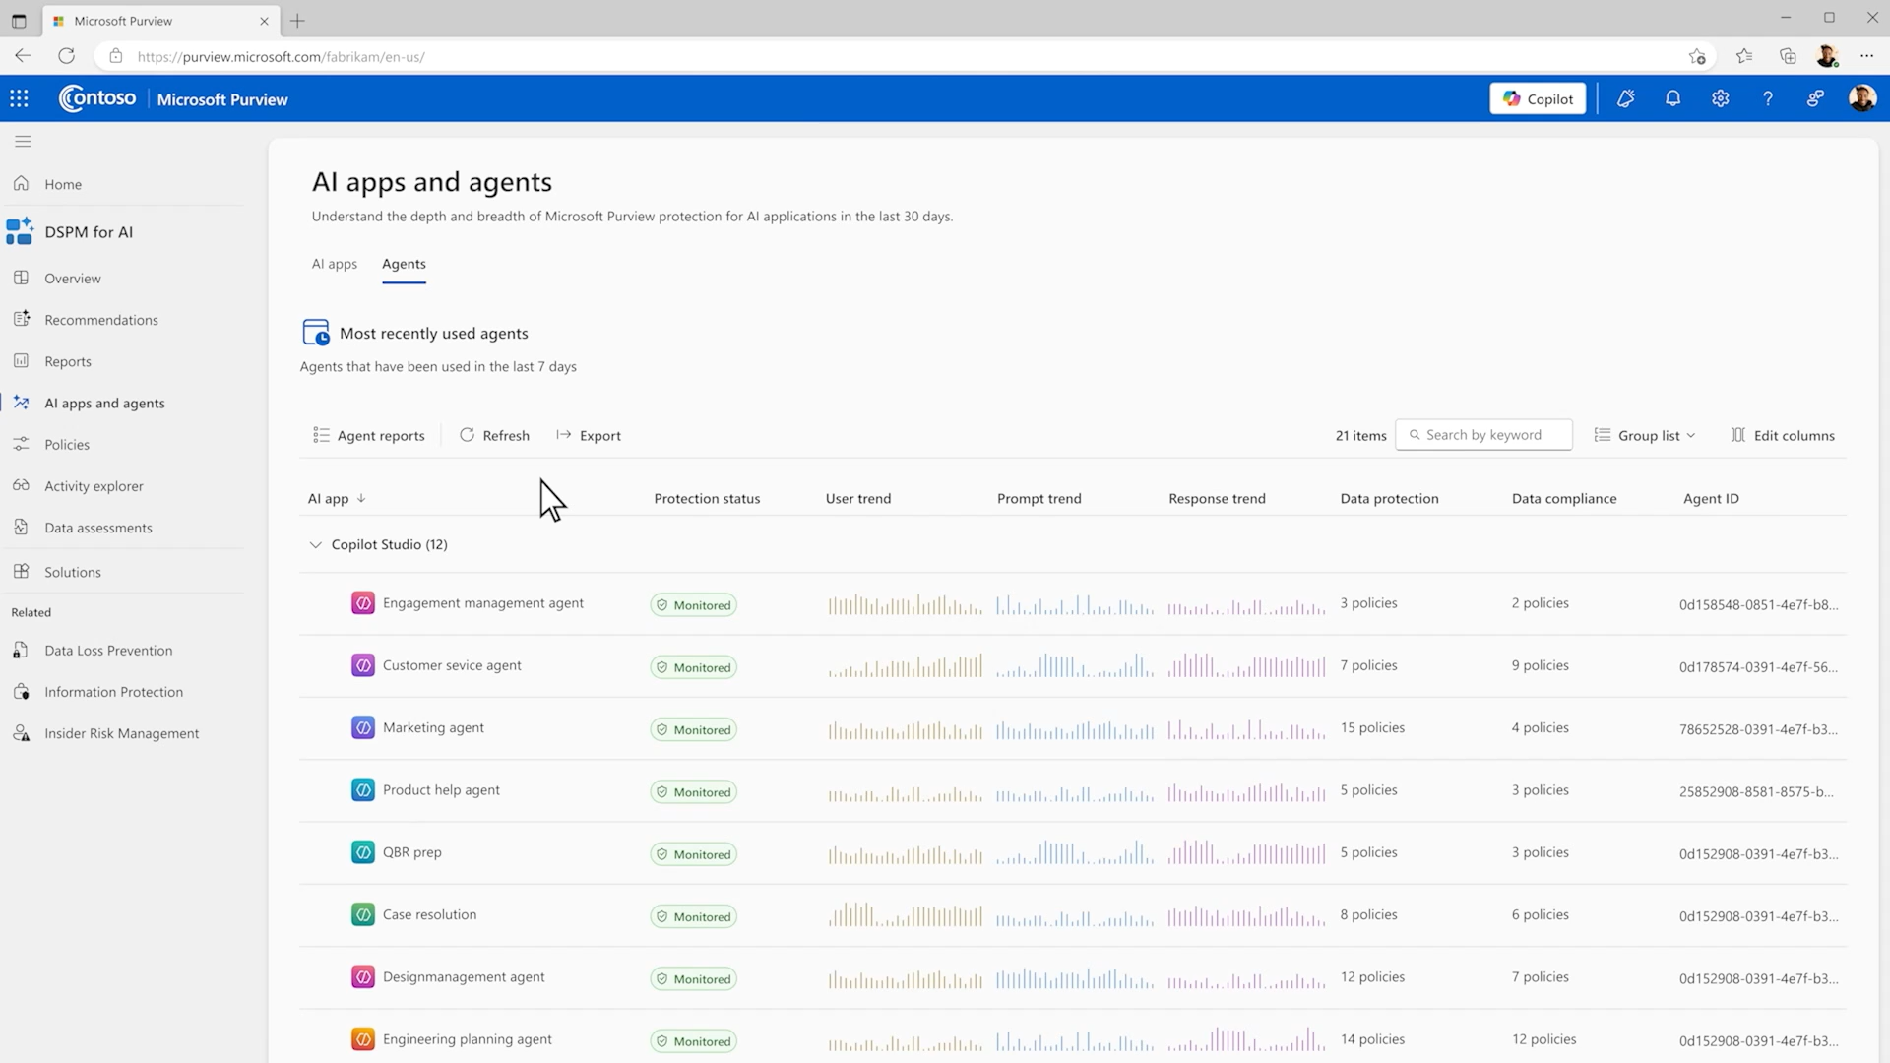

Slide 48
Copilot Control System
Security & Governance
Management controls
Measurement & reporting

Slide 49
Thank you

Slide 50






















































































































